Slide 1



Searches for light scalars at LHC and interpretation of the findings
F. Richard
In the name of the Calcutta-Orsay-Montpellier collaboration
CosPT Workshop II/2022
December 2022

Slide 2
Introduction
Before the HEP community can choose between the proposed e+e- colliders, a valid question to ask is: which energy is needed to observe directly BSM physics ?
In other words, which are the masses of the lightest BSM particles ?
If there are such particles, they should already appear in LHC present data as was the case for h(125) at Tevatron
My prejudice, to avoid “blind searches”: as for the Higgs in the SM and the pions in QCD, the lightest objects are scalars residuals from a symmetry breaking mechanism
With the help of experts listed at the end of this talk, I have carried such an investigation and tried to interpret consistently several indications from LHC by extending the usual 2HD models to triplets (Georgi Machacek model GM)
Given the short time allocated, I will only very partially cover this vast topic and concentrate on one channel, H(650), of major relevance for our future

Slide 3
1st indication : H->ZZ into 4 leptons
The cleanest channel for discoveries
From a combination of published histograms done in 1806.04529 with 113.5 fb⁻¹ from CMS (2/3) and ATLAS (1/3) one observes a peak at M_{H}~660 GeV Γ_{H}~100 GeV, ~90 fb with s/b=42/14 ~3.75 s.d. local significance
With 139 fb-1 ATLAS a ~3.5 s.d. effect at the same mass 2103.01918
With 139 fb-1, with sequential cuts, an excess is observed at the same mass, s/b=9/2 ~2.1 s.d., for VBF->H(660)->ZZ ~30 fb 2009.14791
The corresponding cross section is below the inclusive cross section ~90fb implying a significant ggF contribution
CMS analyses in four leptons, inclusive+VBF, are not yet published
These results call for a combination of both analyses before one can draw a valid conclusion
Could stop here but…

Slide 4
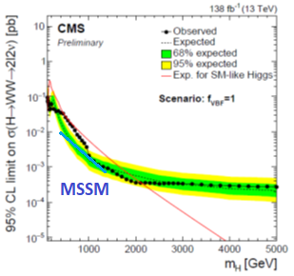
Evidence for VBF->H(650)->W+W- ->ℓℓvv
Large top background even after b-jet vetoing (NB: plot for 60 fb-1 for µe)
Wide signal predicted ±50% mass resolution
VBF->H(650)->ℓℓvv (µµ ee and µe) observed with 3.8 s.d. local (2.6 global) significance
The VBF cross section ~160±50 fb, close to SM, is 5 times larger than ZZ, inconsistent with GM which predicts for the scalar H5 WW/ZZ=0.5 !
Within 2HD, h(125)WW from CMS gives sin²(α−β)~0.97±0.09 meaning that H(650)WW~(0.03± 0.09)SM
2 s.d. upper limit in blue
Both interpretations are inconsistent !
An attempt from ATLAS does not reach the same sensitivity (only µe) ATLAS-CONF-2022-066

Slide 5
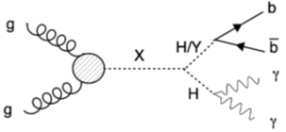
Evidence for gg+VBF->H(650)->Y(90)+h(125)->bb+γγ
3.8 s.d. at mH=650 GeV and mY=90 GeV at ICHEP22
Mass resolution on Y does not allow to distinguish between Z and h(95) 2203.13180
CP says that bb cannot come from Z->bb but could be h(95)
The cross section is dominant over other processes ~200 fb
Could come from a different resonance
HIG-21-011

Slide 6
Interpretation of findings
H(650) cannot be accommodated within 2HD nor H5 from GM (ggF contribution and ZZ/WW)
Would require an extension of GM which are under investigation (see Gilbert Moultaka talk)
Adding previous evidences for H(650), one gets > 7 s.d. global (assuming h(125)h(95) comes from the same scalar)
Reinforced evidence for h(95) 2204.05975
Evidences for A(400)->ττ and Zh from ATLAS not confirmed
New evidence for A->ZH(330)->Zhh from ATLAS at 3.8 s.d. ATLAS-CONF-2022-043
See 2208.00920 and 2112.00921 for alternate interpretations of H(650)

Slide 7
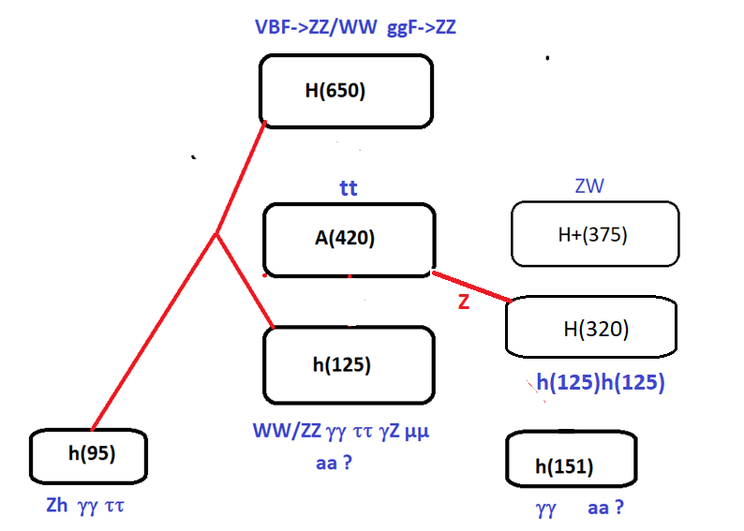
SUMMARY ON BSM CANDIDATES

Slide 8
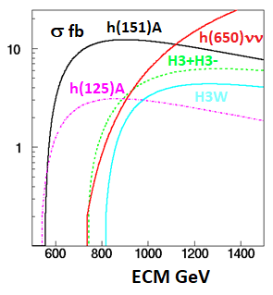
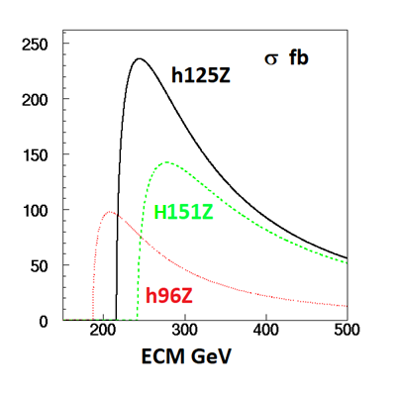
GM cross sections in e+e-
TeV linear colliders
Assumes mass degeneracy inside multiplets : mH3+=mA
These are complex modes requiring the highest L and almost ideal reconstruction efficiency
Higgs factories
Large x-sections allowing very precise measurements

Slide 9
Conclusions
Growing evidence for H(650) observed by CMS into WW and into h(95)h(125)
ATLAS has not yet searched h(95)h(125) nor CMS released ZZ into 4 leptons
VBF->H(650)->WW is inconsistent with two doublet models
The pattern of decays of H(650) into ZZ/WW calls for an extension of the GM model
This is also true for the recent ATLAS observation of A(420)->H(330)Z
Before believing we still need understanding : major role of theory
These observations offer a rich and new landscape for HEP, in particular for future for e+e- colliders under discussion and motivate a linear e+e- collider reaching no less than 1 TeV
Complex final states implied by GM will have a critical impact in the design of future LC detectors

Slide 10
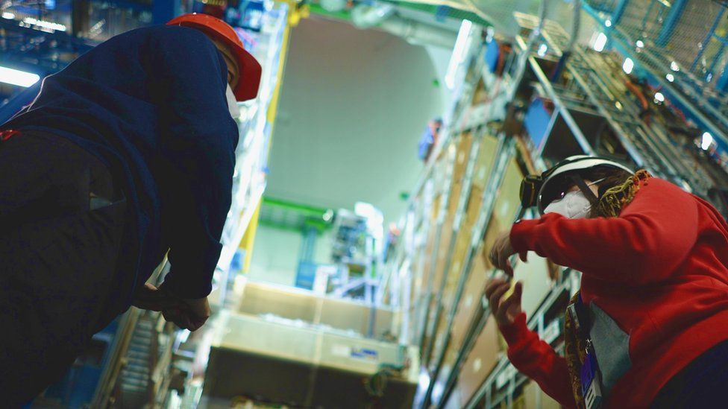
BBC: Large hadron collider: A revamp that could revolutionise physics

Slide 11
References
Global interpretation of LHC indications within the Georgi-Machacek Higgs model, Talk presented at the International Workshop on Future Linear Colliders (LCWS2021).
François Richard (IJCLab, Orsay)(Mar 22, 2021)
e-Print: 2103.12639 and ref therein
Searches for scalars at LHC and interpretation of the findings Anirban Kundu (Calcutta U.),
Alain Le Yaouanc (IJCLab, Orsay), Poulami Mondal (Calcutta U.), François Richard (IJCLab, Orsay)
Contribution to 2022 ECFA Workshop on e+e- Higgs/EW/TOP factories
e-Print: 2211.11723

Slide 12
Acknowledgements
Contributions from Gilbert Moultaka are gratefully acknowledged.
This work has benefitted from discussions with Sven Heinemeyer and Howard Haber through various workshops.
Thanks to Pawel Jan Klimek for providing useful infos about ATLAS results.

Slide 13
APPENDIX

Slide 14
Missing slides & additional slides (lack of lime)

Slide 15
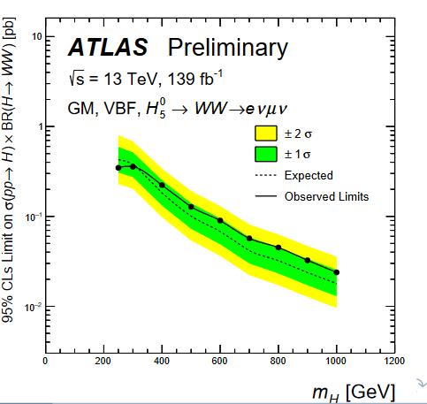
H->WW->µevv from ATLAS
ATLAS has provided a preliminary result (PISA) on VBF->H5->WW in µevv (not µµ nor ee) ATLAS-CONF-2022-066
Like CMS, ATLAS sees a wide excess around 650 GeV but with only at the 1 s.d. level
ATLAS can set a 200 fb 2 s.d. limit for
σ(pp->H)xBR(H->WW)
This limit is compatible with the observation of CMS 160±50 fb
ATLAS has a smaller efficiency as compared to CMS (retain only µe)

Slide 16
Charged Higgs searches
ATLAS has attempted to combine the searches for H5 into ZZ->ℓ⁺ℓ⁻ℓ’⁺ℓ’⁻, H+->ZW+ and H++->W+W+ , assuming a common mass m5 for these particles and varying the mixing parameter sin(θ_{H})
They have also searched for the DY process pp->H5++ H5- - ->W+W+W-W- which allows to eliminate the dependence on sin(θ_{H}).
These exclusions however do not consider the potential cascades of these particles into the triplets H3+ and A, like for instance H5++ ->H3+W+ which could weaken these limits assuming 100% W+W+
ATL-PHYS-PUB-2022-008

Slide 17
A(420)->ZH(320)->Zh(125)h(125)
Great ingenuity !
local (global) significance of 3.8σ (2.8σ)
hh into 4b using mass constraint to improve resolution
ATLAS-CONF-2022-043
Second appearance of triple Higgs coupling !
No interpretation in minimal GM
Calls for an extra doublet

Slide 18
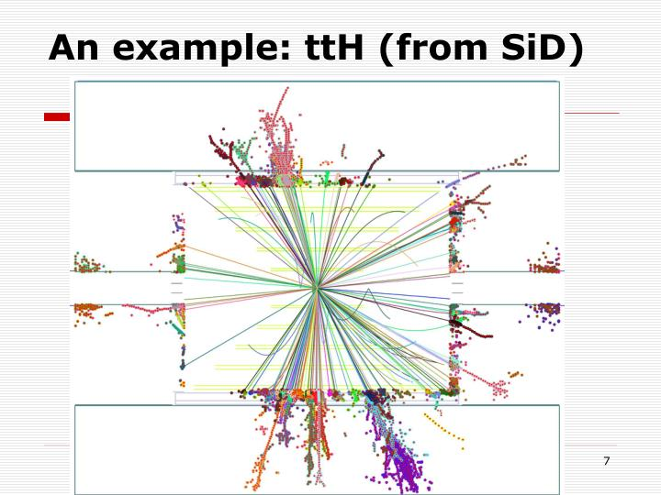
Complex events

Slide 19
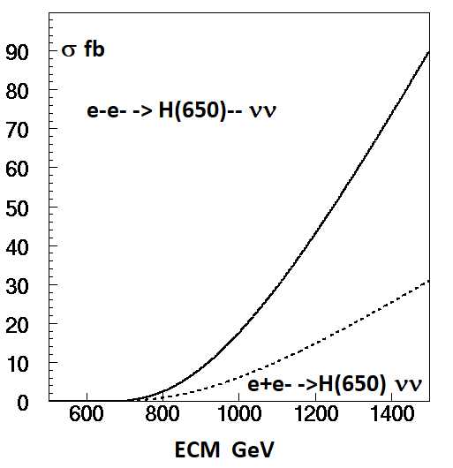
VBF at a LC
ECM=1 TeV is sufficient to observe the full GM scalar spectrum provided one can use VBF
Requires highest possible luminosity, ~8000 fb-1 with ILC at 1 TeV 1903.01629
>1.5 TeV to produce H5++ H5 - - in e+e- but 1 TeV enough in VBF e-e- ->W-W-νν->H5- - νν

Slide 20
GM model issues

Slide 21
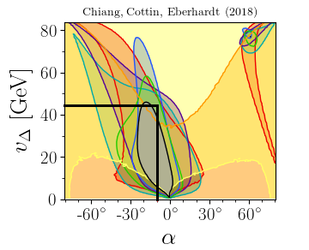
Giorgi-Machacek for pedestrians
Allows I=2, H++, without violating ρ=M²w/Mz²cos²θw=1 at tree level
Is achieved by combining 1 isospin doublet (v_{φ}) + 2 triplets, one real the other imaginary, with the same vacuum expectations :
=1 with v_{χ}=v_{ξ}
Predicts a 5-plet of physical states H5++ H5+ H50 H5- H5– Fermiophobic only produced by VBF
+ 3-plet H3+ H30 (CP-odd) -> A(400)
Mass degeneracy inside multiplets usually assumed but unnecessary for ρ=1 see 2111.14195
+ Singlets h(125) and H mixing angle α
Allows A(400)->hZ but A(400)->HZ much larger if mH~mh
Couplings depend on 2 mixing angles constrained by LHC observations
Tentative choice: sinα~-0.15 and sinθH~0.5 (v_{χ}=43 GeV) to agree with PM
1807.10660

Slide 22
GM predictions
h(125)->WW/ZZ SM close to SM OK
h(125)->tt/bb + 28% /SM
ZZ/WW~2 for H5 instead of 0.5 in SM
while H(650) has ZZ/WW~1/5
A(400)->bb,ττ/tt >>1 GM requires 1
There are two singlet candidates h(95) and h(151) while GM only predicts one singlet
singlet->ττ bb only through mixing with SM h
Extensions or alternate to GM badly needed
A SUSY version of GM already exists

Slide 23
The GM model for advanced
GM is constituted by one doublet φ and two triplets, one complex χ and one real ξ, with the same vacuum expectations to get ρ=1
Y=1/2 T=1/2 vφ Y=1 T=1 vχ Y=0 T=1 vξ
Only φ couples to fermions
They form the following physical states, dominantly triplet
H1 and H1’ have following composition
The physical states are
The mixing angle α has to be small to avoid altering the doublet properties of the SM h(125)
E.g. sin α=-0.15 & sH=0.5, vφ=213 GeV for the doublet, vξ=vχ=43.5 GeV for the triplets

Slide 24
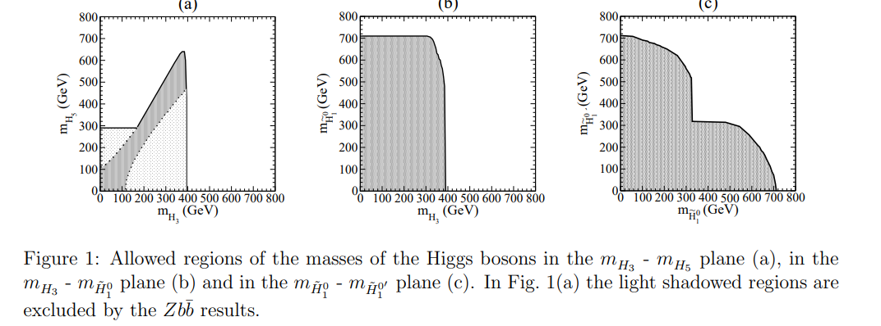
Perturbative unitarity
Works beautifully for SM with h(125) well below the bound ~ 1 TeV
Very constraining for GM: all within reach of a TeV collider 0712.4053

Slide 25
SGM: a SUSY version of GM
1308.4025
GM does not necessarily mean compositeness
SGM provides all the “goodies” of SUSY
Perturbativity, computability
EWSB naturally triggered
Mh predicted with less “tension” on stop masses with extra contributions to RC
DM candidate
Complex/rich world with ~20 Higgs scalars + some extra scalars

Slide 26
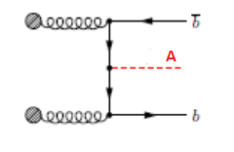
Need for extending GM
Is GM satisfying the various observations ?
The answer is clearly NO
This is the case for H(650) ZZ/WW<<1 while H5 has 2
The fermionic couplings of A(400) which tell us that Yt~SM while Yb,τ >> SM and GM but this needs confirmation
The remedy for fermions is to add an extra doublet and benefit from an enhancement of Yb,τ~tanβ~20 ‘à la MSSM’. Too naïve since then Yt~1/tanβ
The Yukawa alignment mechanism is a more general scheme sufficient to suppress FCNC and allowing an independent tuning for u,d,ℓ 0908.1554
It assumes that both doublets couple to all fermions requiring Y2f=ξfY1f where Y1f and Y2f are the Yukawa couplings to the two doublets φ1 and φ2, and where ξf is an arbitrary constant which can be complex and differ for u,d,ℓ
One can then have Yb,τ >> SM even if tanβ ~1 and Yt~SM 0908.1554
Note finally that this extension naturally occurs in the SUSY version of GM 1308.4025

Slide 27
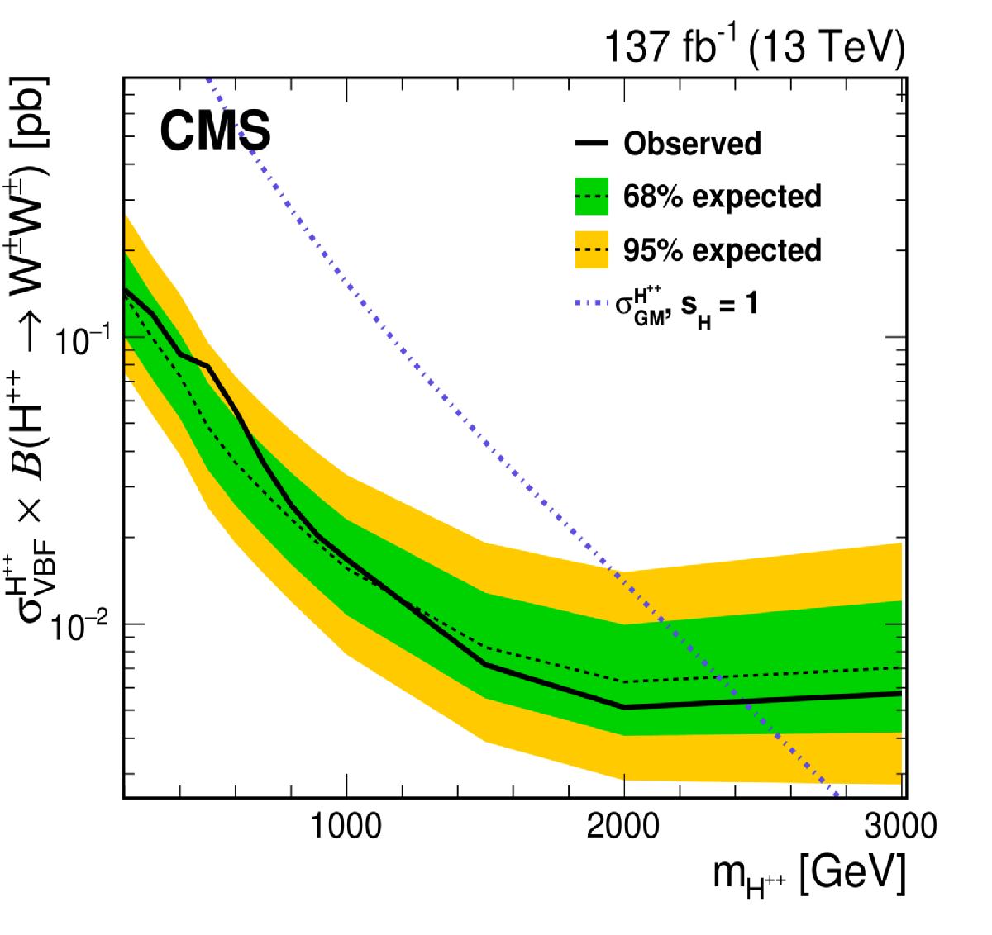
What about H5+ and H5++ ?
2104.04762
ATLAS-CONF-2022-005
CMS cross sections assume s_{H}=1 are divided by 4 for s_{H}=0.5
If H3+ is light H3+Z and H3+W+ become dominant and these resonances become wide
Coincident excess at mH5+~375 GeV for ATLAS (2.8sd) & CMS while naïve GM predicts 650 GeV
Not excluded in eGM 2111.14195

Slide 28
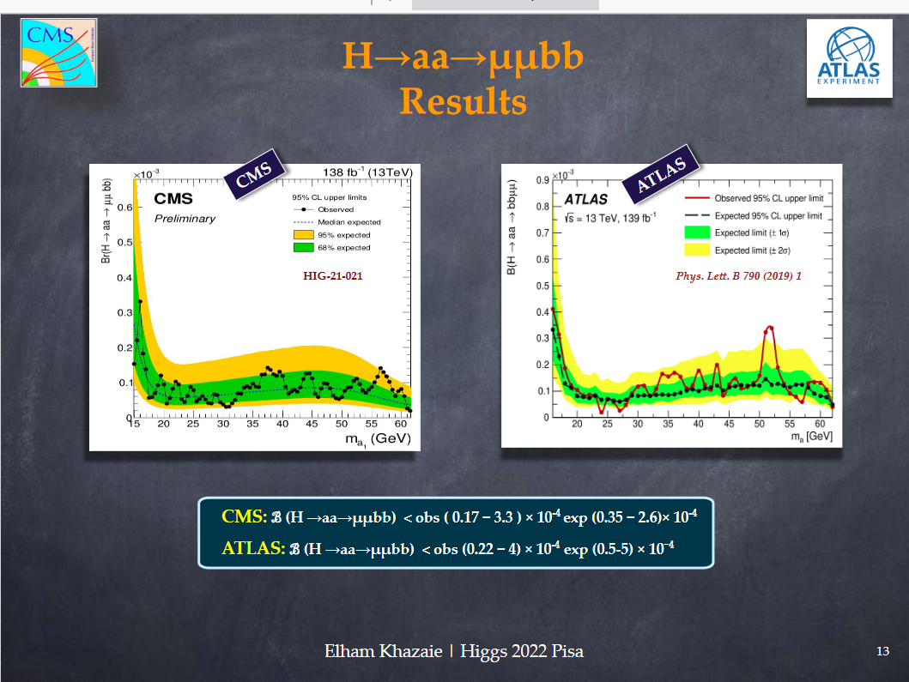
Update on h(125)->aa
Result shown at HIGGS22-PISA
With more sensitivity, CMS does not observe the indication from ATLAS
It does not exclude it either
CMS HIG-21-021

Slide 29
e+e- Colliders

Slide 30
LUMINOSITY at 1 TeV
In reference 1903.01629 a running scenario of ILC at 1 TeV collecting 8000 fb-1 has been envisaged
Beneficial for Higgs self-coupling measurement
Discoveries at LHC would boost these studies at ILC and CLIC
Convert ILC into an ERL 2105.11015 and 2203.06476

