Slide 1
SuSpect3
Jean-Loic Kneur Gilbert Moultaka, Michael Ughetto, Dirk Zerwas, Abdelhak Djouadi
L2C, CPPM AstraZeneca, IJCLab and DMLab, CAFP NICPB
November 23, 2021
Introduction
Concept
Conclusions and Outlook

Slide 2
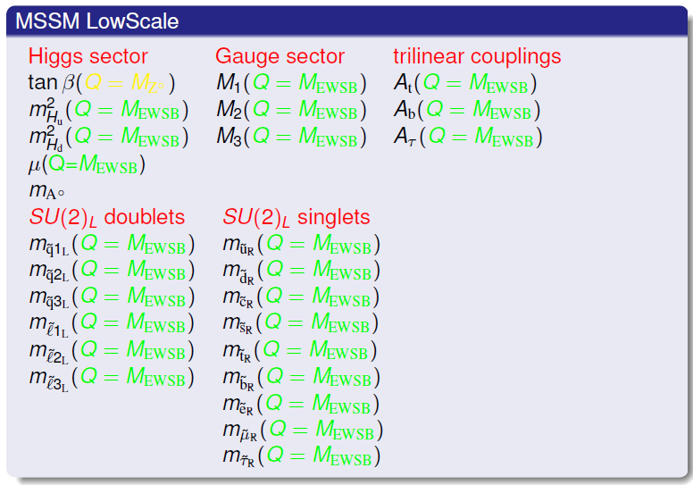
Introduction
fermion ↔boson
has “no” problems with radiative corrections (quadrat. div.)
has a light Higgs Boson (<140GeV)
interesting pheno at the TeV scale
3 neutral Higgs bosons: h, A, H
1 charged Higgs boson: H±
and supersymmetric particles
Many different models:
(p)MSSM (minimal supersymmetric extension of the standard model)
mSUGRA
GMSB
AMB
NMSSM
spin-0 | spin-1/2 | spin-1
Squarks q_{R}, q_{L} | q
 | Gluino: g | g
Sleptons: ℓ_{R}, ℓ_{L} | ℓ
h,H,A | Neutralino χ_{i=1-4} | Z, γ
H± | Charginos:χ±_{i=1-2} | W±
~
~
~
R-Parity
Production of SUSY particles in pairs
(Cascade-) decays to the lightest SUSY particle
LSP stable, neutral and weakly interacting: neutralino (χ₁)
less than half of the particles observed
Great hope for discovery due to LHC CM increase to 13.6TeV (you have heard that before?)
~
~

Slide 3
History of SuSpect
A brief history:
1997 GDR Supersymmetry (Pierre Binetruy)
Working group MSSM
1997-2002 Definition of phenomenological MSSM (pMSSM)
sfermions: 1st and 2nd generation universality
No new sources of FCNC and CP violation
1999 Publication MSSM report: arXiv:hep-ph/9901246 (406 citations)
2002 Publication of Spectrum Calculator SuSpect: Comput.Phys.Commun.176:426-455,2007 (1083 citations)
Abdelhak Djouadi, Jean-Loic Kneur, Gilbert Moultaka
pMSSM (of the MSSM WG +3 parameters), mSUGRA, mGMSB,….
2003 Susy Les Houches Accord (SLHA): JHEP 0407:036,2004
Interoperability of Spectrum, Decay and Cross section calculators
2012 Discovery a R=+1 particle: h
2013 Relic density MSSM with SuSpect2 (Sophie): Phys. Rev. D 89, 055017 (2014)
2013 Start on major rewrite in C++ (SuSpect3)
Gilbert + Jean-Loic + Michael Ughetto (thesis internship LAL)+DZ + Abdelhak
Revisit sfermion universality
Use C++ for inheritance
SLHA compatibility
2015 Relic density NMSSM with SFitter (Anja Butter Master Thesis LAL): Phys. Rev. D 93, 015011 (2016)
2022 Definition and implementation of the mhMSSM (Rima el Khoseifi, JLK, GM, DZ: Eur. Phys. J. C (2022) 82:657
2022 Publication of SuSpect3 (paper and manual): arXiv:2211.16956

Slide 4
Calculating a Supersymmetric Spectrum: Basics
GUT scale ~10¹⁶GeV
Boundary conditions:
High scale: SUSY breaking masses
EWSB scale: μ, m²A(EWSB)
Z scale: tanβ
Numerical solution of coupled RGE:
High Scale to Low Scale in N steps
Ensure EWSB
Iteration at EWSB scale
Radiative corrections EWSB scale:
Higgs Potential
Higgs and SUSY running masses to pole masses
Radiative corrections Z scale:
Corrections to SM couplings (yukawa, W, Z
Ae, Aμ, Ad, As, Au, Ac
RGE
RGE
Derived:
EWSB scale ~10³GeV
RGE
Z scale ~10²GeV

Slide 5
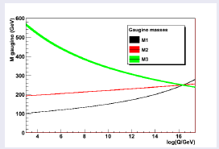
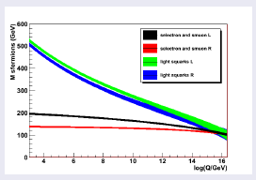
Measuring Unification:
Eur.Phys.J.C71:1520,2011
Simple?
mSUGRA, SUGRA
High Scale MSSM, GMSB, mGMSB, AMSB, mAMSB
NEW
INFLATION
GUT scale ~10¹⁶GeV
GUT scale ~10¹⁶GeV
GUT scale ~10¹⁶GeV
RGE
RGE
High scale ~10¹⁵GeV-10⁶GeV
High scale ~10¹⁵GeV
RGE
Inflation scale ~10¹⁴GeV
RGE
RGE
RGE
Low Scale MSSM
RGE
RGE
RGE
RGE
EWSB scale ~10³GeV
EWSB scale ~10³GeV
EWSB scale ~10³GeV
EWSB scale ~10³GeV
RGE
RGE
RGE
RGE
Z scale ~10²GeV
Z scale ~10²GeV
Z scale ~10²GeV
Z scale ~10²GeV
similar

Slide 6
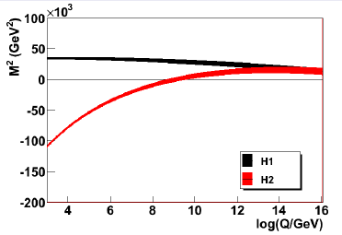
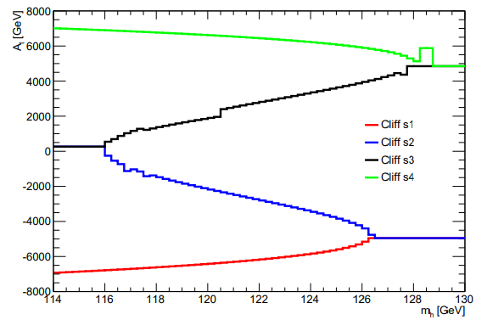
EWSB
Variant 1:
m²Hu
m²Hd
sign(μ)
At,….
Determine:
μ
m²A(EWSB)
Variant 2:
μ
m²A(EWSB)
At,…
Determine:
m²Hd
m²Hu
Variant 3:
μ
mA
At,…
Determine:
m²Hd
m²Hu
NEW
NEW
Variant 6:
μ
mA
mh,…
Determine:
m²Hd
m²Hu
At(EWSB)
NEW
Variant 5:
μ
m²A(EWSB)
mh,…
Determine:
m²Hd
m²Hu
At(EWSB)
NEW
Variant 4:
m²Hu
m²Hd
sign(μ)
mh,…
Determine:
μ
m²A(EWSB)
At(EWSB)
Eur. Phys. J. C (2022) 82:657
Jean-Loic Kneur @CosPT

Slide 7
C++ Inheritance: Models and EWSB
Models:
Base for initialization
Generic bottom up running
Generic models as function of the number of scales (up to 5)
Generic models implement the algorithm:
RGE running
Calculating rad corrs at the right scale
Calculating pole masses
Specific models implement boundary conditions (set the SUSY breaking parameters)
Minimal models inherit from larger models of the same type
EWSB
Base for initialization
3 classes EWSBclassic → Base
Algorithm specific part
m²H_{u} m²H_{d}
μ, mA²(EWSB) (BC at 3 scales)
μ, mA
1 class EWSBmh→ Base
mh
EWSBclassic+EWSBmh
Alg developed for 1 EWSB variant, worked for all 3
Difficulty: diamond inheritance (virtual solved the problem)
NEW
NEW
Examples:
Base → 2scales →LowScaleMSSM
Base → 4scales → GMSB →mGMSB
Base → 4scales → AMSB →mAMSB
….

Slide 8
Upgrades wrt SuSpect2 and Technicalities
Upgrades:
EWSB decoding automatic
EWSB with Higgs inversion
Closer to respecting full SLHA specifications:
EXTERNAL Block index 0: non standard in SuSpect2, now standard treatment
1st and 2nd generation sfermion parameters separated
Complete rad corr Charginos Neutralinos calculated on pole masses instead of previous approximations
Kept SLHA+ capability of fixed EWSB and GUT scales
Implemented inflation model (see Gilbert@CosPT)
Testing:
Comparisons with SuSpect2 (will be maintained)
Compilation gcc 4.8.5 and 8.1.0 with severe flags (well kind of)
Checked all example Models with valgrind
Availability:
v3.1.0
http://suspect.in2p3.fr
wget http://suspect.in2p3.fr/tar/suspect3.tar.gz
tar xvfz suspect3.tar.gz
./configure
make
suspect3 –d examples/mSUGRA.in
Code maintenance:
Started with disk
Moved to svn@LAL
Moved to gitlab.in2p3.fr
Implemented CI tests for example files

Slide 9
Conclusions and Outlook
SuSpect3:
Excellent collaboration between theorists and experimentalists lead to:
Major rewrite of SuSpect
Support for more models
New variants of EWSB
Future work:
Part of the DMLab projects: work with SUSYHIT
Improvements on the Higgs Inversion

