Slide 1
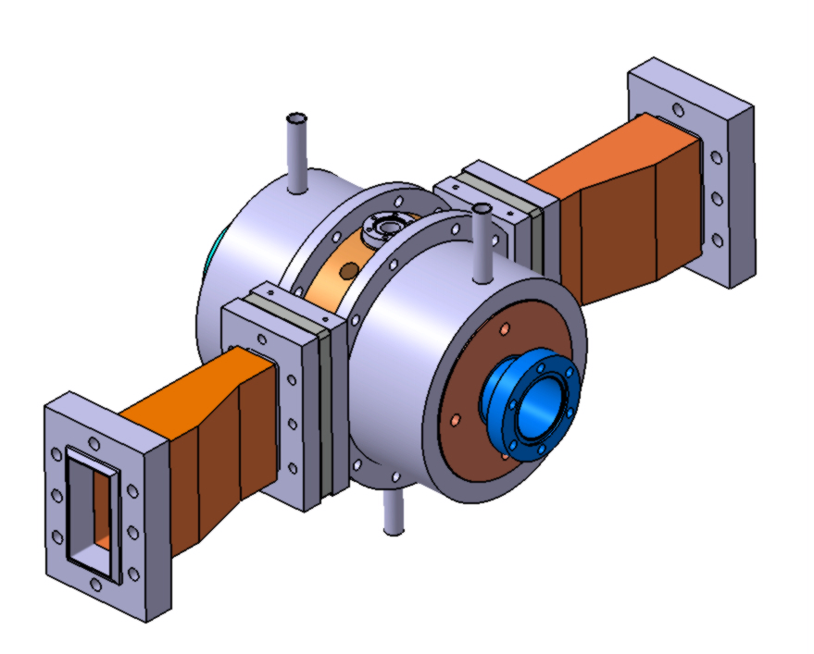
La fabrication additive appliquée aux accélérateurs Nicolas Delerue (avec de nombreuses diapositives de Guntis Pikurs)

Slide 2
Domaine d’intérêt de la FA
Conventional fabrication
Cost per part
La fabrication additive offre la possibilité de réaliser des pièces complexes qui seraient difficilement réalisable autrement.
Économiquement, elle est plus intéressante lorsqu’il faut produire des petites séries de pièces complexes.
Les accélérateurs de particules pour la recherche sont souvent uniques avec des besoins très complexes.
Dans certains cas la FA peut-être apporter des gains de fonctionnalités, des réductions délais de réalisation et des économies.
Additive manufacturing
Break even point
Part complexity
Conventional fabrication
Cost per part
Additive manufacturing
Break even point
Batch Size
Source: Lukas Stepien, Fraunhofer IWS Dresden

Slide 3
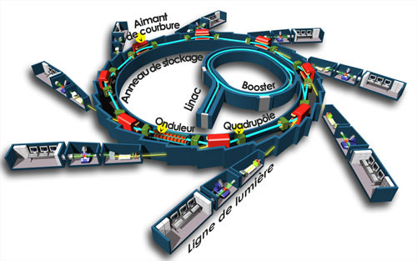
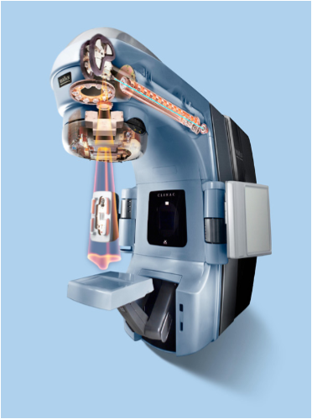
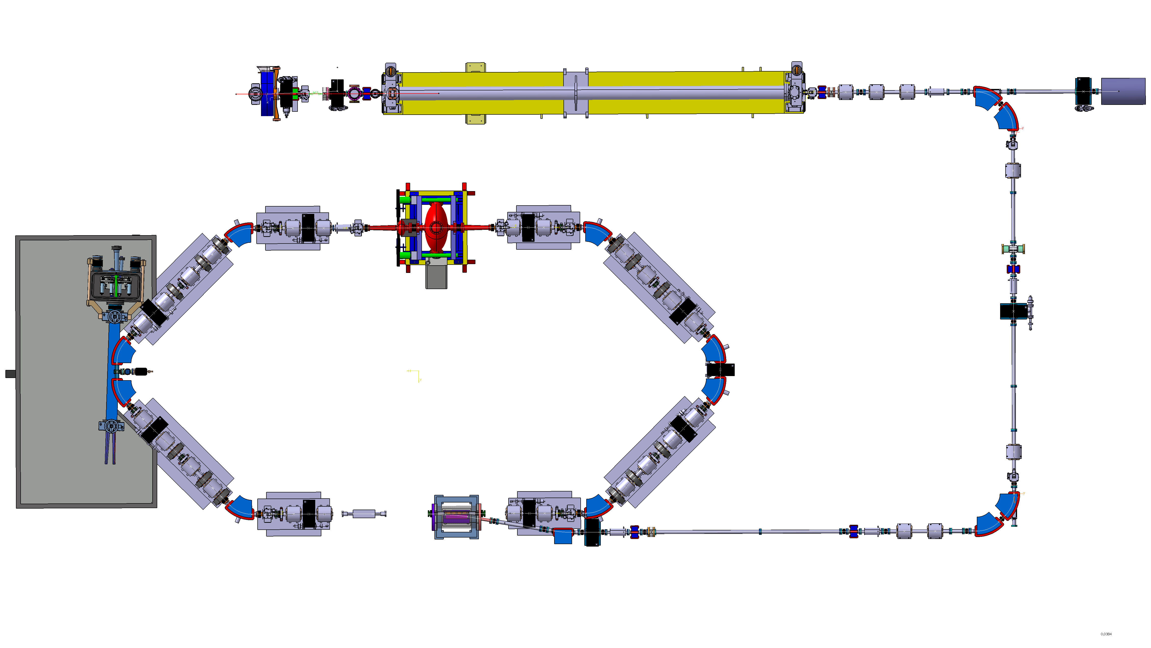
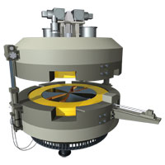
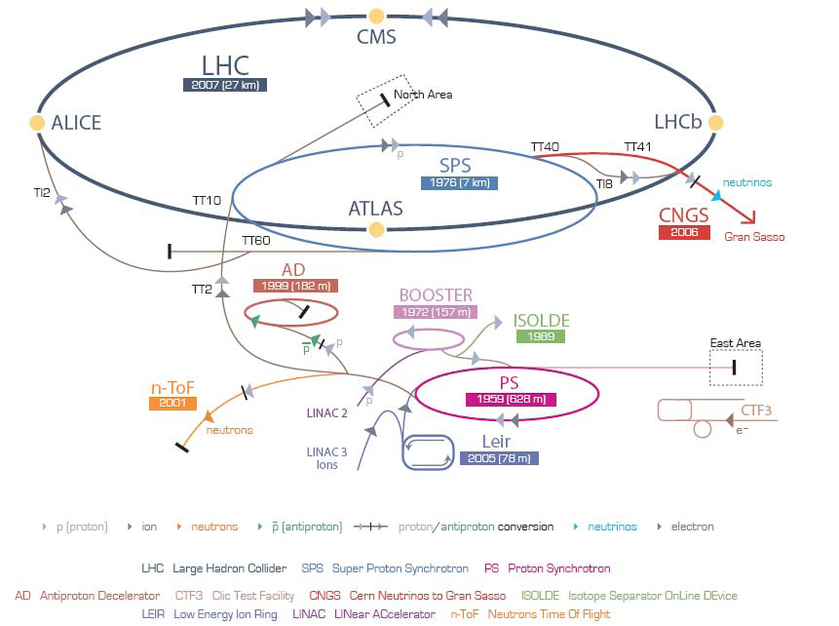
Qu’est-ce qu’un accélérateur de particules?
Les accélérateurs de particules sont des machines très complexes dont la taille varie de quelques mètres à 27km de circonférence.
Certains sont utilisés pour de la production industrielle ou en médecine, d’autres sont utilisés pour la recherche.

Slide 4
Les défis pour les accélérateurs
Matériaux: polymers, métaux principalement, parfois céramique
Des défis:
Impression du cuivre
Impression multimatériaux (conducteur/isolant)
Ultra-vide
Transmission électrique (basse puissance, haute puissance)
Cryogénie
Supra…

Slide 5
Recognized metal additive manufacturing activities within accelerator community

Slide 6
Materials used for accelerator parts

Slide 7
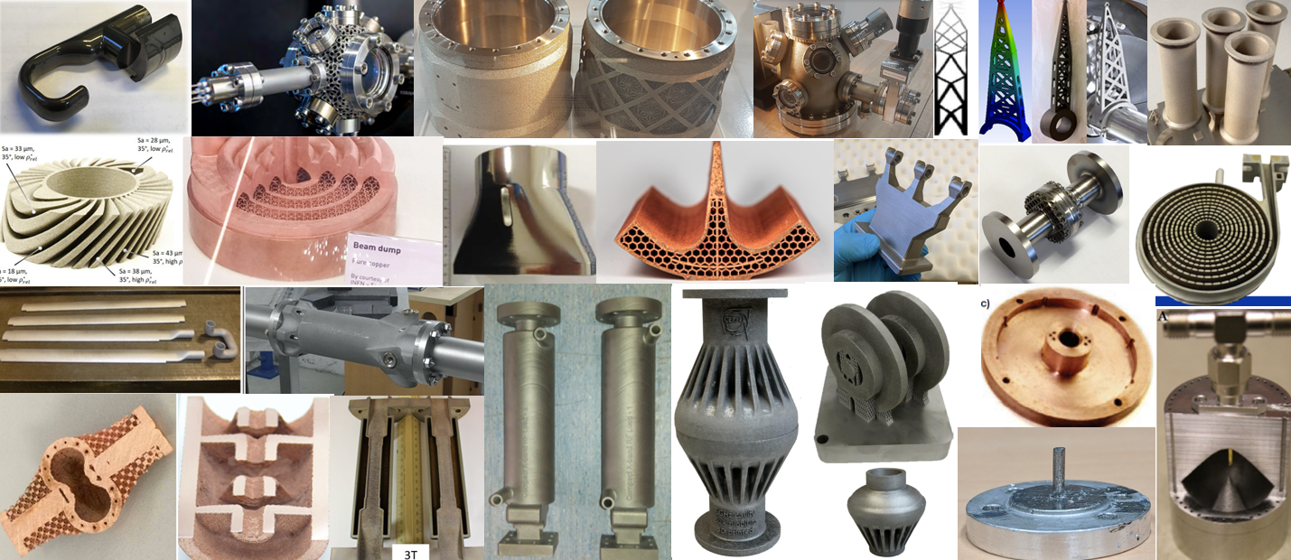
Collage of metal AM parts within accelerators
Reference links to each of pictures in further slides

Slide 8
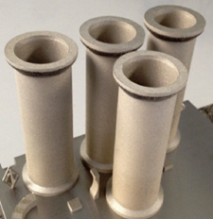
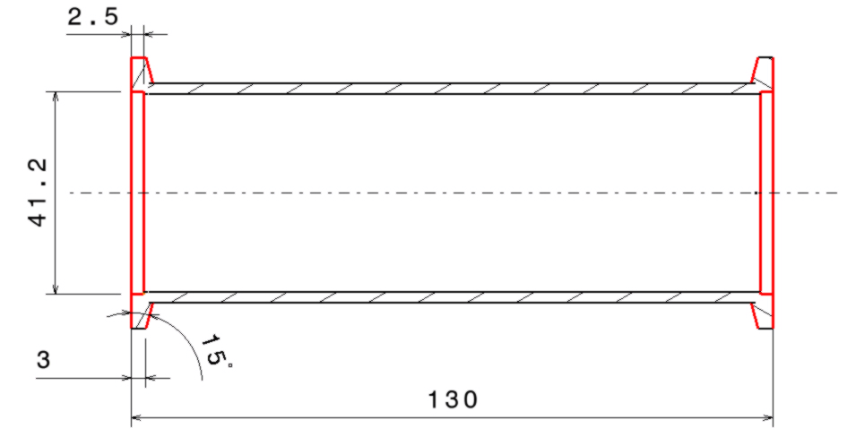
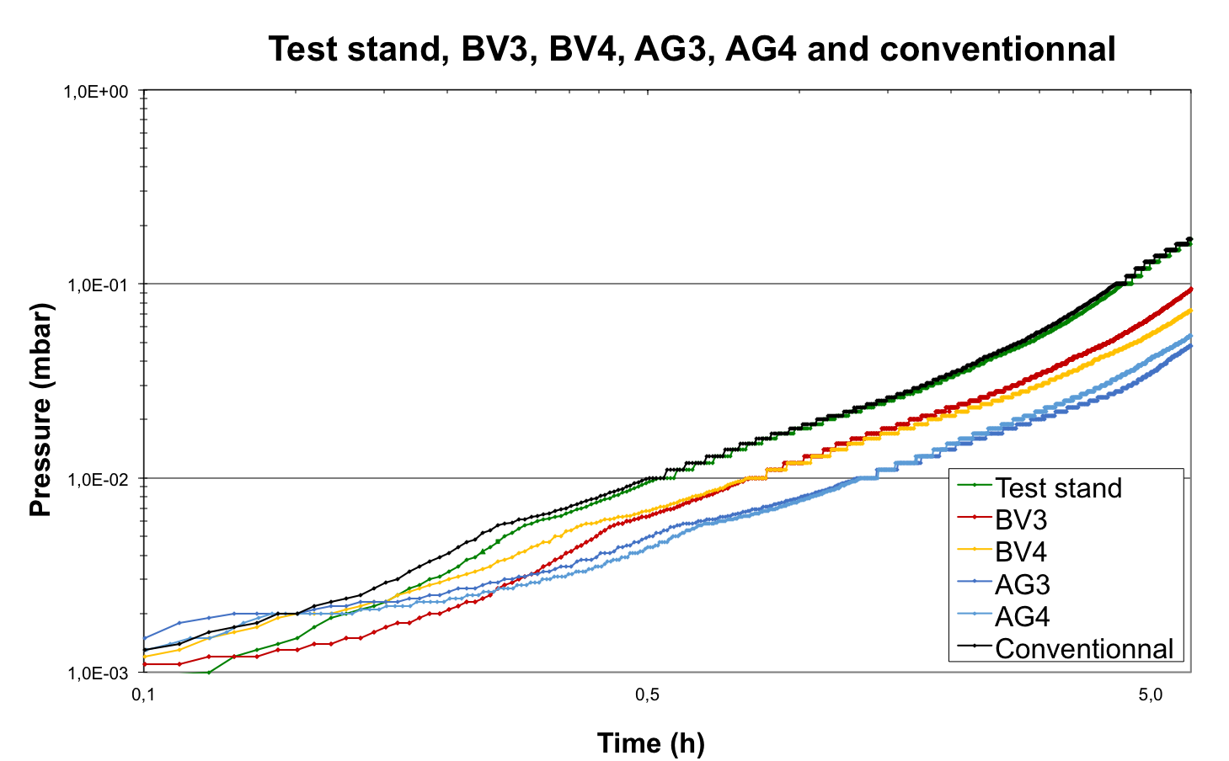
The basic: Ultra High Vacuum
Beyond the use of polymer AM parts as support, one of the first challenge to address was Ultra-High Vacuum compatibility.
The rough surface of the stainless steel parts produced was source of concern.
Several UHV tubes were manufactured and measured by our vacuum group (as well as a conventional tube from a regular supplier).
It was demonstrated that surface roughness is not an issue (except for the flanges).
UHV Performances of both types of tubes were similar.

Slide 9
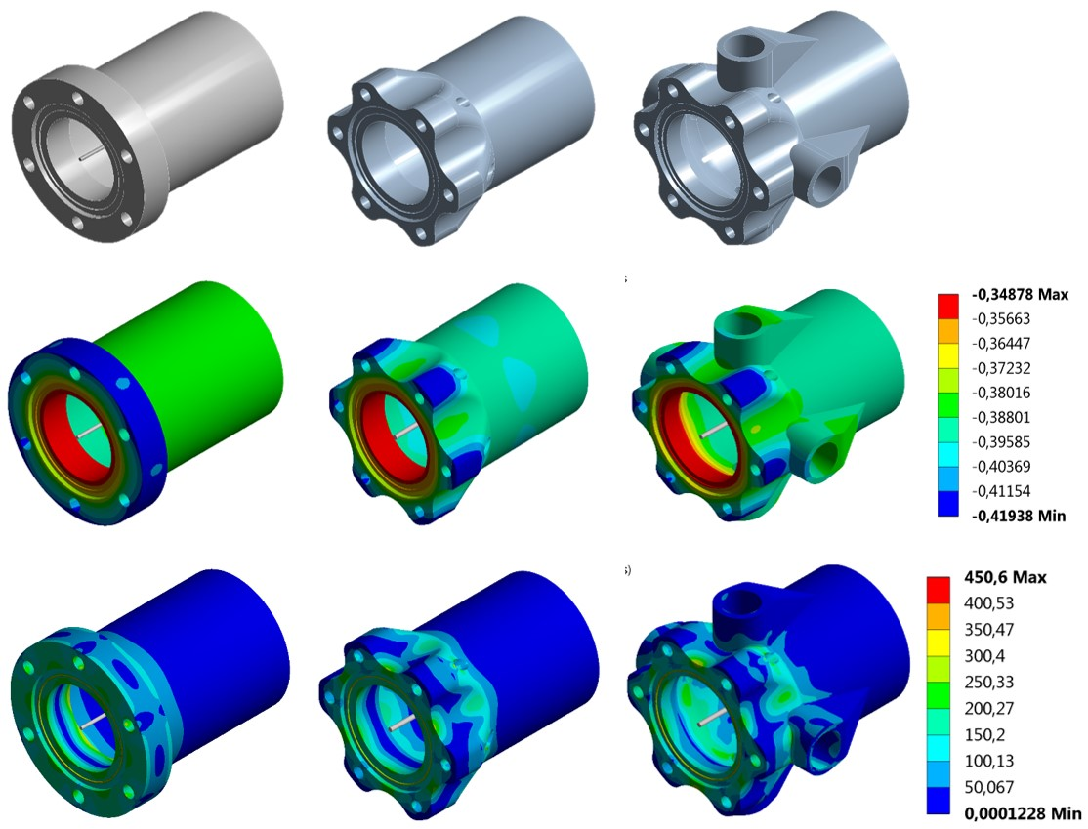
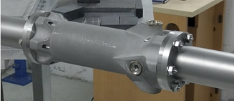
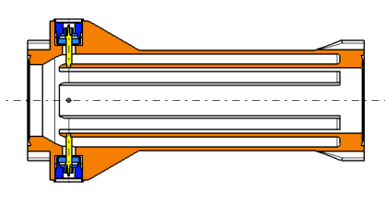
First diagnostic: Beam position monitor
The next step was to produce a working accelerator part.
The choice was to built a beam position monitor as it is mechanically complex.
Topological optimization was used to improve the design.
The use of additive manufacturing allowed to have thinner electrodes (and thus a better impedance matching).
After production the BPM was validate by our vacuum group and then installed on our photo-injector next to two conventional BPMs.
All measurements showed no difference in behaviour between the three BPMs.
Note: At the moment the electrical feedthrough are still sourced externally and note additively manufactured (R&D on this is in progress).

Slide 10
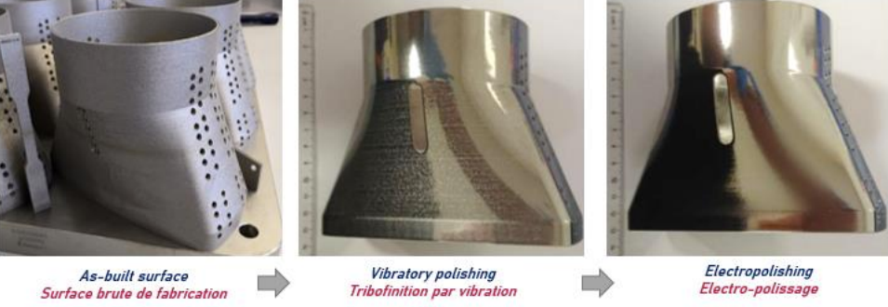
SPS pumping port shielding (CERN)
Courtesy of R. Gerard - CERN EN-MME - Foselev
https://indico.ijclab.in2p3.fr/event/7055/contributions/22436/attachments/16682/21653/R%20GERARD%20-%20La%20Fabrication%20Additive%20me%CC%81tal%20au%20De%CC%81partement%20d%27inge%CC%81nierie%20du.pdf

Slide 11
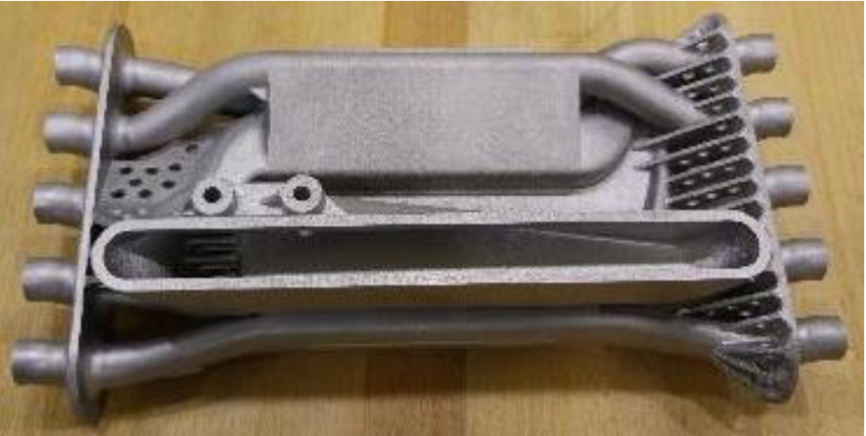
LIEBE: Heat Exchanger Lead-Bishmut/Water
https://indico.cern.ch/event/567462/contributions/2293345/attachments/1353055/2044352/PS_DUMPREVIEW_Metal_Additive_Manufacturing_RG.pdf

Slide 12
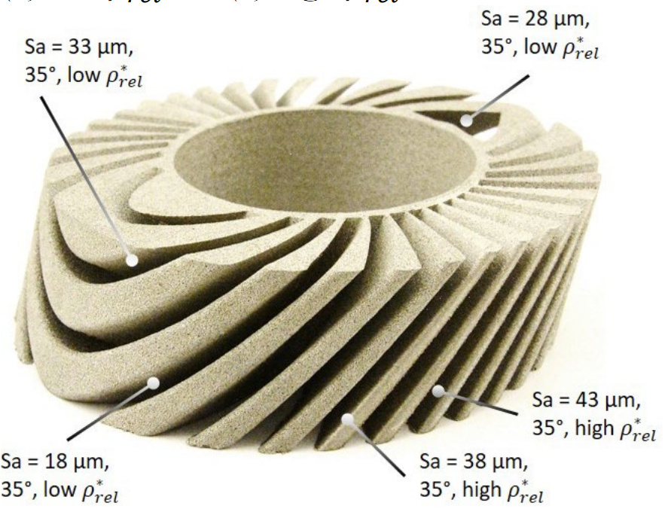
Winding former of superconducting solenoid coil (ETH Zurich)
Material: 316L;
Layer: 30 μm;
Machine: Mlab Cusing R (GE Additive)
Process: PBF-LB/M/316L;
Yb:YAG fiber laser 1070 nm;
Focal diameter of 50 µm;
Max power 100W
Research is focused on manufacturing parameter optimization for different overhangs
https://doi.org/10.3929/ethz-b-000514979

Slide 13
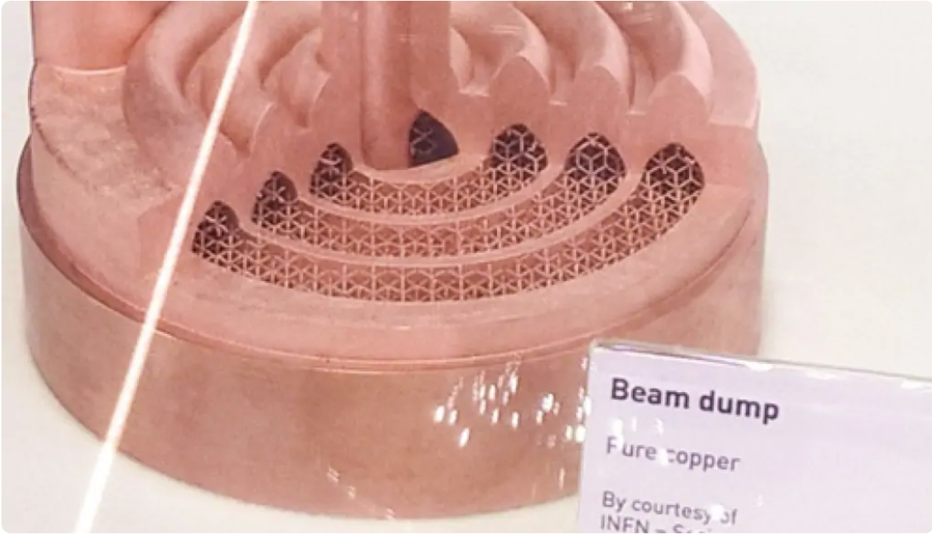
Highly efficient beam dump prototype for SPES LNL INFN
Material: Cu OFHC;
Layer: 30 μm;
Machine: SISMA Mysint100 PM
Process: PBF-LB/M/CuOFHC;
Fiber laser, 1070nm;
Spot size of ~30 μm;
Max power 200W;
Printed volume: 88392 mm³
Printing height Z of 32mm
Print job of ~75 hours
Reached relative density of 98.1 %
https://www.pd.infn.it/eng/infn-proposal-ranked-among-the-best-technology-transfer-projects-selected-by-the-regione-veneto/

Slide 14
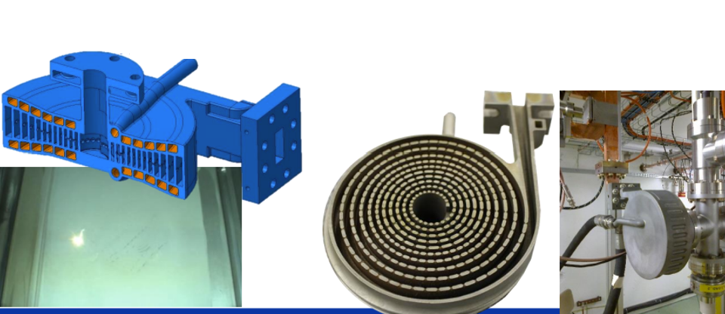
CLIC RF spiral load
https://indico.ijclab.in2p3.fr/event/7055/contributions/22436/attachments/16682/21653/R%20GERARD%20-%20La%20Fabrication%20Additive%20me%CC%81tal%20au%20De%CC%81partement%20d%27inge%CC%81nierie%20du.pdf

Slide 15
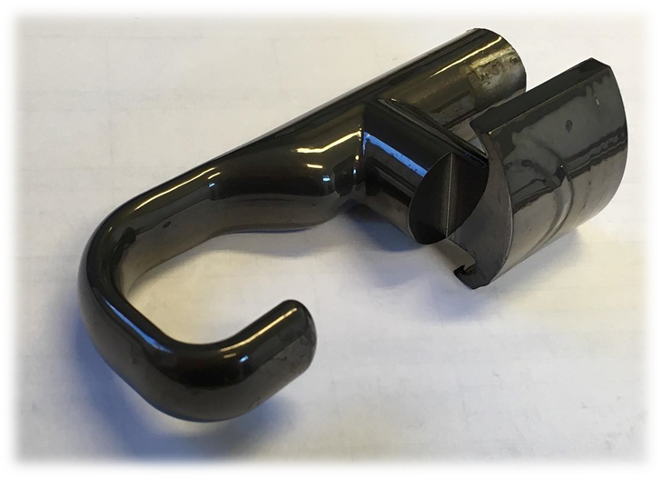
Additively manufactured HOM Coupler (CERN)
Process: PBF-LB/M/Ti6Al4V;
Postprocessed at: BINC Industries,
MMP average material removal 85.5 ± 23.9µm
Final Ra0.02…0.03µm
Courtesy of P.Trubacova (CERN EN-MME)
https://indico.cern.ch/event/708160/contributions/2907448/attachments/1659769/2658741/MMP_development_RD_-_SRF_workshop.pdf

Slide 16
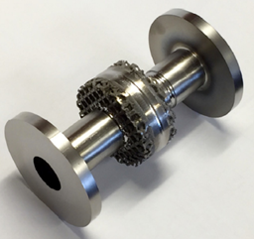
SRF single-cell cavity (RadiaBeam)
Material: 316L; Nb
Technology: PBF-EB/M
Machine: Arcam AB
Developed at: RadiaBeam,
Vacuum:
https://accelconf.web.cern.ch/srf2015/papers/thpb042.pdf)

Slide 17
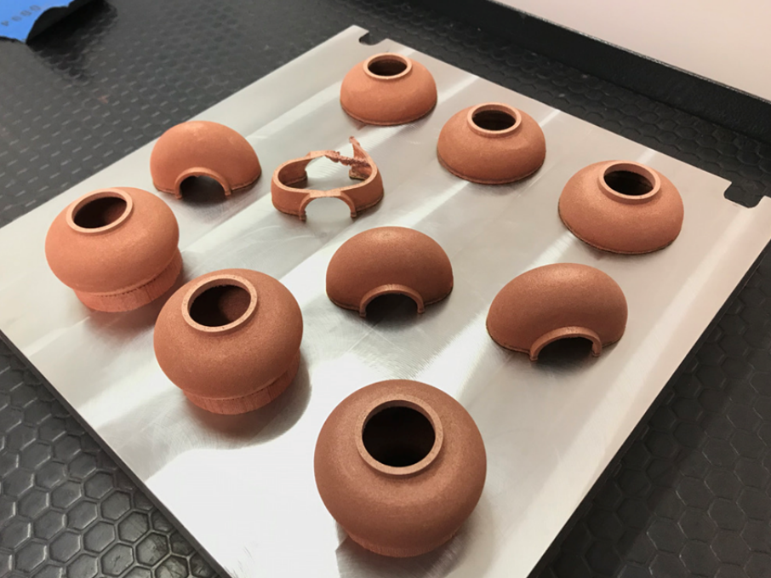
I.FAST WP10.4. RF cavities (INFN DIAM)
Material: Cu OFHC;
Process: PBF-LB/M/CuOFHC;
Postprocessing at: Rossler Italiana S.R.L.
Courtesy of A.Pepato

Slide 18
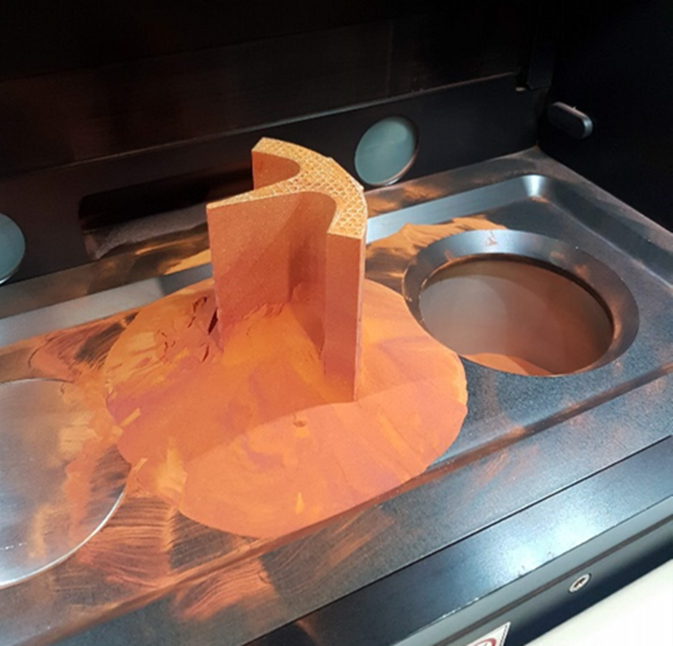
Our experience on OFE-Cu RFQ ¼ sector
Material: m4p™ PureCu gas-atomised spherical shaped powder;
Powder size: 19.5 … 34.9 µm;
Machine: Trumpf TruPrint1000 Green Edition (500W disc laser@515nm wavelength);
Process: PBF-LB/M/OFE-Cu
Process parameters:
Layer thickness 30µm;
Print job: 16h 29min
Trumpf predefined scanning pattern;
Manufactured at: Fraunhofer IWS
Postprocessing at: Rosler Italiana S.R.L.

Slide 19
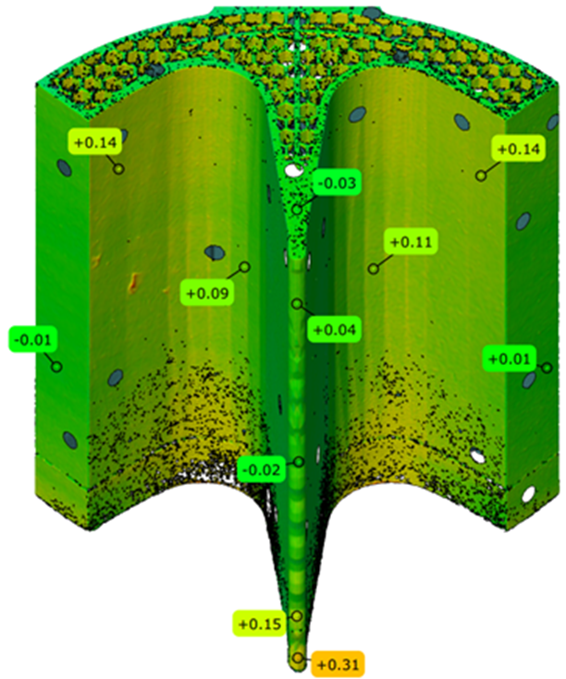
Lessons learned:
Successes:
Good machining performance in terms of geometrical accuracy.
Issues to solve in future:
STL model was not targeted and prepared for best result;
Surface roughness is still challenge and definitely will need multi-step postprocessing;
Circumstantial machine bed failure, due to powder bed sealing issue.
https://doi.org/10.3390/instruments5040035

Slide 20
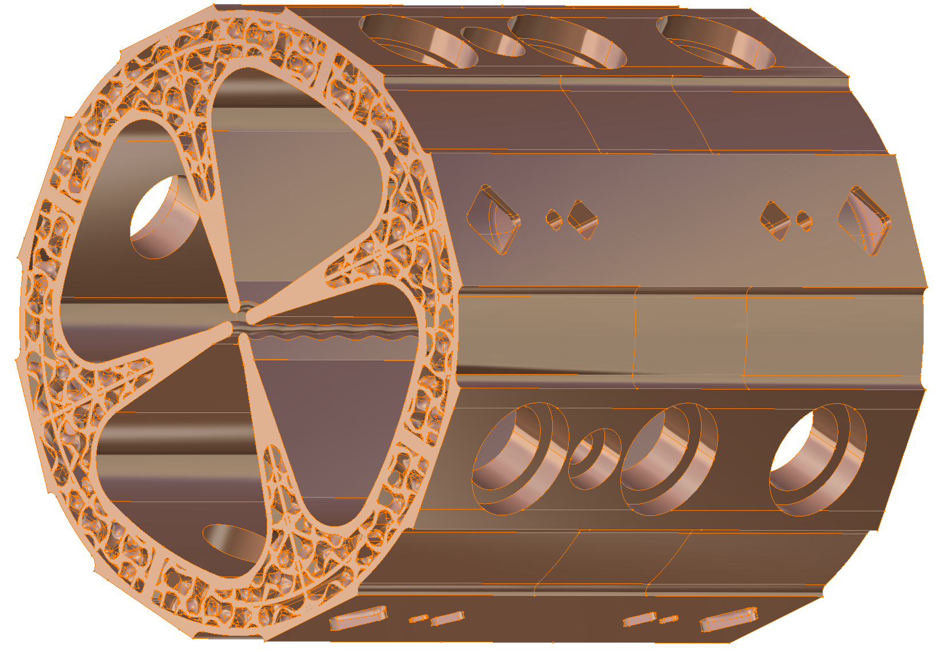
Next step: full sector RFQ
Material: OFE-Cu;
Size~120x120x125mm
Material volume~415.4cm³
Weight~3.714kg
Layer: 30 μm;
Machine: Trumpf 5000 Green eddition?
Process: PBF-LB/M/OFE-Cu;
Green Disc laser, wavelength 515nm?;

Slide 21
Perspectives
La FA ouvre des perspectives intéressantes pour les accélérateurs.
Possibilité de réalisé des formes plus proches des contraintes physiques
Des défis qui sont progressivement surmontés:
Impression du cuivre
Impression multimatériaux (conducteur/isolant)
Ultra-vide
Transmission électrique (basse puissance, haute puissance)
Cryogénie
Supra…
Une progression exponentielle du nombre de publications associées.
À venir: un groupe de travail au sein du RFA

