Slide 1
Ab initio description of nuclear-breakup and decay reactions in light nuclei
Osama YAGHI supervisor: Guillaume HUPIN
PhD financed by "fellowship de deux infinis" IJCLab, CNRS/IN2P3 & Université Paris-Saclay, Orsay, France
Notes:
Hello every one,
My name is Osama Yaghi, I am a phd student here in the IJCLAB.
I will do a short presentation of myself and my project

Slide 2
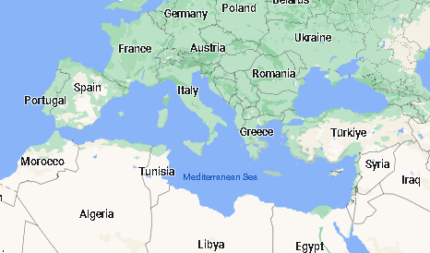
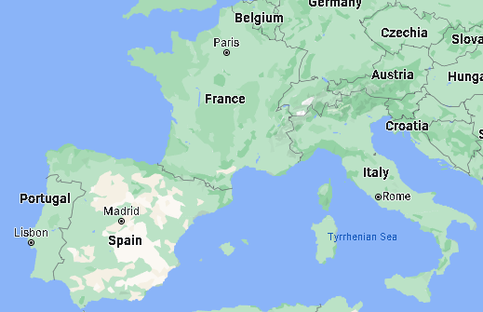
MY Journey
I am from Syria.
Academic Track:
Bachelor’s degree: Applied physics.
Master’s degree: Erasmus Mundus Nuclear Physics program (NUPHYS).
Past research:
Internship: modeling of atmospheric muon flux for the KM3NET experiment.
Thesis: radiative capture reaction rates of interest for the rp-process nucleo-synthesis, in a three body module.
Notes:
First, a little bit about my academic background.
I am from Syria, a country on the east coast of the Mediterranean sea.
I did my bachelor study there and obtained a degree in applied physics.
I did my master’s study in an Erasmus mundus program on nuclear physics, that was hosted by several universities.
I spent two semesters in the university of padova, one semester in caen and one semester in sevilla.
As to my previous research, I did an internship in the LPC in caen on the modeling of atmospheric muon flux at the bottom of the sea, for the KM3NET experiment.
I did my thesis on the ****. It was a theoretical project.
My interests are not limited to one area, rather, I am interested in nuclear physics specifically and physics in general. Especially the intersection with programming and computer science.

Slide 3
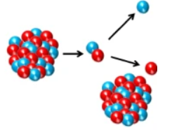
Motivations
We want to develop a unique tool applicable to both nuclear structure and reactions, to enhance our understanding of the strong force at low energy.
Enabling calculation of complex charged nuclear decay.
Enabling us to study nuclear breakup reactions.
Notes:
The goal of my project in the IJCLAB, is to develop a unique tool for both structure and reaction calculations, and to prop the strong nuclear force.
This will allow the calculation of charged nuclear decay, such as proton emission in proton rich nuclei.
And the calculation of break up reactions.

Slide 4
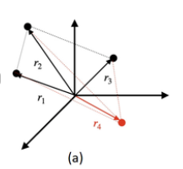
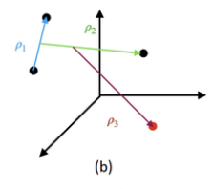
Method
Configuration Interaction (CI):
Eigen-value problem → Matrix diagonalizaiton
No Core Shell Model (NCSM):
HO wavefunctions.
Single particle basis.
Jacobi basis.
NCSM with continuum (NCSMC):
For reaction calculation.
$$\begin{matrix}\left|Ψ_{A}^{J^{π}T}\right\rangle = & ∑_{λ} c_{λ}^{J^{π}T}\left|AλJ^{π}T\right\rangle \\ & +∑_{ν} ∫drr^{2}\frac{γ_{ν}^{J^{π}T}(r)}{r}{\overset{ˆ}{𝒜}}_{ν}\left|Φ_{νr}^{J^{π}T}\right\rangle \end{matrix}$$
Notes:
In general, quantum mechanical problems are eigen-system problems.
The method that we will use is based on configuration Interaction, where the wave function is expanded in a complete basis, and the eigen-value pr become a matrix diagonalization pr.
In particular, we work with some thing called the NCSM: where we use harmonic oscillator wavefunctions, and include the interactions between all the constituents of the nucleus.
Additionally, there is NCSM with continuum: which is used for reaction calculations and is based on working in a generalized model space that is spaned by a discreet basis, and continuous basis.

Slide 5
Complex Scaling
Resonances are associated with complex poles of the S matrix.
The wave solution associated with resonances diverges.
Complex scaling makes these solutions square integrable.
$$φ\left(r→∞\right)=A\left(k\right)e^{−ikr}+B\left(k\right)e^{+ikr}$$
$$≃e^{−ikr}+S(k)e^{+ikr}$$
$$φ_{n}^{res}\left(r→∞\right)=B\left(k_{n}\right)e^{+i\left|k_{n}\right|e^{−ie_{α}r}}$$
$$=B\left(k_{n}\right)e^{ia_{n}r}e^{+b_{n}r}→∞$$
$$\left(\overset{ˆ}{S}\overset{ˆ}{H}{\overset{ˆ}{S}}^{−1}\right)\left(\overset{ˆ}{S}φ_{n}^{res}\right)=\left(ε_{n}−(i/2)Γ_{n}\right)\left(\overset{ˆ}{S}φ_{n}^{res}\right)$$
$$\overset{ˆ}{S}φ_{n}^{res}→0 as r→∞$$
$$\overset{ˆ}{S}f(r)=f\left(re^{iθ}\right)$$
Notes:
The additional tool that we will use is called complex scaling.
The stationary eigen solutions of a system far a way from any potential, can be put in the following form.
Resonances are a very important concept in nuclear reactions. They describe long lived excited states, and are associated with complex poles of this S matrix.
Now, at complex poles in the 4th quadrant of the coordinate system, the stationary solutions diverge.
And since, most of the computational algorithms in quantum mechanics have been developed for Hermitian operators on bounded wavefunctions, they are not suitable for studying resonances.
However, we can use a similarity transformation, that transforms that eigen solutions such that they don’t diverge at infinity, without changing the eigen values of the resonances and the bounded states.

Slide 6
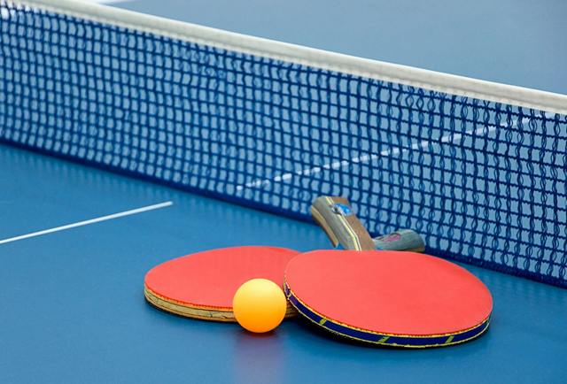
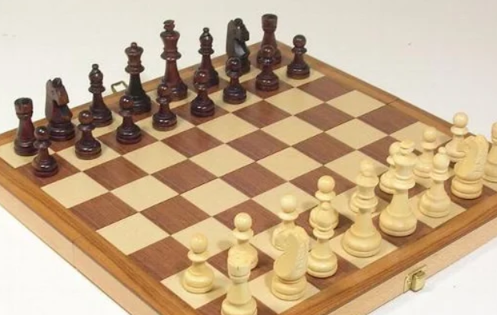
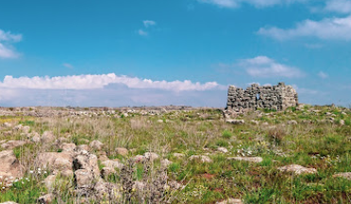
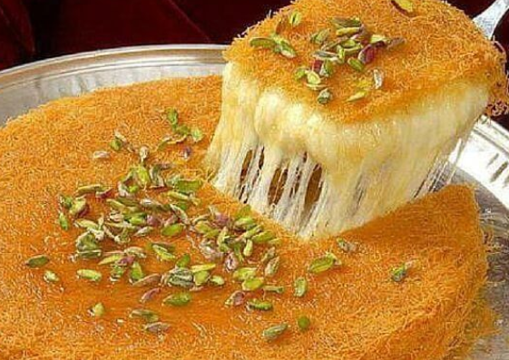
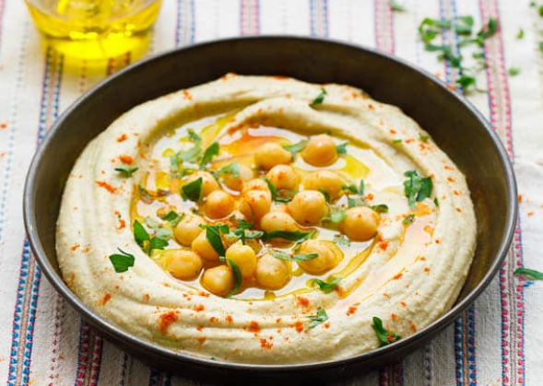
More about myself
My Hobbies:
Table tennis.
Swimming and jogging.
Playing PC games.
Chess.
My Hometown:
Food
Notes:
That is my project, but now more about myself:
In my free time, I like to play table tennis, I like to run and swim. I play video games. And I especially love chess.
My hometown is a village close to nature, so I like having long walks around the area here and the river. It has a very soothing effect on me.
Also my region is famous for very delicious food. So I like to cook some dishes like knafe, tabouli, and hummus!

Slide 7
Merci pour votre attention

