Slide 1
PERLE Collaboration Board Meeting
Meeting agenda:
PERLE Collaboration Status
ESS-Bilbao Presentation
Project Progress
Decision on Cryomodule design (SPL Vs. ESS) and discussion
Resources involvement and funding requirements
AoB
Walid Kaabi, Max Klein, Achille Stocchi,

Slide 2
PERLE COLLABORATION STATUS

Slide 3
Talks with TU Darmstadt
Michaela Arnold, Norbert Pietralla and Walid Kaabi, Max Klein, Achille Stocchi. (22. and 30.11.)
- TUD is interested to join PERLE and work on the booster, possibly taking over a leading responsibility.
- They have an operational ERL facility (sDALINAC) and plan for DICE: 802 MHz, 500 MeV, 20mA at FAIR
and a large number of PhD students.
- Timeline for DICE: preproposal 5/23, proposal 6/24, proposal to build (Forschungsbauantrag 8/26),
technical design (28/29), no procurement before 2030, operation 2034+
Task: electron-RI scattering in collider mode at FAIR (DESTIN is fixed target, E,L..), possibly IVC experiments
This timeline, assuming PERLE moves as planned, makes DICE (if approved) a second generation PERLE
- For TUD at PERLE funds could be accessed within the German Verbundforschung (from BMBF) of 2 PhDs
and similar investment money (300k) per institution. An idea could be that Darmstadt and Mainz with
HZB go for such a request. This may work if CERN supports PERLE visibly.
- Current Status: MoU sent to TUD being checked by legal department at Darmstadt. Expect EoI for next CB.

Slide 4
Discussions with bERLinPro
PERLE and bERLinPro have been recognised an essential pillars of the ERL ESPP strategy.
→ The two projects have the responsibility of exploring a new power regime with two deferent configurations and beam parameters:
bERLinPro: single turn (beam energy 50 MeV) and high current (100 mA)
PERLE: mutli-turn (beam energy at 500 MeV) and relatively lower current (20 mA)
In the framework of the implementation of the European ERL Roadmap, discussions between the two projects were initiated earlier this year with a visit of PERLE team to Berlin, followed by several interactions and agreement to collaborate in the following fields:
Commissioning of the Photoinjectors, starting with the SRF gun at HZB
Development of diagnostics (Beam loss monitors, BPMs, halo monitoring…)
FRT development
Other items are also of mutual interest: SRF cavity preparation and assembly, Control & Command, Safety assessment, Cryogenics needs and cryo-plant dimensioning…
An MoU is currently prepared to formalise the collaboration.
A visit of bERLinPro to Orsay was foreseen next week (06/12), but finally postponed to beginning of next year.

Slide 5
Discussions with ESS-BILBAO
Discussion with ESS-Bilbao started fall 2022. A visit of PERLE team to Bilbao (10-11 October) was the occasion to present the project and to discuss the possible area of collaboration.
ESS-Bilbao is today ready to join PERLE Collaboration. More details in Ibon’s presentation.

Slide 6
ESS-BILBAO PRESENTATION

Slide 7
PROJECT PROGRESS

Slide 8
PERLE Timeline for TDR phase and beyond
Bit of redefinition with the introduction of a P2B phase + in-kind installation
in parallel of the TDR phase
The current phase of the project:
Technical Design phase (→ 2023)
Prepare to Build phase (P2B)
+ in kind installation of DC-gun (→ 2025)
Machine design (Injector, 250MeV and 500 MeV configurations)
Beam dynamics studies
Main systems design (Buncher, Magnets, HOM couplers, full dressed cavity, power couplers, new CM, IP, dump…)
In-Kind adaptation and/or upgrade studies (DC-Gun, Booster, SPL CM) *
Definition of the needs (Diags, Cryogenics, CC, LLRF, Shielding, machine interlock system, infrastructure…)
Experiments with PERLE beam and their specific needs
DC-Gun reinstallation and test
Equipment specifications (for DC gun)
Prototyping and tests (HOM couplers, Single cell booster cavity, B-COM magnet, 5-cells Nb Cavity) *
In-Kind adaptation and/or upgrade work (DC-Gun, Booster, SPL CM)
PERLE administrative regime (Dossier ASN)
Infrastructure (site investigations and work)
* Design of some systems could continue after TDR publication
* Prototyping results could be included in the TDR phase if available

Slide 9
More details Alex Fomin’s talk in the LHeC/FCCeH & PERLE Workshop: https://indico.ijclab.in2p3.fr/event/8623/

Slide 10
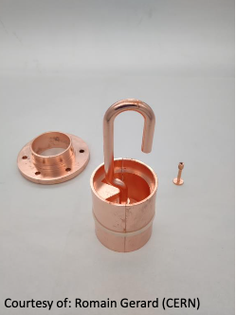
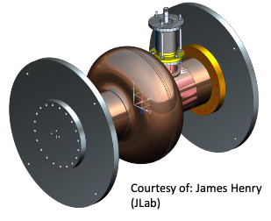
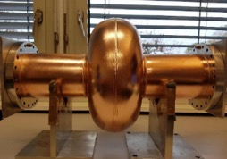
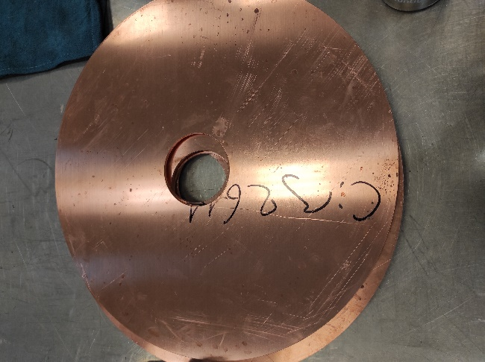
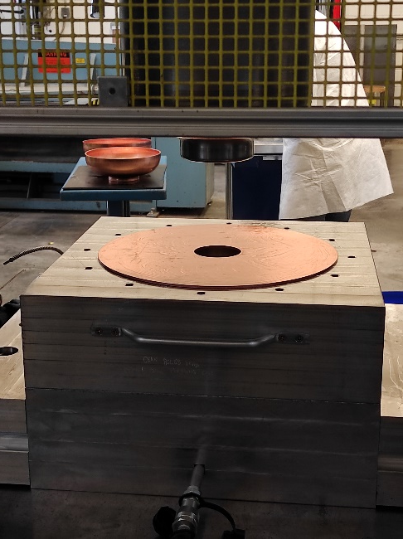
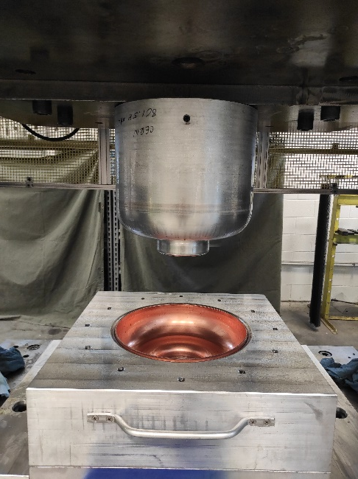
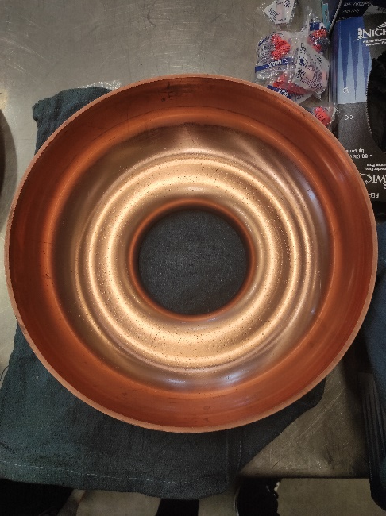
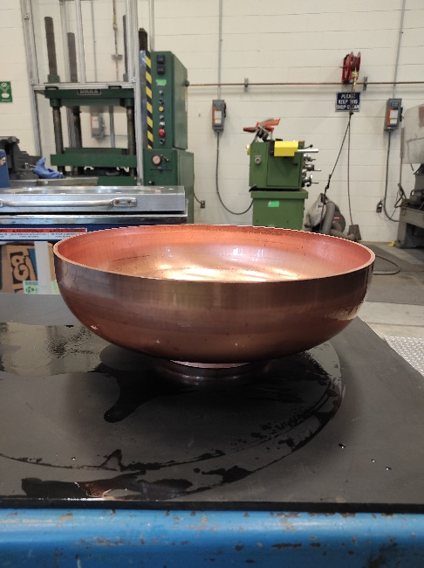
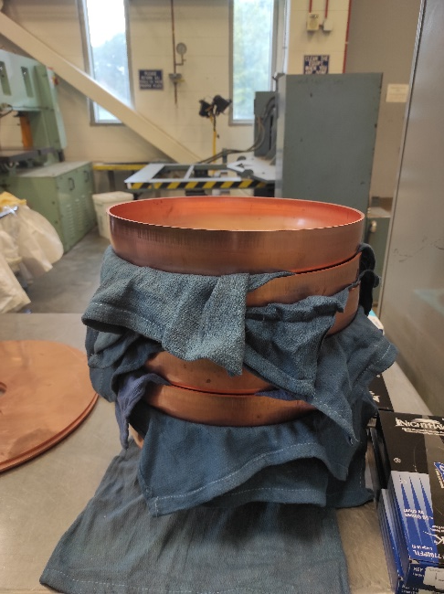
HOM couplers prototyping and tests
Hook type HOM coupler was fabricated at CERN by 3D printing (polymer + Cu coating).
2 other HOM coupler types (probe and DQW) are currently under fabrication at CERN (same technique).
Next steps:
HOM measurements on a monocell then 5-Cell Cu cavity will be performed at Jlab (Feb/March 23). Cavities Fabrication/modifications done by JLAB.
3D metal printing for the DQW coupler: under study with CERN. HOM couplers to be used with the 5-cell Cu cavity prototype in Feb/March 2023.

Slide 11
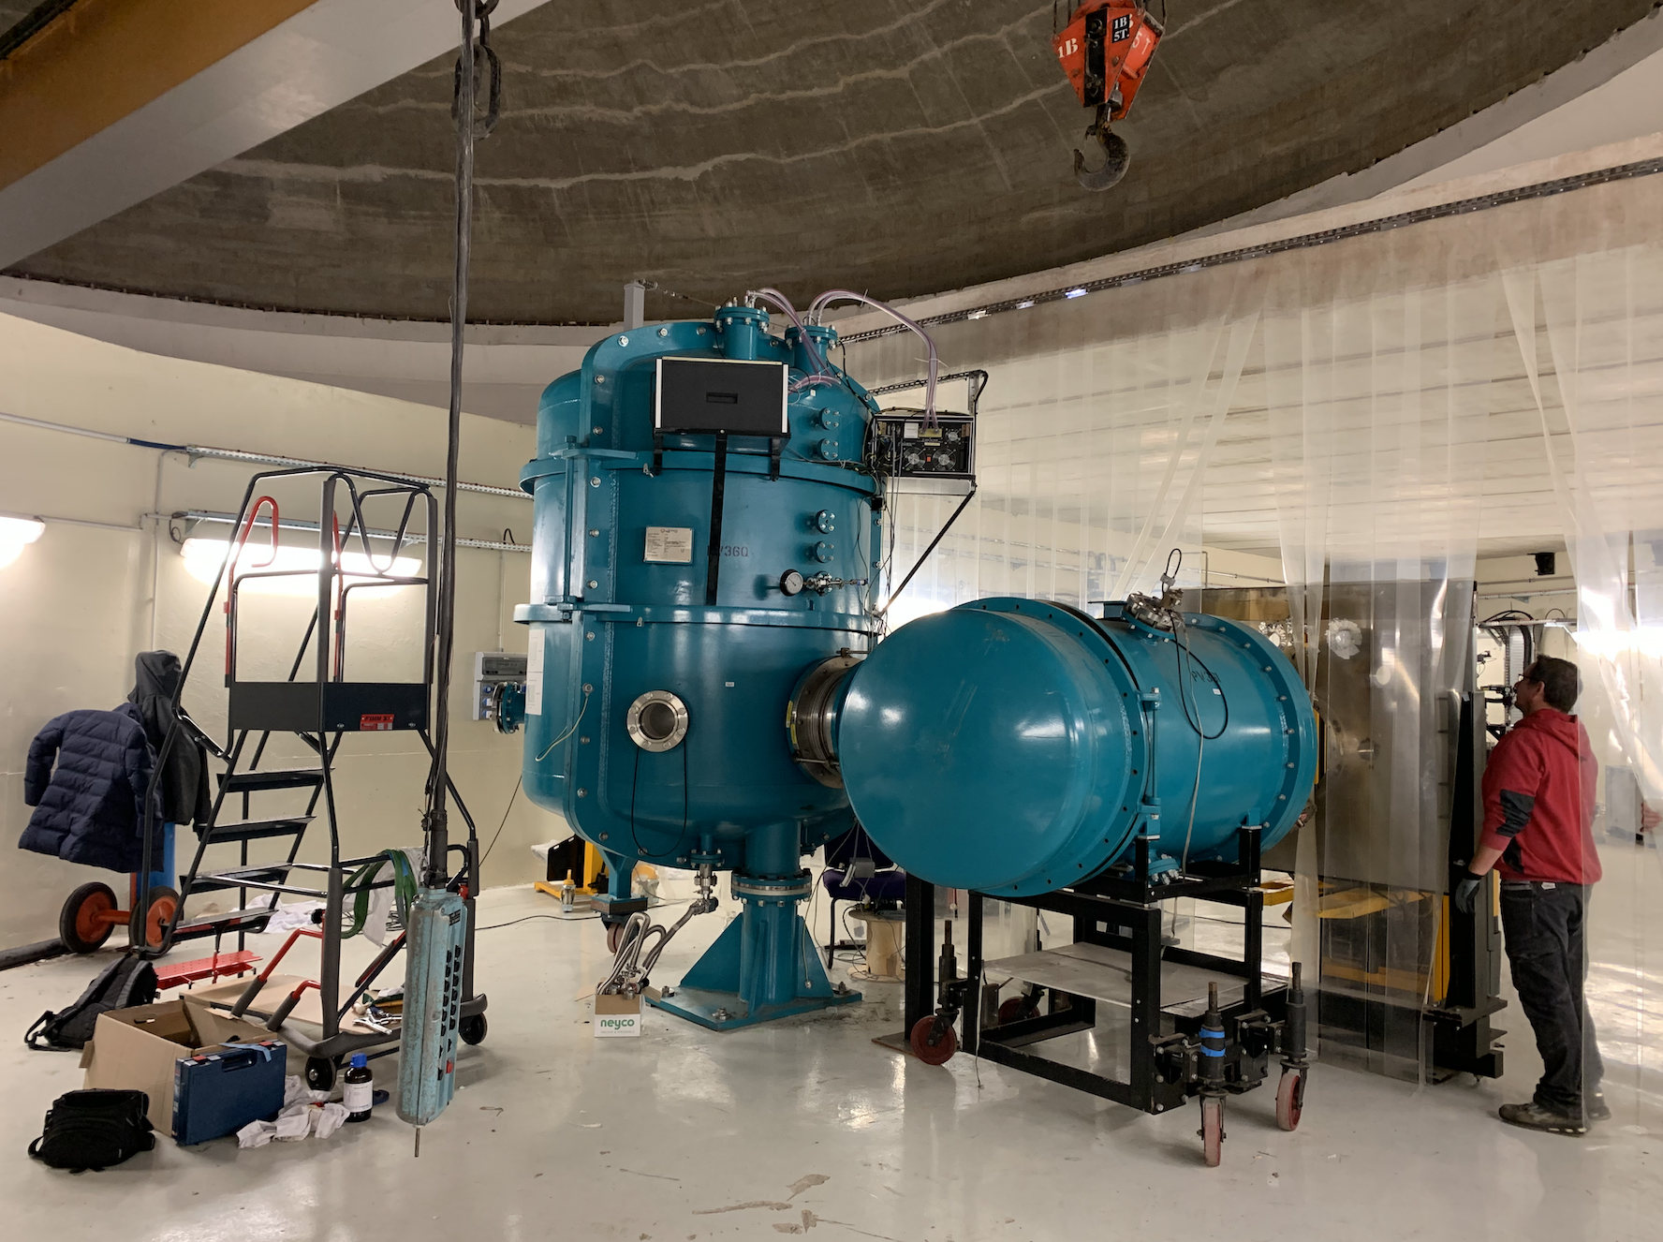
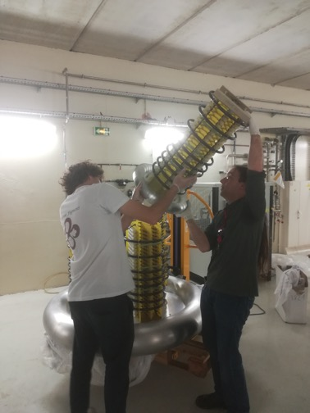
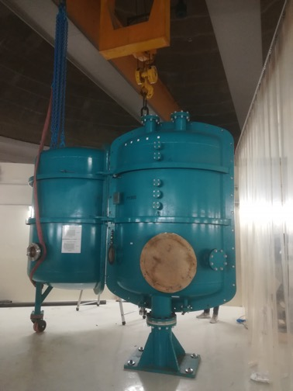
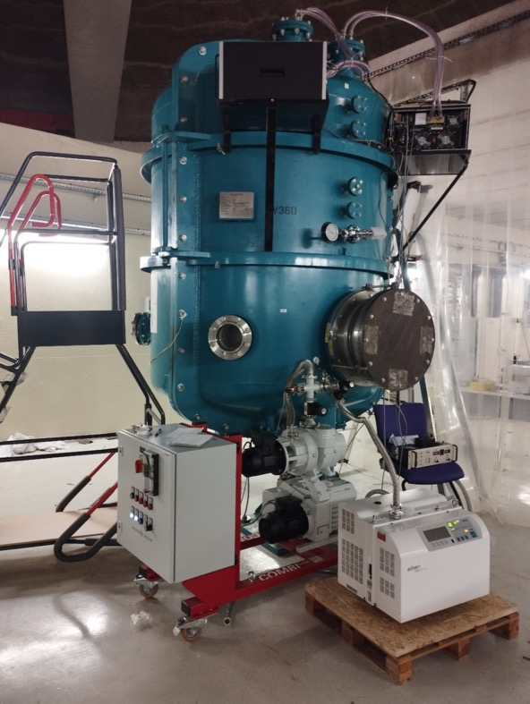
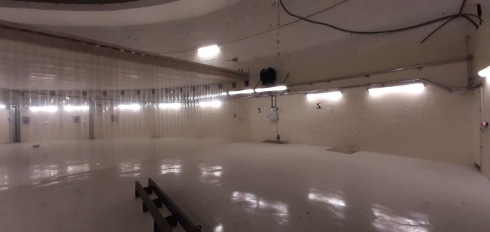
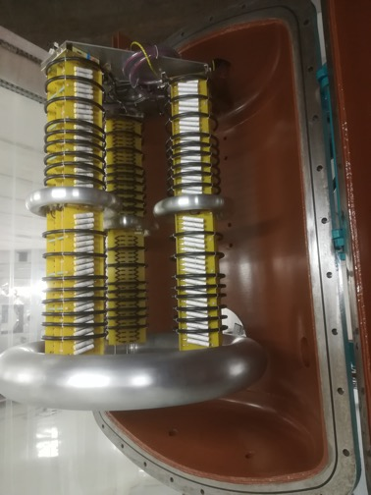
DC gun installation progress
Procurement of the laser system
Request to the french Nuclear Safety Authority (ASN) drafted for operation at HV > 30 kV
Insulation gas system (for 3M™ Novec™ 4710 ) procurement under discussion with suppliers
IGLOO : fully equipped bunker (radioprotection, crane, electrical power, compressed air …)
February 2022
Installation of HV Vessel
June 2022
Test of HV vessel tightness
September 2022
December 2022
Installation of HV columns
July 2022

Slide 12
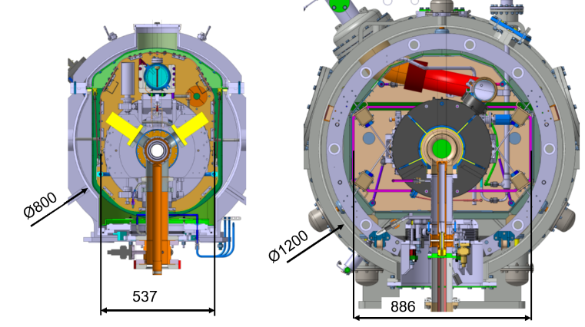
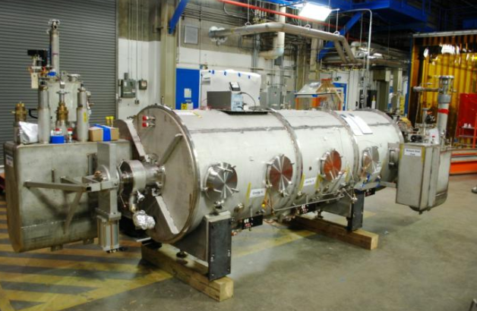
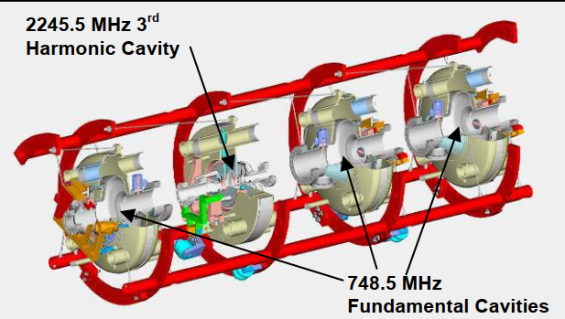
Branching decisions to take very quickly.
250 MeV/500 MeV machines: should we keep two phases scenario ?
Detailed studies on the 250MeV wrt 500 MeV machine to evaluate the pro/cons staging phases considering that the two machines are somehow different (compatibility, demonstration, commissioning, time to upgrade…)
TODAY
SPL (in-kind CERN) or ESS Cryomodule ?
Expected material (quite a lot of Missing components) and funding from CERN not available. ESS cryomodule as a backup solution. The two solutions under detailed studies. Some nice feature of ESS cryomodule : more space inside (+40cm in diameter), More transversal space between cavities, Shorter by ~1m; No supporting system between cavities, last no least…Design validated (prototypes and some series cryomodules already tested at CEA and IJCLab)
SPL
ESS
Can we reuse the Jlab Booster (the module and its valve box) ?
Cavity packages must be changed because of the frequency), Reuse of existing components (space frame...), Cryogenic capability, Alignment, Cost of refurbishing (including disassembly/reassembly, transportation, modifications on the vacuum vessel...)

Slide 13
DECISION ON CRYOMODULE DESIGN

Slide 14
RESSOURCES INVOLVEMENT & FUNDING REQUIREMENTS

Slide 15
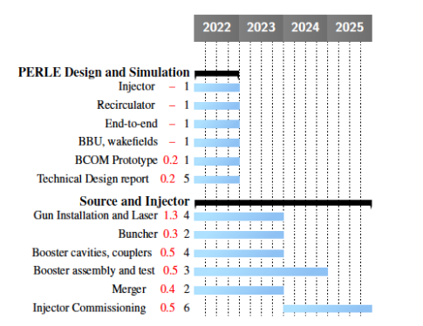
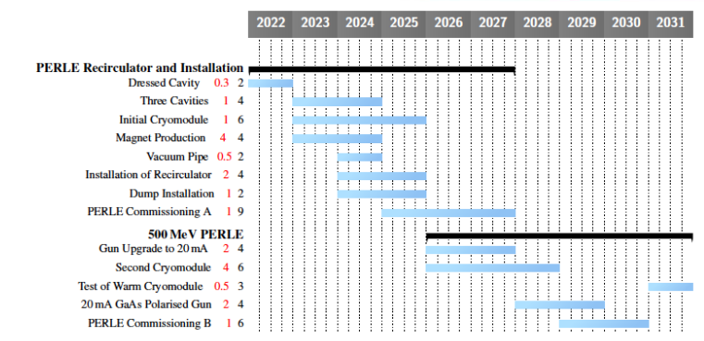
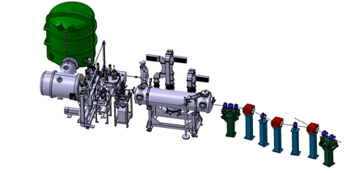
PERLE main Milestones (TDR phase and beyond)
PHASE 1
31 FTE , 10,8M€
PHASE 2 - After 2025
23 FTE , 9,5M€
TDR- Design/Simulation
10 FTE , 0.4M€
PHASE 0 – Injection Line
21 FTE , 3,5M€
2025
End Phase 0: Injection line
2030
End Phase 2: PERLE @ 500MeV
TDR→PHASE 1 : 61 FTE / 14,7M€
PHASE 2 : 23 FTE / 9,5M€
2023
PERLE TDR
2028
End Phase 1: PERLE @ 250MeV
*Extra Infrastrucutre works, under estimation (old estimation ~4M€)

Slide 16
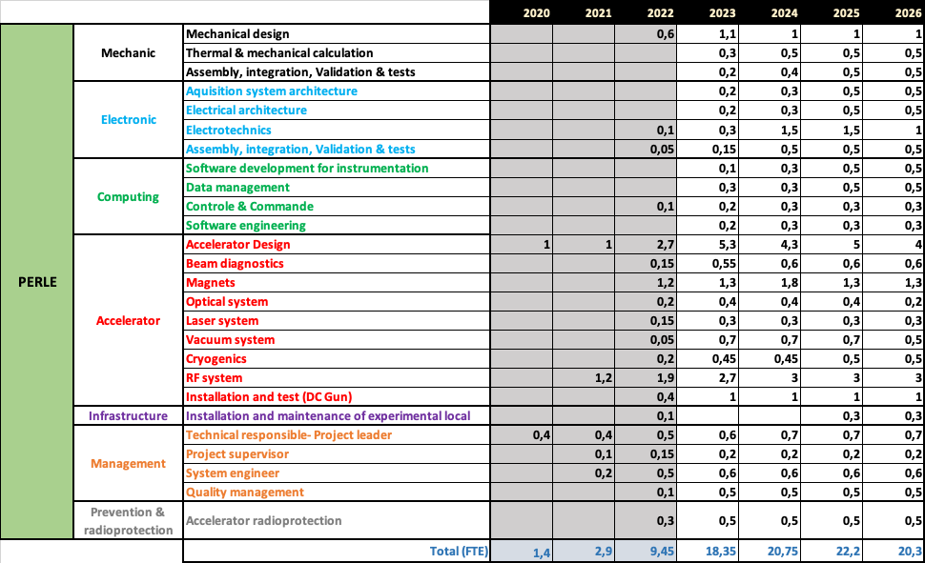
HR involvement and projection increasing in France.
Very large increase in the last months
4 PHD thesis on going !
Detailed work on going in IJClab on HR (see plot below)
Two main comments
The French effort can / could increase
Clear engagements of other partners needed very soon

Slide 17
SPENDING PROFILE
 | 2022 | 2023 | 2024 | 2025
Preparatory to Build Phase | 28,5 | 460 | 585
1) Prototyping and Tests
……. Copper proto cavities (5cell) | 3,5
……. HOM couplers proto epoxy | 10
……. HOM couplers pre-serie Nb |  | 50 | 75
…….. Single cell booster cavity | 0 | 10 | 40
…….. B-COM magnet | 0 | 100 | 0
…….. 5-cell NB cavity | 0 | 150 | 250
........ Cavity preparation and test |  |  | 40
…….. Power couplers | 0 | 20 | 170
........ Couplers preparation and test |  | 25 | 5
2) PERLE administrative regime | 0 | 5 | 5
3) Infrasructure, site investigations and works | 15 | 100
In-Kind Installation up to operation | 140 | 323 | 343 | 25
1) DC - Gun
……. Vacuum system | 0 | 25 | 15 | 0
……. Laser System | 140 | 107 | 153 | 0
……. Photocathode | 0 | 5 | 0 | 0
2) Beam Lines
……. Buncher | 0 | 0 | 175 | 0
…….diagnostic | 0 | 25 | 0 | 25
…… pumping | 0 | 15 | 0 | 0
……. gauges | 0 | 5 | 0 | 0
……. Beam pipe | 0 | 5 | 0 | 0
3) Control Command | 0 | 34 | 0 | 0
4) HIGH VOLTAGE | 0
……. Insulation gaz system | 0 | 70 | 0 | 0
……. Gaz | 0 | 15 | 0 | 0
……. Valves and Pipes | 0 | 10 | 0 | 0
5) Infrastructure | 0 | 7 | 0 | 0
P2B+IN-Kind :
~1.9M€ 2022-2025
Two main comments
French effort to secure this budget the P2B+IN-Kind
Clear engagements of other partners needed very soon

Slide 18
Some final comments.
Considering the very nice progress in the last year,
→ soon (let’s say end 2023/beginning 2024) PERLE timeline would depend on the money flow and on the engagements of the other partners.
FINANCIAL SUPPORT :
Many actions internally in France are going on.
Contributions from other countries so far only in-kind. Probably only DC-gun could be used
HR CONSOLIDATION :
In France consolidation is on going and should be further increased
We need more engagements from international partners
Collaboration agreement foresees/demands bilateral MoUs of IJCLab/IN2P3 with PERLE partner institutes about resource loaded (financial, material) contributions ICRADA now signed and a base for such an agreement with Jlab.
Finances and HR consolidation to be discussed, within PERLE and through the newly formed ERL coordination group.
We should explore EU ways for getting part of the financial support (discussions / actions )

