Slide 1






Muon Collider
D. Schulte
for the International Muon Collider Collaboration
Higgs Hunting, Paris, September 2023
This project has received funding from the European Union’s Research and Innovation programme under GA No 101094300 and GA No 101004730.

Slide 2
Motivation and Goal
Previous studies in US (now very strong interest again), experimental programme in UK and alternatives studies by INFN
New strong interest in high-energy, high-luminosity lepton collider
Combines precision physics and discovery reach
Application of hadron collider technology to a lepton collider
Muon collider promises sustainable approach to the energy frontier
limited power consumption, cost and land use
Technology and design advances in past years
review did not find any showstoppers
Goal is
10+ TeV collider
potential initial energy stage (e.g. 3 TeV)
higher energies to be explored later
2

Slide 3
Muon Collider Overview
Would be easy if the muons did not decay
Lifetime is τ = γ x 2.2 μs
Short, intense proton bunch
Ionisation cooling of muon in matter
Acceleration to collision energy
Collision
Protons produce pions which decay into muons
muons are captured
3

Slide 4
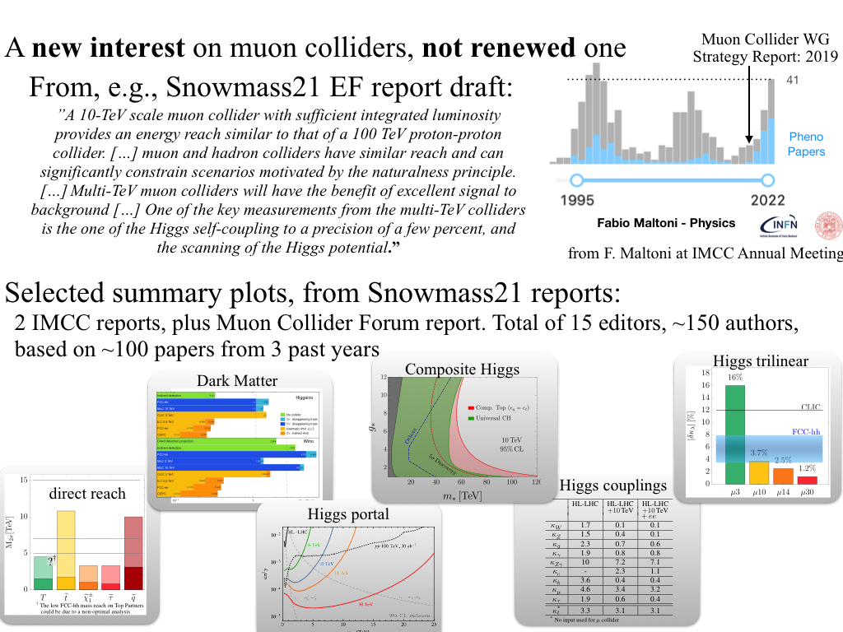
A new Interest in Muon Colliders
A. Wulzer, F. Maltoni, P. Meade et al.
O(150) authors, 15 editors, 100 papers
DELPHES card available
Strong US involvement starting with Muon Smasher’s Guide
and in Muon Collider Forum

Slide 5
Muon Collider Promises
US Snowmass Implementation Task Force: Th. Roser, R. Brinkmann, S. Cousineau, D. Denisov, S. Gessner, S. Gourlay, Ph. Lebrun, M. Narain, K. Oide, T. Raubenheimer, J. Seeman, V. Shiltsev, J. Straight, M. Turner, L. Wang et al.
 | CME [TeV] | Lumi per IP [10³⁴cm⁻²s⁻¹] | Years to physics | Cost range [B$] | Power [MW]
FCC-ee | 0.24 | 8.5 | 13-18 | 12-18 | 290
ILC | 0.25 | 2.7 | <12 | 7-12 | 140
CLIC | 0.38 | 2.3 | 13-18 | 7-12 | 110
ILC | 3 | 6.1 | 19-24 | 18-30 | 400
CLIC | 3 | 5.9 | 19-24 | 18-30 | 550
MC | 3 | 1.8 | 19-24 | 7-12 | 230
MC | 10 | 20 | >25 | 12-18 | 300
FCC-hh | 100 | 30 | >25 | 30-50 | 560
Judgement by ITF, take it cum grano salis
5

Slide 6
Goal and Accelerator R&D Roadmap
Muon collider is on European Accelerator R&D Roadmap
Reviews in Europe and US found no insurmountable obstacle
Implementing workplan
Goal: Project Evaluation Report and R&D Plan to next ESPPU/other processes
10+ TeV collider, potential 3 TeV initial stage
CERN has budget in MTP, hosting a collaboration
Design Study supported by EC, Switzerland, UK and partners contribute
Strong interest in US community to join
Key work
Design of critical beam complex
Address technologies
Prepare demonstrator
http://arxiv.org/abs/2201.07895
6

Slide 7
Muon Collider Timeline
Technically limited timeline
To be reviewed considering progress, funding and decisions
Muon collider important in the long term
Even after potential FCC-hh
But also plan B as next project in Europe and maybe plan A in US and elsewhere
Fast track option if require next as project after HL-LHC:
Lower energy initial option, e.g. 3 TeV
Upgrade to 10 TeV later
  Little extra cost
Subject to funding
Evaluation+decision
Evaluation+decision
7

Slide 8
Initial Target Parameters
Parameter | Unit | 3 TeV | 10 TeV | 14 TeV
L | 10³⁴ cm⁻²s⁻¹ | 1.8 | 20 | 40
N | 10¹² | 2.2 | 1.8 | 1.8
f_{r} | Hz | 5 | 5 | 5
P_{beam} | MW | 5.3 | 14.4 | 20
C | km | 4.5 | 10 | 14
<B> | T | 7 | 10.5 | 10.5
ε_{L} | MeV m | 7.5 | 7.5 | 7.5
σ_{E} / E | % | 0.1 | 0.1 | 0.1
σ_{z} | mm | 5 | 1.5 | 1.07
β | mm | 5 | 1.5 | 1.07
ε | μm | 25 | 25 | 25
σ_{x,y} | μm | 3.0 | 0.9 | 0.63
CLIC at 3 TeV
Target integrated luminosities
Note: currently focus on 10 TeV, also explore 3 TeV
Tentative parameters based on MAP study, might add margins
Achieve goal in 5 years
FCC-hh to operate for 25 years
Aim to have two detectors
2 (6)
28
8

Slide 9
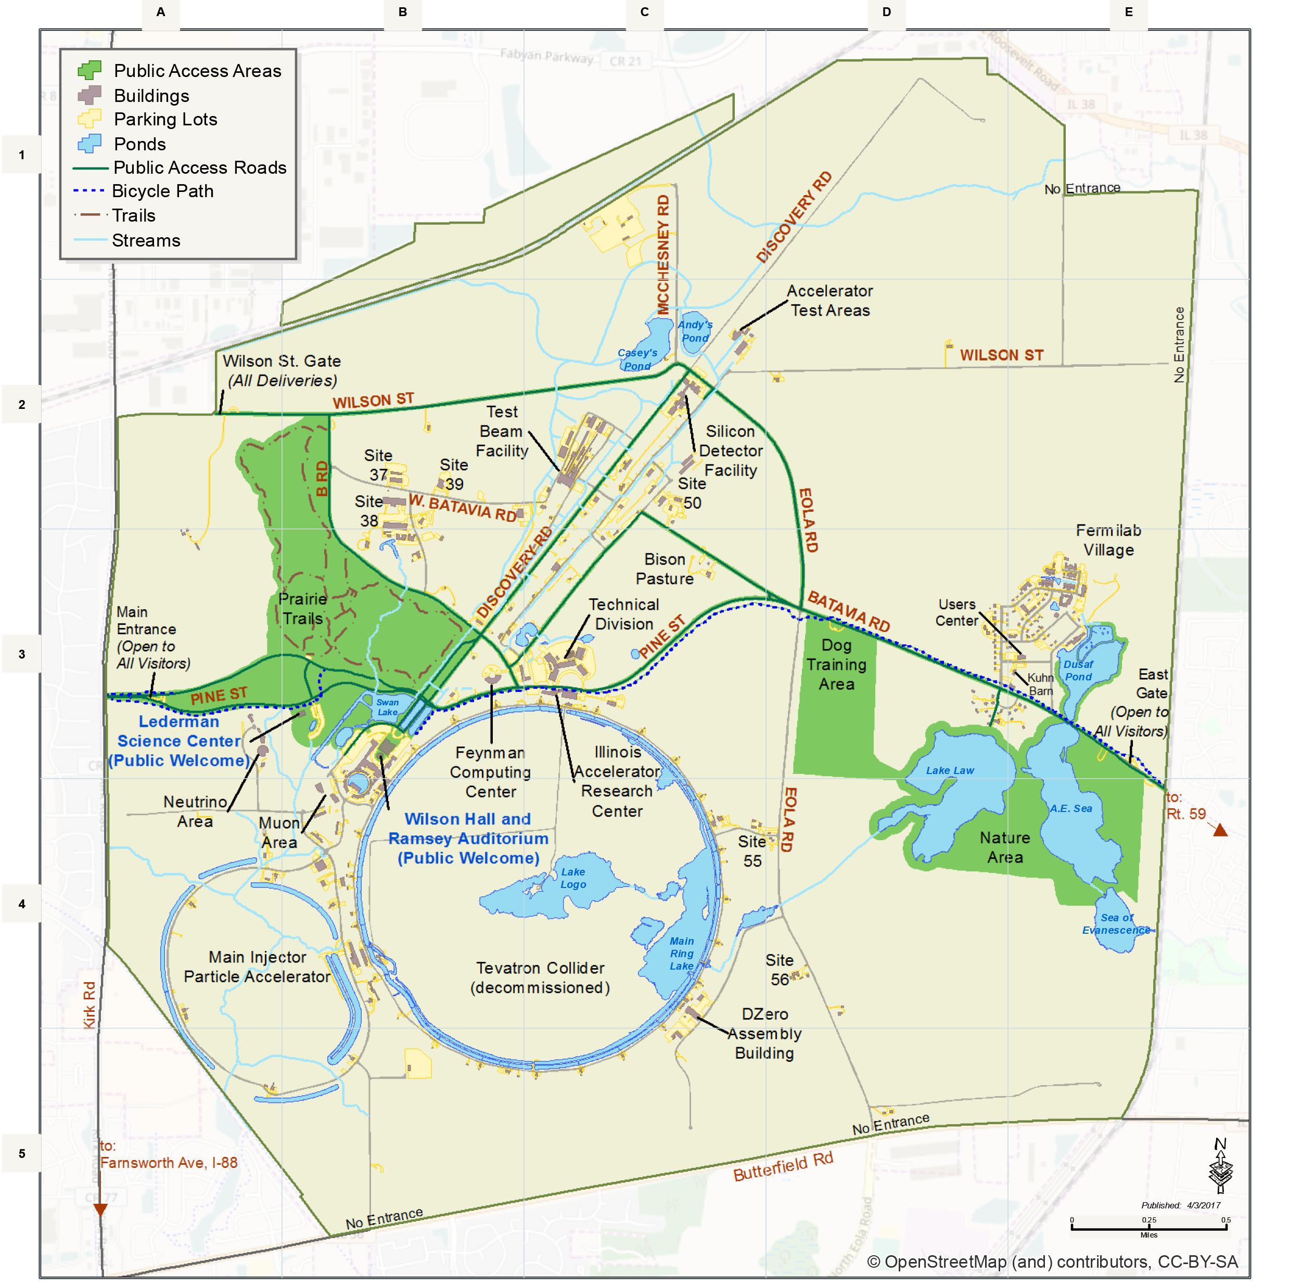
Muon Collider Community
Formed collaboration hosted by CERN to implement R&D Roadmap for CERN Council
EU Design Study approved
(EU+Switzerland+UK and partners)
60+ partners, 40+ already signed MoC
Plan to participate to HORIZON-INFRA-2024-TECH
Goal: prepare experimental programme, e.g. demonstrator, prototypes, …
TIARA wants magnet proposal
US Snowmass has strong support
to contribute to R&D
as a collider in the US
Lia Merminga appointed team that prepared
P5 ask, aim for 50 FTE for accelerators
Some first contacts with others

Slide 10
MoC and Design Study Partners
IEIO | CERN
FR | CEA-IRFU
 | CNRS-LNCMI
DE | DESY
 | Technical University of Darmstadt
 | University of Rostock
 | KIT
IT | INFN
 | INFN, Univ., Polit. Torino
 | INFN, Univ. Milano
 | INFN, Univ. Padova
 | INFN, Univ. Pavia
 | INFN, Univ. Bologna
 | INFN Trieste
 | INFN, Univ. Bari
 | INFN, Univ. Roma 1
 | ENEA
Mal | Univ. of Malta
BE | Louvain
UK | RAL
 | UK Research and Innovation
 | University of Lancaster
 | University of Southampton
 | University of Strathclyde
 | University of Sussex
 | Imperial College London
 | Royal Holloway
 | University of Huddersfield
 | University of Oxford
 | University of Warwick
 | University of Durham
SE | ESS
 | University of Uppsala
PT | LIP
NL | University of Twente
FI | Tampere University
LAT | Riga Technical Univers.
US | Iowa State University
 | Wisconsin-Madison
 | Pittsburg University
 | Old Dominion
 | BNL
China | Sun Yat-sen University
 | IHEP
 | Peking University
EST | Tartu University
AU | HEPHY
 | TU Wien
ES | I3M
 | CIEMAT
 | ICMAB
CH | PSI
 | University of Geneva
 | EPFL
KO | KEU
 | Yonsei University
India | CHEP
IT | INFN Frascati
 | INFN, Univ. Ferrara
 | INFN, Univ. Roma 3
 | INFN Legnaro
 | INFN, Univ. Milano Bicocca
 | INFN Genova
 | INFN Laboratori del Sud
 | INFN Napoli
US | FNAL
 | LBL
 | JLAB
 | Chicago
 | Tenessee
10

Slide 11
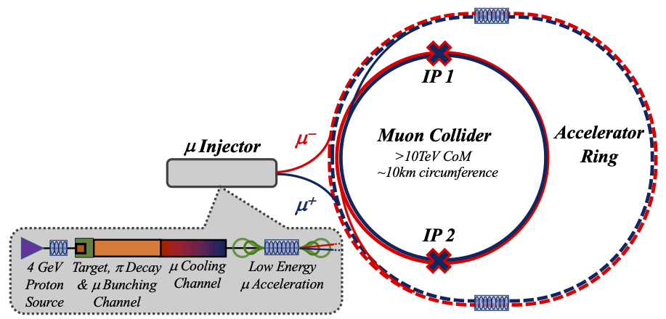
Key Challenges
0) Physics case
4) Drives the beam quality
MAP put much effort in design
optimise as much as possible
2) Beam-induced background
1) Dense neutrino flux
mitigated by mover system and site selection
3) Cost and power consumption limit energy reach
e.g. 35 km accelerator for 10 TeV, 10 km collider ring
Also impacts beam quality
11

Slide 12
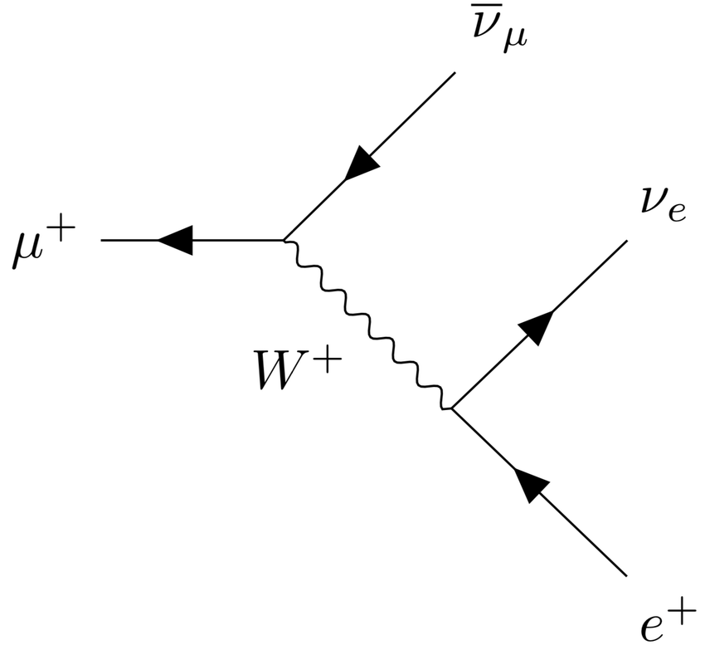
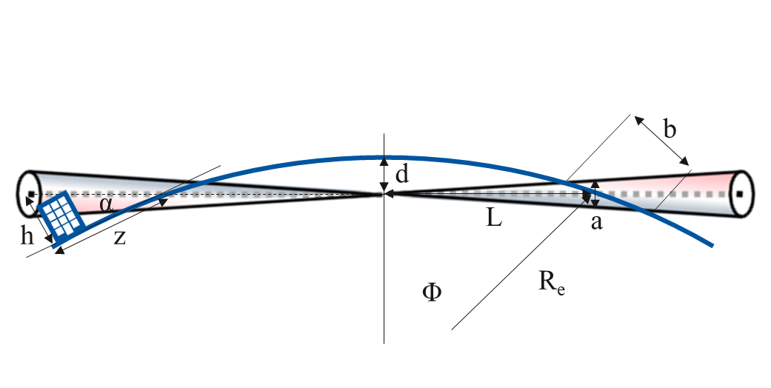
Muon Decay and Neutrino Flux
~600 m
Muon decays per bunch passage
235,000 m⁻¹ at 3 TeV
58,000 m⁻¹ at 10 TeV
t₁
But want to have negligible impact from arcs
Similar impact as LHC
At 3 TeV this is the case for 200 m depth
At 10 TeV use angle change of +/- 1 mradian to go from acceptable to negligible level
  Mockup of mover system planned
  Impact on beam to be checked
Impact of experimental insertions
3 TeV design acceptable with no further work
Maybe acquire land in direction of experiment, also for 10 TeV
t₂

Slide 13
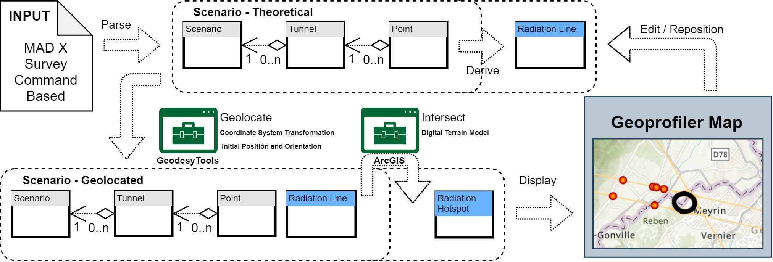
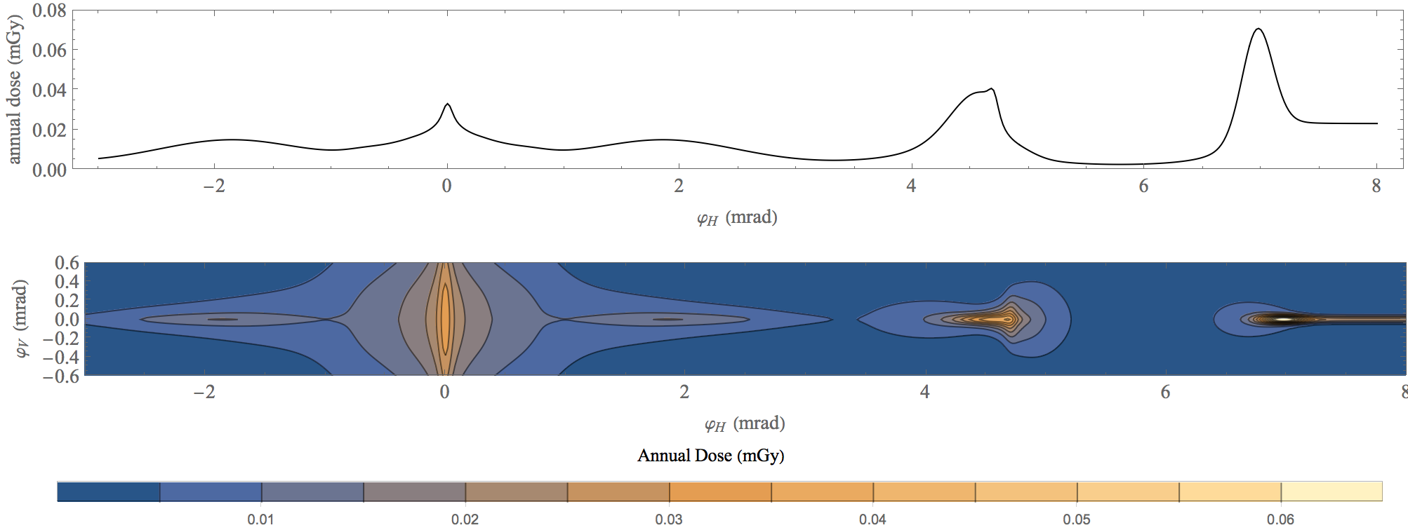
Neutrino Flux
Goal: similar to LHC: limit neutrino flux to have negligible impact, “fully optimised” (10% of MAP goal)
Verify performance of concept to be good for 14 TeV
Mover and support system
FLUKA dose studies
Conformity Verification Scheme
F. Bertinelli et al. (CERN, Riga)
G. Lerner, D. Calzolari, A. Lechner, C. Ahdida
G. Lacerda, Y. Robert, N. Guilhaudin (CERN)
C. Ahdida, P. Vojtyla, M. Widorski, H. Vincke
Flux direction map / lattice design / mover impact on beam
Mitigation:
Site choice tool
C. Carli, K. Skoufaris (CERN)
13

Slide 14
Muon Decay and Detector Background
Detector team
O(69) authors, O(150 signatories)
Muon decays produce electrons and positrons
Loss per unit length almost independent of energy
First results indicate that background does not increase much with energy
1.5 and 3 TeV studies, concept based on CLIC detector
Masks to mitigate background
Detailed FLUKA studies of masks/beamline
Tracking detector radiation level similar to HL-LHC
Studies with beam-induced background in progress
some channels are not affected by background
some improvement required for other channels
Concept for 10 TeV in progress
D. Lucchesi, F. Meloni et al.
14

Slide 15
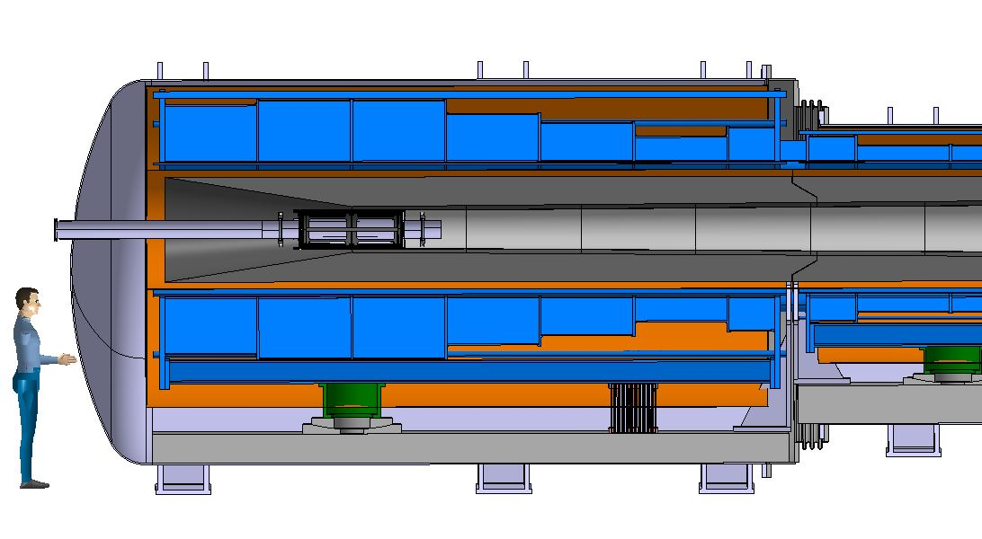
Proton Complex and Target
in target
decay
protons
pions
muons
400 kJ protons to produce 5 x 10¹³ captured muon pairs
5 GeV proton beam, 2 MW = 400 kJ x 5 Hz
Power is at hand
ESS and Uppsala will focus on merging beam into high-charge pulses
Optimisation of parameters planned
Graphite Target
20 T solenoid
to guide pions and muons
Tunsten shielding
To protect magnet

Slide 16
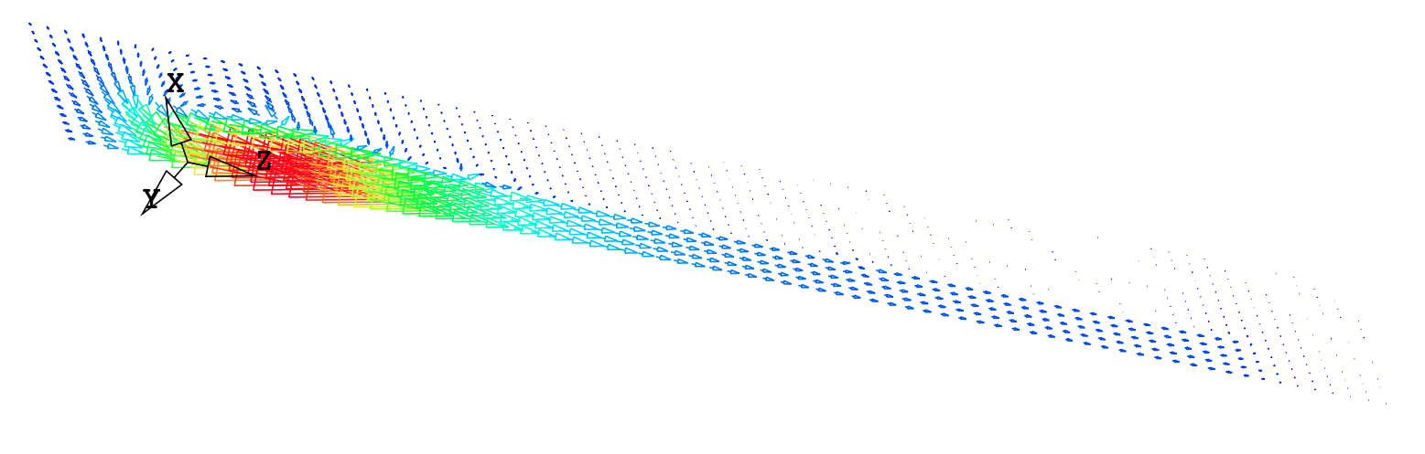
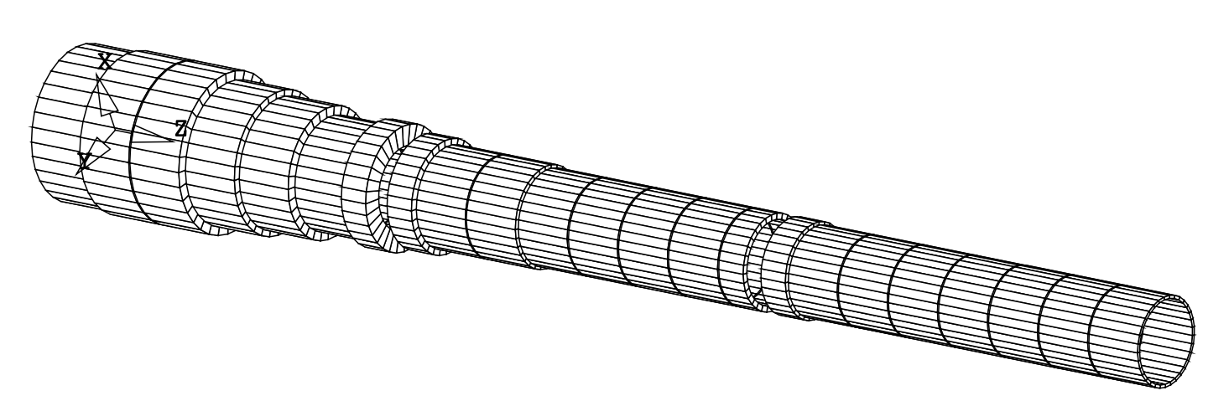
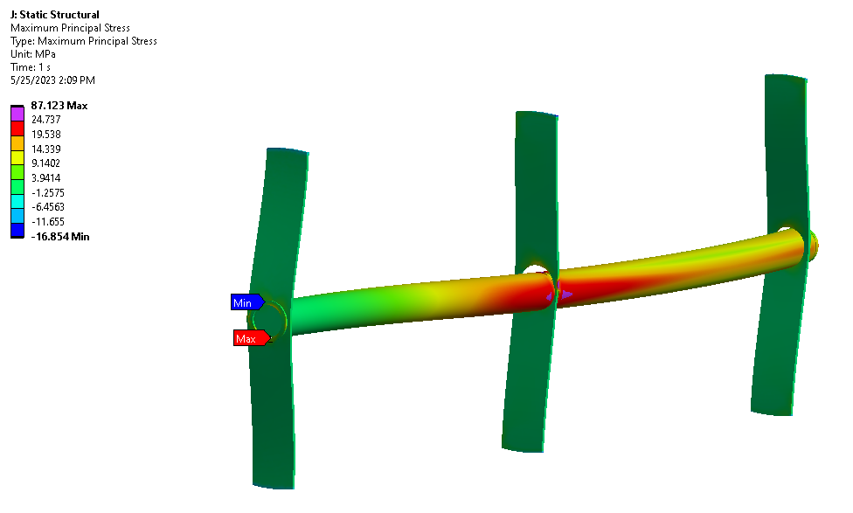
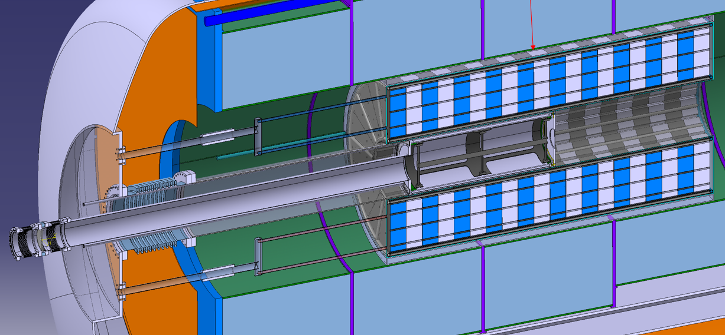
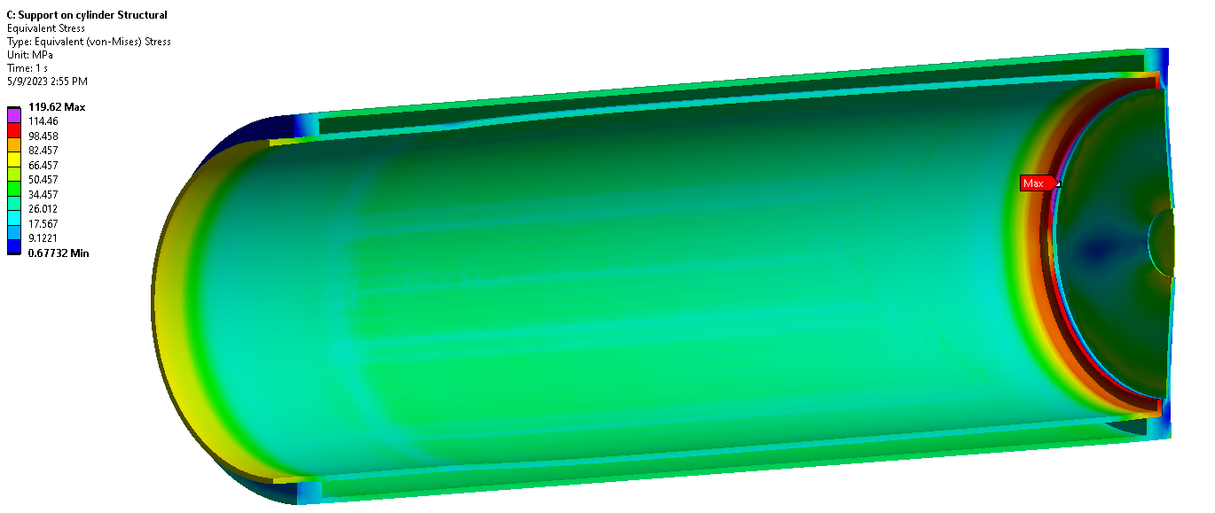
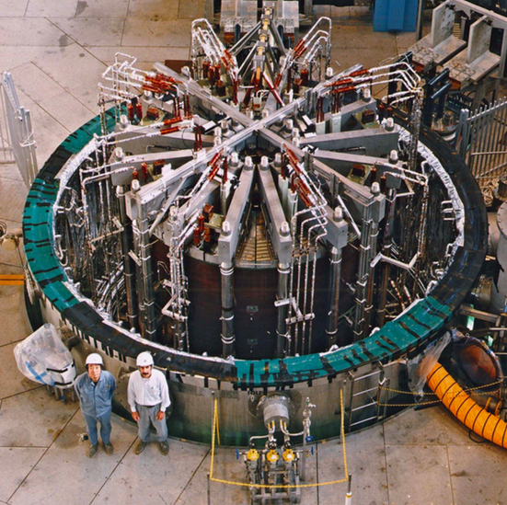
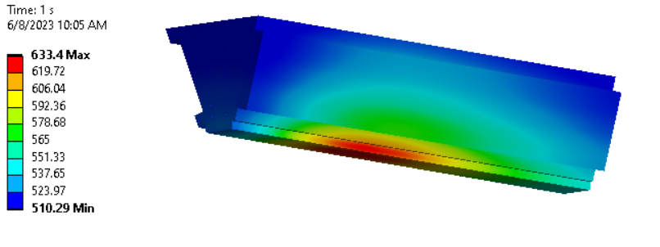
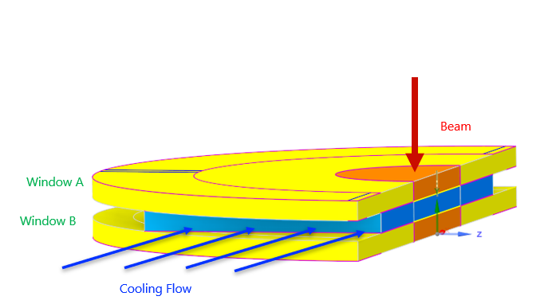
Target Studies
Target solenoid design ongoing
Either large bore 20 T HTS or 15 T LTS with 5 T insert
FLUKA studies:
2 MW target: stress in target, shielding, vessel OK
Need to have closer look at window
Cooling OK
Target
HTS target solenoid: 20 T, 20 K
A Portone, P. Testoni,
J. Lorenzo Gomez, F4E
Integration
Vessel
Cooling, vacuum, mechanics, …
ITER model coil: 13 T Nb₃Sn 1.7 m diameter
Our work is relevant for fusion
Tunsten shielding
Window
16
A. Lechner, D. et al.

Slide 17
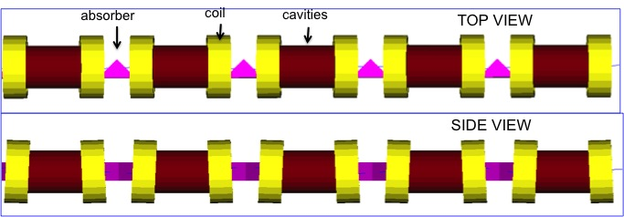
Muon Cooling Principle
High-gradient normal-conducting cavities
C. Rogers, B. Stechauner, E. Fol et al. (RAL, CERN)
Robust absorbers
High-field, superconducting solenoid
Principle has been demonstrated in MICE
Nature vol. 578, p. 53-59 (2020)

Slide 18
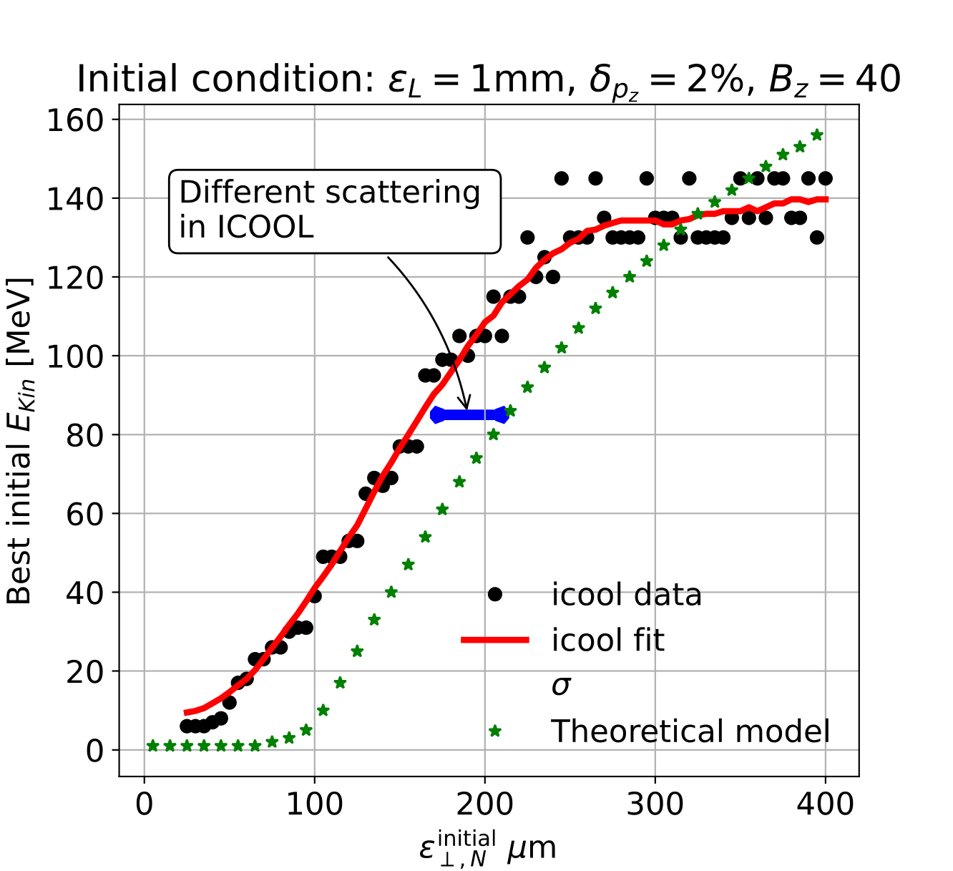
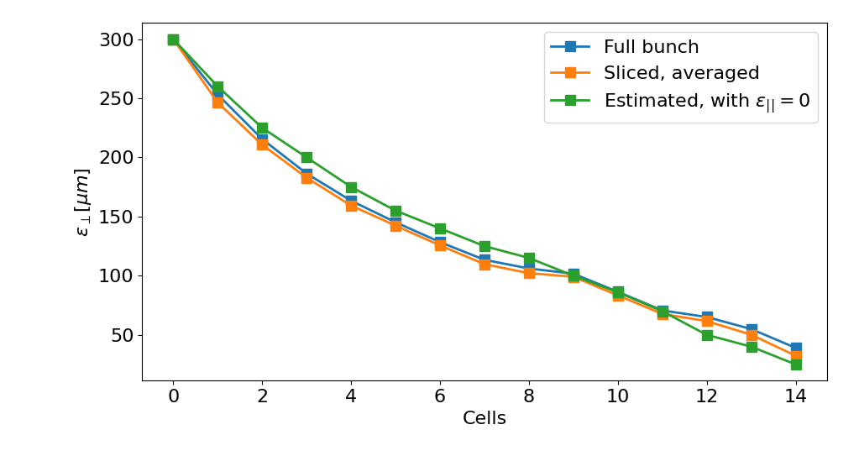
Muon Cooling Performance
MAP design achieved 55 um based on achieved fields
Can expect better hardware
Integrating physics into RFTRACK, a CERN simulation code with single-particle tracking, collective effects, …
A. Latina, E. Fol, B. Stechauner at al.
Working on improved, systematic design, also using better magnets and RF
Currently improved from 55 um to 33 um,
25 um is the goal
Ch. Rogers, Zhu Ruihu, B. Stechauner, E. Vol et al.

Slide 19
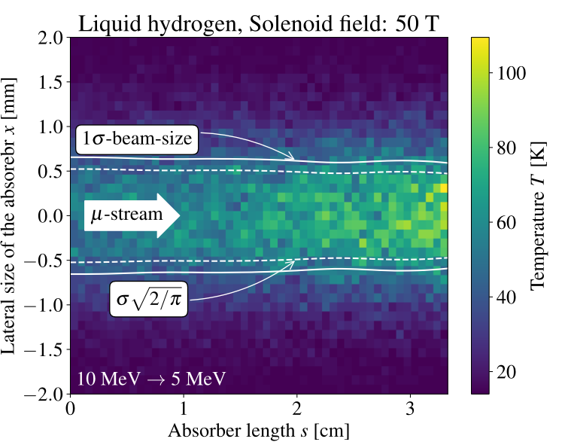
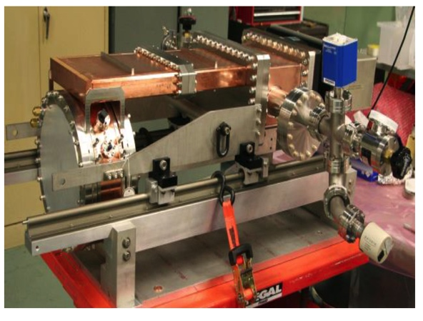
Cooling Cell Technology
Most complex example 12 T
Will develop example cooling cell with integration
tight constraints
additional technologies (absorbers, instrumentation,…)
early preparation of demonstrator facility
Windows and absorbers for high-density muon beam
Pressure rise mitigated by vacuum density
Plan window test in HiRadMat
L. Rossi et al. (INFN, Milano, STFC, CERN),
J. Ferreira Somoza et al.
RF cavities in magnetic field
MAP demonstrated higher than goal gradient
Improve design based on theoretical understanding
Preparation of new test stand, but needs funding
Test stand at CEA (700 MHz, need funding)
Test at other frequencies in the UK considered
Use of CLIC breakdown experiment considered
MuCool demonstrated >50 MV/m in 5 T
H2-filled copper
Be end caps
C. Marchand, Alexej Grudiev et al. (CEA, Milano, CERN, Tartu)
19

Slide 20
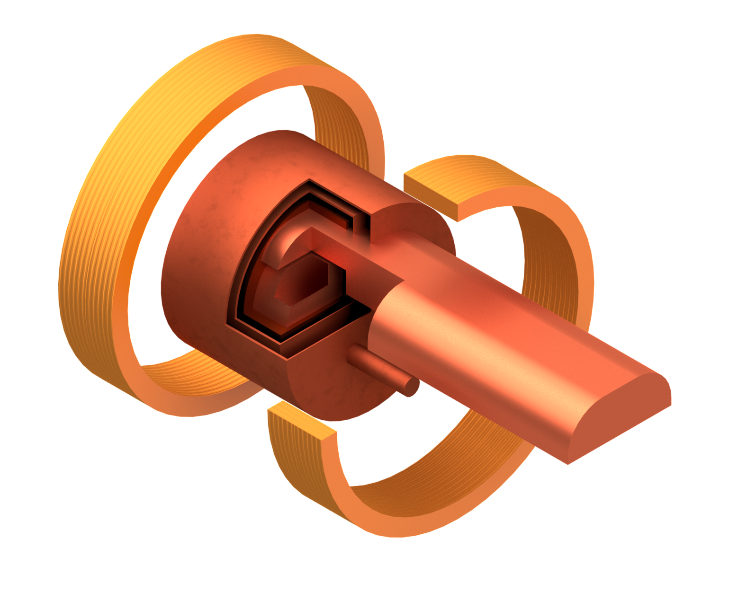
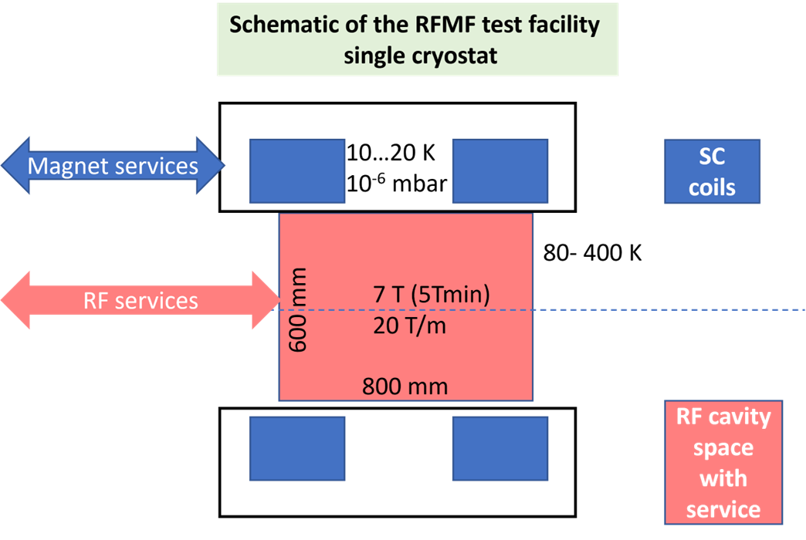
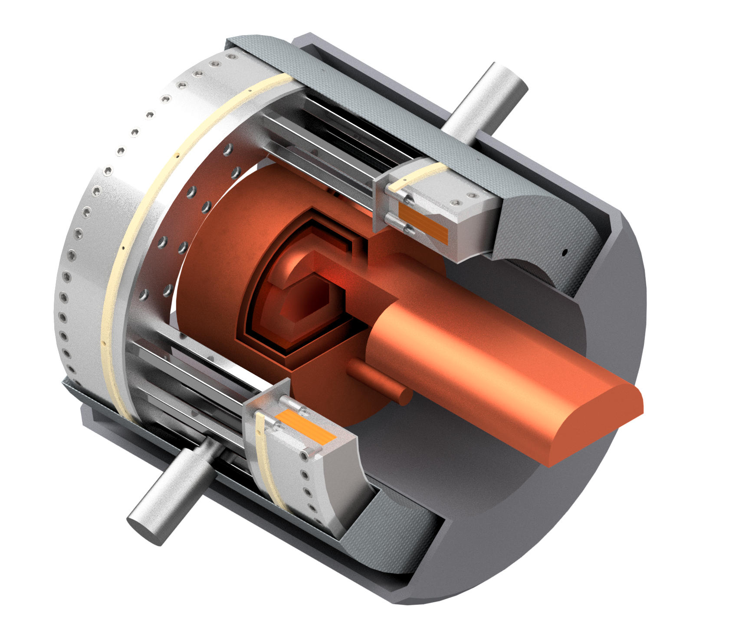
RF Test Stand
Module work focuses on RF test stand at this moment
Important ensure timely R&D plan
Try to identify infrastructure for this
  CEA, INFN, Cockroft, CERN, …
  Will not be cheap so need to find resources
Bare coils and RF cavity
SC HTS coils
RF Wave guide
Pillbox test cavity
Two stage cryocooler
With cryostat
Thermal shield
Coil support structure
Vacuum vessel
Tie rods for repulsion and compression forces
L. Rossi, C. Marchand, D. Giove, A. Gurdiev, G. Ferrand, M. Castoldi, S. Sorti et al.
SC HTS coils

Slide 21
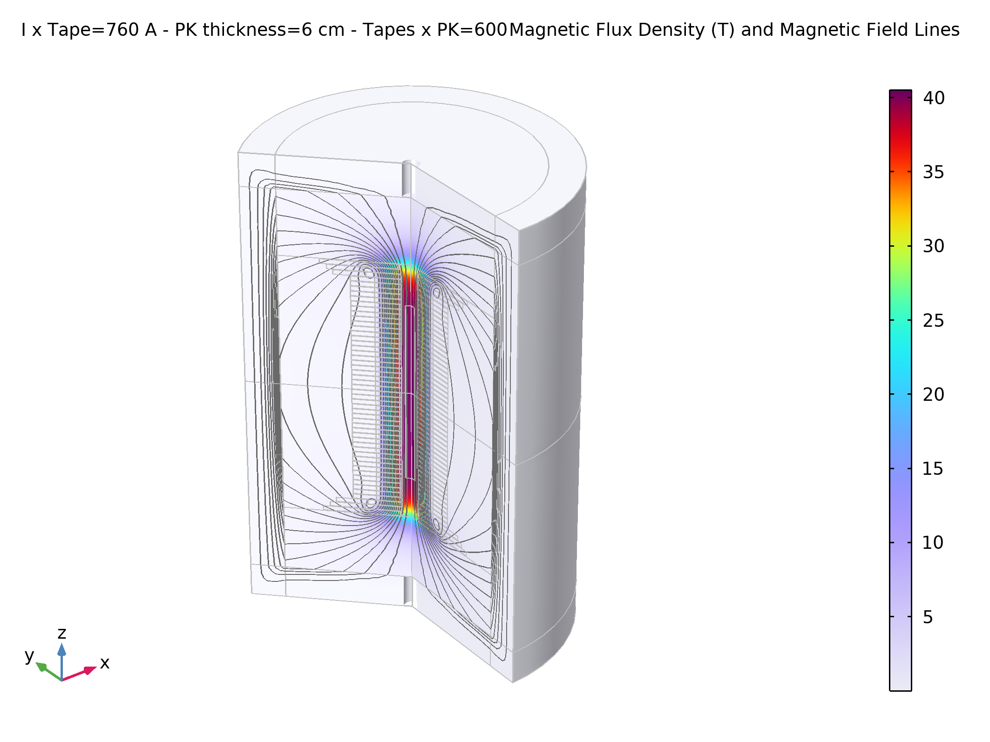
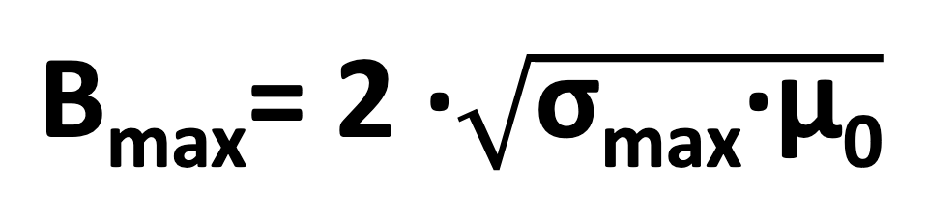
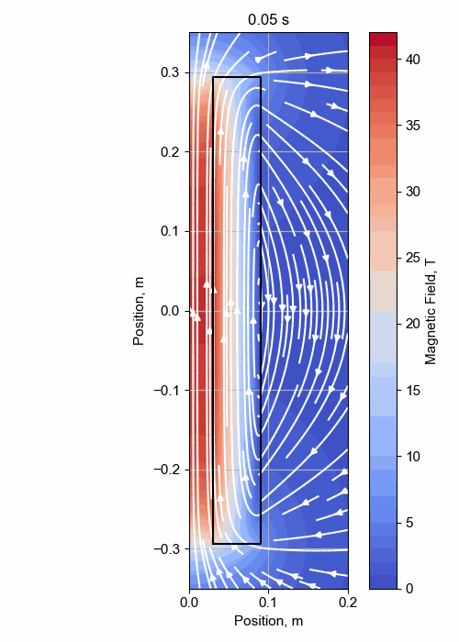

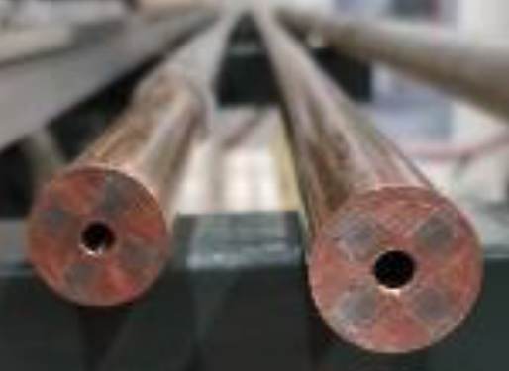
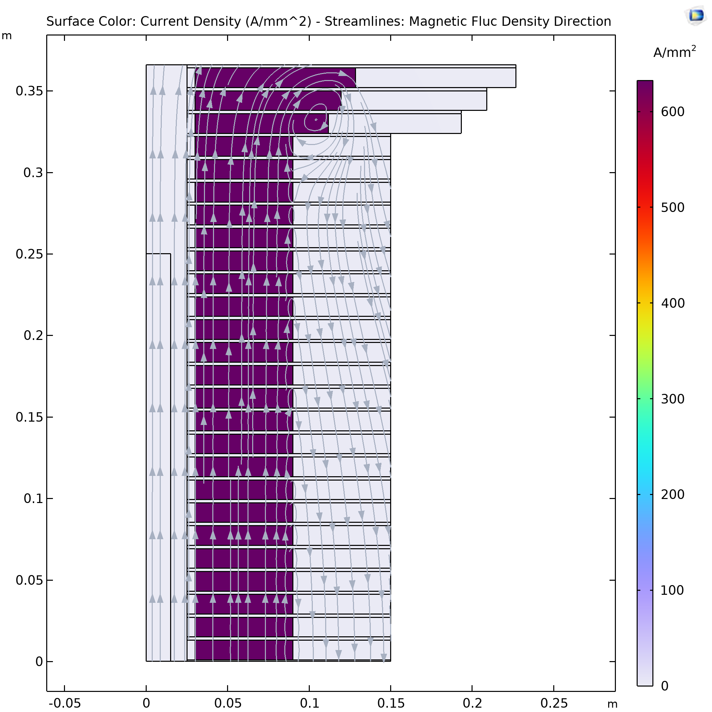
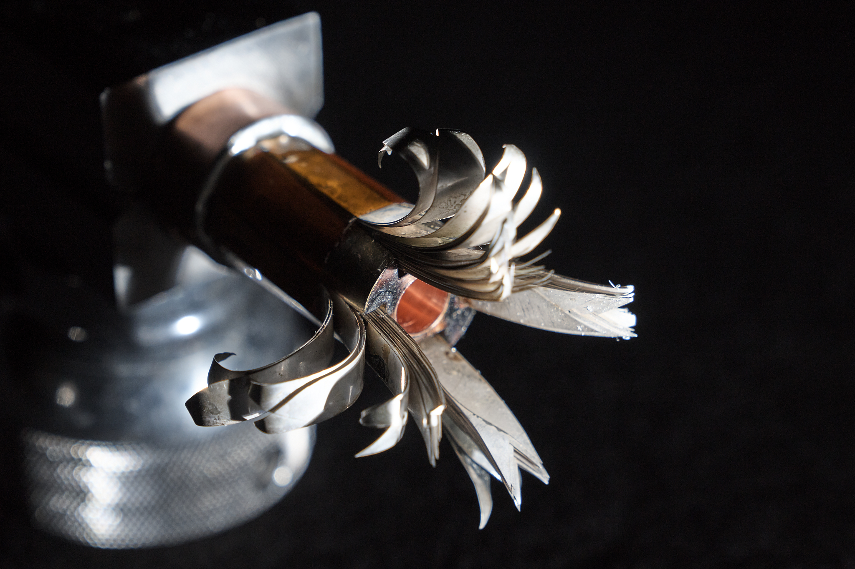
Solenoid R&D
Final Cooling solenoid
Started HTS solenoid development for high fields
Synergies with fusion reactors, NRI, power generators for windmills, …
A Portone, P. Testoni, J. Lorenzo Gomez, F4E
σ_{max} = 600 MPa
32 T LTS/HTS solenoid demonstrated
A. Dudarev, B. Bordini, T. Mulder, S. Fabbri
MIT “VIPER” conductor
Inner Ring
‘Correction’ Coil
Outer Ring
Bore
NHFML
32 T solenoid with HTS
‘Modular’ Coil
MuCol HTS conductor
Operating current: 61 kA
Target solenoid, 20 T, 20 K
1 % Field Homogeneity
Support Plate

Slide 22
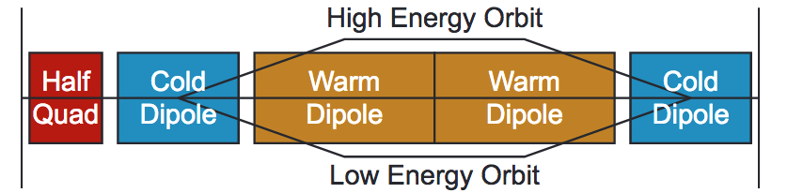
Acceleration Complex
Core is sequence of hybrid pulsed synchrotron (0.4-11 ms)
Alternative FFA
MAP study S. Berg et al.
Started work on key challenges
Integrated design of RCS
  Longitudinal dynamics
  Lattice with realistic hardware specifications
  Collective effects
Concept of key components
  Fast-ramping normal magnets
  HTS alternative
  Efficient power converters
  RF with transient beam loading
initial
final
EMMA proof of FFA principle
Nature Physics 8, 243–247 (2012)
Lattice and integration: A. Chance et al. (CEA)
Long. dynamics and RF systems: H. Damerell, U. van Rienen, A. Grudiev et al. (Rostock, Milano, CERN)
Power converter: F. Boattini et al.
Magnets: L. Bottura et al. (LNCMI, Darmstadt, Bologna, Twente)
FFA: S. Machida et al. (RAL)

Slide 23
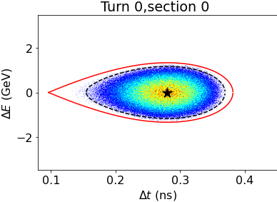
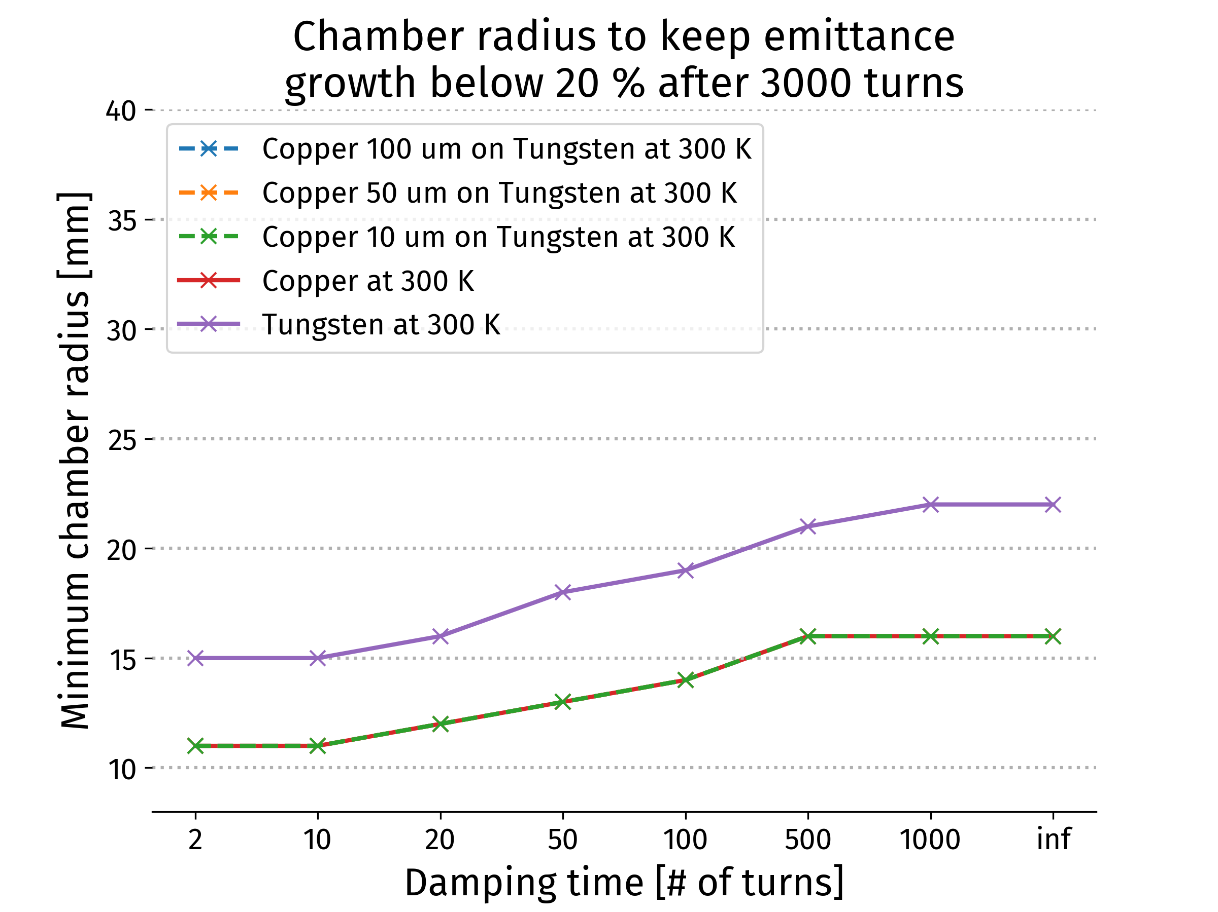
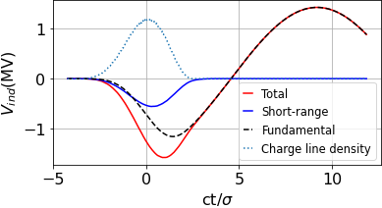
Collective Effects and RF Design
Longitudinal dynamics and RF important due to high bunch charge
> 30 RF stations needed
Orbit length changes require frequency tuning required
Single-bunch HOM power loss up to 10 kW during pulse
CW average is lower, development of high-capacity couplers needed
A. Chance, H. Damerell, F. Batsch, U. van Rienen, A. Grudiev et al. (CEA, Rostock, Milano, CERN)
E. Metral, D Amorim et al. (CERN)
Collider ring single beam instability limits
Conservative feedback
  Copper coating beneficial (few microns)
  Beam-beam studies started
Long. Distribution assumed at injection in RCS1
1.3 GHz appears possible for longitudinal effects and stability
Induced voltages in RCS1 for a single bunch

Slide 24
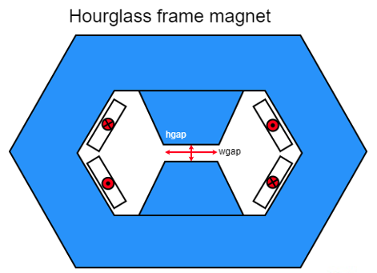
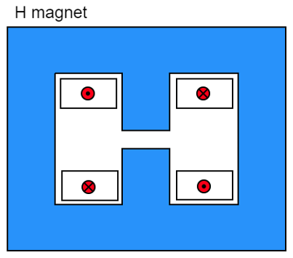
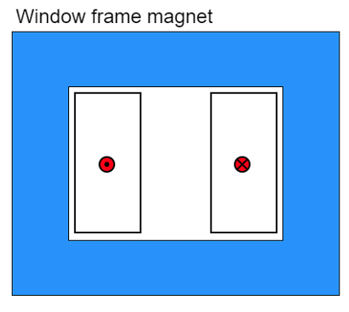
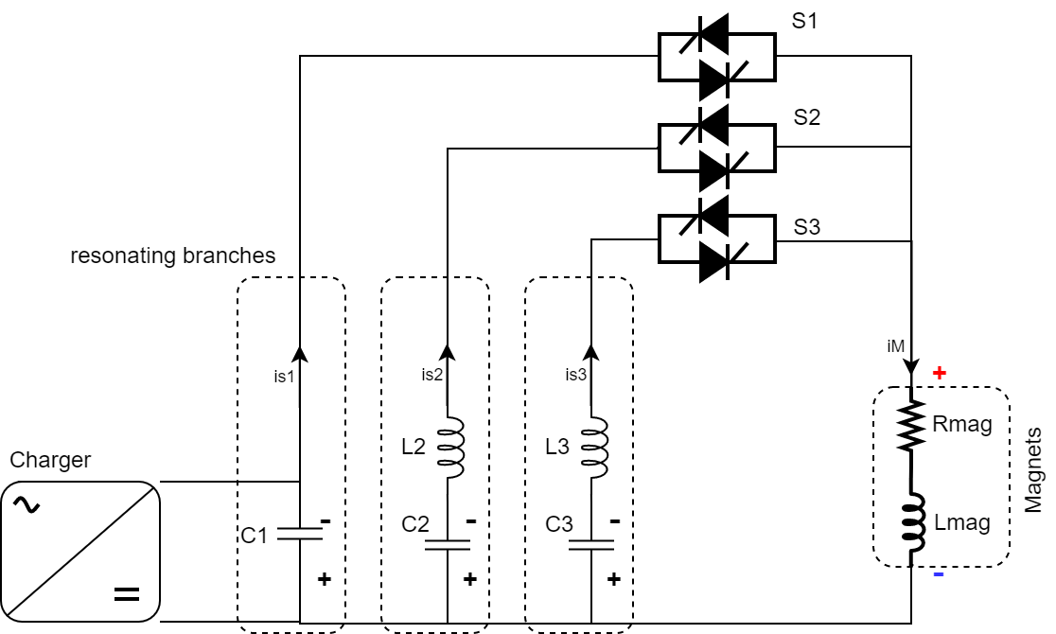
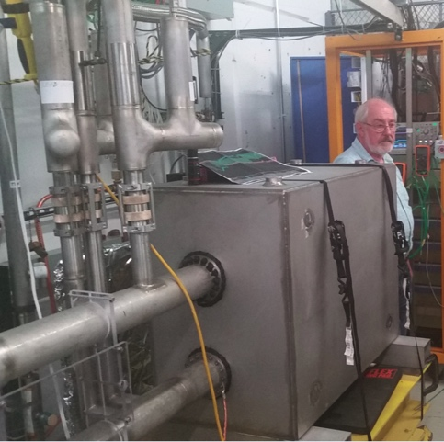
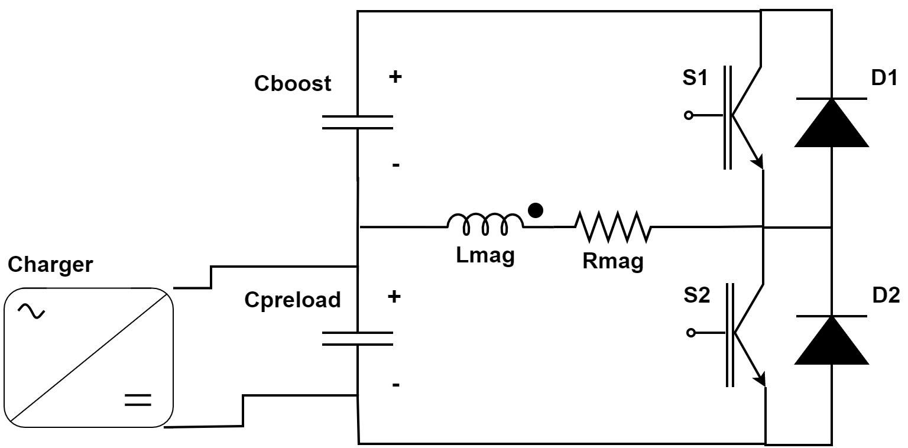
Fast-ramping Magnet System
F. Boattini et al.
Differerent power converter options investigated
Full wave resonance
5.07 kJ/m
5.65…7.14 kJ/m
5.89 kJ/m
Management of the power in the resistive dipoles (several tens of GW):
Minimum stored magnetic energy
Highly efficient energy storage and recovery
Commutated resonance (new)
Could also use HTS driven dipoles
Simple HTS racetrack dipole could match the beam requirements and aperture for static magnets
FNAL 300 T/s HTS magnet

Slide 25
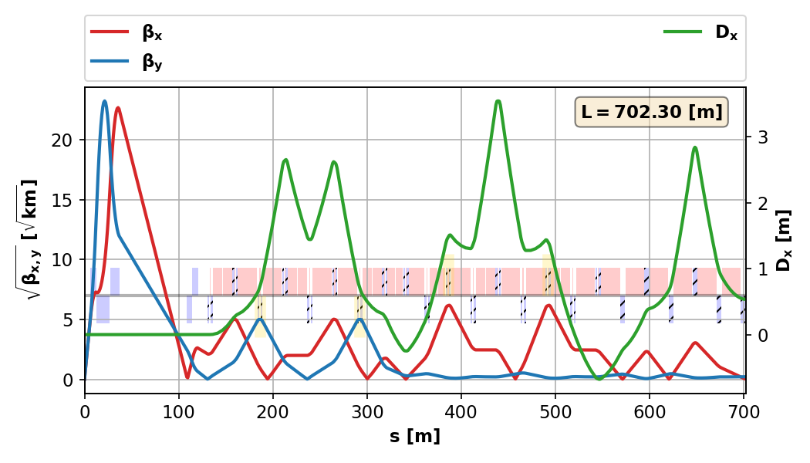
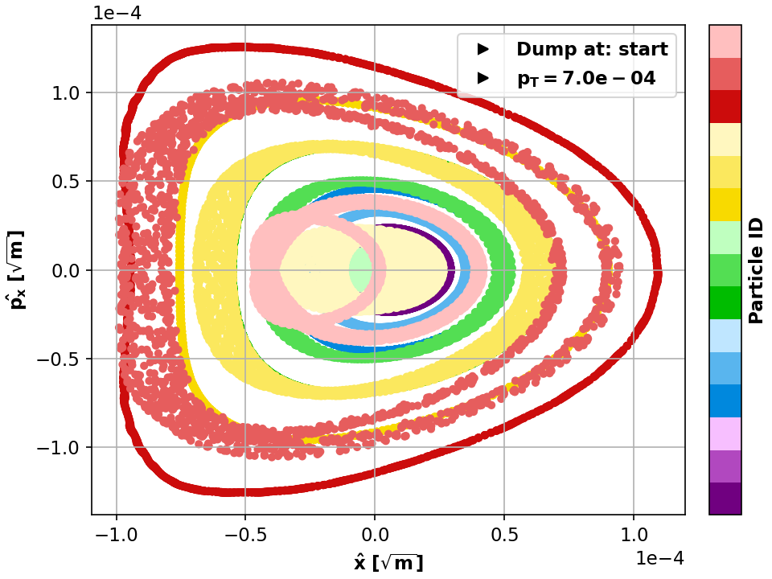
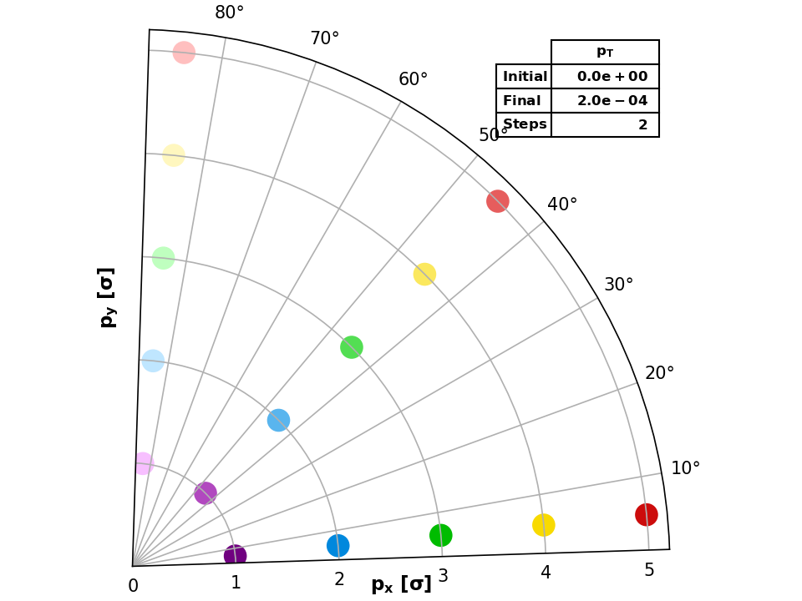
Collider Ring
Challenges:
Very small beta-function (1.5 mm)
Large energy spread (0.1%)
Maintain short bunches
K. Skoufaris, Ch. Carli, support from P. Raimondi, K. Oide, R. Tomas
MAP developed 4.5 km ring for 3 TeV with Nb₃Sn
magnet specifications in the HL-LHC range
Work progressing on 10 TeV collider ring
around 16 T HTS dipoles or lower Nb₃Sn
final focus based on HTS
Important progress: V0.6 good dynamic aperture at almost 0.1% off-energy, approaching the target
pT [%] | DAmin [σ]
0.07 | 5
0.08 | 4
0.09 | 3
0.1 | <1

Slide 26
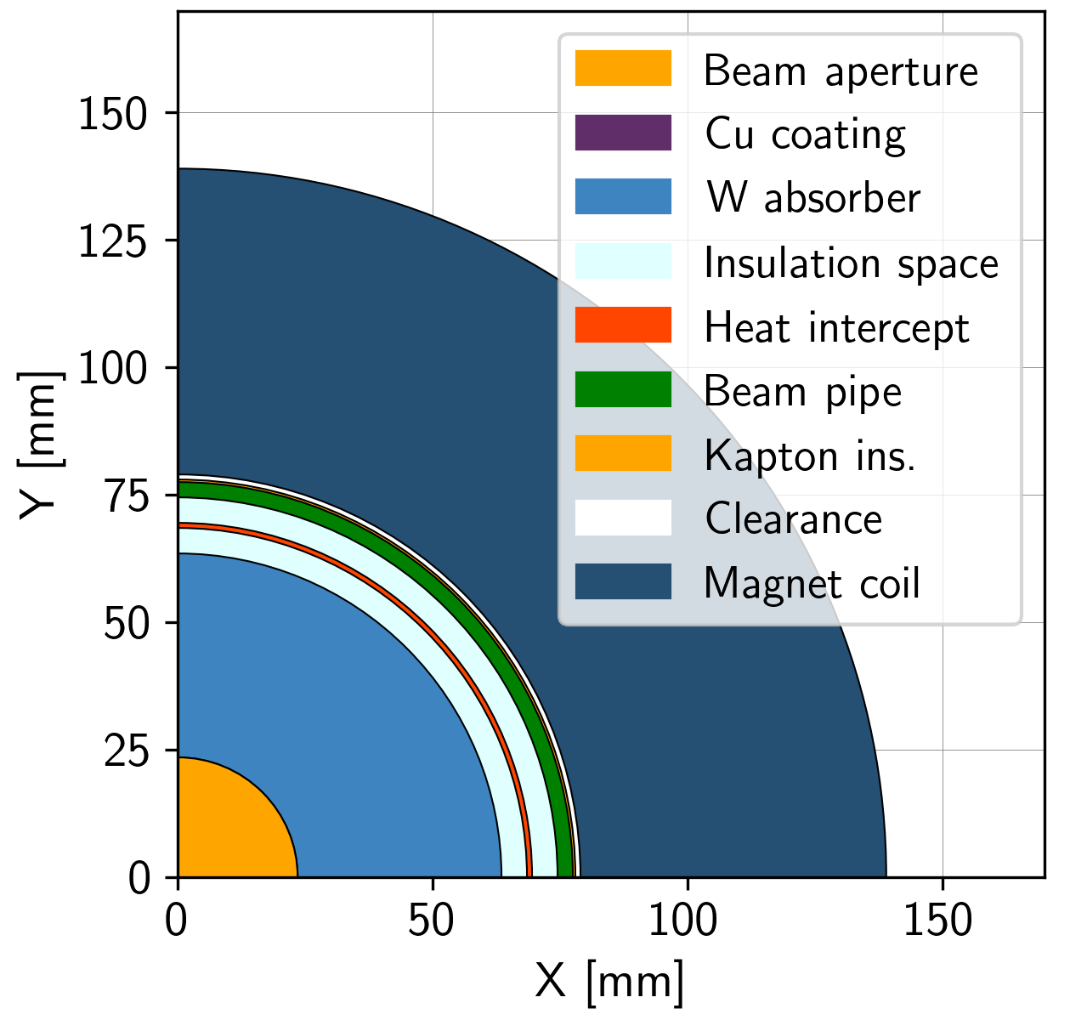
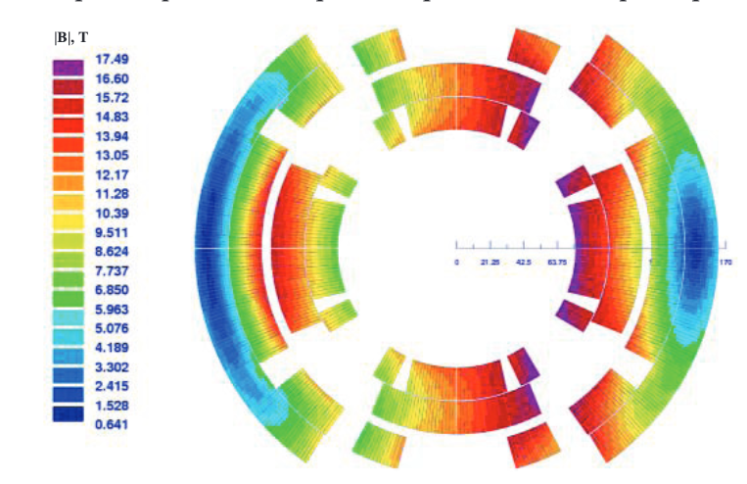
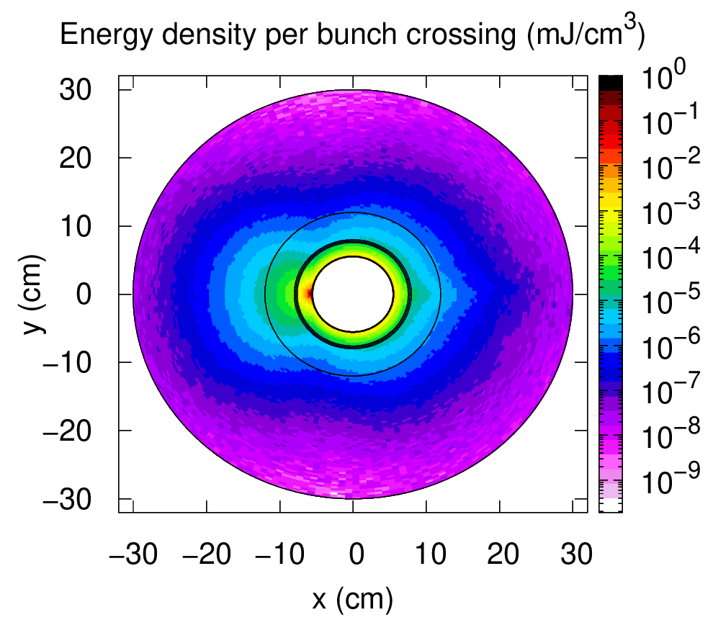
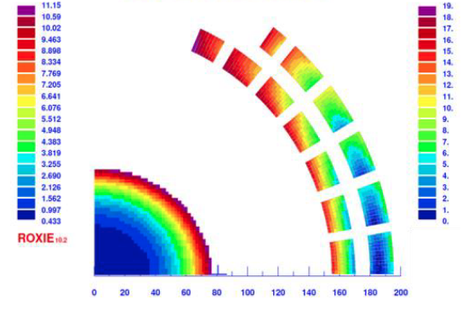
Collider Ring Technology
L. Bottura et al.
Power loss due to muon decay 500 W/m FLUKA simulation of shielding:
Require 30-40 mm tungesten
Few W/m in magnets
No problem with radiation dose
Initial estimate of magnet field limits:
9 T for NbTi, 14 T for Nb₃Sn
Need stress management
Shielding
A. Lechner
D. Calzolari (CERN)
K. Skoufaris, Ch. Carli, D. Amorim, A. Lechner, R. Van Weelderen, P. De Sousa, L. Bottura et al.
Coil
Different cooling scenarios studied
< 25 MW power for cooling possible
Shield with CO₂ at 250 K (preferred) or water
Support of shield is important for heat transfer
Discussion on options for magnet cooling
R. Van Weelderen, P. De Sousa

Slide 27
CDR Phase: Test Facility Dimensions
Downstream diagnostics area, 5 m
Collimation and upstream diagnostics area, 10 m
Target
+ horn (1st phase) /
+ superconducting solenoid (2nd phase)
Cooling area, 50 m
Momentum selection chicane, 10 m
Look for an existing proton beam with significant power
Different sites are being considered
CERN, FNAL, ESS are being discussed
J-PARC also interesting as option
C. Rogers

Slide 28
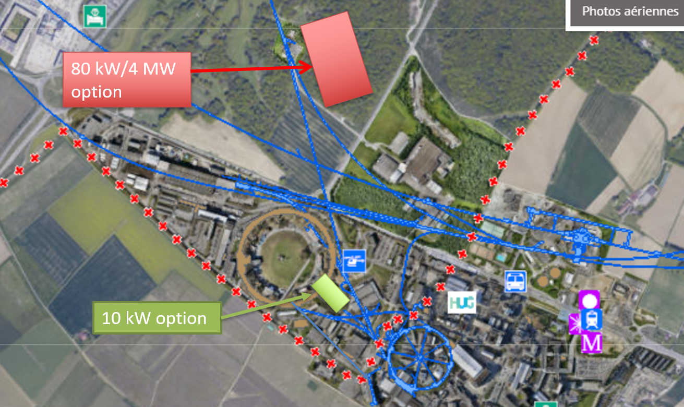
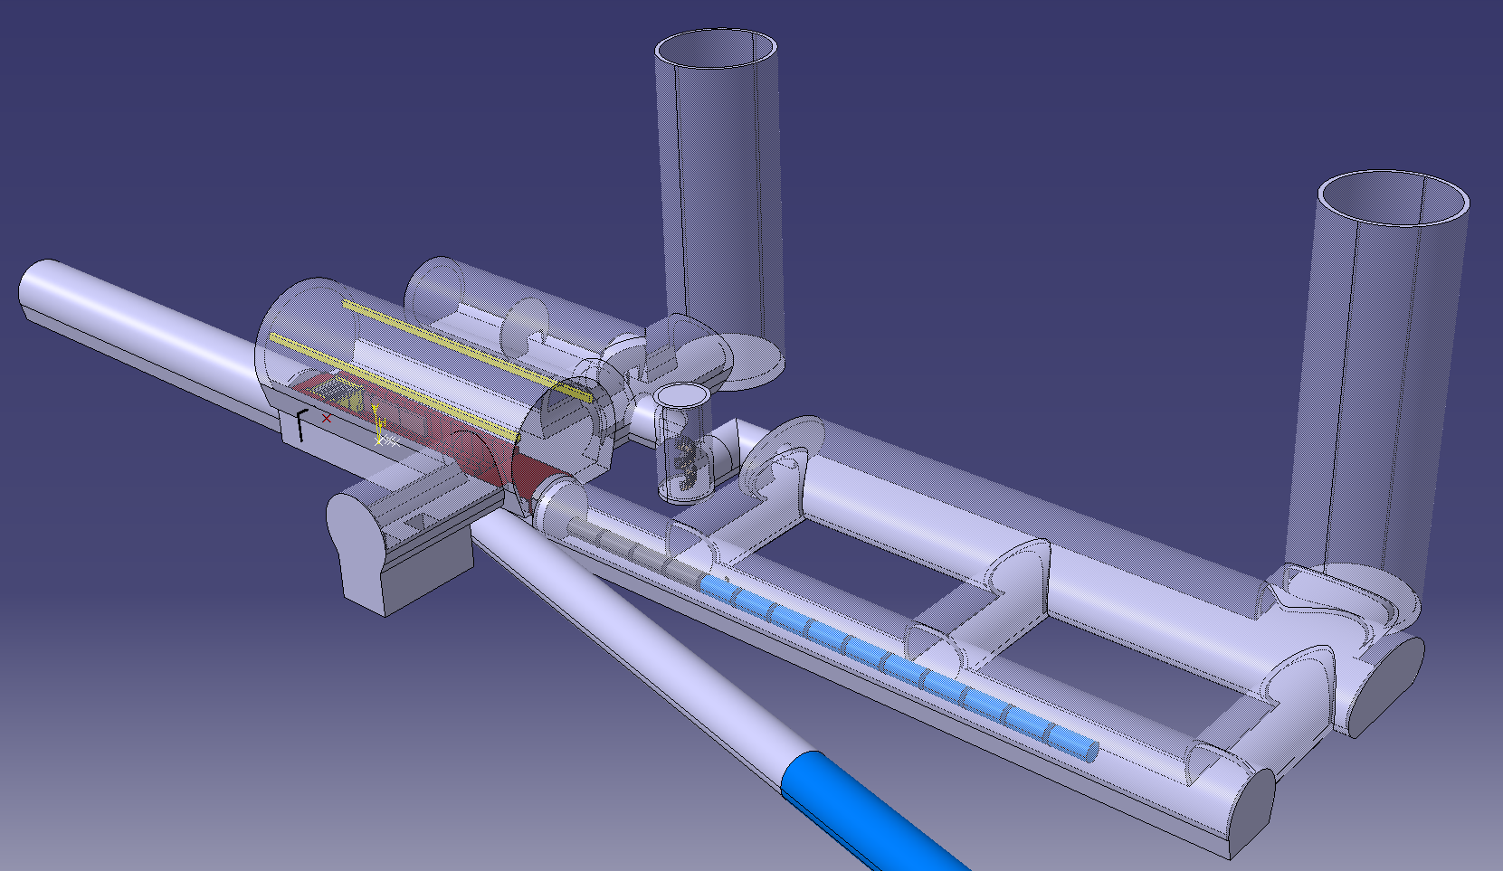
Possible CERN Locations
Consider nTOF-like beam from PS for cooling experiment:
1 pulse of 10¹³ p at 20 GeV per 1.2 s, i.e. 27 kW
maybe O(100kW) possible
If SPL were, installed could use its beam, e.g. 5 GeV, 4 MW
M. Calviani, R. Losito, J Osborn et al.

Slide 29
Conclusion
Muon collider unique opportunity for high-energy, high-luminosity lepton collider
Currently working toward 10+ TeV, potential 3 TeV intermediate stage explored
  Design
  Technology
  R&D programme preparation including demonstrator
Collaboration exists, promises to increase
  More request to EC and other funding agencies
  and in the US P5 process
  Feel that there is important synergy with other facilities and technologies
http://muoncollider.web.cern.ch To join contact muon.collider.secretariat@cern.ch
29

Slide 30
Reserve

Slide 31
Organisation
Collaboration Board (ICB)
Elected chair: Nadia Pastrone
Steering Board (ISB)
Chair Steinar Stapnes
CERN members: Mike Lamont, Gianluigi Arduini
ICB members: Dave Newbold (STFC), Mats Lindroos (ESS), Pierre Vedrine (CEA), N. Pastrone (INFN)
Study members: SL and deputies
Will add US but wait for US decision on members
Advisory Committee
To be defined, discussion in SB
Coordination committee (CC)
Study Leader: Daniel Schulte
Deputies: Andrea Wulzer, Donatella Lucchesi, Chris Rogers

Slide 32
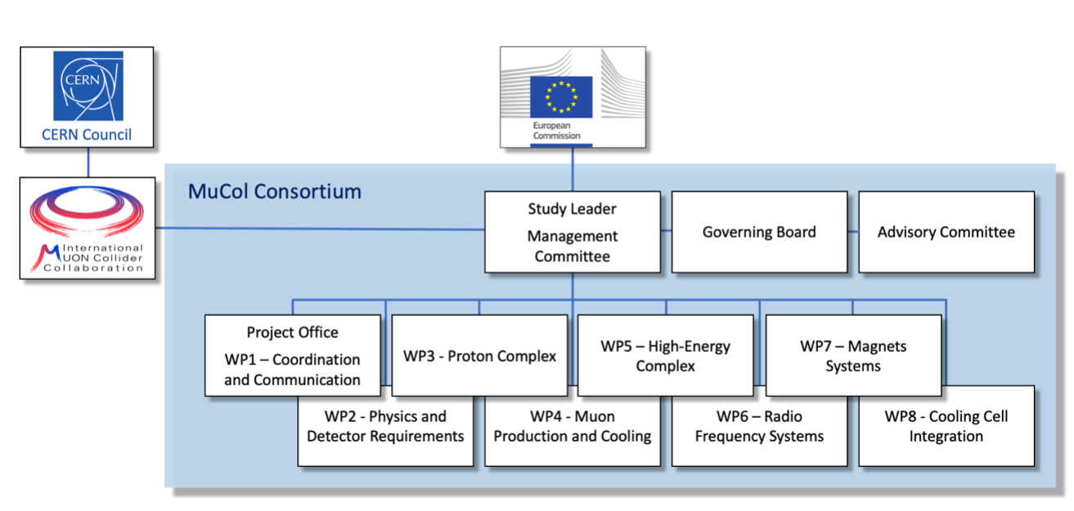
EU Design Study
Has been approved summer 2022
Very helpful to kick-start collaboration
Reapproved early 2023
It appears that there has been some issue with the refereeing of several projects, probably not directly with the muon collider
Brings 3 MEUR from the European Commission, the UK and Switzerland and about 4 MEUR from the partners
Basically nothing for CERN
Kick-off meeting in March 2023:
https://indico.cern.ch/event/1219912
Many thanks to all that contributed
https://mucol.web.cern.ch
Sat celeriter fieri quidquid fiat satis bene

Slide 33


US P5 Ask
S. Jindariani, D. Stratakis, Sridhara Dasu et al.
Goal is to contribute as much as Europe
Start of construction a bit later than in Roadmap
Will try to harmonise/define scenarios once US joins
Total resources would approach Roadmap
Some increase in Europe and Asia assumed
1-2 years delay
But profile is different
33

Slide 34
Muon Collider Luminosity Scaling
Fundamental limitation
Requires emittance preservation and advanced lattice design
Applies to MAP scheme
High beam power
High energy
Large energy acceptance
Dense beam
High field in collider ring
Luminosity per power increases with energy
Provided technologies can be made available
Constant current for required luminosity scaling

Slide 35

Staging
Ideally would like full energy right away, but
staging could lead to faster implementation
Substantially less cost for a first stage
Can make technical compromises
  e.g. 8 T NbTi magnets would increase collider ring from 4.5 to 6 km and reduce luminosity by 25%
Timeline might be more consistent with human lifespan
Upgrade adds one more accelerator and new collider ring
only first collider ring is not being reused

Slide 36
Alternatives: The LEMMA Scheme
LEMMA scheme (INFN) P. Raimondi et al.
Note: New proposal by C. Curatolo and L. Serafini needs to be looked at
Uses Bethe-Heitler production with electrons
45 GeV positrons to produce muon pairs
Accumulate muons from several passages
Excellent idea, but nature is cruel
Detailed estimates of fundamental limits show that we require a very large positron bunch charge to reach the same luminosity as the proton-based scheme
Need same game changing invention

Slide 37
Muon Decay
About 1/3 of energy in electrons and positrons:
Experiments needs to be protected from background by masks
simulations of 1.5, 3 and 10 TeV
optimisation of masks and lattice design started
first results look encouraging
will be discussed at ICHEP
Collider ring magnets need to be shielded from losses
Losses elsewhere will also need to be considered but are less severe
D. Lucchesi, A. Lechner, C Carli et al.
Neutrino flux to have negligible impact on environment
want to be negligible (same level as LHC)
opening cone decreases, cross section and shower energy increase with energy
Above about 3 TeV need to make beam point in different vertical directions
Mechanical system with 15cm stroke, 1% vertical bending
Length of pattern to be optimised for minimal impact on beam
~2 x 600 m
37

Slide 38
Key Challenges
Proton complex
- Compressing protons to few bunches
Target
- Target
- Solenoid
Cooling channel
- Channel design
- Solenoids
- RF in magnetic field
- Absorbers
- Integration
RCS
- Beam dynamics
- Ramping magnets
- Power converter
- RF system
Collider ring
- Optics
- Magnets
- Neutrino flux
- Detector background
38

Slide 39
Roadmap
In aspirational scenario can make informed decisions:
Three main deliverables are foreseen:
a Project Evaluation Report for the next ESPPU will contain an assessment of whether the 10 TeV muon collider is a promising option and identify the required compromises to realise a 3 TeV option by 2045. In particular the questions below would be addressed.
  What is a realistic luminosity target?
  What are the background conditions in the detector?
  Can one consider implementing such a collider at CERN or other sites, and can it have one or two detectors?
  What are the key performance specifications of the components and what is the maturity of the technologies?
  What are the cost drivers and what is the cost scale of such a collider?
  What are the power drivers and what is the power consumption scale of the collider?
  What are the key risks of the project?
an R&D Plan that describes an R&D path towards the collider;
an Interim Report by the end of 2023 that documents progress and allows the wider community to update their view of the concept and to give feedback to the collaboration.
39

Slide 40
R&D Plan
The R&D plan will describe the R&D path toward the collider, in particular during the CDR phase, and will comprise the elements below.
An integrated concept of a muon cooling cell that will allow construction and testing of this key novel component.
A concept of the facility to provide the muon beam to test the cells.
An evaluation of whether this facility can be installed at CERN or another site.
A description of other R&D efforts required during the CDR phase including other demonstrators.
This R&D plan will allow the community to understand the technically limited timeline for the muoncollider development after the next ESPPU.

Slide 41
Minimal Scenario
Will allow partially informed decisions
No conceptual design of neutrino flux and alignment system
No alternative superconducting fast-ramping magnet system
Several collider systems would (almost) not be covered, in particular
  the linacs
  the target complex
  the proton complex
  engineering considerations of the muon cooling cells
  alternative designs for the final cooling system, acceleration, collider ring
No RF test stand would be constructed for the muon cooling accelerating cavities
No conceptual design of a muon cooling cell for the test programme
No conceptual design of a muon cooling demonstrator facility
No concept of RF power sources
No tests/models to develop solenoid technology.

Slide 42
Key Technologies
Magnets
Superconducting solenoids for target and cooling profit from developments for society
  target solenoid comparable to ITER central solenoid fusion
  6D cooling solenoids similar and wind power generators, motors
  final cooling solenoids synergetic with high-field research, NMR
Collider ring magnets
  profit from developments for other colliders FCC-hh, stress-managed magnets
Fast-ramping normal-conducting magnet system
  HTS alternative, power converter
RF systems
superconducting RF, normal-conducting RF, efficient klystrons
Target, cooling absorbers, windows, shielding
Neutrino mitigation mover system, cooling cell integration, …
Detector

Slide 43
Key Technologies, cont.
RF systems
Normal-conducting cooling cavities in magnetic field
  profit from CLIC work
Superconducting accelerator RF
  profit from ILC, …
Efficient power sources
  profit from CLIC work
Beam-matter interaction
Proton target
Cooling absorbers
Shielding (accelerator and detector)
Mechanical system
Neutrino flux mitigation system
Muon cooling cell integration

Slide 44
Collaboration Vision
IMCC is an international collaboration and aims to
Enlarge the collaboration
  Physics interest in all regions, strong US contribution to the muon collider physics and detector, interest in Japan
  First US university have joined collaboration, try to see how to move forward, also with labs
Combine the R&D efforts for the design and its technologies
  Critical contributions in all relevant fields in the US
Consider several sites for the collider
  CERN would be one, FNAL and others should also be considered
  A proposal with alternative sites is stronger for a single site
Consider several sites for the demonstrators
  E.g. Muon production and cooling demonstrator at CERN, FNAL, ESS, JPARC
  e.g. RCS at ESRF or elsewhere
  Target tests
  …

Slide 45
Initial Target Parameters
Target integrated luminosities
Note: currently focus on 10 TeV, also explore 3 TeV
Tentative parameters based on MAP study, might add margins
Achieve goal in 5 years
FCC-hh to operate for 25 years
Aim to have two detectors
Parameter | Unit | 3 TeV | 10 TeV | 14 TeV
L | 10³⁴ cm⁻²s⁻¹ | 1.8 | 20 | 40
N | 10¹² | 2.2 | 1.8 | 1.8
f_{r} | Hz | 5 | 5 | 5
P_{beam} | MW | 5.3 | 14.4 | 20
C | km | 4.5 | 10 | 14
<B> | T | 7 | 10.5 | 10.5
ε_{L} | MeV m | 7.5 | 7.5 | 7.5
σ_{E} / E | % | 0.1 | 0.1 | 0.1
σ_{z} | mm | 5 | 1.5 | 1.07
β | mm | 5 | 1.5 | 1.07
ε | μm | 25 | 25 | 25
σ_{x,y} | μm | 3.0 | 0.9 | 0.63
CLIC at 3 TeV
2 (6)
28
45

Slide 46
US Snowmass
Strong interest in the US community in muon collider
seen as an energy frontier machine
decoupled from LC
US community wants funding for R&D
Goal: match European effort
Community interested in the US to host a muon collider
Meenakshi Narain: Energy Frontier / Large Experiments, Snowmass Community Summer Study July 17-26, 2022
46

Slide 47
US Snowmass, cont.
Implementation Task Force
Muon Collider is a viable option for the HEP future
They made cost and power estimate for muon collider
take it cum grano salis
Place MC in same risk tier as FCC-hh
Thomas Roser et al
47

Slide 48


Muon Collider magnets
HTS !
NC ±1.8 T, 400 Hz 100 mm x 30 mm
SC < 10T
100 mm x 30 mm
20 T, 200 mm
Radiation heat load ≈ 5…10 kW
Radiation dose: 80 MGy
HTS ?
SC dipole
NC dipole
NC dipole
SC dipole
RCS
> 40 T, 60 mm
16 T peak, 150 mm
Radiation heat load ≈ 5 W/m
Radiation dose ≈ 20…40 MGy
HTS ?
HTS !

Slide 49
US Snowmass
Strong interest in the US community in muon collider
seen as an energy frontier machine
decoupled from LC
US community wants funding for R&D
Goal: match European effort
Community interested in the US to host a muon collider
Meenakshi Narain: Energy Frontier / Large Experiments, Snowmass Community Summer Study July 17-26, 2022
49

Slide 50


CARBON TARGET
TARGET VESSEL
Simply supported vessel – stress field
Cantilever supported vessel – stress field
Update to 2 MW
Titanium vessel
Thermomechanical studies made to check the resistance to
high temperatures and cooling pressures
  Titanium vessel capable of withstanding the requirements
No significant dynamic effects observed. Quasi-steady state behavior
Two concepts being studied: simply supported cylinder and cantilever
Graphite rod & supports: stress field
Baseline updated form 1.5 to 2MW
Modeling supports in the model
Studying tilted beam:
  Effect found positive. Reduction of peak temperature from 3280 K (straight) to 2940 K (tilted) due to the lower energy deposition.
  Mechanical stresses: stress wave expected to be “small” but dynamic analysis is ongoing
Evolutions from the design, manufacturing & assembly point of view of every component
Also progress on integration with the solenoid cryostat

Slide 51
Coordination Committee Members
Physics | Andrea Wulzer
Detector and MDI | Donatella Lucchesi
US (detector) | Sergo Jindariani
US (accelerator) | Mark Palmer
Asia (China) | Jingyu Tang
Asia (Japan) | tbd
Protons | Natalia Milas
Muon production and cooling | Chris Rogers
Muon acceleration | Antoine Chance
Collider | Christian Carli
Magnets | Luca Bottura
RF | Alexej Grudiev, Claude Marchand
Beam-matter int. target systems | Anton Lechner
Collective effects | Elias Metral
A strengthening on the physics and detector side is planned
Cooling cell design | Lucio Rossi
Demonstrator | Roberto Losito

Slide 52
EU Design Study
Has been approved summer 2022
Very helpful to kick-start collaboration
Reapproved early 2023
It appears that there has been some issue with the refereeing of several projects, probably not directly with the muon collider
Brings 3 MEUR from the European Commission, the UK and Switzerland and about 4 MEUR from the partners
Basically nothing for CERN
Kick-off meeting in March 2023:
https://indico.cern.ch/event/1219912
Many thanks to all that contributed
https://mucol.web.cern.ch
Sat celeriter fieri quidquid fiat satis bene

Slide 53
EU Design Study Work Programme
Workpackage leaders:
WP 1: R. Losito (CERN)
WP 2: D. Lucchesi (INFN, Padua)
WP 3: N. Milas (ESS)
WP 4: Ch. Rogers (RAL)
WP 5: A. Choince (CEA)
WP 6: C. Marchand (CEA)
WP 7: L. Bottura (CERN)
WP 8: L. Rossi (U. Milano)
Study Leader: D. Schulte (CERN)
Deputy Study Leader: Ch. Rogers (RAL)
Technical Coordinator: R. Losito (CERN)
Gender Advisor: E.J. Bahng (ISU)
Publications: E. Metral
Includes an important part of the work directly and much indirectly

Slide 54
MuCol Timeline
Finish February 2027
Preliminary report by early 2026, in case EU strategy takes place in 2026
Iterating on parameters ad design each year
More detail in Roberto’s presentation

Slide 55


RADIATION SHIELDING
BEAM WINDOW
Cooled window concept
Tungsten slice – Temperature field
Baseline updated to 2 MW
Improved and more detailed concept aiming for a more realistic implementation:
Tungsten slices bounded by a stainless steel vessel filled with pressurized He coolant
Optimization of the helium cooling operational point in function of:
  Number of pipes
  Diameter
  Mass flow
  Max. admissible flow speed & pumping power
  Heat transfer coefficient and temperature
Operational Point: Helium / ø5 mm/0.3 kg/s / 10 bar / 150 pipes
Subsequent thermomechanical analysis found that temperatures and stresses are acceptable for tungsten (633 K at the core)
Temperature at the interface with solenoid around 300 – 310 K
Dynamic stress waves due to one beam shot (at joint)
Stress field shape around the window joint
High requirements in terms of energy density and cooling capabilities
Parametric study made in function of material, thickness, and cooling pressure
Found that 250 microns Berylium can survive one single beam shot far from plasticity.
There is still little safety factor to guarantee the fatigue endurance. More work will be done at this aspect
Radiation damage is biggest challenge. Work on progress to mitigate it.

Slide 56


MICE: Cooling Demonstration
Principle of ionisation cooling has been demonstrated
Use of data for benchmarking is still ongoing
Nature vol. 578, p. 53-59 (2020)
More complete experiment with higher statistics, more than one stage required
Integration of magnets, RF, absorbers, vacuum is engineering challenge
More particles at smaller amplitude after absorber is put in place
56

Slide 57
Organisation
Collaboration Board (ICB)
Elected chair: Nadia Pastrone
Steering Board (ISB)
Chair Steinar Stapnes
CERN members: Mike Lamont, Gianluigi Arduini
ICB members: Dave Newbold (STFC), Mats Lindroos (ESS), Pierre Vedrine (CEA), N. Pastrone (INFN)
Study members: SL and deputies
Will add US but wait for US decision on members
Advisory Committee
To be defined, discussion in SB
Coordination committee (CC)
Study Leader: Daniel Schulte
Deputies: Andrea Wulzer, Donatella Lucchesi, Chris Rogers

Slide 58
Neutrino Flux
O(10¹¹-10¹²) neutrinos per second
Plan to either dilute or likely aquire the land around this spot
Important to know if this is helpful becsause depends on the lattice design
G. Lacerda, Y. Robert, N. Guilhaudin (CERN)
58

Slide 59
Cost and Sustainability
CLIC is highest energy proposal with CDR
No obvious way to further improve linear colliders (decades of R&D)
Cost 18 GCHF, power approx. 500 MW
Rough rule of thumb:
cost proportional to energy
power proportional to luminosity
Muon Collider goals (10 TeV), challenging but reasonable:
Much more luminosity than CLIC at 3 TeV (L=20x10³⁴, CLIC: L=2x10³⁴/6x10³⁴)
Lower power consumption than CLIC at 3 TeV (P_{beam,MC}=0.5P_{beam,CLIC})
Lower cost
Staging is possible
Synergies exist (neutrino/higgs)
Unique opportunity for a high-energy, high-luminosity lepton collider
59

Slide 60
US Snowmass Implementation Task Force
ITP investigated the muon collider and concluded:
Muon Collider is a viable option for the HEP future
ITP provided parametric cost and power estimate for muon collider take it cum grano salis
ITP places MC in same risk tier as FCC-hh
Th. Roser, R. Brinkmann, S. Cousineau, D. Denisov, S. Gessner, S. Gourlay, Ph. Lebrun, M. Narain, K. Oide, T. Raubenheimer, J. Seeman, V. Shiltsev, J. Straight, M. Turner, L. Wang et al.
60

Slide 61
Muon Collider R&D Examples
Detector studies
10 TeV design
Beam-induced background
Promising but more work required
Efficent power converters
Energy recovery for fast-ramping magnets
Muon ionisation cooling
Beam physics
High-field HTS solenoids
40 T HTS solenoid
High-field dipoles (HTS or Nb₃Sn)
Cooling Cell Design
RF in magnetic field

Slide 62
Proton Complex and Target
2 MW proton beam 5 GeV
5 Hz from the combiner
Will explore parameters to optimise proton compolex and target
Will explore higher power
Graphite target baseline with tungsten shield for surrounding solenoid
Good progress on 20 T HTS solenoid design, stress in target, vessel, shielding, more to be done for the window

Slide 63
High-energy Colliders
accelerating cavities
Electron-positron rings are multi-pass colliders limited by synchrotron radiation: LEP, FCC-ee, CEPC
Hence proton rings are energy frontier: LHC, FCC-hh, SppC
N
N
S
S
Electron-positron linear colliders avoid synchrotron radiation, but single pass: SLC, ILC, CLIC
Typically cost proportional to energy and power proportional to luminosity,
Novel approach: muon collider (the first of its kind)
Large mass suppresses synchrotron radiation => multi-pass
Fundamental particle requires less energy than protons
But lifetime at rest only 2.2 μs
Proportional to energy

Slide 64
Physics Goals
Full lepton energy available for production of new particles, in protons only a fraction
Need more luminosity at higher energies as production cross section decreases
Discovery reach
10-14 TeV lepton collisions are comparable to 100-200 TeV proton collisions for production of heavy particle pairs
Luminosity goal
(Similar to L(E_{CM} > 0.99 E_{CM,0}) CLIC at 3 TeV)
4x10³⁵ cm⁻²s⁻¹ at 14 TeV
Yields constant number of events in the s-channel
64

Slide 65
Physics Studies
Details on physics case, detector and accelerator can be found in
Snowmass white papers https://indico.cern.ch/event/1130036/
EPJC report in preparation
Used tentative detector performance specifications in form of DELPHES card
based on FCC-hh and CLIC performances, including masks against beam induced background (BIB)
Please find the card here: https://muoncollider.web.cern.ch/node/14
M. Selvaggi, W. Riegler, U. Schnoor, A. Sailer, D. Lucchesi, N. Pastrone, M. Pierini, F. Maltoni, A. Wulzer et al.
Initial detector simulation studies at 1.5 and 3 TeV indicate that this is a good model
Now moving to 10 TeV
If you are interested to contribute please contact me or the responsible deputies:
Andrea Wulzer (Physics) and Donatella Lucchesi (Detector and MDI)
D. Lucchesi, F. Meloni et al.
65

Slide 66
MICE: Cooling Demonstration
Principle of ionisation cooling has been demonstrated
Use of data for benchmarking is still ongoing
Nature vol. 578, p. 53-59 (2020)
More complete experiment with higher statistics, more than one stage required
Integration of magnets, RF, absorbers, vacuum is engineering challenge
More particles at smaller amplitude after absorber is put in place
66

