Slide 1
Higgs Hunt Historical Talk
Disclaimer
Personal view of the history of the search for the Higgs boson.
Hence, accelerator physics viewpoint.
Topics on which I was personally involved or responsible.
There were many other topics e.g. funding, magnets, cryogenics, civil engineering etc. which I do not describe.
References numbers can be found in the PRAB publication (December 2020).
S. Myers: “IPAC… Accelerator Prize article: Particle accelerators and colliders”…aka.. Fifty Years of Colliders.
Physical Review Accelerators and Beams (PRAB: Vol. 23, 124802 – Published 11 December 2020 ):
URL: https://link.aps.org/doi/10.1103/PhysRevAccelBeams.23.124802
DOI: 10.1103/PhysRevAccelBeams.23.124802

Slide 2
CERN CV: so that you can put the pieces together
1972-1979: Engineer-in-Charge (EiC) on the 1st proton collider (CERN-ISR)
1979-1989: Design team for the Large Electron-Positron (LEP) collider
1990-2000: Operation and performance of LEP and LEP Energy Upgrade (LEP2)
1996-2000: Project Leader for the energy upgrade (LEP2)
2000-2002: Leader of the CERN-SPS-LHC (SL) Division
2003-2008: Leader of the CERN Accelerator Beams (AB) Division:
AB was responsible for all operating CERN accelerators and all accelerator sub-systems for the LHC with the exception of magnets and cryogenics)
2009-2013: CERN Director of Accelerators and Technology with special responsibilities for the LHC
(2014-2015 Head of CERN Medical Applications)
(2016-present: Advanced Oncotherapy: proton linac for proton therapy)

Slide 3
“The Long and Winding Road that” led to the Discovery of the Higgs Boson
The “Beginning”: LEP Note 440 (April 1983)
SSC: Rise and Fall (1983—1993): LHC Approval 1994.
Search for Higgs in LEP2 (2000)
Closure of LEP: end 2000
Following LEP closure: LHC accelerated Preparation
R2E (Radiation to Electronics: 2007 CNGS)
September 10, 2008: First LHC Circulating Beam
8 Days later: nominated DAT: + 19 hours later: Accident
2009: Repair and Recovery of LHC
Initial LHC Collision Energy: 7 TeV cm
Beam Operation (2009-2011)
Preparation for 2012
Nov. 2011 Luminosity Forecasts for 2012
July 4, 2012 Discovery of Higgs
LEP2: What might have been!
>40 Long Years

Slide 4
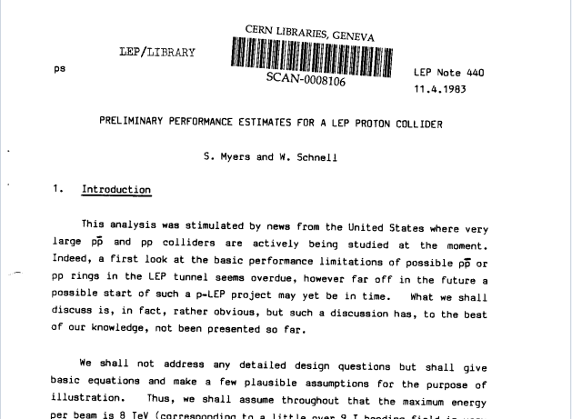
1
April 1983: First Performance Estimates of the LHC (Myers/Schnell)
Followed by LEP Notes 450,460,470
Notes:
During the early 1980s, there was a small team at CERN working on the design of the large electron positron collider LEP. In the US there were ongoing design studies for a very large proton collider. Since I had spent more than 7 years working on the performance of the world’s first proton collider, the CERN ISR, I was invited to participate in some of these workshops in the US. I then started to ask myself a question: what could be the performance of a proton collider in the 27 km LEP tunnel. I showed some first calculations to my boss Wolfgang Schnell who then made additional valuable contributions. The idea of LEP notes was to stimulate new ideas and did not need any permission from the CERN hierarchy for publication. So we published this work as a LEP note. 3 additional LEP notes quickly followed.

Slide 5
LEP Note 440 provided a first look at the design of a proton collider in the LEP tunnel and… It raised many of the points that were subsequently part of the LHC design:
8 TeV per beam,
Performance limitations due to the non-linear beam-beam effect.
a twin-ring accelerator with twin-bore magnets
the urgent need for magnet development,
problems with pile-up (multiple collisions per bunch-crossing)
and beam impedance limitations.
Later in 1983, a dedicated CERN study group was established and the LHC Lausanne workshop took place the following year, …This was the beginning of a detailed technical design of the collider. There has never been never a citation of LEP 440 by the CERN study group.
However, Burt Richter (Nobel Laureate 1976) published the following in 2014 [ PRAB ref 16 ]
“A Look Ahead to Beyond LHC-2014 …
The first mention I know of what became the LHC is in an internal report from the LEP group (LEP note 440, 1983) by Stephen Myers and Wolfgang Schnell about putting a superconducting p-p collider in the LEP tunnel after the LEP e+e- collider had done its job…”

Slide 6
The Rise and Fall of the SSC
(DoE Review:1986)
2
Invited by the US DoE to chair the Accelerator physics sub-panel SSC review in 1986.
In the Executive summary. (DOE-ER-0267)
“…higher confidence in meeting performance goals would be obtained by further studies of magnet aperture requirements.”
Accelerator physics sub-panel chapter was more specific:
“At present the basic techniques employed to study the effects of magnetic field quality have not been developed to the extent required to conclude that the magnet designs for the SSC are conservative……..one must hold open the possibility that the field qualities have to be improved…….and for the magnets an increase in aperture may be required…”
These two highly controversial statements were the result of many hours of “word-smithing” with the DoE and the SSC design team.
Notes:
Review was in Berkeley California and covered full 5 day.

Slide 7
The Rise and Fall of the SSC
2
The SSC circumference (87km) was three times larger than the existing “LHC” tunnel (i.e. LEP)
Energy of the SSC was much higher than anything which could be proposed for LHC.
To be competitive, the luminosity for the LHC was purported to be 10 times higher than that of the SSC.
Following the 1986 review, an SSC site selection committee was set up to evaluate proposed sites for construction.
In November 1988, the day after George Bush was elected president, the site at Waxahachie, Texas was chosen. Texas had promised to contribute one billion dollars to the project.
After the announcement of the site selection, a second “site specific” review of the SSC was organised for July 1990.
Notes:
Texas (a town of 18,000 people about 25 miles southwest of Dallas) was chosen.

Slide 8
The Rise and Fall of the SSC: DoE Review in 1990
2
Invited to chair the 1990 collider accelerator physics sub-panel review.
This was an interesting period for colliders: LEP was up and running and was outperforming the Californian Stanford Linear Collider.
SSC had already received US approval: would surely preclude approval for the LHC.
In September 1990, the review committee conclusions [18].
“… the proposals from the previous review in 1986 have been followed:
  …Comparing the SCDR with the CDR of 1986…Injection energy has been doubled to 2 TeV. The Dipole magnet aperture increased from 40 to 50 mm. A new 90-degree lattice and shorter cell length…”

Slide 9
The Rise and Fall of the SSC
(DoE Review in 1990)
2
These technical changes incurred substantial increases in the cost of the SSC.
“…Escalating to as-spent dollars, … results in a TPC of $8.4 billion …”
“The SSC CDR has documented the estimated cost for constructing an SSC facility at $3.01 billion in FY 1986 dollars,…
From 1986 to 1990, the SSC estimated cost had increased by 280%!
In the collider physics sub-panel, we noted that, the focusing magnets aperture remained at 4 cms! This meant that the vacuum aperture seen by the beam was repeatedly changing from 4 cms to 5 cms, (large increase in the “impedance” seen by the beam provoking many possible beam instabilities). The accelerator physics sub-panel proposed an increase in the quadrupole aperture to 5cm to reduce the impedance.

Slide 10
2. Summary: Cost Escalation
Demise of the SSC (1993)
SSC project endorsed in 1983 estimated budget $2.8bn
DOE review 1986: estimated budget $3.01bn
1987 Congress informed of budget escalation to $4.4bn
November 1988; State of Texas offer $1bn of funding
DOE Review after site selection, 1990: official budget $8.7b
October 1993 budget estimates escalate to $12bn. US Congress cancel the project after $2bn had already been spent.
The demise of the SSC opened the door to the LHC:
CERN council approved the LHC in December 1994 (but, without an increase in budget).
Notes:
1995 to 2000 CERN was designing the LHC, operating LEP, constructing LEP2 and operating LEP2.

Slide 11
CERN 1995-2000
CERN was highly overstretched
  Operating LEP and all other accelerator facilities and experimental areas
  Designing and constructing LHC (sc magnets)
  Designing and Constructing LEP2 (sc cavities)
  Operating LEP2

Slide 12
3: The search for the Higgs at LEP2 (2000)
14th June 2000: First H candidate event 206.7 GeV (ALEPH)
  Reconstructed Higgs mass 114.3 GeV/c2
20th July: LEP Committee
  ALEPH presented excess at high masses
31st July & 21st Aug: events 2 & 3 for ALEPH
  Things are heating up!
5th September: LEP Committee
  Excess only in ALEPH, only 4 jets
September 14th: Research board:
  ONE MONTH run extension GRANTED (LHC startup)

Slide 13
3: Higgs Search in LEP2
October 10^{th:} LEPC: Update of the results
  The signal excess grows up to 2.6σ
16th October: Missing energy candidate from L3...
November 2nd: scheduled end of LEP operations (after 1 month extension)
November 3rd, LEPC: The new data confirm the excess again. The significance grows up to 2.9σ
LEP running in 2001 is requested
November 3rd LEPC - closed session:
  No recommendation
November 7th: Research board
  No recommendation (vote split 8 - 8)
November 8th DG decision (LM):
“LEP has closed for the last time:”

Slide 14
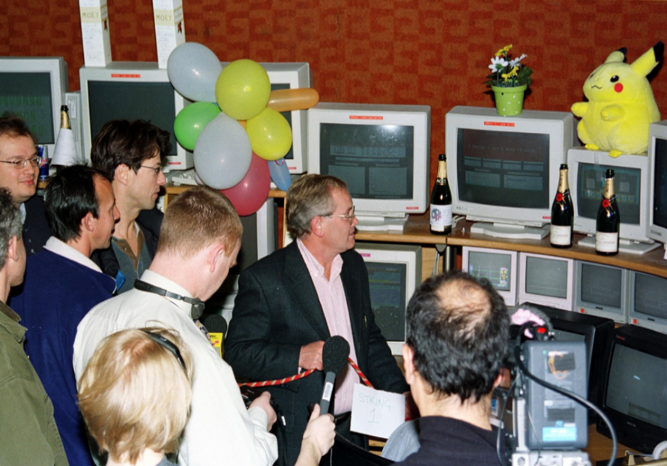
4: LEP Closure in 2000: LEP teams devasted
In the photo:
Roger Bailey (recently deceased),
Ralph Assmann,
Paul Collier,
Mike Lamont,
Steve Myers
Andy Butterworth

Slide 15
NOT A POPULAR DECISION!
BUT history has shown it to be the right one!
This allowed massive redeployment of skilled and experienced CERN staff from LEP2 to the LHC design. With this new focus, the design of the LHC gathered real momentum

Slide 16
5: LHC Preparation
(Following the closure of LEP)
LHC Machine Committee Mission February 14, 2001
Use the experience and expertise gained in LEP to prepare beam commissioning and operation of the LHC collider
Evaluate and maximise the performance of the injectors,
Evaluate experience with other relevant machines,
Create a competent, experienced trained team,
Prepare a detailed scenario for initial commissioning,
Specify special software requirements for commissioning and operation.
LMC 1
BAILEY Roger, CLAUDET Serge, CORNELIS Karl, EVANS Lyn, FAUGERAS Paul, FERNQVIST Gunnar, JEANNERET Jean-Bernard, KOUTCHOUK Jean-Pierre, LAMONT Mike, LINNECAR Trevor, MERTENS Volker, MYERS Steve (Chair), POOLE John, PROUDLOCK Paul, ROY Ghislain, RUGGIERO Francesco, SABAN Roberto, SASSOWSKY Manfred, SCANDALE Walter, SCHMICKLER Hermann, SCHMIDT Rudiger, TSESMELIS Emmanuel, WENNINGER Jorg
http://lhc.web.cern.ch/lhc/lcc/lcc.htm

Slide 17
6: Oct. 2007: Radiation to Electronics (R2E)
CNGS physics run started in early October 2007. (One year before the scheduled start-up of the LHC)
In the following days, successive failures in the ventilation system resulted in the physics run be stopped on October 22nd, two weeks ahead of time.
The CNGS installed electronics were Commercial-Off-The-Shelf (COTS) not selected for radiation tolerance. They were susceptible to the effects of radiation, … single event effects, both hard and soft.
The fluence (>20MeV hadrons) in the CNGS (was ~10⁷ n.cm⁻² when the run was abandoned.
The assumed “safe” fluence (>20MeV hadrons) for LHC was 100 times higher (10⁹ n.cm⁻²)
PANIC for LHC Operation!

Slide 18
Comparative dose rates in LHC
The assumed “safe” fluence (>20MeV hadrons) for LHC was 10⁹ n.cm⁻²
The average fluence was measured at the location of the failed CNGS electronics
The simulated dose rates around LHC are given below for nominal beam intensity with estimated losses (probably optimistic) and for 200 days operation.
CRASH Programme to mitigate R2E

Slide 19
Mitigation Options
What Can Be Done (in general)
Solve & Gain Time
Improve & Gain Time
RELOCATION
SHIELDING
Solve & Remain Flexible
No Major CE
RAD-TOL DESIGN
CIVIL ENGINEERING

Slide 20
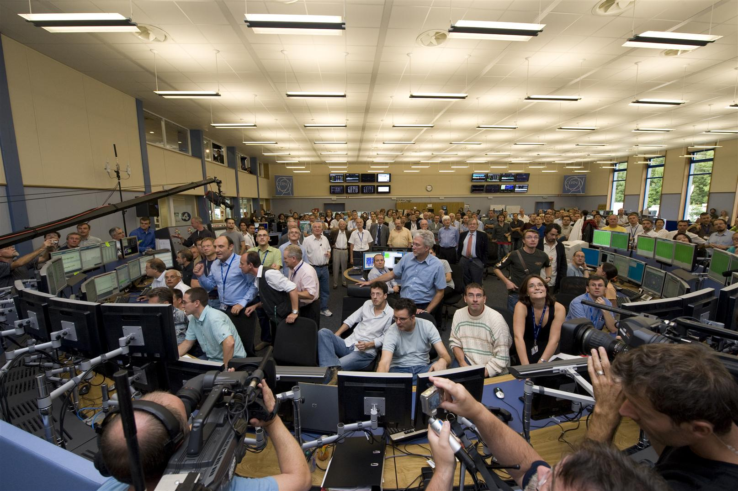
7. On September 10, 2008; It worked!

Slide 21
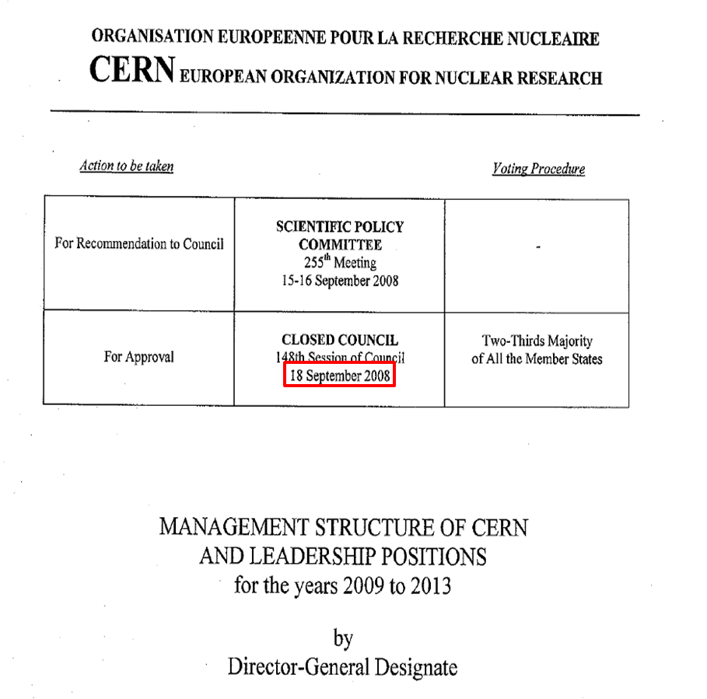
8
A further 8 days later
S.Myers appointed Director for Accelerators and Technology with Special responsibilities for the LHC
Notes:
CERN Council approves my nomination as Director of Accelerators and Technology

Slide 22
The next day: LHC imploded + exploded
September 19, 2008
  Making the last step of dipole circuit in sector 34, to 9.3kA
  At 8.7kA, Electrical arc developed which punctured the helium enclosure
One inter-magnet connector (out of 100,000) was «badly» soldered and…
The magnet protection system did not protect
Notes:
22

Slide 23
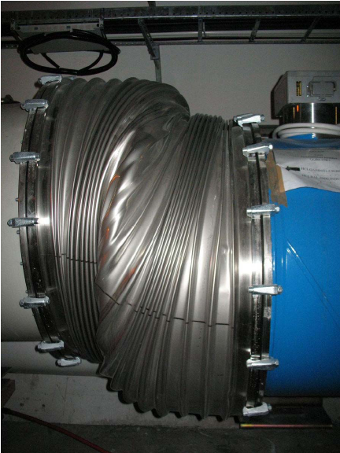

Consequences
23
Notes:
23

Slide 24
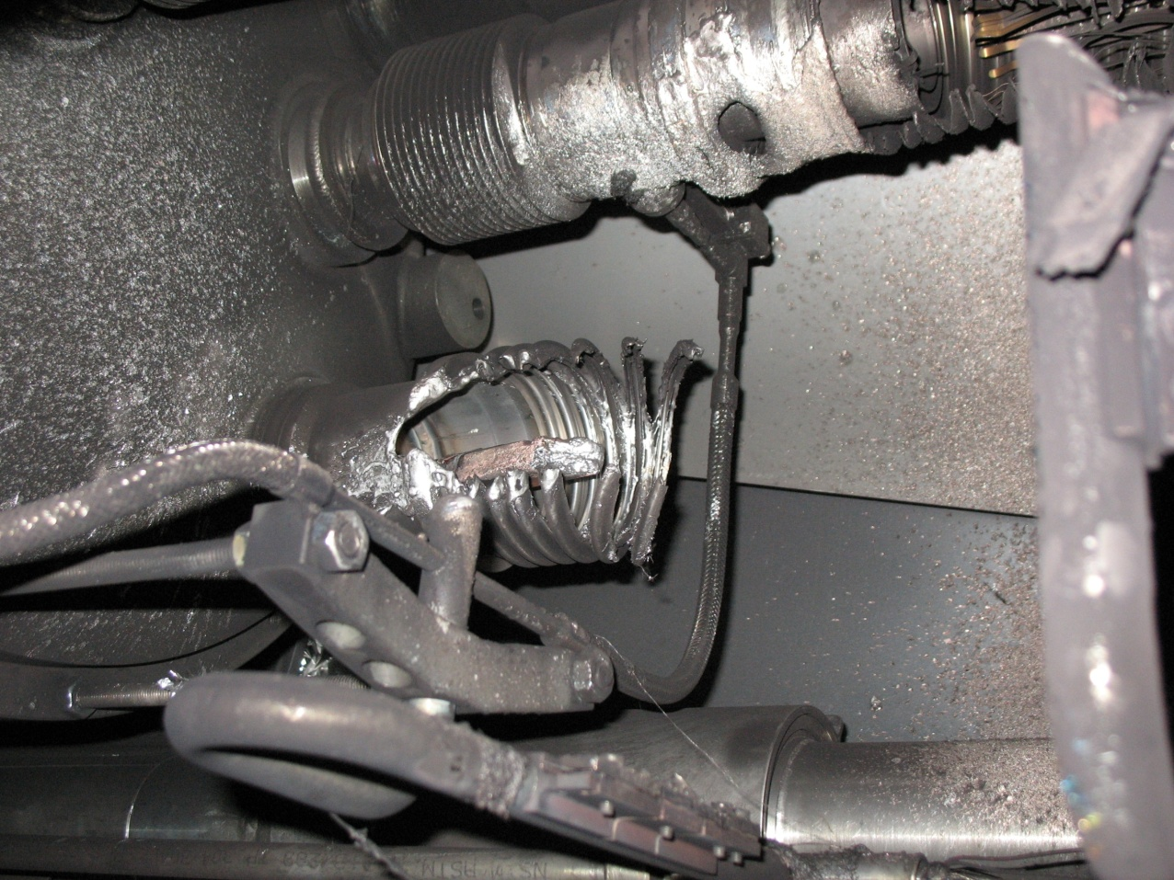
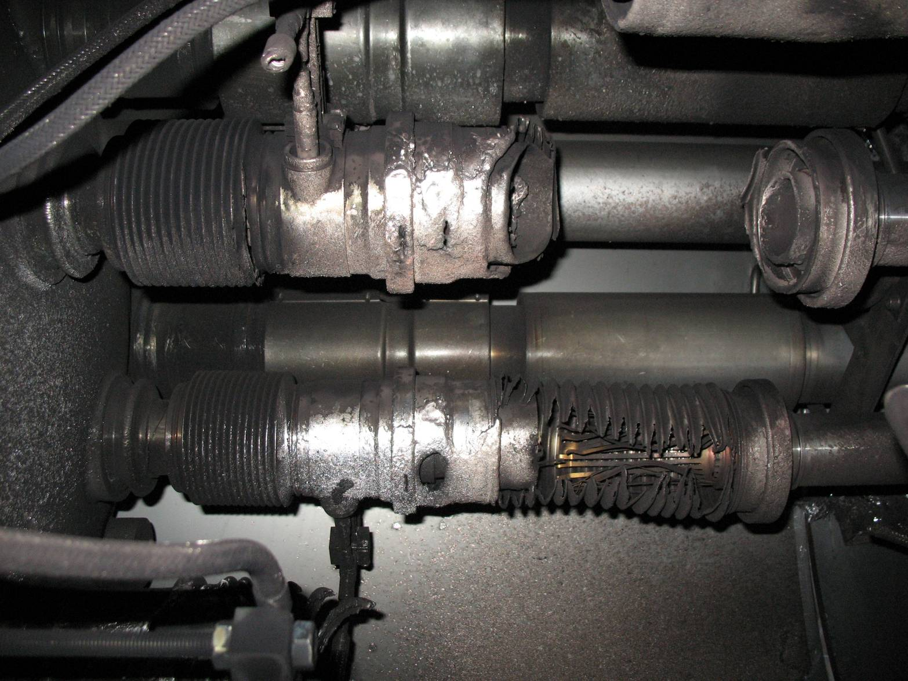
Electrical arc between C24 and Q24
V lines
M3 line

Slide 25
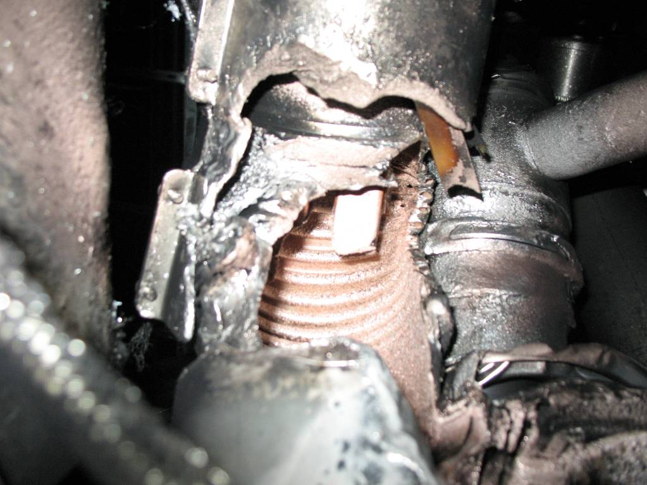
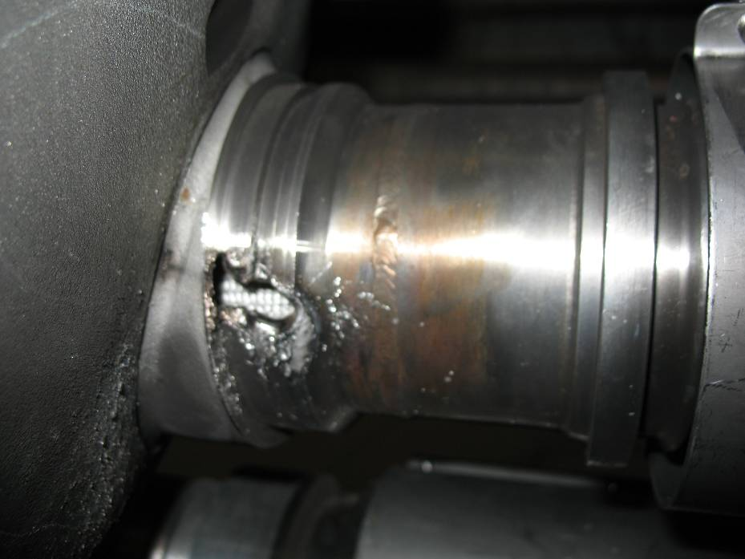
Collateral damage: secondary arcs
QBBI.B31R3 M3 line
QQBI.27R3 M3 line

Slide 26
Following the glory of the start-up, immediately followed by a serious failure.
Why did the Media not Crucify CERN?
Lehman Brothers!
Bankruptcy (640B$US)of Lehman Brothers on September 15, 2008, 4 days before the LHC accident.
The press had bigger gooses to cook, fortunately for CERN.

Slide 27
Offending Bus bar splice
27
Notes:
27

Slide 28
Fault tree [1/3]
What went wrong?
Observed on magnet
Absence of soldering
No sensitive detection on bus bar
Resistance 220 nOhm
Bad contact with stabilizer
Electro-thermal model
Thermal runaway
Meltdown, open circuit
Power converter fast discharge
Electrical arc

Slide 29
Fault tree [2/3]
Electrical arc
He vessel perforation
Beam pipe perforation
Soot
He discharge in insulation vacuum
Inadequate sizing of relief devices (MCI)
Loss of beam vacuum
Contamination by soot
Blast
ODH in tunnel
Mechanical damage to MLI
Pressurization of vacuum enclosures
Trip AUG
Break vent door
Contamination by MLI

Slide 30
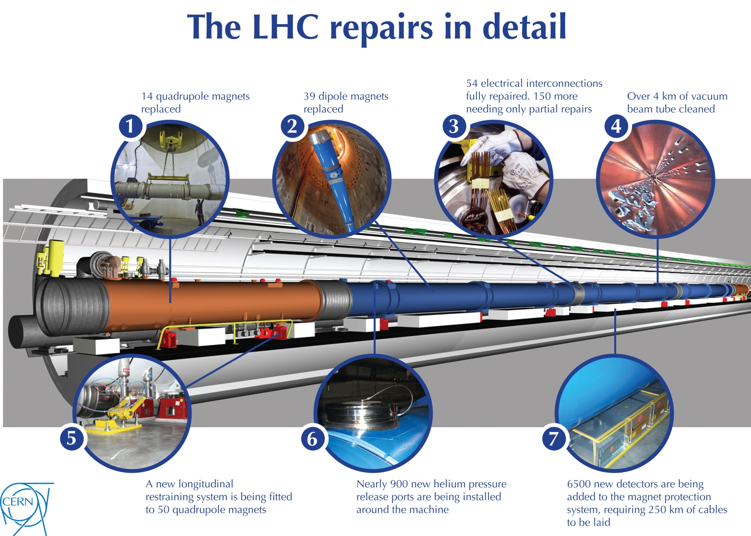
9. 2009: Repair and Recovery
+ 8 cryogenics!

Slide 31
Comments on Repairs
All the work done from November 2008 to April 2009 made us certain that a repeat of September 19 should NEVER happen.
  The offending connector in this incident had an estimated resistance of 220nΩ. We had measured all 10,000 inter-magnet connectors and the maximum measured resistance was 2.8nΩ.
However, in April 2009, another shock: we uncovered a different possible failure scenario which could under certain circumstances produce an electric arc in the “copper stabilizers” of the magnet interconnects

Slide 32
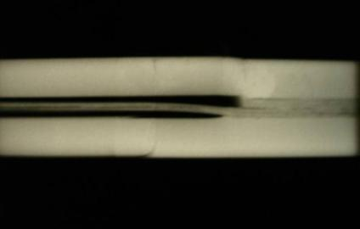
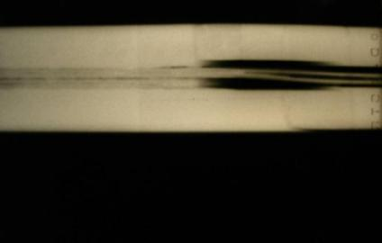
Bad surprise after gamma-ray imaging of the joints: Void is present in most of bus extremities because SnAg (Tin/silver)flows out during soldering of the joint
Gamma rays QBBI.B25R3-M3 before disconnection (QRL connection & QRL lyra sides)
Courtesy:
Christian Scheuerlein
wedge
bus
U-profile
bus
A. Verweij, TE-MPE. 28 April 2009, TE-TM meeting
Notes:
Tin-Silver

Slide 33
Summary June 2009
The enhanced quality assurance introduced during sector 3-4 repair revealed new data concerning the copper bus bar in which the superconductor is embedded.
Tests have demonstrated that the process of soldering the superconductor in the interconnecting high-current splices can cause discontinuity of the copper part of the busbars and produce voids which prevent contact between the superconducting cable and the copper: Dangerous in case of a quench
There was not enough time to do a complete repair!
Only mitigation: operate at reduced collision energy.
? What is the highest SAFE energy?

Slide 34
10 Difficult Decision on Initial Beam Operating Energy
(August 2009)
Highest measured value of (R_{long}) in 5 sectors at 300K was 53μΩ.
To Operate at 7TeV cm
  Simulations show that resistances of ≤120μΩ are safe from thermal runaway under conservative assumed conditions (i.e. >x2 safety margin)
To Operate at 10TeV cm
  Simulations show that resistances of ≤67μΩ are safe from thermal runaway. (i.e. only a 25% safety margin)
Decision: Operation initially at 7 TeV cm
  During Operation
  monitor carefully all quenches to gain additional information.
  Continue simulations and validation of simulations by experimentation (FRESCA)
Then when considered safe: operate at around 8TeV cm.
Was 7 or 8 TeV cm enough energy to discover the Higgs?

Slide 35
11. Beam Operation 2009-2011

Slide 36
11. Beam Commissioning Plan
Global machine checkout
Essential 450 GeV commissioning
Trial ramps
Machine protection commissioning 1
Experiments’ magnets at 450 GeV
2009
Xmas
450 GeV collisions***
Ramp commissioning to 1.2 TeV
System/beam commissioning
Machine protection commissioning 2
2010
3.5 TeV beam & first collisions
Full machine protection qualification
System/beam commissioning
Pilot physics

Slide 37
11. Summary of LHC Commissioning 2009
November 20th 2009
  First beams around again
November 29th 2009
  Both beams accelerated to 1.18 TeV simultaneously
December 8th 2009
  2x2 accelerated to 1.18 TeV
  First collisions at 2.36 TeV cm!
December 14th 2009
  Stable 2x2 at 1.18 TeV
  Collisions in all four experiments
LHC - highest energy collider
Limited to 2 kA in main circuits (1.18 TeV) during deployment and testing of new Quench Protection System

Slide 38
11. First Collisions at 7TeV cm
March 30, 2010

Slide 39
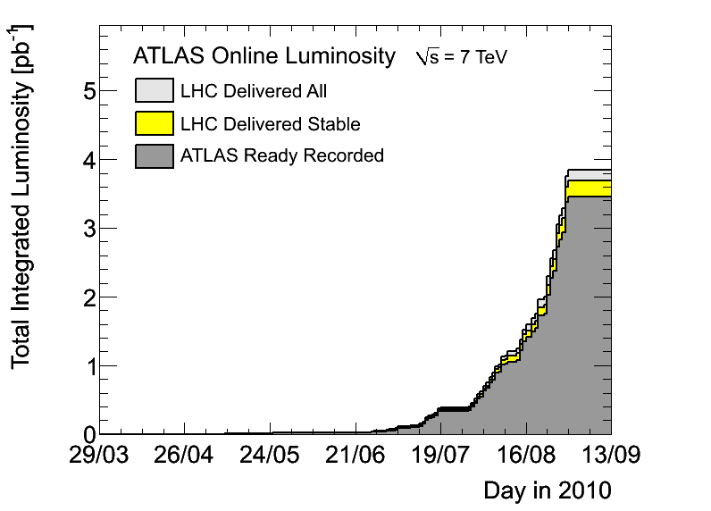
11. 2010: 4pb⁻¹ (move to bunch trains)
Bunch Trains Set Up
Ultra-Cautious operation

Slide 40
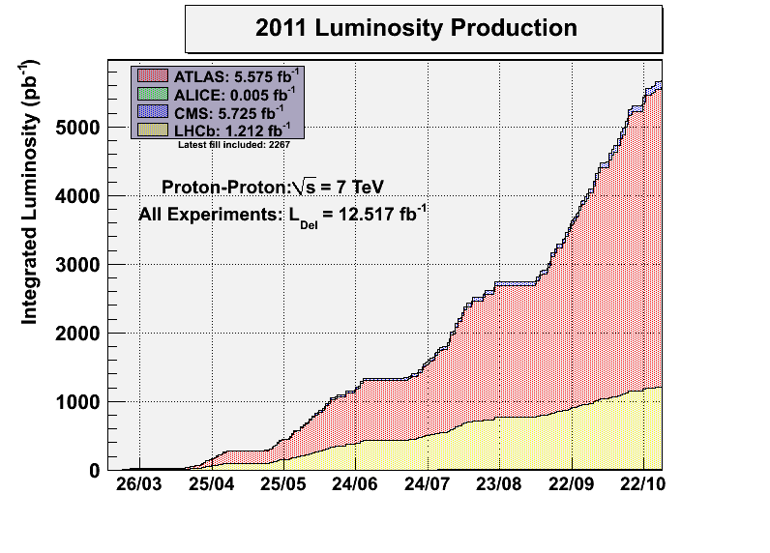
11.
~5600pb⁻¹

Slide 41
12. Preparation for 2012
Goal: Discover the Higgs Boson
Constraints and Parameters:
R2E
Collision energy
Needed luminosity to discover Higgs
Luminosity Forecasts using 2011 results

Slide 42
12. R2E: Expectations (Nov 2011)
In 2011, about 50% of the unwanted beam dumps were due to SEEs
Even so the machine availability was “acceptable”
2012 R2E predictions showed that with an integrated luminosity up to ~16fb⁻¹ we should have the same machine availability
The minimum expectation is that LHC (due to the mitigation actions) would have the same availability in 2012 even with an increased luminosity by a factor of 3

Slide 43
12. 2012 Collision Energy
Decision: “safe” to go to 8TeV cm

Slide 44
13. Luminosity Forecasts 2012
Green light from R2E
Decision to increase the beam energy to 8TeV cm.
Used the luminosity results from 2011 physics
I simulated the expected integrated luminosity as a functin on of time in 2012.
Compared this with the expected integrated luminosity needed for detection of a Higgs at 5σ.
I presented these results to CMS and ATLAS on 21 & 22 November 2011.

Slide 45
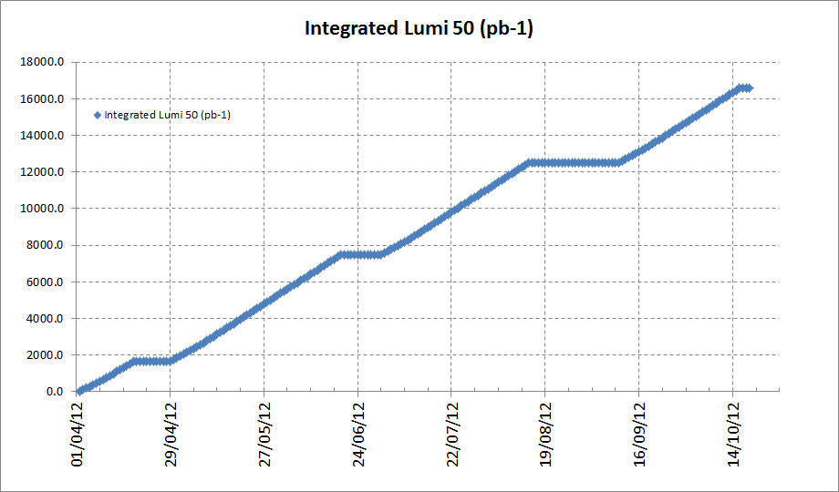
13. 2012 Simulated Integrated Luminosity
E= 4TeV
Beta* = 0.7m
148 days of physics

Slide 46
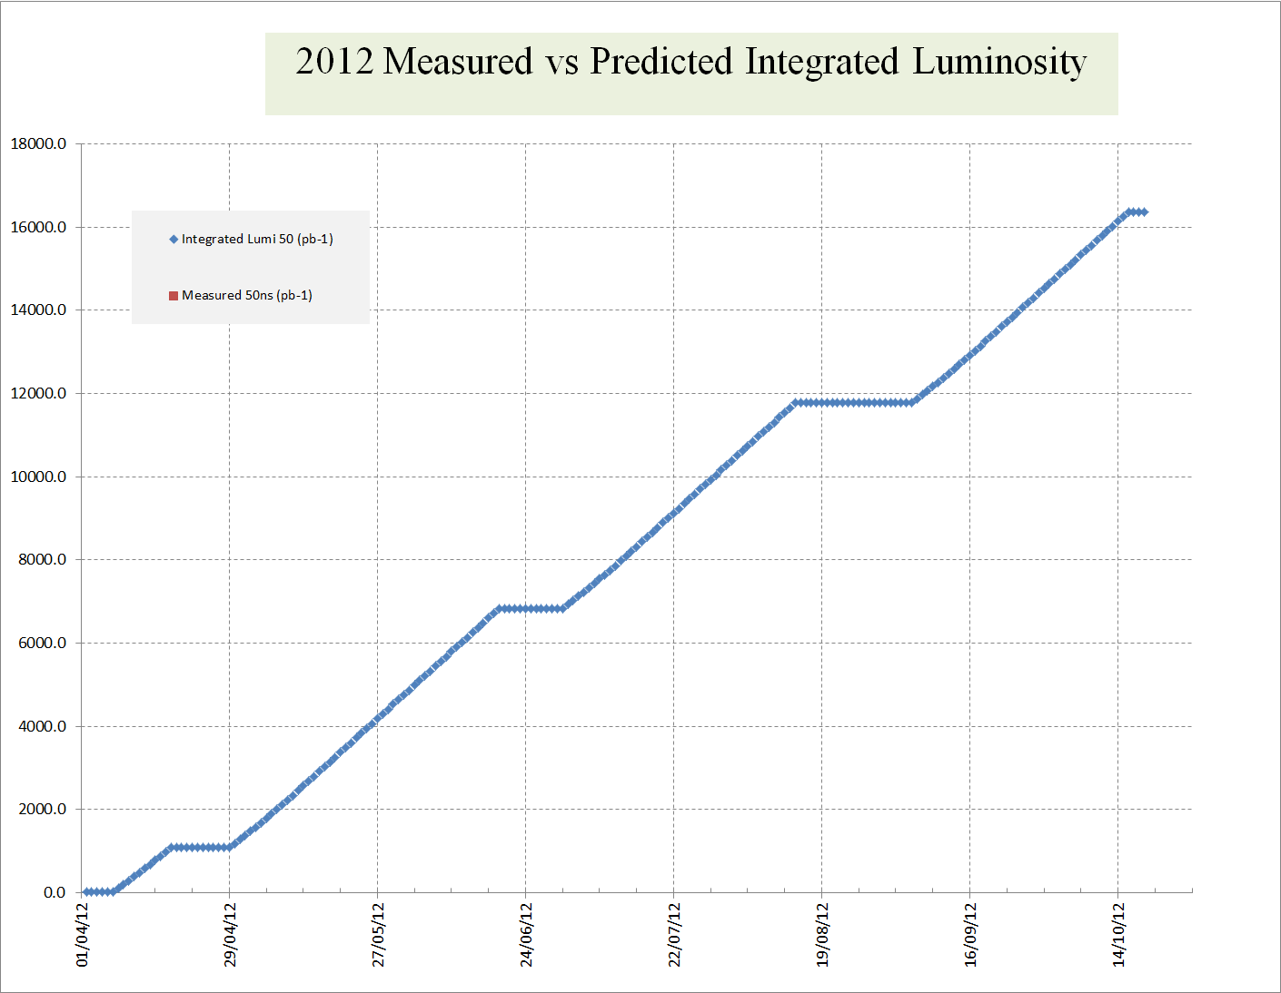
13. 2012 Simulated Integrated Luminosity vs Needs for Higgs
Estimated Luminosity needed for Higgs
i.e. If Higgs and Lumi predictions are correct: discovery in mid-September 2012

Slide 47
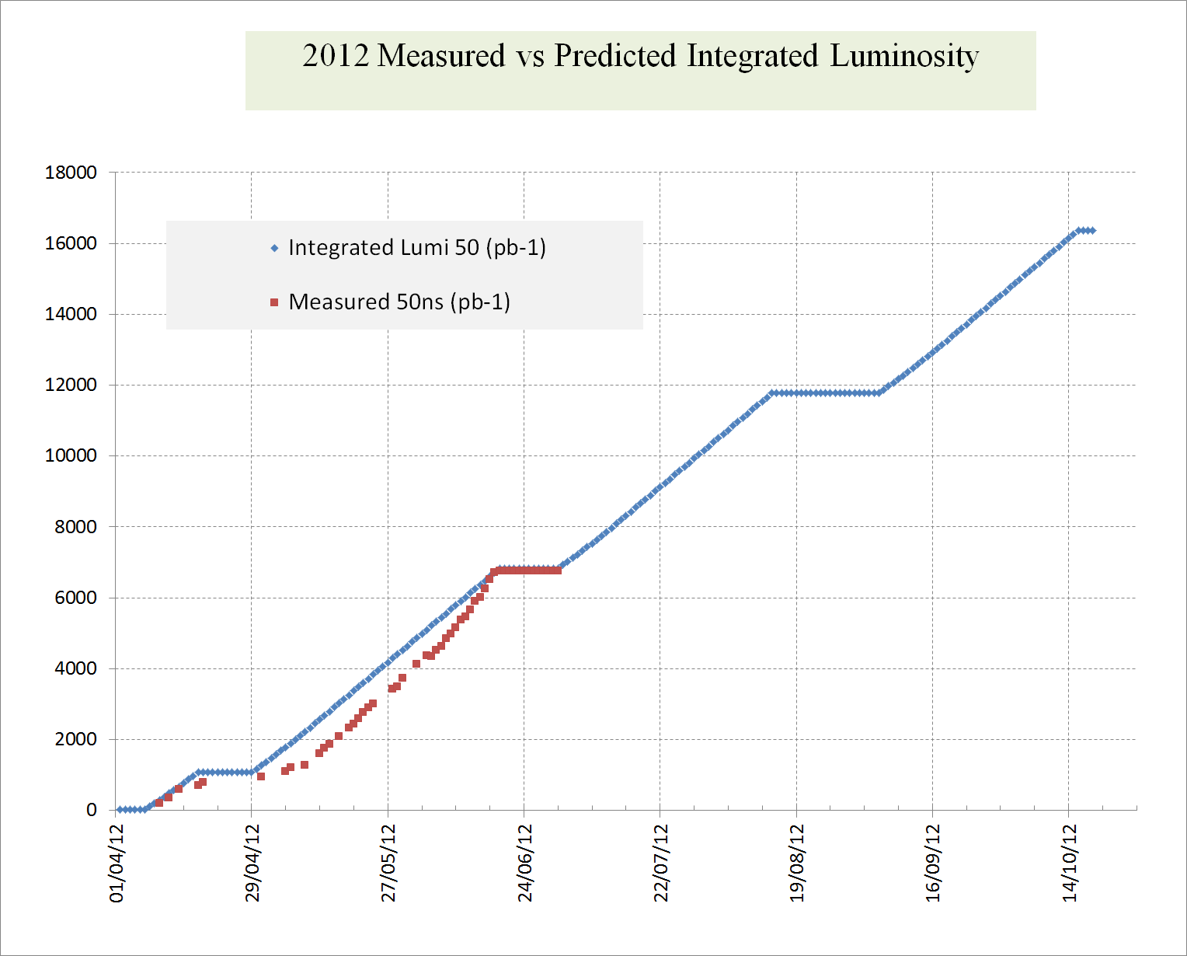
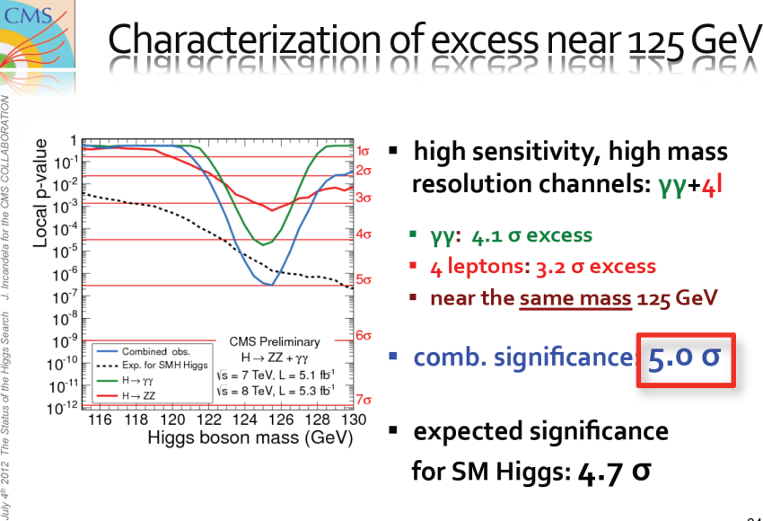
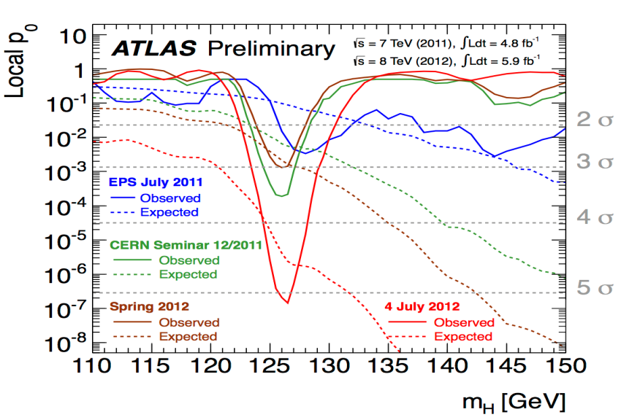
14. 2012 Run
The needed luminosity was over-estimated!
4th July: Melbourne

Slide 48
15: Higgs and LEP2: What might have been!
LEP started operation in 1989 and continued during 1990.
In September 1990, the CERN LEP experiments committee (LEPC) organised a meeting in Cogne, Italy to review the future of the LEP collider
Following agreement with the LEPC, prepared slides showing projected beam energy as a function of the number of installed superconducting (sc) cavities.
The maximum number of sc cavities, was 384 which completely filled all possible spaces around LEP.
When I reached the slide with 288 sc cavities, the DG ordered me to stop, as “there was no mandate for this presentation”. I was confused as I had clear instructions from the LEPC as to what I should present. But I stopped as ordered.
It was another 5 years before the subject of filling LEP with sc cavities was ever openly discussed. In 1995 a workshop on Physics at LEP2 was organised by Altarelli, Sjostran and Zwirner. Once again, we presented the options for filling LEP2 with sc cavities and wrote:

Slide 49
15: Higgs and LEP2: What might have been!
“By removing all the Cu cavities and making the layout of Points 2 and 6 identical to that of Points 4 and 8, a total of 384 sc cavities could be installed in LEP, …
The following year 1996, the decision was made to discontinue the industrial production of the sc cavities. (288 cavities total)
With 384 cavities LEP2+ could have reached around 223 GeV in the centre of mass and (knowing what we know now) possibly discovered the Higgs’ boson 10 years earlier than the LHC.
What might have been!

Slide 50
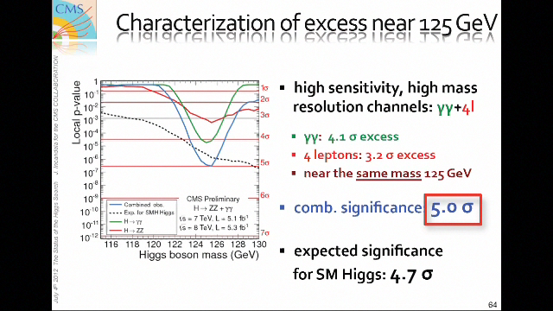
CERN Auditorium July 4, 2012

Slide 51
That’s it folks!
Thank you for your attention

