Slide 1
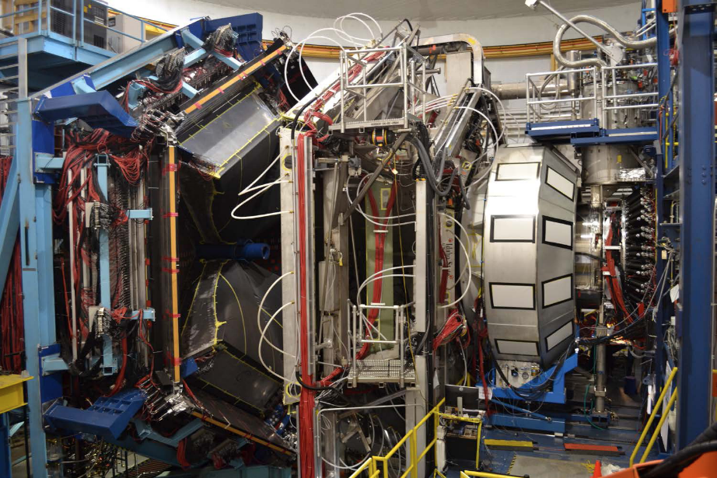
Hall B Status Report
News from the Hall B Group
Hall B Setup Changes
Status of RG-C Data Taking
Status of Alignments & Calibrations
Developments and Upgrades
Updated Run Group Schedule
Collaborations & Cooperations
Backup: Recent Analyses and Papers
[V.D. Burkert, L. Elouadrhiri, et al., Nuclear Inst. and
Methods in Physics Research, A 959 (2020) 163419]
Patrick Achenbach
March 2o23

Slide 2


Hall B Group News
Joseph Newton left from his postdoc position
Linda Ceraul retired after working with Hall B for decades;
Thanks a lot for her long-standing support of our activities!
New administrative support and travel coordinator is Jessica Adams
Email: jadams@jlab.org
Point of contact for users
Help in organizing meetings on site
Current job openings: 1 Staff Scientist, 1 Postdoc, 1 Senior Designer
Follow-up job opening: Staff Scientist

Slide 3
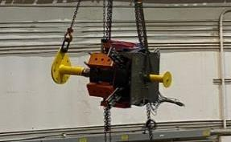
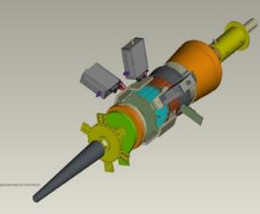
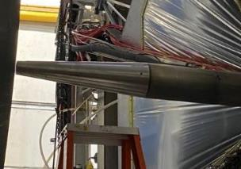
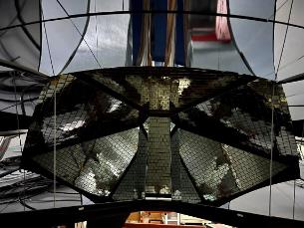
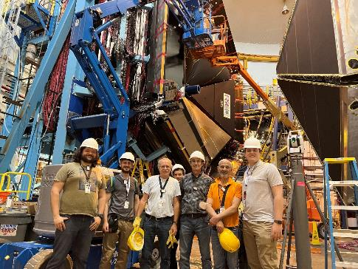
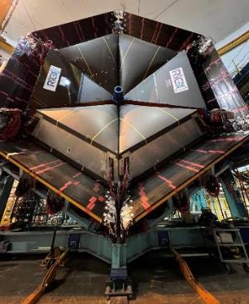
Hall B Setup: Polarized Target, Møller Shield, RICH Detectors
Longitudinally polarized cryo-target inside solenoid
→ James: Performances of the longitudinally polarized target for CLAS12
Forward Tagger
Replaced with …
… new large Møller shield
2-sector coverage with 50,048 channels
FT-cal
FT-hodo
FT-tracker
Additional
2nd RICH:
Proton
Deuteron
< ~ 80% H polarization
< ~ 45% D polarization
DNP by 140 GHz µwaves
1 K with ℓHe refrigerator

Slide 4
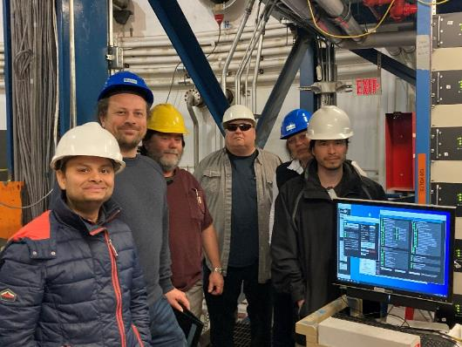
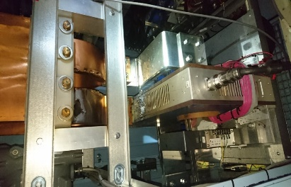
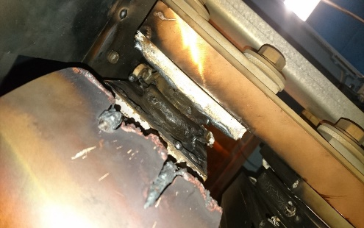
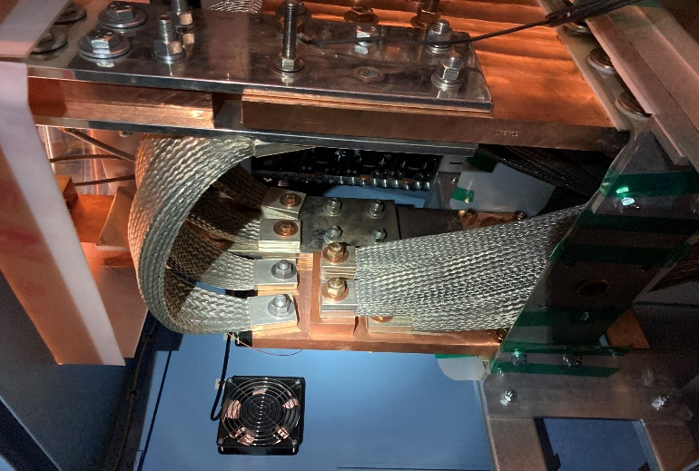
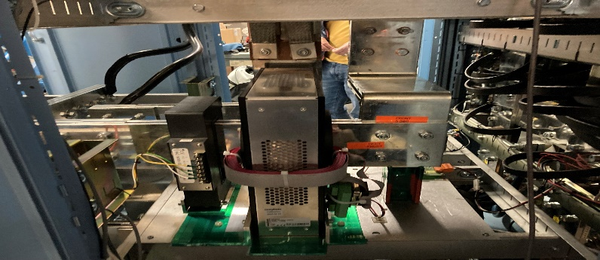
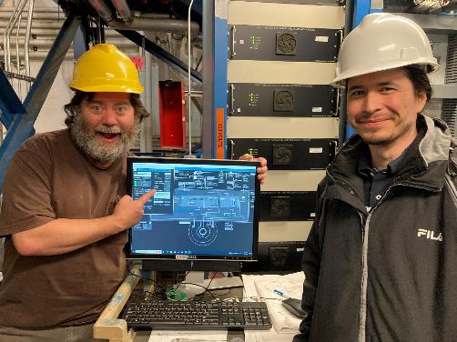
Solenoid Power Supply Failure
Polarity reversal at > 1000 A → melted copper links and contacts (11/11/22)
Team from Danfysik, DC Power, Hall B, DSG
Hall B was down for 80 days during current RG-C run →
Approved physics program could not get completed before SAD 2023
Repair completed (01/30/23)

Slide 5
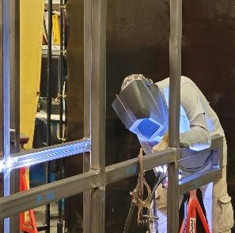
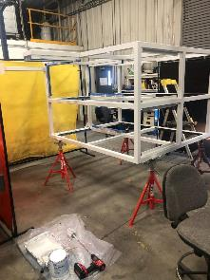
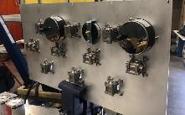
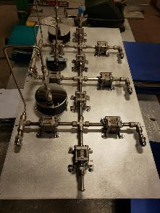
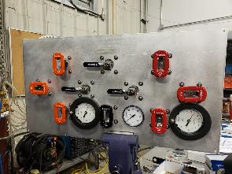
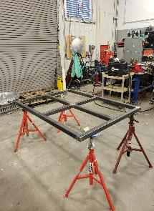
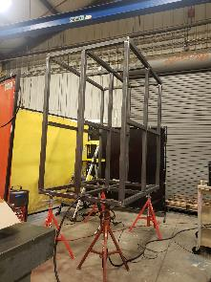
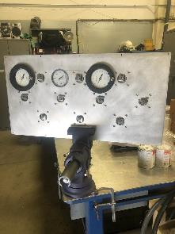
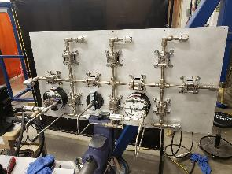
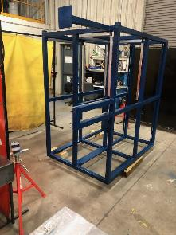
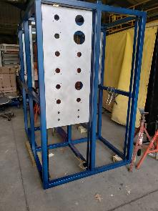
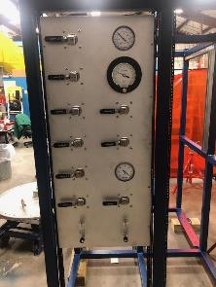
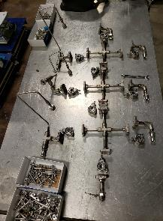
Run Group D Preparations at JLab
Development of unpolarized cryo target
Refurbishment of non-maintained Saclay target
→ Xiangdong: Status of the Hall-B targets for CLAS12 experiments

Slide 6
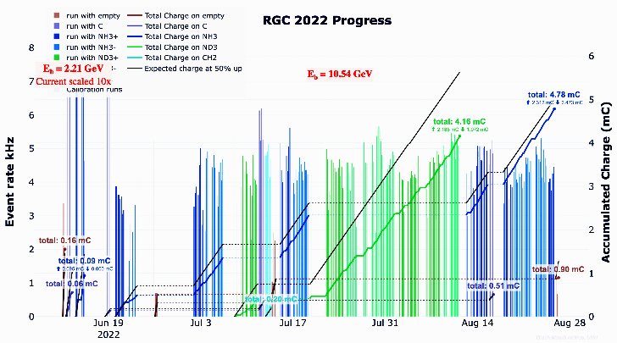
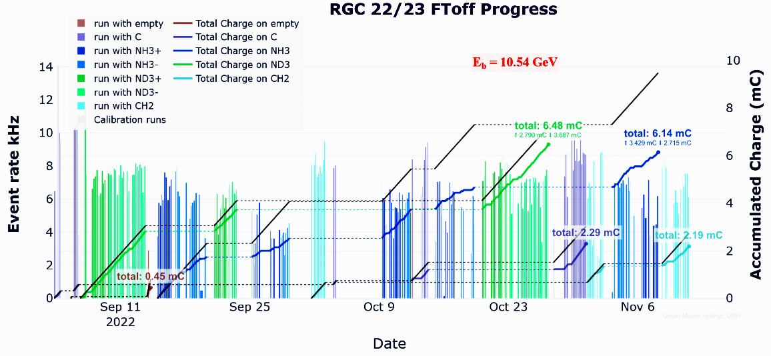
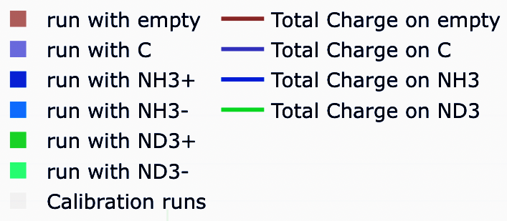
Run Group C Data Taking 2022
1st period: June – Aug 2022
2nd period: Aug – Nov 2022
Physics: NH₃ & ND₃
Calibration (dilution factor, background subtraction, alignment): C, CH₂, CD₂, empty, zero-field
Expected Charge

Slide 7
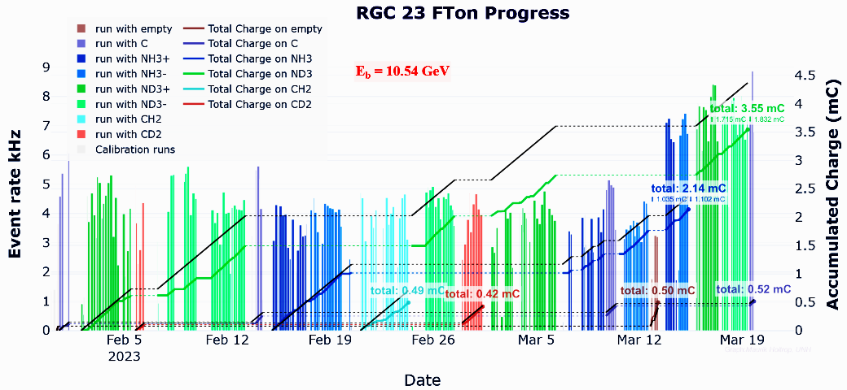
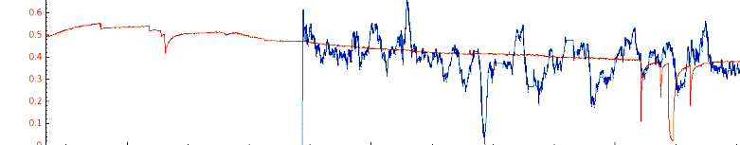
Run Group C Data Taking 2023
Back in business since end of January reaching 96% of total scheduled data
Online trigger-bit polarization reconstruction follows relative NMR reading closely
Highest degree of polarization in ND₃ ever observed by the target experts
→ Noémie: RG-C end of run and first look at physics
Red: NMR reading
Blue: trigger-bit reconstruction

Slide 8
Detector Alignment, Calibration, Reconstruction
Status:
  Calibration work proceeding efficiently with good interactions across the groups
    RG-B (LD2 @ 11 GeV): pass-2 review held on Oct. 28 for Spr19
    RG-A (LH2 @ 11 GeV): pass-2 review upcoming soon for Spr19
    RG-K (LH2 @ 6.5/7.5 GeV): subsystem calibration for pass2 now getting underway
    RG-M (e4n @ 2/4/6 GeV): pass-1 review expected
    RG-C (long polarized target @ 11 GeV): alignments and subsystem calibration for pass-1
  pass-2 cooking submissions delayed waiting for official pass-2 reconstruction software
  → Nathan: Reconstruction: what comes after pass2
  → Veronique: CVT tracking, status and plans
[Daniel Carman, Feb. 2023]

Slide 9
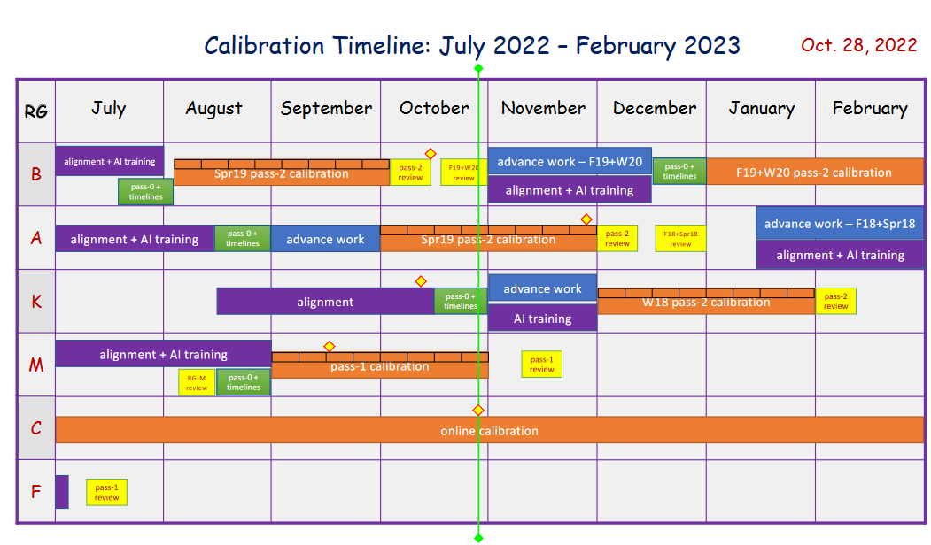
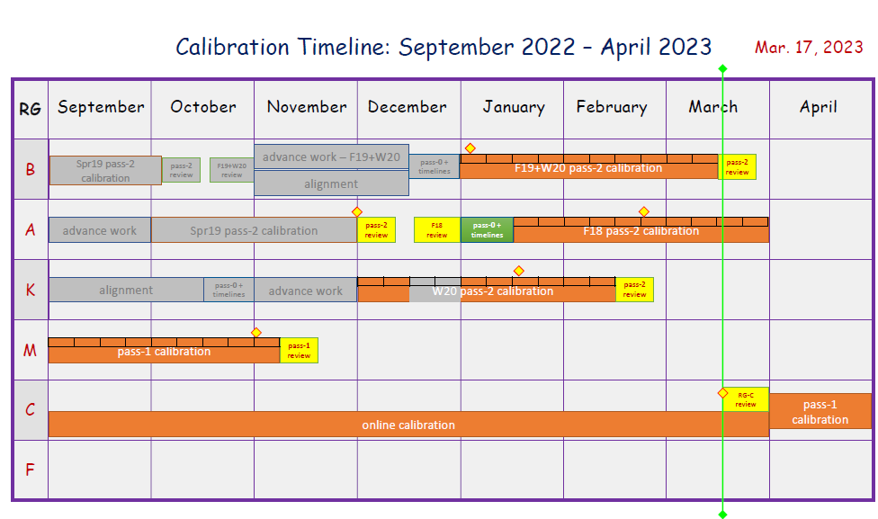
Comparison of Oct and Mar Calibration Timelines
  Improvements to pass-2 code (among other things) for AI-assisted de-noising of hits in the DC, cluster separation in the calorimeter, hit losses in CND, CPU efficiency, displaced vertex finder (?), RICH reconstruction, new banks & flags, …

Slide 10
Preliminary Run Group Scheduling in Hall B
2023 SAD for installation of cryo-target and solids
RG-D: Jul to Sept 2023, ~30 PAC days to compete
RG-K: Sept to Dec 2023, to reach ~50% PAC days
RG-E: Jan to Mar 2024, to reach ~ 50% PAC days
2024 SAD for installation of ALERT
RG-L: Jul to Nov 2024, ~55 PAC days to complete
RG-K: Nov to Mar 2025, ~45 PAC days to complete
2025 SAD for setup/target change
Remaining PAC days for run groups
RG-A: >70 PAC days
RG-B: +/- 40 PAC days
RG-C: +/- 25 PAC days
RG-E: 30 PAC days
RG-M: 10 PAC days
Not scheduled
Non-CLAS12 experiments: PRad-II, π⁰TFF, X17
CLAS12 experiments: Polarized He-3, H-3 and He-3, transv. polarized H/D, long. polarized LiH/LiD
SAD 2023: With more gradient (overhead) but same
energy should mean a stable machine
Mid-2025 is a time non-standard beam energy experiments

Slide 11
Update on Long-Term Schedule
JLab plan to run the 12 GeV electron beam until 2032
JLab plan to run the 22 GeV electron beam from 2040
→ Yves: The CEBAF Positron Beam upgrade
→ Alex: Status of CEBAF upgrades
→ David: Status of Jefferson Lab
→ Patrizia: Physics Perspectives for an energy upgrade at Jefferson Lab
[Thia Keppel & Joe Grames, Positron Workshop, Mar. 2023]
9 more years for present CLAS12 Run Groups
included about 1 year running of non-CLAS expts.
CLAS positron program for 2035 – 37
→ Axel: Proposal for TPE with positron beam
50 nA max. current for polarized beam fits well

Slide 12
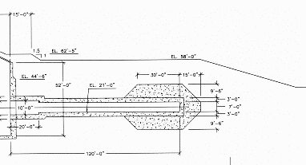
Beam Dump (Phase 1) Upgrade
Hall-B needs:
Alert: 500 – 900 nA
He-3 expt: 2500 nA
Lumi upgrade: 5000 nA
No need for beam blocker anymore due to new safety evaluation
Faraday cup will get moved down towards the end of the tunnel
Work to be accomplished in current scheduled accelerator down
Phase 2 upgrade requires entirely new high-power dump

Slide 13
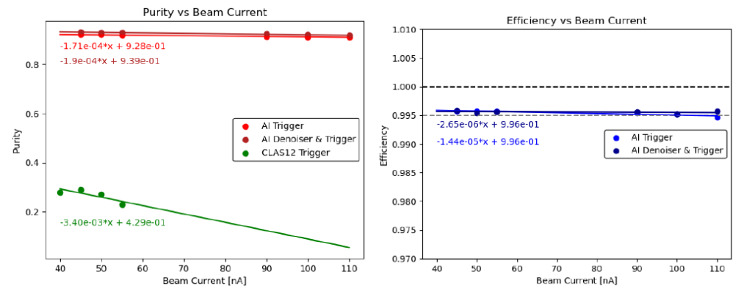
Software Developments & Plans
AI/ML for improved track reconstruction
AI/ML level-3 trigger running on GPUs
Neural networks developed for CLAS12 forward drift chamber tracking led to 15% − 35% increase in physics outcome depending on experiment
[Richard Tyson, Gagik Gavalian et al. 2023]
Includes implementation of secondary event transfer system
Can significantly reduce amount of recorded data
Other developments include
Displaced vertex for finder for hyperon identification by Veronique
Improved DC tracking by Tongtong

Slide 14
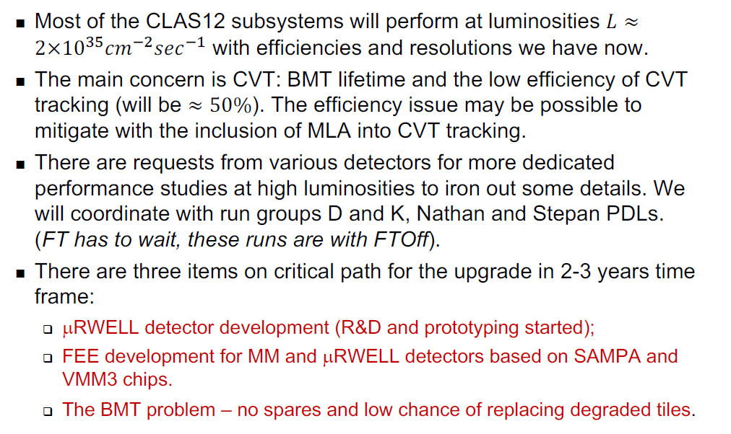
Evaluation of Subsystem Performance for x2 Design Luminosity
Series of Task Force Meetings
RG-A with average luminosity of 0.7×𝐿 and 𝜂 = 0.8 for a single track → in pass-1, analysis with two particles in the final state will get only ~40% of the expected statistics
Renewed evaluation of beamline, forward tagger (FTCal, FTHodo), PMT devices (HTCC, LTCC, RICH, FTOF, ecal, CND,CTOF), forward detector tracking, central detector tracking, DAQ/trigger
From the summary by Stepan:

Slide 15
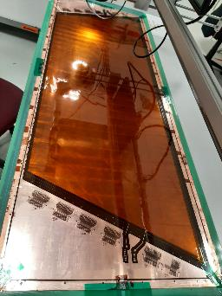
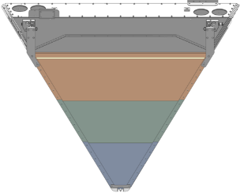

Luminosity Upgrade with Additional Tracker
μRWELL development for luminosity upgrade to
$L={2×10}^{35}{cm}^{−2}\sec^{−1}$
μRWELL with capacitive sharing readout provides 2D points in front of drift chambers
Work on prototype at UVa, CERN,
and JLab during the last months
Time frame of 2 to 3 years for completion
→ Rafayel: Luminosity upgrade for CLAS12
Simulation studies with background merging and μRWELL + DC + AI result in improved inefficiency of better than 0.1 % per nA, better than upgrade design goal
CLAS12 readiness for higher luminosities is key for future success
µRWELL module

Slide 16
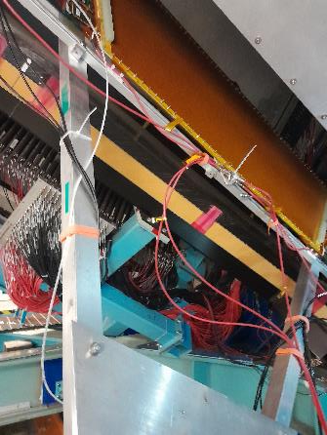
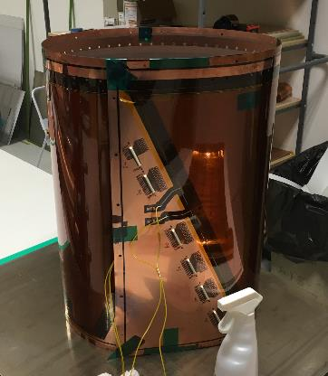
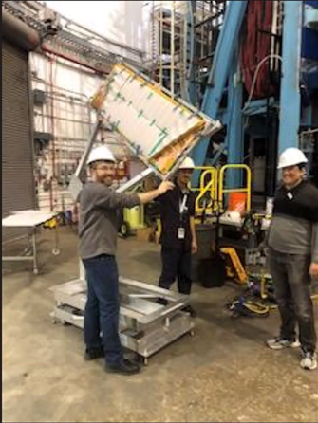
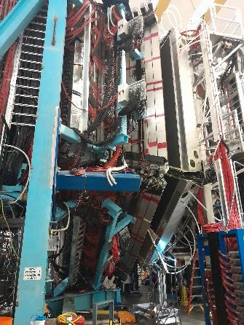
Hardware Developments & Plans
First beam test of a large-area µRWELL during the last days
Implementation of a tracking algorithm with AI/ML → Gagik: Usage of Machine Learning in CLAS12
Cylindrical μRWELL Detector for high luminosities with CLAS12:
DOE Early Career Award application “Low-mass, fast-timing micro-pattern gaseous detector for CLAS12 at ultra-high luminosities” prepared by Florian
DOE Innovative Fusion Technology and Collaborative Fusion Energy Research “Spin Polarized Nuclei for Injection into DIII” application by Xiangdong
Some data were taken, to be continued …

Slide 17
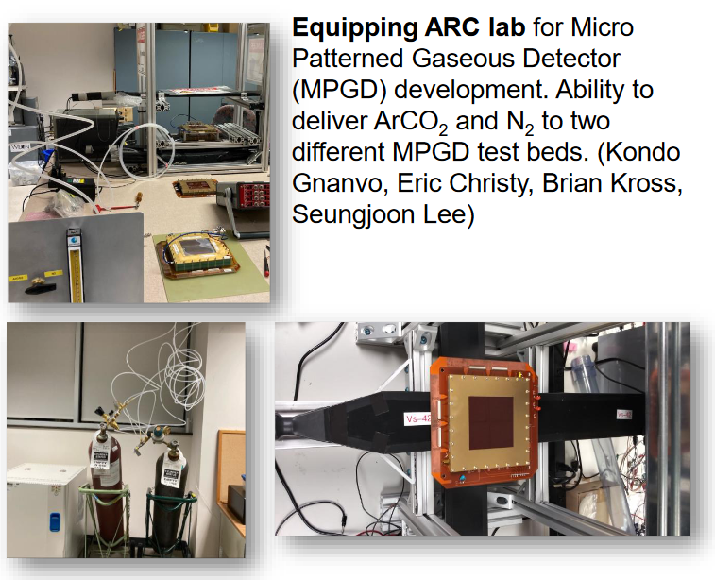
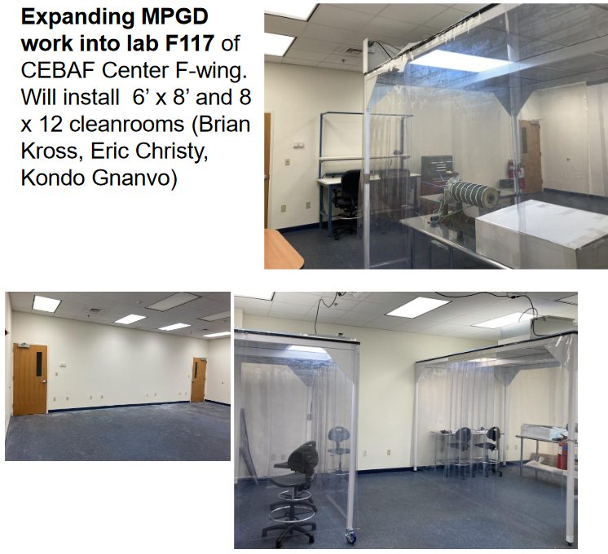
Micro Patterned Gaseous Detectors Lab(s)
Declared need for MPGDs R&D facility in the US
for the Nuclear Physics community
MPGD facility could be modeled on Gaseous Detector Development laboratory at CERN
[Drew Weisenberger, Leadership Meeting, Mar. 2023]
JLab is expanding its R&D activities in MPGDs
CLAS luminosity upgrade will benefit strongly

Slide 18
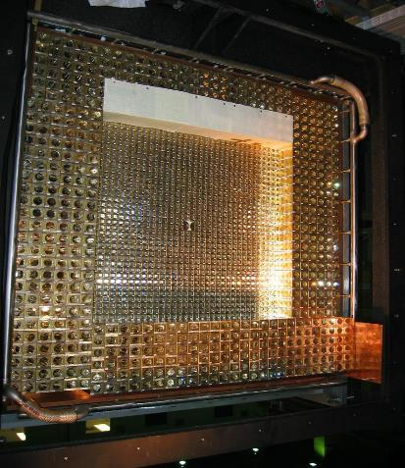
Upgrade of HyCal Calorimeter
Combination of PbWO₄ and Pb-glass detectors (118 x 118 cm²)
PbWO₄ crystals → high resolution
Pb glass → low budget
Two upgrade needs identified:
All 1152 PbWO₄ + 576 Pb glass detectors need new readout
→ inner part upgrade with FADC250v3 by JLab
Light yield of Pb glass is too low for future high-resolution measurements in Hall B → new PbWO₄ crystals needed
Application for MRI Consortium: “Track 2 Development of an enhanced magnetic-spectrometer-free apparatus for ultra-precise forward angle electron scattering experiments " by Ashot Gasparian and collaborators

Slide 19
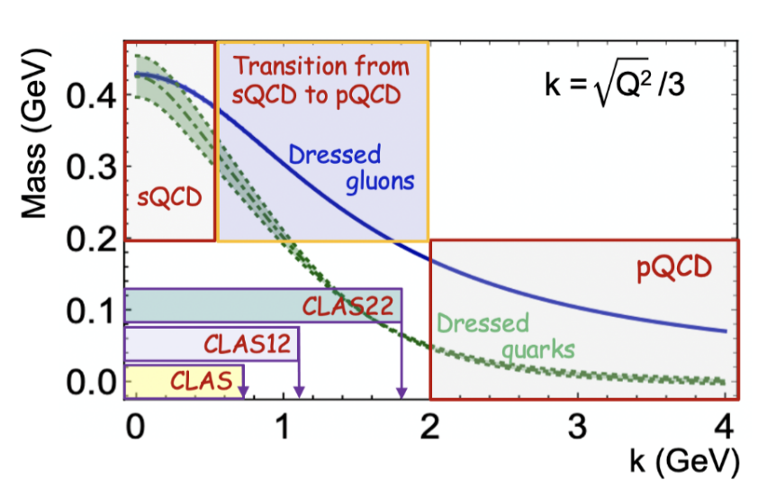
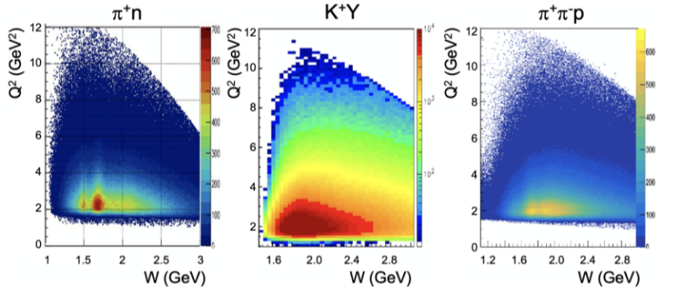
Cooperation with Theoreticians to Explore Emergence of Hadron Mass
Extension of results on electrocouplings of N* states in from pN, ppN, KY, K*Y, KY* exclusive channels to access quark momenta where ~50 % of dressed quark mass is generated in order to resolve the problem on Emergence of Hadron Mass
Long-stay visitor Adnan Bashir to explore N* transition amplitudes with Continuum Schwinger Method
"Nucleon Resonance Electroexcitation Amplitudes and Emergent Hadron Mass" in "Particles 6, 416–439 (2023)
Common Workshop at DNP-JPS Joint Meeting: Exploring excited nucleons with meson, electron, and photon beams
Meson electroproduction yields measured with the CLAS12

Slide 20
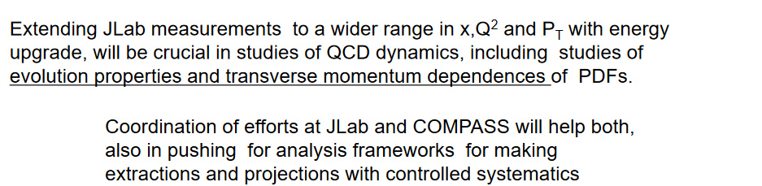
Cooperation with COMPASS
Task Force Meeting in which Harut discussed the need for stronger cooperation across the labs
→ Jan: AMBER: a new QCD facility at CERN
From Harut’s summary:

Slide 21
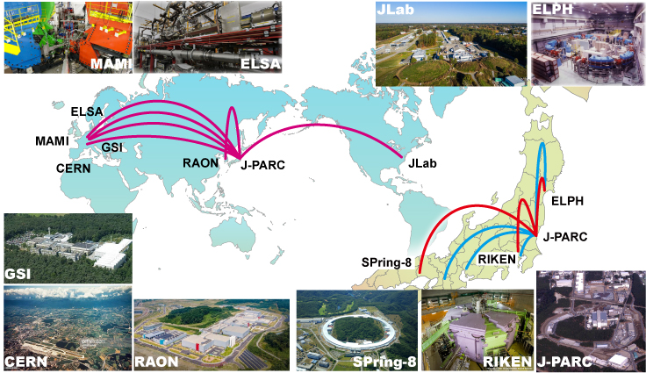
Cooperation with J-PARC
Japan is one of the key players sharing the same objectives in understanding hadron physics, hadron structure, hadron interaction, and hadron mass
The role of international projects in hadron physics at J-PARC is increasing
CLAS Collaboration should seek connection to leading groups

Slide 22


Creating a Platform to Strengthen Collaboration
Currently, J-PARC Hadron Facility Extension Project is largest upgrade project
Proposal for “International Leading Research” has been submitted in 2023
  Formation of baryons with multiple strange quarks
  Λ-p interactions
  Emergence of hadron mass

Slide 23

Summary in Black & White
Run Group C successfully conducted first polarized target experiment with CLAS12, … but not completed
Tracking/reconstruction upgrades, mostly AI assisted, improve performance, … but still no pass-2 cooking
Detector und beam dump upgrades are progressing,
… but μRWELL operation is on a long and winding road
Several publications submitted and analyses in review, … but still no absolute cross sections published
Thanks for the invitation to the center of intellectual Enlightenment, …but sometimes it feels like Paris in the rain

Slide 24
Data Analysis Results in Publication
[Silvia Niccolai, Sept. 2022]

Slide 25


Back-To-Back Dihadron Correlations
Timothy B. Hayward (UCONN)
Harut Avakian (JLab)
First access to a TMD fracture function
First back-to-back analysis of proton-π+ RGA data
Sizable nonzero asymmetries
→ first ever observation of a signal sensitive to TMD fracture functions
PRL published last month
Follow-up analysis involving RGA and RGB in order to study flavor dependence of fracture functions and both positive and negative pions in order to control systematics and test universality
Analysis note ~90% completed, finalizing two remaining systematic uncertainties and working on cross check
H₂ pπ⁺, D₂ pπ⁺
H₂ pπ-, D₂ pπ⁻

Slide 26




Hard Exclusive π⁺ Electro-Production off Protons
Published in PLB 839, 137761 (2023)
blue: GK GPD model magenta: Laget Regge model

Slide 27



Hard Exclusive π⁻Δ⁺⁺ Electro-Production BSA off Protons
Access to transition GPDs
3D structure of resonances
Collaboration review started this week
Paper expected to be submitted to PRL in March

Slide 28




Multidimensional Study of SIDIS Single π‒ and π⁰ BSA
4D:
1D:
Second round of the analyis review
ongoing since January
black: π⁺
red: π⁰
blue: π⁻
Extension of published π⁺ SIDIS
Flavor decomposition of TMDs

Slide 29

Inclusive (e,e’X) Cross Section
V. Klimenko, UConn
First results on inclusive (e,e’X) cross sections at 4.0 GeV² < Q² < 10 GeV²
Large coverage in W and Q²
New opportunities for insight into PDF in resonance region and for exploration of quark-hadron duality
PRELIMINARY
PRELIMINARY
PRELIMINARY
PRELIMINARY
PRELIMINARY
PRELIMINARY
Analysis note and draft of paper submission by first half 2023
Black - preliminary cross sections
Red – CLAS data, Phys. Rev. D67, 092001 (2003)

Slide 30

SIDIS kinematics for Λ electroproduction with CLAS6
Probing QCD Dynamics
Study of transverse momentum broadening and multiplicity ratio
Paper submitted to PRL, under review

Slide 31



DVCS Beam-Spin Asymmetries
$$ep→e^{′}p^{′}γ$$
Greatly extend the Q² and Bjorken-x phase space
Submitted to PRL

Slide 32


Heavy Photon Search 2016 Run
Including bump hunt and displaced vertex analysis
Submitted to PRD

Slide 33

Beam Spin Asymmetry for Deeply Virtual Kaon Production
First round of the analysis review finished in November
Finalizing the response to the first round
Second round of the analyis review expected

Slide 34




Beam Spin Asymmetry for Deeply Virtual π0 Production
Andrey Kim (UConn)
Paper is under the CLAS ad-hoc review (round 1)

Slide 35



Deeply Virtual Neutral Pion Cross Section
CLAS12 data significantly extends kinematic reach compared to previous measurements and with higher statistics
Currently calculating correction factors and systematic uncertainties to arrive at quantitative conclusions
Process is sensitive to chiral-odd GPDs, distinct from DVCS
Robert Johnston (MIT)
Kinematic Reach

Slide 36



Beam Spin Asymmetry for Exclusive Vector Meson ρ0 Electroproduction
Nicholaus Trotta (UConn), Kyungseon Joo (UConn), Andrey Kim (UConn)
ep -> eρ⁰(p): ρ⁰ decays into π⁺π^{-,} protons are identified by missing mass, pions only in Forward Detector
Exclusive vector meson ρ⁰ channel is sensitive to GPDs H, E at leading twist and H_{T} and $\overline{E_{T}}$ at next leading twist
A_{LU}^{sin(φ)} vs -t
A_{LU}^{sin(φ)}
BSA
0.1
0.15-
0
0.1-
-0.1
0.01-
0.1
0
0.5
-t (GeV²)
0
Invariant Mass π⁺ π⁻ (0 < φ < 45; 0.23 < -t < 0.46)
-0.1
0.1
0
-0.1
0
100
200
300
0
100
200
300
φ (deg)

Slide 37



Cross section for J/ψ photoproduction
Analysis status
Event selection and particle identification
Additional use of AI to identify leptons above 4 GeV
Irreducible backgrounds (from photon conversion and pion decays) are subtracted using same-charge lepton events
Overall normalization factors obtained from Bethe-Heitler events
Cross-section extracted for proton (both electron-positron and di-muon channel), bound neutrons and bound protons
Pierre Chatagnon (Jefferson Lab) & Richard Tyson (Glasgow)
Figure 1: Output spectrum of the BDT used to distinguish leptons from pions at momenta larger than 4 GeV. The BDT uses all information from the electromagnetic showers provided by the CLAS12 calorimeter.
Path forward
Ongoing studies to better understand the overall normalization, especially understand the particle detection efficiencies in both data and Monte-Carlo
Upcoming pass 2 data will provide greatly improved tracking efficiency, providing significantly more statistics
Systematic uncertainties remain to be studied
Figure 3: Unnormalized cross-section extracted from proton, bound neutron and bound proton in both final state of interest
Figure 2: Invariant mass spectrum of the lepton pair after irreducible background subtraction, compared the normalized yields from Monte-Carlo simulation

Slide 38






Beam Spin Asymmetries for π± π⁰ Dihadron Production
Gregory Matousek (Duke University)
Beam spin asymmetries of dihadron SIDIS allow for targeted extraction of the twist-3 PDF e(x) and twist-2 DiFF
Main Challenge: has large combinatorial background
Requires sideband (or sWeighting) procedure for projecting out background asymmetries
Strict event cuts, increasing purity yet decreasing statistics
Solution: Train a GBTs model to classify SIDIS photons from bkg.
channel supplements published results​
Inputs: Train on 3 feature types:
Event-wide information
Photon intrinsic (E,θ,…)
Intrinsic to photon’s Nearest Neighbors (N-N)
Outputs: 0<p<1 prediction score for each photon
New N-N approach rejects photons created by secondary interactions
GBT asymmetries consistent with old approach
Factor of 4 error reduction for asymmetries
Statistics are large enough for 2d binning
Potential for π⁰π⁰ dihadrons

Slide 39
Studies of Proton Fracture Functions in ep → epX

Slide 40



Neutral Pion Multiplicity in SIDIS
Number of neutral pions generated in the five-dimensional SIDIS phase space (x, Q², z, p_{T}², φ_{h}) divided by the DIS phase space (x, Q²).
Related to the D⁰(z) fragmentation function describing the probability of quarks fragmentating into neutral pions, and further serve as a test on the isospin symmetry between D⁰(z) and the charged pion fragmentation functions.
Extraction of cosine moments from φ_{h} dependence and studying the acceptances utilizing bin-by-bin and multidimensional unfolding methods.
Preliminary results will be presented at upcoming April APS meeting.
Marshall B. C. Scott (ANL)
Example Multiplicities for one x-Q² Bin
Very Preliminary :
RG-A Fall Inbending
(x,Q²) phase space : triangular bin from point (0.15, 2.28) to (0.24, 2.75) to (0.24, 3.63)

Slide 41









Measurements of the Cosφ_{h} and Cos2φ_{h} Moments of the Unpolarized SIDIS π+ Cross-section at CLAS12
Richard Capobianco (UCONN/Argonne)
Working towards the extraction of the cos(φ_{h}) and cos(2φ_{h}) moments of unpolarized SIDIS cross-section for charged pions using RG-A data
The collected statistics enable a high-precision study of these azimuthal moments which probe the Boer-Mulders function and Cahn effect
The high statistics data will, for the first time, enable a multidimensional analysis of both moments over a large kinematic range of Q², x_{B}, z, and P_{T}.
  Reaction Studied: ep→eπ⁺(X)
CLAS12 RG-A Experimental Data
Q² vs x_{B}
CLAS12 RG-A Experimental Data
z vs P_{T}
Q²-x_{B} Bin 8
The lepton-hadron Unpolarized SIDIS Cross-Section:
Reconstructed
The Boer-Mulders and Cahn effects are present in the Structure Functions:
Unfold the data using Simulated and Experimental data and fit the new distribution with the function:
$$A+B \cos{ϕ_{h}}+C \cos{{2ϕ}_{h}}$$
Where A, B, and C will then be used to calculate the azimuthal moments from the cross-section equation
Unfolded
(Example)
Do for every Q²-x_{B} and z-P_{T} bin to get A, B, and C as functions of all 4 variables

