Slide 1
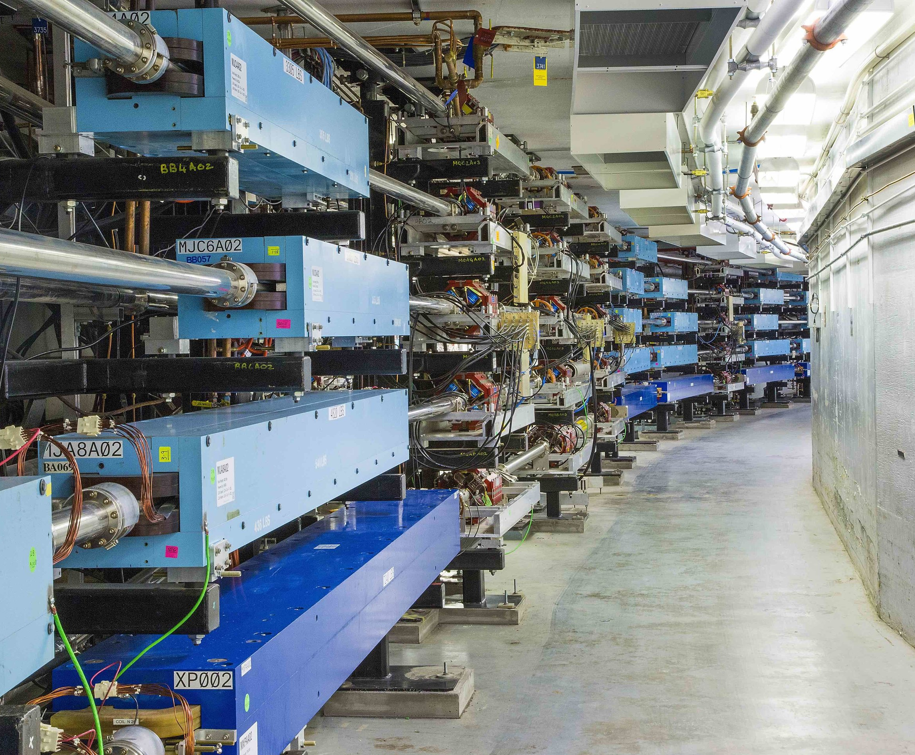

Status of CEBAF Upgrades
  Positron Program at 12 GeV
  22 GeV CEBAF FFA* Energy Upgrade
*FFA (Fixed Field Alternating-Gradient)
Alex Bogacz
Accelerator Physics Group Leader

Slide 2

Future CEBAF − Overview
Expanding the 12 GeV capability with e+
Builds two new polarized injectors (e+/e-)
Retains present polarized e- injector
Multi-hall capability is a high priority
Capability happens after Moller
Expanding energy reach to 22 GeV with e-
Requires new 650 MeV polarized injector
Builds upon e+ infrastructure
Adds permanent magnet FFA arcs for highest energies
Retains multi-hall capability
Production of Highly Polarized Positrons Using Polarized Electrons at MeV Energies, D. Abbott et al., Phys. Rev. Lett. 116 (2016) 214801
Physics with CEBAF at 12 GeV and future opportunities, J. Arrington et al, Progress in Particle and Nuclear Physics, Volume 127, 103985 (2022)

Slide 3
Expands 12 GeV capability with e+
Joe Grames
Build two new injectors…
  10 mA polarized e- injector
  100 kW positron target
Two beam sources for CEBAF
  Retains original 4-hall polarized e- injector
  Adds new pair (e-/e+) and limited pol e- injector
Prioritizes
  Multi-hall capability (alt. is <4 halls)
  cw operation (alt. is pulsed <100% DF)
Timeline
  e+ capability happens after Moller
  Demonstration of e+ beams happens before this PEPPo

Slide 4
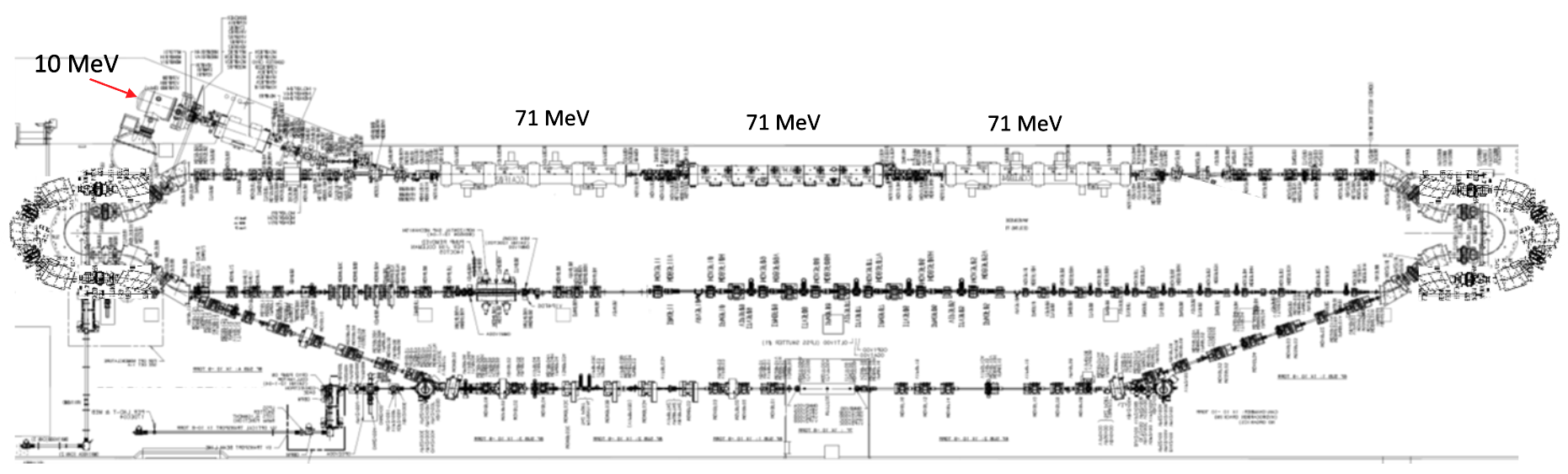
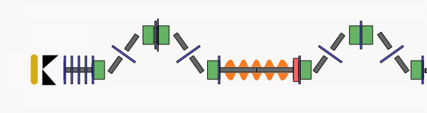
LERF Polarized Positron Injector Concept
Focus is developing a technical report on a polarized e⁺ injector at LERF
  High current polarized electron injector (10 MeV/10 mA)
  High current 1-3 mA LINAC (two C75 CM)
  Positron conversion target (~100 kW)
  Positron bunch collection and momentum selection
  Positron bunch compression and acceleration to 123 MeV
Joe Grames
More from Yves Roblin
#1 – Compact 10 mA P-Gun, Wien filter, 10 MeV e- injector
#6 – SRF accelerate e+ to 123 MeV
#2 - SRF accelerate to 120 MeV
#5 – Transport e+
#3 – Extract e- to target
#4 - Produce and collect e+ 20 to 60 MeV
#7 – Evaluating 123 MeV spin rotator concept
#8 – Transport e+ at 123 MeV to CEBAF

Slide 5
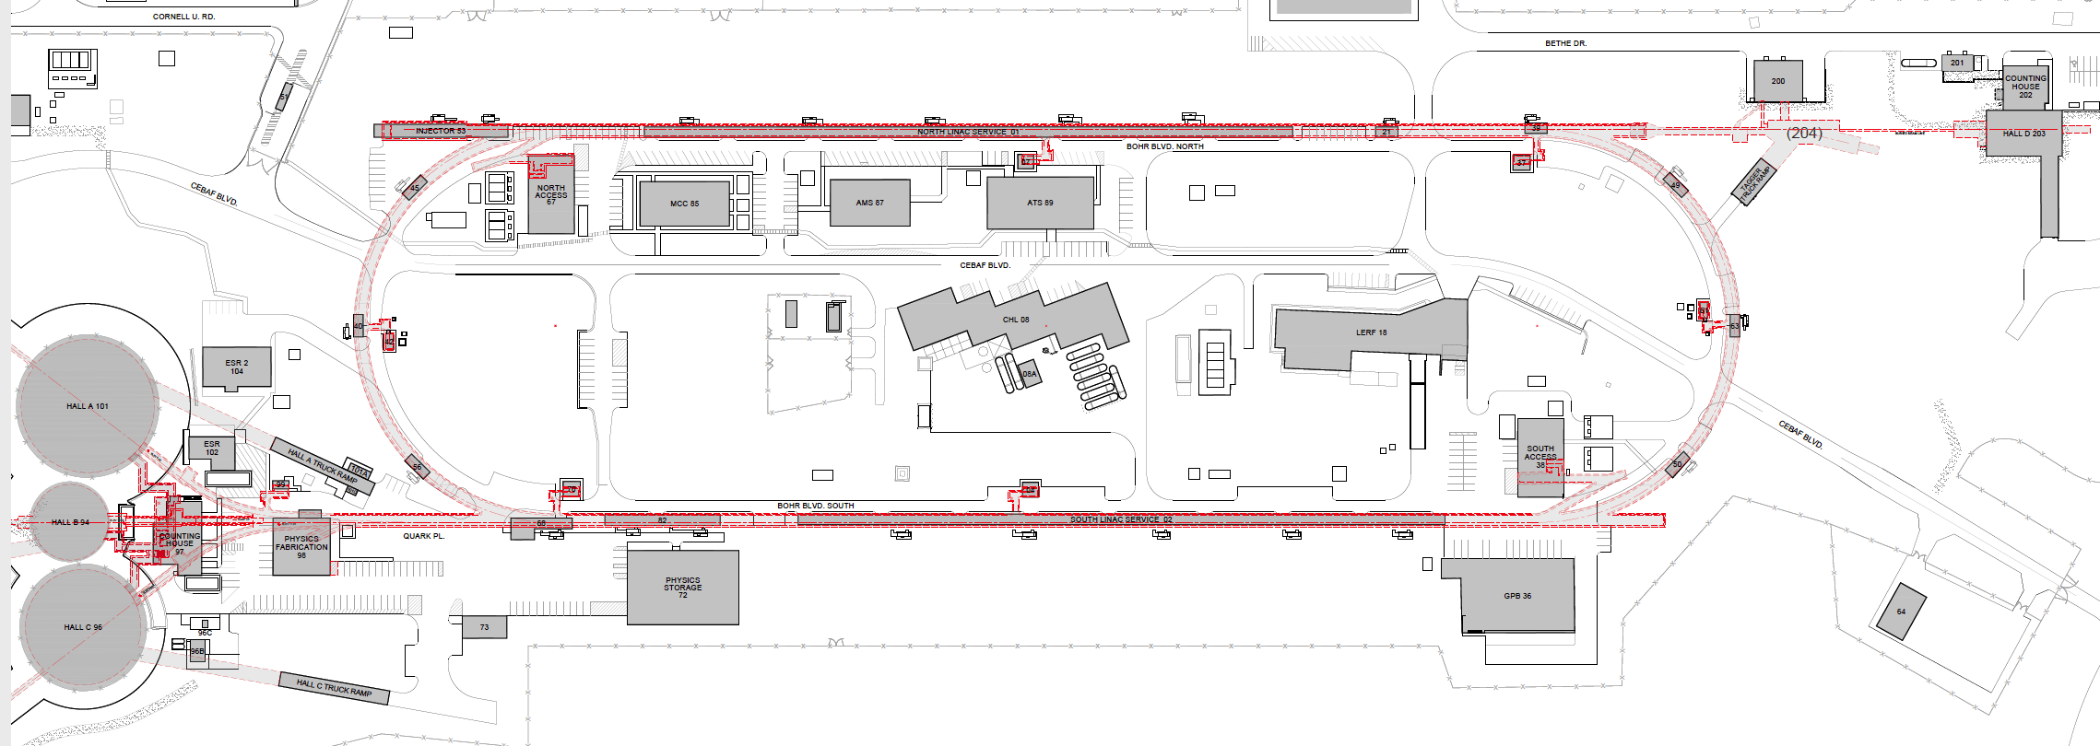
An electron/positron injector vault is required for 12 GeV e+ and 22 GeV e-
Positron will be generated at LERF at 123 MeV and transported via new tunnel for injection to CEBAF, then usual acceleration to 12 GeV.
Joe Grames
Existing FEL + long beam line
123 MeV e+ for 12 GeV CEBAF
650 MeV e- for Energy Upgrade
Green option is presently more cost effective and provides options for staging positron and energy upgrade

Slide 6
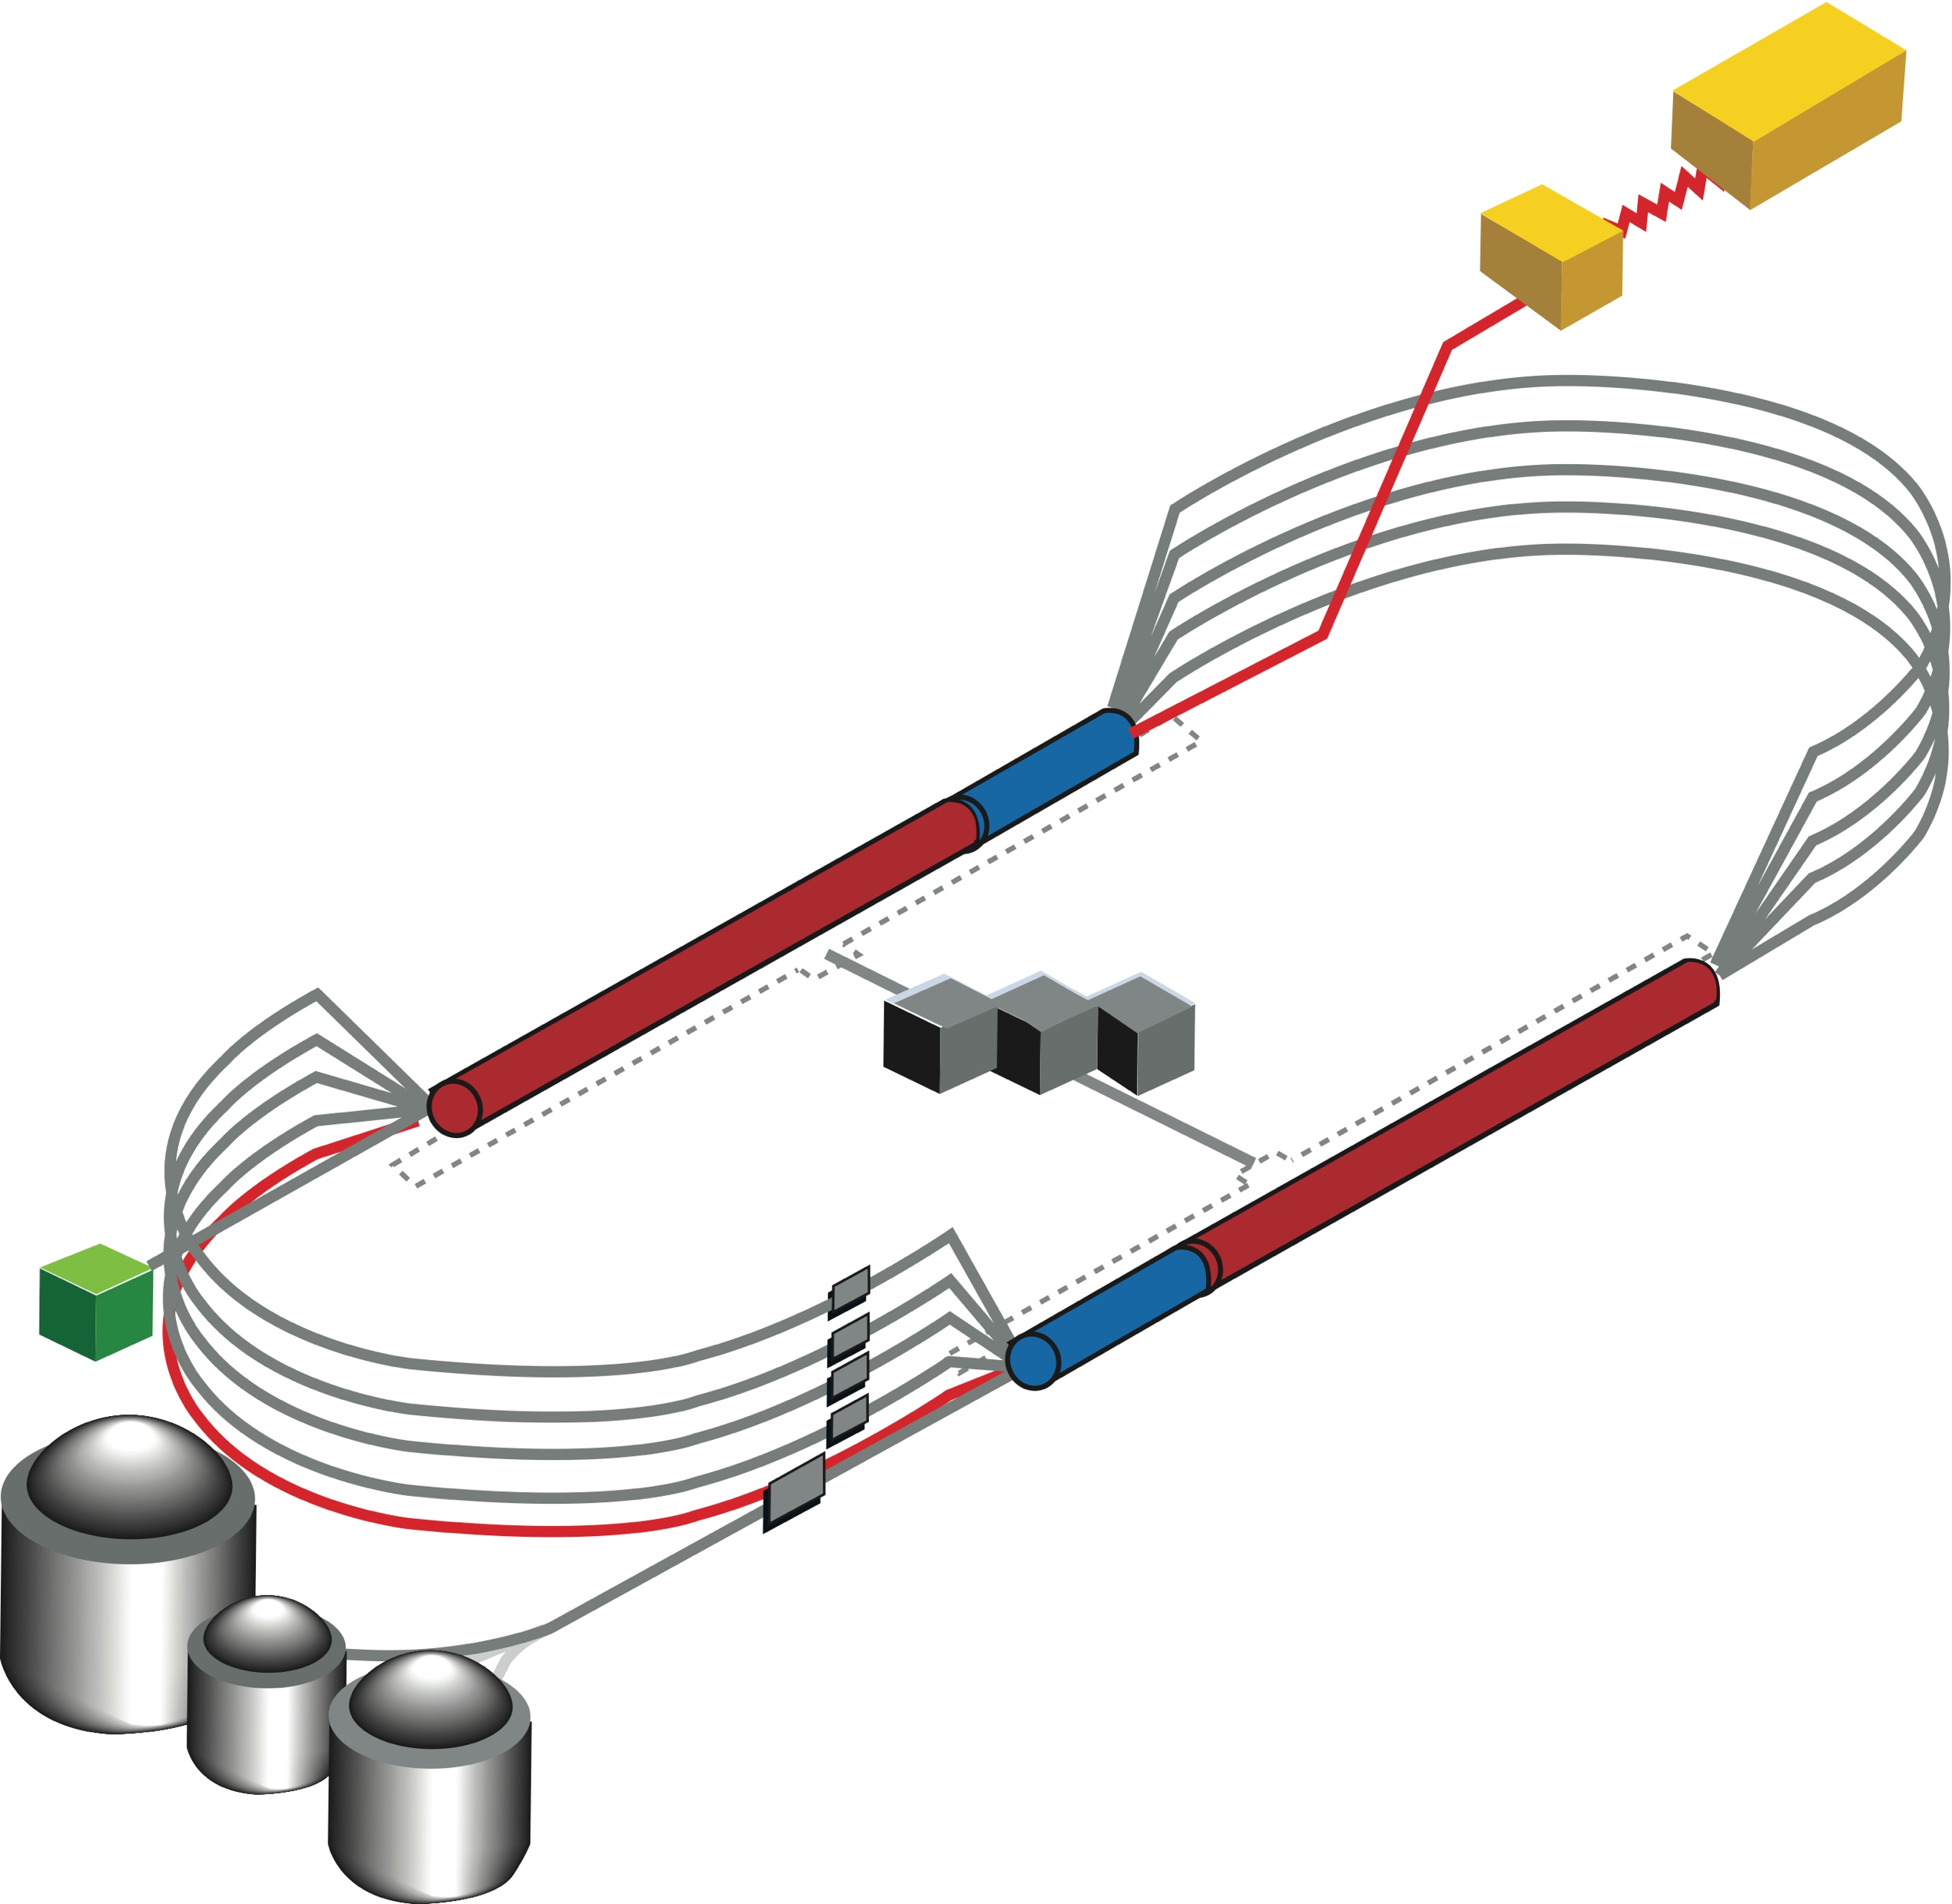

CEBAF FFA Energy Upgrade – Baseline under Study
  Starting with 12 GeV CEBAF
  NO new SRF (1.1 GeV per linac)
  New 650 MeV recirculating injector
  Remove the highest recirculation pass (Arc 9 & A) and replace them with two FFA arcs including time-of-flight chicanes
  Recirculate 4 + 6.5 times to get to 22 GeV
TOF
650 MeV
TOF
Enabling Technology:
Novel permanent magnets, -like used for power and cost savings
Pass Arithmetic: 5 -1 + 6.5 = 10.5

Slide 7
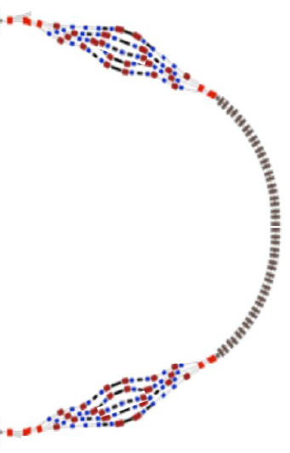
FFA CEBAF with -like Arcs

Slide 8
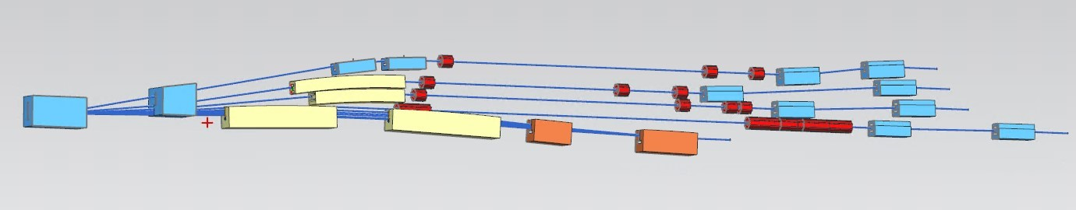
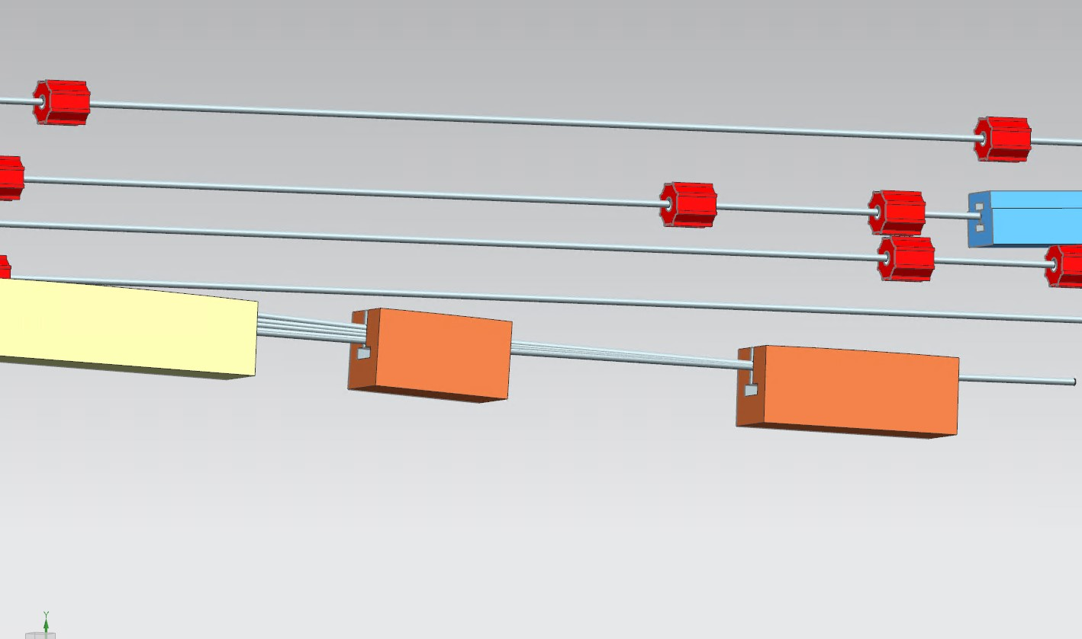
Modified Switchyard to Accommodate Six FFA Passes
pass 1
pass 2
pass 3
pass 4
FFA passes 5-10
FFA passes 5-10

Slide 9
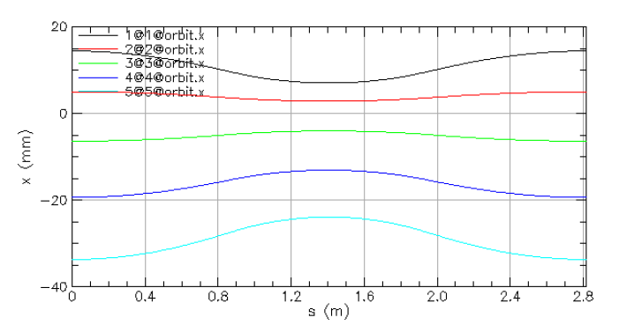
FFA Arc − Compact FODO Cell
orbits
Large momentum acceptance FFA cell, configured with combined function magnets capable of transporting six beams with energies spanning a factor of two
Arc composed of 86 cells, L_{cell} = 2.8 m
Closely spaced orbits for all six beams (~ 5 cm)
Low betas (~ 5 m)
Extremally low dispersions (a few cm) - Virtue of combined function FFA magnets
dispersions
beta functions
E=22.65 GeV
E=20.45 GeV
E=18.25 GeV
E=16.05 GeV
E= 13.85 GeV
E=11.65 GeV
B_{F}
B_{D}
B_{F}

Slide 10
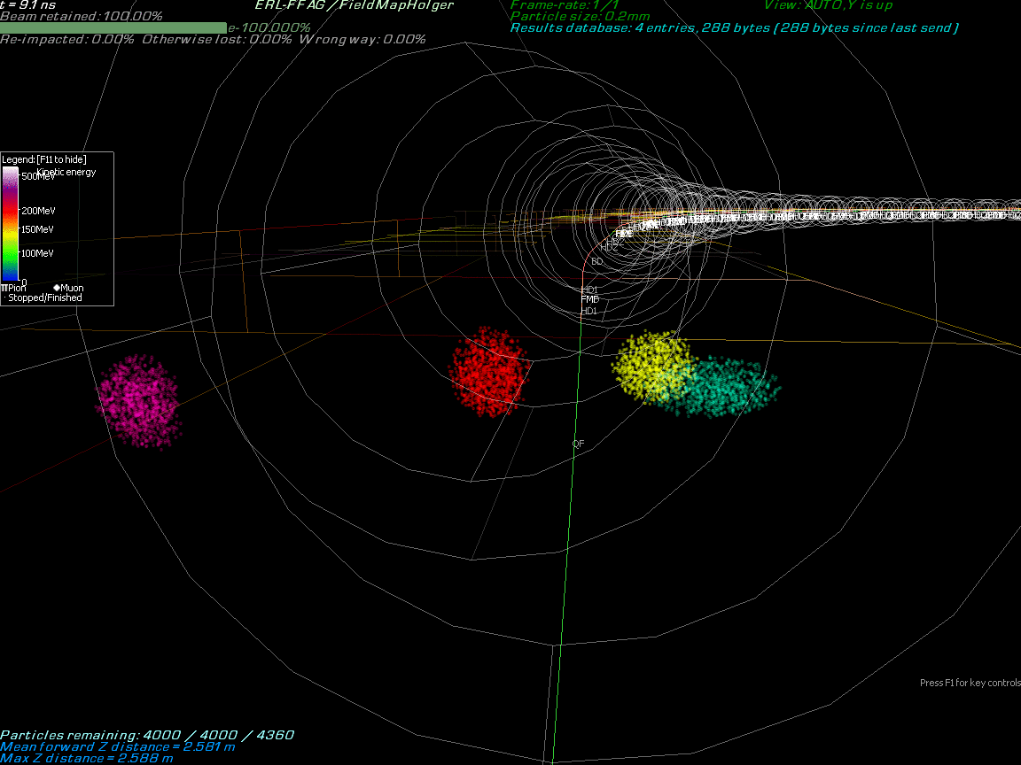
Multi-Bunch Dynamics in FFA Arc

Slide 11
Permanent Magnet Design – Open Mid-plane Geometry
10 cm
10 cm
10 cm
10 cm
Focusing Magnet BF
G_{F}= -41.13 T/m
L_{QF}= 1.67 m
B_{F}= -0.812 T
Defocusing Magnet BD
G_{D}= 43.44 T/m
L_{BD}= 1.24 m
B_{D}= -0.593 T
magnets: from 38cm² to 78cm²

Slide 12
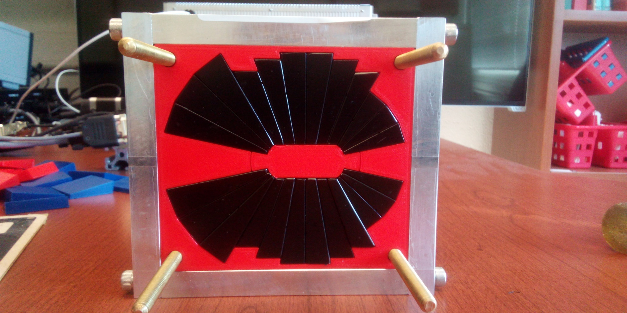
Assembled Prototype Magnet
A prototype open midplane BF magnet was built and evaluated for mechanical integrity. Magnetic measurement confirmed a robust design with >1.5 Tesla in good field region, 10⁻³ field accuracy. Radiation resilience tests will be carried out at CEBAF.
Stephen Brooks, BNL
Open midplane design with >1.5 Tesla in good field region, 10⁻³ field accuracy

Slide 13
FFA Arc to Straight Architecture
One needs to merge different energy orbits transitioning to the straight
Simultaneously the dispersion has to vanish at arc ends.
Beta functions need to be compatible with higher-beta optics in the linacs (~250 meter betas).

Slide 14
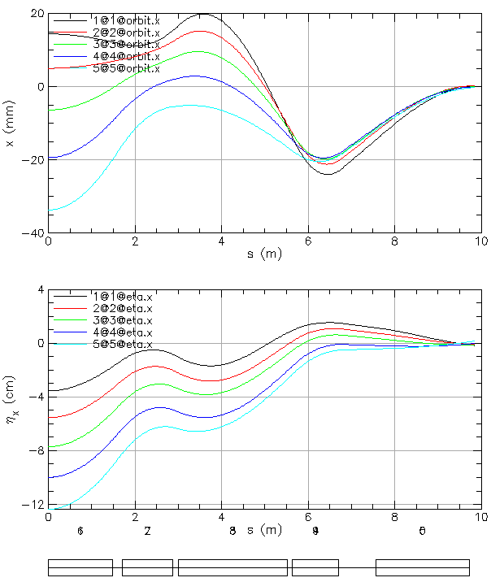
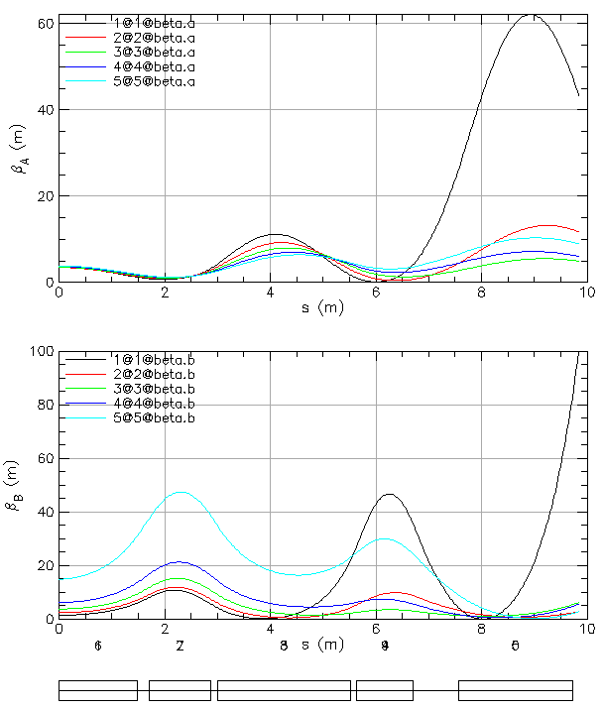
FFA Arc to Straight – Compact Merger
Breaking cell symmetry by altering (length, bend) of a few magnets to merge different energy orbits at arc ends.
Simultaneously, the dispersion and its derivative are suppressed at arc ends.
Furthermore, beta functions need to be matched to higher-bets of the linacs (~250 meter betas).
This simplifies switchyard and reduces its functionality to pathlength and momentum compaction adjustment.

Slide 15
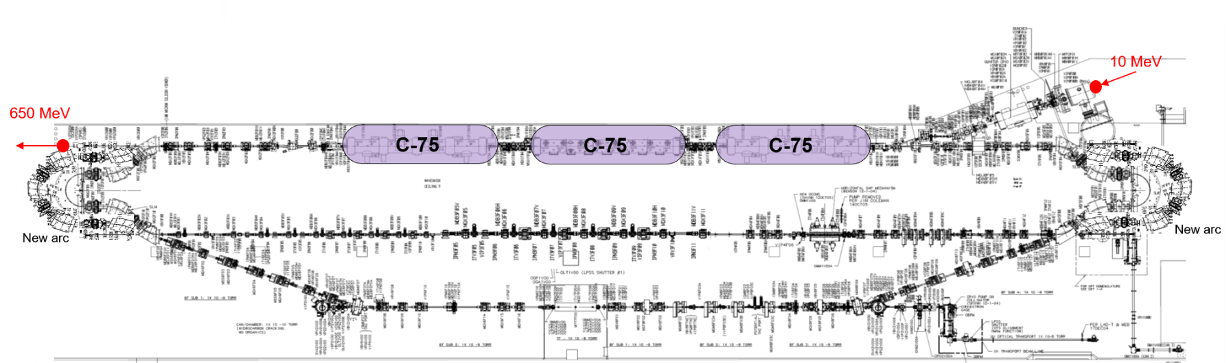
Injector Upgrade − 650 MeV Recirculating Injector
With the present 123 MeV injector, the difference in the first and final pass energies in the North Linac is too large (1:175) to effectively control the beam.
650 MeV recirculating injector (3-pass) based on LERF will allow a manageable difference in energies (1:33)

Slide 16
Recirculating Injector Based on LERF (3-pass)
10 MeV + 3 × 3 × 71 MeV = 650 MeV
10 MeV
436 MeV
C-75
C-75
C-75

Slide 17
Injector Upgrade − 650 MeV Recirculating Injector
10 MeV + 3 × 3 × 71 MeV = 650 MeV
10 MeV + 3 × 3 × 71 MeV = 650 MeV
10 MeV
650 MeV
436 MeV
C-75
C-75
C-75
C-75
C-75
C-75
New arc
New arc

Slide 18
Synergy Between the Positron Source and 650 MeV Injector
#1 – Compact 10 mA P-Gun, Wien filter, 10 MeV e- injector
#6 – SRF accelerate e+ to 123 MeV
#2 - SRF accelerate to 120 MeV
#5 – Transport e+
#3 – Extract e- to target
#4 - Produce and collect e+ 20 to 60 MeV
#7 – Evaluating 123 MeV spin rotator concept
#8 – Transport e+ at 123 MeV to CEBAF
Positrons program ends prior to 22 GeV FFA, so LERF can be repurposed for 650 MeV electrons.

Slide 19
Energy Loss, Emittance Dilution (4-pass CEBAF)
  Doubling the energy, while staying within current CEBAF footprint, makes the synchrotron radiation effects of paramount importance.
  Quantum nature of a ‘recoil’ effect on electrons due to photon emission makes significant impact on both the transverse and longitudinal beam dynamics, leading to cumulative emittance growth (transverse and longitudinal).
Energy loss
Emittance dilution
Natural energy spread

Slide 20
Energy loss, Emittance Dilution (6-pass FFA)
6 passes
Synchrotron radiation mitigation in FFAs
  High fill factor (92% space filled with bends) increases significantly the bend radius, ρ.
  By virtue of extremally small dispersion and betas, the horizontal emittance dispersion, <H>, is highly suppressed (factor of 20 lower then in a conventional CEBAF arc lattice).

Slide 21
Hall B Optics at 22 GeV
Jay Benesch
500
Circa 2004
1
BETA_X&Y[m]
DISP_X&Y[m]
0
-1
0
BETA_X
BETA_Y
DISP_X
DISP_Y
162.892
N Name S[cm] L[cm] B[kG] G[kG/cm] BendAng[deg]
4 MLA2C02 309.989 230
45 MBE2C01 4654.59 100 16.4734 0.0668709 1.28616
49 MBE2C03 4804.59 100 16.4734 0.0668709 1.28616
53 MBE2C05 4954.59 100 16.4734 0.0668709 1.28616
57 MBE2C07 5104.59 100 16.4734 0.0668709 1.28616
109 MBE2C09 8382.59 100 -16.4734 0.0668709 -1.28616
113 MBE2C11 8532.59 100 -16.4734 0.0668709 -1.28616
117 MBE2C13 8682.59 100 -16.4734 0.0668709 -1.28616
121 MBE2C15 8832.59 100 -16.4734 0.0668709 -1.28616

Slide 22
Hall B Optics at 22 GeV
500
1
QA → QR, QP
BETA_X&Y[m]
DISP_X&Y[m]
0
-1
0
BETA_X
BETA_Y
DISP_X
DISP_Y
162.892
N Name S[cm] L[cm] B[kG] G[kG/cm]
14 MQA2C01 1986.59 30 .427067
20 MQA2C02 2516.59 30 .870369
26 MQA2C03 3046.59 30 0 -1.68056
32 MQA2C04 3576.59 30 .250474
38 MQA2C05 4428.59 30 0 1.75297
61 MQA2C31 5701.59 30 0 -9.16649
65 MQA2C32 5816.59 30 0 8.55783
69 MQA2C32A 5876.59 30 0 8.55783
73 MQA2C33 5991.59 30 0 -9.16649
77 MQA2C34 6563.59 30 0 -9.16649
81 MQA2C35 6678.59 30 0 9.16649
N Name S[cm] L[cm] B[kG] G[kG/cm]
85 MQA2C35A 6738.59 30 0 9.16649
89 MQA2C36 6853.59 30 0 -9.16649
93 MQA2C37 7425.59 30 0 -9.16649
97 MQA2C38 7540.59 30 0 8.53111
101 MQA2C38A 7600.59 30 0 8.53111
105 MQA2C39 7715.59 30 0 -9.17547
127 MQA2C40 8963.09 30 0 -2.48529
135 MQA2C41 9085.59 30 0 -4.72046
143 MQA2C42 9208.09 30 0 3.44888
151 MQA2C43 9330.59 30 0 2.58799

Slide 23



Hall B Beam Sizes at 22 GeV
0.1
0.1
$$σ_{x,y}$$
$$=D_{y} \frac{Δp}{p}$$
$$σ_{y}$$
Size_X[cm]
Size_Y[cm]
0
0
0
Ax_bet
Ay_bet
Ax_disp
Ay_disp
162.892
  Horizontal emittance (normalized): 60 mm mrad
  Vertical emittance (normalized): 1 mm mrad
  Energy spread: 1×10⁻³

Slide 24
Summary
Expanding 12 GeV capability with positrons (after Moller experiment)
  Two new polarized injectors (e+/e-)
  Will retain present polarized e- injector and multi-hall capability
Expanding energy reach to 22 GeV with electrons (after 12 GeV positron program)
  Recirculate 4 passes with the current CEBAF with 650 MeV Injector
  Plus Additional 6 passes via a single FFA: 10 – 22 GeV
  Open mid-plane permanent magnet design: B-field ≤ 1 T, Gradient ≤ 50 T/m
  Synchrotron Radiation impact on beam quality:
    Net transverse emittance dilution (normalized): 60 mm mrad
    Net natural energy spread: 1×10⁻³
    Net synchrotron radiated energy: 0.9 GeV
  Engineering analysis and cost estimates in progress
  Ready for Long Range Planning submission
at 22 GeV, β = 20 m → σ = 150 microns

Slide 25




The FFA@CEBAF Collaboration
†

Slide 26
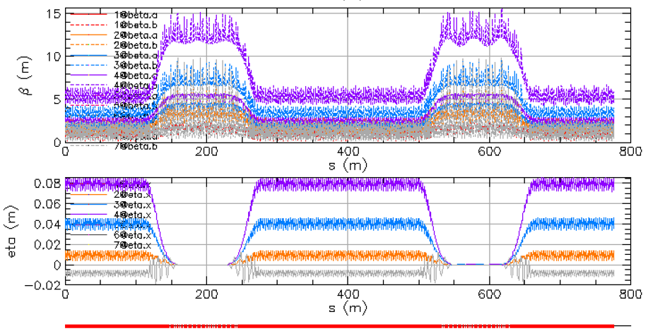
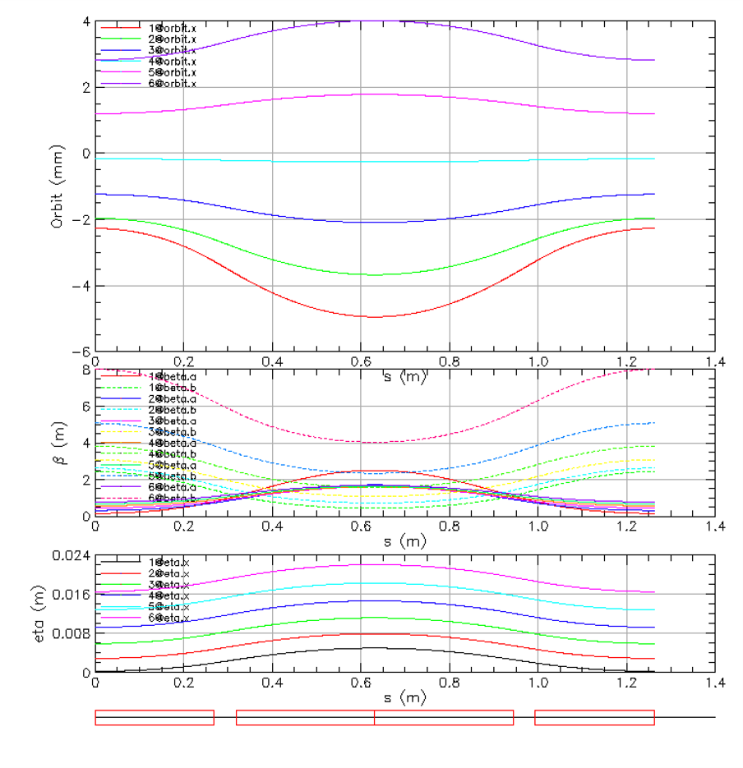
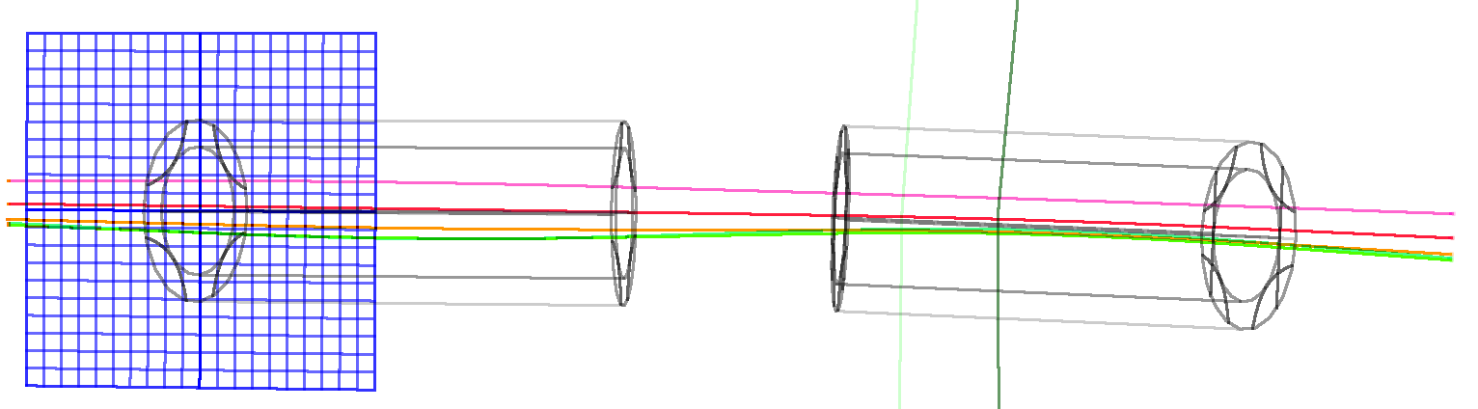

Thanks for your attention!

Slide 27
Backup Slides

Slide 28
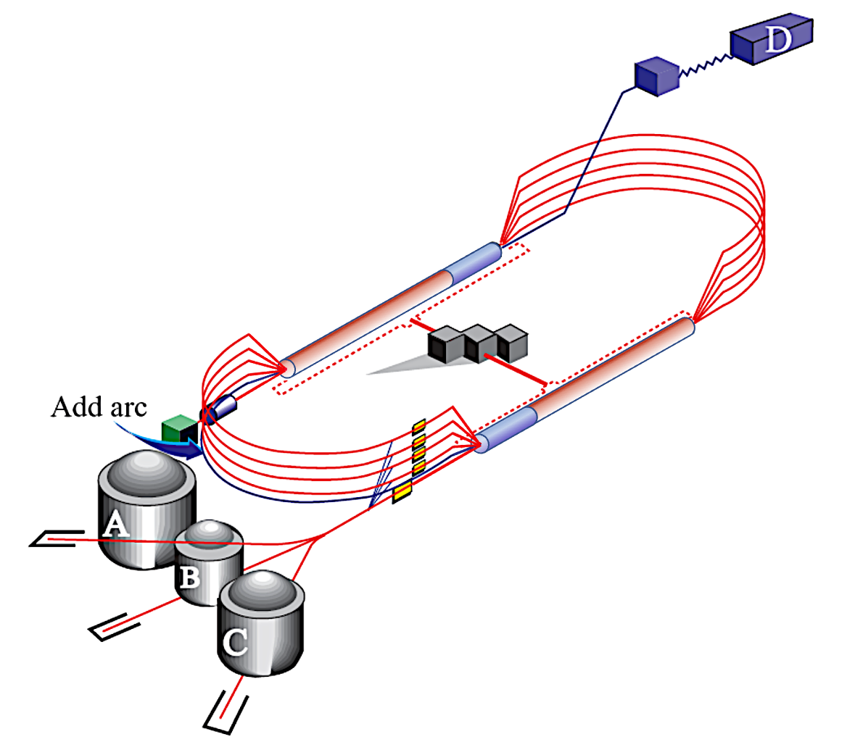
CEBAF Energy Upgrade 10.55 → 23.75 GeV
4 existing lines + 6 FFA turns
12 GeV
23.75 GeV
Injector at 650 MeV
1.75 GeV
3.95 GeV
6.15 GeV
23.75 GeV
8.35 GeV
EAST FFA
Energy range
80.6 m
#1-10.55 GeV
#2-12.75 GeV
#3-14.95 GeV
#4-17.15 GeV
#5-19.35 GeV
#6-21.55 GeV
1.75
3.95
6.15
1.1 GeV
8.35
0.65 GeV
2.85 GeV
5.05 GeV
7.25
1.75 GeV
9.45
1.1 GeV
0.650
80.6 m
2.85 GeV
Energy range
5.05 GeV
7.25 GeV
22.65 GeV
9.45 GeV
WEST FFA
#1-11.65 GeV
#2-13.85 GeV
#3-16.05 GeV
#4-18.25 GeV
#5-20.45 GeV
#6-22.65 GeV
22 GeV CEBAF FFA Energy Upgrade
28

