Slide 1




Beam spin asymmetries for DVCS on proton and neutron from a deuterium target
Adam HOBART, Silvia Niccolai
International workshop on CLAS12 physics and future perspectives at Jlab
21-24 March 2023

Slide 2
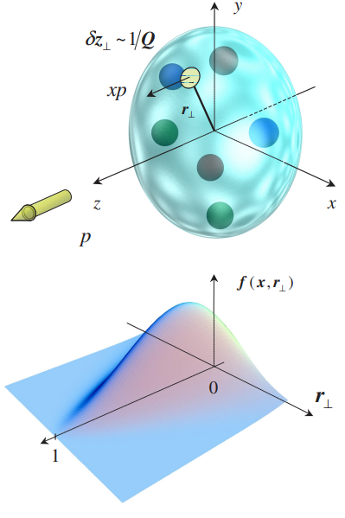
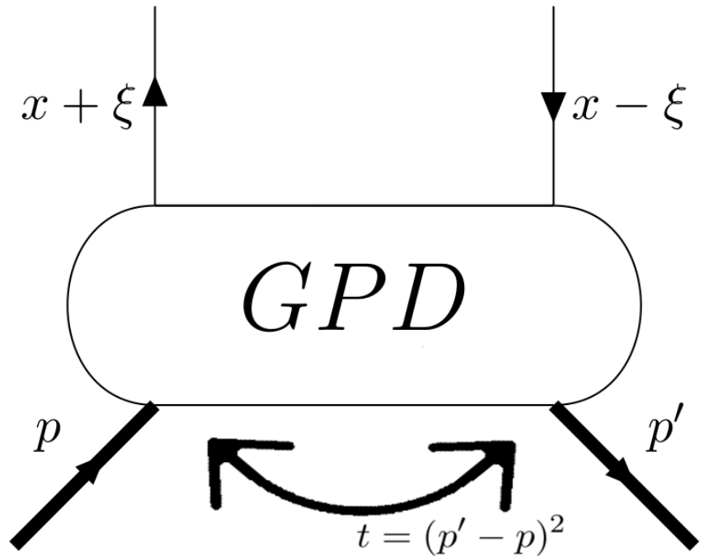
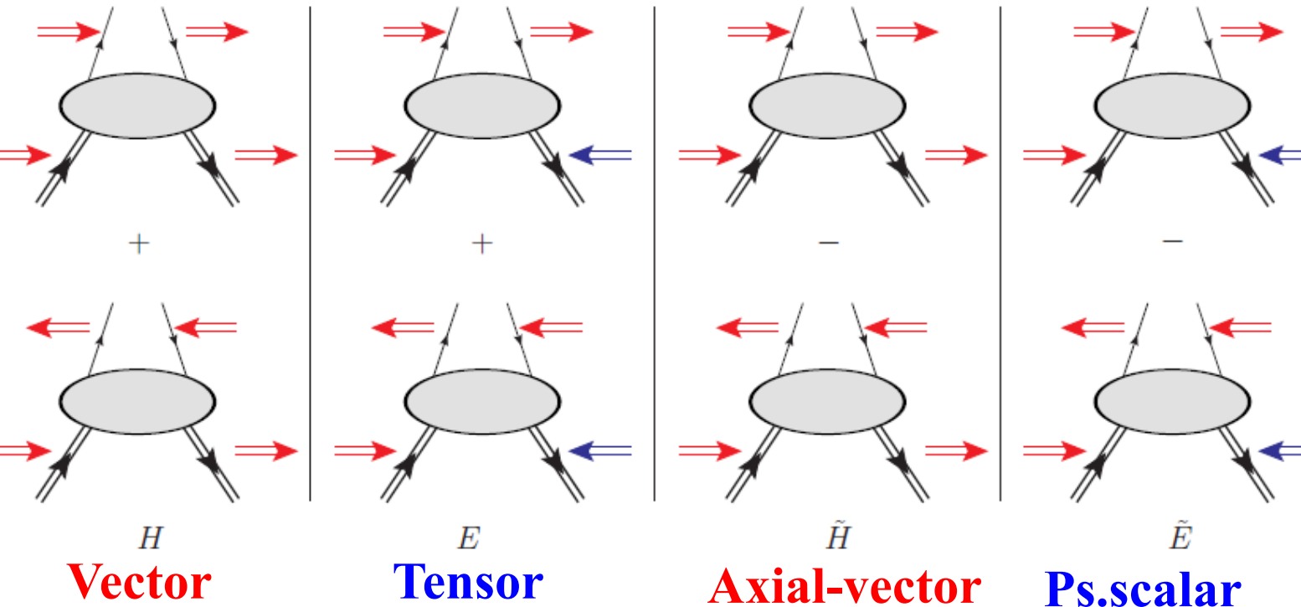
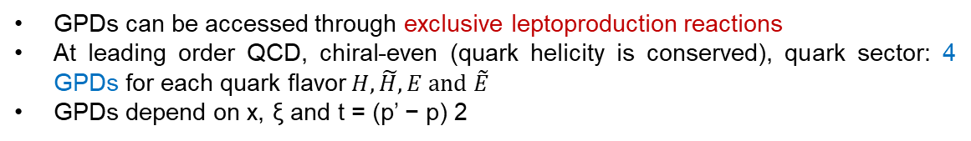
GPDs
Belitsky, Radyushkin, Physics Reports, 2005
QCD at low energies: non perturbative regime
  Need structure functions to describe nucleon structure
GPDs
Correlation of transverse position and longitudinal momentum of partons in the nucleon & the spin structure - through Ji’s sum rule X. Ji, Phy.Rev.Lett.78,610(1997)
GPDs can be accessed through exclusive leptoproduction reactions
At leading order QCD, chiral-even (quark helicity is conserved), quark sector: 4 GPDs for each quark flavor$H, \tilde{H}, E and \tilde{E}$
GPDs depend on x, ξ and t = (p’ − p) 2
Quark-helicity independent
Quark-helicity dependent
Conserve nucleon’s spin
Flip nucleon’s spin

Slide 3
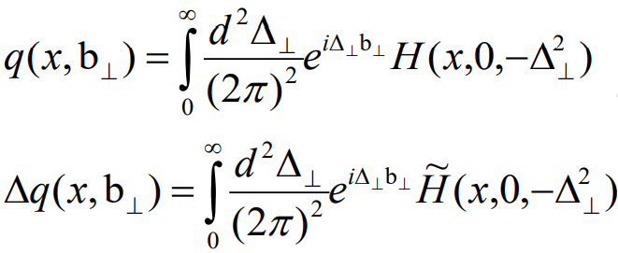
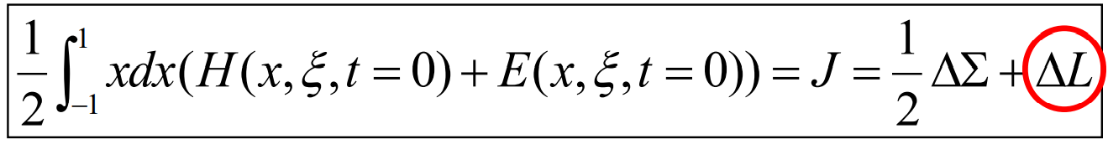
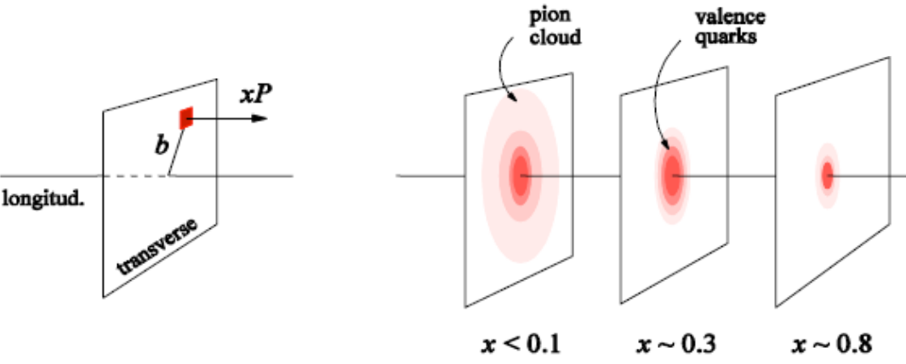
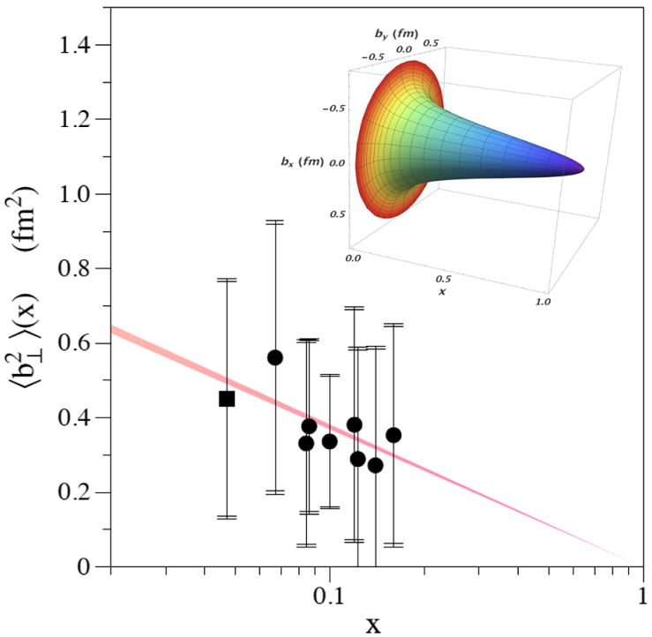

Why are GPDs important?
GPDs: Fourier transforms of non-local, non-diagonal QCD operators
Nucleon tomography
M. Burkardt, PRD 62, 71503 (2000)
Quark angular momentum
X. Ji, Phy.Rev.Lett.78,610(1997)
Nucleon spin:
$$\frac{1}{2}=\frac{1}{2}ΔΣ+ΔL+ΔG$$
The intrinsic spin of the quarks can not explain the origin of the spin of the nucleon (nucleon Spin Crisis)
Intrinsic spin of the gluons
GPDs: quantify the contribution of orbital angular momentum of quarks to the nucleon spin
R. Dupré, M. Guidal, M.Vanderhaeghen, PRD95, 011501 (2017)

Slide 4
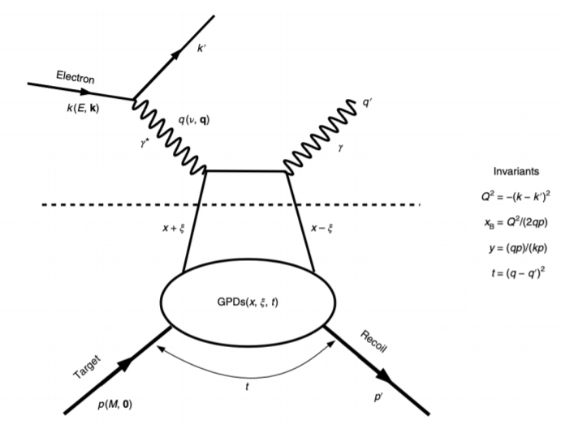
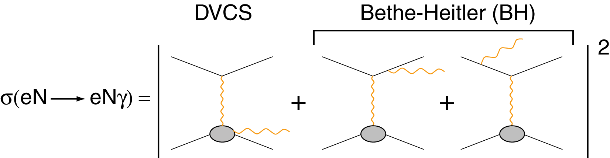
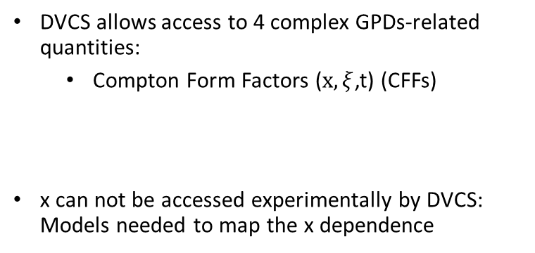
Deeply Virtual Compton Scattering of leptons off nucleons
BH is purely electromagnetic and parametrised by FFs
Experimentally measured observables:
  Sensitive to the DVCS-BH interference part (linear in CFFs)
    Should have: Beam polarized and/or target polarized
  Access to a combinations of CFFs
    The separation of CFFs requires the measurement of several observables
  Depending on the target (proton or neutron): different sensitivity to the CFFs (GPDs)
    The flavor separation of GPDs requires measurements on both nucleons
DVCS allows access to 4 complex GPDs-related quantities:
  Compton Form Factors ($x,ξ$,t) (CFFs)
x can not be accessed experimentally by DVCS: Models needed to map the x dependence

Slide 5
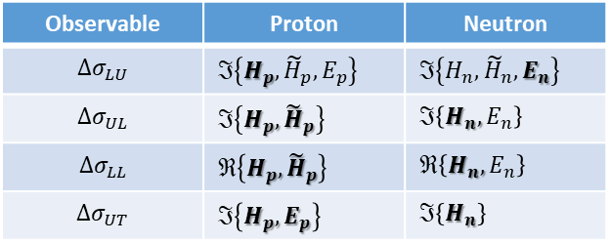
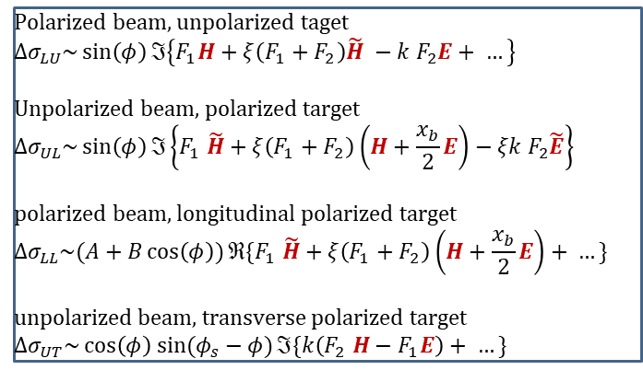
Deeply Virtual Compton Scattering: physics observables and their link to CFFs
Polarized beam, unpolarized taget
$$Δσ_{LU}\sim \sin\left(φ\right)ℑ\left\{F_{1}H+ξ\left(F_{1}+F_{2}\right)\tilde{H} −k F_{2}E+ …\right\}$$
Unpolarized beam, polarized target
$$Δσ_{UL}\sim \sin\left(φ\right)ℑ\left\{F_{1} \tilde{H}+ξ\left(F_{1}+F_{2}\right)\left(H+\frac{x_{b}}{2}E\right)−ξk F_{2}\tilde{E}\right\}$$
polarized beam, longitudinal polarized target
$$Δσ_{LL}\sim (A+B\cos\left(φ\right))ℜ\{F_{1} \tilde{H}+ξ\left(F_{1}+F_{2}\right)\left(H+\frac{x_{b}}{2}E\right)+ …\}$$
unpolarized beam, transverse polarized target
$$Δσ_{UT}\sim \cos\left(φ\right) sin⁡(φ_{s}−φ)ℑ\{k\left(F_{2} H−F_{1}E\right)+ …\}$$
Different contributions from $F_{1}$ and $F_{2}$ for the different nucleons
Observable | Proton | Neutron
$$Δσ_{LU}$$ | $$ℑ\left\{H_{p}, {\tilde{H}}_{p}, E_{p}\right\}$$ | $$ℑ\left\{H_{n}, {\tilde{H}}_{n}, E_{n}\right\}$$
$$Δσ_{UL}$$ | $$ℑ\left\{H_{p}, {\tilde{H}}_{p}\right\}$$ | $$ℑ\left\{H_{n}, E_{n}\right\}$$
$$Δσ_{LL}$$ | $$ℜ\left\{H_{p}, {\tilde{H}}_{p}\right\}$$ | $$ℜ\left\{H_{n}, E_{n}\right\}$$
$$Δσ_{UT}$$ | $$ℑ\left\{H_{p}, E_{p}\right\}$$ | $$ℑ\left\{H_{n}\right\}$$
γ
e’
φ
e
N’
Model predictions (VGG) for different values of quarks’ angular momentum
DVCS with an unpolarized deuterium target :
Scattering off neutron (nDVCS): GPD E
  Determination of Ji sum rule
    Contribution of orbital angular momentum of quarks to the nucleon spin
Scattering off proton (pDVCS): GPD H
  Quantify medium effects
    Essential for the extraction of BSA of a “free” neutron (de-convoluting medium effect via comparison with DVCS on hydrogen target)
J_{u}=.3, J_{d}=.1
J_{u}=.1, J_{d}=.1
J_{u}=.3, J_{d}=.3
J_{u}=.3, J_{d}=-.1

Slide 6
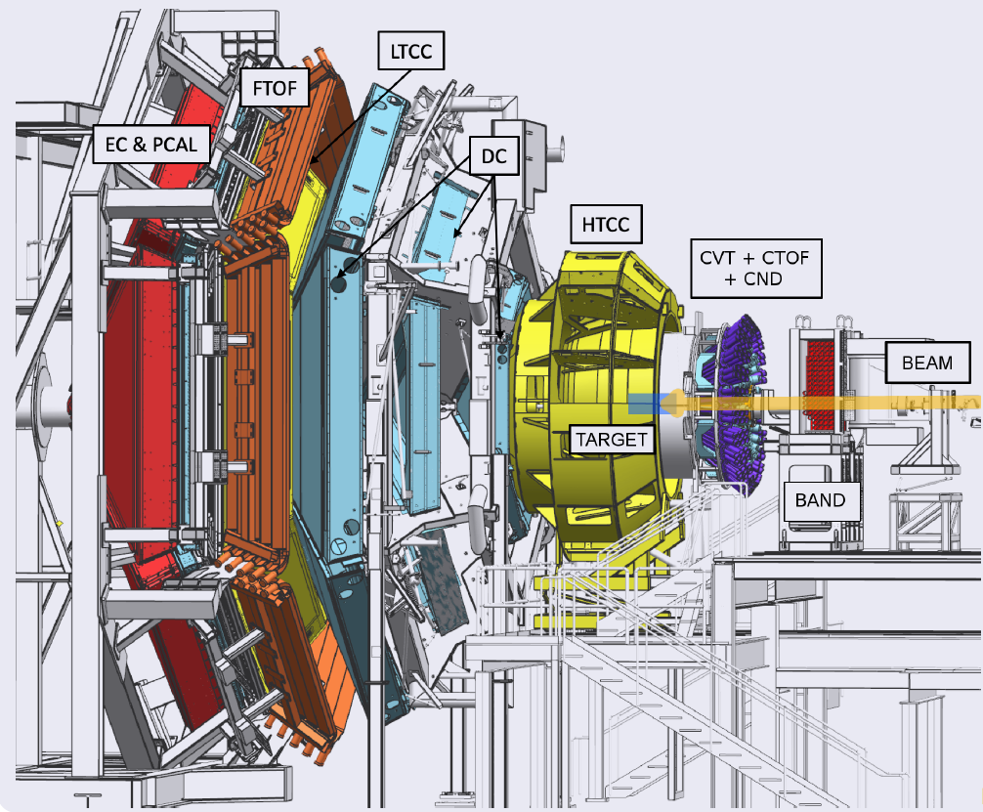
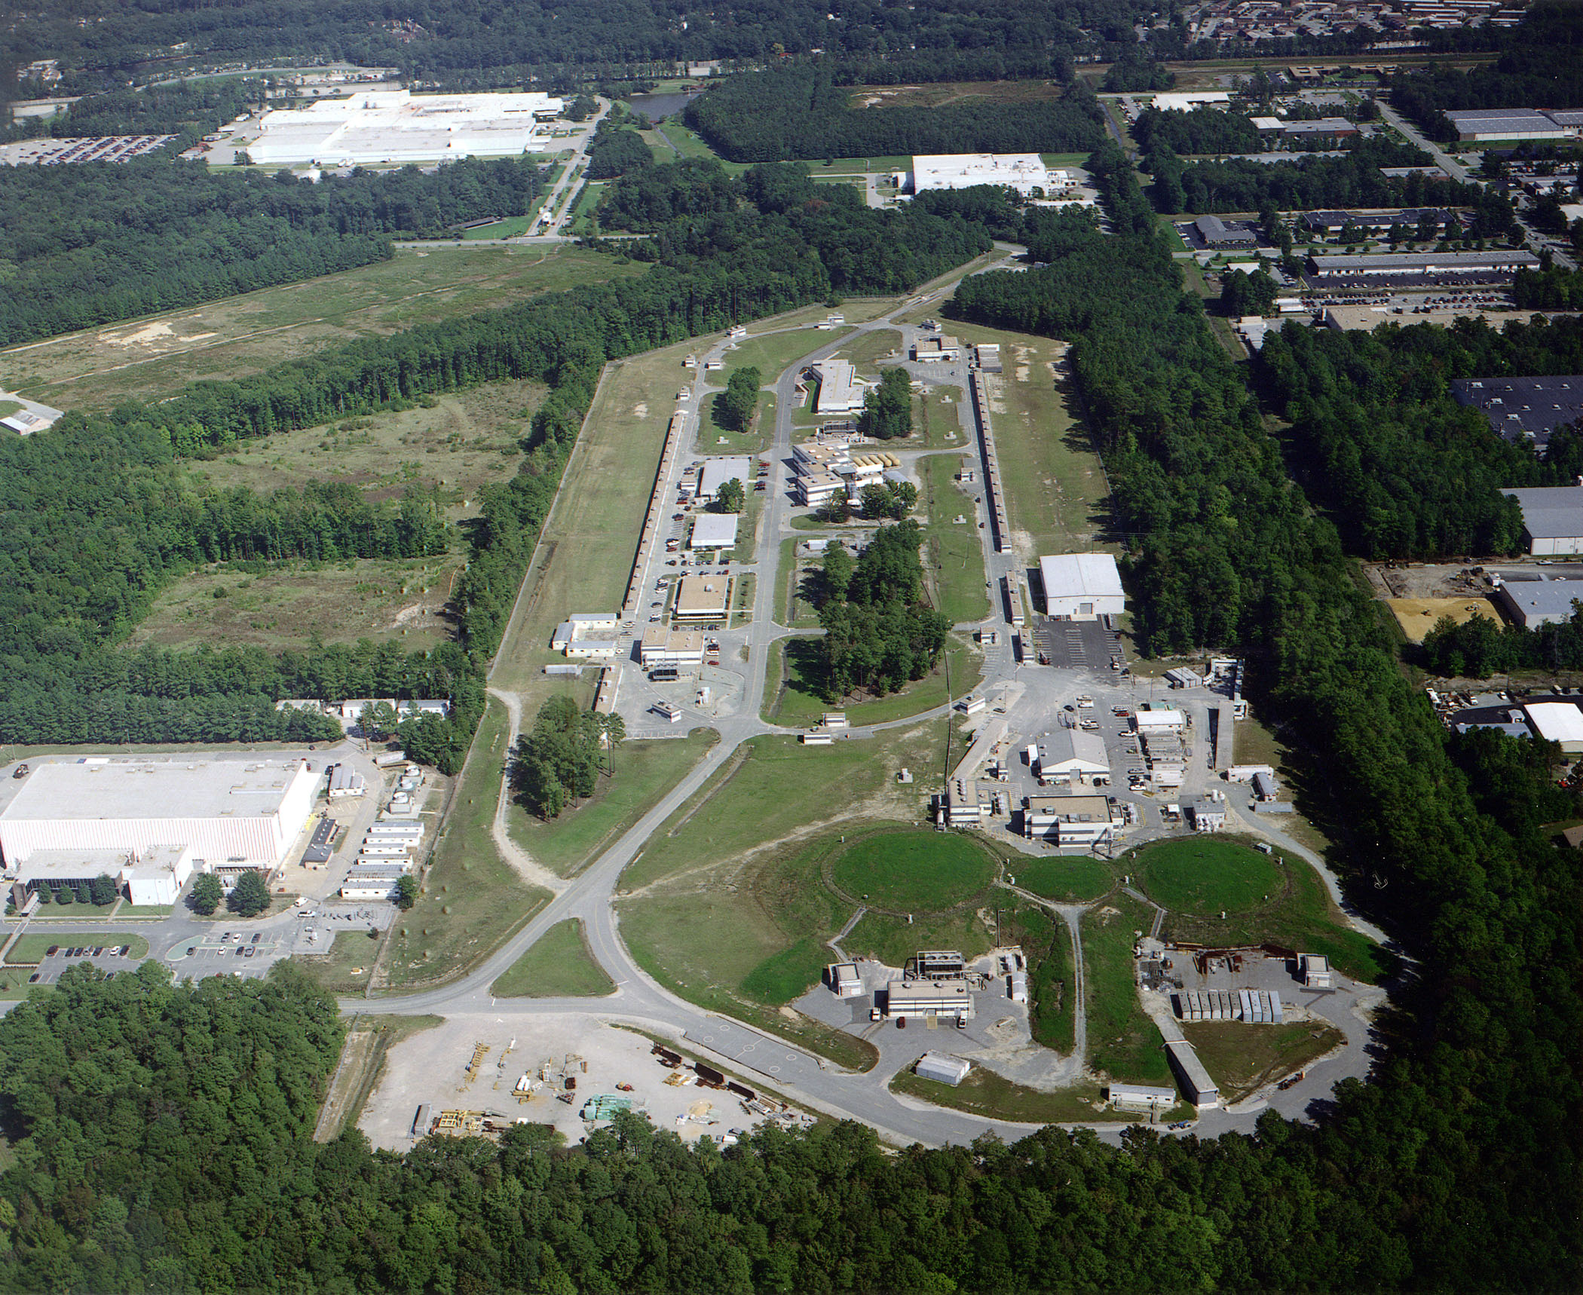
The CEBAF and CLAS at Jefferson Laboratory
Continuos Electron Beam Accelerator Facility
  Up to 12 GeV electrons
CLAS12
D
A
B
C
TARGET

Slide 7
CLAS12: DVCS with an unpolarized deuterium target
Under internal review
A 10.6/10.4/10.2 GeV electron beam
  With an average polarization of 86%
  Scattering off an unpolarized Liquid Deuterium target of 5 cm length
The exclusivity of the event is insured by:
  Electron detection: Cherenkov detector, drift chambers and electromagnetic calorimeter
  Photon detection: sampling calorimeter or a small PbWO4-calorimeter close to the beamline
  Proton detection: Silicon and Micromegas detector OR Neutron detection: Central Neutron Detector
For Neutron Detection:
  Machine Learning techniques are applied to improve the Identification and reduce charged particle contamination
Construct all the possible combinations of final state particles: ed->e’Nγ(Nspec) (N:nucleon)
  Best candidate in event is selected based on best exclusivity criteria (a multi-dimensional χ2-like variable including exclusivity variables)
  The combination of variables that give the minimum value for the χ2-like variable is supposed to be the best choice for a DVCS event
  This choice coincides at 97% with the option of choosing the highest energy final state particles
Build exclusivity variables of 12 possible candidates
Electron
Proton/Neutron
photon
Candidate 1
Candidate 1
Candidate 1
Candidate 2
Candidate 2
Candidate 2
Candidate 3

Slide 8
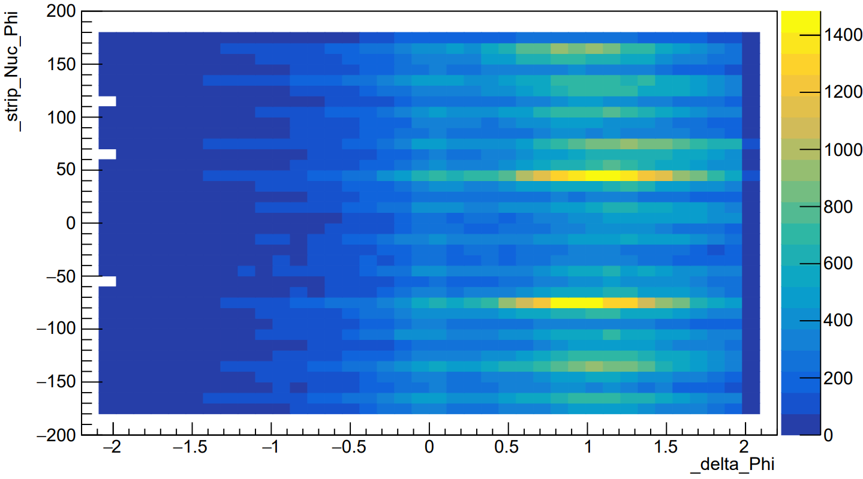
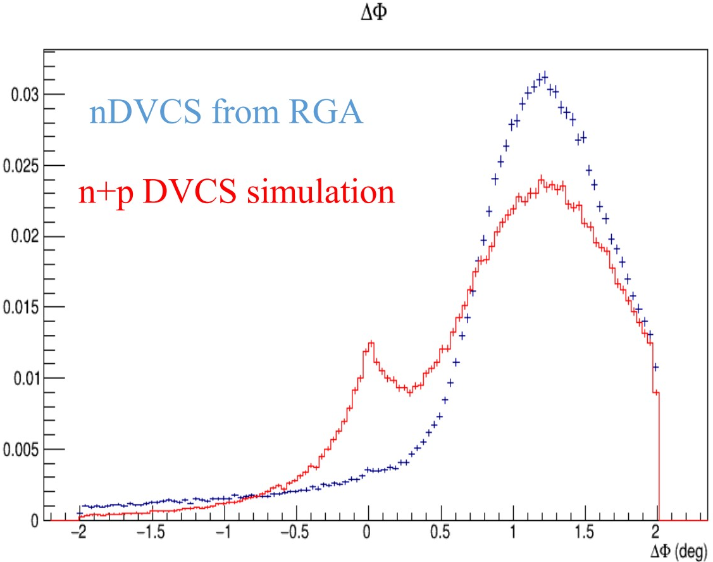

Improving the neutron selection with ML techniques
Under internal review
The tracking of the CVT is neither 100% efficient nor uniform
In the dead regions of the CVT protons have no associated track and thus can be misidentified as neutrons
Protons roughly account for more than >40% contamination in the “nDVCS” signal sample Current approach, based on Machine Learning & Multi-Variate Algorithms:
  We reconstruct nDVCS from DVCS experiment on proton requiring neutron PID : selected neutron are misidentified protons
  We use this sample to determine the characteristics of fake neutrons in low- and high-level reconstructed variables
  Based on those characteristics we subtract the fake neutrons contamination from nDVCS
  As a « signal » sample in the training of the ML we use $ep→epπ^{+}$events from DVCS experiment on proton
nDVCS from DVCS on proton
n+pDVCS simulations

Slide 9
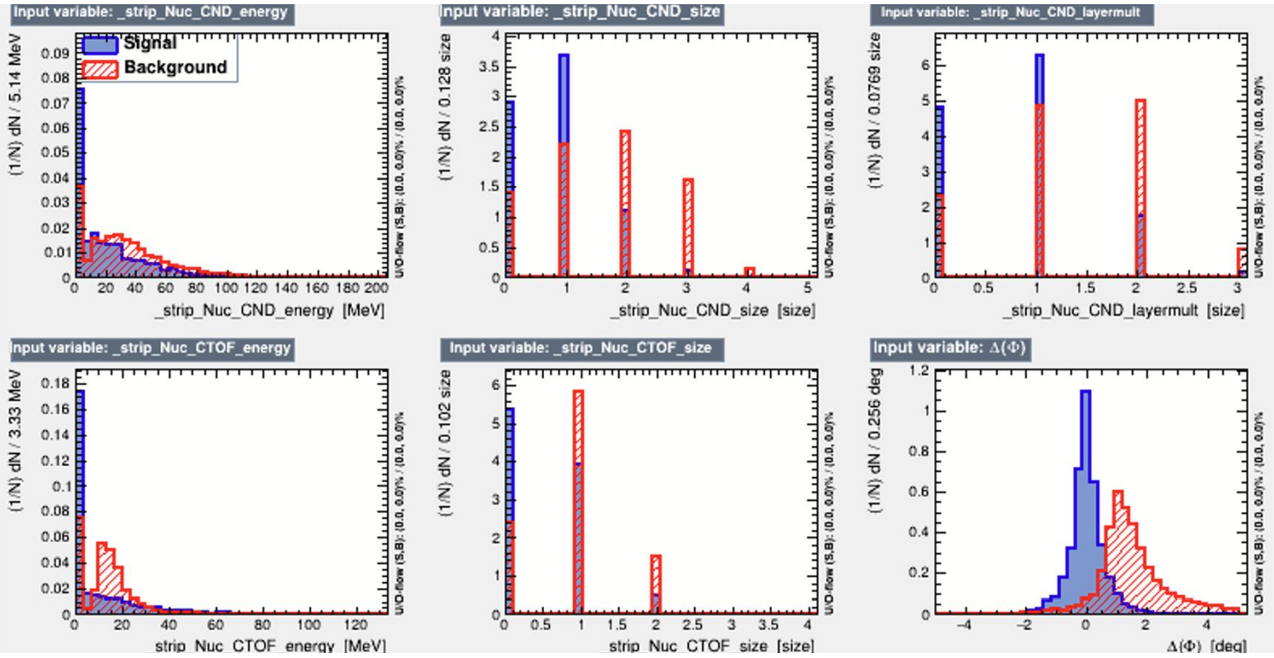
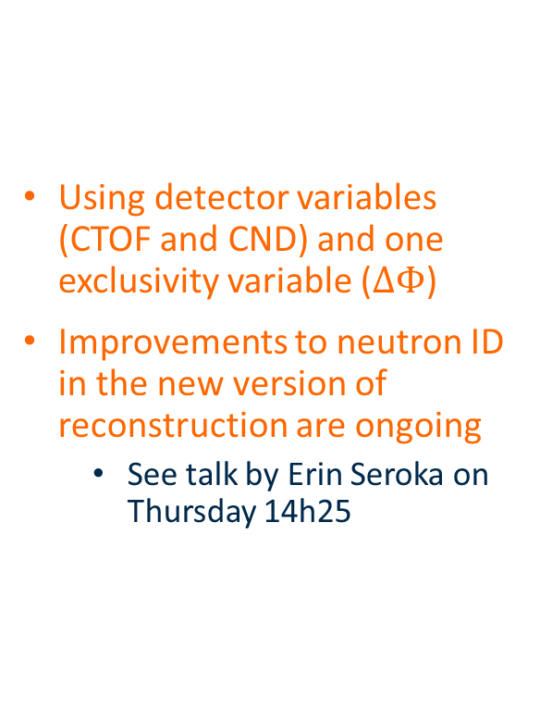
Improving the neutron selection with ML techniques
Under internal review
Using detector variables (CTOF and CND) and one exclusivity variable ($ΔΦ$)
Improvements to neutron ID in the new version of reconstruction are ongoing
  See talk by Erin Seroka on Thursday 14h25

Slide 10
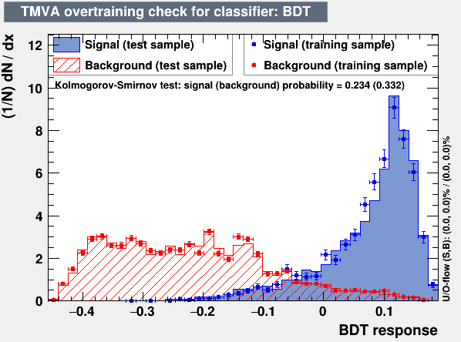
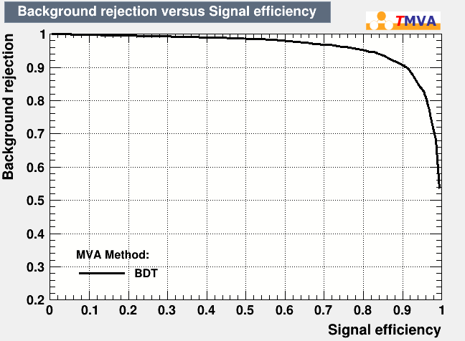
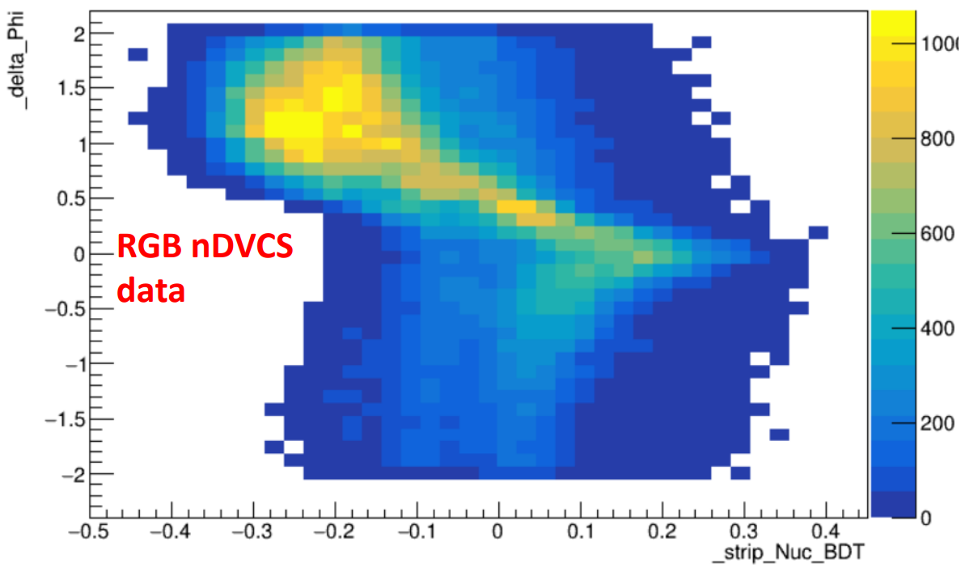
Improving the neutron selection with ML techniques
Under internal review
Advantages of the tool:
Directly trained on data
Better optimization of signal to background ratio
Few percent irreducible contamination is to be taken as a systematic on the BSA
nDVCS data
Tool isolates contamination

Slide 11
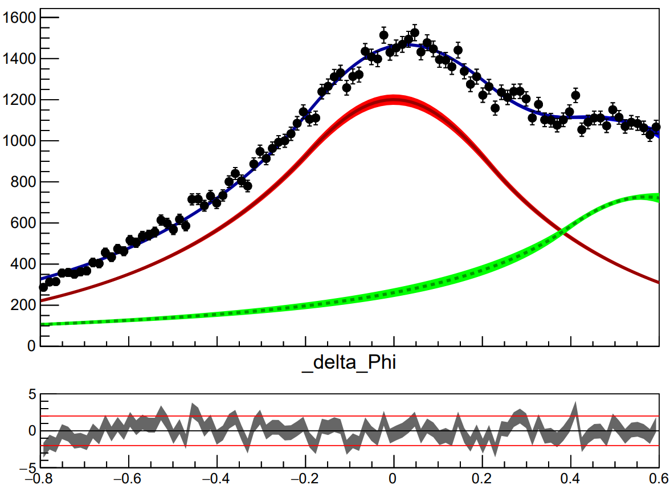
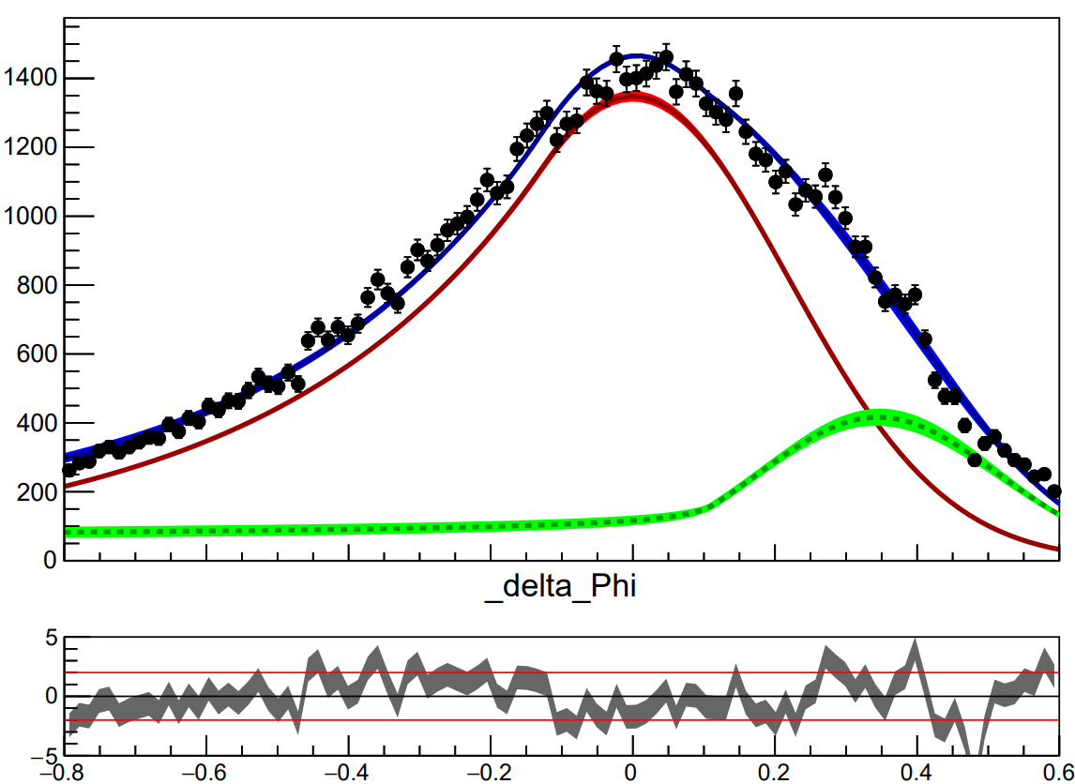

Improving the neutron selection with ML techniques
Under internal review
Estimate residual proton contamination through fit to $ΔΦ$ on the nDVCS signal sample before and after BDT cut
The residual contamination amounts to 0.8% absolute systematic error on the BSA
Before BDT cut: 31% contamination
after BDT cut: 4.5% contamination
True neutrons
Fake neutrons
True neutrons
Fake neutrons
Shapes are estimated from fits to the signal and background samples used for training: double sided Crystal-Ball function

Slide 12
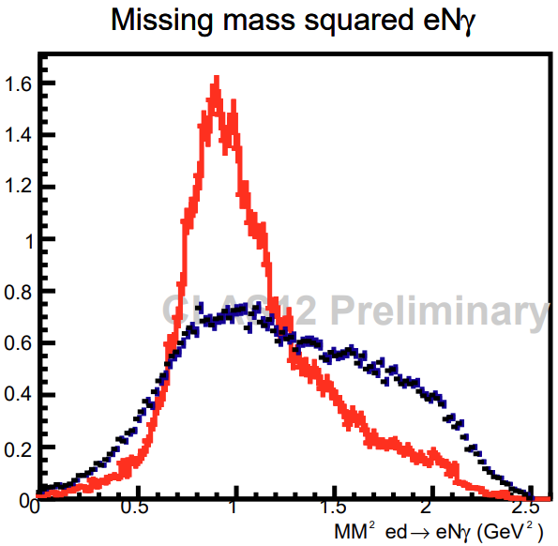
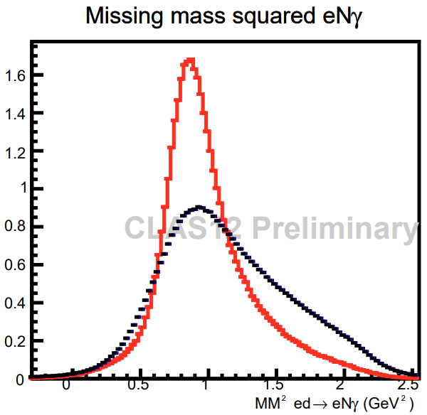

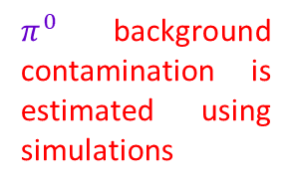
CLAS12: DVCS with an unpolarized deuterium target
Under internal review
The nDVCS (pDVCS) final state is selected with the following exclusivity criteria: (N:nucleon)
  Missing mass
    e d → e N γ X
    e N → e N γ X
    e N → e N X
  Missing momentum
    e d → e N γ X
  ΔΦ, Δt, θ(γ,X)
    Difference between two ways of calculating Φ and t
    Cone angle between measured and reconstructed photon
Exclusivity selection is optimized with a 4-D $χ^{2}$-like distribution including ΔΦ, Δt, θ(γ,X) and missing mass e N → e N X
  This is the same variable used to select best candidate
Simulation
Data with $π^{0}$ contamination
Data with 𝜋^0 contamination
nDVCS
$π^{0}$ background contamination is estimated using simulations
pDVCS

Slide 13

π⁰ background subtraction
Under internal review
Subtraction using simulations of the background channel
Monte Carlo simulations:
  GPD-based event generator for DVCS/pi0 on deuterium
  DVCS amplitude calculated according to the BKM formalism
  Fermi-motion distribution evaluated according to Paris potential
Description of the method:
  Estimate the ratio of partially reconstructed eN π⁰(1 photon) decay to fully reconstructed eN π⁰ decays in MC
  This is done for each kinematic bin to minimize MC model dependence
  Multiply this ratio by the number of reconstructed eN π⁰ in data to get the number of eN π⁰(1 photon) in data
  Subtract this number from DVCS reconstructed decays in data per each kinematical bin
Systematic on π⁰ background subtraction is estimated by using sPlot technique as a crosscheck method
$$Simulations:R=N(eNπ_{1γ}^{0})/N\left(eNπ^{0}\right)$$
Data : $N\left(eNπ_{1γ}^{0}\right)=R∗N\left(eNπ^{0}\right), N\left(DVCS\right)=N\left(DVCS_{recon}\right)−N(eNπ_{1γ}^{0})$
M. Pivk and F.R. Le Diberder, NIMA 555 1 2005

Slide 14
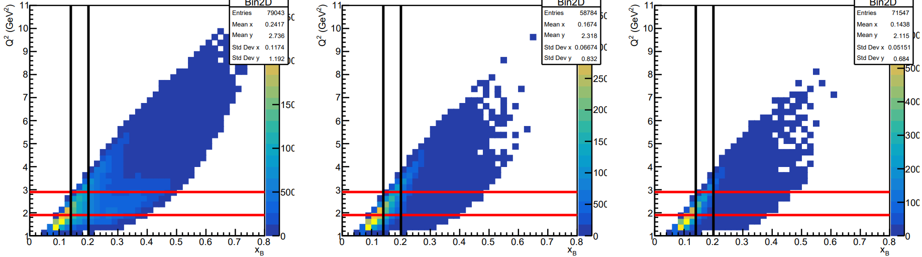
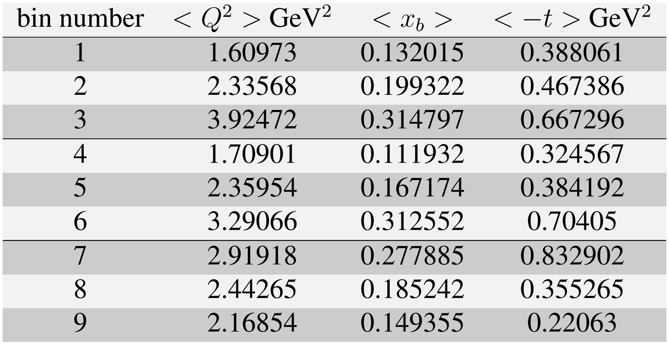
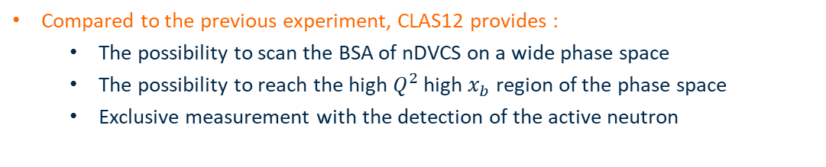
CLAS12: nDVCS with an unpolarized deuterium target
Under internal review
First-time measurement of nDVCS with detection of the active neutron
4
5
6
4
5
6
4
5
6
7
8
9
3
3
3
2
2
2
1
1
1
Compared to the previous experiment, CLAS12 provides :
  The possibility to scan the BSA of nDVCS on a wide phase space
  The possibility to reach the high $Q^{2}$ high $x_{b}$ region of the phase space
  Exclusive measurement with the detection of the active neutron

Slide 15
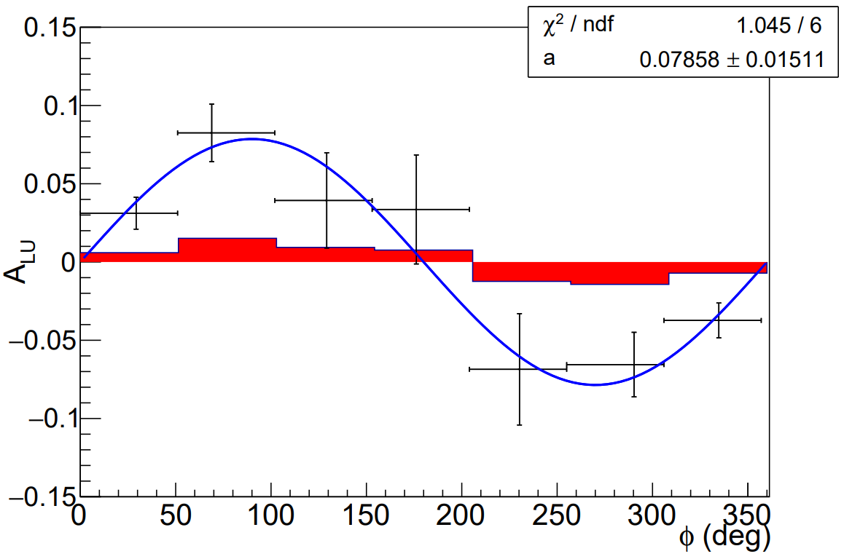
CLAS12: nDVCS with an unpolarized deuterium target
Under internal review
Observation of positive BSA for nDVCS
Systematic errors include:
  Error due to beam polarization
  Error due to selection cuts
  Error due to residual proton contamination
  Error due to merging of data sets with different energies
Statistics is expected to triple with remaining scheduled beam time and improvements with pass2 reconstruction software; systematics will also be reduced as neutron contamination will be lower
Red: total systematic
Errors are statistical only

Slide 16
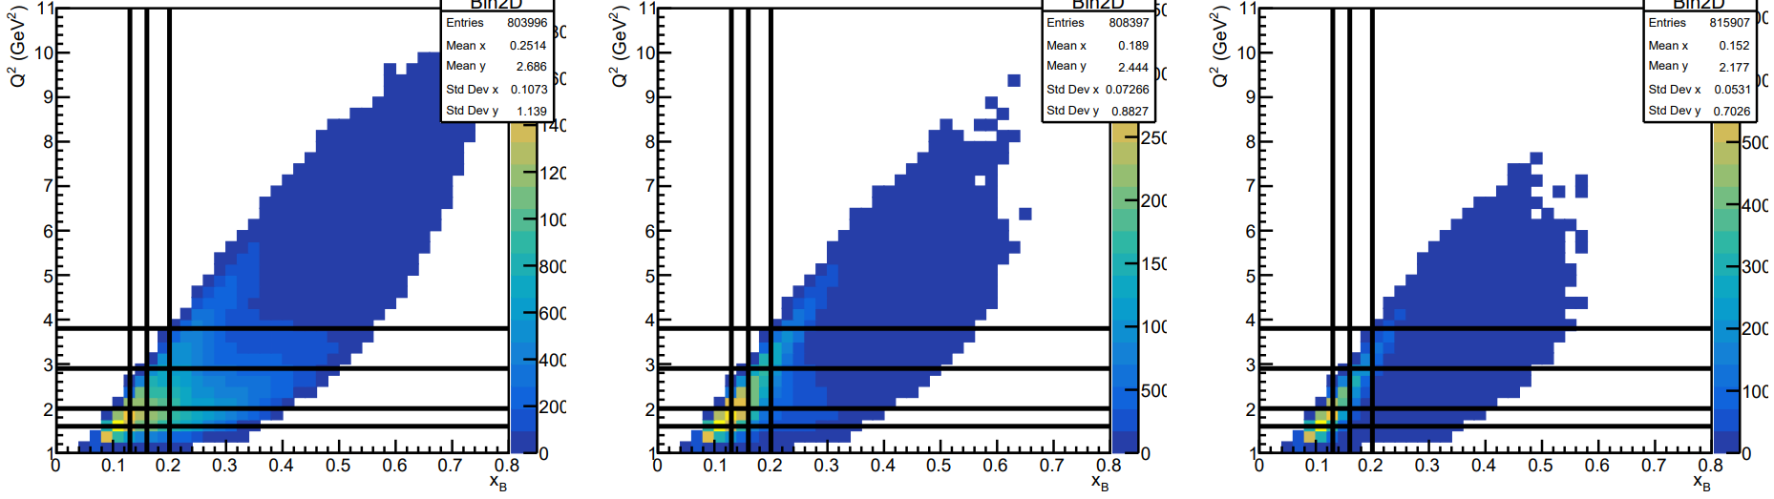
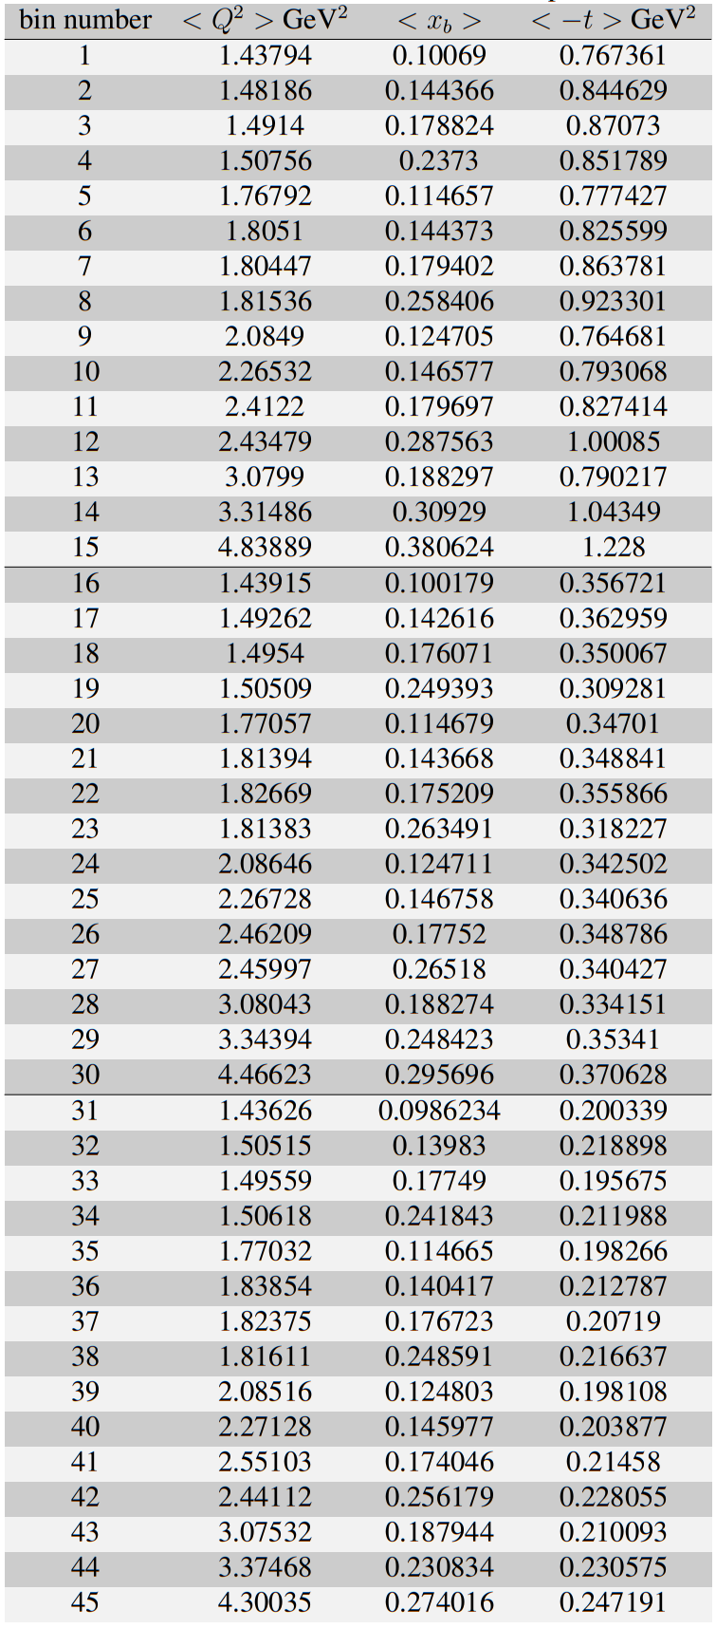
CLAS12: pDVCS with an unpolarized deuterium target
Under internal review
First-time measurement of incoherent pDVCS on deuteron
Bin numbering starts from left to right and from bottom up
Complementary to previous experiment on proton target:
  Quantify medium effects on GPDs

Slide 17
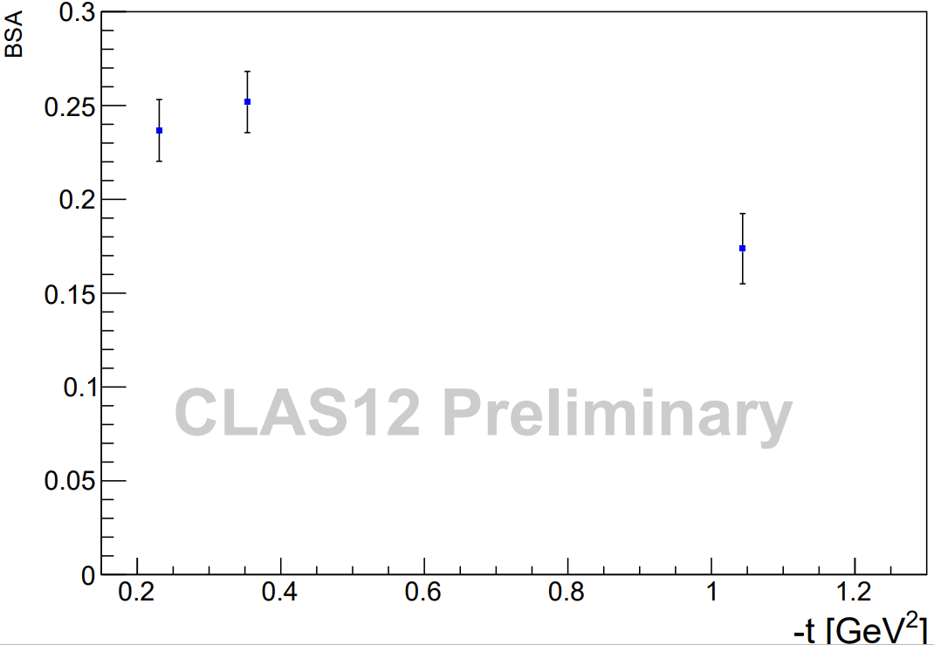
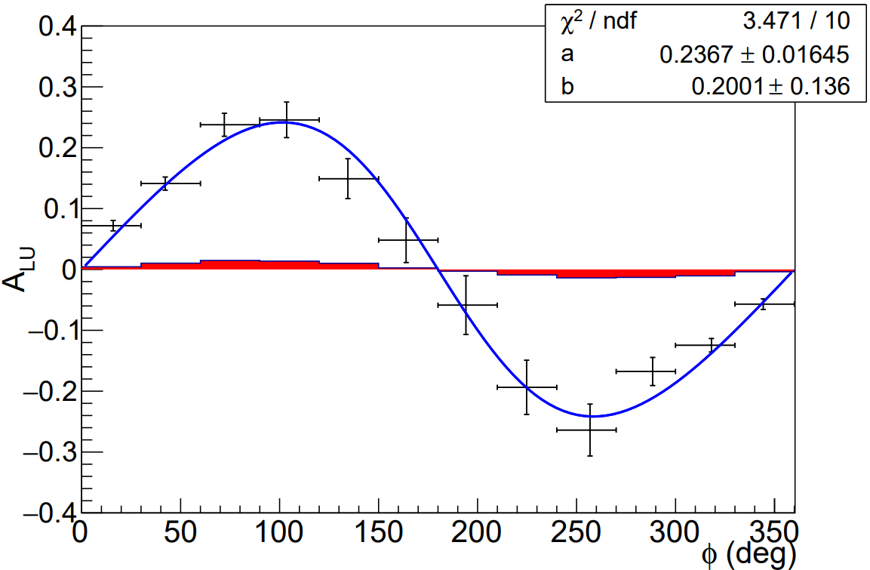
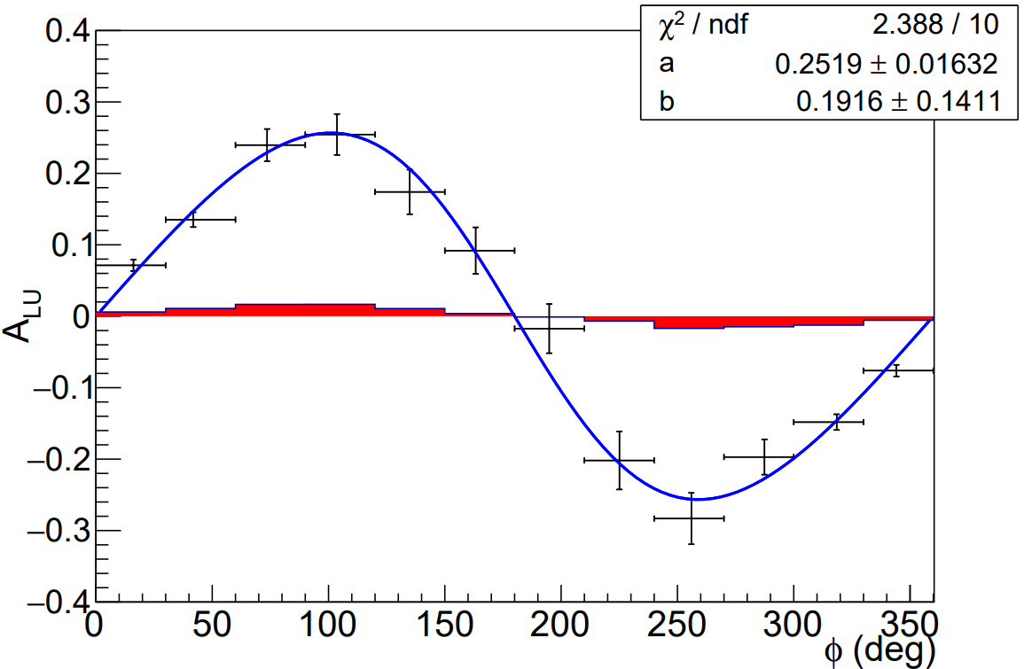
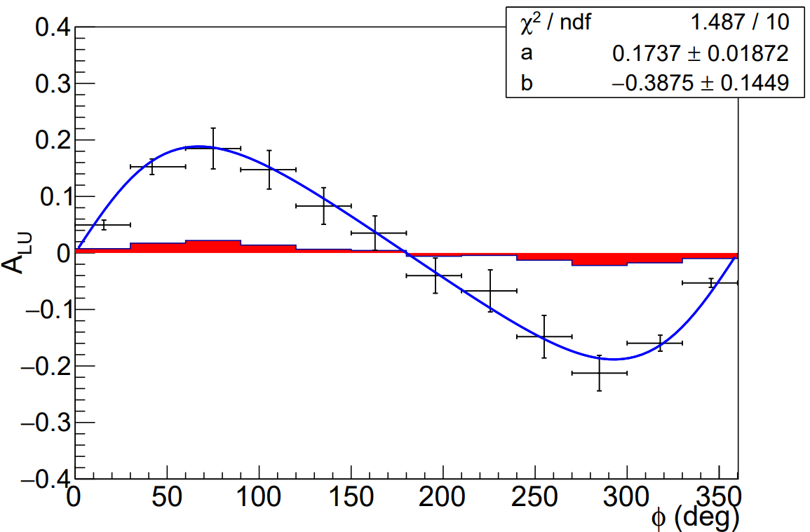
CLAS12: pDVCS with an unpolarized deuterium target
Under internal review
Observation of positive BSA for nDVCS
Systematic errors include:
  Error due to beam polarization
  Error due to selection cuts
  Error due to merging of data sets with different energies
Statistics is expected to triple with remaining scheduled beam time and improvements with reconstruction software
44
29
14

Slide 18
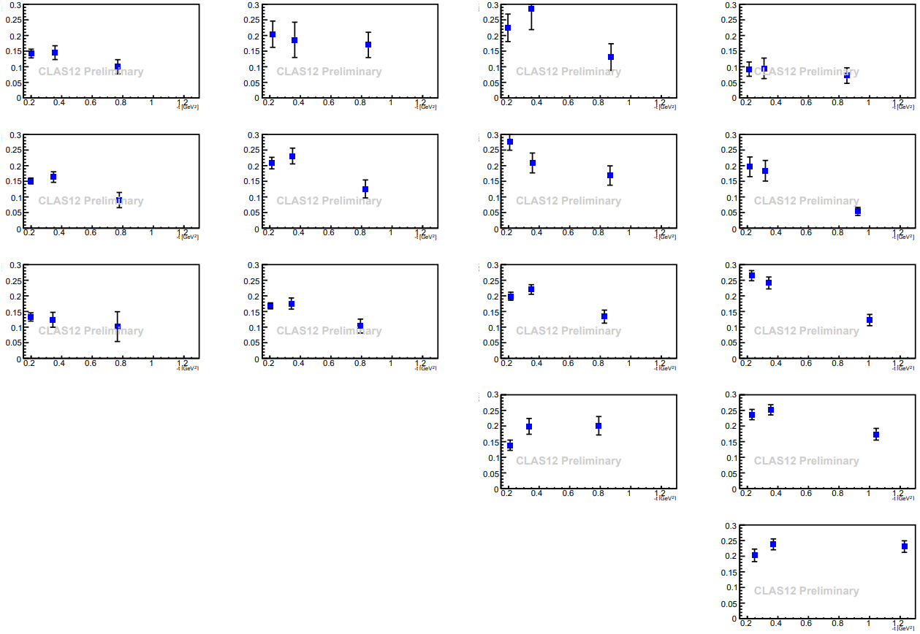








CLAS12: pDVCS with an unpolarized deuterium target
Under internal review
$$x_{b}$$
[0.04,0.13] [0.13,0.16] [0.16,0.2] [0.2,0.41]
$$Q^{2}$$
[1,1.6] ${GeV}^{2}$
[1.6,2] ${GeV}^{2}$
[2,2.9] ${GeV}^{2}$
Variation of $sin(Φ)$ amplitude
[2.9,3.8] ${GeV}^{2}$
To be compared to BSA with free-proton data
[3.8,7.4] ${GeV}^{2}$

Slide 19
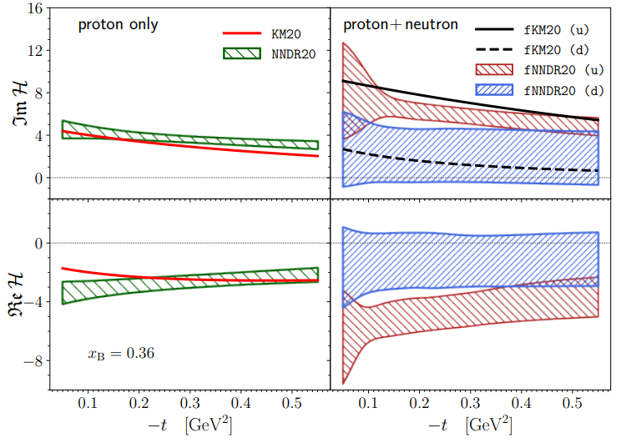
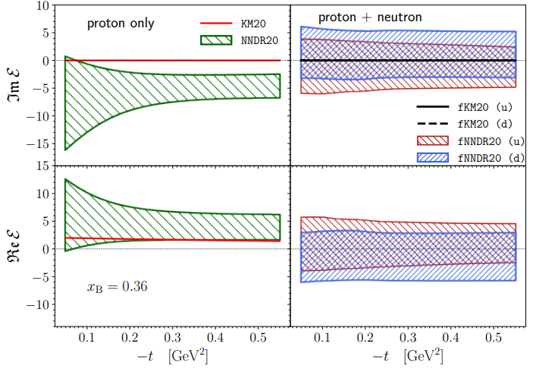
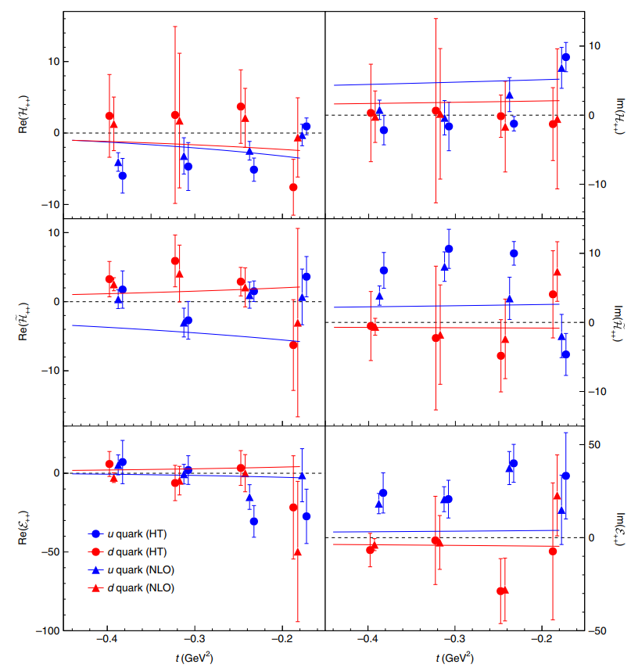
Impact of new data
Previous attempt at flavor separation
Another attempt by Marija Čuić et al arxiv 2007.00029
Benali, M., Desnault, C., Mazouz, M. et al. Nat. Phys. 16, 191–198 (2020)
+data from: Mazouz, M. et al. Phys. Rev. Lett. 99, 242501 (2007).
Next talk by Marija will show the impact of the results presented here on flavor separation
Stay tuned and be here after the break!

Slide 20
Conclusions
GPDs are powerful tool to explore the structure of the nucleons and nuclei
  Nucleon tomography, quark angular momentum, distribution of forces in the nucleon
Exclusive reactions can provide important information on nucleon structure
  DVCS via the extraction of GPDs
CLAS12 offers a wide kinematical reach over which the GPDs dependence on different kinematical variables can be scanned
  Data to add constraints on GPDs in unexplored regions of the phase space
  Possibilities to measure new observables using different experimental configurations
    Flavor separation of GPDs
Promising results from incoherent DVCS on deuteron (n and p channels) from CLAS12 data
  First BSA measurement from neutron-DVCS with tagged neutron
  First measurement of BSA for proton-DVCS with deuterium target
    To be compared to free-proton DVCS BSA measured by CLAS12
G. Christiaens, M. Defurne, D. Sokhan V.Ziegler et al., arXiv (2022) 221111274.

