Slide 1
ThomX Ring commissioning as for January 2023
First turn obtained
Storage without RF cavity obtained =>~400 turns
Storage with RF cavity low voltage ~20 kV obtained => more than 100k turns (on scope 100 ms beam storage)

Slide 2
Ring commissioning with beam (phases)
Phase | Description
B.1 | Injection and first turn: injection commissioning, threading, commissioning beam instrumentation
B.2 | Establish circulating beam: closed orbit, orbit correction, tunes, chromaticity
B.3 | Stored beam and extraction: precise measurements, BBA, feedback systems, beam diagnostics (SRM)
B.4 | Machine physics: LOCO, beta beating, beta function and dispersion, diagnostics, beam dynamics studies
Phase | Description
C | Operation with FPC and IP optimization: position and phase scan
D | Ring commissioning at nominal charge: injection tuning and feedback test at the nominal charge, higher α_{p} optics
F | Ring commissioning at 70 MeV: repeat the necessary commissioning steps (phase B)

Slide 3
B1: Injection and first turn

Slide 4
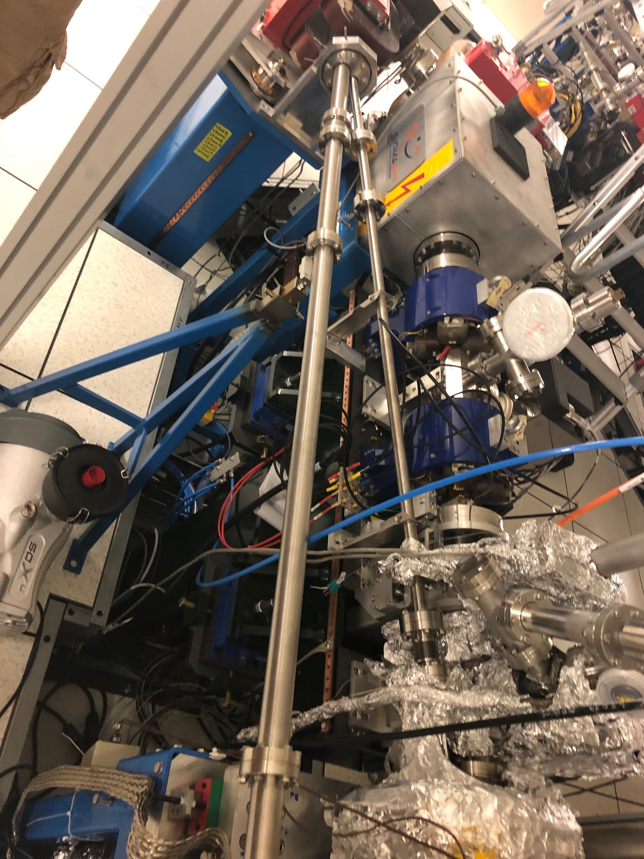
TL-SR key elements for the injection
Injection Dipole
BPM
ICT
BPM
1
DiagS 4
COR
COR
Injection Kicker
BPM
Septum
Extraction Kicker
3
2
BPM
Automatic algorithm RCDS to tune the injection (7 parameters):
TL vert corrector 3
TL vert corrector 4
TL hor corrector 3
TL hor corrector 4
DPI current
Septum voltage
Kicker voltage
BPM
IP

Slide 5
Requirements to the injector (to be discussed)
Reproducibility and stability measured and shown (charge, energy, orbit SHOT BY SHOT and DURING THE DAY)
Parameters ( for injection/first turns): E = 50 MeV, dE/E = 0.1 %, Charge = 100 pC, emittance = ~2 mm mrad, pointing stability =
MEASUREMENTS???
Parameters ( for beam physics): E = 50 MeV, dE/E = 0.1 %, Charge = 100 pC, emittance = ~2 mm mrad, pointing stability =

Slide 6
Transfer line
Big problem: every shift different settings of the TL => impossible to adjust every time the Ring. For example: TL dipole current can change from 162 – 174 A
Jumps of TbTSum from 0 to its max value
Jumps of energy/orbit (phase jumps) in TL => cancel injection at all
We see two main problems: 1) stability of injector 2) unknown loaded TL optics

Slide 7
TL + Ring (old data from 2016)

Slide 8
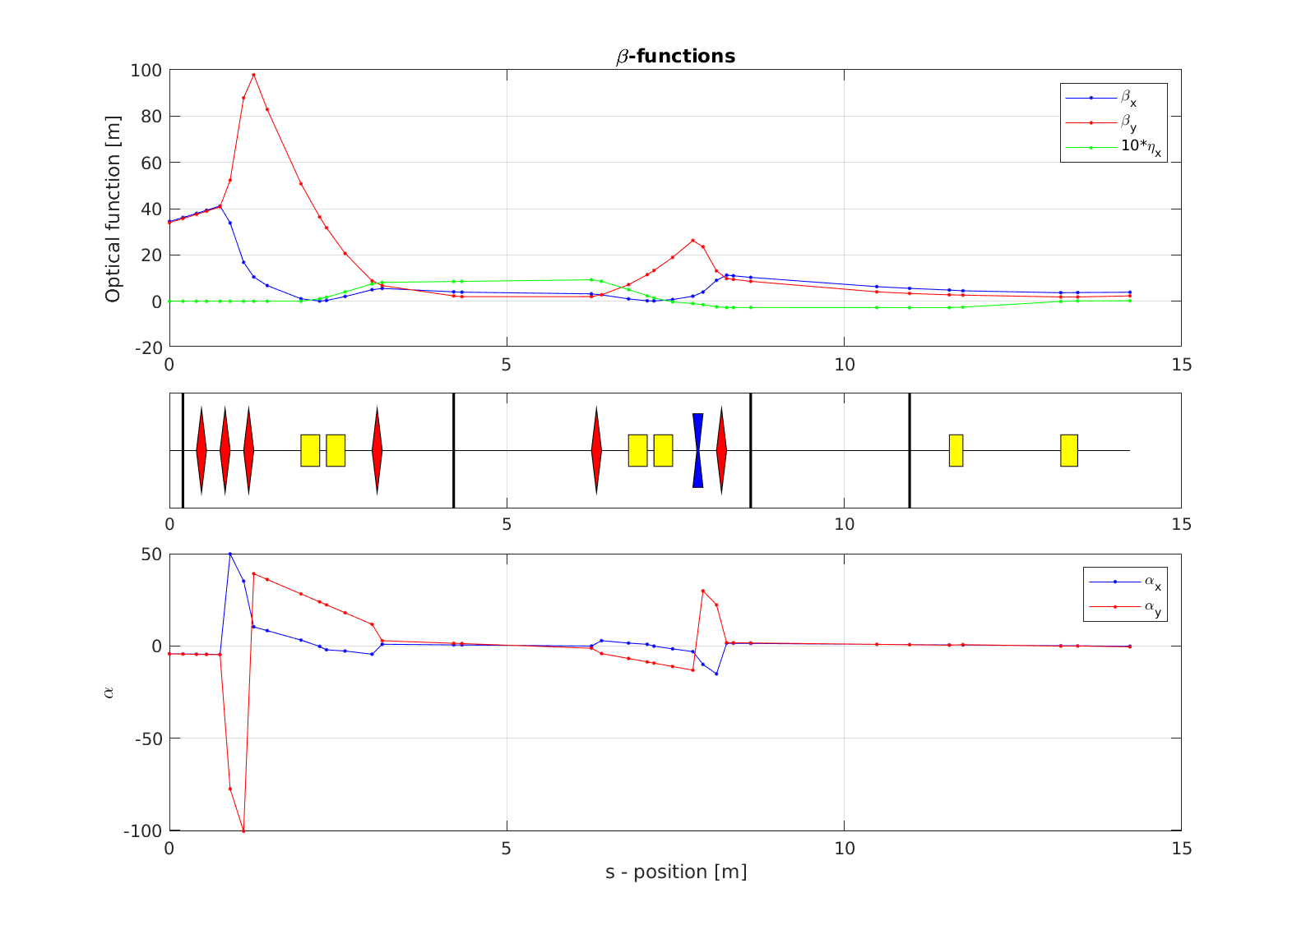
TL_OC optics, is it correct?

Slide 9
Transfer line
Our understanding of things: emittance measurements => optics fitting => loading the optics and scaling => what it gives ???
Our observations: after RF section beam size is small, emittance is small
We would like to know the current optics of the TL.
What is the problem to load the lattice and work always at the same conditions ?
The best: we think we had dx= 0.04 * 0.01 = 0.4 mm => Disp = 4 cm @DPI => in the TL, the small size at the screen. In the ring we have bigger value
What we need: not zero dispersion at the screen 3 location but the value according to the optics

Slide 10
Summary (TL)
More time now should be spent on Injector to make it reliable and known.
- More stable beam in the TL - More information on the optics used - More documentation by the linac group on the lack of reproducibility from one day to the next in the linac/TL from their point of view
More systematic measurements of energy/energy spread, orbit, dispersion, emittance, charge…

Slide 11
B2: Establish circulating beam

Slide 12
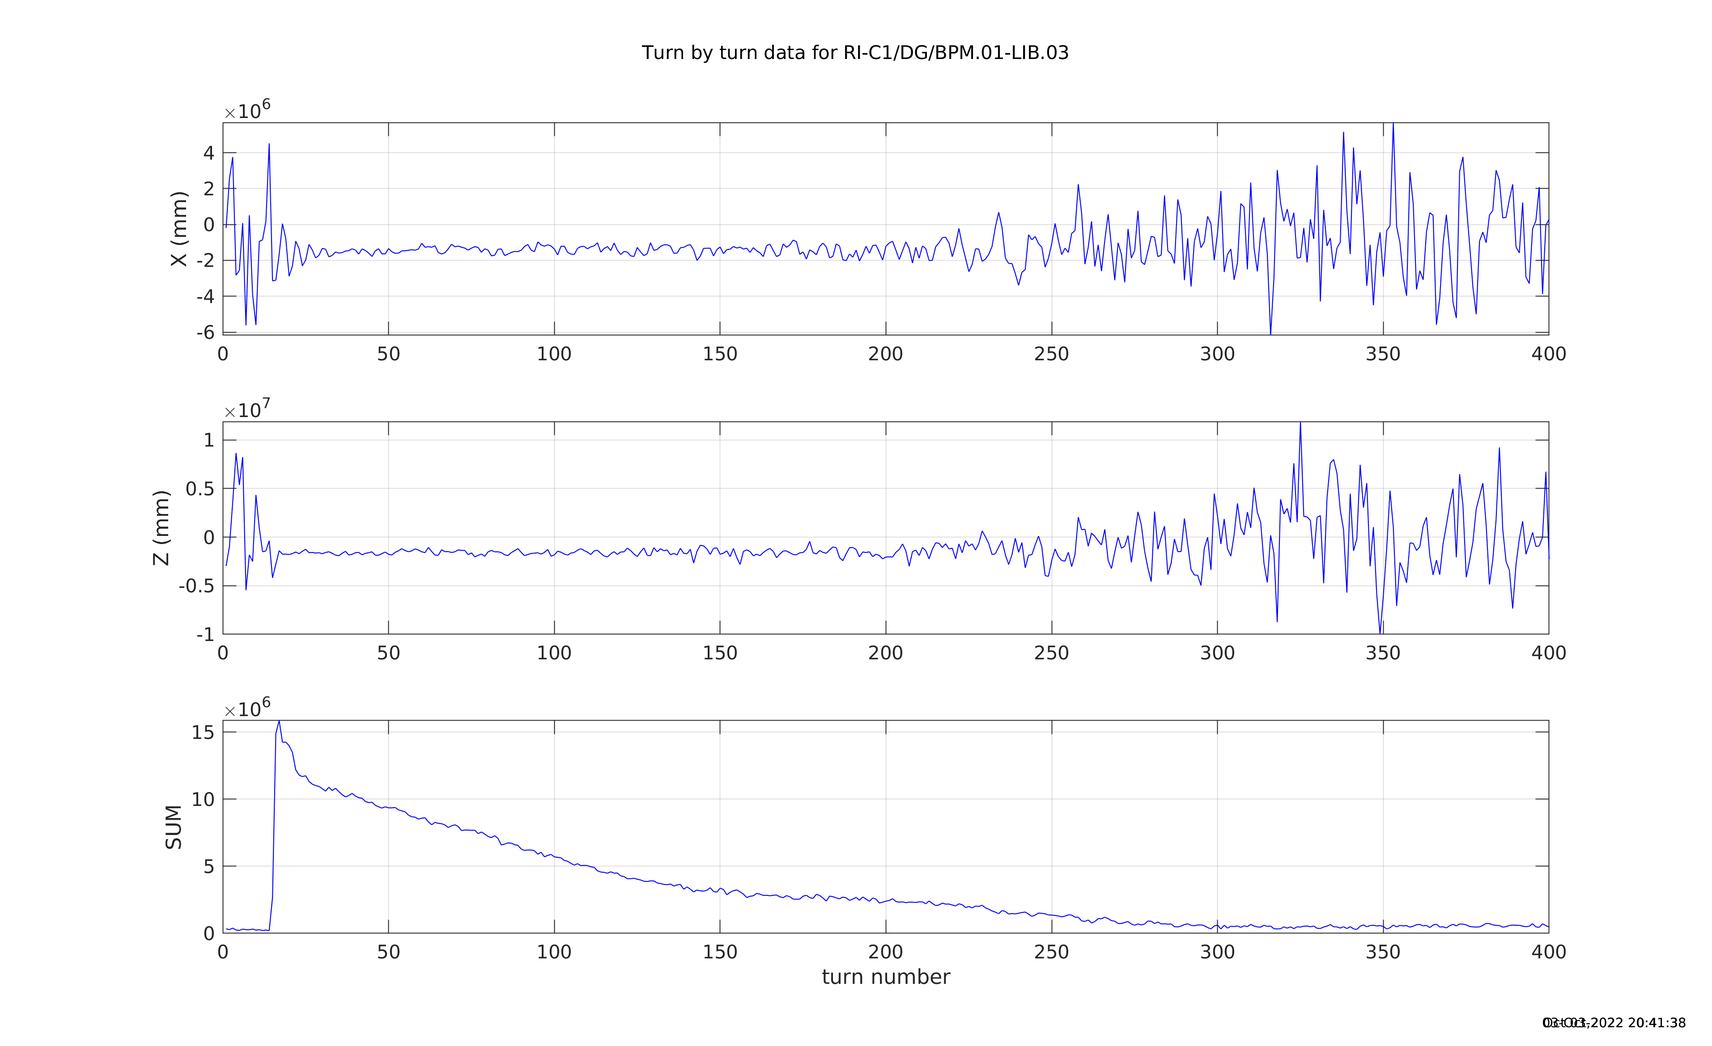
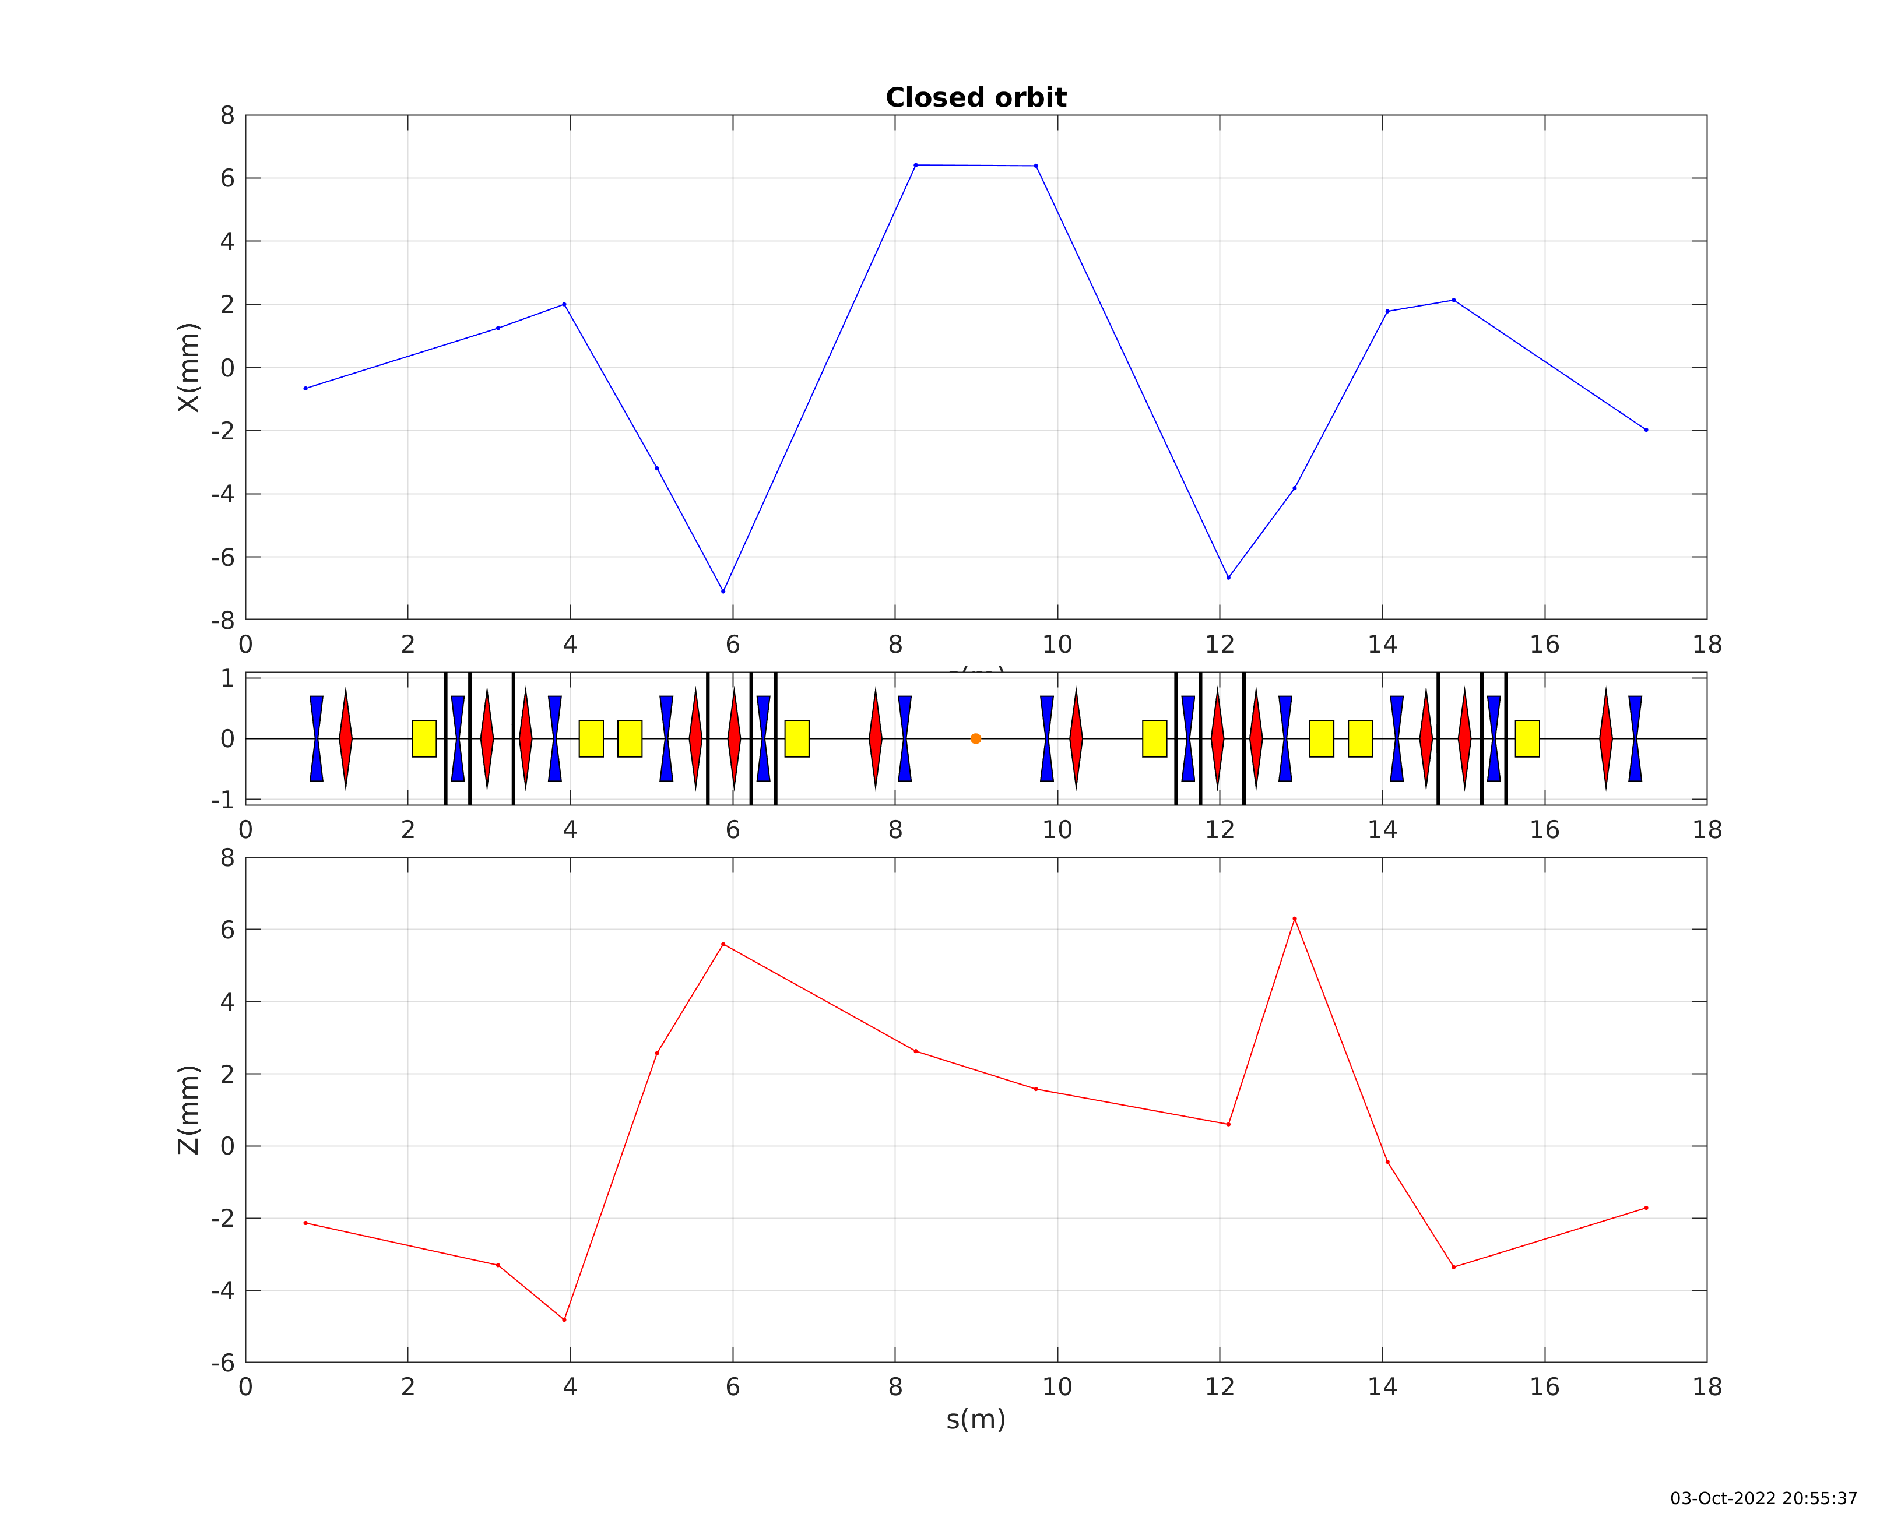
First Turns ~300 turns (3 October 2022)

Slide 13
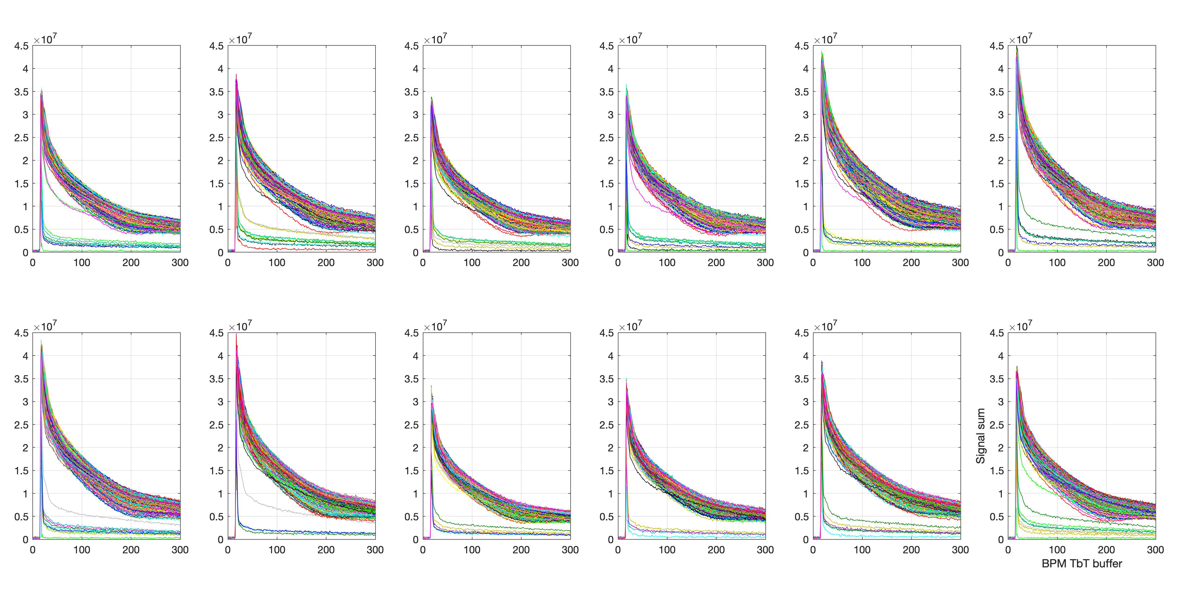
BPM signal sum (7 October 2022)
(the 1st BPM after injection)
Trig 1:500

Slide 14
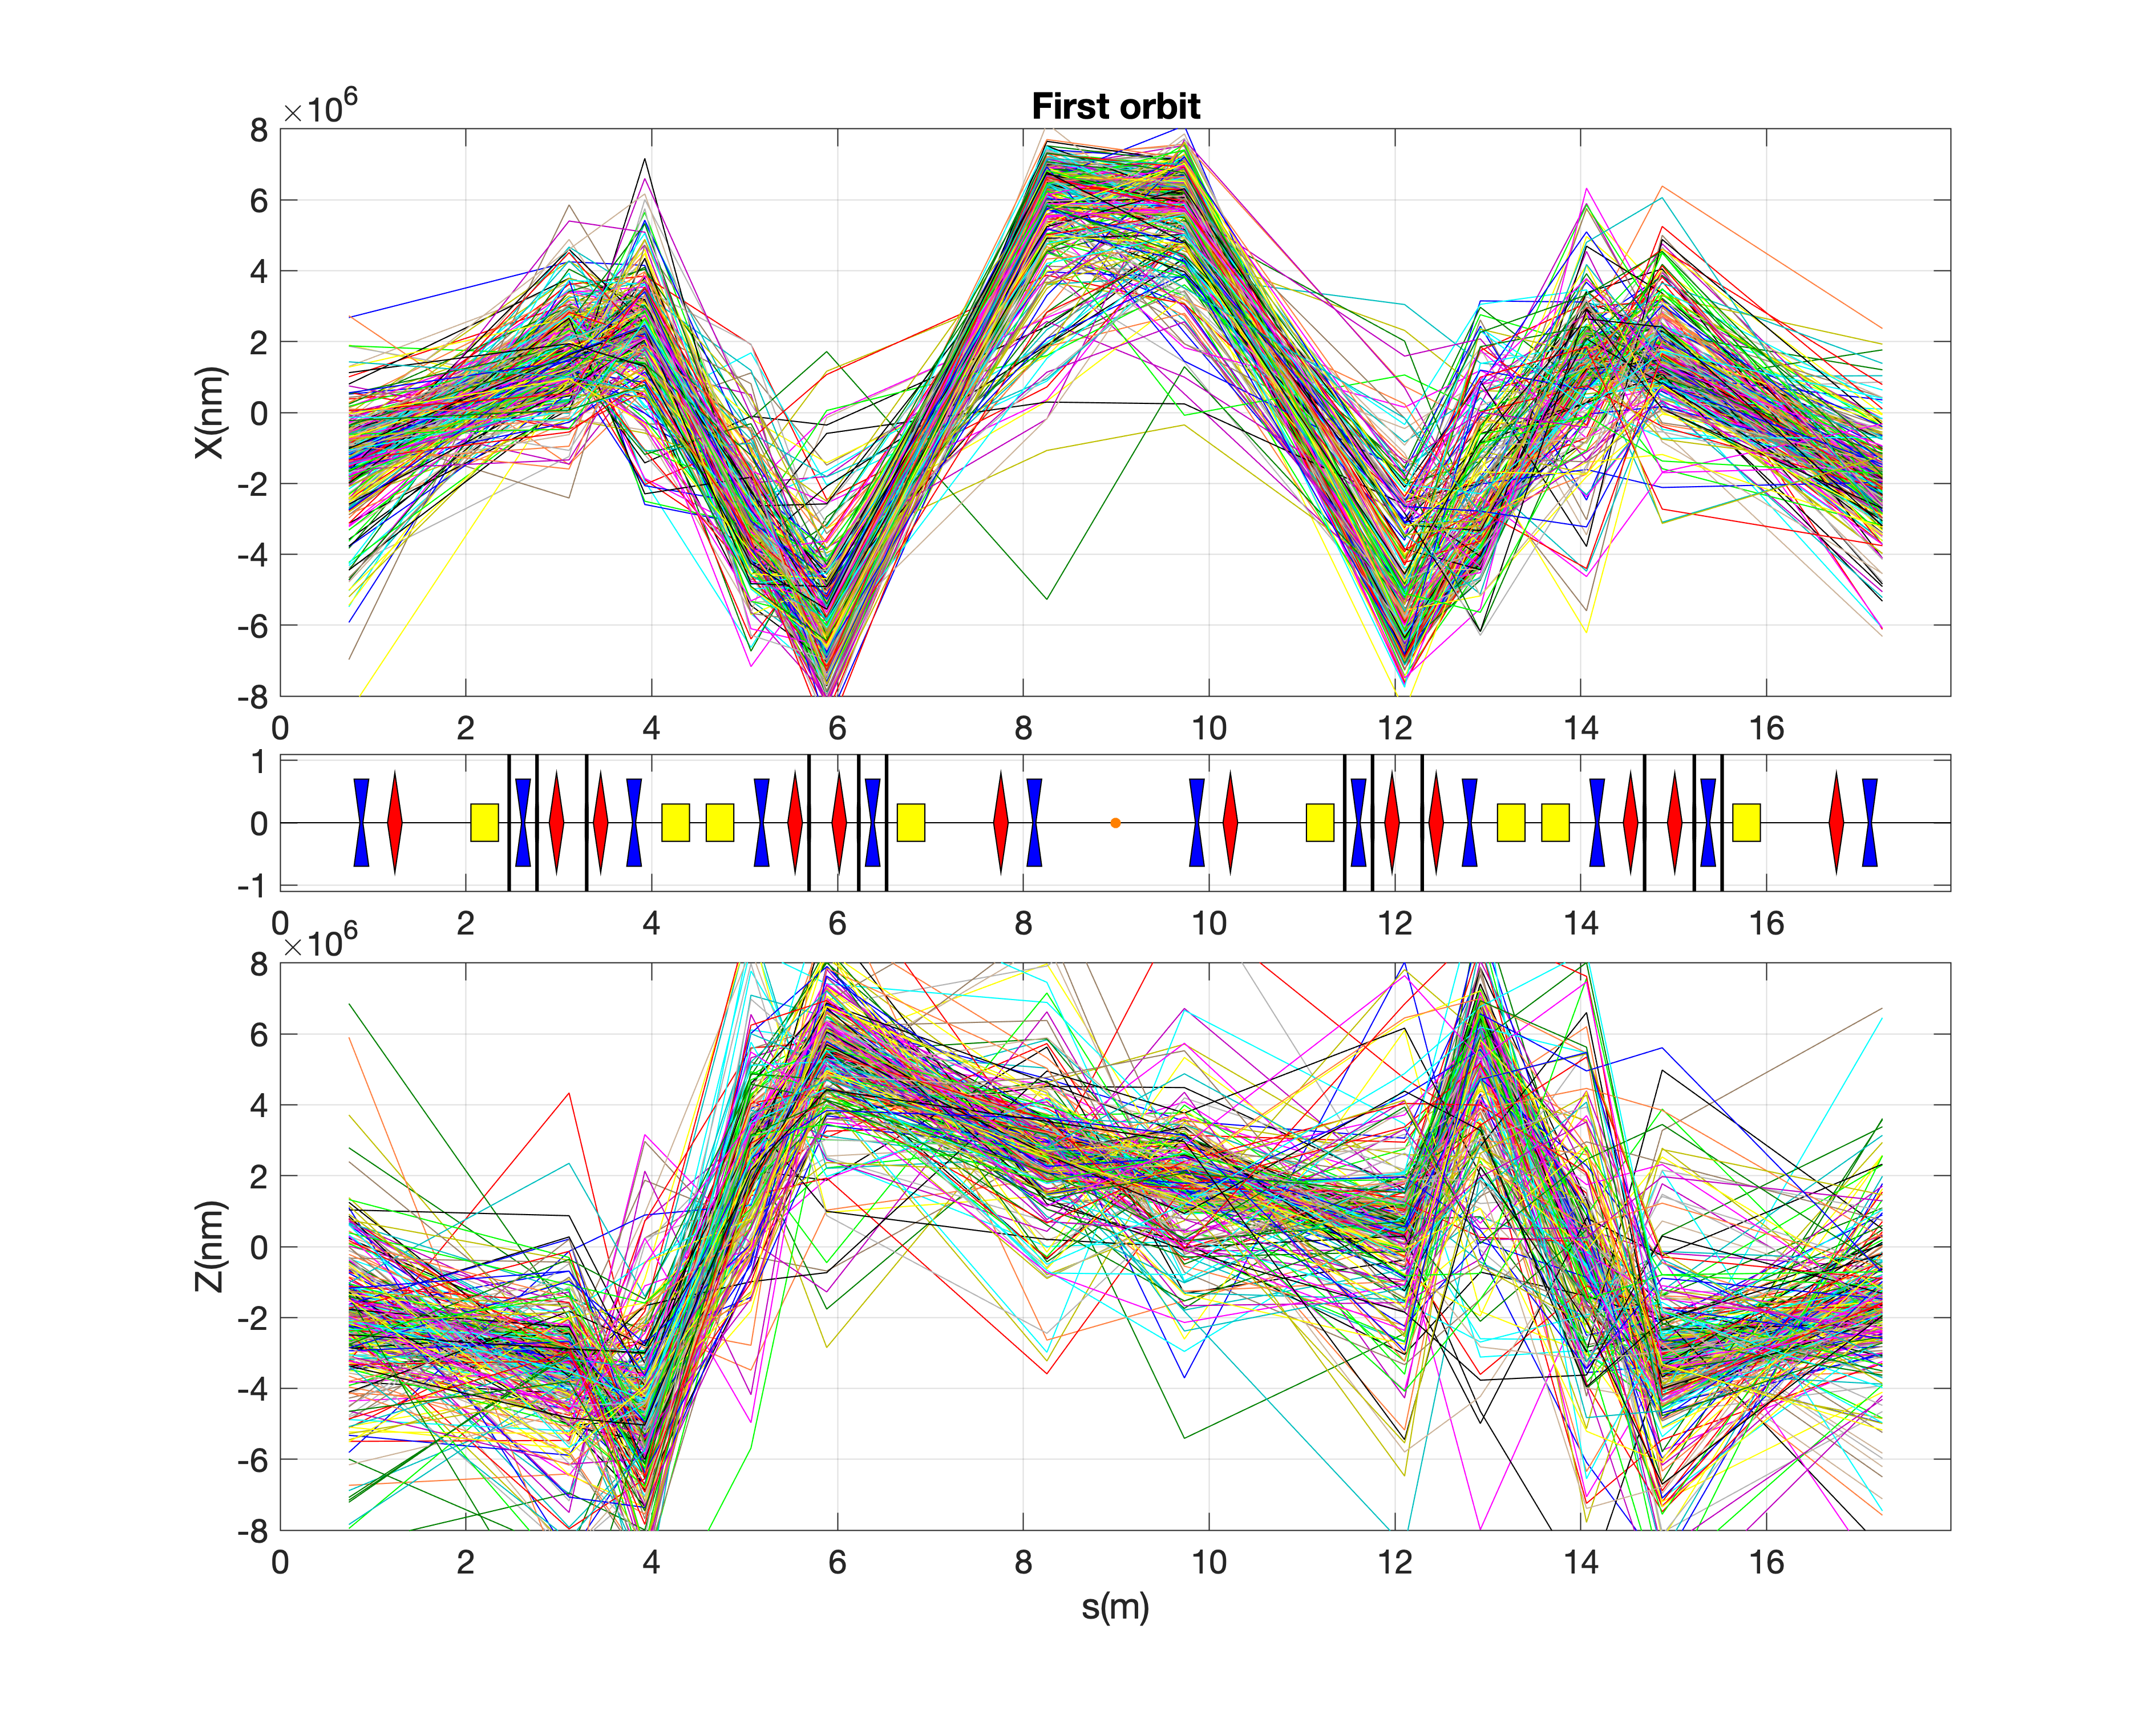
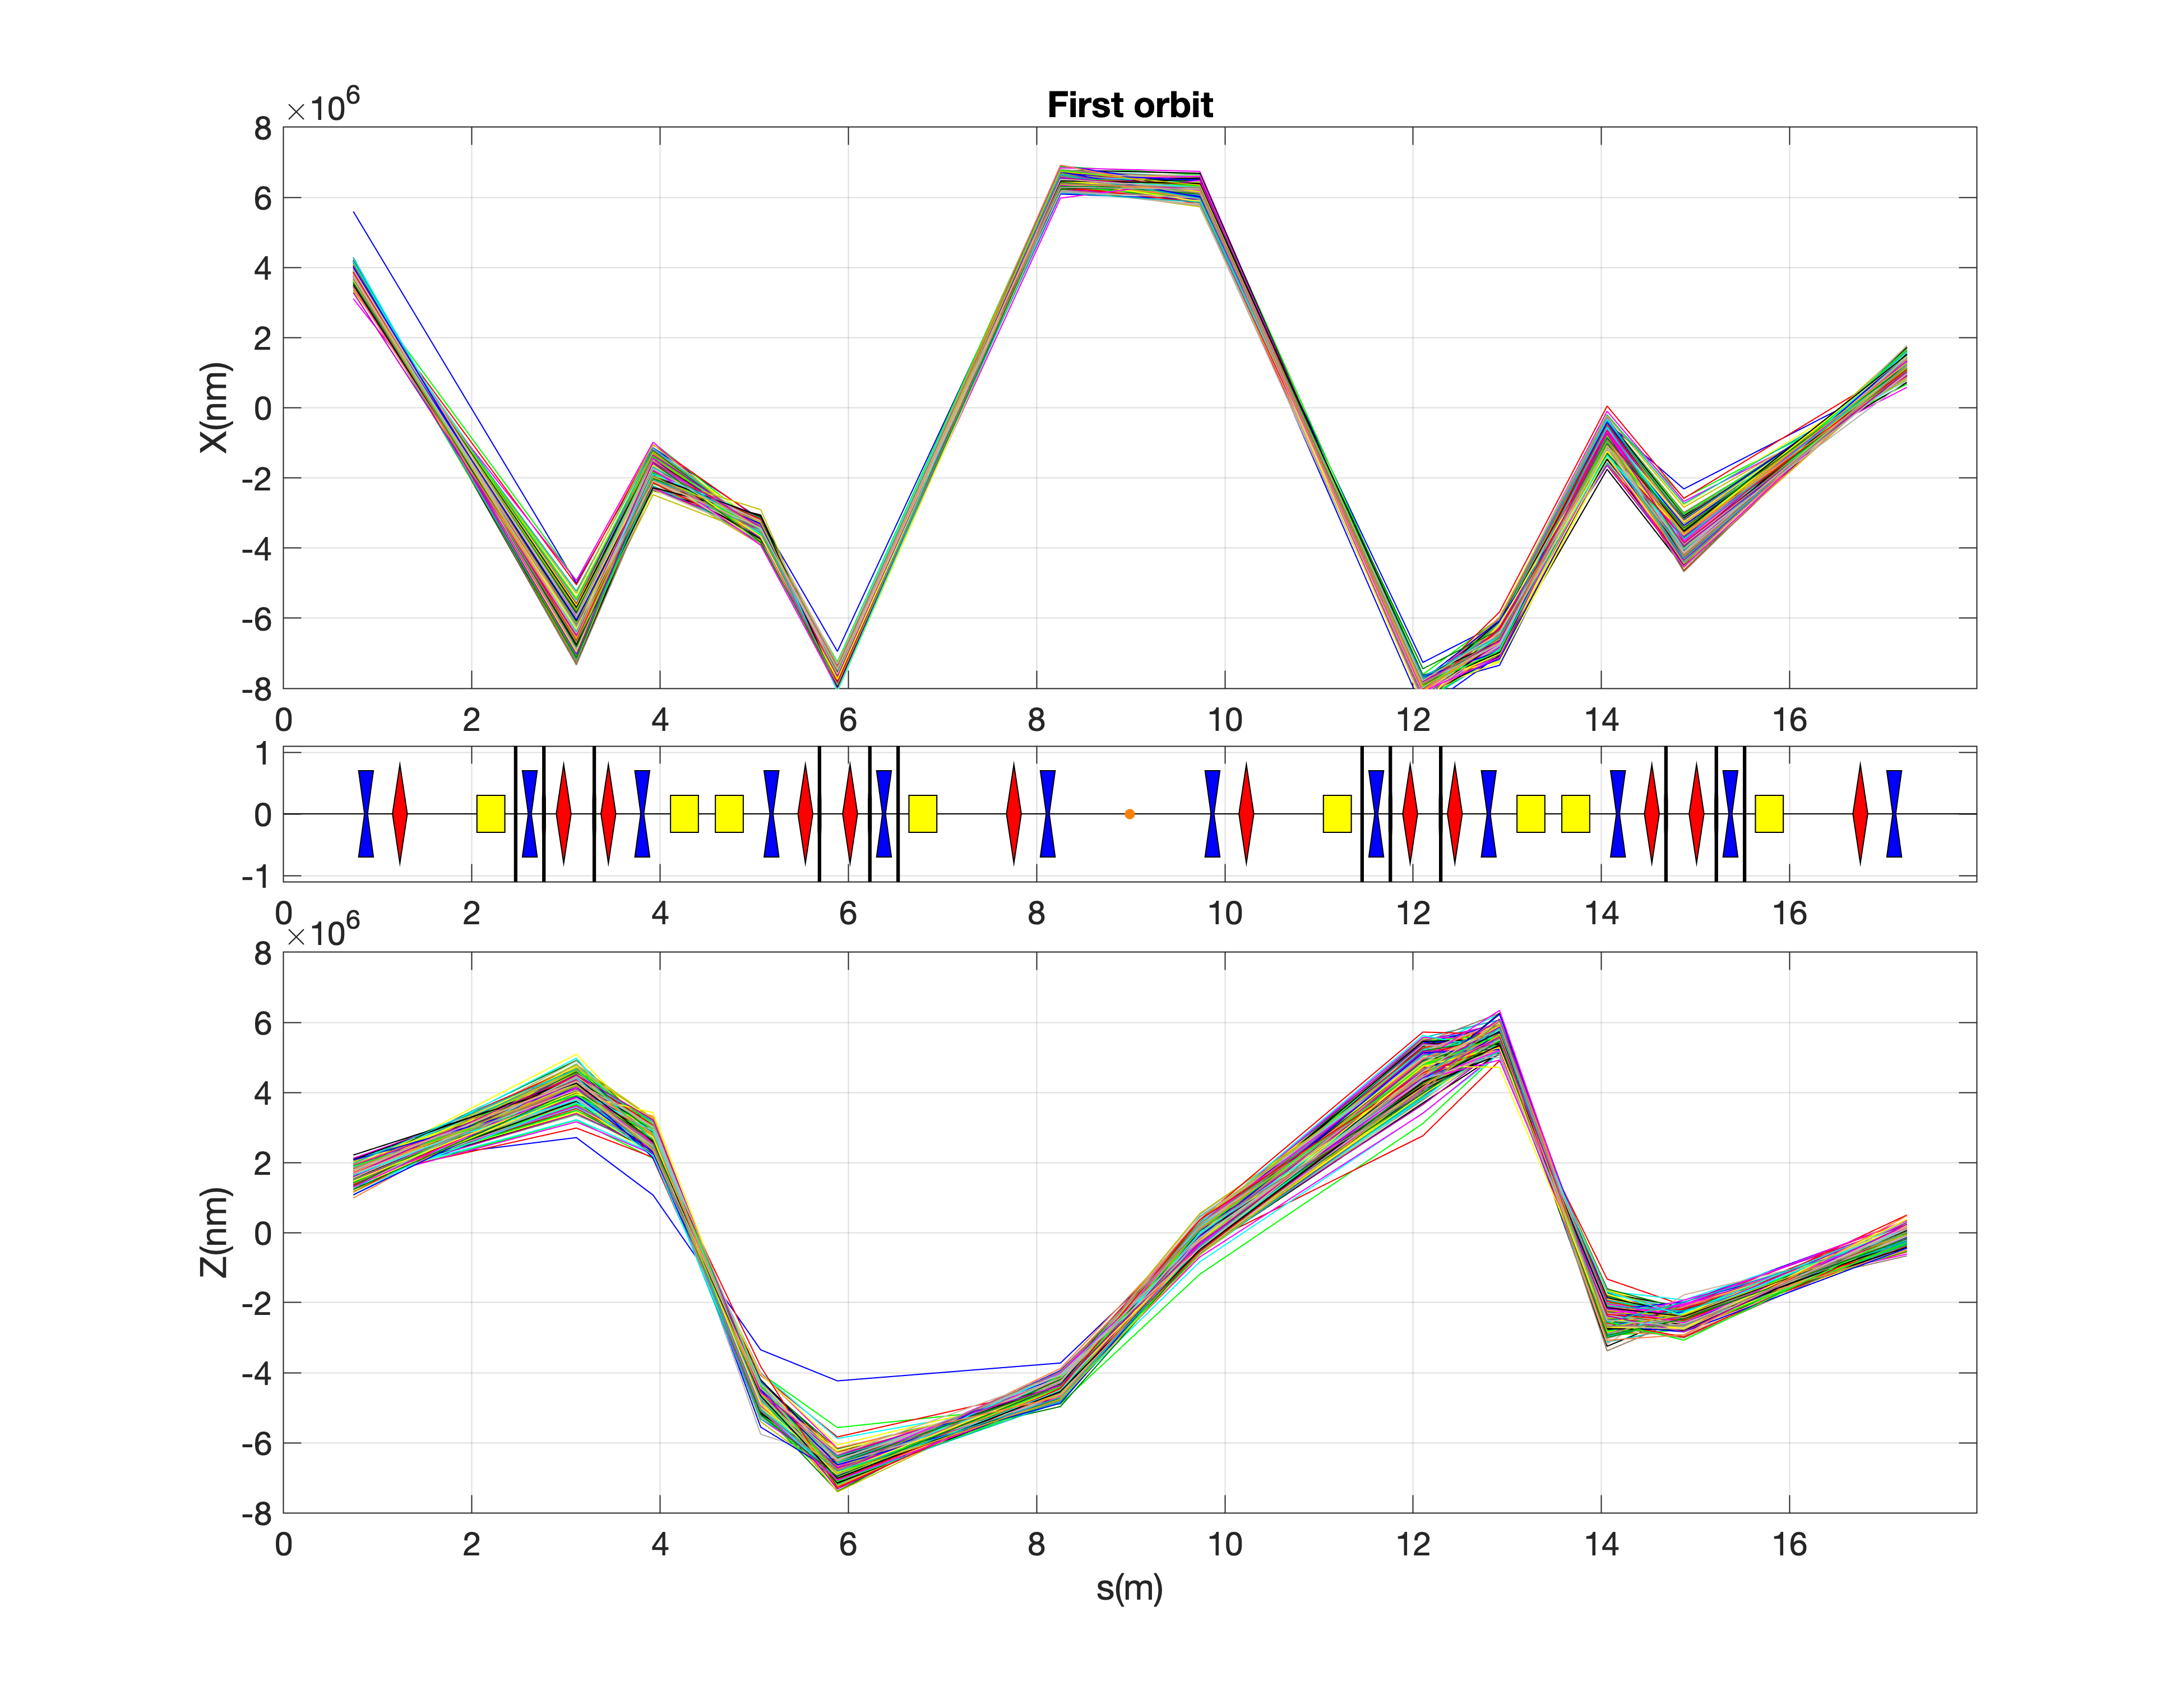
X-/Y- orbit turn-by-turn 03/10 vs. 07/10
03/10/2022
07/10/2022
Data from one injection
Turns: 16:end

Slide 15
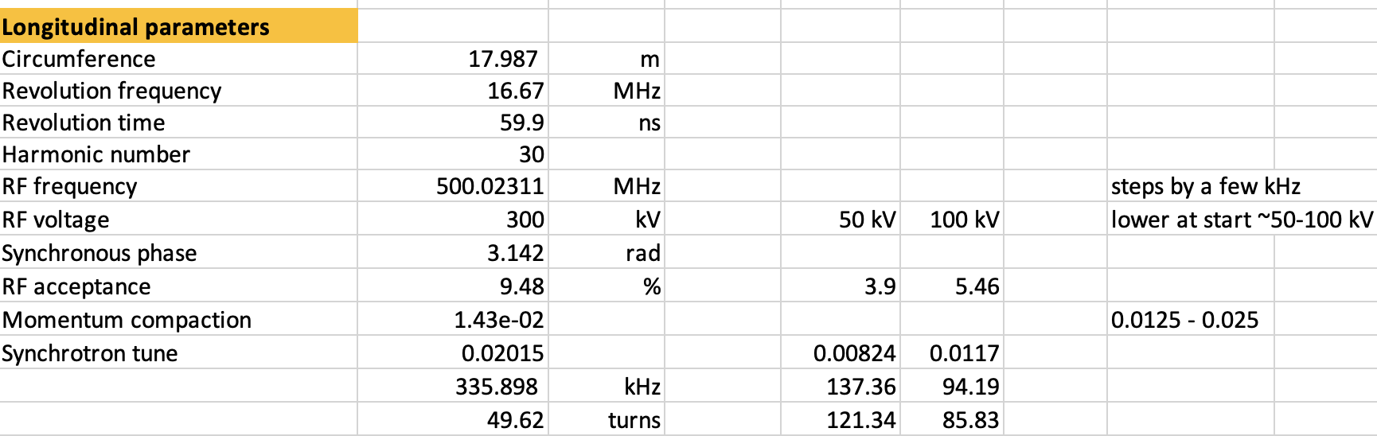
RF cavity ON
We took one BPM electrode and mixed it signal with the 500 MHz signal from timing system (which is send to the RF cavity)
Due to this, we could observe with the o-scope a proper RF frequency of the cavity matched with the revolution frequency of the e- in the ring
Now, we use the spare electrode in order not to disturb the measurements of the ring orbit
December, 8 2022

Slide 16
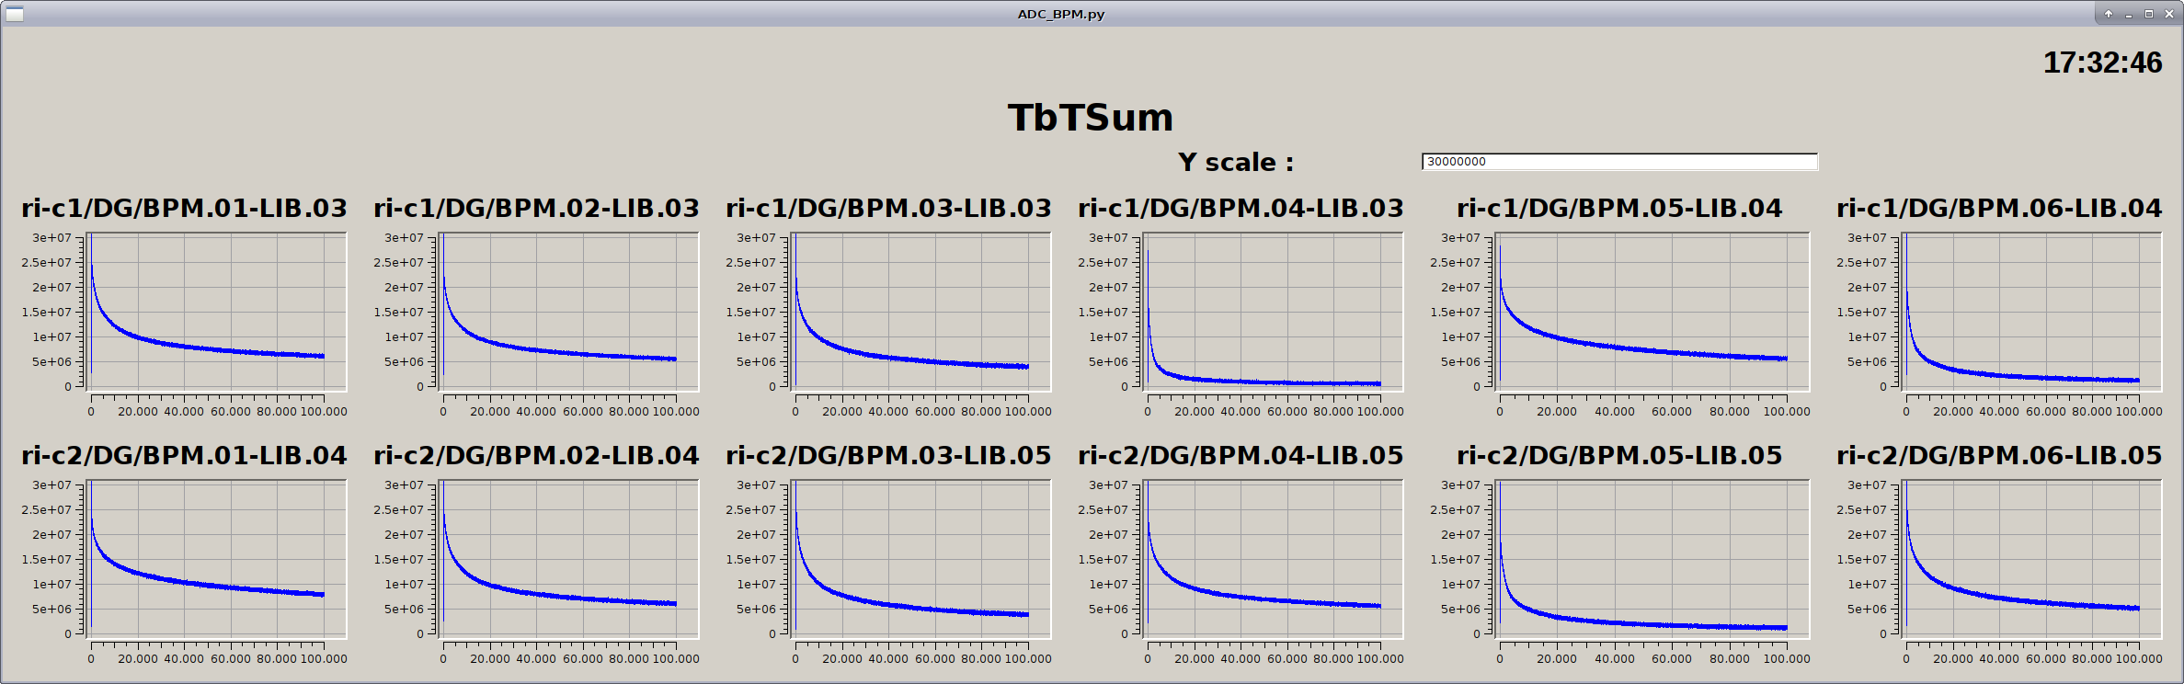
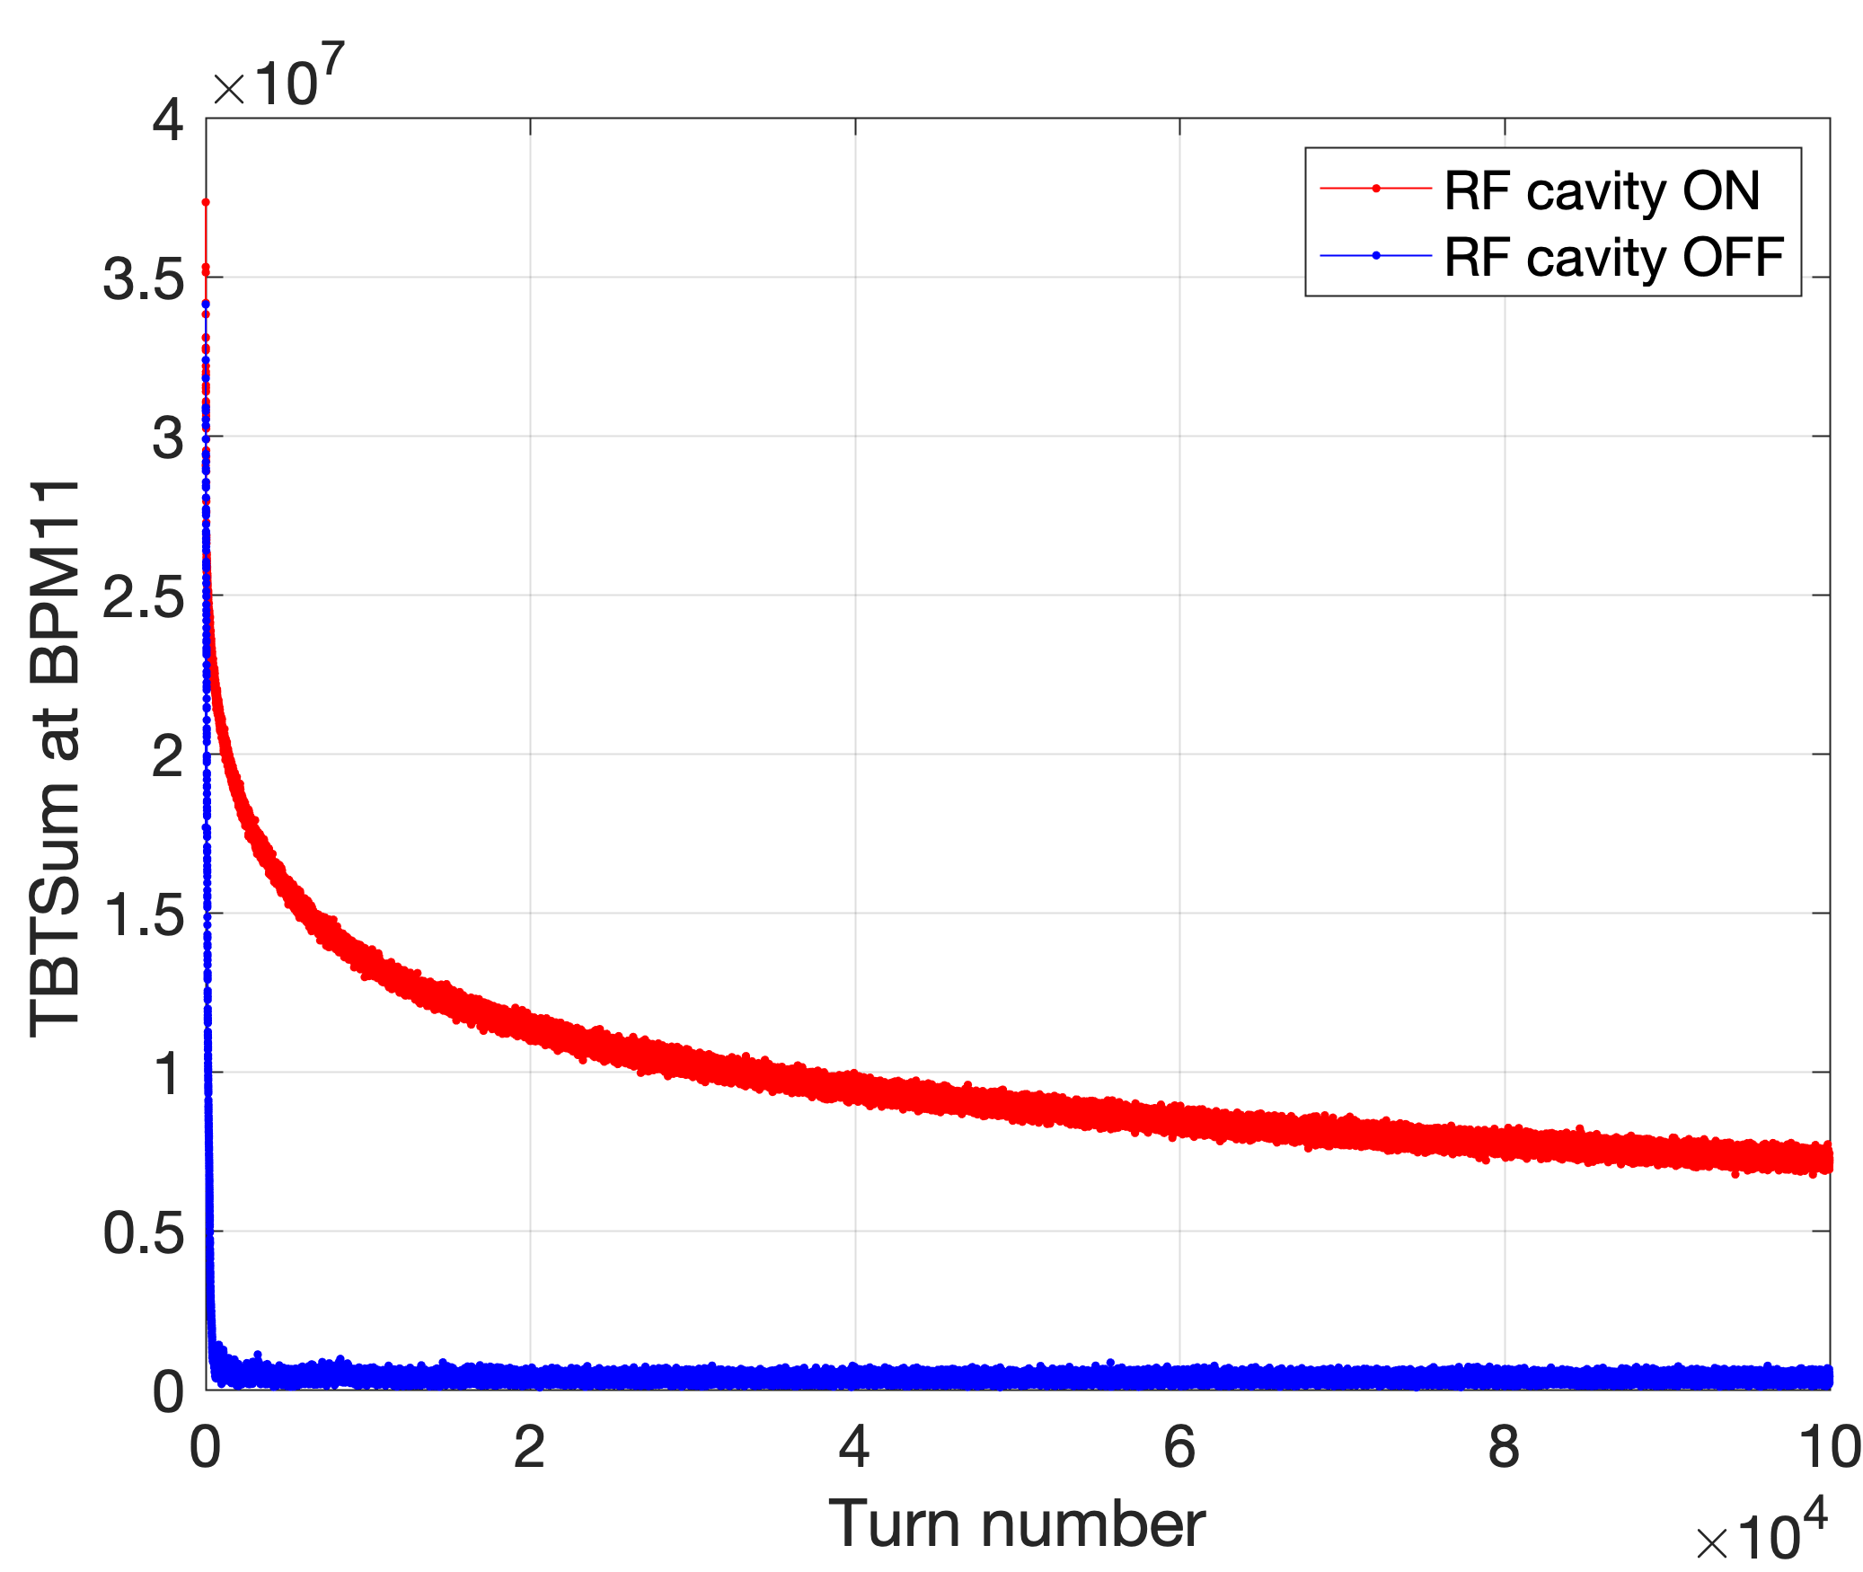
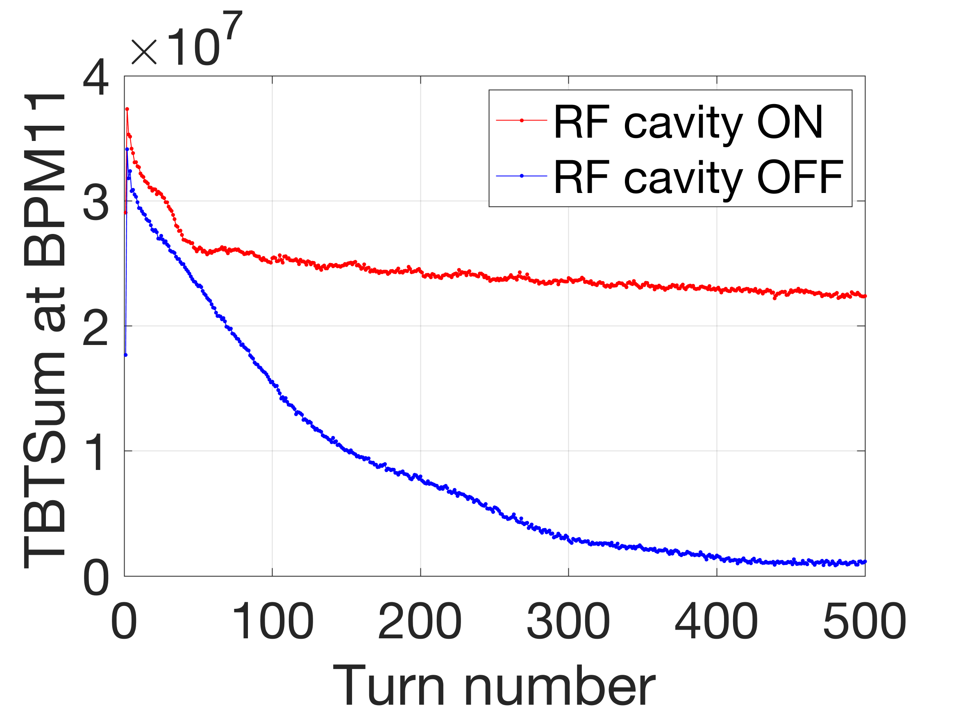
Storage with RF cavity > 200k turns (8 Dec. 2022)
Beam Storage
Cavity voltage 34.48 kV (reflected power sometimes not checked)
Freq = 500.4138 MHz cf. nominal 500.02311 MHz
Cavity voltage 75.0 kV
Cavity voltage 123.0 kV

Slide 17
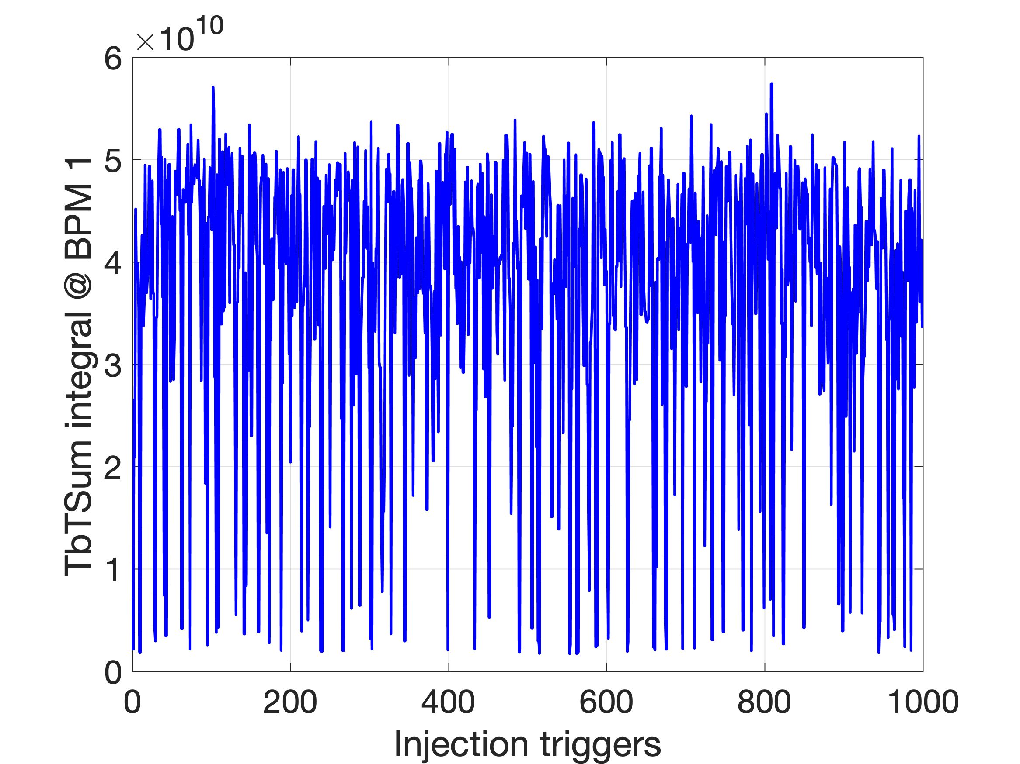
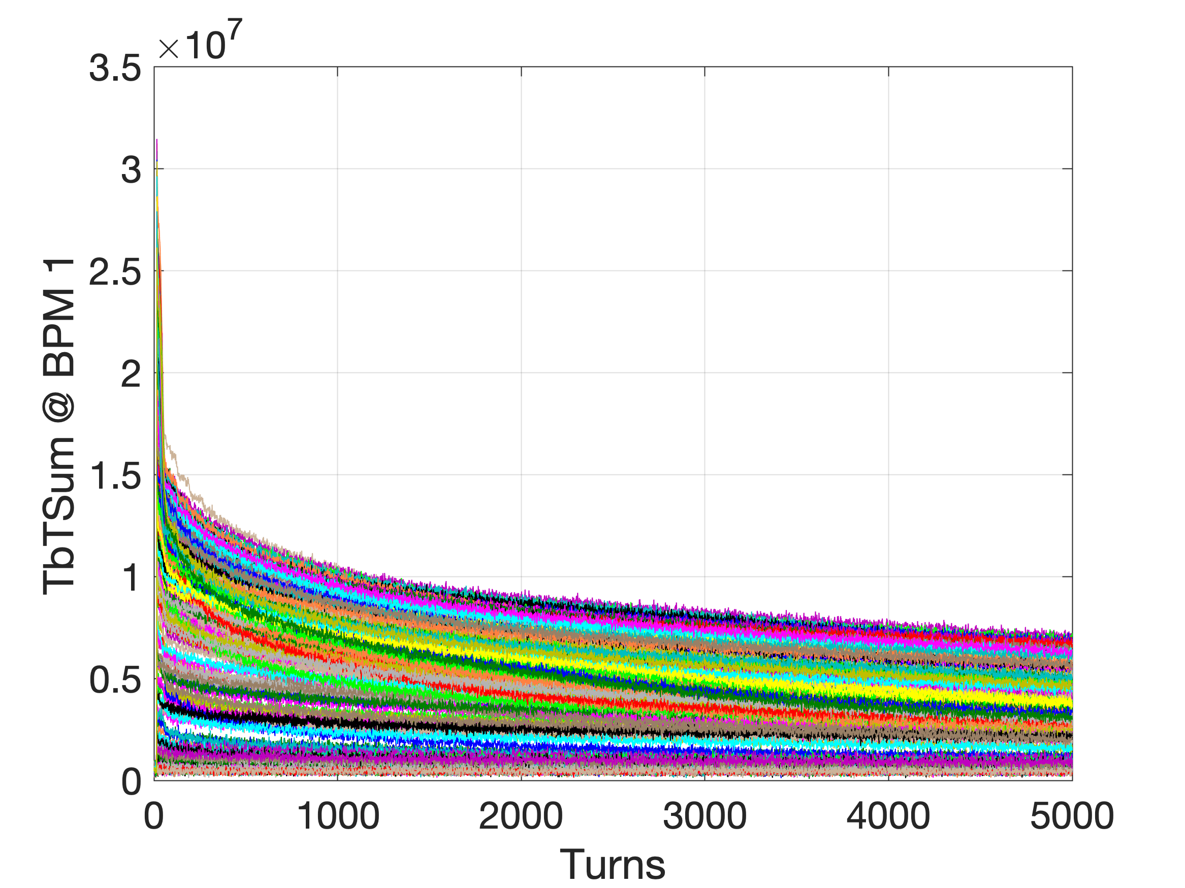
Storage with RF cavity (8 December 2022)
DATA SET ALLdata_2022-12-08_16-45-36.mat

Slide 18
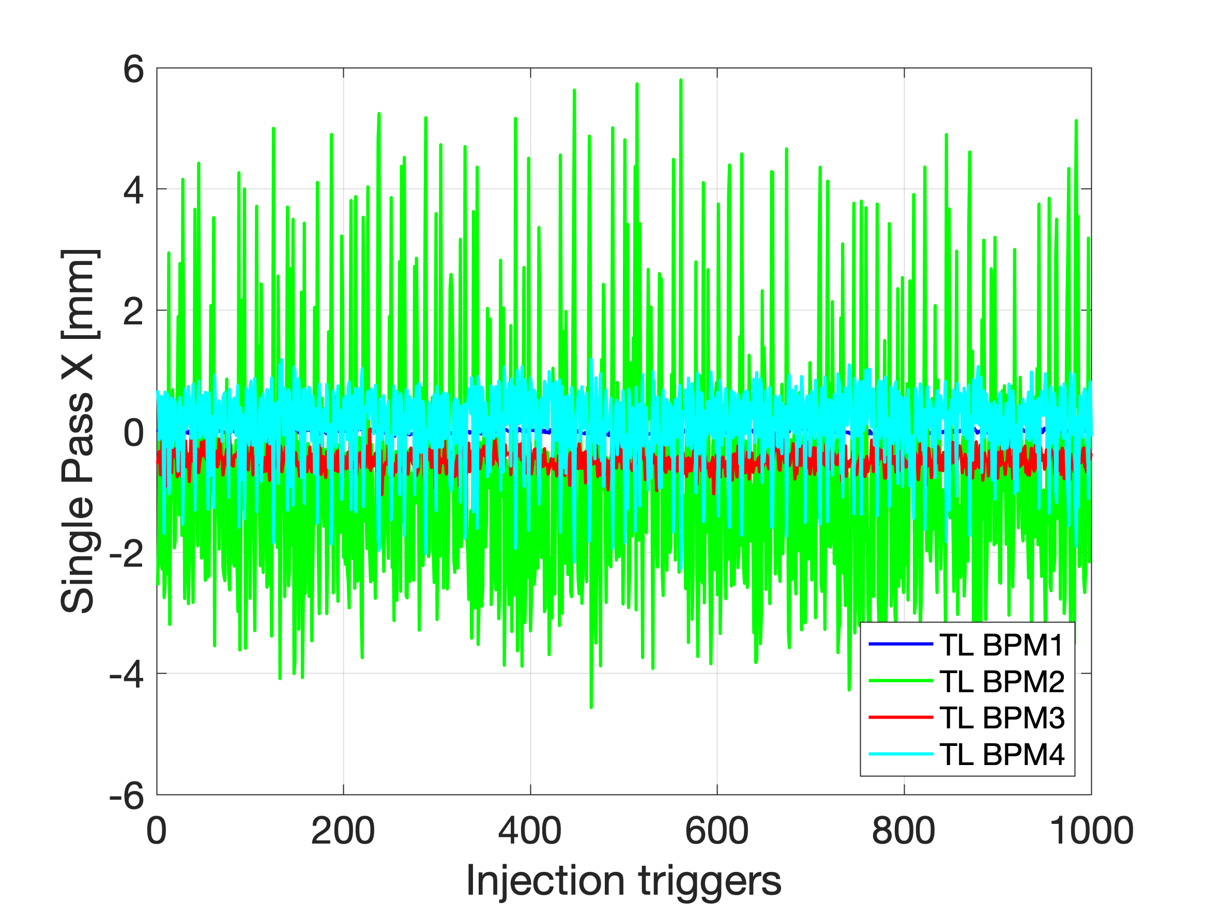
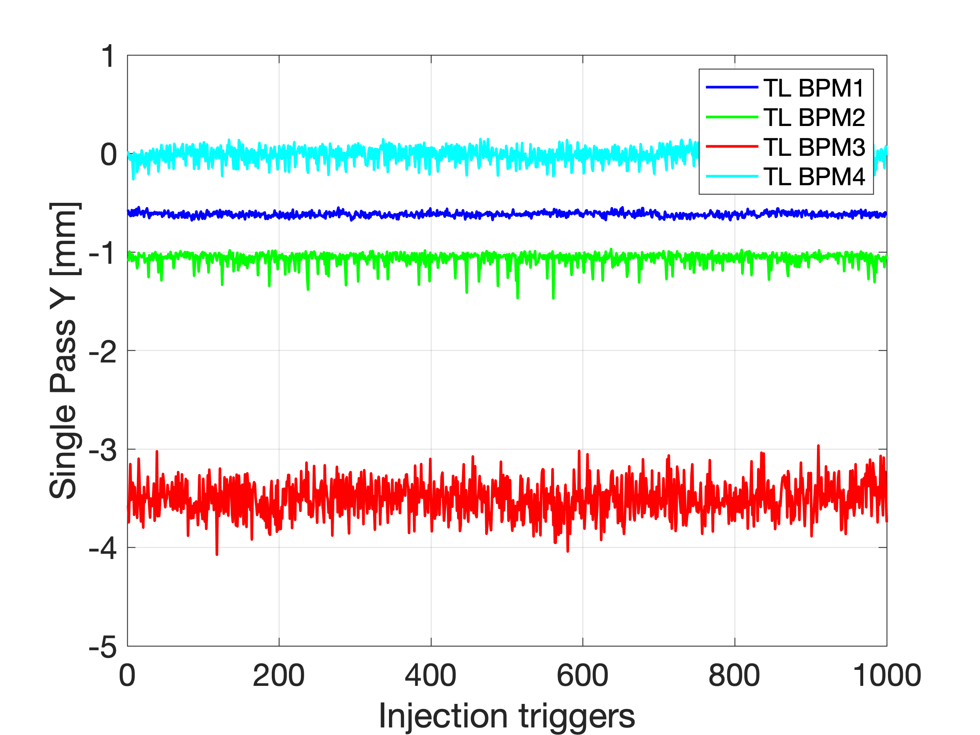
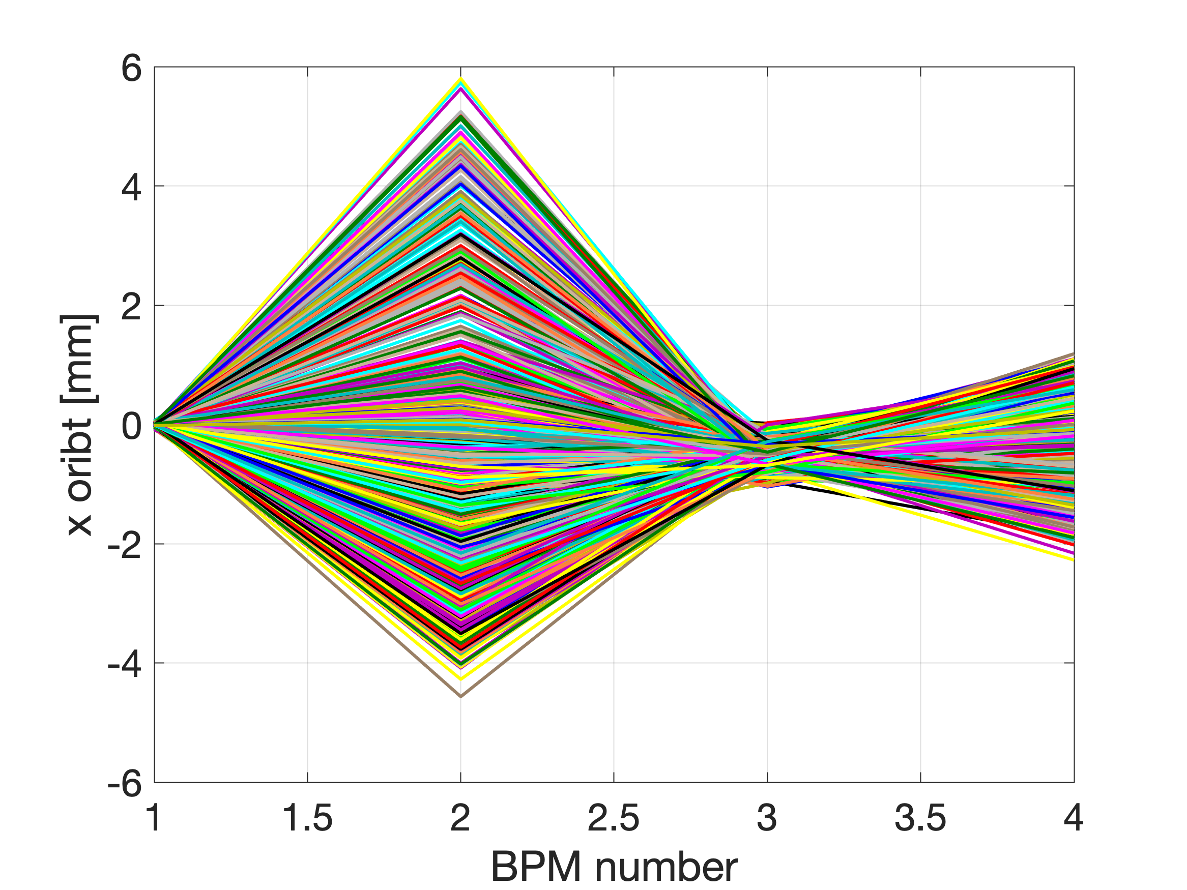
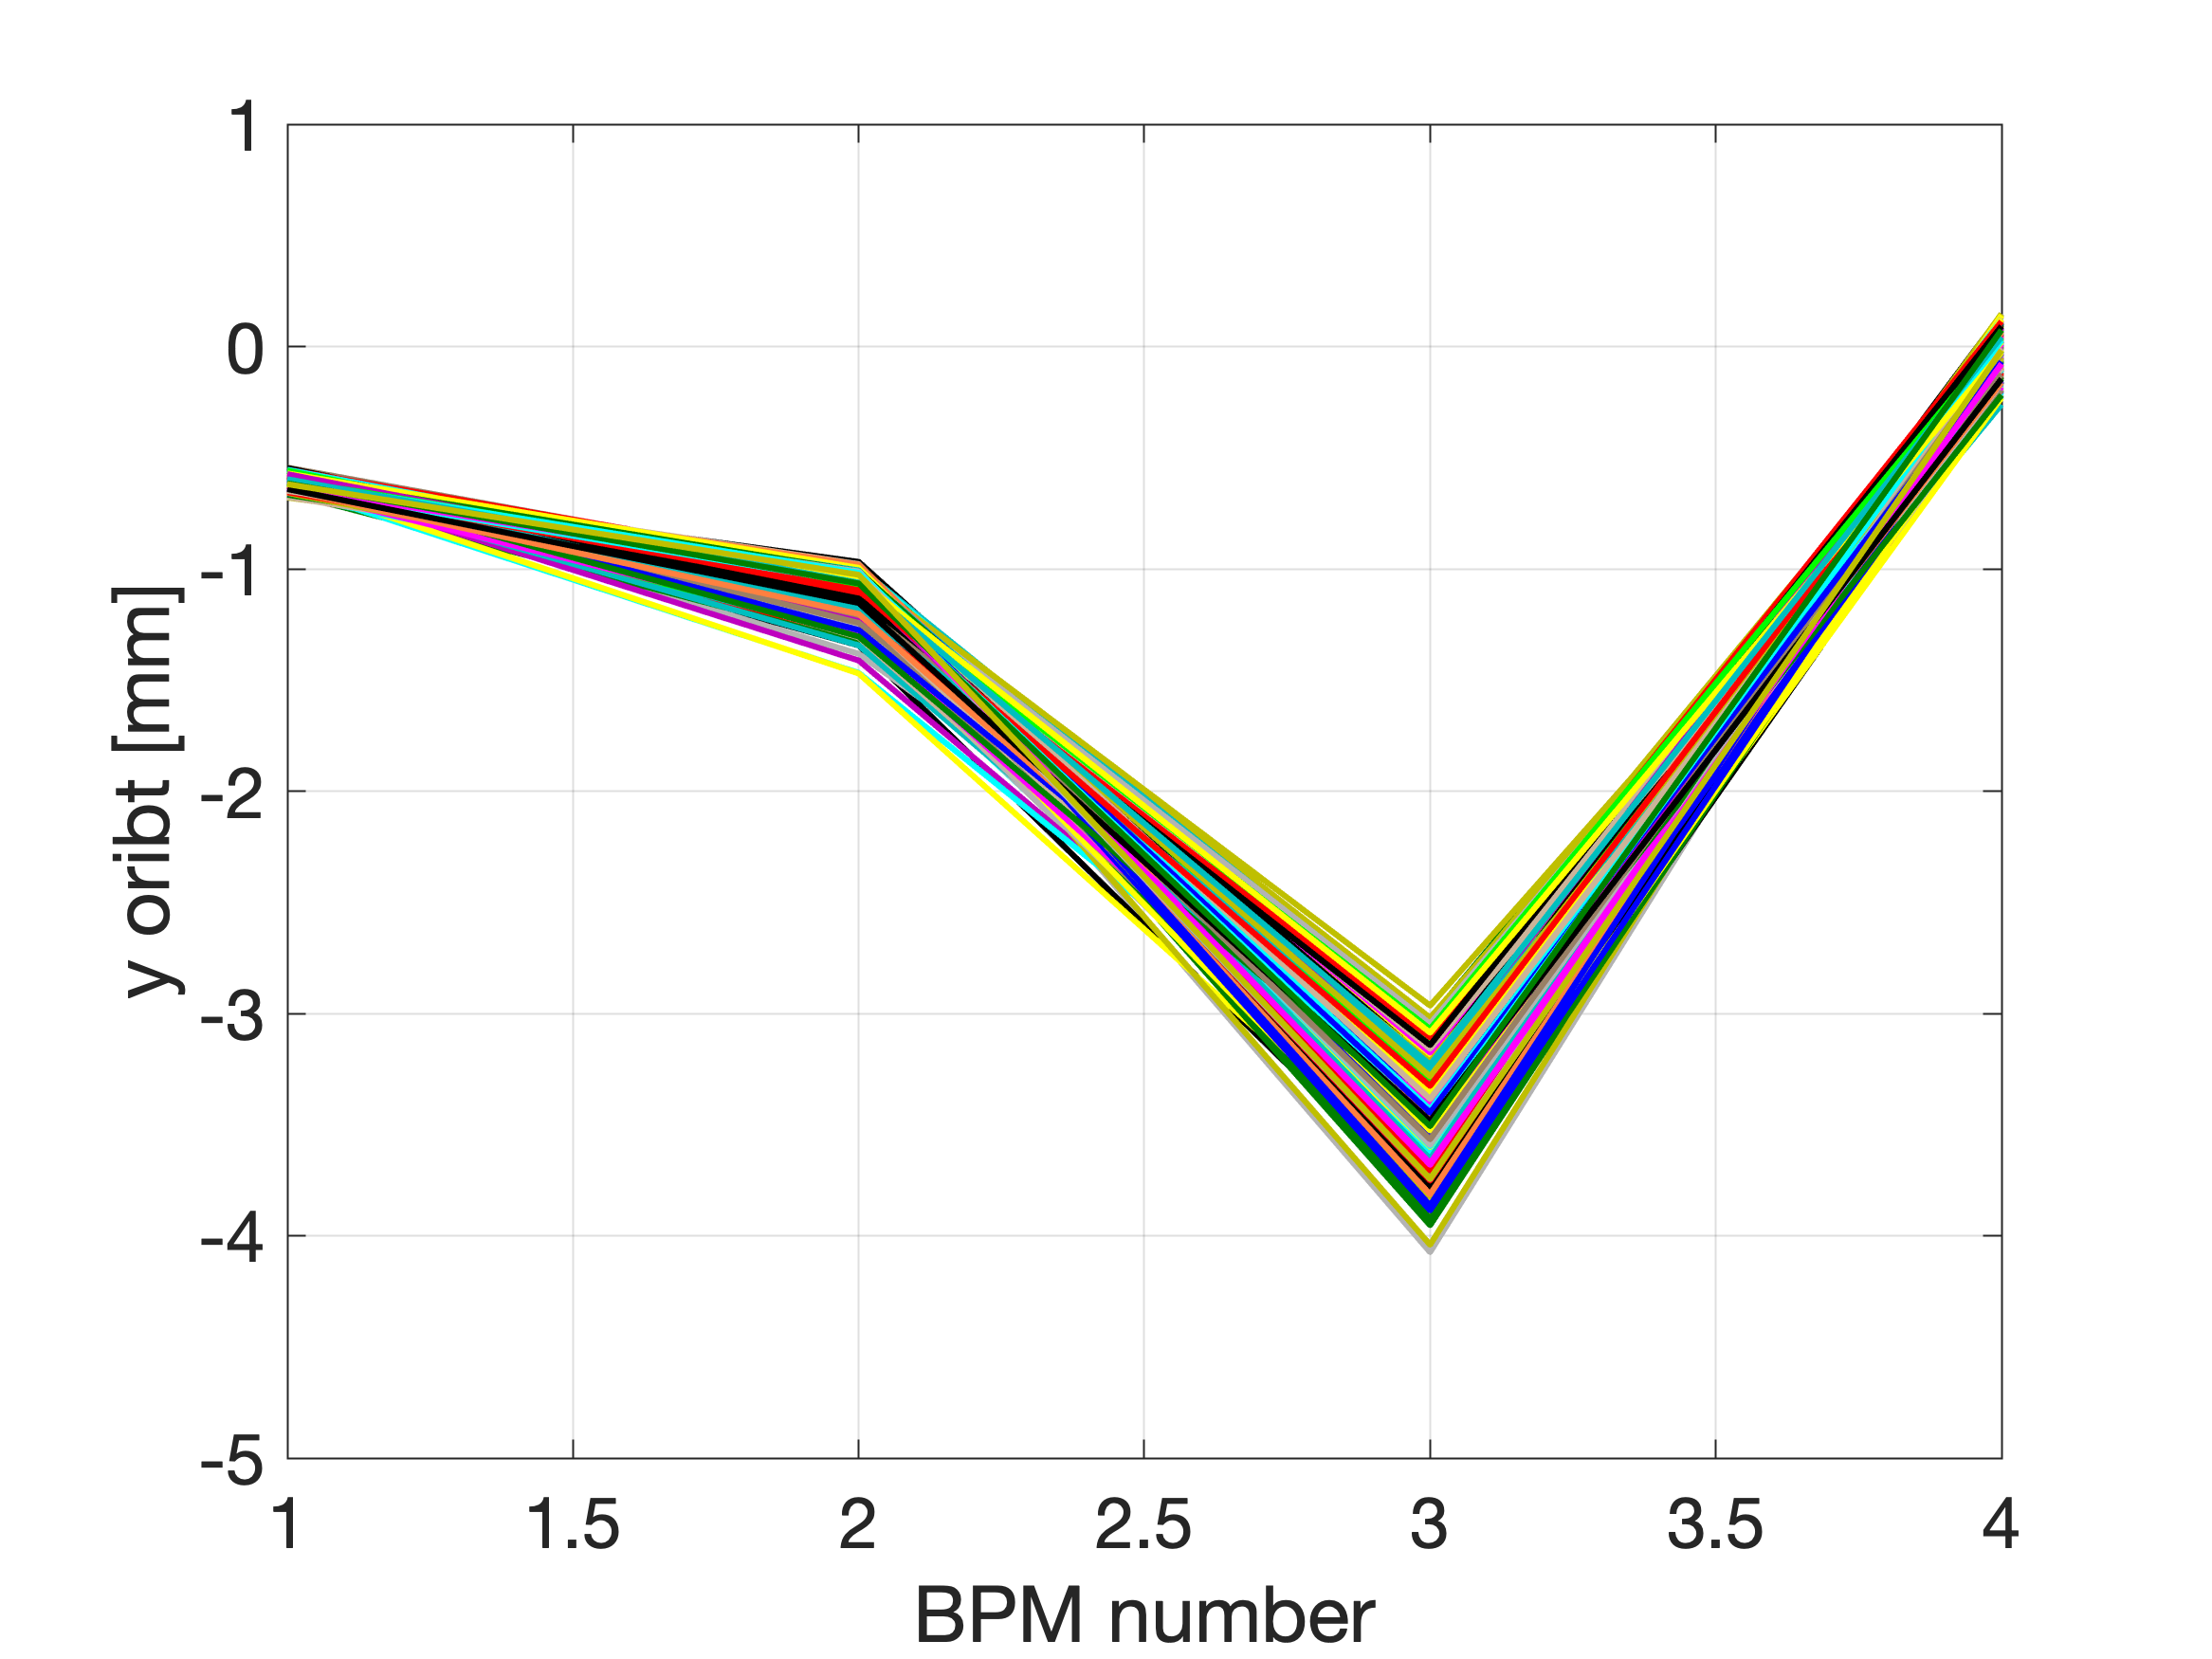
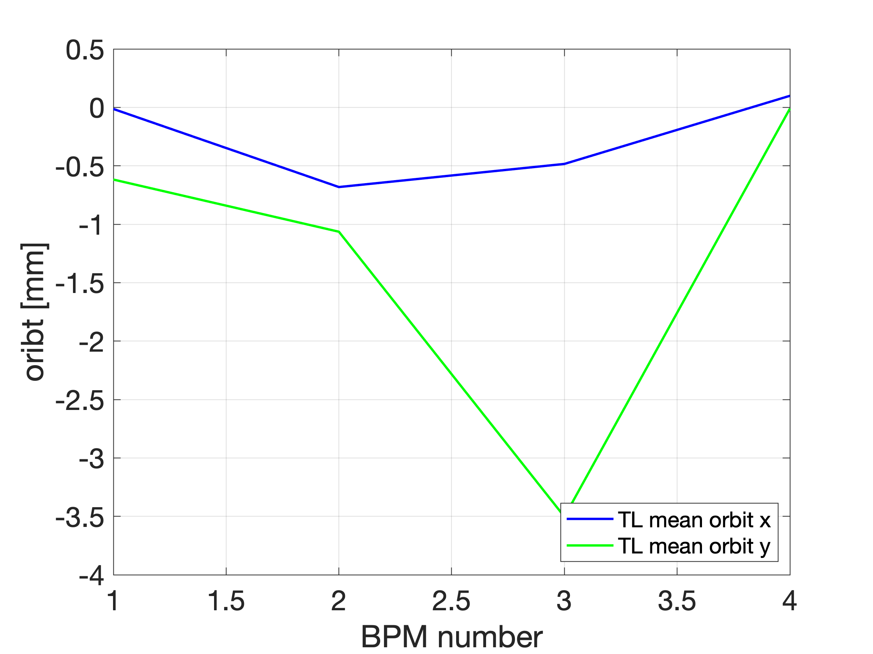
Transfer Line (8 December 2022)
DATA SET
ALLdata_2022-12-08_16-45-36.mat

Slide 19
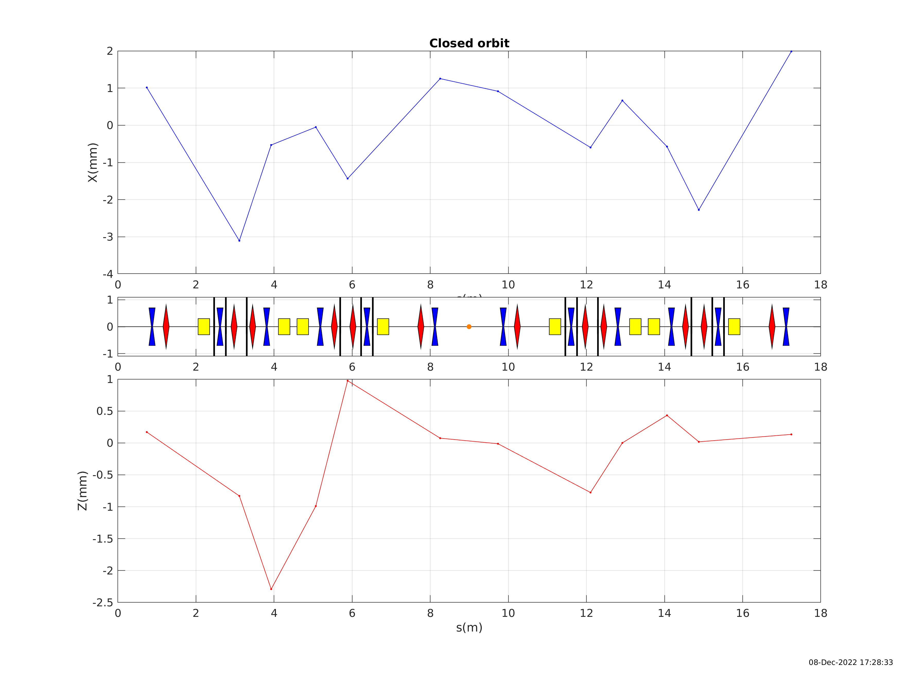
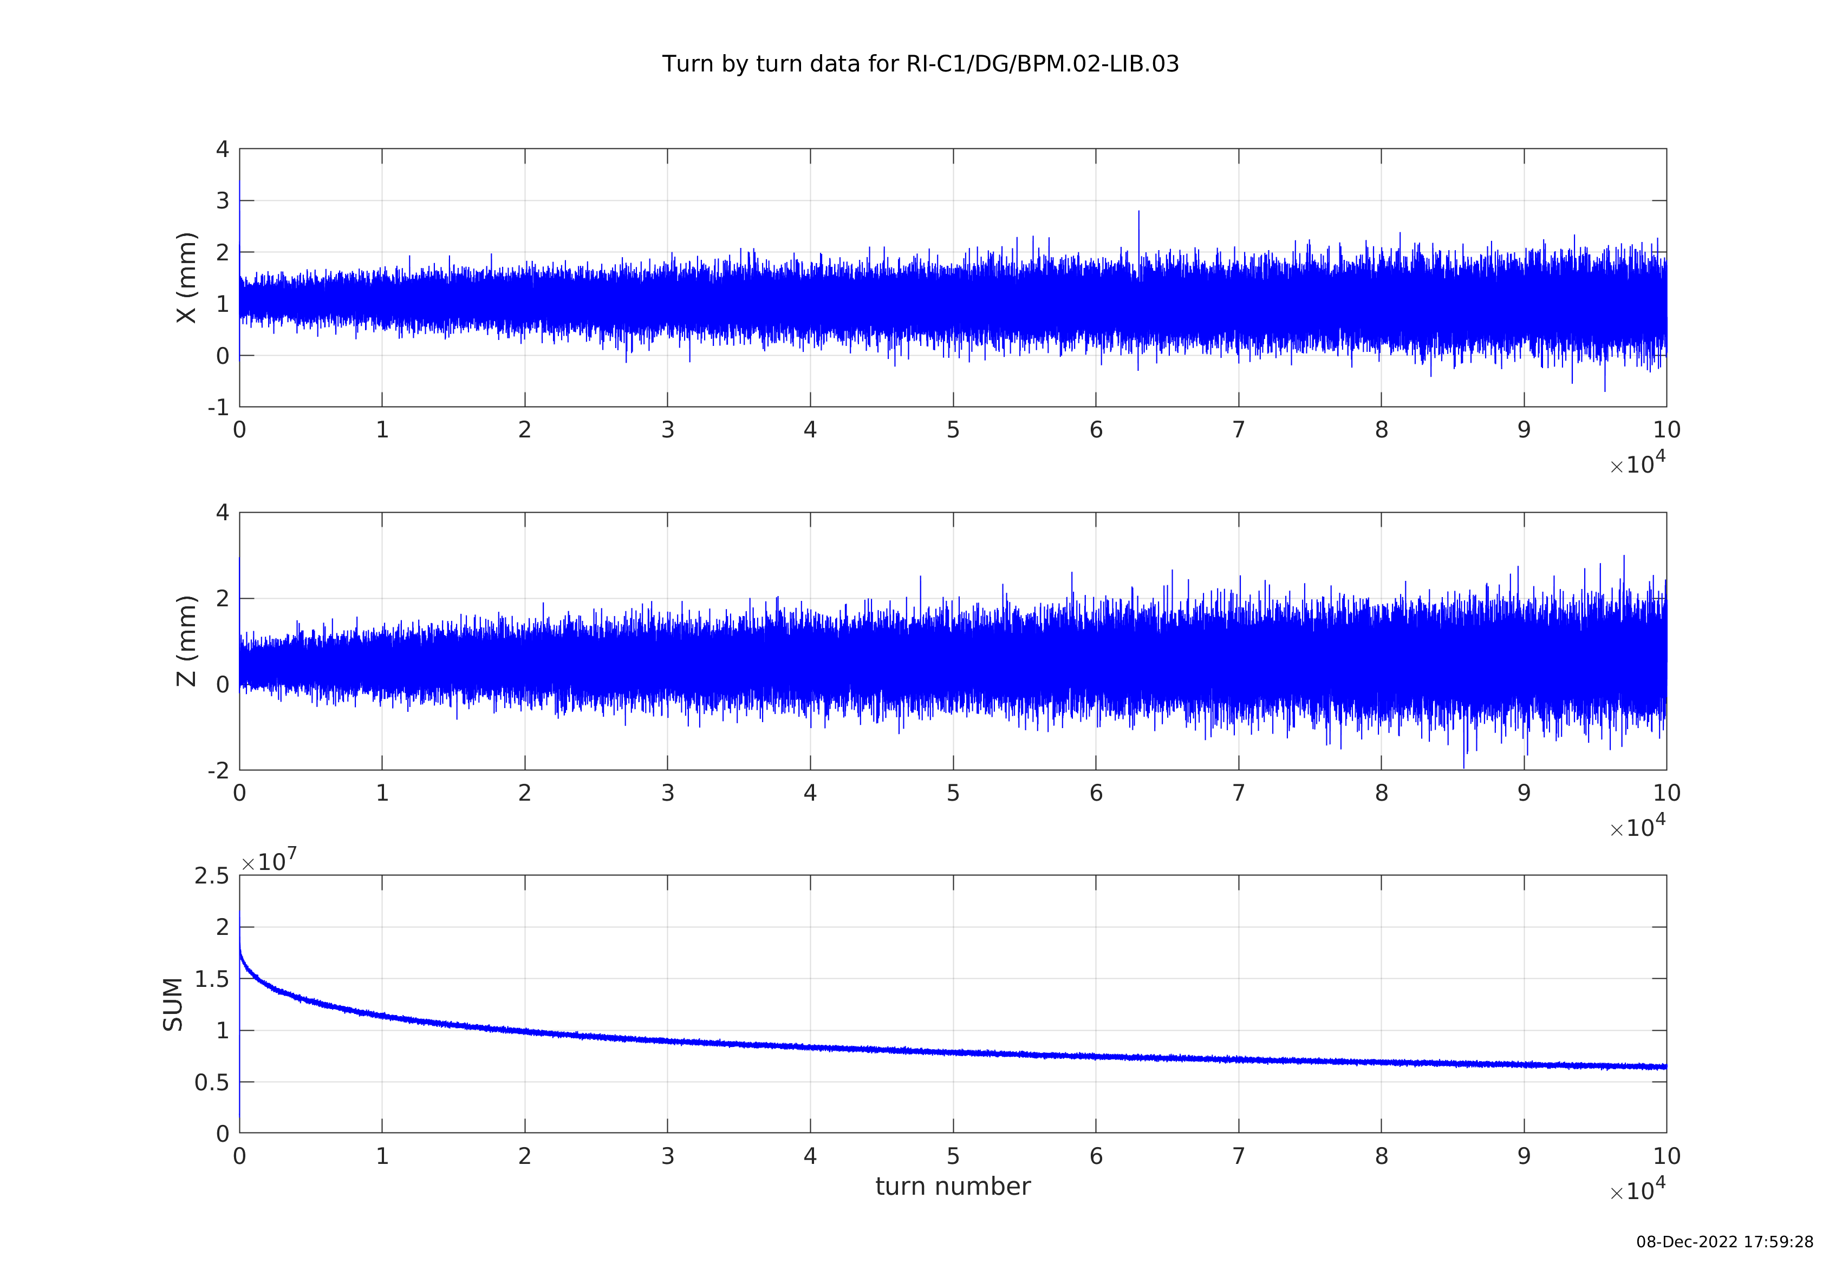
Storage with RF cavity > 200k turns (8 Dec. 2022)

Slide 20
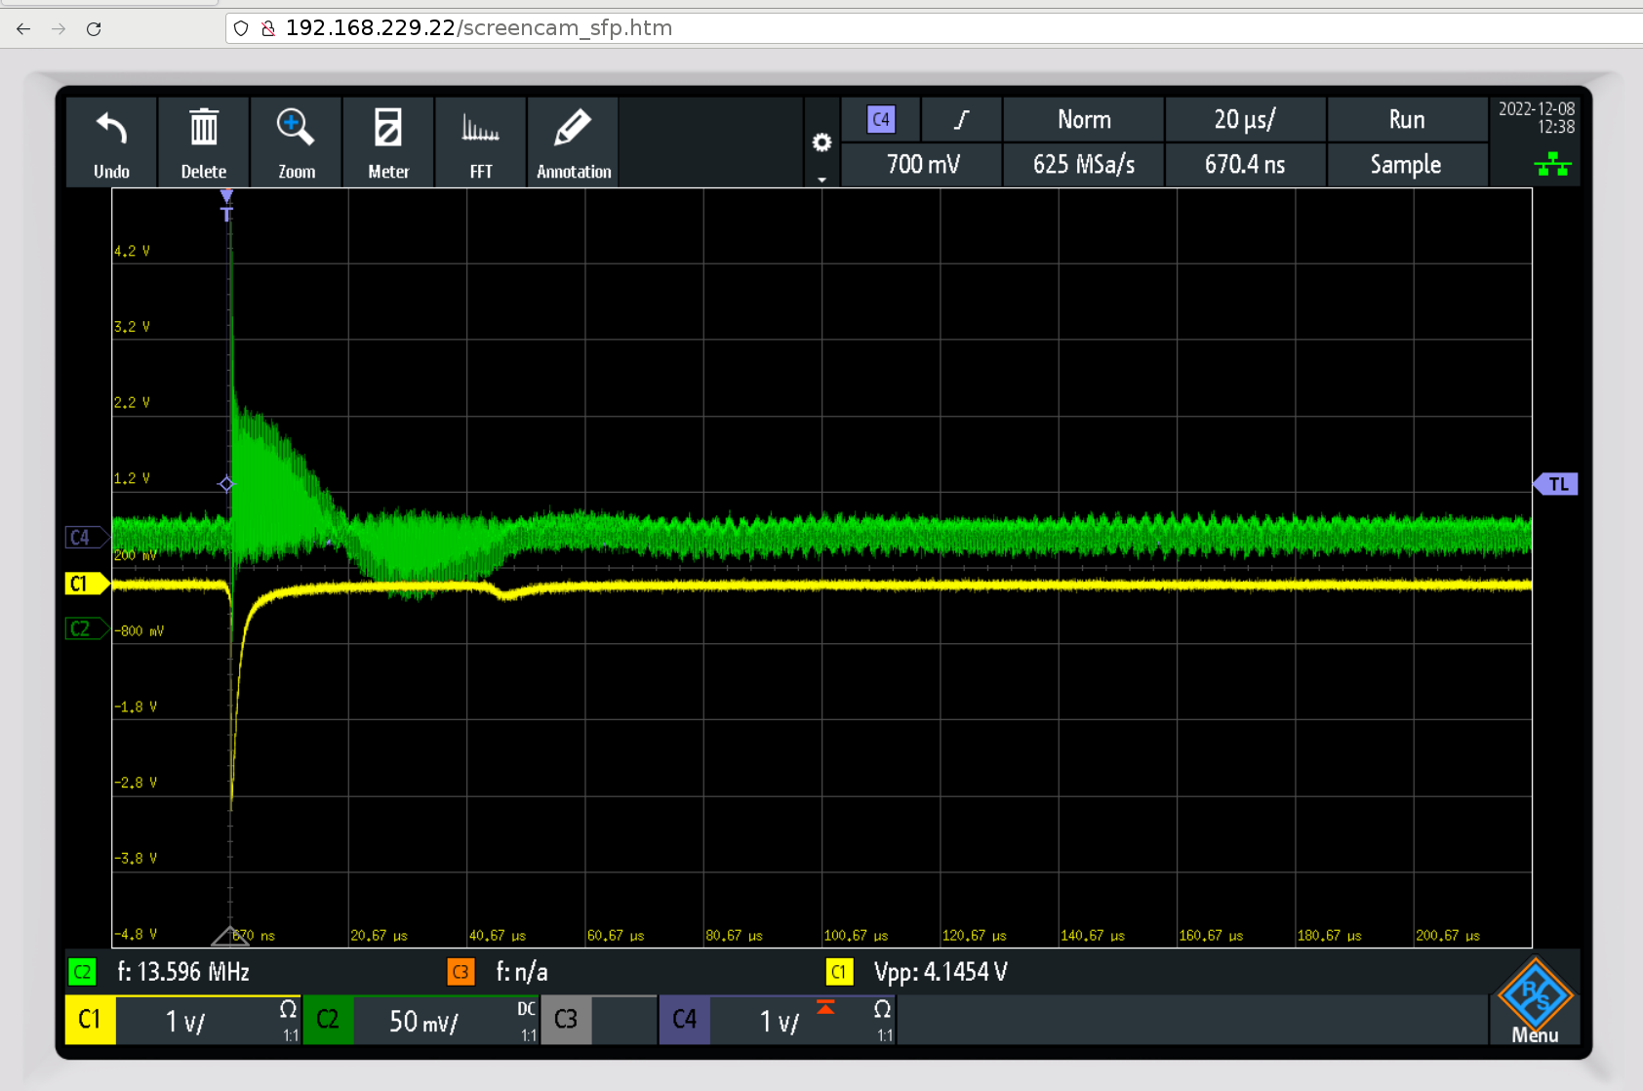
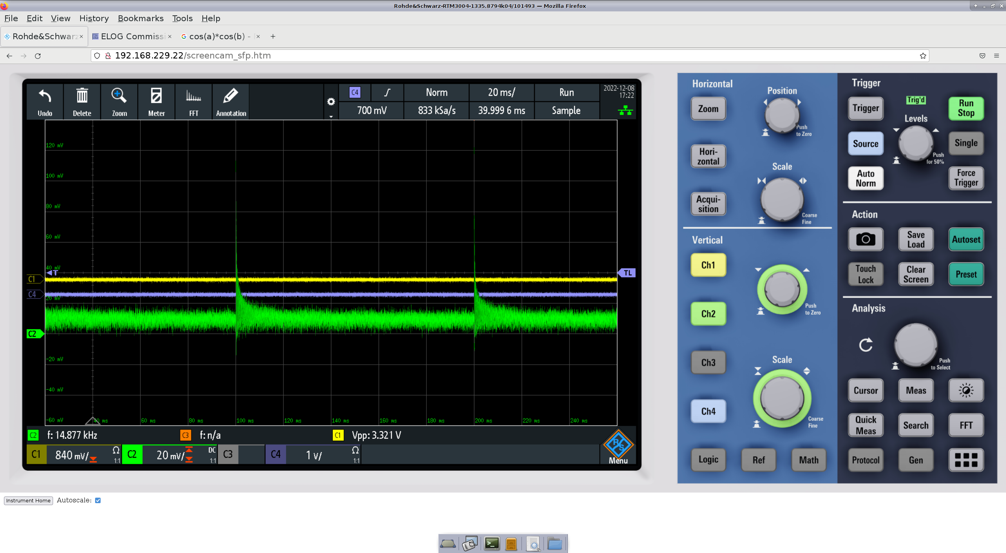
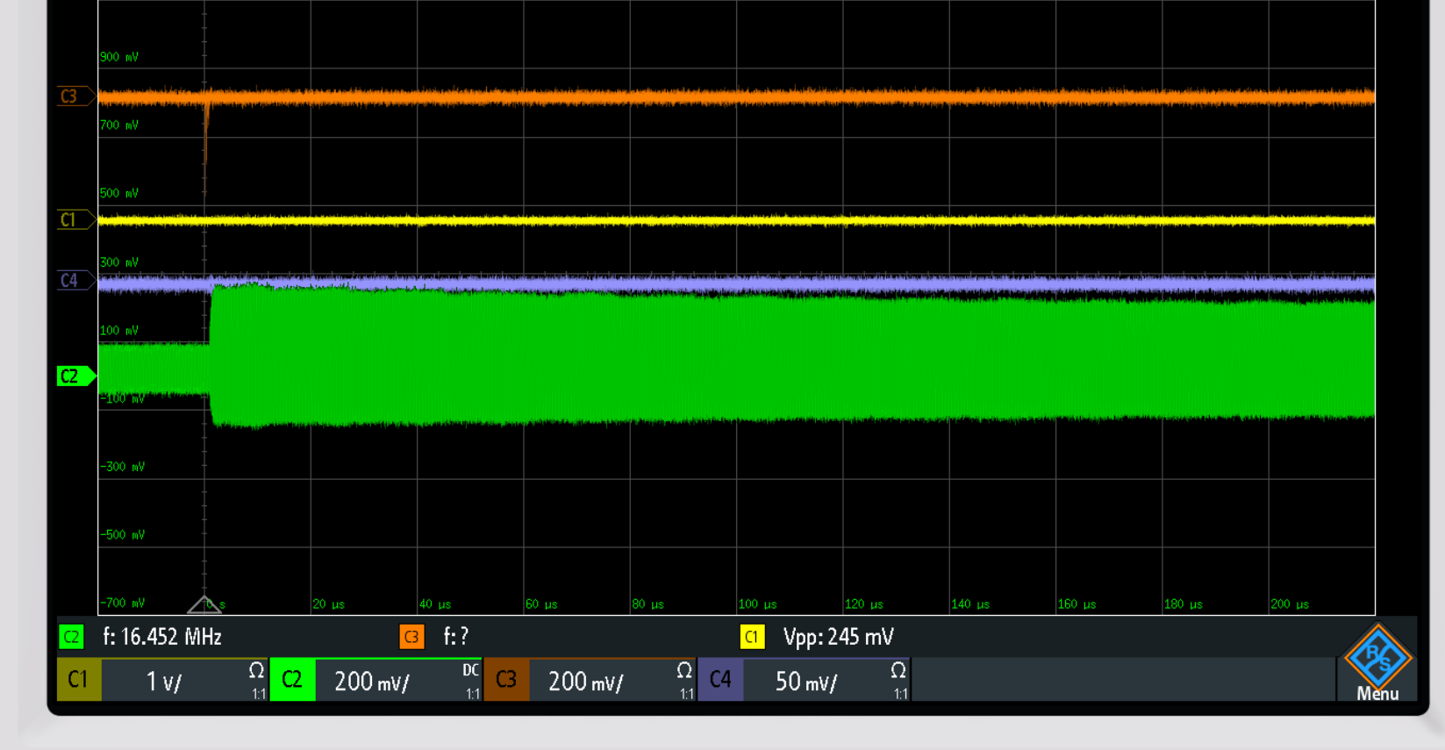
Mixing 500 MHz with BPM electrode connected to the o-scope
December, 9 2022
Storage 100 ms (10 Hz) or even 1 sec.

Slide 21
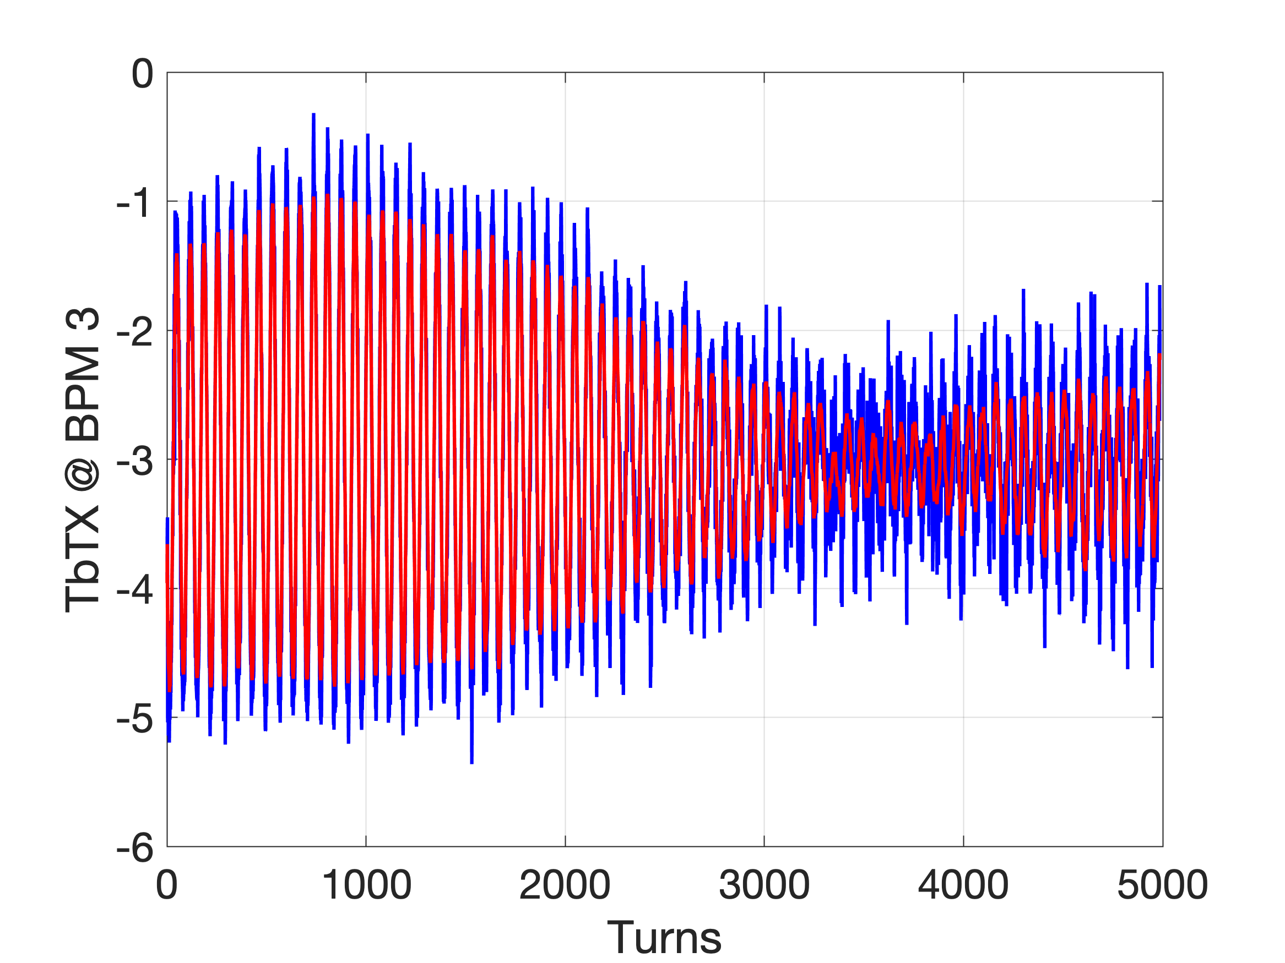
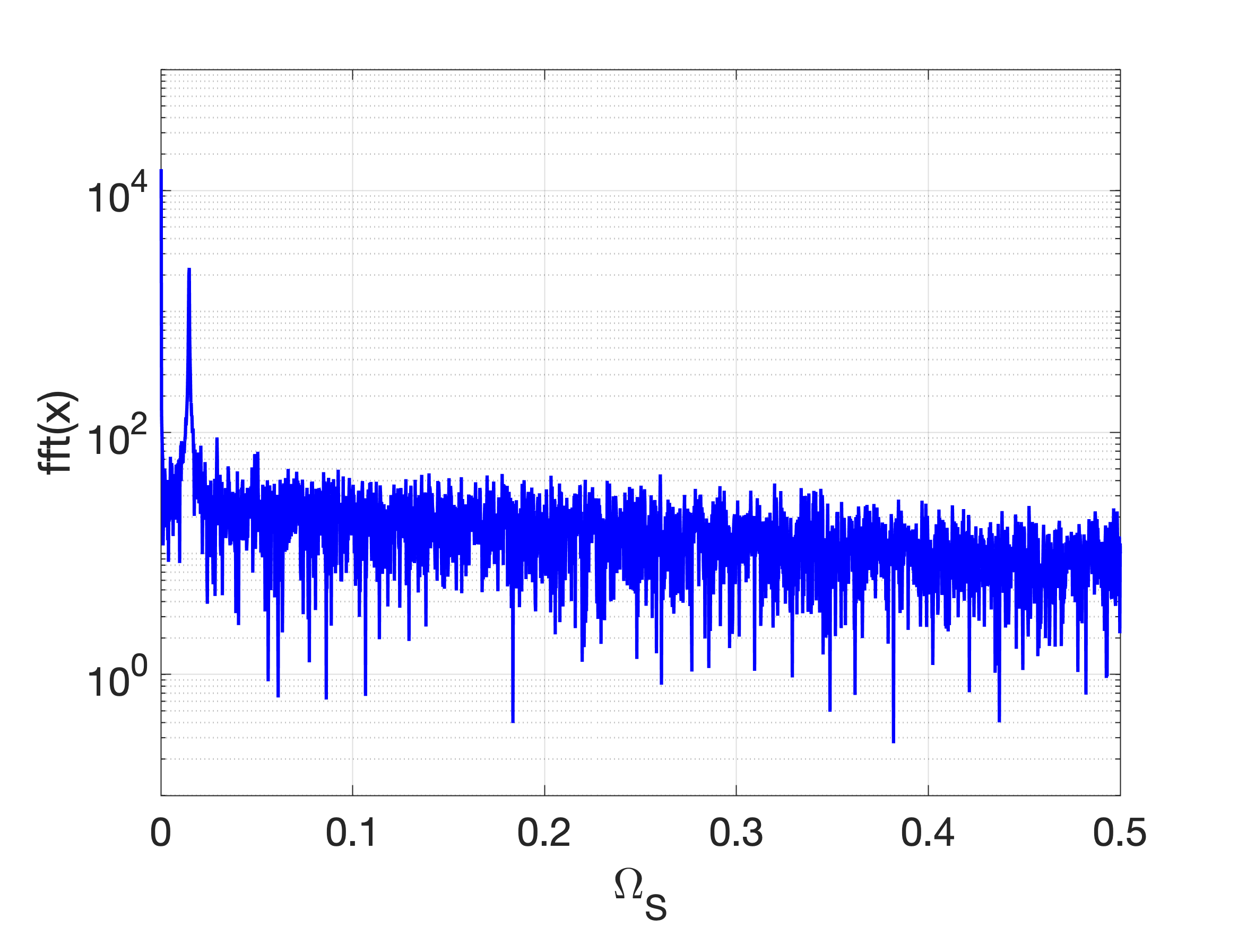
Check synchrotron oscillations
RF frequency = 500.4138 MHz
Synch. Tune form data = 136.6 turns
136.6 turns => ~40 kV

Slide 22
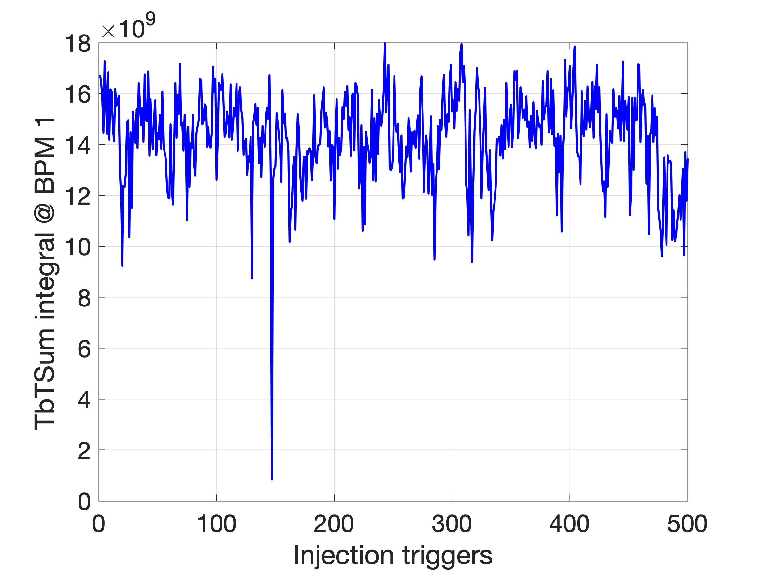
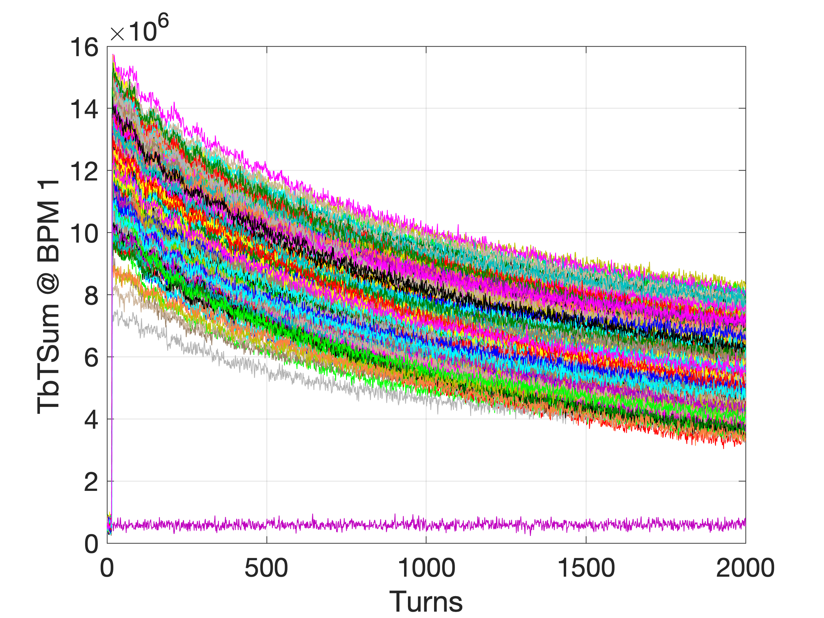
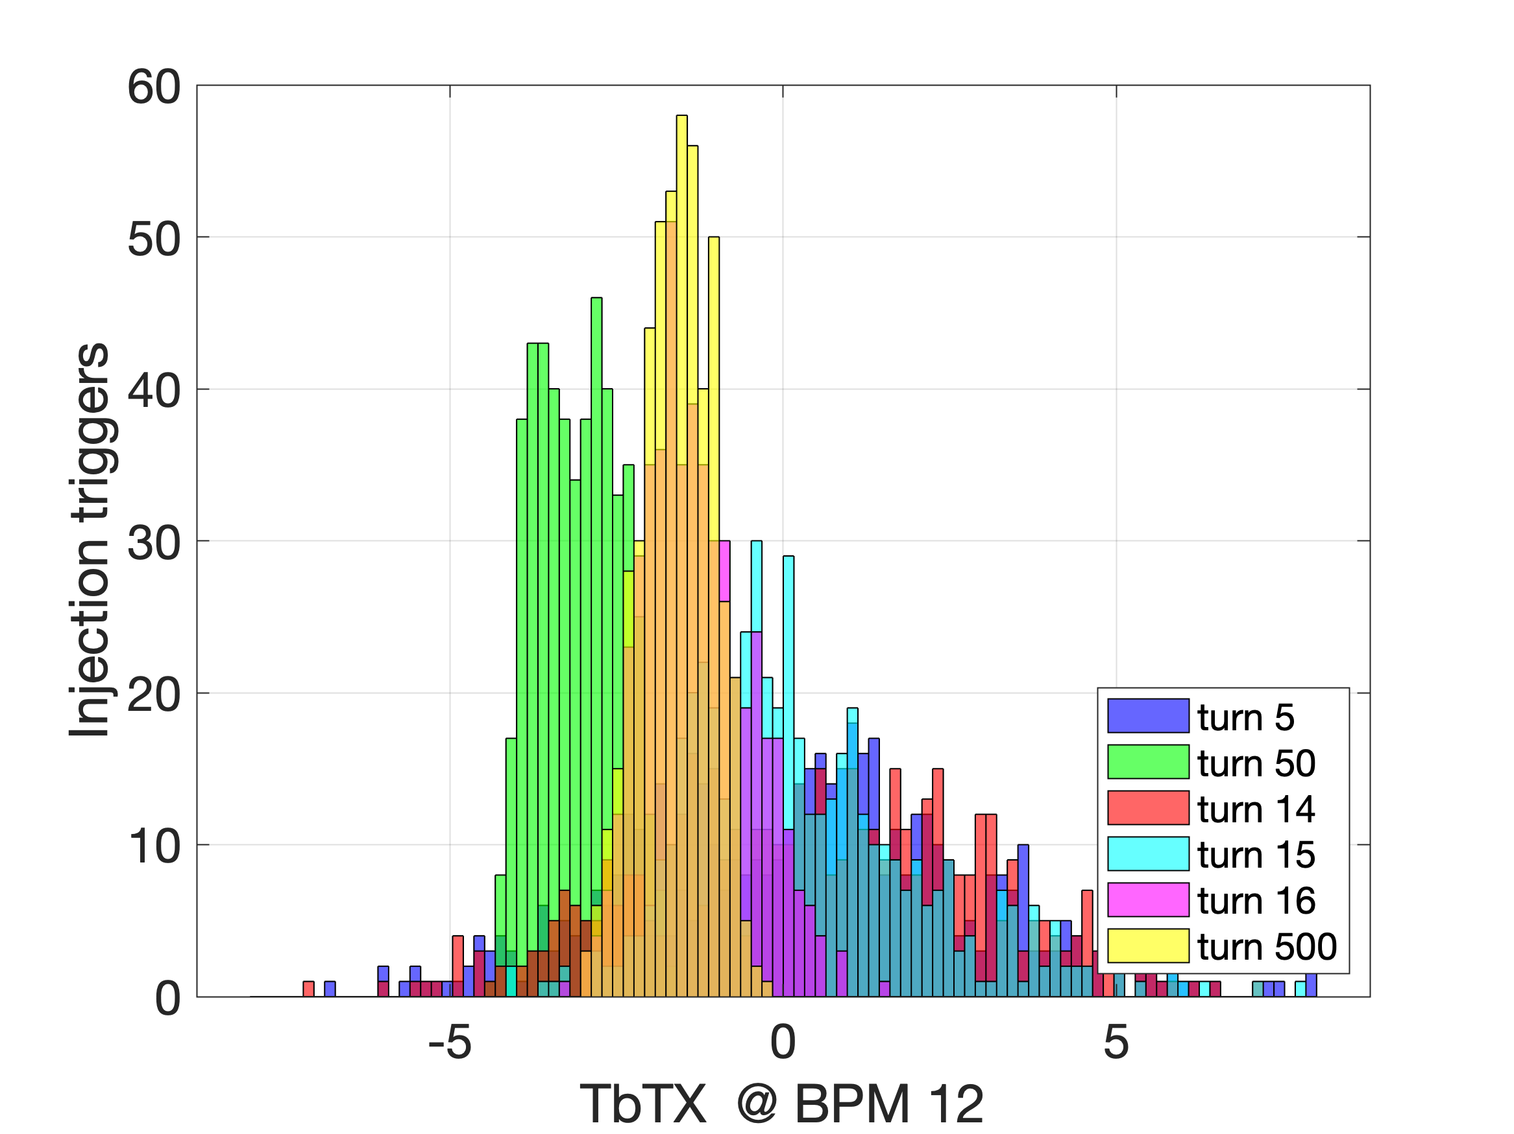
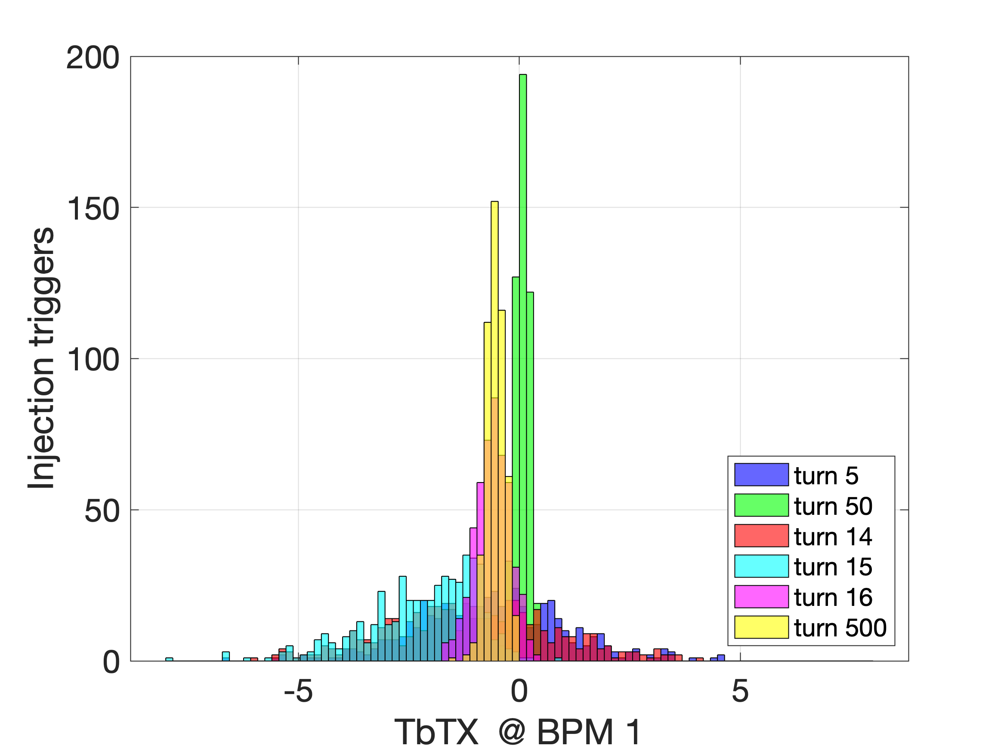
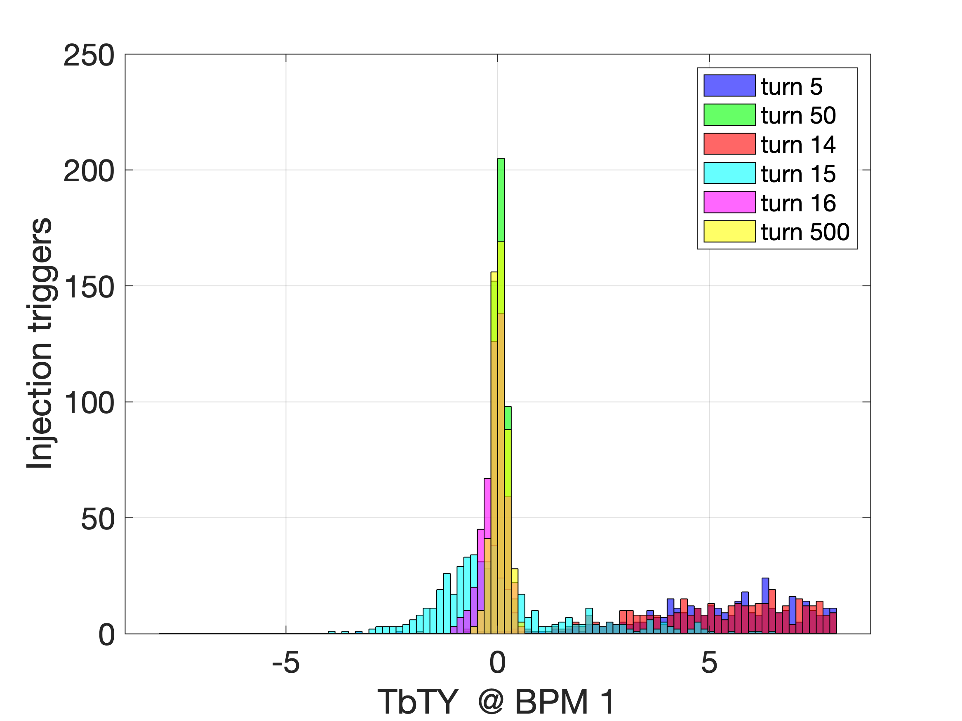
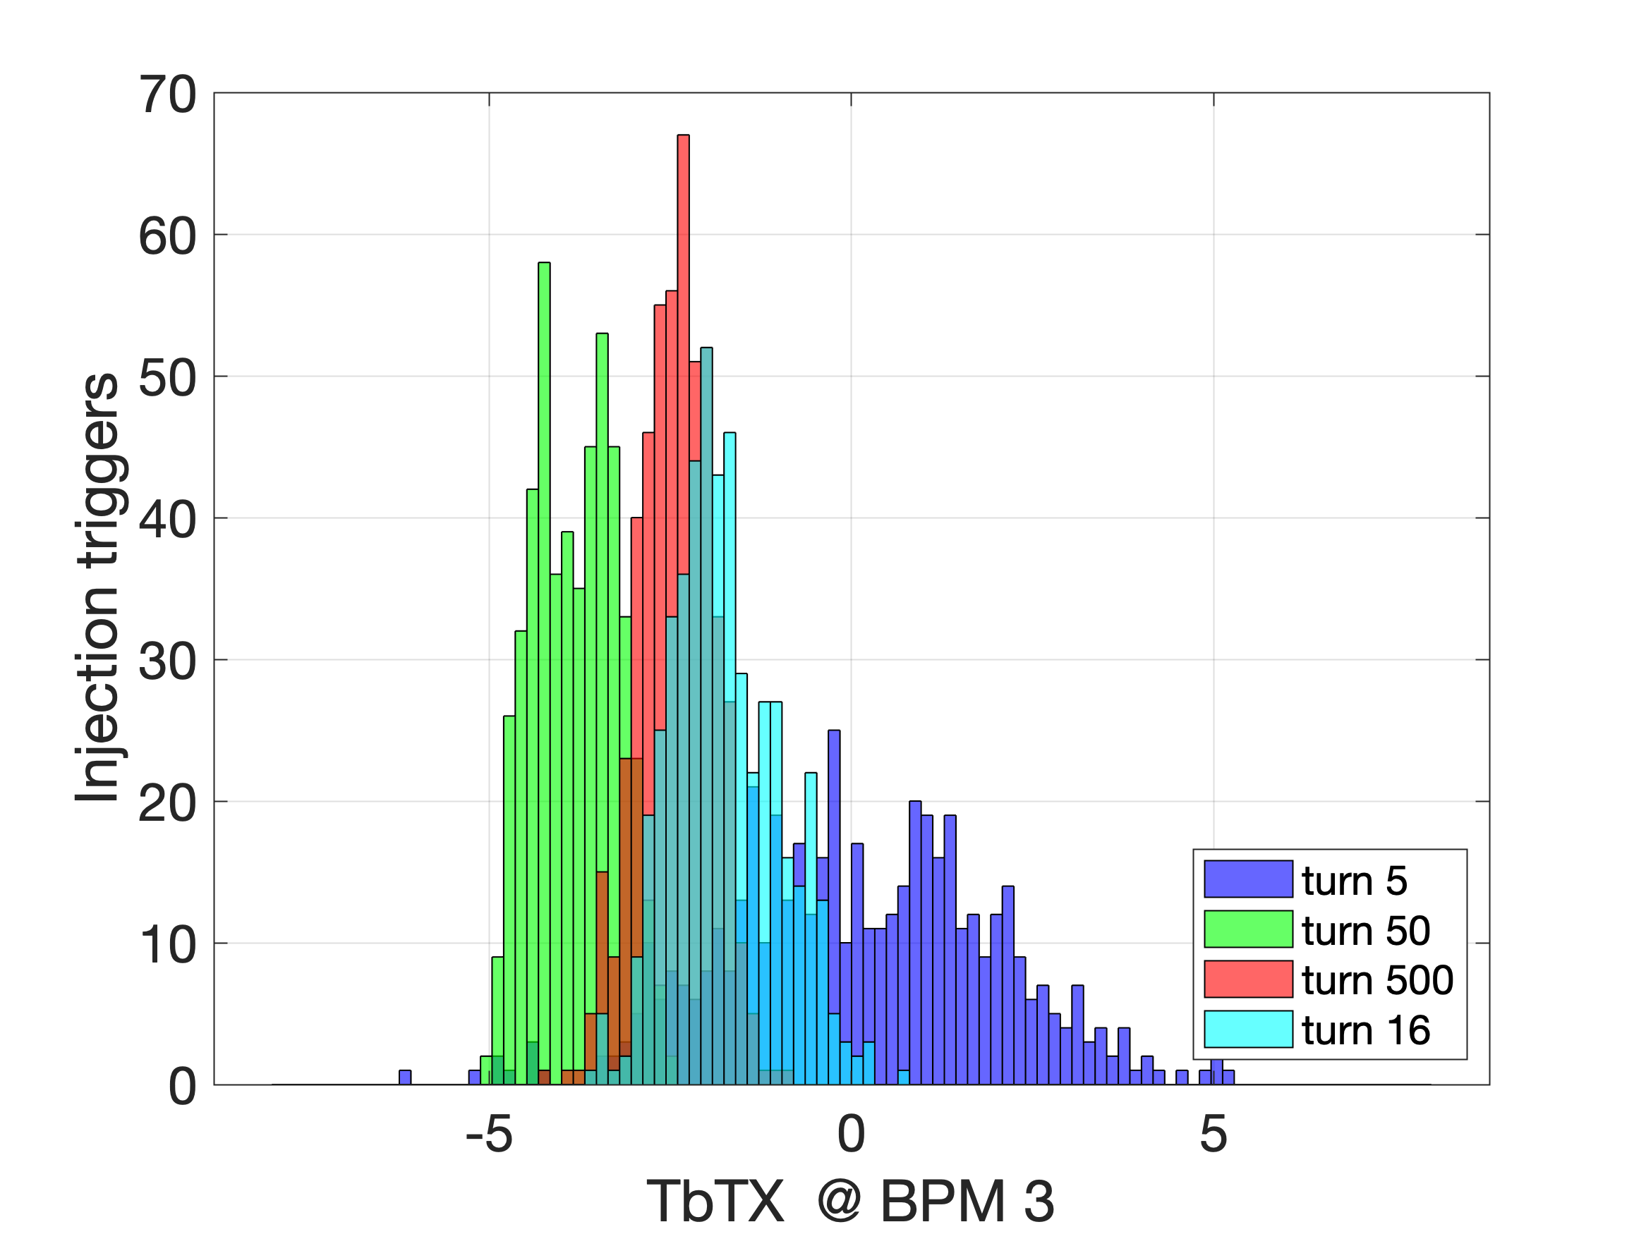
Storage with RF cavity (13 January 2023)
Radioprotection tests
DATA SET
ALLdata_2023-01-13_12-30-57.mat

Slide 23
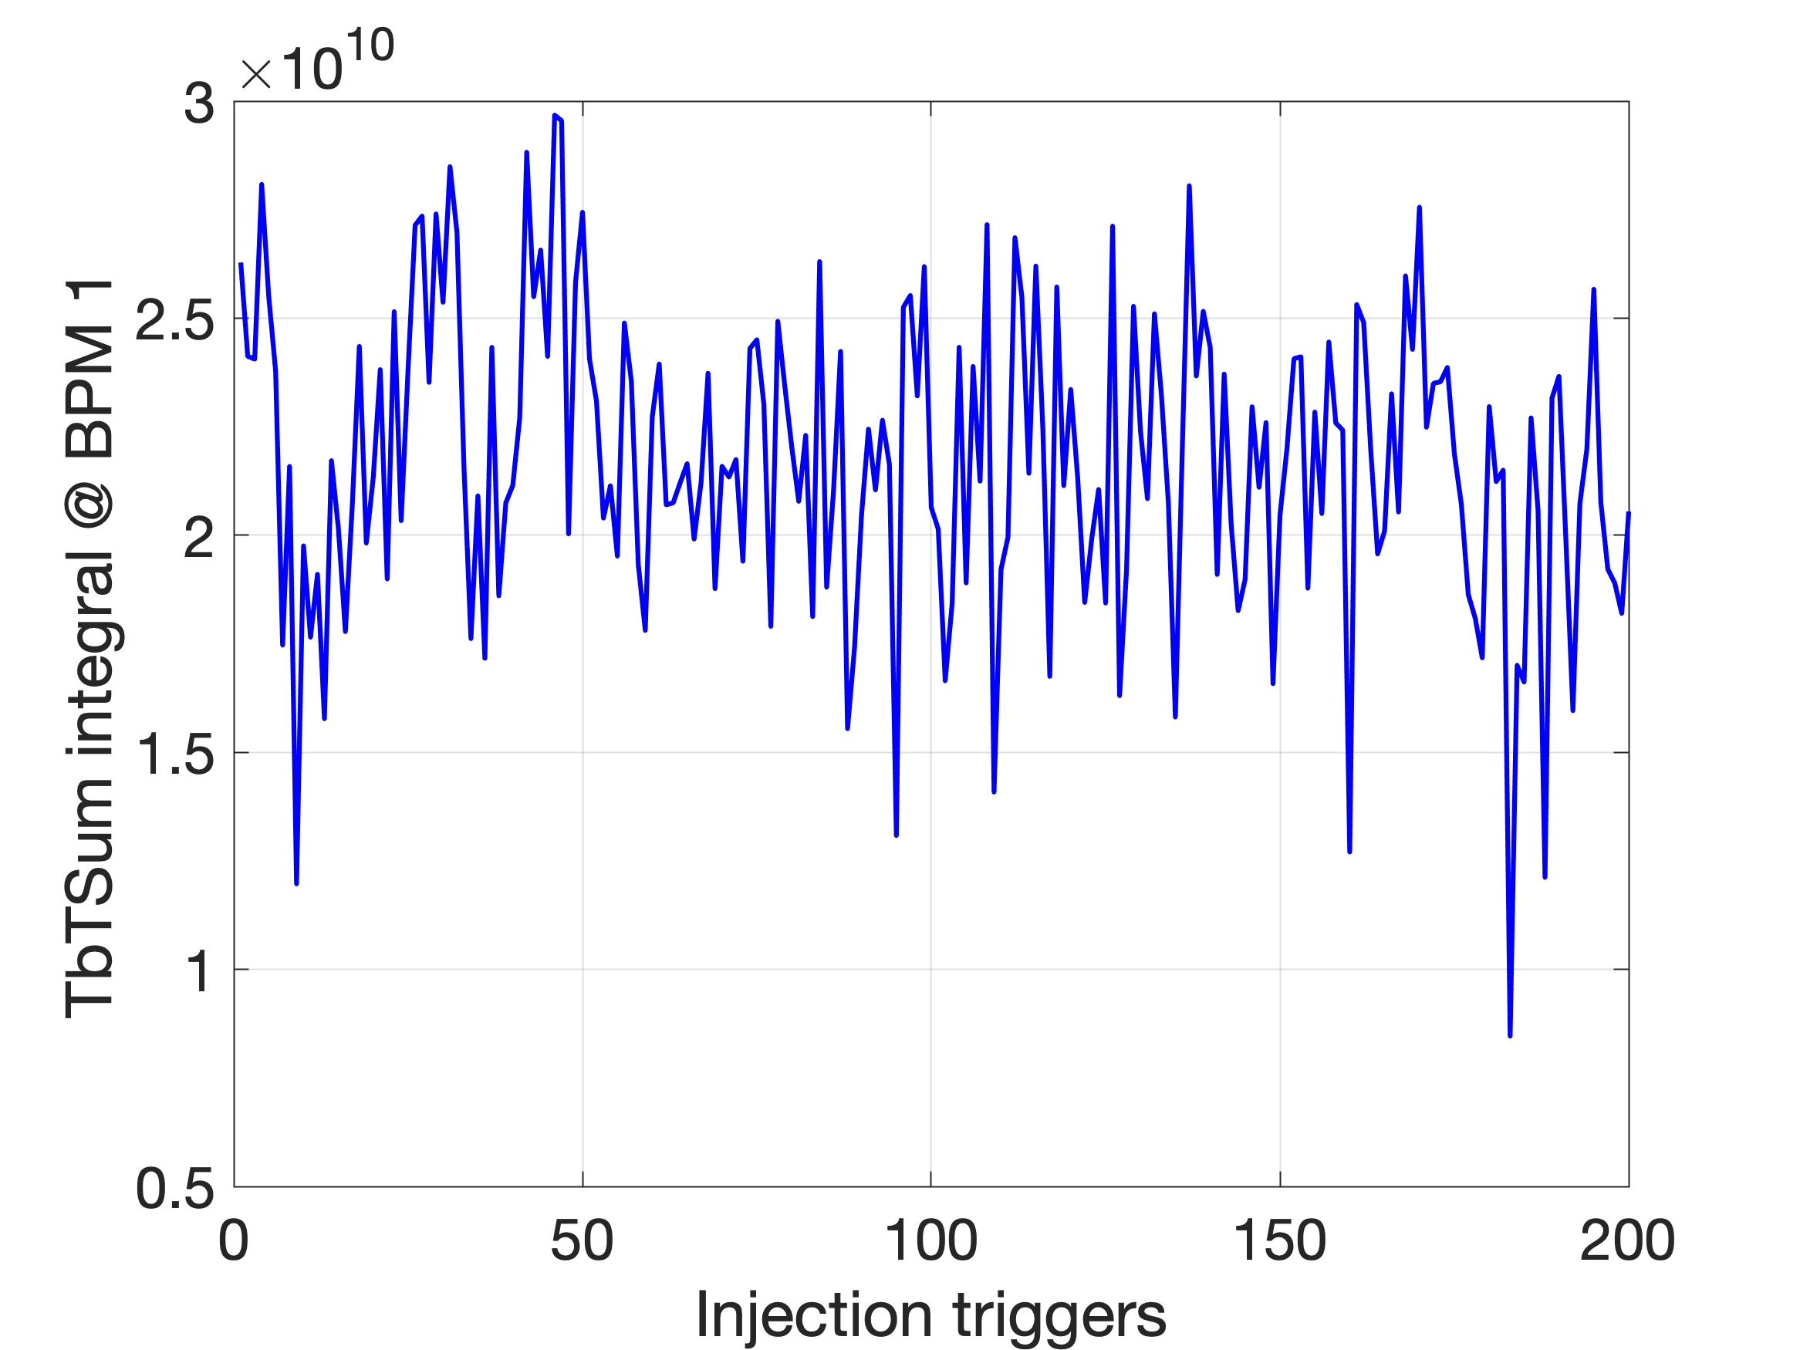
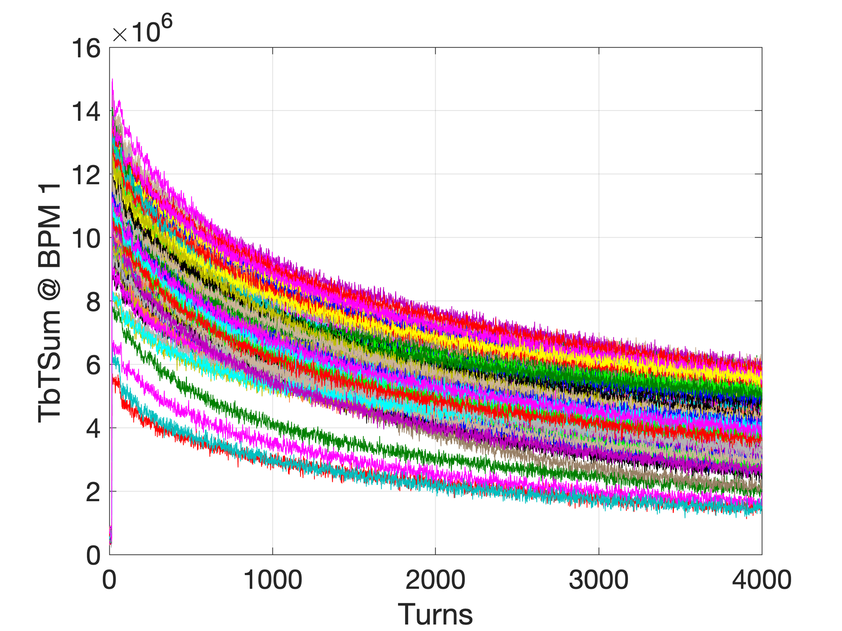
Storage with RF cavity (13 January 2023)
DATA SET
ALLdata_2023-01-13_13-26-54.mat

Slide 24
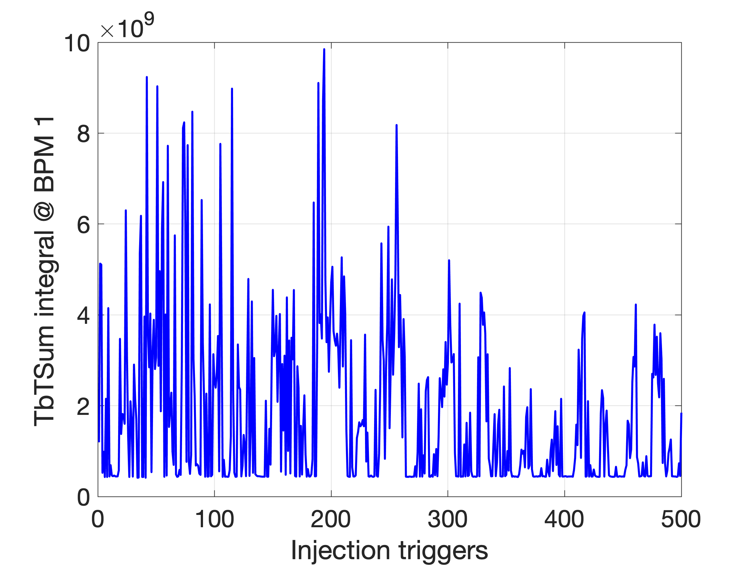
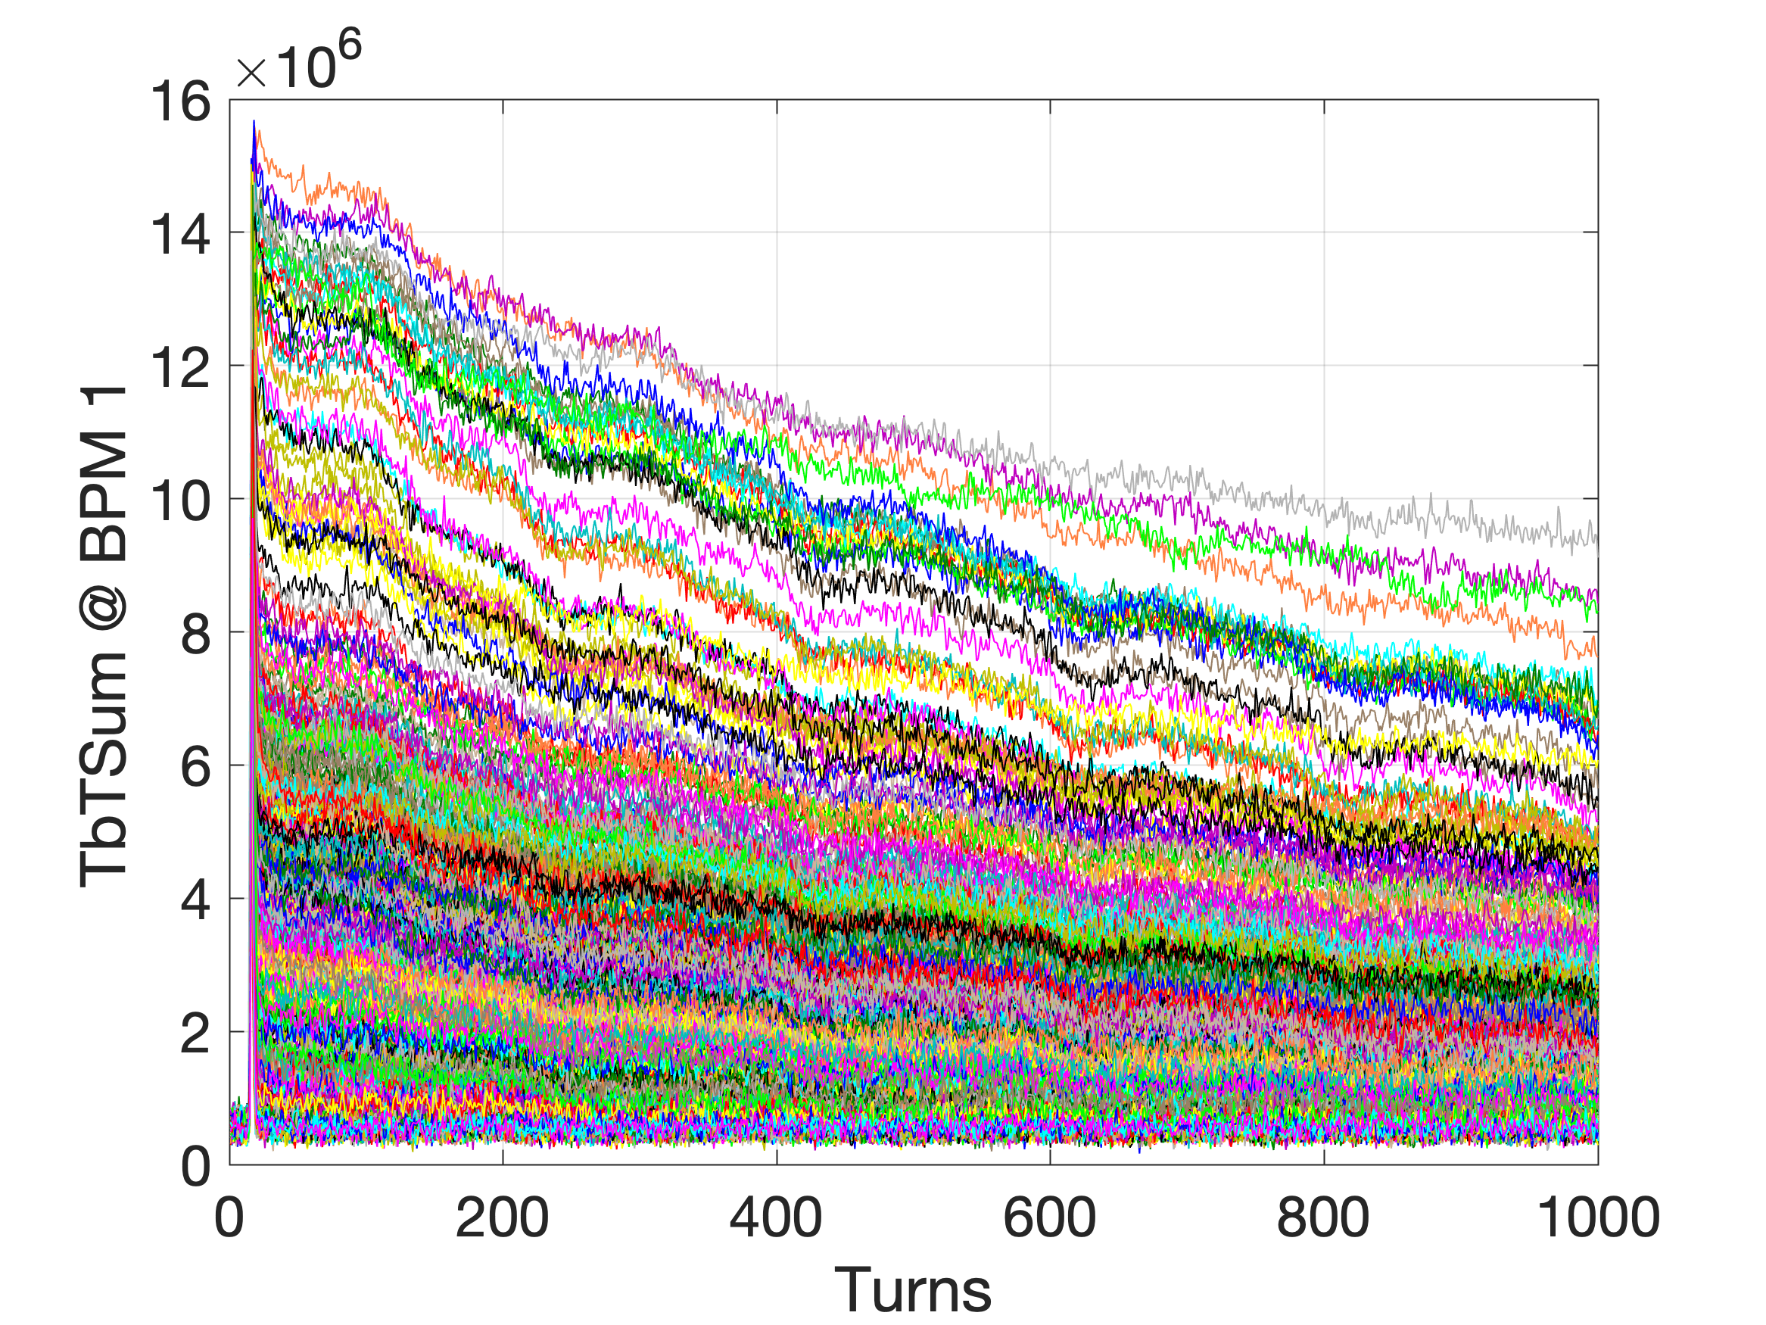
Storage with RF cavity (13 January 2023)
DATA SET
ALLdata_2023-01-13_14-40-51.mat

Slide 25
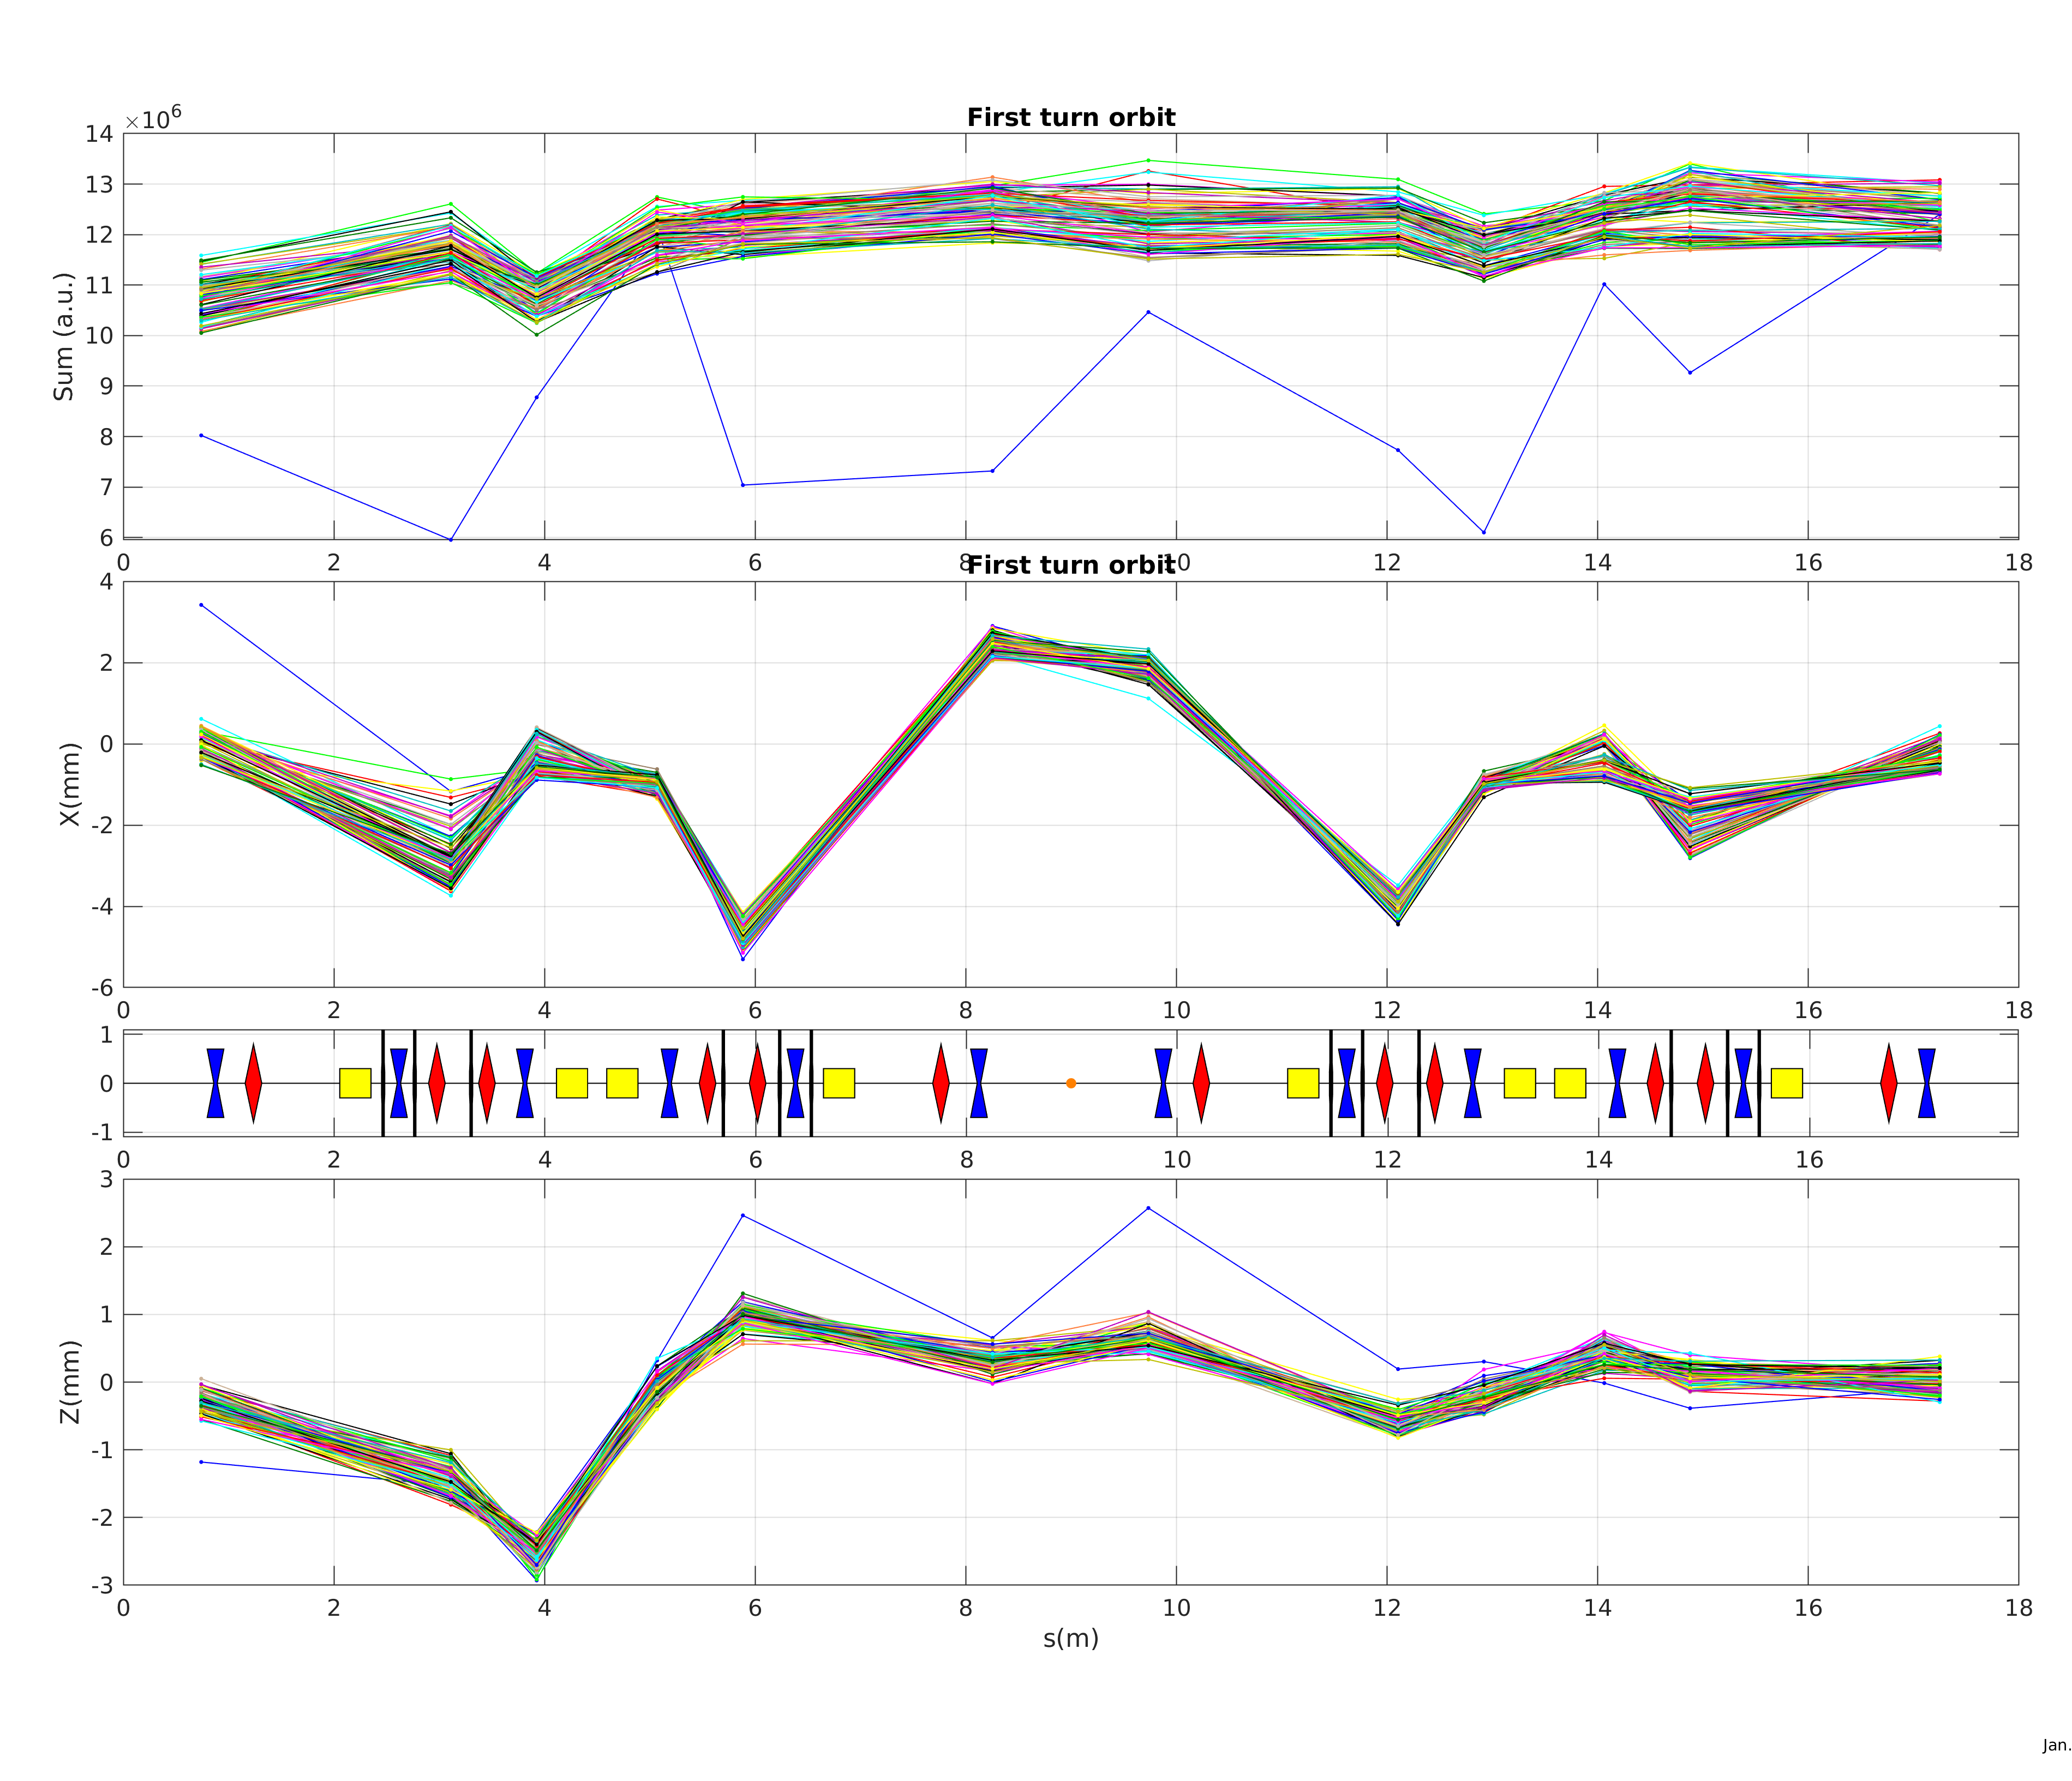
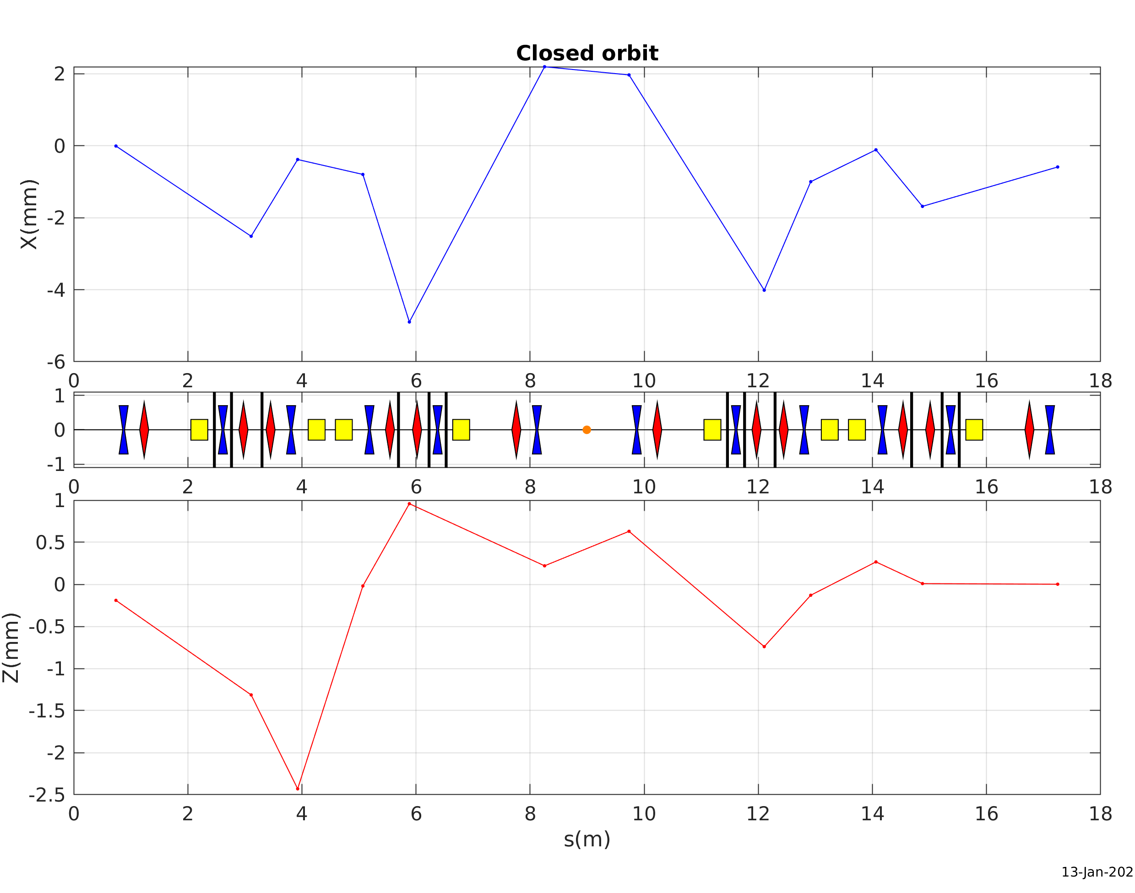
Storage with RF cavity (13 January 2023)
First 100 turns
Average orbit takin during 10sec
Mean between turn 100: 1000

Slide 26
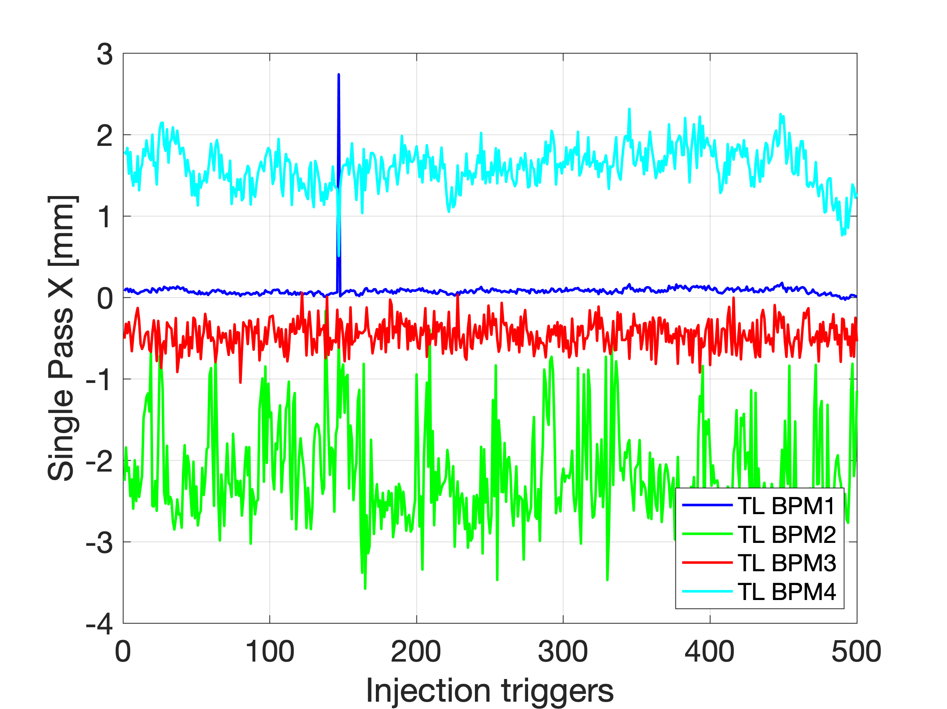
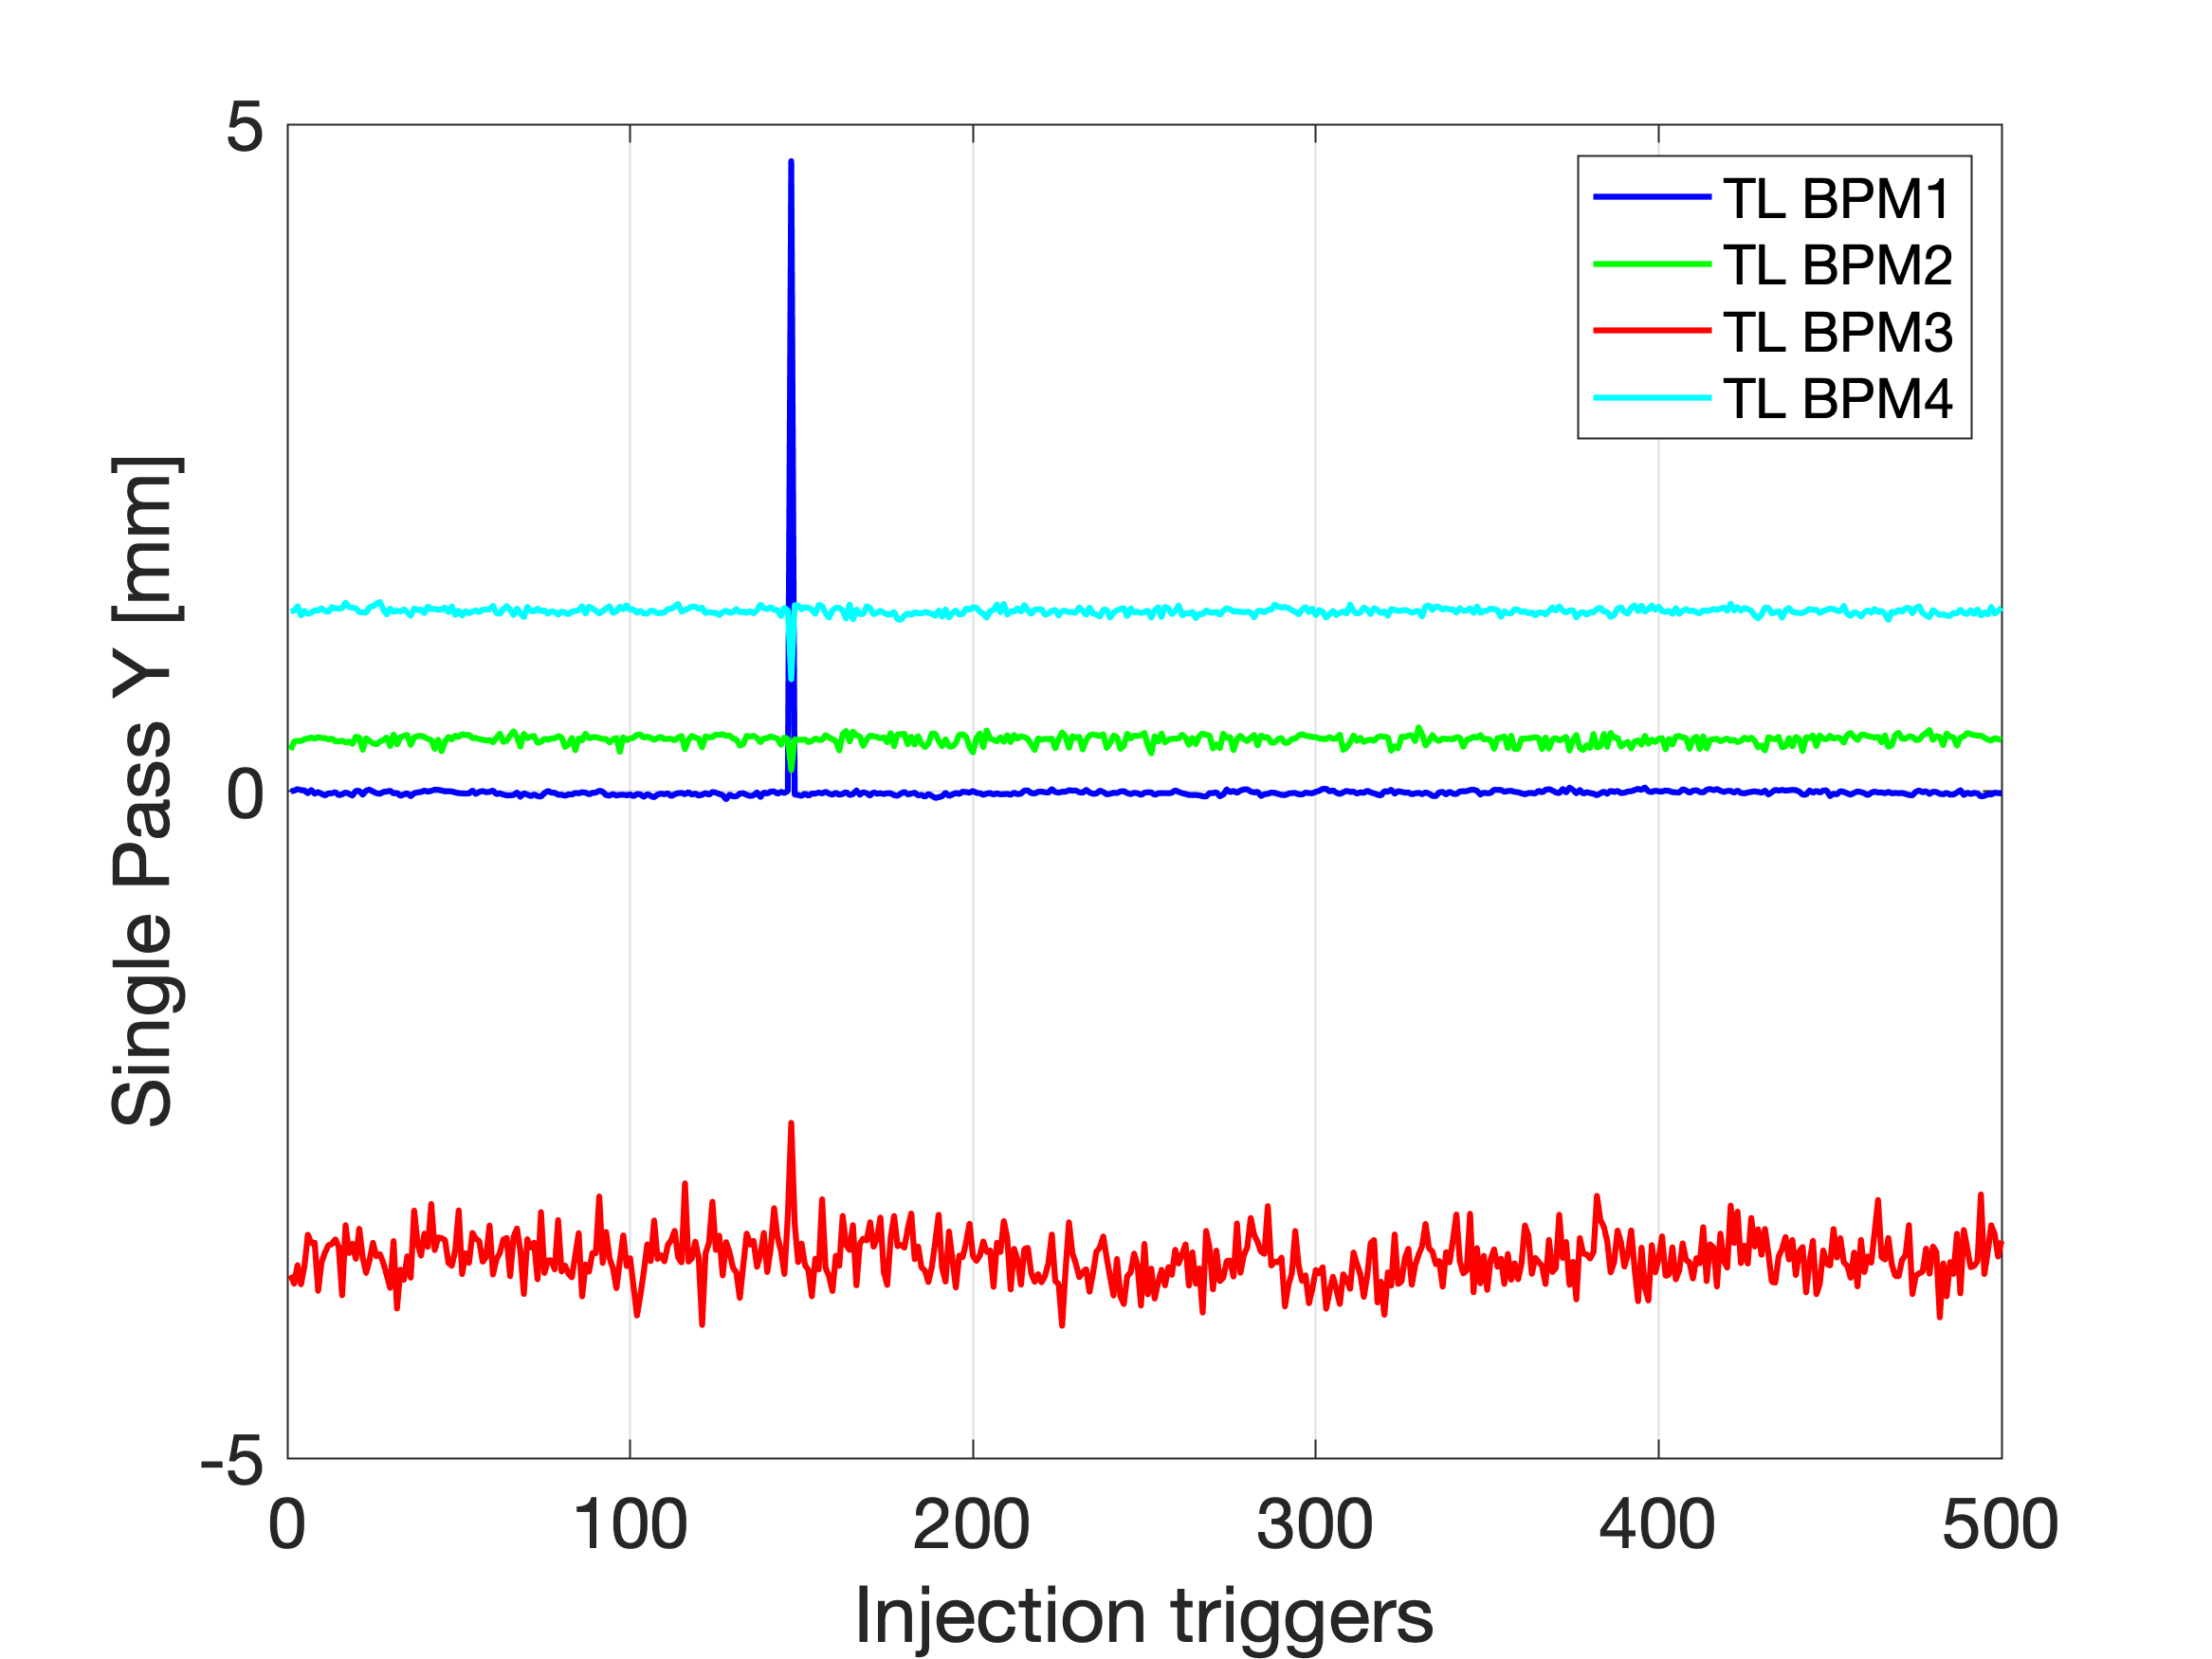
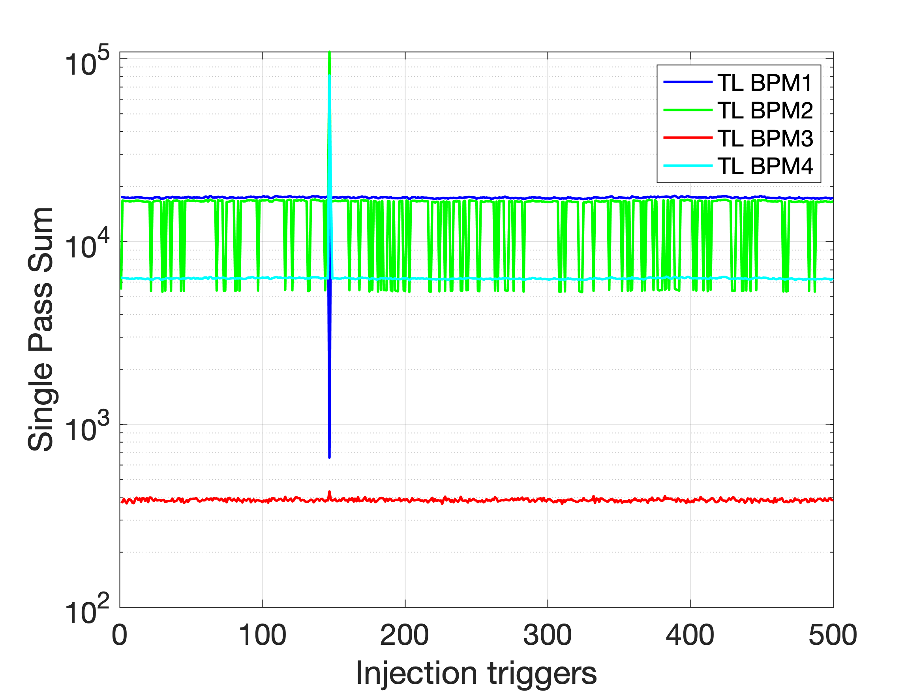
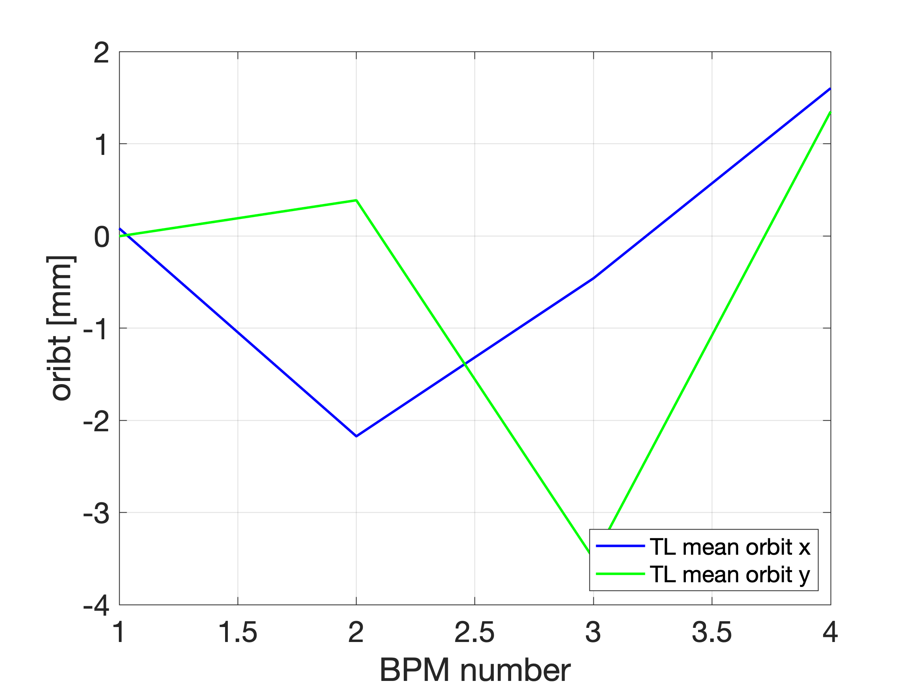
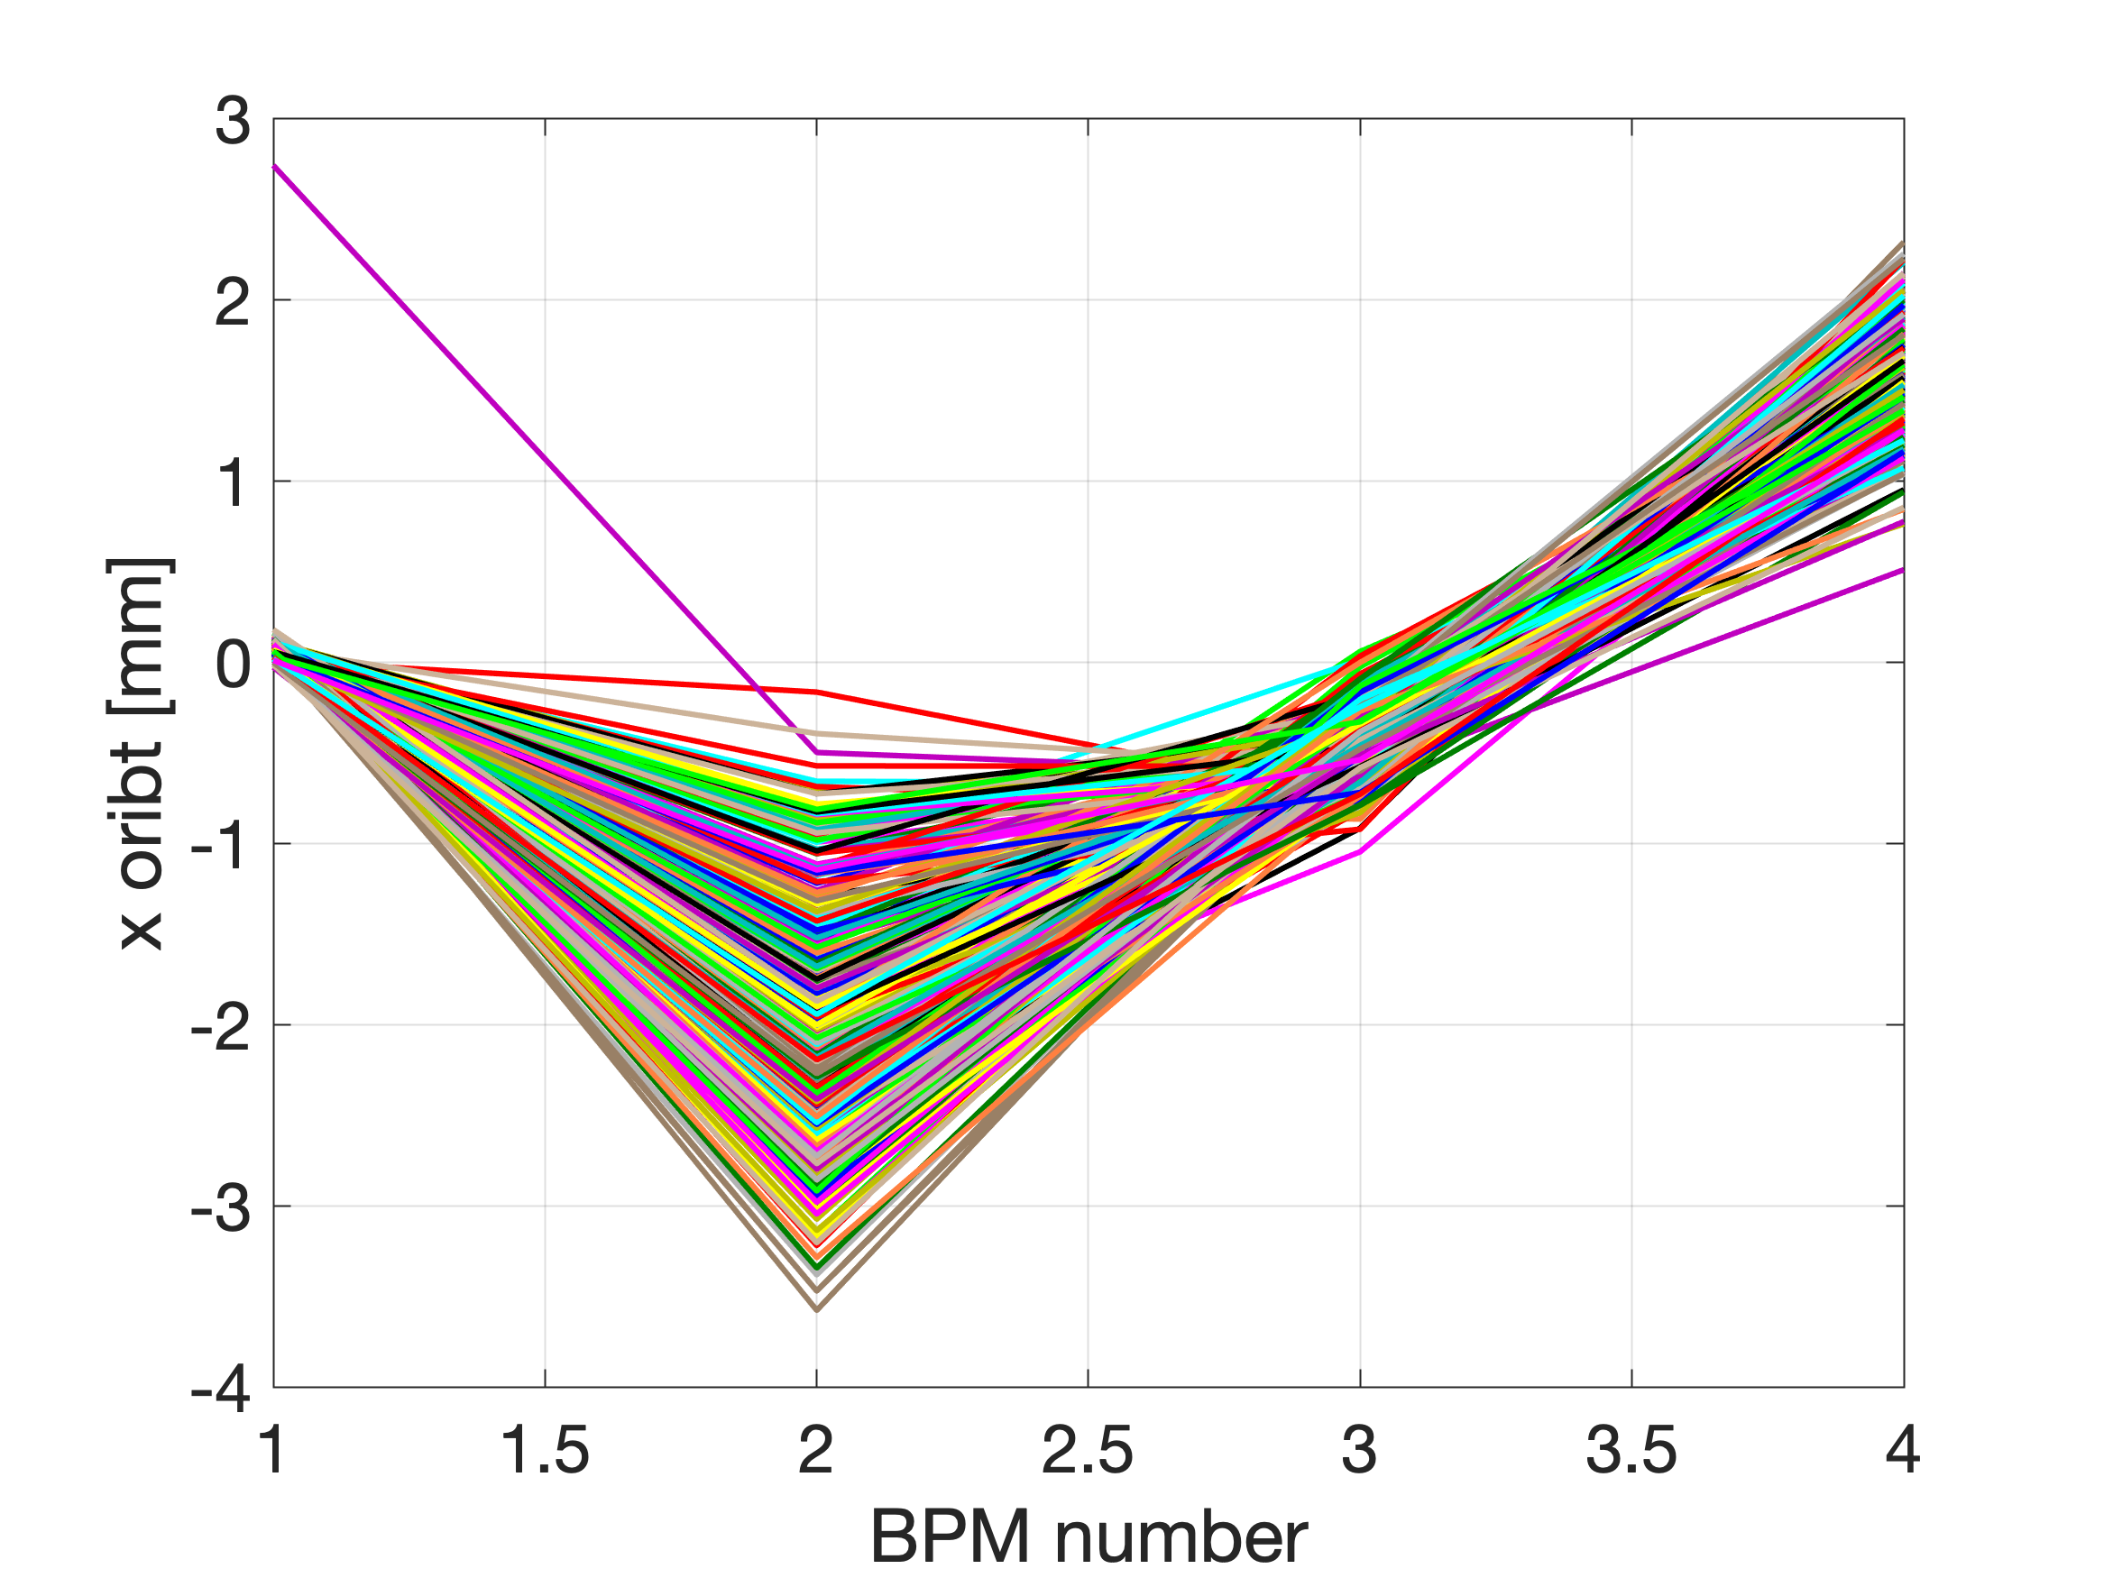
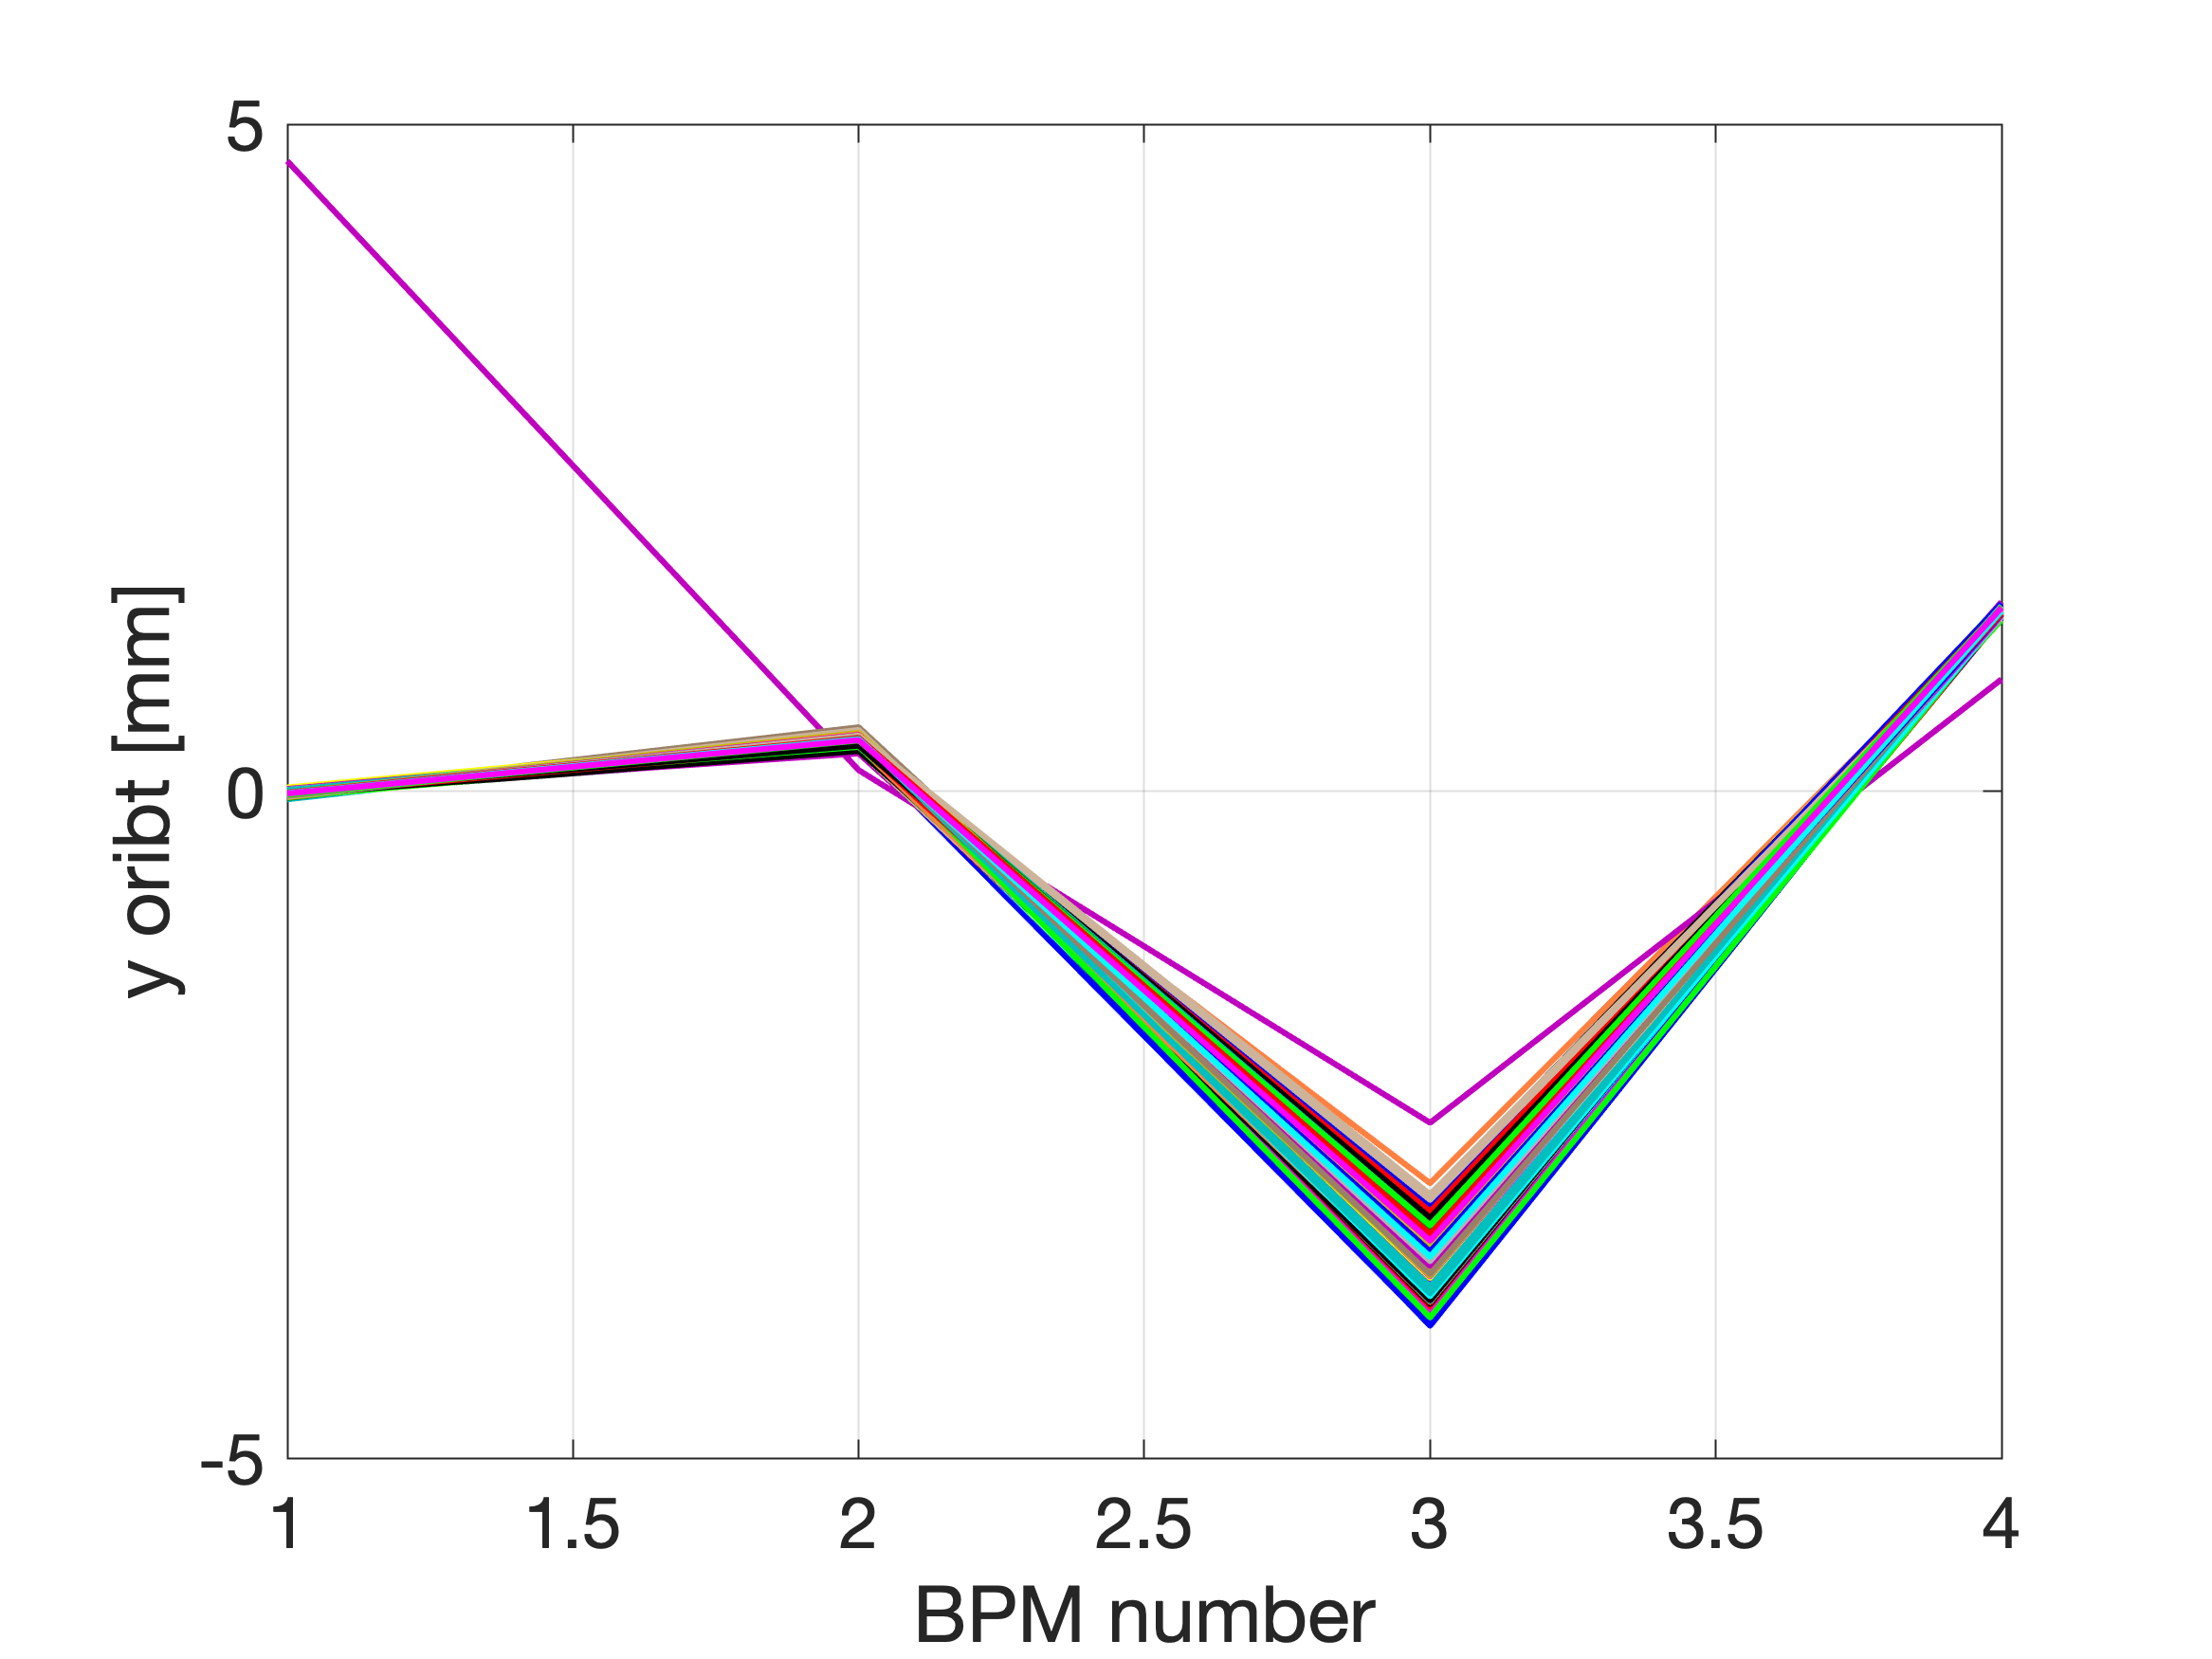
DATA SET
ALLdata_2023-01-13_12-30-57.mat

Slide 27
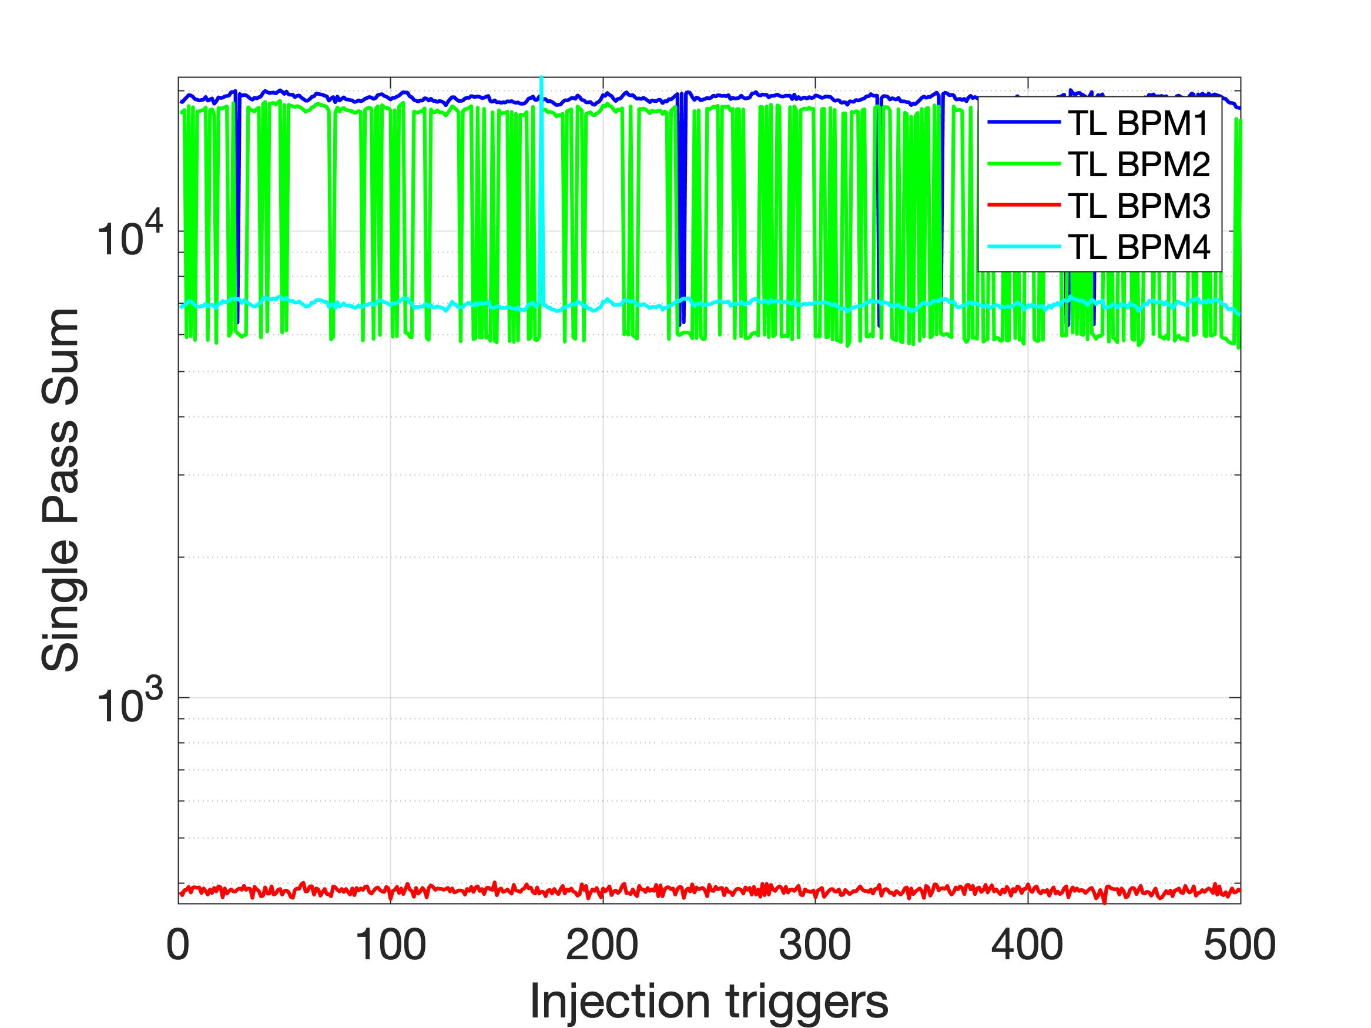
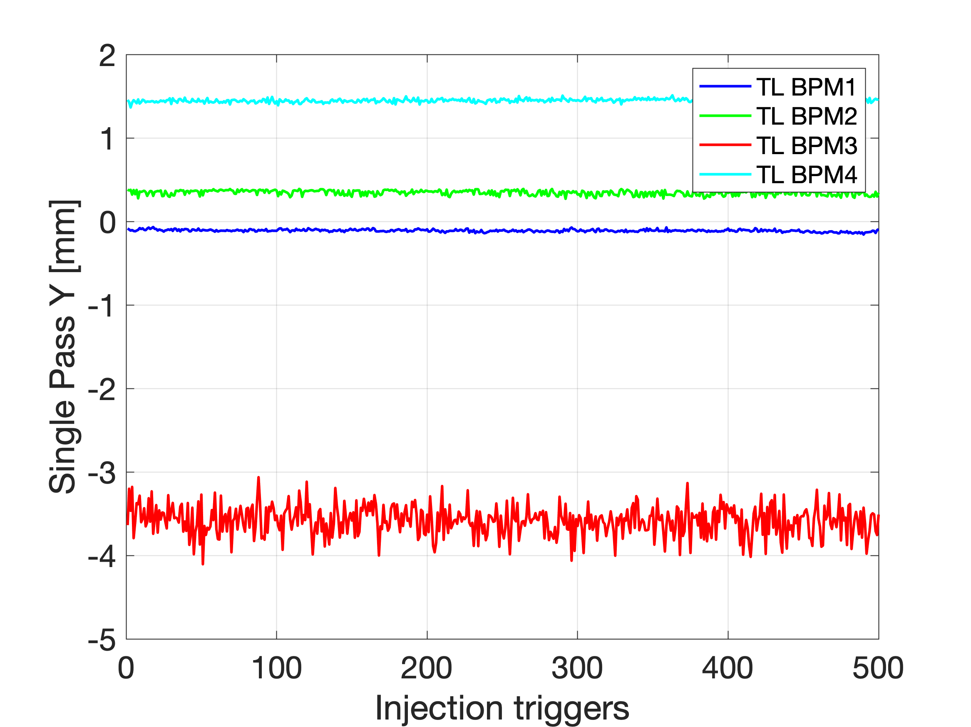
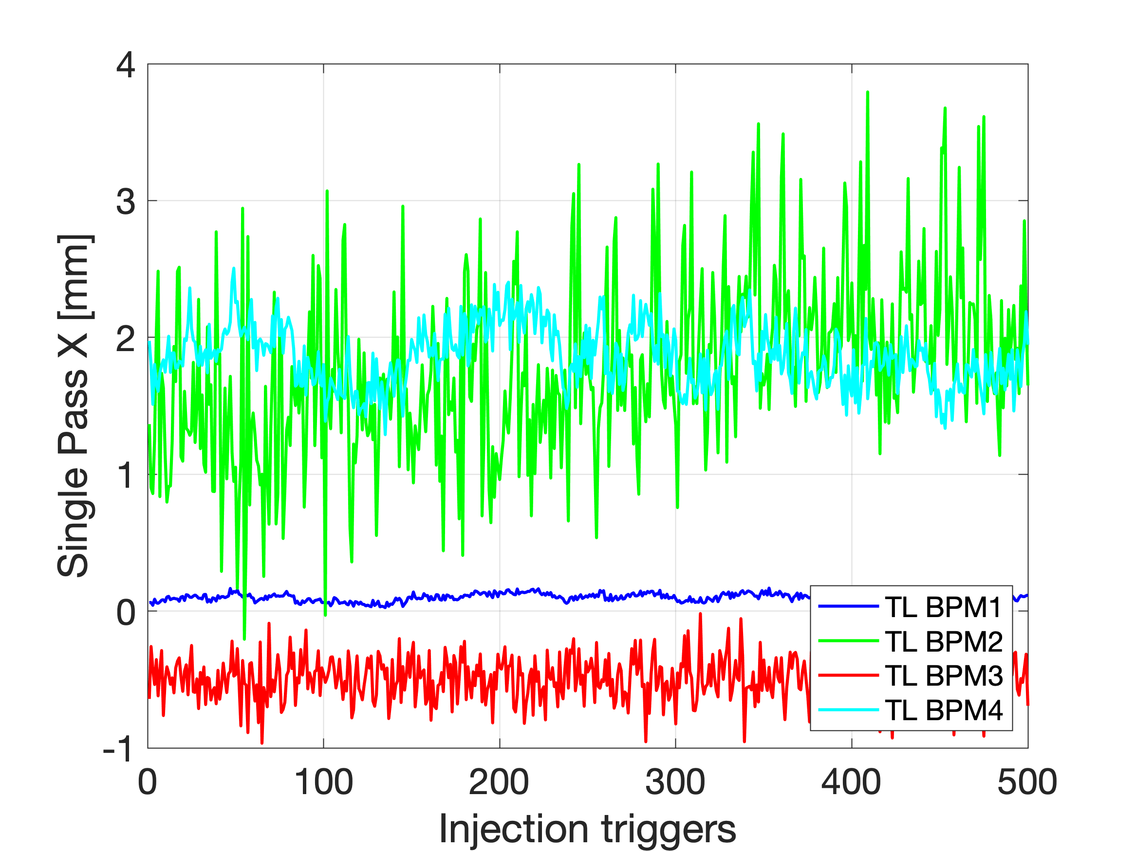
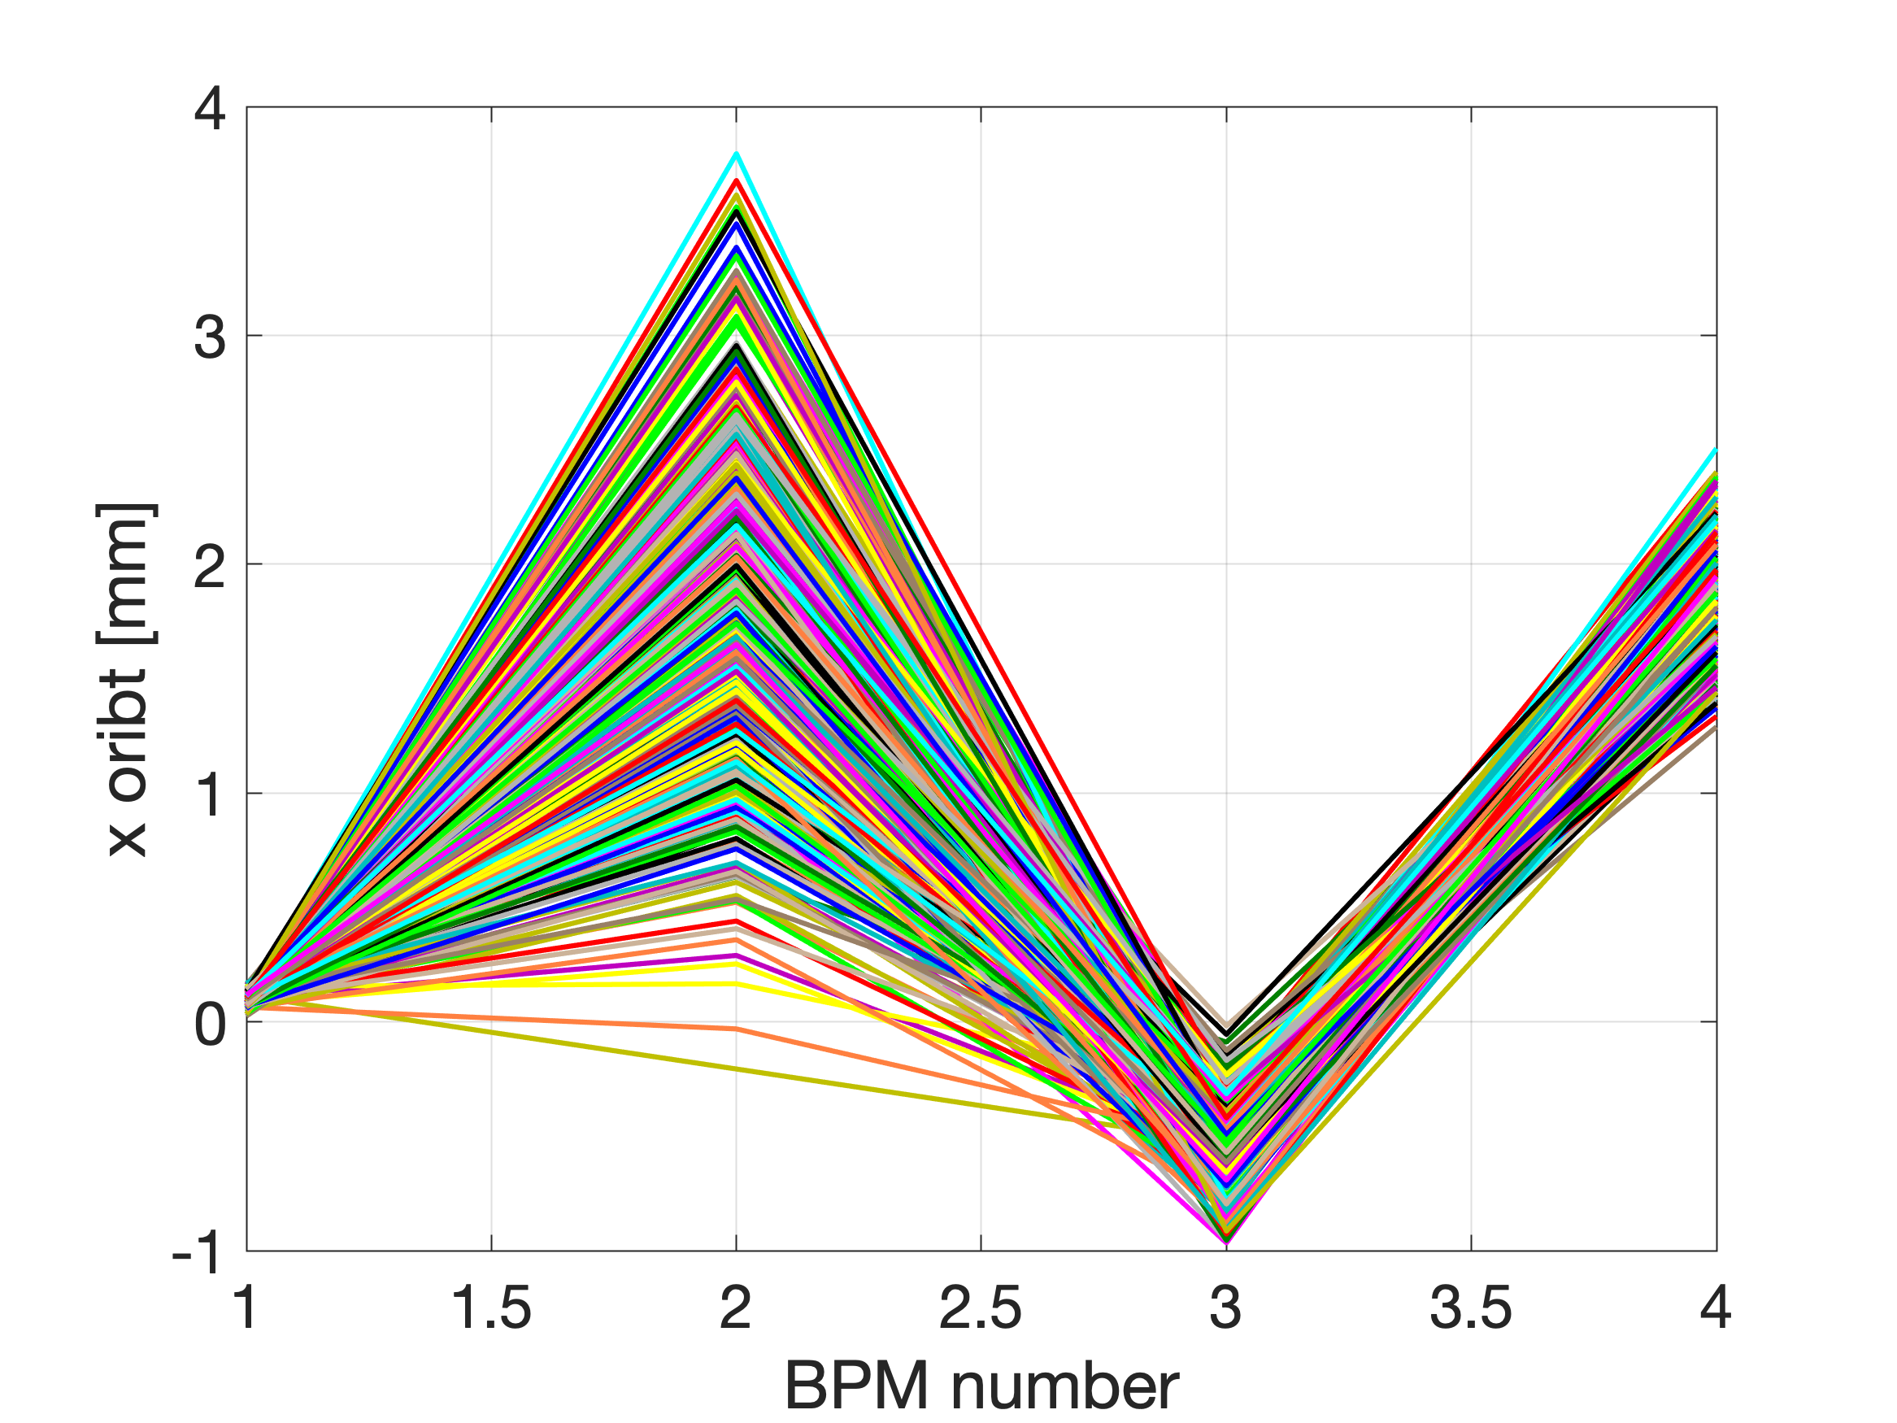
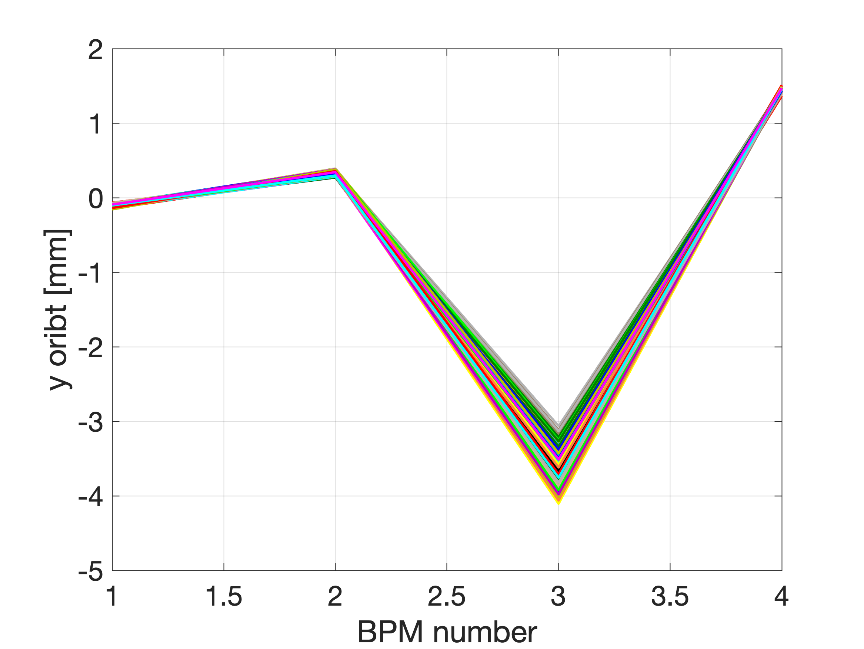
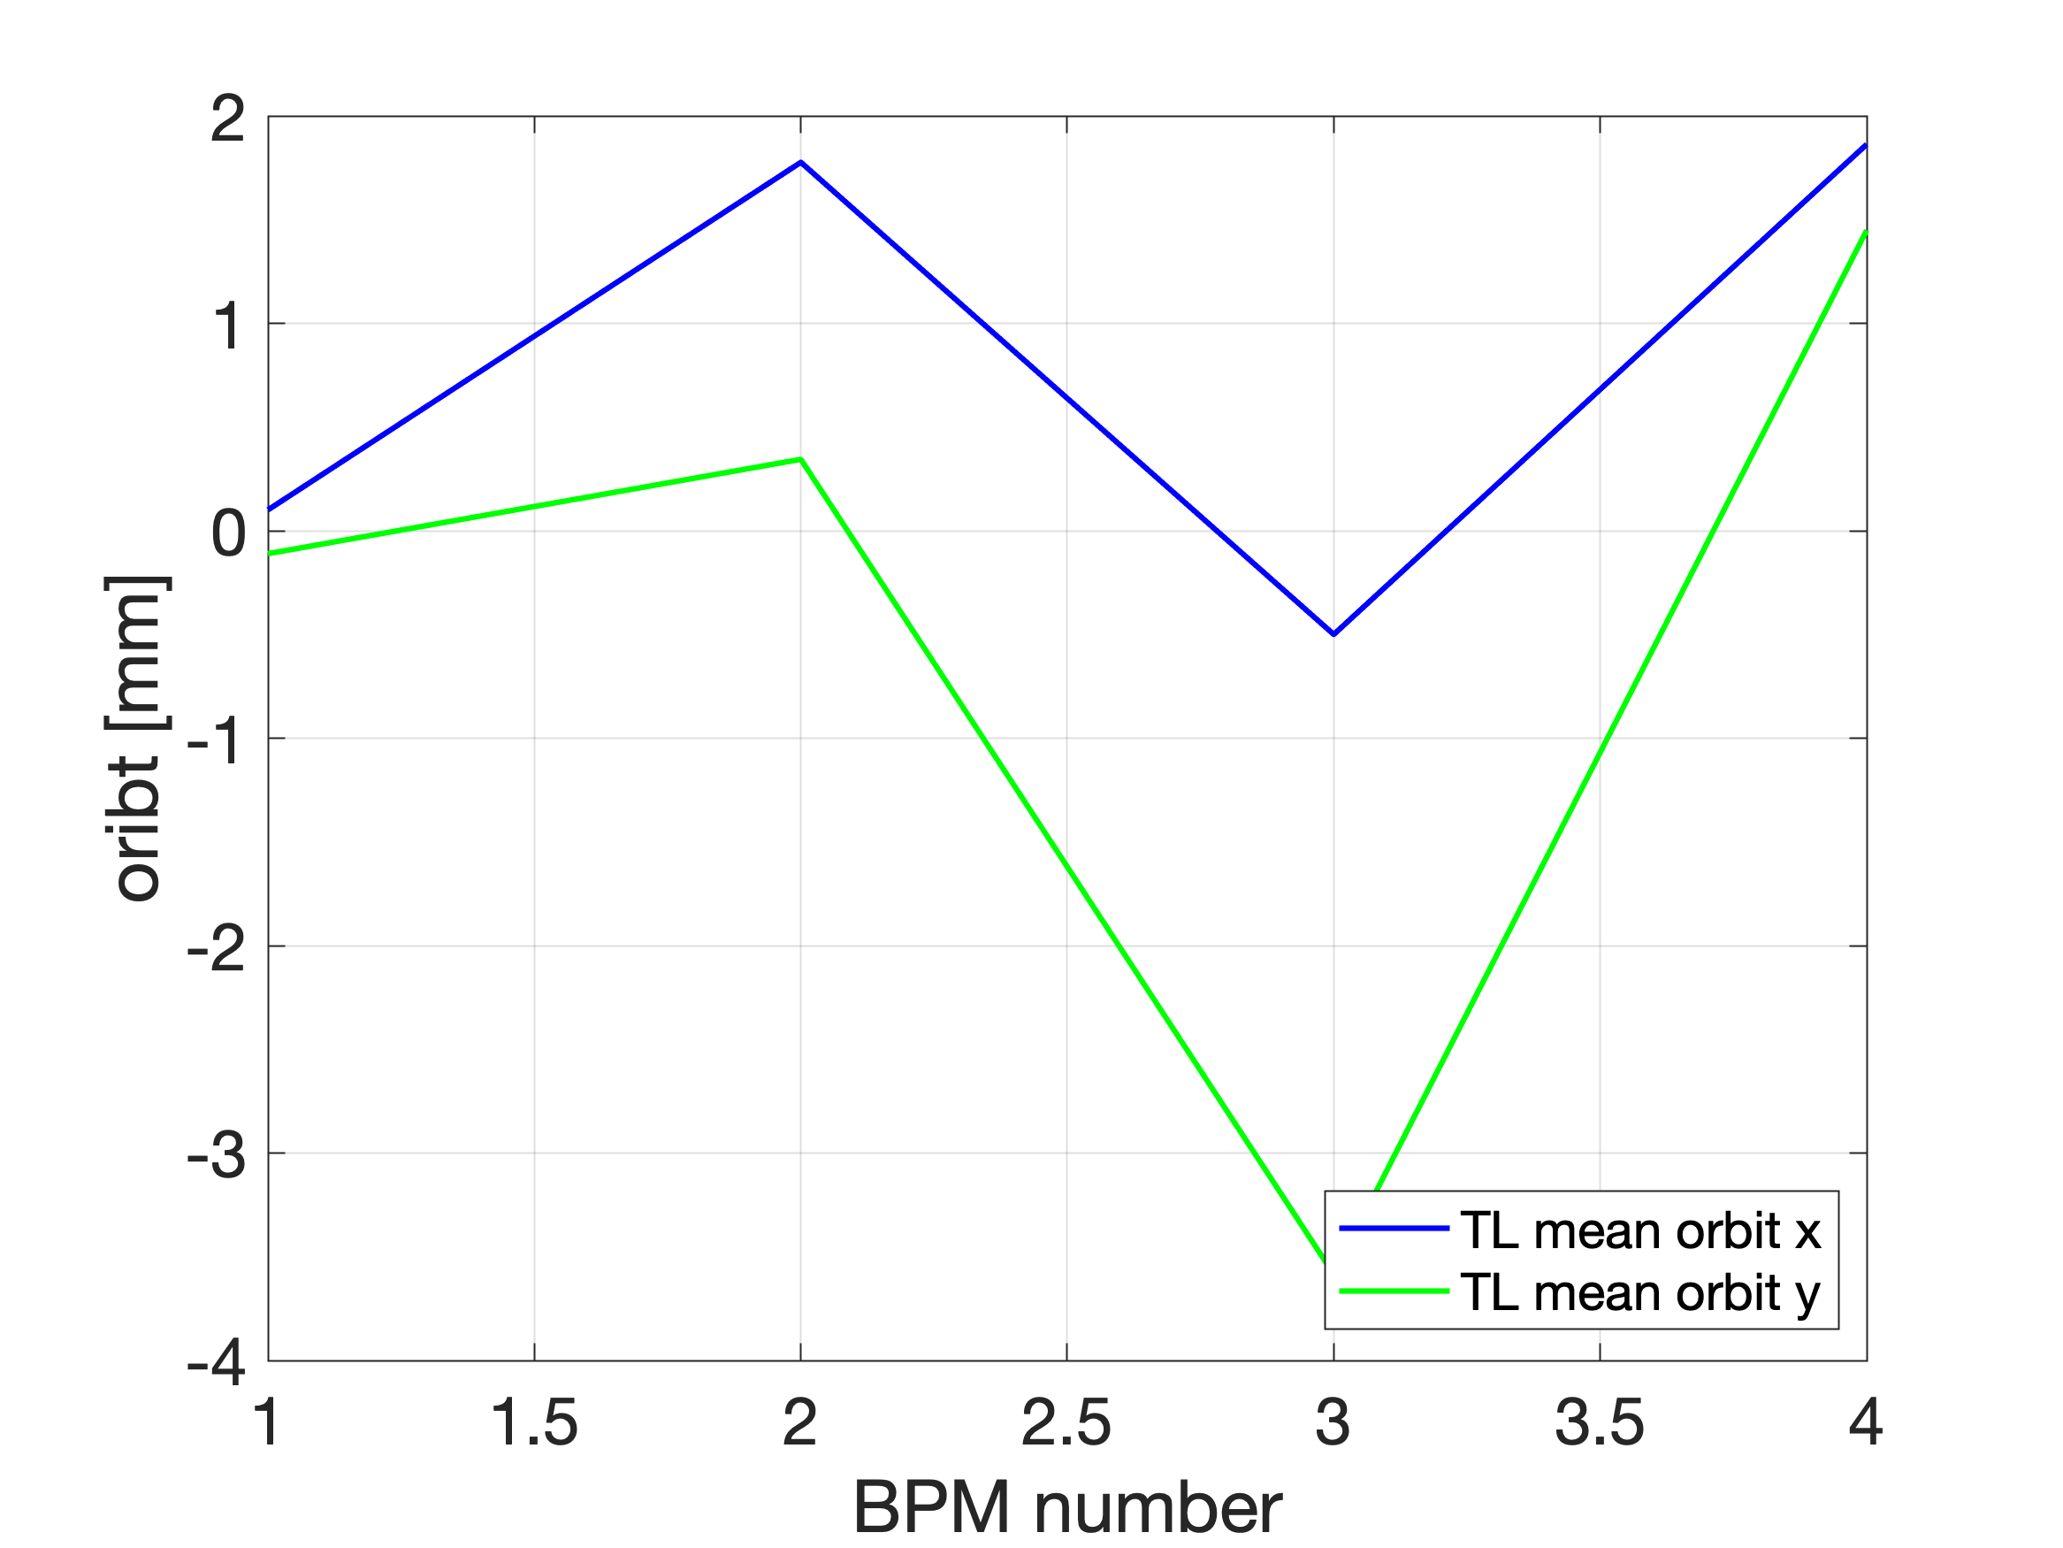
DATA SET
ALLdata_2023-01-13_14-40-51.mat

Slide 28
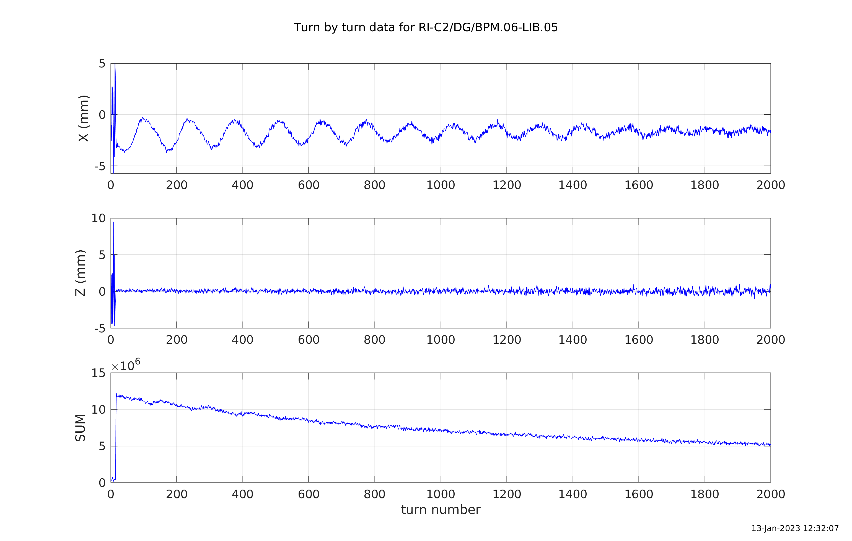
Check synchrotron oscillations

Slide 29


Check synchrotron oscillations
DATA SET ALLdata_2023-01-13_12-30-57.mat
RF frequency = 500.4335 with about 10 kV
Synch. Tune from data = 264.8 turns
@10 kV it has to be => 271.7799 turns

Slide 30


Check synchrotron oscillations
DATA SET ALLdata_2023-01-13_15-11-04.mat
RF frequency = 500.4334
Synch. Tune form data = 394.4 turns

Slide 31
Storage with RF cavity

Slide 32
Current situation
We menage to store the beam with low RF voltage (< 50 kV)
At higher values, difficult to store
During the scanning, the RF cavity should be manually tuned, the final control of the cavity is not yet ready

Slide 33
Global overview of the Ring commissioning

Slide 34


Global view. Data taken during Ring runs
During each shift we saved data in the same format in matlab. (~90 files , 10 Gb) Optics and BPMs for Ring and TL.
We combine all this data to have a global view on the injection , beam position and stability of parameters during 11/2022, 12/2022 and 01/2023.

Slide 35

Good that we have RCDS
Notes:
Good that we use RCDS

Slide 36



Injection stability at TL bpm4

Slide 37



Integral of TbTSum at first BPM in the ring.

Slide 38
Orbit and Orbit correction

Slide 39
Current situation
Orbit in the ring is quite stable
Correction works. Sometimes is not really effective.
Next steps (injector is not stable)
Should look at the misalignments
Measurements of the ORM

Slide 40
Tune measurements 3.17/1.64
Betatron tune H: 3.16998 (52835.37215 [kHz])
V: 1.64018 (27337.53540 [kHz])
Momentum Compaction Factor: 1.42815e-02

Slide 41
Current situation
We tried to look at the tune via the FFT
4-turn algorithm also does not work
The results are very strange. We do not see the betatron oscillations
Reasons
Data treatment of Libera, mixing of 2 turns, Libera settings ?
Trigger problem ?
Try more sophisticated analysis of TbT data ?

Slide 42

First trial for tune estimation

Slide 43



Slide 44



(13 January 2023)

Slide 45
ThomX beam emittance measurement
By the ring team

Slide 46
Layouts
Linac exit
Transfer line exit
QP3 to screen distance is 2000 mm
QP7 to screen distance 2249 mm

Slide 47
QP3 quadruple scan from 24.04.2022
β_{x} = 4.73, α_{x} = 1.34

Slide 48
QP7 quadruple scan from 16.12.2022
β_{x} = 4.33 m α_{x} = 3.77

Slide 49
QP7 quadruple scan from 14.10.2022
β_{x} = 16.74 m α_{x} = 27.12

Slide 50
BACKUP

Slide 51

MML
[1 4]
[1 3]
[1 2]
[1 1]
QP2
-QP1
-QP1
QP2
[1 1]
[2 6]
HCOR
HCOR
[1 2]
[2 5]
HCOR
HCOR
[1 3]
-QP31
-QP31
[2 4]
HCOR
[1 5]
BPM 1
BPM 12
[2 12]
HCOR
QP41
[1 1]
QP41
[1 6]
[1 12]
QP4
BPM 2
BPM 11
QP4
[1 7]
[1 11]
-QP3
[1 2]
RI-C1
-QP3
[1 8]
BPM 3
BPM 10
BPM 4
RI-C2
BPM 9
-QP3
-QP3
QP4
BPM 5
BPM 8
QP4
QP41
BPM 6
BPM 7
QP41
HCOR
[1 12]
-QP31
HCOR
[1 4]
-QP31
[2 1]
[2 2]
[2 3]
[2 4]
[2 3]
HCOR
QP2
-QP1
-QP1
QP2
HCOR
[1 5]
[2 2]
HCOR
HCOR
[2 1]
[1 6]

Slide 52
Tango
QP.04
QP.03
QP.02
QP.01
STR.01-H.01
STR.01-V.01
STR.06-H.01
STR.06-V.01
STR.02-H.01
STR.02-V.01
STR.05-H.01
STR.05-V.01
STR.03-H.01
STR.03-V.01
QP.05
QP.12
BPM.02-LIB.03
BPM.01-LIB.03
STR.04-H.01
STR.04-V.01
QP.06
QP.11
QP.07
BPM.03-LIB.03
BPM.06-LIB.05
QP.10
QP.08
RI-C1
QP.09
BPM.04-LIB.03
BPM.05-LIB.05
BPM.05-LIB.04
RI-C2
BPM.04-LIB.05
QP.09
QP.08
QP.10
BPM.06-LIB.04
BPM.03-LIB.05
QP.07
STR.04-H.01
STR.04-V.01
QP.11
BPM.01-LIB.04
BPM.02-LIB.04
QP.06
STR.03-H.01
STR.03-V.01
STR.05-H.01
STR.05-V.01
QP.12
QP.05
QP.01
QP.02
QP.03
QP.04
STR.02-H.01
STR.02-V.01
STR.06-H.01
STR.06-V.01
STR.01-H.01
STR.01-V.01

Slide 53


8 Dipoles
24 Quadrupoles
12 Sextupoles
2 Kickers
1 Septum
1 RF cavity
12 BPM
12 Correctors
ThomX SR: L = 18 m, T = 60 ns, Frep = 16.7 MHz
28x40

Slide 54


Slide 55

First turn (19 September 2022)
Injection + threading

Slide 56

BPM signal sum (3 October 2022)
(the 1st BPM after injection)
Trig 1:500

Slide 57


Storage with RF cavity (6 January 2023)
After several studies, we found the proper RF frequency for current ring settings 500.4259 MHz (~15 ms of beam storage with 20 kV)
After orbit correction the storage was 100 ms with ~20 kV RF and fRF = 500.404 MHz

Slide 58


Storage with RF cavity (6 January 2023)

Slide 59


Example of RF frequency scan

Slide 60



Storage with RF cavity (6 January 2023)
DATA SET ALLdata_2023-01-06_17-53-46.mat

Slide 61





Transfer Line (6 January 2023)
DATA SET
ALLdata_2023-01-06_17-53-46.mat

Slide 62


Check synchrotron oscillations

Slide 63

TbT data (x-position)

Slide 64

BPM TbT data reconstruction (to be completed)

Slide 65






DATA SET
ALLdata_2023-01-13_13-26-54.mat

Slide 66
QP7 quadruple scan from 14.10.2022

