Slide 1


Enhancing accelerators modeling, control and associated technology with AI application
BArbara Dalena CEA Paris-Saclay and Paris-Saclay University
Adnan GHRIBI CNRS Ganil & CEA Paris-Saclay
Notes:
Dans le prochains 20 minutes environs je vais vous presenter une petites revievue de techniques d’intelligence artificielle appliques aux accelerateurs
Et ses perspectives (grace à l’initiative de Adnan)

Slide 2
Acknowledgements and remarks
For give me the possibility to review the AI for the Accelerators
Bureau de la Division Accélérateurs de la Société Française de Physique
For useful discussions and for providing material
F. Gargiulo, F. Poirier, V. Gautard, S. Liuzzo, S. Marini, F. Massimo, I. Andriyash, D. Uriot
From whom I have taken some of the material for this presentation
I. Vidana, G. Valentino, G. Azzopardi, A. Eichler, S. Pioli, A. Edelen, E. Fol, K. Rajput, IDRIS
The list of examples given in this presentation is not exhaustive and is filtered by my personal analysis

Slide 3
Outline
Introduction to AI
AI and Accelerators
  Anomaly detection
  Accelerator modeling
  Accelerator control
Example of national and international successful applications
Perspectives

Slide 4
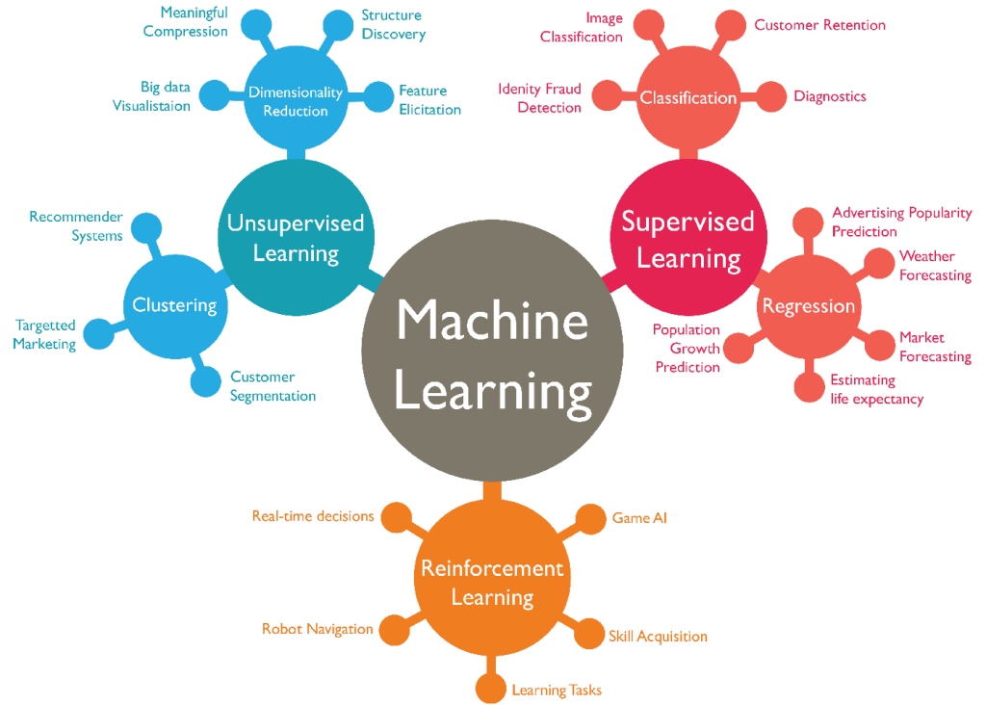

Slide 5
SOME DEFINITION
SUPERVISED LEARNING
Known input-output (feature-label) relations are given to the machine learning algorithm.
Once the model is trained based on the known data, one can use unknown data into the
model to get predictions.
UNSUPERVISED LEARNING
The output of the input training data is unknown. The input data is fed to the Machine Learning algorithm and is used to train the model which then is employed to search for patterns in the data.
REINFORCEMENT LEARNING
Given a framework of rules and goals, an agent (algorithm) learns in an interactive environment by trial and error using feedback from its own actions and experiences and it gets rewarded or punished depending on which strategy it uses. Each reward reinforces the current strategy, while punishment leads to an adaptation of its policy.

Slide 6
HOW MACHINE LEARN

Slide 7
SUCCESS FACTORS
1. DATA
  Huge amount of data to train algorithms and new techniques to label them, due to increasing digitization of environments
2. ENVIRONMENT/FRAMEWORK
Facebook, google, Amazon, academic research, start-ups…
Software layers: Torch, pyTorch, Keras, Tensorfow, cuda…
3. HARDWARE
CPU, GPU, TPU, FPGA, SuperComputers

Slide 8
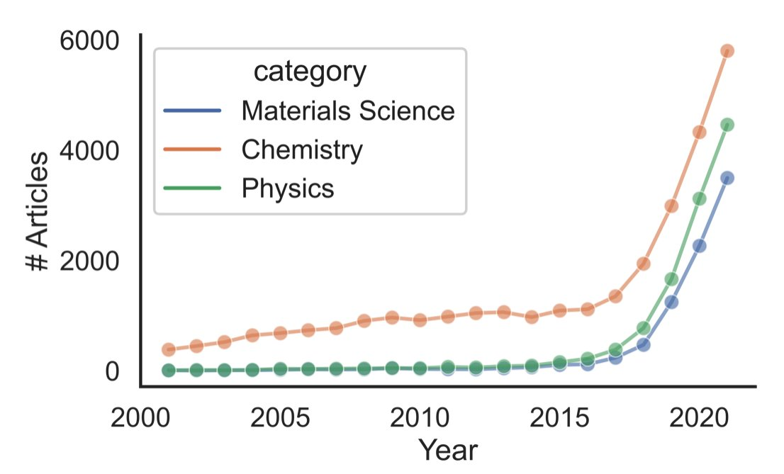
Trend of ML in SCIENTIFIC publications
Accelerator physics
https://twitter.com/BenBlaiszik/status/1496509101915967490
Percentage of publication per year related with AI in most common Accelerator Physics journals from OpenAlex https://openalex.org (Courtesy of F. Gargiulo)

Slide 9
AI and Accelerators
Why is ML useful for particle accelerators?

Slide 10
AI AND ACCELERATOR
In US laboratories:
“ML techniques have been applied to particle accelerators since the late 1980s-1990s, for accelerator control and tuning […]
None of these systems were eventually used routinely as part of an accelerator’s main control system due to limitations in the then-available hardware, algorithms, and software packages, as well as the limited accessibility of good data sets and simulation tools.”
A. Edelen et al., arXiv:1811.03172 [physics.acc-ph]
anomaly detection
modeling
Machine Learning (ML) can be useful for
control

Slide 11
Anomaly detection
Accelerators are complex objects that require monitoring of many interacting subsystems:
ML technique can be used to detect precursors of faults
  Quench of superconductive magnets or superconductive RF cavities faults
  Beam loss predictions
Anomaly detection algorithms can also be used to identify bad signals:
  Bad readings from beam position monitors
  Assist to automated collimator alignment
⇒ improve beam quality, machine protection, availability of the accelerator
The less splits are needed, the more “anomalous”

Slide 12
ACCELERATOR MODELING
(surrogate models AND Optimization Algorithms)
Existing machine
anomaly detection
ML can learn models that combine information from physics-based simulations with measured data
provides real-time simulations in control rooms to improve beam time and quality (CONTROL)
modeling
control
Future accelerators
Accurate simulations are essential for the design and the optimization of future machines
ML can speed up simulations and reduce CPU time, providing fast surrogate models of non-linear phenomena
ML can increase the extend of parameter space optimization for challenging accelerator design problems and allow faster exploration of various competing parameters (see talk F. Massimo and G. Kane )

Slide 13
ACCELERATOR CONTROL
Tuning, control
  Complement and SPEED-UP fine-tuning of machine settings by operators or online optimization routines, and dedicated feedback
VIRTUAL DIAGNOSTICs
  Create new instruments or observations, exploiting correlations between cheap signals and beam quality (see C. Lassalle poster)
  Provide estimate of beam parameters in case of missing instruments
ADVANCED DATA ANALYSIS
  Use image data, clustering and correlations algorithms to automatically detect beam losses, aberrant behavior, classify quench or modes of beam instabilities (ANOMALY DETECTION)
anomaly detection
modeling
control

Slide 14
EXAMPLE OF NATIONAL AND INTERNATIONAL SUCCESSFUL APPLICATIONS

Slide 15

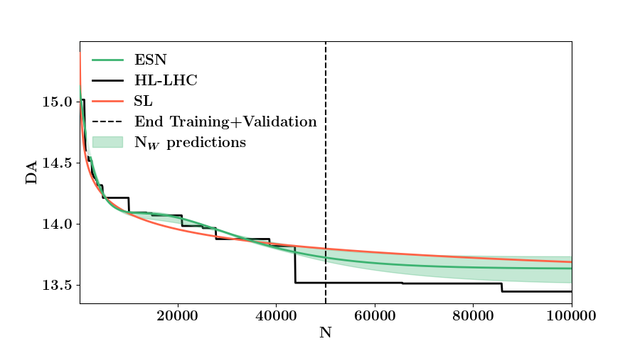
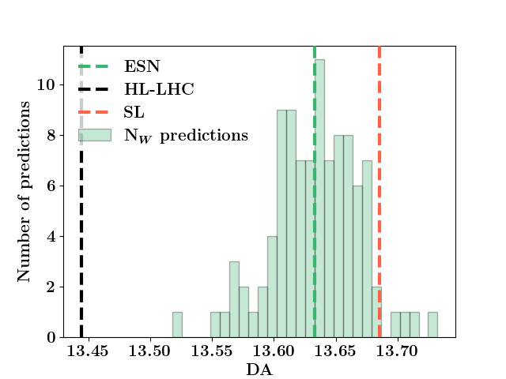
Application to beam physics
Reservoir Computing networks models and replicates the time evolution of Dynamic Aperture, allowing to speed–up tracking simulations for high energy hadron storage rings.
M. Casanova, B.D. et al. , Eur. Phys. J. Plus (2023) 138: 559
Echo State Networks
[σ]
(⇒ see also Q. Bruant poster)

Slide 16
Anomaly detection Analysis
Isolation Forest with decision tree is used by at CERN to detect faulty BPMs signals that remain after SVD cleaning of turn by turn optics measurements data.
E. Fol et al. WEPGW081 IPAC 2019
K-mean, Density-Based Spatial Clustering and Isolation Forest in combination with PCA is used by F. Poirier et al. at ARRONAX Cyclotron to identify anomalies that occur for non-labelled multi-variate data during radio-isotopes production.
F. Poirier et al. TUPM036 IPAC2023

Slide 17
AUTOMATED Anomaly detection
Establish the operational settings of ~100 LHC collimators by automatically detect true and false alignment-spikes.
Successfully deployed in operation with a gain of a factor three in alignment time.
G. Azzopardi et al. NIMA 934, 2019, 10
Errant beam prediction at SNS accelerator
Predict an upcoming machine trip before it occurs to potentially allow the crew to change settings to avoid it
Use pulses leading to a trip (tagged "Before") and identify features that indicate an upcoming failure
Data science pipeline:
identify accelerator failures
with > 80% accuracy
K. Rajput

Slide 18
Optimization in control room
Machine Learning Frameworks/tools for accelerators:
Xopt+BADGER (SLAC)
- For simulations (models) or experiments (data)
Independent of optimization algorithm + easy to incorporate custom algorithm
Provides interface for operation in control room
Used at ESRF in collaboration with DESY, LNBL and SLAC for tuning of the EBS storage ring lifetime and injection efficiency with Bayesian techniques (S.Liuzzo et al., MO3AO01, ICALEPCS 2023)
GeOFF and the Machine Learning Platform (CERN)
Framework for operational use of RL and numerical optimization
provide ecosystem for accelerator optimization and control
provide compatibility with as many algorithms as possible
facilitate the progression manual tuning → numerical optimization → machine learning
⇒ Used at CERN for almost all accelerators (see talk A. Lasheen)
EURO-LABS project supports efforts towards agnostic usage and portability

Slide 19
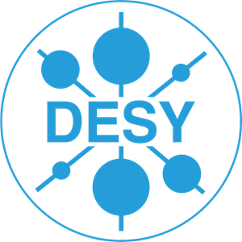


TOWARDS an autonomous accelerator
Autonomous operation of FLUTE, ARES LINACs
Deep Deterministic Policy Gradient algorithm and Twin Delayed Deep Deterministic policy gradient demonstrate ability to solve beam optimization tasks on simulated data.
A. Eichler et al. TUPAB298 IPAC 2021
Q-learning algorithm ( Markov decision process ) applied to automatically optimize energy and charge of the DAΦNE LINAC, coupled with DBSCAN Algorithm used to detect RF fault and stop automated operation, within few days of dedicated operation.
S. Pioli et al. THAL03 ICALEPCS 2021

Slide 20
perspectives
What can we do more ?

Slide 21

Example: InTheArt
  Les objectifs :
    Partager les connaissances et appréhender les nouvelles techniques en IA
    Discuter et travailler ensemble à travers un groupe ouvert, transverse au CEA et au-delà
  Participants (~150 personnes):
    CEA : DAM, DES, DRF, DRT
    CNRS
    Université Paris-Saclay
  Financement PTC (Programme Transverse de Compétence – CEA)
  Pour y participer/contribuer : Valerie.gautard@cea.fr
Des seminaries (https://indico.in2p3.fr/event/17858/page/2883-2022)
Des formations
Des workshops
Web sites: IntheArt : https://indico.in2p3.fr/event/17858/page/1967-intheart
  GitLab : https://drf-gitlab.cea.fr/InTheArt
  Redmine : https://forge.in2p3.fr/projects/intheart?jump=welcome
Coutesy of V. Gautard

Slide 22
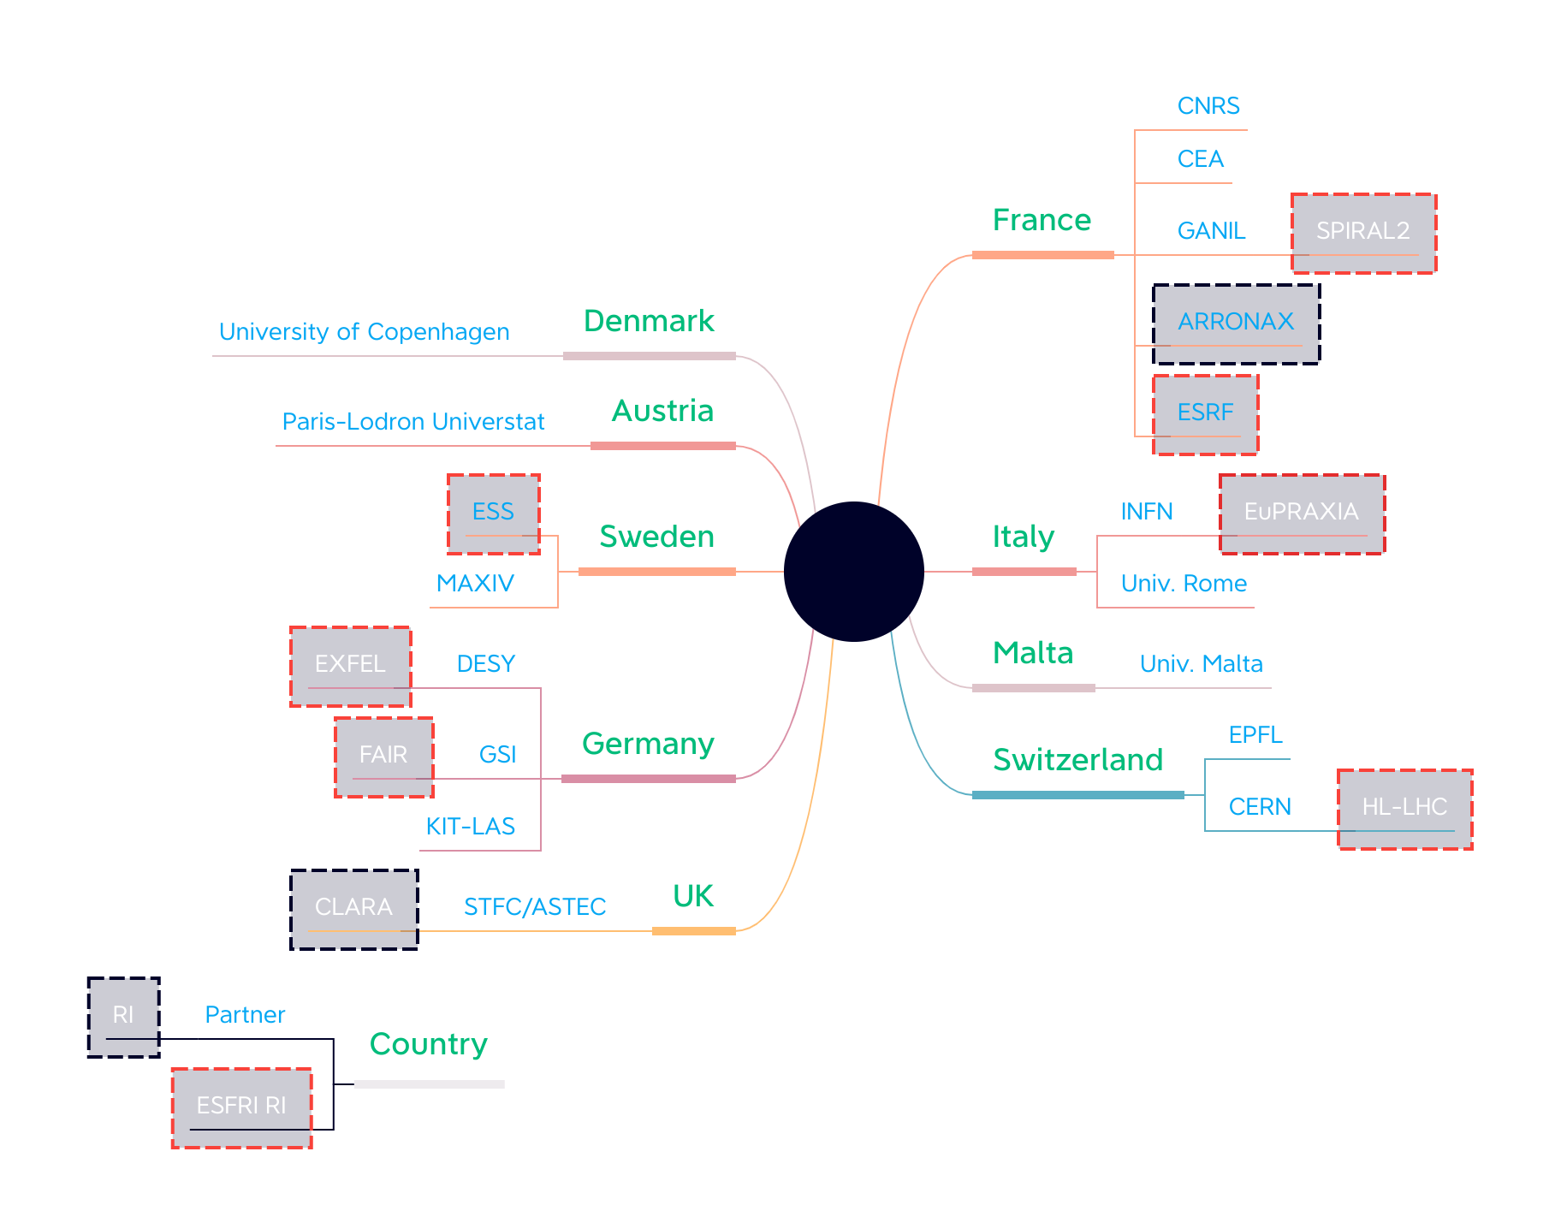
A new synergetic approach
Unlock the use of artificial intelligence in particle and nuclear accelerators as well as in light/neutron sources;
Tackle all challenges of particle accelerators.
A French network: M4CAST
Multiphysics Modeling, Machine learning and Model-based Control in Accelerators Science and Technology
A European network: TRAINABLE
TowaRds An International network for multiphysics modelling, machine learning And model-Based control in accelerator sciences and technoLogiEs
target an Horizon Europe project ARTIFACT
ARTificial Intelligence For Accelerators, user Communities and associated Technologies
9 countries, 18 partners
Courtesy of A. Ghribi

Slide 23
STRATEGY
Guidelines to unclock the use of AI in accelerators
Standardize and open our data and approaches
Structure ourselves to work in a fertile collaborative space
Transfer links (astrop, HEP, medecine, …)
Training: students as well as professionals
Courtesy of A. Ghribi

Slide 24
TOWARDS a MORE SUSTANAIBLE DEVELOPMENT
Outcomes:
  Enhance scientific competitiveness of Research Infrastructures (RI)
  Enhanced RI capacities to address research challenges and EU policy priorities ;
  Increase collaboration of research infrastructures with universities, research organization and industry
  Increase of technological level of industries
  Integration of research infrastructures into local, regional and global innovation systems and promotion of entrepreneurial culture
Courtesy of A. Ghribi

Slide 25
THANK YOU

