Slide 1
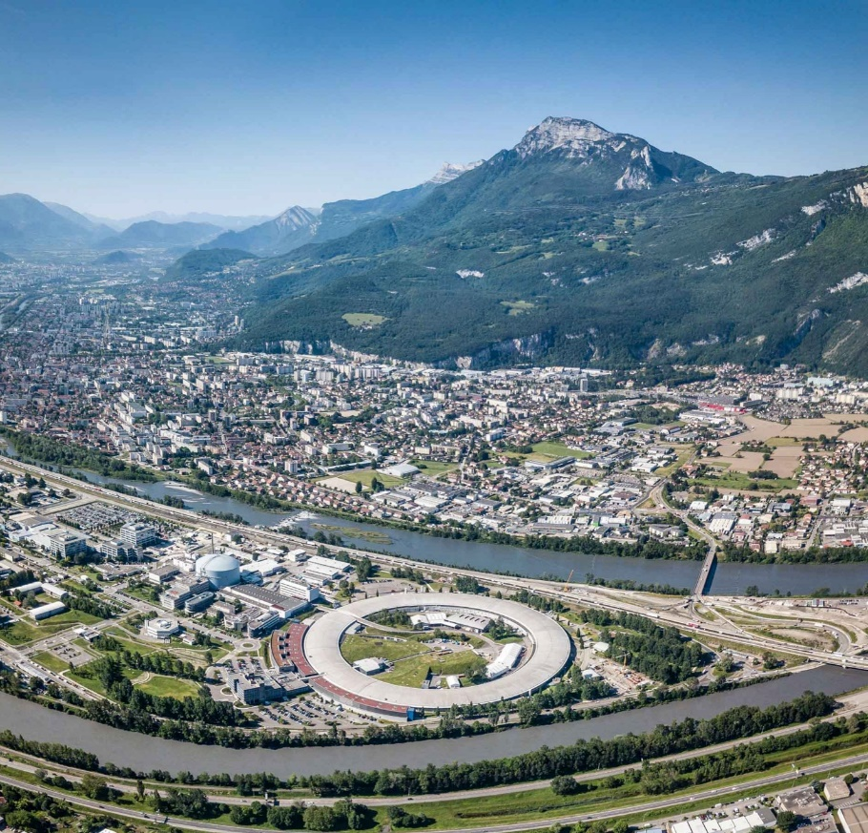
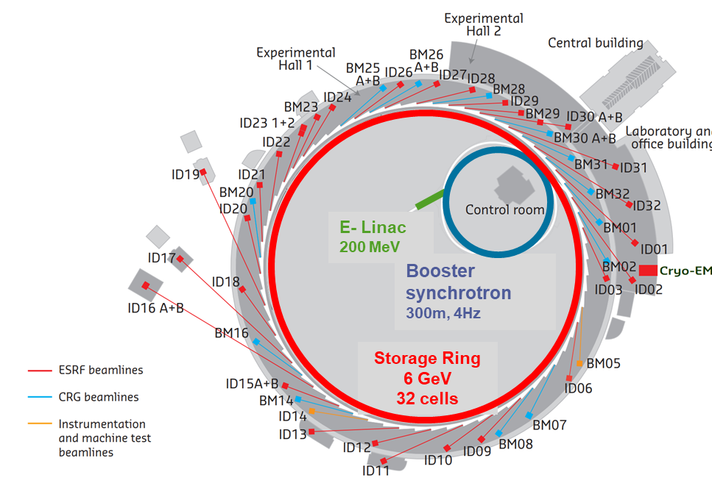
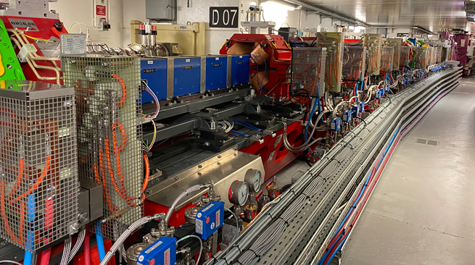
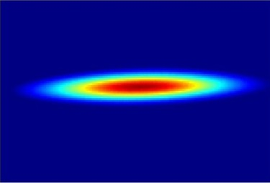
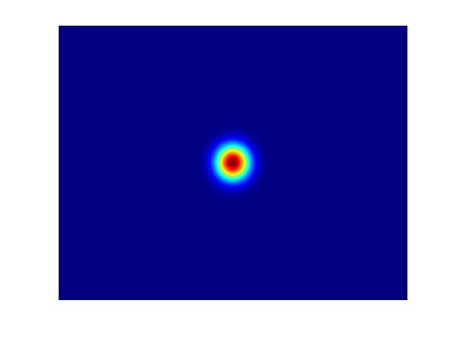
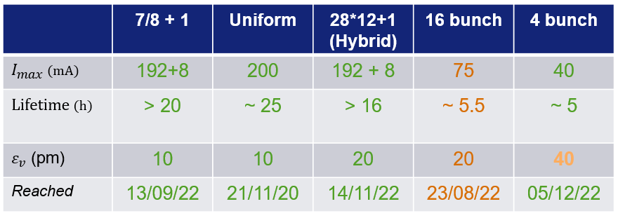
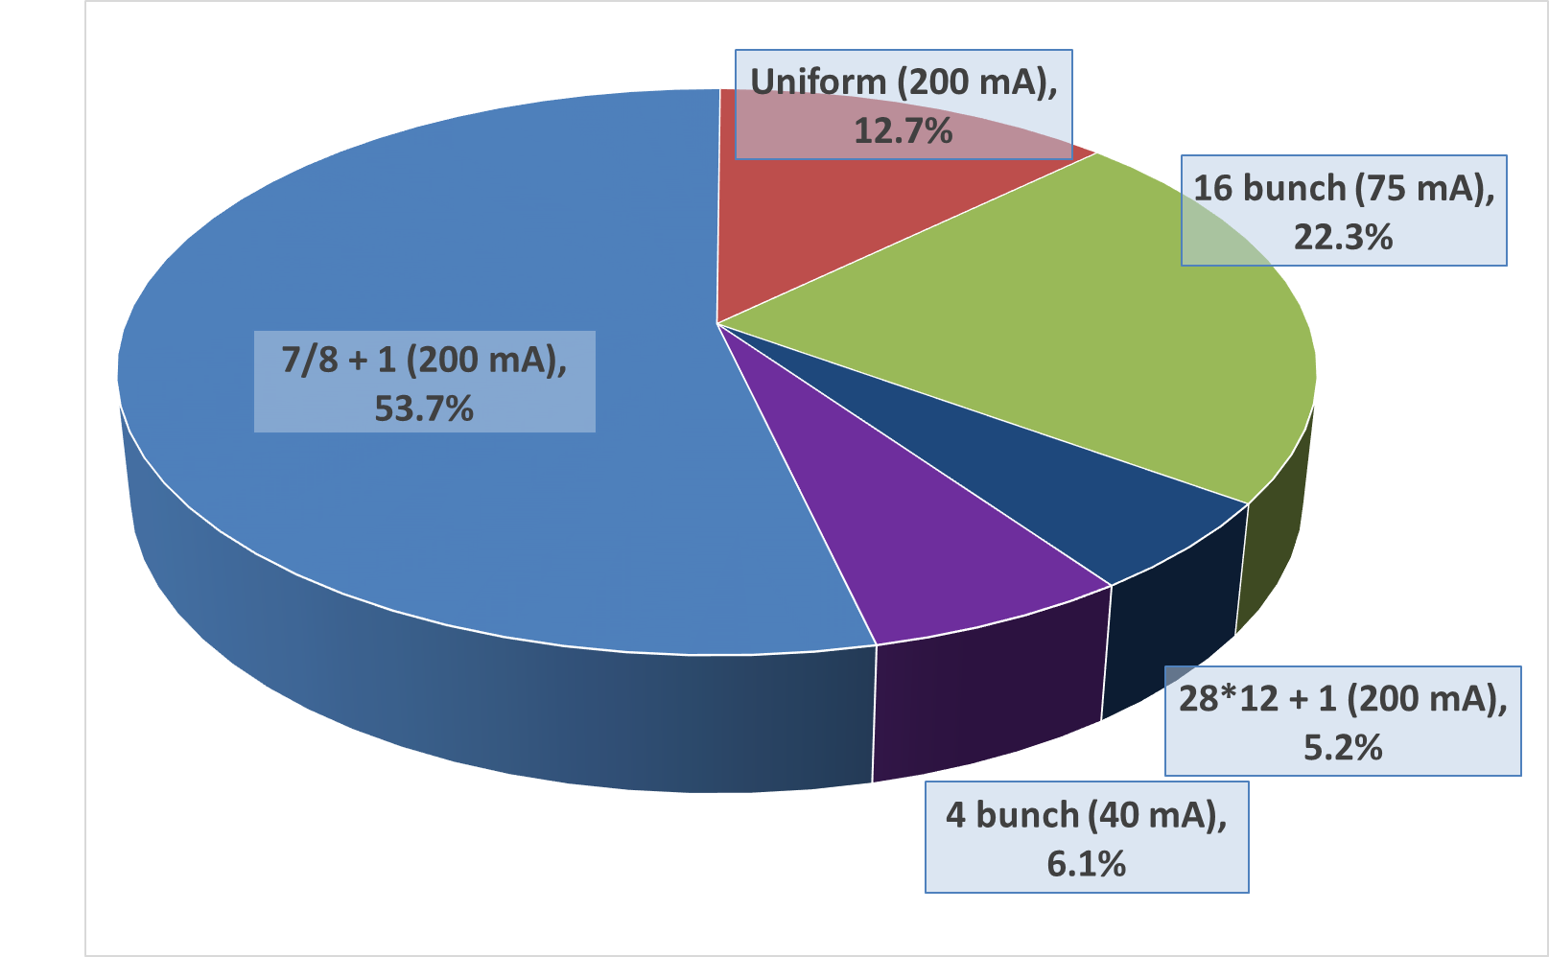
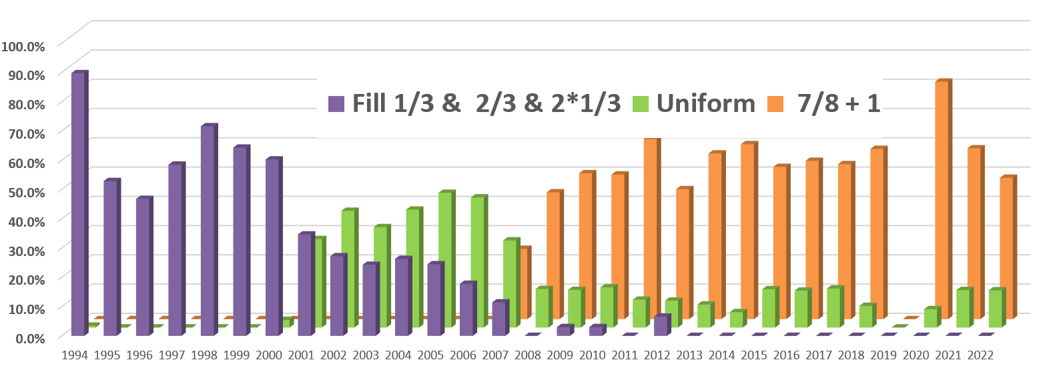
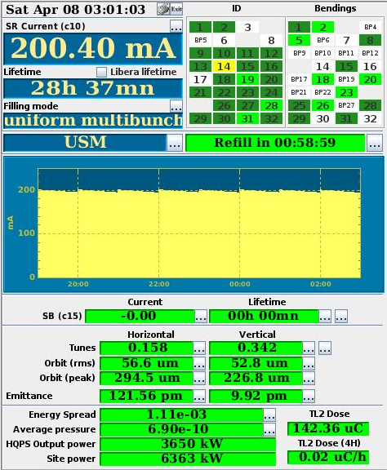
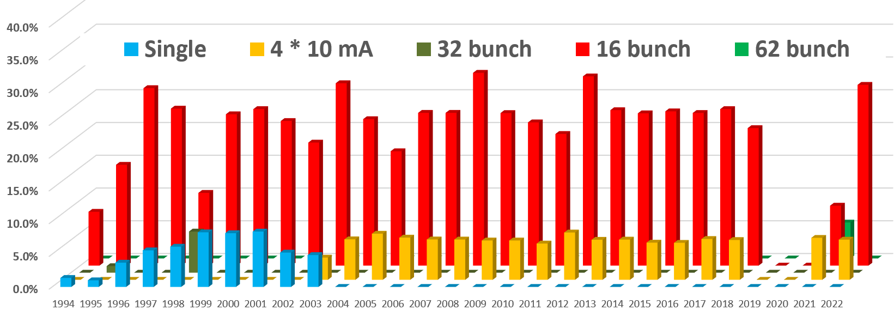
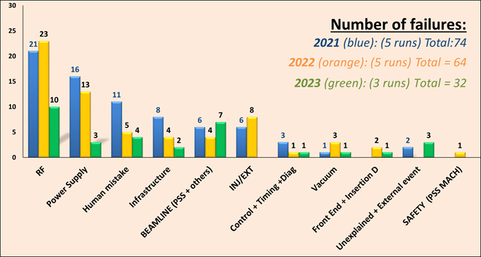
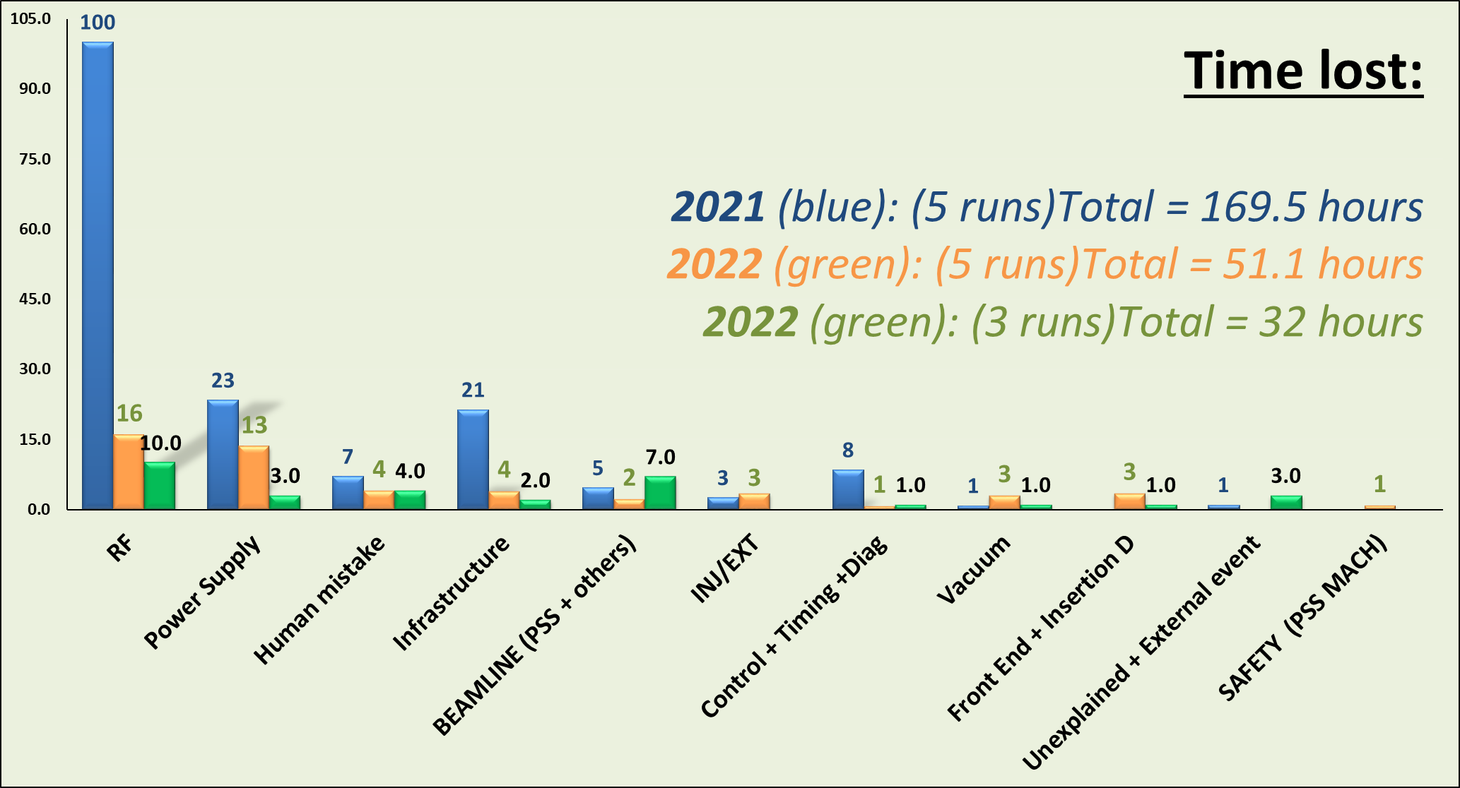
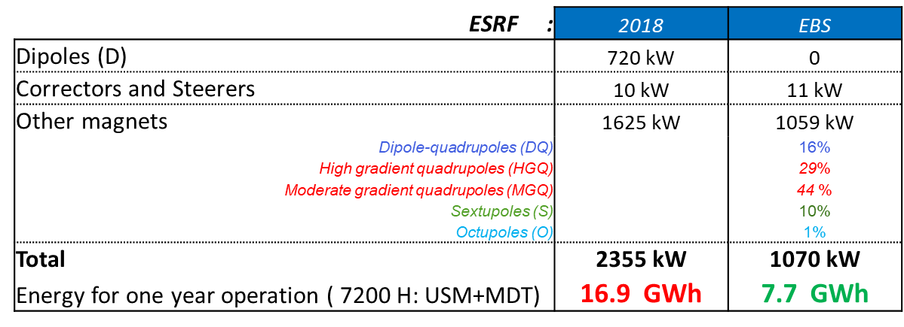
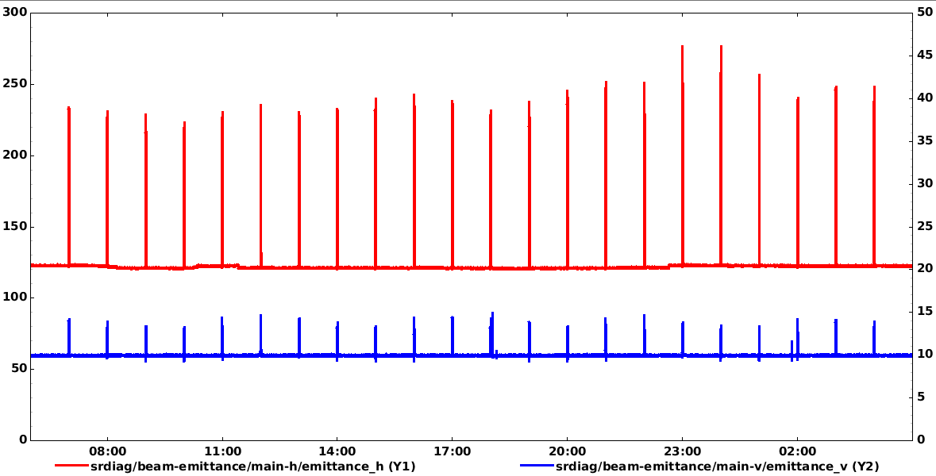
OPERATION OF THE ESRF-EBS LIGHT SOURCE
G. Le Bec, B. Roche, J-L Revol, .
On behalf of the Accelerator & Source Division
The European Synchrotron Radiation Facility - Extremely Brilliant Source (ESRF-EBS) is a facility upgrade allowing its scientific users to take advantage of the first high-energy 4th generation storage ring light source. In December 2018, after 30 years of operation, the beam stopped for a 12-month shutdown to dismantle the old storage ring and to install the new X-ray source. On 25th August 2020, the user programme restarted with beam parameters very close to nominal values. Since then beam is back for the users at full operation performance and with an excellent reliability. This poster reports on the present operation performance of the source, highlighting the ongoing and planned developments.
22 partner nations
Annual budget: 100 million euros
Staff: 630 people, 40 different nationalities
Legal status: Private civil company subject to French law
 | Units | ESRF | ESRF-EBS
Energy | GeV | 6 | 6
Circumference | m | 844.4 | 844
Lattice |  | DBA | HMBA
Current | mA | 200 | 200
Lifetime | h | 50 | 23
Emittance H | pm rad | 4000 | 133
Emittance V | pm rad | 4 | 10*
The Extremely Brilliant Source upgrade :
Decrease the horizontal emittance
Increase the source brilliance
Increase the source coherence
ESRF
ESRF_EBS
Filling modes
90 mA
Intensity limitation for 16 bunch due to mechanical weakness of the kicker ceramic chambers
Vertical emittance artificially increased from 1 to 10 or 20 pm.rad for an operational lifetime
All timing modes delivered with a purity of 10⁻⁹ with cleaning process in the booster
 | 2017 | 2018 | 2020 | 2021 | 2022 | 2023(07)
 |  |  | EBS | EBS | EBS | EBS
Availability (%) | 98.3 | 98.5 | 96.1 | 96.4 | 99.1 | 99.3
Mean time between failures (hrs) | 64.3 | 104.3 | 46.0 | 66.4 | 88.5 | 121.7
Mean duration of a failure (hrs) | 1.11 | 1.60 | 1.80 | 2.42 | 0.83 | 0.8
Reliability:
Reliability of the new accelerator comparable to the old machine
Only 1.6% of refill skipped
Energy saving with ESRF-EBS: 12 GW/year
for a total electricity consumption of 50 GWh / year in 2023
Beam stability:
Despite the reduction in the horizontal emittance, the beam stability fulfils today the beamline requirements
Injection perturbations are a limitation for the full exploitation of EBS despite the implementation of a damping system, and the top-up frequency limited to 1 Hour
Horizontal emittance
The operation oriented developments:
New ceramic kickers chambers
Solid-State Amplifiers (SSA)
4Th Harmonic cavities
Injection upgrade
Mini-beta optics
Vertical emittance
‘Les Journées accélérateurs’, Roscoff, France , 3-6 October, 2023
ESRF – The European Synchrotron – 71 Avenue des Martyrs, Grenoble, FRANCE - Tel +33 (0)4 76 88 20 00

