Slide 1
Study of Lepton Violation Universality with semitauonic decays in LHCb
_{Status and Prospects}
Guy Wormser (IJCLab)
on behalf of the LHCb Collaboration

Slide 2
Lepton Flavour Universality
Lepton Flavour Universality is one of many « ad hoc » symmetries and « pillars » of the Standard Model
  Baryon number, lepton number, (charged) lepton flavour,…
It postulates that the properties of the three charged leptons (e,μ,τ) are the exactly the same beside their mass.This does not need to be the case in many New Physics models
First hints of Lepton Flavour Universality violation appeared 10 years ago with BABAR publication regarding semi-tauonic B decays. This field became « the hottest game » in town with results coming both from charged and neutral currents

Slide 3
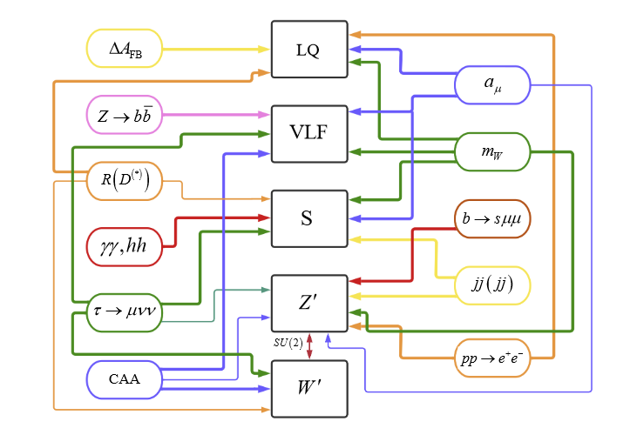
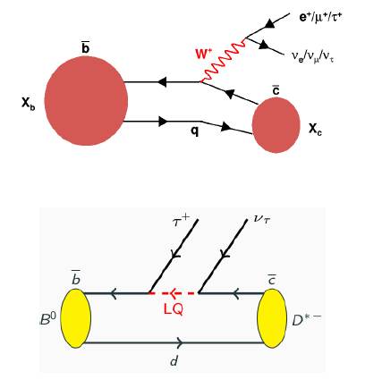
Panorama of SM anomalies
A. Crivellin , arxiv:hep-ph 2304.01694

Slide 4
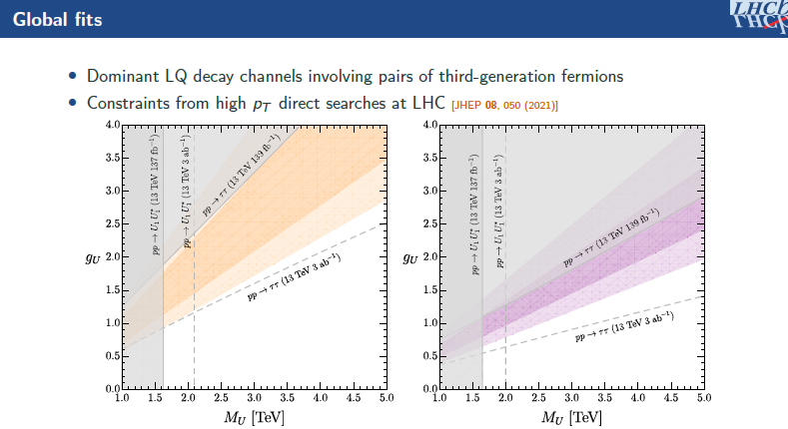

Slide 5
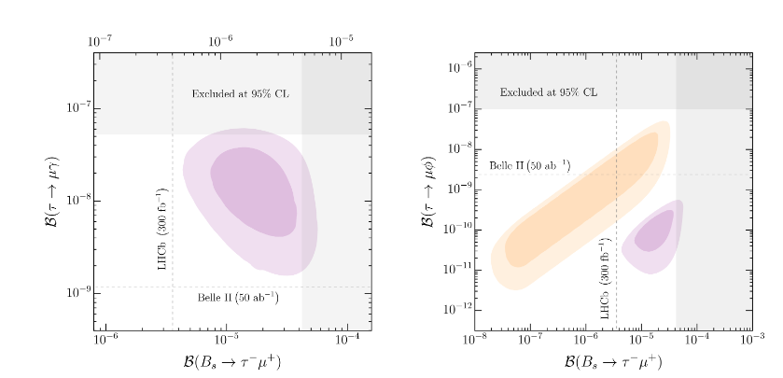
In this model, Lepton Flavour violation should be seen (B→μτ, Kμτ)
C. Cornella et al., https://arxiv.org/pdf/2103.16558.pdf

Slide 6
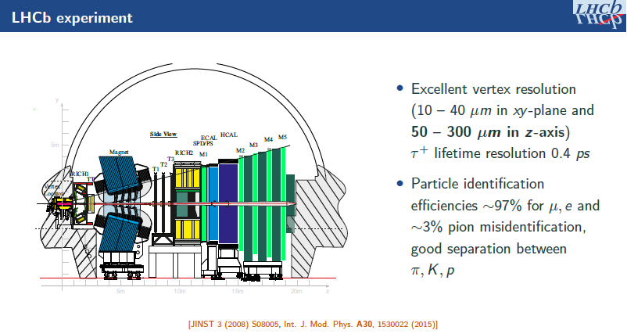

Slide 7
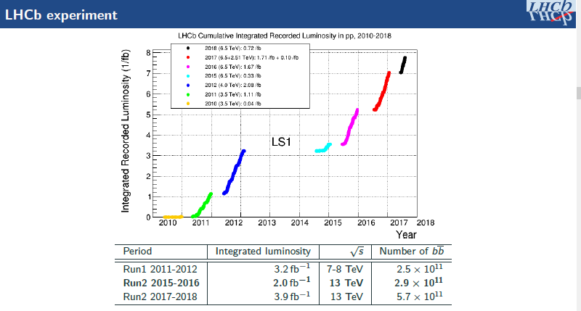
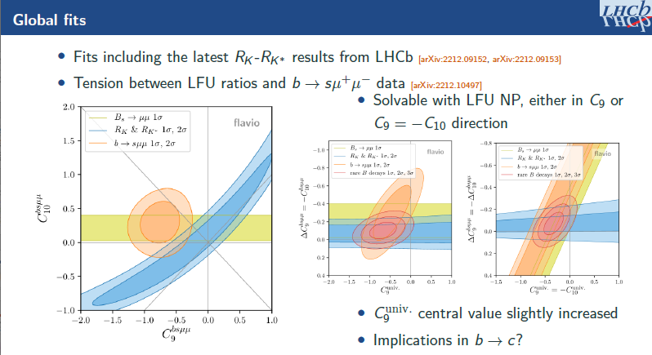

Slide 8


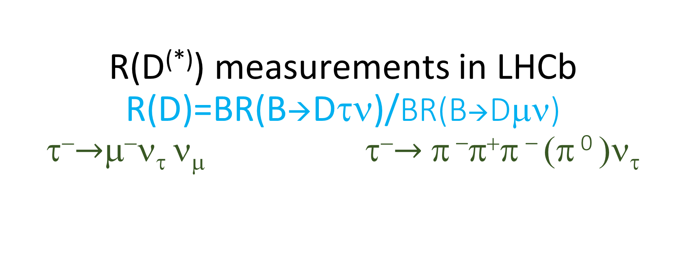
R(D^{(*)}) measurements in LHCb
R(D)=BR(B→Dτν)/BR(B→Dμν) τ⁻$→$μ⁻ν_{τ} ν_{μ} τ⁻$→$π –π⁺π – (π ⁰ )ν_{τ}
Made in LAL !
Pros
  Direct measurement of R(D,D*)
  High statistics
Cons
  Double charm background control must be very good (mostly D⁺)
  Sensitive to D** μ⁻ν_{μ}
Pros
  The possibility to measure the τ vertex is the key to reject the background and obtain a high purity sample
  The 3π dynamics of the τ decay is very specific : possible to distinguish τ decays from the main double charm background from D_{s} decays
Cons
  Access to R(D) requires an external BR
  Lower statistics

Slide 9
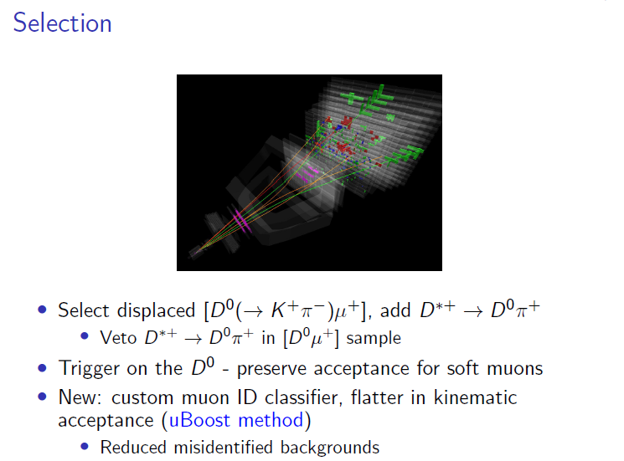
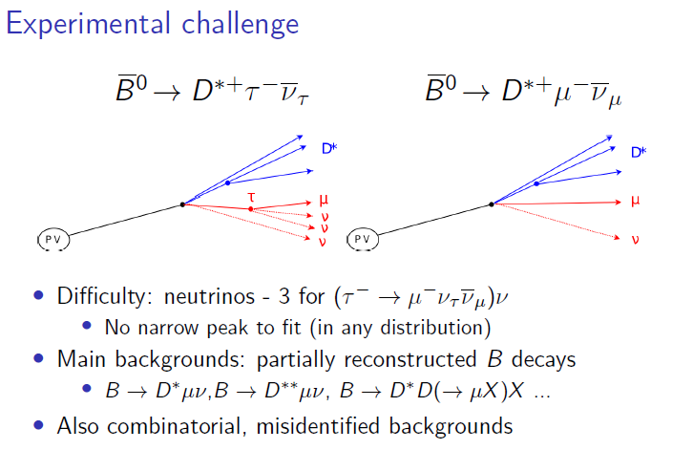
Simultaneous measurement of R(D) and R(D*) using muonic τ decays
LHCb-PAPER-2022-039
arxiv:2302.02886

Slide 10
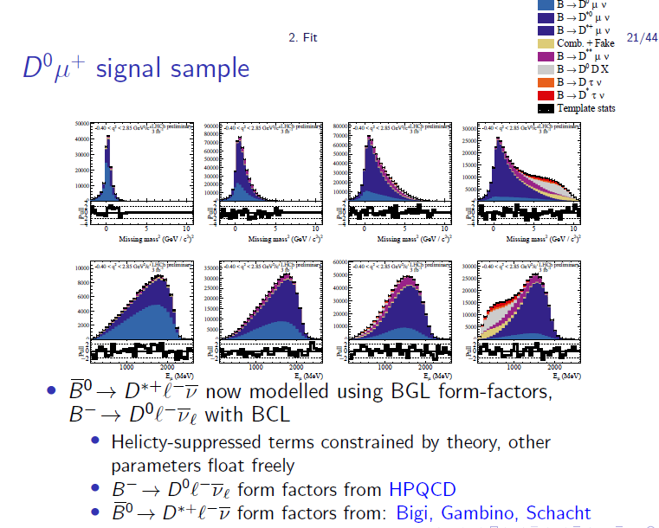
LHCb-PAPER-2022-039
arxiv:2302.02886

Slide 11
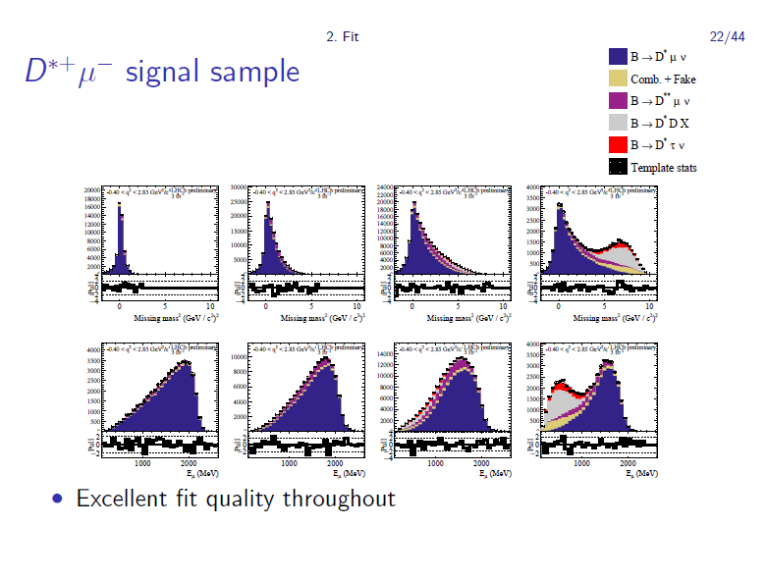
LHCb-PAPER-2022-039
arxiv:2302.02886

Slide 12
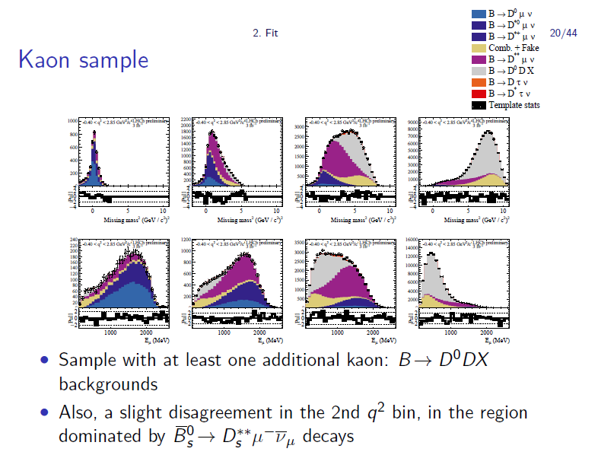
LHCb-PAPER-2022-039
arxiv:2302.02886

Slide 13
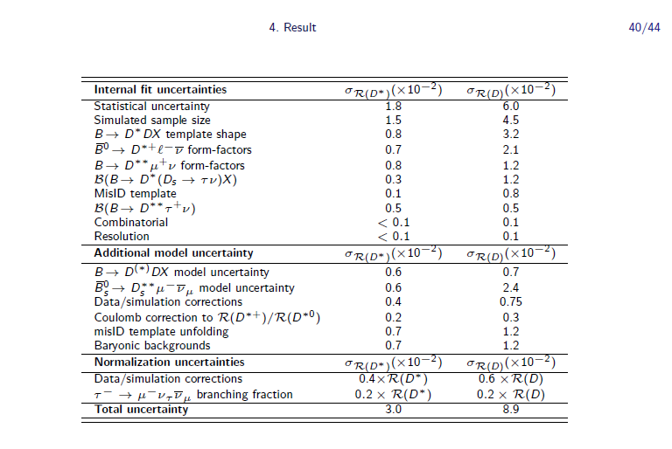
LHCb-PAPER-2022-039
arxiv:2302.02886

Slide 14
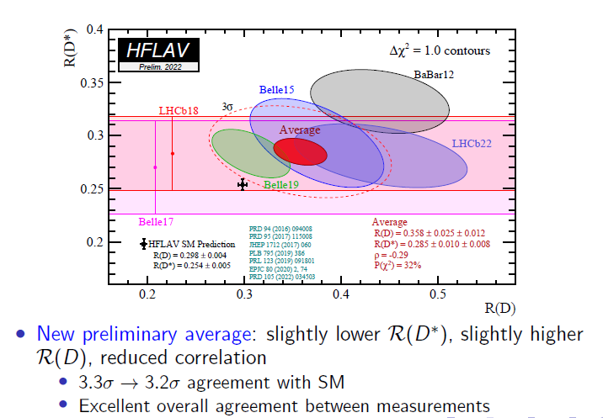
HFLAV 2022

Slide 15
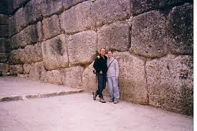
New R(D*) measurement with hadronic τ decays at 13 TeV(2 fb⁻¹)
Vertex topology of the usual B decay
100 times larger than the signal
K⁺
π⁻
π⁻
B→D*⁻π⁺π⁻π⁺(+X)
D⁰
y
π⁰’s …
B
z
π⁺
PV
Δz>4σ_{Δz}
π⁻
p
p
π⁺

Slide 16
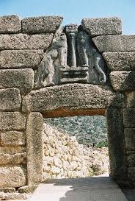
Selection: detached vertex
K⁺
π⁻
π⁻
B⁰→D*⁻τ⁺ν_{τ}
ν_{τ}
D⁰
y
ν̅_{τ}
B⁰
τ⁺
z
π⁺
Δz>4σ_{Δz}
π⁻
p
p
π⁺

Slide 17
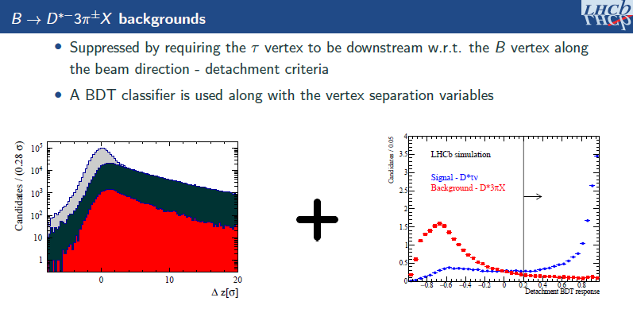
LHCb-PAPER-2022-052
arxiv:2305.01463
LHCb simulation
Prompt D*3πX
Double Charm
Signal
Background rejection >99,9% !

Slide 18
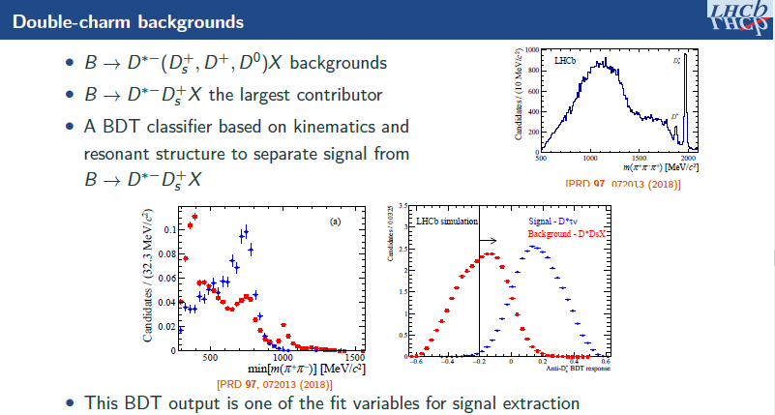
LHCb simulation
BR(D_{s}→3πX)=32.8% ± 0.9%
BES-III arxiv:2212.13072

Slide 19
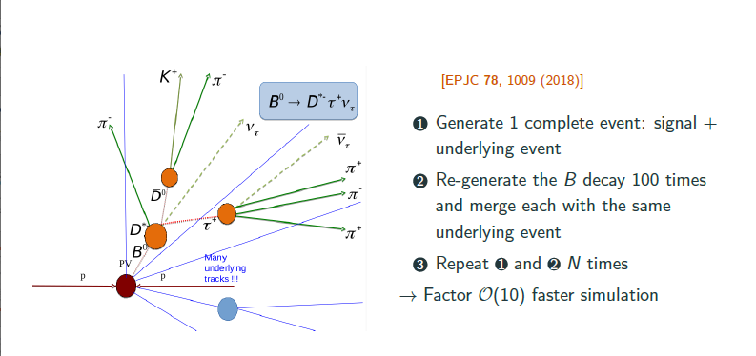
Using ReDECAY was key to get high stat MC

Slide 20
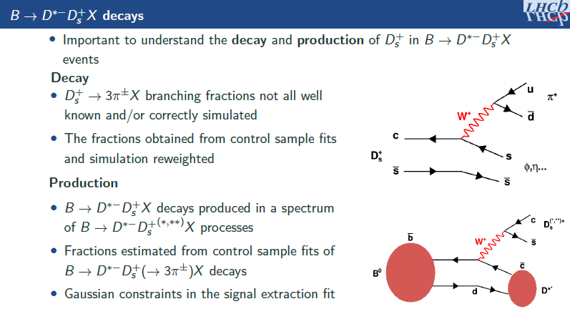
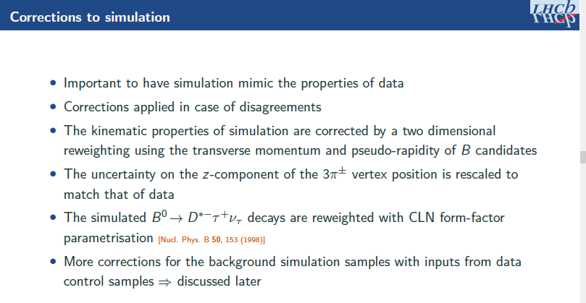

Slide 21
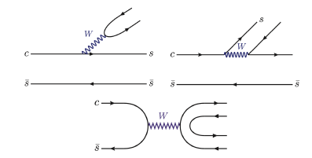
Detailed phenomenology study of inclusive Ds decays in 3 pions
(Bo Fang, Paris Saclay, Wuhan co internship PhD student)
The 3 Feynman diagrams in Ds decays : external W emission, internal W emission, annihilation

Slide 22
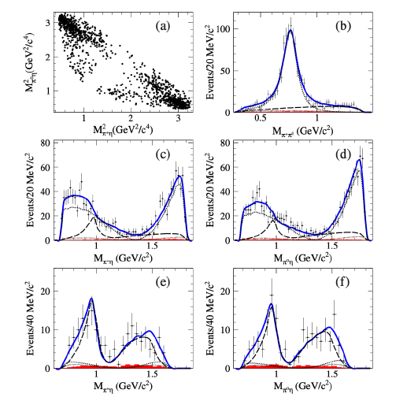

D⁺_{s} → ηπ⁺π°
Phys. Rev. Lett., 123(11):112001, 2019

Slide 23
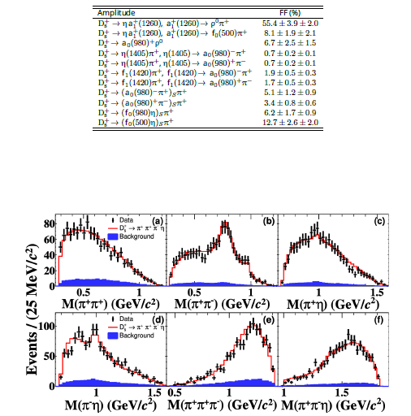
D⁺_{s} → ηπ⁺π⁻π⁺
BES-III, Phys. Rev. D, 104:071101, 2021

Slide 24

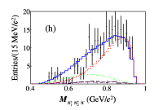
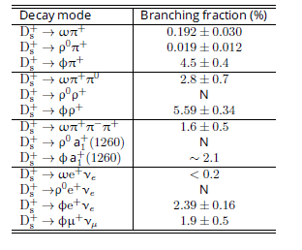
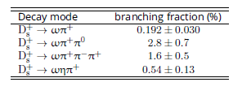
D⁺_{s} → φ/ωπ⁺π⁻π⁺
JHEP07(2022)051

Slide 25
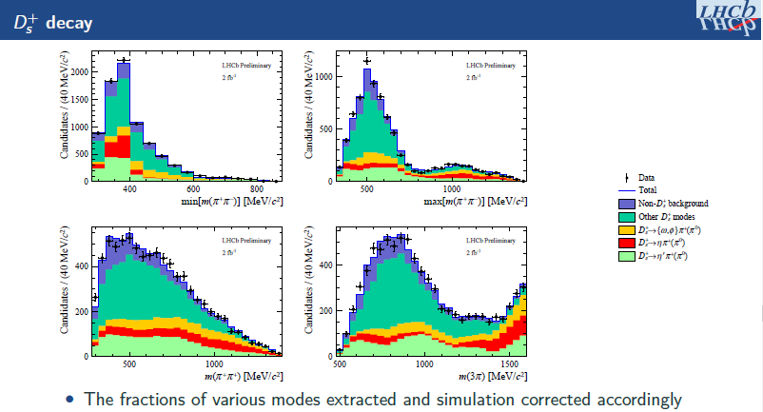
LHCb-PAPER-2022-052
arxiv:2305.01463

Slide 26
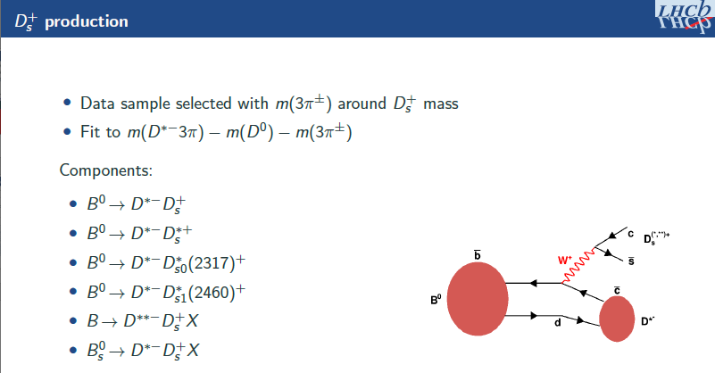

Slide 27
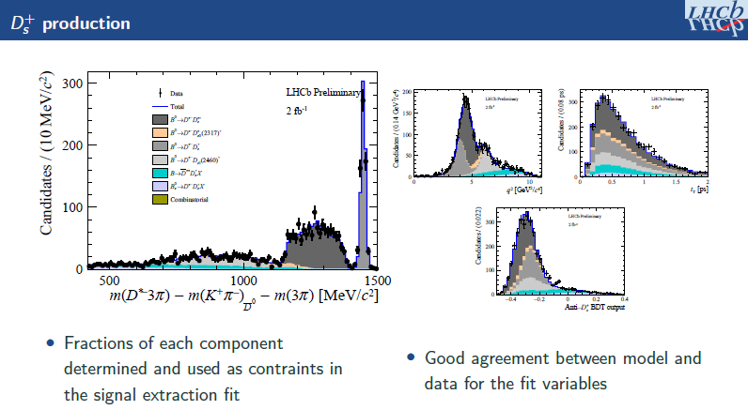
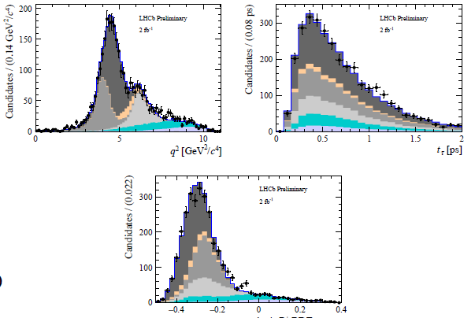
LHCb-PAPER-2022-052
arxiv:2305.01463

Slide 28
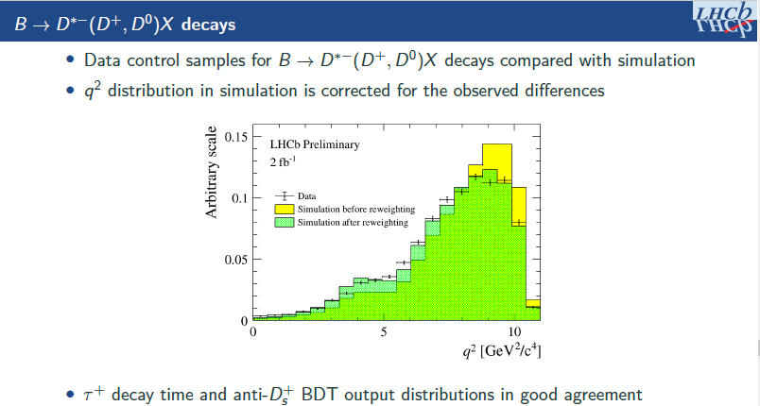
LHCb-PAPER-2022-052
arxiv:2305.01463

Slide 29
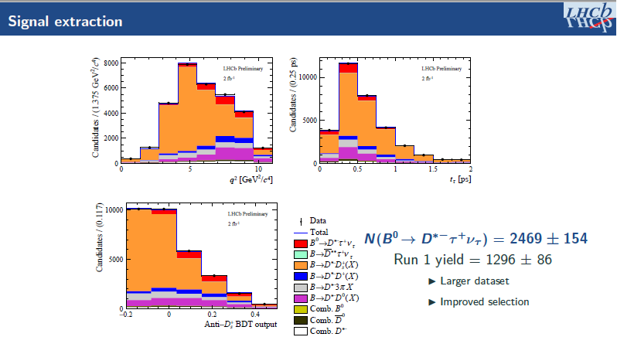
LHCb-PAPER-2022-052
arxiv:2305.01463

Slide 30
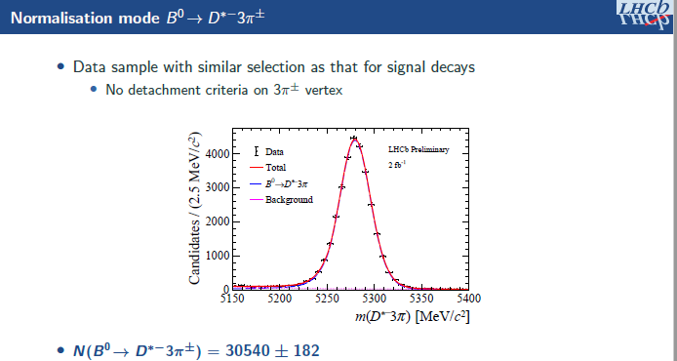
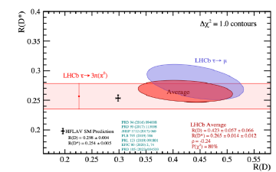
Backup
LHCb-PAPER-2022-052
arxiv:2305.01463

Slide 31
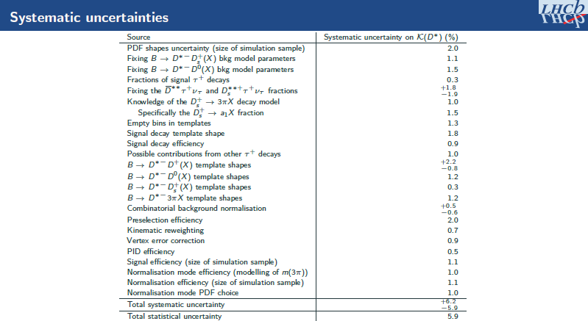
LHCb-PAPER-2022-052
arxiv:2305.01463

Slide 32
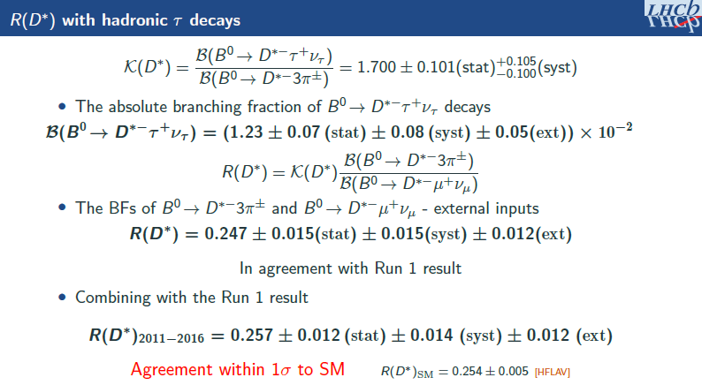
LHCb-PAPER-2022-052
arxiv:2305.01463

Slide 33
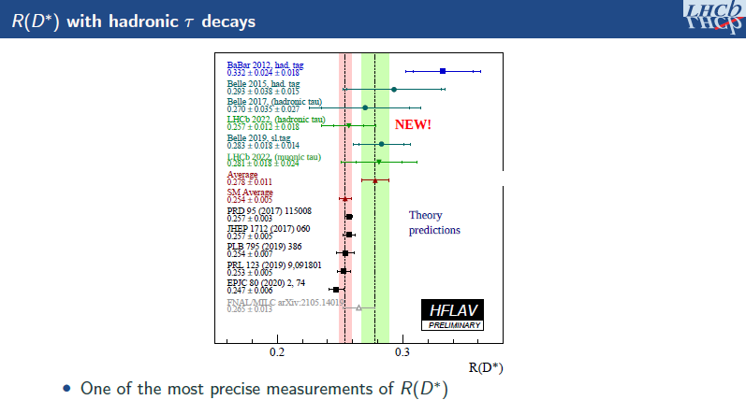
LHCb-PAPER-2022-052
arxiv:2305.01463

Slide 34
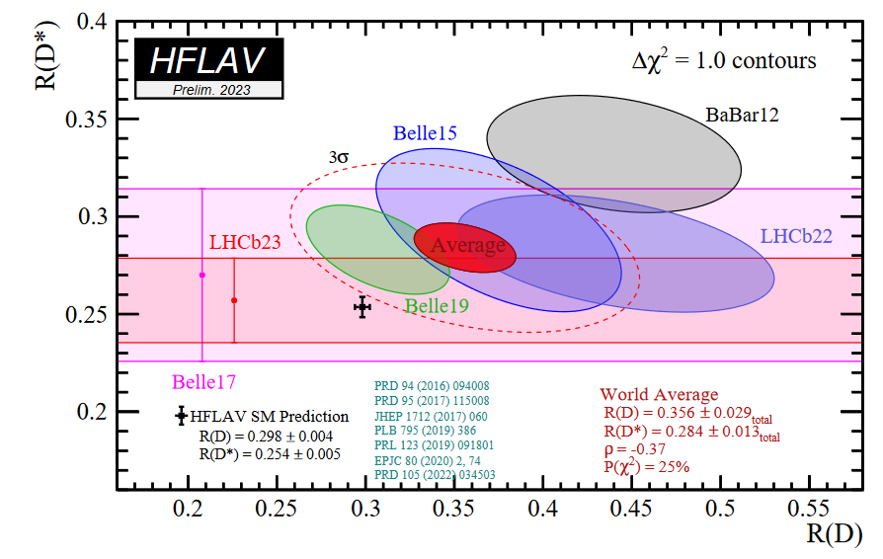
Deviation from SM : 3.2 σ

Slide 35
Upcoming D* polarization measurement in B°→D*τν decays in LHCb
Study performed by/with Davide Fazzini, P2IO Postdoc, 2018-2020, now in Milano University
Many discussions with Damir Becirevic at the time
Motivation
  Sensitive to new physics , independently of R(D*)
  Potential to pin down the spin of the particle responsible for LFUV
  Coupled to R(D*), can provide interesting limits to Wilson Coefficients of a Charged Current Effective Field Theory
  Can be accessed experimentally when using the hadronic tau decay mode

Slide 36
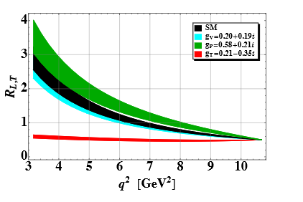
D* polarization very sensitive to NP mediator spin
hh
D. Becirevic et al.,
arXiv:1907.02257
F_{l}=R_{L,T}/(1+R_{L,T})

Slide 37
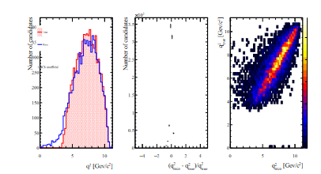
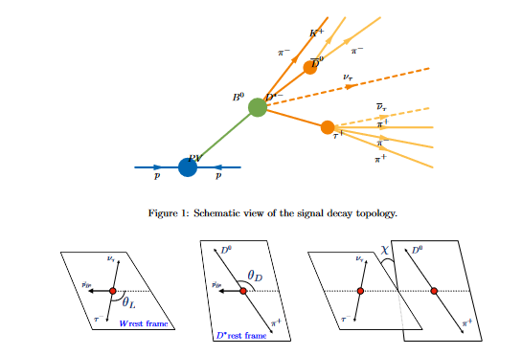
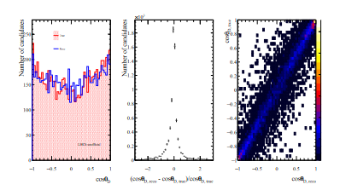
Kinematic reconstruction of B°→D*τν
True vs reconstructed LHCb simulation
q²
cosθ_{D}

Slide 38
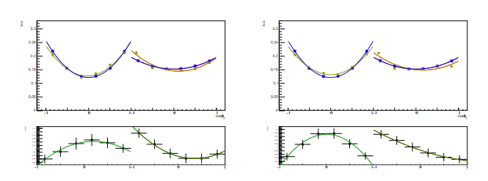
Corrections for unpolarized events
LHCb simulation

Slide 39
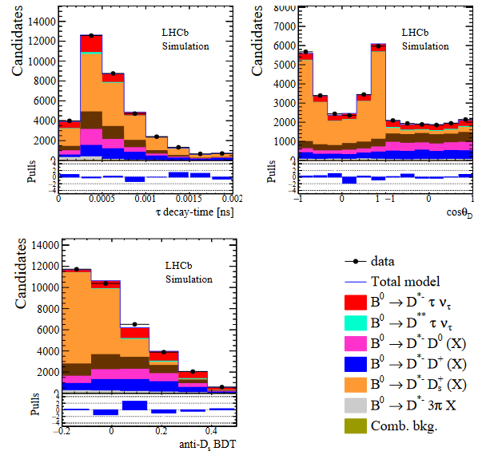

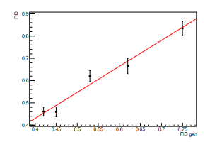
Fit using pseudo-data sample
LHCb simulation

Slide 40

R(D^{(*)}) summary
New simultaneous measurement of R(D) and R(D*)using muonic channel
New updated measurement of R(D*⁺)
Discrepancy level between new WA and SM prediction 3.2 σ
  « Le canard est toujours vivant »
Compatible with SM and with the present WA
D*⁺ Polarization measurement with hopefully the best precision coming up soon
 | LHCB-PAPER-2022-039 arXiv:2302.02886
LHCb-PAPER-2022-052
arxiv:2305.01463

Slide 41
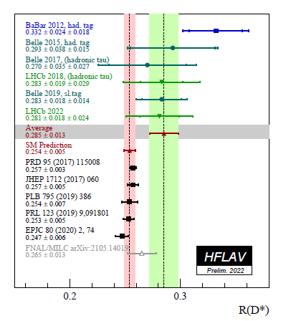
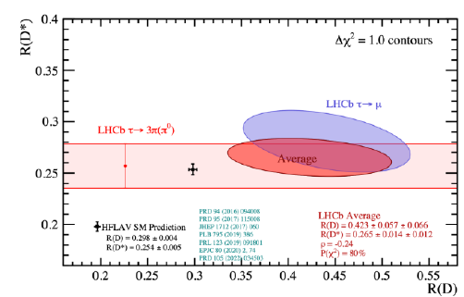
LHCb only R(D)-R(D*)

Slide 42
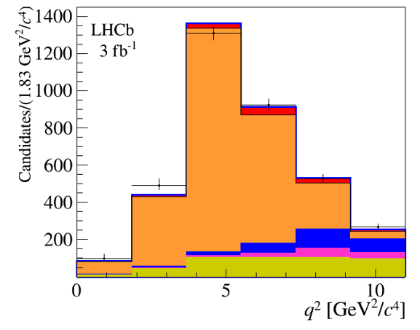


R($Λ_{c}^{+}$) High BDT(>0.66
LHCb-PAPER-2021-044 PhysRevLett128,191803 (2022)

Slide 43

Largest systematic : template shapes
LHCb-PAPER-2021-044PhysRevLett128,191803 (2022)

Slide 44


Physics results
LHCb-PAPER-2021-044
PhysRevLett128,191803 (2022)
K($Λ_{c}^{+}$) ≡B($Λ_{b}^{0}{→Λ}_{c}^{+}$τ⁻ν̅_{τ})/B($Λ_{b}^{0}{→Λ}_{c}^{+}$π⁻π⁺π–)
K($Λ_{c}^{+}$) = 2.46 ± 0,27 (stat) ± 0,40 (syst)
Using B($Λ_{b}^{0}{→Λ}_{c}^{+}π^{−}π^{+}π^{−}$)_{no} $Λ_{c}^{∗+}$ =(0. 614 ± 0.094)% [PDG2020],
B($Λ_{b}^{0}{→Λ}_{c}^{+}$τ⁻ν̅_{τ})=(1,50 ± 0,16 (stat) ± 0,25 (sys) ± 0,23 (ext)) %
(SM expectation=(1.8± 0.1 )%
Using B($Λ_{b}^{0}{→Λ}_{c}^{+}μ\text{−}$ν̅_{μ}) $=$ (6.2 ±1.4)% [PDG2020],
R($Λ_{c}^{+}$)=0.242 ± 0.026 (stat) ± 0.040 (syst) ± 0.059 (ext)
(SM expectation=0.324 ± 0.004)
F. Bernlochner et al., Physical Review D 99 055008 (2019)
with input from W. Detmold, C. Lehner, S. Meinel, Physical Review D 92 034503 (2015)

Slide 45

Constraints on New Physics models
(including all meson-based results)
A. Datta et al., Journal of High Energy Physics 1708 (2017) 131
Our result excludes regions of the parameter space of effective theories with only one vector, axial-vector or tensor coupling

Slide 46

Semitauonic prospects in LHCb
LHCb is now leading this field, which was thought to be impossible to address
Many more semitauonic results expected soon using the muonic and hadronic τ decay channel :
  D* polarization measurement
  R(D*), R(D**°), R(D°), R(D⁺) using the full Run2 data
  R(D⁺)
Work is also ongoing on R(D_{s}), R(J/ψ), full angular analysis
 | Rev. Mod. Phys. 94, 015003 (2022)

