Slide 1
PERLE-France Collaboration Meeting
Meeting agenda:
  Project status and general information (A. Stocchi & W. Kaabi)
  RF systems: Status and future plans (G. Olry)
  ERL design and beam dynamics studies (J. Michaud)
  AoB

Slide 2
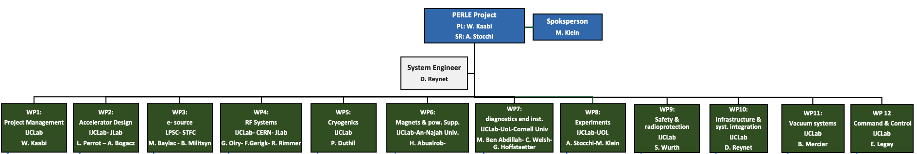








Project Organisation: PERLE Collaboration & PERLE- France
Denis Reynet System Engineers + Infrastructure (IJCLab)
Luc Perrot Beam Dynamics (IJCLab)
Maud Baylac Gun Installation and Operation (LPSC)
Guillaume Olry RF System (IJCLab)
Patxi Duthil Cryogenic (IJCLab)
Hadil Abualrob Magnets (An-Najah / IJCLab)
Mohammed Ben Abdillah Diagnostics and Instrumentations (IJCLab)
Sébastien Wurth Security Issues (IJCLab)
Bruno Mercier Vacuum System (IJCLab)
Eric Legay Command and Control (IJCLab)
New comers

Slide 3
PERLE Timeline for TDR phase and beyond
The current phase of the project:
Technical Design phase (→ 2023)
Prepare to Build phase (P2B) (→ 2025)
Machine design (Injector, 250MeV and 500 MeV configurations)
Beam dynamics studies
Main systems design (Buncher, Magnets, HOM couplers, full dressed cavity, power couplers, new CM, IP, dump…)
In-Kind adaptation and/or upgrade studies (DC-Gun, Booster, SPL CM) *
Definition of the needs (Diags, Cryogenics, CC, LLRF, Shielding, machine interlock system, infrastructure…)
Experiments with PERLE beam and their specific needs
Prototyping and tests (HOM couplers, Single cell booster cavity, B-COM magnet, 5-cells Nb Cavity) *
PERLE administrative regime (Dossier ASN)
Infrastructure (site investigations and work)
And also:
DC-Gun reinstallation and test
Equipment specifications and procurement (for DC gun)
In-Kind adaptation and/or upgrade work (DC-Gun, ESS CM)
* Design of some systems could continue after TDR publication
* Prototyping results could be included in the TDR phase if available

Slide 4
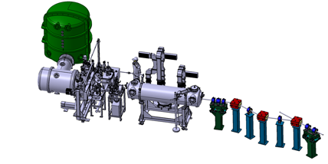
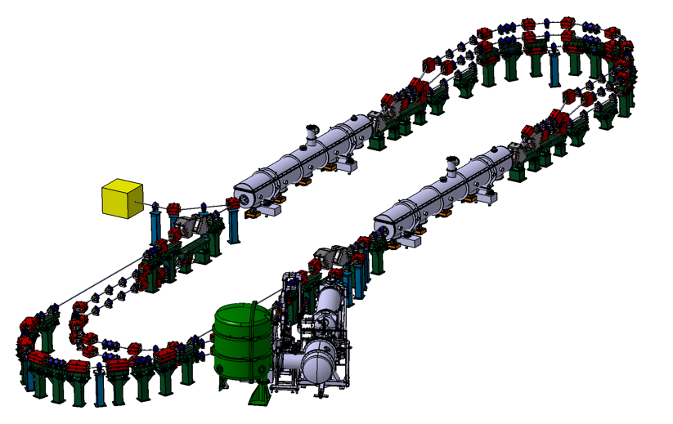
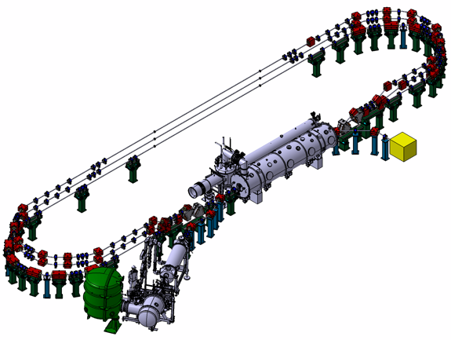
PERLE Timeline for TDR phase and beyond
Technical Design phase (TDR)
Prepare to Build phase (P2B)
Installation phases
Phase 1: Installation of the injection line
Phase 2: PERLE 250 MeV version
Phase 3: PERLE 500 MeV version
2020
2021
2022
2023
2024
2025
2026
2027
2028
2029
2030
2031

Slide 5
Evaluation of the project
In the last months, PERLE project was presented and reviewed by different lab instance:
October 19th 2022: IJCLab Scientific and Strategic Council
March 17th 2023: IJCLab Scientific Council
March 20th, 2023: PERLE Steering Committee
The main recommendations are:
More support (Manpower and fund) needed from the collaboration, especially in the upcoming construction phases.
Manpower projection for the next phases: still to be improved, especially by identifying missing expertise and back-up solutions, consolidation of the available resources at IJCLab over the years, identification and consolidation of collaboration members implication…
The timeline is very ambitious and success oriented: define scientific and technical milestones allowing to evaluate the project progress, especially regarding the expectations of the international community (ESPP roadmap).
The Budget: The lab could finance the first steps of the project and the opportunities it may have, but the project fund require more important fund and political support from several national and international bodies. We are encouraged to apply to the European and national call within a strong collaboration.
Effort to be implemented soon to address the crucial question of PERLE administrative classification (Dossier ASN).
Still waiting for the written version

Slide 6
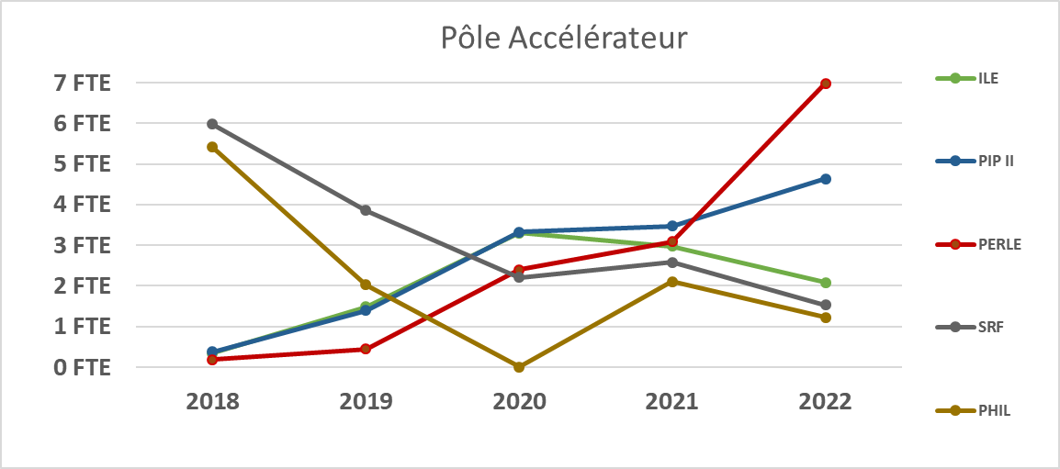
HR involvement and projection - French level mostly
Significant increase in 2022 of the forces contributing to PERLE that will continue in the coming years according to the phasing strategy.
Up to 20 FTE secured.
IJCLab/ France has to increase that.
BUT
We need similar exercise from the other partners.
Action on going.
→ Here the evolution of IJCLab manpower implication on the project in the past three years and an estimation for the 3 upcoming ones:
Year | 2020 | 2021 | 2022 | 2023 | 2024 | 2025
FTEs | 1,9 | 3 | 7 | 16 | 18 | 20
* For the past years, the table do not include other French lab involvements (LPSC + GANIL) + a split site PhD with Liverpool University.

Slide 7
Financial resources- Budget Estimation and spending profile
The global cost of the full machine ~27 MEuros.
(This estimation did not include manpower cost)
The following table presents an Ideal Spending Profile splitted in P2B phase, Construction, Construction-Infra (infrastructure equipment installation) and Upgrade to 500 MeV.
 | 2022 | 2023 | 2024 | 2025 | 2026 | 2027 | 2028 | 2029 | 2030 | 2031 | Total (k€)
P2B (k€) | 168,5 | 630 | 610 | 218 | 0 | 0 | 0 | 0 | 0 | 0 | 1626,5
Construction (k€) | 0 | 0 | 0 | 2970 | 7300 | 6200 | 1050 | 0 | 0 | 0 | 17520
Constr.-Infra (k€) | 0 |  | 100 | 500 | 1100 | 1600 | 500 | 0 | 0 | 0 | 3800
Upgrade 500 MeV (k€) | 0 | 0 | 0 | 0 | 0 | 0 | 350 | 1600 | 1830 | 550 | 4330

Slide 8
Budget – Spending profile in graphs
Ideal Spending Profile in k€ splitted in P2B phase, CONSTRUCTION, CONSTRUCION-INFRA and UPGRADE to 500 MeV.
Focus on P2B phase
We are trying to secure it
Spending Profile in k€ for P2B phase detailing the cost for TDR + Prototyping and the installation of the DC-Gun.

Slide 9
Search for financial support
We are actively looking at different possibilities to get extra funds for the P2B phase and beyond.
Beyond PERLE, but really PERLE and bERLinPro oriented, we are about signing an MoU CNRS/HZB
iSAS: European INFRA-TECH project 11 research partners (CNRS, CERN, ESS, DESY, VUB, CEA, HZB, INFN, UKRI, UL, EPFL) Asked 5M€. Financial support for the construction of the full cryomodule of a cost of about 3M€. The IN2P3 has guarantee the matching funds at the level of 1.0M€ complemented by the lab.
Possibility of having ESS and INFN-LASA-Milano in PERLE Coll.
Contribution ESS vessel cryomodule
APP P2I call: Submission of the project GUN+: Equipment for laser system performances upgrade (75 k€) + Contribution to the installation of a laser room (25 k€).
France 2030 will propose new project oriented calls (current 2023) ~5M€.
Important role played by ERL panel with a mandate by the CERN Council in the ESPP Roadmap has as a main task to guarantee that the ERL RoadMap and so PERLE could get the sufficient financial support to success the ESPP strategy.
In-Kind contributions:
  Approved: DC gun from Daresbury, CM vessel ESS (around 700k€).
  Potential in-Kind Contributions under discussions: CBETA equipment, Booster (JLab? Darmsdadt?), Buncher (ESS-Bilbao?)

Slide 10
ISAS: Innovate for Sustainable Accelerating Systems
EU call HORIZON-INFRA-2023-TECH-01-01: New technologies and solutions for reducing the environmental and climate footprint of RIs. Project submitted to EU on March 9, 2023
The objective of iSAS is to innovate those technologies that have been identified as being a common core of SRF accelerating systems and that have the largest leverage for energy savings with a view to minimizing the intrinsic energy consumption in all phases of operation
Project lead by CNRS
  Scientific coordinator : J. D’Hondt (VUB)
  Project coordinator : A. Stocchi
International consortium :
  11 research partners (CNRS, CERN, ESS, DESY, VUB, CEA, HZB, INFN, UKRI, UL, EPFL)
  6 industrial partners

Slide 11
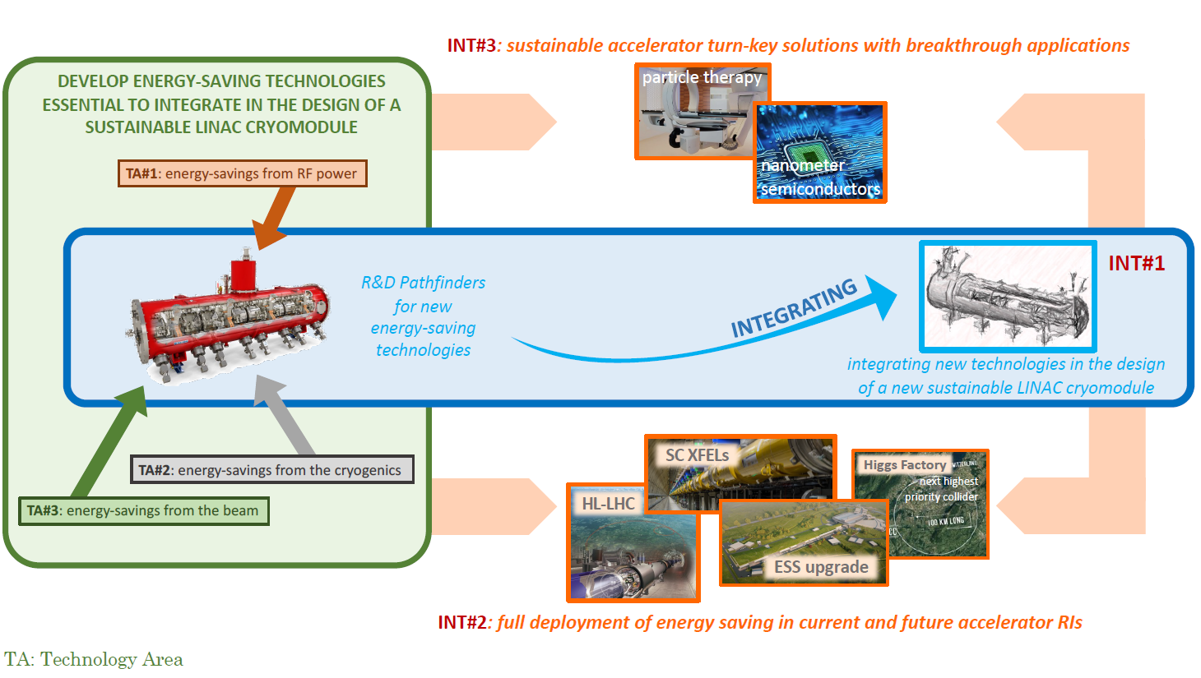
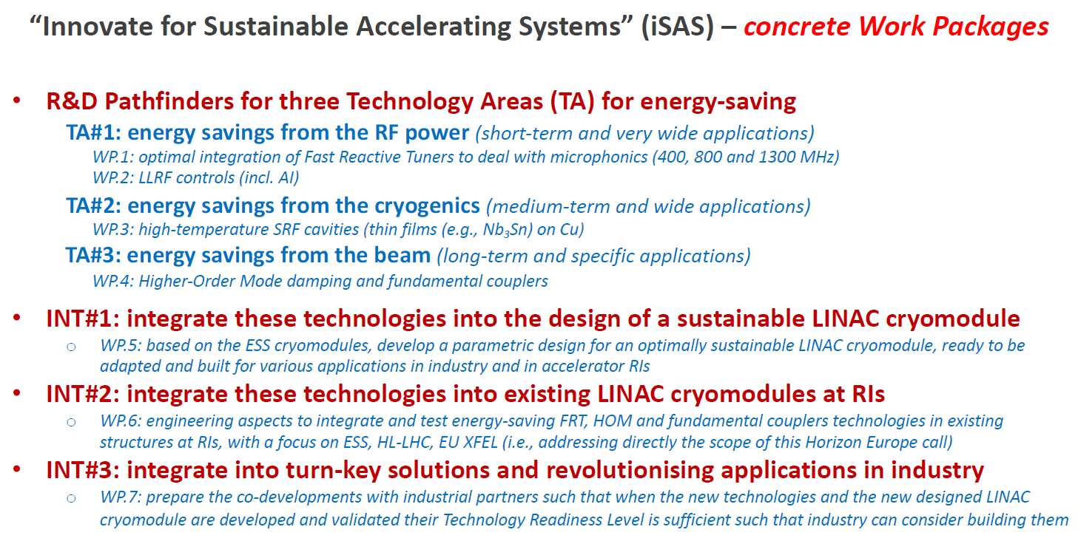
ISAS: Innovate for Sustainable Accelerating Systems

Slide 12
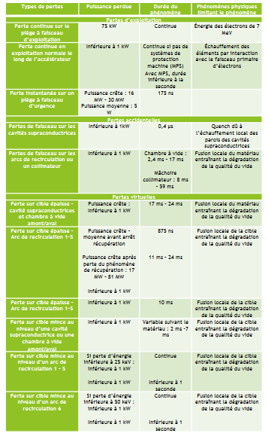
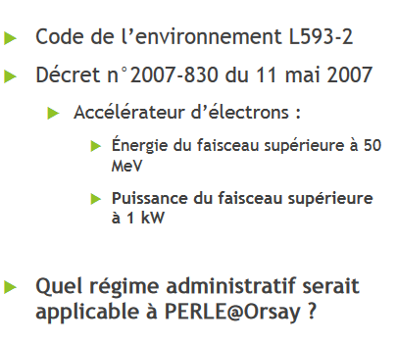
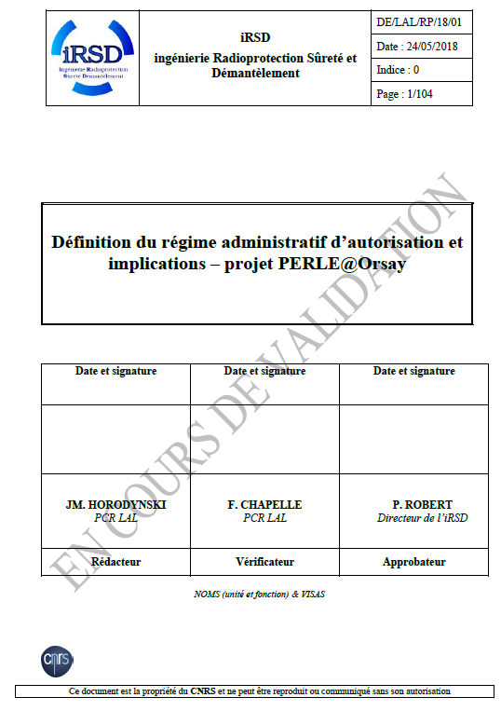
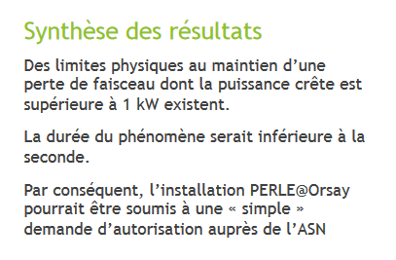
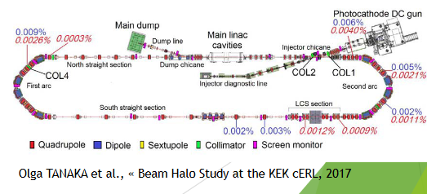
Administrative Classification of PERLE
A study was ordered to IRSD in 2018 and released in 2019.
Preliminary conclusions.
~100 pages document
Today, a task-force is formed to:
Continue and complement these studies to have a preliminary discussion with ASN by Summer 2023.
Start the required studies and the draft of the ASN document for PERLE in the upcoming years
Some benchmarking with cERL and JLab former ERLs.

Slide 13
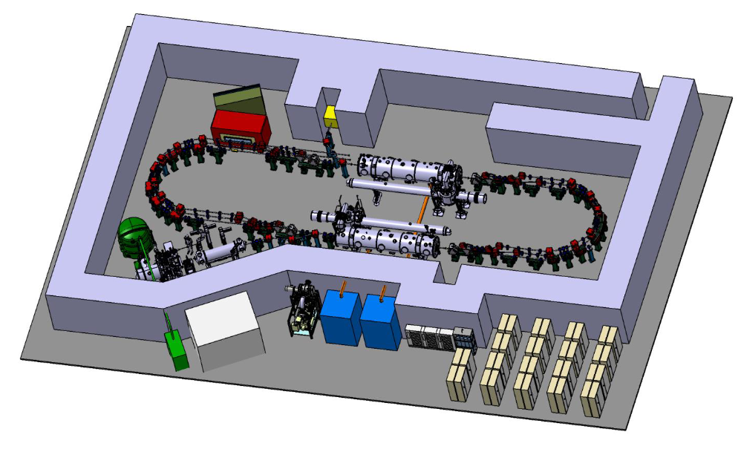
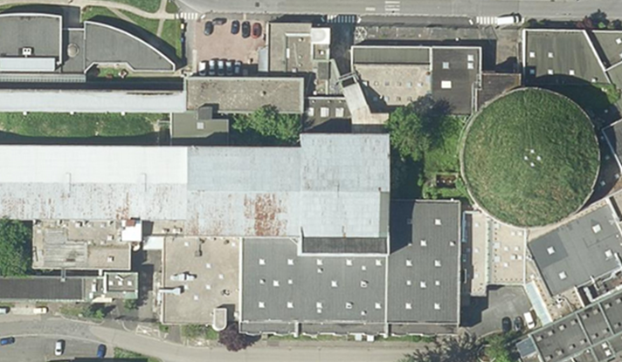
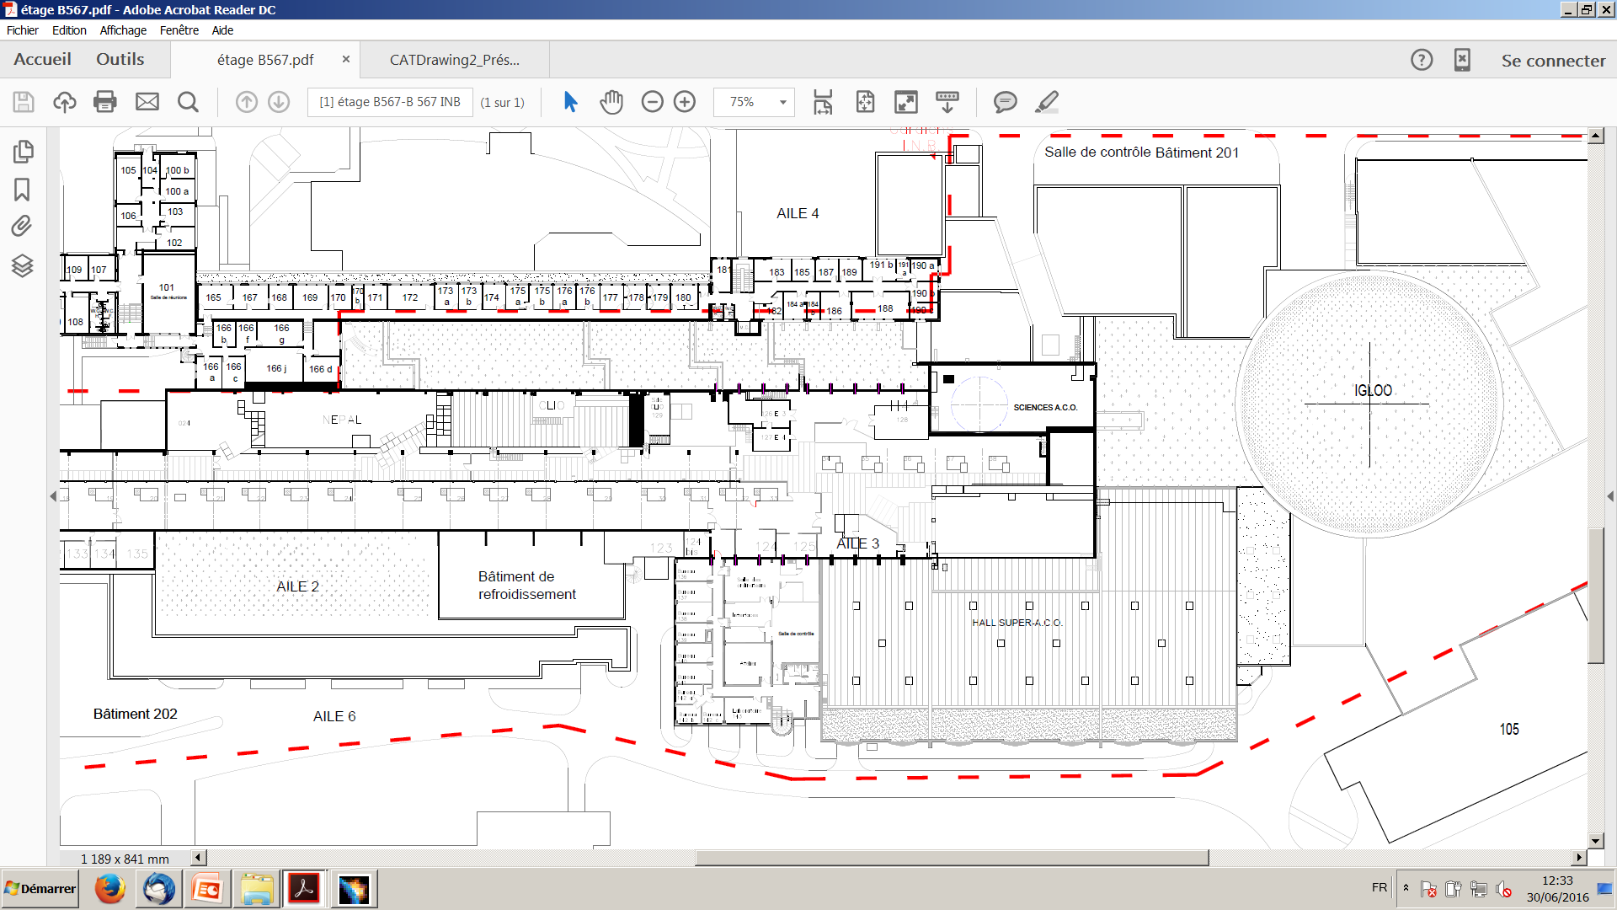
PERLE Footprint and site studies
Two sites are currently considered and will be studied in details within the CPER program for possibly host PERLE: The Super ACO hall and the IGLOO.
36 m
IGLOO
PERLE feature a total footprint of:
30 meters long, 15 meters wide and 3.4 meters high.
Super ACO Hall
37 m
55 m

Slide 14
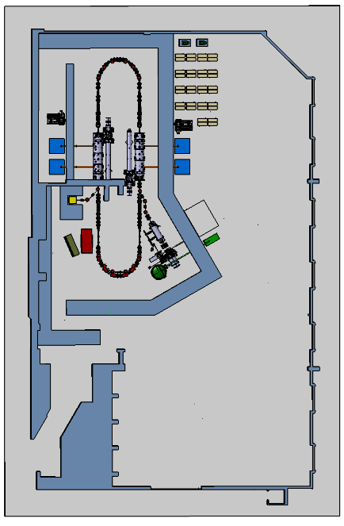
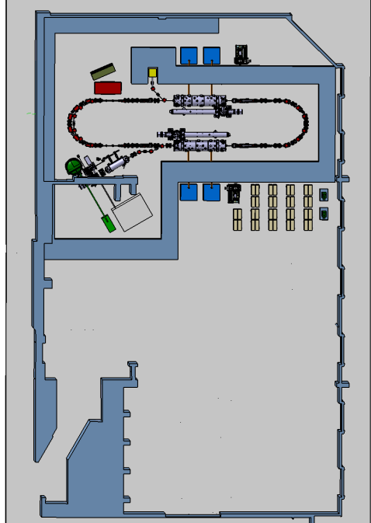
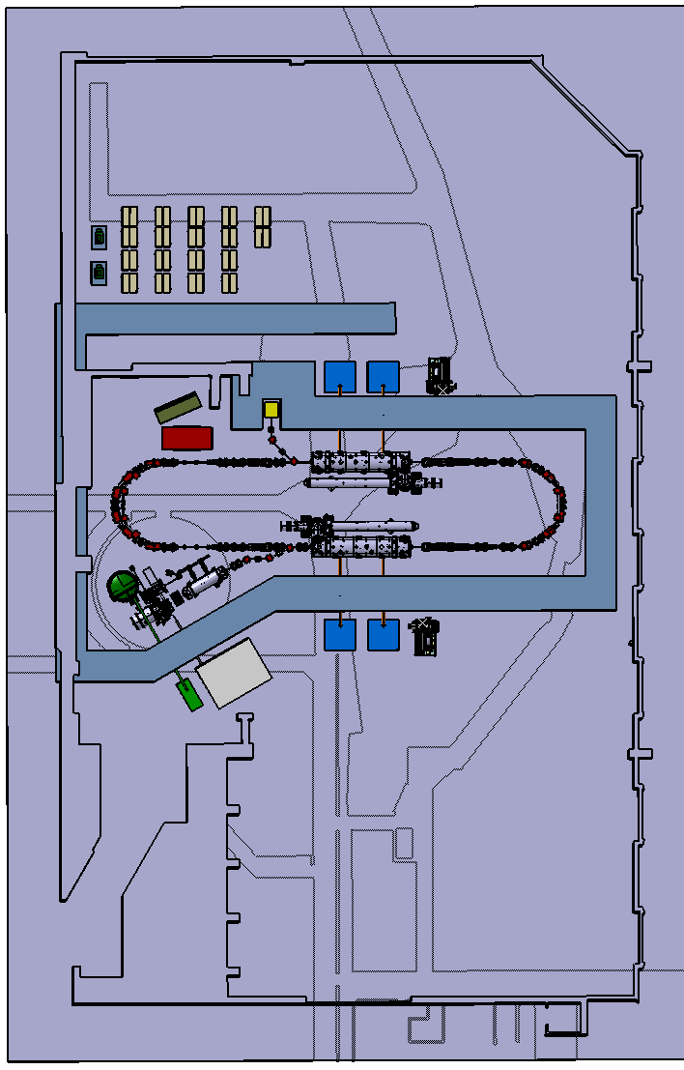
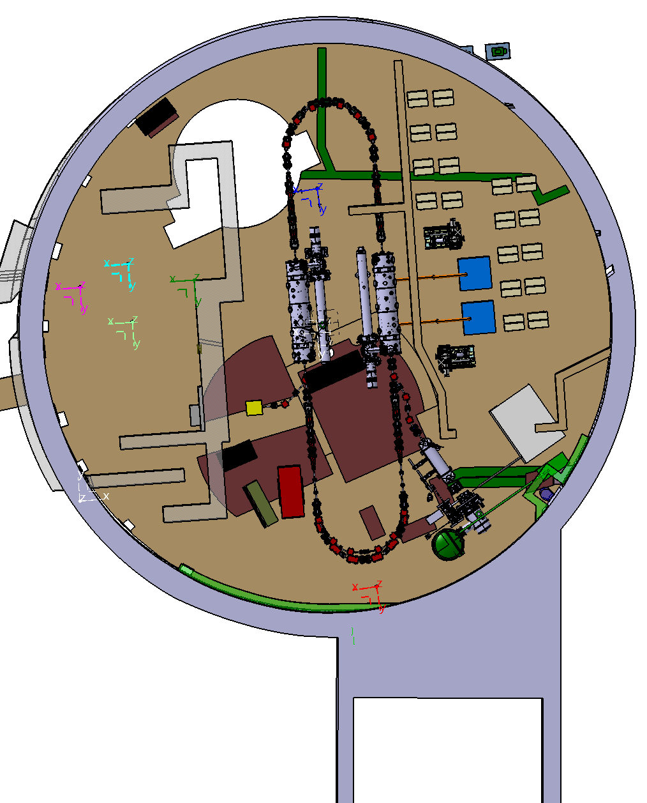
PERLE Footprint and site studies

Slide 15
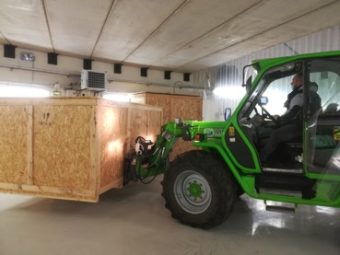
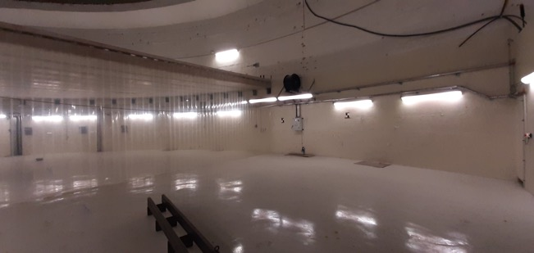
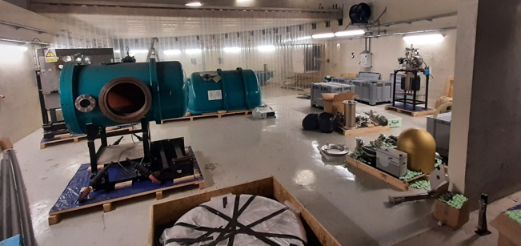
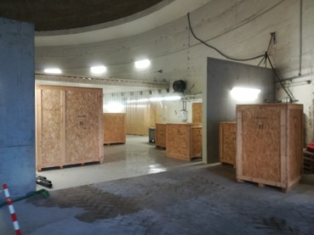
PERLE e- Source
Alice (Daresbury) DC gun received at Orsay on May 2019. We are currently working on its re-installation and operation at low parameters, then studying its upgrade to meet PERLE requirements.
The “Igloo”: Equipped experimental hall to host the DC gun
All received parts transferred to the installation area (March 22)

Slide 16
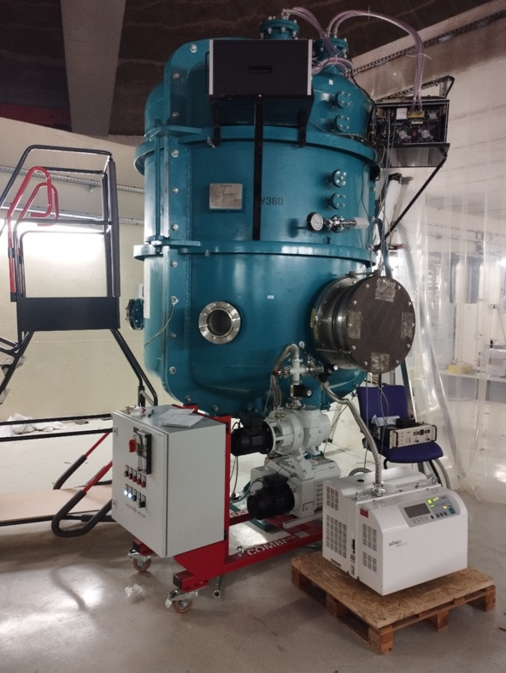
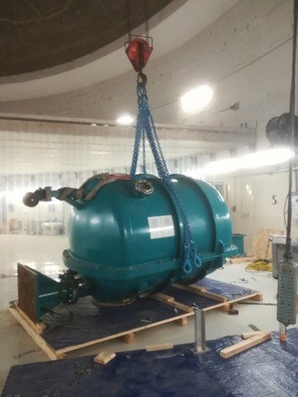
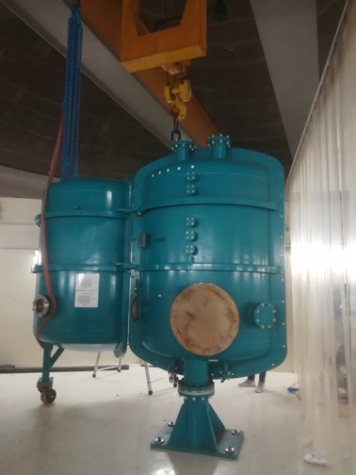
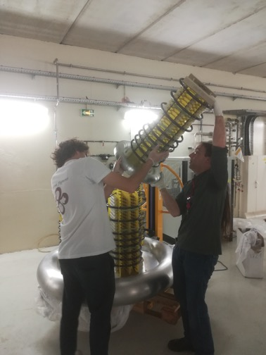
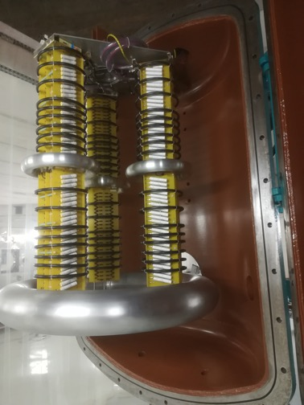
PERLE e- Source
HV vessel installation
(June 22)
HV power supply assembly
(July 22)
Checking the HV vessel tightness
(September 22)

Slide 17
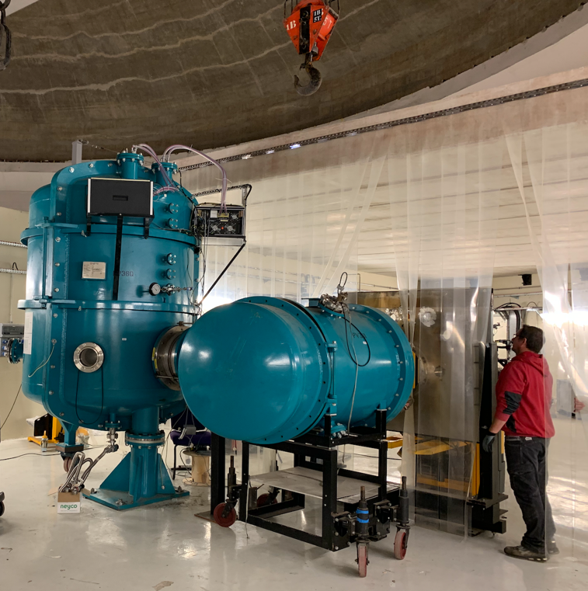
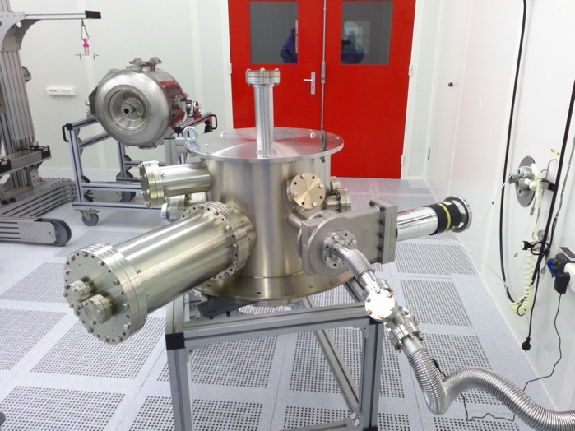
PERLE e- Source
Vacuum pumping of gun new chamber after ultrasonic cleaning (December 2023)
Installation of the gun vessel (November 22)

Slide 18
PERLE e- Source
Accomplished
  Permit from Nuclear Safety Authorization (ASN), required for operation at high voltage, submitted in Dec
  Laser and optical system procurement and installation
  Installation of HV structure, leak test under progress
  Installation of laminar flux (ISO5)
  Functional test of solenoids, steerers
To be completed in 2023
  Insulation gas system procurement
  Purchase vacuum components (NEG, turbo pumps, gauges, …)
  Procure photocathodes
  Develop command-control system and safety interlocks
  Installation of laser and optical system
  Gun fully assembled and under vacuum
  When ASN permit granted, HV conditioning for operation at 350 kV
First beam tests expected in 2024
Very recently
New opportunity
Discussion on going with RI to « buy » a full equipped DC Gun

Slide 19
Announcement: Next PERLE Collaboration Meeting
PERLE Collaboration Meeting at CERN, June 22 and 23, 2023
https://indico.cern.ch/event/1266985/
In person meeting, from Thursday 9am to Friday 4pm.
Kjell Johnson Auditorium (ZOOM possible).
Dinner Thursday evening
This is a two days meeting of the PERLE Collaboration for discussing progress and plans to build the first high electron current ERL facility, at IJCLab Orsay. In the focus will be the technical status and accompanying recent developments,
including the iSAS initiative towards sustainable accelerator technology and news on LHeC/FCC-eh.
Potential new members of the Collaboration: ESS Lund, INFN Milan, TU Darmstadt – will be presented to CB when clear

Slide 20
Thank you for your attention!

