Slide 1
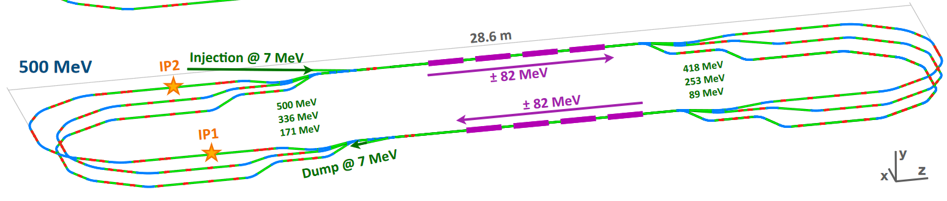
PERLE France Meeting
PERLE beam dynamics status

Slide 2
PERLE France Meeting
Injector design
Injector : from RF gun to booster
Merger : from booster to PERLE
PERLE lattice and design
Global architecture
Optimization and matching
Beam dynamics studies
Tools developed
Effects investigated

Slide 3
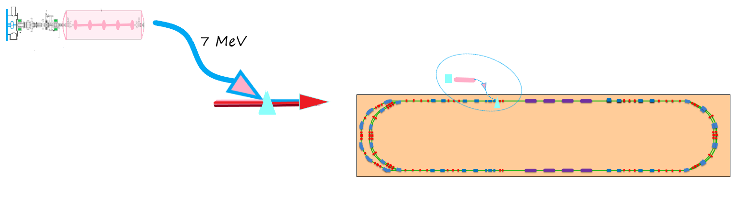
PERLE injector purpose and specifications
The injector is the link between the $e^{−}$ source and the machine
350 keV
Photocathode
7 MeV
Booster
eGun
Injector
Merger
PERLE
It should match the Perle specifications initially set at :
Emittance | Bunch charge | Rep. rate | Current | RMS bunch lenght | Total inj. energy
<6mm.mrad | 500 pC | 40.1 MHz | 20 mA | 3 mm | 7 MeV

Slide 4
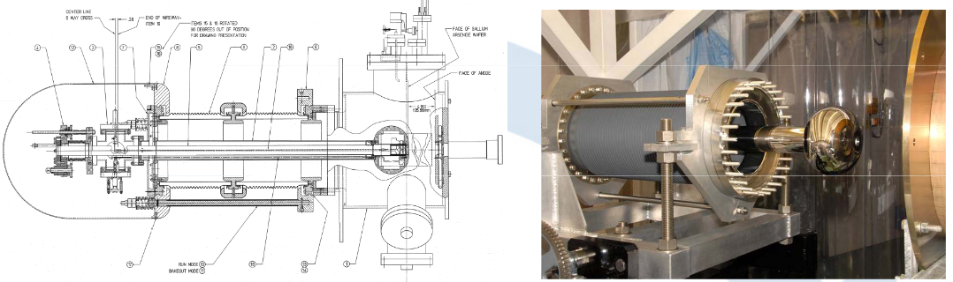
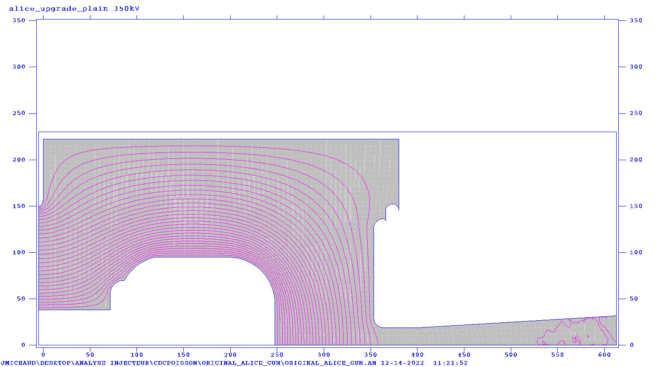
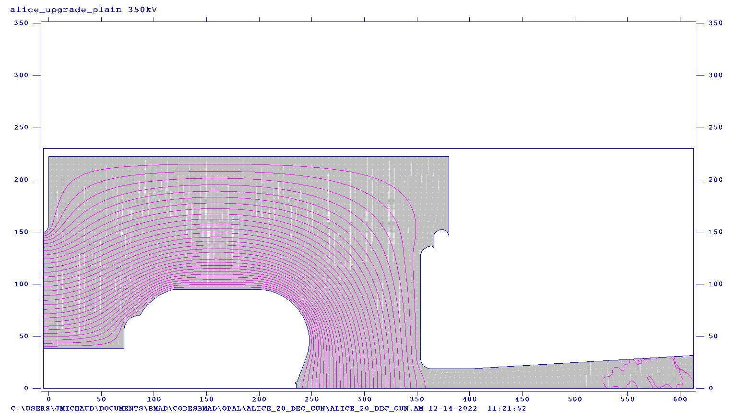
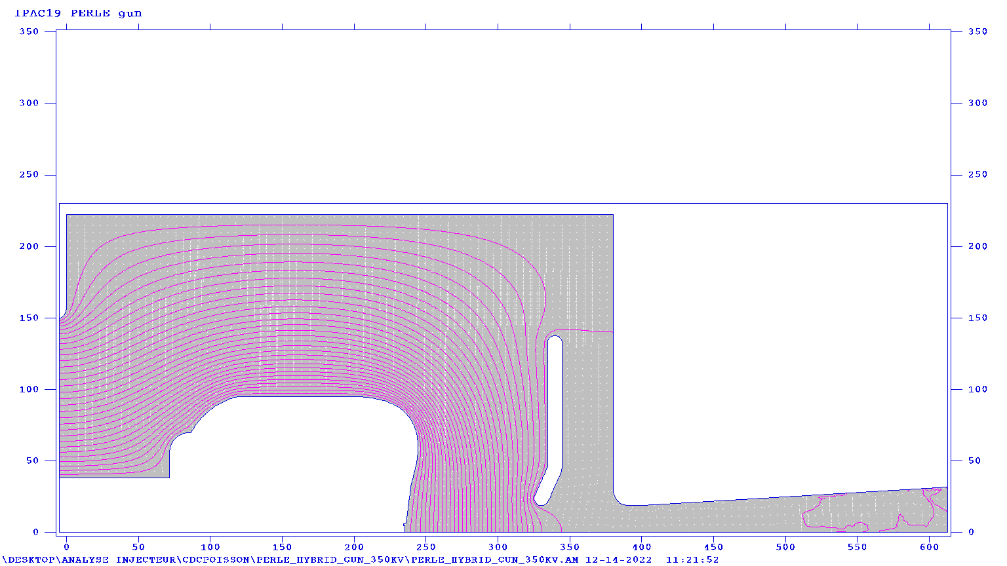
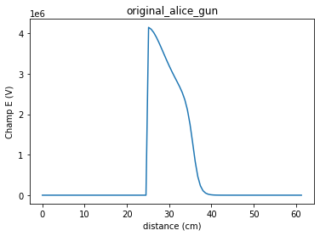
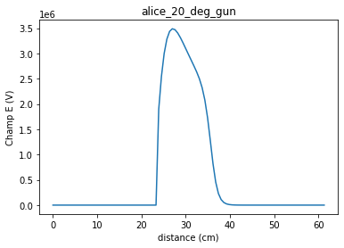
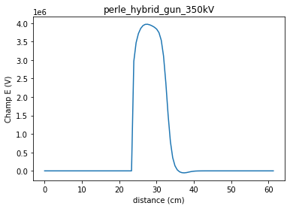
Alice Photoinjector
Original gun under installation at IJCLab
R. Roux
M. Baylac
D. Reynet
Original alice gun
Upgrade alice gun
Optimized alice gun
POISSON mesh
Field map

Slide 5
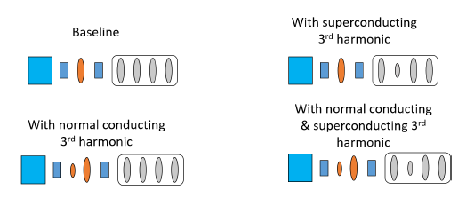

4 possible injector designs : from Ben Hounsell’s PhD thesis
Elements :
:DC Egun
(350kV)
:Solenoid
:NC RF cavity
(buncher)
:SC RF cavity
(booster)
As all designs seem to meet the specifications, only Baseline design has been studied (for now)
Studies by F. Bouly (LPSC), J. Michaud (IJCLab), R. Roux (IJCLab)

Slide 6
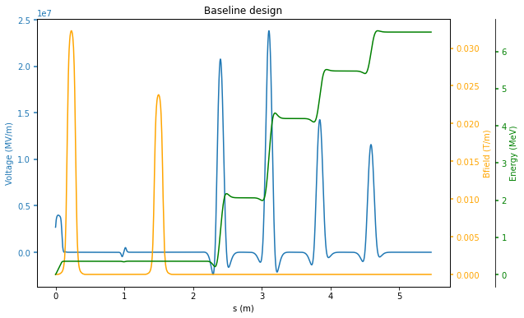
Injector Fields and energy
Solenoid
Solenoid
Egun
Buncher
Booster

Slide 7

Machine parameters
Elem. attribute | Value
Egun Voltage | 350 kV
Egun laser freq. | 40 MHz
Bunch charge | 500 pC
Solenoid 1 field | 0.0323 T
Buncher Field | 1,305 MV/m
Buncher freq | 801 MHz
Solenoid 2 field | 0.0238 T
Booster field | 20.8/24.0/14.4/11.7 MV/m
Booster freq | 801 MHz
Current injector design
meets Perle specification
Specifications initially given for Perle
might not be totally fixed :
This will depend on full start-to-end Perle tracking
(Especially bunch lenght and energy spread)
Spec | Value
Transverse emittance | <6mm.mrad
Bunch charge | 500 pC
Bunch freq | 40 MHz
Beam current | 20 mA
RMS bunch lenght | 3 mm
Total inj. energy | 801 MHz
Reducing one value might mean, increasing another quantity
➔ Design of injector is not totally fixed yet (fields amplitudes, elements positions…)

Slide 8
Working plan for injector
Booster and injector needs to be consolidated
Need of simple, robust design and efficient tuning procedure
Implementation of 3D field maps
« M-shape » has to be controlled according to ERL recquirements
Beam dynamics design has to be accorded to real elements :
New buncher design
Cryomodule design
Cavity independently powered (Tbd)
Integration of the full beamline:
Steerers
Beam diagnostics (test bench) positions and recquirements have to be defined
To do so : benchmark with different codes
OPAL (J. Michaud) : Code used for original design by B. Hounsell. Does 3D tracking including collective effects
ASTRA (R. Roux) : Powerful code using field maps including space charge
TraceWin (F. Bouly) : Well known code @IN2P3. Envelope and tracking including field maps and space charge. Need to be tested for electrons.
‘M-shape’
Longitudinal beam distribution at the Booster exit E_{k} = 6.5 MeV

Slide 9
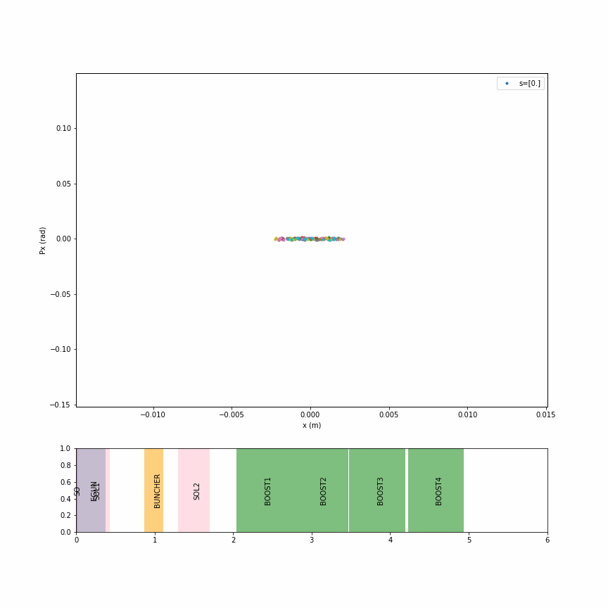
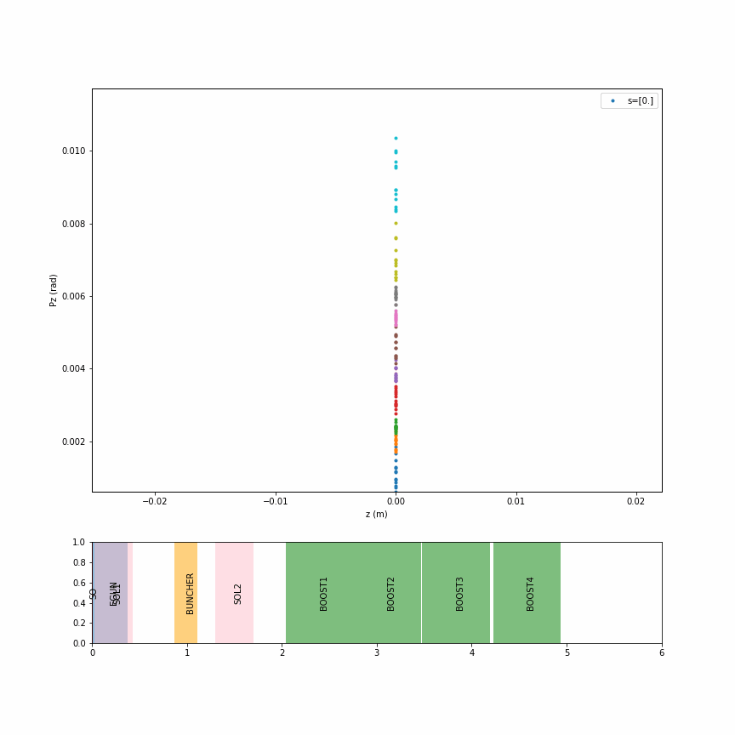
From the beam point of vue
Transverse phase space (x-px)
Longitudinal phase space (z-pz)
Solenoids focus beam in transverse plans
Buncher focus beam in longitudinal
M shape in z-pz axis at the end of injector : could be a problem

Slide 10
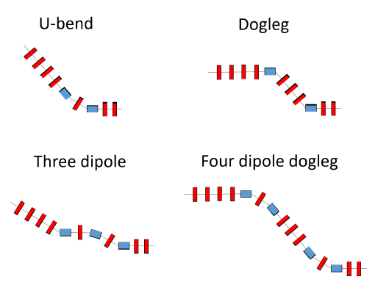
4 different merger design (from B. Hounsell PhD thesis)
Merger : Matching the injector beam to the eigen-ellipse of PERLE
Studies by B. Jacquot (GANIL)
Constraints :
Compact: not a big constraint.
Achromaticity: avoid emittance increase
Circulating beam perturbation to be considerer:
Transverse matching to be done with minimal number of quadrupoles in ring
Flexibility: various injector conditions

Slide 11
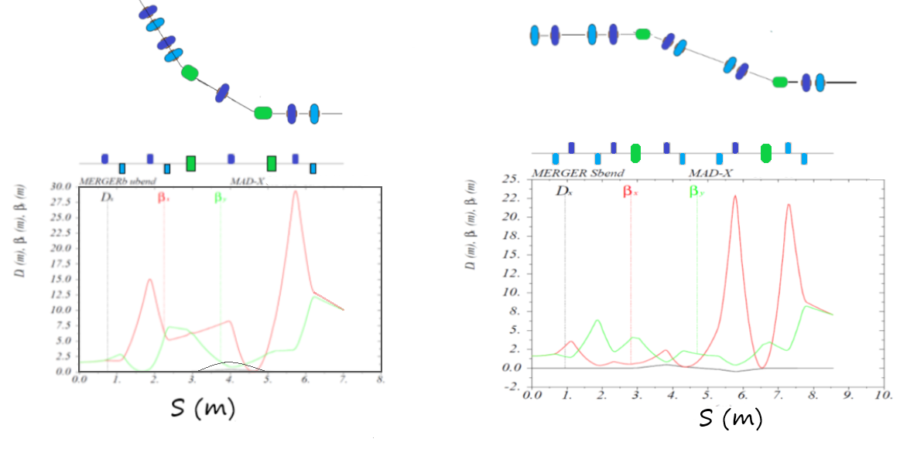
The 2 simplest mergers : UBEND and SBEND
UBEND
SBEND (dogleg)
Matching : OK for the two geometries
UBEND is the simplest (7 quads) : solution preferred 2x 22,5° (Bend ~ 15cm)
SBEND (10 quads required) could be preferred for building consideration (parallel to the ring)
7 MeV
250 MeV
Deal with the circulating beam perturbation (influence of « re-injection chicane) :
With 22.5° magnet : 83MeV beam ➔ Δx’ ~ 33 mrad
166MeV beam ➔ Δx’~ 17 mrad
250MeV beam ➔ Δx’~ 11 mrad
Quads n° : 2 quads in ring and 4 quads after 7MeV booster needed

Slide 12
Injector : conclusion
Injector design and associated files transmitted to us by Nov. 2022
Input files for simulations
Field maps
Thesis of Ben Hounsell
Simulations of :
Injector with different codes : OPAL (J. Michaud), ASTRA (R. Roux), TRACEWIN (F. Bouly)
Merger by B. Jacquot
Degrees of freedom for specification matching : laser pulse lenght, laser spot size, buncher/booster voltages/phases.
Simulations of Perle show that a 3mm bunch lenght might be too long (unstability during deceleration)
➔ necessity to investigate for shorter bunch lenght (2mm)

Slide 13
PERLE France Meeting
Injector design
Injector : from RF gun to booster
Merger : from booster to PERLE
PERLE lattice and design
Global architecture
Optimization and matching
Beam dynamics studies
Tools developed
Effects investigated

Slide 14
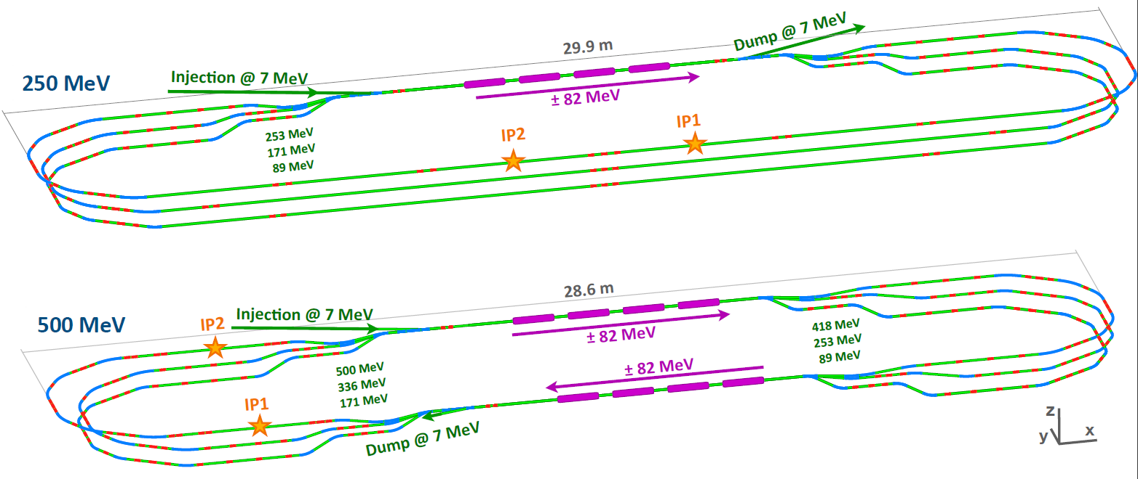
Two models studied
Arcs are identical : reduction of immediate expenses and construction time :
1 (of 2) cryomodules, 60 (78) dipoles and 136 (148) quads)
Fields in quads are consistant with current design (no saturation)
250 MeV version :
3 energies -> 6 arcs
1 linac
1 spreader ; 1 merger
3 straight sections
500 MeV version :
6 energies -> 6 arcs
2 linac
2 spreader ; 2 merger
Images and design (250MeV) by Alex Fomin

Slide 15
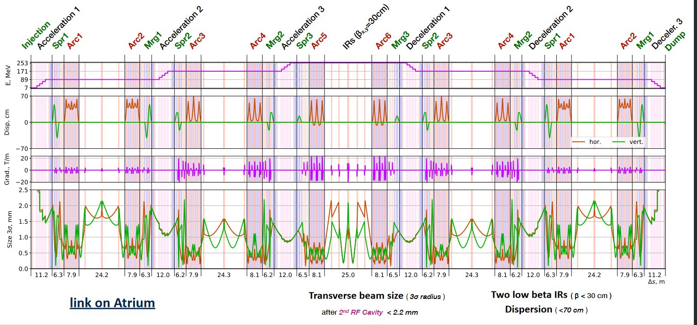
Lattice parameters : 250 MeV version

Slide 16
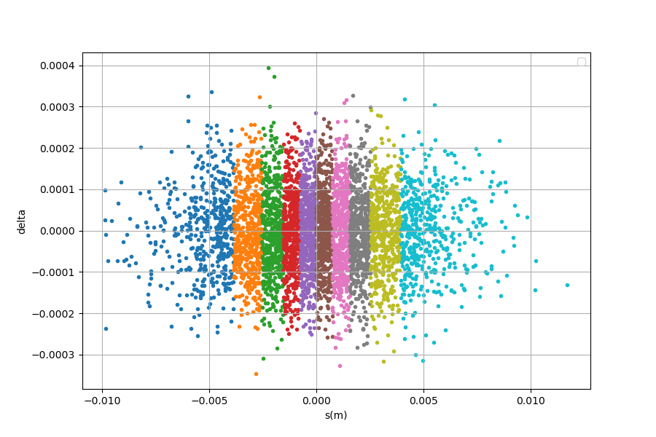
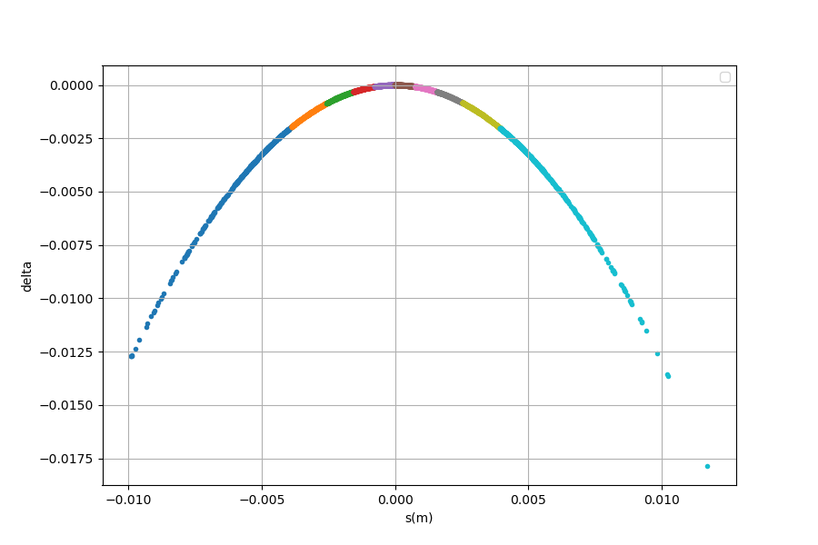
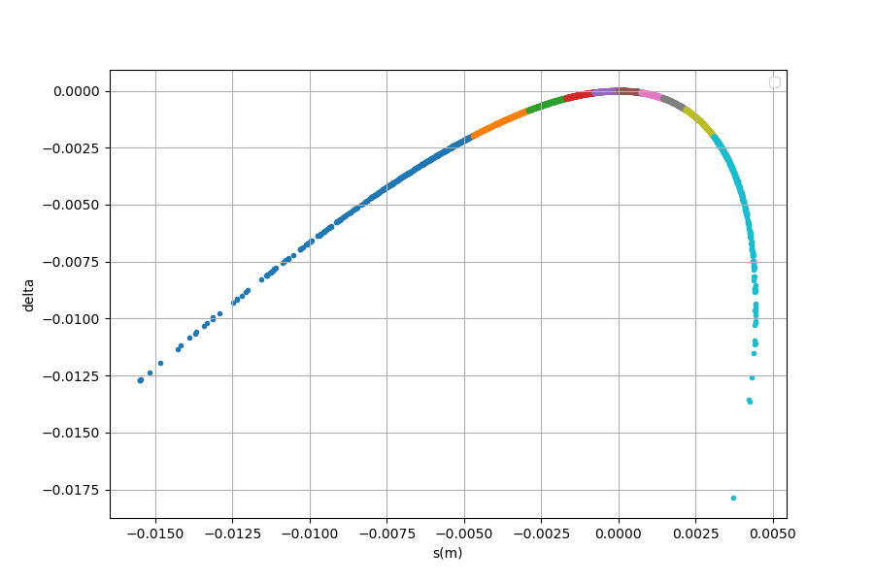
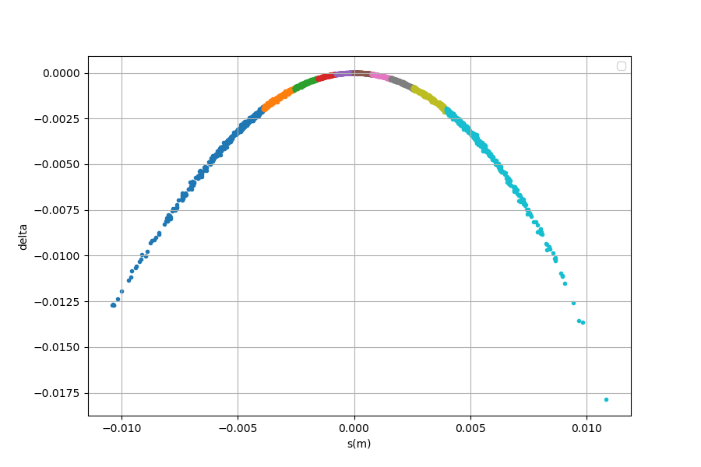
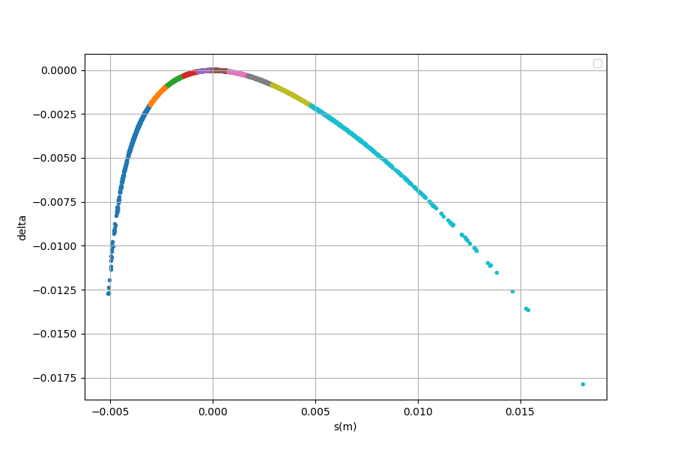

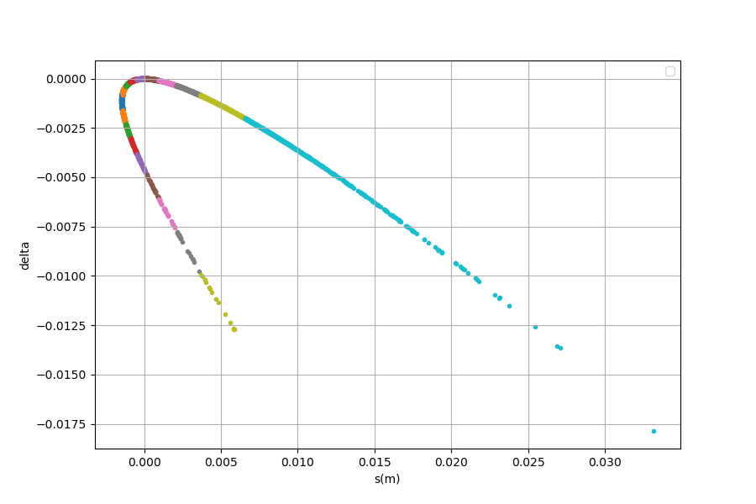
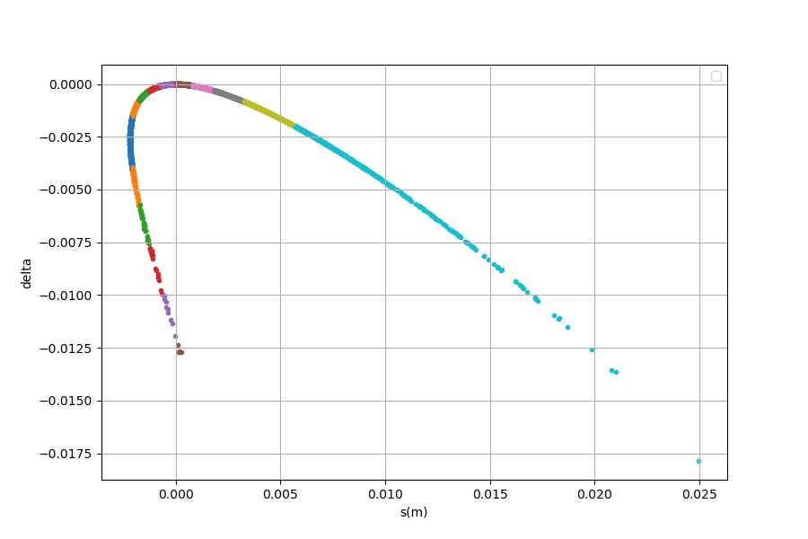
Stacking effect on 250 MeV lattice – longitudinal emittance
Injection
Post-linac
Spreader
Middle arc1
End arc 1
Str section
Arc 2
Merger
Lack of symmetry (lack of 1 spreader and 1 merger) in 250MeV lattice creates stacking effect.
➔ Can be corrected by closing term M56 (momentum compaction factor)

Slide 17
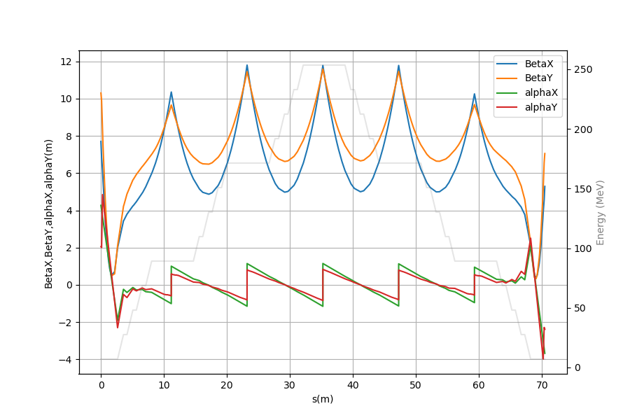






Optimization objectives
What needs to be tuned :
What can we play on :
Twiss functions stable over all linacs
Merger output :
initial twiss functions
$$3σ_{y,x}<2,2 mm$$
- K1 gradient of quads in spreader
(7 quads families)
$$D_{y}=D_{y}^{′}=0$$
$$β_{start}=β_{end}$$
$$α_{center}=0$$
- K1 gradient of quads in arcs
(11 quads families)
$$D_{x}={D′}_{x}=0$$
$$M_{56}=0$$

Slide 18
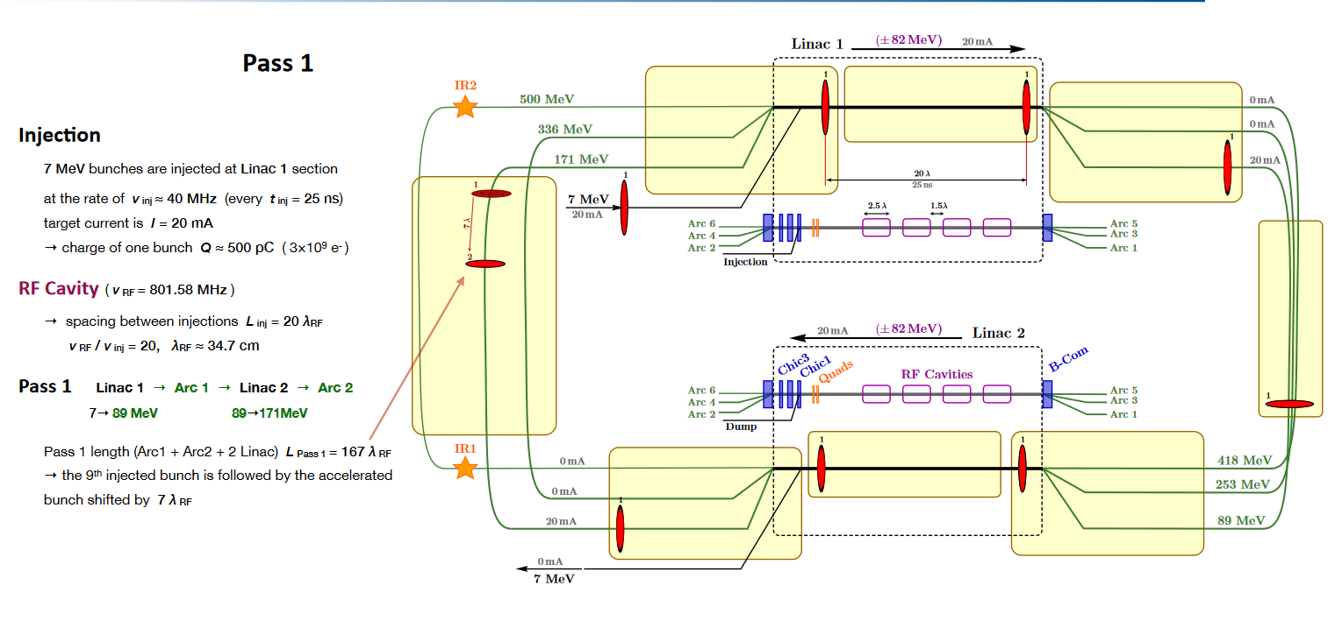
Filling pattern (Alex Fomin)

Slide 19
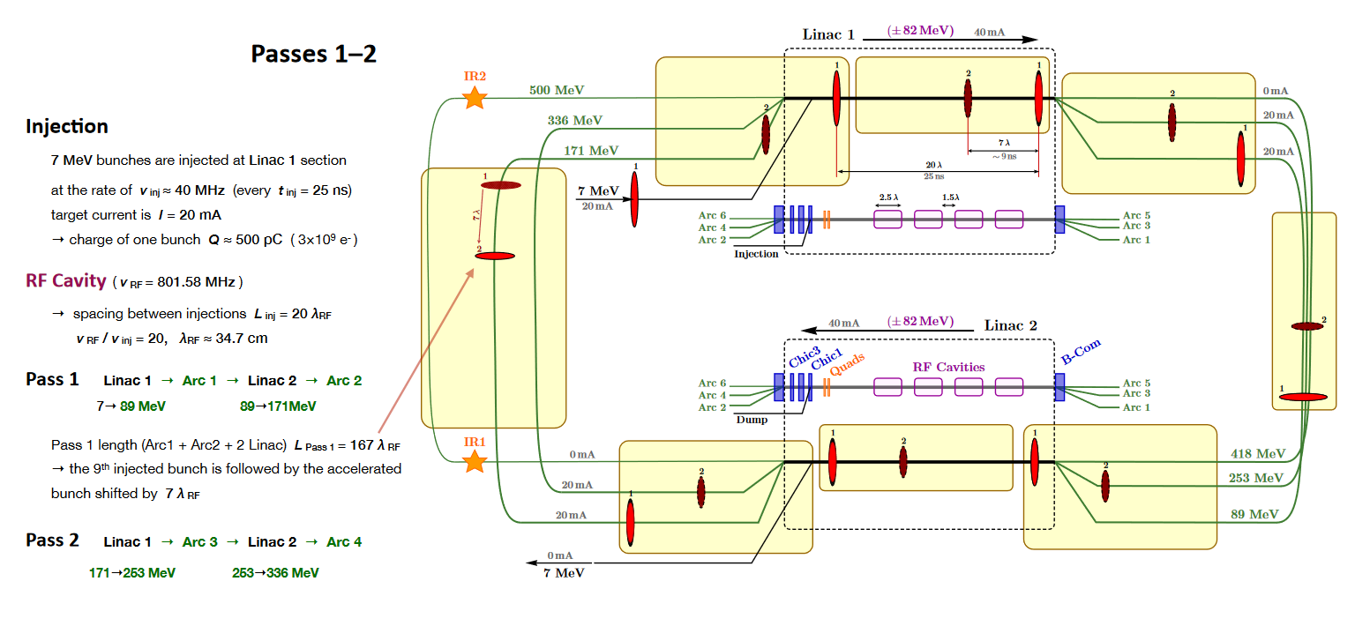

Slide 20
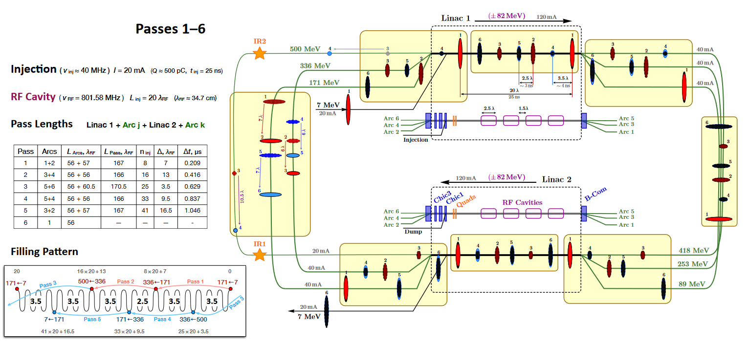

Slide 21
PERLE France Meeting
Injector design
Injector : from RF gun to booster
Merger : from booster to PERLE
PERLE lattice and design
Global architecture
Optimization and matching
Beam dynamics studies
Tools developed
Effects investigated

Slide 22
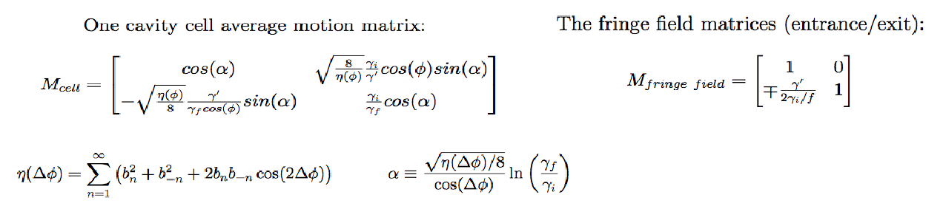
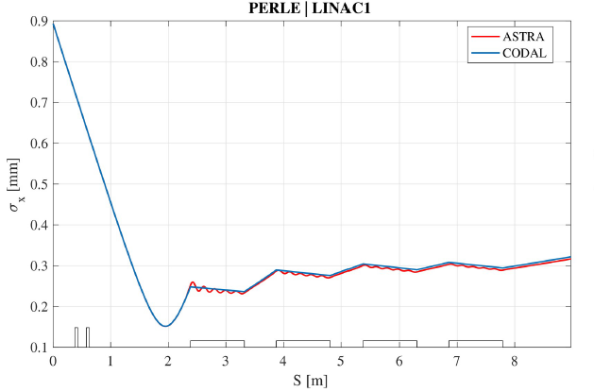
Beam dynamics in CODAL
Transverse particle motion in radiofrequency linear accelerators
J. Rosenzweig (UCLA), L. Serafini (Milan U.)
PhD work of Coline Guyot :
Analytical model implemented in CODAL
Benchmarked with field maps (ASTRA)

Slide 23
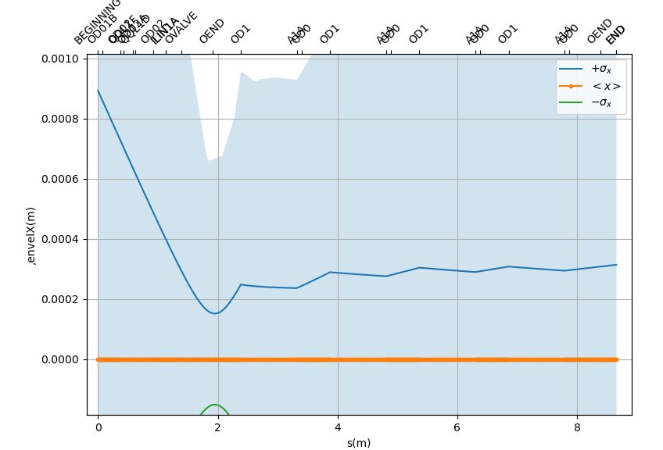
Code benchmarking : LINAC transverse dynamics
BMAD, ASTRA & CODAL agree on 6D Linac dynamics
Coline Guyot
BMAD
CODAL/ASTRA
Actually, dynamics equations from the same publication !

Slide 24
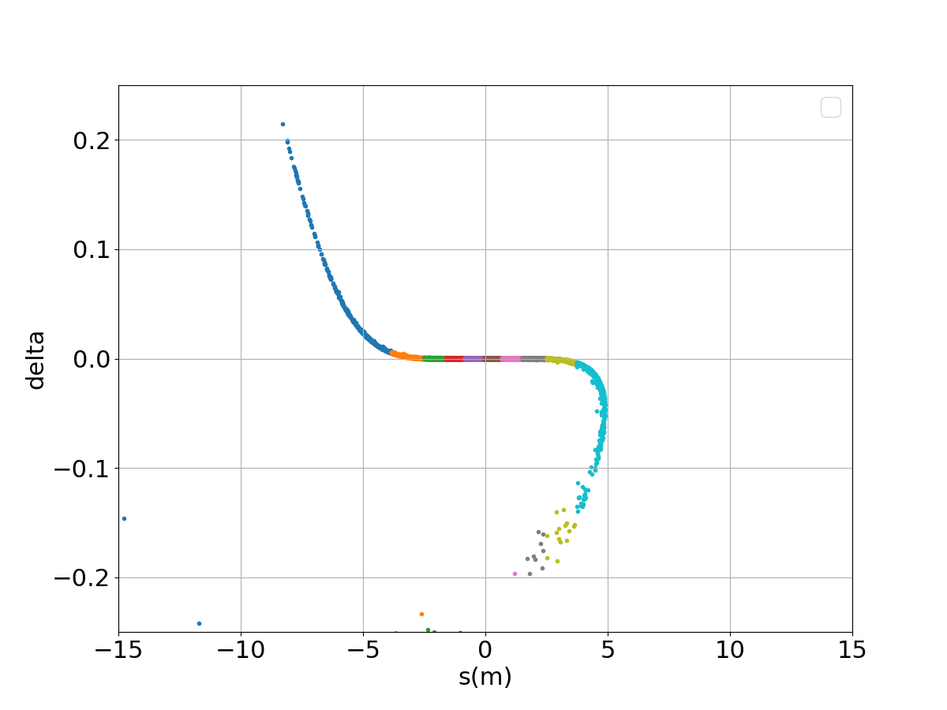
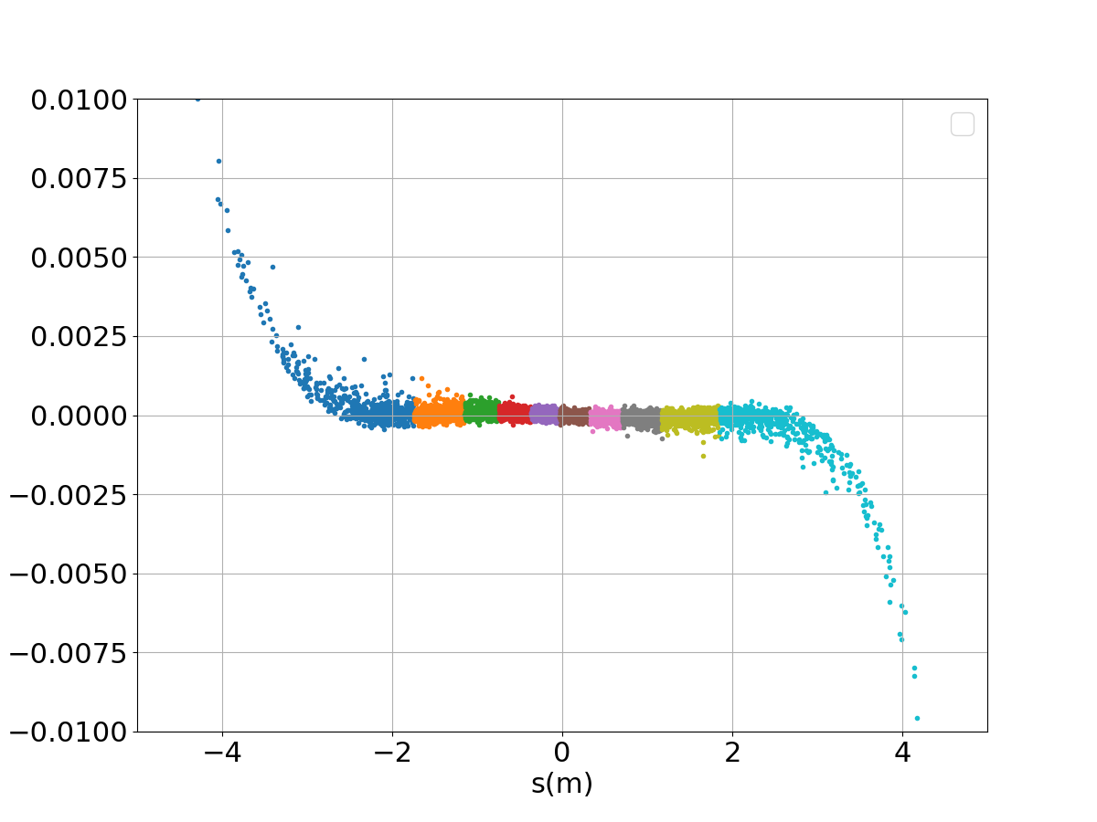
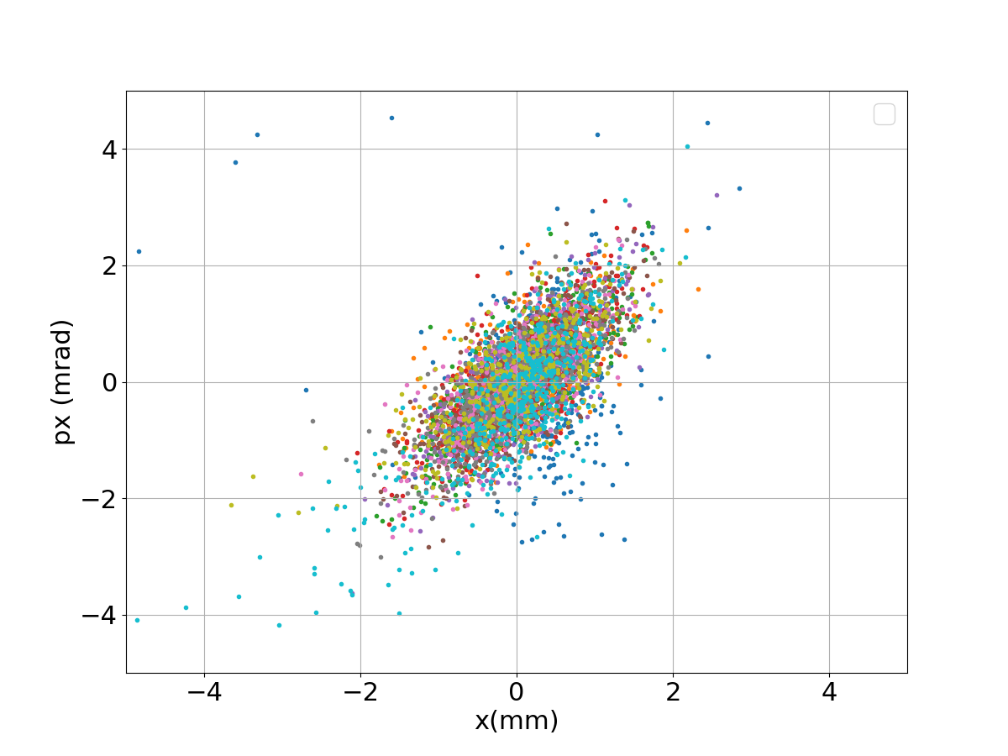
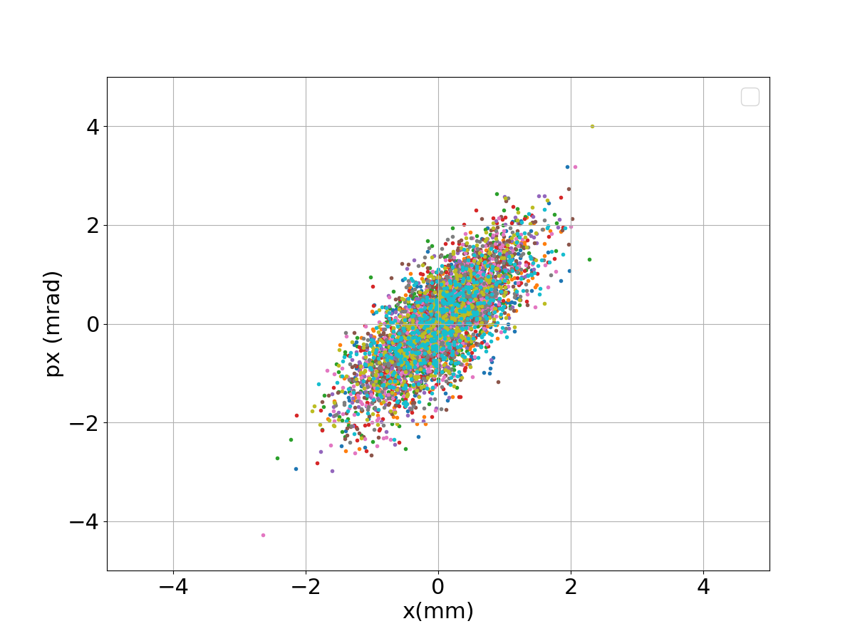
Bunch lenght 3mm or 1,4mm (250 MeV)
3mm bunch lenght
1,4mm bunch lenght
Studies showned by Kevin Andre :
z/pz
Single and multi-bunch tracking for PERLE (Kevin Andre talk at
PERLE collaboration meeting 16/07/21)
“So far the issue is the RF curvature for 3 mm bunch length more than the CSR even for 1.4 mm bunch length”.
x/px
Migh reconsider initial spec of
3mm bunch lenght for the injector
Possible solutions :
Play with off-crest phase advance in linac
Sextupoles
BMAD simulations (high order tracking, no collective effects)

Slide 25
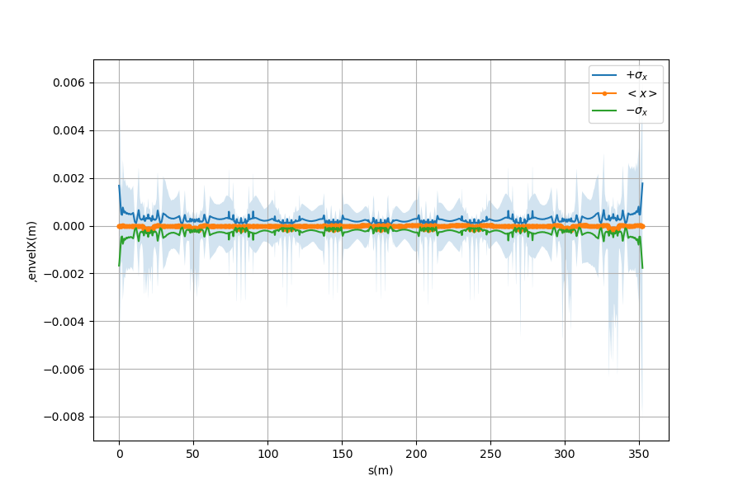
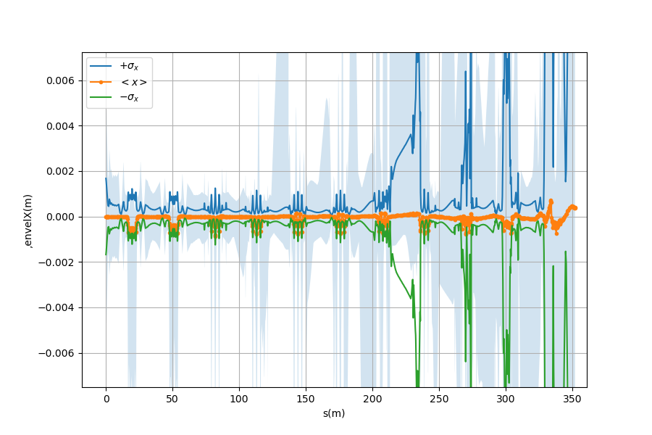
Transverse beam size
Transverse beam size stable
for a 1,4mm beam
Transverse beam size unstable after deceleration
for a 3mm beam
Preliminary simulations (BMAD) show a limit at ~2 - 2,5mm bunch lenght
(CSR and collective effects not included yet)

Slide 26
Conclusion
Lattice design is now fully finalised :
Reference trajectory and envelops
Dispersion closed
Twiss parameters stable/symetric
Momentum compaction factor stable
Filling patterns
Tools developed/benchmarked :
Numerical tool for multiturn and collective effects is ready (PhD work of C. Guyot)
BMAD simulations ready : CSR, space charge, linac dynamics benchmarked, lattice matched
Next steps :
Start-to-end multiturn tracking (bunches of many particles)
Include collective effects (space charge, CSR…) in simulations
Higher-order optics (sextupoles…)
Everything should be tuned finely : e-spread, chirp…
Injector parameters should be re-defined from these studies (especially bunch lenght)
Other studies ongoing:
Misalgnments & magnet studies by Rasha
Halo formation and beam loss (Master student – Belgium, Lode Vanhecke)
Diagnostics integration in lattice : all activities in proximity with WP diags
PTC under investigation (linac dynamics)

Slide 27
Thank you !
WP02 : Accelerator design members at IN2P3
Coordinator : Luc Perrot
PERLE beam dynamics:
R. Abukeshek, A. Fomin, C. Guyot (supervisor : C. Bruni), J. Michaud, L. Perrot
Injector and merger:
F. Bouly, B. Jacquot, J. Michaud, R. Roux

Slide 28
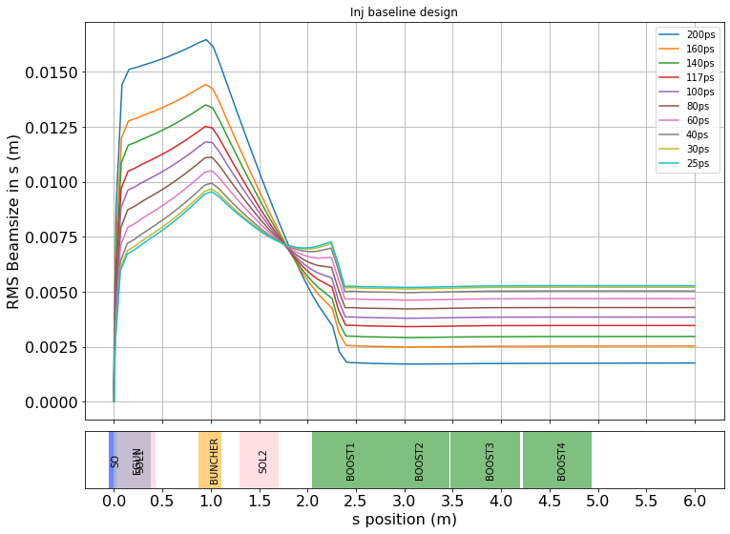
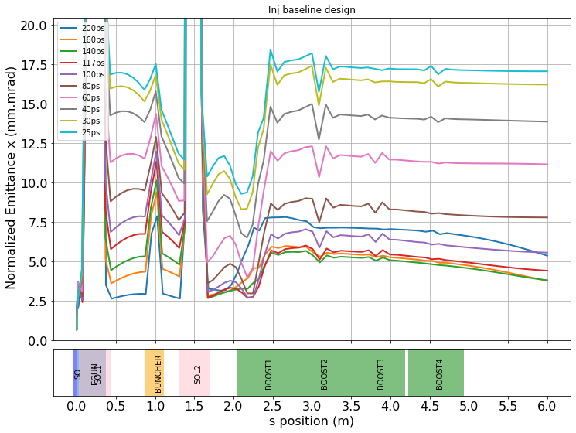
Try to play with different parameters
Exemple : effect of eGun laser pulse lenght on the beam :
RMS bunch lenght
Transverse emittance
Buncher focal point
Beam size fixed (v = c)

Slide 29
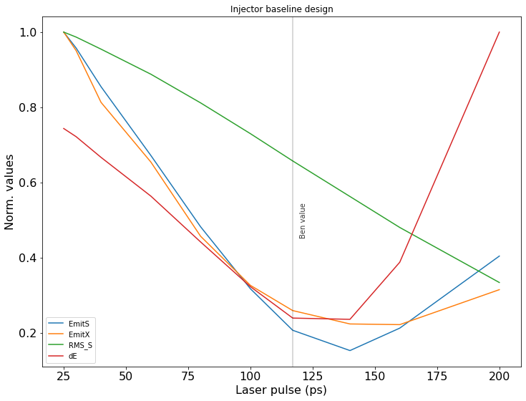

Slide 30
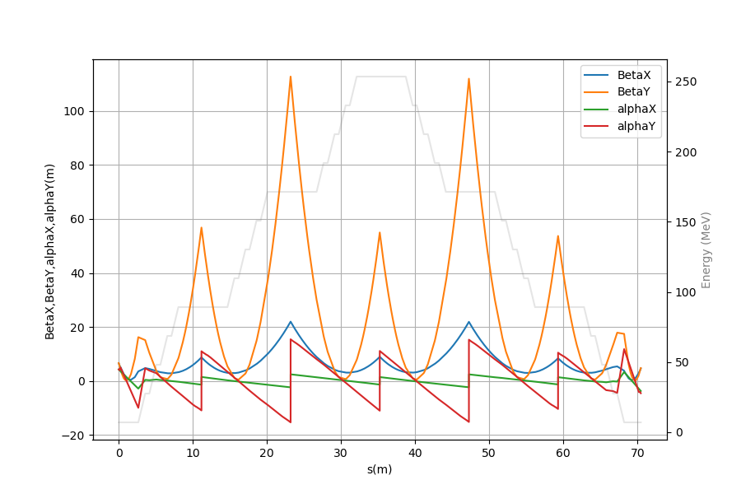
Step 3 : Full passes (Linacs only) matching
Inject final twiss as initial conditions : a good (1st) guess but not totally stable
Adjust init. twiss
Not stable (high betas)
Stable (minimum Betas)

Slide 31
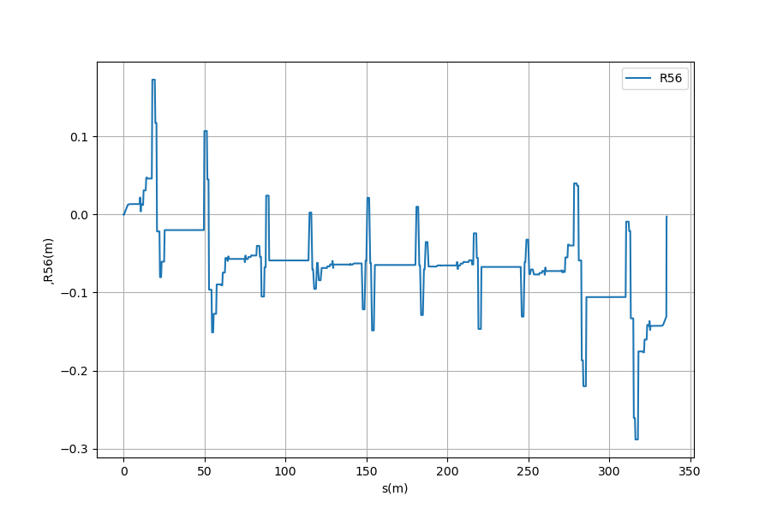
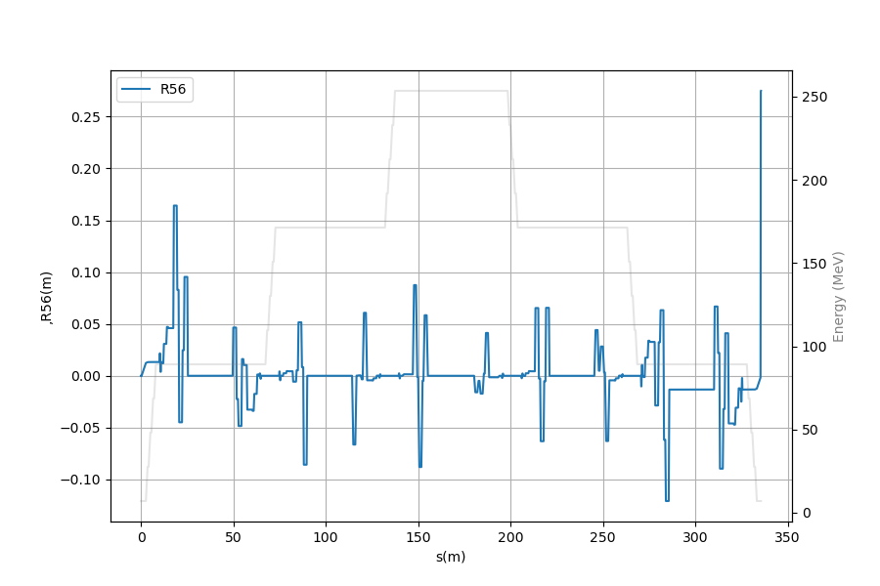
Momentum compaction (R56 term)
Match R56 = 0 on :
End arc1
End merger 1
End arc3
…
Additional conditions:
Disp x & y =0 (end arcs)
Disp’ x & y = 0 (end arcs)
Alpha x & y = 0 (center arcs)
Alpha x & y = 0 (center strs)
Not closed for 250 MeV lattice ( because of lack of merger)
Need to cancel at injection

