Slide 1


Innovate for Sustainable Accelerating Systems
(iSAS)
Achille Stocchi
achille.stocchi@ijclab.in2p3.fr
IJCLab(CNRS) & Paris-Saclay
Jorgen D’Hondt
Jorgen.DHondt@vub.be
IIHE & Vrije Universiteit Brussel
Horizon Europe iSAS proposal, March 2023

Slide 2

The energy efficiency of present and future
accelerators […] is and should remain an area
requiring constant attention.
A detailed plan for the […] saving and re-use of
energy should be part of the approval process
for any major project.
European Strategy for Particle Physics 2020

Slide 3
Where do accelerators use power ?

Slide 4
Basic structures of a particle accelerator
particle production
beam preparation
beam acceleration
experiment
beam
dump

Slide 5
Basic structures of a particle accelerator
particle production
beam preparation
beam acceleration
experiment
beam
dump
cooling @ 2K

Slide 6
Basic structures of a particle accelerator
particle production
beam preparation
beam acceleration
experiment
beam
dump
∼50%
magnets ∼10%
others ∼35%
cooling @ 2K
∼5%
Example: typical power consumption for an electron-positron Higgs Factory
the highest priority next collider for particle physics
example FCC@250GeV

Slide 7
Basic structures of a particle accelerator
recover this
energy
reduce most of this energy
beam acceleration
particle production
beam preparation
beam acceleration
experiment
beam
dump
∼50%
∼50%
magnets ∼10%
others ∼35%
cooling @ 2K
∼5%
Example: typical power consumption for an electron-positron Higgs Factory
the highest priority next collider for particle physics
example FCC@250GeV

Slide 8
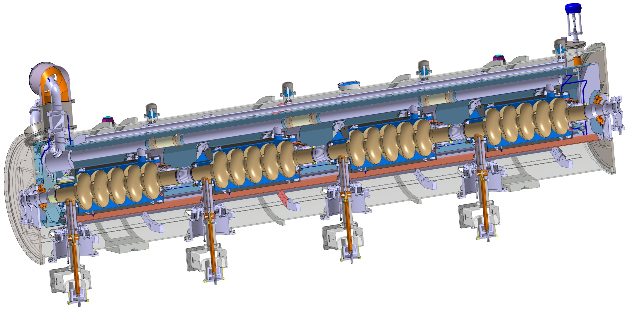
Key building block for beam acceleration: the SRF cryomodule
cooling
beam
power
Transferring grid power to the particle beam

Slide 9
Superconducting Radio Frequency (SRF) is the enabling technology for modern accelerators
The main energy-saving technologies are universally applicable across SRF cryomodules and accelerators
(e.g., ESS, EuXFEL, HL-LHC, …)

Slide 10
From Grid to Beam
RF power generation
GRID
cryogenics
Picture adopted from M. Seidel (IPAC 2022)

Slide 11

From Grid to Beam
RF power generation
GRID
cryogenics
Picture adopted from M. Seidel (IPAC 2022)

Slide 12
From Grid to Beam
RF power generation
efficiency ~30-60%
GRID
RF power load
by detuned cavities
∼ Δω²
beam power
dumped
or
radiated
cryogenics
dissipated heat
∼ 1/Q₀
efficiency
∼ T / (300K – T)
power-inefficiency

Slide 13
From Grid to Beam
improve amplifier efficiency
e.g. solid state amplifiers for oscillating power demands
RF power generation
recover the energy from the beam
e.g. ERL reaching
100% recovery
efficiency ~30-60%
GRID
RF power load
by detuned cavities
∼ Δω²
beam power
dumped
or
radiated
dealing with microphonics
e.g. Fast Reactive Tuners
cryogenics
dissipated heat
∼ 1/Q₀
mitigation with novel technologies
efficiency
∼ T / (300K – T)
operate cavities at higher T & improve Q₀ of cavities
e.g. Nb₃Sn from 2K to 4.2K ➔ 3x less cooling power needed

Slide 14
Three main iSAS Technology Areas
energy savings from the RF power
RF power generation
energy savings
from the beam
efficiency ~30-60%
GRID
RF power load
by detuned cavities
∼ Δω²
beam power
dumped
or
radiated
cryogenics
dissipated heat
∼ 1/Q₀
efficiency
∼ T / (300K – T)
energy savings
from the cryogenics

Slide 15
from the overall Accelerator R&D Roadmap
and responding to a Horizon Europe call, we
Innovate for Sustainable Accelerating Systems (iSAS)
with focus on these three main iSAS Technology Areas (TAs)
to develop energy-saving solutions
for cryomodules of modern SRF accelerators
with support from
Enterprise Europe Network (EEN), EuXFEL GmbH, I.FAST, LEAPS, LDG and TIARA

Slide 16
HORIZON-INFRA-2023-TECH-01-01
New technologies and solutions for reducing the environmental and climate footprint of RIs
REGULATIONS
Specific conditions
  Expected EU contribution per project: around 5M EUR.
  Consortia must include at least 3 different research infrastructures, each of them being an ESFRI infrastructure, and/or a European Research Infrastructures Consortium (ERIC) or another research infrastructure of European interest (i.e. a research infrastructure which is able to attract users from EU or associated countries other than the country where the infrastructure is located). Consortia should be built around a leading core of at least 3 world-class research infrastructures and can include a wider set of RIs.
  Other technological partners, including industry and SMEs, should also be involved, thus promoting innovation and knowledge sharing through co-development of new technical solutions for research infrastructures.
  Proposals should built on and explain any synergies and complementarities with previous or current EU grants, including those under other parts of the Framework Programmes.
Expected Outcome
Reduction of environmental impacts (including climate-related)
Optimisation of resource and energy consumption integrated through the full life cycle of research infrastructures
Increased long-term sustainability of European research infrastructures
Scope
      The aim of this topic is to deliver innovative technologies and solutions which reduce the environmental and climate footprint of RIs through the full life cycle of research infrastructures. Proposals should identify common methodologies, among the concerned RIs, to assess environmental impact and strategies to reduce it, as well as efficiency gains in the broader ecosystem.
      Proposals should address the following aspects, as relevant:
        new technologies and solutions for research infrastructures enabling transformative resource efficiency (e.g. energy consumption) and reduction of environmental (including climate-related) impacts, including, when relevant, more sustainable and efficient ways of collecting, processing and providing access to data;
        validation and prototyping;
        training of RI staff for the operation and use of the new solutions;
        action plans to deploy the new developments at wider scale and ensure their sustainability;
        measures to ensure an environmentally effective integration of the solutions in the local contexts;
        societal engagement to foster acceptance of the solutions in the local and regional communities.

Slide 17
HORIZON-INFRA-2023-TECH-01-01
New technologies and solutions for reducing the environmental and climate footprint of RIs
A strong and broad impact with a 5M EUR EU-project
develop an impactful and well-motivated project that is also a catalyser for
the implementation of the Accelerator R&D Roadmap
Goal: develop, prototype and validate the essential energy-saving and energy-recovery SRF technologies to potentially retrofit existing Research Infrastructures and integrate in the design of a novel sustainable LINAC cryomodule with a broad portfolio of future applications in industry and at accelerator Research Infrastructures (RIs)
Sustain the impactful 20th-century accelerator applications into an energy-low 21st century!
REGULATIONS
Specific conditions
  Expected EU contribution per project: around 5M EUR.
  Consortia must include at least 3 different research infrastructures, each of them being an ESFRI infrastructure, and/or a European Research Infrastructures Consortium (ERIC) or another research infrastructure of European interest (i.e. a research infrastructure which is able to attract users from EU or associated countries other than the country where the infrastructure is located). Consortia should be built around a leading core of at least 3 world-class research infrastructures and can include a wider set of RIs.
  Other technological partners, including industry and SMEs, should also be involved, thus promoting innovation and knowledge sharing through co-development of new technical solutions for research infrastructures.
  Proposals should built on and explain any synergies and complementarities with previous or current EU grants, including those under other parts of the Framework Programmes.
Expected Outcome
Reduction of environmental impacts (including climate-related)
Optimisation of resource and energy consumption integrated through the full life cycle of research infrastructures
Increased long-term sustainability of European research infrastructures
Scope
      The aim of this topic is to deliver innovative technologies and solutions which reduce the environmental and climate footprint of RIs through the full life cycle of research infrastructures. Proposals should identify common methodologies, among the concerned RIs, to assess environmental impact and strategies to reduce it, as well as efficiency gains in the broader ecosystem.
      Proposals should address the following aspects, as relevant:
        new technologies and solutions for research infrastructures enabling transformative resource efficiency (e.g. energy consumption) and reduction of environmental (including climate-related) impacts, including, when relevant, more sustainable and efficient ways of collecting, processing and providing access to data;
        validation and prototyping;
        training of RI staff for the operation and use of the new solutions;
        action plans to deploy the new developments at wider scale and ensure their sustainability;
        measures to ensure an environmentally effective integration of the solutions in the local contexts;
        societal engagement to foster acceptance of the solutions in the local and regional communities.

Slide 18
“Innovate for Sustainable Accelerating Systems” – brief abstract
AMBITION – With the ambition to maintain the attractiveness and competitiveness of European research infrastructures and to enable Europe’s Green Deal, we propose to Innovate for Sustainable Accelerating Systems (iSAS) by establishing enhanced collaboration in the field to broaden, expedite and amplify the development and impact of novel energy-saving technologies to accelerate particles. The objective of iSAS is to innovate those technologies related to the cryomodule that have been identified as being a common core of SRF accelerating systems and that have the largest leverage for energy savings with a view to minimizing the intrinsic energy consumption in all phases of operation.
METHODOLOGY – Based on a recently established European R&D Roadmap for accelerator technology and based on a collaboration between leading European research institutions and industry, several interconnected technologies will be developed, prototyped, and tested, each enabling significant energy savings on their own in accelerating particles. The collection of energy-saving technologies will be developed with a portfolio of forthcoming applications in mind and to explore energy-saving improvements of existing research infrastructures on the ESFRI Roadmap, for example the ESFRI Landmarks HL-LHC, ESS and EuXFEL. Considering the developments realised, the new energy-saving technologies will be coherently integrated into the parametric design of a new accelerating system, a LINAC SRF cryomodule, optimised to achieve high beam-power in accelerators with an as low as reasonably possible energy consumption.
IMPACT – Through inter- and multidisciplinary research that delivers and combines various technologies, it is the long-term ambition of iSAS technologies to reduce the energy footprint of SRF accelerators in future research infrastructures by half, and even more when the systems are integrated in Energy-Recovery LINACs.

Slide 19
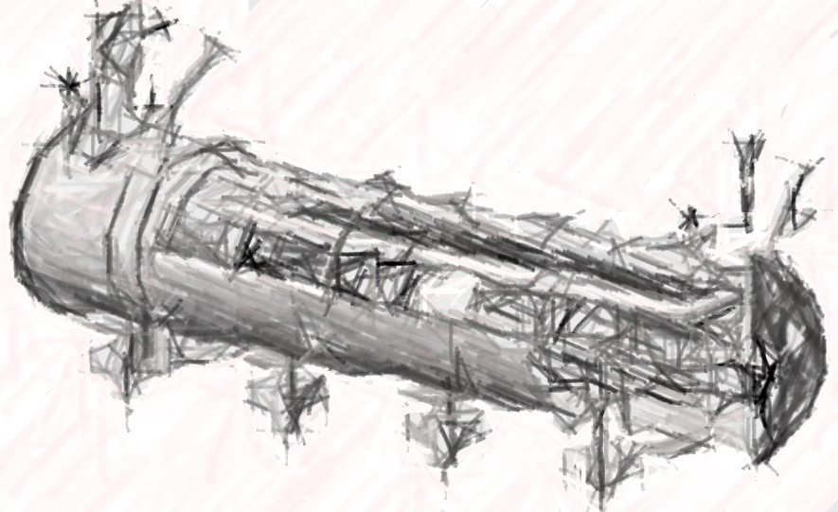
particle therapy
nanometer
semiconductors
INNOVATE TECHNOLOGIES TOWARDS
A SUSTAINABLE ACCELERATING SYSTEM
TODAY
NEW DESIGN

Slide 20
DEVELOP ENERGY-SAVING TECHNOLOGIES ESSENTIAL TO INTEGRATE IN THE DESIGN OF A SUSTAINABLE LINAC CRYOMODULE
particle therapy
nanometer
semiconductors
R&D Pathfinders for new
energy-saving technologies
TA: Technology Area

Slide 21
DEVELOP ENERGY-SAVING TECHNOLOGIES ESSENTIAL TO INTEGRATE IN THE DESIGN OF A SUSTAINABLE LINAC CRYOMODULE
particle therapy
nanometer
semiconductors
INT#1
R&D Pathfinders for new
energy-saving technologies
INTEGRATING
integrating new technologies in the design of a new sustainable LINAC cryomodule
TA: Technology Area, INT: Integration Activities

Slide 22
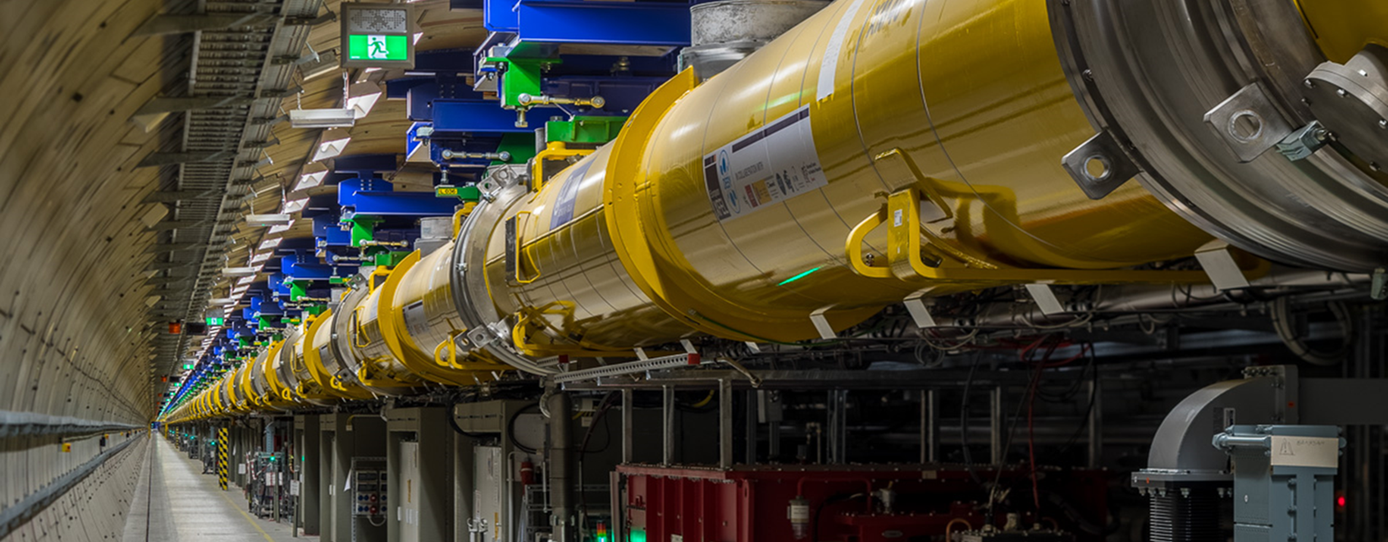
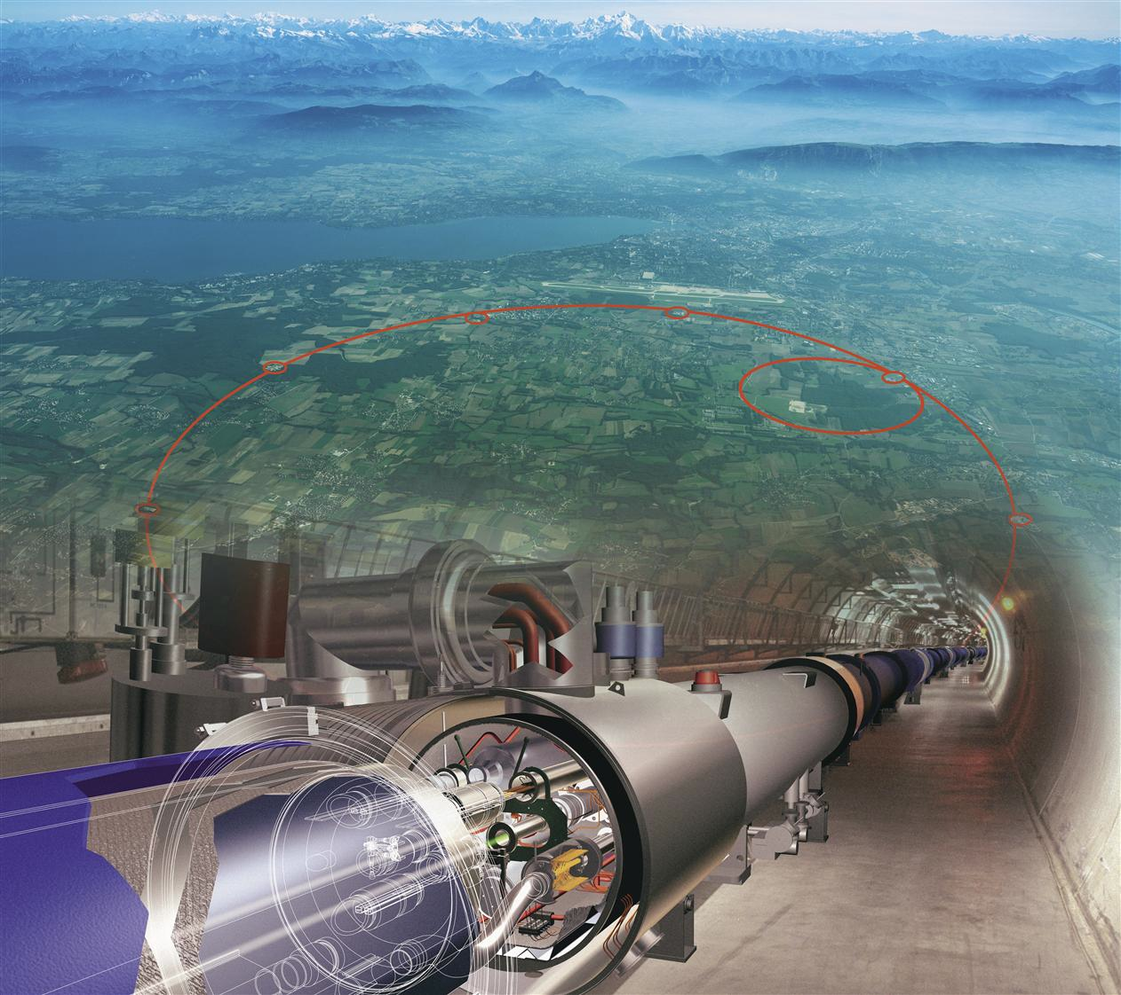
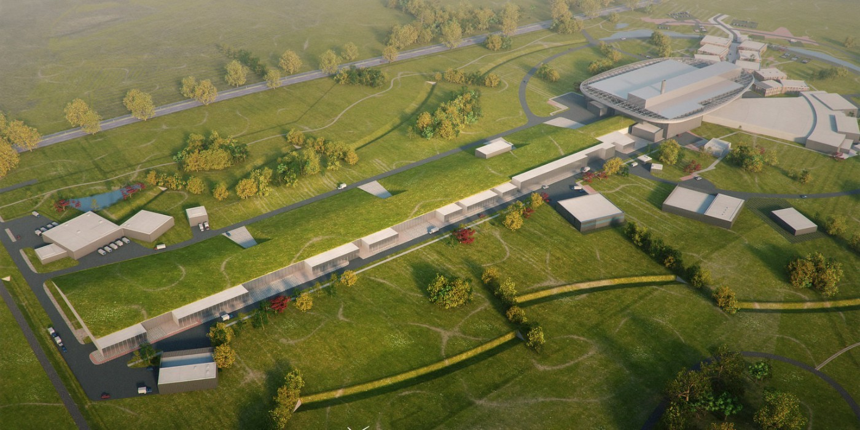
DEVELOP ENERGY-SAVING TECHNOLOGIES ESSENTIAL TO INTEGRATE IN THE DESIGN OF A SUSTAINABLE LINAC CRYOMODULE
particle therapy
nanometer
semiconductors
INT#1
R&D Pathfinders for new
energy-saving technologies
INTEGRATING
integrating new technologies in the design of a new sustainable LINAC cryomodule
SC XFELs
HL-LHC
ESS upgrade
INT#2: full deployment of energy saving in current and future accelerator RIs
TA: Technology Area, INT: Integration Activities
RIs: Research Infrastructures

Slide 23
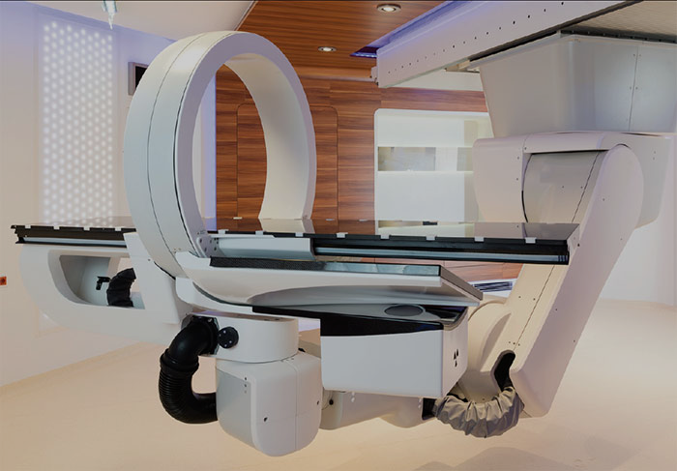

INT#3: accelerator turn-key solutions with breakthrough applications
particle therapy
DEVELOP ENERGY-SAVING TECHNOLOGIES ESSENTIAL TO INTEGRATE IN THE DESIGN OF A SUSTAINABLE LINAC CRYOMODULE
particle therapy
nanometer
semiconductors
nanometer
semiconductors
INT#1
R&D Pathfinders for new
energy-saving technologies
INTEGRATING
integrating new technologies in the design of a new sustainable LINAC cryomodule
SC XFELs
HL-LHC
ESS upgrade
INT#2: full deployment of energy saving in current and future accelerator RIs

Slide 24
iSAS Objectives – Technology Areas
TA#1: energy-savings from RF power – While great strides are being made in the energy efficiency of various RF power generators, the objective of iSAS is to ensure additional impactful energy savings through coherent integration of the RF power source with smart digital control systems and with novel tuners that compensate rapidly cavity detuning from mechanical vibrations, resulting in a further reduction of power demands by up to a factor of 3.
TA#2: energy-savings from cryogenics – While major progress is being made in reusing the heat produced in cryogenics systems, the objective of iSAS is to develop superconducting cavities that operate with high performance at 4.2 K (i.e., up to 4.5 K depending on the cryogenic overpressure) instead of 2 K, thereby reducing the grid-power to operate the cryogenic system by a factor of 3 and requiring less capital investment to build the cryogenic plant.
TA#3: energy-savings from the beam – Significant progress has been achieved in maintaining the brightness of recirculating beams to provide high-intensity collisions to experiments, but most of the particles lose their power through radiation or in the beam dump system. The objective of iSAS is to develop dedicated power couplers for damping the so-called Higher-Order Modes (HOMs) excited by the passage of high-current beams in the superconducting cavities, enabling efficient recovery of the energy of recirculating beams back into the cavities before it is dumped, resulting in energy reduction for operating, high-energy, high-intensity accelerators by a factor ten.

Slide 25
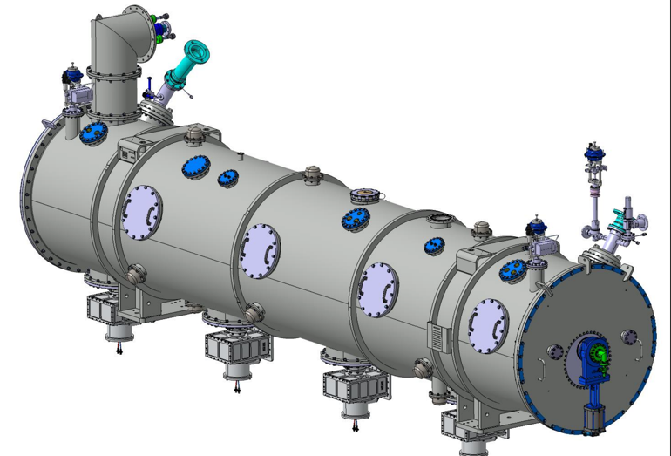
iSAS Objectives – Integration Activities
INT#1: integration into the design of a LINAC cryomodule While LINAC cryomodules are designed for specific accelerators, the objective of iSAS is to address the common engineering challenges of integrating iSAS energy-saving technologies into a parametric design of a new sustainable accelerator system.
INT#2: integration into existing RIs – While various RIs envisage upgrades, the objective of iSAS is to expedite the technical integration of energy-saving technologies by retrofitting existing accelerating systems. An existing cryomodule will be adapted, ready to demonstrate energy recovery of high-power recirculating beams in the PERLE research facility, paving the way for high-energy, high-intensity electron beams with minimal energy consumption.
INT#3: integration into industrial solutions – While iSAS technologies are emerging, the objective of iSAS is to plan for concrete co-developments with industry to expedite reaching a Technology Readiness Level (TRL) sufficiently advanced towards largescale deployment of the new energy-saving solutions at current and future RIs as well as to prepare the path for industrial applications. For many future RIs and industrial applications SRF is the enabling technology.

Slide 26
iSAS concrete Work Packages
R&D Pathfinders for three Technology Areas (TA) for energy-saving
  TA#1: energy savings from the RF power (short-term and very wide applications)
      WP.1: optimal integration of Ferro-Electric Fast Reactive Tuners (FE-FRT) to deal with microphonics (400, 800 and 1300 MHz)
      WP.2: low-level RF controls (LLRF controls incl. AI)
    TA#2: energy savings from the cryogenics (medium-term and wide applications)
      WP.3: high-temperature SRF cavities above 4.2 K (thin Nb₃Sn films on Cu)
    TA#3: energy savings from the beam (long-term and specific applications)
      WP.4: Higher-Order Mode damping and fundamental power couplers
INT#1: integrate these technologies into the design of a sustainable LINAC cryomodule
  WP.5: based on the ESS cryomodules, develop a parametric design for an optimally sustainable LINAC cryomodule, ready to be adapted and built for various future applications in industry and in accelerator RIs
INT#2: integrate these technologies into existing LINAC cryomodules at RIs
  WP.6: engineering aspects to integrate and test energy-saving iSAS technologies in a cryomodule, and verify the options to retrofit existing SRF systems at RIs, with a focus on ESS, HL-LHC, EuXFEL
INT#3: integrate towards turn-key solutions and applications in industry
      WP.7: prepare the co-developments with industrial partners such that when the new technologies and the new designed LINAC cryomodule are developed and validated, their Technology Readiness Level is sufficient such that industry can consider building them

Slide 27
iSAS cross coordination
The ambition of iSAS is to pave the way by developing common solutions for the engineering and industrial challenges to expedite the integration of energy-saving solutions.
The methodology to achieve the iSAS objectives is based on a profoundly cross-disciplinary fertilization
between different disciplines, from RF engineering to material science, electronics, mechanical engineering,
and cryogenics, with co-developments between leading research and industrial institutions.

Slide 28
iSAS develops, prototypes & validates SRF energy-saving technologies
TA#1: energy-savings from RF power
The objective is to significantly reduce the RF power sources and wall plug power for all SRF accelerators with ferro-electric fast reactive tuners (FE-FRTs) for control of transient beam loading and detuning by microphonics, and with optimal low level radio frequency (LLRF) and detuning control with legacy piezo based systems. iSAS will demonstrate operation of a superconducting cavity with FE-FRTs coherently integrated with AI-smart digital control systems to achieve low RF-power requirements.
Schematic overview to compensate detuning with new FE-FRTs avoiding large power overhead and to compensate with AI-smart control loop countermeasures via the LLRF steering of the RF amplifier the disturbances in SRF cavities that impact field stability

Slide 29
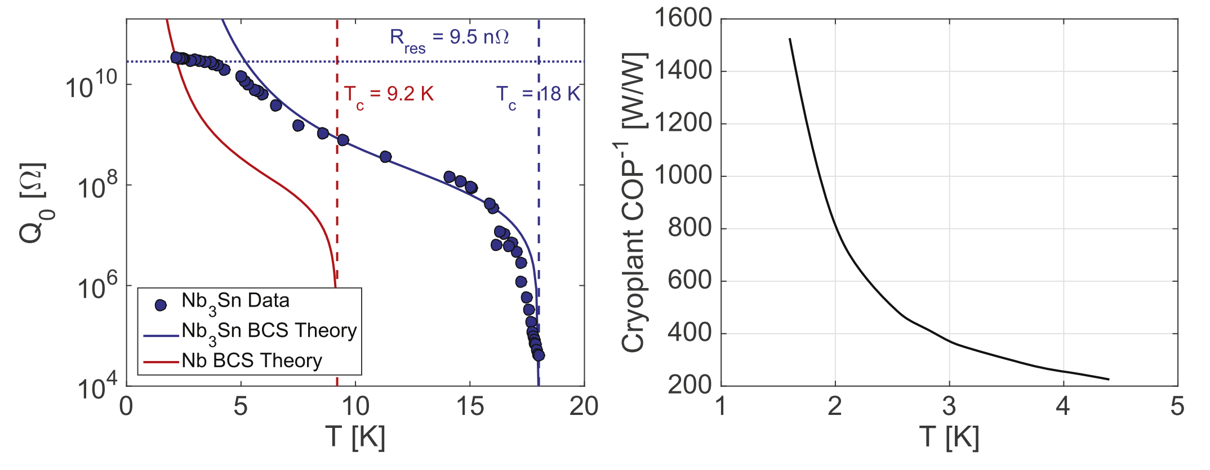
iSAS develops, prototypes & validates SRF energy-saving technologies
TA#2: energy-savings from cryogenics The objective is focused on the development of thin-film cavities and aims to transform conventional superconducting radio-frequency technology based on off-shelf bulk niobium operating at 2 K, into a technology operating at 4.2 K using a highly functionalized material, where individual functions are addressed by different layers. iSAS will optimize the coating recipe for Nb₃Sn on copper to optimize tunability and flux trapping of thin-film superconducting cavities and to validate a prototype beyond the achievements of the ongoing Horizon Europe I.FAST project.
Supercond. Sci. Technol. 30 (2017) 033004
The higher critical temperature (T_{c}) of Nb₃Sn allows for the maximum value of quality factor Q₀ for 1.3 GHz cavities to be achieved at operating temperatures of about 4 K compared to 2 K for Nb (left figure). The graph on the right shows the efficiency of a cryogenic plant (COP) as a function of temperature achieving about 3 times higher COP efficiency when operating at a temperature of 4.2 K than at 2 K. This suggests that operating a cryogenic plant at 4.2 K with Nb₃Sn SRF cavities, can lead to significant better performances and energy savings.

Slide 30
iSAS develops, prototypes & validates SRF energy-saving technologies
TA#3: energy-savings from the beam The objective is to reduce the total power deposited into the cryogenics circuits of the cryomodule of the Higher-Order Mode (HOM) couplers and fundamental power couplers (FPCs) leading to a significant reduction of the heat loads and the overall power consumption. iSAS will improve the energy efficiency of the FPCs and HOM couplers by designing and building prototypes that will be integrated into a LINAC cryomodule capable of energy-recovery operations and to be tested in accelerator-like conditions.
towards full high-power energy recovery

Slide 31
Technology Readiness Level (TRL)
The readiness of the energy-saving iSAS technologies will be improved to prepare them towards industrialisation and cost-effective mass production for current and future RIs.
The objective of iSAS is for RIs and European industry to co-develop industrial solutions for energy-savings technologies in accelerators, delivering applications that can be implemented across various accelerator-driven research and non-research infrastructures.

Slide 32
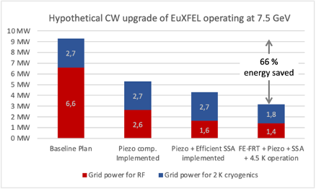
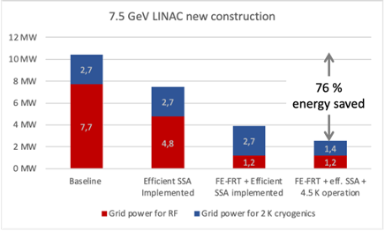
Impact of iSAS technologies on FELs
example EuXFEL
For an upgrade of EuXFEL to CW, a refurbishment of the injection LINAC cavities is being considered. This could provide the opportunity to retrofit some iSAS technology developments as well. The figure (left) depicts the expected energy savings if various iSAS developed technologies are implemented (assumption: 0.1 mA beam current), the degree of modifications, but also the benefits, are increasing from left to right. The achievable total energy savings amounts to 66%, more than 6 MW, avoiding 2.9 tons CO₂ per hour of operation for Germany’s electrical energy mix (485 g CO₂/kWh). Future LINACs can be optimally designed to take full advantage of the iSAS technologies, as integrated in the cryomodule being designed in iSAS. The right figure shows that the full savings for a 7.5-GeV LINAC is of the order of 76% (RF + cryogenics cavity cooling). Not included here are the additional potential savings by optimizing the heat load from HOM and FPC couplers – for the Cornell system their load accounts for nearly 4 MW – or any scheme to recover the beam power (750 kW in these examples).

Slide 33
Impact of iSAS technologies on SRF accelerators
example Cornell ERL LINAC
“Cornell Energy Recovery LINAC Project Definition Design Report”
G. Hoffstatter, S. Gruner, M. Tigner, eds. (2013)
iSAS develops new designs for both fundamental power couplers and HOM couplers dedicated to beam operation at very high currents while minimizing their static and dynamic heat loads in the cryogenic system. The reduction in the required cryogenic power will depend on the final design but the energy savings potential is expected to be large. As an example, the adjacent figure shows the grid power required to cool various parts of the cryomodules in the 5-GeV Cornell ERL LINAC design for different configurations of the cryogenics. The HOM and fundamental power couplers account for nearly half of the full cryogenic load. Even a moderate improvement can thus save powers in the MW range. The required cooling power scales linearly with the beam energy, so for the most ambitious future SRF accelerators, the savings in wall-plug power can be in the tens of MW and more range.
Grid power for cooling the Cornell ERL LINAC.
(figure adapted from reference)

Slide 34
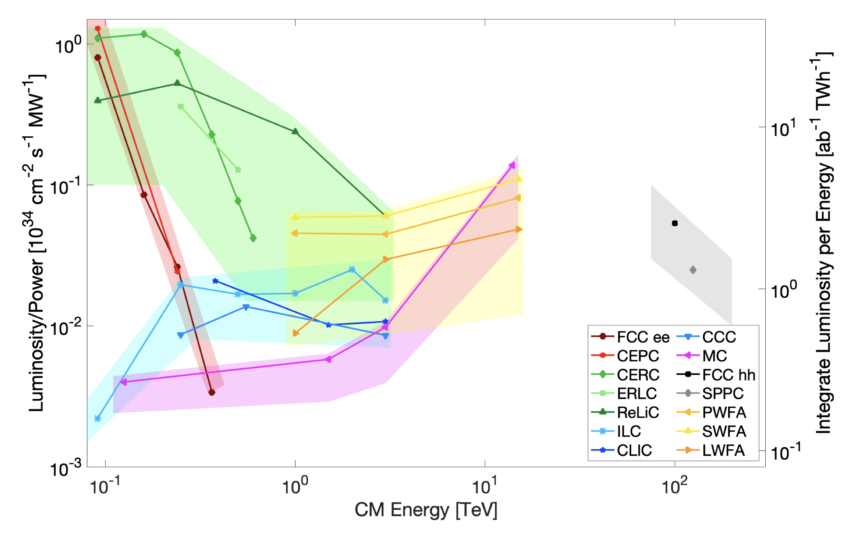
Impact of iSAS technologies on HEP e⁺e⁻ colliders
example future e+e- Higgs Factories
Z
CERC: ERL-based 100km e⁺e⁻ Higgs Factory
This plot suggests that with an ERL version of a Higgs Factory one might reach
x10 more Higgs bosons
or
x10 less electricity costs
NOTE: several additional challenges identified to realise these ERL-based Higgs Factories
WW
ZH
Collider Implementation Task Force
Snowmass Report
arXiv:2208.06030v1
CERC
tt
snapshot of lots of work in progress
full scrutiny of ERL-based proposals yet to come
FCC-ee
References for CERC: PLB 804 (2020) 135394 and arXiv:2203.07358

Slide 35
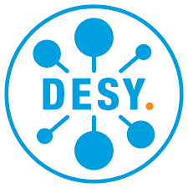










iSAS organisation
Spread over 4 years: ∼1000 person-months of researchers and ∼12.6M EUR
(of which 5M EUR is requested to Horizon Europe)
+ industrial companies: ACS Accelerators and Cryogenic Systems (France), RI Research Instruments GmbH (Germany), Cryoelectra GmbH (Germany), TFE Thin Film equipment srl (Italy), Zanon Research (Italy), EuclidTechLab (USA)

Slide 36
Governing Board
Chair: Dave Newbold (STFC)
All (associate) partner institutes
Coordination Panel
Scientific Coordinator: Jorgen D’Hondt (Uni Brussels)
Deputy Scientific Coordinators: Giovanni Bisoffi (INFN) & Jens Knobloch (HZB)
Project Coordinator and Office: Achille Stocchi (CNRS)
External Relations: Maud Baylac (CNRS)
Ex-officio: chair Governing Board & chair Advisory Board
Advisory Board
Chair: Frederick Bordry (CERN)
International experts
Integration Activities
Management WP9
Coordination & Management
CNRS team coordinated by Ketel Turzo (CNRS)
WP5 INT#1
Design new CM
Nuno Elias
(ESS)
WP6 INT#2
Existing RIs
Guillaume Olry
(CNRS)
WP7 INT#3
Industry
Giorgio Keppel
(INFN)
WP1 FE-FRT Axel Neumann (HZB)
Societal Impact WP8
WP2 LLRF Holger Schlarb (DESY)
Task#1: Training & Early Career
Task#2: Outreach & Dissemination
Task#3: Diversity & Equity
Task#4: Open Science
CNRS team coordinated by Ketel Turzo (CNRS)
Technology Areas
WP3 4K Cavity Cristian Pira (INFN)
WP4 HOM & FPC Yolanda Gomez-Martinez (CNRS)
Industry Board
Steering Committee

Slide 37
Innovate for Sustainable Accelerating Systems (iSAS)
As a leading pathfinder to enable sustainable SRF accelerators, with iSAS the most impactful new energy-saving technologies will be developed, validated, and integrated towards industrial solutions with a direct and verifiable impact on current research infrastructures and their upgrades.
The outcomes of iSAS are expected to help reshape what is feasible in the future landscape of continuous-wave SRF accelerators.
As a leading pathfinder to enable sustainable SRF accelerators, In the long term, the impact of iSAS is to reduce the energy footprint of future SRF accelerators in research infrastructures by at least half, and to unlock new facilities that maintain Europe's leading position to enable fundamental science breakthroughs in an energy sustainable manner.
The new sustainable technologies will stimulate the European industry to take a leading role in building cost- and energy-efficient SRF systems for new accelerators with impact in, for example, the semiconductor and medical sectors.

