Slide 1
Accélération laser-plasma kHz en continu dans l’Hydrogène, et étude de l’influence de la nature du gaz sur la qualité du faisceau
J. Monzac, S. Smartsev, J. Huijts, L. Rovige, I.A. Andriyash, A. Vernier,
J. Kaur, A. Cavagna, Z.Cheng, R. Lopez-Martens and J. Faure

Slide 2
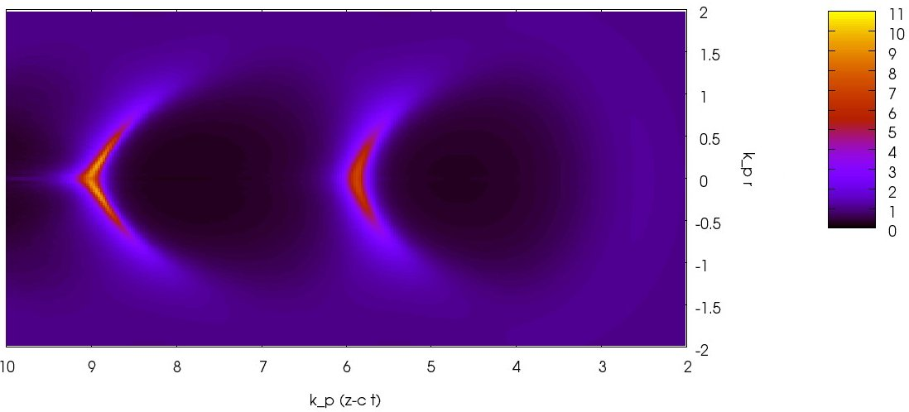
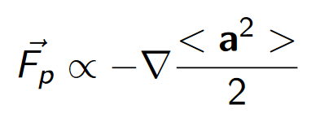
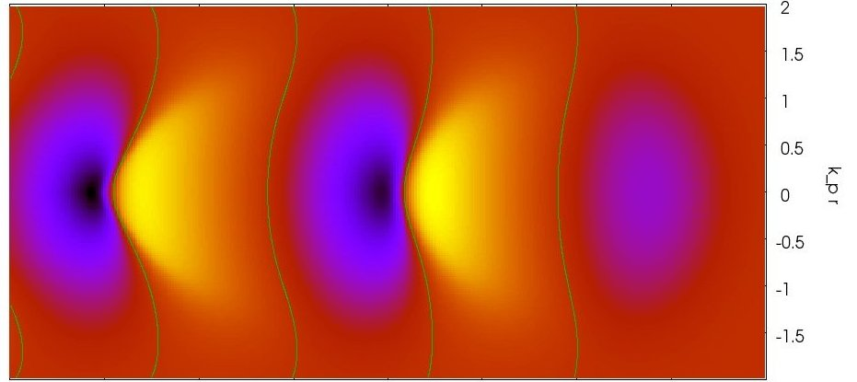
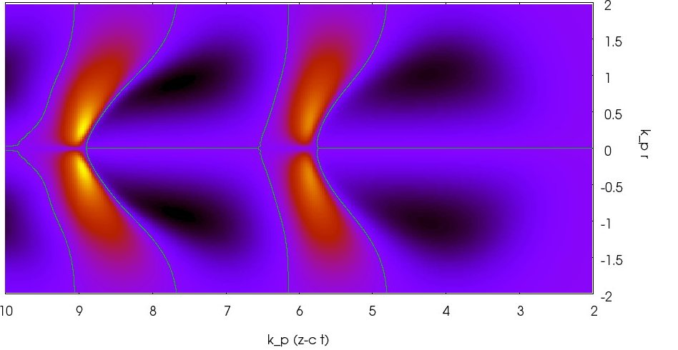
Laser-Wakefield acceleration
Ponderomotive force :
R
λ_{p}
accelerating
E_{z}
Extreme fields : 1 MeV / 10 µm
- Compact accelerator
- Mitigates space charge
focusing
E_{r}
Tajima & Dawson, 1970

Slide 3
kHz LPA and scaling laws
Laser pulse has to be resonant with plasma wave :
R
R ≈ λ_{p}/2, cτ ≈ λ_{p}/2
λ_{p}
1 J
mJ
Laser energy scaling
τ = 30 fs
τ = 3 fs
Electron energy gain
100 MeV - 1 GeV
1-10 MeV
kHz LWFA : requires few mJ, 3-5 fs laser pulses
Lu et al., PRSTAB 10, 0613001 (2007)
Beaurepaire et al., NJP 16, 023023 (2014)

Slide 4
Why kHz ?
+ Statistics in the experiments (source and applications)
+ Thermic equilibrium
+ Active Feedback loop possible (work in progress : bayesian algorithm to automate the optimisation of e- beam)
+ Electrons in the range 1-20 MeV : useful in diverse applications

Slide 5
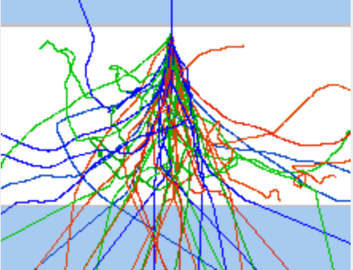
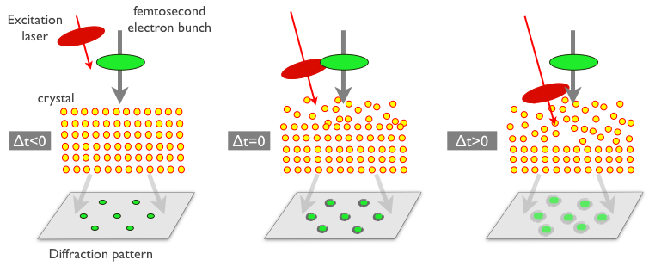
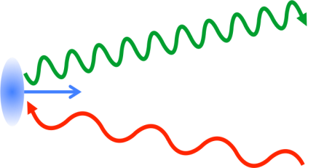
« Low Energy » Applications
Femtosecond irradiation:
pulsed radiolysis (Muroya, Rad. Phys. Chem. 2008)
radiobiology, radiation hardness
Ultrafast electron diffraction for watching atomic motion in real time in complex materials
(Mourou & Williamson, APL 41, 44 (1982), Miller, Science 343, 1108 (2014) )
Electrons for driving a fs X-ray source @ kHz :
20 MeV electrons → 10 keV X-ray via Compton scatt.
(Ta Phuoc, Nat. Phot. 2012)
electron
X-rays
photons

Slide 6
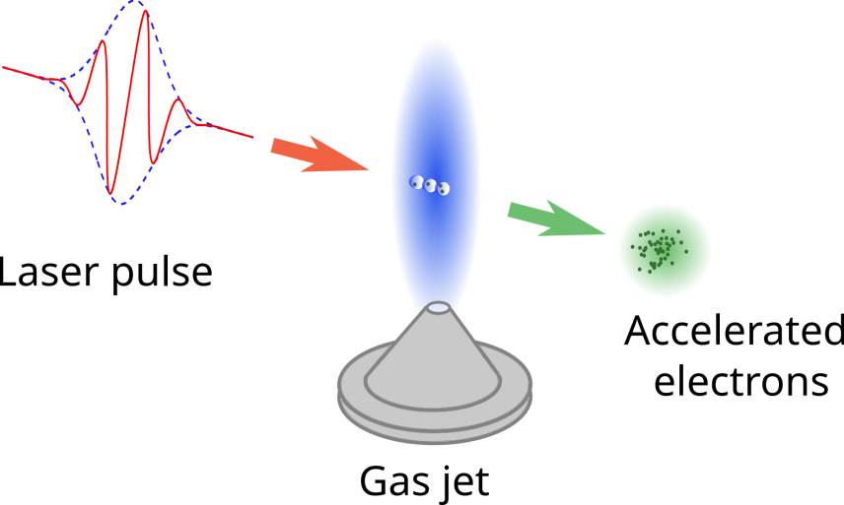
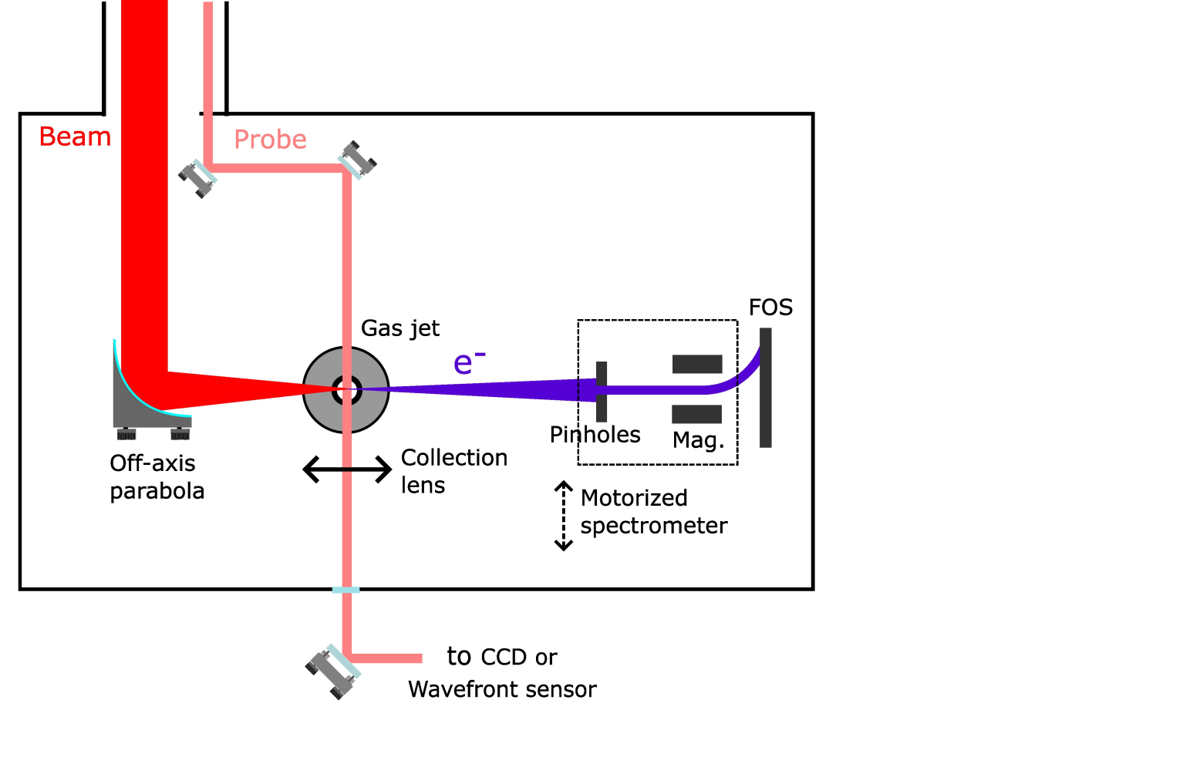
Experimental set-up
Laser :
  τ = 4.0 fs (=1.5 optical cycle at 800nm)
  E = 2.5 mJ
  Spot : 5 µm FWHM
  CEP-controlled : 300 mrad RMS stability (30 mrad on 200 averaged shots)
  I = 2 ﮲10¹⁸ W.cm⁻²
Gas : N₂

Slide 7
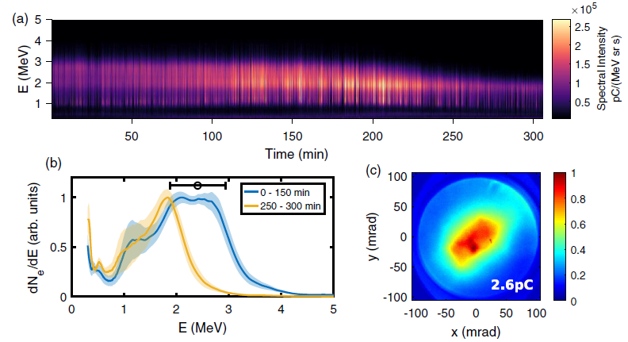
State of the accelerator at the beginning of my PhD
12 M shots
Gas used : Nitrogen
Electrons : 2/3 MeV
few pC routinely
Implementation of shocked jets,
leading to a better stability
L. Rovige et al., PRAB 23, 093401 (2020)

Slide 8

Shocked jets to stabilize the injection
The idea : slowing down the accelerating structure
1
1
2
3
2
pulse
3
Effective slow down
The density gradient
localizes e- injection
Stabilization of the e- beam
Schmid et al., PRSTAB 13, 091301 (2010)
8

Slide 9
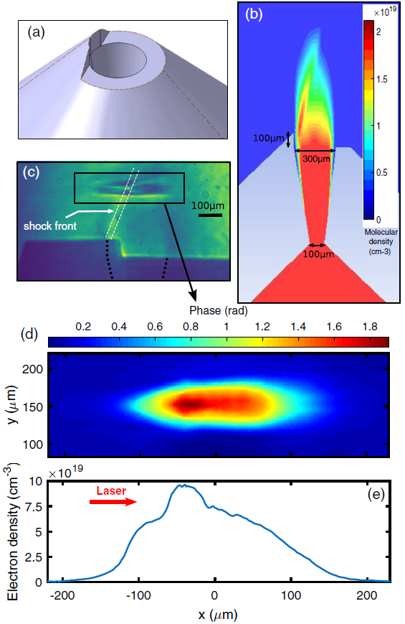
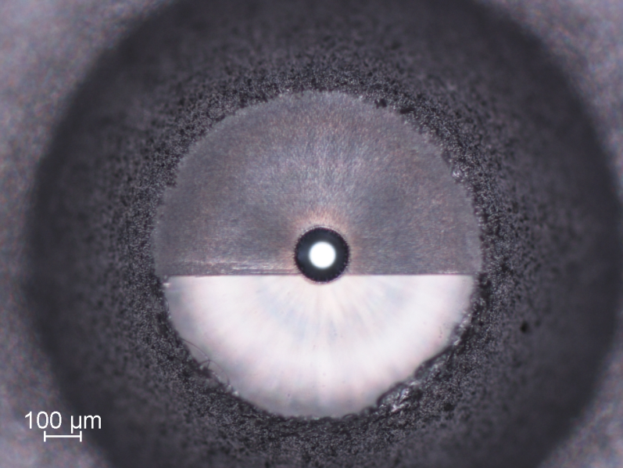
Shocked jets for kHz LPA
Importance of the shock:
High density region higher up
Stabilizes injection
L. Rovige et al., PRAB 23, 093401 (2020)
V. Tomkus et al. Opt. Express 26, 27965 (2018)

Slide 10
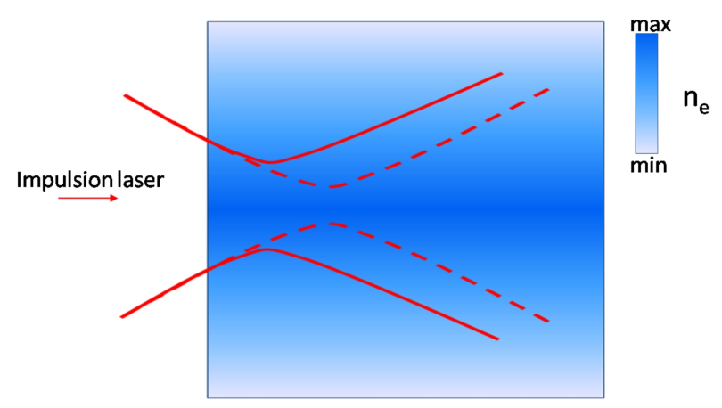
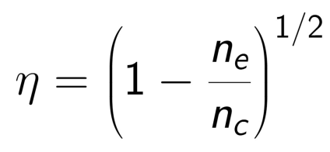
Differential pumping for using lighter gases
 | 1+ | 2+ | 3+ | 4+ | 5+ | 6+ | 7+
N (eV) | 14.5 | 29.6 | 47.4 | 77.5 | 97.9 | 552.1 | 667.0
He (eV) | 24.6 | 54.4
H (eV) | 13.6
N₂ provides 10 electrons : operation at 20 - 30 bars backing pressure
But : non-uniform ionization induces
defocusing of the laser pulse
He or H₂ only provides 2 electrons : requires 100 - 150 bars in the free-flowing gas jet
Need for differential pumping

Slide 11
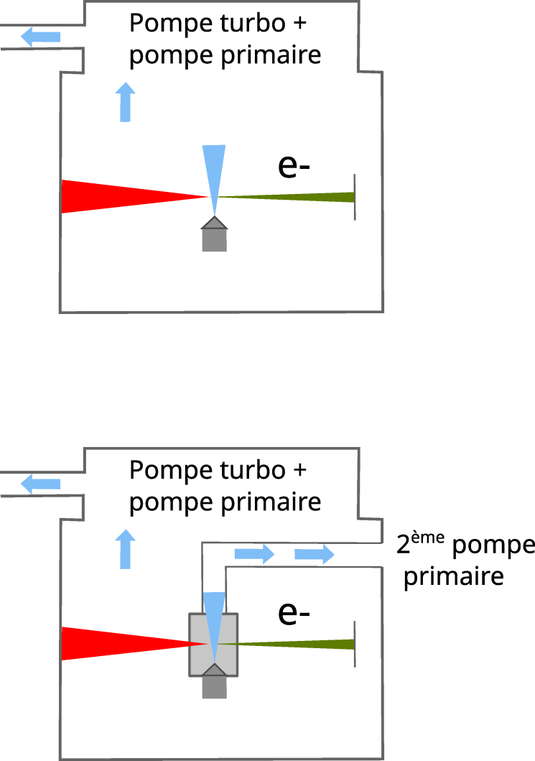
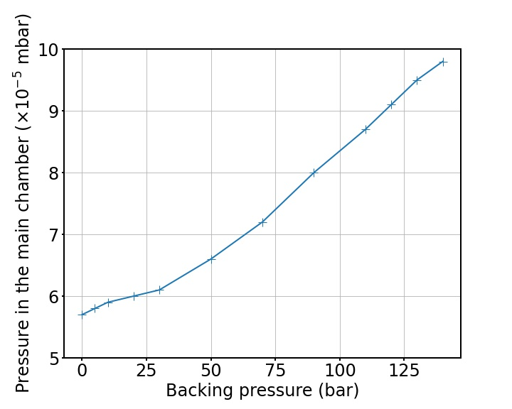
Differential pumping for using lighter gases and new gas line to provide safely hydrogen
Miniature interaction chamber :
3 cm
P_{He/H2} = 100-150 bar

Slide 12
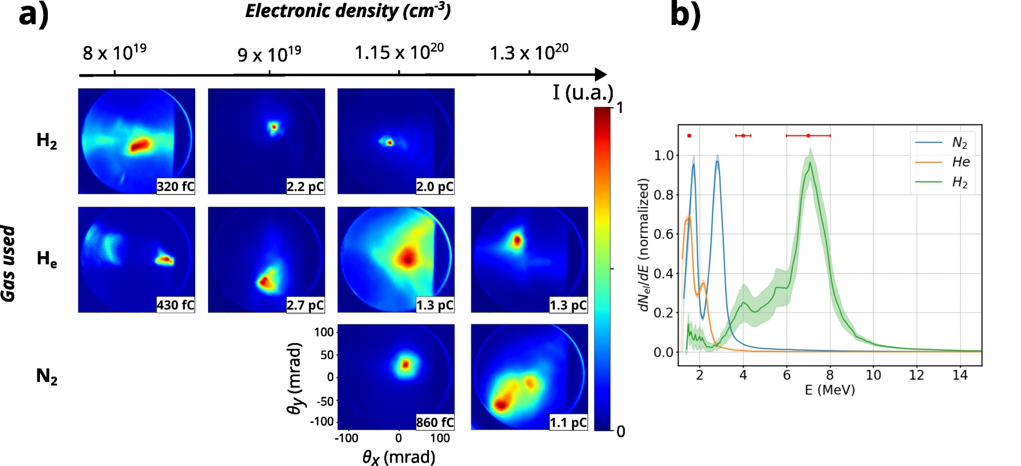
Influence of the gas specie on the accelerated electrons
n_{e} = 1.15 × 10²⁰cm⁻³
Hydrogen stands out : Higher energy : from 2.5 MeV in N₂ to 7 MeV in H₂
Higher charge : > 2 pC / shot
Smaller beam profile : 15 mrad in H₂ vs 49 mrad in N₂

Slide 13
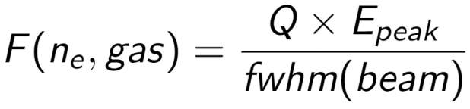
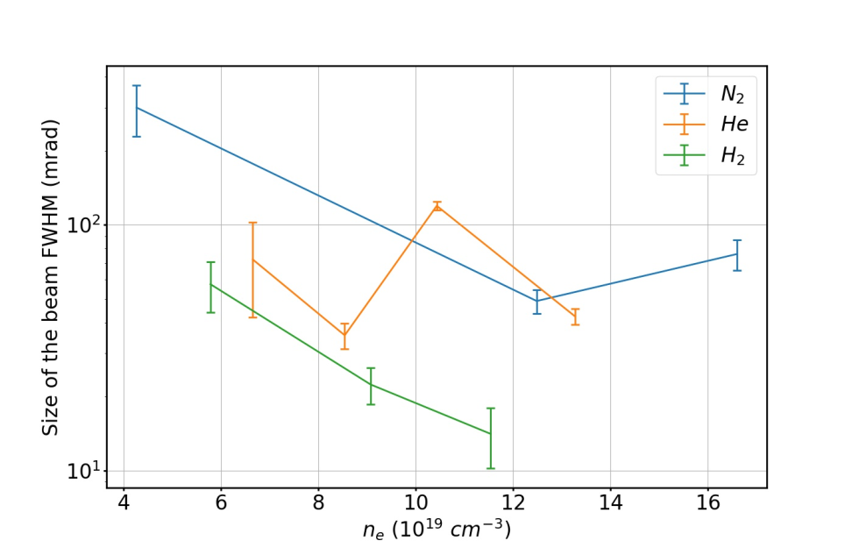
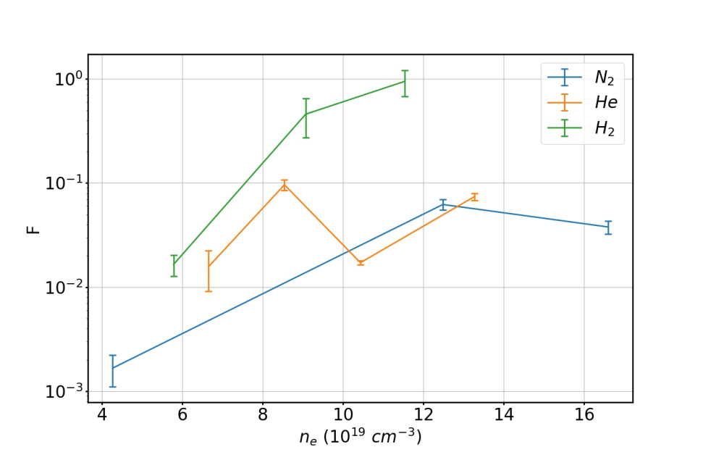
Systematic comparison
Fwhm averaged on both direction :
Smaller beams in H₂

Slide 14
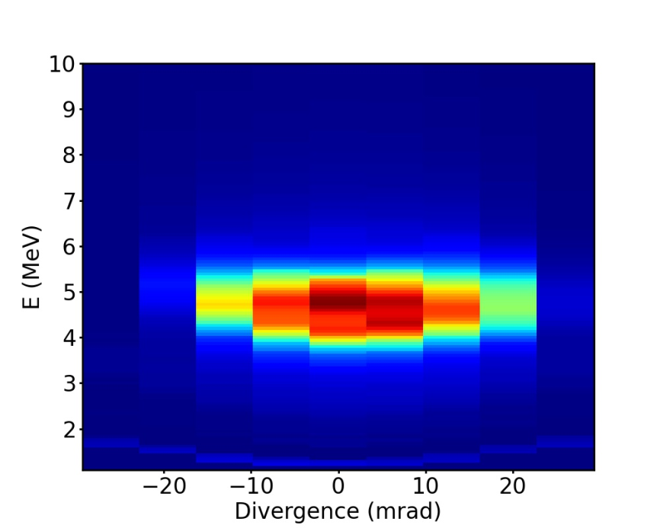
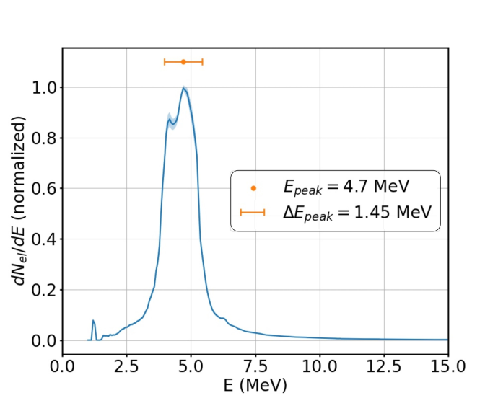
Exploring H2 : monoenergetic beam at 4.7 MeV
n_{e} = 6.6 x 10¹⁹ cm⁻³
Statistics over 100 shots :
E_{peak} | 4.7 ± 0.1 MeV | 2 %
E _{spread} | 1.3 ± 0.14 MeV | 10 %
Q | 970 ± 30 fC | 3 %
Beam size (fwhm) | 55 ± 9 mrad | 16 %
Beam pointing stability | 2 mrad rms

Slide 15
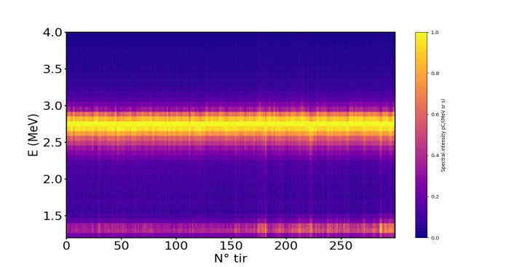
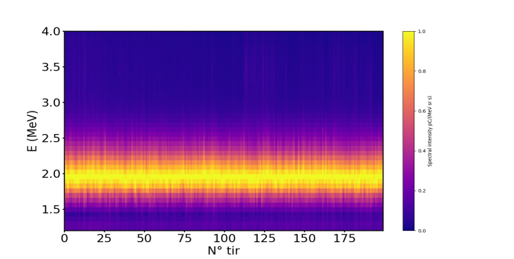
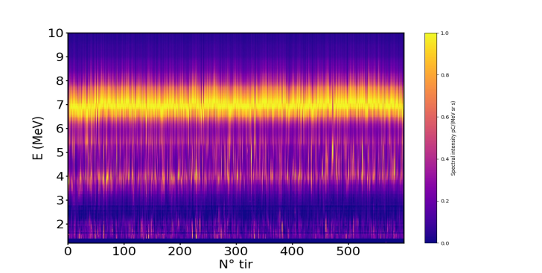
Exploring H2 : Stability of the beams
E_{peak} = 2.7 ± 0.02 MeV
FWHM beam = 54.1 ± 5.0 mrad
RMS centroid = 2 mrad
Q = 340 ± 20 fC
n_{e} = 5.7 x 10¹⁹ cm⁻³
1 acquisition = 500 shots
acquisition
E_{peak} = 1.9 ± 0.02 MeV
FWHM beam = 20.8 ± 4.0 mrad
RMS centroid = 3 mrad
Q = 2.0 ± 0.2 pC
n_{e} = 9.1 x 10¹⁹ cm⁻³
1 acquisition = 50 shots
acquisition
E_{peak} = 6.9 ± 0.5 MeV
FWHM beam = 12.2 ± 4.0 mrad
RMS centroid = 15 mrad
Q = 1.9 ± 0.4 pC
n_{e} = 1.2 x 10²⁰ cm⁻³
1 acquisition = 5 shots
acquisition

Slide 16
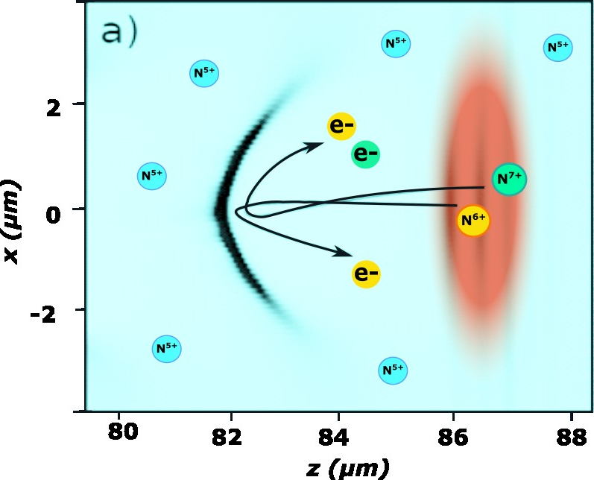
Ionization injection : H₂ doped with N₂
 | 1+ | 2+ | 3+ | 4+ | 5+ | 6+ | 7+
N (eV) | 14.5 | 29.6 | 47.4 | 77.5 | 97.9 | 552.1 | 667.0
The electron beams is expected
to be much more stable
C. Thaury and al., Sci. Reports, 2015

Slide 17
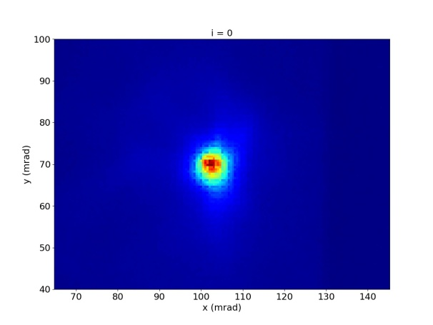
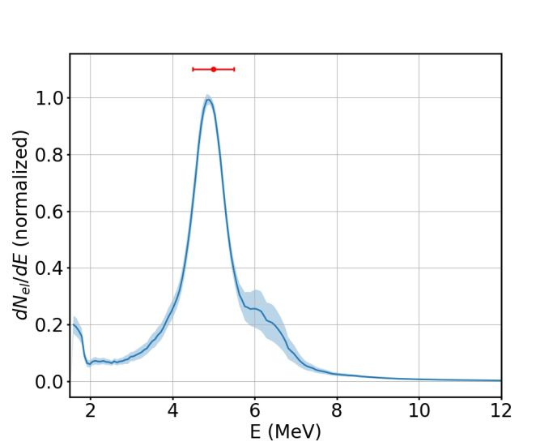
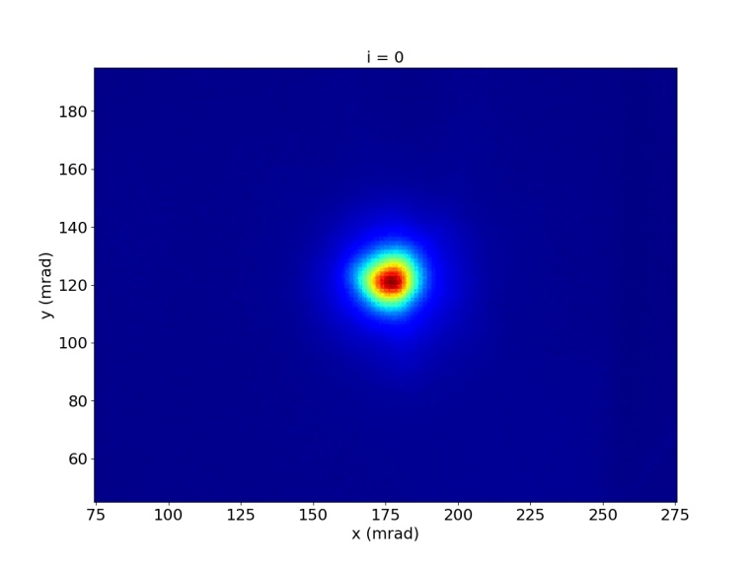
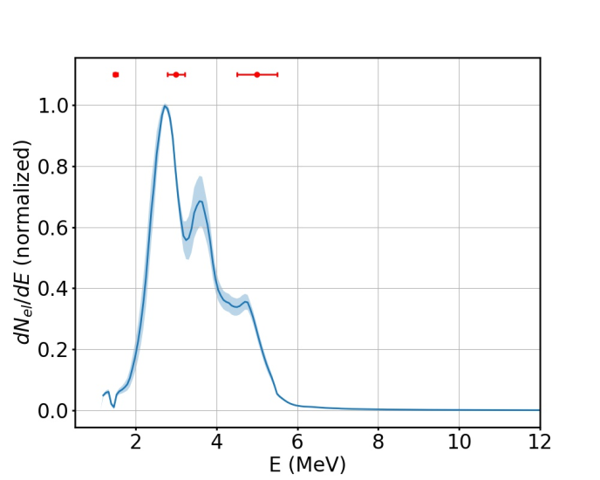
Results from H₂ doped with N₂
n_{e} = 7.4 x 10¹⁹ cm⁻³
Video : single shot beam
n_{e} = 1.1 x 10²⁰ cm⁻³
Video : single shot beam

Slide 18
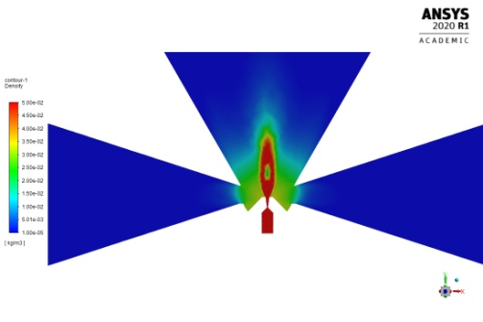
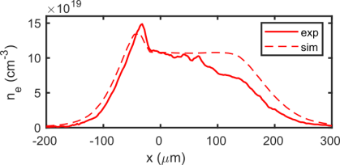
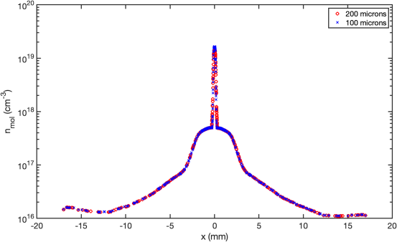
Work in progress: simulations
Macro
Micro : PIC

Slide 19
Conclusion
Demonstration of effective kHz LPA using Hydrogen
Higher beam quality using N₂ instead of H_{2 :} smaller beams, higher energies with the same parameters
Excellent stability of the beams using H₂, even better with H₂ + N₂
Simulations on macro and micro scale

Slide 20


The team
kHz laser-plasma source
J. Monzac, S. Smartsev, A. Vernier, I. Andriyash, J. Faure
Salle Noire Laser system:
J. Kaur, A. Cavagna, A. Kalouguine, Z. Cheng,
R. Lopez-Martens
Gas jet fabrication:
V. Tomkus, V. Girdauskas, G. Raciukaitis, J. Dudutis ,
V. Stankevic , P. Gecys

Slide 21
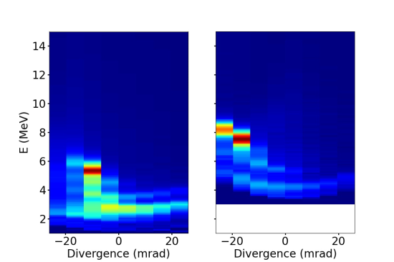
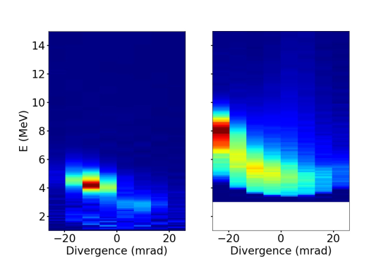
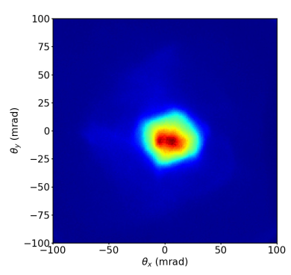
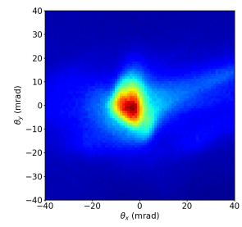
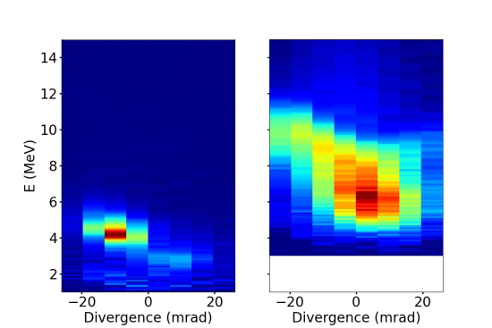
Les plus hautes énergies qu’on a atteint : 10 MeV

