Slide 1
Laser Plasma Accelerators and VHEE for Radiotherapy
Abhishek Panchal
Doctorant, Physics at High Intensity group
Thesis supervision: Sandrine Dobosz Dufrenoy & Tiberio Ceccotti

Slide 2
Outline
Introduction to Flash radiotherapy
Laser plasma accelerators as a source for high energy and high dose rate radiation
Experiments on high dose rate effect on Fricke dosimeter
UHI100 laser facility
Conclusion and future perspectives

Slide 3
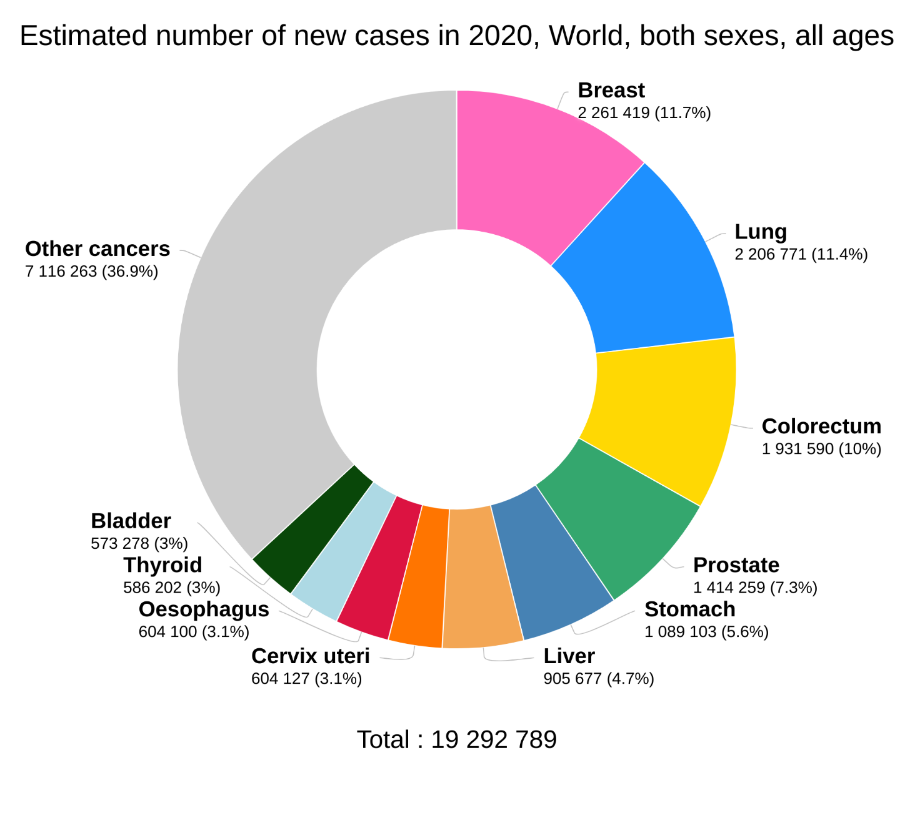
Context
Cancer is the leading cause of death worldwide (one in six deaths)
Treatments usually include surgery, radiotherapy and/or systemic therapy (chemotherapy, hormonal treatment, targeted biological therapies)
Around 50% of cancer patients are treated with external beam radiotherapy^{[1]}
Radiotherapy works by damaging the DNA of tumour cells with ionizing radiation.
Data source: Globocon 2020 Graph production: Global Cancer Observatory (http://gco.iarc.fr)
[1] Yap, M.L.; Zubizarreta, E.; Bray, F.; Ferlay, J.; Barton, M. Global Access to Radiotherapy Services: Have We Made Progress during the Past Decade? J. Glob. Oncol. 2016, 2, 207–215.

Slide 4
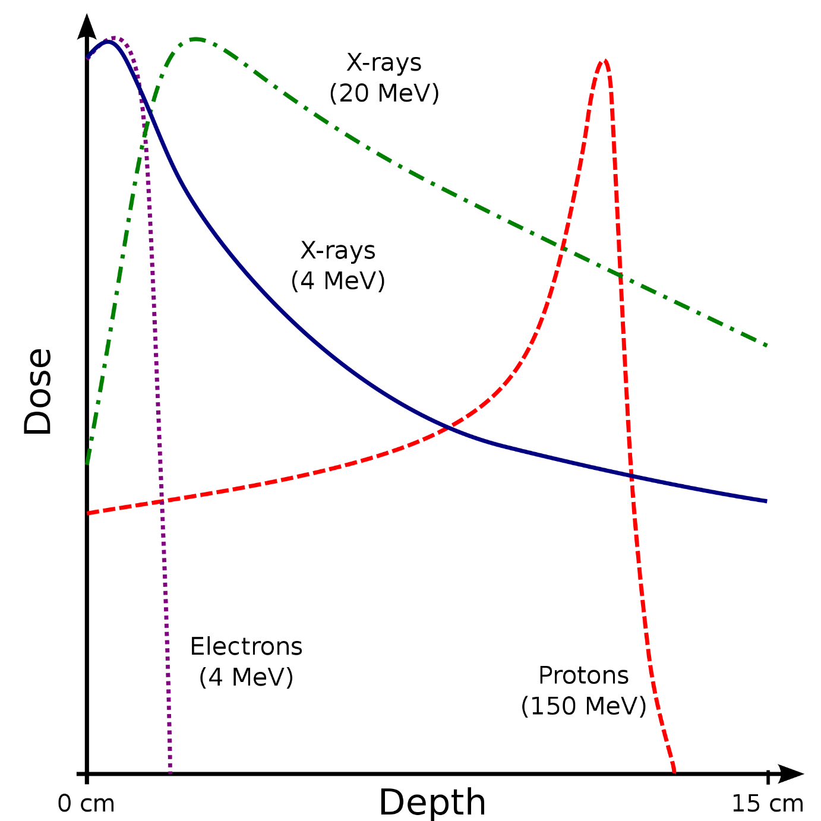
Ionizing radiation for radiotherapy
Photons
Linear accelerators
Electrons
Linear accelerators
Protons and heavy ions
Cyclotrons or synchrotrons
Dose-depth curve for various particles
100%
X-rays (20 MeV)
Bragg peak
X-rays (4 MeV)
Relative Dose
Electrons 4 MeV
Protons 150 MeV
Dose: amount of energy absorbed per unit mass (Gray = Joule/Kg)
Notes:
Electron beam energies around 4-20 MeV

Slide 5
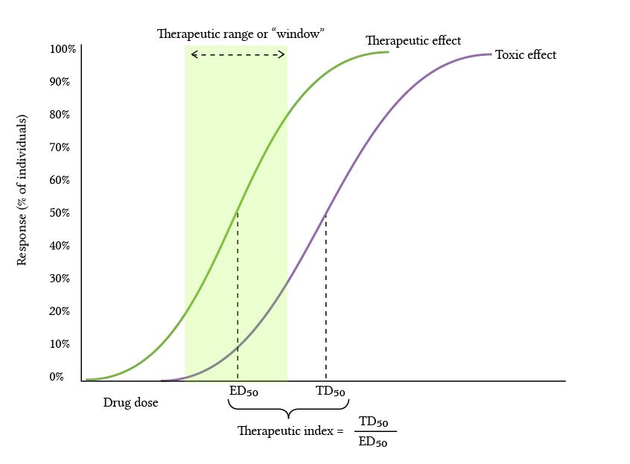
Therapeutic index
Tumour control probability (TCP)
Normal tissue complication probability (NTCP)
Radiotherapy is only curative in the therapeutic window
Goal of radiotherapy research is to increase the therapeutic index or widen the therapeutic window
Some ways to widen the therapeutic window
Increase radio sensitivity of tumours: push the TCP curve to the left
Decrease the damage by radiation on surrounding healthy tissues: push the NTCP curve to the right
Therapeutic window
TCP
NTCP
Probability
Radiation Dose
Typical TCP curve

Slide 6
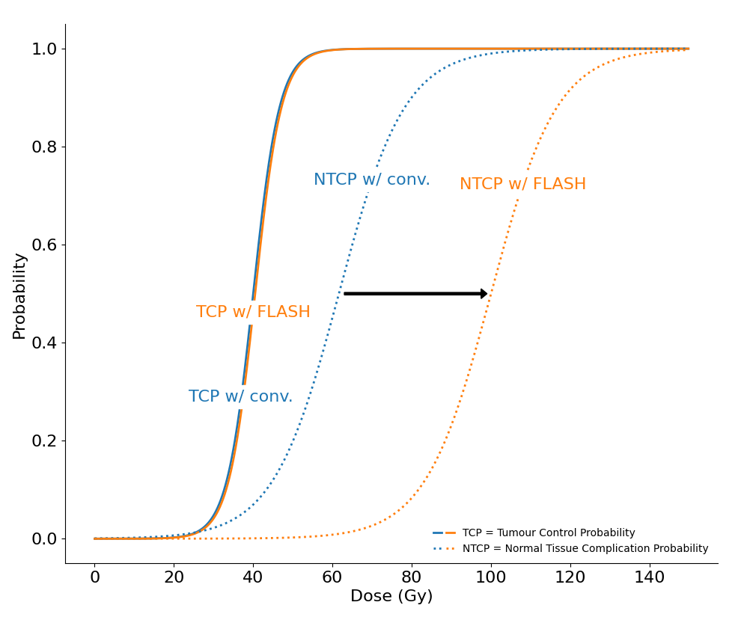
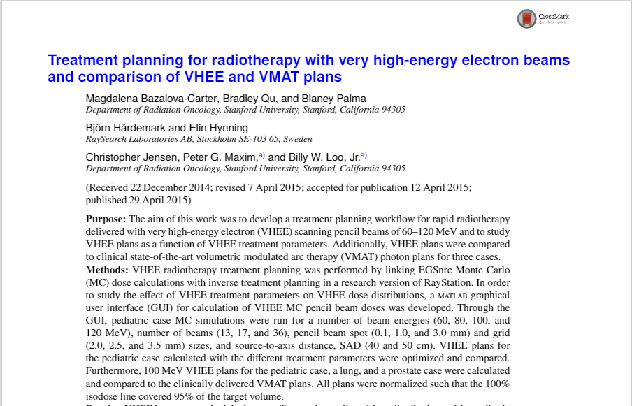
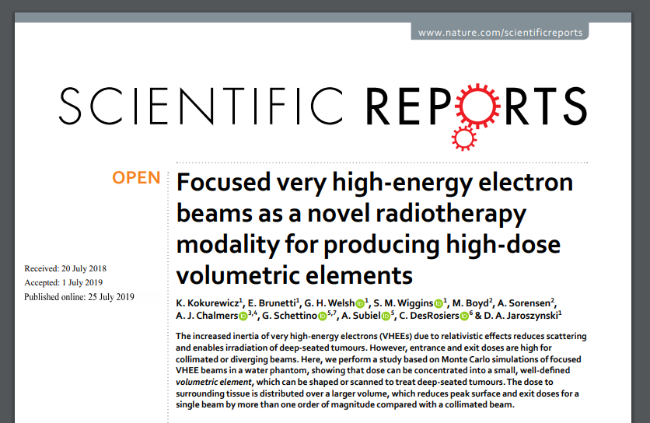
Flash radiotherapy
FLASH effect - high dose rate (HDR) (>40Gy/s) deposition of energy spares surrounding healthy tissues with unchanged effectiveness on the tumour
Favaudon, Vincent, et al. "Ultrahigh dose-rate FLASH irradiation increases the differential response between normal and tumor tissue in mice." Science translational medicine 6.245 (2014): 245ra93-245ra93.
Underlying biological process not fully understood!

Slide 7
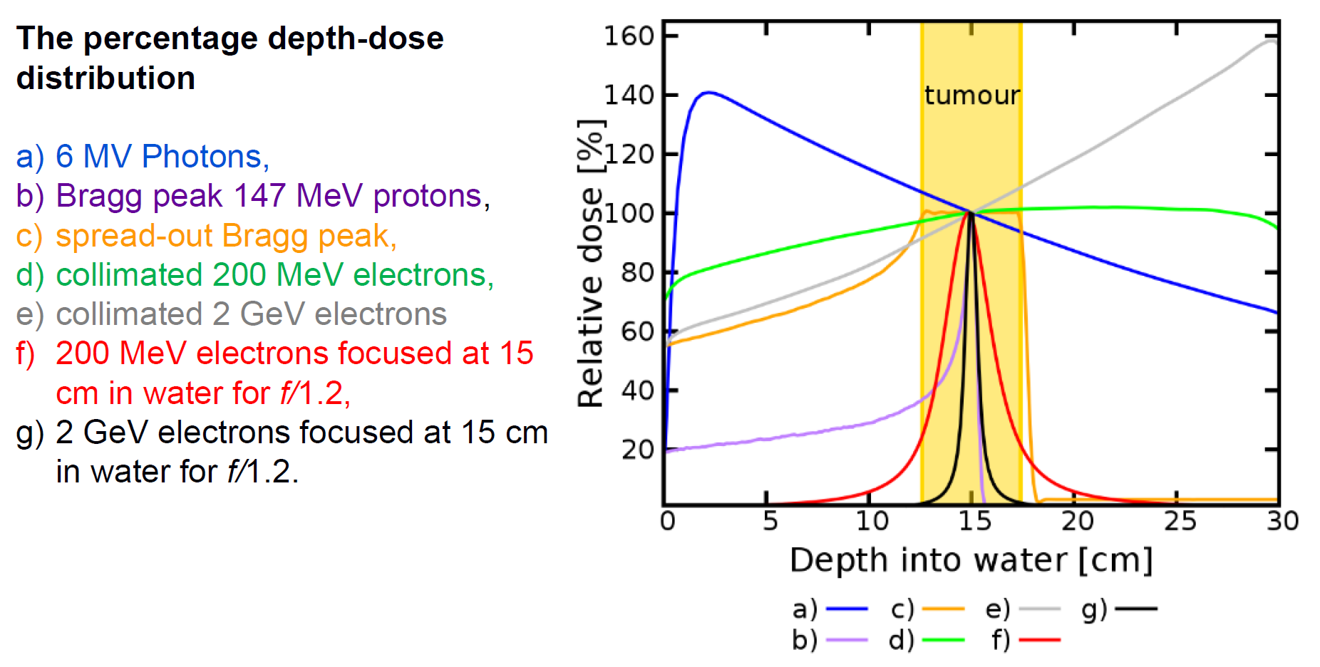
Very high energy electrons (VHEE)
Comparison of dose-deposition between focussed VHEE and other particles
VHEE: electron energy typically ranging from 50-250MeV
Some advantages of VHEE:
Deep penetration in tissues
Easy to focus
Reduced scattering
Reduced susceptibility to tissue inhomogeneities
VHEE are a good candidate for conventional radiotherapy and Flash radiotherapy
Kokurewicz, K., Brunetti, E., Curcio, A. et al. An experimental study of focused very high energy electron beams for radiotherapy. Commun Phys 4, 33 (2021).

Slide 8
LPA as a source for HDR and VHEE
Characteristics of electrons from LWFA
Energy: up to GeV
Bunch length: fs to ps → corresponding peak dose-rates of 10¹⁰ – 10¹² Gy/s
Charge: 10s of pC to nC
Dose-rate: $\frac{total dose delivered}{total irradiation time }$
State of the art laser wakefield acceleration experiments (2020)
LPAs are much more compact than conv. Accelerators !
Property | Value | Laser driver | Reference
Energy | 7.8GeV (±5%, 5pc) | 31J, 30fs, 60μm | Gonsalvez (2019) -LBNL
Bunch length | 5-10μm | 1.1J, 35fs, 20μm | Lundh (2011) - LOA Kaluza (2014) - Jena Heigholt (2015) - UMu
Charge | >1nC (@330 MeV) | 10J, 40fs, >25μm | Götzfried (2020) - LMU

Slide 9
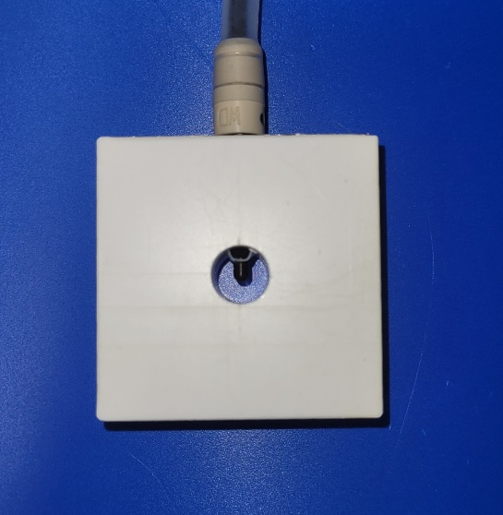
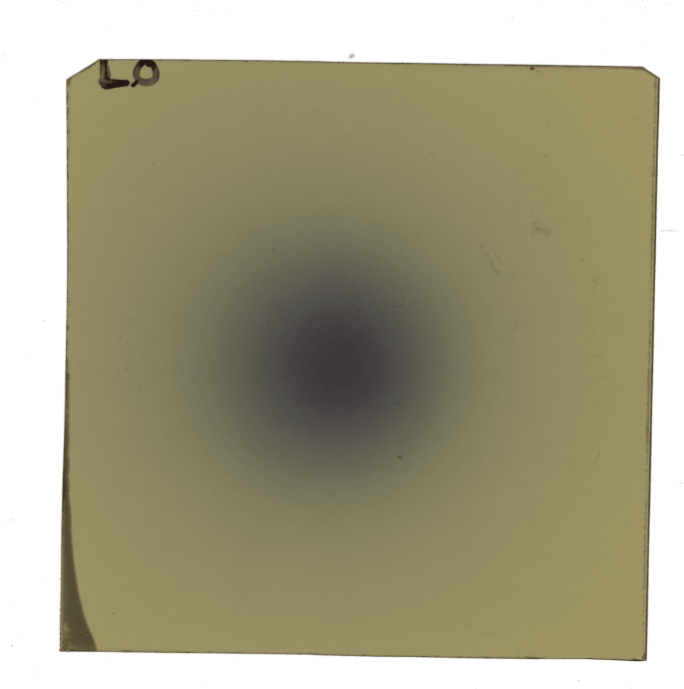
UHDR Dosimetry
Types of dosimeter:
Ionization chamber dosimeters
Collection of electron-ion pairs created by ionisation of gas on electrodes connected to high voltage.
The measurement of the signal proportional to the charge on the electrometer gives the radiation dose.
Relative dosimeters (Radiochromic films)
It consists of a micro meter thick sensitive layer. Interaction of ionising radiation causes polymerisation of the dye molecule, resulting in a blackening at the macroscopic level.
The sensitivity of the dose measured is dependent on the thickness of the active material
Chemical dosimeters
In this kind of dosimeters the ionizing radiation typically produces reaction products that are relatively stable and can be measured directly by colour changes or simple analytical procedures.
Razor Nano Chamber
EBT3 film

Slide 10
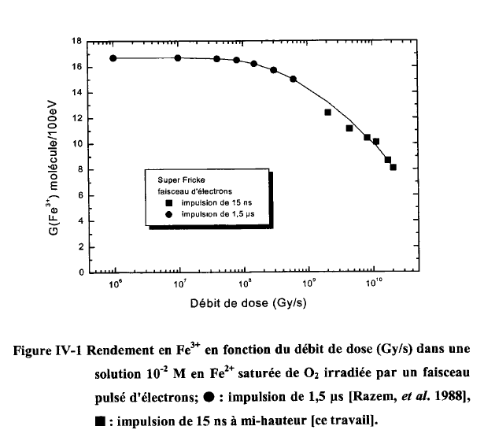
Influence of dose-rate on Fricke solution
Fricke Dosimetry
The main principle behind Fricke or ferrous sulphate dosimetry is the oxidation of ferrous (Fe²⁺) ions into ferric (Fe³⁺) ions.
The change in the concentration (c) of Fe³⁺ ions as a function of increasing dose (D) gives the primary yield (G)
$$G=c/D$$
Primary yield is defined as: The number of free radicals per absorbed 100 eV, present during the chemical stage of water radiolysis
Trupin-Wasselin, Virginie. Primary processes in radiation chemistry. LET (Linear Energy Transfer) effect in water radiolysis. No. FRCEA-TH--782. CEA/Saclay, 2000.

Slide 11
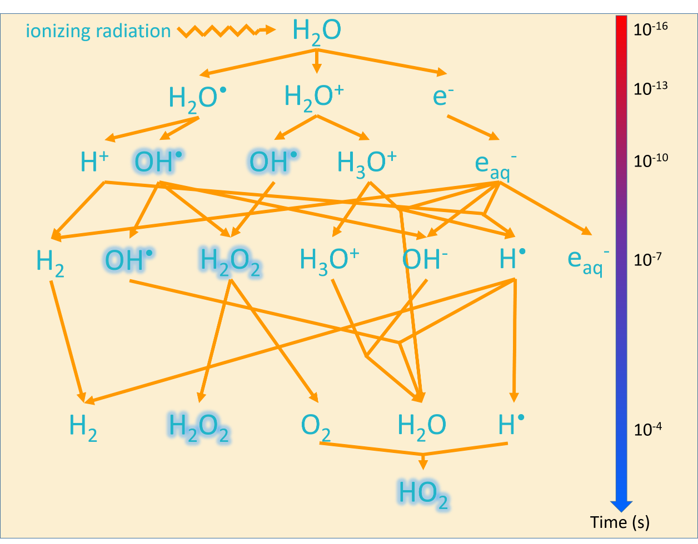
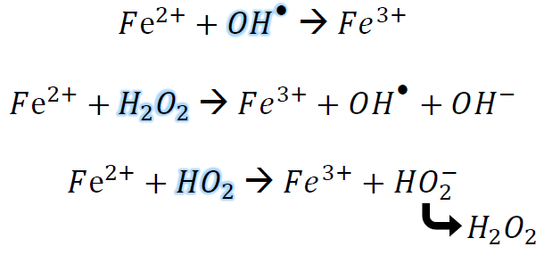
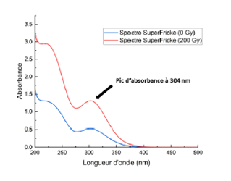
Radical reactions in Fricke dosimeter
Fricke solution is 96% water by weight
Oxidation of Fe²⁺ ions
Absorption spectrophotometry
Buxton, George. "An overview of the radiation chemistry of liquids." Radiation Chemistry (2008): 3-16.
Cuvette with Fricke sol.
Broadband light source
Photodiode
Incident radiation
Transmitted radiation
Emission
Absorption
Transmission
Detection

Slide 12
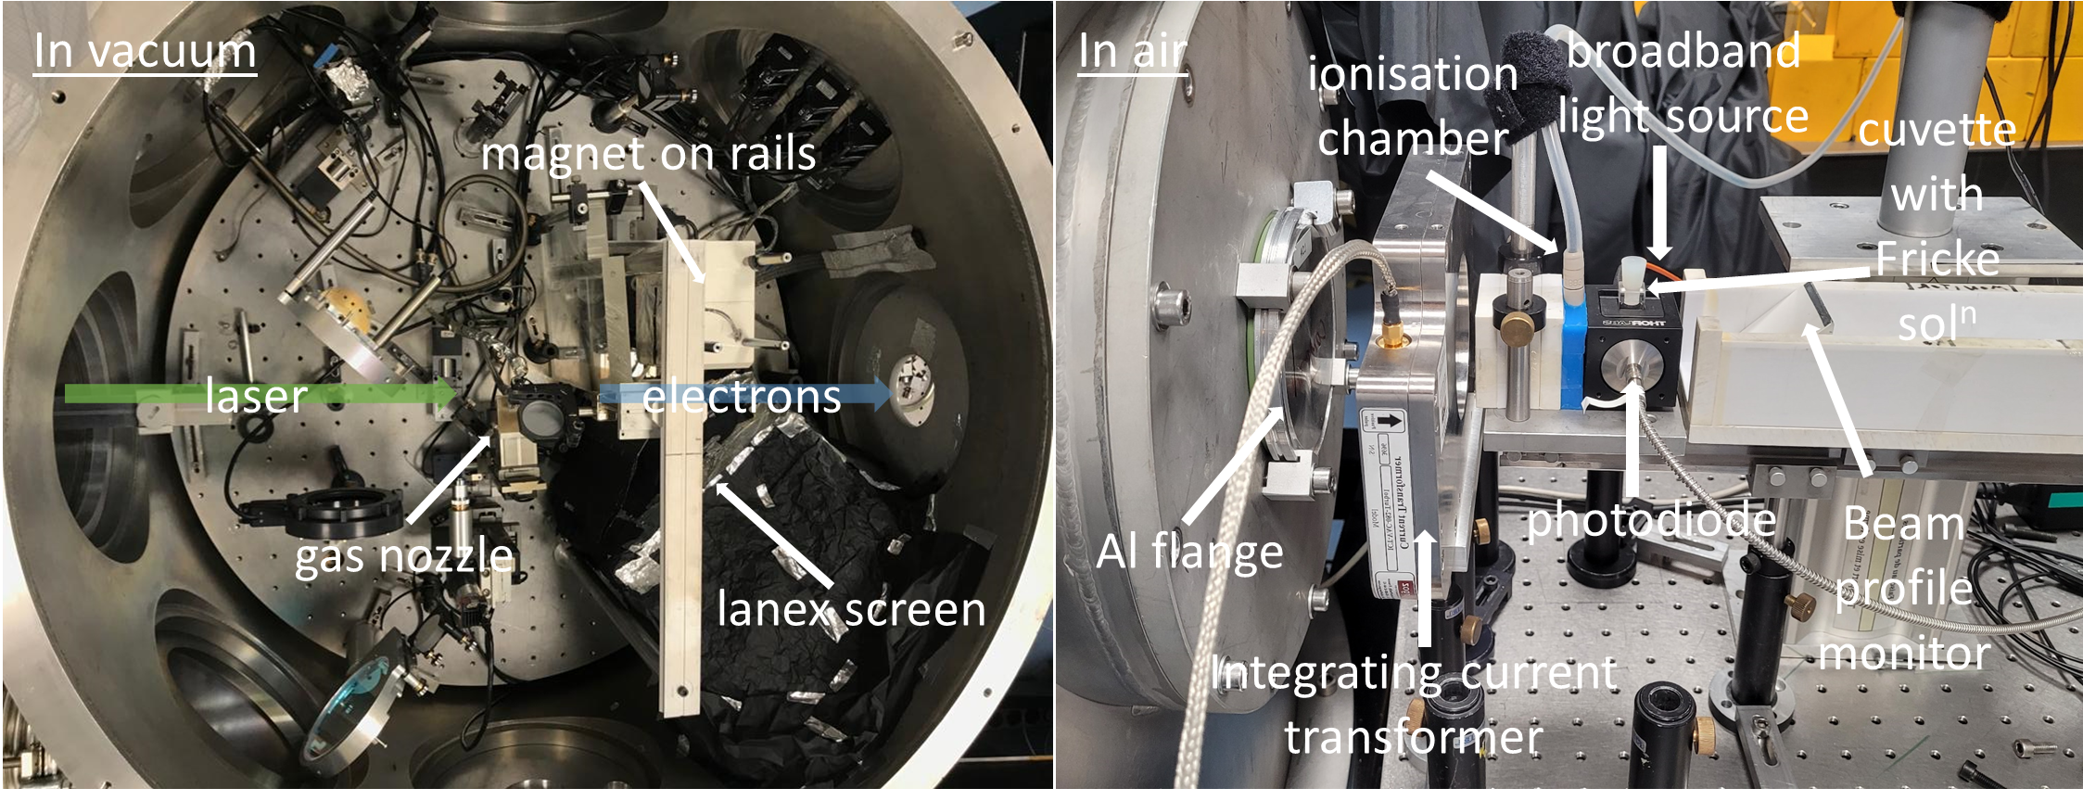
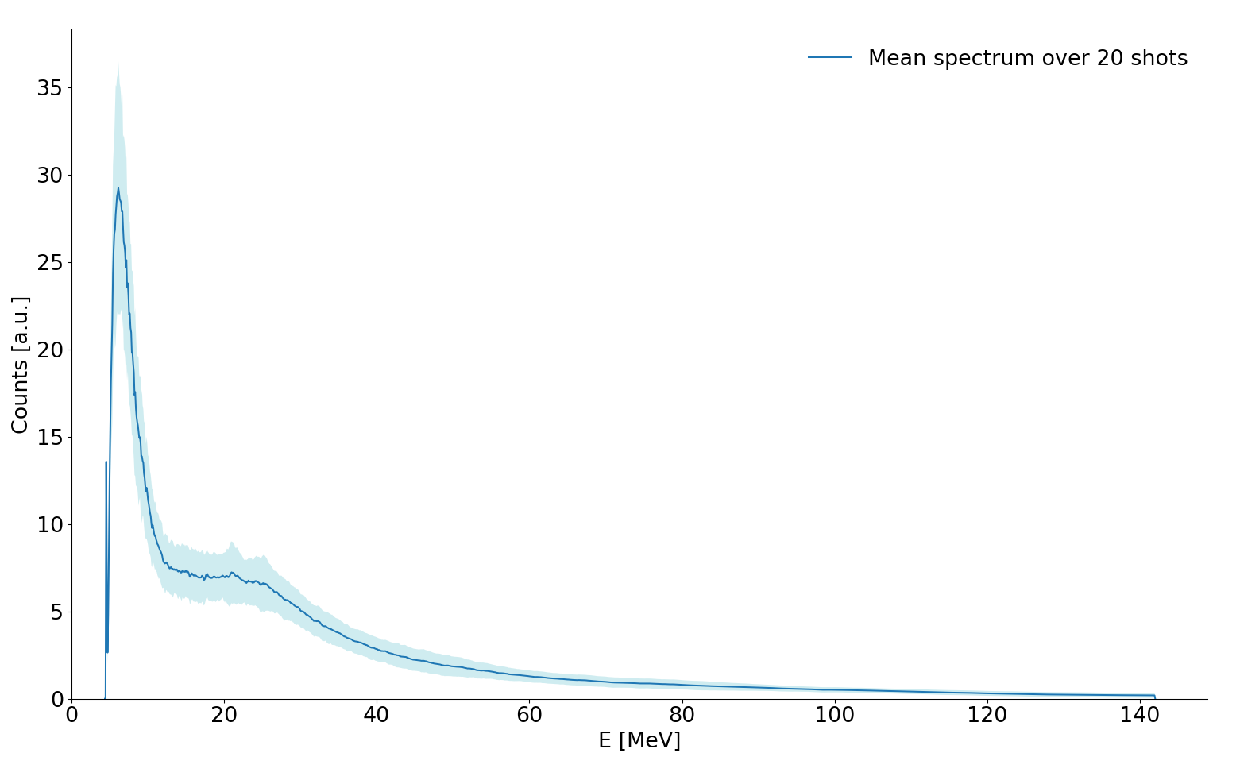
Experiment to study UHDR effect on Fricke dosimeter
Experiments done at LOA in collaboration with A. Flacco (LOA) and G. Baldacchino (LIDYL)
2.5mm
Laser and gas parameters:
Energy = 1.3 J
Intensity = 3.5 x 10¹⁸ W cm⁻²
Pulse duration = 30 fs
Gas used: N₂
Pressure = 6 bar
Electron beam characteristics:
Energy range: 4.5 – 28.5 MeV
Mean bunch charge = 800 ± 200 pC
Divergence = 10 mrad FWHM
Estimated bunch length = 1.48 ps

Slide 13
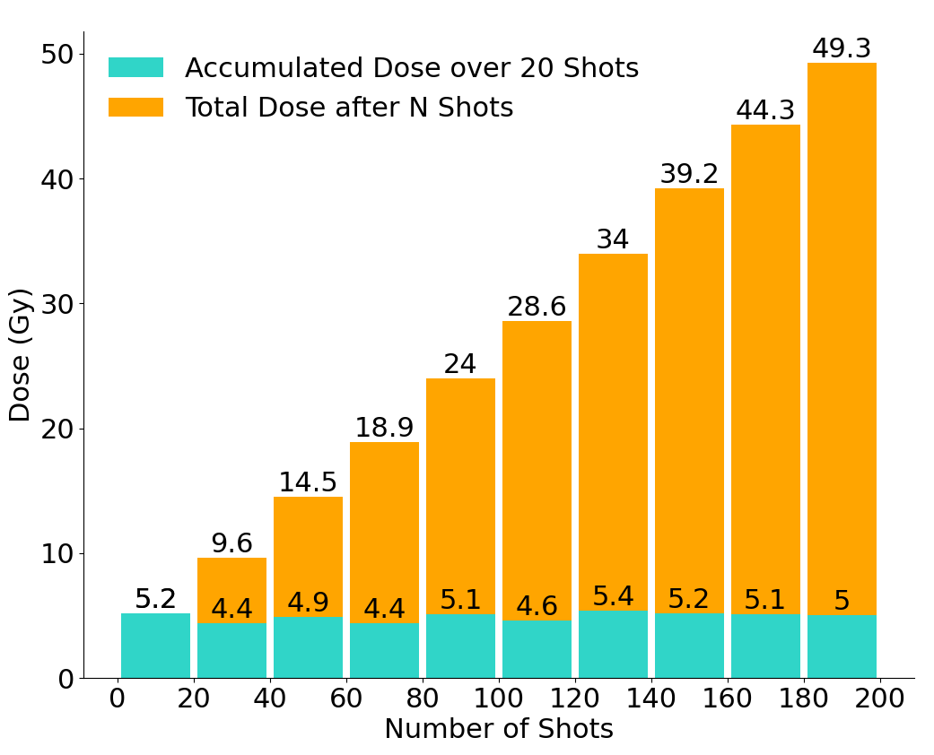
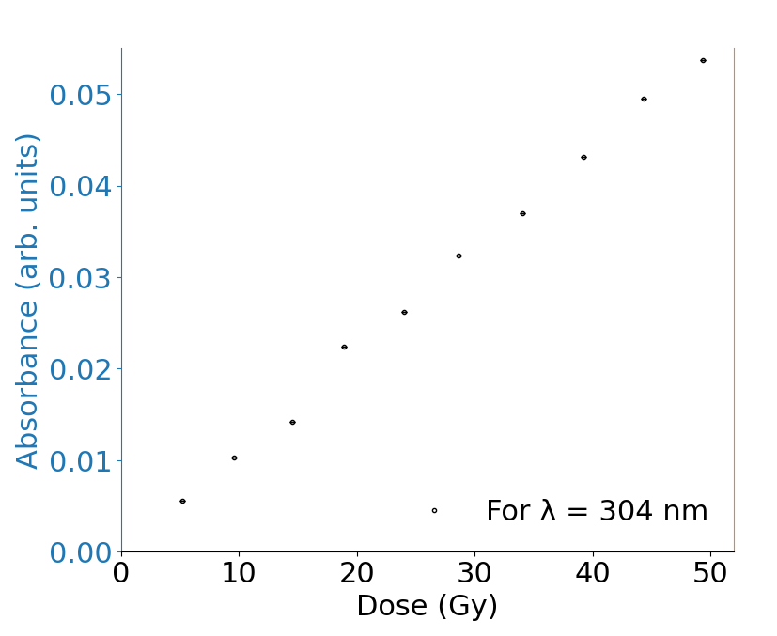
Experiment to study UHDR effect on Fricke dosimeter
Dose Measurement
Average dose over 20 shots (delivered at 0.5Hz repetition rate) = 4.93 Gy. Average dose rate = 0.123 Gy/s
Peak dose rate = dose delivered in one shot/pulse width (electron bunch length)
= 0.2465Gy/1.48ps. Peak dose rate = 1.6 x 10¹¹ Gy/s
Absorbance of Fe³⁺ ions in Fricke solution as a function of dose

Slide 14
Conclusions
Observe the effect of dose-rate on primary yield of Fe³⁺ ions
The primary yield of Fe³⁺ ions depends on the corresponding yield of the oxidising species:
Future experiments to isolate the yields of OH radicals and aqueous electrons using scavenging molecules
$$G\left(Fe^{3+}\right)=G\left(OH^{•}\right)+2G\left(H_{2}O_{2}\right)+3[G\left(e_{aq}^{−}\right)+G\left(H^{•}\right)]$$

Slide 15
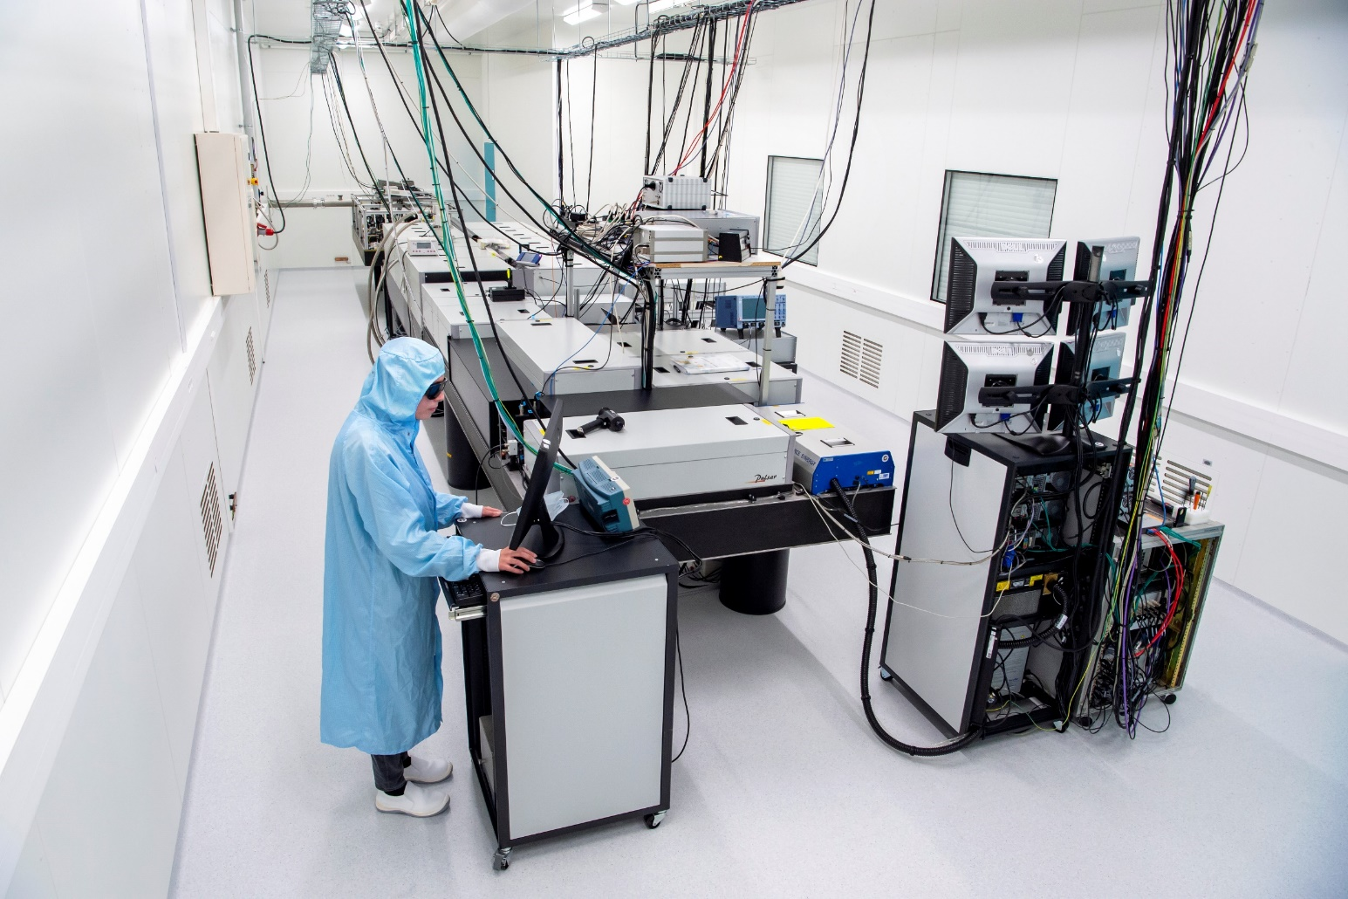
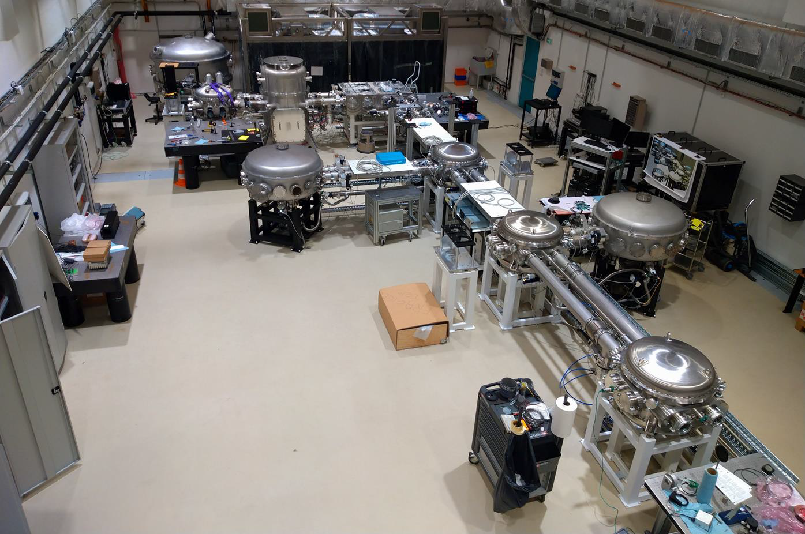
UHI100 platform @ CEA LIDyL
100TW commercial Ti:Sa laser
Experimental room in radioprotected area (220 m²)
Spatial and temporal laser pulse shaping
UHI100 platform is open for beamtime through National Comité de programme and European network like EUROLABS and LaserLab.
Experimental chambers
2.5 J (before compression)
25fs
10⁹ temporal contrast
5Hz repetition rate
2 UHI beams each one with its own double plasma and deformable mirrors
1 probe beam (10mJ)

Slide 16
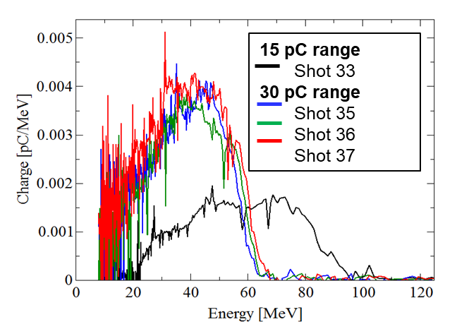
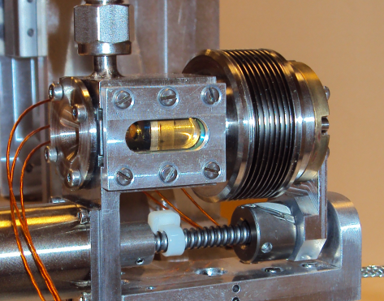
Perspectives (1)
Single compartment gas cell developed through LIDYL/LPGP collab, tested at LIDYL, LLC and APOLLON
Experiments planned on UHI100 with a double compartment gas cell target developed by LPGP
Goals:
To independently control the injection and the acceleration process by using a mixture or N₂ and H₂ in 1st compartment and pure H₂ in 2nd compartment
To achieve low energy spread and high charge electron beams

Slide 17
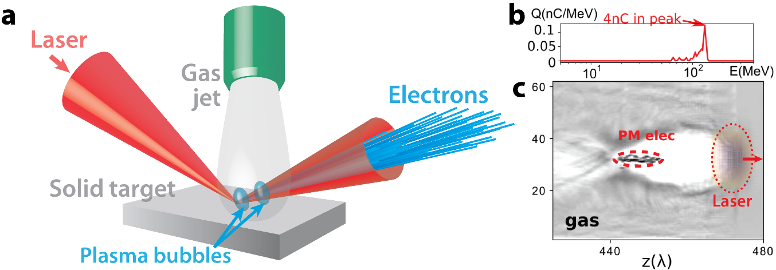
Perspectives (2)
Hybrid target LPA source in collaboration with LOA
E ≈ up to 200MeV
θ < 5 mrad
Charge ≈ 100s of pC
From Thomas Clark’s presentation

Slide 18
Perspectives (3)
Radiobiology studies (Project DEXTER) – INANOTHERAD collaboration with CEA Fontenay-aux-roses
Goals: Irradiation of cells and in-vitro studies to investigate extreme high dose rate effect in biological samples using electrons from a laser plasma accelerator.

Slide 19
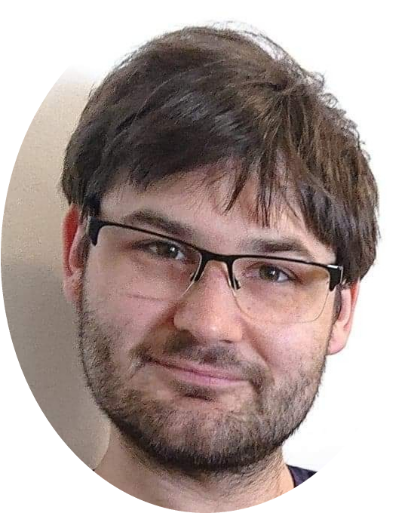
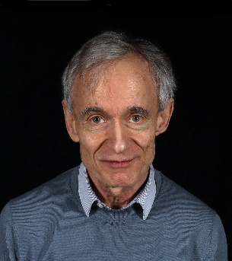
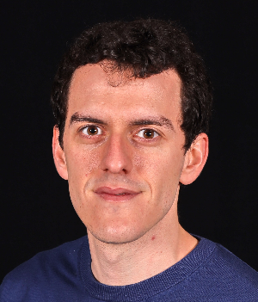
Acknowledgements
T. Ceccotti
A. Panchal
K. Oubrerie
O. Gobert
Experiment
F. Réau
(technicien laser – UHI100)
P. Forestier-Colleoni
S. Dobosz Dufrénoy
Physics at High Intensity group
I. Kara
J.M. Morchain
(Technicien)
Theory/Numerical simulations
H. Vincenti
P. Bartoli
N. Zaïm
M. Poirier
T. Clark
L. Fedeli

