Slide 1
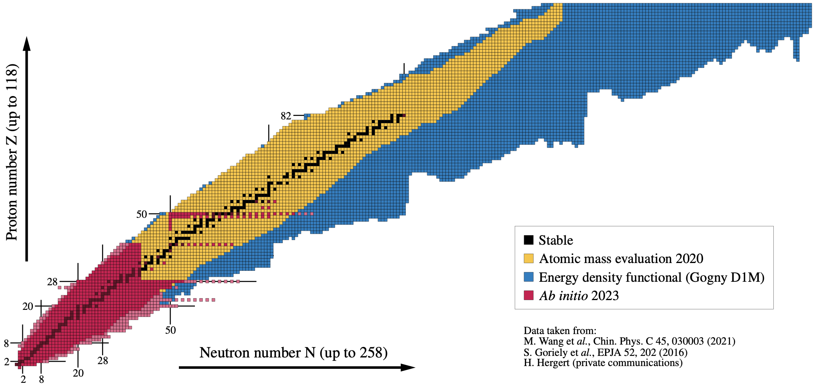


Current frontiers in the ab initio description of atomic nuclei
Only 1) polynomially-scaling method
2) nuclear structure theory [for ab initio nuclear reaction theory see Talk by G. Hupin]
²⁰⁸Pb
2023
Figure: B. Bally
June 12th – 16th 2023, Ecole doctorale PHENIICS
Thomas DUGUET

Slide 2










Collaborators on ab initio many-body methods/calculations
B. Bally
J.-P. Ebran
M. Frosini
A. Porro
A. Roux
A. Scalesi
V. Somà
G. Stellin
S. Bofos
H. Hergert
P. Navratil
P. Demol
A.Tichai
P. Arthuis
R. Roth
C. Barbieri
T. R. Rodriguez
G. Hagen
T. Papenbrock
J. M. Yao

Slide 3
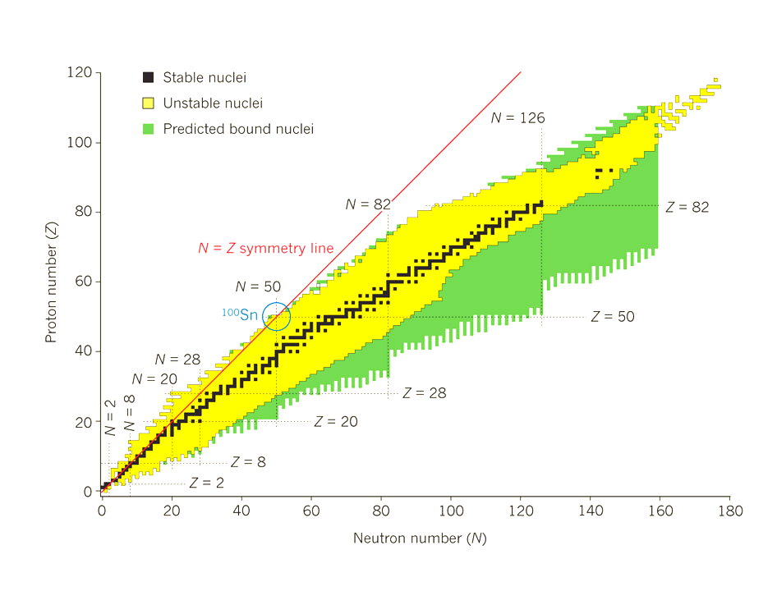
Elementary facts and « big » questions about nuclei
Oganesson ₁₁₈Og added to Mendeleïev table in 2016
252 stable isotopes, ~3100 synthesized in the lab
Heaviest synthesized element Z=118
How many bound (w.r.t strong force) nuclei exist; 9000?
Heaviest possible element?
Less than 50% known (>10⁻²²s) → Discovery of ~15 per year in the years 2010s
→ Several 100s from next generation facilities
Enhanced stability near Z=120?126?
2p decay beyond the proton drip line in ⁴⁵Fe in 2002
Modes of instability (α, p, β, γ decays, fission)
Are there more exotic/rare decay modes?
Ex: ν-less 2β decay = test of standard model?
Gravitational wave + kilonova from neutron stars merger in 2017
[figure from Bazin 2012]
Elements up to Fe produced in stellar fusion
How have heavier elements been produced?
Exotic r-process nucleosynthesis ; but where?
Updated in 2019 to Z=9 (22 neutrons) and Z=10 (24 neutrons)
Shown to disappear away from stability in 1975/1993
Neutron drip-line known up to Z=8 (16 neutrons)
Where is the neutron drip-line beyond Z=10?
Over-stable "magic" nuclei (2, 8, 20, 28, 50, 82, …)
How other magic numbers evolve with N-Z?

Slide 4

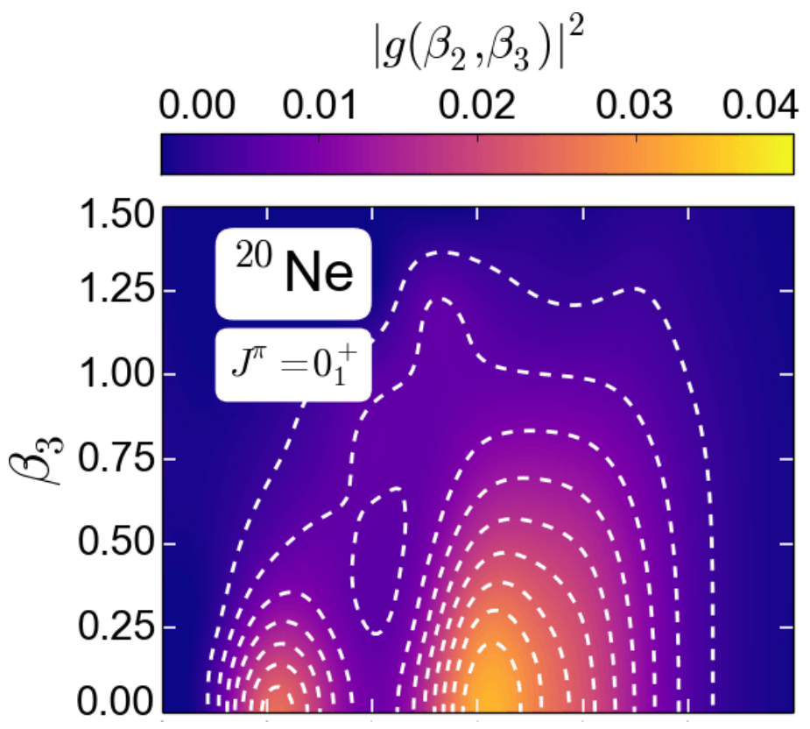
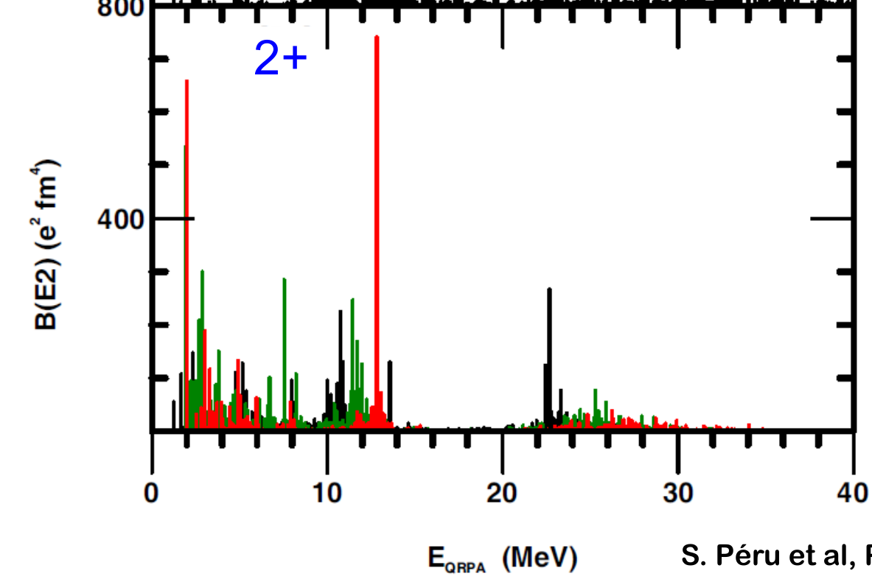
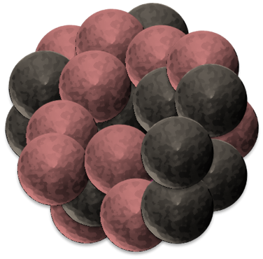
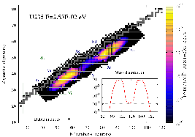
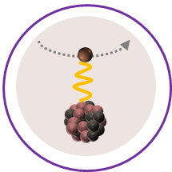
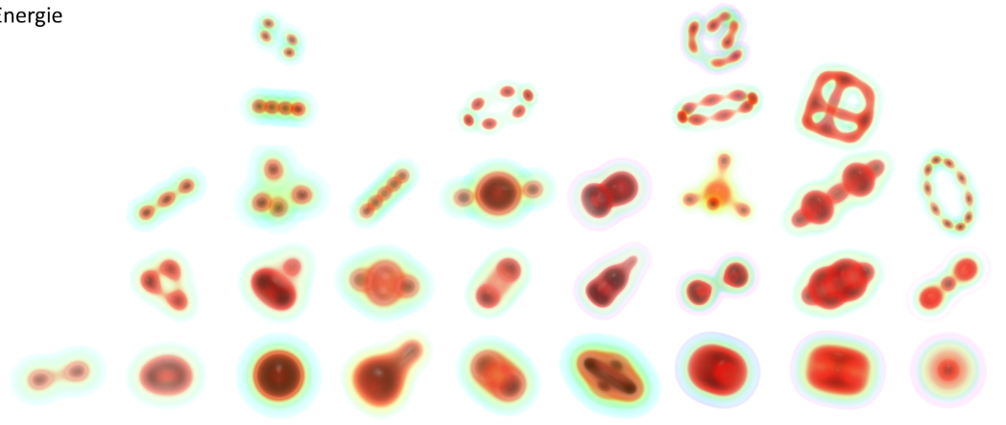
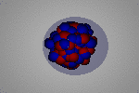
The atomic nucleus as a 4-components quantum mesoscopic system
An extremely rich and diverse phenomenology
Nucleus: bound (or resonant) state of Z protons and N neutrons
Several scales at play:
Ground-state
masses, radii, density distributions …
p & n momenta ~ 100 MeV
Separation energies ~ 10 MeV
Vibrational excitations~ 1 MeV
Ab initio long-term endeavor
Can nuclear systems be described
From nucleons and their interactions (right balance between reductionism/emergence?)
Rooted in QCD (sound connection to underlying EFT?)
Systematically (complete phenomenology?)
Accurately enough (relevant to experimental uncertainty?)
Excitation spectra
energies, transition probabilities, response function to electroweak probes, …
Rotational excitations ~ 0.1 MeV
⦿ Strongly collective correlations emerge
⤏ angular correlations ⇒ deformation
⤏ pairing correlations ⇒ superfluidity
⤏ quartetting correlations ⇒ clustering
Decay modes
lifetime, yields, …
Reactions
cross sections, …
Rich diversity of nuclear phenomena

Slide 5
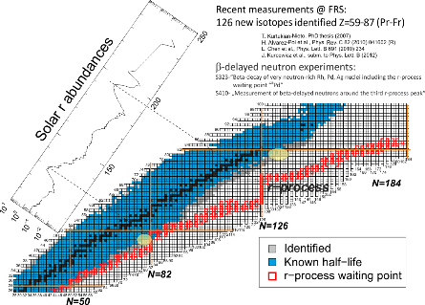
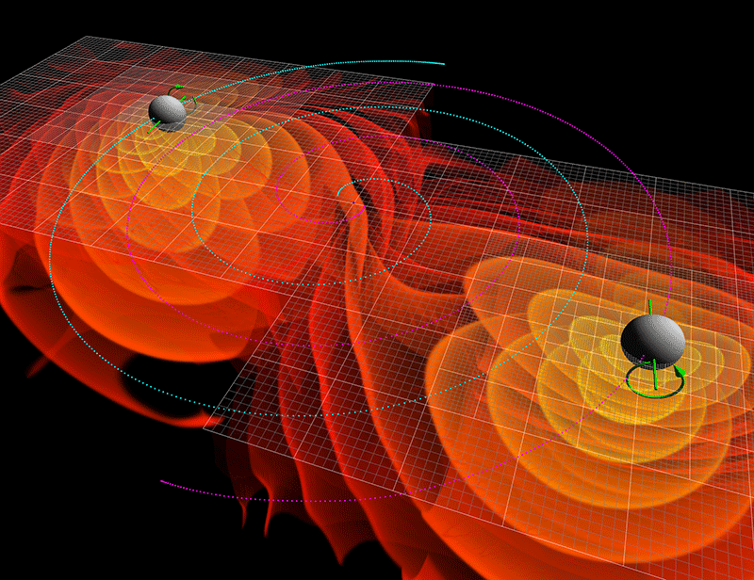
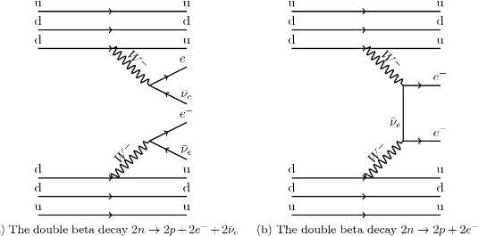


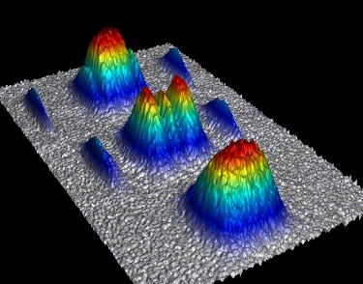
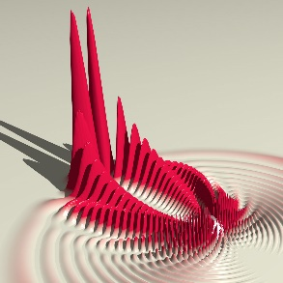





The atomic nucleus as a laboratory test
A multi-scale and multi-physics connector
Nuclei and homogeneous nuclear matter
Many scales at play, e.g.
Astrophysics
Neutron star, supernovae, nucleo-synthesis (GW and kilonova)…
Nuclei: 10⁻¹⁵ m
Factor 10¹⁹!
Neutron star: 10 km
Standard model of particle physics
0ν2β, unitarity of CKM matrix, PT
Dark matter
Nucleus-WIMP scattering
Mesoscopic many-body systems
Molecules, atoms, cold atom gases…
Large-scale experiments
Radioactive ion beam facilities

Slide 6
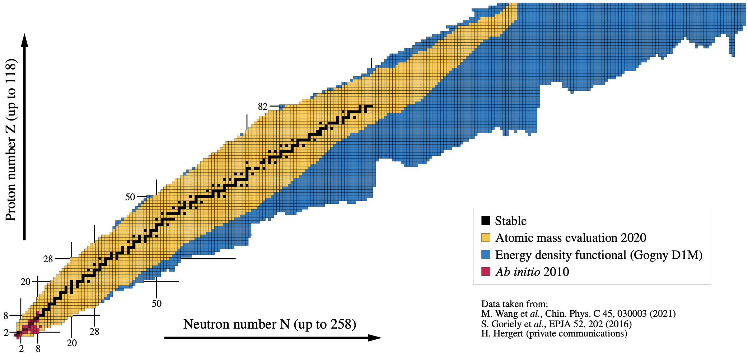
Ground-state ab initio nuclear chart… then
2010
[Figure: B. Bally]

Slide 7
Ground-state ab initio nuclear chart… now!
Quite nice progress!
How possible?
Why not earlier?
Why not faster?
Why not further yet?
2023
²⁰⁸Pb
Uncertainty quantification in ²⁰⁸Pb
Hu et al., Nature Physics (2022)
Charge radii in ¹³⁸Xe
Arthuis et al., PRL (2020)
Detailed structure of ¹⁰⁰Sn
Morris et al., PRL (2018)
Binding energy ¹⁰⁰⁻¹⁷⁰Sn
Tichai, Demol, Duguet (2023)
Mass and spectroscopy ~¹³²Sn
Miyagi et al., PRC (2022)
Global mass predictions of ~700 nuclei
Stroberg et al., PRL (2021)
Rotational excitations
Novario et al., PRC (2021)
Hagen et al., PRC (2022)
Frosini et al., EPJA (2022)
[Figure: B. Bally]

Slide 8
Contents
⦿ The « ab initio » approach to atomic nuclei at low energy
⦿ Solving the A-body Schrödinger equation
○ The leading technical problem: beating the « curse of dimensionality »
○ The subleading technical problem: further handling the dimensionality
○ Going beyond p-shell nuclei to doubly closed-shell nuclei
○ Evaluating systematic and statistical uncertainties
○ Dealing with the ~90% of nuclei that are of open-shell character
⦿ Further challenges in view of further extensions

Slide 9
Contents
⦿ The « ab initio » approach to atomic nuclei at low energy
⦿ Solving the A-body Schrödinger equation
○ The leading technical problem: beating the « curse of dimensionality »
○ The subleading technical problem: further handling the dimensionality
○ Going beyond p-shell nuclei to doubly closed-shell nuclei
○ Evaluating systematic and statistical uncertainties
○ Dealing with the ~90% of nuclei that are of open-shell character
⦿ Further challenges in view of further extensions

Slide 10
The « ab initio » theoretical scheme
Ab initio = Chiral EFT = low-energy realization of QCD
Effective degrees of freedom
Nucleons
Hadronic Physics
QCD
Pions
m_{π} = 150MeV
800MeV
Manifestation of chiral symmetry breaking at low energy
[Weinberg, Gasser, Leutwyler, van Kolck, ..]
150MeV
+ …
High-energy via contact interactions
Physics of nuclei
χEFT
N
N
∞ # operators compatible with symmetries of QCD
𝜋
+ …
Pion-driven interactions explicit
N
N
    See U. van Kolck’s lecture
1) Organize according to expected importance = Power Counting
2) Truncate at working order k → Systematic uncertainty (1)
3) Adjust Low Energy Couplings → Statistical uncertainty (2)

Slide 11
Chiral effective field theory = interactions expansion
►Can k-body, k>3, be omitted in A>>3?
►N^{3/4}LO 2N for high precision; 3N? 4N?
►More profound issues…
Major challenges

Slide 12
Oversimplified/schematic historical background
Hamiltonian
High-precision
χEFT-based
SRG transfo
High-precision
OBE-inspired
Phenomenological
OBE
χEFT-based era
?
1950
1960
1970
1980
1990
2000
2010
2020
Yukawa
OBE
model
Chiral EFT
(χEFT)
π-less EFT
Novel χEFT
Power counting

Slide 13
The « ab initio » theoretical scheme
Chiral EFT = low-energy realization of QCD
Effective degrees of freedom
Nucleons
Hadronic Physics
QCD
Pions
m_{π} = 150MeV
800MeV
Manifestation of chiral symmetry breaking at low energy
[Weinberg, Gasser, Leutwyler, van Kolck, ..]
150MeV
+ …
High-energy via contact interactions
Physics of nucleic
χEFT
N
N
∞ # operators compatible with symmetries of QCD
+ …
4) Solve A-body Schrödinger Equation
𝜋
Pion-driven interactions explicit
N
N
    Quickly impossible to do exactly
    → Systematic error (3)
1) Organize according to expected importance = Power Counting
2) Truncate at working order k → Systematic uncertainty (1)
►What accuracy can be reached?
►How does this evolve with A=N+Z?
►All types of nuclei equivalent?
3) Adjust Low Energy Couplings → Statistical uncertainty (2)

Slide 14
Contents
⦿ The « ab initio » approach to atomic nuclei at low energy
⦿ Solving the A-body Schrödinger equation
○ The leading technical problem: beating the « curse of dimensionality »
○ The subleading technical problem: further handling the dimensionality
○ Going beyond p-shell nuclei to doubly closed-shell nuclei
○ Evaluating systematic and statistical uncertainties
○ Dealing with the ~90% of nuclei that are of open-shell character
⦿ Further challenges in view of further extensions

Slide 15
Nuclear A-body quantum problem: the leading problem
One-body Hilbert space
A-body Hilbert space
« The curse of
dimensionality »
Basis of
Basis of
NCSM method
Ex: n_{dim} =10² to study ¹²C (A=12) n_{dim}^{A} = 10²⁴!
Diagonalization
Three numerical regimes
1) 2 < dim < 10⁵ = exact diago
2) 10⁵ < dim < 10¹⁰ = few EVs
3) 10¹⁰ < dim = untractable
Courtesy M. Frosini
¹⁶O sets the limit today (with 10¹⁰ dim ok in practice)

Slide 16
Oversimplified/schematic historical background
Hamiltonian
High-precision
χEFT-based
SRG transfo
High-precision
OBE-inspired
Phenomenological
OBE
χEFT-based era
?
1950
1960
1970
1980
1990
2000
2010
2020
Yukawa
OBE
model
Chiral EFT
(χEFT)
π-less EFT
Novel χEFT
Power counting
Many-body calculations
p-shell
(A<16)
Variational
p-shell
(A<16)
VMC
p-shell
(A<16)
GFMC, NCSM
1950
1960
1970
1980
1990
2000
2010
2020

Slide 17
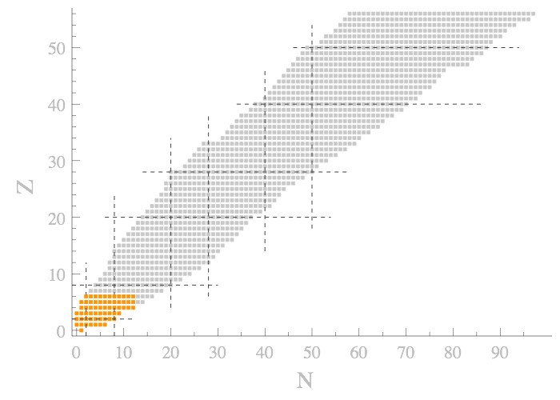
Evolution of ab initio nuclear chart vs type of method
One-body Hilbert space
A-body Hilbert space
« The curse of
dimensionality »
Full-fledged method, e.g. diagonalization
Light nuclei
Exponential cost n^{A}
2005
GFCM, NCSM
~50

Slide 18
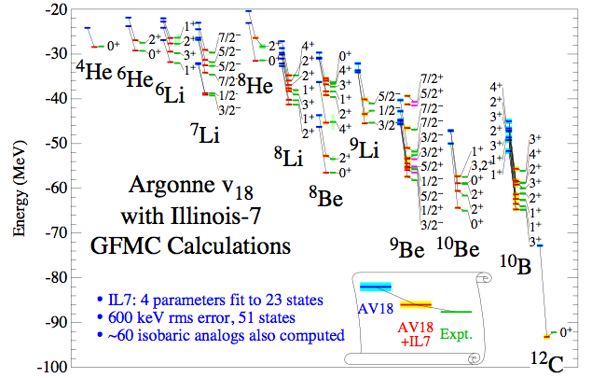
Ab initio calculations of p-shell nuclei
Green function Monte Carlo
No-core shell model
NCSM Calculations
χEFT NN+3N(lnl)
λ_{SRG} = 2 fm⁻¹
[Pieper, Wiringa 2001]
[Somà, Navratil, Raimondi, Barbieri, Duguet, 2020]
►Quasi exact solutions (up to exprapolations uncertainties in n_{dim}) at exponential cost
►Approach currently limited to p-shell nuclei (A≤16)... and to A~25 with additional tricks
Need approximate methods to solve A-body SE at n_{dim}^{p} (fixed p) cost to go beyond p-shell nuclei (A<16)
►n_{dim}^{A} is the major problem to beat (see later) but what about scaling of n_{dim} itself with A?

Slide 19
Contents
⦿ The « ab initio » approach to atomic nuclei at low energy
⦿ Solving the A-body Schrödinger equation
○ The leading technical problem: beating the « curse of dimensionality »
○ The subleading technical problem: further handling the dimensionality
○ Going beyond p-shell nuclei to doubly closed-shell nuclei
○ Evaluating systematic and statistical uncertainties
○ Dealing with the ~90% of nuclei that are of open-shell character
⦿ Further challenges in view of further extensions

Slide 20
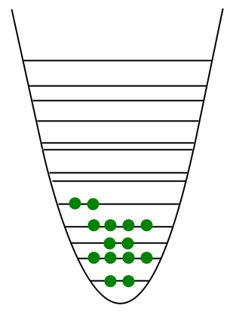
Nuclear A-body quantum problem: the subleading problem
Ex:
Spherical HO basis of H₁
⦿ Before a CPU problem one might be facing a storage problem because of n_{dim}
k-body force
↕
2k-index tensor
a = (n_{a},l_{a},j_{a},m_{a},t_{a})
e_{1max}
↕
n_{dim}
ã = (n_{a},l_{a},j_{a})
Four-index tensor
ň_{dim} << n_{dim}
k-body states up to e_{kmax} = k*e_{1max}
Naive storage cost n_{dim}^{2k}
►grows exponentially with interaction rank k
► 4N >> 3N >> 2N >> 1N
ħω
Six-index tensor
[R. Roth et al., PRC90 (2014) 024325]
1-body: e_{1max}
2-body: e_{2max}
3-body: e_{3max}
Uncoupled
JT-coupled
Jacobi
⦿ Uncoupled → JT-coupled matrix elements
Reduction by, e.g., factor ~100 for 3N at e_{3max} = 12
►Huge gain
3NF HO Matrix Elements
Ok, but what e_{1max}/e_{2max}/e_{3max} are needed as a function of A?

Slide 21
Similarity renormalization group transformation of H
►Need very large n_{dim} (e_{max}) due to hard core of V^{2N} → large ME between low and high basis states
→ Unitary Similarity Renormalization Group (SRG) transformation of H to tame it down
2N
NCSM
[Roth, Reinhardt, Hergert 2008]
Relative momentum basis of H₂
►Drastically accelerated convergence / n_{dim}
►Need much smaller values of n_{dim}
[R. Roth et al., PRC90 (2014) 024325]
►Needed JT-coupled SRG-evolved 3N matrix elements
Uncoupled
JT-coupled
Jacobi
Low-to-high off-diagonal matrix elements suppressed
➝ Mass A~50 (e_{1max} = 13 / e_{2max} = 26 / e_{3max} = 16)
2NF ~ 2GB 3NF ~ 25GB
SRG = huge help for ab initio calculations up to A~80
➝ Mass A~100 (e_{1max} = 15 / e_{2max} = 30 / e_{3max} = 20)
2NF ~ 7GB 3NF ~ 350GB
→ Too much to handle
3NF HO Matrix Elements
More tricks needed to reduce the load to go beyond A~100
Eventually truncating n_{dim} is always a source of error (3) to gauge

Slide 22
Oversimplified/schematic historical background
Hamiltonian
High-precision
χEFT-based
SRG transfo
High-precision
OBE-inspired
Phenomenological
OBE
χEFT-based era
?
1950
1960
1970
1980
1990
2000
2010
2020
Yukawa
OBE
model
Chiral EFT
(χEFT)
π-less EFT
Novel χEFT
Power counting
Many-body calculations
p-shell
(A<16)
Variational
p-shell
(A<16)
VMC
p-shell
(A<16)
GFMC, NCSM
1950
1960
1970
1980
1990
2000
2010
2020

Slide 23
Oversimplified/schematic historical background
Hamiltonian
High-precision
χEFT-based
SRG transfo
High-precision
OBE-inspired
Phenomenological
OBE
χEFT-based era
?
1950
1960
1970
1980
1990
2000
2010
2020
Yukawa
OBE
model
Chiral EFT
(χEFT)
π-less EFT
Novel χEFT
Power counting
Many-body calculations
p-shell
(A<16)
Variational
p-shell
(A<16)
VMC
p-shell
(A<16)
GFMC, NCSM
1950
1960
1970
1980
1990
2000
2010
2020
Need approximate methods to solve A-body SE at n_{dim}^{p} (fixed p) cost to go beyond p-shell nuclei (A<16)

Slide 24
Contents
⦿ The « ab initio » approach to atomic nuclei at low energy
⦿ Solving the A-body Schrödinger equation
○ The leading technical problem: beating the « curse of dimensionality »
○ The subleading technical problem: further handling the dimensionality
○ Going beyond p-shell nuclei to doubly closed-shell nuclei
○ Evaluating systematic and statistical uncertainties
○ Dealing with the ~90% of nuclei that are of open-shell character
⦿ Further challenges in view of further extensions

Slide 25
Evolution of ab initio nuclear chart vs type of method
One-body Hilbert space
A-body Hilbert space
« The curse of
dimensionality »
Expansion many-body methods
Hamiltonian partitioning
Unperturbed state
Fully correlated state
Wave operator
« Easy »
to solve
Expansion series
Typically: spherical Hartree-Fock approx
Dynamical correlations due to H₁
Wave-operator expansion
q_{max}
►Tuncated expansion = n_{dim}^{p} cost
→ Systematically improvable
►Become quickly expansive as q ⸕
→ Typically q_{max} ≤ 3
→ Systematic source of error (5)
q_{max}
Perturbative
q_{max}
with
Non-perturbative
Coefficients calculated at n_{dim}^{p} cost

Slide 26
Background to set up expansion methods in nuclei
50
Spherical nuclear shells
¹³²Sn
50
¹⁰⁰Sn
28
j=l+s → 2j+1 degeneracy
20
⁵⁶Ni
⁶⁸Ni
⁷⁸Ni
« Magic » numbers
=
Closed major shells
Protons
Neutrons
8
28
⁴⁰Ca
20
2
⁴⁸Ca
¹⁶O
²⁸O
8
⁴He
Doubly « Magic » nucleus = « double noble gas »
2
1 set for protons
1 set for neutrons
Spherical Slater determinant unperturbed state
Spherical HO 1-body basis
Particle states a,b,c…
Hole states i,j,k…
Hartree Fock unperturbed state = variational optimal

Slide 27
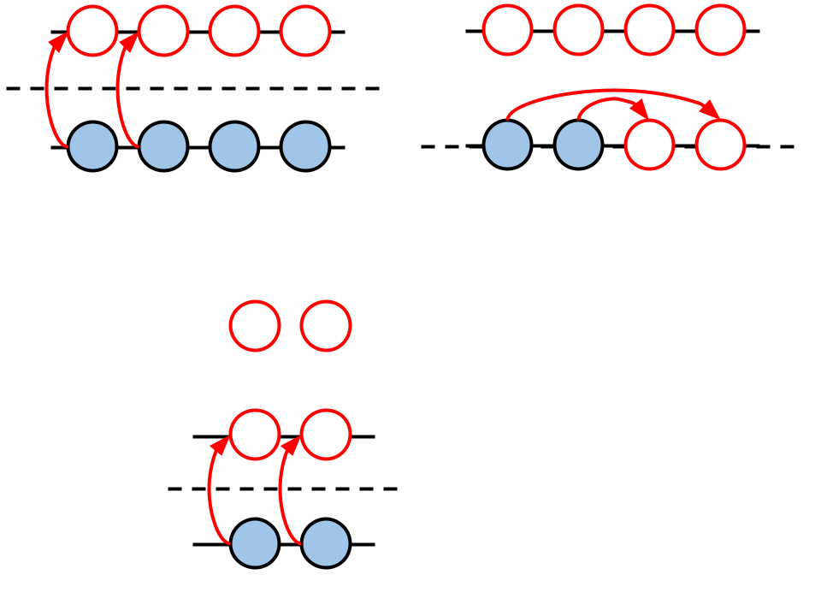
Background to set up expansion methods in nuclei
50
Spherical nuclear shells
¹³²Sn
50
¹⁰⁰Sn
28
j=l+s → 2j+1 degeneracy
20
⁵⁶Ni
⁶⁸Ni
⁷⁸Ni
« Magic » numbers
=
Closed major shells
Protons
Neutrons
8
28
⁴⁰Ca
20
2
⁴⁸Ca
¹⁶O
²⁸O
8
⁴He
Doubly « Magic » nucleus = « double noble gas »
2
1 set for protons
1 set for neutrons
« Dynamical » correlations on top
Closed-shell from H₀
Perturbative: sMBPT
Non-perturbative: sCC, sDSCGF, sSR-IMSRG
► « Dynamical » correlations induced by H₁

Slide 28




Example 1: Coupled Cluster (CC) method
Spherical Slater determinant unperturbed state
Particle states a,b,c…
Hole states i,j,k…
Normal ordering via Wick’s theorem with respect to
Anti-symmetric fields Λ^{ij} function of
Six-index tensor
Too expensive to handle
NO2B approximation
1-3% error in closed shell
[R. Roth et al., PRL 109 (2012) 052501]
Effective 2-body operators
Captures essential of 3-body
Many-body method with 2-body

Slide 29
Example 1: Coupled Cluster (CC) method
Slater determinant reference state
Individual excitations
np-nh excitations of the vacuum
Orthonormal basis of H_{A}
CC ansatz
CC wave operator Ω
Cluster amplitudes
Unknowns of the problem
with
n-tuple connected cluster operator
Energy and amplitude equations
Pure excitation operators
Truncate, e.g. T^{A}= T^{A}₁+T^{A}₂ (CCSD)
Solve for n=1,2
Connected = terminating exponential
Algebraic expression through Wick’s theorem/diagrammatic rules
Ex: for the energy
Unperturbed

Slide 30
Example 2: In-medium SRG (IMSRG) method
1. Normal order H with respect to unperturbed spherical (e.g. HF) Slater determinant
Working basis of H₁ and initial MEs
Hamiltonian
holes
SR HF Slater determinant
with
particles
Transformation to HF one-body basis
Standard Wick’s theorem with respect to
Normal-ordered operator with respect to | Φ >

Slide 31
Example 2: In-medium SRG (IMSRG) method
Matrix elements of normal-ordered operators
Large part of the original 3N transfered into effective lower-rank tensors/NO operators
Neglect residual NO 3N operator = NO2B approx

Slide 32
Example 2: In-medium SRG (IMSRG) method
Basis of H_{A}= elementary (npnh) excitations of | Φ >
2. Flow equation for normal-ordered form of H(s)
Initial condition
n
m
Flow equation
each step
up to n+m-1
Induced k-body terms
Chosen « off-diagonal » Hamiltonian defining η(s)
Suppress coupling
of | Φ > to individual
IR np-nh excitations
=IR dynamical correlations pre-processed in H(s)
Coupling driven to 0 for s->∞
ph&pphh matrix elements
with
Neglect flowing k-body operators with n ≤ k ≤ A = IMSRG(n) approx → violates unitarity (small?)
IMSRG(2) workhorse of current ab initio calculations

Slide 33
Example 2: In-medium SRG (IMSRG) method
Basis of H_{A}= elementary (npnh) excitations of | Φ₀ >
2. Flow equation for normal-ordered form of H(s)
Initial condition
Flow equation
Induced k-body terms
Requires to handle up to A-body operators to be exact = impossible
Neglect flowing k-body operators with n ≤ k ≤ A = IMSRG(n) approx → violates unitarity (small?)
IMSRG(2) workhorse of current calculations; IMSRG(3) is state-of-the-art
Decoupling simplified

Slide 34
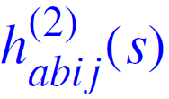
Example 2: In-medium SRG (IMSRG) method
SR-IMSRG(2)
N³LO chiral-EFT (no 3N here) SRG evolved λ = 2 fm⁻¹
[Hergert et. al, Phys. Rep. 2016]
Decoupling
Well under way after 20 steps (s=2.0)
Numerically achieved at s=18.3
Convergence
MBPT(2)/CCSD/Λ-CCSD(T) with evolving H(s)
IR dynamical correlations from H(s) very much reduced s ≥ 10⁻¹
Full decoupling (i.e. zero correlations) achieved for s ≥ 2

Slide 35
Zoology of expansion many-body methods
Dynamic correlations
(Expansion of wave operator on top of unperturbed state)
Tsukiyama et al., 2010
Coester, 1958
Hagen et al., 2007
sSR-IMSRG
Non-perturbative
sCC
sDSCGF
Martin, Schwinger, 1959
Barbieri, Dickoff, 2001
Moller, Plesset, 1934
Roth et al., 2010
Perturbative
sMBPT
Spherical
Hartree-Fock
Closed shell

Slide 36
Oversimplified/schematic historical background
Hamiltonian
High-precision
χEFT-based
SRG transfo
High-precision
OBE-inspired
Phenomenological
OBE
χEFT-based era
?
1950
1960
1970
1980
1990
2000
2010
2020
Yukawa
OBE
model
Chiral EFT
(χEFT)
π-less EFT
Novel χEFT
Power counting
Many-body calculations
Closed shell (A<70)
sMBPT, sCC,
sDSCGF,
sSR-IMSRG
p-shell
(A<16)
Variational
p-shell
(A<16)
VMC
p-shell
(A<16)
GFMC, NCSM
1950
1960
1970
1980
1990
2000
2010
2020
MBPT
SCGF,
CC
SR-IMSRG

Slide 37
Evolution of ab initio nuclear chart vs type of method
One-body Hilbert space
A-body Hilbert space
« The curse of
dimensionality »
Full-fledged method, e.g. diagonalization
Light nuclei
Exponential cost n^{A}
2005
GFCM, NCSM
~50

Slide 38
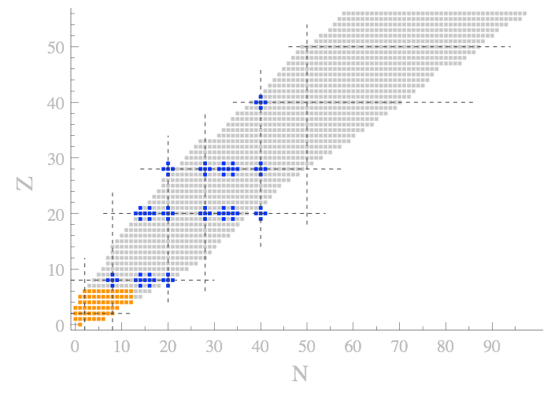
Evolution of ab initio nuclear chart vs type of method
One-body Hilbert space
A-body Hilbert space
« The curse of
dimensionality »
Full-fledged method, e.g. diagonalization
Light nuclei
Exponential cost n^{A}
2010
GFCM, NCSM
Doubly closed-shell nuclei
Exponential cost n’^{p}
sMBPT, sCC, sDSCGF, sSR-IMSRG
~50
~180
Expansion methods

Slide 39
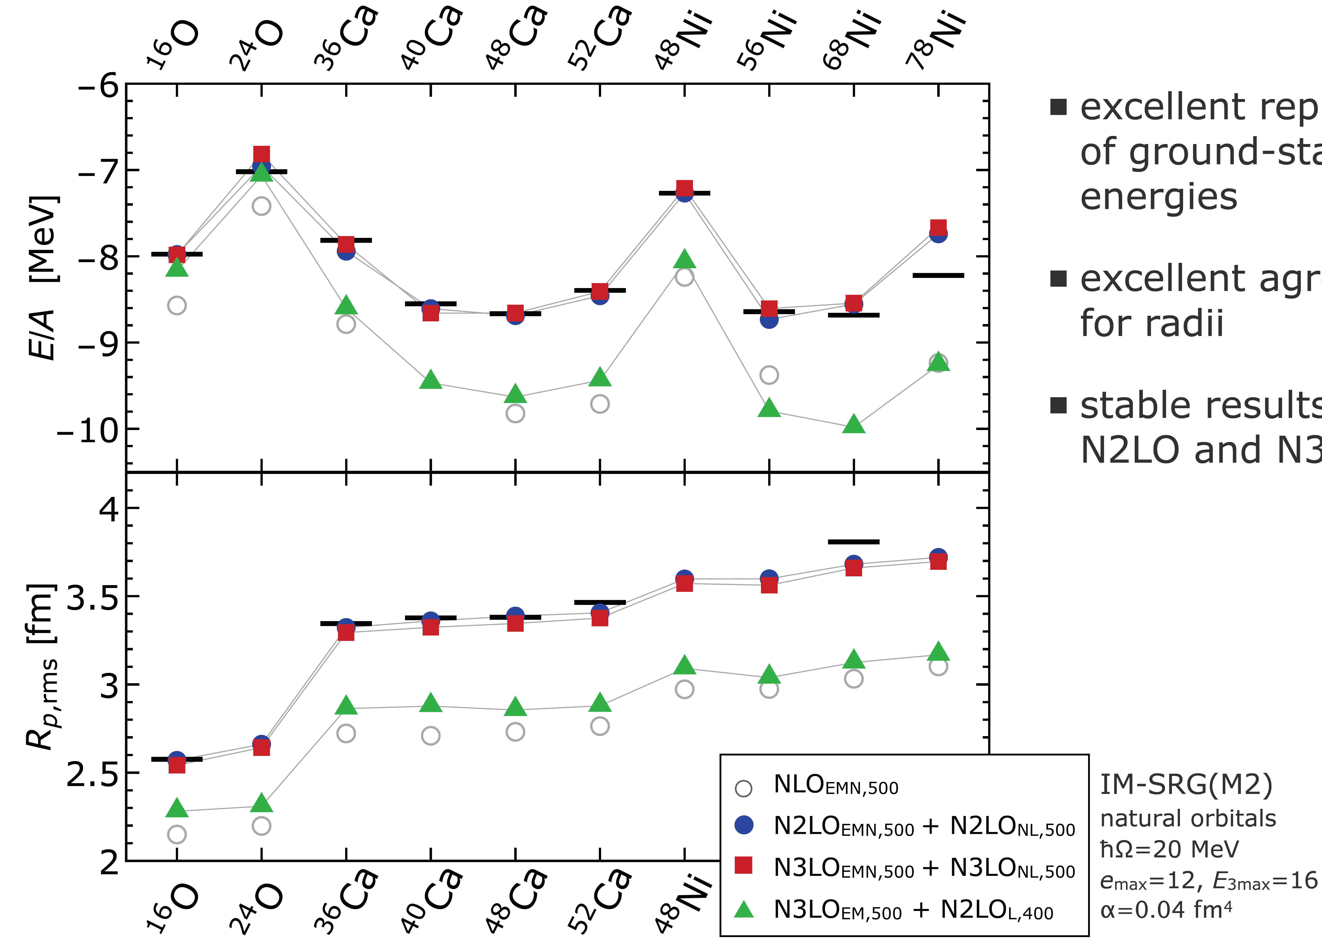
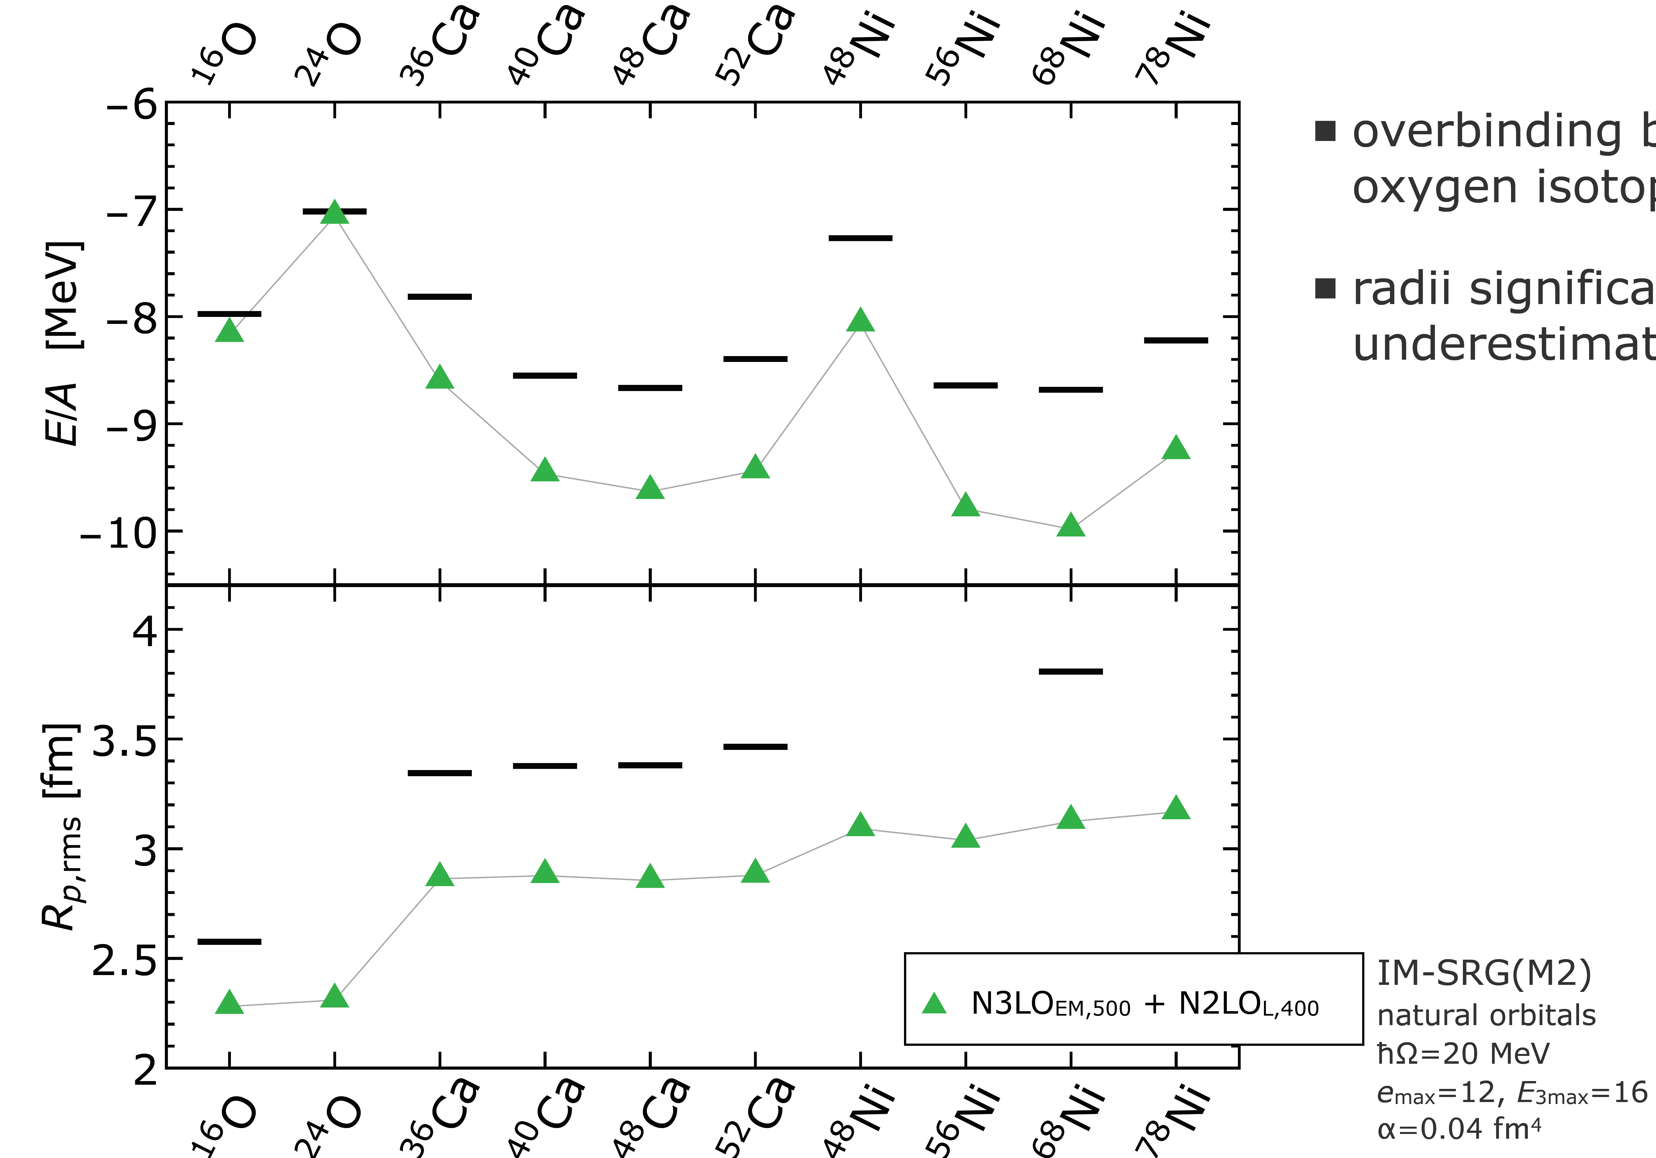
Ab initio calculations of doubly closed-shell nuclei
Situation pre-2019
New situation
[Huther et al. 2019]
New consistent chiral family at NLO, N²LO, N³LO
○ Non-local 3N regulator
○ C_{D} LEC tuned to BE(¹⁶O) (⁴He slightly relaxed)
[Huther et al. 2019]
○ Excellent reproduction of binding energies
sSR-IMSRG(2)
○ Excellent agreement for radii
○ Net improvement from NLO to N²LO
○ Stable from N²LO to N³LO
Successful -ab initio description
-of doubly closed-shell
-ground states
-up to A=78
[Entem, Machleidt 2003, Navrátil 2007, Roth et al. 2012]
(Inconsistent) Chiral N³LO 2N + N²LO 3N interactions
○ Overbinding beyond ^{A}O that increases with mass
○ Charge radii are consistently too small from ¹⁶O till ⁷⁸Ni
Up to 20% error with data

Slide 40
Contents
⦿ The « ab initio » approach to atomic nuclei at low energy
⦿ Solving the A-body Schrödinger equation
○ The leading technical problem: beating the « curse of dimensionality »
○ The subleading technical problem: further handling the dimensionality
○ Going beyond p-shell nuclei to doubly closed-shell nuclei
○ Evaluating systematic and statistical uncertainties
○ Dealing with the ~90% of nuclei that are of open-shell character
⦿ Further challenges in view of further extensions

Slide 41
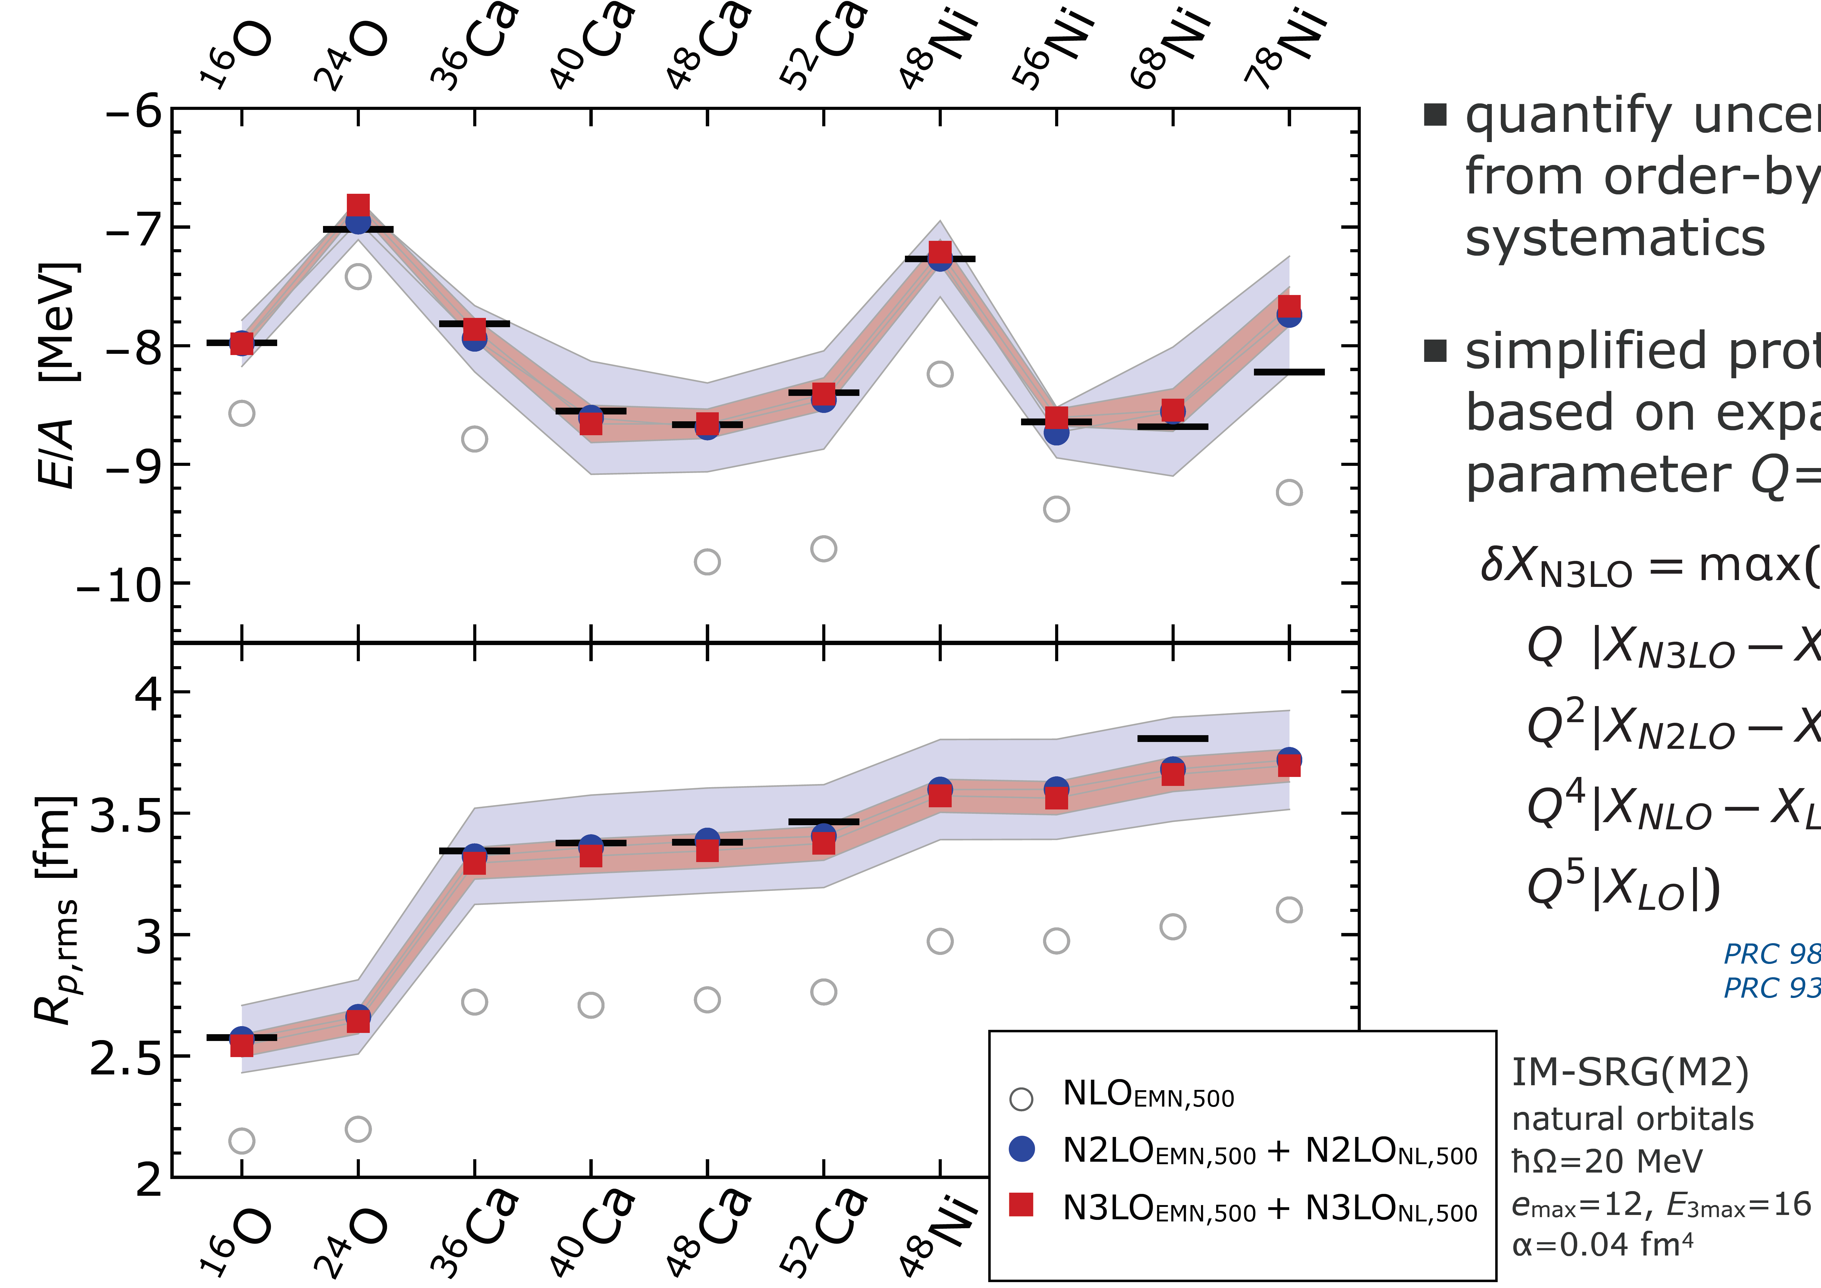
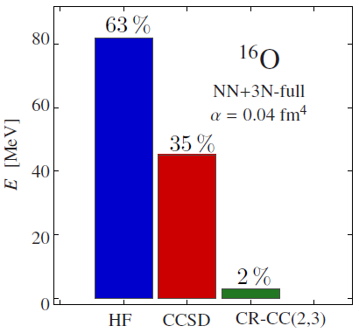
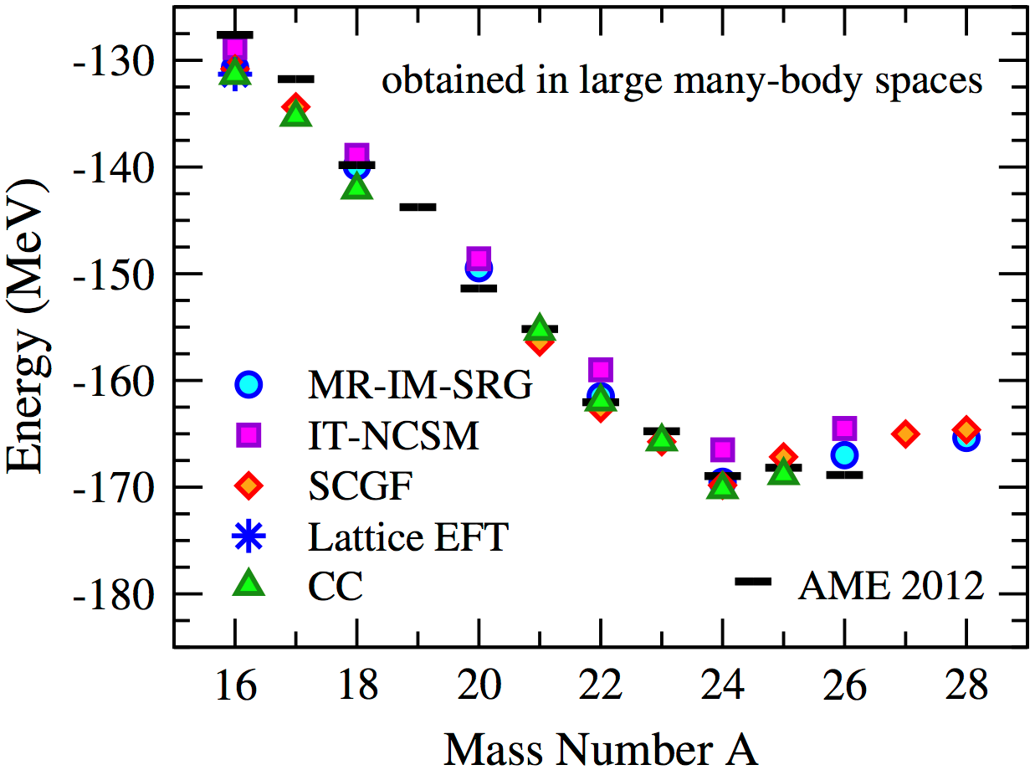
Systematic uncertainties
Truncated χEFT Hamiltonian expansion = Error (1)
Order-by-order estimate [Binder et al. 2018]
BE and radii at N³LO: 5-6% up to A~80
[Huther et al. 2019]
Truncated A-body expansion = Error (5)
[Binder et al. 2015]
[Hebeler et al. 2015]
λ = 2.25 fm⁻¹
Work-horse methods = ~3%
Top-tier methods < 1%
Truncated basis expansion = Error (3)
1-body: e_{1max}
2-body: e_{2max}
3-body: e_{3max}
ħω
A~50 < 1%
A~200 ~ 8%
[Hu et al. 2022]

Slide 42
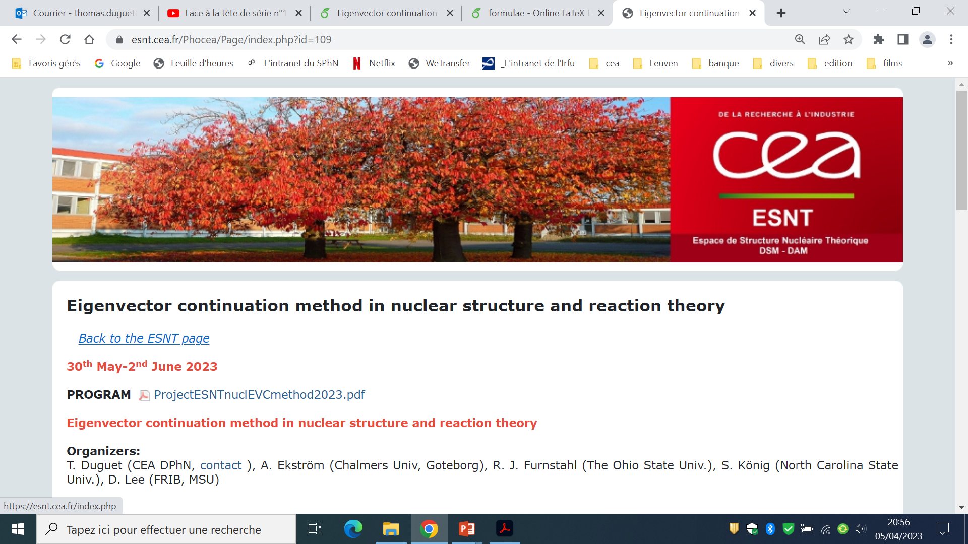
Statistical uncertainties
Propagating parameter uncertainties of H = Error (2) + Global Sensitivity Analysis
N simulations = expensive
Simulations = 20y of CPU
↕
Emulations = 1h on a laptop
^{CCSD}
¹⁶O
Intense activity around this method in ab initio nuclear structure and reaction
fit
N sets
± 5%
1 114 112 samples
A-body observables
with
statistical uncertainties
⦿ Emulator based on the Eigenvector Continuation method
[Ekstrom, Hagen. PRL (2019)]
[Frame et al. PRL (2018)]
1) Solve for a small set (few 100s) of parameter values = moderate
2) Diagonalize the huge number of in small basis generated in 1) = cheap
⦿ Rule of the game
Evaluating any source of error = repeating several/many/very many times the ab initio calculation
Enormous increase of the cost
Reducing systematic error = going to next order or larger n_{dim}
Huge increase of the cost

Slide 43
Contents
⦿ The « ab initio » approach to atomic nuclei at low energy
⦿ Solving the A-body Schrödinger equation
○ The leading technical problem: beating the « curse of dimensionality »
○ The subleading technical problem: further handling the dimensionality
○ Going beyond p-shell nuclei to doubly closed-shell nuclei
○ Evaluating systematic and statistical uncertainties
○ Dealing with the ~90% of nuclei that are of open-shell character
⦿ Further challenges in view of further extensions

Slide 44
Evolution of ab initio nuclear chart vs type of method
One-body Hilbert space
A-body Hilbert space
« The curse of
dimensionality »
Full-fledged method, e.g. diagonalization
Light nuclei
Exponential cost n^{A}
2010
GFCM, NCSM
Doubly closed-shell nuclei
Exponential cost n’^{p}
sMBPT, sCC, sDSCGF, sSR-IMSRG
~50
~180
Do expansion methods mentioned so far apply to all types of nuclei?
Can we keep benefiting from n_{dim} → ň_{dim} from JT coupling?
Ground-state properties so far: immediate access to spectroscopy?
Expansion methods

Slide 45
Categories of nuclei vs correlations vs expansion method
50
Nuclear shells from SC ([H,J²]=0) Hartree-Fock
¹³²Sn
50
¹⁰⁰Sn
28
j=l+s → 2j+1 degeneracy
20
⁵⁶Ni
⁶⁸Ni
⁷⁸Ni
« Magic » numbers
=
Closed major shells
Protons
Neutrons
8
28
⁴⁰Ca
20
2
⁴⁸Ca
¹⁶O
²⁸O
8
⁴He
Doubly « Magic » nucleus = « double noble gas »
2
1 set for protons
1 set for neutrons
Closed-shell = weak « dynamical » correlations
Open-shell = weak « dynamical » + strong IR « static » correlations
Controlled expansions
Closed-shell from H₀
Uncontrolled expansions
Open-shell from H₀
Inappropriate
choice for this number of nucleons
Ex:
Ex:
►weak « dynamical » correlations induced by H₁
►strong « static » correlations from H₁

Slide 46
Categories of nuclei vs correlations vs expansion method
50
Nuclear shells from SC ([H,J²]=0) Hartree-Fock
¹³²Sn
50
¹⁰⁰Sn
28
j=l+s → 2j+1 degeneracy
20
⁵⁶Ni
⁶⁸Ni
⁷⁸Ni
« Magic » numbers
=
Closed major shells
Protons
Neutrons
8
28
⁴⁰Ca
20
2
⁴⁸Ca
¹⁶O
²⁸O
8
⁴He
Doubly « Magic » nucleus = « double noble gas »
2
1 set for protons
1 set for neutrons
Nuclei categorization
Mostly
open-shell
even-even
ground-states
91.3%

Slide 47
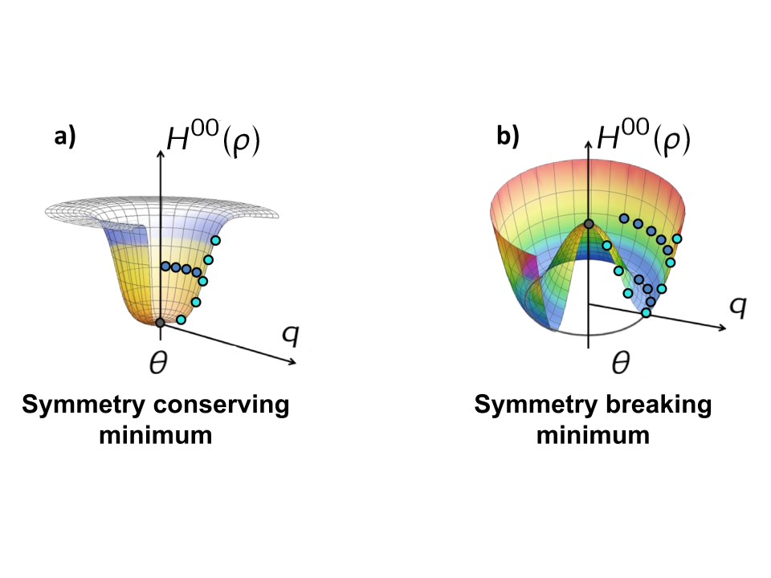
Evolution of ab initio nuclear chart vs type of method
One-body Hilbert space
A-body Hilbert space
« The curse of
dimensionality »
Expansion many-body methods
Appropriate partitioning
Unperturbed state
Fully correlated state
« Easy »
to solve
Expansion series
Symmetries
…and so far
Doubly open shell: SU(2)
Singly open shell: U(1)
Degeneracies
Spontaneous symmetry breaking
BUT we can allow
Prohibitive for open-shell nuclei
Physics of deformation
Physics of superfluidity
Safe expansion methods again
Ex:
sHF → dHFB state
Strong static correlations
Degeneracy
lifted

Slide 48
Evolution of ab initio nuclear chart vs type of method
One-body Hilbert space
A-body Hilbert space
« The curse of
dimensionality »
Expansion many-body methods
Appropriate partitioning
Unperturbed state
Fully correlated state
« Easy »
to solve
Expansion series
Bogoliubov reference state
but constrain such that
Perturbative: BMBPT
Non-perturbative: BCC, GSCGF, SR-BIMSRG
Hartree Fock Bogoliubov unperturbed state = variational optimal

Slide 49

Example: Bogoliubov Coupled Cluster (BCC) method
Bogoliubov reference state
Normal ordering via Wick’s theorem with respect to in quasi-particle basis
Η^{ij} matrix elements function of
6-qp operators
Similarly for A and Ω=H−λA
PNO2B approximation
[Ripoche, Tichai, Duguet, EPJA 2020]
Six-index tensors
Too expensive to handle
NO2B approximation
Simply remove H^{[6]}?
SC rank-reduction
[Frosini et al. EPJA 2021]

Slide 50
Example: Bogoliubov Coupled Cluster (BCC) method
Bogoliubov reference state
Quasi-particle excitations
Orthonormal basis of Fock space
Bogoliubov CC ansatz
Reduces to npnh excit. in closed-shell
Cluster amplitudes
Unknowns of the problem
with
as soon as T is truncated
symmetry contamination
but « simple » theory with n^{p} cost
n-tuple connected cluster operator
Energy and amplitude equations
Pure excitation operators
Truncate, e.g. T= T₁+T₂ (BCCSD)
Solve for n=1,2
Constrained to be true in average
Connected = terminating exponential
Algebraic expression through Wick’s theorem/diagrammatic rules
Ex: for the energy
Unperturbed

Slide 51
Zoology of expansion many-body methods
Dynamic correlations
(Expansion of wave operator on top of unperturbed state)
Italic = not yet implemented
PAN@CEA
Tichai et al., 2022
Signoracci et al., 2015
Demol et al., 2022
Hagen et al., 2022
dCC
sSR-IMSRG
dBCC
Non-perturbative
sCC
dSR-BIMSRG
sDSCGF
dGSCGF
Breaking&Restoring
Symmetries for
Open-shell nuclei
Somà et al., 2013
Gorkov, 1958
Duguet, 2015
Perturbative
sMBPT
dBMBPT
Tichai et al., 2018
Frosini et al., 2022
Spherical
Hartree-Fock
Deformed [SU(2)]
Hartree-Fock-Bogoliubov [U(1)]
Static correlations
(Class of unperturbed state)
Closed shell
Open shell
Good sym.
Lost. sym.

Slide 52
Complexity of developing novel many-body formalisms
Formal stage
Prototyping
Reduction
Production
Months to years
~ 6 months
~ 6 months
~ 6 months
Formalism
Truncation scheme
First numerical code
Symmetry reduction
Optimisation
Wick theorem + diagrammatic representation
Ex: diagrams at play in BIMSRG(2)
Deriving BIMSRG(3,4…) equations by hand ►forget it!
[Tichai et al., 2022]

Slide 53
Complexity of developing novel many-body formalisms
Formal stage
Prototyping
Reduction
Production
Months to years
~ 6 months
~ 6 months
~ 6 months
Formalism
Truncation scheme
First numerical code
Symmetry reduction
Optimisation
Wick theorem + diagrammatic representation
Automated Diagram Generator
  Arthuis, Duguet, Tichai, Lasseri, Ebran, CPC 240 (2019)
  Arthuis, Tichai, Ripoche, Duguet, CPC 261 (2021)
  Tichai, Arthuis, Hergert, Duguet, EPJA 58 (2022)
Design numerical code to perform automated derivation&mathematical evaluation of the diagrams

Slide 54
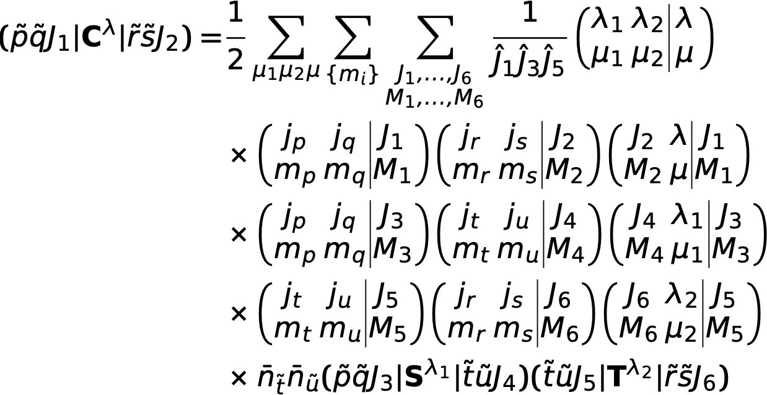
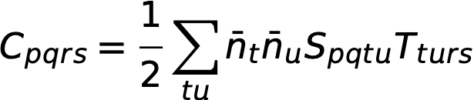


Complexity of developing novel many-body formalisms
Formal stage
Prototyping
Reduction
Production
Months to years
~ 6 months
~ 6 months
~ 6 months
Formalism
Truncation scheme
First numerical code
Symmetry reduction
Optimisation
Wick theorem + diagrammatic representation
Algebra recoupling
To be eliminated
Automated Diagram Generator
  Arthuis, Duguet, Tichai, Lasseri, Ebran, CPC 240 (2019)
  Arthuis, Tichai, Ripoche, Duguet, CPC 261 (2021)
  Tichai, Arthuis, Hergert, Duguet, EPJA 58 (2022)
SU(2) symmetry
+
Angular momentum recoupling
n_{dim}
ň_{dim}
Gain n_{dim}⁶ theory
emax
#[nljm]
#[nlj]
ratio
(ratio)⁻⁶
2
40
12
0.3
~1300
4
140
30
0.214
~10400
Clehsch-Gordon coefficient identities…
6
336
56
0.166
~48000
8
660
90
0.136
1.6 · 10⁵
10
1140
132
0.116
4.1 · 10⁵
12
1820
182
0.1
10⁶
14
2740
240
0.088
2.1 · 10⁶
BIMSRG(3) ~100 terms
Do it by hand? ► forget it!

Slide 55
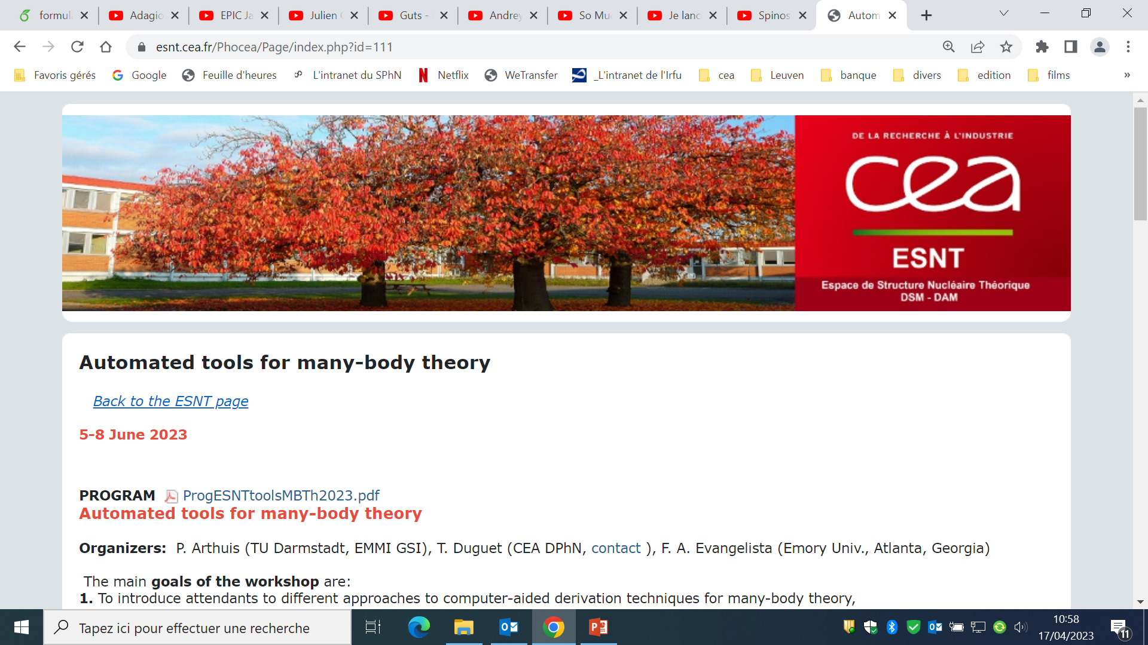
Complexity of developing novel many-body formalisms
Formal stage
Prototyping
Reduction
Production
Months to years
~ 6 months
~ 6 months
~ 6 months
Formalism
Truncation scheme
First numerical code
Symmetry reduction
Optimisation
Faster and safer with automation
Graph theory methods & open-source libraries
Gain formal and numerical insights
Wick theorem + diagrammatic representation
Programming language
+
Desktop computer
Algebra recoupling
Programming language
+
HPC cluster
Intense activity in many-body community at large
Quantum chemistry, nuclear physics, atomic physics, condensed matter physics
Automated Diagram Generator
  Arthuis, Duguet, Tichai, Lasseri, Ebran, CPC 240 (2019)
  Arthuis, Tichai, Ripoche, Duguet, CPC 261 (2021)
  Tichai, Arthuis, Hergert, Duguet, EPJA 58 (2022)
Angular Momentum Coupling
  Tichai, Wirth, Ripoche, Duguet, EPJA 56 (2020)
Automated Code Generation
  Drischler, Hebeler, Schwenk, PRL 122 (2019)
Design numerical code to identify network of Clebsch-Gordon coefficients and perform its reduction

Slide 56
Evolution of ab initio nuclear chart vs type of method
One-body Hilbert space
A-body Hilbert space
« The curse of
dimensionality »
Full-fledged method, e.g. diagonalization
Light nuclei
Exponential cost n^{A}
2010
GFCM, NCSM
Doubly closed-shell nuclei
Exponential cost n’^{p}
sMBPT, sCC, sDSCGF, sSR-IMSRG
~50
~180
Breaking only U(1): sHFB unperturbed state
►Still benefiting from n_{dim} → ň_{dim}
Expansion methods

Slide 57
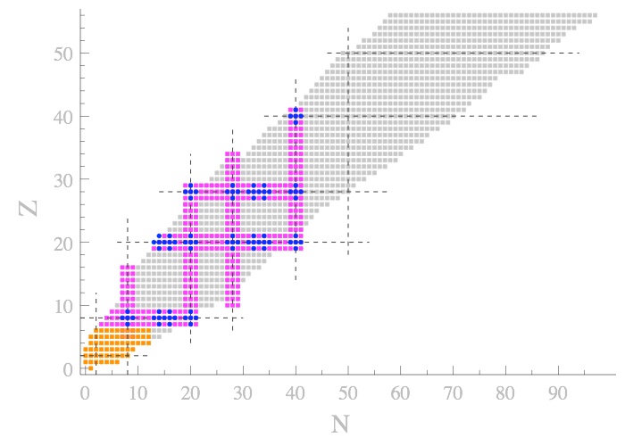
Evolution of ab initio nuclear chart vs type of method
One-body Hilbert space
A-body Hilbert space
« The curse of
dimensionality »
Full-fledged method, e.g. diagonalization
Light nuclei
Exponential cost n^{A}
2013
GFCM, NCSM
Doubly closed-shell nuclei
Exponential cost n’^{p}
sMBPT, sCC, sDSCGF, sSR-IMSRG
Singly open-shell nuclei
Exponential cost n’’^{p}
~50
~180
~840
sBMBPT, sBCC, sGSCGF
Breaking only U(1): sHFB unperturbed state
►Still benefiting from n_{dim} → ň_{dim}
Expansion methods

Slide 58
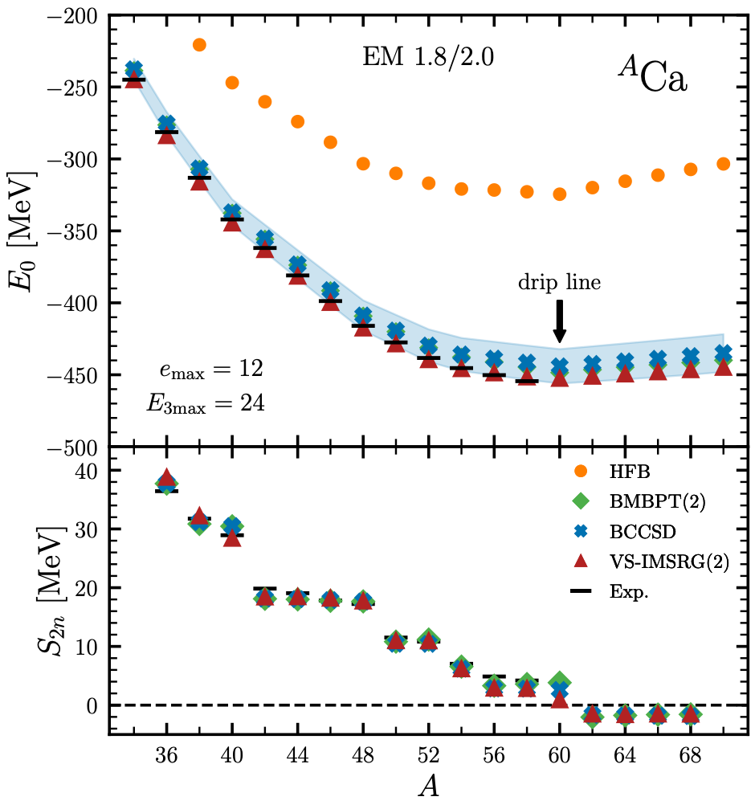
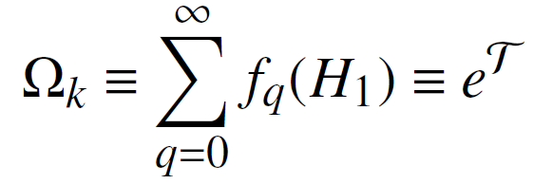
Ab initio calculations of singly open-shell nuclei - 1
sHFB
[Tichai, Demol, Duguet, in preparation 2023]
Dynamical correlations
Break U(1) ►
BMBPT
BCC
Calculations for neutron-rich tin isotopes
coming out this week (A~150)!
Heaviest open-shell nuclei computed ab initio so far
-q=0 : sHFB
-q=1 : 0
-q=2 : sBMBPT(2)
-q=3 : sBMBPT(3)
⸽
-q=0 : sHFB
-q=1 : sBCCS
-q=2 : sBCCSD (BMBPT(3) complete)
-q=3 : sBCCSDT
⸽
Long semi-magic isotopic chains of mid-mass nuclei are accessible
Two-neutron drip line predicted at N=40 for all three methods
BCC error band from many-body uncertainty estimate due to missing triples correlations
►Consistent with non-polynomial VS-IMSRG(2) (~ab initio shell model) calculation
BMBP(2) ≈ BCCSD because « soft » interaction making A-body problem perturbative

Slide 59
Ab initio calculations of singly open-shell nuclei - 2
Absolute binding energy
Two-neutron shell gap
sHFB
e_{max} = 13
E_{3max} = 16
2N+3N (lnl) χEFT
sGSCGF-ADC(2)
Dynamical correlations
Proton open shell
→ Green’s function formulation
Break U(1) ►sGSCGF
-q=0 : « ADC(1) » (sHFB)
-q=1 : « ADC(2) »
-q=2 : « ADC (3) »
⸽
-q=n-1 : « ADC(n) »
sSCGF-ADC(3)
[Somà, Barbieri, Duguet, Navaratil, 2021]
    See V. Somà’s lecture
Neutron drip line predicted beyond N=40 for the 7 isotopic chains
Singly [doubly] closed-shell Ca isotopes at ADC(2) [ADC(3)] truncation level
►~3% [0.6%] error on BE !
►~6% on rms charge radii (<1% with optimized χEFT interaction)
BE and shell structure deteriorates going from ^{A}Ca to doubly open-shell ^{A}Sc, ^{A}Ti, ^{A}K, ^{A}Ar…?

Slide 60
Ab initio calculations of singly open-shell nuclei - 2
(E_{th}-E_{exp})/A vs empirical deformation parameter
[Somà, Barbieri, Duguet, Navaratil, 2021]
sGSCGF-ADC(2)
2N+3N (lnl) χEFT
Proton open shell
Proton open shell
Error at sGSCGF-ADC(2) level grows with doubly open-shell character
Error correlated with empirical measure of deformation
►Missing quadrupole collective correlations
►What are the options to improve on that?
1) Keep as spherical HFB state but go to (much) higher order in ADC(n) expansion series?
►Cost ň_{dim}^{p} with significant p ⸕… very much not optimal
2) Break SU(2): becomes deformed HFB state
►Natural inclusion of quadrupole correlations without increase of p!
►However ň_{dim} → n_{dim}: more manageable scaling but significant increase still

Slide 61
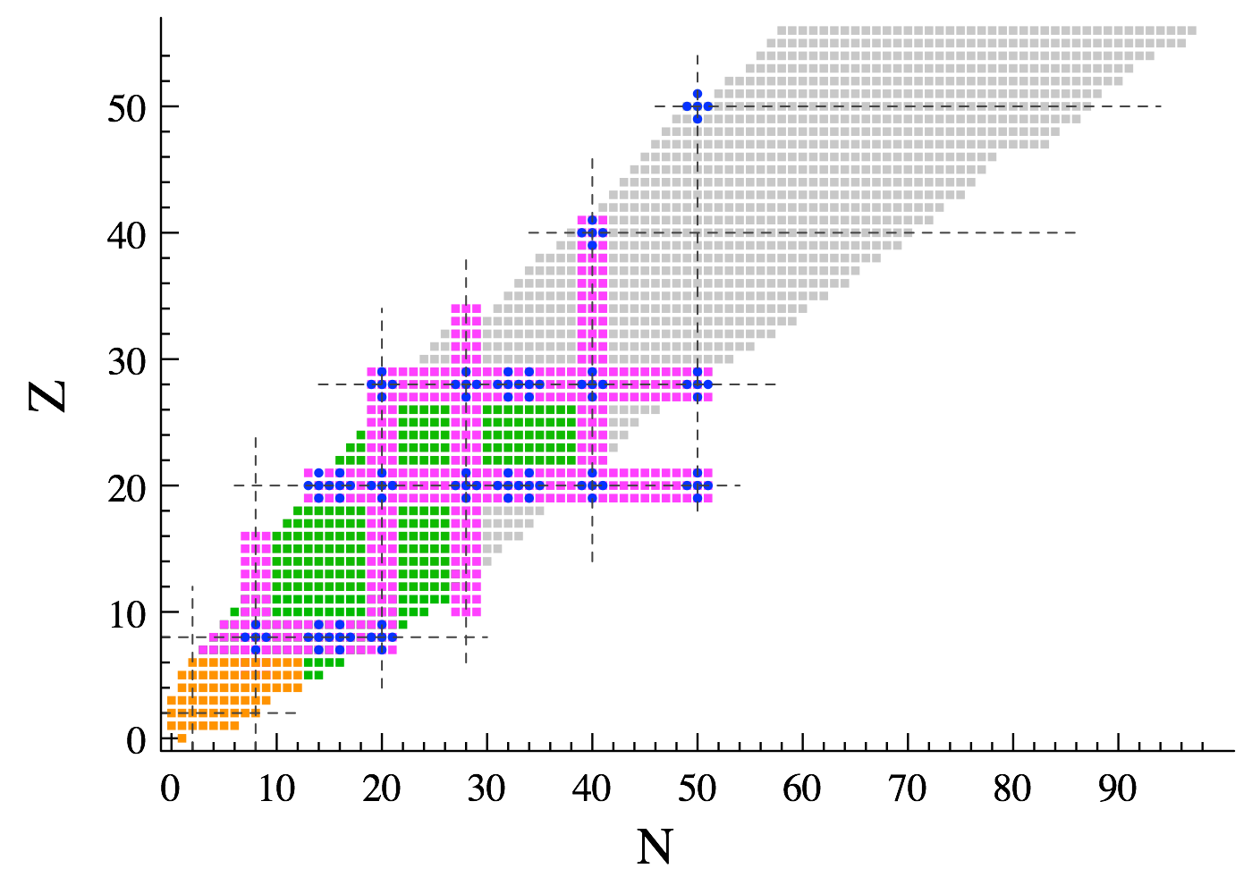
Evolution of ab initio nuclear chart vs type of method
One-body Hilbert space
A-body Hilbert space
« The curse of
dimensionality »
Full-fledged method, e.g. diagonalization
Light nuclei
Exponential cost n^{A}
2023
GFCM, NCSM
Doubly closed-shell nuclei
Exponential cost n’^{p}
sMBPT, sCC, sDSCGF, sSR-IMSRG
Singly open-shell nuclei
Exponential cost n’’^{p}
~50
~180
~840
>1000
sBMBPT, sBCC, sGSCGF
Doubly open-shell nuclei
Exponential cost n^{p}
dBMBPT, dBCC, dGSCGF
Expansion methods
Ground-state properties so far: access to collective spectroscopy?

Slide 62
Zoology of expansion many-body methods
Dynamic correlations
(Expansion of wave operator on top of unperturbed state)
Italic = not yet implemented
PAN@CEA
Full CI
(exact solution)
dCC
sSR-IMSRG
dBCC
Duguet, 2015
?
Non-perturbative
sCC
dSR-BIMSRG
PBCCSD
sDSCGF
dGSCGF
Breaking&Restoring
Symmetries for
Open-shell nuclei
Hagen et al., 2022
Frosini et al., 2022
Perturbative
dBMBPT
PBMBPT
PGCM-PT
sMBPT
MCPT
Tichai et al., 2018
Duguet, 2015
Spherical
Hartree-Fock
Deformed [SU(2)]
Hartree-Fock-Bogoliubov [U(1)]
Mixing of
Sym restr HF (MCHF)
Sym brok.&restor. HFB (PGCM)
Bally et al., 2020
Frosini et al., 2021
Static correlations
(Class of unperturbed state)
Closed shell
Open shell
Open shell
Good sym.
Lost. sym.
Good. sym.
Rot. excitations
Good. Sym.
Rot. excitations
Vib. excitations

Slide 63
Evolution of ab initio nuclear chart vs type of method
One-body Hilbert space
A-body Hilbert space
« The curse of
dimensionality »
Full-fledged method, e.g. diagonalization
Light nuclei
Exponential cost n^{A}
2023
GFCM, NCSM
Doubly closed-shell nuclei
Exponential cost n’^{p}
sMBPT, sCC, sDSCGF, sSR-IMSRG
Singly open-shell nuclei
Exponential cost n’’^{p}
~50
~180
~840
>1000
sBMBPT, sBCC, sGSCGF
Doubly open-shell nuclei
Exponential cost n^{p}
dBMBPT, dBCC, dGSCGF
Expansion methods

Slide 64
Evolution of ab initio nuclear chart vs type of method
One-body Hilbert space
A-body Hilbert space
« The curse of
dimensionality »
Full-fledged method, e.g. diagonalization
Light nuclei
Exponential cost n^{A}
2023
GFCM, NCSM
Doubly closed-shell nuclei
Exponential cost n’^{p}
sMBPT, sCC, sDSCGF, sSR-IMSRG
Singly open-shell nuclei
Exponential cost n’’^{p}
~50
~180
~840
>1000
sBMBPT, sBCC, sGSCGF
Doubly open-shell nuclei
Exponential cost n^{p}
dBMBPT, dBCC, dGSCGF PBCC, MR-IMSRG,
PGCM-PT
Expansion methods

Slide 65
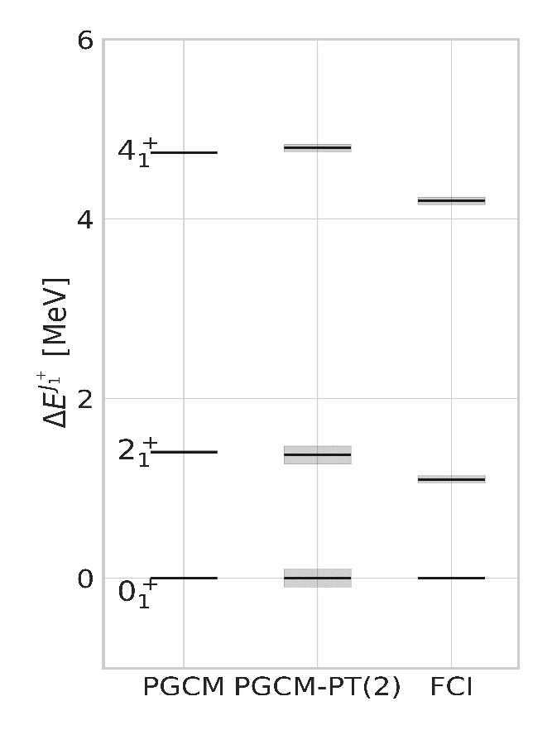
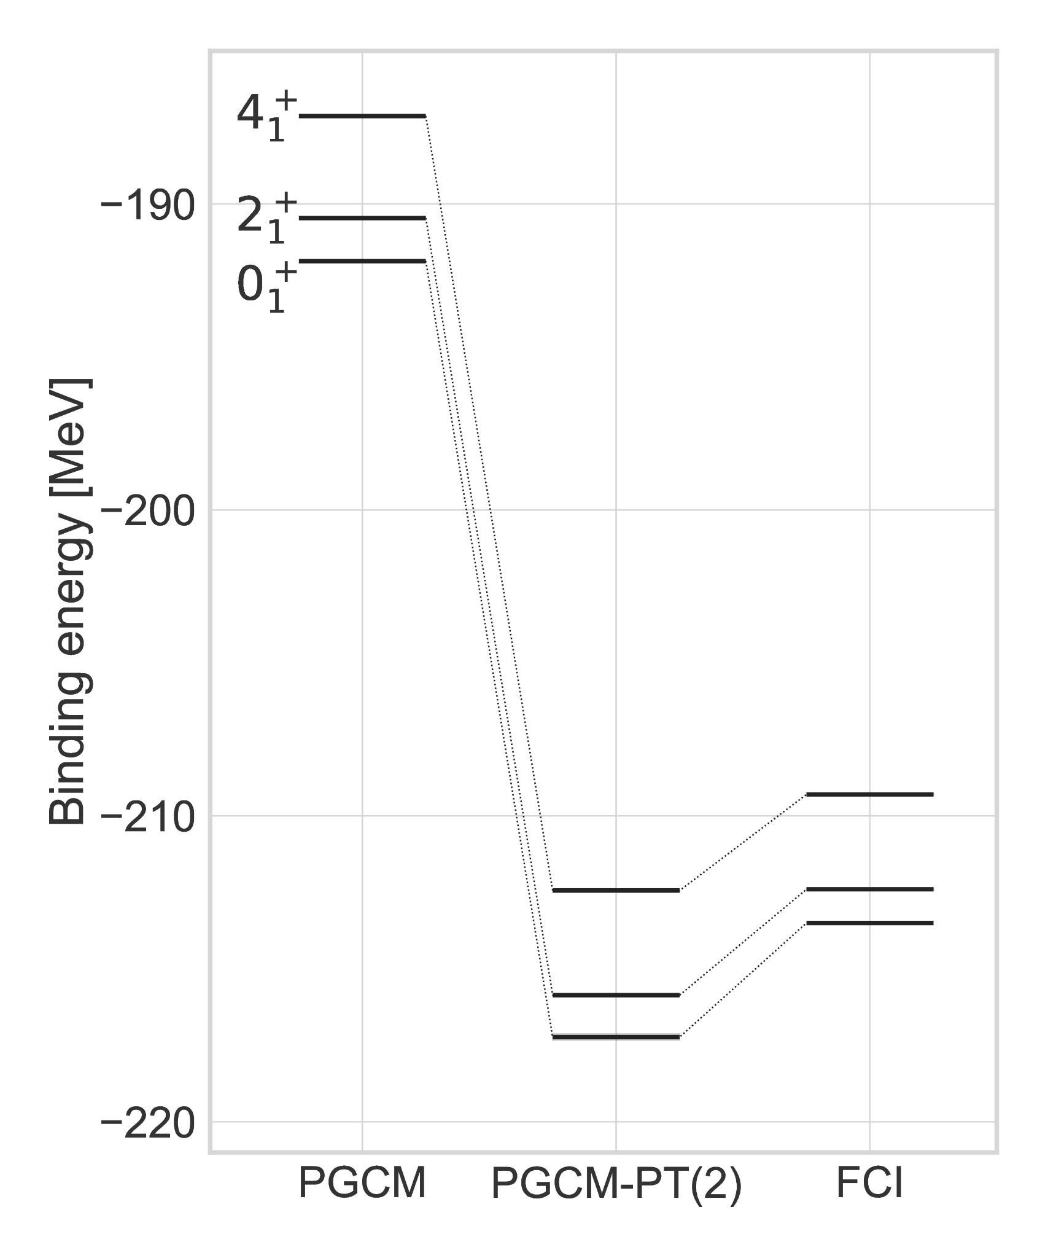
Ab initio collective spectroscopy in doubly open-shell nuclei
Yrast states
[Frosini et al., 2022]
PGCM
Ground-state rotational band
2N χEFT
²⁰Ne
→ Beyond mean-field unperturbed state
→ Appropriate to all types of nuclei
→ Good symmetries
→ Collective spectroscopy
²⁰Ne
[Hagen et al., 2022]
Dynamical correlations
→ Multi-reference perturbation theory
Absolute energies
→ 1-2% systematic error at PGCM-PT(2) vs FCI
→ Consistent dynamical correlations for each J
Extend applications to
Vibrational excitations
Transitional nuclei
Shape coexistence
Rotational excitations
→ Good vs FCI (~250keV too dilated)
→ Fine cancellation of PT(2) correlations
PGCM good approx. to ab initio spectroscopy: only n_{dim}⁴ vs n_{dim}⁸ for PGCM-PT(2)
→ Consistent with PCC

Slide 66
Oversimplified/schematic historical background
Hamiltonian
High-precision
χEFT-based
SRG transfo
High-precision
OBE-inspired
Phenomenological
OBE
χEFT-based era
?
1950
1960
1970
1980
1990
2000
2010
2020
Yukawa
OBE
model
Chiral EFT
(χEFT)
π-less EFT
Novel χEFT
Power counting
Many-body calculations
Closed shell (A<70)
sMBPT, sCC,
sDSCGF,
sSR-IMSRG
Closed and open shell
(A<130)
dBMBPT, dBCC, PBCC
dGSCGF, MR-IMSRG,
LEFT, MCPT, PGCM-PT
p-shell
(A<16)
Variational
p-shell
(A<16)
VMC
p-shell
(A<16)
GFMC, NCSM
1950
1960
1970
1980
1990
2000
2010
2020
MBPT
SCGF,
CC
SR-IMSRG
(P)BMBPT, (P)BCC,
MR-IMSRG, MCPT,
PGCM-PT

Slide 67
Contents
⦿ The « ab initio » approach to atomic nuclei at low energy
⦿ Solving the A-body Schrödinger equation
○ The leading technical problem: beating the « curse of dimensionality »
○ The subleading technical problem: further handling the dimensionality
○ Going beyond p-shell nuclei to doubly closed-shell nuclei
○ Evaluating systematic and statistical uncertainties
○ Dealing with the ~90% of nuclei that are of open-shell character
⦿ Further challenges in view of further extensions

Slide 68
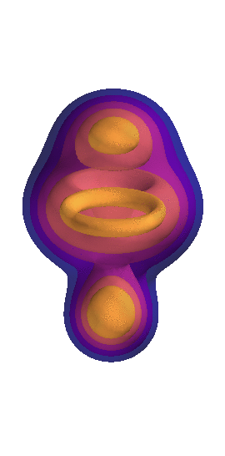
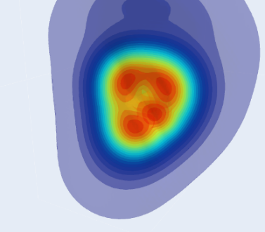


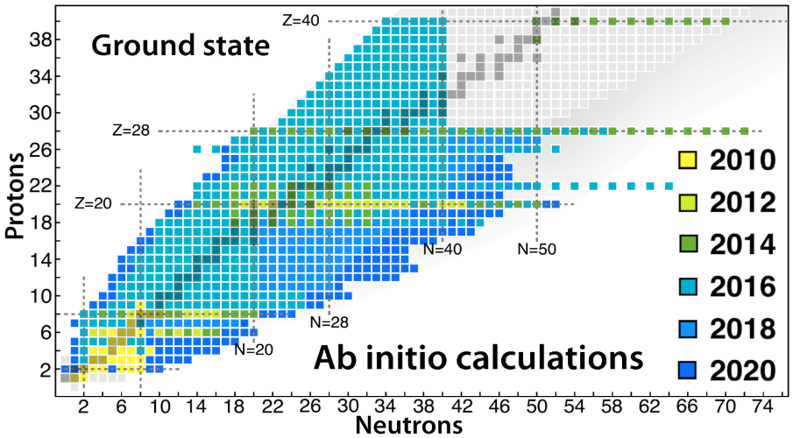
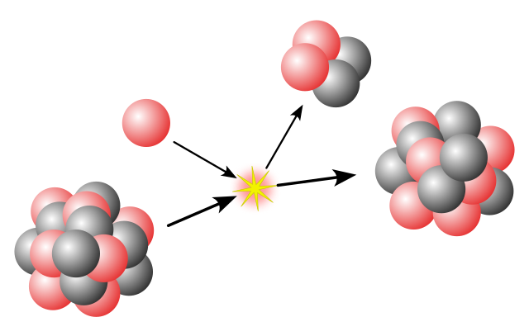
Some ab initio frontiers
SPECTROSCOPY
UNCERTAINTIES
Systematic
Single-particle excitations
Collective excitations
Clustering
  Hamiltonian
¹⁶O
²⁰Ne
Tetrahedral
ground state
intrinsic density
  A-body solution
[Frosini et al., 2023]
[Bally et al., 2023]
1⁻/3⁻ vibration (¹⁶O+α ↔ ¹²C + 2α) at 7.2 MeV
OPEN-SHELL
  Basis representation
Novel many-body methods
Memory&CPU ⸕: Ñ^{p} → N^{q} (Ñ<<N)
Statistical
[Hergert, 2020]
MANY-BODY
METHODS
fit
ACCURACY
  Algebra cost ⸕
  Difficult manually
  Numerical cost ⸕
    Memory&CPU: N^{p} → N^{q} (q>p)
MASS
Memory&CPU ⸕: N^{p} with N ⸕
Importance of AN forces?
HAMILTONIAN
REACTIONS
[Hu et al, 2022]
  S=0/S≠0 interactions
  Power counting
  Currents
  Fit
  Light nuclei
  Optical potential
  Transition densities

Slide 69
Going to heavier/open-shell nuclei with greater accuracy
HO single-particle basis
⦿ Many-body calculations employ tensors and compute tensor networks
1) Input tensors
a = (n_{a},l_{a},j_{a},m_{a},t_{a})
e_{1max}
↕
n_{dim}
k-body force
↕
2k-index tensor
ħω
Naive storage cost n_{dim}^{2k}
►grows polynomially with n_{dim}
► grows exponentially with interaction rank k
2) Output tensors: example for CC many-body theory in the CCD approximation
Energy evaluation
↕
Tensor network of n_{dim}^{p} cost (here p=4)
Unknown tensor T₂ evaluation
↕
Iterative (=non-perturbative) tensor network
►n_{dim}^{q} CPU cost (here q=6)
► n_{dim}^{r} storage cost (here r=4)
Wave operator Ω_{k} in CCD
T₂ = 2p-2h excitation operator

Slide 70
Push ab initio many-body calculations
⦿ Further trick to push calculations to heavier doubly closed-shell nuclei
Careful on-the-fly decoupling of the sole needed matrix elements at each step
➝ Mass A~208 (e_{1max} = 14 / e_{2max} = 28 / e_{3max} = 28)
[Hu et al., 2022]
⦿ Techniques to push calculations to heavier/doubly open-shell/better accuracy (<1%)
→ Data compression techniques for tensors with n_{dim}^{p} cost
Tensor Factorization = reduce p
High accuracy (BCC tensor T₃) in light closed-shell
[Tichai et al., 2019] (sMBPT(3))
40
ň_{dim}
[Zurek et al., 2024, in preparation]
Realistic J-coupled basis
Importance Truncation based on (B)MBPT = reduce n_{dim}
Strongly reduced J-coupled basis
10⁵ compression
1% error on ΔE⁽⁴⁾
[Tichai, Ripoche, Duguet, 2019] (sBMBPT4)
[Porro et al., 2021] (sGSCGF(2))
Number of T₃ entries
[Hoppe et al., 2022] (sSR-IMSRG(2))
Natural orbitals based on (BMBPT) = reduce n_{dim}
IT on ΔE⁽⁴⁾ in ¹⁸O
[Hoppe et al., 2021] (sSR-IMSRG(2))
[Scalesi et al., 2022 in preparation] (dBMBPT(3); sGSCGF(2))
5

