Slide 1
Nuclear collective behaviors
PHENIICS doctoral school lectures

Slide 2
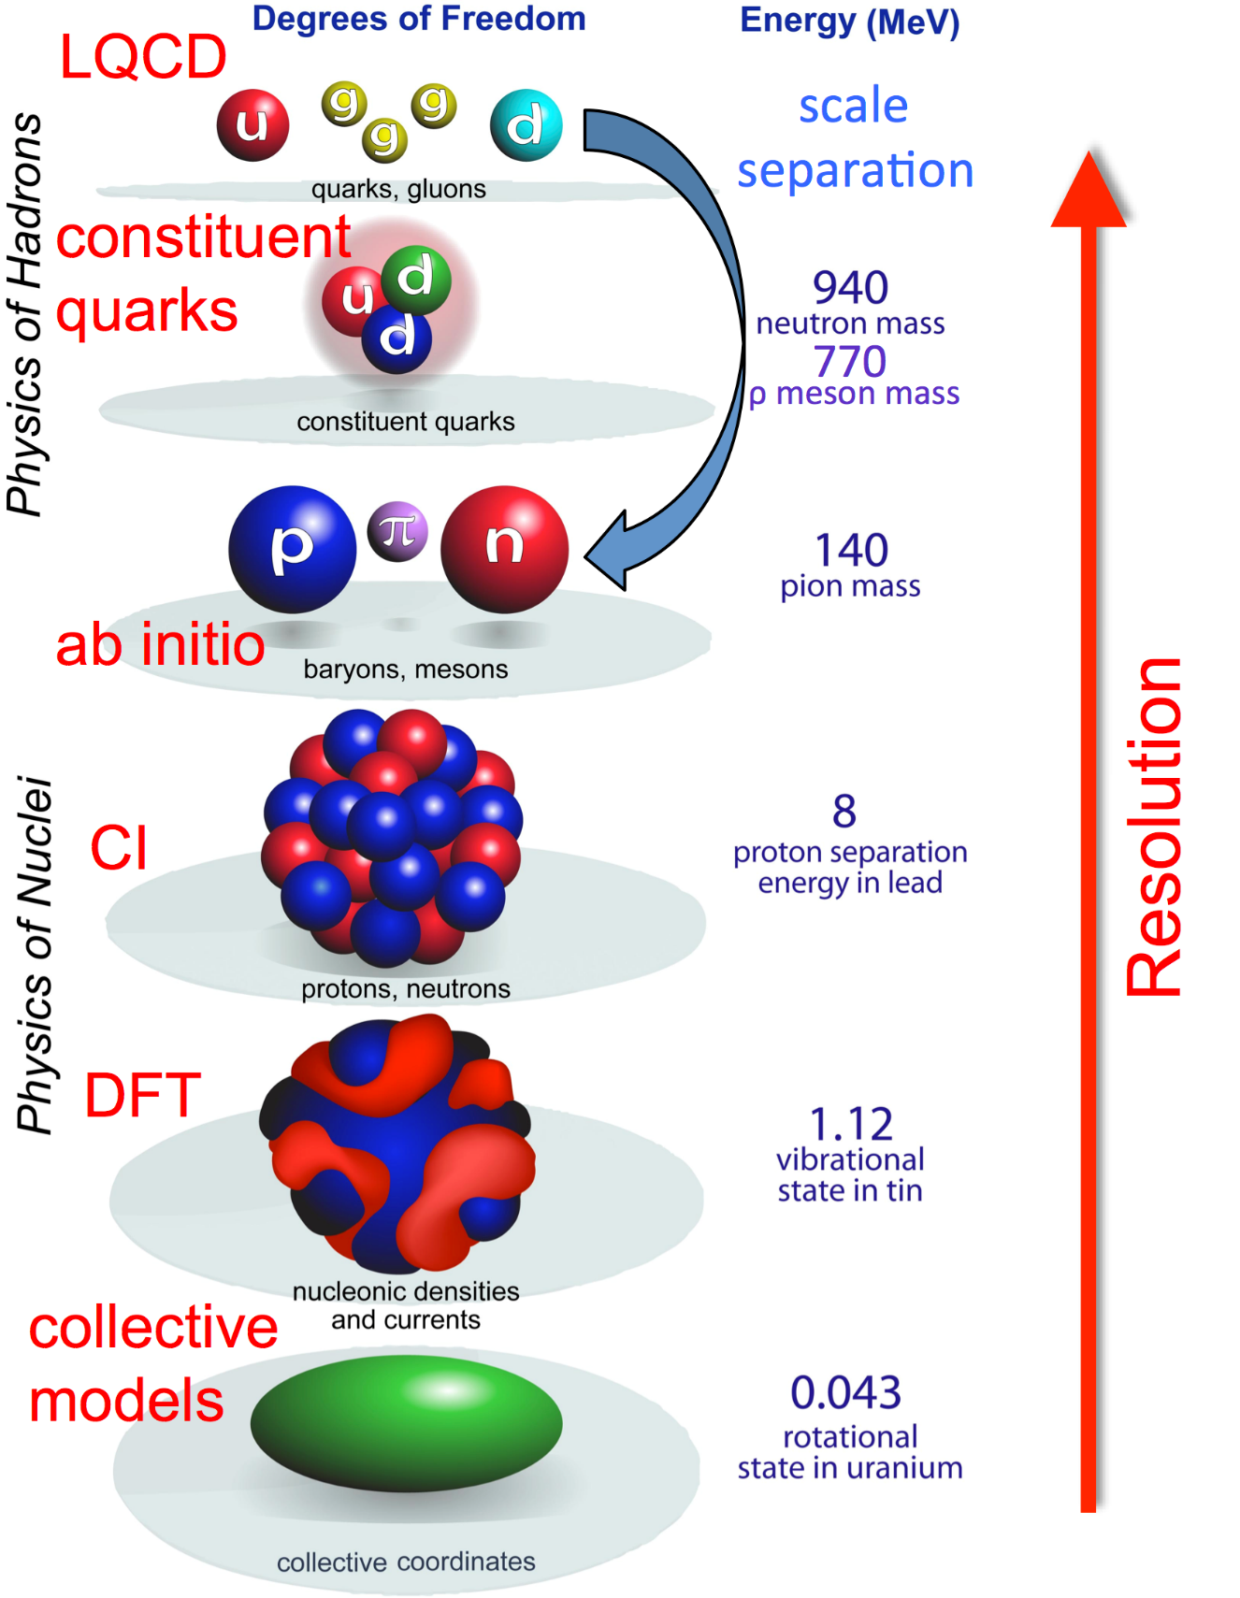
Scales in nuclear phenomenology
Nuclei are mesoscopic self-bound systems
Too small for statistical description (individual excitations)
Too large for individual treatment (collective motion)
Superposition of single-particle motion with many-particle excitations
Difficult to give unified model successfully incorporating the two effects
Not directly observable distinction between the two
Focus today on « collectivity » in spectroscopy
Deformation, rotations, vibrations, clustering
Only mentioned: fission, alpha emission, etc.

Slide 3
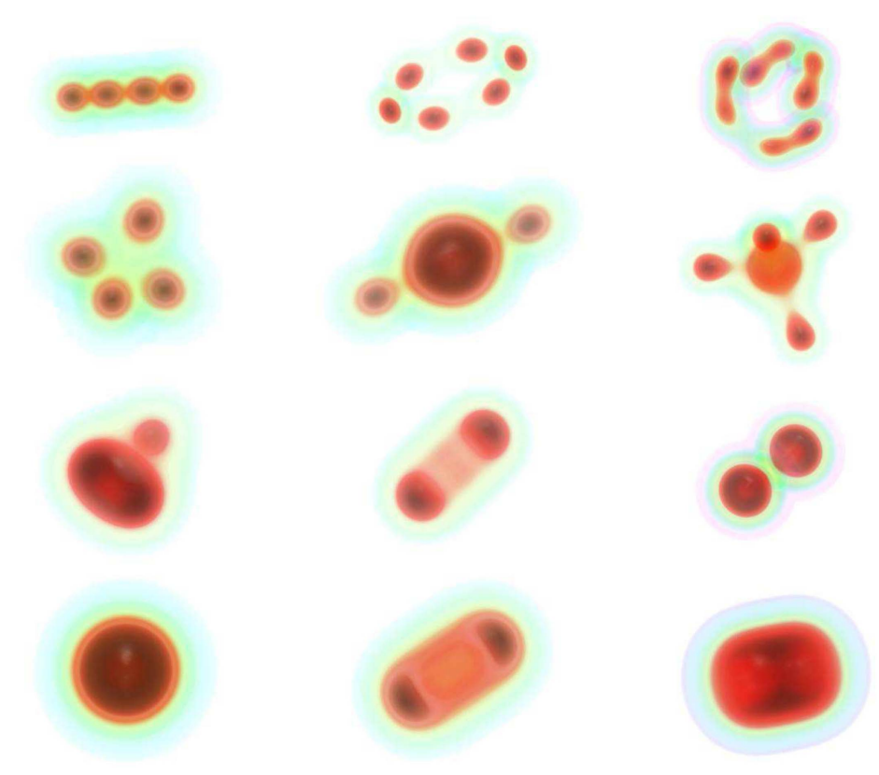
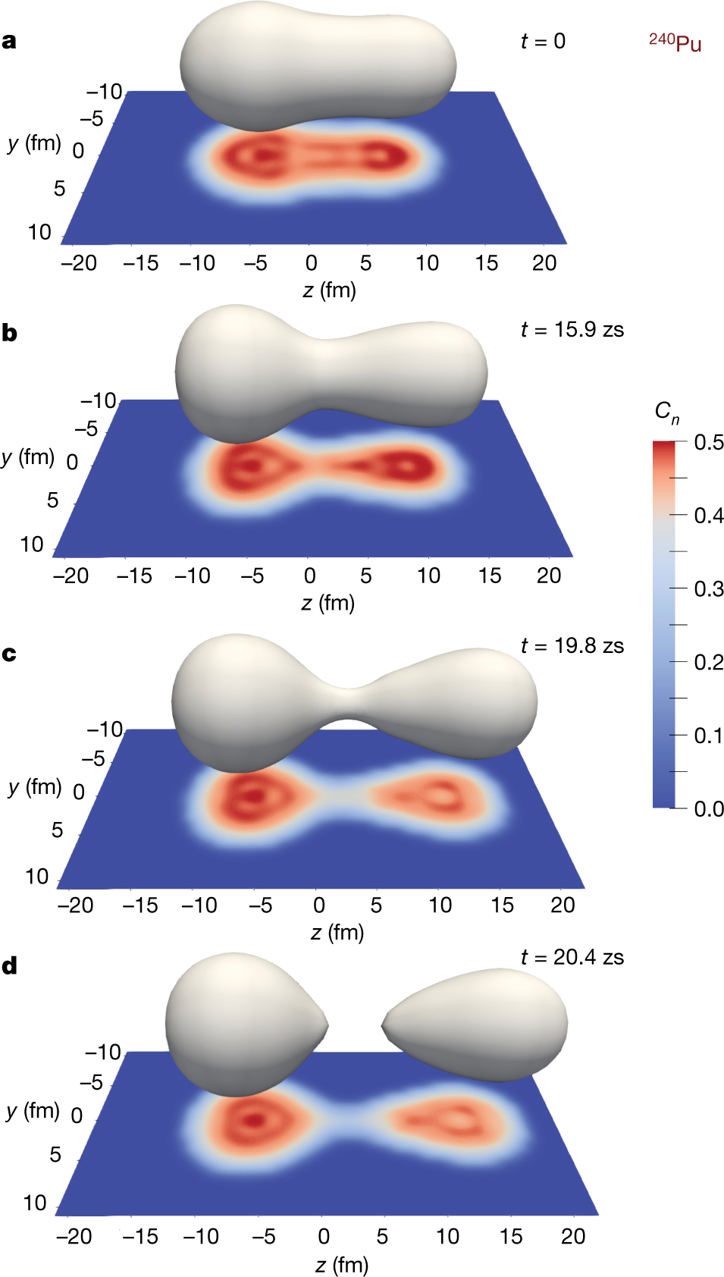
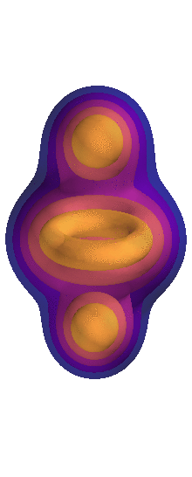
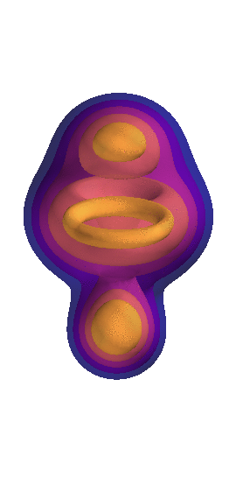
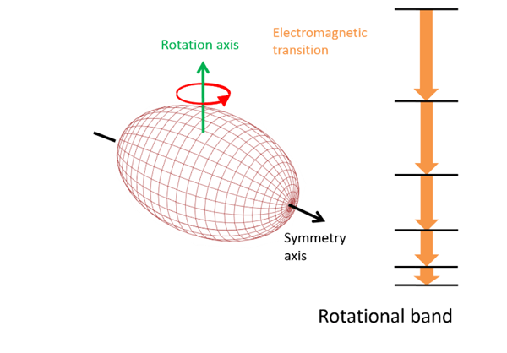
Panorama of collective behaviors
Giant resonance
and cluster oscillations
Rotations
Ground state deformation
and clustering
Ebran et al, Nature 2012
Nuclear fission
Scamps and Simenel, Nature 2018

Slide 4
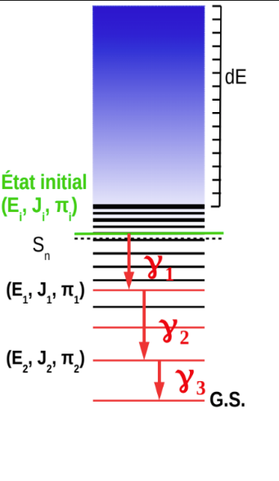
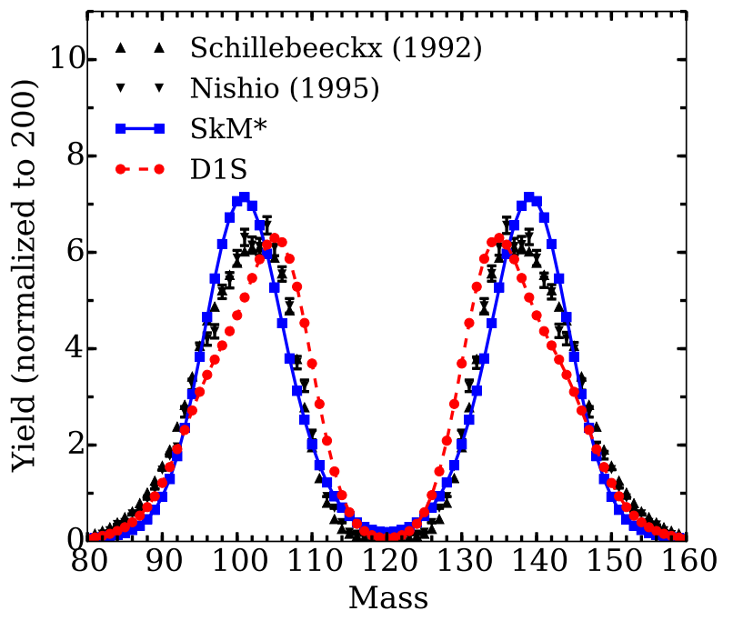
Role in applications
Deexcitation properties and neutron capture
Fission yields
Cluster emission
Courtesy of J.P. Ebran
Regnier et al, PRC 2016

Slide 5
Outline
Nuclear problem and elements of formalism
Macroscopic models of the nuclei
Mean-field theory
Harmonic vibrations with Quasi Random Phase Approximation
Long range collective motion with Projected Generator Coordinate Method

Slide 6
Nuclear problem
1

Slide 7
Nuclear many-body problem
$$H|Ψ^{J^{π}NZ}〉=E^{J^{π}NZ}|Ψ^{J^{π}NZ}〉$$
Nuclear Hamiltonian
Many-body correlated wave function
Full description of ground and excited states
Energy levels
Spectroscopic moments
Transition probabilities
Directly comparable with experiment
Observation of different class of states
Spacings, intensity of transitions
Explained by capturing certain class of effects in models
Multi-particle multi-hole, deformation, rotation
Collective effects

Slide 8
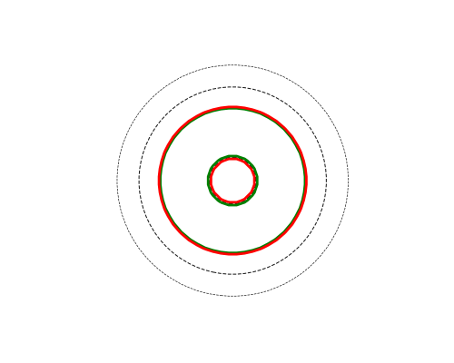
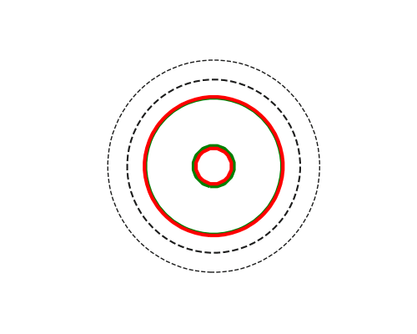
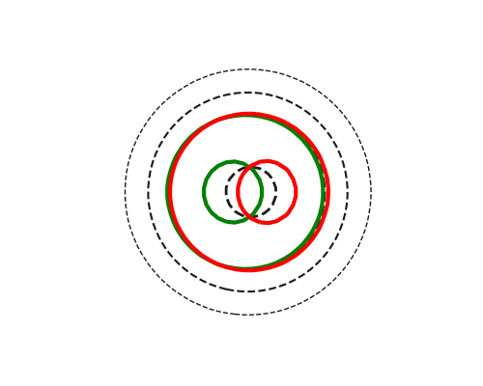
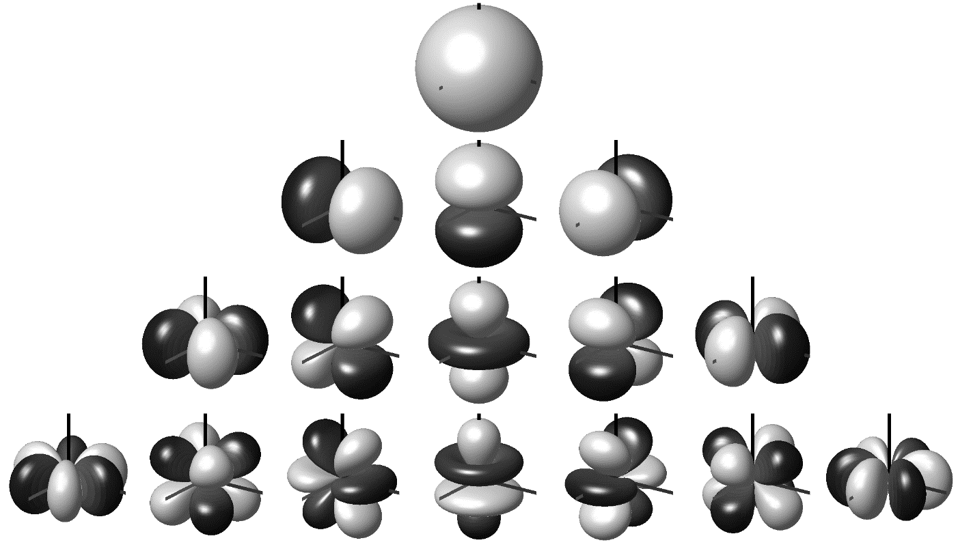
Electromagnetic transitions
Interaction between nucleus and EM field ⬄ Photon absorbtion / emission
Long wavelength approximation ($λ≫R_{0}∼A^{\frac{1}{3}}$)
$$E^{LM}∼r^{L}Y^{LM}(θ,φ)$$
Electric transition operator
$$M^{LM}∼\vec{μ}\left(r\right)⋅\vec{∇}\left[r^{L}Y^{LM}\left(θ,φ\right)\right]$$
Magnetic transition operator
Eletromagnetic transitions and moments play an important roles, because they are one of the few structure quatities directly accessible by experiment, and will therefore be used to adjust models of the nuclei and / or validate these models
Spherical tensors
$$B\left(XL,{iJ}_{i}→fJ_{f}\right)=\frac{1}{2J_{i}+1}\sum_{M_{f}}{\sum_{M_{i}}{\sum_{K}{|{〈fJ_{f}M_{f}\left|T^{LK}\right|iJ_{i}M_{i}〉|}^{2} }}}$$
Reduced transition probability
$$Q_{s}\left(XL,νJ\right)=〈νJJ\left|T^{L0}\right|νJJ〉$$
Spectroscopic moment

Slide 9
Symmetries in nuclear physics
Continuous symmetries
Translations ⇒ Total momentum operator $P=\sum_{i}{p_{i}}$.
Rotations ⇒ Angular momentum $J$ : SO(3) ⬄ SU(2).
Gauge transformations ⇒ Particle number $A$
Isospin (approximate) ⇒
Discrete symmetries
Spatial inversion ⇒ Parity operator $𝒫$
Time reversal ⇒ Time reversal operator $𝒯$
Other symmetries not necessarily used in practice

Slide 10
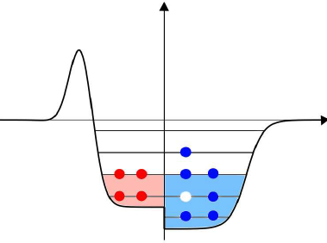
Second quantization
One body Hilbert space $ℋ_{1}$
Wave function $ψ_{i}(r_{1})$, shell structure
A-body Hilbert space $ℋ_{A}=⊗_{A}ℋ_{1}$
Independent particles $Ψ\left(r_{1},⋯,r_{A}\right)=?$
States can be either symmetric or antisymmetric wrt. exchange of two particles
Fermionic system
Pauli principle
$$Ψ\left(r_{1},⋯r_{A}\right)≡\frac{1}{A!}\left|\begin{matrix}ψ_{1}\left(r_{1}\right) & … & ψ_{A}(r_{1}) \\ ⋮ & ⋱ & ⋮ \\ ψ_{1}\left(r_{A}\right) & … & ψ_{A}(r_{A})\end{matrix}\right|$$
Slater Determinant
Occupation number representation
How many particle populate each state
$|n_{1}⋯n_{N}〉∈ℱ≡⊕_{A}ℋ_{A}$ - Fock space
$n_{i}∈\{0,1\}$ for fermions
Particle-hole picture

Slide 11
Second quantization for fermions
Creation /annihilation operators $c_{i},c_{i}^{†}$
$$\left\{c_{i},c_{j}^{†}\right\}=δ_{ij} \left\{c_{i},c_{j}\right\}=\left\{c_{i}^{†},c_{j}^{†}\right\}=0$$
$c_{i}|n_{1},⋯,n_{i},⋯〉=σ_{i}n_{i}|n_{1},⋯,1−n_{i},⋯〉$
$c_{i}^{†}|n_{1},⋯,n_{i},⋯〉=σ_{i}\left({1−n}_{i}\right)|n_{1},⋯,n_{i}+1,⋯〉$
One body Hilbert space $ℋ_{1}$
One-body basis $\{|i〉\}$
Independant particle vacuum
$$|Φ〉≡\prod_{i}^{A}{c_{i}^{†}|0〉}$$
Operator representation
$$O≡O^{\left[0\right]}+O^{\left[1\right]}+O^{\left[2\right]}+⋯$$
$$O^{\left[1\right]}≡\sum_{ij}{o_{ij}^{\left[1\right]}c_{j}^{†}c_{i}}$$
$$O^{\left[2\right]}≡\frac{1}{4}\sum_{ijkl}{{\overline{o}}_{ijkl}^{\left[2\right]}c_{l}^{†}c_{k}^{†}c_{i}c_{j}}$$
1-body density matrix
$$ρ_{ij}≡〈Φ\left|c_{j}^{†}c_{i}\right|Φ〉$$
$|Φ〉$ fully characterized by $ρ$
$$ρ^{2}=ρ, Tr\left(ρ\right)=A$$
Wick theorem
$$〈Φ\left|O\right|Φ〉=O^{\left[0\right]}+\sum_{ij}{o_{ij}^{\left[1\right]}ρ_{ij}} \\ +\frac{1}{2}\sum_{ijkl}{{\overline{o}}_{ijkl}^{\left[2\right]}ρ_{ik}ρ_{jl}}$$

Slide 12
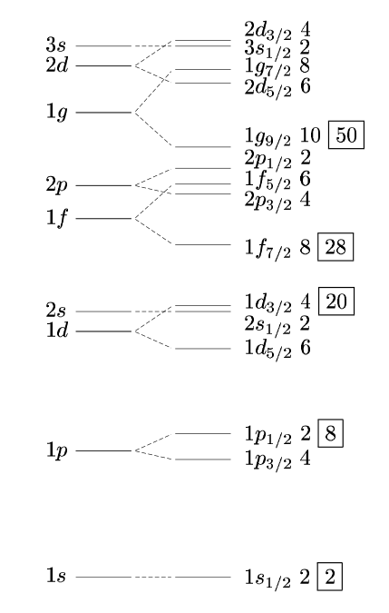
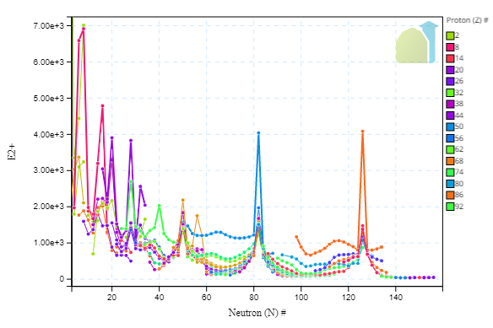
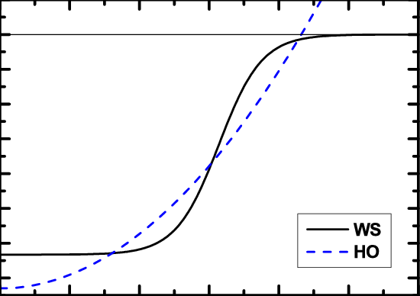
Origin of shells and sign of collectivity
Nucleus is a confined quantum system
Expected to display shell structure
Nucleons in potential hole:
harmonic oscillator
Woods-Saxon potential
$$V_{WS\left(r\right)}=\frac{V_{0}}{1+\exp\left(\frac{r−R_{0}}{a}\right)}$$
2. Add spin-orbital interaction
Filling shells with independent particles
Classification of closed/open-shell nuclei
Individual excitations as model for spectrum
Accurate for closed-shell nuclei
Not able to model efficiently other nuclei
Lack of interaction between nucleons
No multi-particle effects

Slide 13
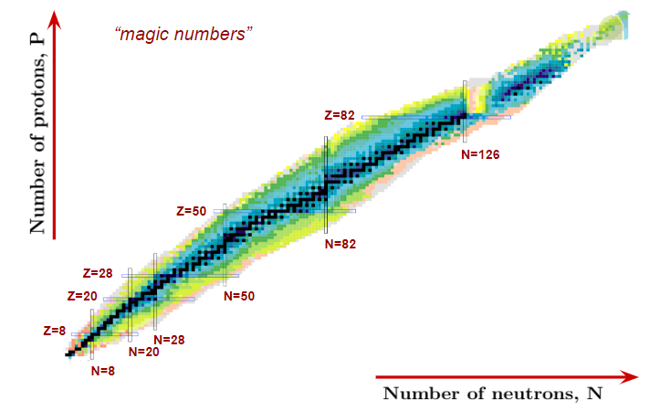
Towards solutions of nuclear problem
Solving nuclear many-body problem is a complex task
Considering only single-particle motion is useful
Experimental sign of shell structure for ground state
Good reproduction of some excitations / transitions
but most nuclei are open-shell
Strong correlations especially in the outer shell
Need for a collective description of nucleus
One first attempt at that is to build macroscopic models of nuclei
Nuclei interpreted as structure-less macroscopic objects
Excitations are interpreted as macroscopic shape vibrations
Questions / remarks?

Slide 14
Macroscopic models
2
Modelisation of nucleus as collective object
➔ No account of interal structure

Slide 15
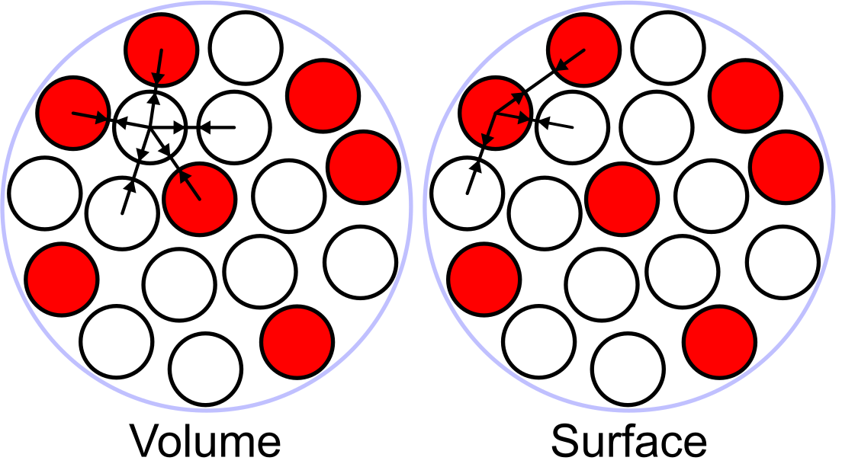
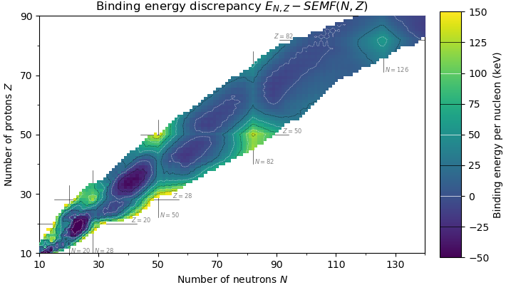
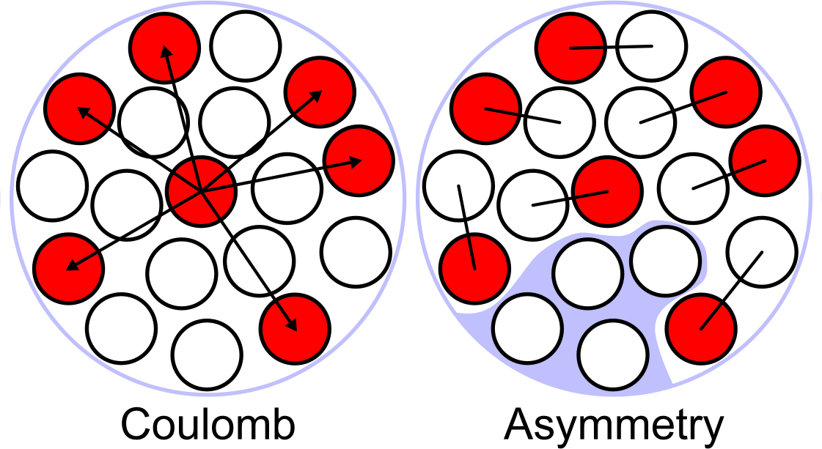
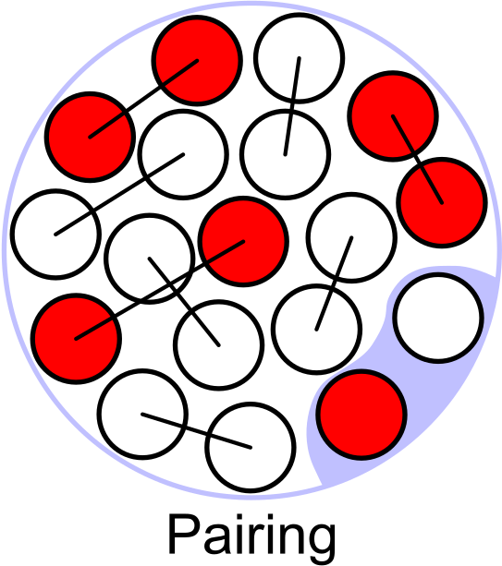
Bethe-Weizsäcker Formula
Nucleus is considered as a droplet of uniform « nuclear matter » holding together via the action of several competing effects
$$E_{B}=a_{V}A - a_{s} A^{⅔} - a_{C}\frac{Z\left(Z-1\right)}{A^{⅓}} -a_{A}\frac{{\left(N−Z\right)}^{2}}{A} +δ(N,Z)$$
Volume term: constant binding energy per nucleon at equal density of protons and neutrons (strong force)
Surface term: describes reduction of binding due to nucleons on surface (similar to surface tension)
Coulomb term: electrostatic repulsion of protons, proportional to Z²/A^{1/3}
Asymmetry term: decrease in binding for unequal number of p and n, based on Pauli principle
Pairing term: spin coupling

Slide 16
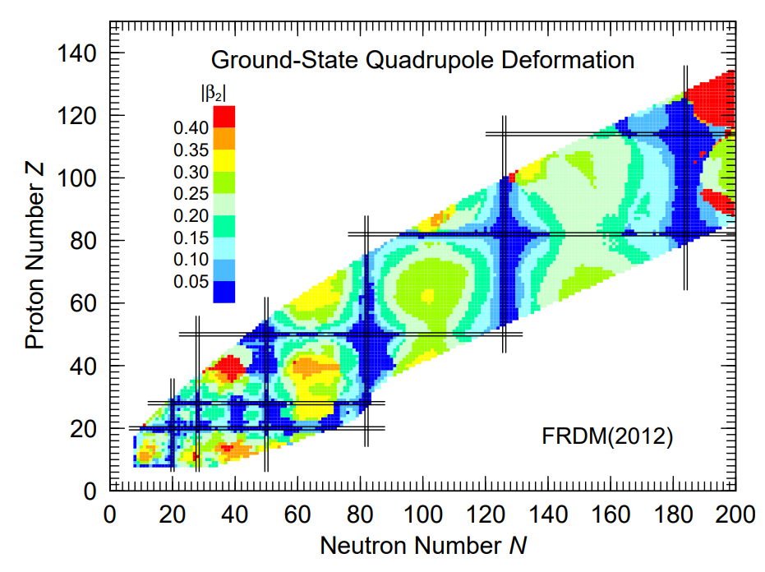
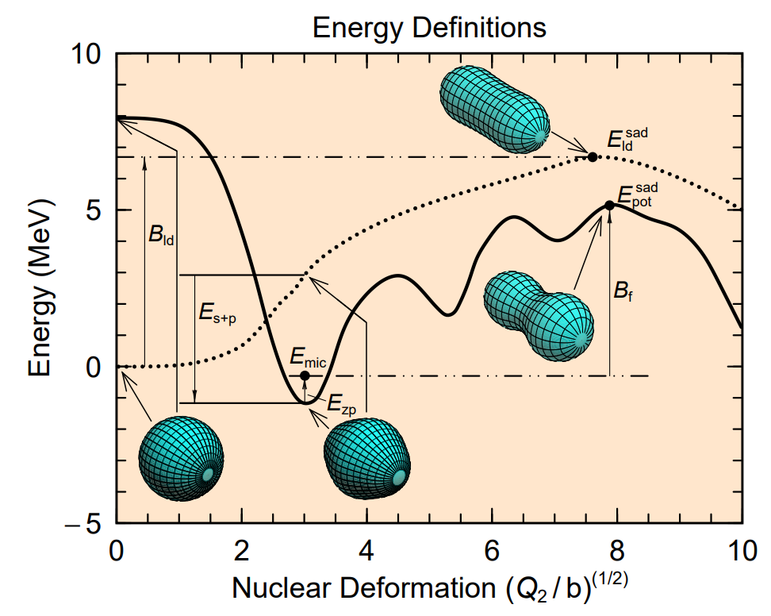
Deformation and shell effects
Moller et al, 2012
Generalizations of Bethe-Weizsäcker introduce many more terms
Influence of deformation
Shell effects corrections (deformation energy)
Qualitative description of fission
Next goals : describe collective spectroscopy in 3 steps:
Harmonic vibrations around spherical g.s.
Rotation of a deformed rigid rotor
Vibration-rotation coupling in deformed g.s.

Slide 17
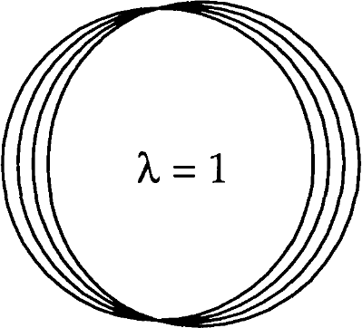
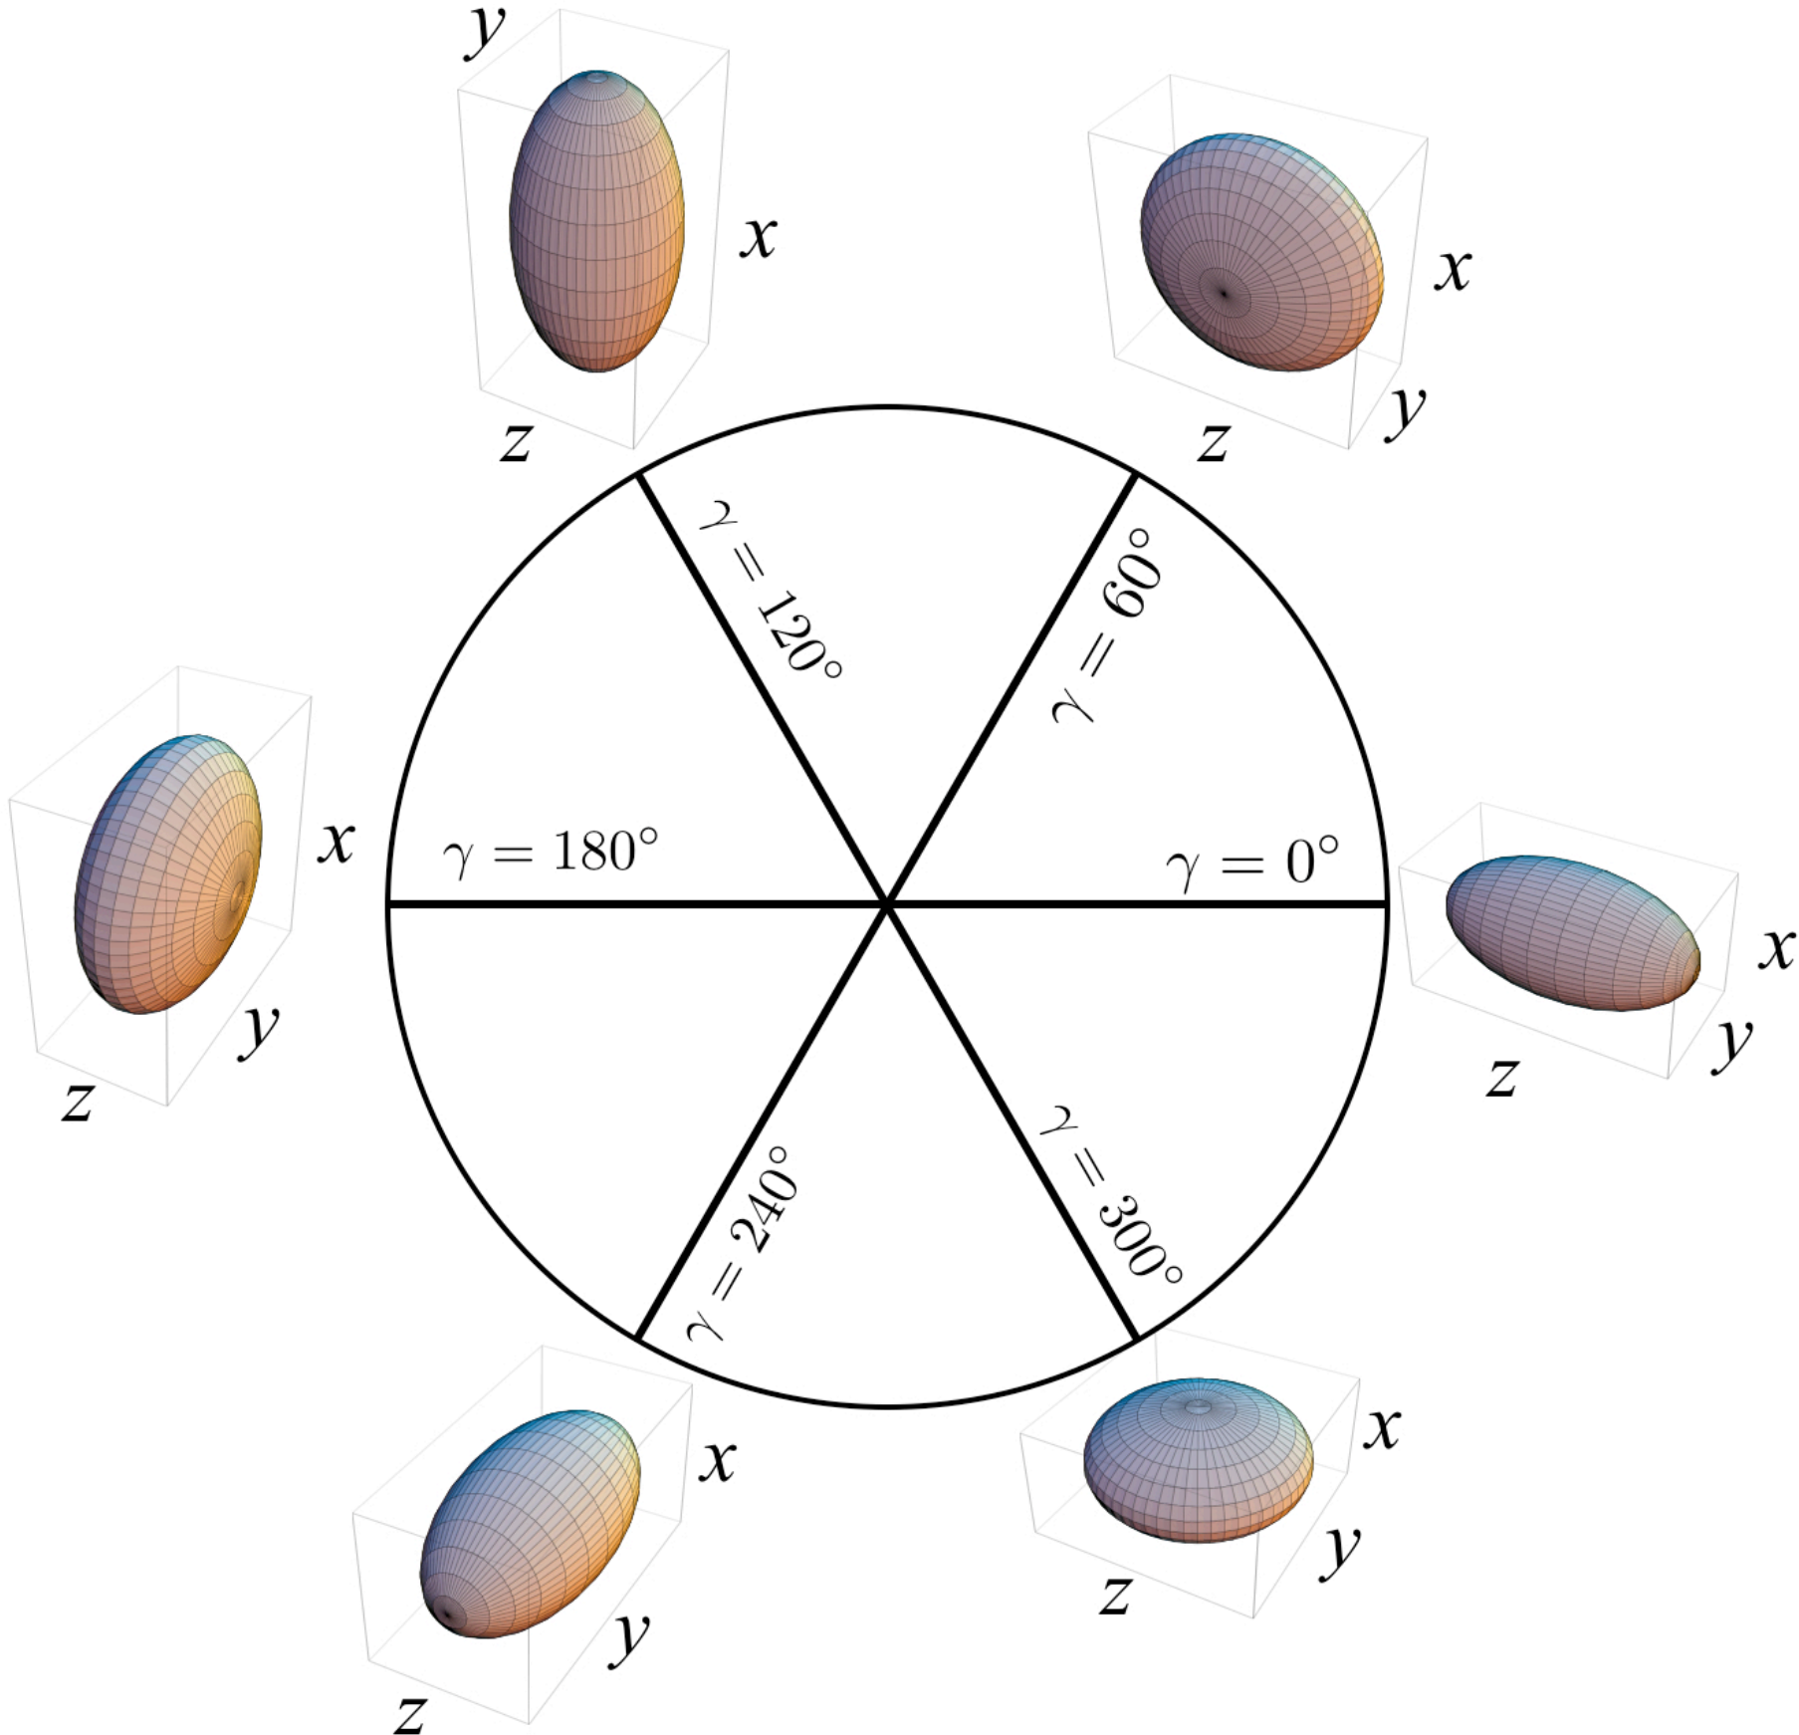
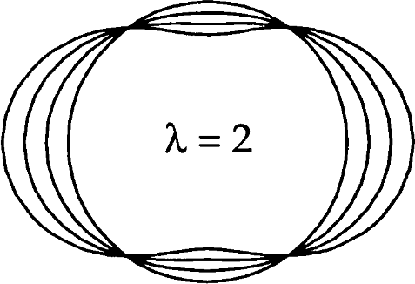
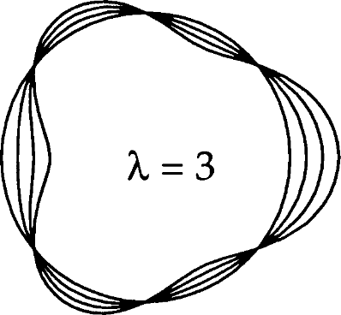
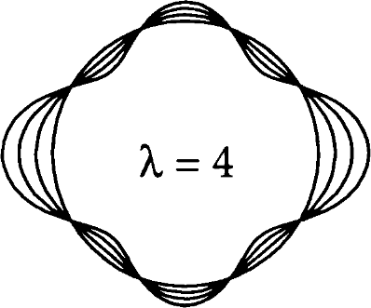
Harmonic oscillations: collective Hamiltonians
Generation of liquid drop picture to vibrations around spherical reference
Assuming time-dependent shape oscillation of the nucleus
$$R\left(θ,φ,t\right)=R_{0}\left(1+\sum_{μλ}{α_{λμ}\left(t\right)Y^{λμ}\left(θ,φ\right)}\right)$$
$α_{λμ}\left(t\right)$ is collective coordinate of the nucleus
Homogeneous approximation: $λ<A^{\frac{1}{3}}$
In practice, only $λ=2$ considered
$β,γ$ triaxial plane
In case of parity + time-reversal symmetry, one quadrant needed
oblate
unique, triaxial
prolate
oblate
prolate
prolate
oblate

Slide 18
Quadrupole oscillations in spherical nucleus
Expanding LDM for small quadrupole shape oscillations $H=\frac{B_{2}}{2}\sum_{μ}{{\left|{\dot{α}}_{2μ}\right|}^{2}+\frac{C_{2}}{2}\sum_{μ}{{\left|α_{2μ}\right|}^{2}}}$
Multi-dimentional harmonic oscillator
Spectrum obtained by quantizing
Given $π_{λμ}=\frac{B_{2}}{2}{\dot{α}}_{λμ}$, phonon operators are defined as
$β_{μ}^{†}≡\sqrt{\frac{B_{2}ω_{2}}{2ℏ}}α_{2μ}+i\sqrt{\frac{1}{2B_{2}ℏω_{2}}}{\left(−1\right)}^{μ}π_{2−μ}$ and $β_{μ}^{†}≡\sqrt{\frac{B_{2}ω_{2}}{2ℏ}}{\left(−1\right)}^{μ}α_{2−μ}−i\sqrt{\frac{1}{2B_{2}ℏω_{2}}}π_{2μ}$
$H$ takes a simple expression $H=\left(\sum_{μ}{β_{μ}^{†}β_{μ}}+\frac{5}{2}\right)ℏω_{2}⇒E=ℏω_{2}\left(N+\frac{5}{2}\right)$
Multi-phonon spectrum $|0〉, β_{μ}|0〉, {\left[β_{μ}×β_{μ^{′}}\right]}^{2I}|0〉$
reproduces experiment for the low lying vibrational states
For high excitations, couplings and anharmonicities come into play
Caveat: sole description of positive parity natural states $0^{+},2^{+},4^{+}$
Quadrupole transition operator
$$Q_{λμ}∼α_{2μ}−\frac{10}{\sqrt{70}}π{\left[α×α\right]}_{μ}^{2}$$
$$0^{+},2^{+},4^{+},6^{+}$$
$$0^{+},2^{+},4^{+}$$
$$2^{+}$$
$$0^{+}$$

Slide 19
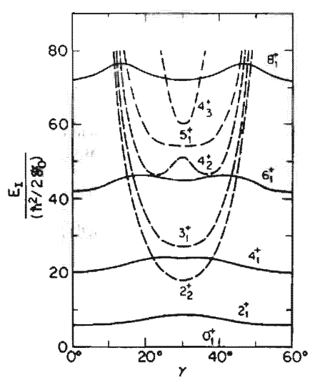
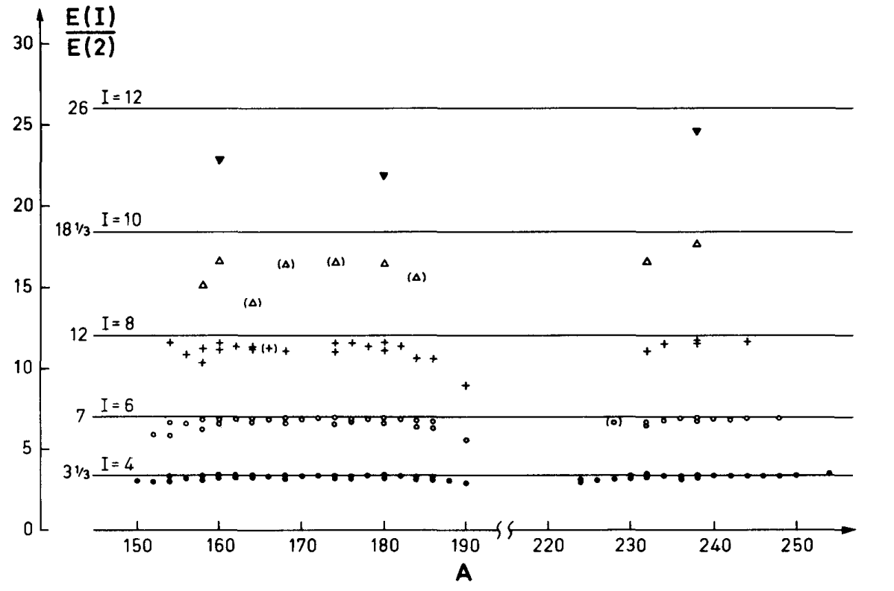
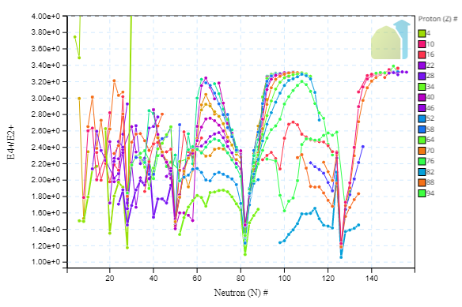
Rotational model
‘ stands for the fact that we are in the intrisic frame of the nucleus
Deformation parameter determined by exp. transition
Rigid rotor Hamiltonian: fixed deformation $β_{0}$
Axial symmetry: $H=\frac{1}{2Θ}(J_{x}^{′2}+J_{y}^{′2})$ with spectrum $E^{I}=\frac{ℏ^{2}I\left(I+1\right)}{2Θ}$ and transitions $B\left(E2,J_{i}→J_{f}\right)={\left(\frac{3ZR_{0}^{2}}{4π}\right)}^{2}β_{0}^{2}{\left(1+\frac{2}{7}\sqrt{\frac{5}{π}}β_{0}\right)}^{2}$
Triaxial case: $H=\sum_{i}{\frac{J_{i}^{′2}}{{2Θ}_{i}}}=\frac{1}{4}\left(\frac{1}{Θ_{x}}+\frac{1}{Θ_{y}}\right)\left(J^{′2}−J_{z}^{′2}\right)+\frac{J_{z}^{′2}}{2Θ_{z}}+\frac{1}{2}\left(\frac{1}{Θ_{x}}−\frac{1}{Θ_{y}}\right)(J_{+}^{′2}+J_{−}^{′2})$
Inertia determined by exp. Level spacing
No closed form solution
Deviation at higher energies

Slide 20
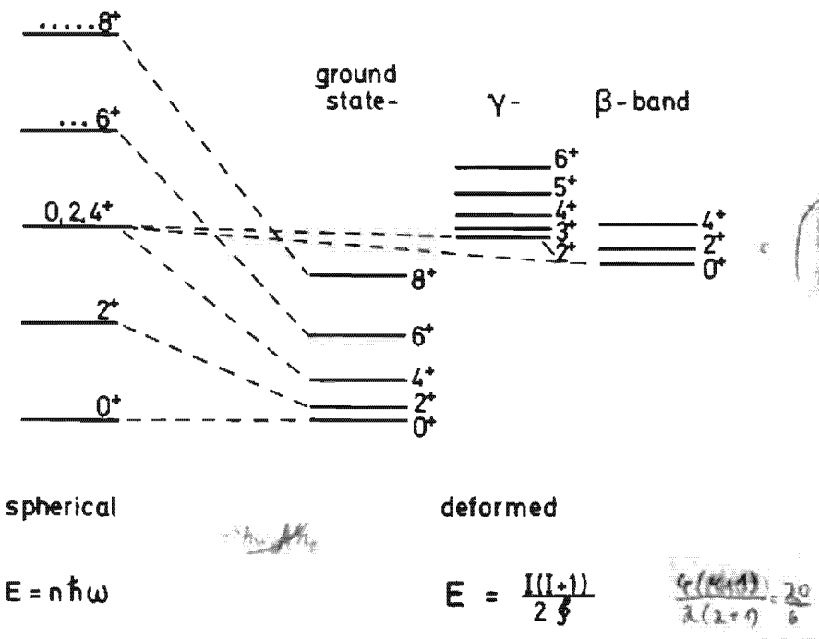
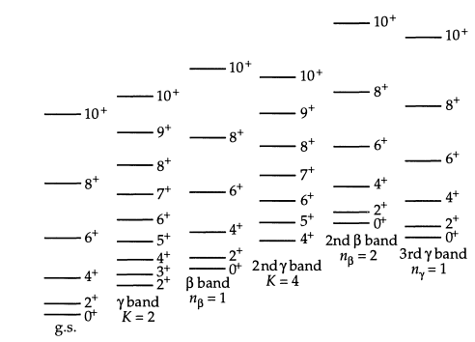
Coupling rotations and vibrations
Common case : axially symmetric nucleus displaying
$β$ vibrations
$γ$ vibrations ($K, n_{γ}$)
Rotational band on top of vibrations
$$E_{n_{β}n_{γ}IK}=ℏω_{β}\left(n_{β}+\frac{1}{2}\right)+ℏω_{γ}\left(2n_{γ}+\frac{1}{2}\left|K\right|+1\right)+\frac{ℏ^{2}}{2Θ}[\left(I\left(I+1\right)−K^{2}\right]$$
Spectrum varies strongly with three frequencies $\left(ω_{β}, ω_{γ}, Θ\right)$
Smooth connection
Spherical purely vibrational nucleus towards perfect rotor
Reality somewhere in-between
Comparison of energies, ratios, transitions with experiment

Slide 21
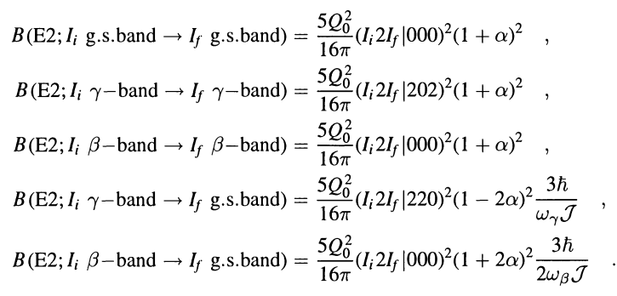
How to use these models in practice
$$E_{n_{β}n_{γ}IK}=ℏω_{β}\left(n_{β}+\frac{1}{2}\right)+ℏω_{γ}\left(2n_{γ}+\frac{1}{2}\left|K\right|+1\right)+\frac{ℏ^{2}}{2Θ}[\left(I\left(I+1\right)−K^{2}\right]$$
Greiner Maruhn (1985) pp. 160-161
Experiment gives low-lying level-scheme
Parameters adjusted in every nucleus
Predictions made in higher energy levels

Slide 22
Limitations of collective models
Thanks to their flexibility, possible to describe spectra of many nuclei
But, systematic deviations observed mainly due to anharmonicities
Experimental spectra of spherical nuclei not degenerate
Anarmonicities in deformed nuclei + shape coexistence
Not all states described by previous calculations (negative parity band, $1^{+}$)
Special treatment for odd nuclei (vibrations + asymetric rotor + particle coupling)
Refinement exist, but are bound to be eventually descriptive
No knowledge of internal structure of nucleus, need for systematic readjustment of parameters
Other approaches exist that were not mentioned (group theory, cluster models, etc.)
Note : can be derived as low-energy realisation of microscopic theories of nuclei
Towards microscopic description of collective states
Start with A structure-less nucleons as degrees of freedom
Postulate a (2-body) interaction between the nucleons
Solve A-body Schrödinger equation
Questions / remarks

Slide 23
Mean-field theory
3
Approximation of solutions of Schrödinger equation
Independent particle picture

Slide 24
Approximation of the Schrödinger equation
Exact solutions of Schrödinger equation expanded on set of Slater determinants
$$|Ψ^{J^{π}KNZ}〉≡\sum_{\left\{i_{1},⋯,i_{A}\right\}∈N^{A}}{α_{i_{1}⋯i_{A}}c_{i_{1}}^{†}⋯c_{i_{A}}^{†}|0〉}$$
This formulation is inpractical, especially to capture collectivity that requires mpmh : too expensive
Alternate way: approximate ground state with simple state and build collective spectrum on top of it
Useful input from macroscopic models that can offer guidance for the right collective coordinates

Slide 25
Hartree Fock theory for closed-shell systems
Hartree Fock theory approximates ground state as best particle independent state $|HF〉≡{argmin}_{|Φ〉 SD} \frac{〈Φ\left|H\right|Φ〉}{〈Φ|Φ〉}$
Assuming $H=\sum_{ij}{t_{ij}c_{i}^{†}c_{j}+\frac{1}{4}\sum_{ijkl}{{\overline{v}}_{ijkl}c_{i}^{†}c_{j}^{†}c_{k}c_{l}}}$ the energy of a SD $|Φ〉$ reads $E=\sum_{ij}{t_{ij}ρ_{ji}+\frac{1}{2}\sum_{ijkl}{{\overline{v}}_{ijkl}ρ_{ki}ρ_{lj}}}$
Minimization under constraint $ρ^{2}=ρ$ and $Tr\left(ρ\right)=A$ introducing $L[ρ]=E[ρ] −Tr\left(Λ\left(ρ^{2}−ρ\right)\right)$
Initial $ρ$
$$0=δL[ρ] \\ ⇔0=t_{ik}+\sum_{lj}{{\overline{v}}_{ijkl}ρ_{lj}}−Λ\left(ρ−Id\right) \\ ⟺0=\left[h,ρ\right]$$
Compute mean-field potential
Generated by independent nucleons
$h[ρ]$
Multiplying left and right by $ρ$
HF minimization ⬄ find a particle basis where $h$ and $ρ$ diagonal
Construct the new SD by
occupying the lowest shells
$$ρ$$
Compute basis transformation
diagonalizing the potential
$(a)=M(c)$
Canonical basis
Shell structure with HF energies
$O(N^{4})$ complexity

Slide 26
Hartree Fock theory for closed-shell systems
Hartree Fock theory approximates ground state as best particle independent state $|Φ〉≡{argmin}_{|Φ〉 SD} \frac{〈Φ\left|H\right|Φ〉}{〈Φ|Φ〉}$
This amounts to a minimization of $E=T⋅ρ+V⋅ρ⋅ρ$ under constraint that $ρ$ is a projector
The basis where $ρ$ is diagonal is called canonical basis (occupied states, single-particle energies, etc.)
Closed shell
Open-shell
Degenerate mean-field
to replace with multi-configurational state
Combination of mp-mh
« Collectivity » in the ground state
Alternative to explicit mpmh:
Symmetry breaking (& restoration)
Gapful theory
Gapless theory

Slide 27
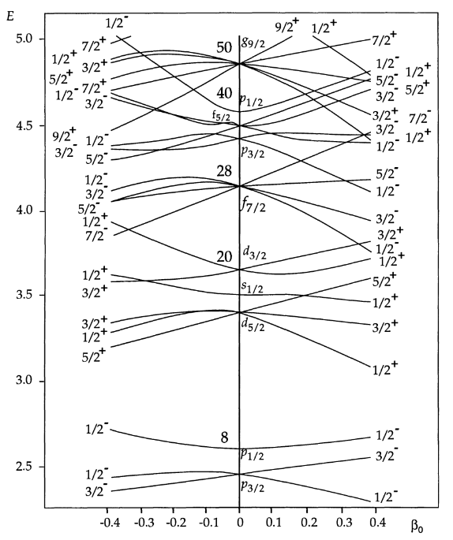
Symmetry breaking and correlations
Hand-waving argument for deformation : example of deformed harmonic oscillator
Symmetry breaking is very powerful trick to capture collective effects for free
Symmetry | Breaking | Ground state | Excited states
U(1) | N, Z | Superfluidity | Pairing oscillations
SU(2) | J, K | Deformation | Rotational/vibrational bands
Parity | Pi | LR asymmetry | Negative parity bands
Open-shell
« Closed-shell »
Warning
SB eventually is « a trick »
Proper eigenstates have good J, pi
Not directly observable
Symmetry restoration needed BMF
Ground & excitated states
Deformation reshuffles HO levels
Every crossing ⬄ p-h excitation
Deformation easily captures mp-mh
Gapless theory
Gapful theory

Slide 28
Bogoliubov algebra and HFB equations
In order to break symmetries (especially particle number) at mean-field, need more general basis
Quasi-particle operators generalize particle / holes in order to allow fractional occupation numbers
Quasi-particle operators $\left(\begin{matrix}β \\ β^{†}\end{matrix}\right)≡𝒲\left(\begin{matrix}c \\ c^{†}\end{matrix}\right)$
With $𝒲=\left(\begin{matrix}U & V \\ V^{∗} & U^{∗}\end{matrix}\right)and 𝒲^{†}𝒲=𝒲𝒲^{†}=1$
$β,β^{†}$ obey fermionic commutation rules
Definition quasiparticle vacuum $|Φ〉∝\prod_{i}{β_{i}|0〉}$ s.t. $∀β, β|Φ〉=0$
Note
Bogoliubov transformation $𝒲$ encodes all information on $|Φ〉$
Mixing particle and holes ⬄ breaking particle number symmetry
Diagonality properties of U and V ⬄ deformation, parity breaking
Bogoliubov states generalize Slater-Determinants while keeping most of their properties
HFB equations generalize HF’s
Same structure
Common basis for $ℛ, ℋ$
Positive qp. Energies
Basis of Fock space
$$|Φ^{ijk⋯}〉≡β_{i}^{†}β_{j}^{†}β_{k}^{†}⋯|Φ〉$$
$$ρ_{ij}≡〈Φ\left|c_{j}^{†}c_{i}\right|Φ〉=V^{∗}V^{T} \\ κ_{ij}≡〈Φ\left|c_{j}c_{i}\right|Φ〉=U^{∗}V^{T} \\ ℛ≡\left(\begin{matrix}ρ & κ \\ −κ^{∗} & 1−ρ^{∗}\end{matrix}\right) \\ ℛ^{2}=ℛ \\ 𝒲^{†}ℛ𝒲=\left(\begin{matrix}0 & 0 \\ 0 & 1\end{matrix}\right)$$
$$E\left[Φ\right]=E\left[ℛ\right] \\ ℋ≡\frac{δE}{δℛ }=\left(\begin{matrix}h & Δ \\ −Δ^{∗} & {−h}^{∗}\end{matrix}\right)$$
Wick theorem still holds
Simple expression for $E[ℛ]$
Minimize E under constraint on particle number
$$δ\left(E−λTr\left(ρ\right)\right)=0⇔\left[𝓗^{′},𝓡\right]=0$$
with $ℋ^{′}≡\left(\begin{matrix}h−λ & Δ \\ −Δ^{∗} & {−h}^{∗}+λ\end{matrix}\right)$

Slide 29
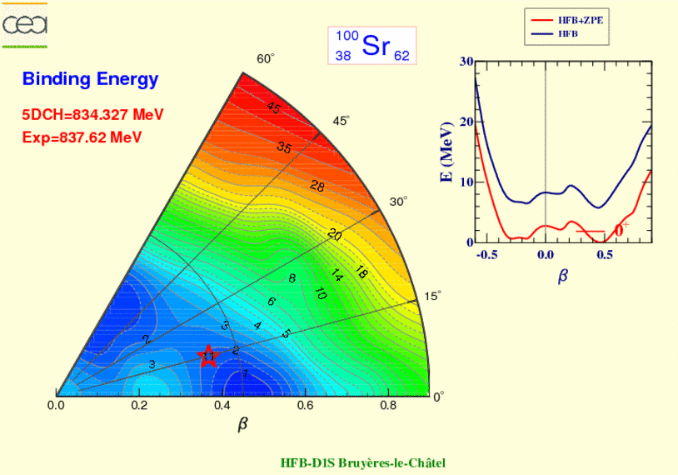
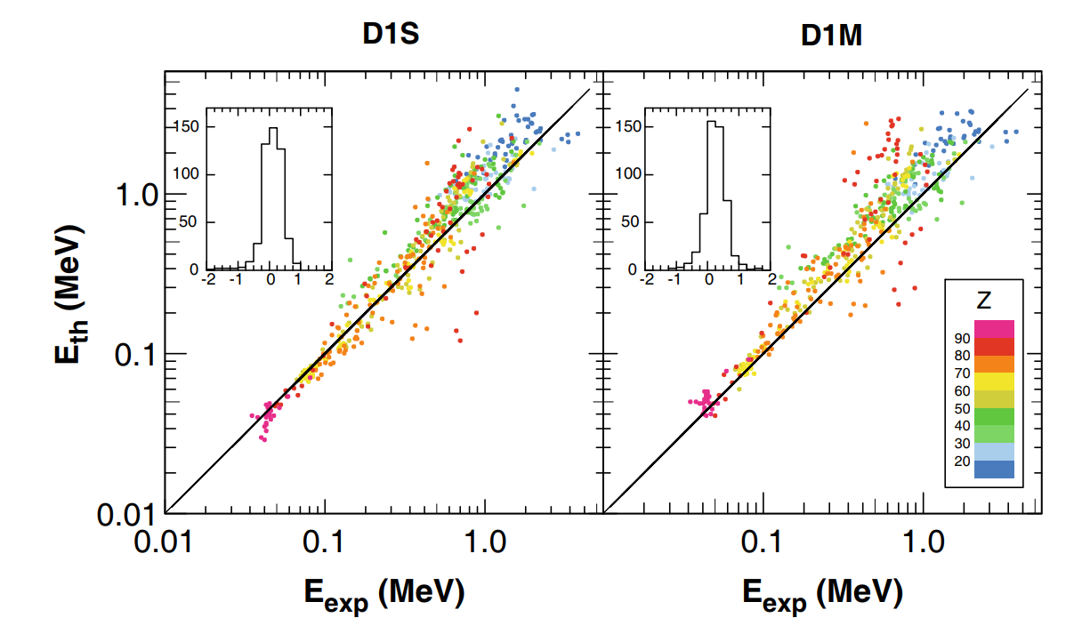
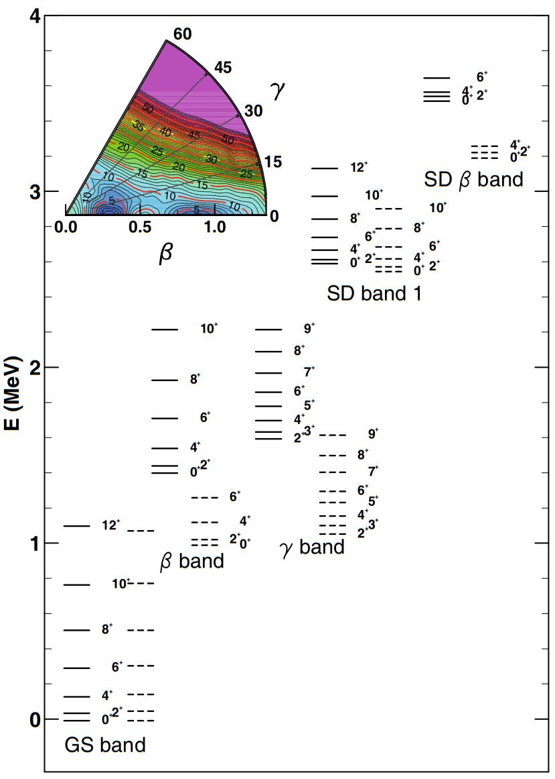
CHFB and applications to spectroscpy
HFB method can easily be generalized to minimize constrained equations (Lagrange multipliers)
Monitor shape of system, through collective macroscopic variable $q≡(β,γ,r^{2},β_{30},β_{40},δ_{pair},J_{x}, J_{y}, J_{z},⋯)$ $⇒|Φ\left(q\right)〉$
Prediction of deformation properties of mean-field approximation (total energy surface, inertia, etc.)
Gorieli et al. EPJA (2016)
Construction of 5D-collective hamiltonian model
Systematic micro-macro spectrum calculation

Slide 30
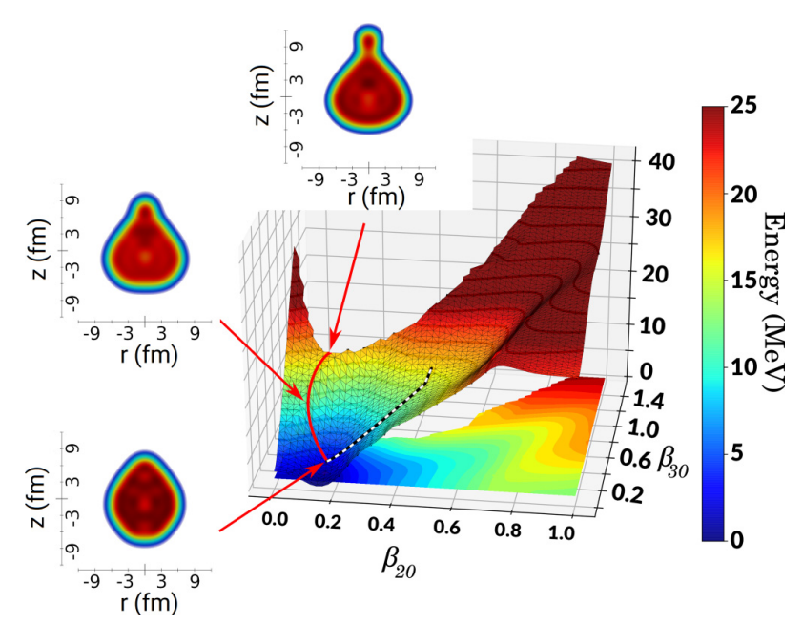
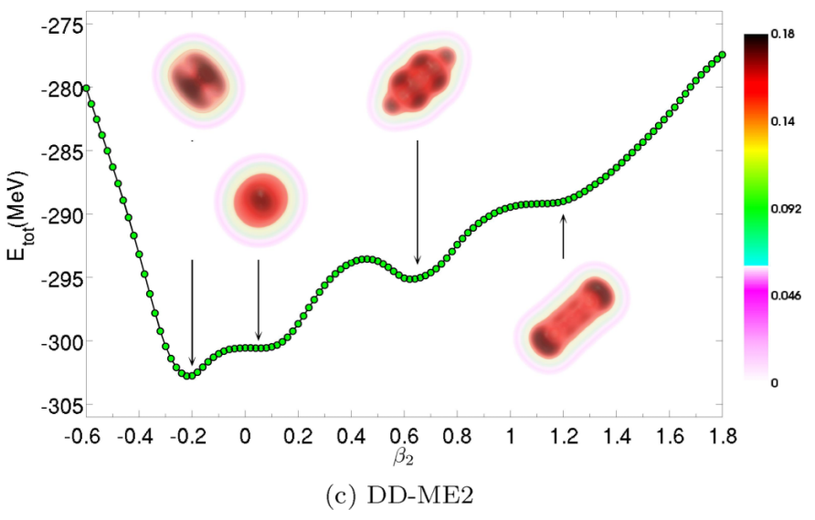
Application to clustered states
HFB density profile spontaneously display clustered structures
Highly collective pheomenon
Localization of nucleons
Cluster organisation change with deformation
Specific vibration modes from cluster oscillations
$${}^{20}Ne$$
Mercier et. Al PRC (2020)
$${}^{24}Mg$$
Alpha-emission
Ebran et. al, PRC 2014

Slide 31
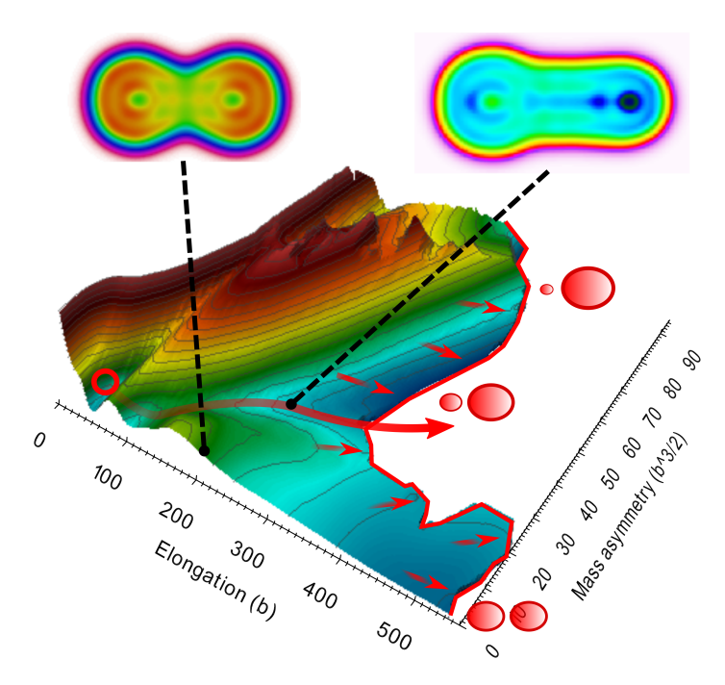
Application to nuclear fission
Fission is a highly collective process involving large deformations
CHFB projects the energy surface on collective coordinates
$Q^{20}$ for the elongation, until two fragments split
$Q^{30}$ for the mass asymmetry
Post-treatment needed to extract relevant quantities
Fission path(s)
Scission points
Fragment yields
Energy of the fragments
Courtesy of D. Regnier (private communication)

Slide 32
Insight into symmetry-broken state
$$|Φ〉=\sum_{NZJKπ}{c_{NZJKπ}|ψ^{NZJKπ}〉}$$
Simple independent quasi-particle state
Obtained through low-dimensional procedure
Wrong quantum number
Strongly correlated many-body states
Many states hidden in one mean-field
Rotational states
How to disentangle individual states?
Apply group rotations to distinguish irreducible representations
Symmetry group | Rotation operator $R$ | Norm kernel $〈Φ\left|R\right|Φ〉$
U(1) neutron | $$R\left(φ_{N}\right)=e^{iφ_{N}\hat{N}}$$ | $$n\left(φ_{N}\right)=\sum_{N}{n_{N}e^{iφ_{N}N}}$$
U(1) proton | $$R\left(φ_{Z}\right)=e^{iφ_{Z}\hat{Z}}$$ | $$n\left(φ_{Z}\right)=\sum_{Z}{n_{Z}e^{iφ_{Z}Z}}$$
SO(3) rotation | $$R\left(α,β,γ\right)=e^{iα\hat{J_{z}}}e^{iβ\hat{J_{y}}}e^{iγ\hat{J_{z}}}$$ | $$n\left(α,β,γ\right)=\sum_{JKM}{n_{KM}^{J}D_{KM}^{J}\left(α,β,γ\right)}$$
$𝒫$ parity | $$R\left(φ_{π}\right)=(1+φ_{π}\hat{Π})$$ | $$n\left(φ_{π}\right)=n_{+}+{\left(−1\right)}^{φ_{π}}n_{−}$$
Same arguments for all operators
Each component is expressed as
rotated symmetry broken mean-field
Rotational bands emerge from projection
Collectivity again captured with deformation+rotation (vibration to come)
Question: is $|Φ〉$ correctly optimized?
Wigner D matrix
All components can be isolated via generalized multi-dimensional Fourier analysis
$$c_{NZJKπ}^{2}∝\sum_{φ_{π}∈\{0,1\}}{∫dφ_{N}∫dφ_{Z}dαdβdγ{\left(−1\right)}^{πφ_{π}}e^{−iNφ_{N}−iZφ_{Z} }D^{∗}\left(α,β,γ\right)〈Φ|R\left(φ_{π}\right)}R\left(φ_{N}\right)R\left(φ_{Z}\right)R\left(α,β,γ\right)|Φ〉$$

Slide 33
Projected mean-field theory
Variational equations optimize $|Φ〉$, but we are interested in projected components
Can we find the state with the lowest projected energy?
Better justified on a quantum mechanical level
Avoid accidental collapse of the wave-function on symmetry conserving mean-field
$$|Φ〉=\sum_{NZJKπ}{c_{NZJKπ}|ψ^{NZJKπ}〉}$$
$$E^{proj}\left[Φ\right]≡\int_{G}{dgx\left(g\right)〈Φ|HR\left(g\right)|Φ〉}$$
Minimum after projection very different from before projection
A posteriori variation useful only if we know right coordinate in advance
$|Φ〉$ is entirely defined by its generalized density matrix $ℛ$
Possible to rewrite energy as function $E^{proj}\left[Φ\right]=E[ℛ]$
Derivatives can be taken as in HFB case $ℋ≡\frac{∂E^{proj}}{∂ℛ}$
Main difference being appearance of a geometrical term emerging from $x\left(g\right)$
For now: formulae derived but not systematically used in realistic applications

Slide 34
Conclusion on mean-field
Mean-field is an approximation of the ground state
Naturally captures some collectivity through deformation and symmetry restoration
Quasi-particle moving independantly in their self-generated mean-field
Natural applications in conjonction with macroscopic models
Ad-hoc deformation properties replaced by microscopic ingredients
Applications to spectroscopy, fission, clusters
Next step, describe coherently excitations and ground state
Towards microscopic description of vibrational states
Harmonic oscillations around ground state
Questions / remarks

Slide 35
Harmonic oscillations
4
Quasi Random Phase Approximations

Slide 36
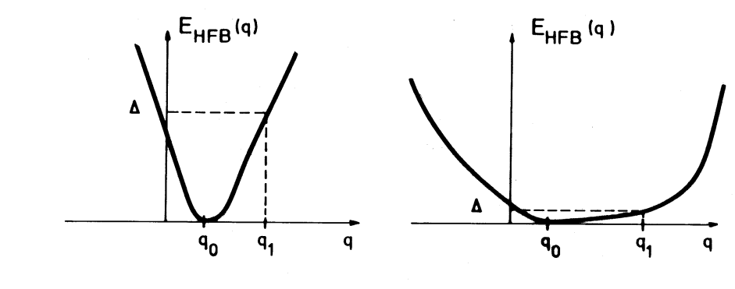
Vibrations in hard and soft nuclei
Deformation properties of nuclei allow a separation in two distinct classes : hard and soft nuclei
Hard nuclei vibrational motion will be well described by harmonic oscillations
Soft nuclei vibrational modes are more long range and strongly anharmonic
Method of choice to describe small oscillations is Quasi Random Phase Approximation

Slide 37
Derivation of QRPA with EOM method
Start with exact eigenstates $H|ν〉=E_{ν}|ν〉$
Define $Q_{ν}^{†}≡|ν〉〈0|$ such that $|ν〉=$ $Q_{ν}^{†}|0〉$ and $Q_{ν}^{†}|ν〉=0$
We obtain the Equation of Motion $\left[H,Q_{ν}^{†}\right]|0〉=\left(E_{ν}−E_{0}\right)Q_{ν}^{†}|0〉$
Left multiplying with arbitrary $〈0|δQ$
$$〈0|[δQ,\left[\left[H,Q_{ν}^{†}\right]\right]|0〉=(E_{ν}−E_{0})〈0\left|\left[δQ,Q_{ν}^{†}\right]\right|0〉$$
QRPA approximation
$|0〉$ is approximated by $|QRPA〉$ containing 4qp on top of $|HFB〉$
$Q_{ν}$ takes the 2qp form $Q_{ν}^{†}=\frac{1}{2}\sum_{kl}{{(X}_{kl}^{ν}β_{k}^{†}β_{l}^{†}−Y_{kl}^{ν}β_{l}β_{k})}$
$$〈QRPA|[β_{k}β_{l}\left[\left[H,Q_{ν}^{†}\right]\right]|QRPA〉=ω_{ν}〈QRPA\left|\left[β_{k}β_{l},Q_{ν}^{†}\right]\right|QRPA〉$$
$$〈QRPA|[β_{k}^{†}β_{l}^{†}\left[\left[H,Q_{ν}^{†}\right]\right]|QRPA〉=ω_{ν}〈QRPA\left|\left[β_{k}^{†}β_{l}^{†},Q_{ν}^{†}\right]\right|QRPA〉$$
$$A_{kk^{′}ll^{′}}=〈HFB | {[β}_{k^{′}}β_{k},\left[H,β_{l}^{†}β_{l^{′}}^{†}\right]]|HFB〉 \\ B_{kk^{′}ll^{′}}=〈HFB | {[β}_{k^{′}}β_{k},\left[H,β_{l^{′}}β_{l}\right]]|HFB〉$$
Quasi-Boson Approximation
$|QRPA〉$ replaced with $|HFB〉$
Normalization and orthogonality conditions
$$\sum_{kl}{(X_{kl}^{ν}{X_{kl}^{ν^{′}}}^{∗}}−Y_{kl}^{ν}{Y_{kl}^{ν^{′}}}^{∗})=δ_{νν^{′}} \\ \sum_{νν^{′}}{\left(X_{kl}^{ν}{X_{k^{′}l^{′}}^{ν}}^{∗}−Y_{kl}^{ν}Y_{k^{′}l^{′}}^{ν}\right)=δ_{kk^{′}}δ_{ll^{′}}}$$
$$\left(\begin{matrix}A & B \\ B^{∗} & A^{∗}\end{matrix}\right)\left(\begin{matrix}X^{ν} \\ Y^{ν}\end{matrix}\right)=w_{ν}\left(\begin{matrix}1 & 0 \\ 0 & −1\end{matrix}\right)\left(\begin{matrix}X^{ν} \\ Y^{ν}\end{matrix}\right)$$
Note: $\left(\begin{matrix}A & B \\ B^{∗} & A^{∗}\end{matrix}\right)⇔\frac{∂^{2}E[𝓡]}{∂𝓡^{2}}$ expressed in qp. basis
HFB stability condition ensures reality of eigenvalues
Quasi Boson Approximation valid if
${|Y}_{kl}^{ν}\left|≪{|X}_{kl}^{ν}\right|$ (weakly correlated QRPA g.s.) : pure 2qp state
${|X}_{kl}^{ν}|≪1 ∀kl$ avoiding fully occupied state : collective state
Transition densities
$$𝒲\left(\begin{matrix}0 & X^{ν} \\ Y^{ν} & 0\end{matrix}\right)𝒲^{†}=\left(\begin{matrix}ρ^{0→ν} & κ^{0→ν} \\ −{\overline{κ}}^{0→ν} & {−\overline{ρ}}^{0→ν}\end{matrix}\right) \\ 〈0\left|F\right|ν〉=Tr\left(F^{†}ρ^{0→ν}\right)$$

Slide 38
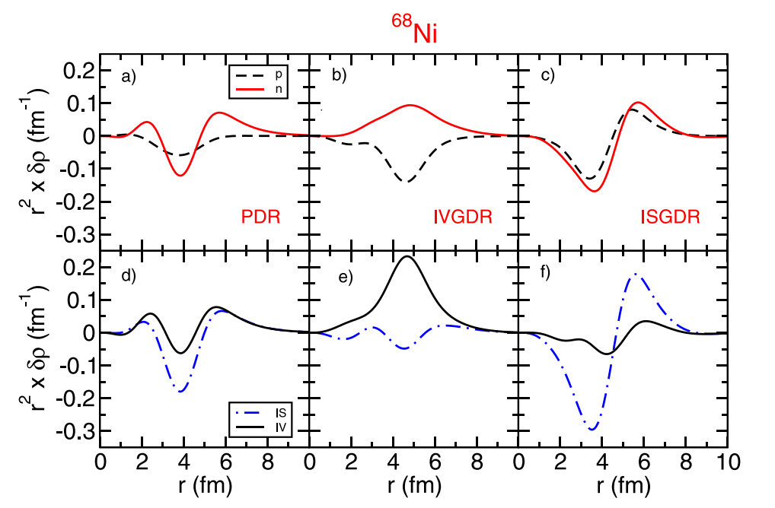
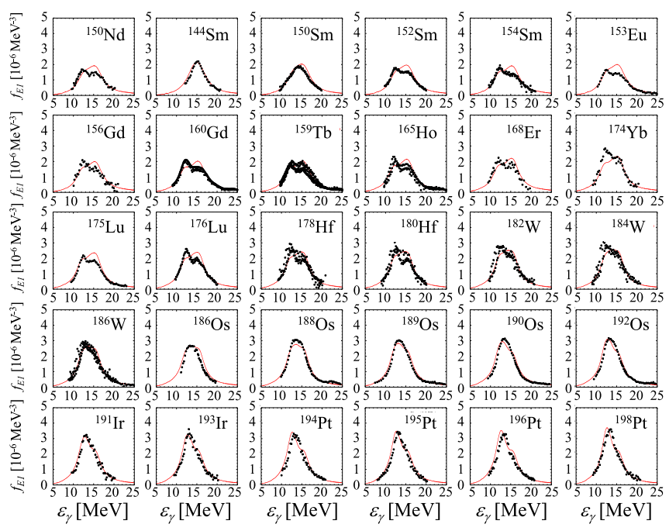
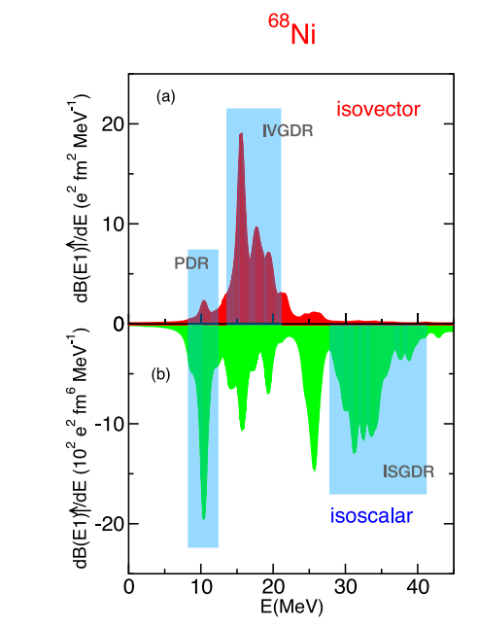
Illustration of QRPA
Giant resonance described as coherent superposition of 1p1h excitations
Direct application for neutron capture (reactor physics, astrophysics)
Pygmy resonance at low energy ($S_{n}$)
Looking at transition densities
Very different behavior
IVGDR : p and n in opposite direction
ISGDR : p and n coherent
Pygmy : neutron skin oscillation
Goriely et al. (2018)
Lanza et al. (2023)

Slide 39
Finite Amplitude Method formulation of QRPA
Scaling of QRPA : storage in $O\left(N^{4}\right)$, diagonalization in $O\left(N^{6}\right)$
Improved by symmetry restrictions (axiality)
Still expensive computation for 1p1h…
Simplier to solve in quasi-particle basis
$$ℛ_{0}=\left(\begin{matrix}0 & 0 \\ 0 & 1\end{matrix}\right), \left[ℱ\left(ω\right),ℛ_{0}\right]=\left(\begin{matrix}0 & F^{02} \\ F^{20} & 0\end{matrix}\right), ℋ_{0}=\left(\begin{matrix}E_{ν} & 0 \\ 0 & −E_{ν}\end{matrix}\right)$$
$δℛ(ω)$ is also anti-diagonal $δℛ\left(ω\right)=\left(\begin{matrix}0 & X(ω) \\ Y(ω) & 0\end{matrix}\right)$
QFAM amplitudes obtained through set of non linear equations
$$X_{μν}\left(ω\right)=−\frac{F_{μν}^{02}\left(ω\right)+δH_{μν}^{02}(ω)}{E_{μ}+E_{ν}−ω} \\ Y_{μν}\left(ω\right)=−\frac{F_{μν}^{02}\left(ω\right)+δH_{μν}^{02}(ω)}{E_{μ}+E_{ν}+ω}$$
Alternative derivation of QRPA from Time-Dependent HFB
$$\dot{iℛ}=\left[ℋ\left[ℛ\right]+ℱ\left(t\right),ℛ\right]$$
Harmonic oscillation hypothesis
$$ℱ\left(t\right)=η\left(ℱ\left(ω\right)e^{−iωt}+{ℱ\left(ω\right)}^{†}e^{iωt}\right) \\ ℛ\left(t\right)=ℛ_{0}+η\left(δℛ\left(ω\right)e^{−iωt}+δℛ{\left(ω\right)}^{†}e^{iωt}\right) \\ \frac{∂E[ℛ]}{∂ℛ}=ℋ\left[ℛ\right]=ℋ_{0}+η\left(\frac{∂^{2}E\left[ℛ\right]}{∂ℛ^{2}}⋅δℛe^{−iωt}+h.c.\right)$$
Solution in frequency space
$$ωδℛ\left(ω\right)=\left[ℋ_{0}+δℋ\left(ω\right)+ℱ\left(ω\right),ℛ_{0}+δℛ\left(ω\right)\right] \\ ωδℛ\left(ω\right)=\left[ℋ_{0},ℛ_{0}\right]+ℋ_{0}δℛ\left(ω\right)−δℛ\left(ω\right)ℋ_{0}+\left[δℋ\left(ω\right)+ℱ\left(ω\right),ℛ_{0}\right]$$
HFB-like self-consistent equations
Global complexity $O(N^{4})$ for each frequency $ω$
Finite Amplitude Method replaces expensive matrix diagonalization by self-consistent equations
QRPA equations solved iteratively for each phonon…

Slide 40
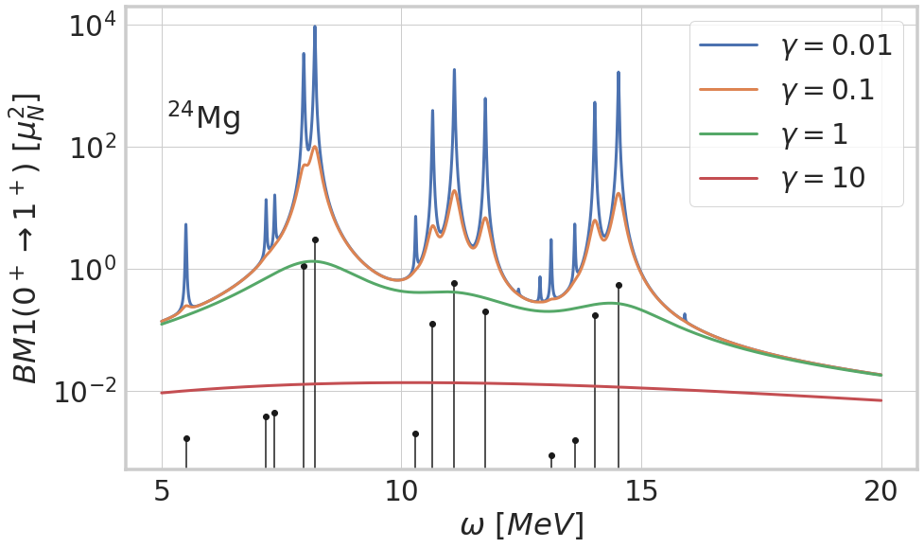
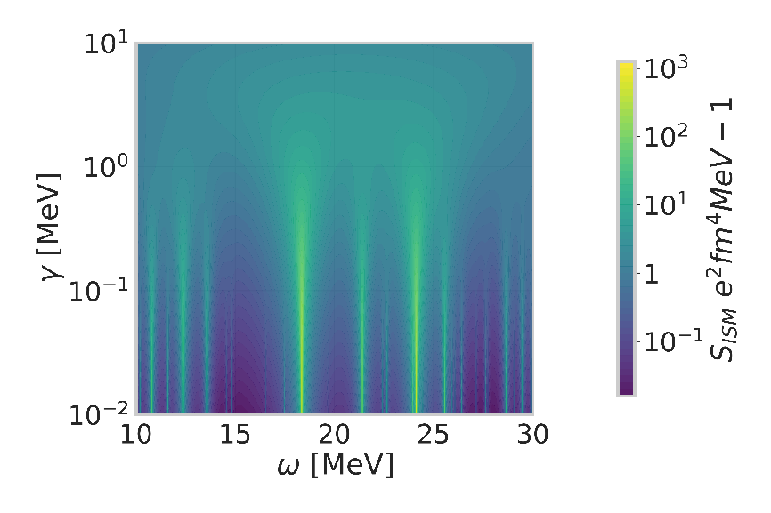
Finite Amplitude Method 2
For a real frequency $ω$, QFAM response will be infinite for QRPA phonon frequency, 0 otherwise : not really practical
Introduction of complex frequency $ω_{γ}=ω+iγ$
Convolutes QRPA spectrum with width $γ$
QFAM does not access exact spectrum directly
Calculation of strength function
$$S\left(F,ω_{γ}\right)≡−\frac{1}{π}Im \left\{Tr\left(𝓕^{†}δ𝓡\left(ω_{γ}\right)\right)\right\} \\ =\frac{γ}{π}\sum_{ν}{\frac{B(0→ν)}{{\left(ω−Ω_{ν}\right)}^{2}+γ^{2}}−\frac{B(0→ν)}{{\left(ω+Ω_{ν}\right)}^{2}+γ^{2}}}$$
Connection with matricial QRPA through complex integration
$$\sum_{ν∈𝒞}{Ω_{ν}^{k}B\left(0→ν\right)=\frac{1}{2iπ}\oint_{𝒞}{ω^{k}S\left(F,ω\right)dω}} \\ \sum_{ν∈𝒞}{X_{kl}^{ν}}〈0\left|F\right|ν〉=\frac{1}{2iπ}\oint_{𝒞}{X_{kl}\left(ω\right)dω}$$

Slide 41
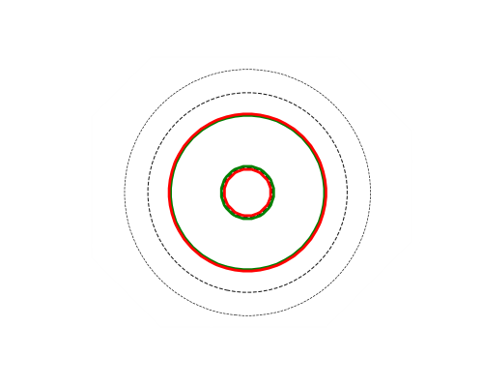
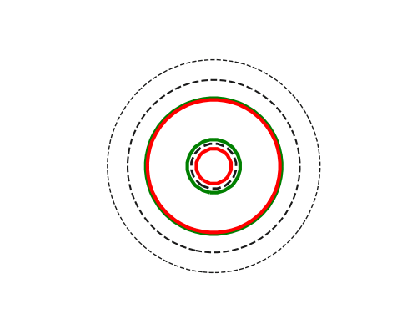
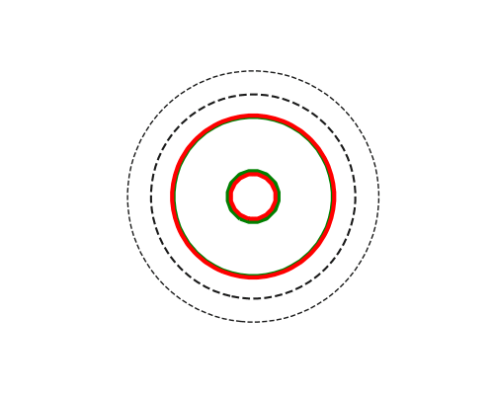
Illustration of QRPA-FAM
Step 1
Modelisation of ground state
HFB mean-field
Step 2
Choice of harmonic probe $ℱ$
Spin – Parity
Isoscalar / isovector
Step 3
Linear response of ground state
For each frequency $ω$
With finite width $ω→ω+iγ$
O16
Isoscalar monopole
« Breathing mode »
Other possible probes
Isovector monopole
Low frequency
Discrete states
Individual excitations
High frequency
Leaving validity domain
Isovector dipole
Giant resonance
Collective excitation

Slide 42
Limitations of QRPA and extensions
Harmonic limitation of QRPA is quite limiting for applications
No account of fragmentation that is partly due to complex configurations
Missing anharmonicities, especially in « soft » nuclei, or with shape coexistence
No account of rotations, that need symmetry restoration
Systematic shift w.r.t. experiment observed with most of nuclear interactions
Each points could be adressed separately, but we will focus on a method that tackles all aspects at once
Questions/remarks?
$$J=1$$
$$J=2$$
$$J=3$$
$$J=0$$

Slide 43
PGCM
5
Projected Generator Coordinate Method

Slide 44
PGCM Ansatz and equations
Main features of PGCM
Include anharmonic correlations into the spectrum
Map macroscopic intuitions to microscopic calculations
Natural inclusion of rotational physics via symmetry restoration
order par.
Collective variable $q$
Macroscopic shape parametrization
Conjugate variable $θ$
Rotational mode (symmetry restoration)
Nice microscopic realisation of CH
$$|Ψ_{μ}^{J^{π}KNZ}〉≡∫dqdθ f_{μ}^{J^{π}KNZ}\left(q\right)g^{J^{π}KNZ}(θ)|Φ\left(q;θ\right)〉$$
$$N_{pq}^{J^{π}NZ}≡〈Φ\left(p\right)\left|P^{J^{π}NZ}\right|Φ\left(q\right)〉 \\ H_{pq}^{J^{π}NZ}≡〈Φ\left(p\right)\left|{HP}^{J^{π}NZ}\right|Φ\left(q\right)〉$$
Variational principle HWG
$$\sum_{q}{H_{pq}^{J^{π}KNZ}f_{μ}^{J^{π}KNZ}\left(q\right)}=ℰ_{μ}^{J^{π}KNZ}\sum_{q}{N_{pq}^{J^{π}KNZ}f_{μ}^{J^{π}NZ}\left(q\right)}$$
Hamiltonian kernels
Norm kernels
Low-dimentional diagonalisation
Mp-mh replaced by shape oscillations and rotations
Reduces to QRPA for small oscillations and no rotation

Slide 45
Details on calculation of PGCM kernels
$$N_{pq}^{J^{π}KNZ}=\int{dθg^{J^{π}KNZ}\left(θ\right)〈Φ\left(p\right)\left|R\left(θ\right)\right|Φ\left(q\right)〉} \\ H_{pq}^{J^{π}KNZ}≡\int{dθg^{J^{π}KNZ}\left(θ\right)〈Φ\left(p\right)\left|HR\left(θ\right)\right|Φ\left(q\right)〉}$$
Onishi Formula
$$〈Φ\left(p\right)\left|R\left(θ\right)\right|Φ\left(q\right)〉=\sqrt{\det\left({\left[U{\left(p\right)}^{T}R{\left(θ\right)}^{∗}U{\left(q\right)}^{∗}+V{\left(p\right)}^{T}R\left(θ\right)V{\left(q\right)}^{∗}\right]}^{−1}\right)} \\ =pf\left(\begin{matrix}V{\left(p\right)}^{T}U\left(p\right) & V{\left(p\right)}^{T}R\left(θ\right)V{\left(q\right)}^{∗} \\ −V{\left(q\right)}^{†}R{\left(θ\right)}^{∗}V\left(q\right) & U{\left(q\right)}^{†}V{\left(q\right)}^{∗}\end{matrix}\right)$$
Off-diagonal Wick theorem
$$〈Φ\left(p\right)\left|HR\left(θ\right)\right|Φ\left(q\right)〉=\frac{1}{〈Φ\left(p\right)\left|R\left(θ\right)\right|Φ\left(q\right)〉}\left\{T⋅ρ\left(p,q,θ\right)+\frac{1}{2}V⋅ρ\left(p,q,θ\right)⋅ρ\left(p,q,θ\right)+\frac{1}{4}V⋅κ\left(p,q,θ\right)⋅κ^{∗}\left(p,q,θ\right)\right\} \\ ρ\left(p,q,θ\right)=R\left(θ\right)V{\left(q\right)}^{∗}{\left[U{\left(p\right)}^{T}R{\left(θ\right)}^{∗}U{\left(q\right)}^{∗}+V{\left(p\right)}^{T}R\left(θ\right)V{\left(q\right)}^{∗}\right]}^{−1}V{\left(p\right)}^{T} \\ κ\left(p,q,θ\right)=R\left(θ\right)V{\left(q\right)}^{∗}{\left[U{\left(p\right)}^{T}R{\left(θ\right)}^{∗}U{\left(q\right)}^{∗}+V{\left(p\right)}^{T}R\left(θ\right)V{\left(q\right)}^{∗}\right]}^{−1}U{\left(p\right)}^{T} \\ κ^{∗}\left(p,q,θ\right)=−R{\left(θ\right)}^{∗}U{\left(q\right)}^{∗}{\left[U{\left(p\right)}^{T}R{\left(θ\right)}^{∗}U{\left(q\right)}^{∗}+V{\left(p\right)}^{T}R\left(θ\right)V{\left(q\right)}^{∗}\right]}^{−1}V{\left(p\right)}^{T}$$
PGCM kernel computation obtained from series of independent HFB-like contractions

Slide 46
Discussion on PGCM
Marevic et al. PRC 2019
$(β_{2},β_{3})$ PGCM in Ne20
Clustered 2$α$+C12 / $α$+O16 configurations
Large collective motion important for gs description
$(β_{2},β_{3})$ PGCM in C12
Clustered CHFB configurations
Prediction of Hoyle state as linear $α$-chain
Good description of rot+vib
Frosini et al. EPJA 2021

Slide 47
Investigating multi-phonon states in PGCM
A. Porro, PhD thesis
Origin of fragmentation in PGCM
Presence of multi-configurational states in spectrum
1p1h, 2p2h, 3p3h, etc. -> ingredients for NLD
Simple 1-dimentional example with radial oscillations of Ti46
Beyond GMR peaks
« Echo » of giant resonance, regularily spaced
Strong, linearily growing inter-states connections
Follows closely textbook quantum oscillator example
Ti46

Slide 48
Investigating multi-phonon states in PGCM
Origin of fragmentation in PGCM
Presence of multi-configurational states in spectrum
1p1h, 2p2h, 3p3h, etc.
Realistic calculation with mode coupling
A. Porro, PhD thesis
Realistic multi-phonons
Deviation from textbook example
Coupling between modes
Many more peaks in the strength
Follows to a good approximation the 1d case
Motivation for combinatorial method with QRPA to get NLDs

Slide 49
Beyond PGCM, a new journey begins
PGCM is tailored to capture long range collective motion
Collectivity well reproduced (rotations, vibrations)
Emergence of multi-phonon states from first principle
However… not all phenomena are collective!
Some excitations only involve a low number of ph excitations
Largest contribution of binding energy precisely come from 2p2h configurations (cf. Thomas/Vittorio)
Solution: derive a formalism that coherently incorporates the two aspects…
… but that’s for the next time!

Slide 50
Thank you for your attention!

Slide 51
References
Cours NPAC JF Berger (2008)

