Slide 1
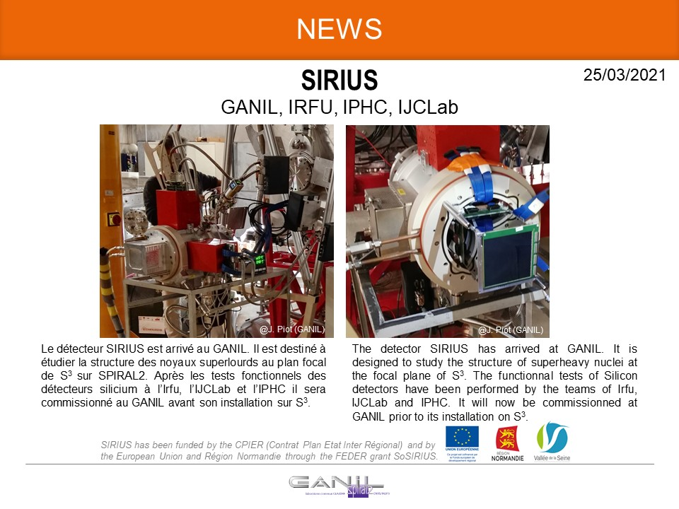
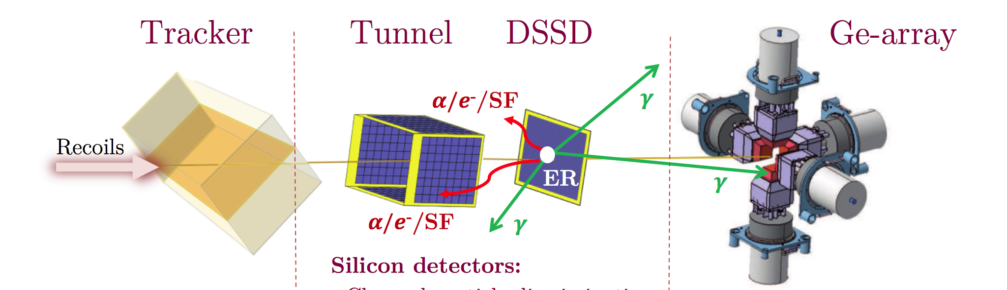
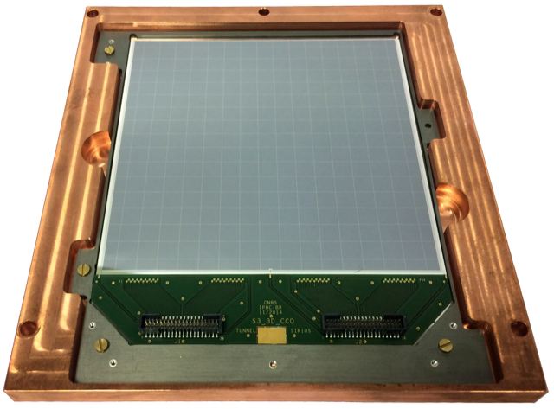
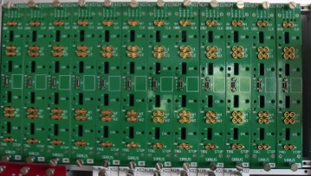
S3-SIRIUS (recap)
pôle nucléaire et pôle ingénierie
SIRIUS: the detection system to be installed at the focal plane of S³ @ GANIL
for heavy element spectroscopy
Our implication
→ upgraded NUMEXO2 mezzanine cards for the DSSD and the tunnel
→ front- and back-end electronics for the tunnel (digital feedback CSP)
NUMEXO2
+ FADC-DAC
P. Brionnet et al., Nucl. Instr. Meth. 1015 (2021) 165770
And experimental + Geant4 know-how

Slide 2
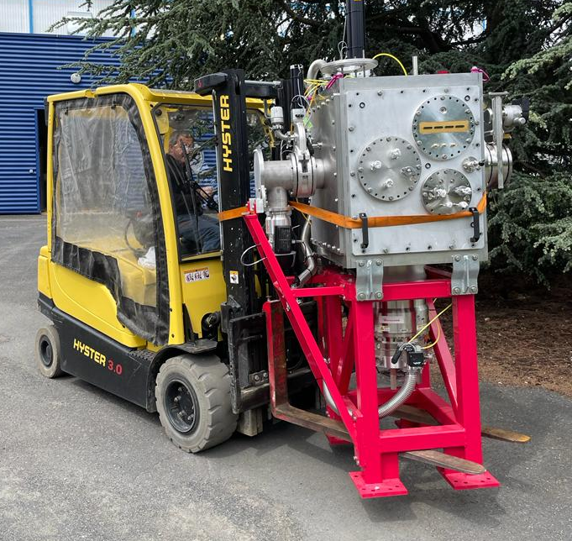
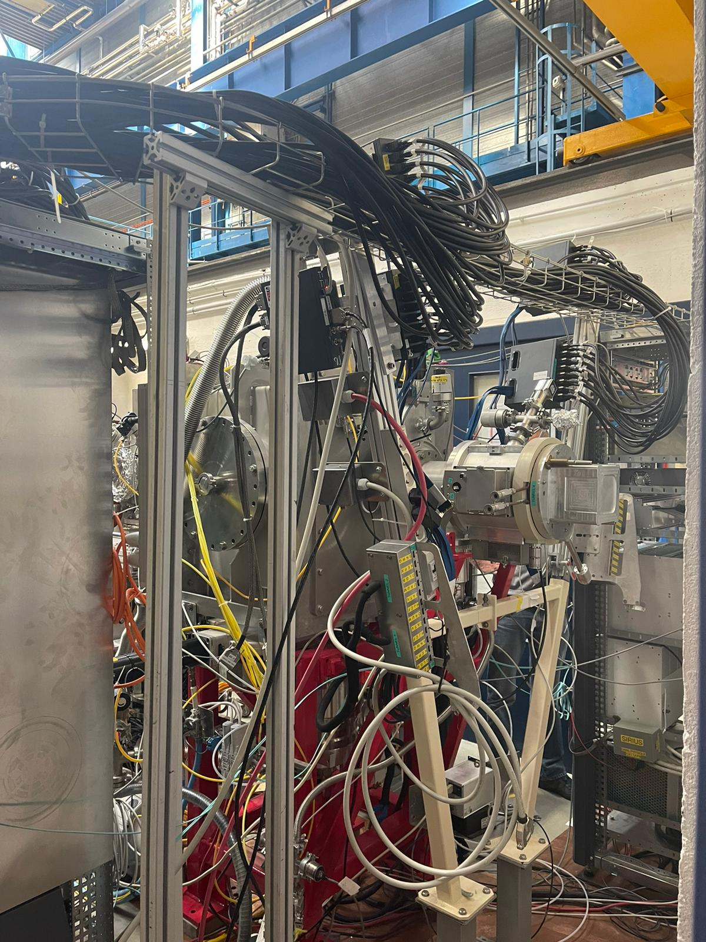
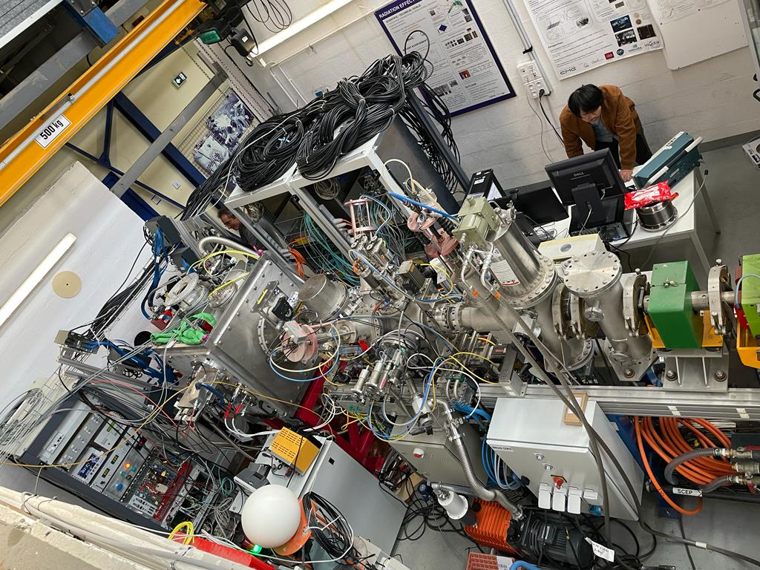
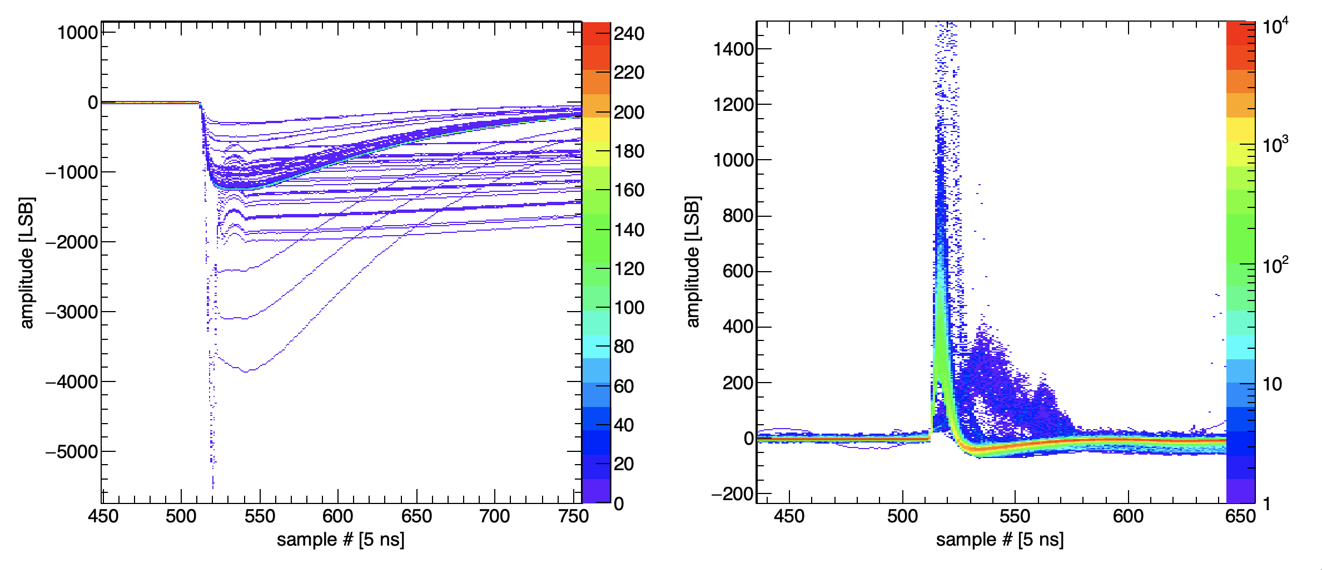
First in-beam SIRIUS at IRRSUD/GANIL 10-12/06
²³⁸U beam
@ ~50 MeV
DSSD
SeD
Digitised preamplifier signals written to disc
Goals:
Realistic test of TRACKER & DSSD elect.
Synchronisation of TRACKER & DSSD elect.
Spatial resolution of TRACKER
Temporal resolution of TRACKER & DSSD
Signal processing on-going
X’,Y’
T₁ -
E
X,Y
T₀ → TOF

Slide 3
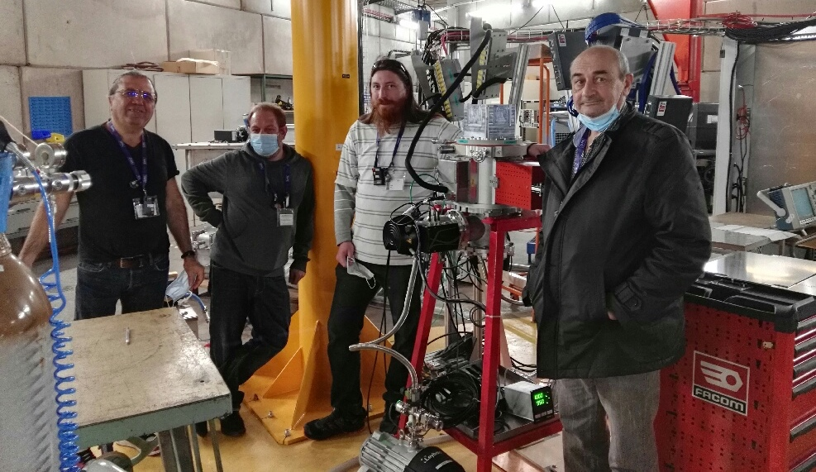
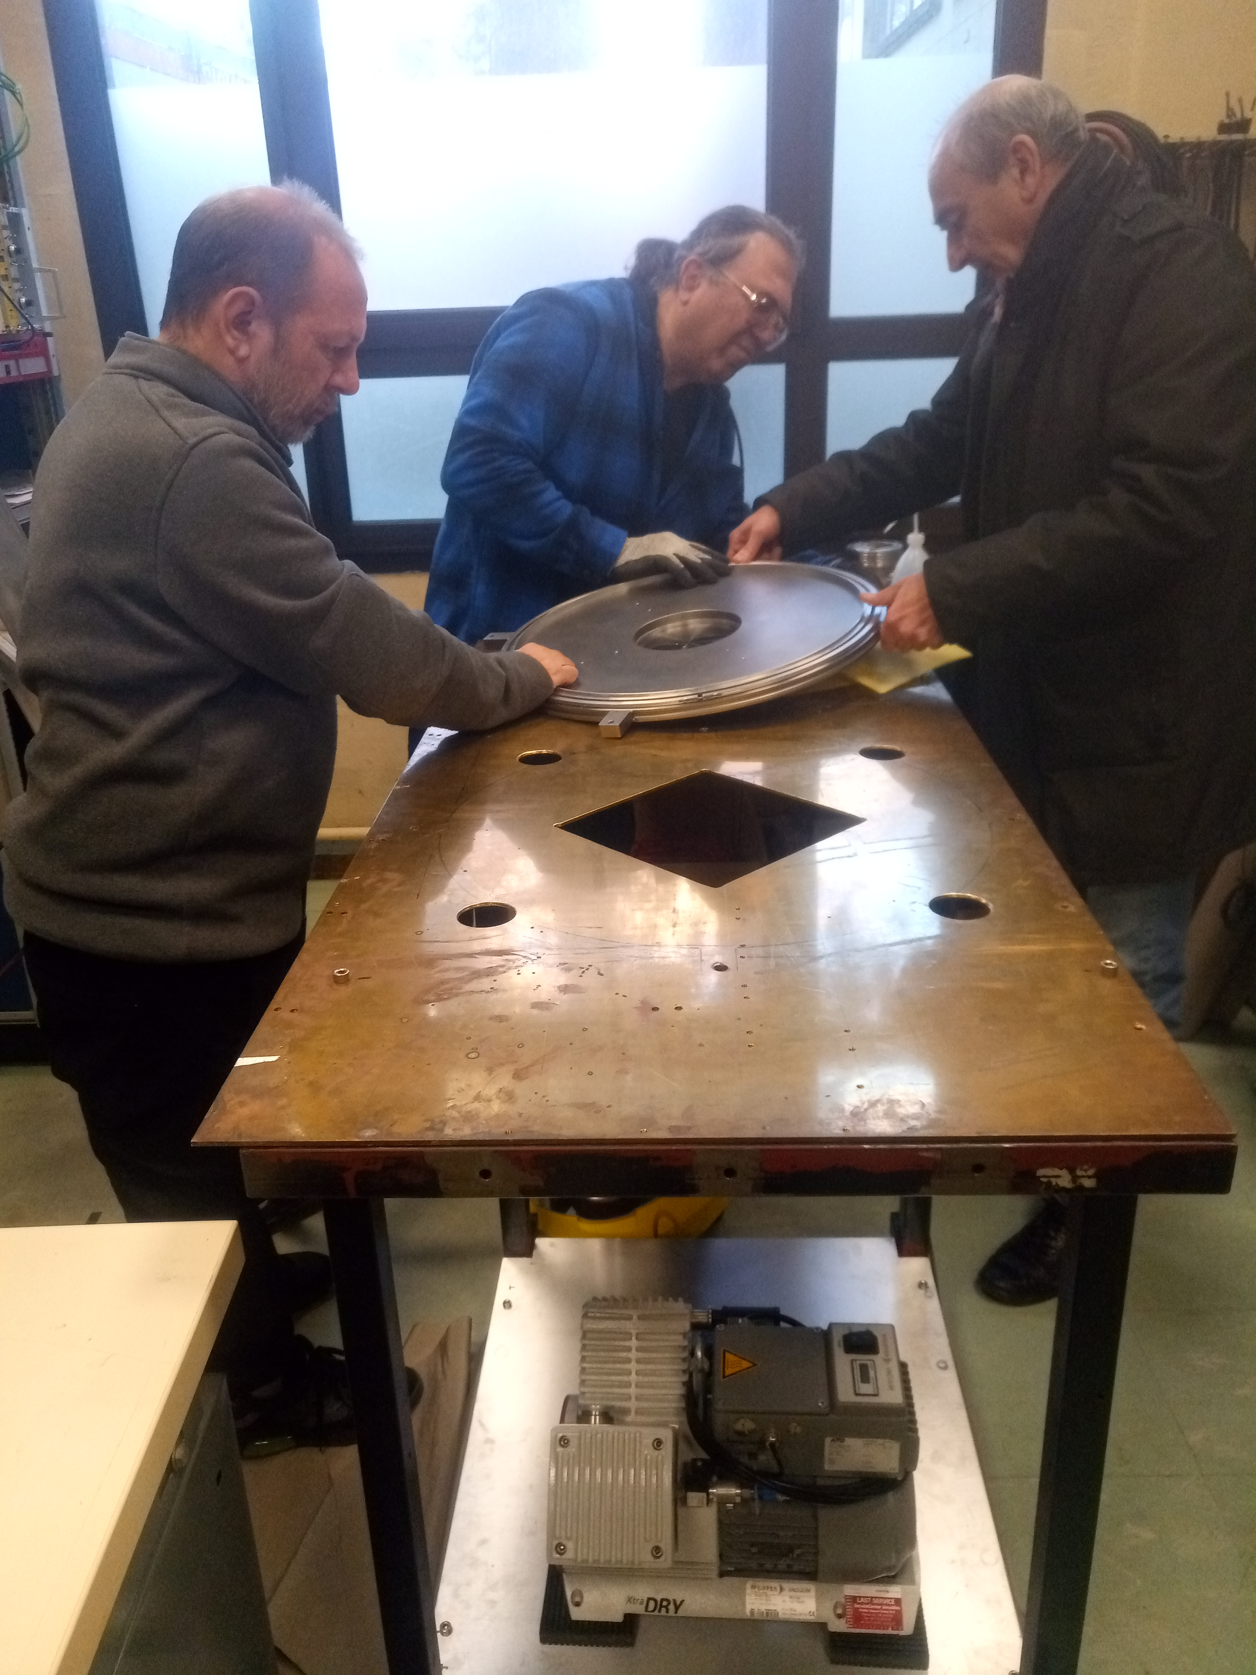
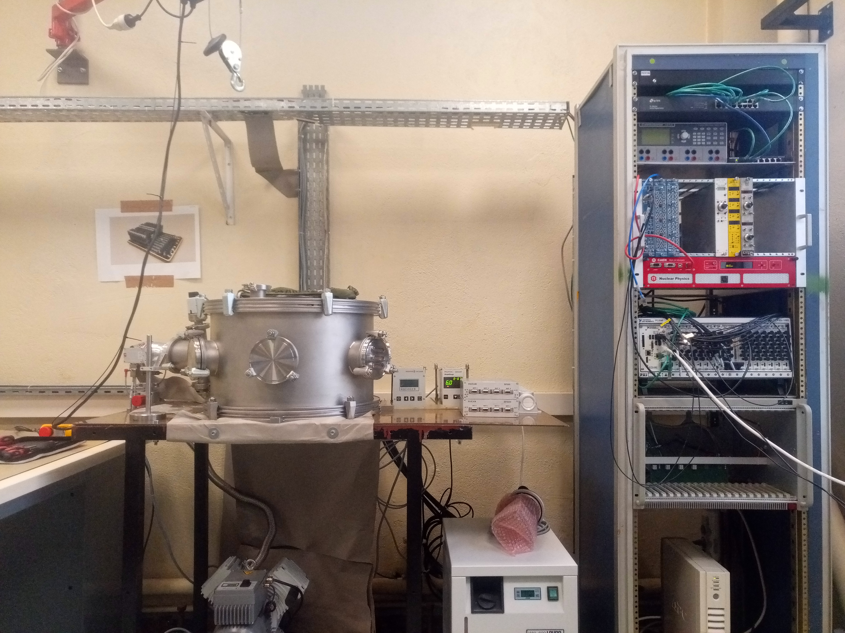
S3-SIRIUS: 2023 funding
Mission (GANIL): 4k
→ set-up SIRIUS
→ electronics tests + updates
Mission (hors GANIL) : 1k
→ maintenance/upgrades of test benches used at sub-contractors
→ Consultation/repairs/upgrades/maintenance electronic cards + HV
→ transport of tunnel detector(s) for local tests
Equipment (local) : 4k
→ maintenance/upgrades of test benches used at the IJCLab
remote control + EMC upgrades
cryo-fluid+cable replacements
4k ➔ scavanger mode
SHEXI → XI-SHE (X-ray Identification of Super Heavy Elements)
P2I request of ~100 k unsuccessful….

Slide 4
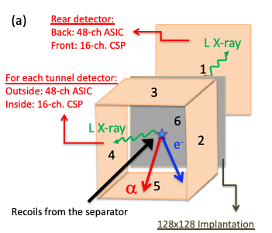
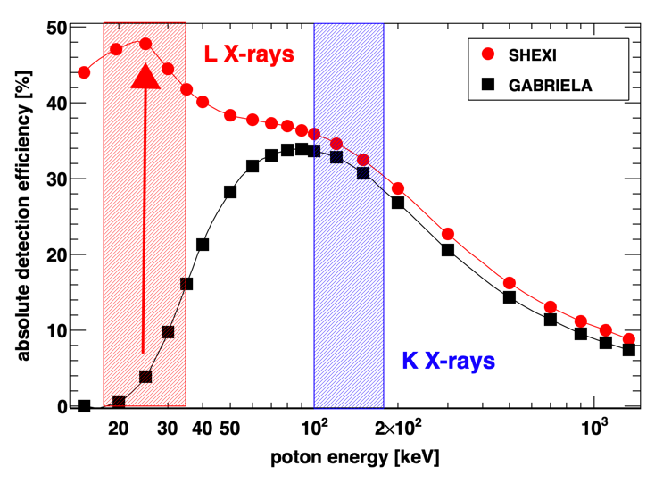
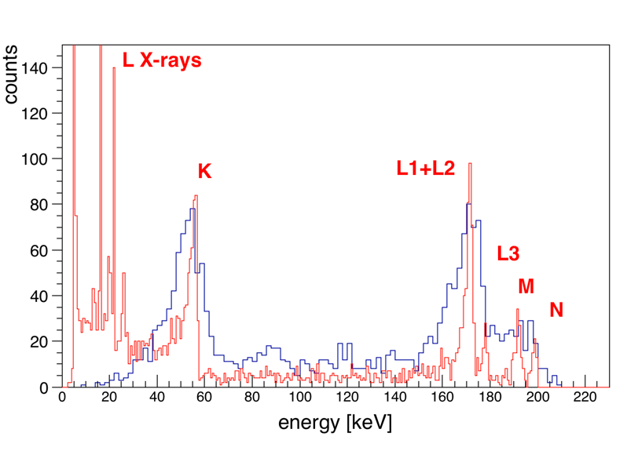
S3-SIRIUS upgrade →SHEXI (…Management Board Approved)
Upgrade of the tunnel and veto detectors + associated electronics
→ L-Xray detection
Z identification of SHE
+ world leading ICE spectroscopy
²⁵¹Fm as an example:
GABRIELA data
vs
SHEXI simulation

Slide 5
P2I request → AP-2024….(TGIR?)
Description brève | P2I request | GANIL... | Already bought
PXIe controller (32GB/512 SSD/24 GB/s) | 15 480 €
500 MHz digitizer + cable + shipping | 23 625 €
PXIe chassis, 250 MHz digitizer, signal generator, monitor |  |  | 32 000 €
3x 8-ASIC carrier boards + 3 signal conditioning boards |  |  | 20 880 €
3x 8-ASIC carrier boards + 3 signal conditioning boards (differential) + development + bias board + cables, connectors, vacuum feed-throughs | 33 700 €
Si detector (+NRE for masks) |  |  | 18 000 €
High precision low-current high voltage module (requested ~1 year ago) |  | 7 000 €
Circulating liquid chiller (-25C) |  |  | 10 500 €
Development of a 16-channel PCB for charge sensitive preamplifers. 16 PIONEER CSA, 16 ATOMKI CSA, 16 NeTInstruments CSA. bias board + cables, connectors vacuum feed-throughs | 18 700 €
XY-theta positioner (for sources) in the vacuum |  |  | 16 000 €
Workstation + NAS disc storage | 6 500 €
TOTAL | 98 005 € | 7 000 €
4 000 €
45 180

Slide 6
S3-SIRIUS-COMMISSIONING + Upgrade part-I (2024 funding request)
Mission (GANIL) : 5k
→ firmware updates
→ set-up SIRIUS in S3 Hall + source commisioning: α-γ coinc. measurements)
→ commissioning of S3 ?
Mission (hors GANIL) : 1k
→ maintenance/upgrades of test benches used at sub-contractors
→ Consultation/repairs/upgrades/maintenance electronic cards + HV
Equipment (local) : 14k
→ maintenance/upgrades of test benches used at the IJCLab
(cables/connectors/collimators and source holder/stepper motor control/
UPS repair)
→ workstation
SIRIUS Upgrade : 41.2k
→ DAQ upgrade
→ 16-channel preamp for alpha/fission range + D2S + connectors/cables/PCB
→ 6/8 channel high precision low-I HV
TOTAL = 61.2 k

Slide 7




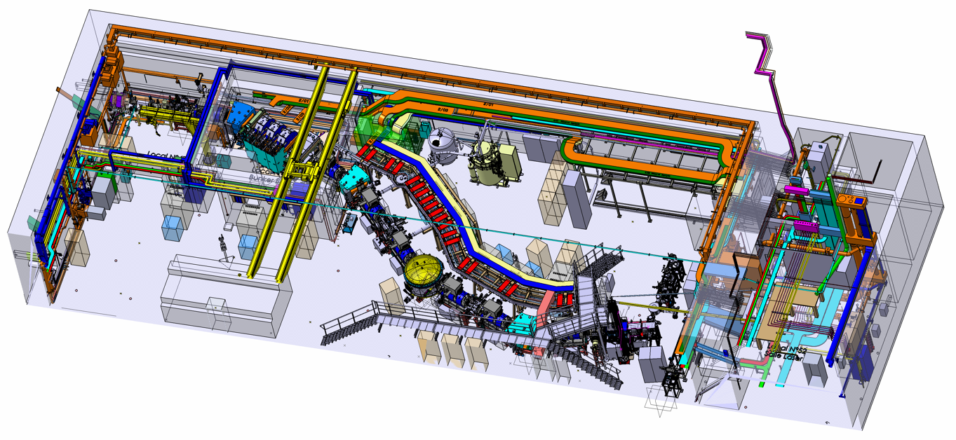
S³-Spectrometer
(S3-CS2021: H. Savajols)
Target station
Beam Dump
Superconducting Multipole Triplets
and Power-Supply Systems (x7)
Cryogenics
Dipole 1
Dipole 2
Open RT Triplet
Electric Dipole
Dipoles 3
last year claimed commissioning in Q3/Q4-2023
S³ Cryo-pump en panne après réparation → entraîné un nouveau retard… 2024 ?

Slide 8
Virtual “exploitation sur site”
Still extracting results from GABRIELA data pre 03/2022
A.V. Isaev , …, A. Lopez-Martens, … K. Hauschild, et al., “Structure of the prompt neutron multiplicity distribution in the spontaneous fission of ²⁵⁶Rf”, Phys. Lett. B (2023) 138008
R. Chakma, A. Lopez-Martens, K. Hauschild et al., ‘’Investigation of isomeric states in ²⁵⁵Rf’’, Phys. Rev. C 107 (2023) 014326
A. Lopez-Martens, K. Hauschild and the GABRIELA collaboration, ‘’Spectroscopy of super heavy elements with GABRIELA’’, Eur. Phys. J. A 58 (2022) 134
K. Hauschild, A. Lopez-Martens et al., “Alpha-decay spectroscopy of ²⁵⁷Rf”, Eur. Phys. J. A 58 (2022) 6
A. Lopez-Martens, K. Hauschild, et al., “Fission properties of ²⁵³Rf and the stability of neutron-deficient Rf isotopes”, Phys. Rev. C 105 (2022) L021306
M. Tezekbayeva, A. Lopez-Martens, … K. Hauschild, et al., “Study of the production and decay properties of neutron-deficient nobelium isotopes“, Eur. Phys. J. A 58 (2022) 52
A.V. Isaev, …, A. Lopez-Martens, … K. Hauschild, et al., ’’Prompt neutron emission in the spontaneous fission of ²⁴⁶Fm’’, Eur. Phys. J. A 58 (2022) 108
A.V. Isaev, …, A. Lopez-Martens, … K. Hauschild, et al., ‘’The SFiNx Detector System’’, Phys. Parti. Nucl. Letters 19 (2022) 37
→ Still invited to conferences… eg GRC this year (paid for by PN)
More papers already in the pipeline: ²⁵⁰No, ²⁵⁴No, ²⁵⁵No, ²⁵⁶Rf, ²⁵⁷Db
Further delays in S3 → digging deeper into the data
→(Hopefully) More invitations + another analysis workshop
request 5k€

