Slide 1
ThomX meeting Ring commissioning June 19, 2023

Slide 2
Anneau :
* Point sur l'état actuel du stockage. - Quel qualité de stockage et à quelles fréquences ? Par exemple quelles fréquences ont été essayées, si le stockage est possible ou non, et si oui donner la valeur du ratio : charge(t=100ms) / charge(t=0) et un plot d'allure de la décroissance sur les 100 ms. - Pour un "bon stockage" (peut importe la fréquence), quelle est la taille du faisceau a l'IP attendu, y-a-t-il un moyen de le mesurer (directement ou indirectement) ?
* Quelles sont les possibilités pour rattraper le défaut de fréquence ? Lesquelles ont été investiguées et quels sont les résultats/conclusions les concernant (possible, impossible, manques de données) ? Merci d'aborder les points suivants : - Quelle est la fréquence minimum pour laquelle on peut stoker le faisceau ? Comment elle est atteinte ? - Quelles sont les différentes orbites investiguées ? Lesquelles sont stables ? - Est il envisageable de stocker (rapidement) à une fréquence entre 500MHz et 500.2MHz ? Si non pourquoi ?
* Quelle est la stratégie envisagées (mesures et études à faire et les résultats envisagées) ? Quels sont les points bloquants envisagés ?
* Quelles sont les besoins pour mener à bien le plan d'action ? Une estimation de la durée de "l'étude" serait apprécié.

Slide 3
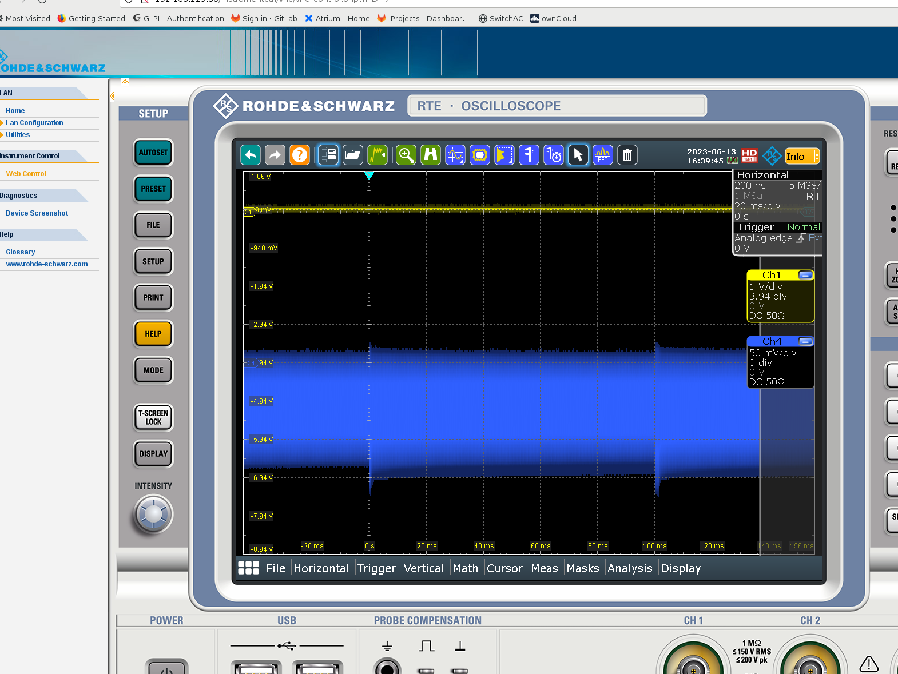
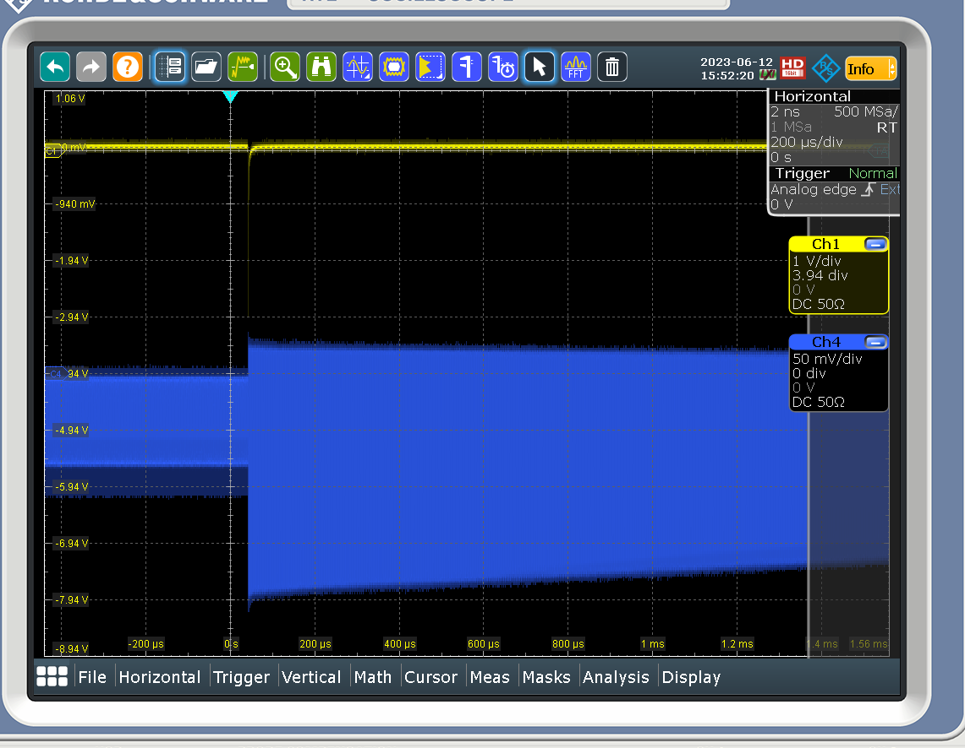
Storage quality
@500.38 MHz
Tuesday 13/06
Eff after 100 ms is ~ 90-95%
Monday 12/06
Eff after 100 ms is ~ 33%

Slide 4
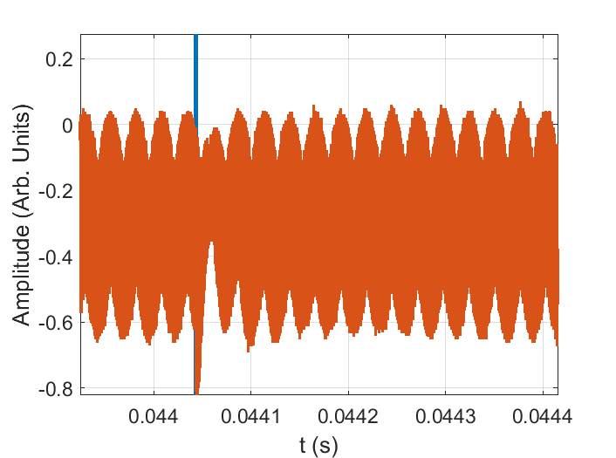
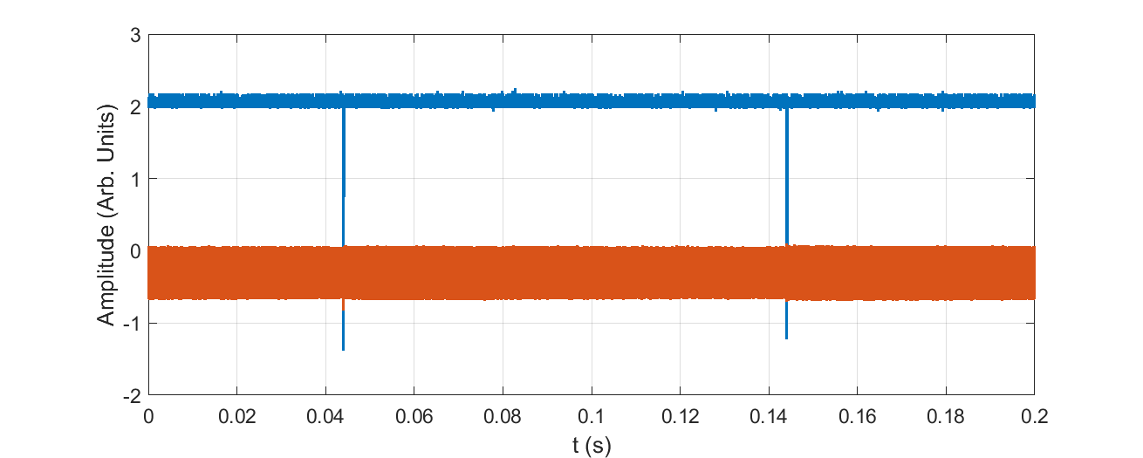

Slide 5
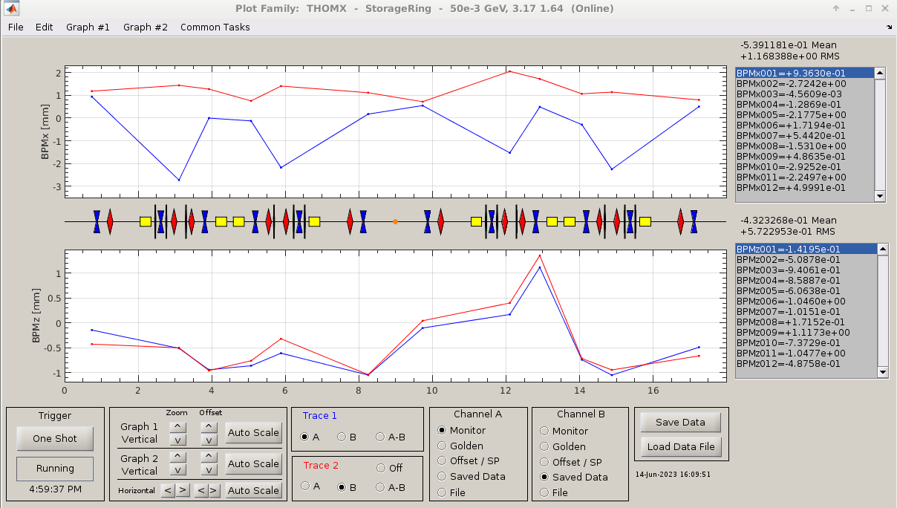
Storage quality (data last Friday)
@500.38 MHz
After energy, phase optimization, the working RF frequency was found to be 500.32 - 500.33 MHz (fine tuning with the orbit).

Slide 6
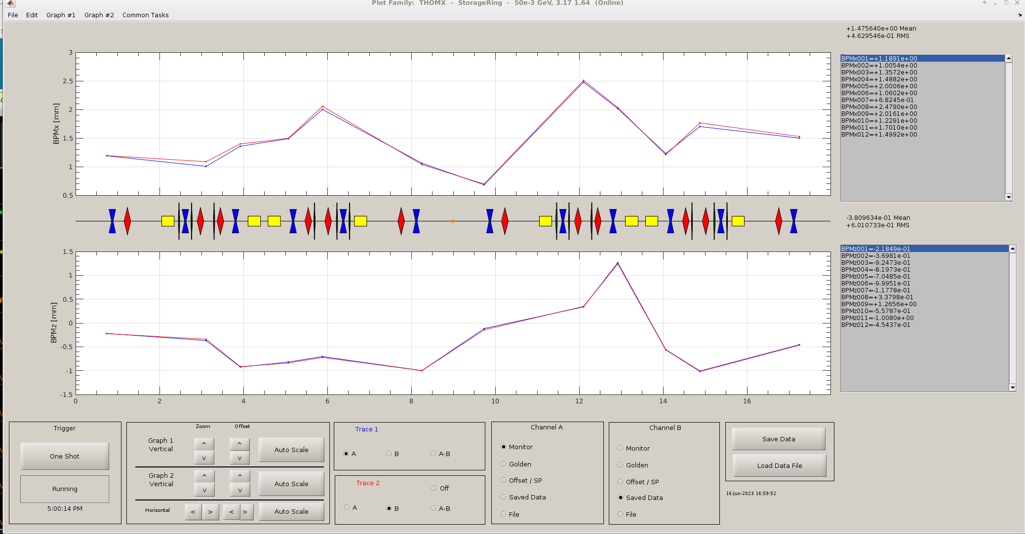
Storage quality (data last Friday)
@500.33 MHz
This orbit now is the same as without RF

Slide 7
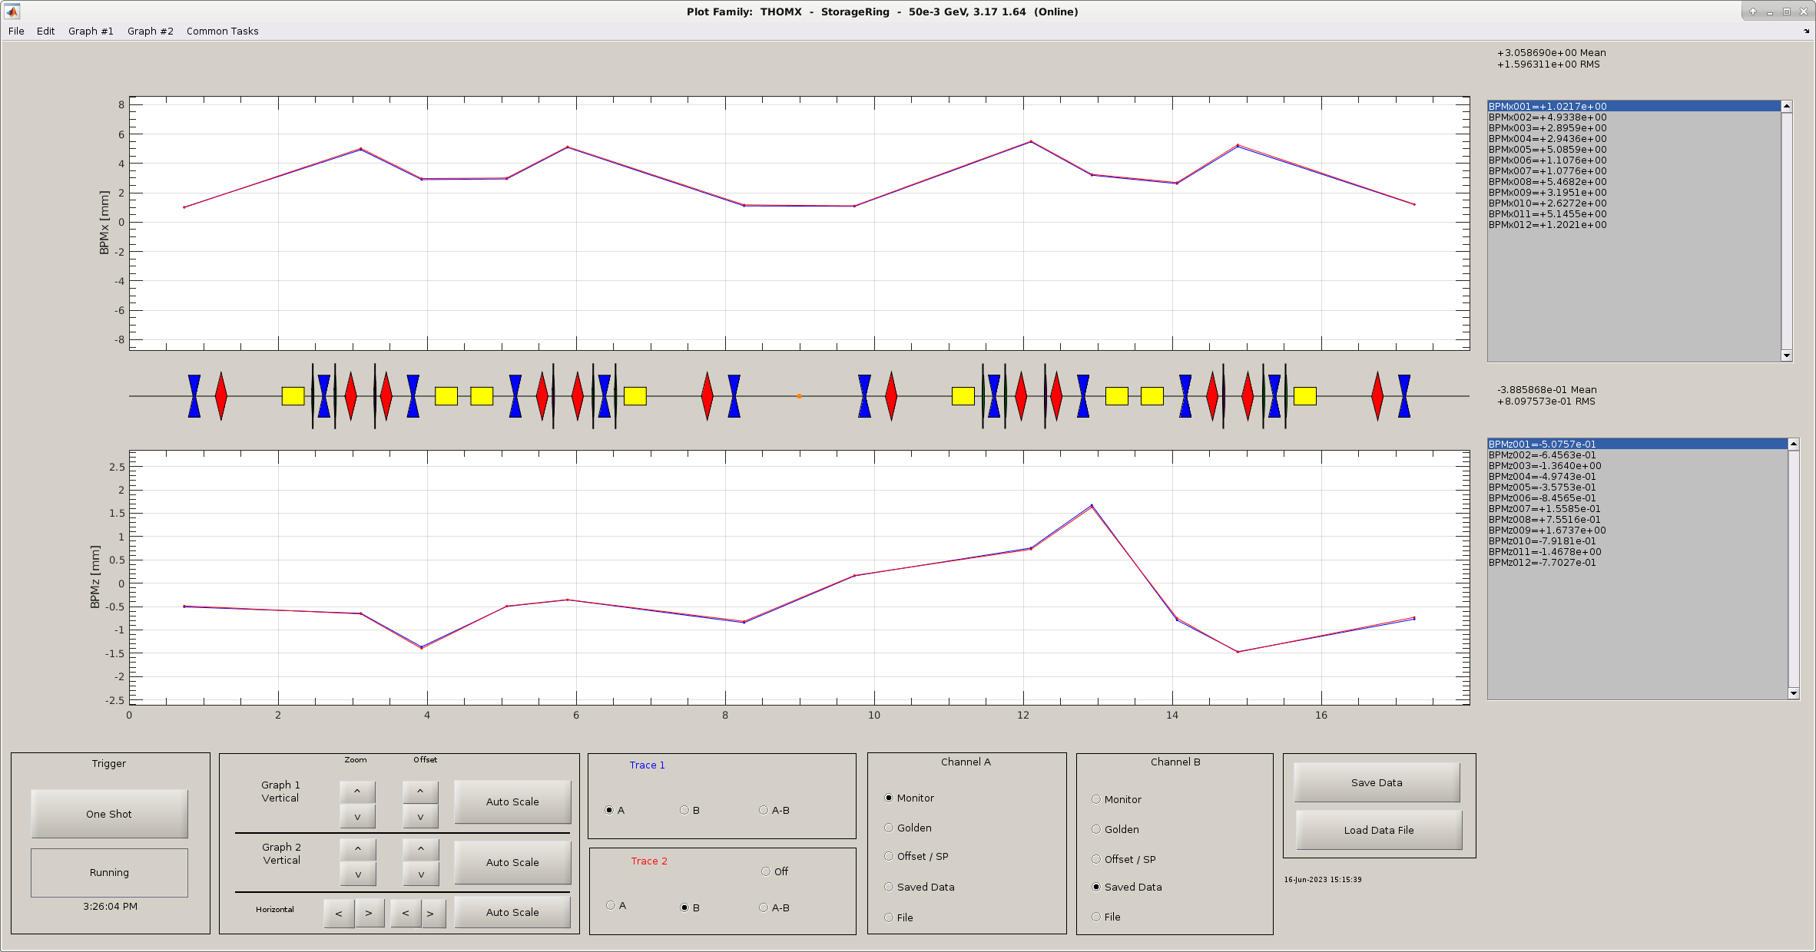
Storage quality (data last Friday)
At the moment the lowest frequency at which we can potentially operate is 500.27 MHz.
Machine is depleted!
At 500.22 MHz beam was quickly lost. No storage obtained.

Slide 8
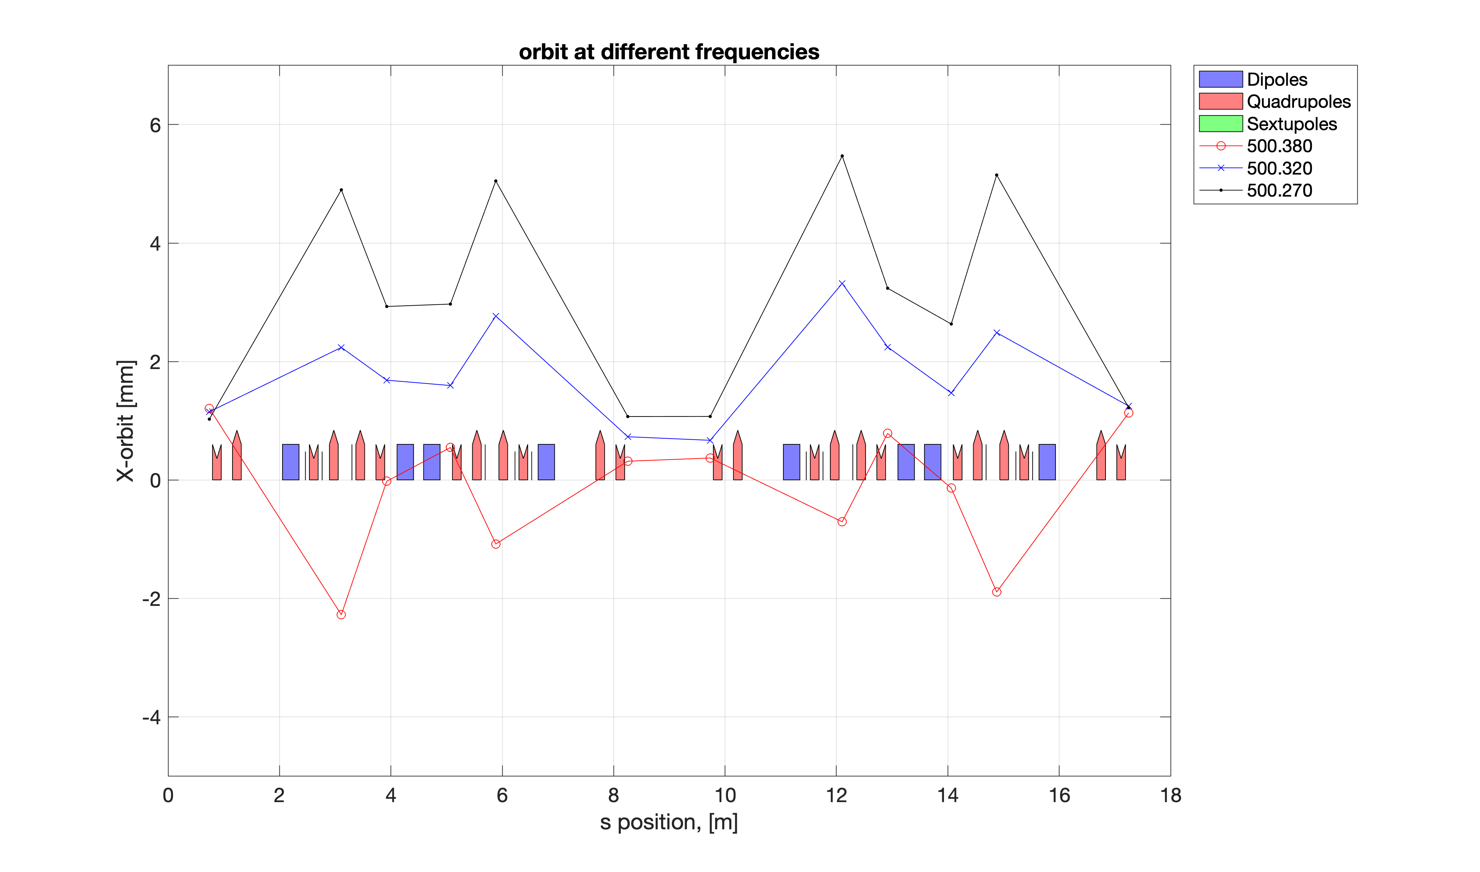
Orbits

Slide 9
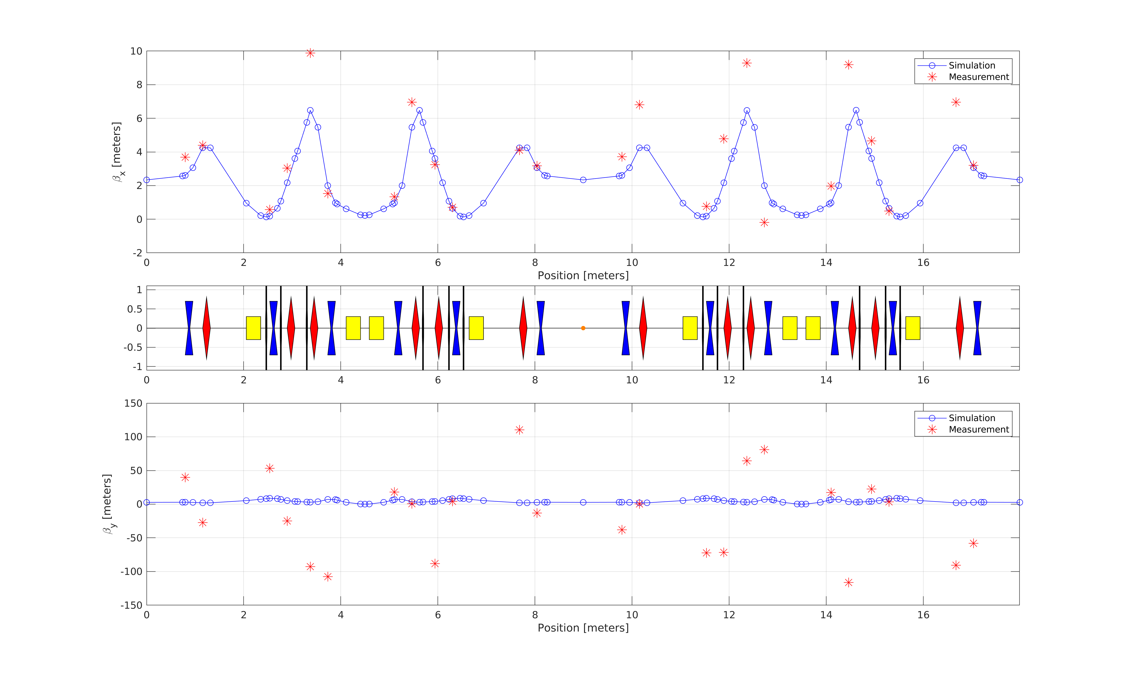
Beam size at the IP
At the moment the only way is to estimate from the beta function and emittance. Only indirect measurements. To early to say something.

Slide 10
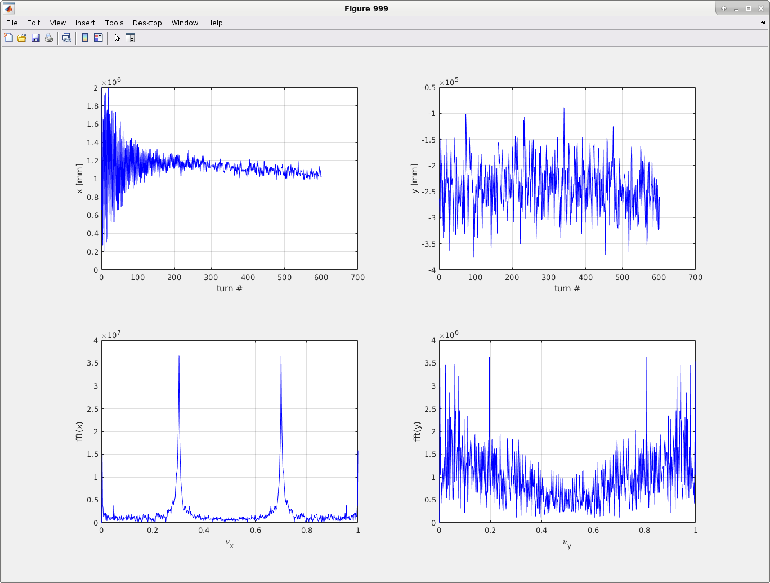
Tune (nominal, tunestep)

Slide 11
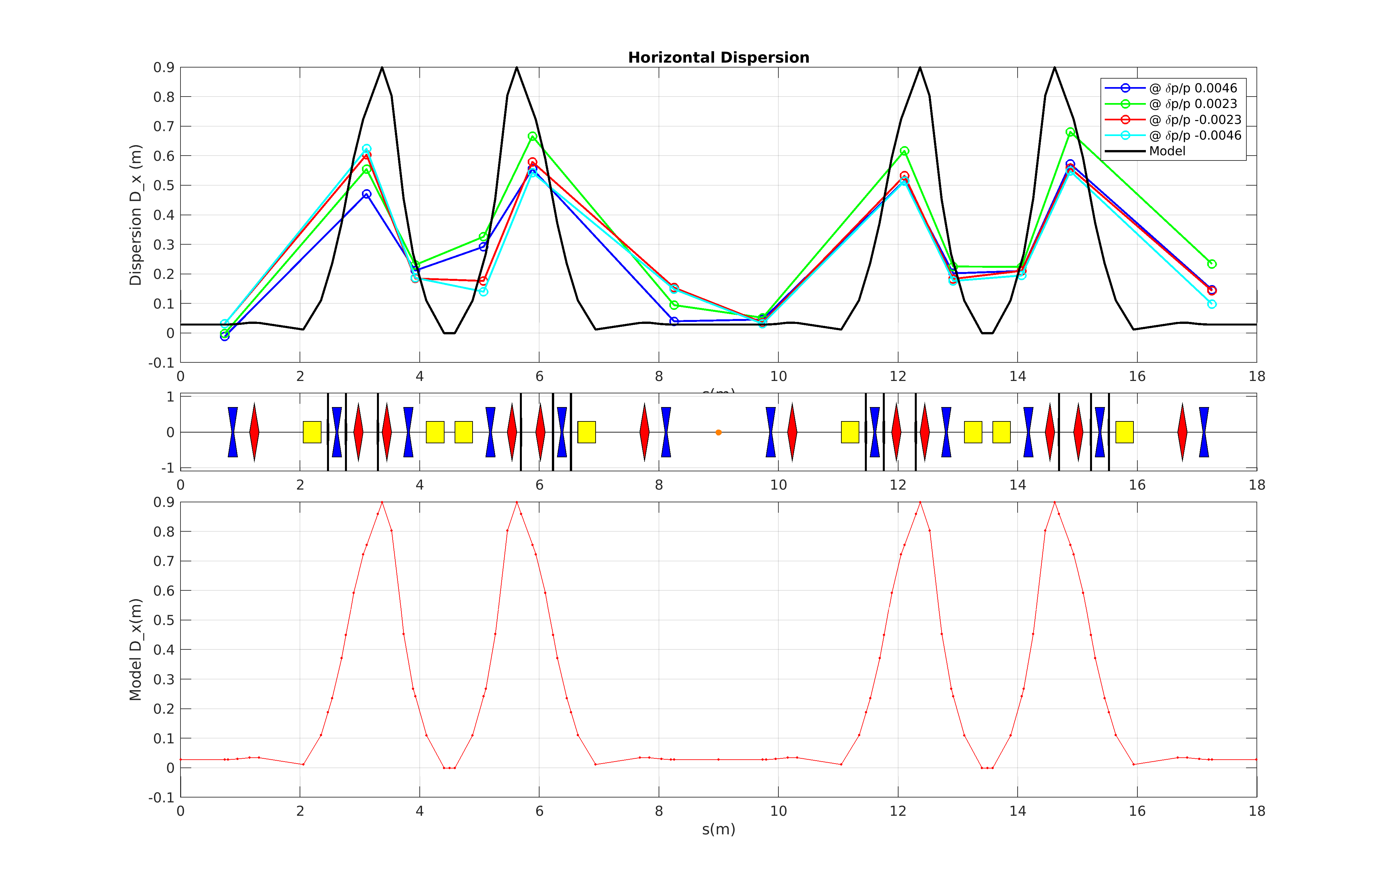
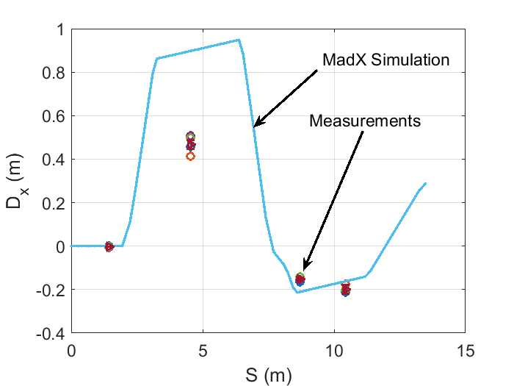
First Dispersion measurements (prelimenary)

Slide 12
Difference in the revolution frequency
We observe that the frequency at which we can operate is bigger than nominal 500.0231 MHz. Typically it is 500.38 – 500.4 MHz.
Based on the orbit studies, we see that the real revolution frequency @50 MeV is more 500.33 MHz (to be confirmed with orbit studies).
At the moment the lowest frequency at which we can potentially operate is 500.27 MHz. Machine is depleted!
Potential reasons:
mechanical alignment/obstacle => check the alignment, monitor the beam losses
dipole field => simulations, magnet study

Slide 13
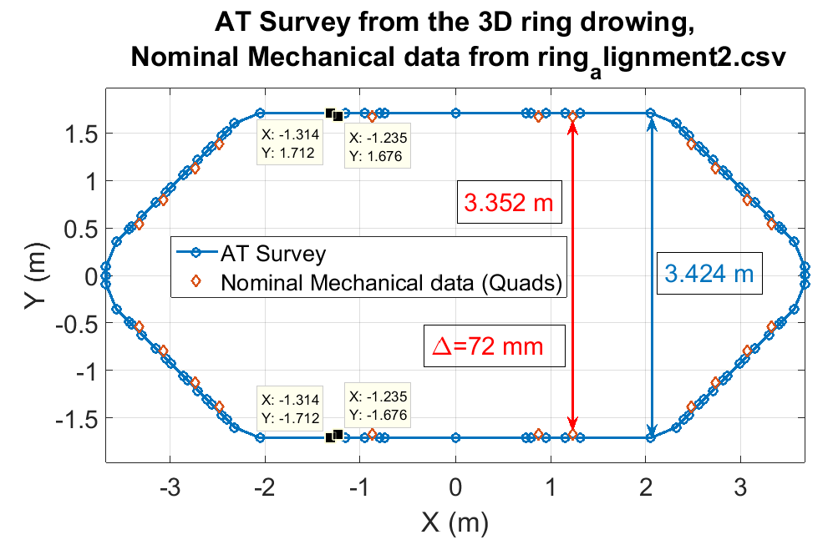
Mechanical alignment
Check of the survey (to be continued)

Slide 14
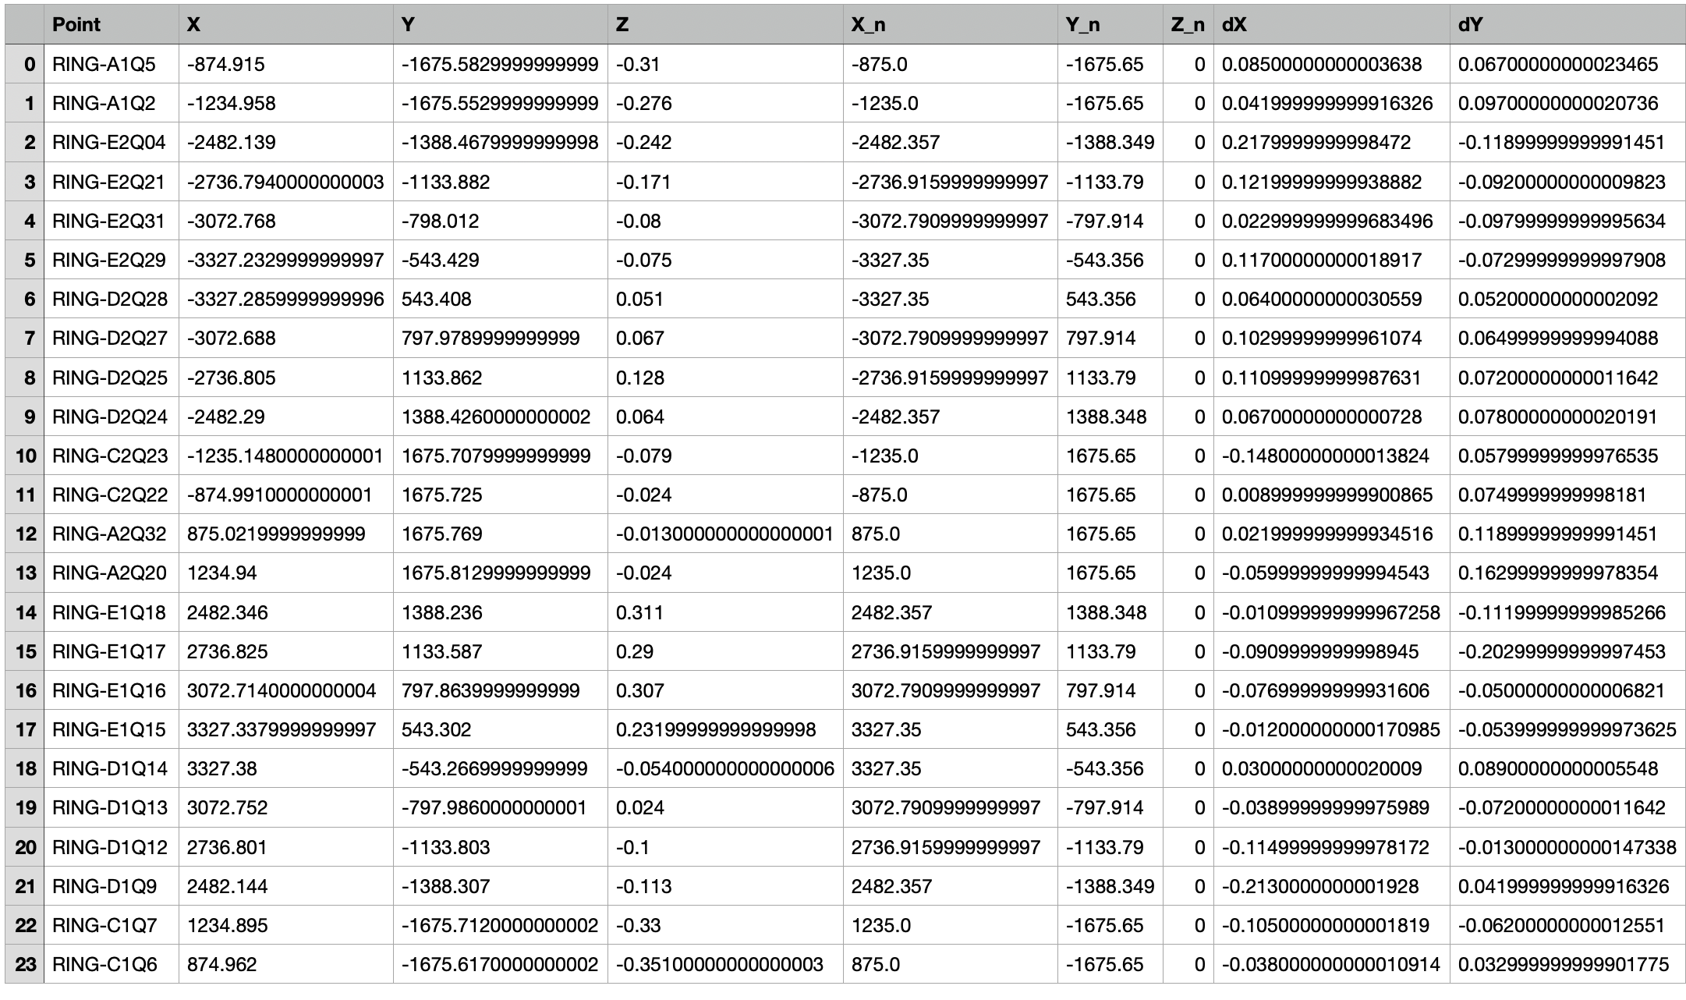
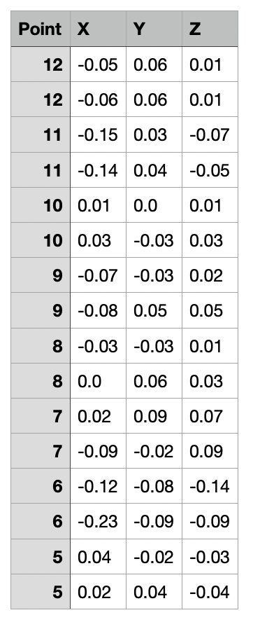
Alignment data
24 Quads
2 points per dipole

Slide 15
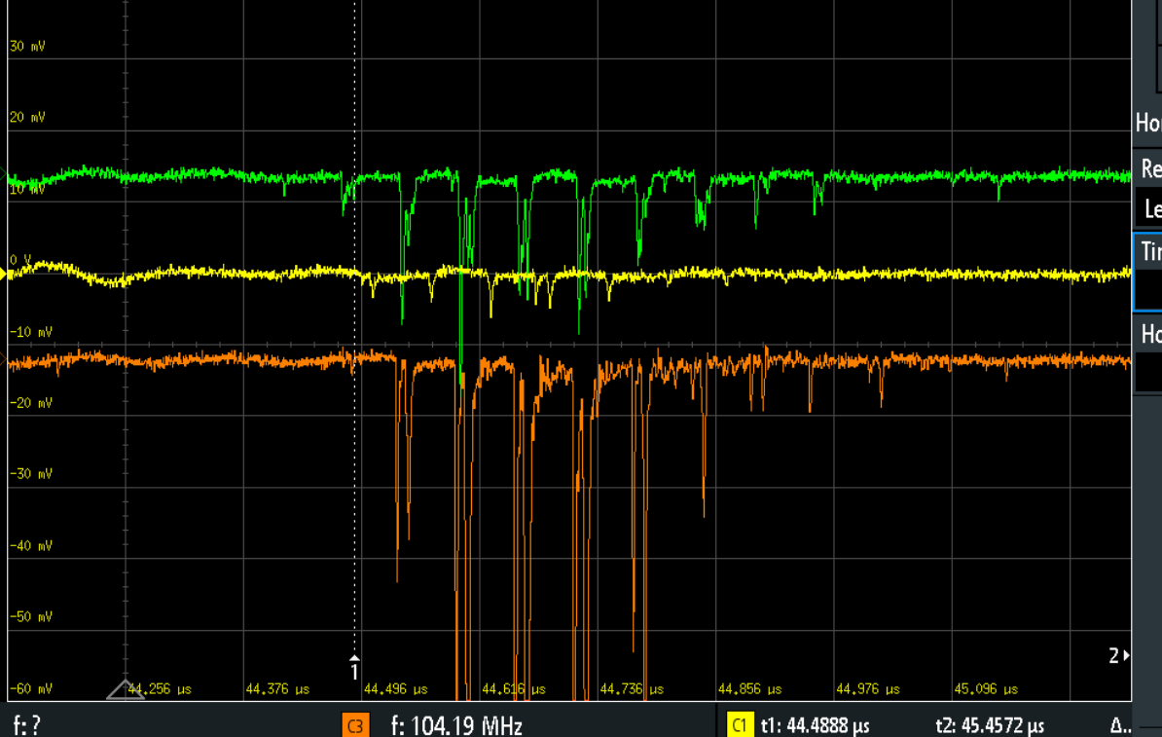
BLM
4 fibers were installed in the ring
3 connected on Friday
BLM turn-by-turn
Scintillators to be
commissioned.

Slide 16
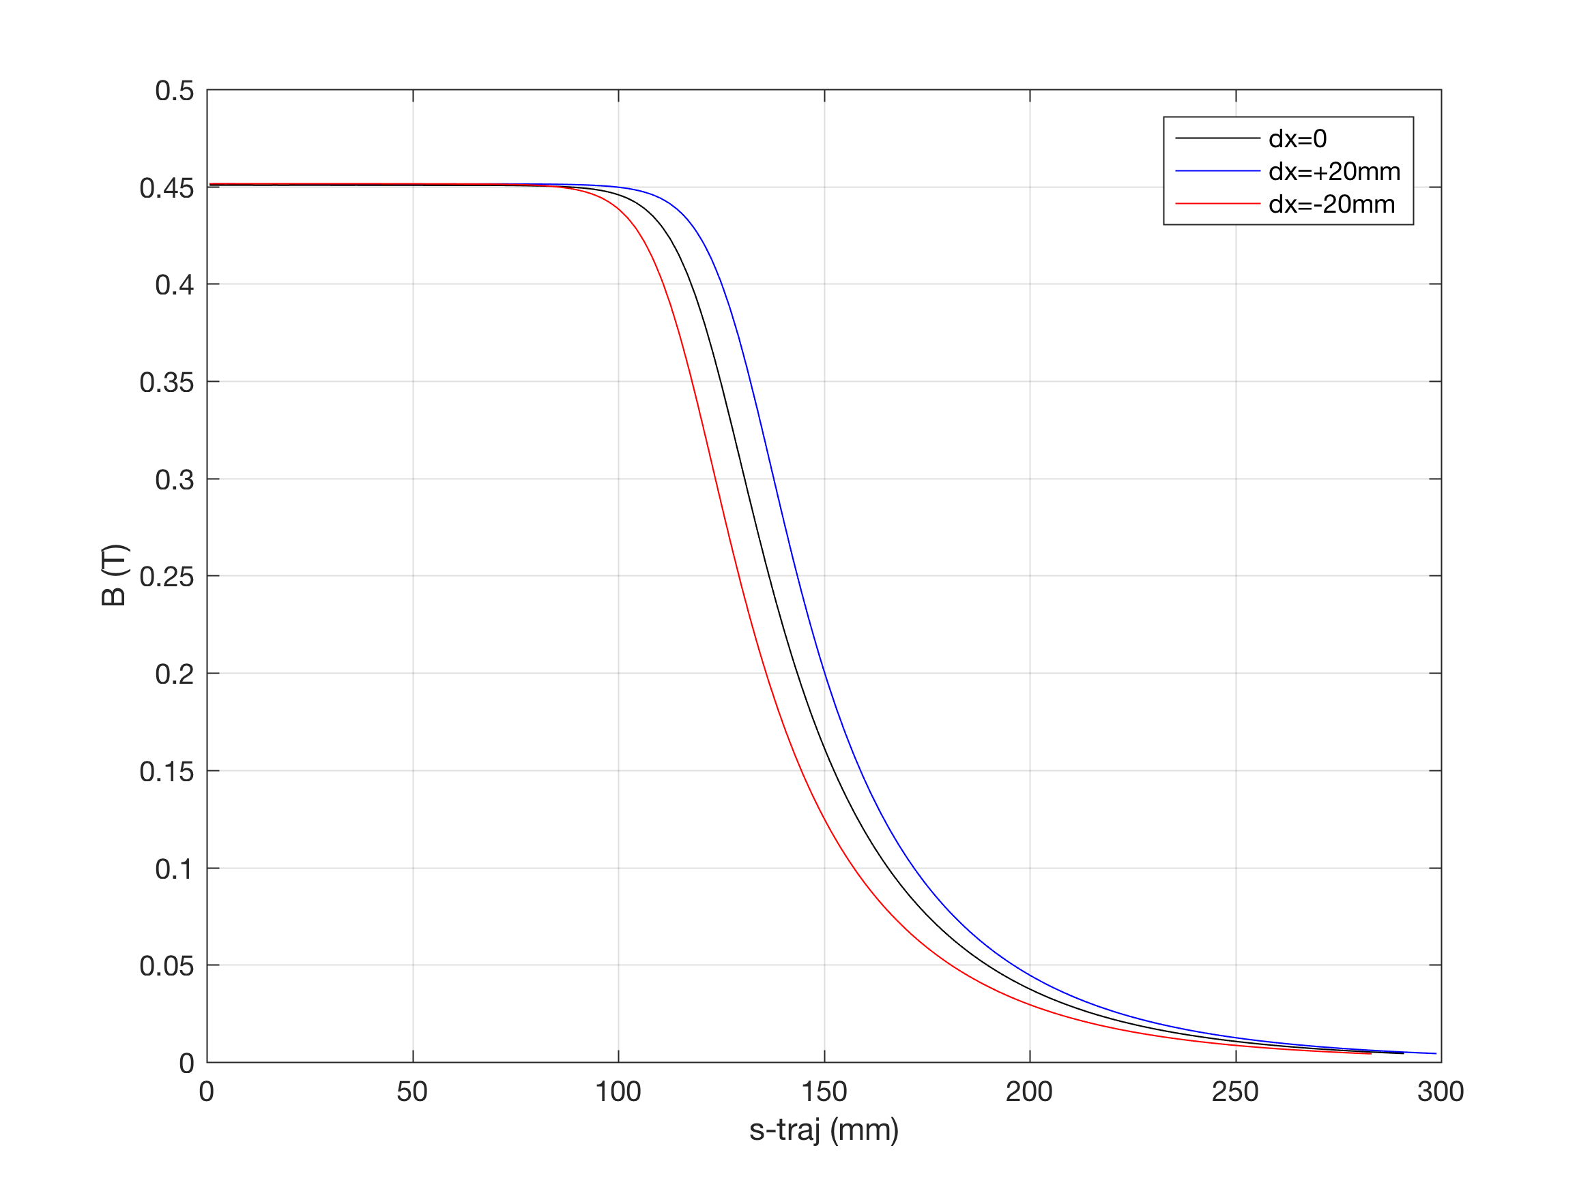
RF frequency problem: 500.4 MHz vs. nominal one 500.02 MHz
Probably it comes from dipoles
20160208a_THOMX#009_fieldmap_160A.xlsx
We strongly need the help from magnet expert.
Reliable OPERA 3D fieldmap at nominal current
Possible measurements and validations

Slide 17
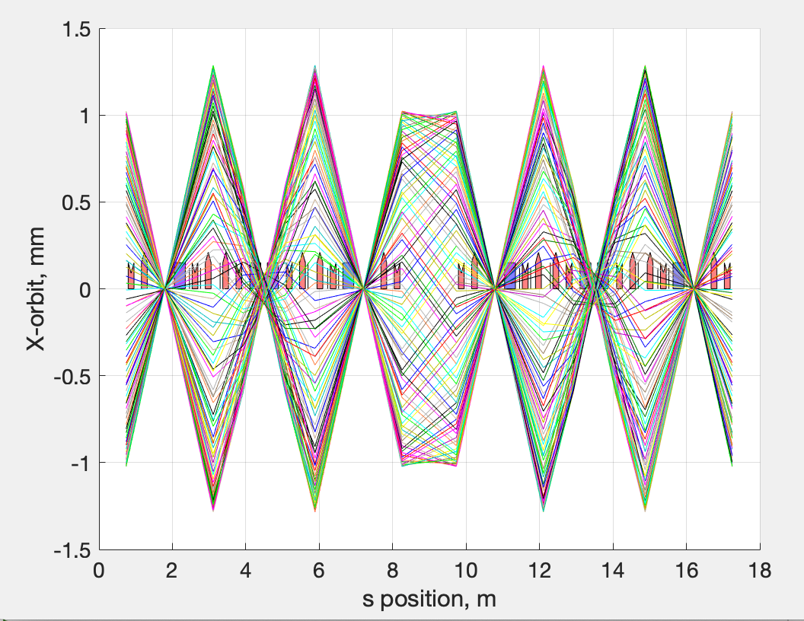
RF-TRACK study of THOMX orbit with realistic dipole field (PRELIMENARY).
Nominal optics, dipole = SBEND
SBEND
Accelerator Toolbox (AT)
Ls = 17986.73472830443
Nturns = 10
P = 50.50741510000000
freq = 499.9972584455388
Without RF
DipoleMap
100 turns
Nominal optics, dipole = DipoleMap
dX =-1;
scale_dip = 1.0;
Ls = 17978.75639596509
Nturns = 10
P = 50.50741510000000
freq = 500.2182390022786
Take this DipoleMap settings as nominal

Slide 19
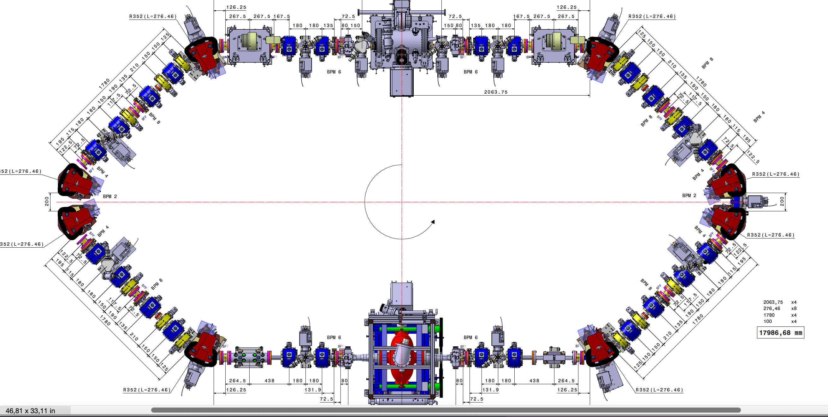
MML
[1 4]
[1 3]
[1 2]
[1 1]
QP2
-QP1
-QP1
QP2
[1 1]
[2 6]
HCOR
HCOR
[1 2]
[2 5]
HCOR
HCOR
[1 3]
-QP31
-QP31
[2 4]
HCOR
[1 5]
BPM 1
BPM 12
[2 12]
HCOR
QP41
[1 1]
QP41
[1 6]
[1 12]
QP4
BPM 2
BPM 11
QP4
[1 7]
[1 11]
-QP3
[1 2]
RI-C1
-QP3
[1 8]
BPM 3
BPM 10
BPM 4
RI-C2
BPM 9
-QP3
-QP3
QP4
BPM 5
BPM 8
QP4
QP41
BPM 6
BPM 7
QP41
HCOR
[1 12]
-QP31
HCOR
[1 4]
-QP31
[2 1]
[2 2]
[2 3]
[2 4]
[2 3]
HCOR
QP2
-QP1
-QP1
QP2
HCOR
[1 5]
[2 2]
HCOR
HCOR
[2 1]
[1 6]

Slide 20
Tango
QP.04
QP.03
QP.02
QP.01
STR.01-H.01
STR.01-V.01
STR.06-H.01
STR.06-V.01
STR.02-H.01
STR.02-V.01
STR.05-H.01
STR.05-V.01
STR.03-H.01
STR.03-V.01
QP.05
QP.12
BPM.02-LIB.03
BPM.01-LIB.03
STR.04-H.01
STR.04-V.01
QP.06
QP.11
QP.07
BPM.03-LIB.03
BPM.06-LIB.05
QP.10
QP.08
RI-C1
QP.09
BPM.04-LIB.03
BPM.05-LIB.05
BPM.05-LIB.04
RI-C2
BPM.04-LIB.05
QP.09
QP.08
QP.10
BPM.06-LIB.04
BPM.03-LIB.05
QP.07
STR.04-H.01
STR.04-V.01
QP.11
BPM.01-LIB.04
BPM.02-LIB.04
QP.06
STR.03-H.01
STR.03-V.01
STR.05-H.01
STR.05-V.01
QP.12
QP.05
QP.01
QP.02
QP.03
QP.04
STR.02-H.01
STR.02-V.01
STR.06-H.01
STR.06-V.01
STR.01-H.01
STR.01-V.01

Slide 21
Ring commissioning with beam (phases)
Phase | Description
B.1 | Injection and first turn: injection commissioning, threading, commissioning beam instrumentation
B.2 | Establish circulating beam: closed orbit, orbit correction, tunes, chromaticity
B.3 | Stored beam and extraction: precise measurements, BBA, feedback systems, beam diagnostics (SRM)
B.4 | Machine physics: LOCO, beta beating, beta function and dispersion, diagnostics, beam dynamics studies
Phase | Description
C | Operation with FPC and IP optimization: position and phase scan
D | Ring commissioning at nominal charge: injection tuning and feedback test at the nominal charge, higher α_{p} optics
F | Ring commissioning at 70 MeV: repeat the necessary commissioning steps (phase B)

Slide 22
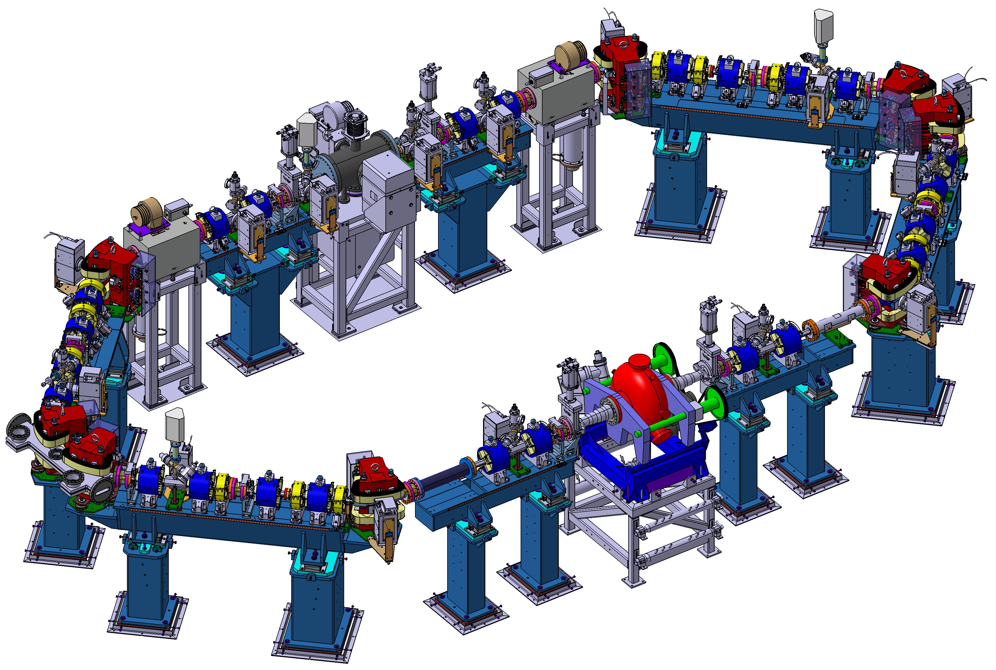
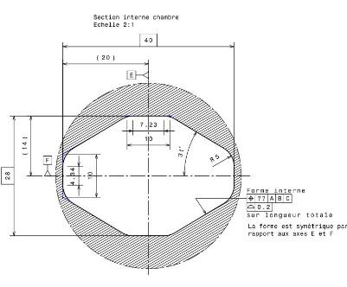
8 Dipoles
24 Quadrupoles
12 Sextupoles
2 Kickers
1 Septum
1 RF cavity
12 BPM
12 Correctors
ThomX SR: L = 18 m, T = 60 ns, Frep = 16.7 MHz
28x40

Slide 23
