Slide 1
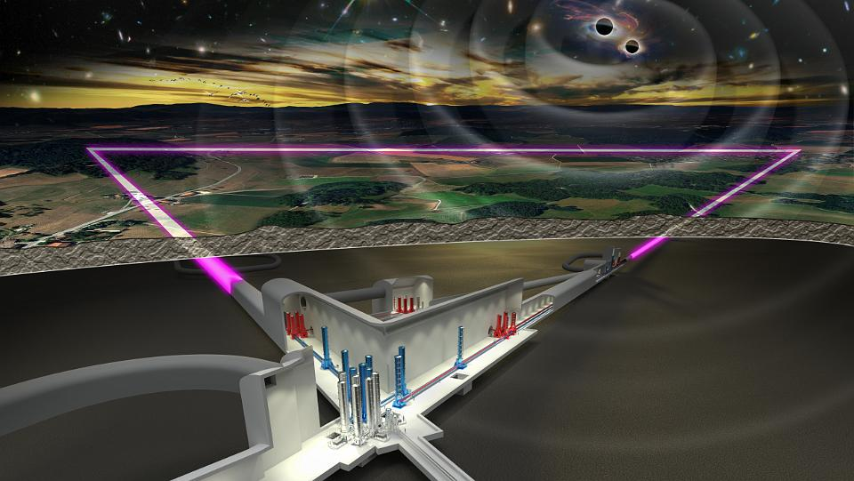
SCB/SPB Meeting Summary
ET Annual Meeting 16th Nov 2023
Wim Walk, Nikhef
Orsay, 16 Nov 2023

Slide 2
SPB/SCB Sessions
Tuesday Nov. 14 from 14:10 to 15:55
  Introduction to Sardinia Candidature Activities (Domenico D’Urso)
  Progressing towards the 4D geological characterization of the Einstein Telescope site in Sardinia (Luca. Cardello)
  Summary of site characterization activities at the Sardinia candidate site for the Einstein Telescope (Matteo. Di Giovanni)
  Review on Sardinia Measurements: data repository (Alessio Fiori)

Slide 3
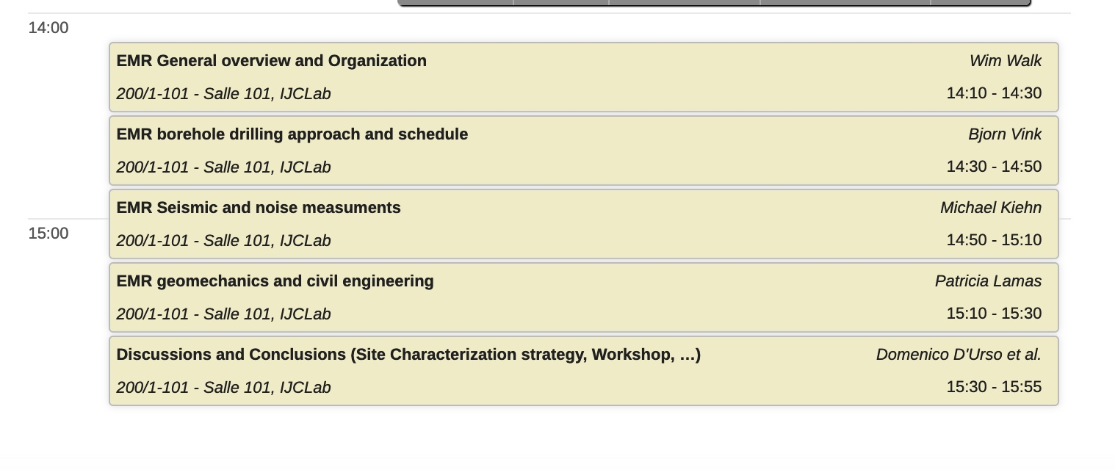
SCB / SPB Presentations
Wednesday 15 Nov, afternoon – Salle 101, IJCLab & online
Completed, Ongoing & Upcoming Geo-studies EMR
EMR Noise Measurements, Active & Passive Seismic. Results and recommendations
Civil Engineering approach for EMR region

Slide 4
SPB/SCB Sessions
Tuesday Nov. 14 from 14:10 to 15:55
  Introduction to Sardinia Candidature Activities (Domenico D’Urso)
  Progressing towards the 4D geological characterization of the Einstein Telescope site in Sardinia (Luca. Cardello)
  Summary of site characterization activities at the Sardinia candidate site for the Einstein Telescope (Matteo. Di Giovanni)
  Review on Sardinia Measurements: data repository (Alessio Fiori)

Slide 5
Overview of WP4 Milestones and Deliverables
Standardized Data Interpretation
Discussion with ISB on WDs and WPs
Common working group is going to be set up and thematic meetings will be organized to eliminate differences between the different approaches.
Dedicated Workshop including related WPs from ISB – December 6th-7th 2023 https://indico.nikhef.nl/event/4820/ to discuss the status of noise understanding towards a definition of a common methodology (Registration is required for both in person participation and online participation)
A document will be prepared to report a standardization on measurement methodologies and agreements on common tools to be used for noise estimation

Slide 6
SPB/SCB Sessions
Tuesday Nov. 14 from 14:10 to 15:55
  Introduction to Sardinia Candidature Activities (Domenico D’Urso)
  Progressing towards the 4D geological characterization of the Einstein Telescope site in Sardinia (Luca. Cardello)
  Summary of site characterization activities at the Sardinia candidate site for the Einstein Telescope (Matteo. Di Giovanni)
  Review on Sardinia Measurements: data repository (Alessio Fiori)

Slide 7


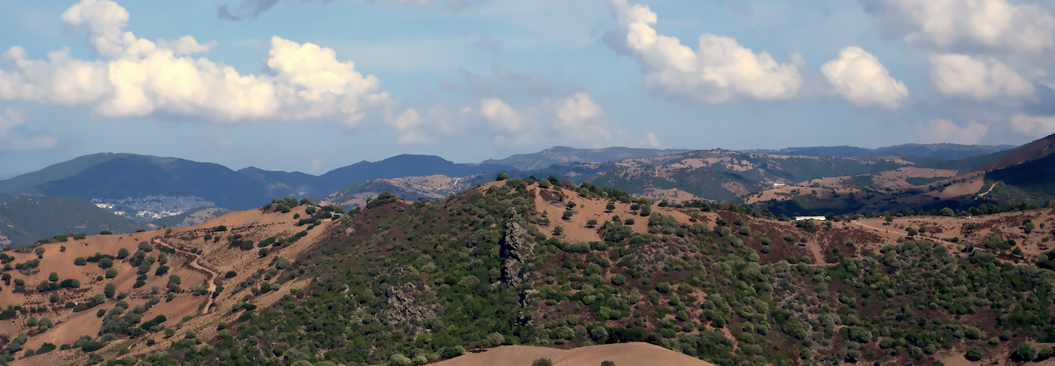
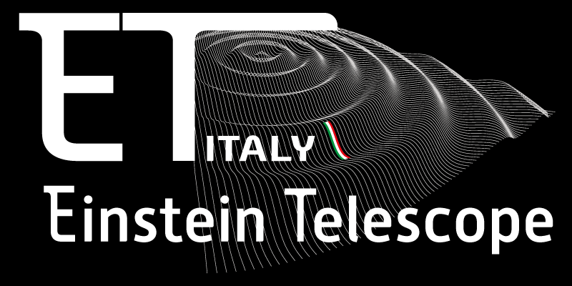
Progressing towards the 4D geological characterization of the Einstein Telescope site in Sardinia (Italy)
Paris-Saclay University – 2nd Einstein Telescope Annual Meeting – Observational Science Board (OSB) – 14/11/2023
Giovanni Luca Cardello*
Università degli Studi di Sassari
INFN - Laboratori Nazionali del Sud
*Contacts: glcardello@uniss.it
on behalf and with the contribution of the ET collaboration
Notes:
This communication embarks on a scientific voyage through the Chaotic complex of the northern Volsci Range, offering profound insights into the geological history of the Apennines. By scrutinizing the stratigraphy, structural characteristics, and formative processes of this mélange, this study contributes substantively to the broader understanding of orogenic evolution and the pivotal role played by mélange terrains in shaping the geological tapestry of our planet.

Slide 8
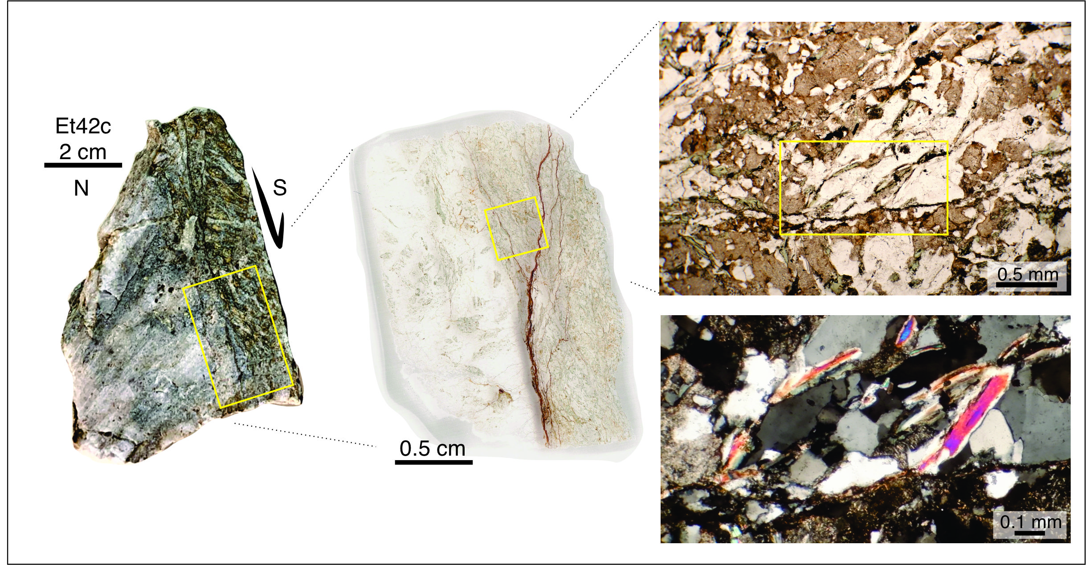
FAULT CONTACTS WITH VEINS
Lithological main boundaries are marked by mica and chlorite rich shear zones evolving to cataclasites. These fault zones have been locally injected by thick quartz veins.
The main fault zones were likely site of post-Variscan hydrothermal circulation
Qz-veins and cataclasitic bands are as thick as ten meters.
N
S

Slide 9

PART 4. FUTURE WORK
Geochronology for the fourth dimension:
  U-(Th)-Pb (Zircon, Monazite) (7-12 samples) to define emplacement age of granitoids and, protolith and peak metamorphism ages of metamorphic rocks
  Raman Spectroscopy (about 20 samples – Scottland)
  Ar–Ar dating on white mica (5-7 samples) to get information about timing of the ductile-brittle transition
  Low-temperature thermochronometry on apatite and zircons to unravel the thermal history eventually related to faults and the vertical movements that could be potentially related to them
    (Apatite Fission Tracks (25 samples)
    (U-Th-Sm)/He Apatite (15 samples)
    (U-Th-Sm)/He Zircon (7 samples)
  Fault Gouge K-Ar dating of illite-bearing fault gouge collected from faults that potentially provide the age of the last brittle movements of the area
T
I
M
E

Slide 10
SPB/SCB Sessions
Tuesday Nov. 14 from 14:10 to 15:55
  Introduction to Sardinia Candidature Activities (Domenico D’Urso)
  Progressing towards the 4D geological characterization of the Einstein Telescope site in Sardinia (Luca. Cardello)
  Summary of site characterization activities at the Sardinia candidate site for the Einstein Telescope (Matteo. Di Giovanni)
  Review on Sardinia Measurements: data repository (Alessio Fiori)

Slide 11
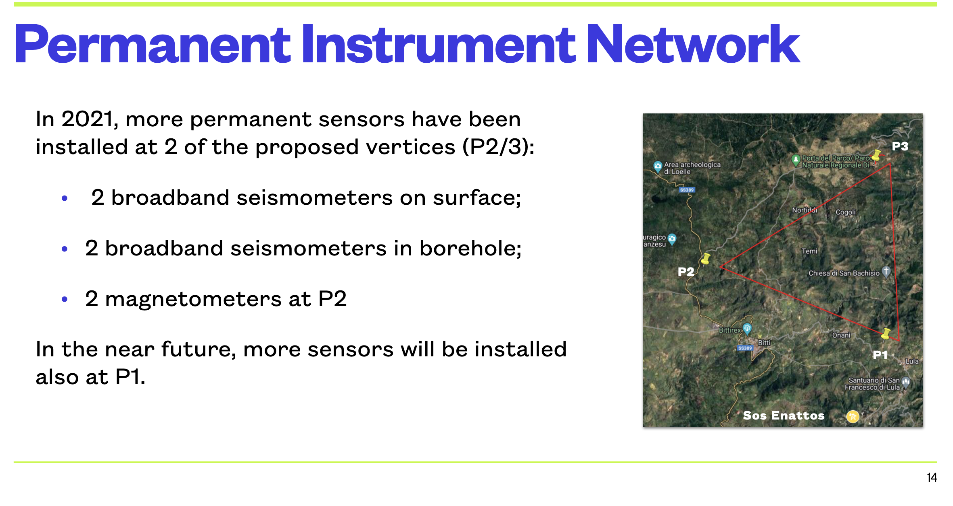

Slide 12
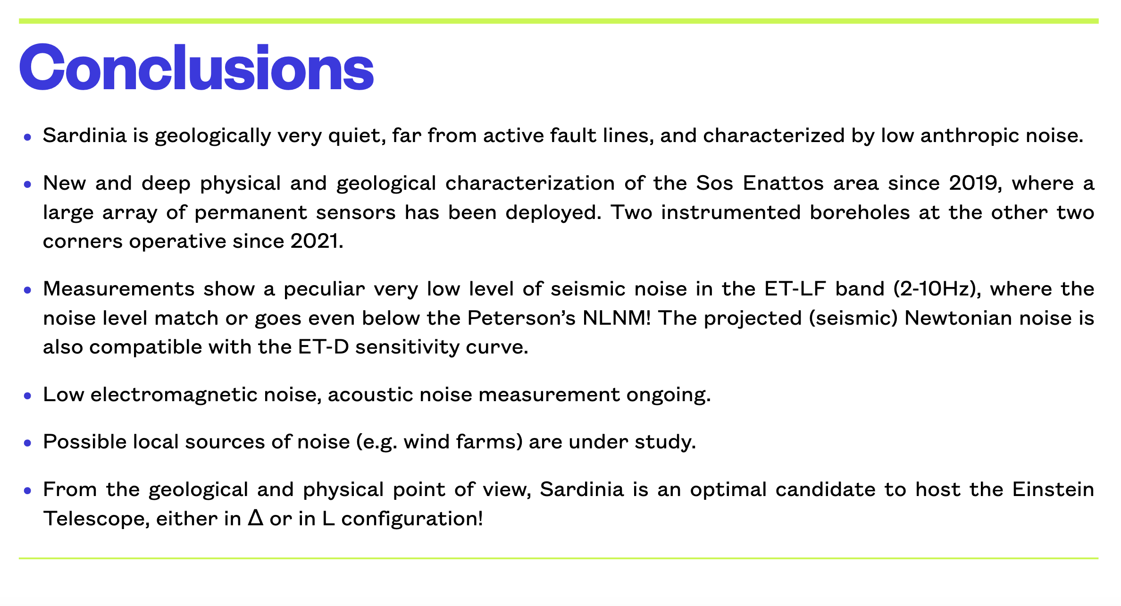

Slide 13
SPB/SCB Sessions
Tuesday Nov. 14 from 14:10 to 15:55
  Introduction to Sardinia Candidature Activities (Domenico D’Urso)
  Progressing towards the 4D geological characterization of the Einstein Telescope site in Sardinia (Luca. Cardello)
  Summary of site characterization activities at the Sardinia candidate site for the Einstein Telescope (Matteo. Di Giovanni)
  Review on Sardinia Measurements: data repository (Alessio Fiori)

Slide 14
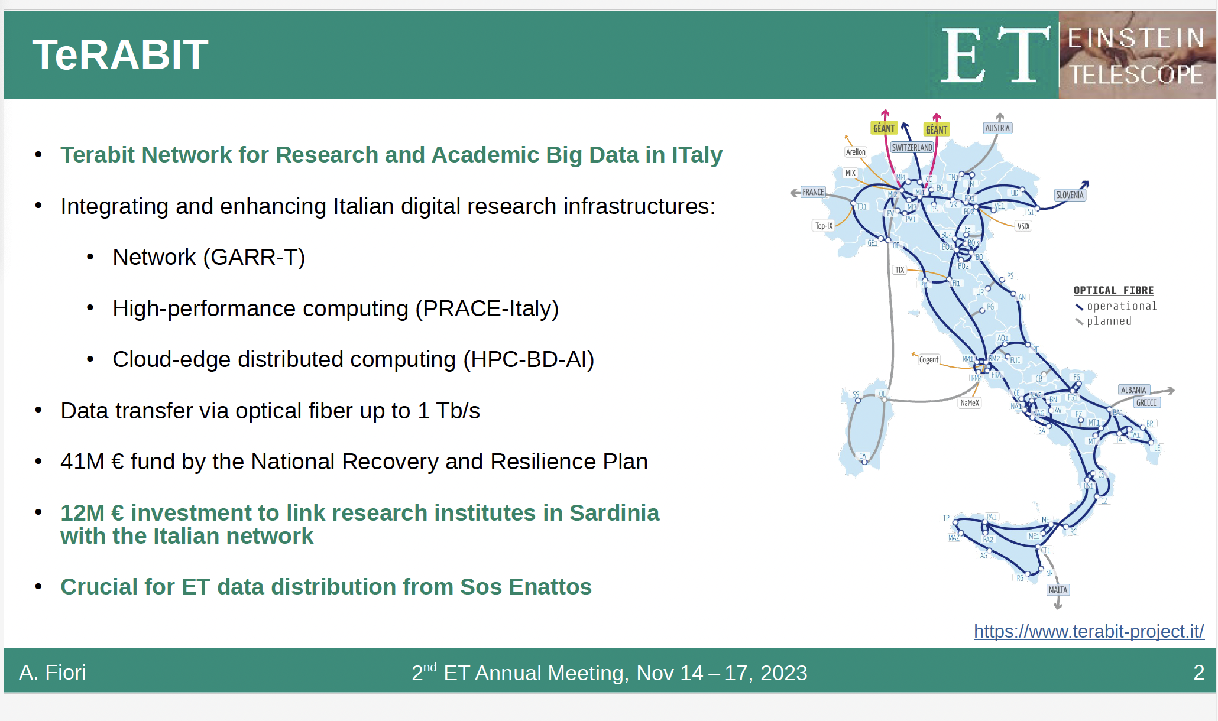

Slide 15
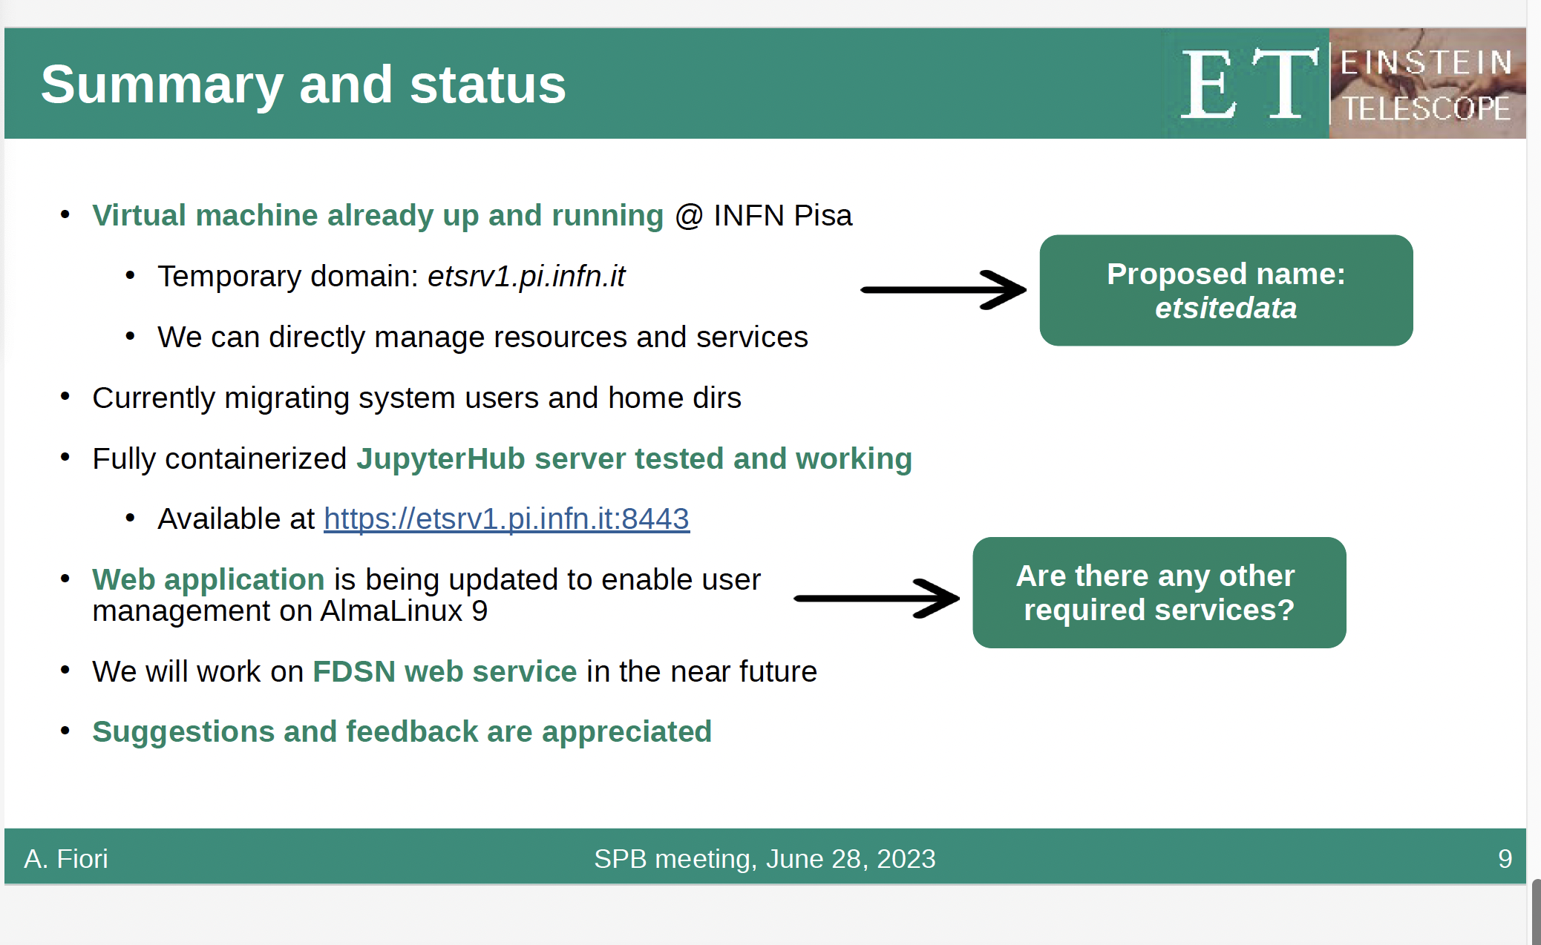

Slide 16
SCB / SPB Presentations
Wednesday 15 Nov, afternoon – Salle 101, IJCLab & online
Completed, Ongoing & Upcoming Geo-studies EMR
EMR Noise Measurements, Active & Passive Seismic. Results and recommendations
Civil Engineering approach for EMR region

Slide 17
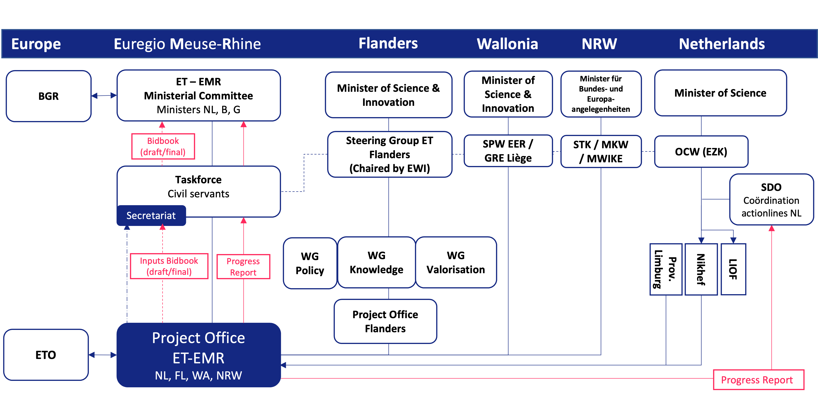
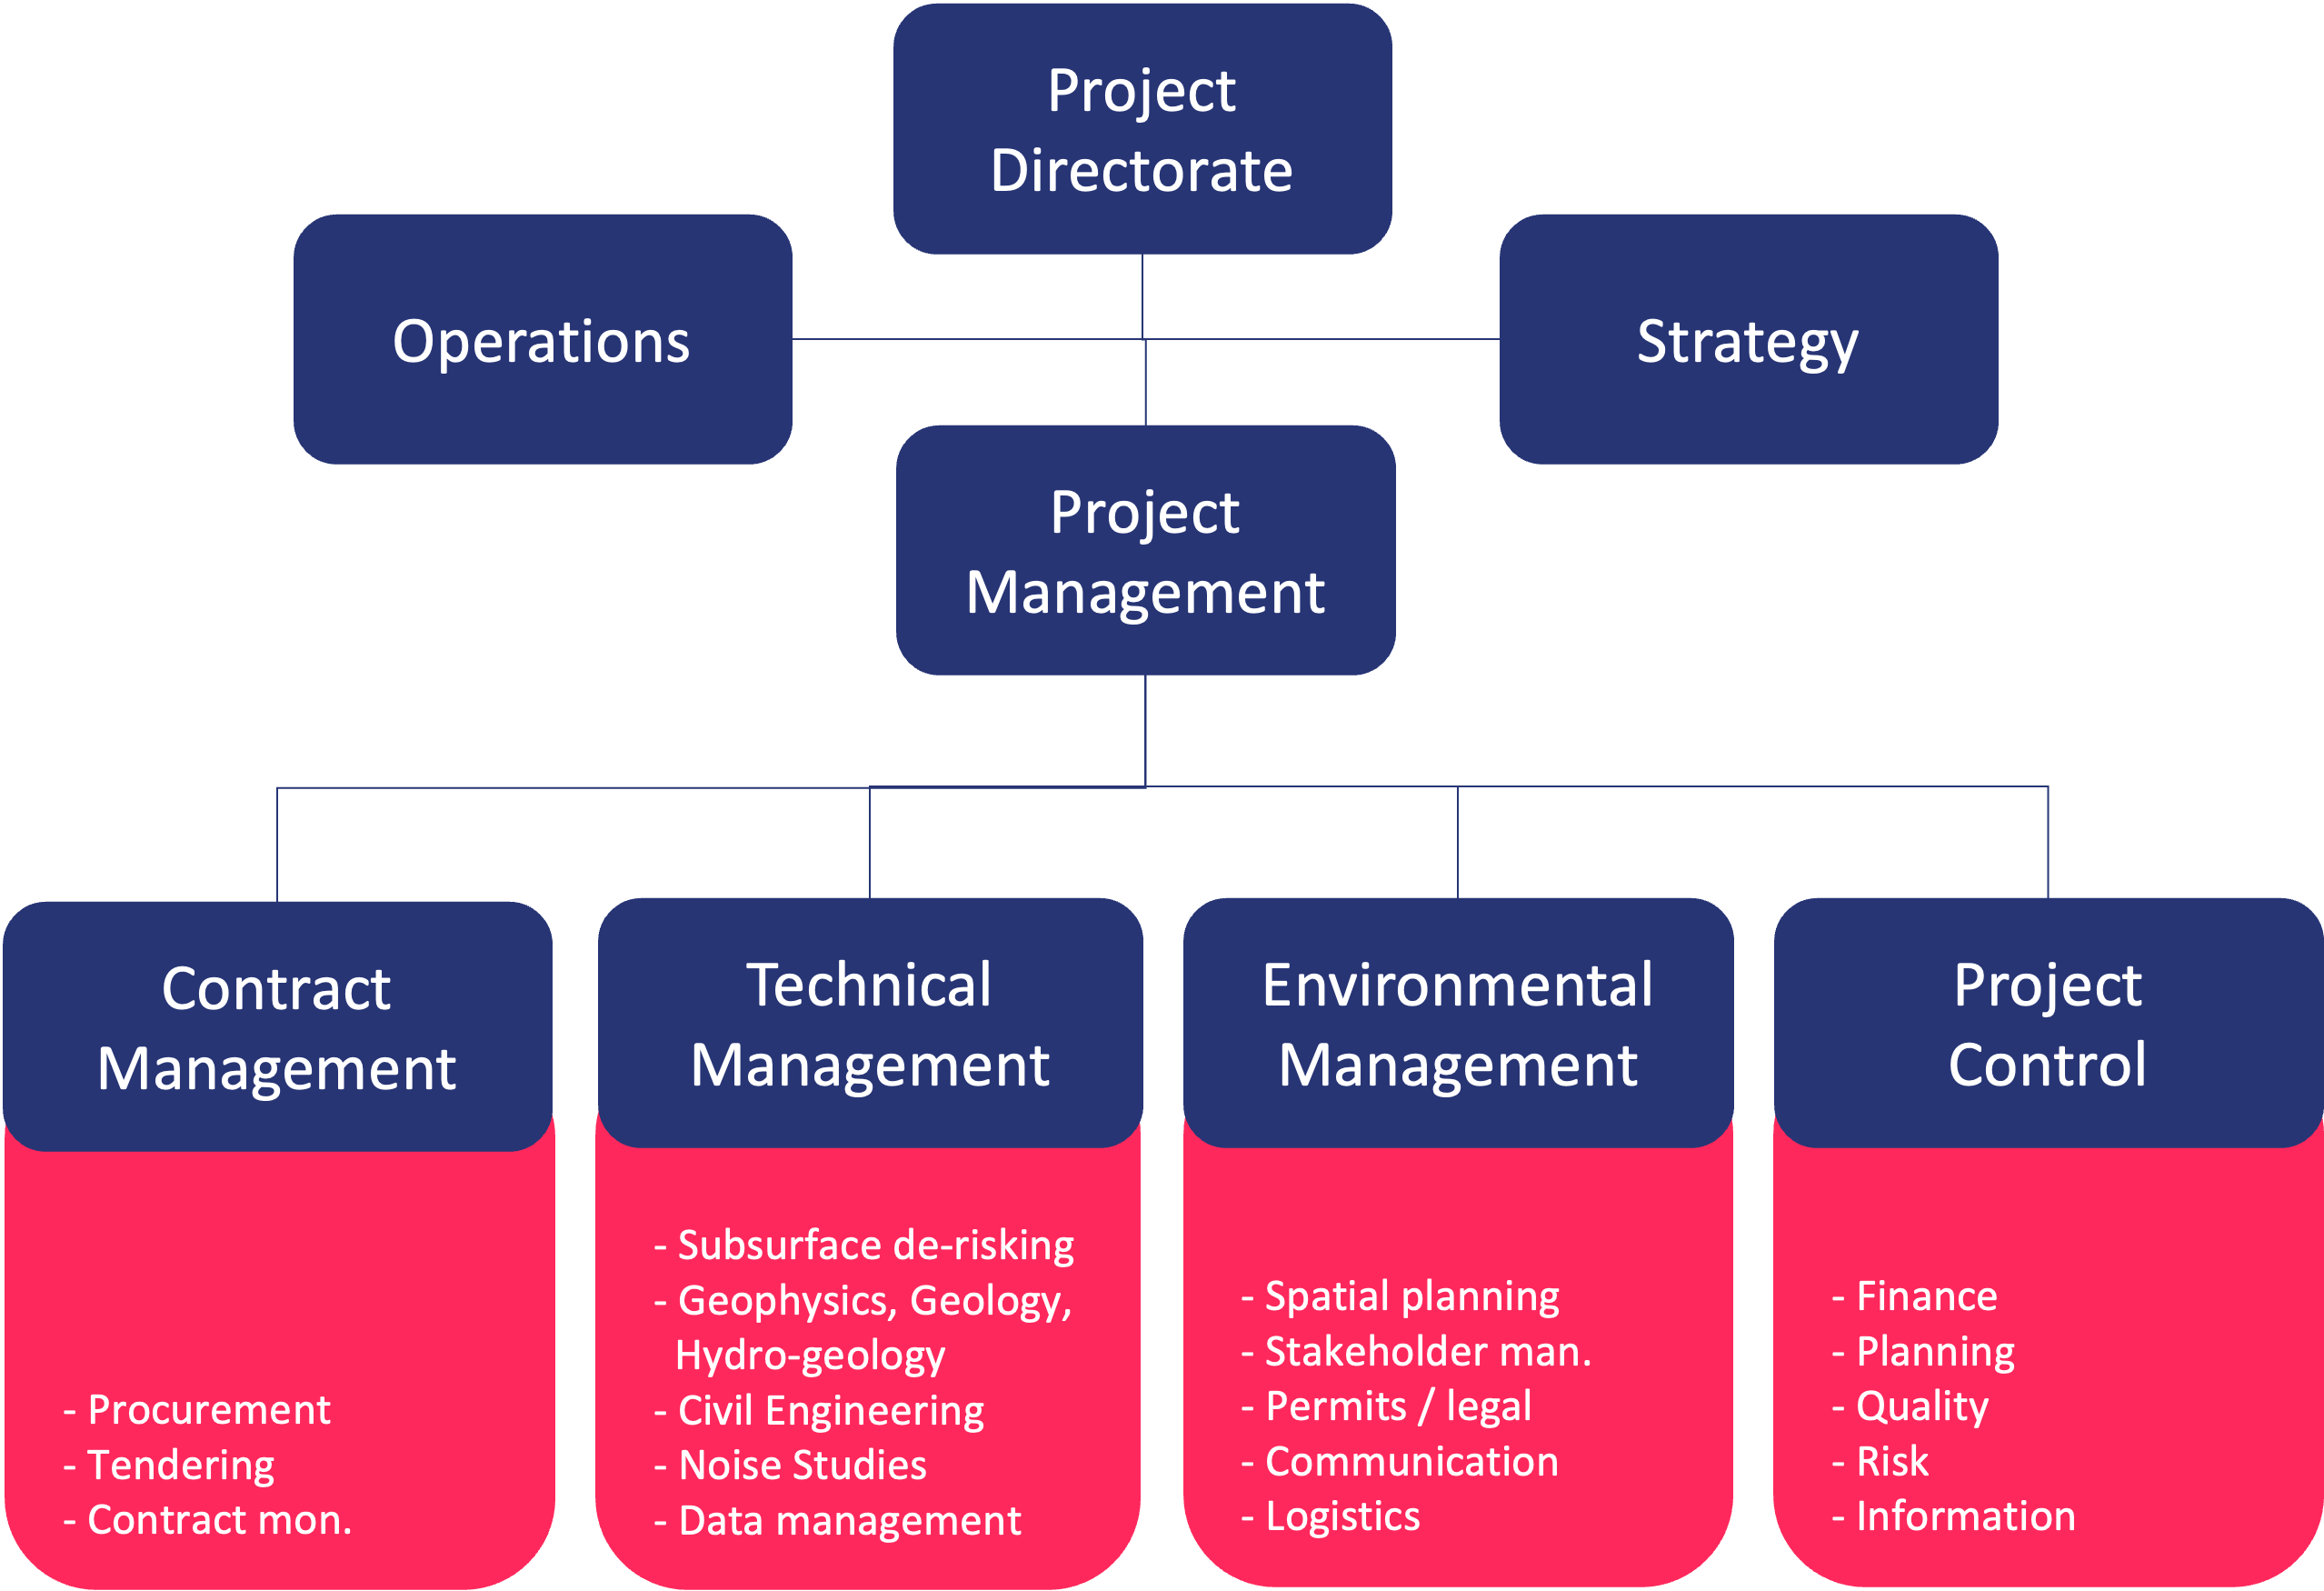

Slide 18
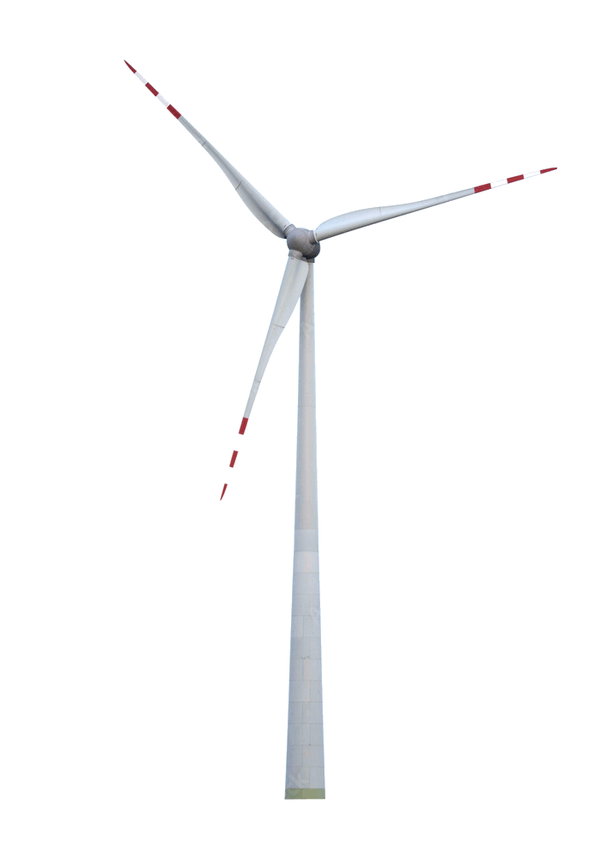
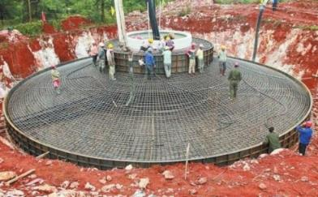
Impact study windturbines – Project defined
Project period: 2024 - 2025
Client: ET-EMR project office
Executive: Nikhef, RWTH, Uliège, KU Leuven and Hasselt University
WP 1: Impact assessment of windturbines (prof. F. Nguyen)
WP 2: Mitigating measures effects and costs (prof. A. Stahl)
WP 3: Legal aspects (L. van der Auwermeulen)
Project Management (R. Schlooz); Communication (H. Schroen)

Slide 19
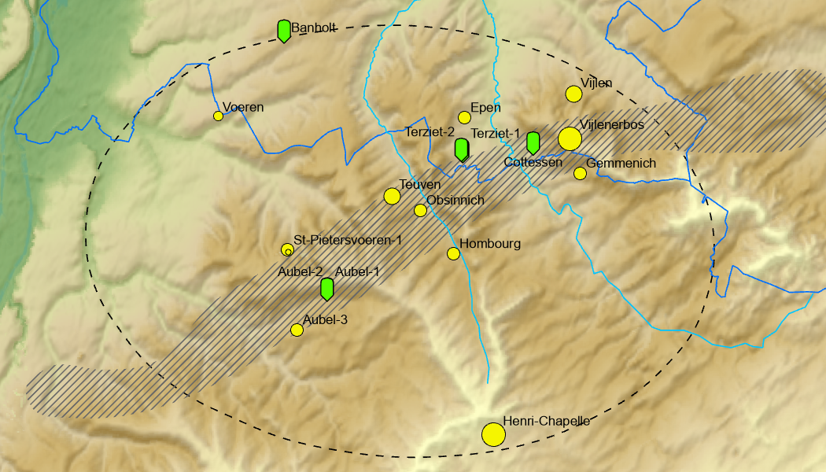
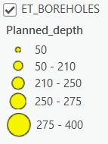
Next 10 Boreholes (finish by June 2024)

Slide 20
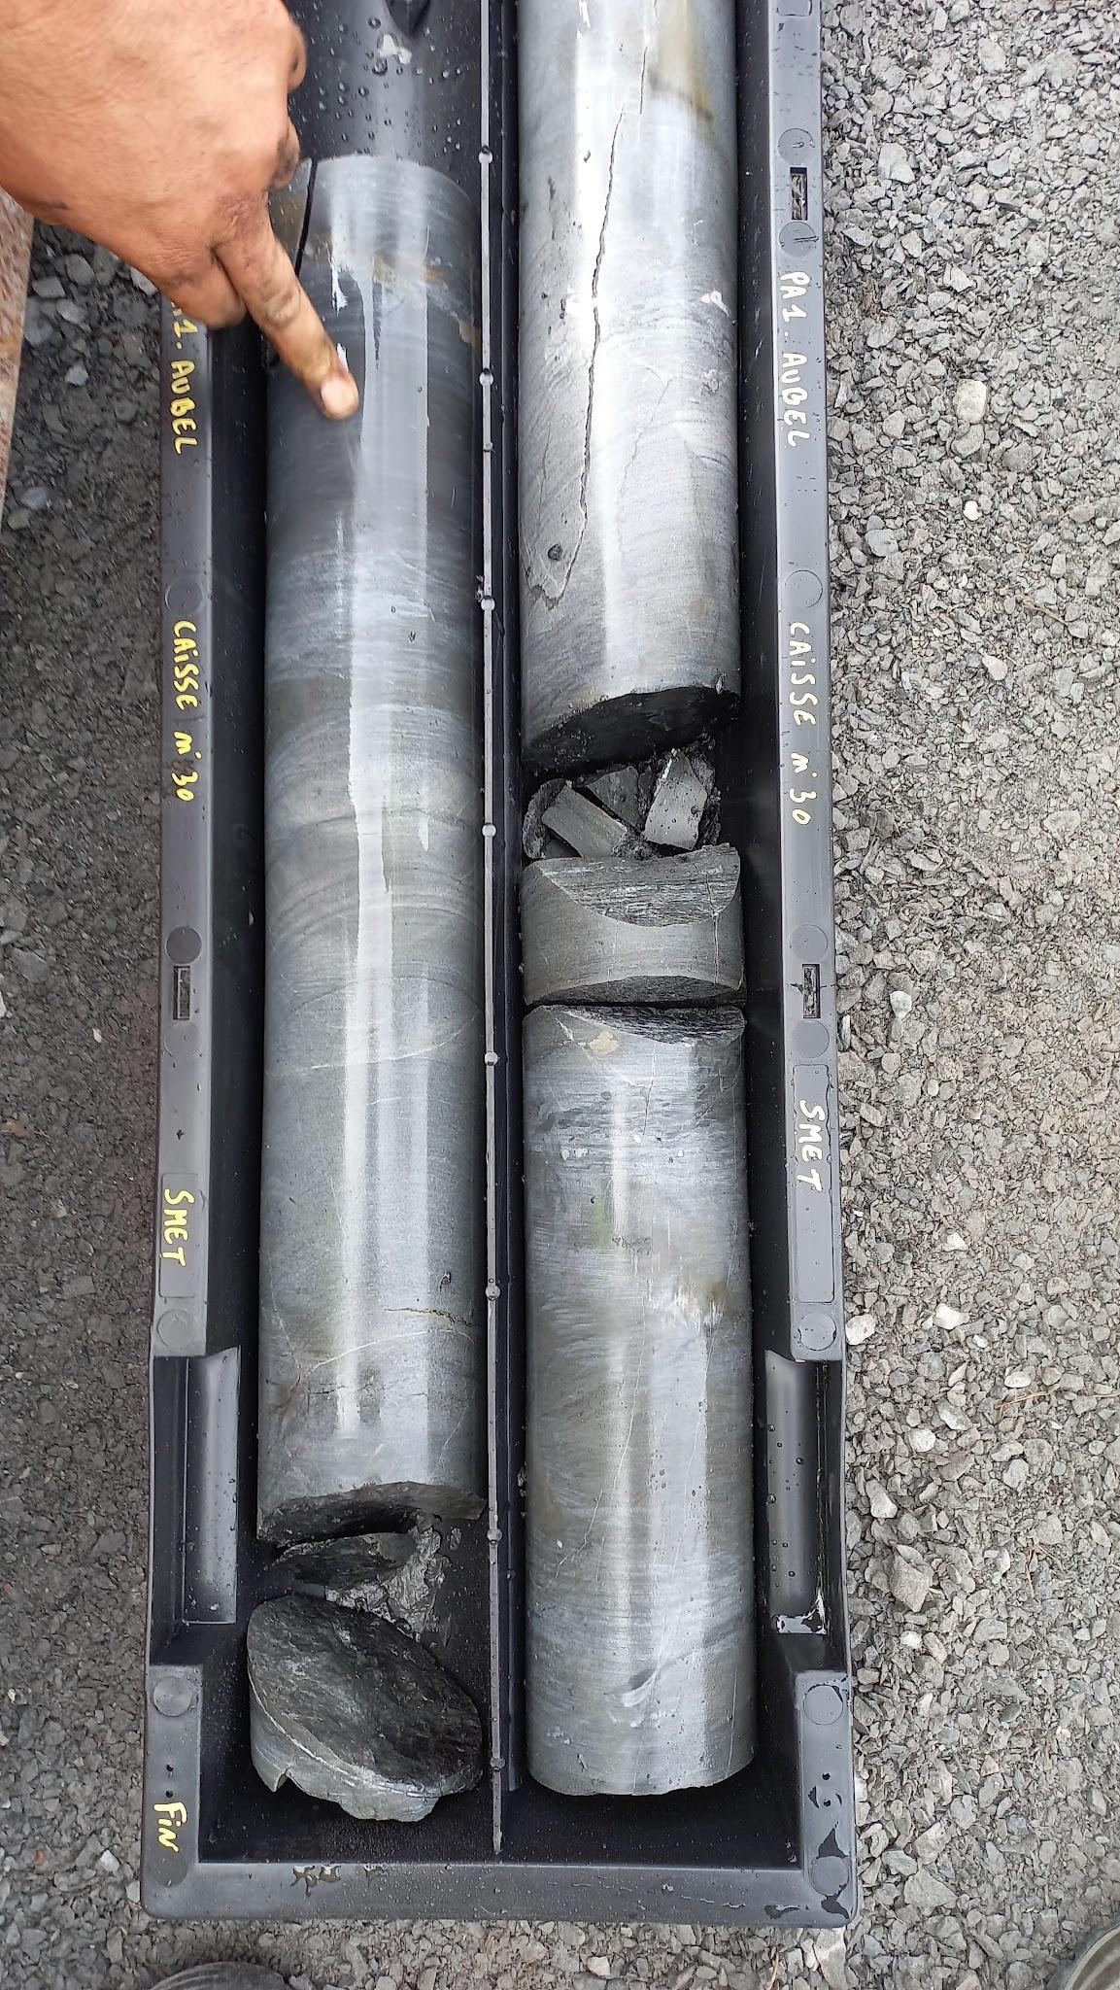
Next 10 Boreholes (finish by June 2024)

Slide 21
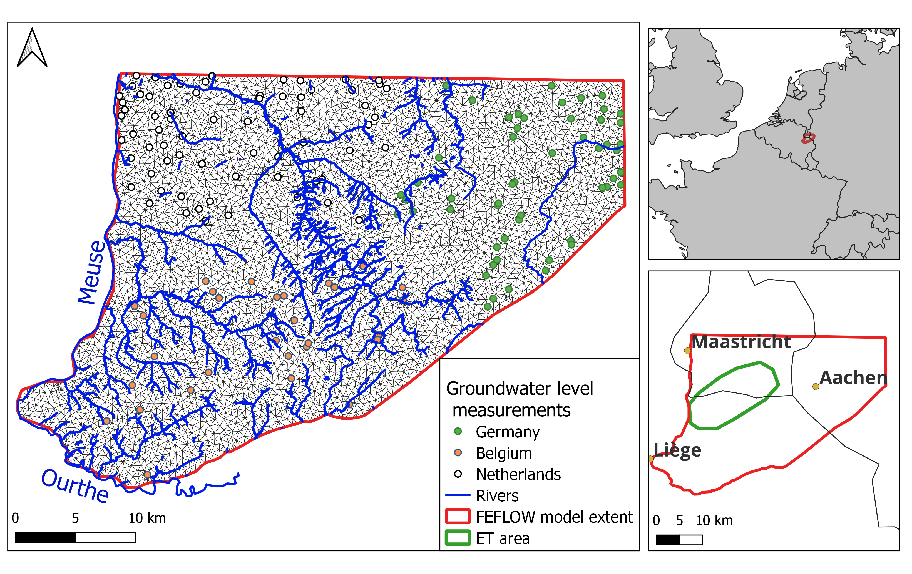
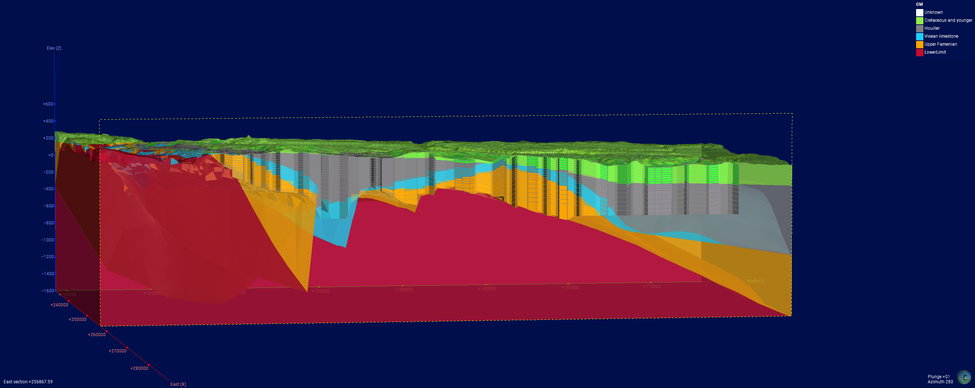
Regional groundwater numerical model
Feflow® hydogeological flow model construction :
Finite element mesh
Boundary conditions, river network
Groundwater water level observations (168 points), groundwater abstraction (Wallonie, Germany, Netherlands)
Topography, geology
River network, groundwater level measurements and mesh of the finite elements model.
Hydrogeological model according to regional geological model

Slide 22
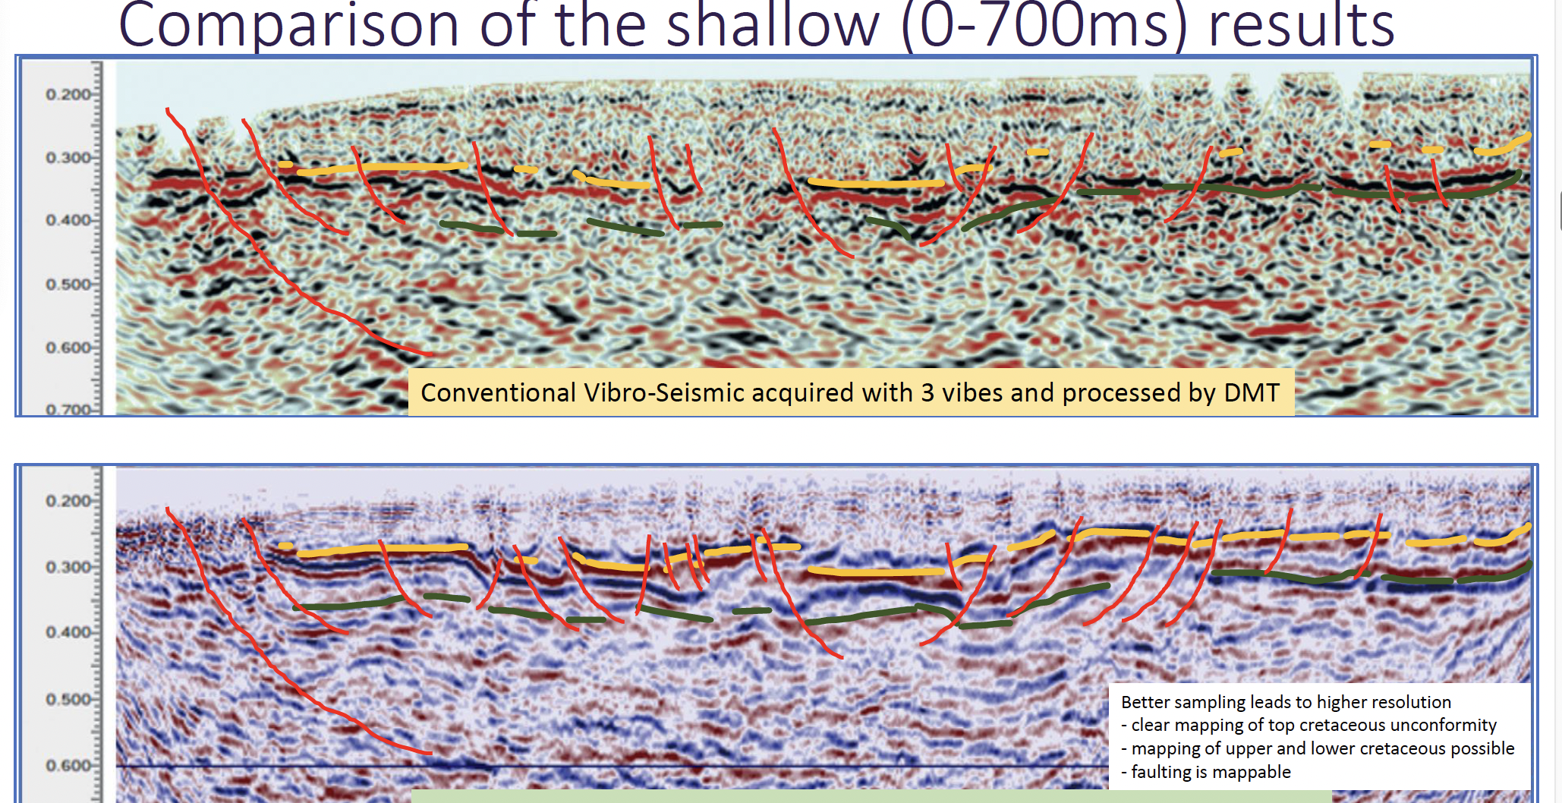

Slide 23
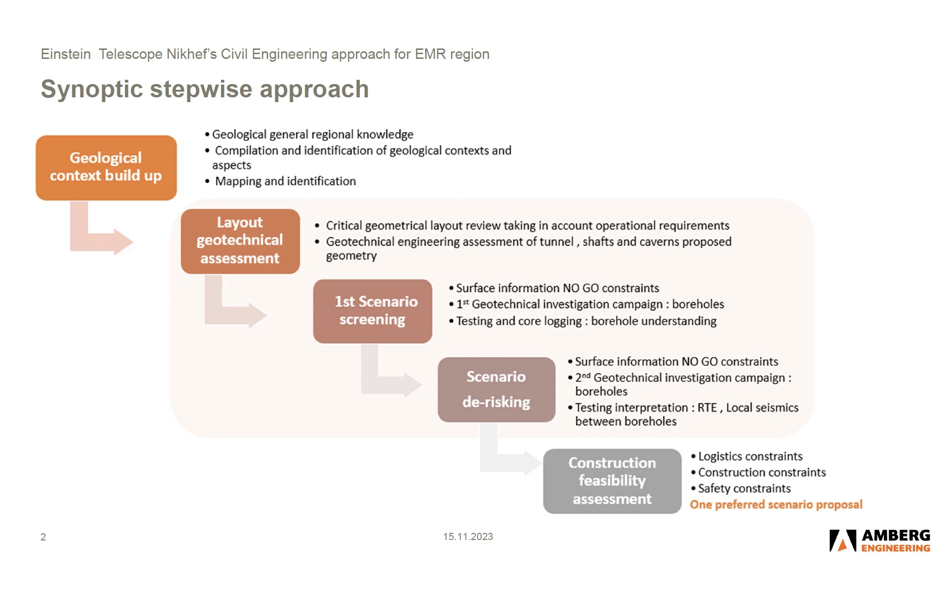
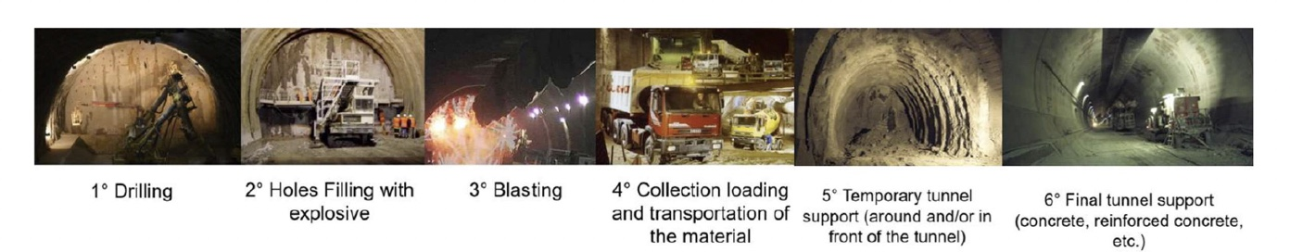

Slide 24
Discussion

Slide 25
SCB/SPB Meeting Summary
ET Annual Meeting 16th Nov 2023
?
Wim Walk, Nikhef
Orsay, 16 Nov 2023

Slide 26
See you in Amsterdam, 6-7 December

Slide 27
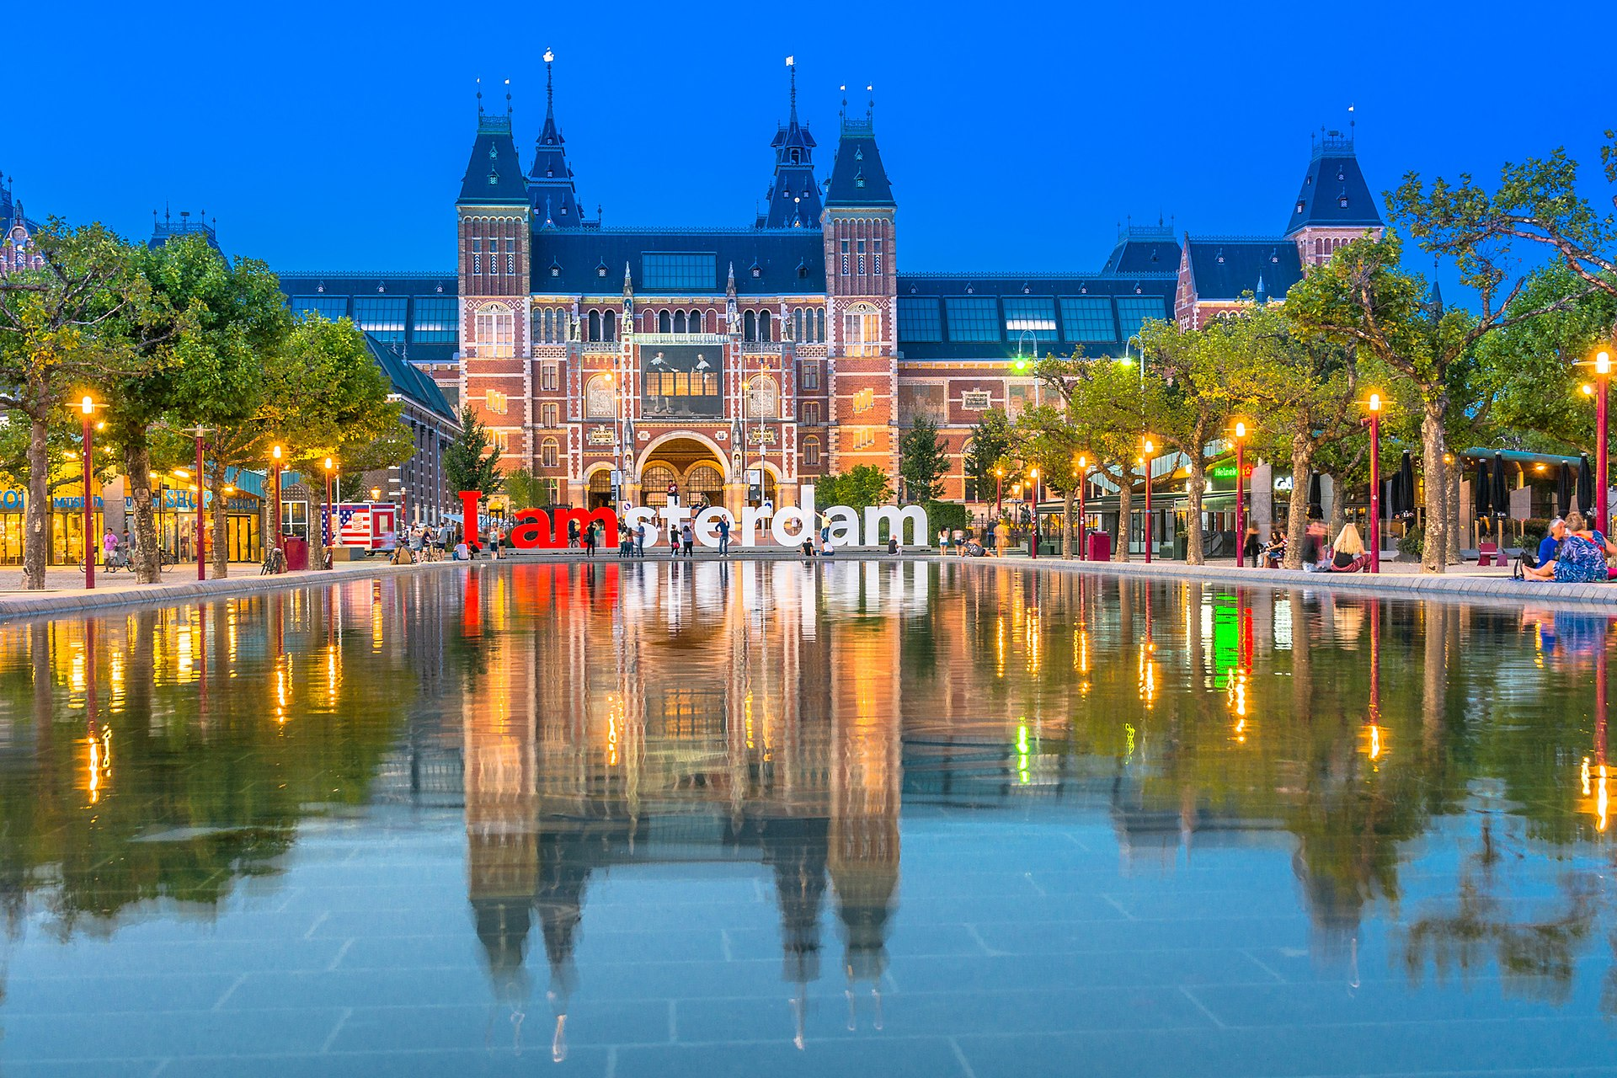
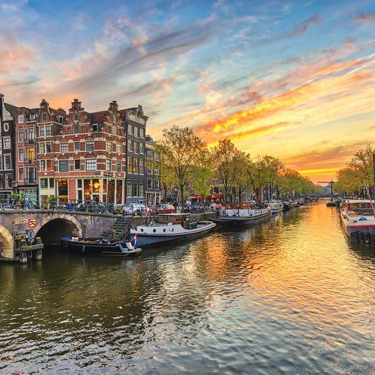
See you in Amsterdam, 6-7 December

