Slide 1
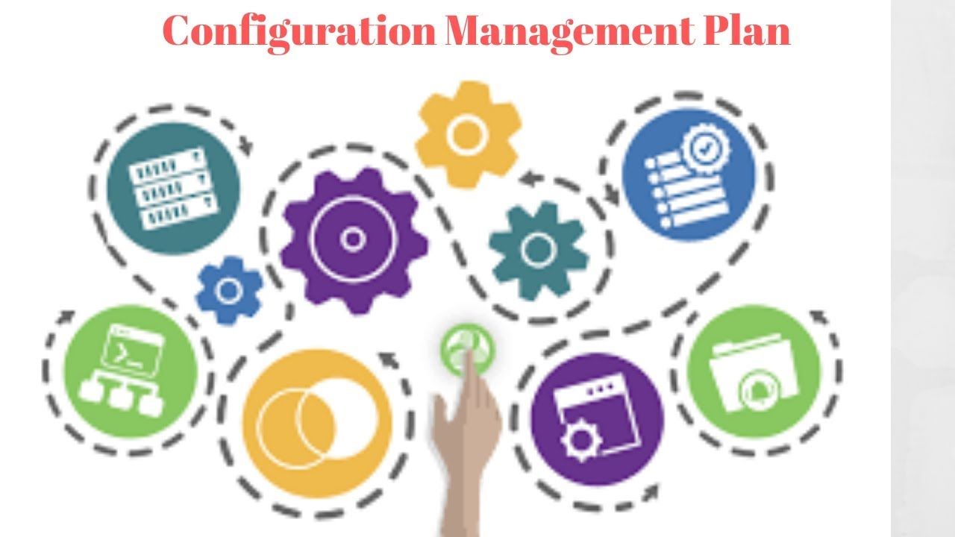
WP5 Project Office
Christian Olivetto
on behalf of the PO Team
16/11/2023
ET Annual Meeting

Slide 2
Configuration Management but what is it ?
The process of controlling and documenting change for the development
system is called Configuration Management.
Configuration Management is part of the overall change management
approach.
It allows large teams to work together in stable environment while still
providing the flexibility required for creative work and ultimately ensures
that the scientific requirements are met, whatever the life of the project.
16/09/2023
ET Annual Meeting

Slide 3
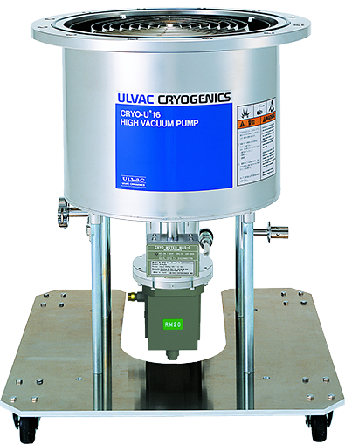
Configuration Management in Action (1)
Parameters
Param 1: external dimensions
Param 2: power consumption
Param3: vaccum speed
Param4: Frequency Spectrum
Param5, 6, …
PBS HF Level 3:
1.1.2
Vacuum&Cryogenics
Requirements Level 3
PBS HF Level 4:
1.1.2.3
Cryopumps
Cryopump N°15
Requirements
Level 4
PBS HF Level 5:
1.1.2.3.15
Cryopumps
Requirements
Level 5
16/09/2023
ET Annual Meeting

Slide 4
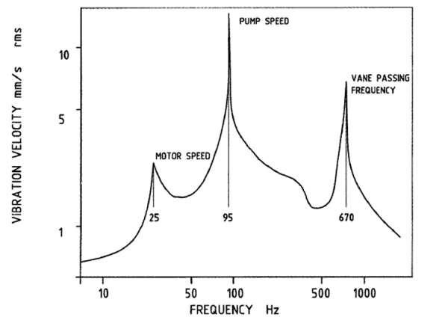
Configuration Management in Action (2)
PBS HF Level 5:
1.1.2.3.15
Cryopumps
Parameters
Param 4: Frequency Spectrum
Requirements
Level 5
Frequency Spectrum
Cryopump N°15
Verification/Validation between
Requirement: Frequency Spectrum
Parameter: Frequency spectrum
16/09/2023
ET Annual Meeting

Slide 5
Configuration Management in Action (3)
PBS HF Level 5:
1.1.2.3.15
Cryopumps
Parameters
Param 4: Frequency Spectrum
Requirements
Level 5
Cryopump N°16
Verification between
Requirement: Frequency Spectrum
New Parameter: Frequency spectrum
New manufacturer
New product
16/09/2023
ET Annual Meeting

Slide 6
Configuration Management in Action (4)
Traceability of
Configuration Change
Changement request
Made by subsystem manager
The CCB comittee verify that
The new parameter du to new pump
Has no impact on requirement of
Level 5, Level 4, .. top level
And no impact also for subsystems
with interfaces
New manufacturer
New product
16/09/2023
ET Annual Meeting

Slide 7
Configuration Management in Action (5)
Changement request
Made by subsystem manager
assessing the impact of requested changes
1: Impact on parameters
2: Additional management effort to revise
Schedule and notify affected subsystems
3: Impact on control account design documents
Impact on quality of the system
The risk of increased cost changes at later
Stages of the project.
The CCB comittee verify also all
Aspects of impact of requested
Changes.
16/09/2023
ET Annual Meeting

Slide 8
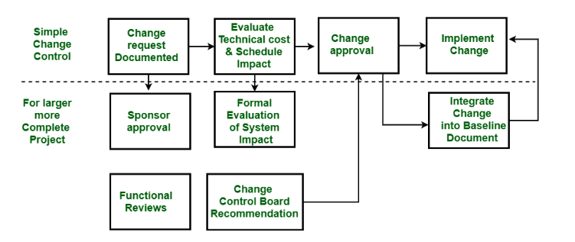
Configuration Management in Action (6)
Changement request traceability
Made by subsystem manager
Changement request traceability
Made by CCB committee
16/09/2023
ET Annual Meeting

Slide 9
Configuration Management in Action (7)
Impact of change can be on:
- Schedule
- Cost
- Layout
All systems and subsystems can be impacted and this
the real challenge is how to guarantee complete
traceability and impact on every major change.
Changes that can even impact the highest level of
scientific sensitivity.
Changement request traceability
Made by CCB committee
16/09/2023
ET Annual Meeting

Slide 10
Preliminary Conclusions (1)
Configuration management is intended to streamline and automate business
processes, and to establish and maintain consistency of a intrument’s performances,
the functional, and physical attributes with its requirements, design, and operational information throughout its life.
It is a formal discipline to help assure the quality and long-term support of
complex products through consistent identification.
In short, we need configuration management because it is a systematic engineering
process that carefully manages and keeps track of configuration changes to
ensure traceability.
16/09/2023
ET Annual Meeting

Slide 11
Preliminary Conclusions (2)
The project office must implement this configuration management
by convincing and adapting the process to a large-scale scientific instrument.
This implementation must be based on validation of the change request flow,
its validation and traceability.
If we want to guarantee deployment of all the products making up the
ET instrument, and guarantee its performance throughout its life, this
configuration management is an essential element.
16/09/2023
ET Annual Meeting

Slide 12
Preliminary Conclusions (3)
The Configuration Management Plan impacts not only hardware, but also budget, planning and layouts
Also the physics case can be described as high level requirements, to link a full traceability
Possible millestones to start and develop the Configuration Management Plan =>
16/09/2023
ET Annual Meeting

Slide 13
Preliminary schedule of CMP deployment
Workflow validation
Flowchart
Exercice on practical
Subsystem/product
Upgrade and
Improvement
Requirements Table
Template
Analyse of Change Impact on interfaces, parameters with others subsystem/product
Flowchart Validation
Parameters Table
Template
Upgrade and
Improvement
16/09/2023
ET Annual Meeting

Slide 14
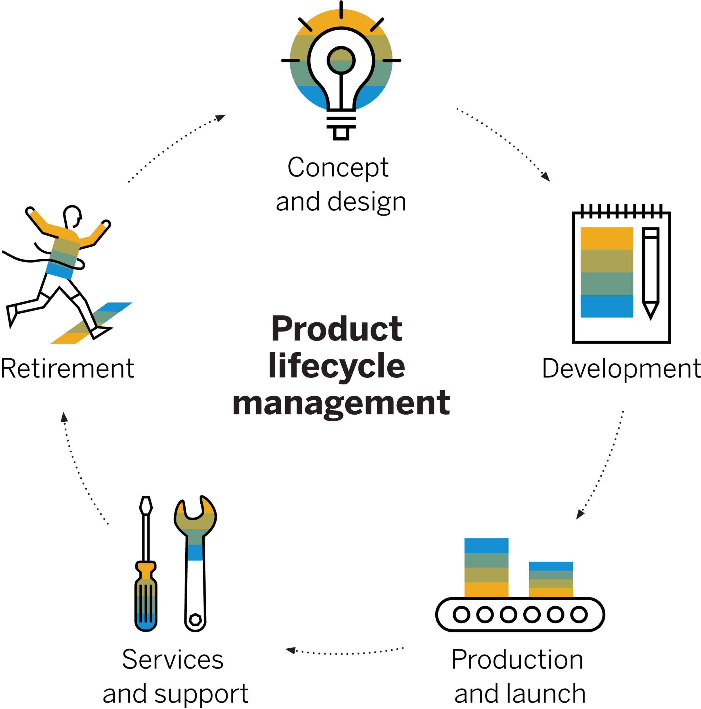
WP5 Project Office
Christian Olivetto
on behalf of the PO Team
16/11/2023
ET Annual Meeting

Slide 15
PLM tool what’s this (1)
Product Lifecycle Management (PLM) software is a cloud-based tool that helps to manage
the resources required to design, launch, test, market, and administrate a product or service.
Product lifecycle management software enables geographically-dispersed,
multi-disciplinary, teams to strategically collaborate with partners and
customers using trusted, up-to-date product information.
For large scientific experiment, PLM advantages are:
- A common platform for seamless global collaboration
- Centralized data for a single model throughout the instrument's lifecycle
- Consistent planning and technical configuration
- Indexed data for intuitive access to information and data analysis
- total traceability for ….
16/09/2023
ET Annual Meeting

Slide 16
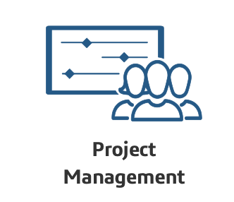
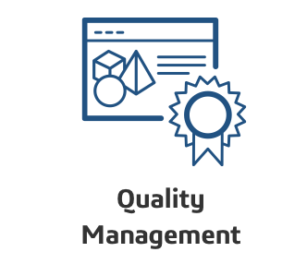
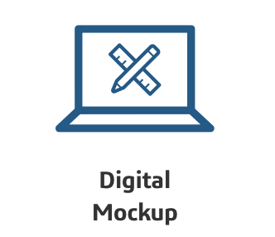
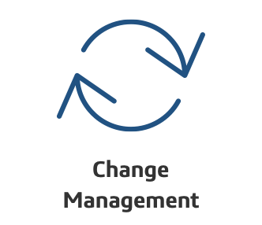
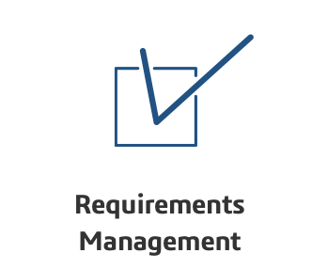
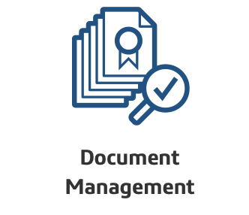
ET expertises organisation tools (1)
in projects as large and complex as the
Einstein Telescope lots of expertises has
Been requested.
for each area of expertise, we need one or
more specific tools to meet your needs
16/09/2023
ET Annual Meeting

Slide 17
ET expertises organisation tools (2)
Each specific tool is optimised for
Each expertise domain.
Each domain need a tool but also
One person to deploy and maintain it
each area of expertise requires exchanges
with the others, so we need to develop
software gateways
One person more
And we hope that all these interfaces
Works correctly
16/09/2023
ET Annual Meeting

Slide 18
ET expertises organisation tools (3)
Large scale scientific projects (CERN, ESS,
ITER,NASA,…) and High Industrial Projects
to optimise interfaces between each
expertise domain prefer to use a PLM
Tool on cloud =>
- Central data-base and global interfaces
- Specific module for each expertise
- Unique maintenance and version upgrade
- controlled risk of evolution and
sustainability over several decades
16/09/2023
ET Annual Meeting

Slide 19
PLM tool Preliminary Conclusion (1)
Product Lifecycle Management Tool Features: has to be studied in order to identify to ET needs
User requests/Needs indepentently of any final tool or solution
To this end, a working group including all WP, expertises (Financial, Management, Docs
Mgt, Infrastructure, Configuration, Risk Mgt, Integration, Logistic,..) will be set-up.
Analyse solutions deployed on others scientific projects, gain, issue, reality,
In real condition, test one or two real solution with ET requirements and organisation
Propose a unique tool (or not) with final investigation report to ET management and evaluate
Cost licences, Deployment, Maintenance, Training support to the collaboration for next phase
Of ET project.
16/09/2023
ET Annual Meeting

