Slide 1

Sustainability Workshop 2023 Nov. 16. – Nov. 17. 2023
Reuse of Tunnel Excavation Material
WP 9
Elisabeth Hauzinger – Montanuniversität Leoben (Austria)

Slide 2
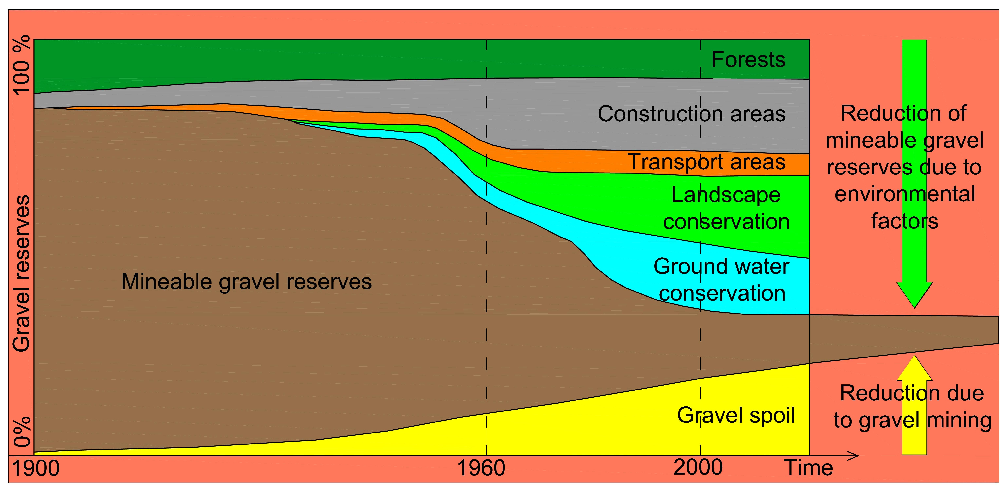
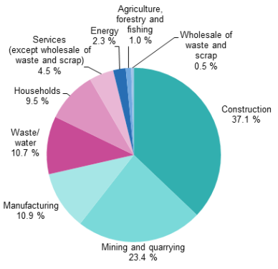
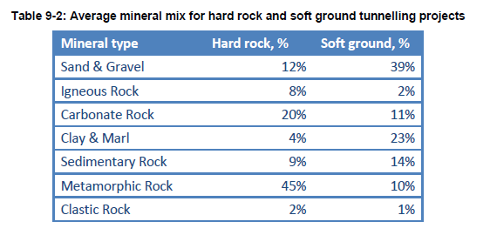
Why Reuse of Tunnel Excavation Material?
Scarcity of Building Raw Materials
Longer transport routes
Higher CO₂ emissions
Import dependency
© Kündig et al., 1997
© Eurostat
500 million tons construction & demolition waste in EU per year, only 25% are recycled.
Average composition of excavated tunnel material from hard and soft rock tunnel construction projects
© DRAGON

Slide 3
General Conditions
Technical
Geological
Chemistry/ mineralogy/ strength properties of excavated materials
Legal
Tunnel advance method, -length, -diameter
Material yield parameters
Customer specifications
Economic
Supply and demand
Material analysis
Processing technology
End of waste character
Ownership
Transport route/ -range to customers / landfills
Site organisation
Processability
Raw material price vs. landfilling costs
Geological situation
Waste law

Slide 4
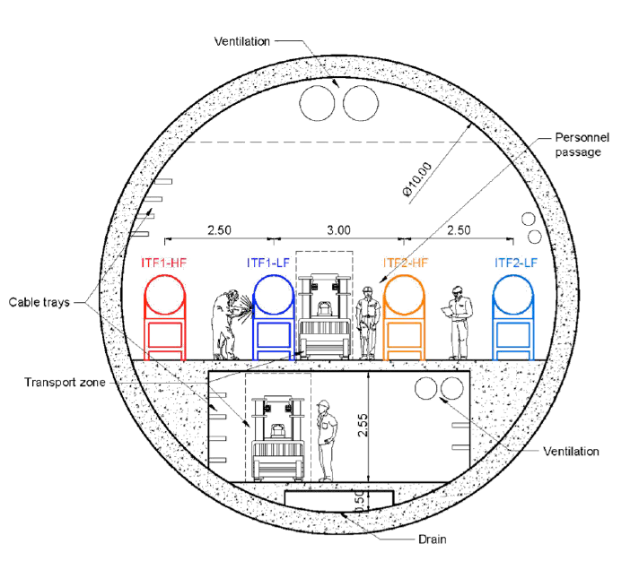
Geological Investigations
Einstein Telescope
Triangular or L-shape, total tunnel length of 30 km & diameter of 7 m
Together with caverns, service & access tunnels and shafts → total excavated volume ~ 4.4 Mio m3 ↔ muck volume ~ 5.3 m3
Exact location not yet determined
Investigations of the Underground
Wide ranged investigation methods
Results
Geological characterisation
Classification of Subsurface
Rock classification | Mineral composition | Rock descriptions
Very weak marl | - | Numerous, closed micro-fissures, low stiffness, ductile behaviour, swelling potential
Weak marl | Clay=45-60, quartz=15-30, calcareous minerals=20-30 | Micro-crystalline quartz, medium-high plasticity, minor micro-fissures, swelling potential
Medium-weak marl | Clay=20-45, quartz=20-40, calcite=20-30 | Well cemented, low plasticity
Weak sandstone | Clay=5-20, quartz=40-70, calcareous minerals=5-45, feldspar=5-10 | Fine-grained, poorly cemented
Medium sandstone |  | Rare discontinuities
Strong sandstone |  | Better cemented, fewer discontinuities
Geotechnical
UCS, Tensile Strength, CERCHAR Test Point Load, LCPC Test, …
Geochemical & Petrophysical
Eluate, water absorption, porosity & permeability, density, TOC, …
Mineralogical
XRD, XRF, ICP-MS, Optical Microscopy, FTIR, …
(Borehole-) Geophysics
Gamma-Gamma, SP, Dilatometer, Seismics, …
© ET Symposium April 2018
© Haas (2022)

Slide 5
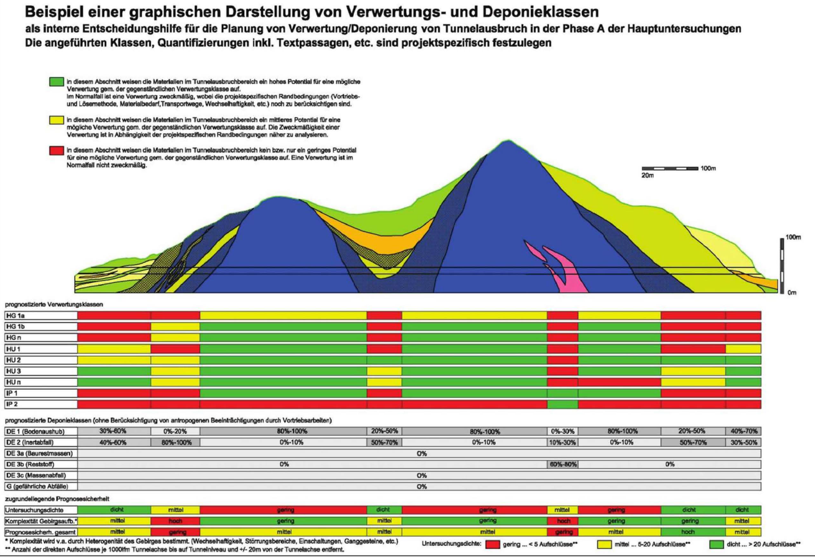
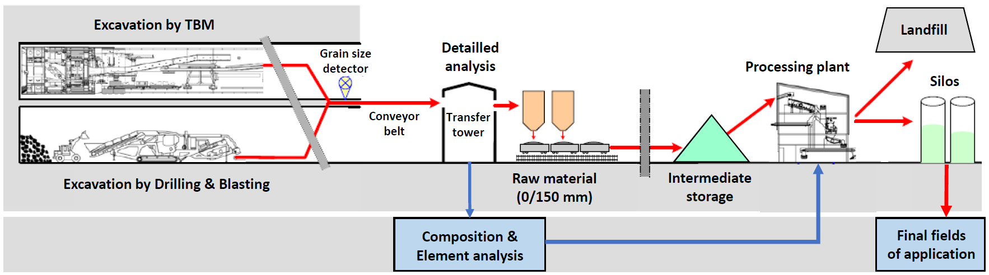
Strategies for Reuse of Tunnel Excavation Material
Graphic representation of underlying forecast reliability and associated recovery and landfill classes of a tunneling project in phase A of the main investigations (ÖBV 2015)
Strategies for reuse
Strategies for the reuse of excavated material should at least meet following requirements:
Real time characterisation of material
Onsite online-analyses on conveyors to detect impurities and pollutions as well as grain size
Sorted and classified material is processed further into respective products
Technical Feasibility
Economic Viability
Social Benefits
Project Relevance
© CERN 2022
© Terzis et al. (2021)

Slide 6
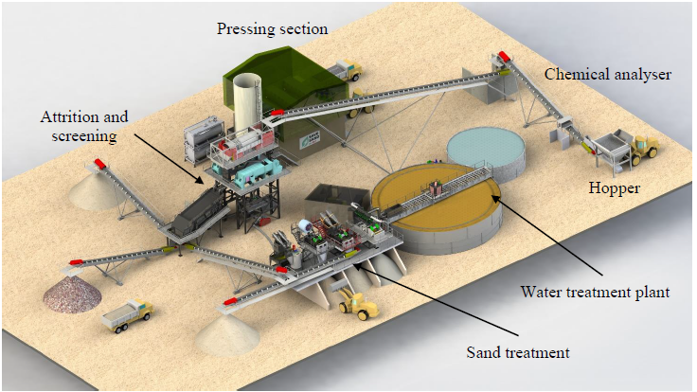
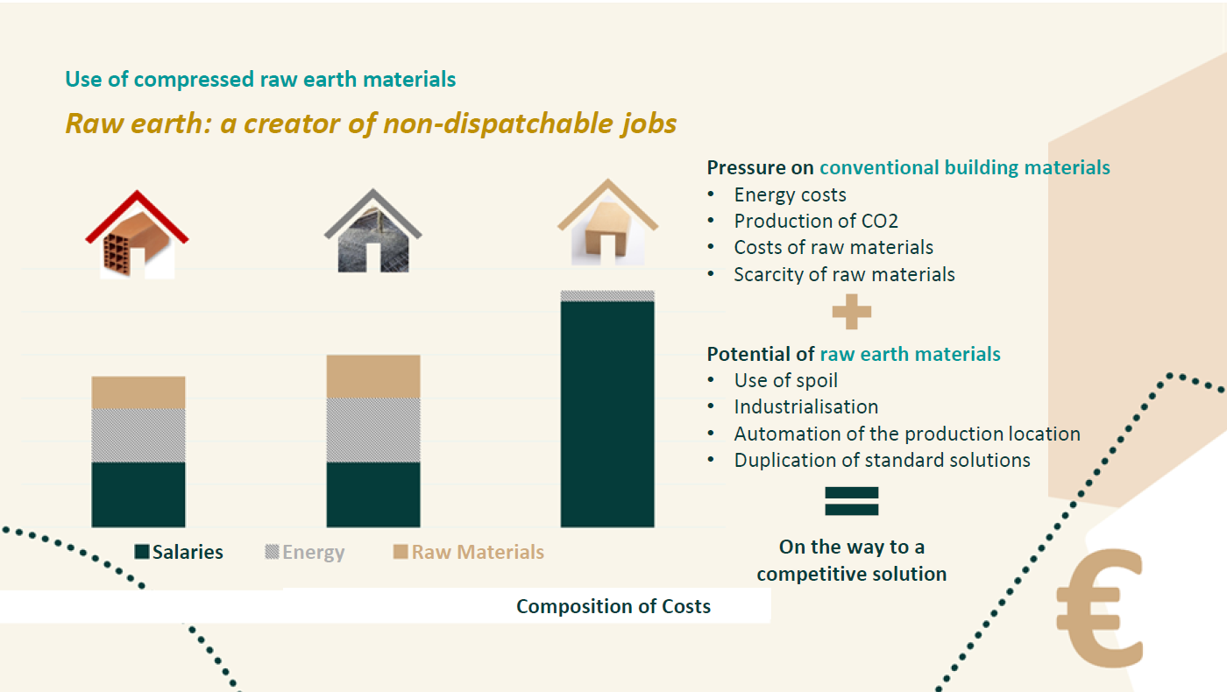
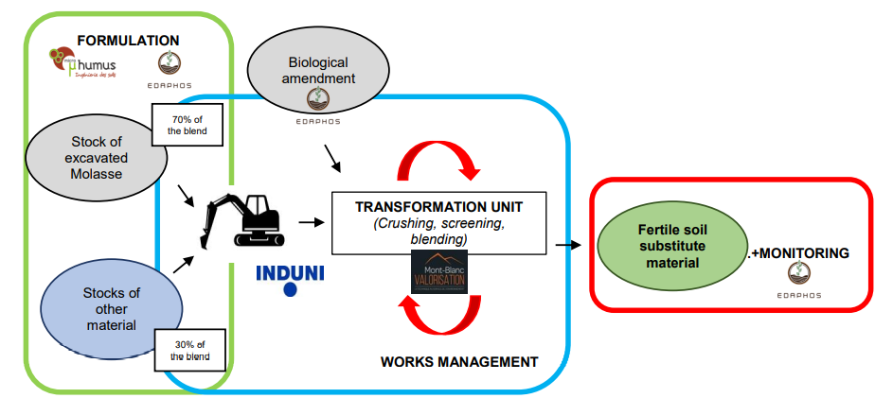
Reuse Scenarios
Geotechnical Parameters
Mineralogical & chemical parameters
Voroin et al. (2021)
Recycled construction materials
Substitute for secondary construction materials
Industrial raw materials
Aggregates for concrete & shotcrete
Road construction
Railway ballast
…
Low Carbon Cement
Geopolymers
Raw Earth Bricks
Mineral Wool
…
Silica Sands
Magnesite
Feldspar
Mica
Sulfates
Clay minerals
…
Graftieaux et al. (2021)
© Carlesso et al. (2021)

