Slide 1
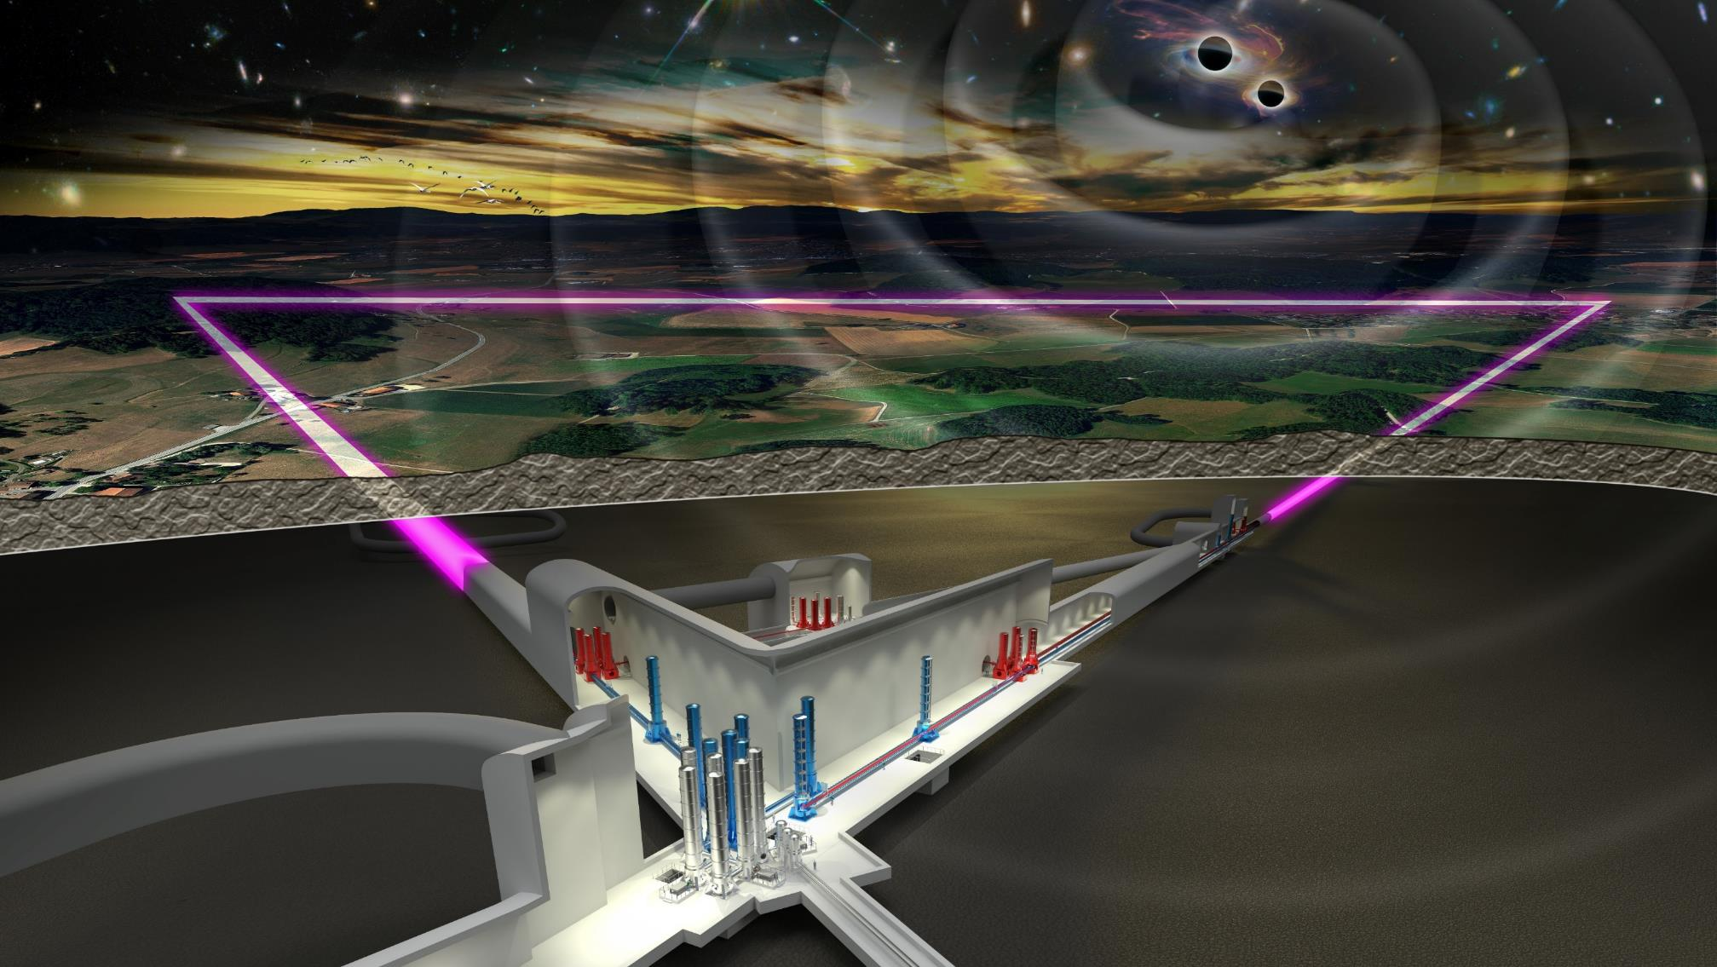
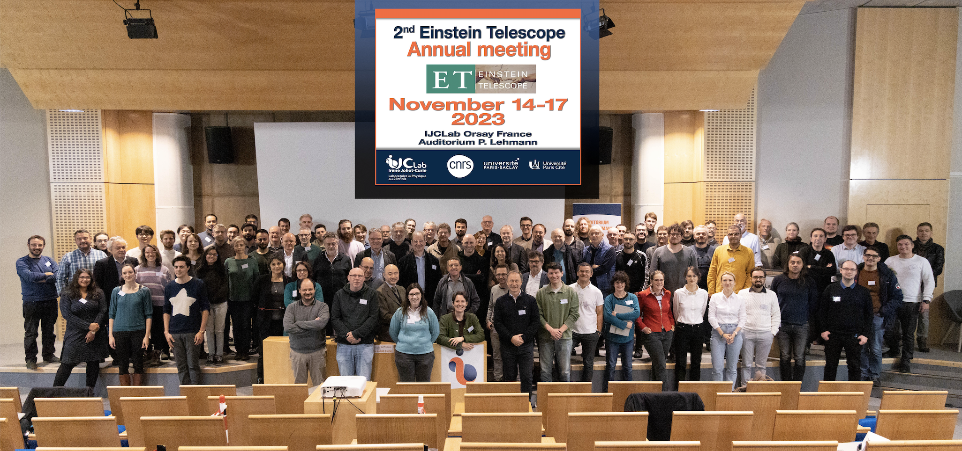
Sustainability in the ET Collaboration
Initial Thoughts
Harald Lück
2nd ET Annual Meeting 2023

Slide 2
Sustainability in the ET Collaboration
So far, the ET Collaboration as such is fairly ignorant on sustainability.
It requires education,
but the topic of sustainability is wider than just the sustainability in the design of the instrument.

Slide 3
Sustainability
Ecological Sustainability:
Computing
Collaboration will do most of the DA, which is computationally very expensive. Heavy Carbon footprint.
Have to find the right balance between decreasing energy consumption and longevity of hardware.
How much and where to balance science output vs. carbon footprint?
Travelling to
Meetings, own and other conferences
To the site(s) Try to maximise remote access possibility for detchar and commissioning activities in the design of systems.
To work
A thought triggered by the discussion on food: how to strike the balance between sustainability and patronizing? Doesn't only apply for food. Where does it apply to Collaboration aspects?

Slide 4
Non-Ecological sustainability
Sustainable Research:
secure long term funding for the Collaboration
Long term social evolution of the Collaboration.
Sustainable “supply of fresh scientists”
Knowledge sustainability (2G – 3G gap?)
Social Sustainability:
long term partnerships with local suppliers (Rather a task for the legal entity later)
R&D activities are concerned with the same sustainability aspects as the infrastructure. New instruments and devices should be designed with the sustainability of all aspects in mind as they need to be considered for the infrastructure.
Biggest influence of the Collaboration on sustainability in terms of design choices is now!

Slide 5
Difficulties
From today‘s perspective, sustainability is an add-on.
„Scientists are paid to do science.“
Requires additional resources. While in ETO such finances can finally be included in construction and operation costs, the Collaboration does not have such central resources.

