Slide 1
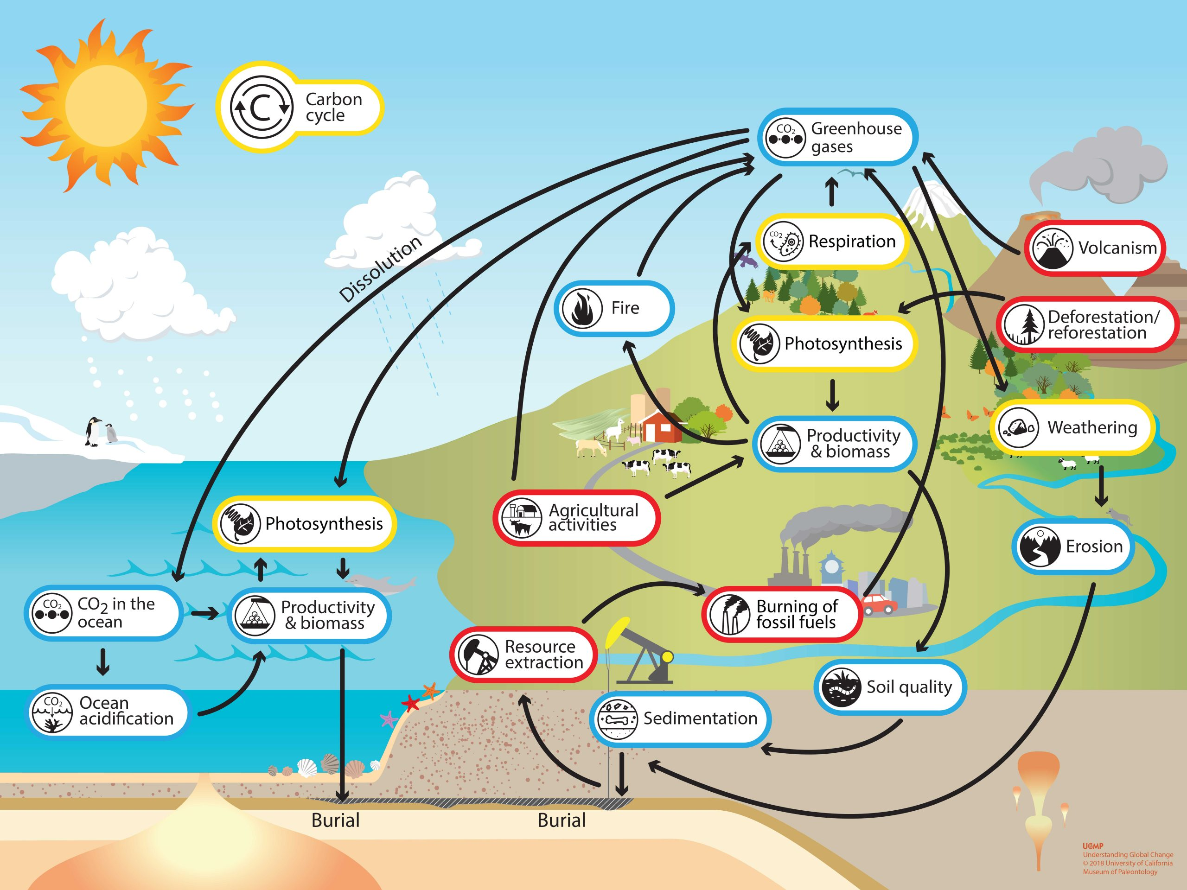

Thoughts on
ET Sustainability
Michele Punturo

Slide 2
ET phases
The sustainability of ET must be evaluated on 4 different phases
  Technical design
  Construction
  Operation
  Decommissioning
Sustainability is conjugated with productivity:
  Efficiency = environmental impact / productivity

Slide 3
Technical Design phase
Environmental impact factors
Productivity factors
Intense workshop and meeting activities to build the community and to define hot topics
  travels
Moderate use of computing resources
Realization of distributed R&D facilities
  Civil constructions
  Production of mechanical and electronic elements
  Scarce use of electric power
Technical and scientific papers
Patents
Moderate distributed economic impact

Slide 4
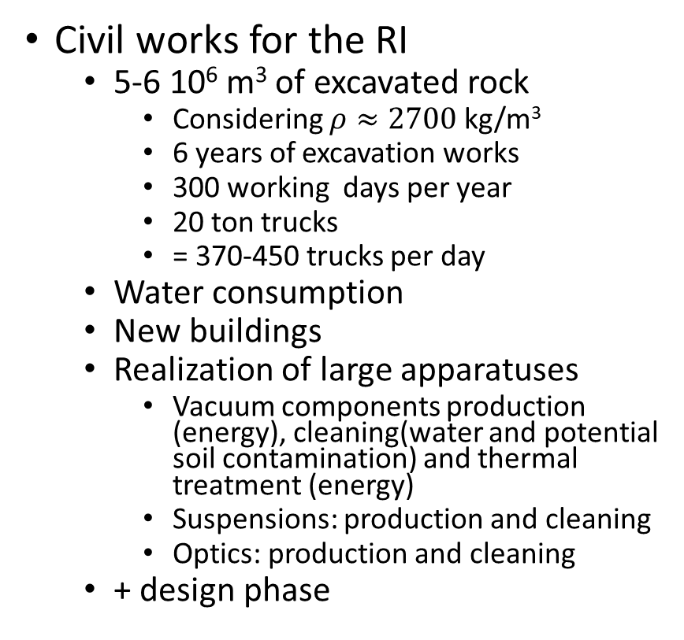
Construction phase
Environmental impact factors
Productivity factors
Civil works for the RI
  5-6 10⁶ m³ of excavated rock
    Considering $ρ≈2700$ kg/m³
    6 years of excavation works
    300 working days per year
    20 ton trucks
    = 370-450 trucks per day
  Water consumption
  New buildings
  Realization of large apparatuses
    Vacuum components production (energy), cleaning(water and potential soil contamination) and thermal treatment (energy)
    Suspensions: production and cleaning
    Optics: production and cleaning
  + design phase
Huge local economic impact
Local restoration works
Technical and scientific papers
Patents

Slide 5
Operation phase
Environmental impact factors
Productivity factors
Moderate energy consumption
Water collection
  Learn from LNGS experience
Cleaning of components
Moderate workshop and meeting activity
Relevant local economic impact
Technical and scientific papers

Slide 6
Decommissioning phase
Environmental impact factors
Productivity factors

