Slide 1

ETO Engineering Department
Patrick Werneke
2nd Einstein Telescope Annual Meeting
14.11.2023

Slide 2
Towards ET Dual Organizational Structure
1) project organization (towards legal entity) and 2) scientific collaboration
ETO (ET Organization)
ET Collaboration
Board of Governmental Representatives
Collaboration Board
Board of Scientific representatives
Coordinators
Executive Board
ET Directorate
Specific Boards
ET-PP
INFRA-DEV
Project Office
ISB
OSB
EIB
EU project coordination
WP1:
WP2:
WP3:
...
Engineering
Department
SPB
…
...
…..

Slide 3
Towards ET Dual Organizational Structure
1) project organization (towards legal entity) and 2) scientific collaboration
ETO (ET Organization)
ET Collaboration
Board of Governmental Representatives
Collaboration Board
Board of Scientific representatives
Coordinators
Executive Board
ET Directorate
Local Teams
Sardinia and EMR
Specific Boards
ET-PP
INFRA-DEV
Project Office
ISB
OSB
EIB
EU project coordination
WP1:
WP2:
WP3:
...
Engineering
Department
SPB
…
...
...

Slide 4
Engineering Department: mandate
The Engineering Department will design, procure, install, commission, operate, maintain and eventually, dismantle:
The technical infrastructure systems needed to host the gravitational wave detector (e.g. civil engineering, technical Infrastructures).
and
The special systems needed to operate the gravitational wave detector (e.g. vacuum, cryo, monitoring & survey).

Slide 5
Engineering Department
The activities of the Engineering Department are in the following fields:
Civil Engineering:
  Underground shafts, caverns and tunnels
  Surface buildings, roads, landscaping, ….
Technical Infrastructure:
  Cooling & ventilation, electricity, access and alarms, water management, ….
Mechanical Engineering:
  The technical systems associated with the gravitational wave detector: vacuum, cryogenics, survey, materials

Slide 6
Engineering Department
The activities of the Engineering Department are in the following fields:
Installation and operation:
  Logistics, transport, handling and lifting
  Responsible for clean operations
Coordination and integration (In close collaboration with the Project Office):
  Information management: lifecycle management, CAD, visualization
  Integration studies and maintenance of the engineering documentation
  Organization and scheduling of the installation and interventions
  Coordination of the activities for installation, interventions and changes
  Coordination of safety in the field
Giving technical support to the ET collaboration and local teams

Slide 7
Engineering Department
Engineering Department
Patrick Werneke
Civil
Engineering
Maria Marsella
Technical Infrastructure
X
Mechanical Engineering
X
Logistics and Installation
X
Coordination and Integration
X
CERN SCE-SAM-FS
Wissam Wahbeh (FHNW)
Jonathan Bratanata – 1.0 FTE start in February ‘24 (Nikhef)
Andrea Paoli (EGO)
KU Leuven
X
Infrastructures Engineer – 0.5 FTE (INFN)
X
X
X
X
Vacuum Beam Pipe:
CERN TE-VSC
Guillaume Deleglise (LAPP) – 0.2
Romain Bonnand (LAPP) – 0.15
Alexandre Lacroix (LAPP) – 1.0
Marije Barel (Nikhef) – 1.0
Rafael Garcia (IFAE) – 0.5
Cryogenics:
X
Max Majoor (Nikhef) – 1.0
Martin Adams (Nikhef) - 0.2
Integration Engineer – 0.5 FTE (INFN)
Draft version of the ED organizational chart

Slide 8
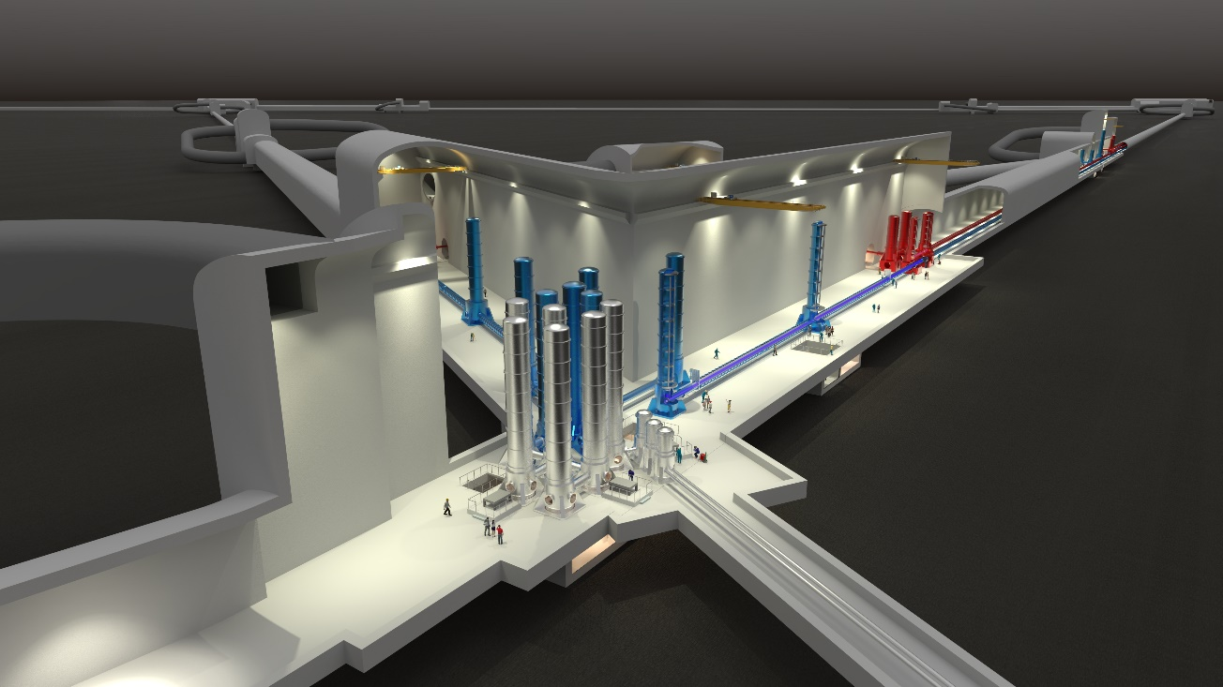
Engineering Department: ET Phases and deliverables
ET is currently in Phase I of a Design and Preparation Phase, which ends with the selection of a site for ET.
Deliverables for Phase 1 - for Δ and 2L:
  (Preliminary) Technical Design Report
  Cost report of the research infrastructure (Phase 2 + following phases)
  Planning report (Phase 2 + following phases )
  Organizational report (Phase 2 + following phases)
  Site evaluation report

Slide 9
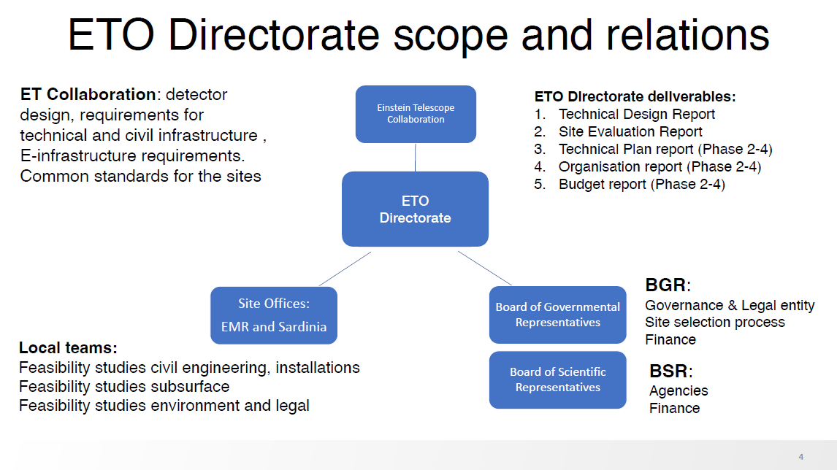
Engineering Department: ET Phases and deliverables
For the deliverables ETO needs to work closely with the ET Collaboration and Local Teams.
  The ET Collaboration is responsible, amongst others, for
  the interferometer design and requirements.
  The Local Teams will conduct , amongst others, site feasibility studies.

Slide 10
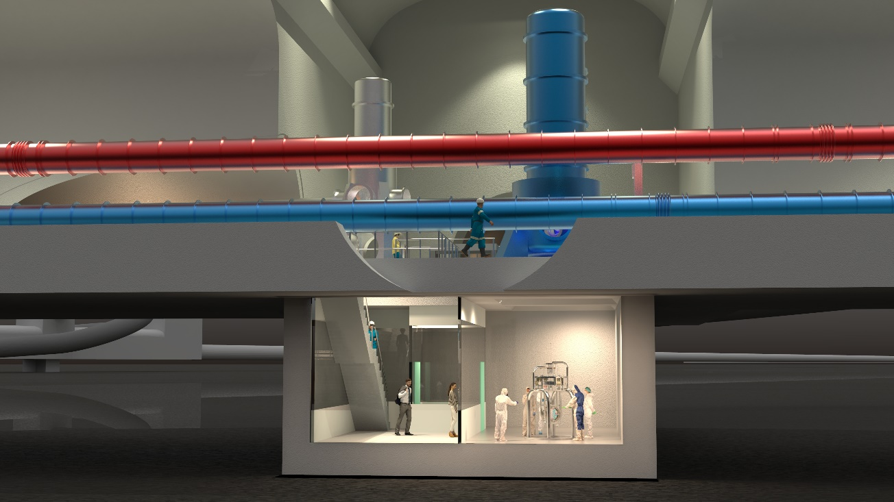
Engineering Department: ET Phases
Phase 2 + following Phases:
Preparatory Phase 2: this phase will end with the final TDR, costing overview, risk assessment and schedule for the construction
Implementation Phase: this phase will end with the Einstein Telescope commissioned
Operation Phase
Termination Phase

Slide 11
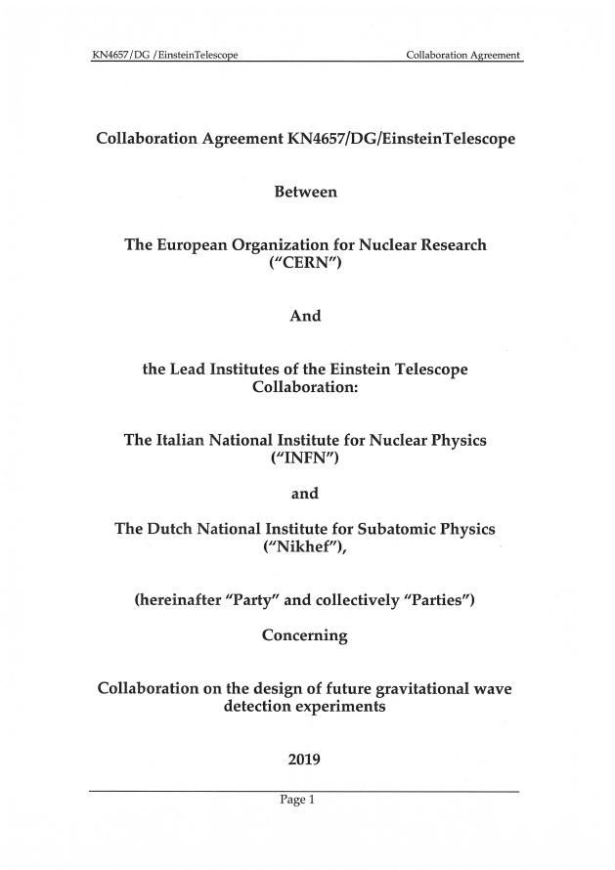

Collaboration with CERN
Several similarities between ET and CERN – specifically related to vacuum and underground infrastructures.
We have an MOU with CERN for their support on technical topics.
The MOU was setup with INFN and Nikhef. IFAE has joined as a fourth partner.
More partners are welcome.

Slide 12
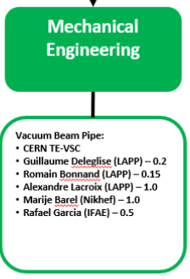
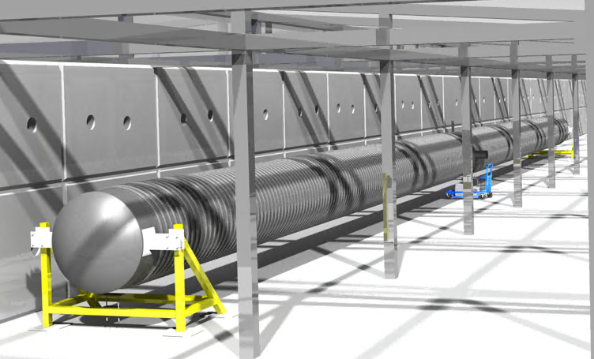
Collaboration with CERN
Vacuum Beam Pipe:
The CERN vacuum team has the responsibility to deliver the technical design for the ET beampipe at the end of a three year project. MOU partners will provide financial support for related CERN fellowships.
  Coordinate the efforts of the institutes that work for the ET beampipes;
  Ensure the link with the vacuum community of the CE.
  Propose less expensive technical solutions that fulfil the requirements
  Leading to a pilot sector and a TDR by end of 2025.
See presentation from Carlo and Luigi
Note: Antwerp and Gent University are supporting TE-VSC

Slide 13
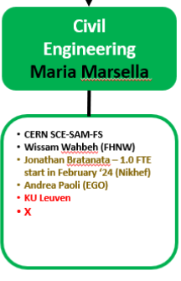
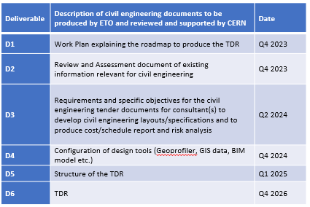
Collaboration with CERN
Civil Engineering:
Recently signed a MOU with CERN CERN Civil Engineering to provide support towards the technical design for the underground structure.
MOU partners will provide financial support for CERN fellow.
Goal: Preliminary TDR: Q4 2026

Slide 14
Collaboration with CERN
Civil Engineering:
Recently signed a MOU with CERN CERN Civil Engineering to provide support towards the technical design for the underground structure.
MOU partners will provide financial support for related CERN fellowships.
Goal: Preliminary TDR: Q4 2026

Slide 15
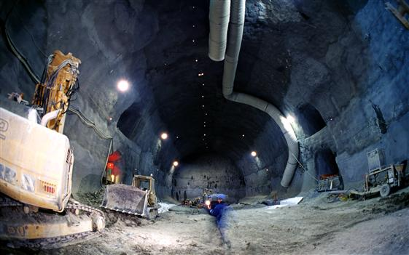
Civil Engineering session
Wednesday parallel session 11:10 – 13:10 in Salle 101
Agenda:
Engineering Department Mandate and organization
Roadmap for Civil Engineering Preliminary TDR organization
Links between special systems and civil infrastructure: lesson learnt from the beam pipe design
SPB contributions to civil engineering roadmap
Seed questions and future actions

Slide 16
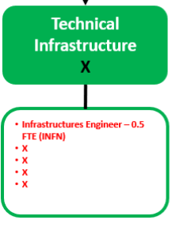
Possible collaboration with CERN
CERN Engineering Department
Cooling and Ventilation
Access and Safety
Electrical Engineering
Water Management
We are discussing support with CERN, but we also need internal “specialists” (In-kind) from ET(O) to work with CERN.

Slide 17
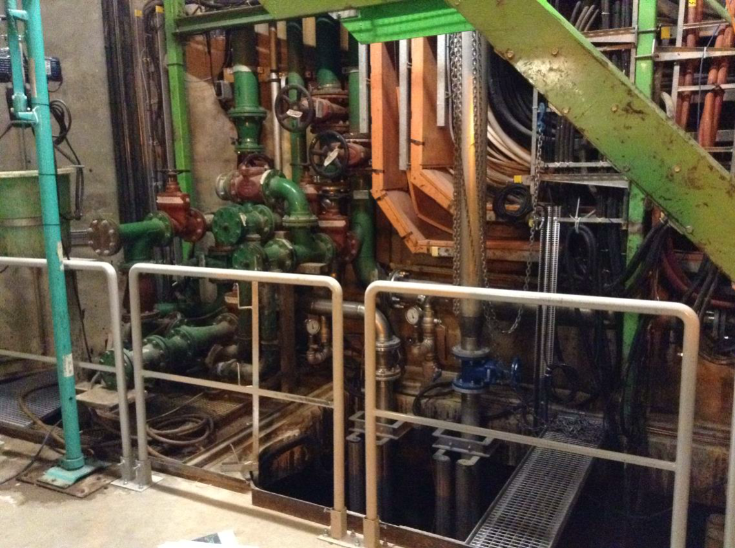
Possible collaboration with CERN
CERN Engineering Department
Cooling and Ventilation
Access and Safety
Electrical Engineering
Water Management
We are discussing support with CERN, but we also need internal “specialists” (In-kind) from ET(O) to work with CERN.
80 m3/h underground water infiltration
Backup sump
2 pumps (1+1)
Main sump
3 pumps

Slide 18
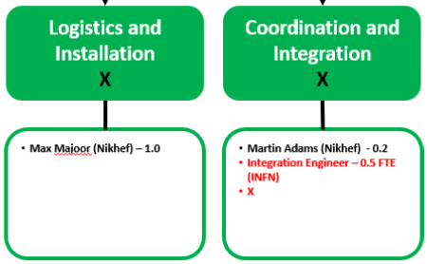
Possible collaboration with CERN
CERN Engineering Department
and HSE:
Logistics and Transport (Handling)
Layout and Integration
Information Management
Occupational Health & Safety and Environment (ETO)
We are discussing support with CERN, but we also need internal “specialists” (In-kind) from ET(O) to work with CERN.

Slide 19
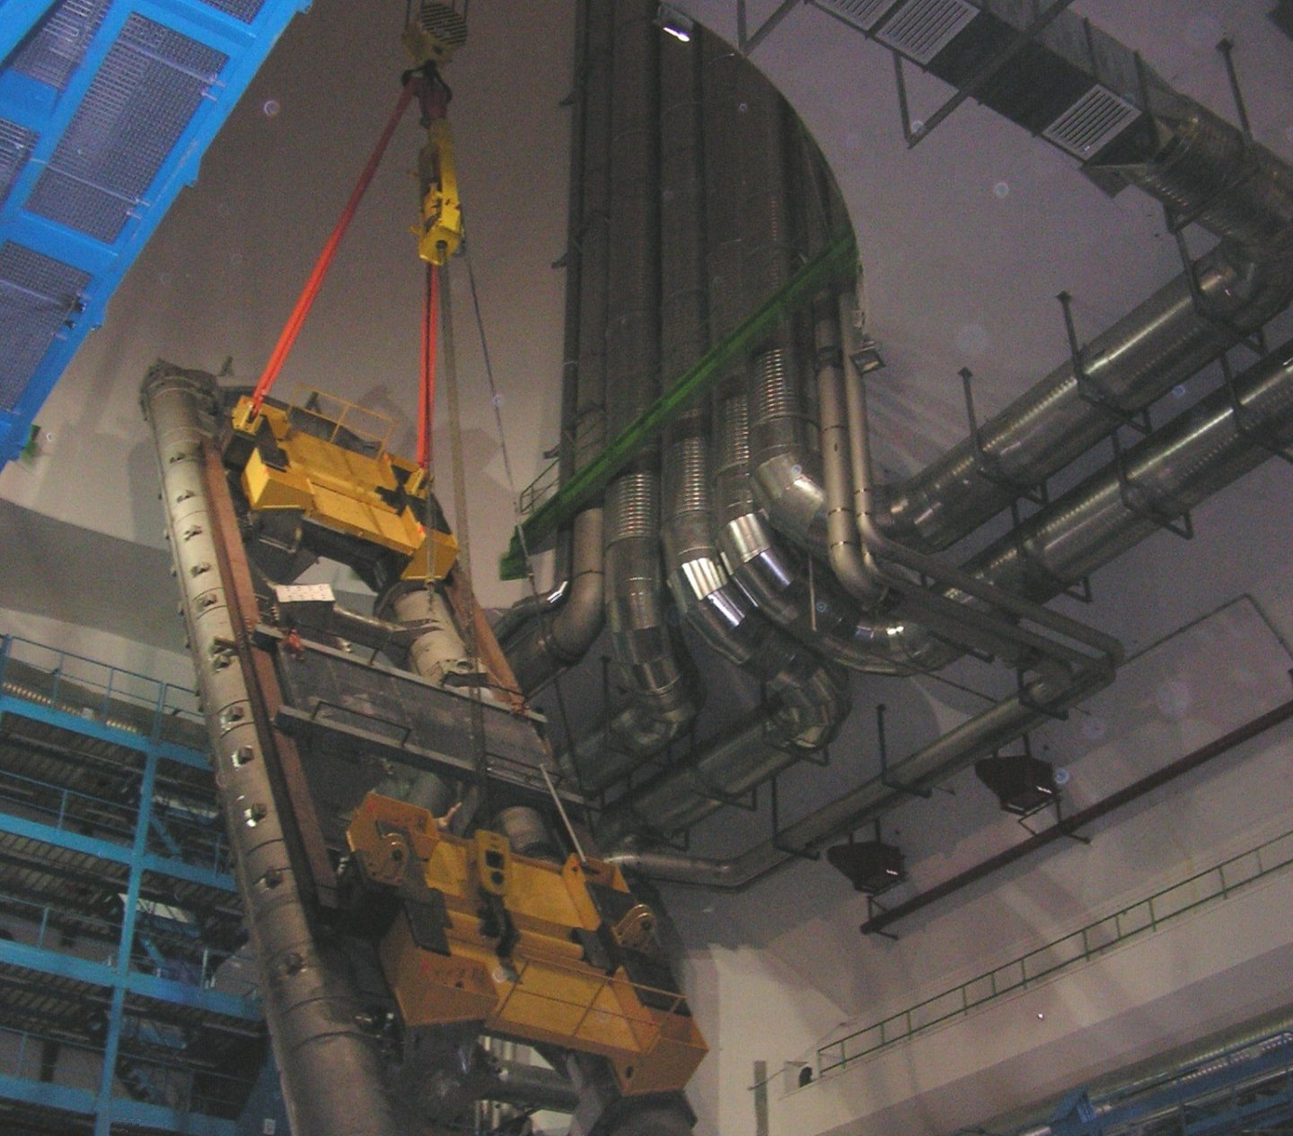
Possible collaboration with CERN
CERN Engineering Department
and HSE:
Logistics and Transport (Handling)
Layout and Integration
Information Management
Occupational Health & Safety and Environment (ETO)
We are discussing support with CERN, but we also need internal “specialists” (In-kind) from ET(O) to work with CERN.

Slide 20
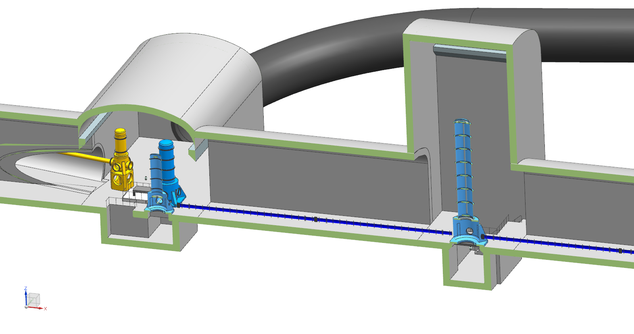
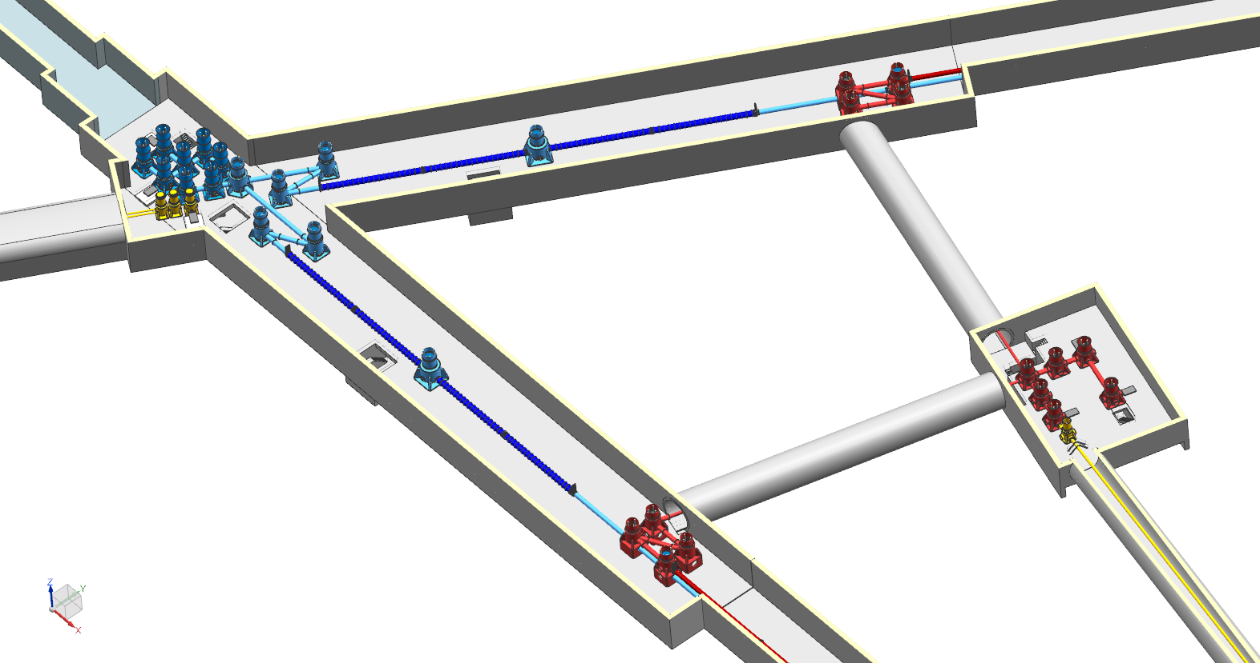
Logistics and Installation
For Civil Engineering: started the process of “remodeling” the space needed for ET: including installation and maintenance.
Need discussions with several ISB Divisions + requirements
  E.g.: Logistics for installation and maintenance
Approved layout of ET?
Pictures from the ET design: ET Layout 8 (2020)

Slide 21
Summary
The Engineering Department team is growing, but will need more support to fulfil our tasks for Phase 1:
  In most teams, but specifically for Technical Infrastructures we need support
  Recruitment process of the ET-PP resources is almost complete
Started the work on Civil Engineering with CERN: more info in the parallel session on Wednesday
MOU with CERN for Civil Engineering in addition to the Vacuum Beam Pipe
Expect an MOU with the CERN Engineering Department first half 2024

Slide 22
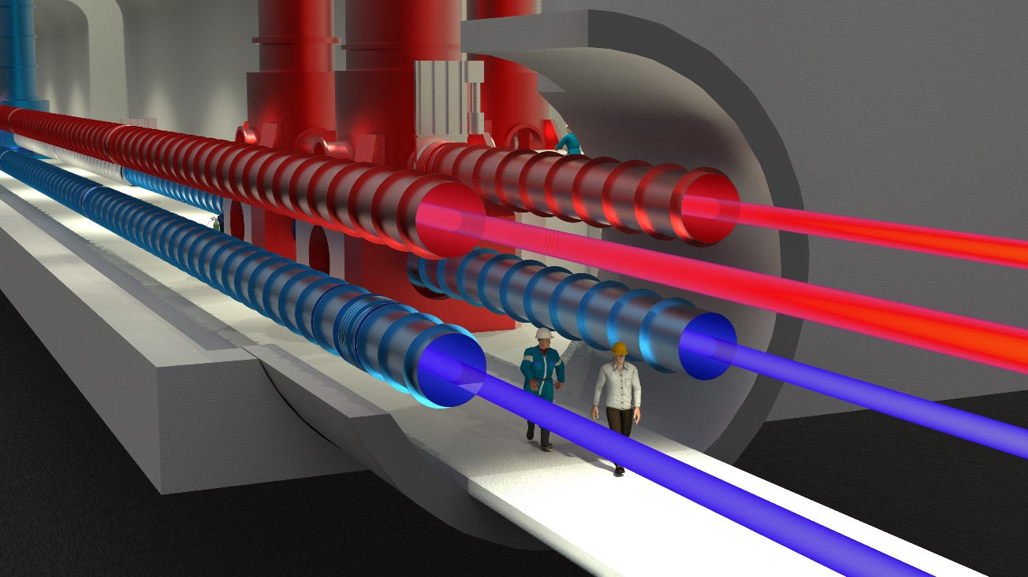
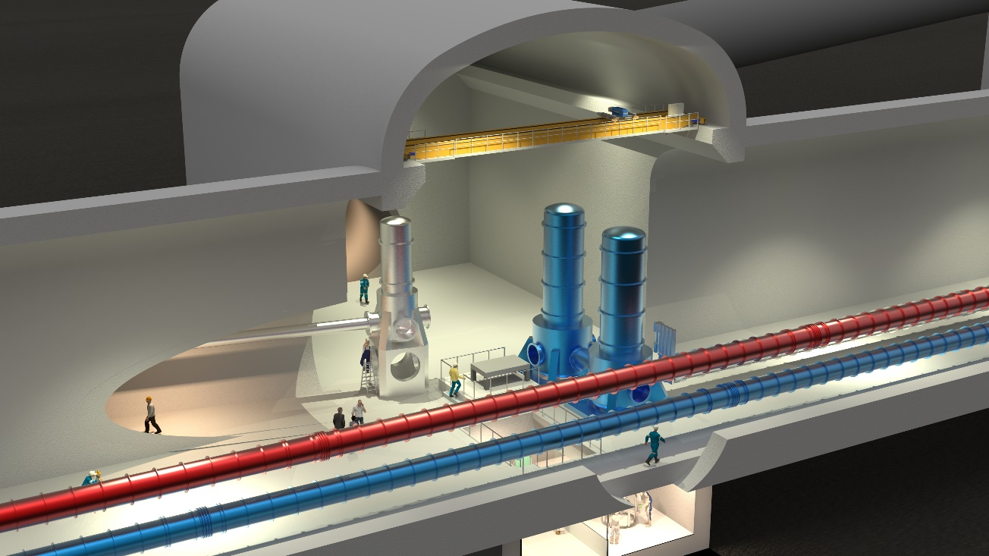
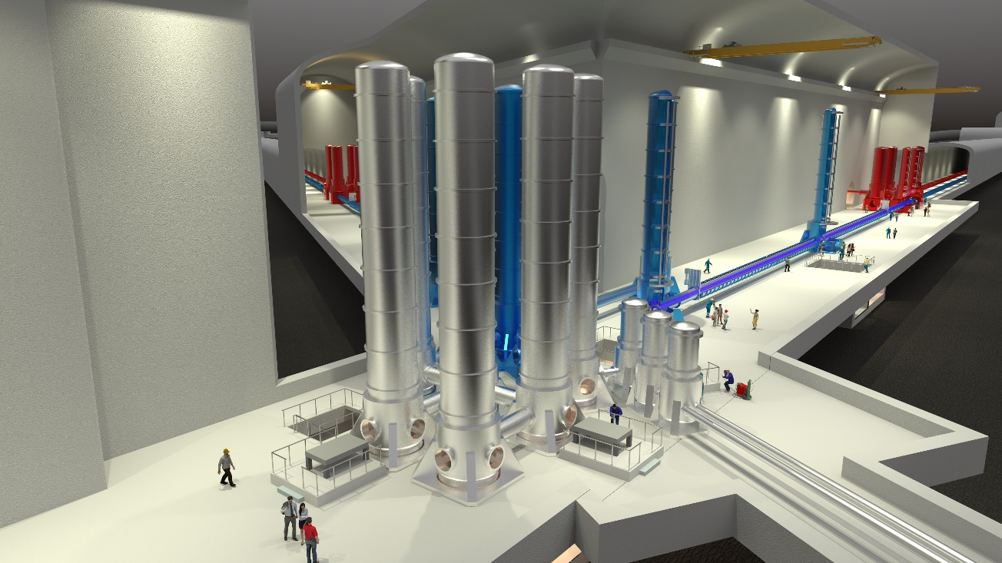
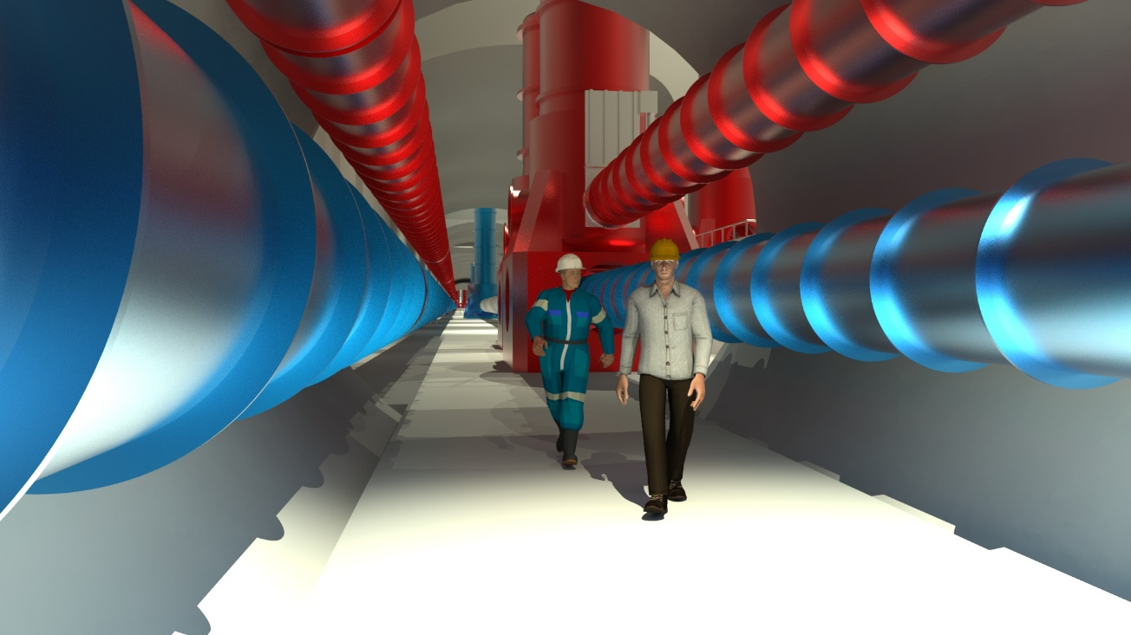
End

