Slide 1
The role of communication
Martine Oudenhoven, head of ETO comms office
Einstein Telescope Collaboration meeting
14 November 2023

Slide 2
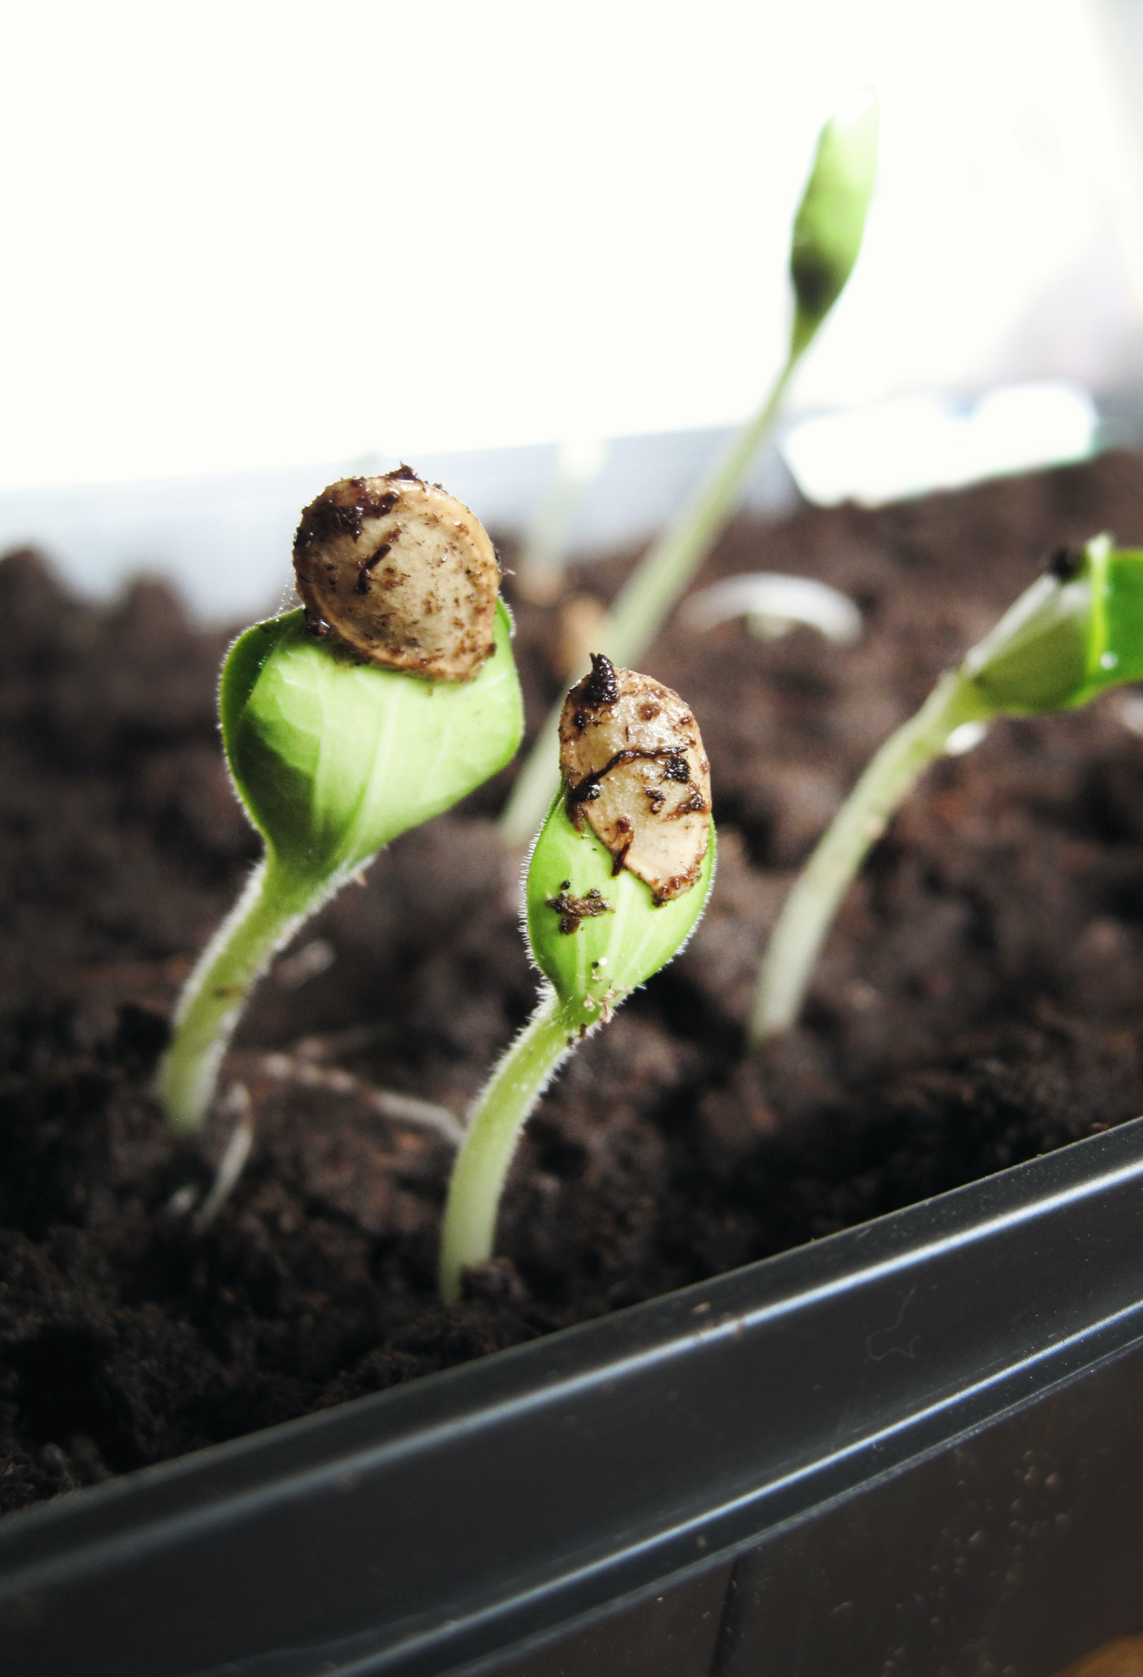
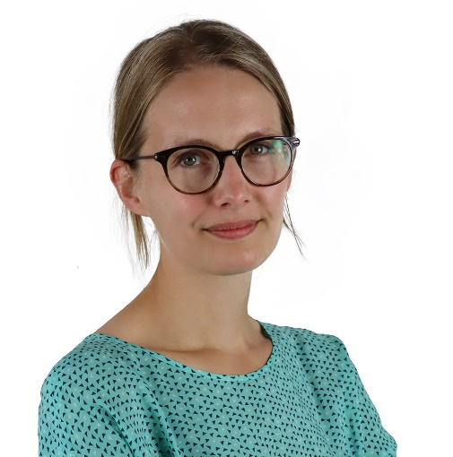
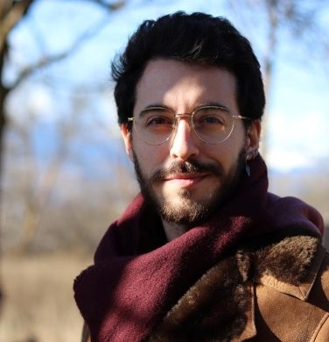
Martine Oudenhoven
Head of Communication Office
Based at Nikhef
“Not an outreach person.”
“Person who probably has been thinking the most about the communication of the Einstein Telescope”
Josep (Pep) Freixanet
Communication officer
Based at IFAE
“Unconventional science communicator”
“A fresh pair of eyes for the communication of the Einstein Telescope”
The ETO communication office is starting up
Photo by Jen Theodore on Unsplash

Slide 3
Our mission: Establishing ETO, while powering the Einstein Telescope at large
Establishing the Einstein Telescope Organisation:
Strategic work (stakeholders analysis, advice to directors,)
Internal communication
Work plan, starting up office
Powering the Einstein Telescope at large:
ET-PP WP10 (strategy, website, social media, logo, …)
Other supranational activities
Alignment of different activities/entities
Keep an eye on the bigger picture

Slide 4
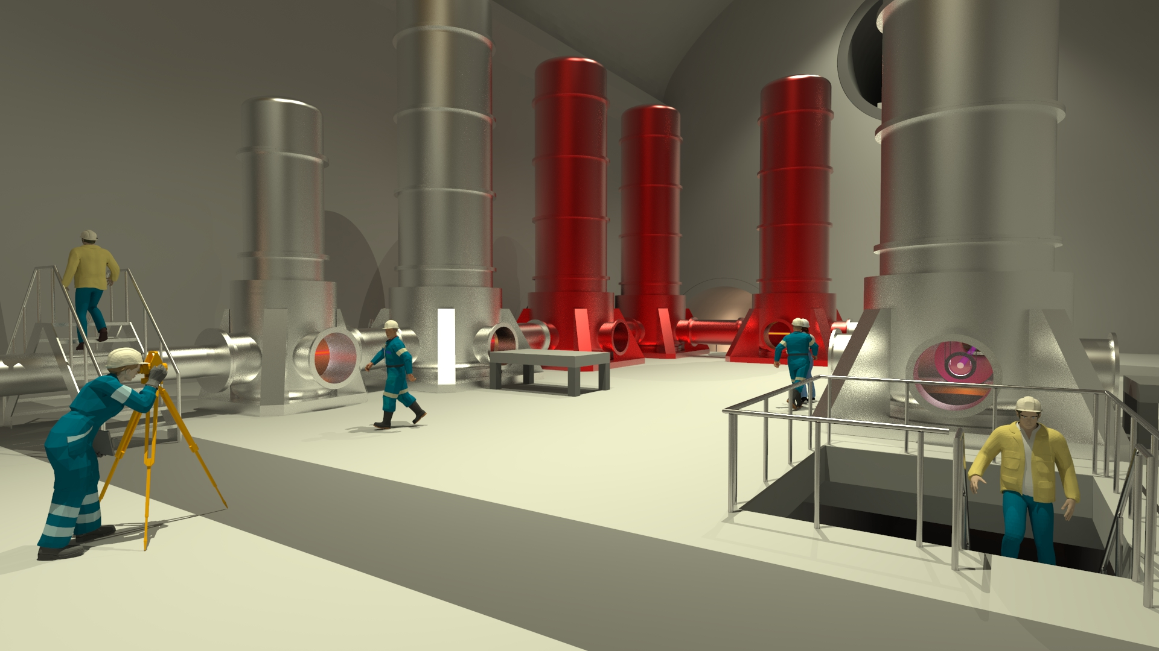
If we want the Einstein Telescope to be built, we need a lot more political and financial support than we have right now. Communication is one of the keys in achieving this.

Slide 5
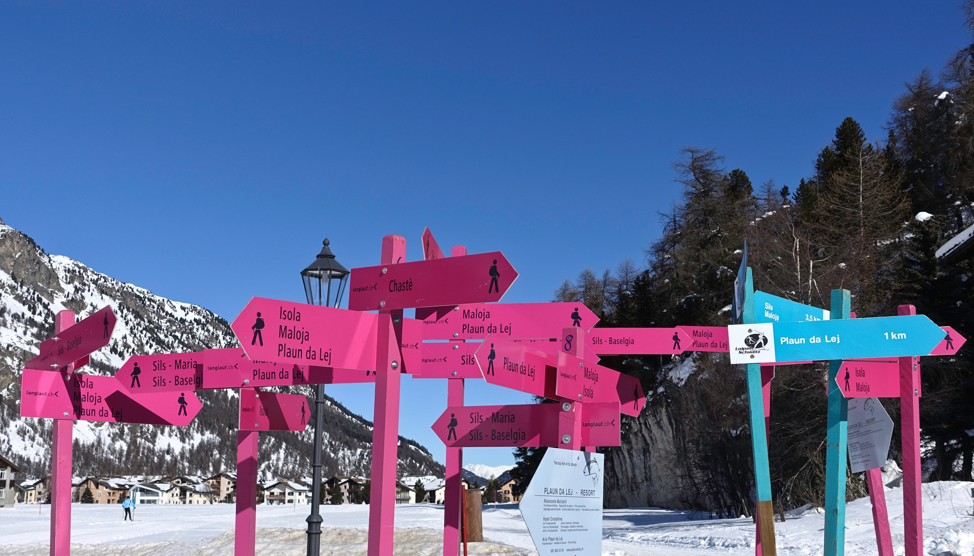
One of the main communication (and organisation) problems
So many projects, websites and logos!
At the moment we are confusing people, even people who are close to the Einstein Telescope.
How is everything organised?
Many people wearing different hats
Gravitational what?
We cannot afford this! We have to show we are a strong initiative that’s worth investing in.
Photo by Daniele Levis Pelusi on Unsplash

Slide 6
The Einstein Telescope communication entities
The Einstein Telescope
(Europe-wide)
(The) Einstein Telescope
(general)
National communities
(in countries that are not a potential site)
ET Scientific Collaboration
ET Organisation
Potential site/bid Sardegna (including local/regional projects)
Potential site/bid EMR (including local/regional projects)
Potential site/bid Sachsen (including local/regional projects)
Notes:
ET-EU: Should appear as one, even though behind the screens there are different entities
The potential sites are ‘special cases’ with very specific communication needs and aspects. E.g. building a hostconsortium with local/regional stakeholders, different level of commitment from governments, more dialogue with local/regional stakeholders to ensure their support etc. This means that they are really different entities/identities in practice
National communities: Also need to ensure commitment/support, but on a different level than potential host countries

Slide 7
What if I am affiliated with multiple entities and thus ‘wearing multiple ET-hats?’
No worries, that’s how science works. But it’s also why it’s so important to align and connect the different entities and make sure they are not in competition.
Be aware that the outside world will often not grasp this, and see only one hat. So before communicating check yourself: which hat does my audience think I’m wearing? And does that match the main hat I’m actually wearing today?
Photo by Stephen Hocking on Unsplash

Slide 8
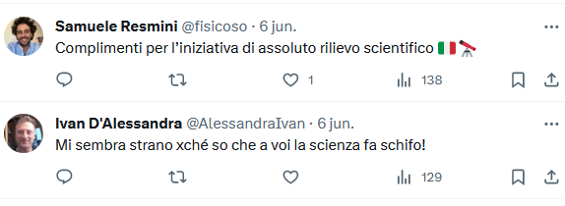
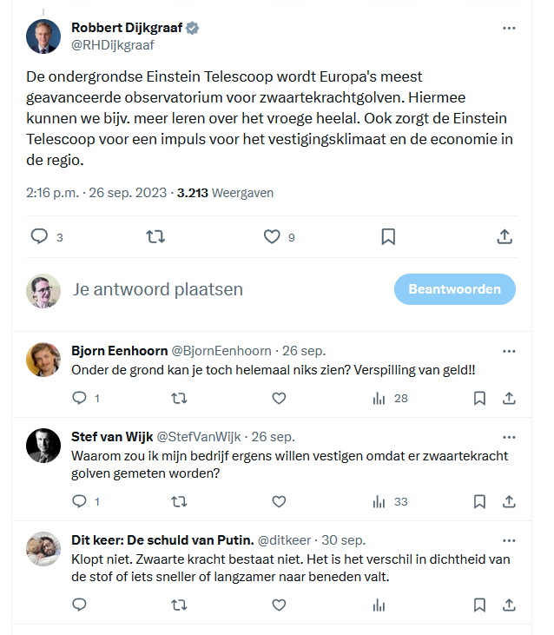
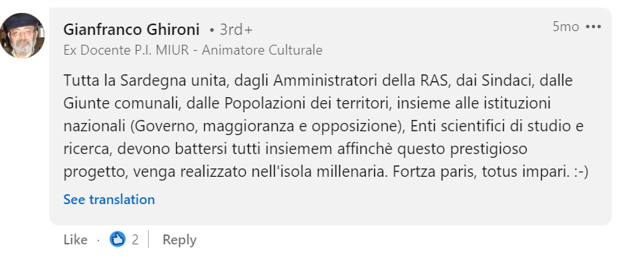
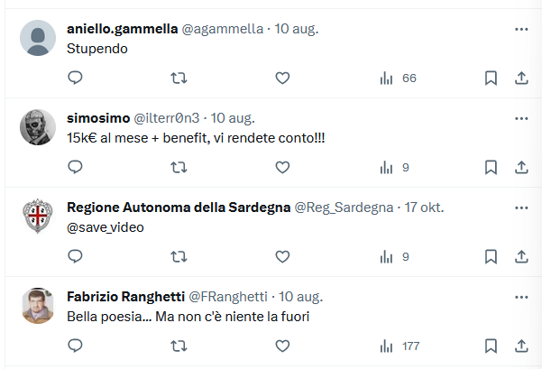
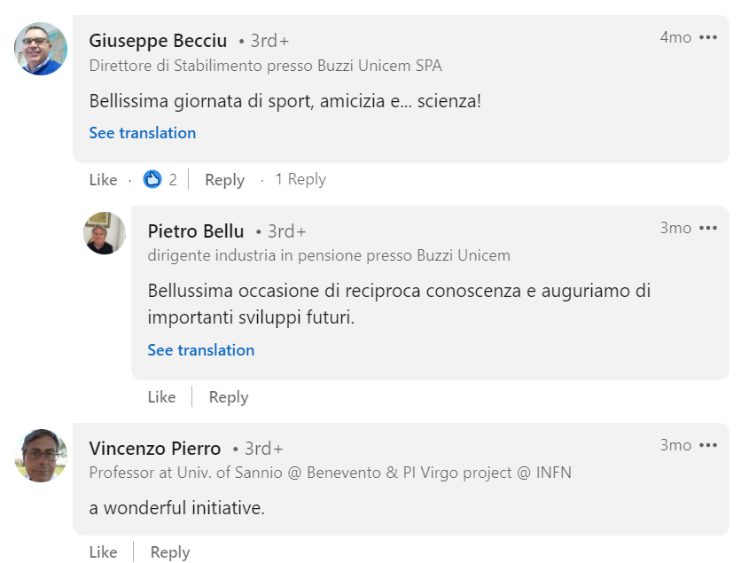
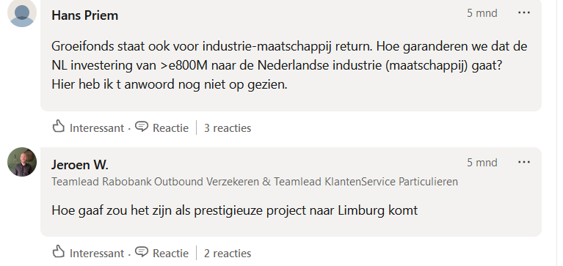
A quick glance at social media: positive but also critical comments

Slide 9
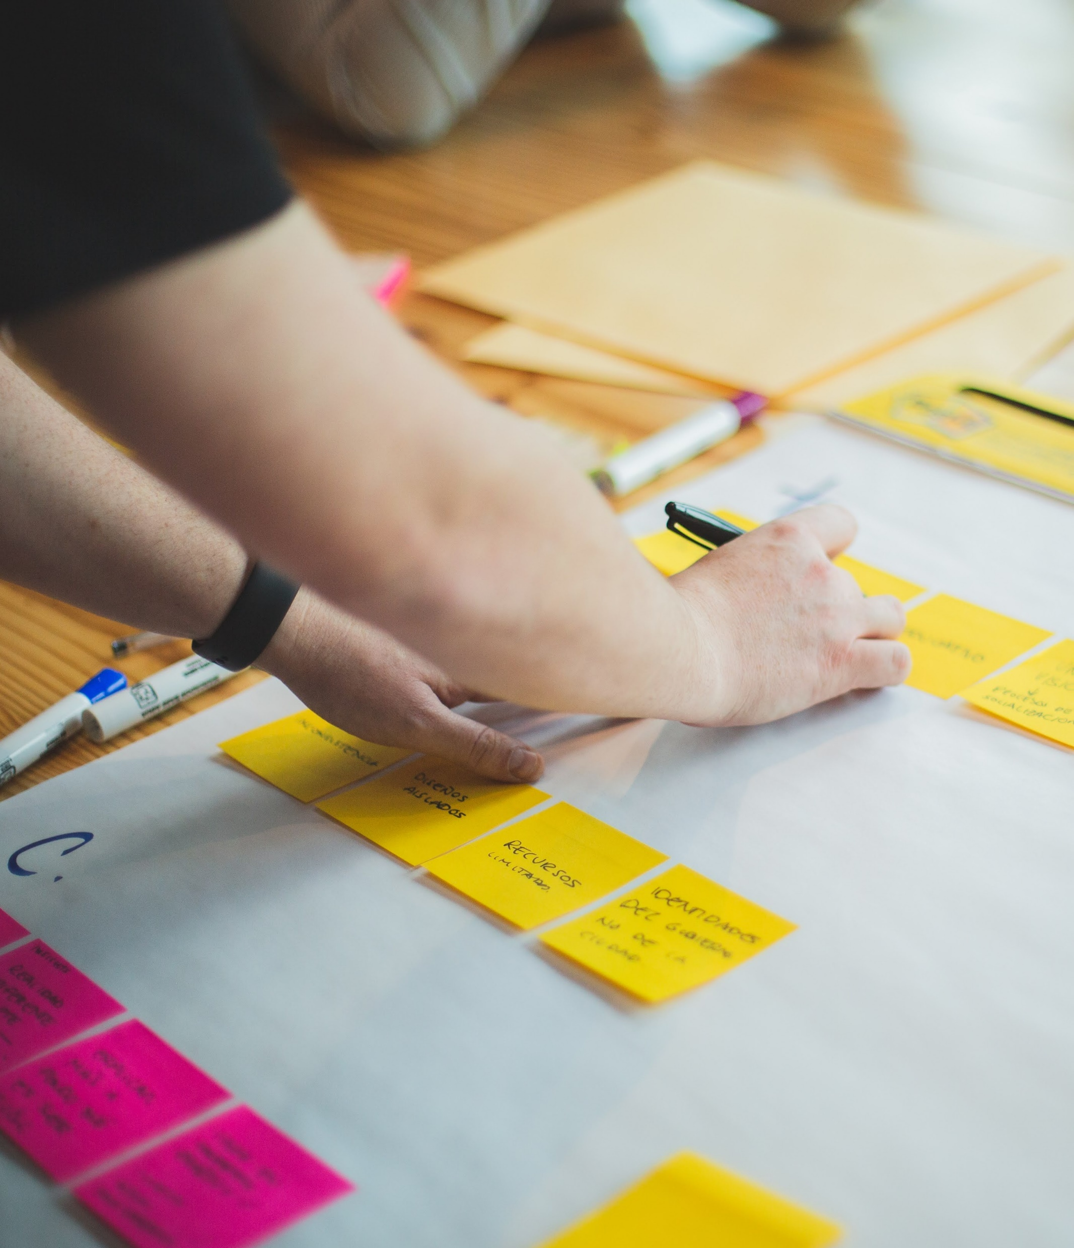
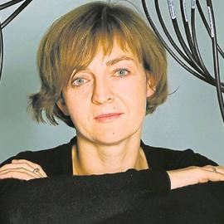
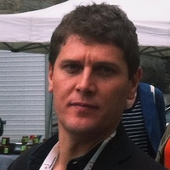
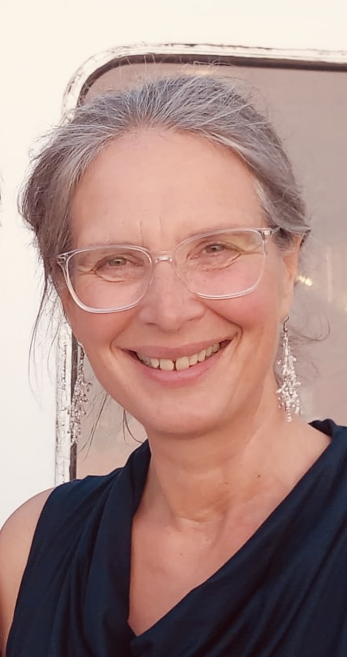
ET-PP Work Package 10: Additional financial support to kickstart communication & outreach
Chairs: Dorota Rosinska & Vincenzo Napolano
Many people involved.
Link to ET Collaboration: Susanne Milde
Photo by Brands&People on Unsplash

Slide 10
ET-PP Work Package 10:
Kickstarting communication activities
D10.1 Initiate strategic media and communications plan (M11)
D10.2 Launch consortium website and social media accounts (M24)
D10.3 Formulate strategic media and communications plan (M24)
D10.4 Complete bank of graphics, multimedia resources (M36)
D10.5 Launch ECR mentorship and training programme (M44)

Slide 11
ET-PP Work Package 10:
How we work
All hands meetings, coordinators meetings, and sub group meetings on different topics
We discuss, and then develop ‘2-pagers’.
The 2-pagers are sent to and discussed with the ‘Leadership Group’ (Spokespersons ET Collaboration + Directors ET Organisation).
If they agree, we continue
This process takes time, but it’s important to lay the foundation well.

Slide 12
ET-PP Work Package 10:
Get involved
15 Nov 9:00 (tomorrow)
Learn more about ET-PP WP10 during the parallel session
16 Nov 12:00 (Thursday)
We need your input!
Join the plenary session:
‘Einstein Telescope logo: a journey of discovery’

Slide 13
A side project: ‘10 reasons to build ET’
Collaborative ‘supranational’ effort, coordinated by Pep Freixanet
Building the science and technology case for ET, in a way that can be used for communication
Be aware: Yuliya Hoika or Sascha Rieger may ask you for your ‘reasons to build ET’ during this ET collaboration meeting
Photo by Etienne Girardet on Unsplash

Slide 14
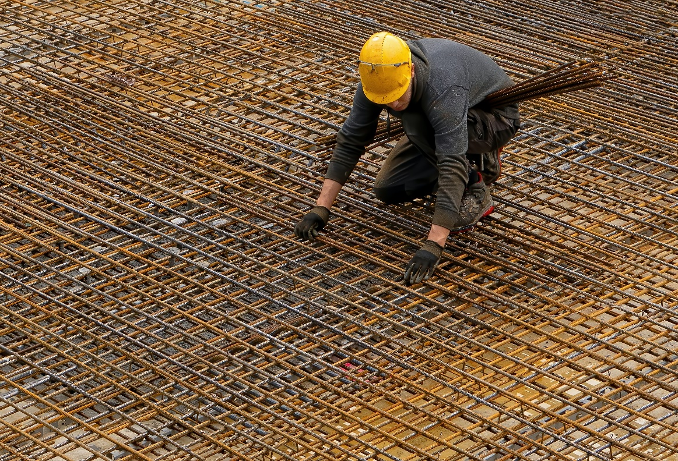
Three messages to take home
Photo by Robert Ruggiero on Unsplash
Let’s work on reducing confusion
We are laying the foundations for communication. This is in part invisible and takes time, but is crucial later on.
Be aware of the hat (people think) you’re wearing
Photo by Ricardo Gomez Angel on Unsplash
Photo by Mediamodifier on Unsplash

