Slide 1
ET vacuum pipe: planning and perspective At CERN
Luigi SCIBILE for the ET-CERN collaboration
2nd Einstein Telescope Annual Meeting, Paris, 14-16 November 2023

Slide 2
Content
ET vacuum pipe planning towards the TDR.
Status of the activities: planning perspective and difficulties.
Future of the Vacuum pipe pilot sector - test facility proposal.

Slide 3
CERN vacuum pipe planning - Main Milestones
INPUT for main milestones
September 2022
October 2022
TDR by end of 2025
A preliminary TDR by end 2024 for INFRADEV deliverable.

Slide 4
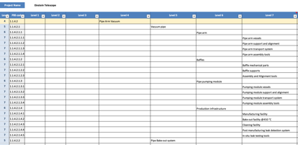
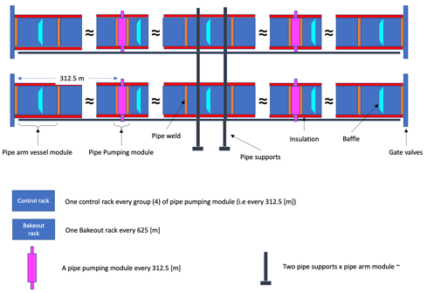
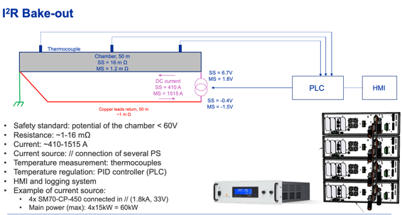
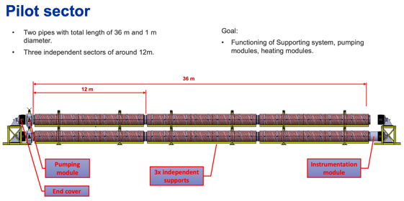
Pilot sector – Preliminary scope (BoQ)
Bill of Quantities (BOQ) based on ET Vacuum Pipe Product Breakdown Structure (PBS)
The Pilot sector includes (latest revision):
1 x Basic infrastructure (Electricity, IT Network, compressed air (?), temperature controlled (+/- 3 degrees) volume.
2 x stacked tubes (Ø 1 m x ~36 m), corrugated and/or VIRGO-like solution.
2 x tubes thermal insulation.
2 x pumping module.
2 x three (6) pressure measuring ports and residual gas analysers.
1 x vacuum control system for the overall pilot sector
1 x bake-out system for the the 2 tubes
1 x set of transport tools.
1 x support structure for the stacked tubes.
Integration of baffles; in a second stage, equipped with instrumentation.
The installation will serve to test:
Installation and alignment of supports and tubes.
Welding and assembly tools and methods.
Leak detection scenarios
Ultimate pressure and outgassing measurement after bake-out.
PBS
Courtesy of Luca Gentini
Courtesy of Gregory Pigny

Slide 5
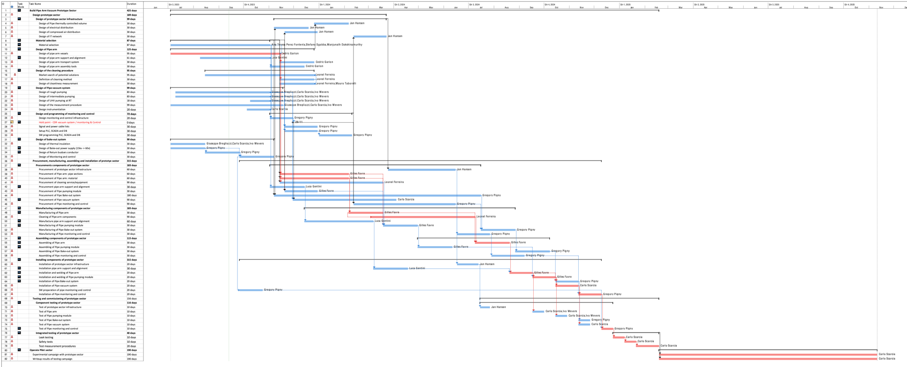
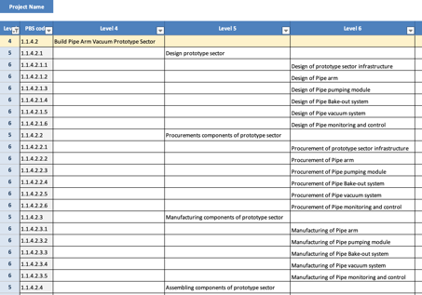
General Planning
Design
WBS
Procurement and Manufacturing
Installation and Testing
Operation

Slide 6
General Planning
In red the Critical Path

Slide 7
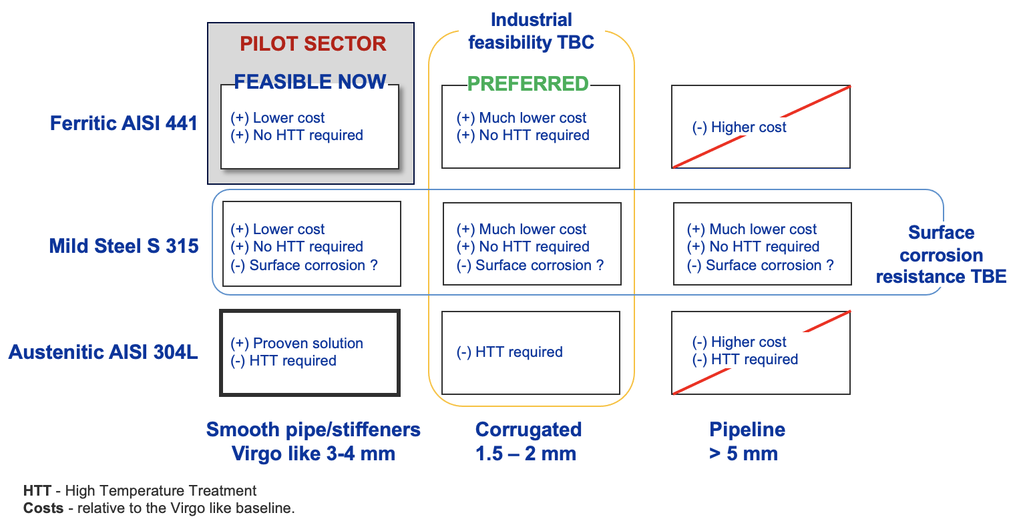
General Planning
Observations:
Design of pipe arm in the critical path.
Hold point to line up choices for the vacuum system and bakeout equipment.
Design
As the corrugated beampipe cannot be fabricated in due time with the required UHV characteristics, it is kept only for design studies while seeking a valid industrial partner.
The VIRGO geometry beampipe made of 4-mm thick AISI 441 is now prioritized for the first test with the pilot sector.
The support system of the pilot sector will be compatible with beampipes of different geometries.
NEXT: A review on material and design of the beampipe for the pilot sector will be organized in the coming months with an international panel.

Slide 8
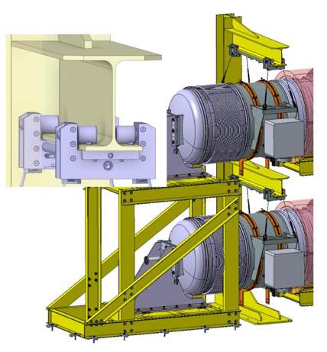
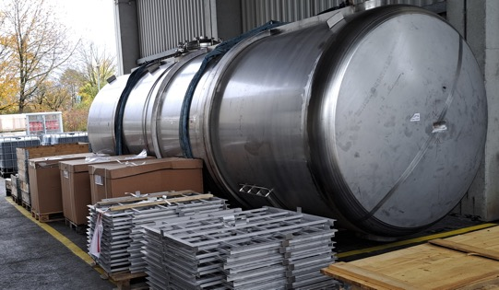
General Planning
Observations:
Procurement of material for the pipes and manufacturing of the sections in the critical path (see also previous slide)
Risk of delays (slack added) for the cleaning.
Procurement and Manufacturing
All components of the pilot sector, but the pipe, have moved to fabrication drawings for procurement.
The technical specification for the procurement of the pilot sector beampipe is being prepared.
Cleaning facilities are being visited to validate methods, cost and planning.
Courtesy of Carlotta Accettura
Courtesy of Leonel Ferreira
Vessel to be polished (internal surface)~ 8 m x 2.5 m diam.
Design and simulation of the pumping modulus

Slide 9
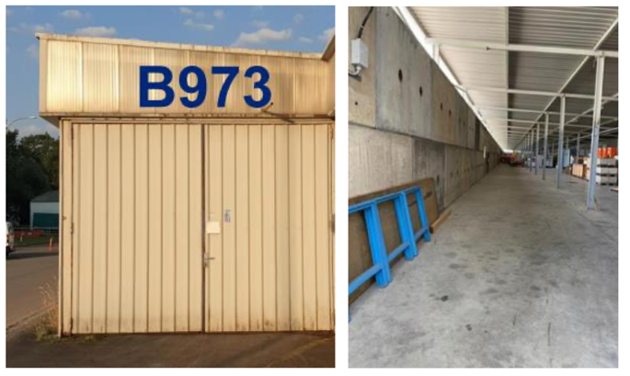
General Planning
Observations:
Installation and testing procedures not optimised yet.
Time contingency on integrated testing.
Installation and Testing
Space is ready to receive the pilot sector
Courtesy of Jan HANSEN

Slide 10
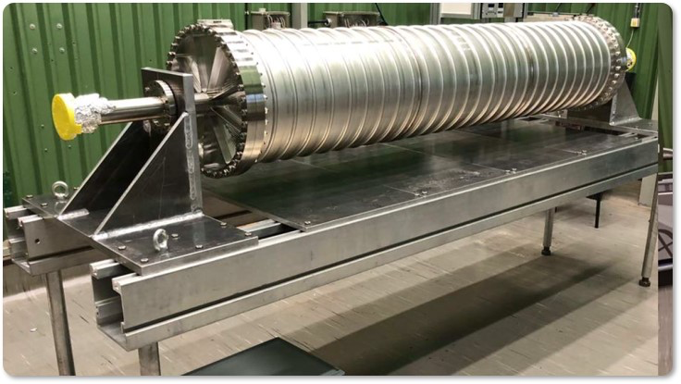
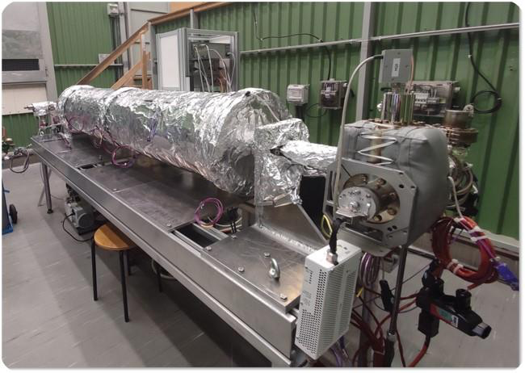
General Planning
Observations:
TDR milestone still FEASIBLE
Courtesy of Carlo Scarcia
Operation
Operation on the pre-pilot vacuum tube
TDR

Slide 11
General planning – Next steps
Forthcoming activities:
Procurement of the pilot sector components – except beampipe (to be done after review).
Review on material and design of the beampipe pilot sector - before procurement.
Finalize integration and requirements for the baffles to be tested with the pilot sector.
We seek industrial partners to produce UHV-compatible corrugated pipes by technologies scalable to ET.

Slide 12
CERN vacuum pipe - perspective
It has become evident in the discussion with the ET community that the vacuum pipe pilot sector might be used for additional purposes beyond preparation of the TDR.
Perspective:
After 2025, extend the usage of the vacuum pipe pilot sector in a TEST FACILITY.
The FACILITY could be used by the ET community for testing materials, equipment, procedures, and eventual outgassing rate of ancillary equipment.
The FACILITY could also be equipment with a Fabry-Perot etalon to:
test under UHV any device inside the ET arms that would potentially put at risk the mirrors and the performance of an optical cavity in the real ET environment and
carry out a long-term monitoring of the performance of the mirrors and the optical cavity over time.
Open to discussion and proposals.

Slide 13
Conclusions
Planning:
A general planning has been setup to monitor the progress towards the implementation of the pilot sector and the TDR by end 2025.
The planning highlights the critical activities and eventual optimizations.
Review on material and design of the beampipe pilot sector - before procurement.
A preliminary TDR by end 2024.
Perspective:
Shall we setup a TEST FACILITY with the vacuum pipe pilot sector?

Slide 15
Spare slide
Industrial feasibility TBC
PILOT SECTOR
FEASIBLE NOW
PREFERRED
Ferritic AISI 441
(+) Lower cost
(+) No HTT required
(+) Much lower cost
(+) No HTT required
(-) Higher cost
Mild Steel S 315
(+) Lower cost
(+) No HTT required
(-) Surface corrosion ?
(+) Much lower cost
(+) No HTT required
(-) Surface corrosion ?
(+) Much lower cost
(+) No HTT required
(-) Surface corrosion ?
Surface corrosion resistance TBE
Austenitic AISI 304L
(+) Prooven solution
(-) HTT required
(-) HTT required
(-) Higher cost
(-) HTT required
Smooth pipe/stiffeners
Virgo like 3-4 mm
Corrugated
1.5 – 2 mm
Pipeline
> 5 mm
HTT - High Temperature Treatment
Costs - relative to the Virgo like baseline.

