Slide 1

E-TEST : Einstein Telescope EMR Site and Technology
Rasa Jamshidi
Precision Mechatronic Group (PML)
2nd Einstein Telescope Annual Meeting: Nov. 14, 2023 -- Nov. 16, 2023

Slide 2
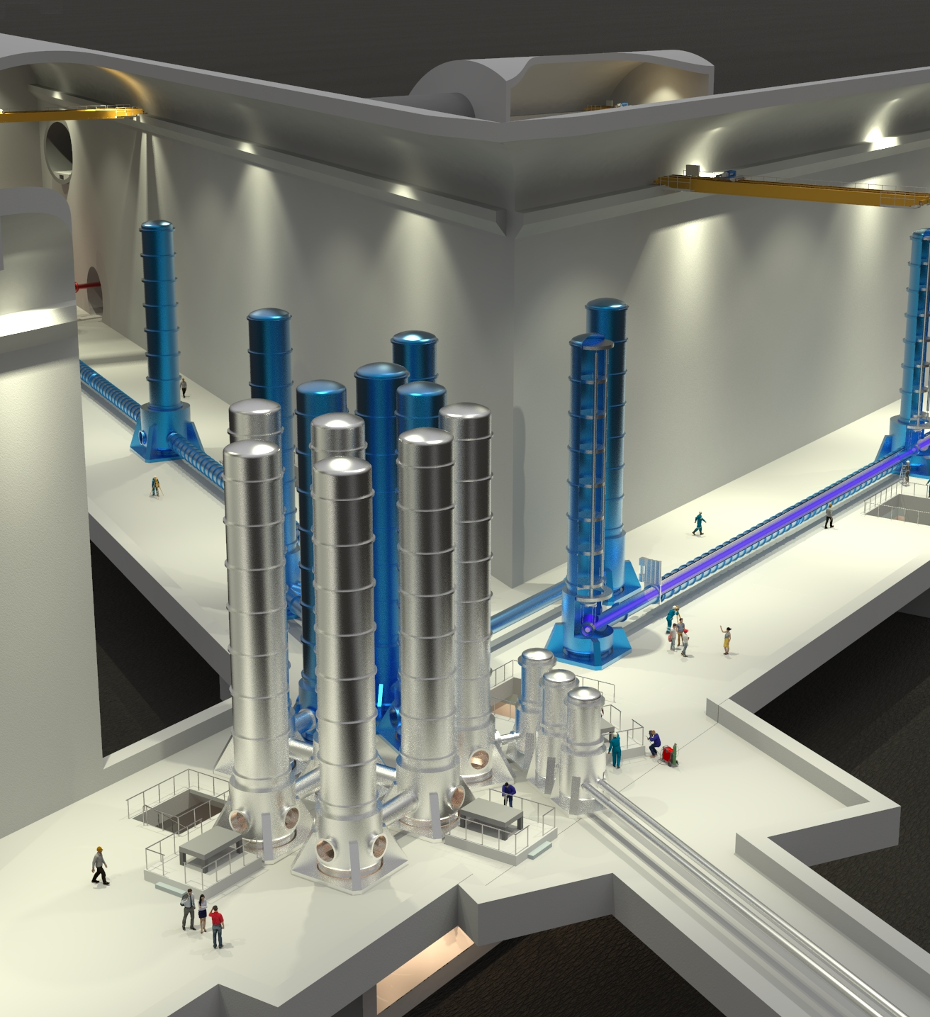
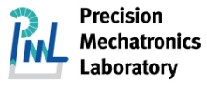




E-TEST objectives
Large mirror (100 Kg)
Cryogenic temperature (10-20 K)
Isolated at low frequency (0.1-10 Hz)
Compact suspension (4.5 meters)
E-TEST feasibility strategy
E-TEST is a project funded by the Interreg Euregio Meuse-Rhine and ET2SME consortium, which allow us to capitalize on existing infrastructure at Centre Spatial Liège (CSL) for the construction of the facility.

Slide 3
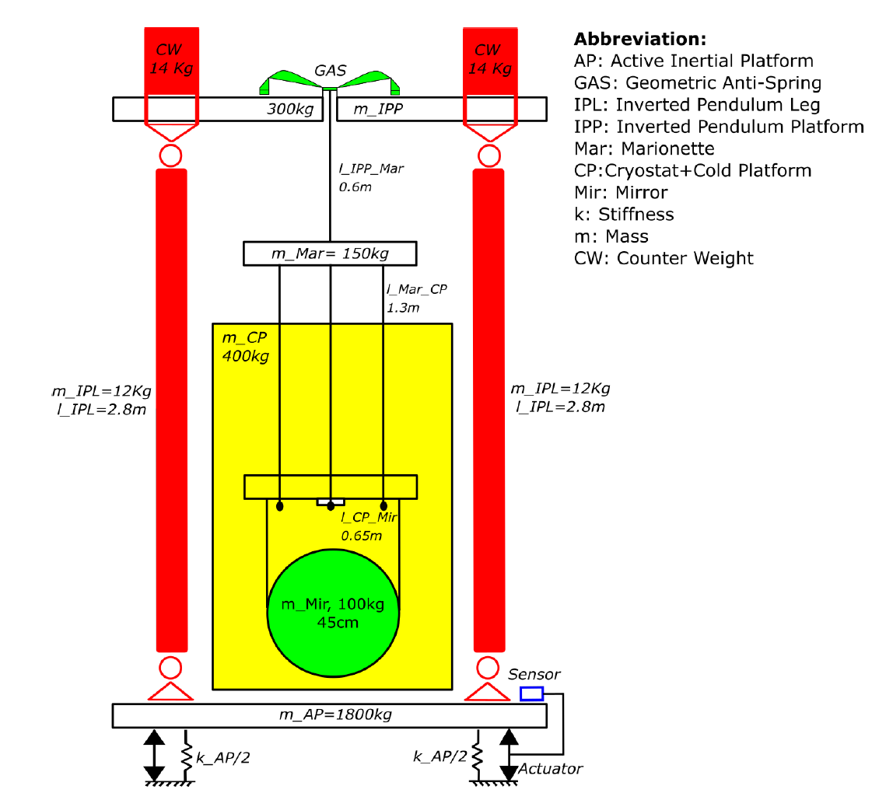
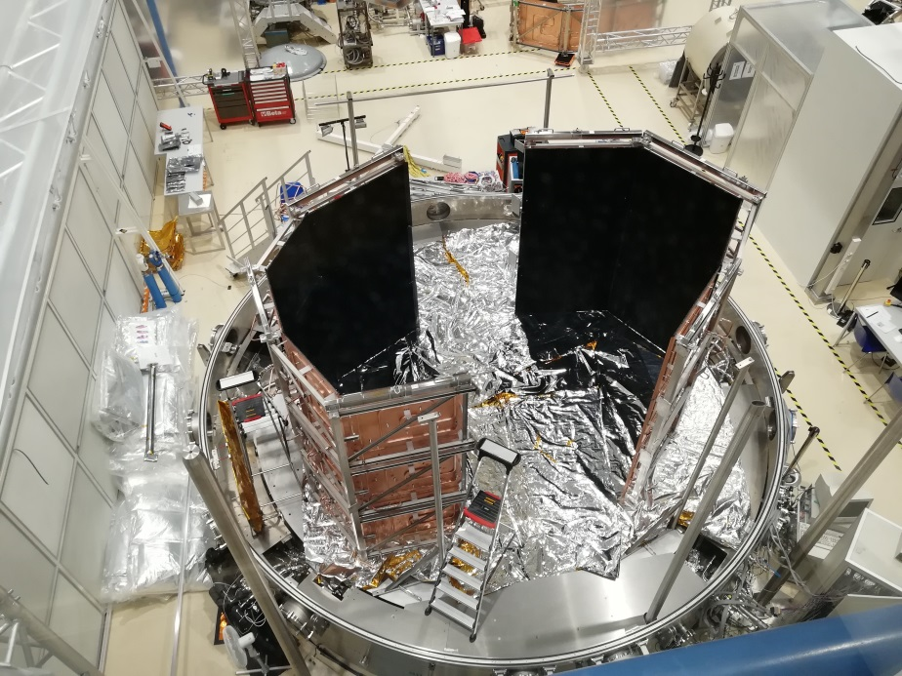
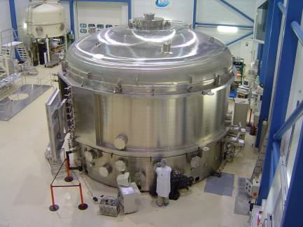
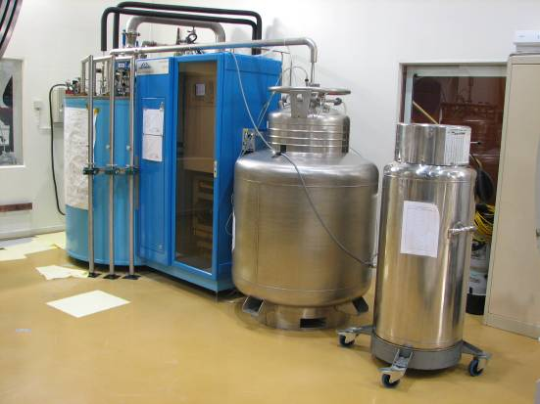
Prototype E-TEST
Liège Space Center
Hybrid (active + passive) isolation
Radiative cooling

Slide 4
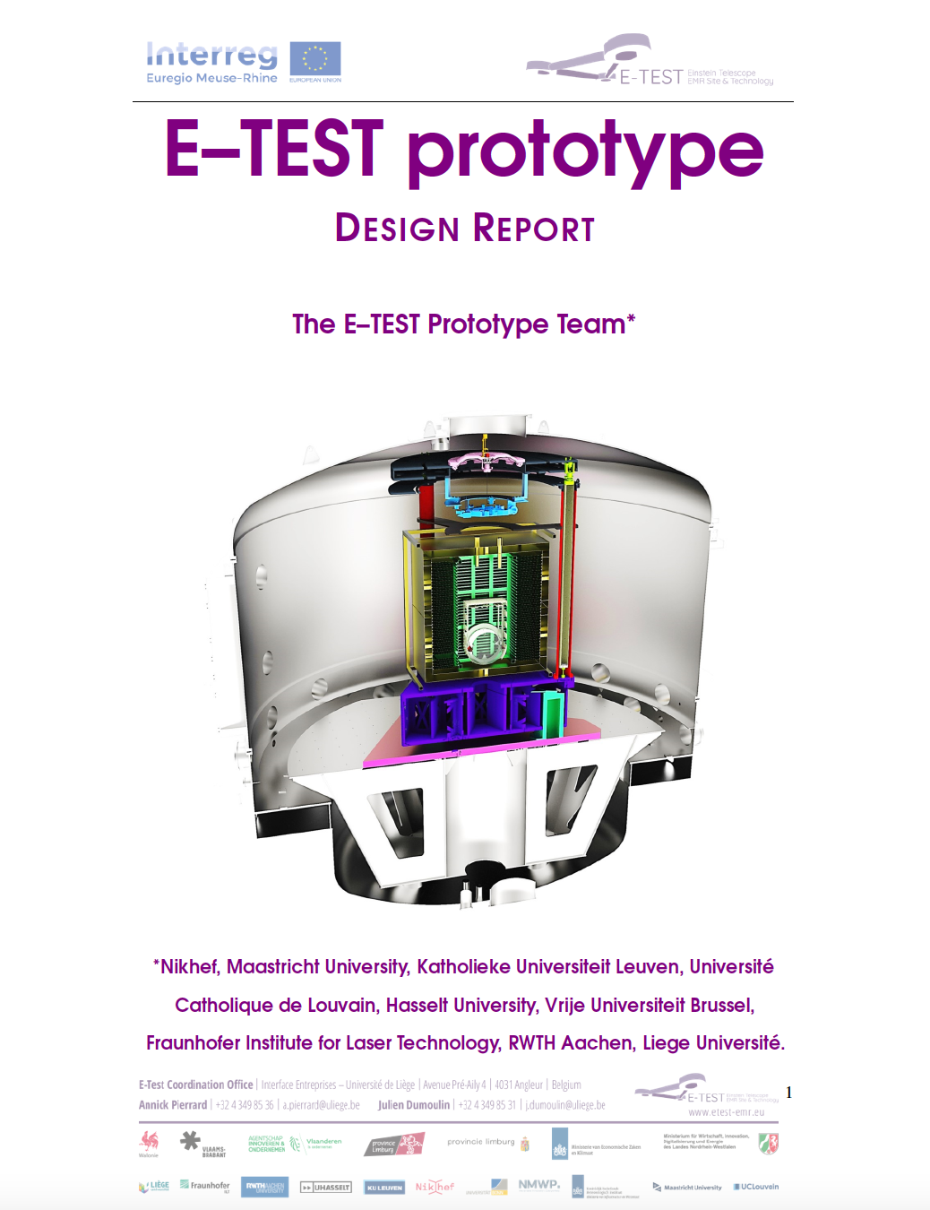
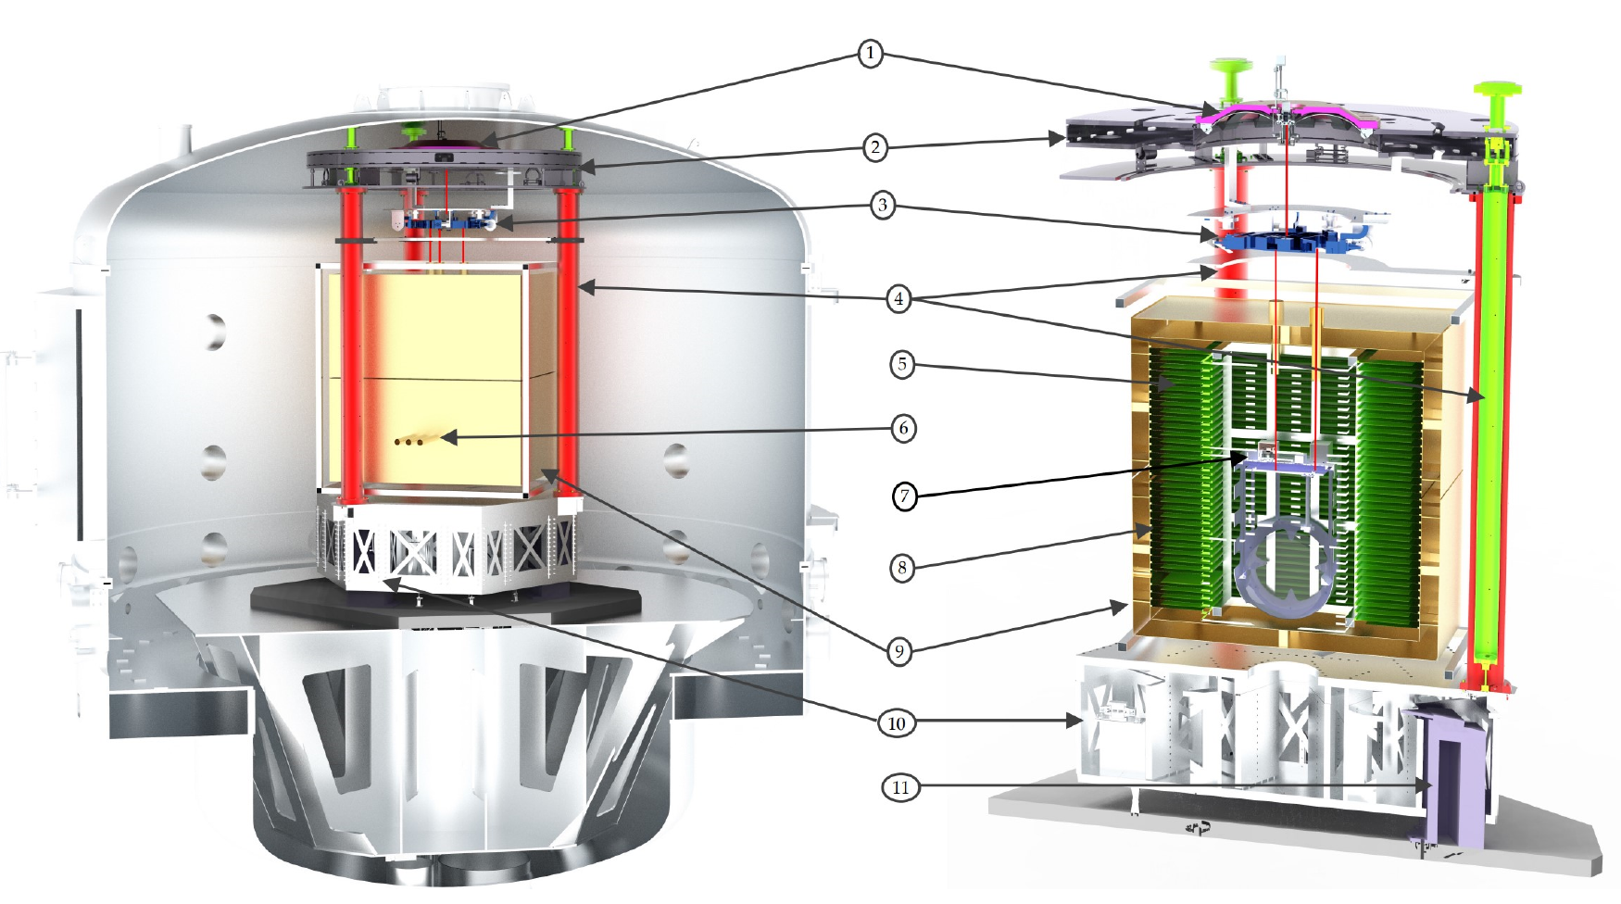
Submitted: 12/2021
Revised: 03/2022
Vibration isolator
1) GAS filter
2) Inverted Pendulum (IP) platform
3) Marionette
4) IP legs
10) Active platform
Cryogenic payload
5) Heat exchanger and
cold platform
7) 25K inner thermal shield
8) 80K outer thermal shield

Slide 5
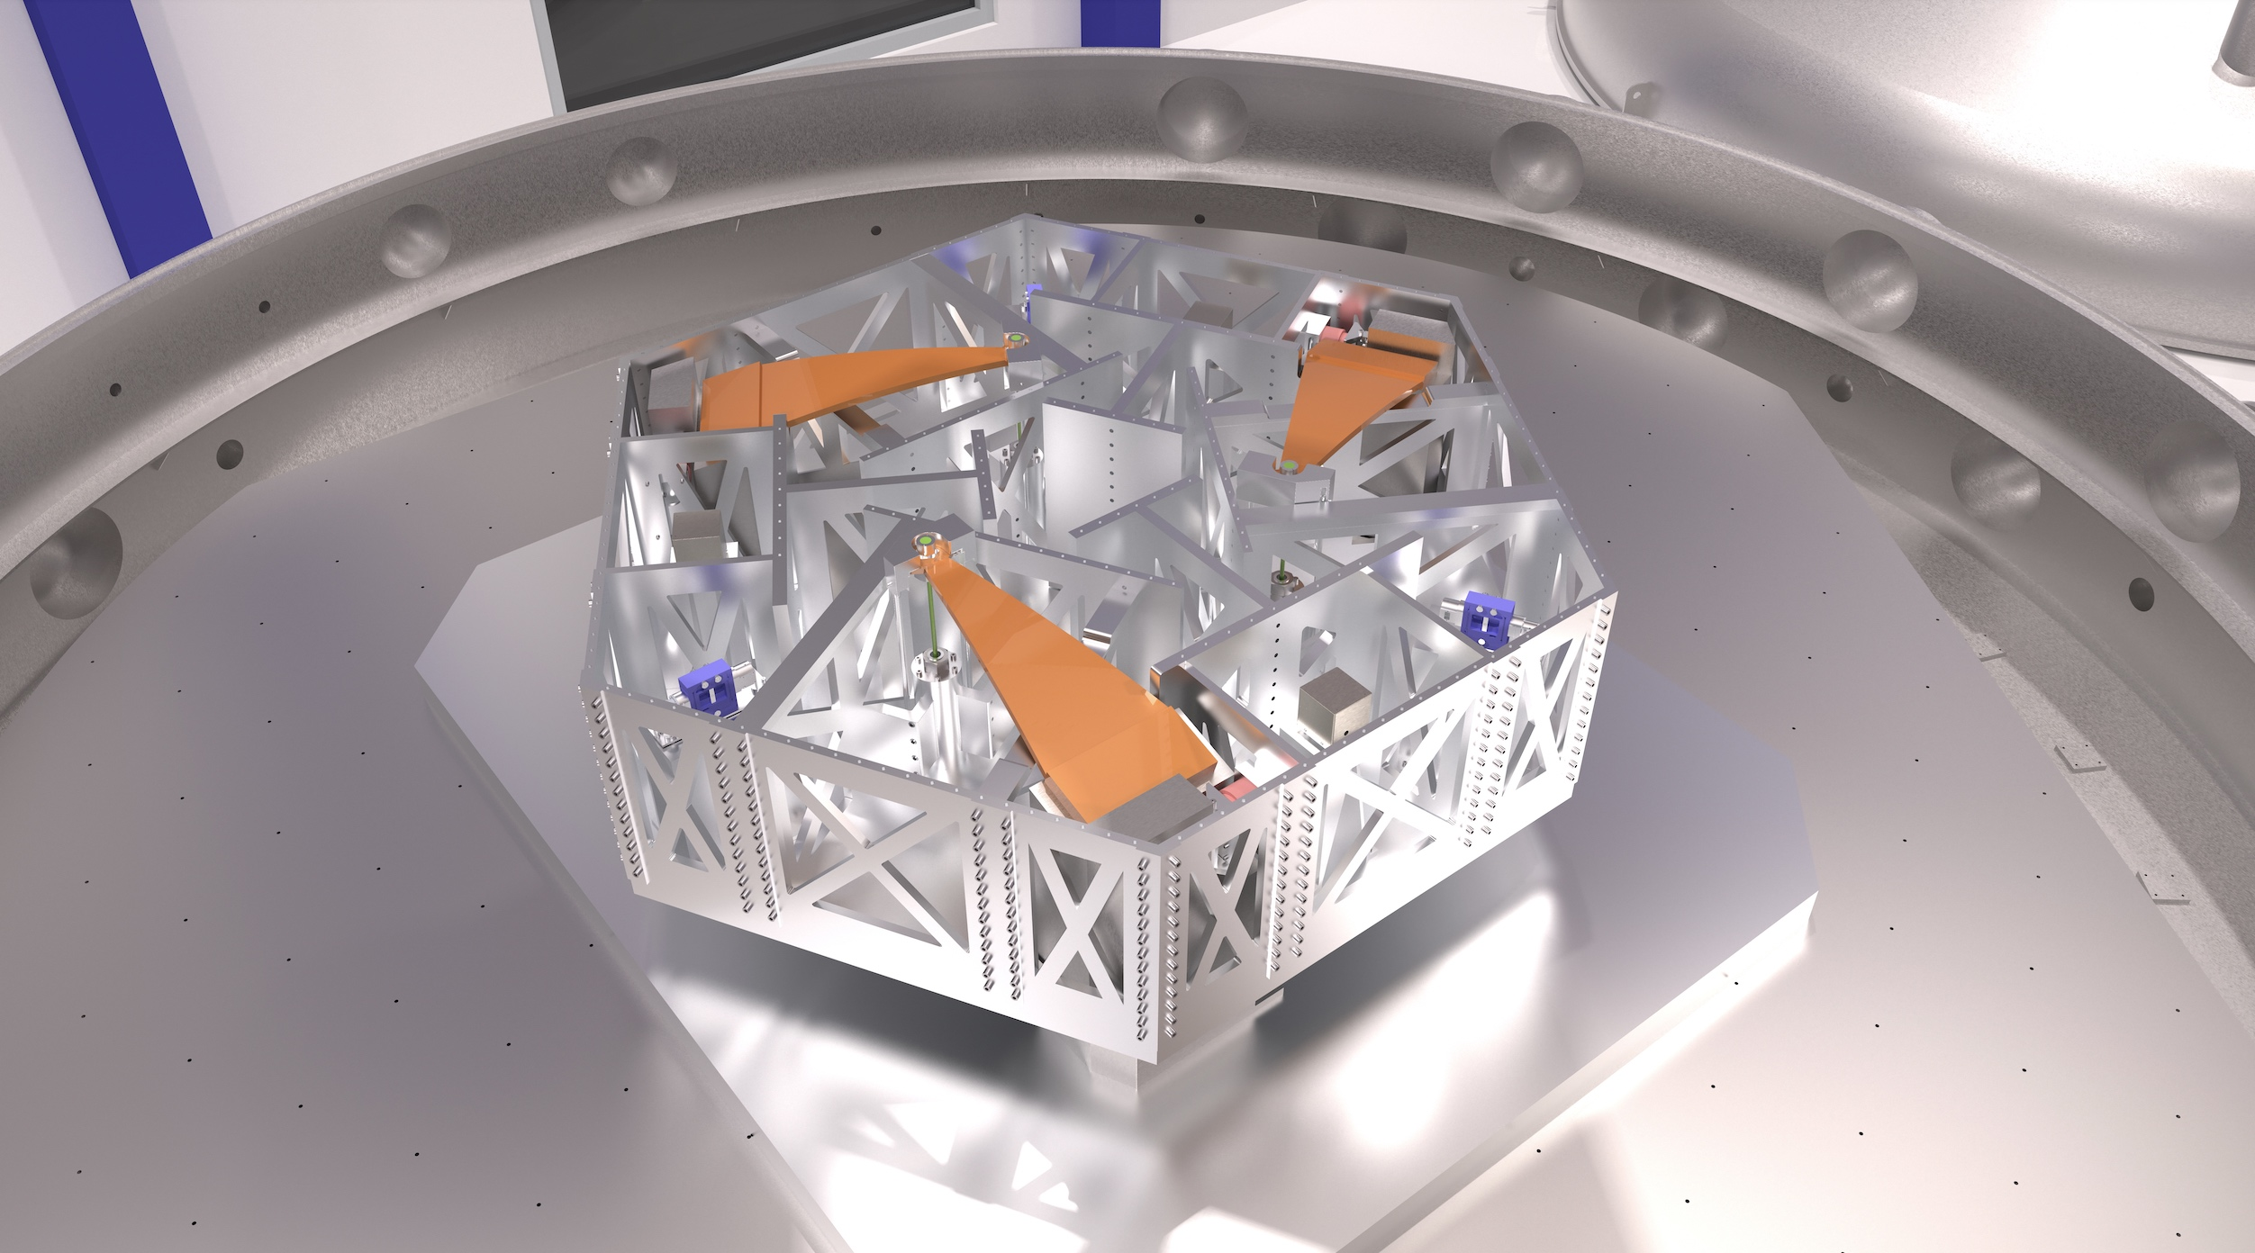
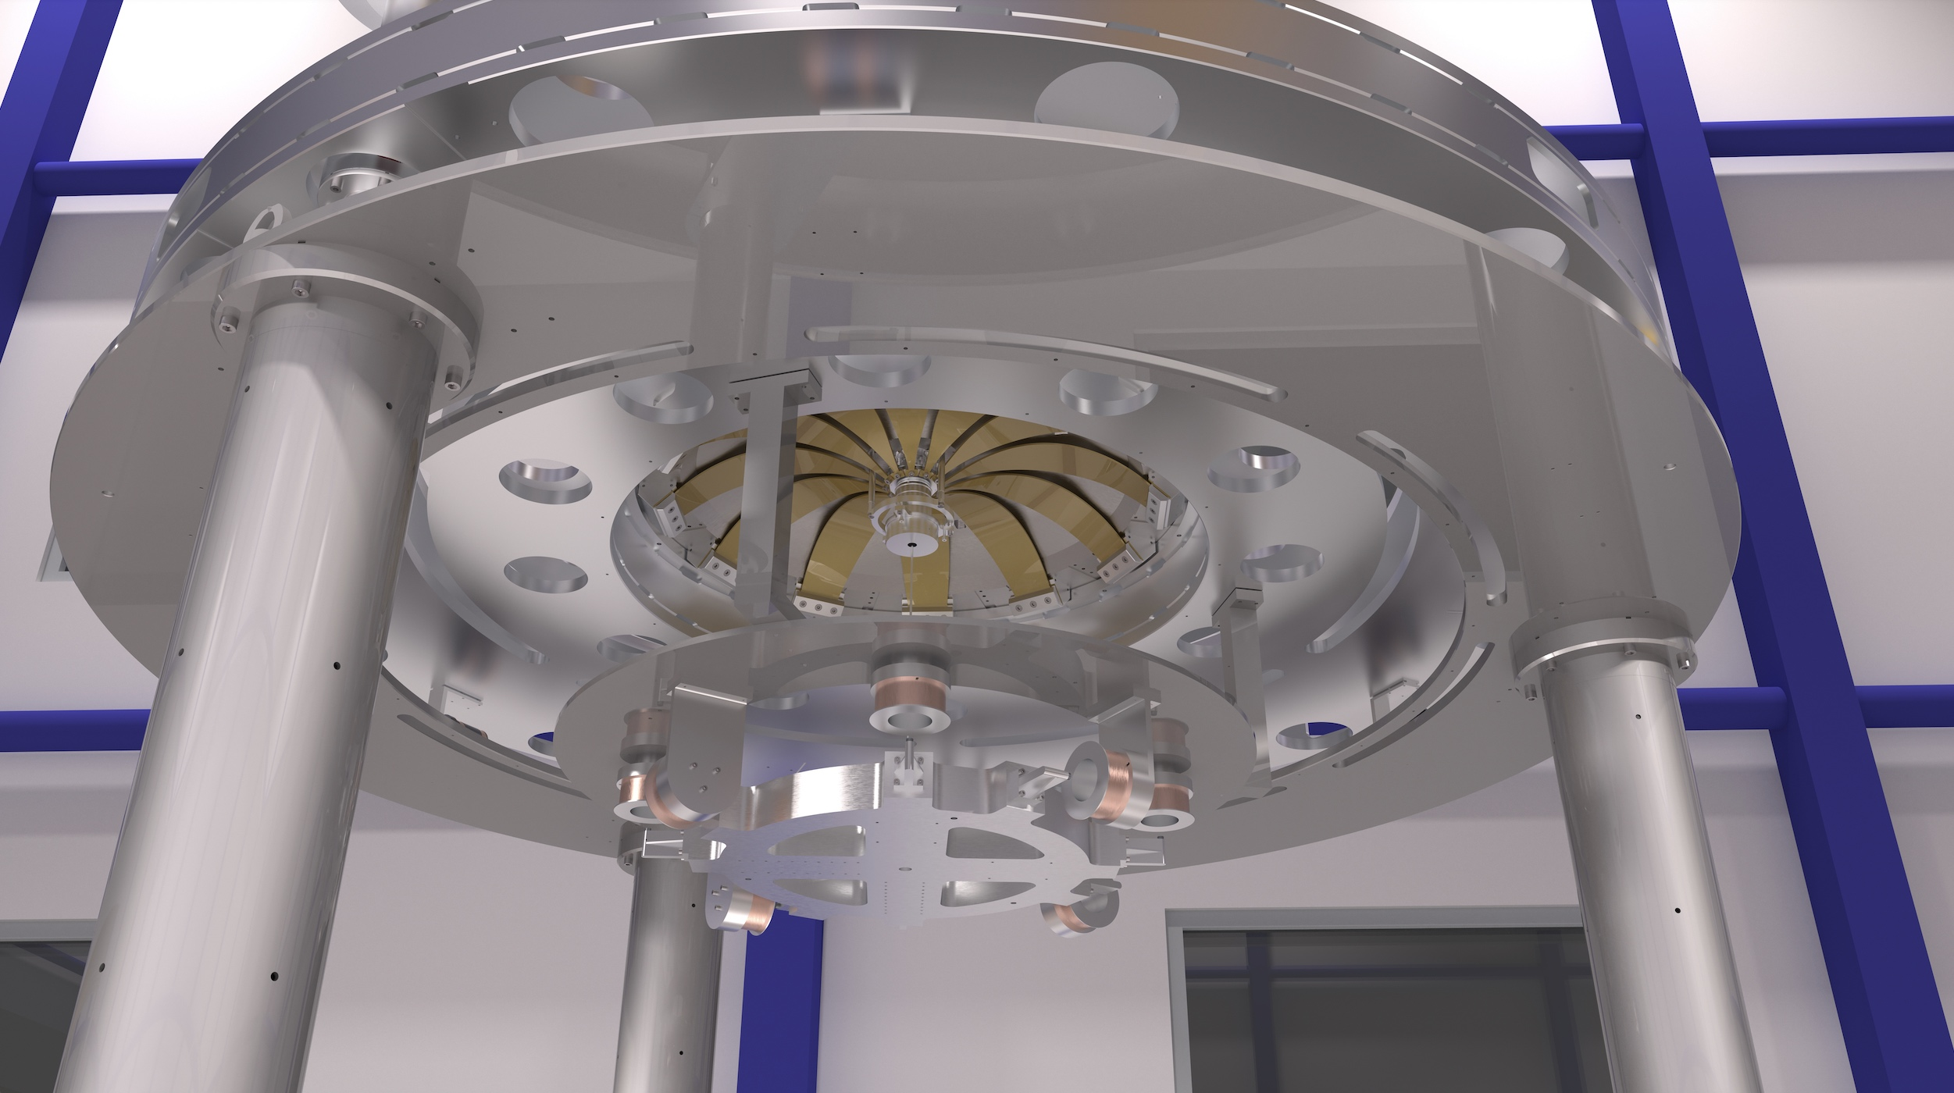
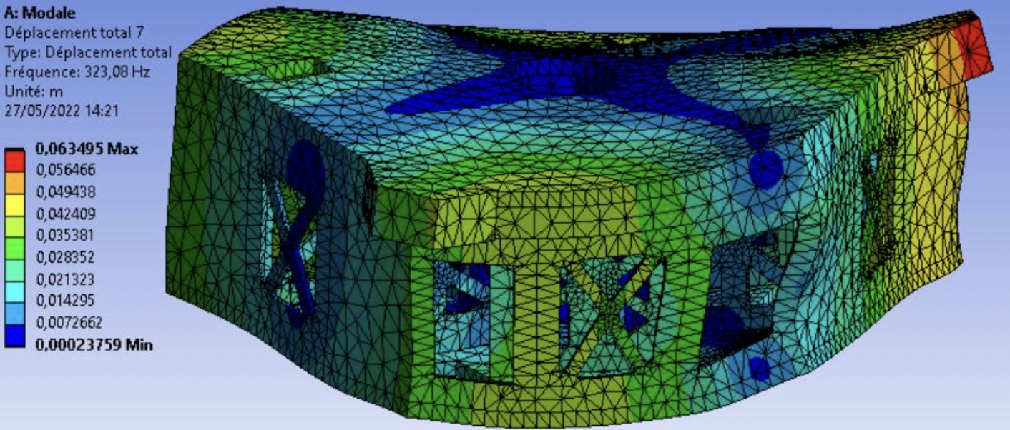
Mechanical design state-of-the-art
Production drawings of the whole prototype finished!
All mechanical parts in production
Start assembly in May 2023
Contact: Ameer Sider (PML)
asider@uliege.be
r.jamshidi@uliege.be

Slide 6
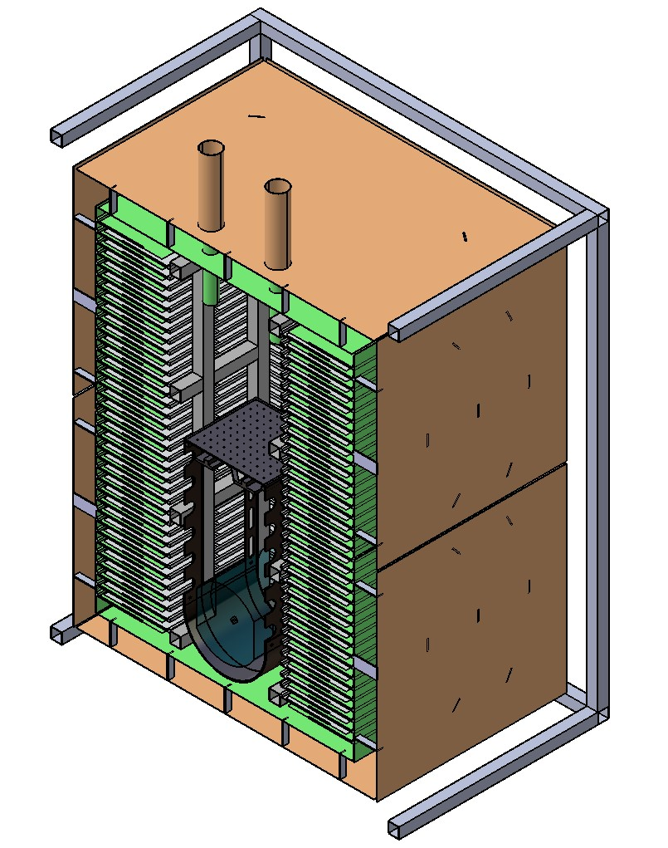
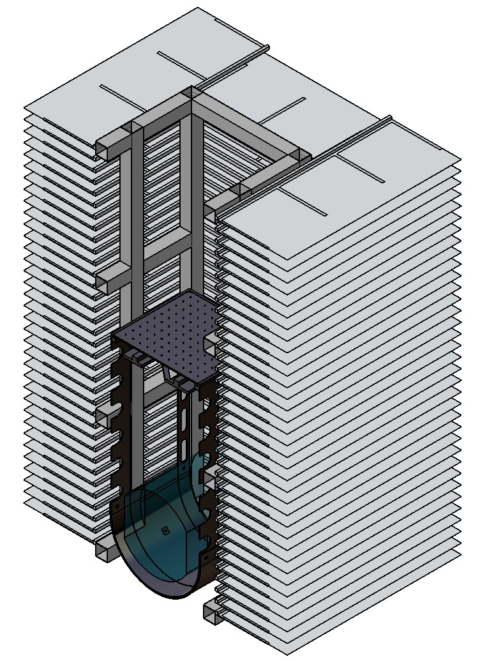
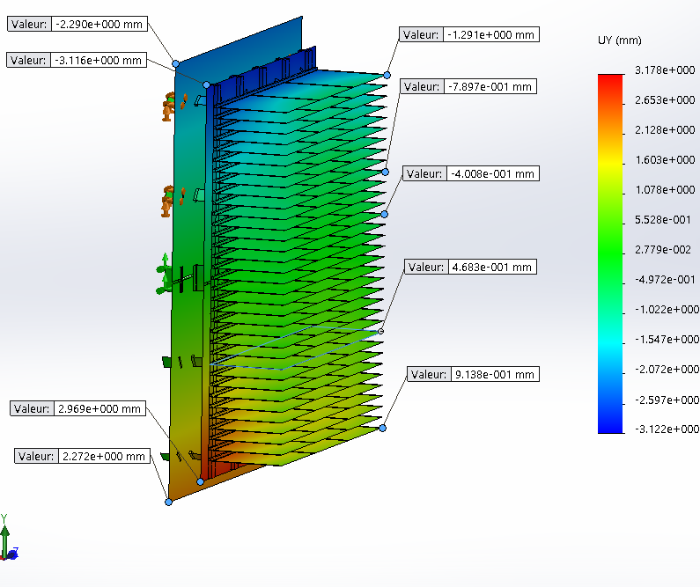
Cryostat development
radiation heat transfer for mirror cooling
overall dimensions: 1.8 x 1.6 x 2 m³
conventional radiator design with horizontal fins (25K)
three 30-mm diameter optical feedthroughs towards the mirror
Outer cryostat
(connected to the vacuum chamber):
80K LN2 shield (brown)
25K GHe panels (green)
Inner cryostat
suspended and conductively linked to the silicon mirror
Contact: Cedric Lenaerts (CSL)
Cedric.Lenaerts@uliege.be

Slide 7
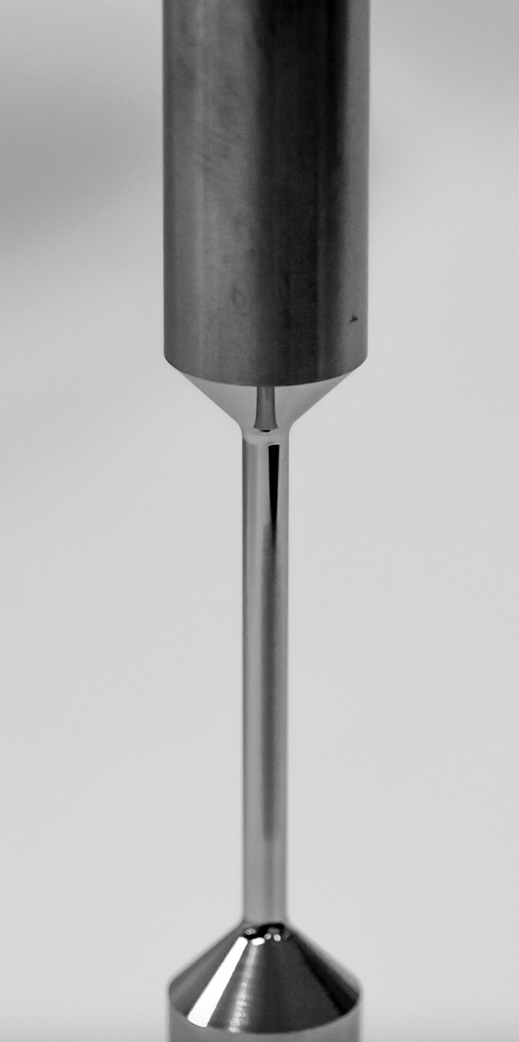
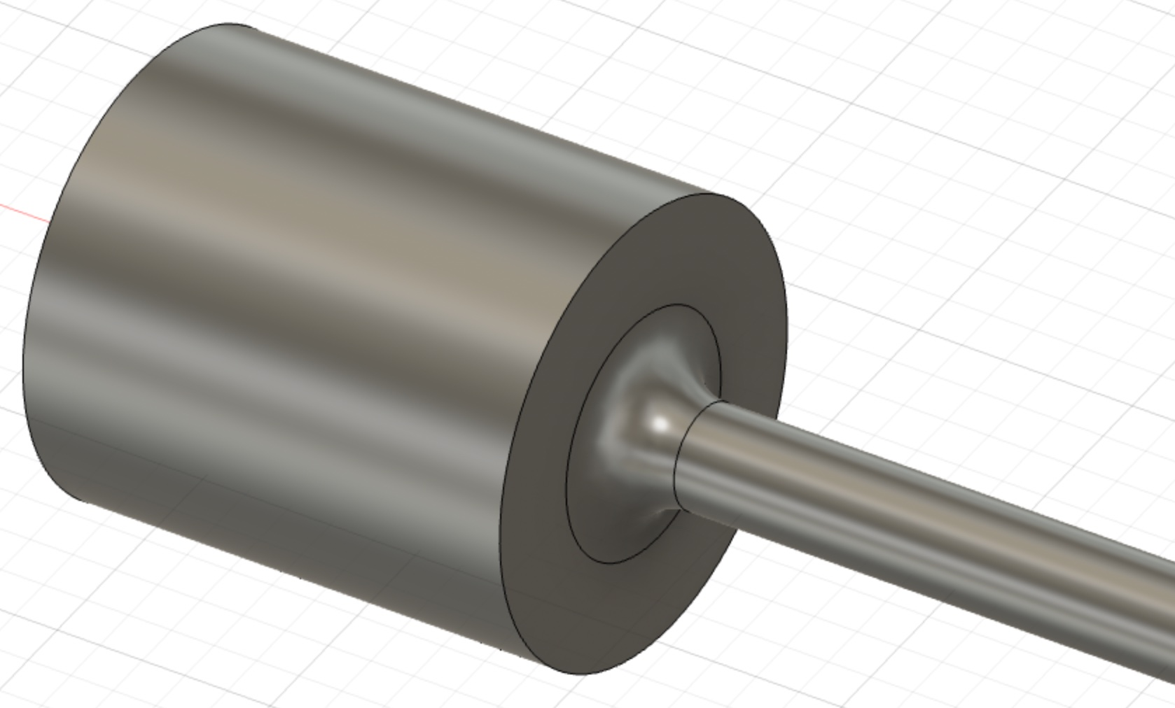
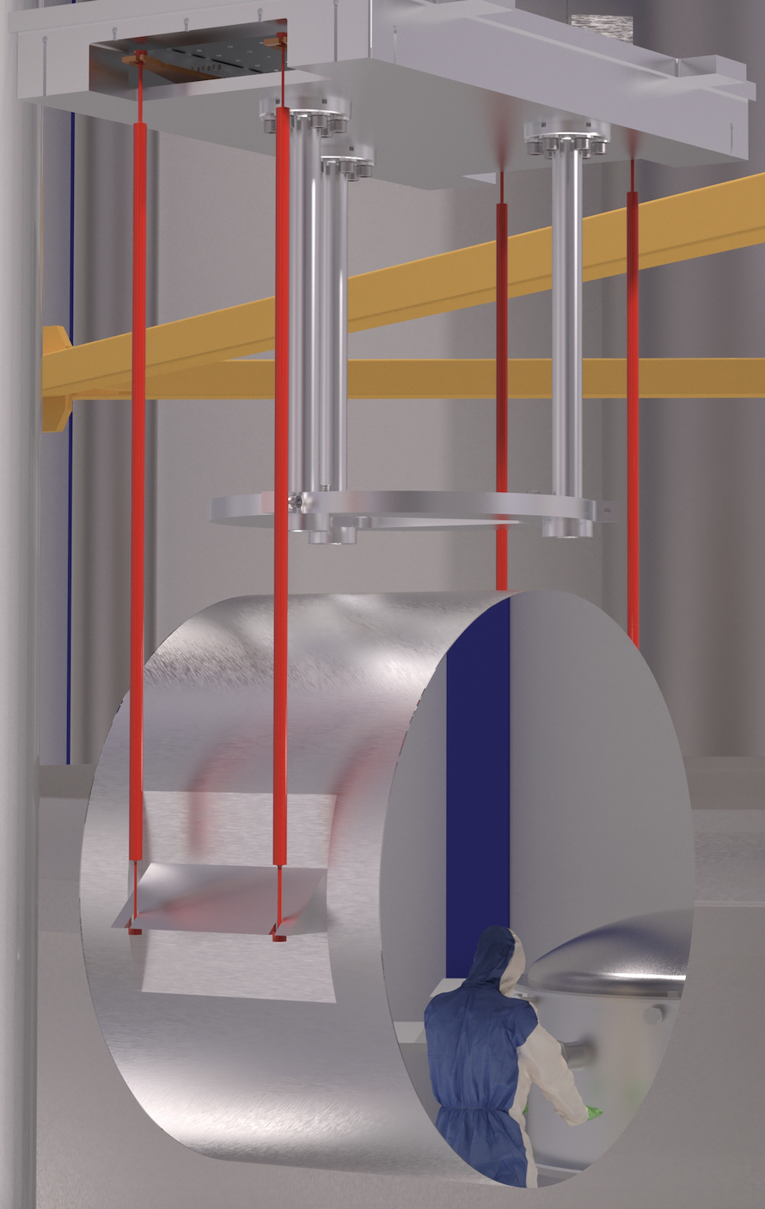
Ultra-cold vibration control
Crystalline silicon mirror suspension
Crucial technology aspect for ET: no proven solution exists
Four machined samples delivered
single crystal
Si suspension rods
⦰ 3-mm
Bonding flat
All samples, including the new ones with bonding flats, sent to Università di Perugia for mechanical loss vs T and tensile strength measurements
ET2SME partners Mat-Tech (NL) and MaTecK (D) will do R&D on Si-metal interfaces
Al-6061 dummy mirror
Contact: Alessandro Bertolini (Nikhef)
alberto@nikhef.nl

Slide 8
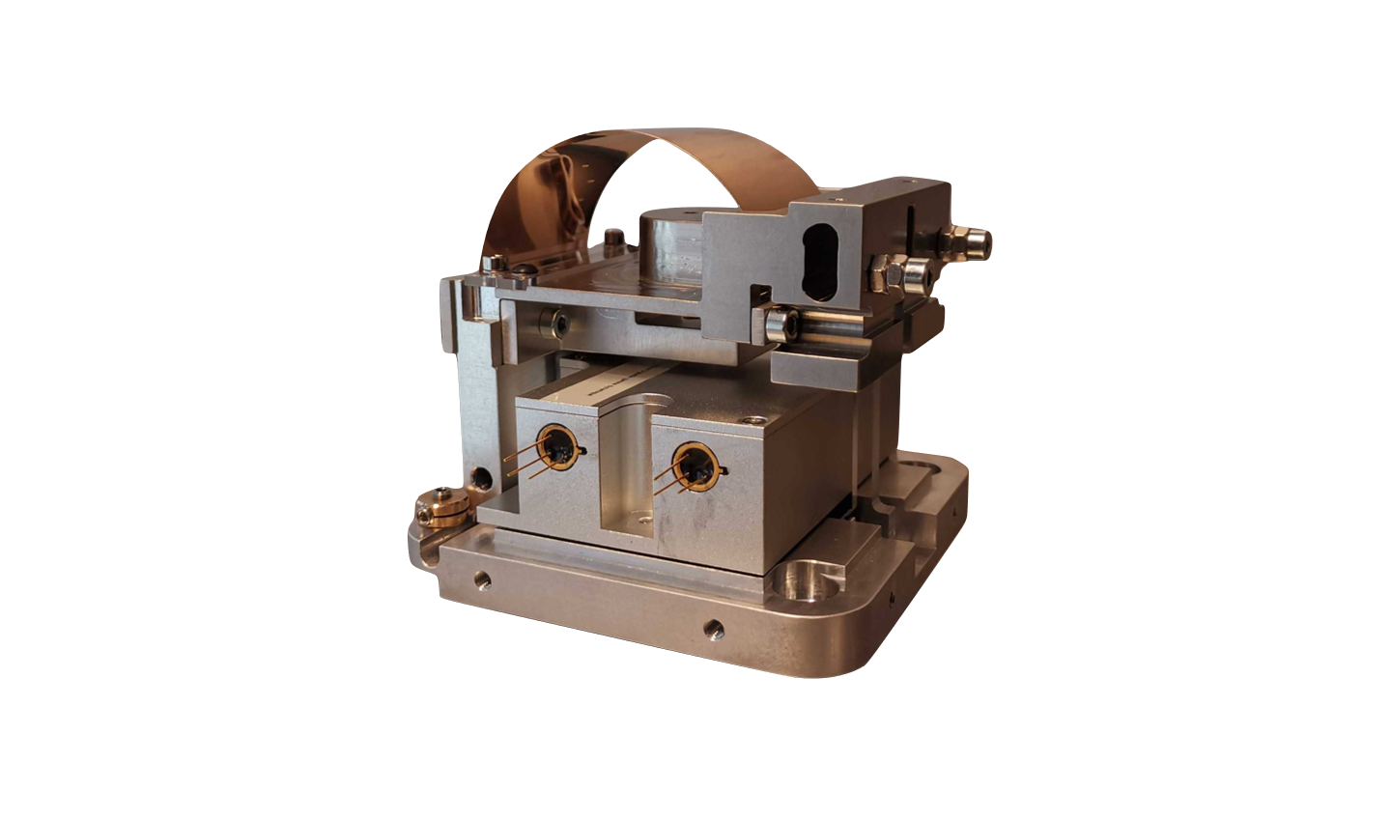
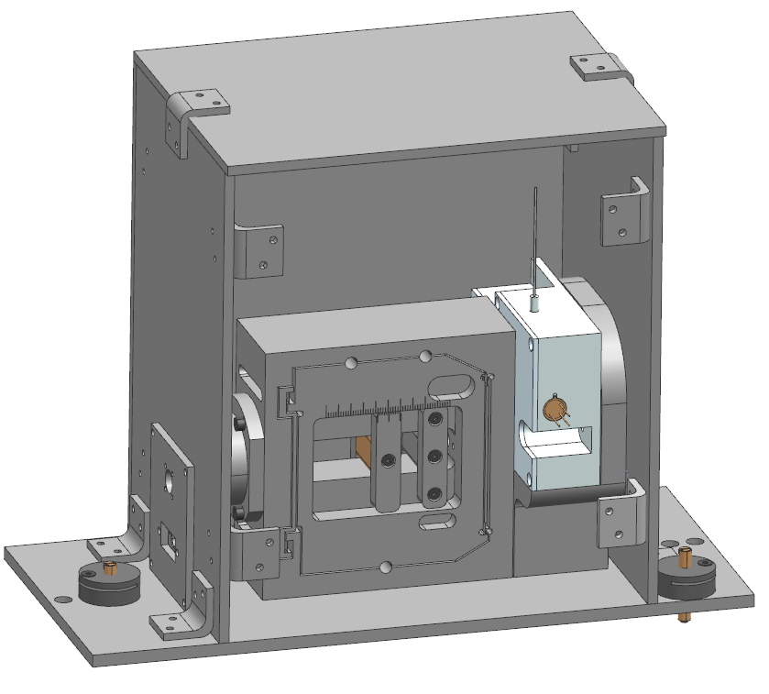
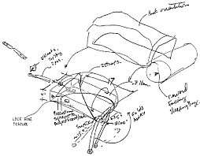
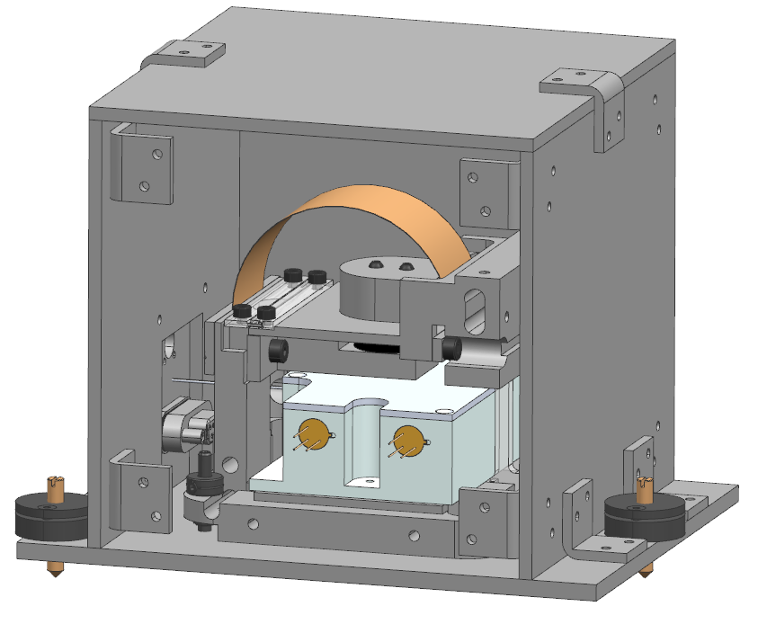
Ultra-cold vibration control
Inertial sensors development for active seismic attenuation at low frequency
Laboratory prototype is getting turned into its final design
Production drawings in progress; manufacturing starting in the coming weeks
Vertical sensor prototype
Vertical sensor
Horizontal sensor
Anthony Amorosi (PML)
Anthony.Amorosi@uliege.be
Loïc Amez-Droz (PML)
lamezdroz@uliege.be

Slide 9
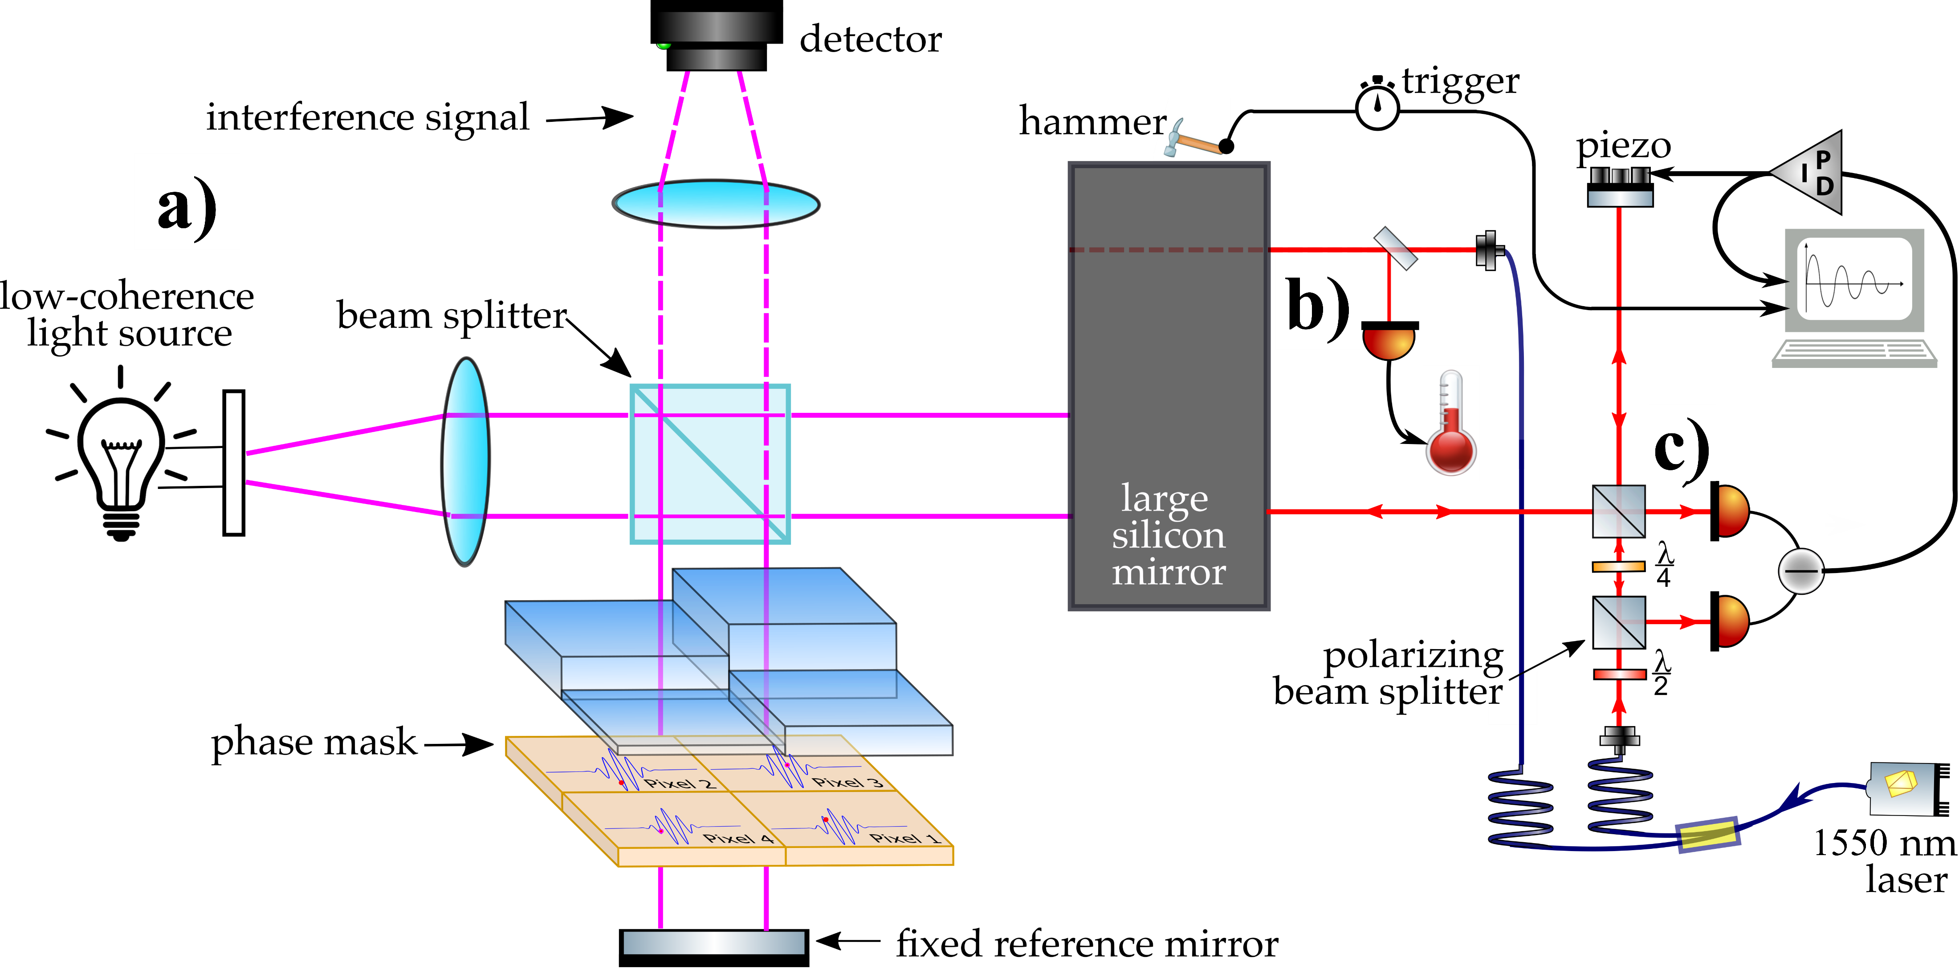
Final validation of the prototype
White light interferometry (residual stress)
Temperature measurement
Quality factor
Tests at CSL timeline:
2023: with dummy Al mirror
2024: with 100kg Si mirror

Slide 10
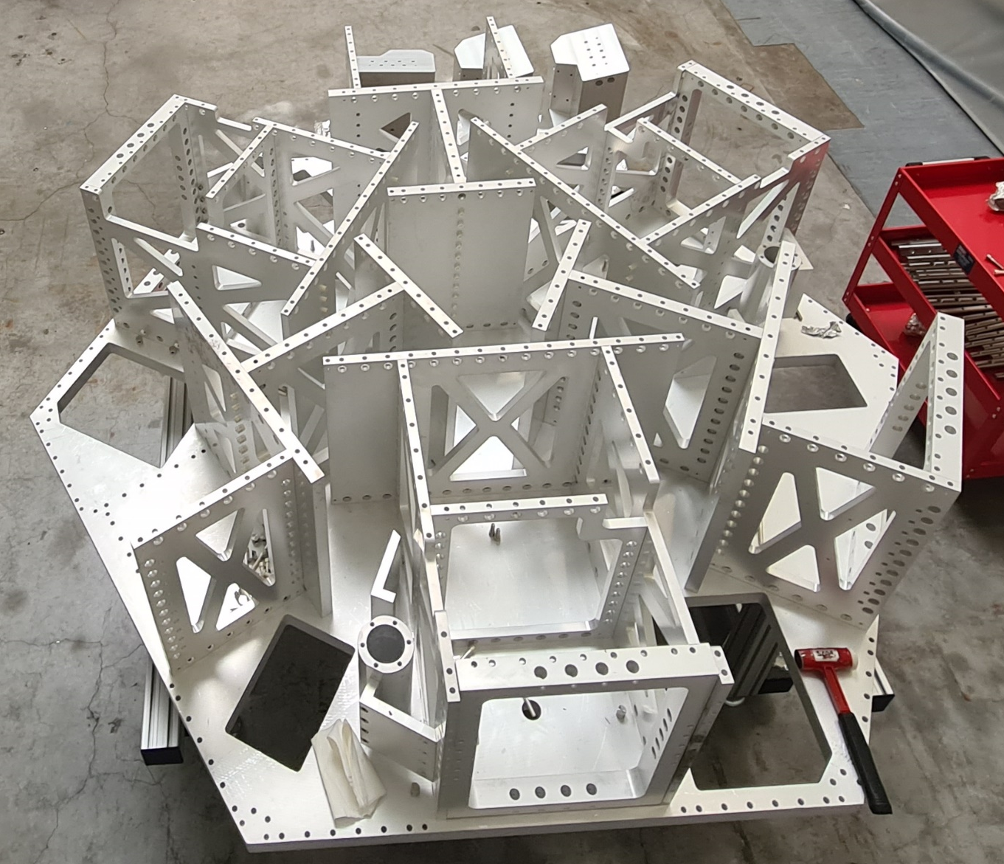
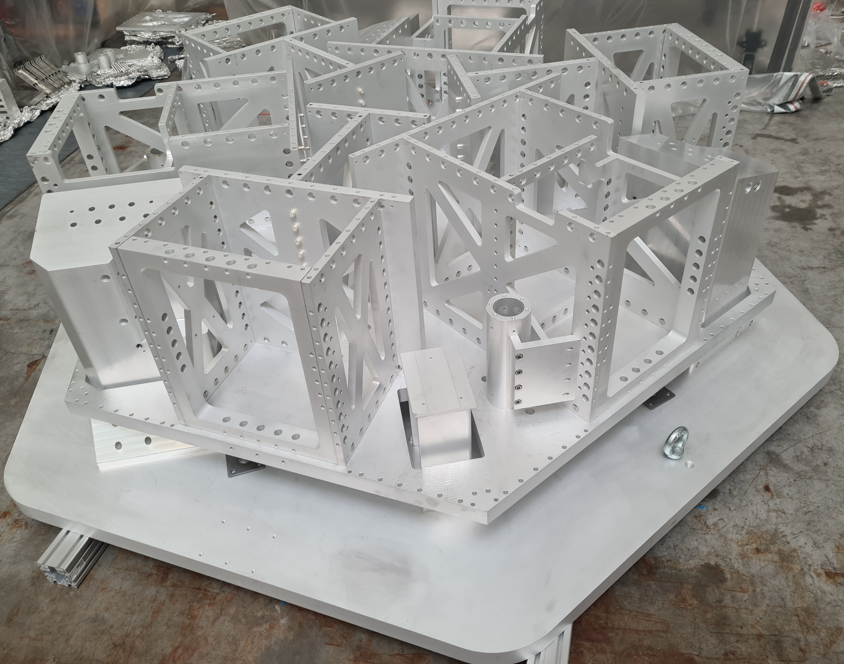
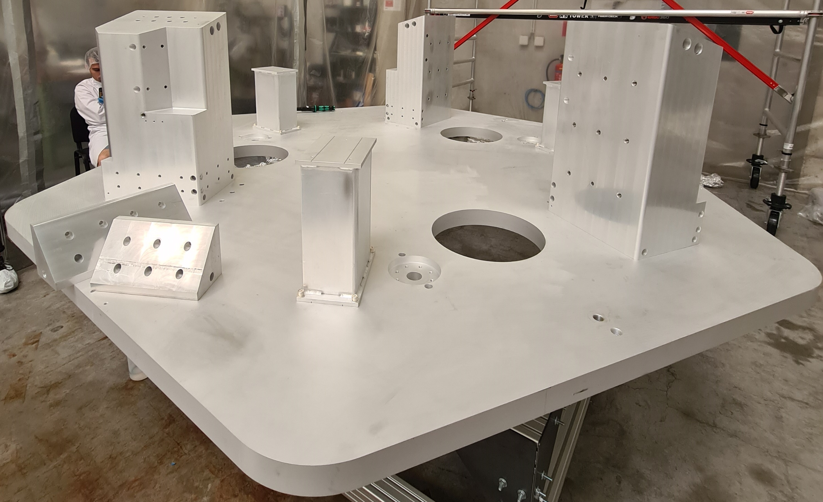
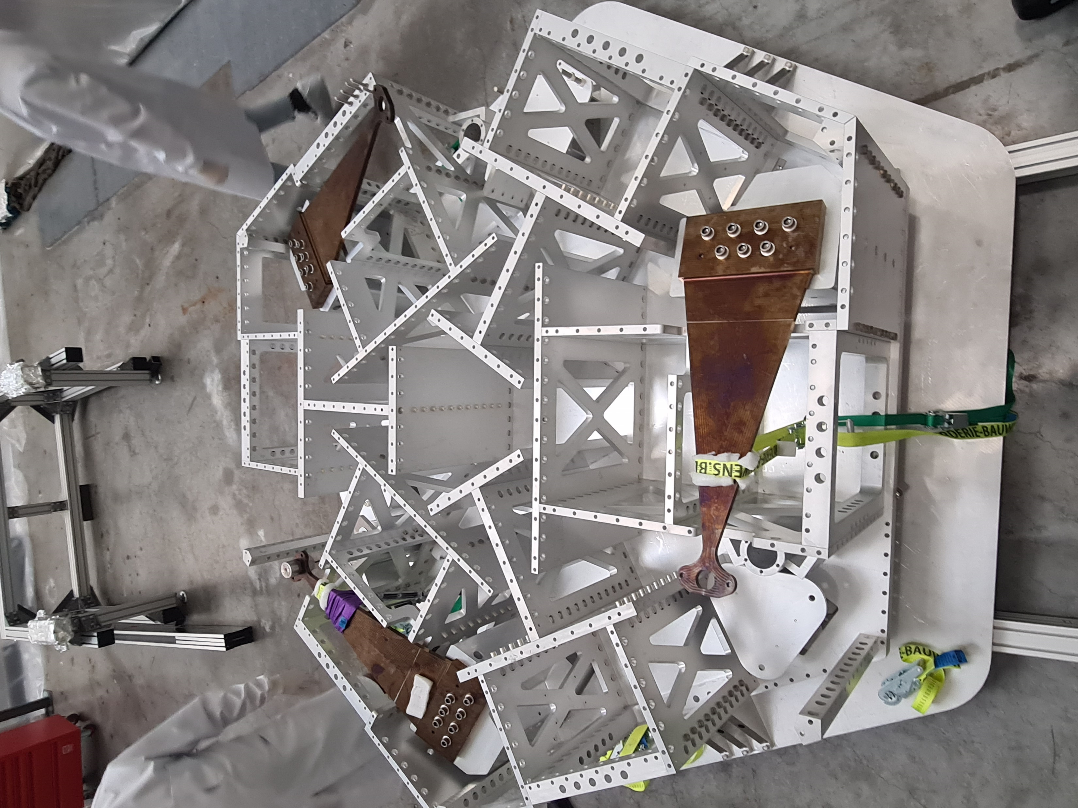
E-Test Assembly Procedure
Active Platform

Slide 11
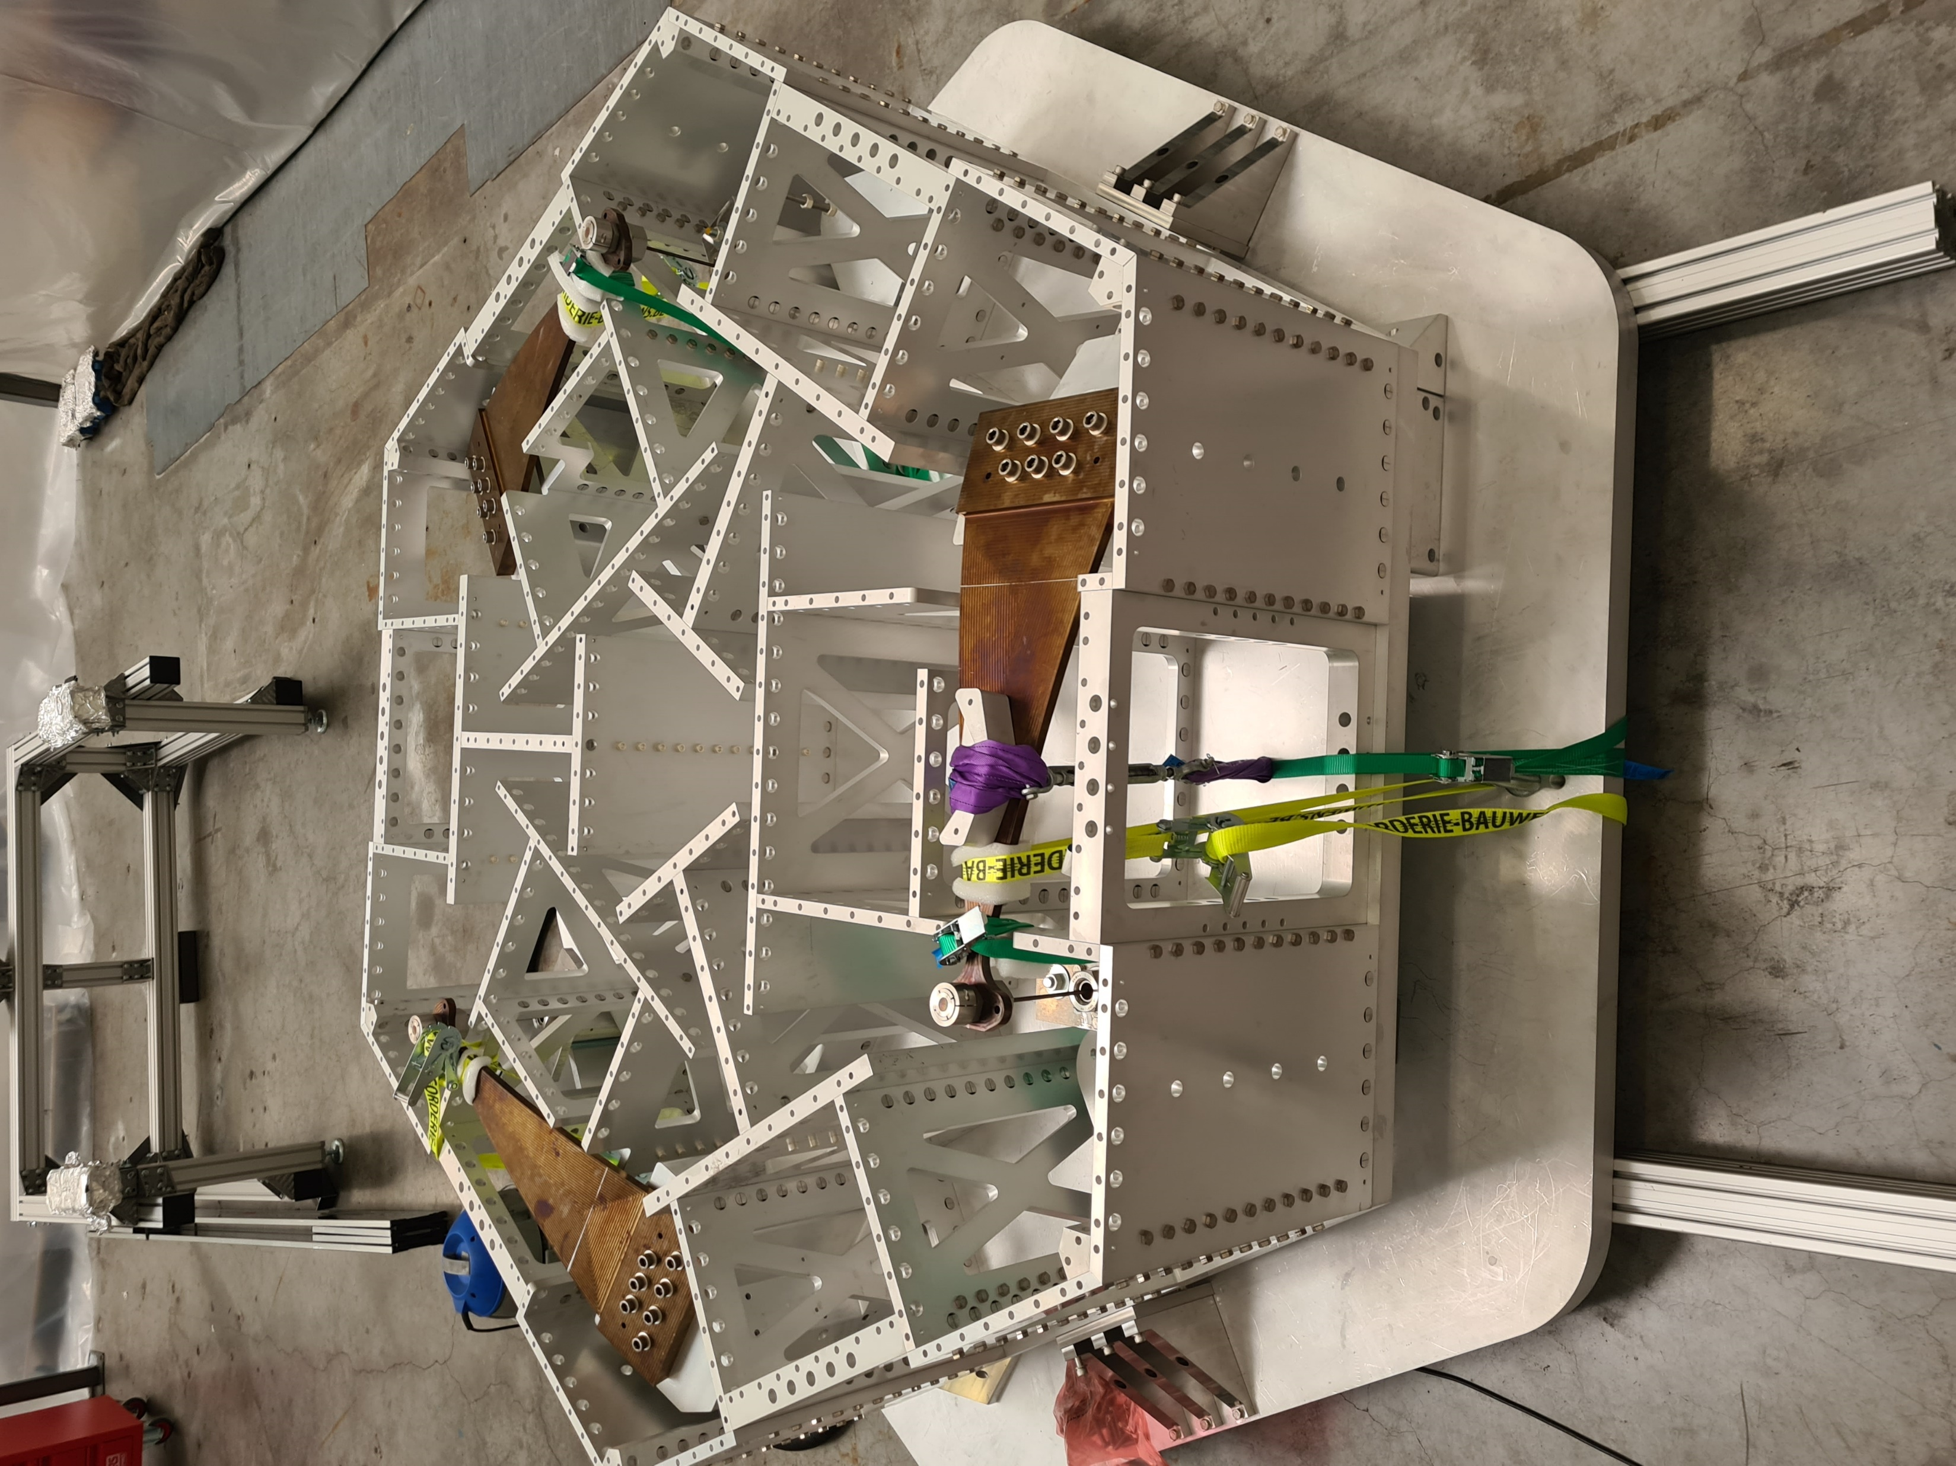
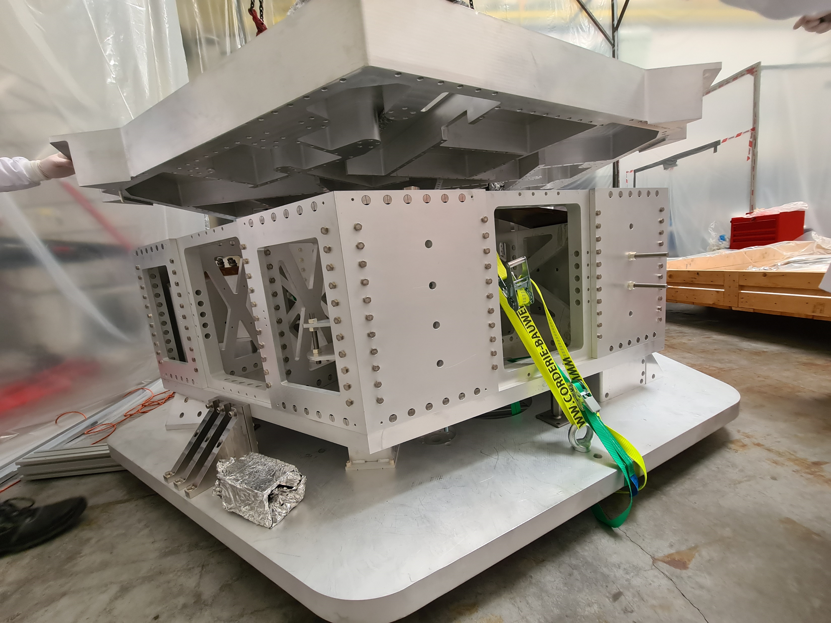
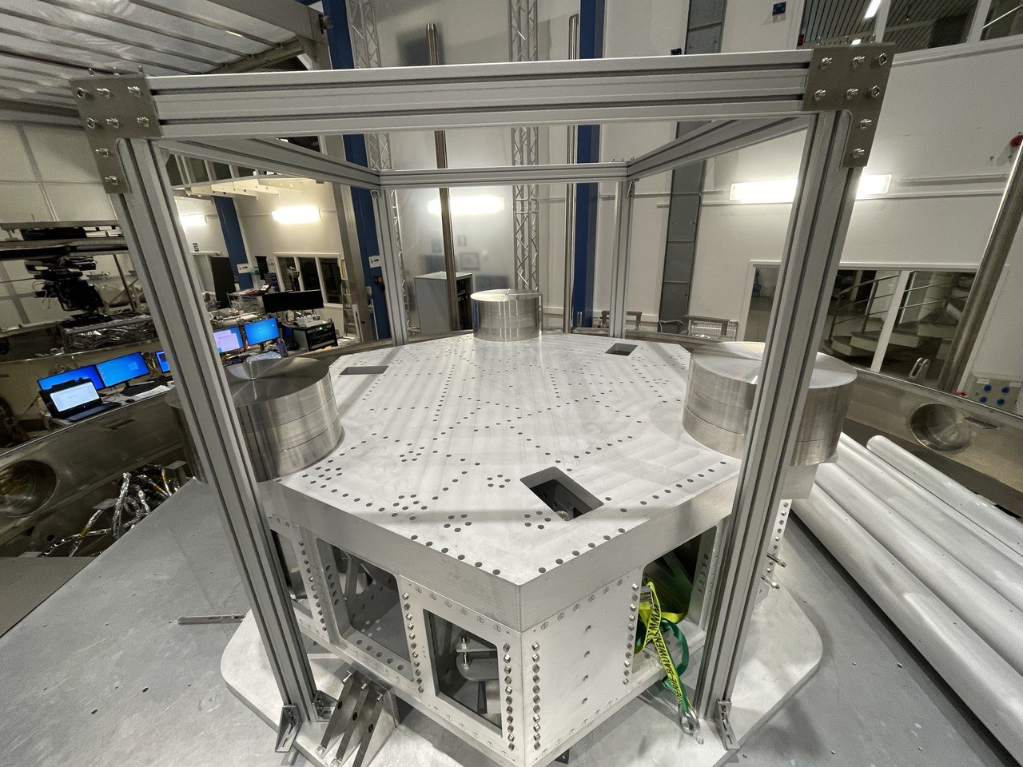
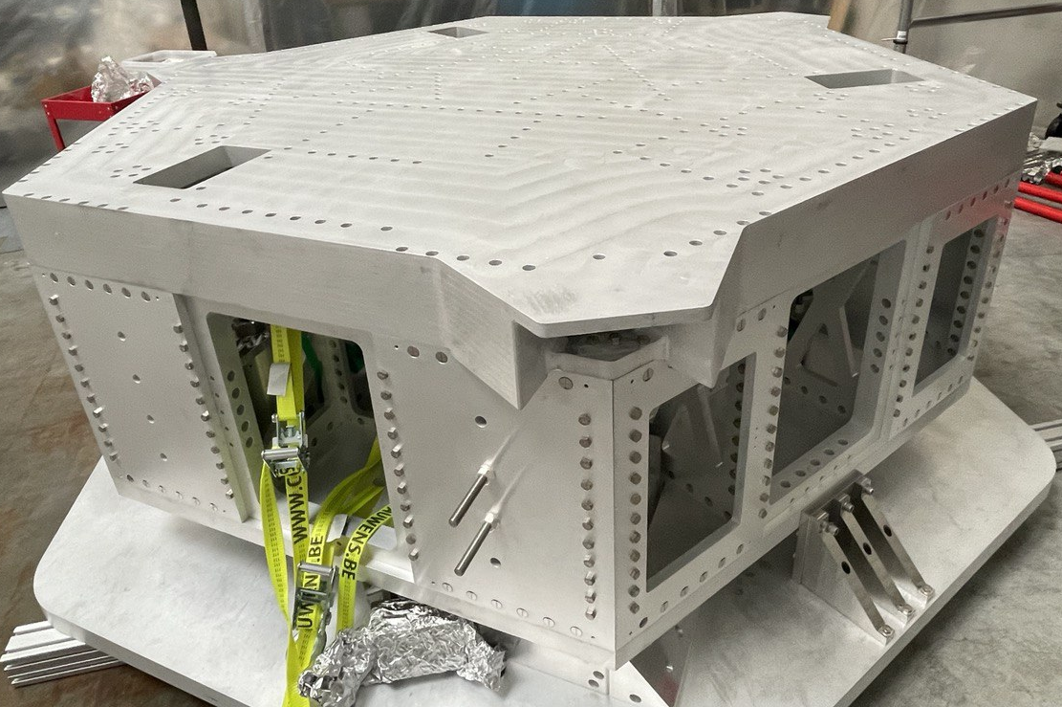
Active Platform

Slide 12
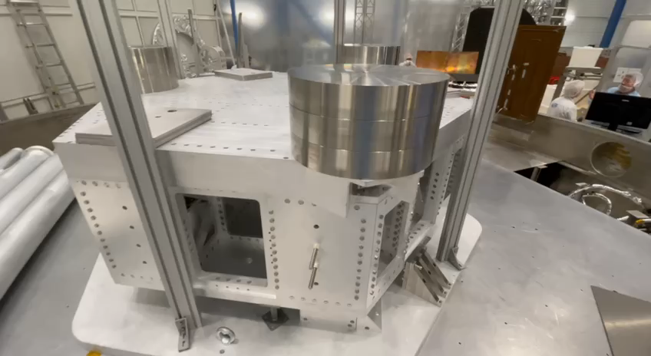
Active Platform

Slide 13
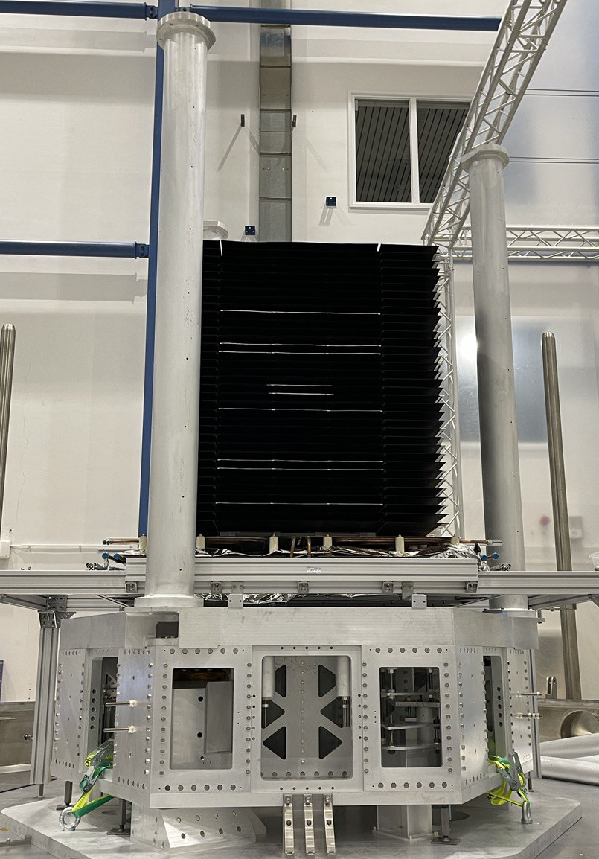
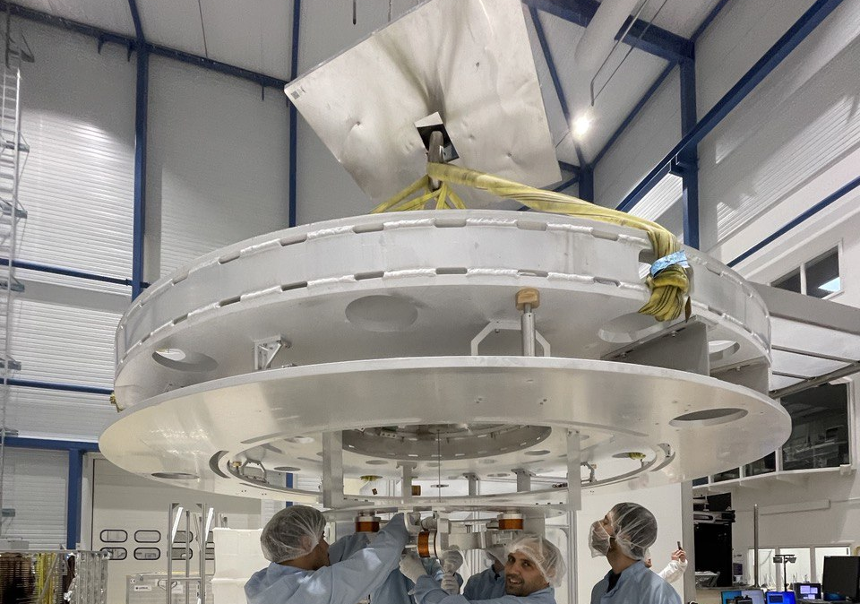
Safety Tubes & Legs & Inner Cryostat
Top Platform

Slide 14
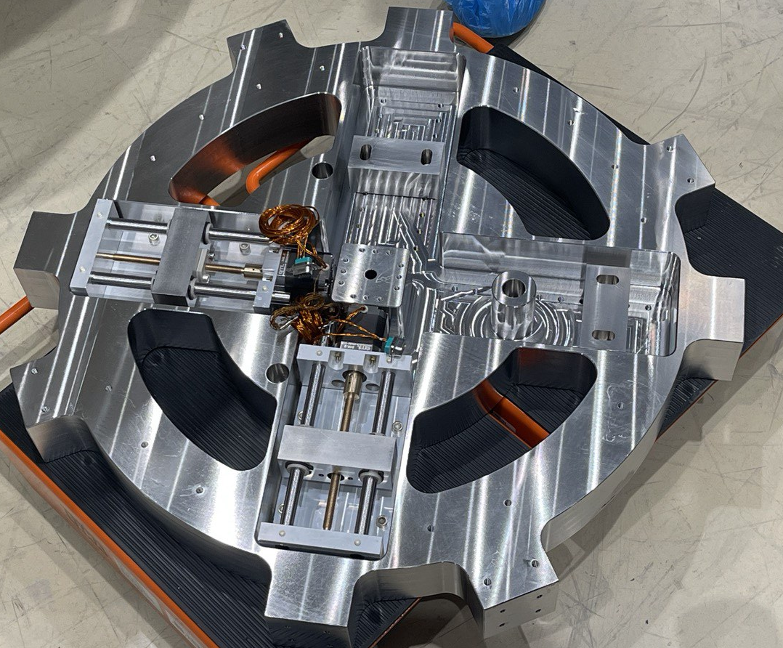
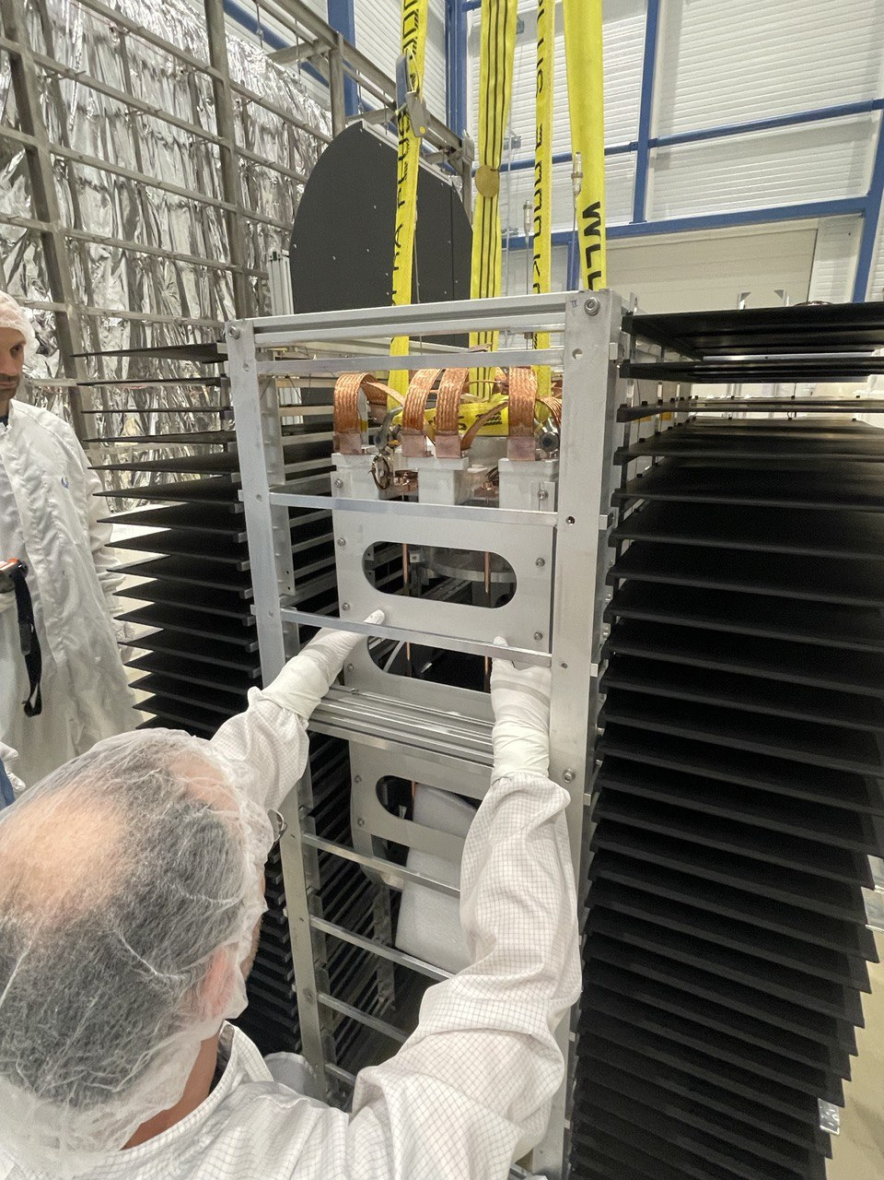
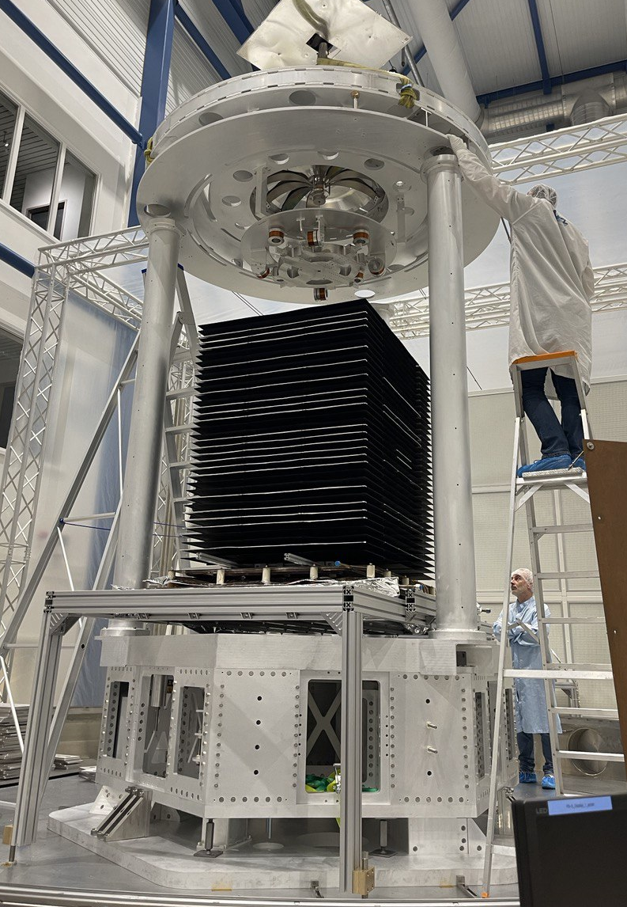
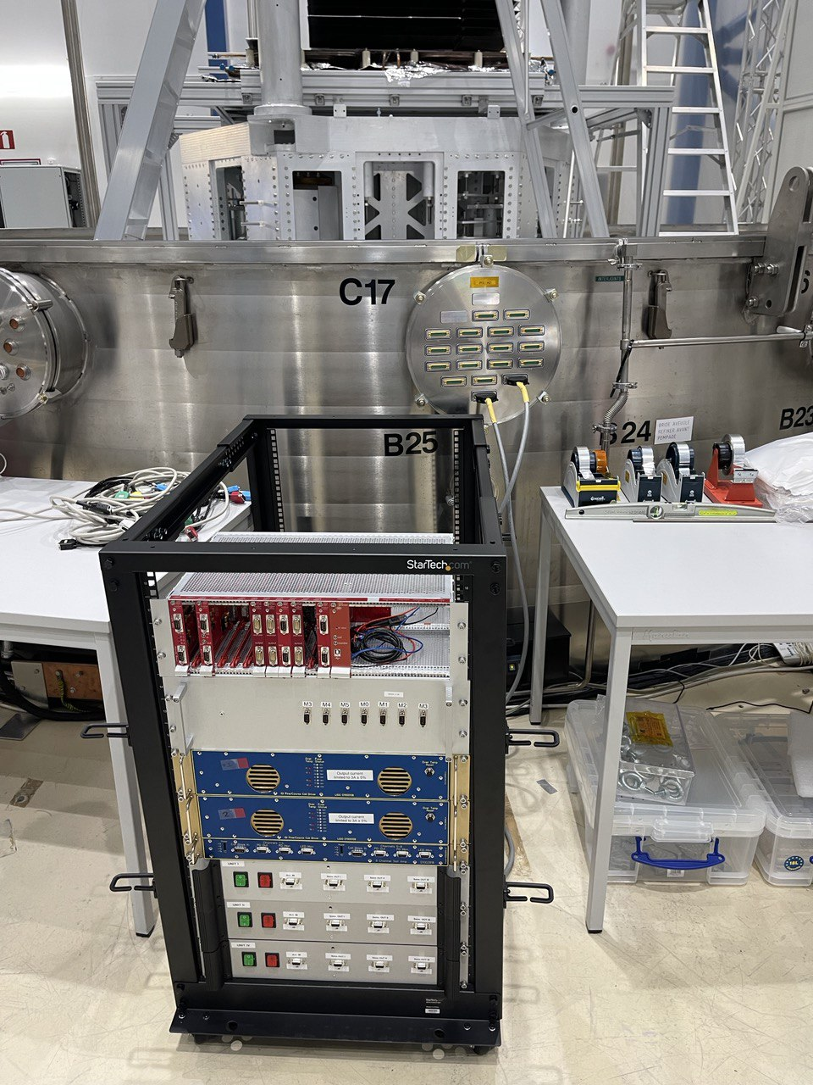
Top Platform on Legs
Mirror Suspension & Cryostat

Slide 15
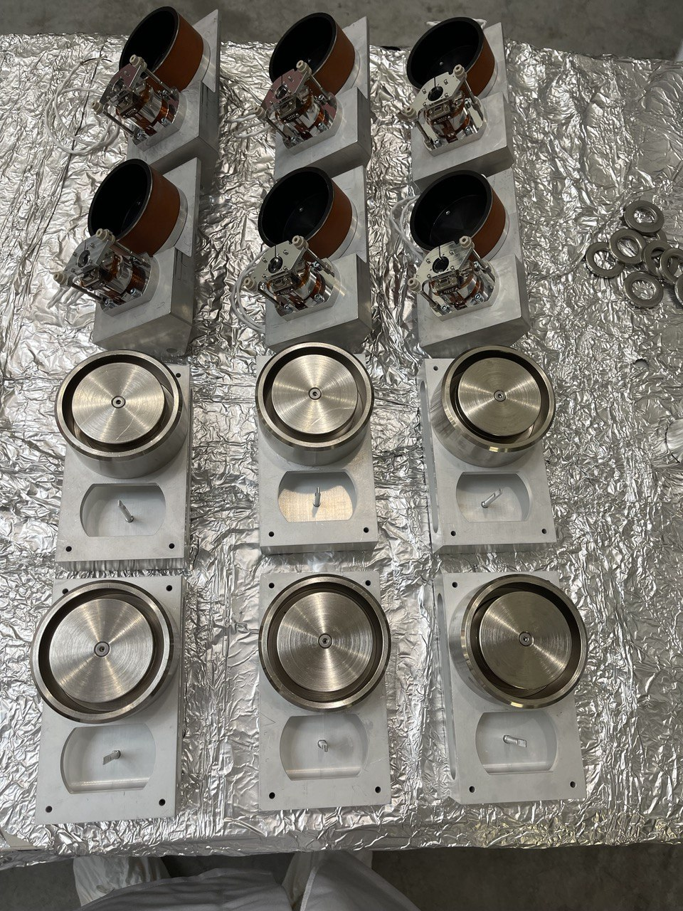
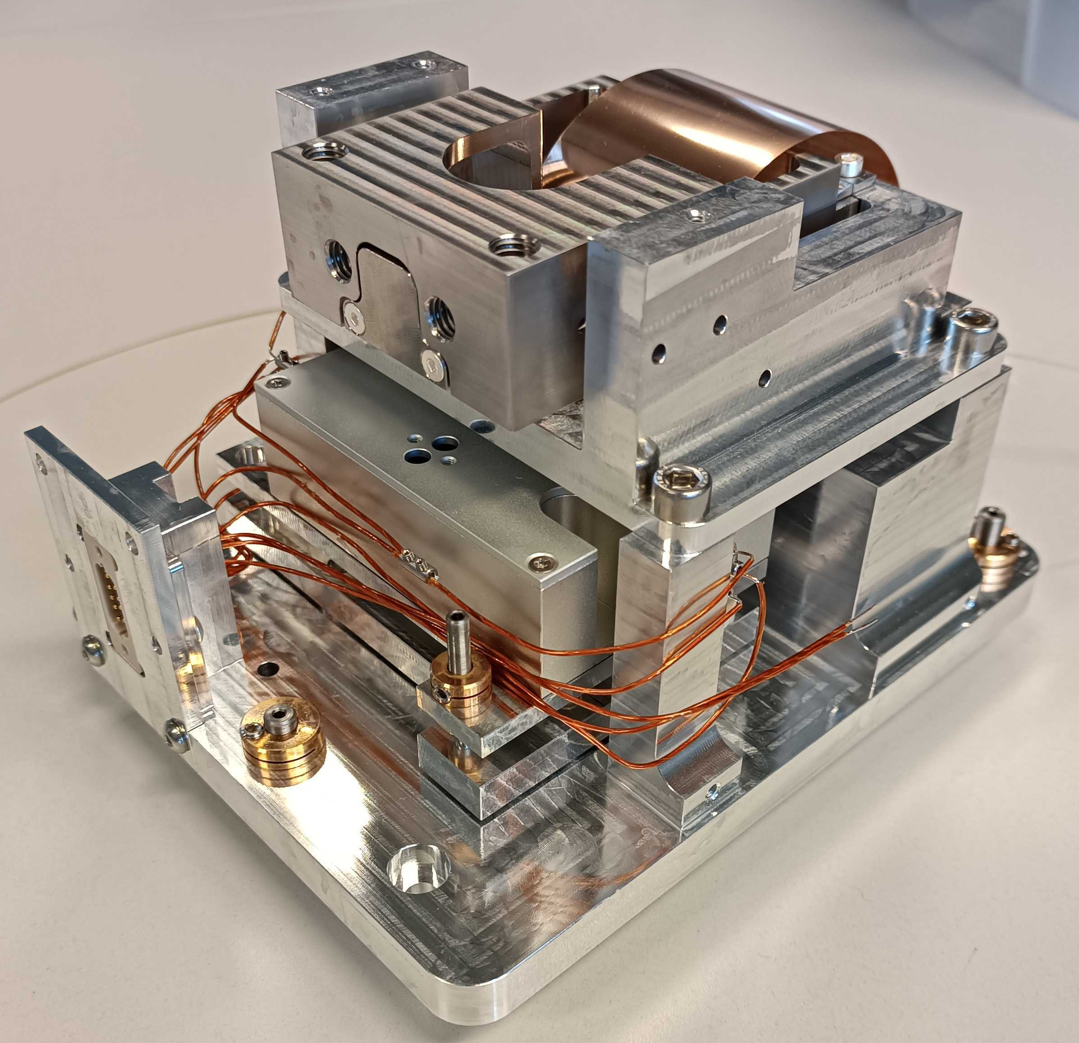
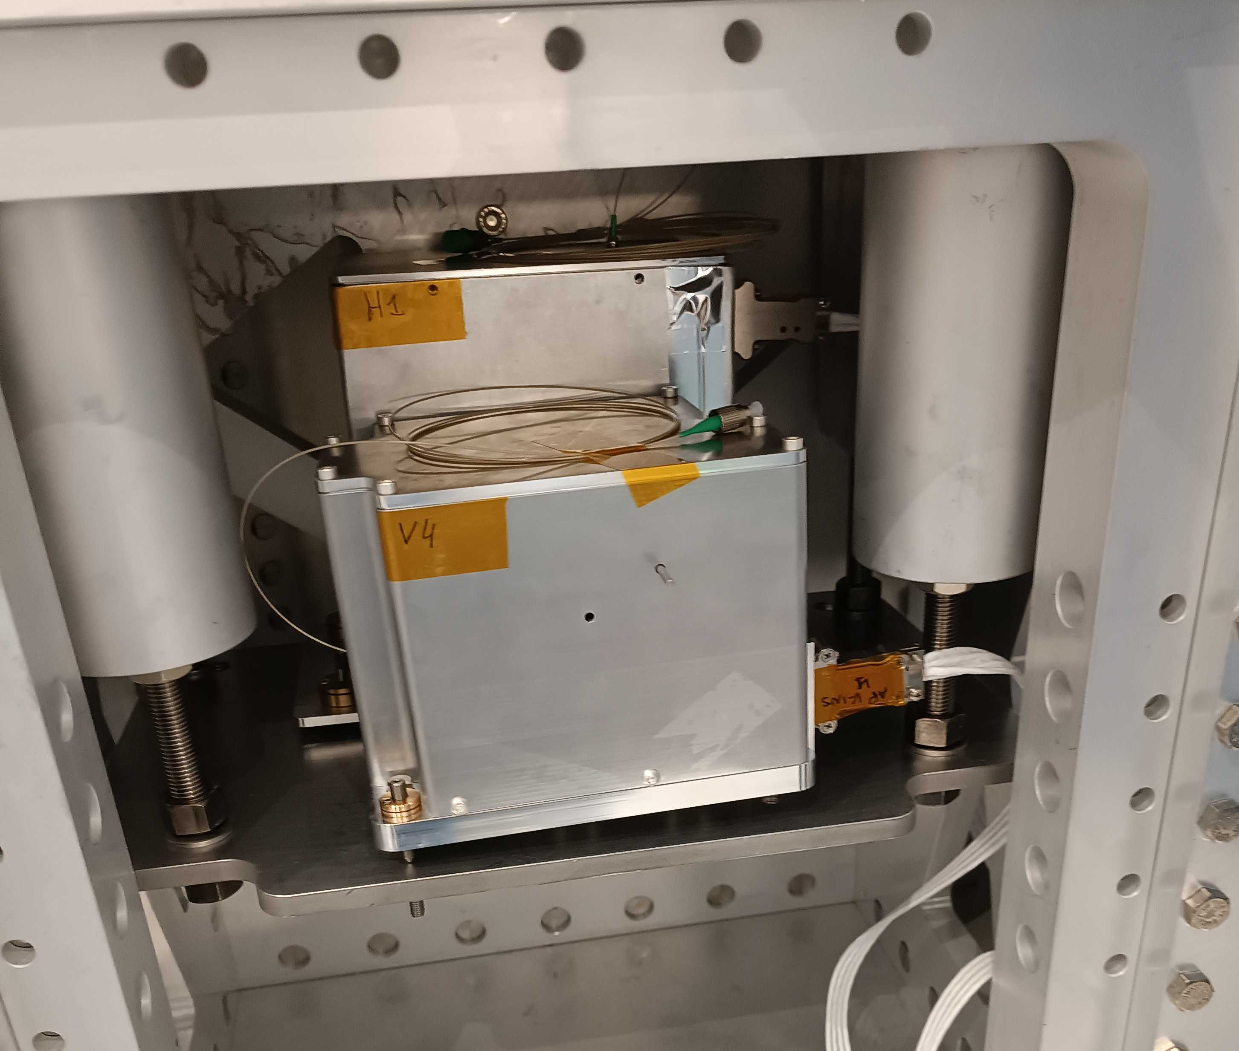
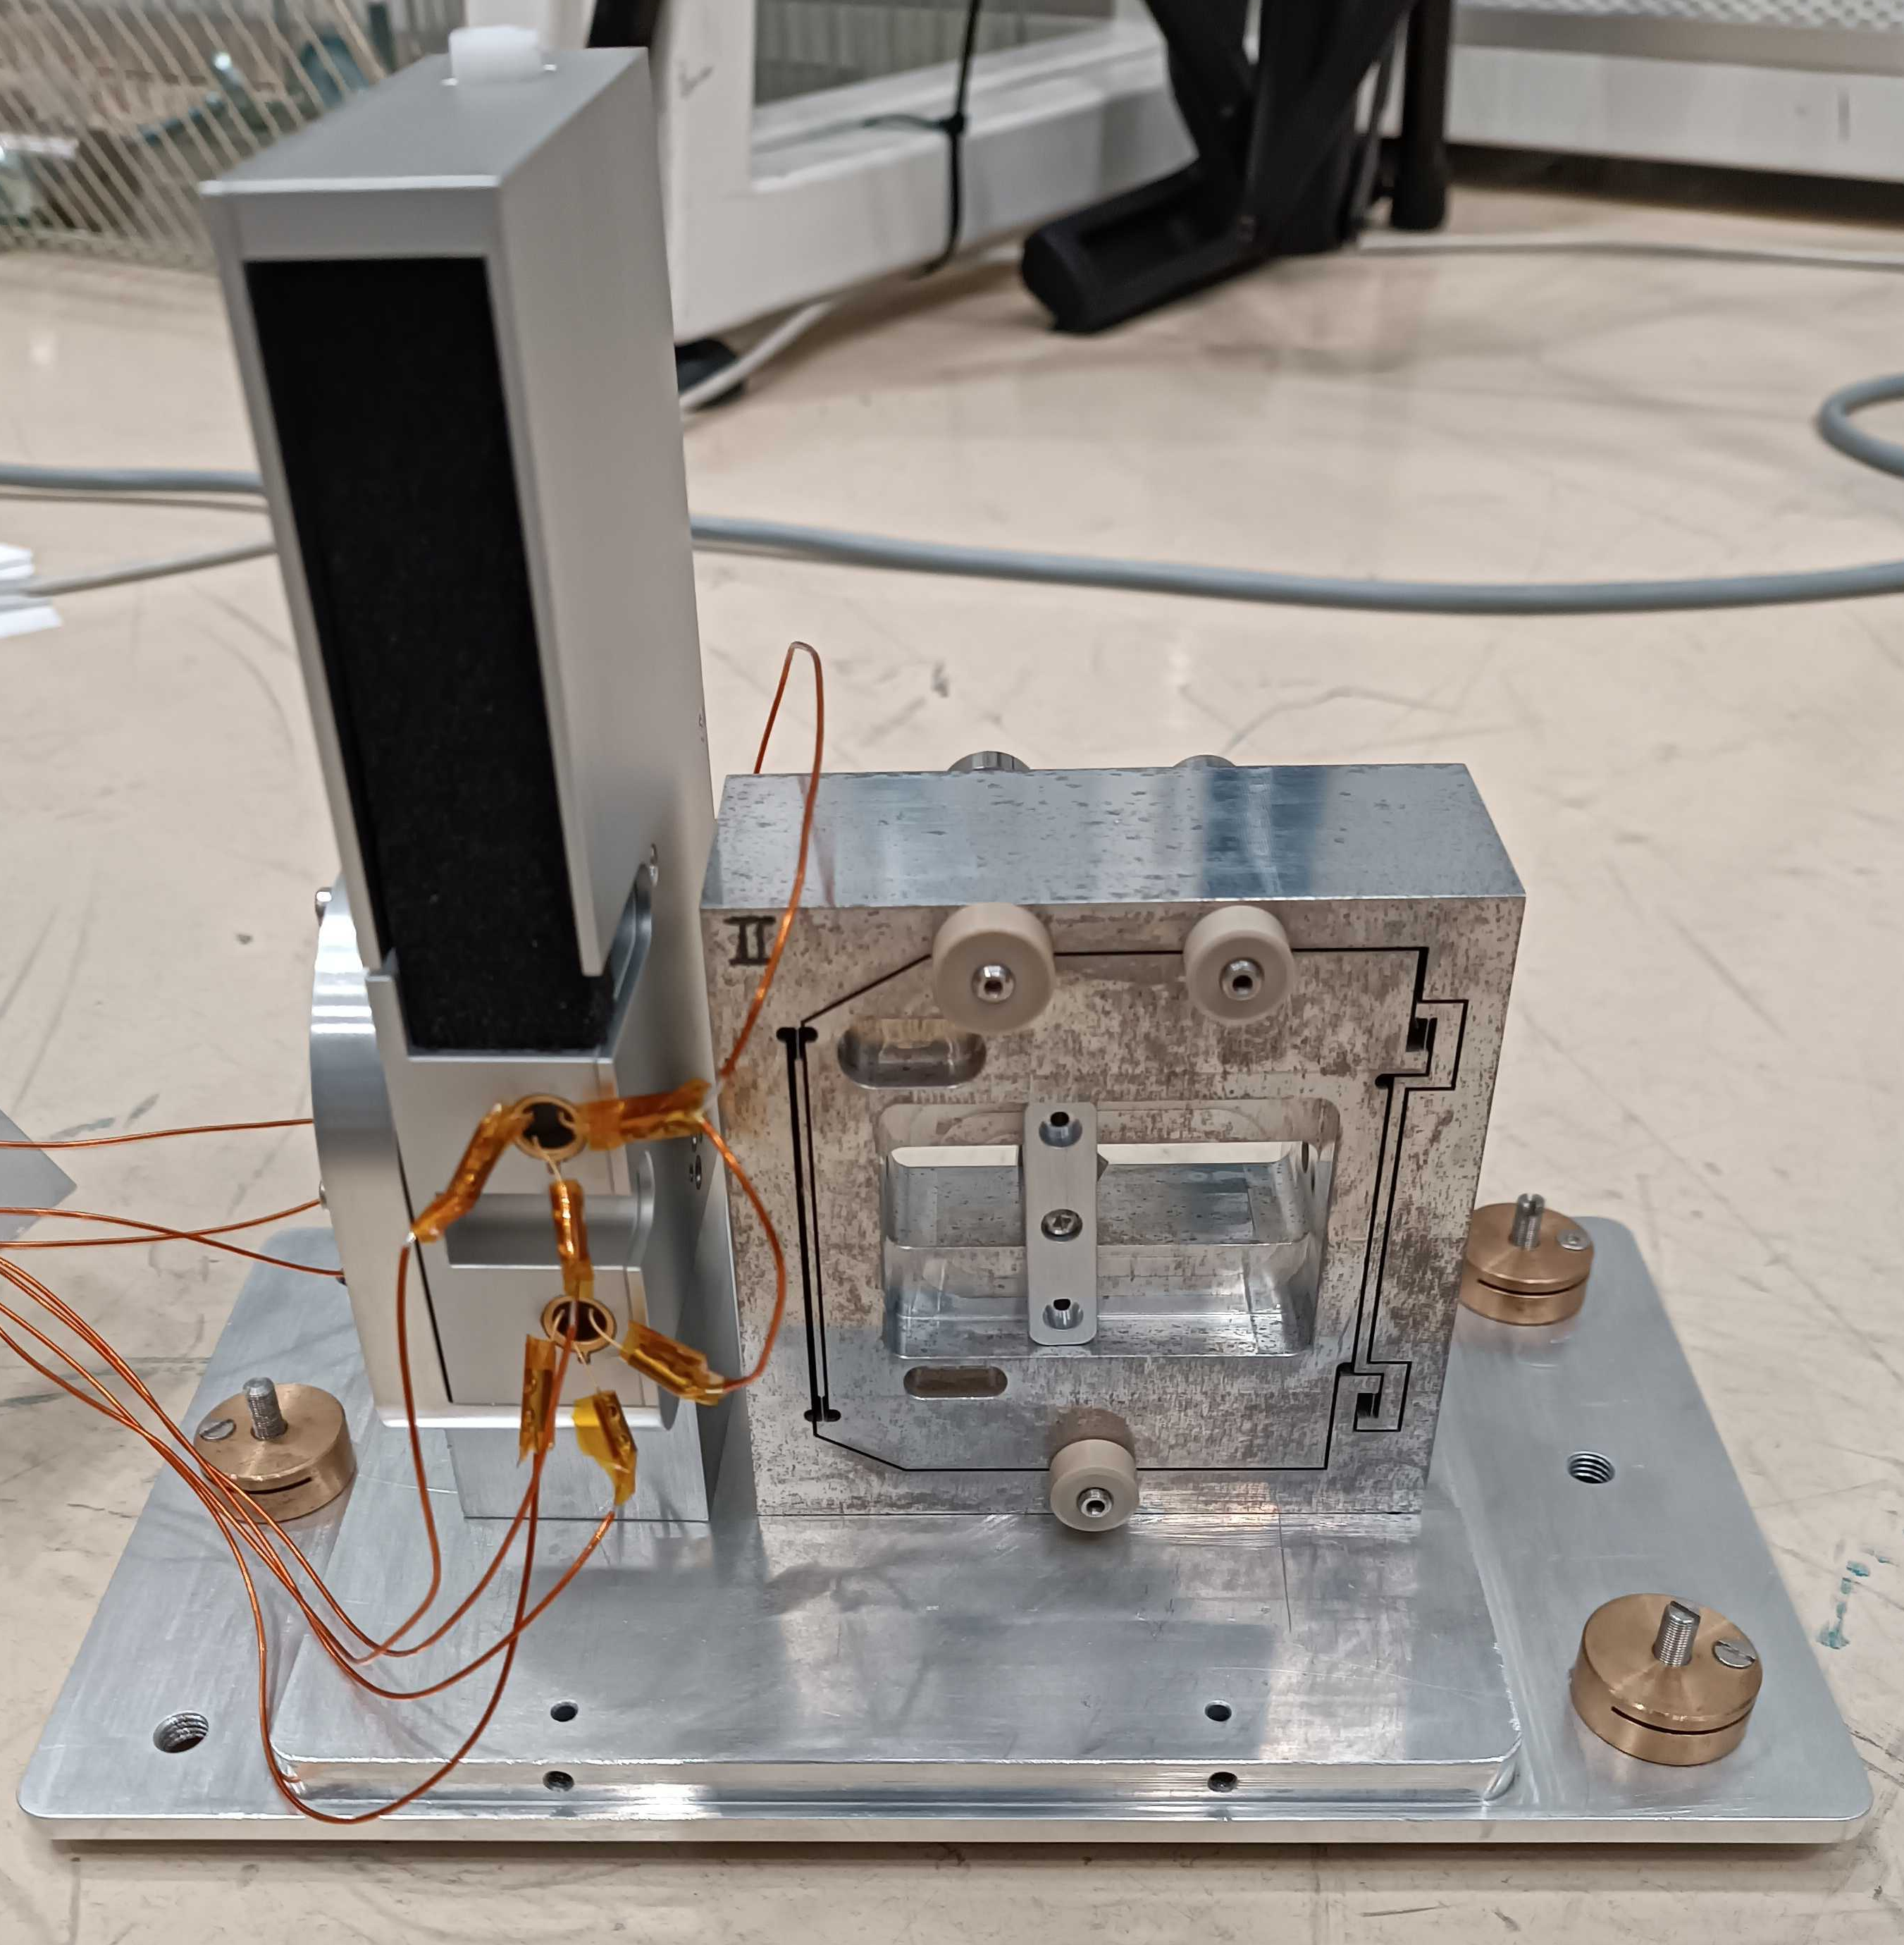
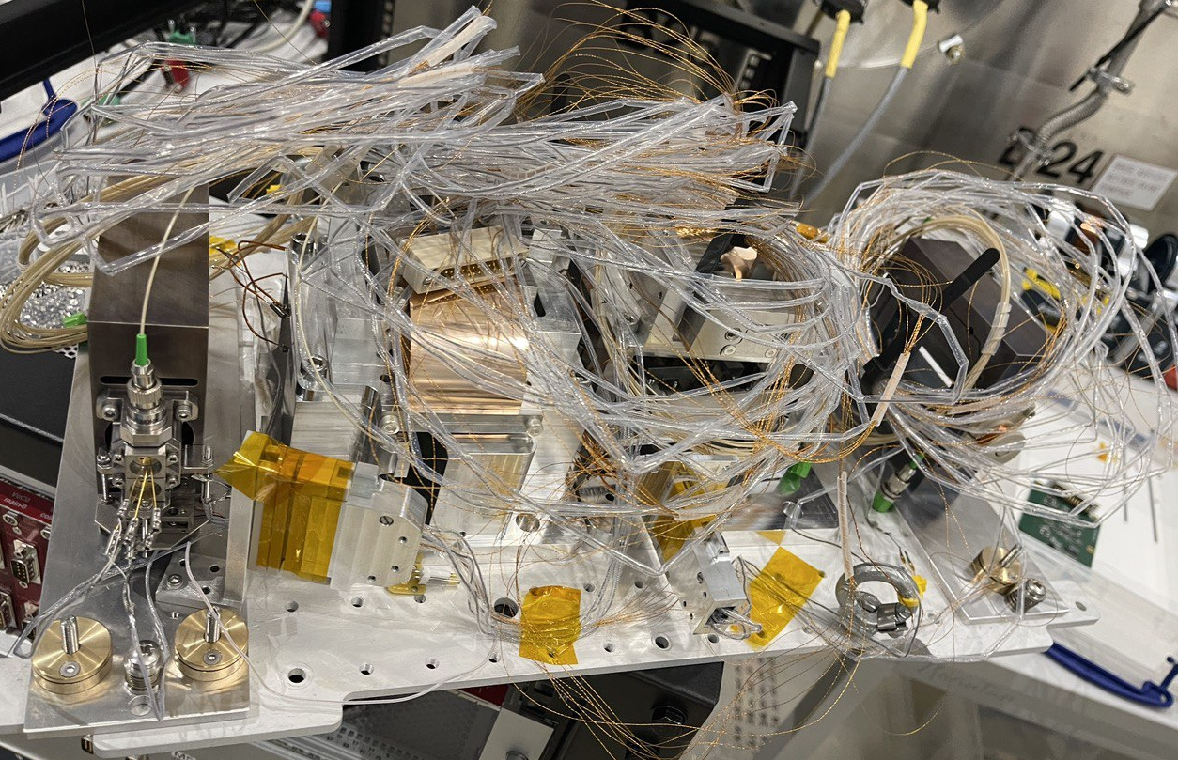
Inertial sensors
Bossem & Actutor

Slide 16
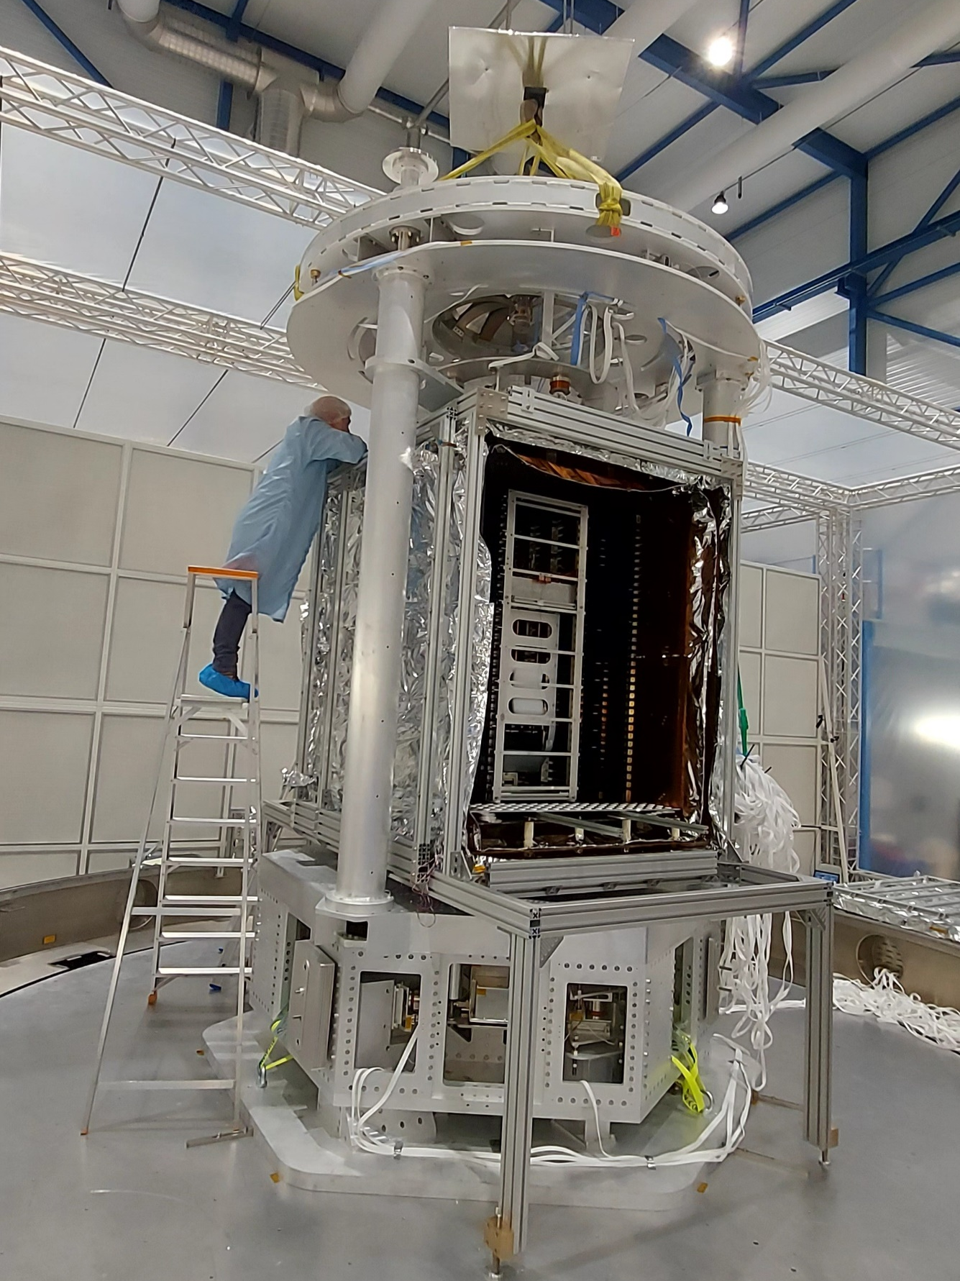

Slide 17
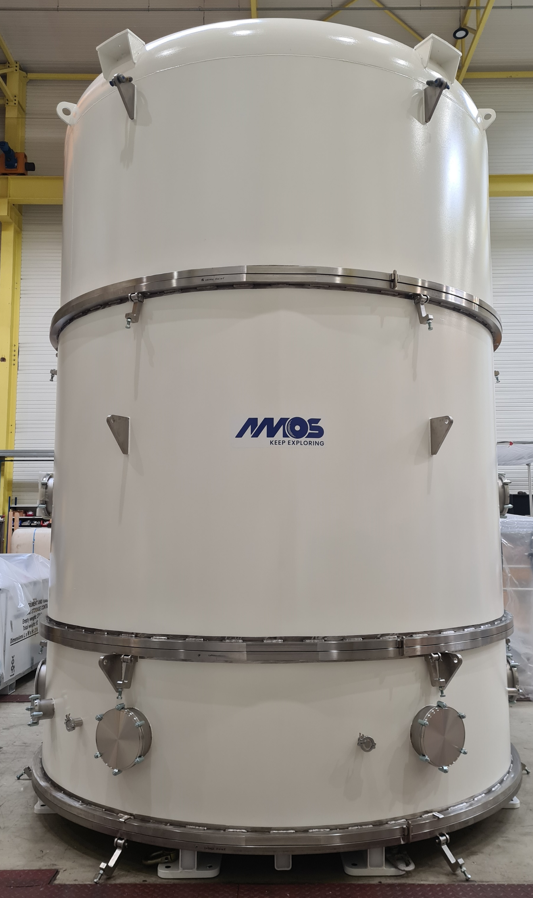

Slide 18

Contacts:
Prof. Christophe Collette
Christophe.Collette@uliege.be
Dr. Rasa Jamshidi
rjamshidi@uliege.be
Useful links:
TDR
https://arxiv.org/abs/2212.10083
E-TEST Project website
https://www.etest-emr.eu/
PML website
http://www.pmlab.be/

