Slide 1
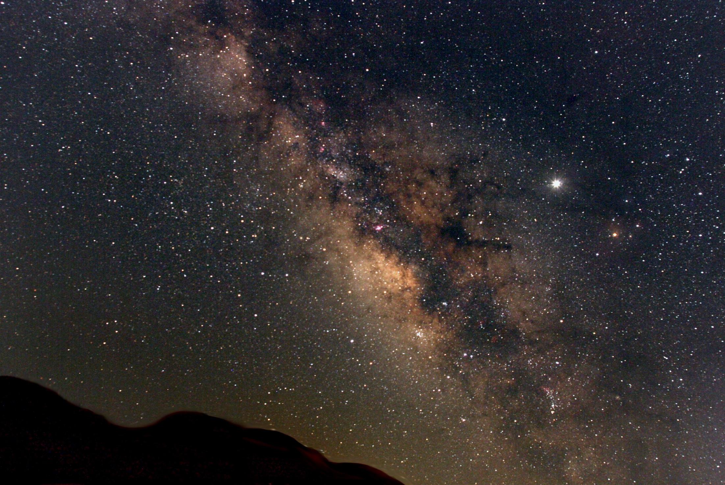
Compact Interferometric Sensor for Local Test Mass Readout
Meenakshi Mahesh*, Leander Goebbels, Jan-Niklas Feldhusen, Tobias Eckhardt, Katharina-Sophie Isleif, Wanda Vossius, Shreevathsa Chalathadka Subrahmanya, Christian Darsow-Fromm, Artem Basalaev, Oliver Gerberding
University of Hamburg
© The Milky Way Galaxy by Derek Rowley
www.physik.uni-hamburg.de/iexp/gwd

Slide 2
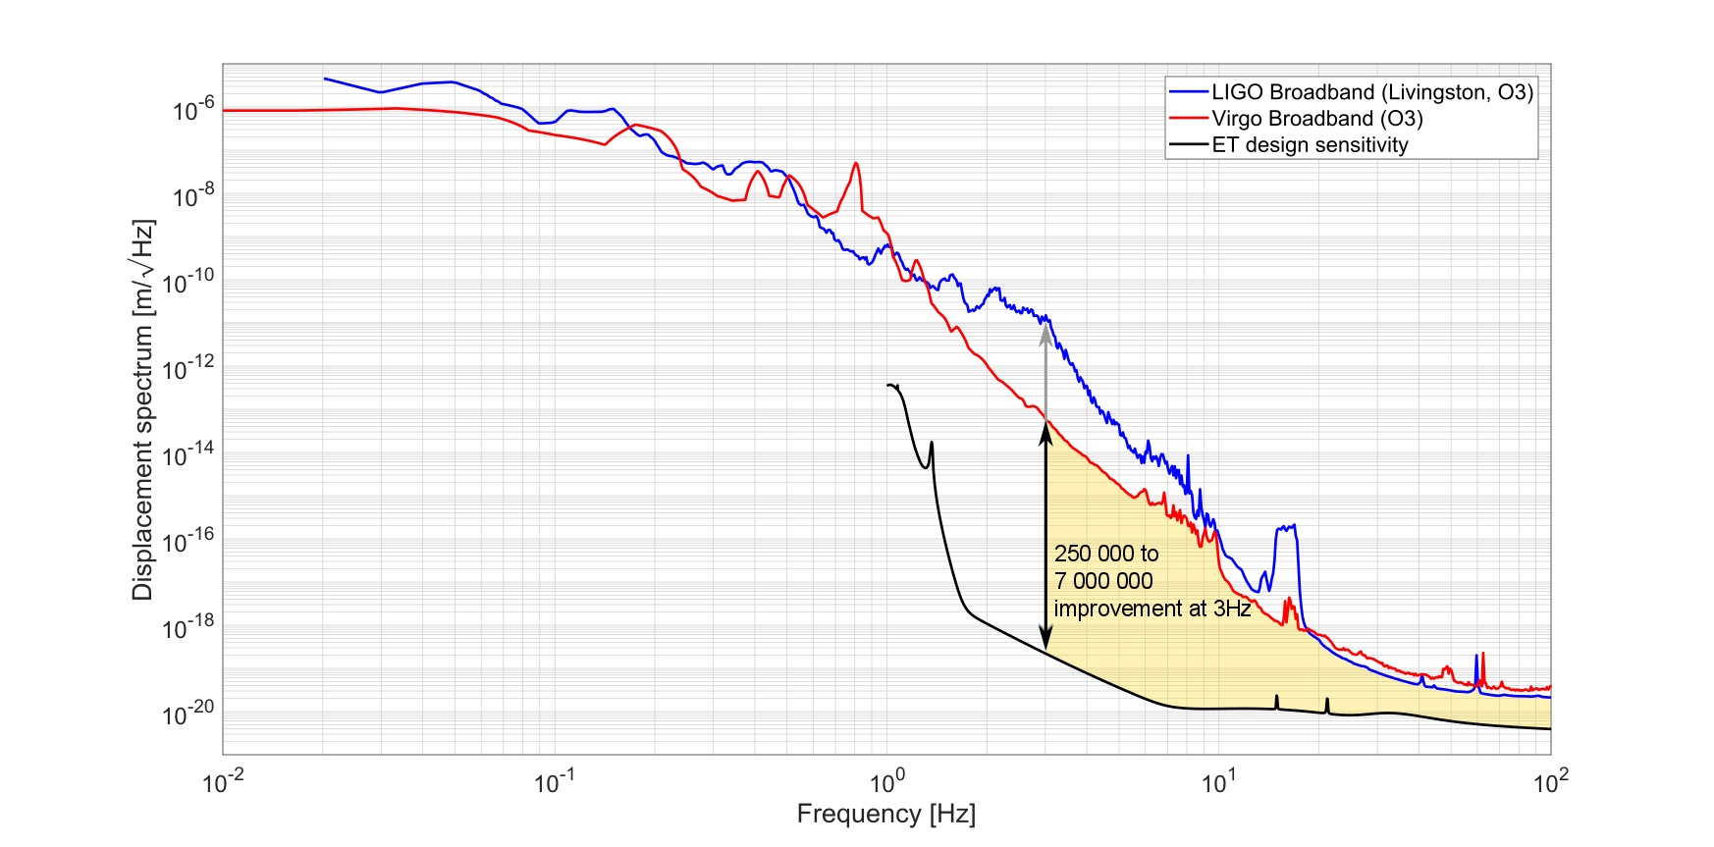
Motivation
Want to achieve higher sensitivity at lower frequency.
Need to reduce noise sources associated with the seismic isolation system and control.[1]
Approach:
Improved local displacement sensing to reduce noise in active seismic isolation and active damping of pendulum modes
Sensor noise reduction will enable improved control to reduce the overall (RMS) mirror motion.
Displacement sensing can also be incorporated in inertial sensors, including rotation sensors and 6D sensors
Figure: Difference between ET’s target sensitivity and the current estimate of advanced LIGO’s and Virgo’s suspension. Credits: Conor Mow-Lowry
 | [1] arXiv:2205.01434 [astro-ph.IM]

Slide 3
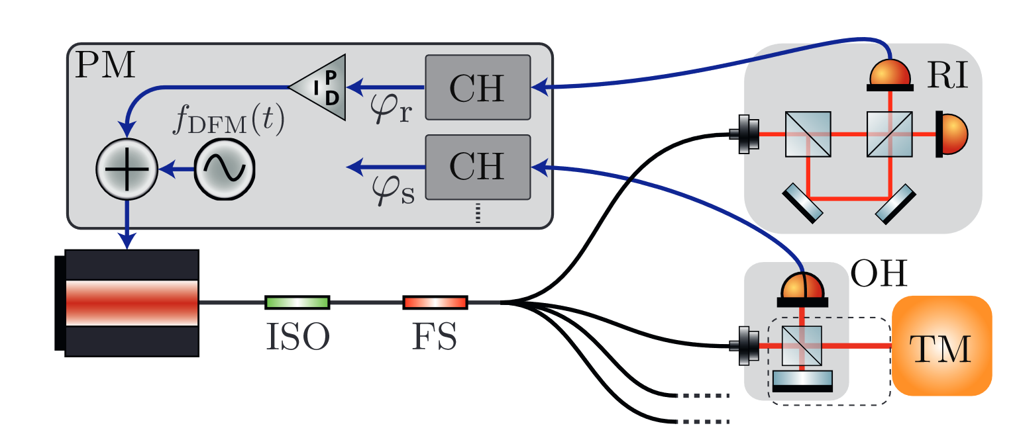
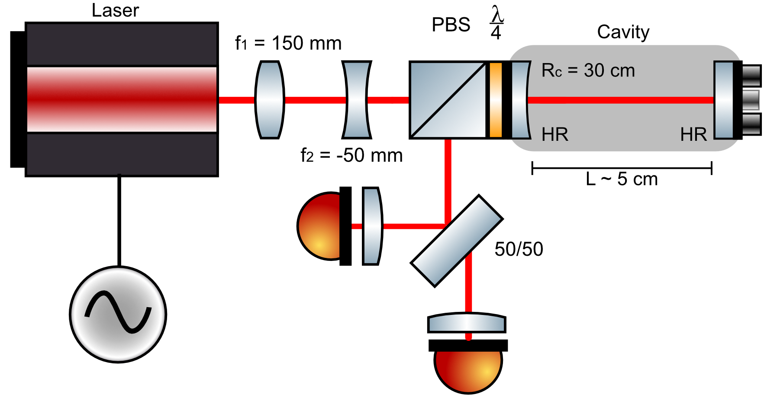
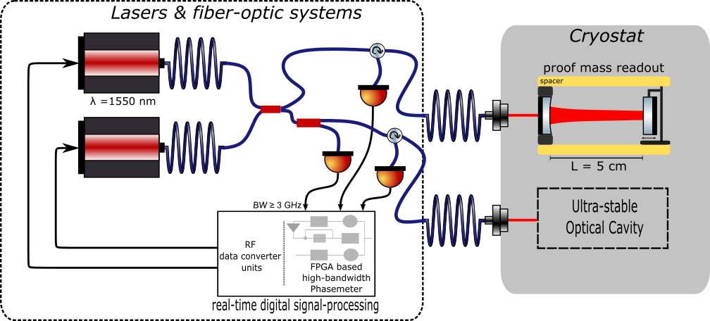
Interferometry for displacement sensors – techniques we study
Deep-frequency modulation interferometry (DFMI)
~10⁻¹⁴m/sqrt(Hz)
dozens of sensors per laser
absolute ranging
Resonantly enhanced DFMI
<10⁻¹⁵m/sqrt(Hz)
dozens of sensors per laser
absolute ranging
Heterodyne cavity tracking readout
<10⁻¹⁵m/sqrt(Hz)
one sensors per laser
best possible performance
O. Gerberding, K.-S. Isleif Sensors 2021, 21(5), 1708
T. Eckhardt, O. Gerberding Metrology 2022, 2(1), 98-113
J. Van Heijningen et al, J. Appl. Phys.133.24 (2023)

Slide 4
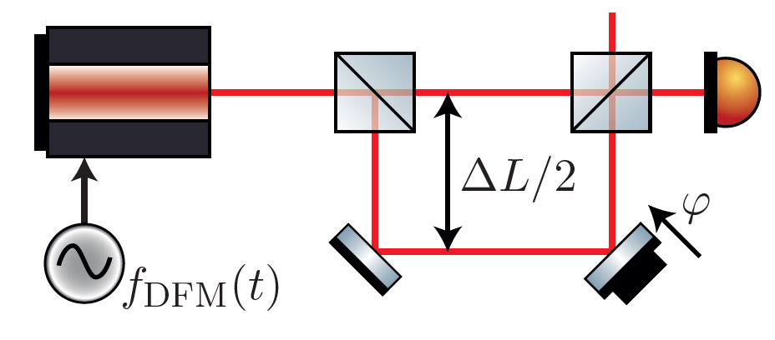
DFMI
Technique to perform low frequency laser interferometry with < pm/√Hz precision.
Strong sinusoidal laser frequency modulation (~3GHz modulation depth with a rate of 1kHz) is applied.
Beat notes are generated from the interference of two homodyning beams that have a time-delay due to an intentional arm-length mismatch.
Waveform of the obtained interferogram for different operating points of the interferometer phase ϕ with a modulation depth m = 6.28 rad
Credits : Oliver Gerberding, "Deep frequency modulation interferometry," Opt. Express 23, 14753-14762 (2015)

Slide 5
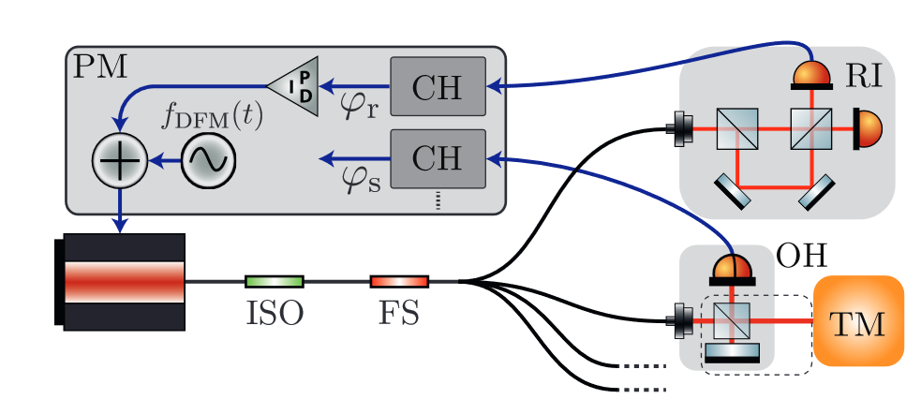
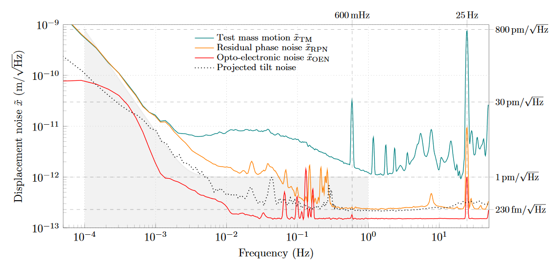
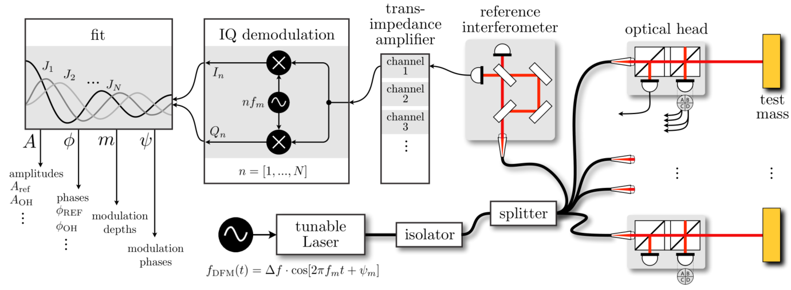
DFMI
A large number of OHs can be connected to a single laser.
Laser noise is common mode and easily rejected
Laser noise is common mode and easily rejected
Past DFMI experiments have achieved displacement-sensing levels of 230 fm/√Hz around 300mHz and tilt-noise readouts with sensitivities of about 20 nrad/√Hz at 40 mHz
Credits : Oliver Gerberding, "Deep frequency modulation interferometry," Opt. Express 23, 14753-14762 (2015)
DOI:10.1103/PhysRevApplied.12.034025

Slide 6
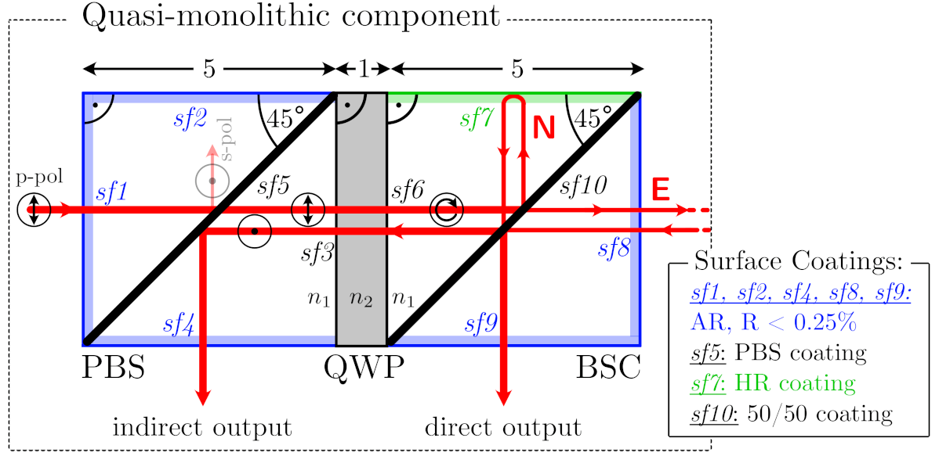
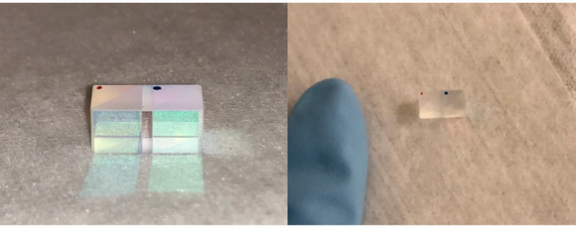
Design of the Optical Head
The core of the design is a quasi-monolithic component (QMC), which consists of :
A polarization beam splitter (PBS) cube.
A quarter wave plate (QWP).
A beam splitting cube (BSC) with 50% reflectivity at the diagonal surface.
Beam diagram showing polarizations
The QMC forms and unequal armlength Michelson interferometer with dual readout. Ideally no light is reflected back into the fiber.
Precision goal: >1pm/sqrt Hz
Gerberding, O.; Isleif, K.-S. Ghost Beam Suppression in Deep Frequency Modulation Interferometry for Compact On-Axis Optical Heads. Sensors 2021, 21, 1708. https://doi.org/10.3390/s21051708

Slide 7
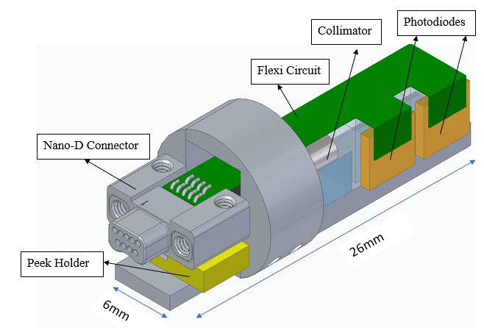
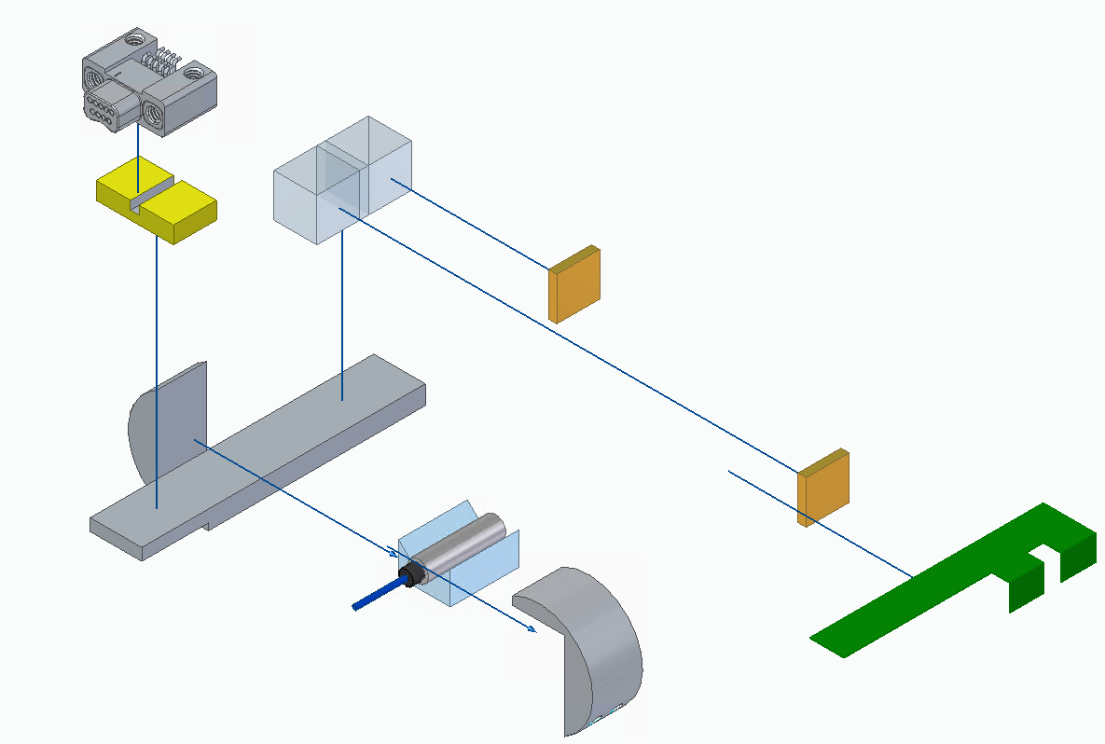
COBRI : Compact Balanced Readout Interferometer
Current prototype: COBRI in half inch mirror mount. Includes photodiode holder with tilted diodes and additional lenses glued onto QMC to focus onto 1mm diodes.
We achieve very high contrast of 94% and production is repeatable and reliable
New Vacuum Compatible model.
After investigation: Wrong coating on BSC of QMC, No performance test yet

Slide 8
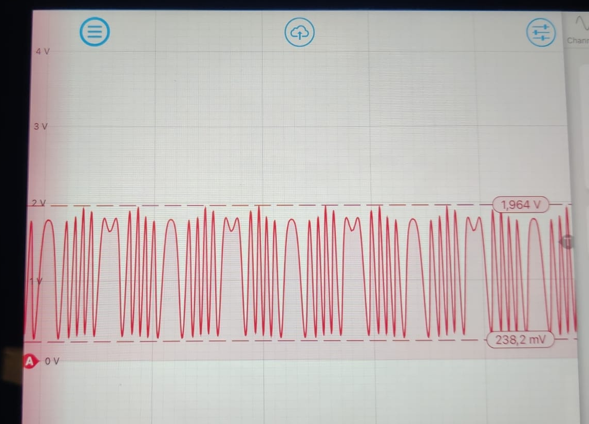
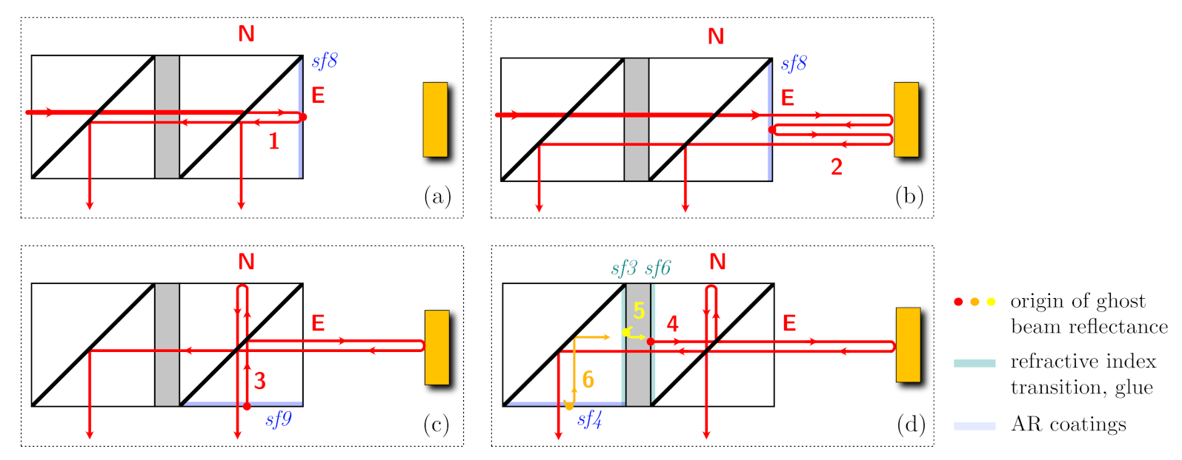
Ghost Beams
On-axis designs usually suffer from ghost beams created at perpendicular surfaces.
We encounter two type of ghost beams :
1. Parasitic beams reflected from undesired surfaces.
2. Parasitic beams due to wrong coating.
The First one can be strongly suppressed using advanced readout algorithms and the dual-readout. Dual readout (both ports) enables us to use balanced detection that cancels most of the ghost beams.
Gerberding, O.; Isleif, K.-S. Ghost Beam Suppression in Deep Frequency Modulation Interferometry for Compact On-Axis Optical Heads. Sensors 2021, 21, 1708. https://doi.org/10.3390/s21051708
Envelop due to wrong coating of 50/50 plate in the QMC

Slide 9
DFMI Readout Algorithm
The signal can be described in Fourier-domain by harmonics of the modulation frequency using Bessel-functions.
A non linear algorithm is employed to extract four fundamental parameters (A, 𝑚, 𝜓, 𝜙) from the signal in real time.
DFMI works over different distances, here shown are examples for distances from 10cm up to 1.1m

Slide 10
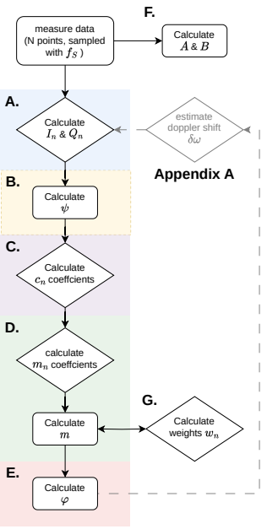
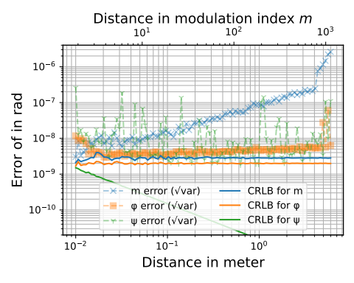
Novel DFMI Readout Algorithm
Use analytical relation between coefficients (Bessel Junction
Efficient, non-recursive phase extraction algorithm.
- faster algorithm
- near optimal precision
- no need for starting values (fit)
Ref: Paper currently in LVK P&P review
DCC No: P2300078
Link: https://dcc.ligo.org/LIGO-P2300078

Slide 11
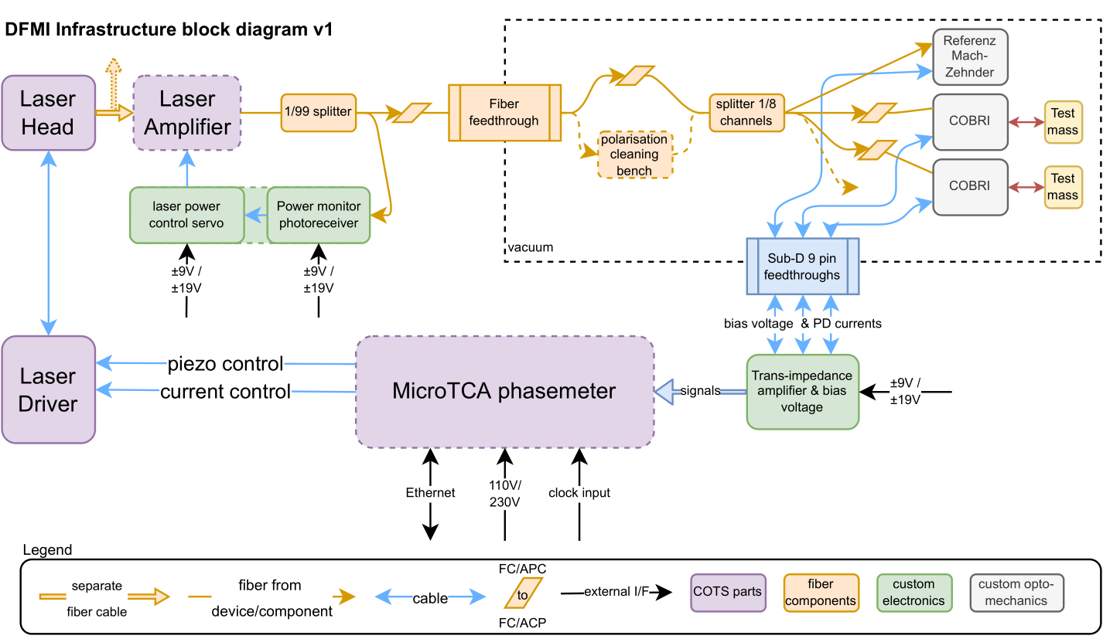
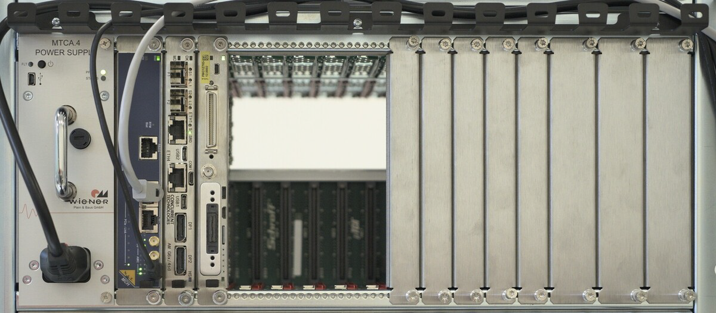
DFMI Infrastructure & Readout
Currently identifying, developing and testing all parts of the DFMI infrastructure
FPGA-based multi-channel phasemeter implementation is ongoing
Will use MicroTCA.4 as basis
One crate could support up to 256 readout channels (128 COBRIs)

Slide 12
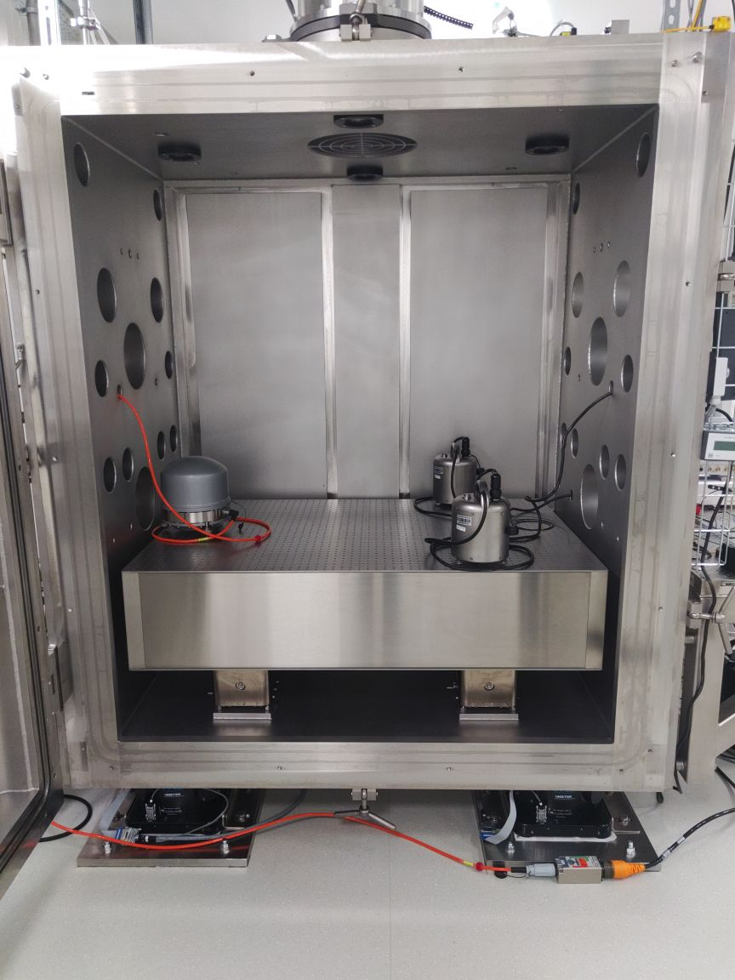
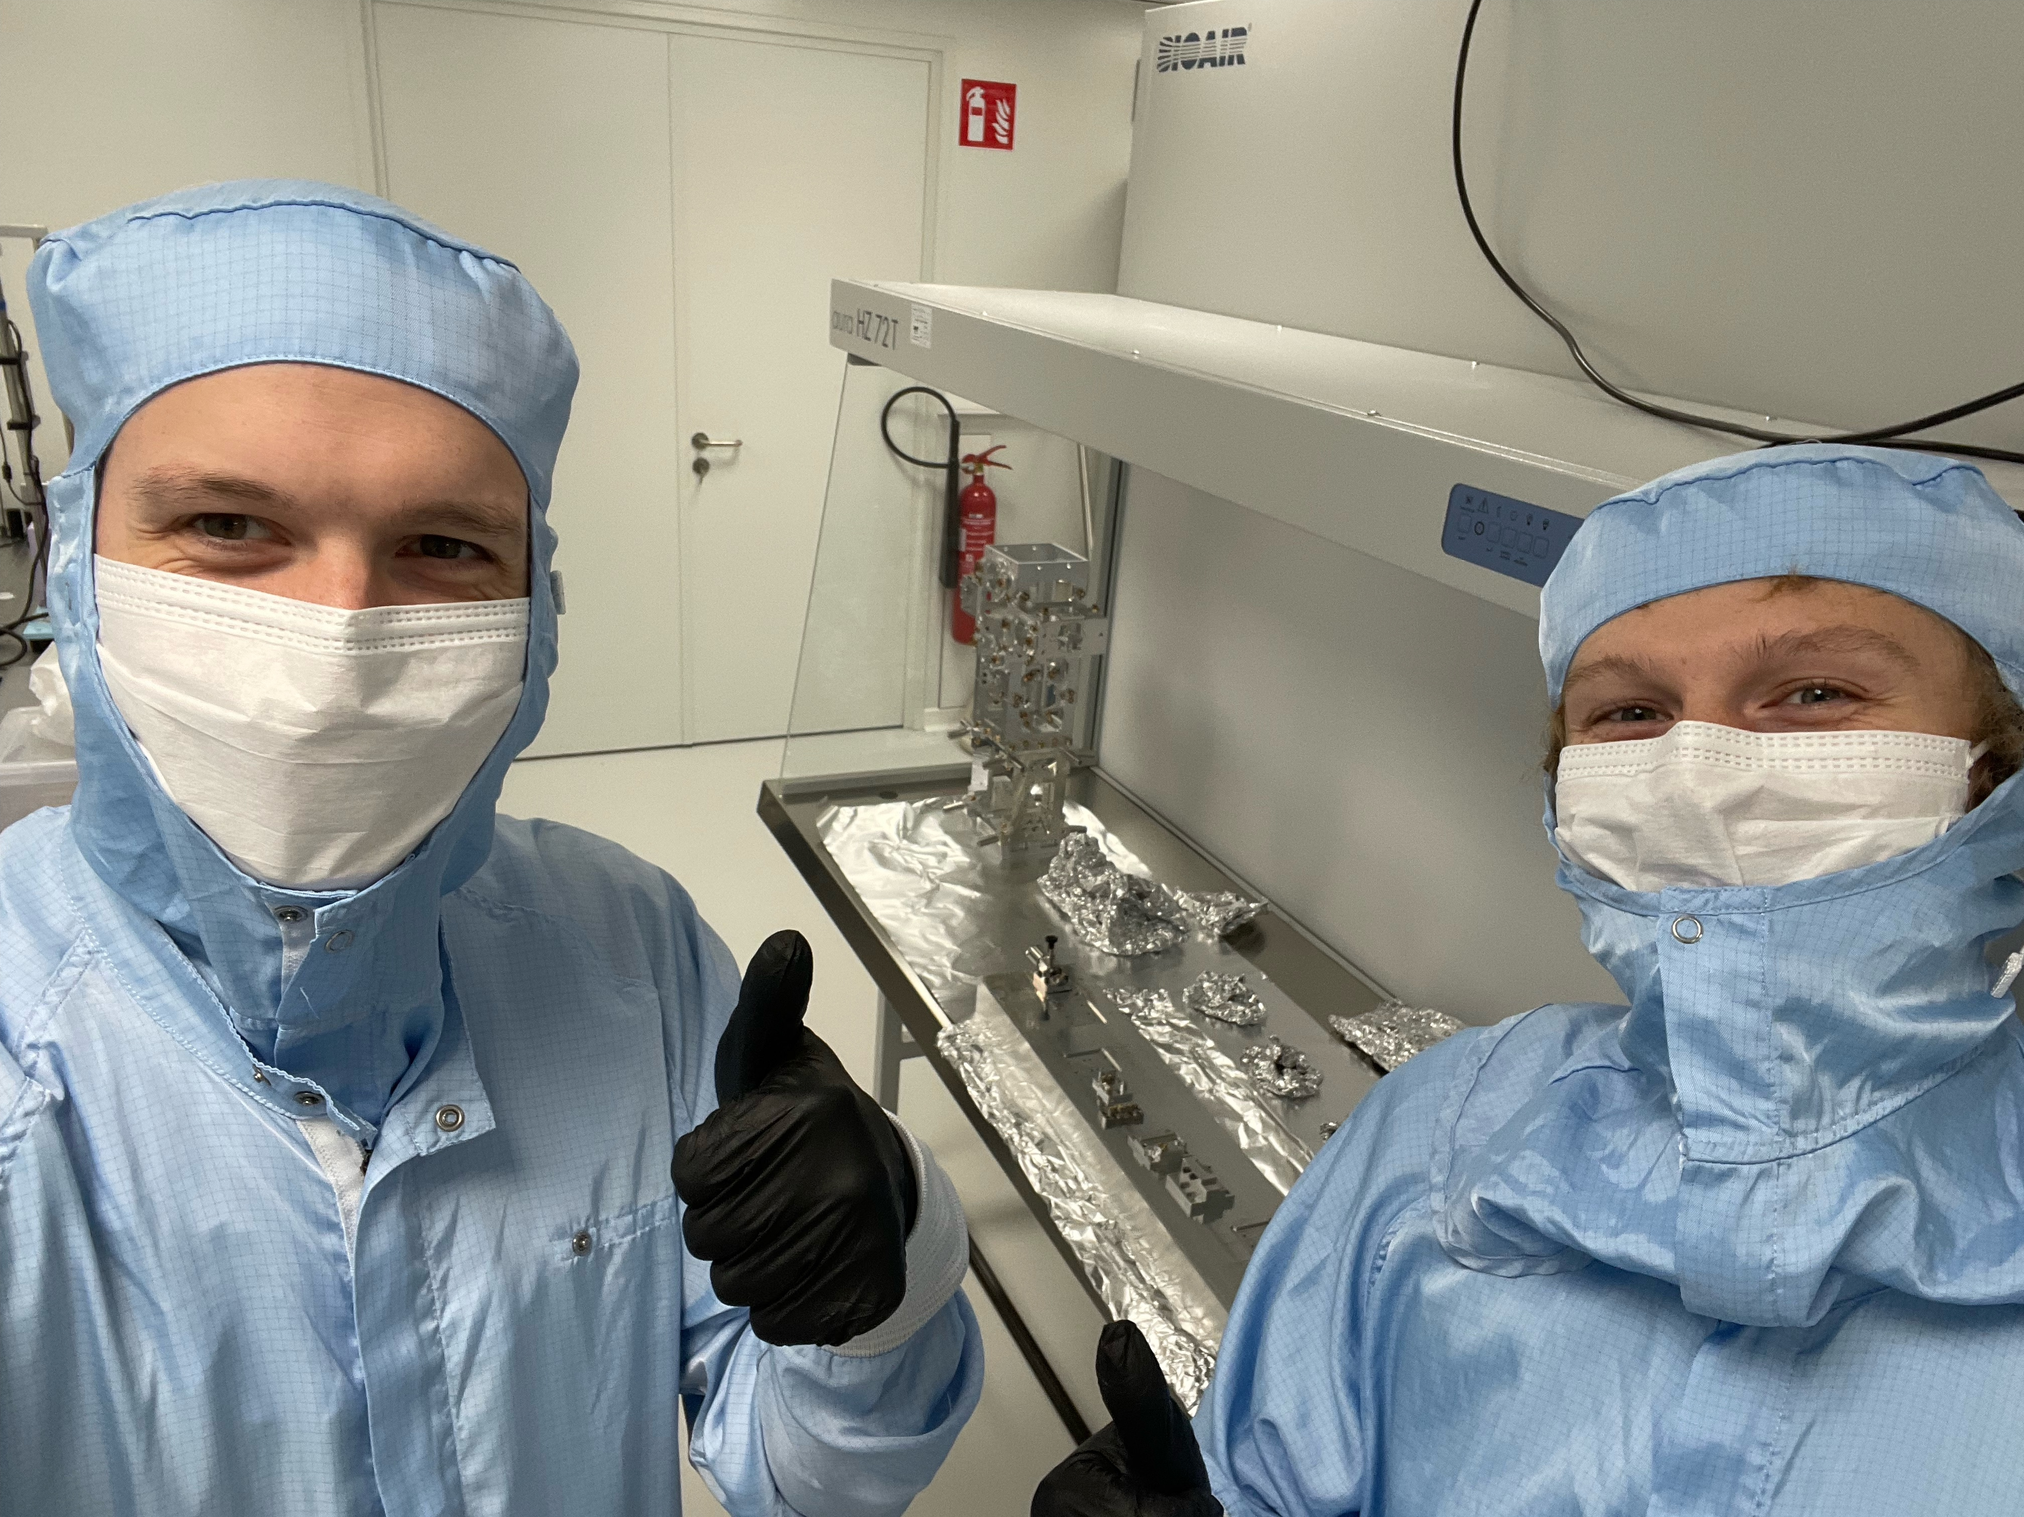
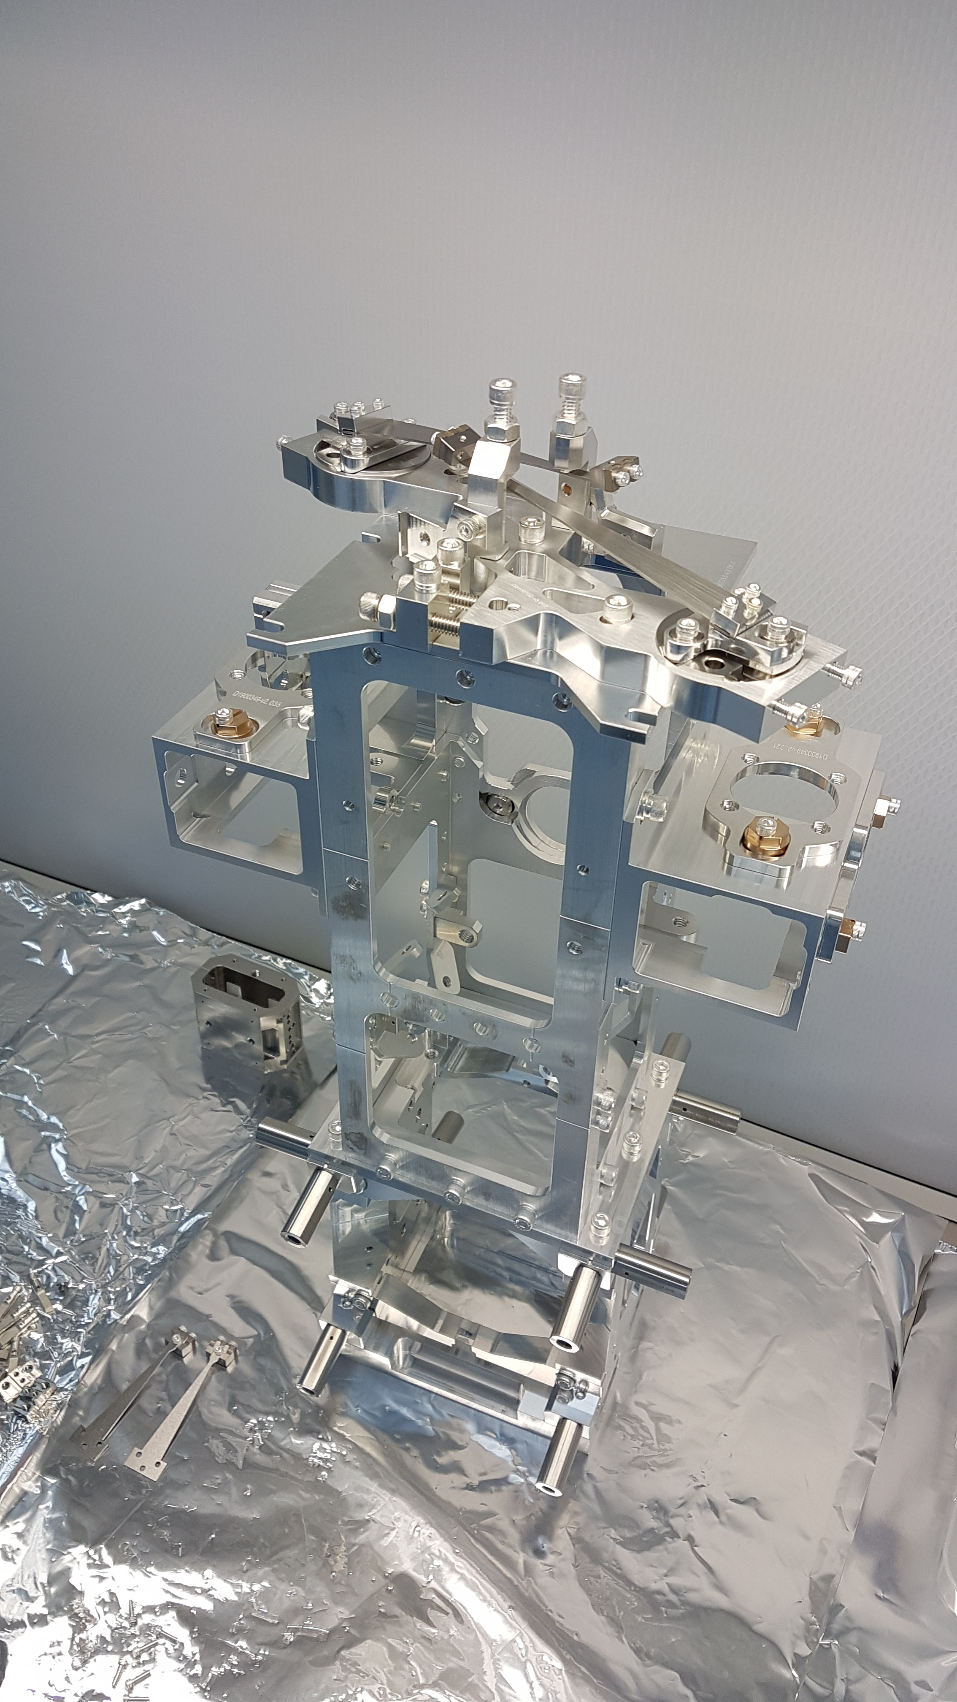
COBRI vs suspensions test in vacuum
VATIGrav : local test facility with a seismically isolated vacuum chamber (6 tons, 1.5m x 1m x 2m)
Currently setting up mirror suspensions for tests : 2 HRTS borrowed from ET-Pathfinder in Maastricht
Results on COBRI use will flow back to ET-Pathfinder
Will set up HRTS in Hamburg.
Will be integrating COBRIs (opposite each BOSEM)
Test in VATIgrav
Leander and Jan-Niklas supporting the work in Maastricht & preparing the HRTS shipment to Hamburg
Ongoing Assembly of HRTS structure in Maastricht by Enrico Porcelli et al.

Slide 13
Interferometry for displacement sensors – techniques we study
Deep-frequency modulation interferometry (DFMI)
~10⁻¹⁴m/sqrt(Hz)
dozens of sensors per laser
absolute ranging
Resonantly enhanced DFMI
<10⁻¹⁵m/sqrt(Hz)
dozens of sensors per laser
absolute ranging
Heterodyne cavity tracking readout
<10⁻¹⁵m/sqrt(Hz)
one sensors per laser
best possible performance
O. Gerberding, K.-S. Isleif Sensors 2021, 21(5), 1708
T. Eckhardt, O. Gerberding Metrology 2022, 2(1), 98-113
J. Van Heijningen et al, J. Appl. Phys.133.24 (2023)

Slide 14
Interferometry for displacement sensors – techniques we study
Deep-frequency modulation interferometry (DFMI)
~10⁻¹⁴m/sqrt(Hz)
dozens of sensors per laser
absolute ranging
Resonantly enhanced DFMI
<10⁻¹⁵m/sqrt(Hz)
dozens of sensors per laser
absolute ranging
Heterodyne cavity tracking readout
<10⁻¹⁵m/sqrt(Hz)
one sensors per laser
best possible performance
O. Gerberding, K.-S. Isleif Sensors 2021, 21(5), 1708
T. Eckhardt, O. Gerberding Metrology 2022, 2(1), 98-113
J. Van Heijningen et al, J. Appl. Phys.133.24 (2023)

Slide 15
Thank you for your attention

Slide 16
Appendix

Slide 17
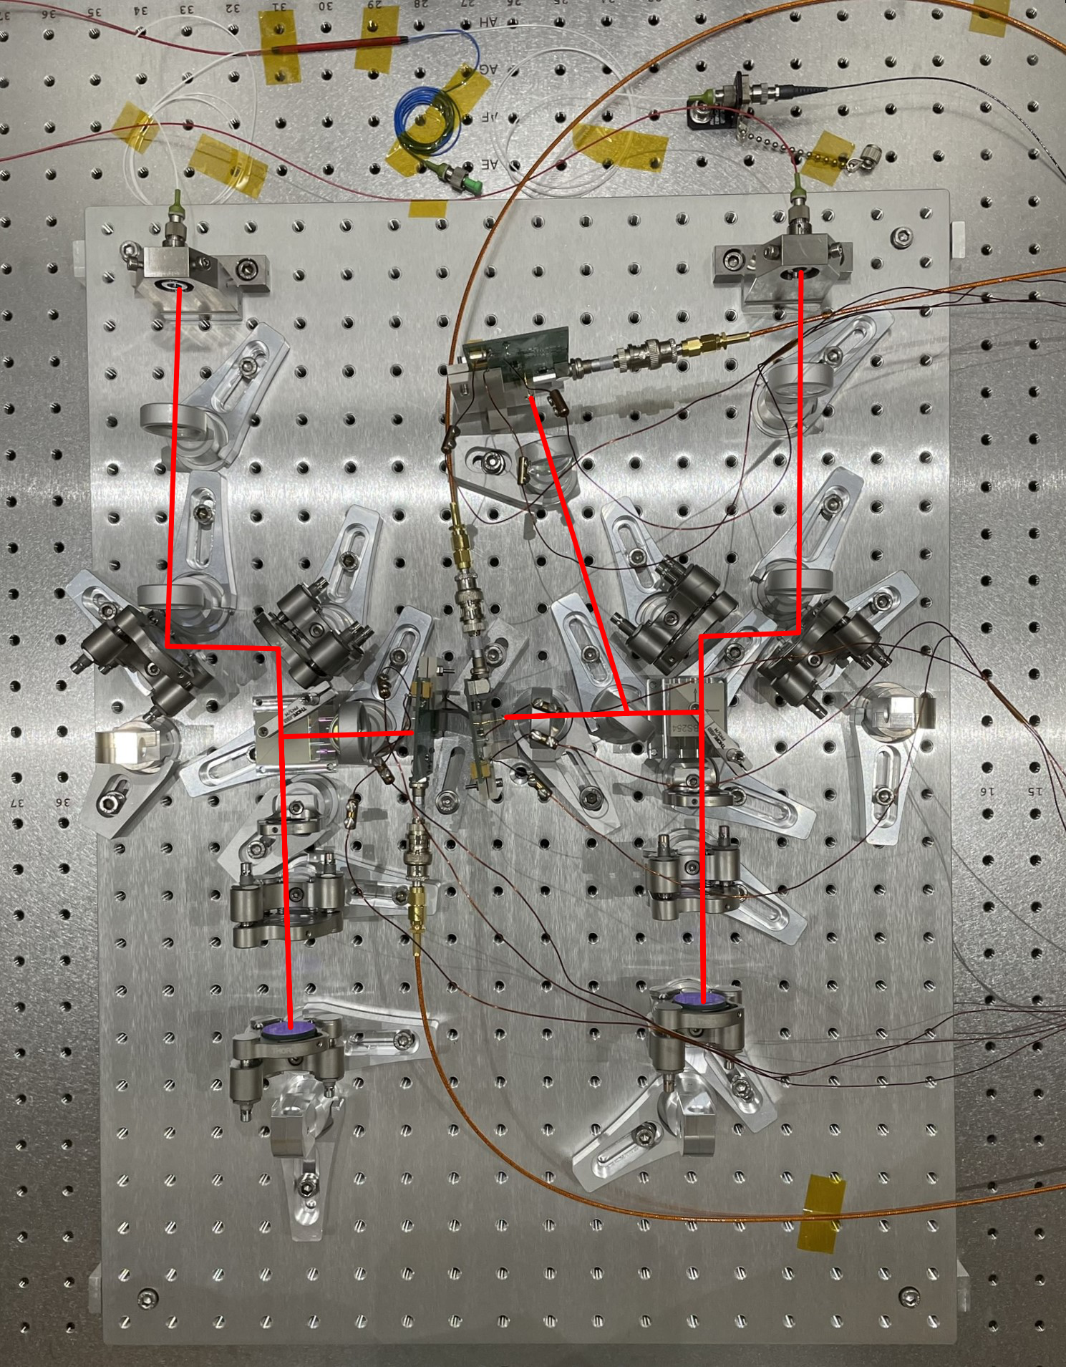
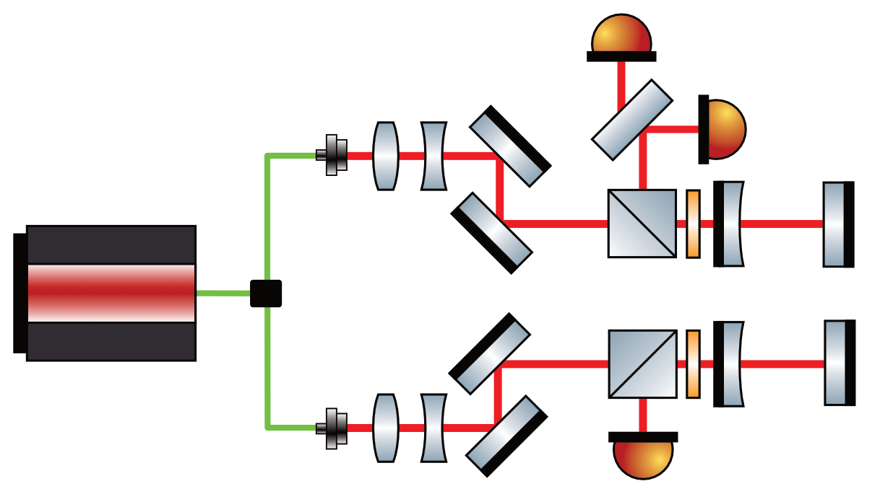
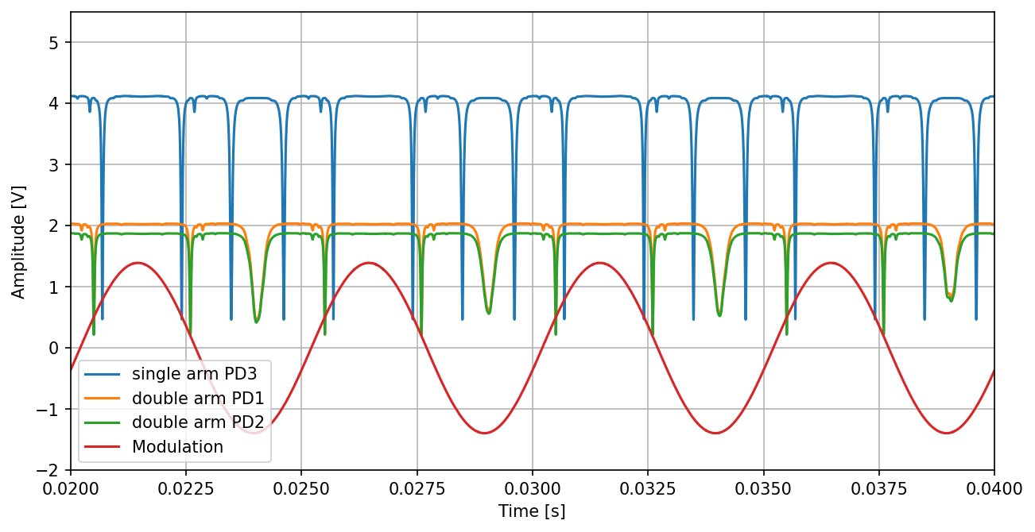
ReDFMI - Setup

Slide 18
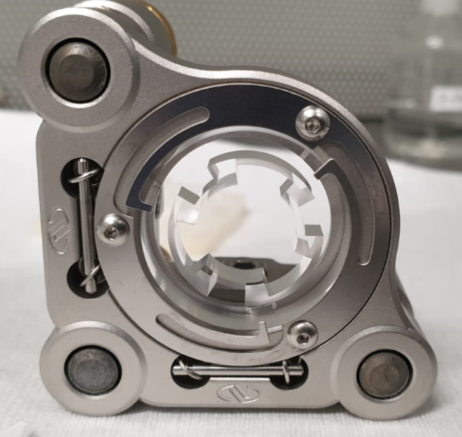
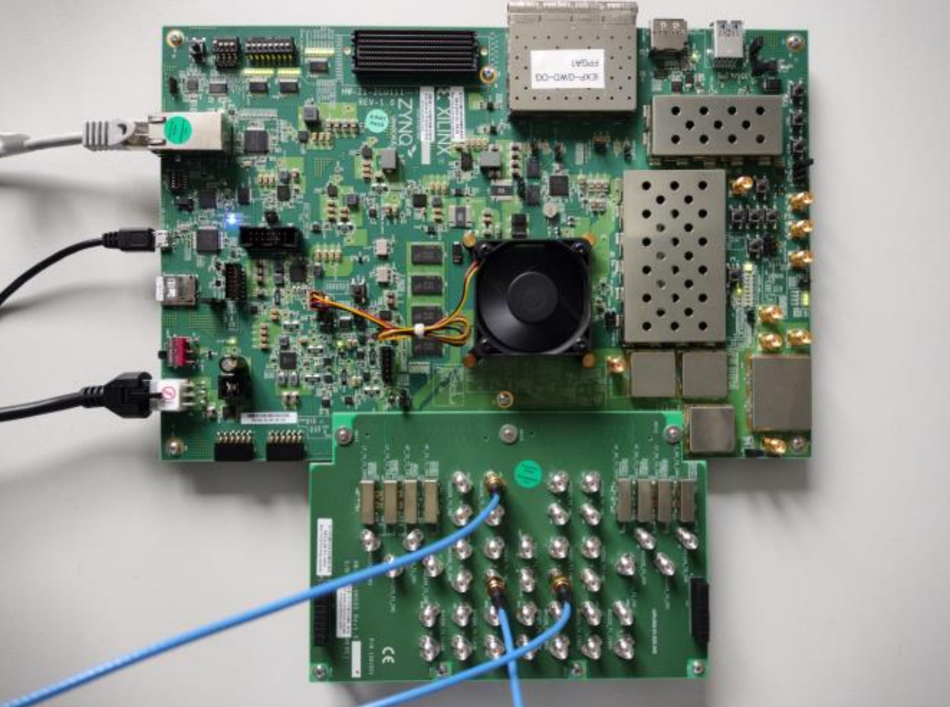
Opto-mechanical inertial sensor readout
J. Carter et al. IEEE INERTIAL, 2020
Mechanical oscillators with high Q
Fused Silica drum
Niobium Watt`s linkage
High-Speed FPGA phasemeter
>2GHz range
>1MHz bandwidth
noise <10⁻¹⁸m/rtHz
Heterodyne cavity tracking readout
5cm cavity length -> 3GHz FSR
J. Van Heijningen et al, J. Appl. Phys.133.24 (2023)

Slide 19
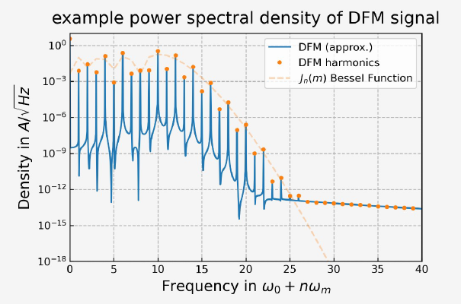
DFMI
The photocurrent is given by the equation:
The signal can be described in Fourier-domain by harmonics of the modulation frequency using Bessel-functions.
Waveform of the obtained interferogram for different operating points of the interferometer phase ϕ with a modulation depth m = 6.28 rad

Slide 20
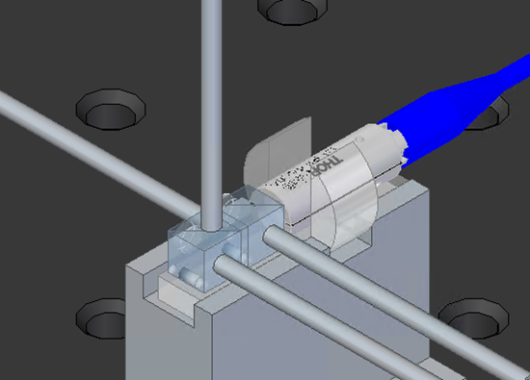
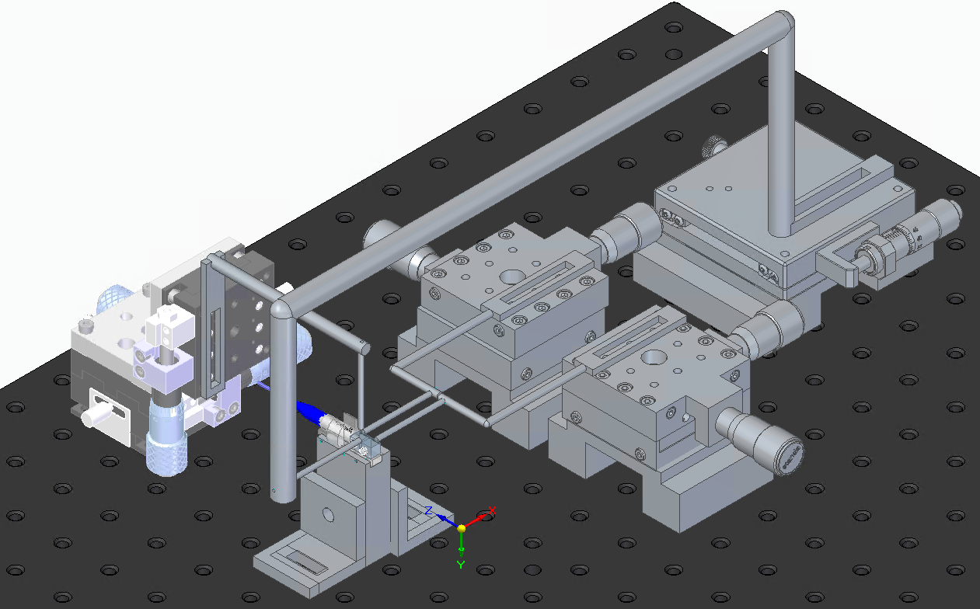
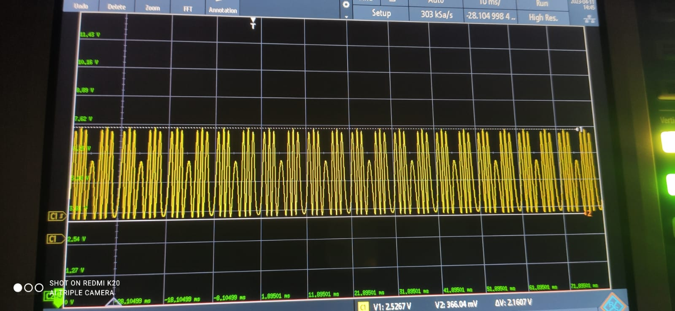
Gluing the QMC
Want to align the QMC to maximum contrast.
The QMC requires alignment in two angles : one in the plane of the carrier and one normal to the plane of carrier.
We use an adjustable mirror as test mass during gluing.
For the alignment in the plane of the carrier we use the controllers a and b.
The alignment in plane normal to the carrier is attained by applying pressure from the top (controller c) to the unequal glue layer.
Controller d is to hold the QMC in place
Signal from the QMC with 94% contrast

Slide 21
Gluing the QMC

Slide 22
Current investigation
Current QMC samples use a non-ideal coating for the central beam splitter in the Michelson:
- instead of 50/50 for both polarizations we have 85-15 for S and p respectively for transmission.
- the phase of the transmitted polarizations is currently not matched.
DFMI signals from COBRIs contain an unexplained envelope that is either caused by the non-ideal coating or by unexpected ghost beams.
Ordering new set of QMC with correct coating.
Currently working on a more detailed model of the current QMC to identify other sources of ghost beams to explain the envelope

Slide 23
Future Goals
Test the sensor for performance by comparing two or more sensors.
Integrate COBRIs with FPGA-based multi-channel phasemeter currently in development
Making new iterations of COBRI.
Make a pendulum suspension system to test the sensor in vacuum.

Slide 24
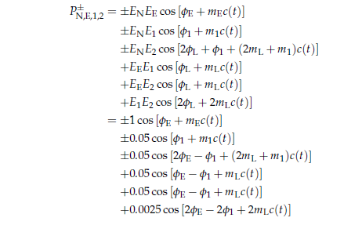

Slide 25
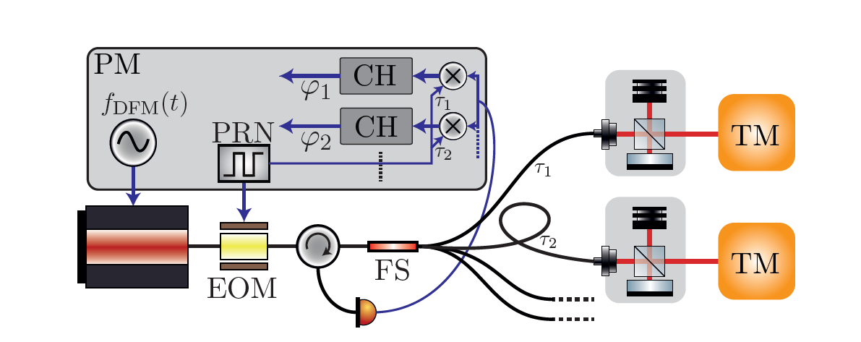
A phase modulation of pseudo random noise codes (c(t)) onto the light distributed to the OHs can be used to generate effective amplitude modulations of the interference signals
The light reflected back from different OHs is combined using fibers with different lengths, chosen in such a way that the individual amplitude modulations are not coherent to each other.
The summed signals are detected on one photo diode and fed into a phase measurement system.
Before each channel is read out using the DPM algorithm, the demultiplexing is achieved by multiplying the input signal with two codes, both delayed by the overall delay tx for that channel and one delayed further by the arm length difference for channel 1.
The achievable performance of such a multiplexed readout is currently unknown, since effects observed in similar readout schemes [10, 9] might limit the performance

