Slide 1
The role of the Civil Engineering in ET Roadmap
(in ETO and in Phase 1)
maria marsella

Slide 2
Phase I - Preliminary CE - TDR and site selection
Support and coordinate the CE activity to design the research infrastructure in the selected construction site(s)
Identify what is relevant for principal approval of construction
Delineation of the documents for BGR and their level of exhaustivity and uncertainty
Establish a suitable team (in-kind and funded by BGR) and set up a detailed work plan including deliverables (specifications, design, schedules, budget)
In Phase 1 two configurations will be studied in parallel

Slide 3
Which are the technical steps ?
Identify data and information needed for preliminary TDR for the underground works, surface buildings and of the related technical infrastructures
Gathering requirements from ET collaboration necessary to design the civil and technical infrastructure and to obtain a cost and risk assessment
Define a standard method for estimating cost uncertainty associated with the different levels of the design development to be adopted in local studies
Identify crucial technical issues relevant to CE to be considered in the evaluating the optimal geometry of the underground infrastructure
Establish process to require and collect deliverables from local teams, and ET collaboration

Slide 4
How to coordinate the activity with local teams ?
Required info
To receive document, under the terms and conditions defined in the GA, to accomplish the preliminary TDR
To ask for a site proposal including a technical design, a time/cost estimation, risk analysis, socio-economic impact, permitting raodmaps,….
To ask for amendments if something needs to be changed
REQUIRED tasks
To implement a plan for responsibilities and coordination of the local teams
To submit request on a set of common documents and reports and the method for quality assessmenet
To display a collaborative framework between SPB and local teams
Bgr in Phase 1
Establish roadmap pillars
Request and evaluate document/proposals
Take decision
…..

Slide 5
How to organize the activity ?
WP to be started in collaboration with CERN are devoted to:
WP1
shared tools/platform for digital modeling
To implement a plan to define design computational methods, multi criteria optimization, adaptable/parametric models, etc.
To establish a procedure to share data interactively with other teams of ETO (shared BIM platform)
WP2
requirements from ED-CB
To support analysis and understanding of requirements and constraints from ISB
to associate them to elements of infrastructure
To classify in terms of relevance (mandatory, preferred, ameliorative)
To identify additonal interreferences
WP3
layouts/specifications
To deliver a refernce version of a BIM model of the ET layout of caverns, shafts, and tunnels for triangle and 2L obtained following a set of minimal requirements discussed an approved by ISB
To share info with the local teams to implement the site- specific design process
To collaborate to elaborate for potential integrations
WP0
cost estimate classification system
To identify a common methodology for attributing the maturity level of the CE design and uncertainty
.

Slide 6
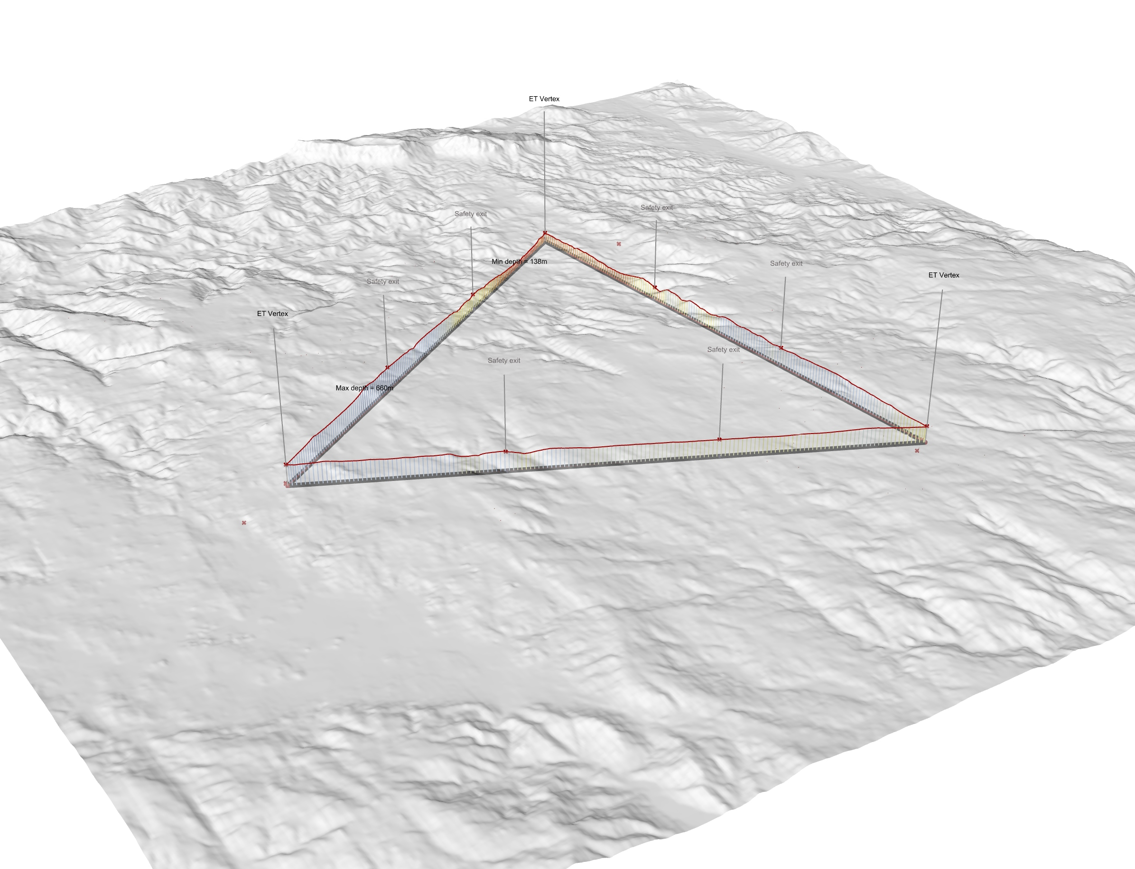
ET: Data and tools to support early-stage infrastructure design in collaboration !
Wissam Wahbeh - XIII Einstein Telescope Symposium - 8.–12. Mai 2023 - Cagliari
Wissam Wahbeh - XIII Einstein Telescope Symposium - 8.–12. Mai 2023 - Cagliari

Slide 7
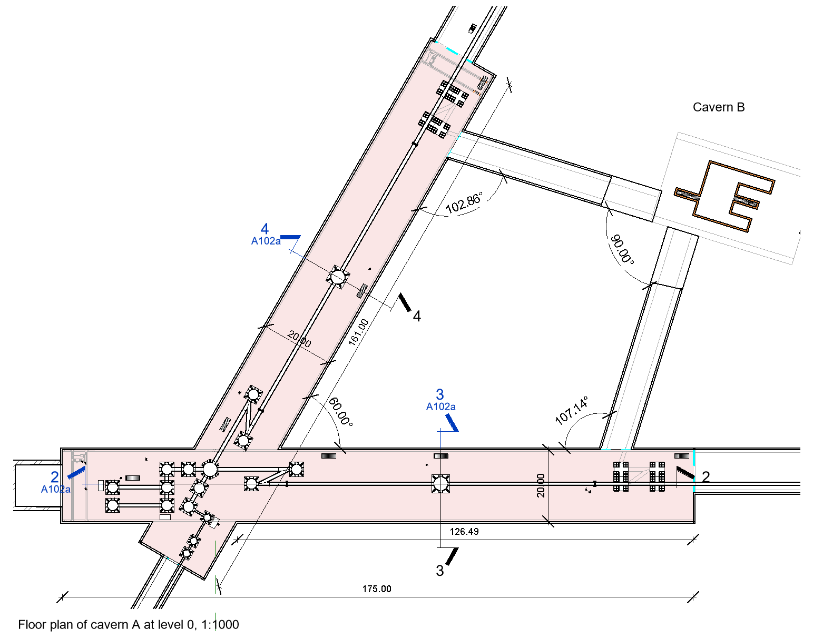
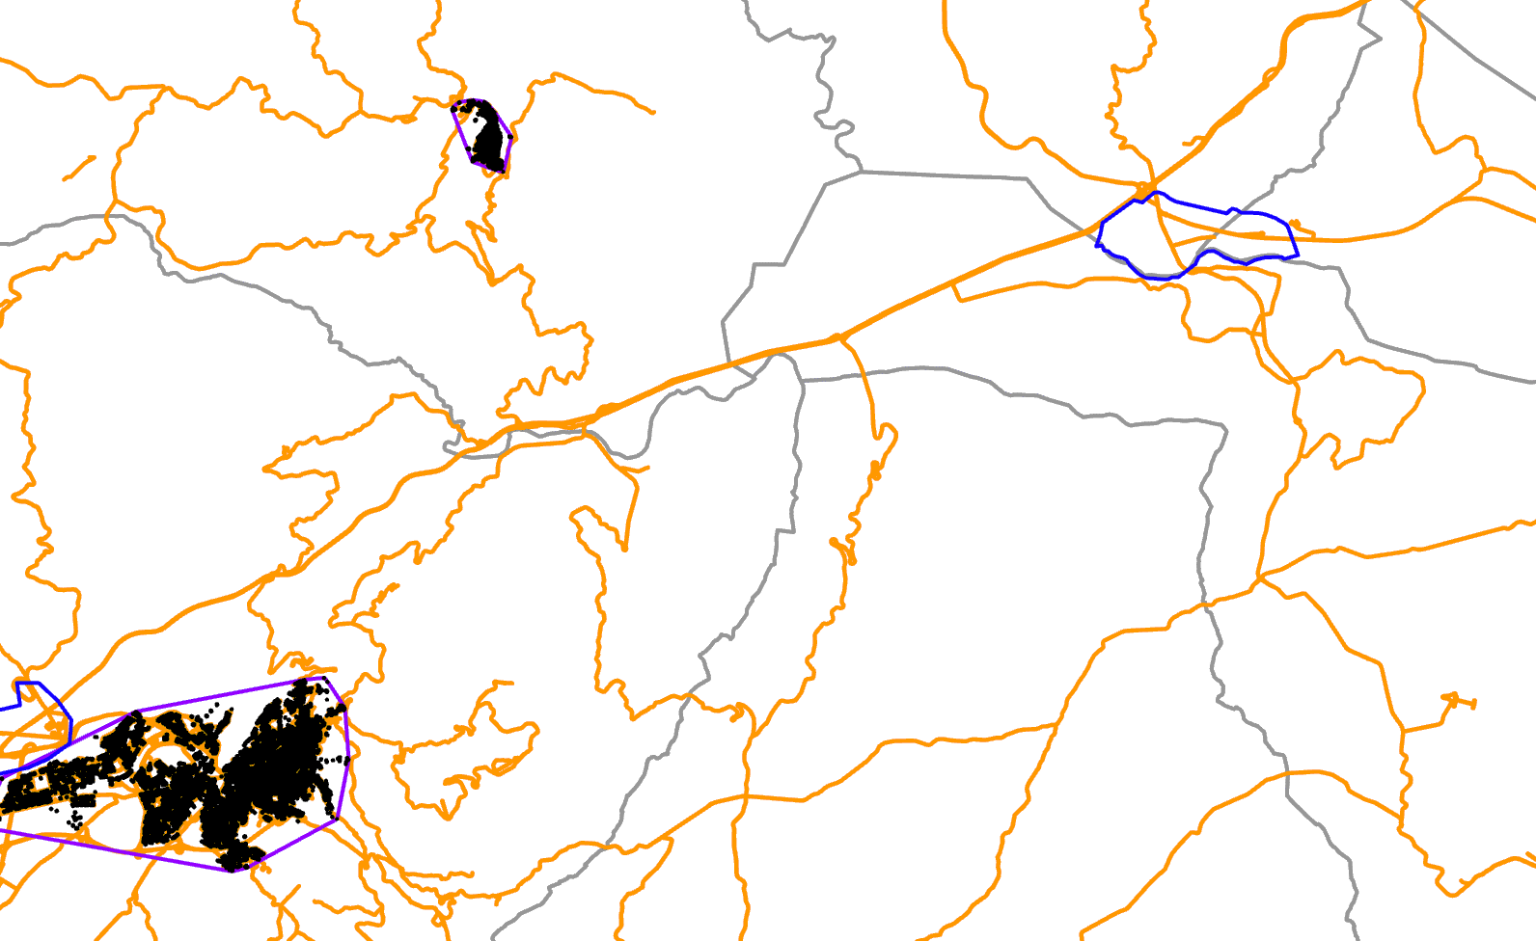
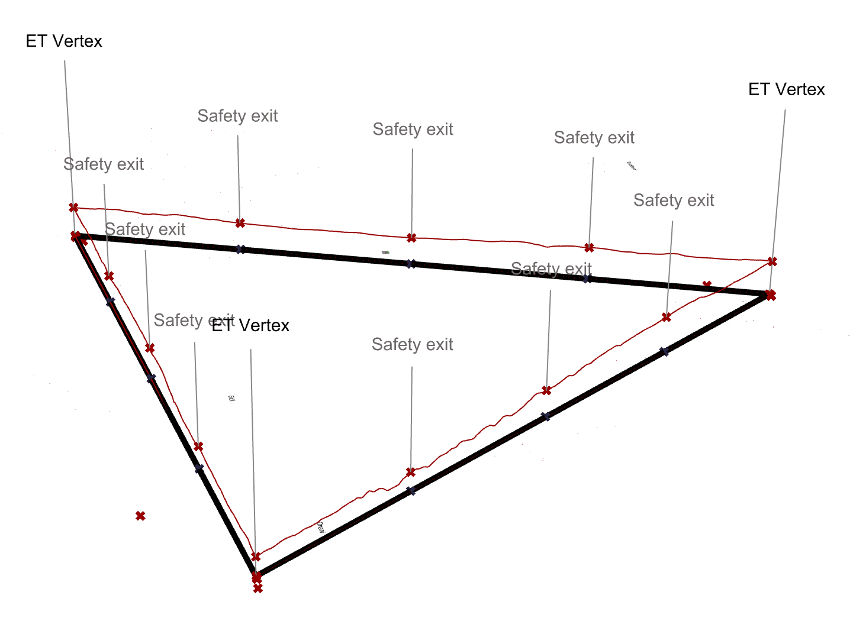
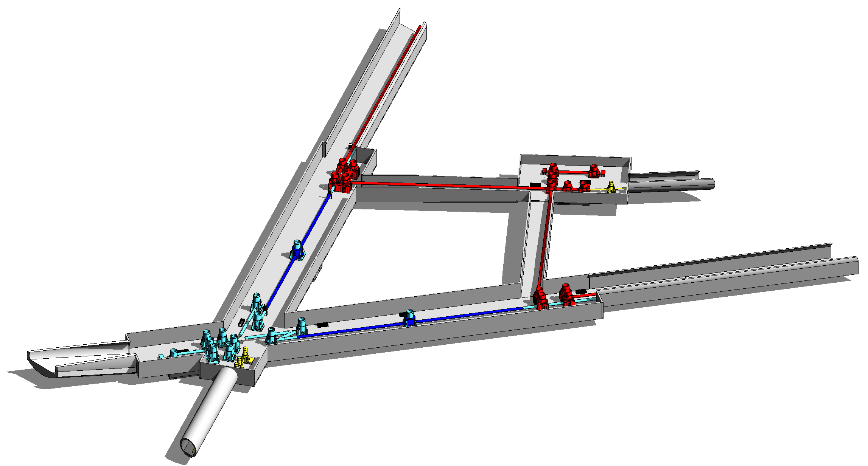
Data and Methods
Municipalities
Road's network
Tech. content
Urban zones
Objects materials
Restricted zones
Constraints
Objects properties
Noisy areas
Terrain 3d model
Evaluation criteria
Level of details need
Geological 3d model
Weighting criteria
…
Geographic Information System (GIS)
Multi objective Optimisation (MOO)
Building Information Model (BIM)
Abstract parametric ET location model
Wissam Wahbeh - XIII Einstein Telescope Symposium - 8.–12. Mai 2023 - Cagliari

Slide 8
How to coordinate the activity within different bodies ?
CB
ETO
Local Team
BGR
ISB
design GW detector (Δ & 2L)
ED
Research Infrastructure TDR
studies for site-dependent design
Site selection
SPB
study site characteristics affectiing ET performance
CE
Civil infrastructure TDR
provide contribution toTDR
proposal for BIDBOOK
PO
requirements and parameters
geometry selection

Slide 9
What is urgent ?

Slide 10
contribute to the selection of geometry
Any geometry can be studied and realized from a civil engineering point of view (eventually optimized or modified to maintain the required performance)
It is a matter of cost ?
It is a matter of technical optimization ?
It is a matter of scientific goals ?
…..

Slide 11
harmonize the activity of the local teams
Assess responsibilities and set up a coordination with local teams to align the activity along the ET roadmap (reference persons)
Define a set of common documents and reports based on same quality parameters and level of detail to be prepared for the preliminary TDR.
Promote a collaborative framework between local teams and SPB that oversee site quality investigations and include specific engineering objectives to support optimization of construction solution, speed of excavation, counteractions for tunnel stability and noise reduction, underground water management, monitoring during operation).

Slide 12
Identify additional topic to include in the roadmap
structural dynamics to support noise models
monitoring system (SHM) investigations
mitigate mechanical vibrations in soft soils and hard rocks
safety solutions
surveying and monitoring
sustainability & environment

Slide 13
Agree on a timeline (considering the needs for CE implementation levels)
 | Phase 1 |  |  | Phase 2 | Local team
 | Geometry selection | Preliminary TDR | Site selection | Final TDR | Local team site-dependent preliminary design | Local team site-dependent final design | Procurement ….. …..
ESFRI
INFRADEV
ETO
CERN MOU |  | Q4 2026
Sardinia |  |  |  |  | Q1 2025
EMR

Slide 14
Additional issues ………….. ………….. …………..

