Slide 1
Links between special systems and civil infrastructure: lesson learnt from the ET beam pipe design
Luigi SCIBILE for the ET-CERN collaboration
2nd Einstein Telescope Annual Meeting, Paris, 14-16 November 2023

Slide 2
Content
Lesson learnt from ET beam pipe design - links with civil infrastructures
Roads network
Buildings
Shafts
Caverns
Tunnels
Logistics
Fabrication
Assembly
Beam pipe dimensions
Vacuum equipment
Underground Welding
Ventilation system
Fire fighting system
Electrical distribution

Slide 3
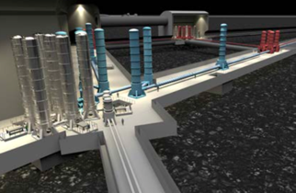
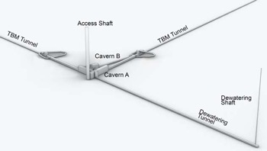
Interfaces/Interferences between the beampipe and civil infrastructure: Overview
The interreferences/interfaces between the beampipe and the civil infrastructure have to be identified throughout the beampipe lifecycle.
Transport
Transport
Tunnel
installation and commissioning
Operation and Maintenance
Decommissioning
Heavy handling
Manufacturing
Materials
Transport
Transport
Manufacturing

Slide 4
Interfaces/Interferences between the beampipe and civil infrastructure: Overview
Road network(s): depending on manufacturing strategy (on-site/off-site).
Transport
Transport
Tunnel
installation and commissioning
Operation and Maintenance
Decommissioning
Heavy handling
Manufacturing
Materials
Transport
Transport
Manufacturing

Slide 5
Interfaces/Interferences between the beampipe and civil infrastructure: Overview
Building(s): depending on manufacturing strategy (on-site/off-site)
Transport
Transport
Tunnel
installation and commissioning
Operation and Maintenance
Decommissioning
Heavy handling
Manufacturing
Materials
Transport
Transport
Manufacturing

Slide 6
Interfaces/Interferences between the beampipe and civil infrastructure: Overview
Shaft(s)*: specifications depends on beampipe length (using⁺ 15 meters )
Transport
Transport
Tunnel
installation and commissioning
Operation and Maintenance
Decommissioning
Heavy handling
Manufacturing
Materials
Transport
Transport
Manufacturing
(*) Assuming no inclined tunnel access
(⁺) Note that in ET design report update 2020 pipe lenght is 20 meters

Slide 7
Interfaces/Interferences between the beampipe and civil infrastructure: Overview
Caverns: Interfaces/Interferences depend on beampipe length and width for the transport during the installation and for the eventual replacement of a tube section in case of failure.
Transport
Transport
Tunnel
installation and commissioning
Operation and Maintenance
Decommissioning
Heavy handling
Manufacturing
Materials
Transport
Transport
Manufacturing

Slide 8
Interfaces/Interferences between the beampipe and civil infrastructure: Overview
Tunnel: Interfaces/Interferences depend on many factors (see separate slides).
Transport
Transport
Tunnel
installation and commissioning
Operation and Maintenance
Decommissioning
Heavy handling
Manufacturing
Materials
Transport
Transport
Manufacturing

Slide 9
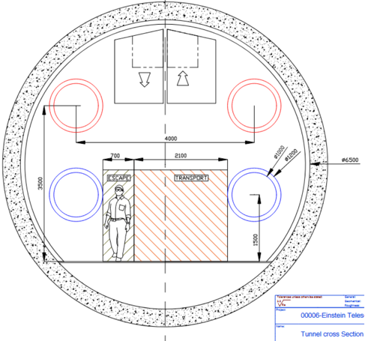
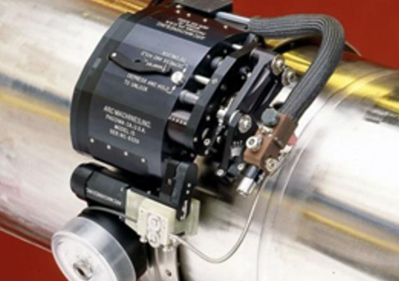
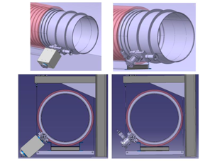
Interfaces/Interferences between the beampipe and the tunnel: cross section
Space required for the supporting structure, for welding and future inspections (min 400mm), for gate valves, for pumping modules and related control units (depending on design installation).
400
400
800
800
800
2720
2720
1100
1100
1100
2180
Fire fighting equipment (water - DN200 pipe?)
Cable trays for communication equipment?
Ventilation and smoke extraction?
Presence of alcoves/enlargements?

Slide 10
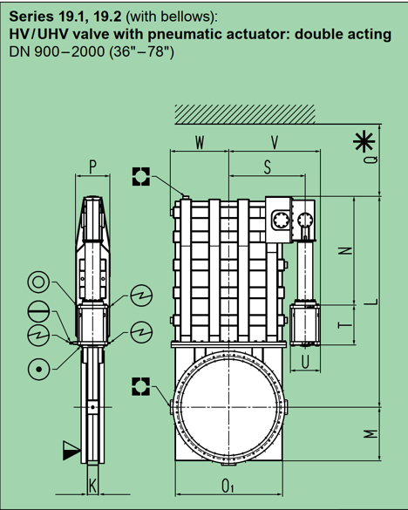
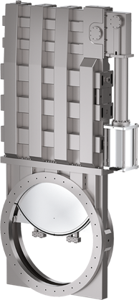
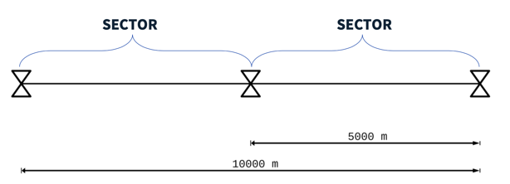
Interfaces/Interferences between the beampipe and the tunnel: cross section
Space required for sectional gate valves (DN1000)
1565 (W+V) x 2751 (L +M) x 356 (P) mm
+ 140 mm (Q)
800
1100

Slide 11
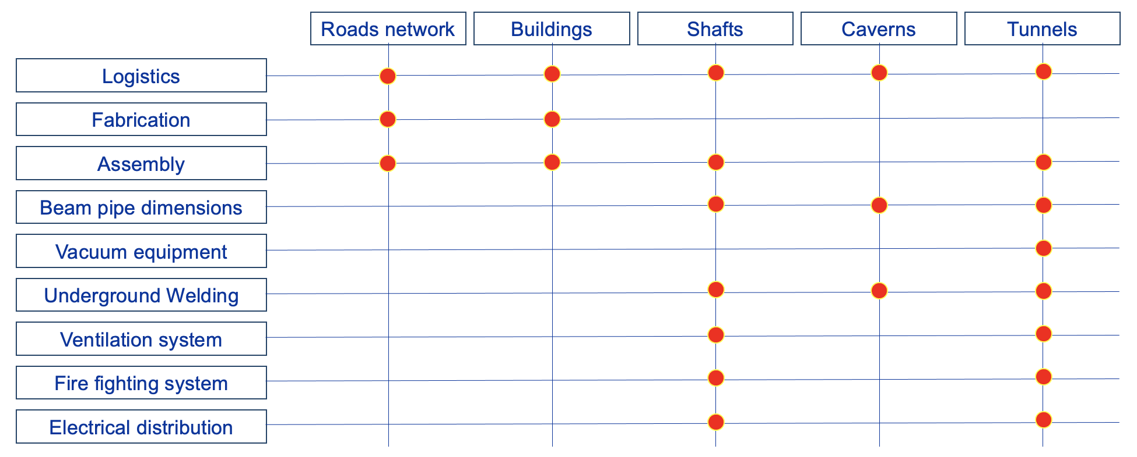
Conclusions
The links between the systems to the installed and the civil infrastructure are many.
It is important to have an estimate of the expected volumes/encombrements to proceed with a proper system integration before freezing the preliminary design of civil infrastructures.
The list of items and activities that are linked to the civil infrastructures has to be exhaustive to reduce the risk of poor design.

