Slide 1
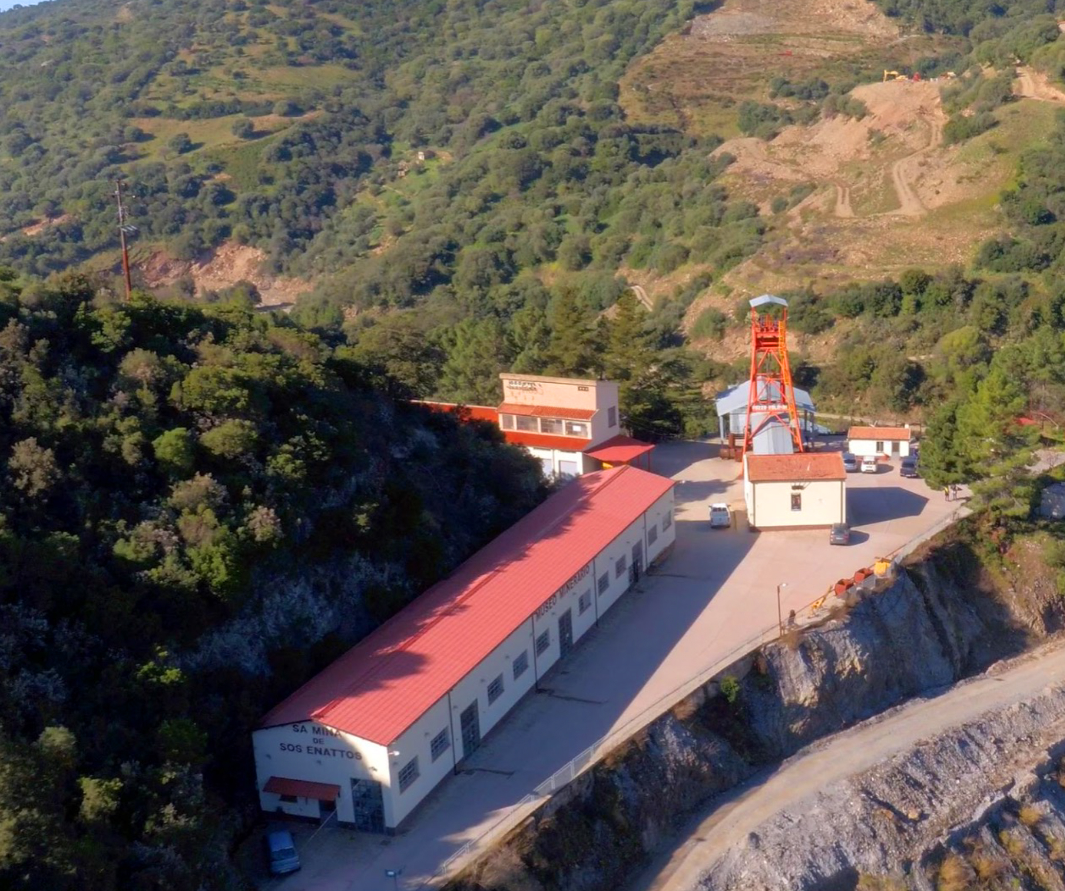
2nd Einstein Telescope Annual Meeting, 15 November 2023
ET Communication
and Public Engagement
in Italy
Matteo Serra
INFN

Slide 2
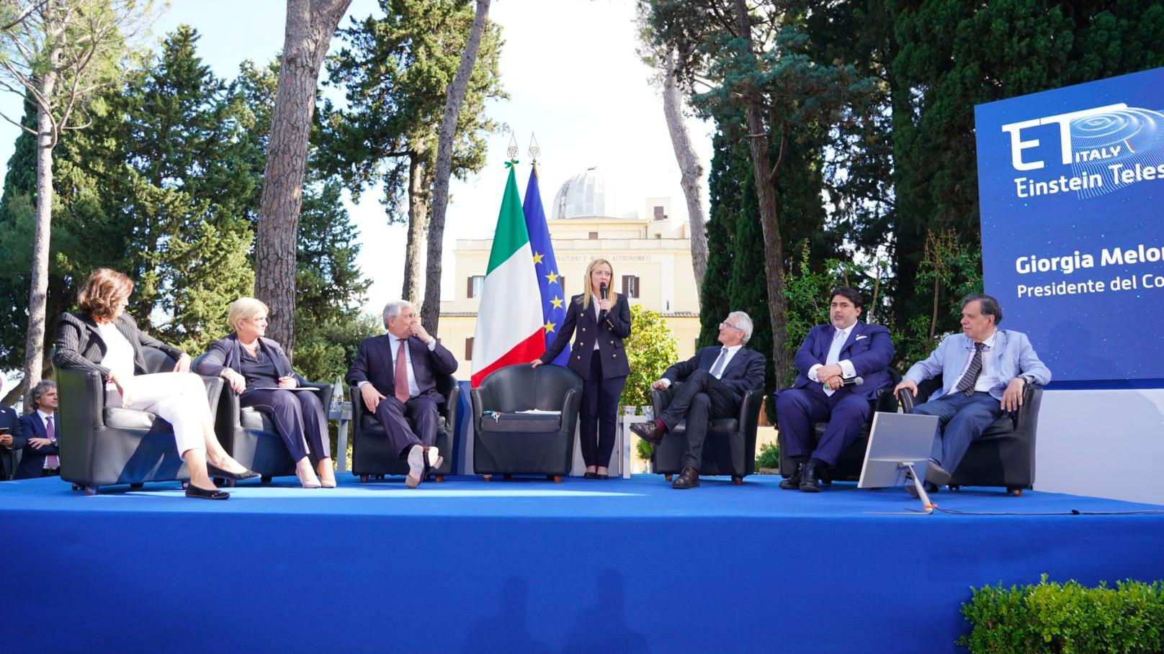
6 June 2023
Official starting point

Slide 3
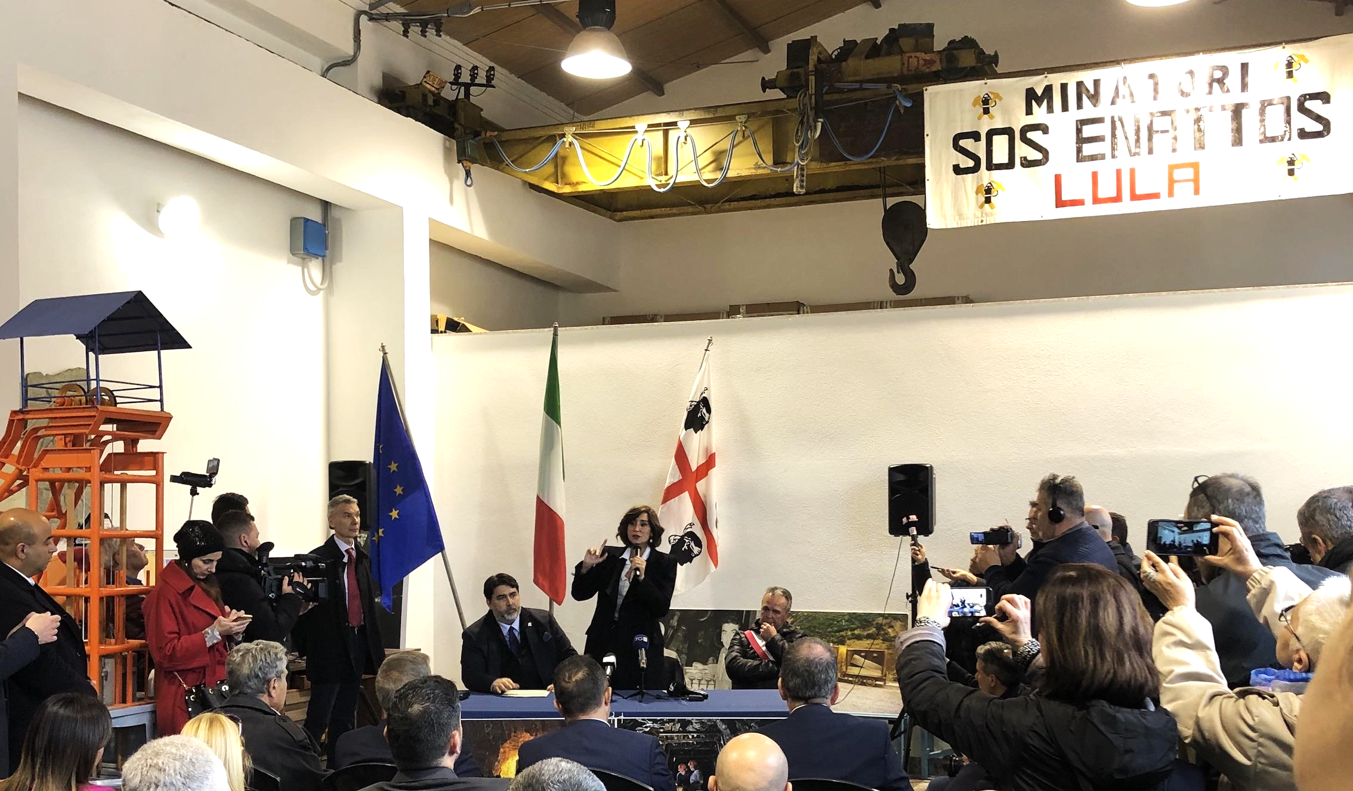
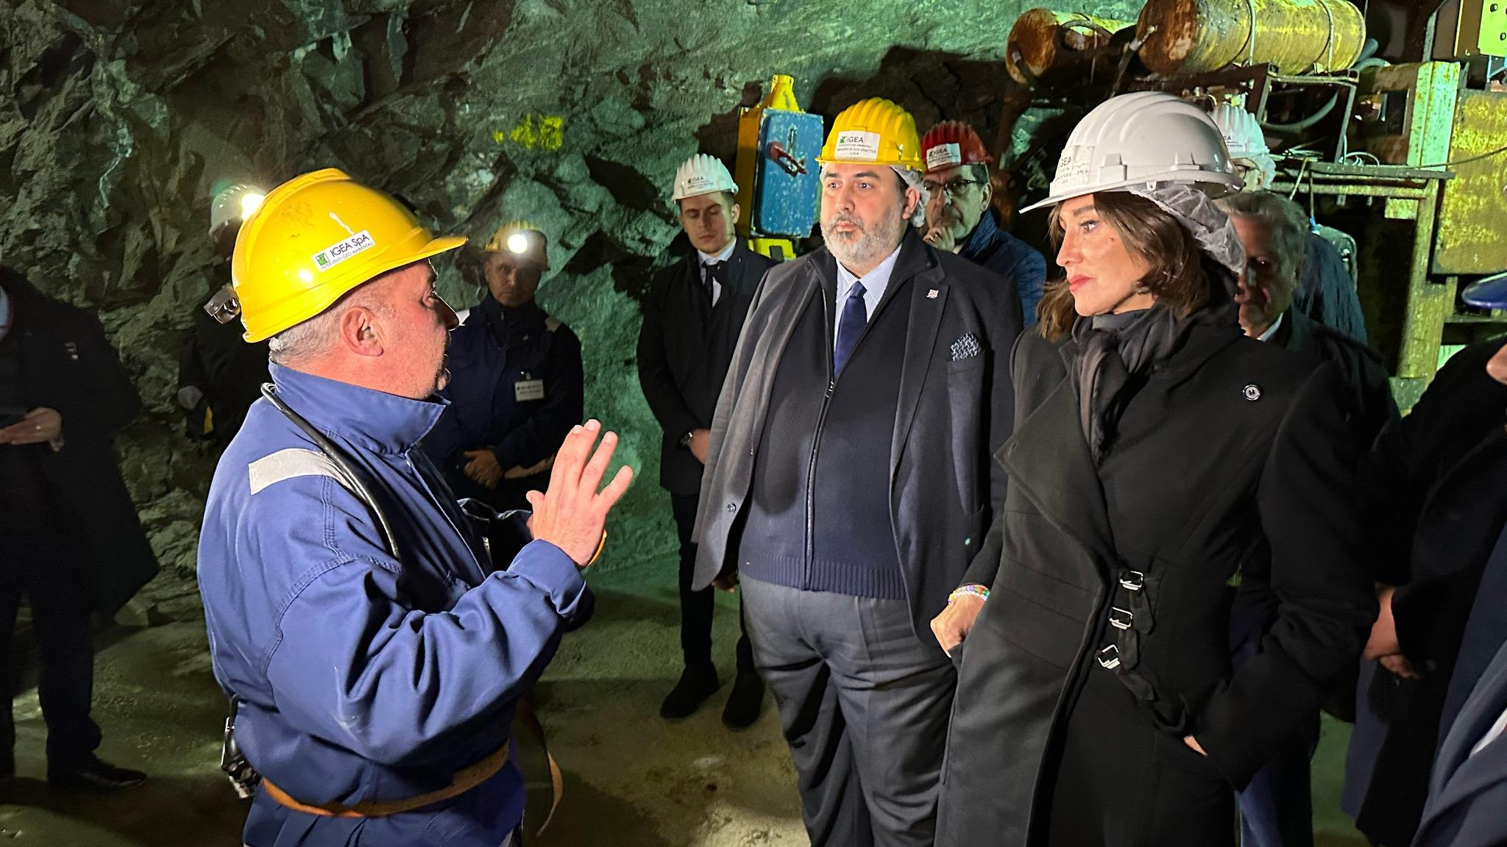
But… the Italian Ministry for University and Research has long supported the Italian candidacy
to host ET
25 april 2023
Minister Anna Maria Bernini
visits Sos Enattos facilities

Slide 4
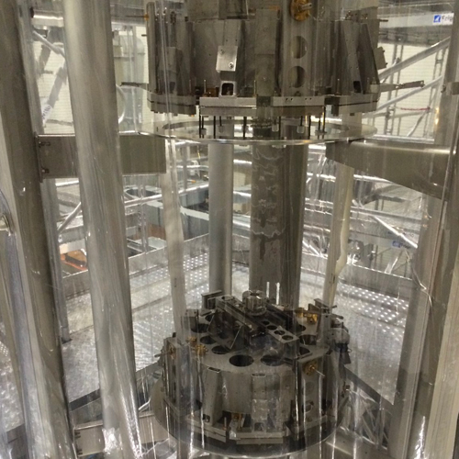
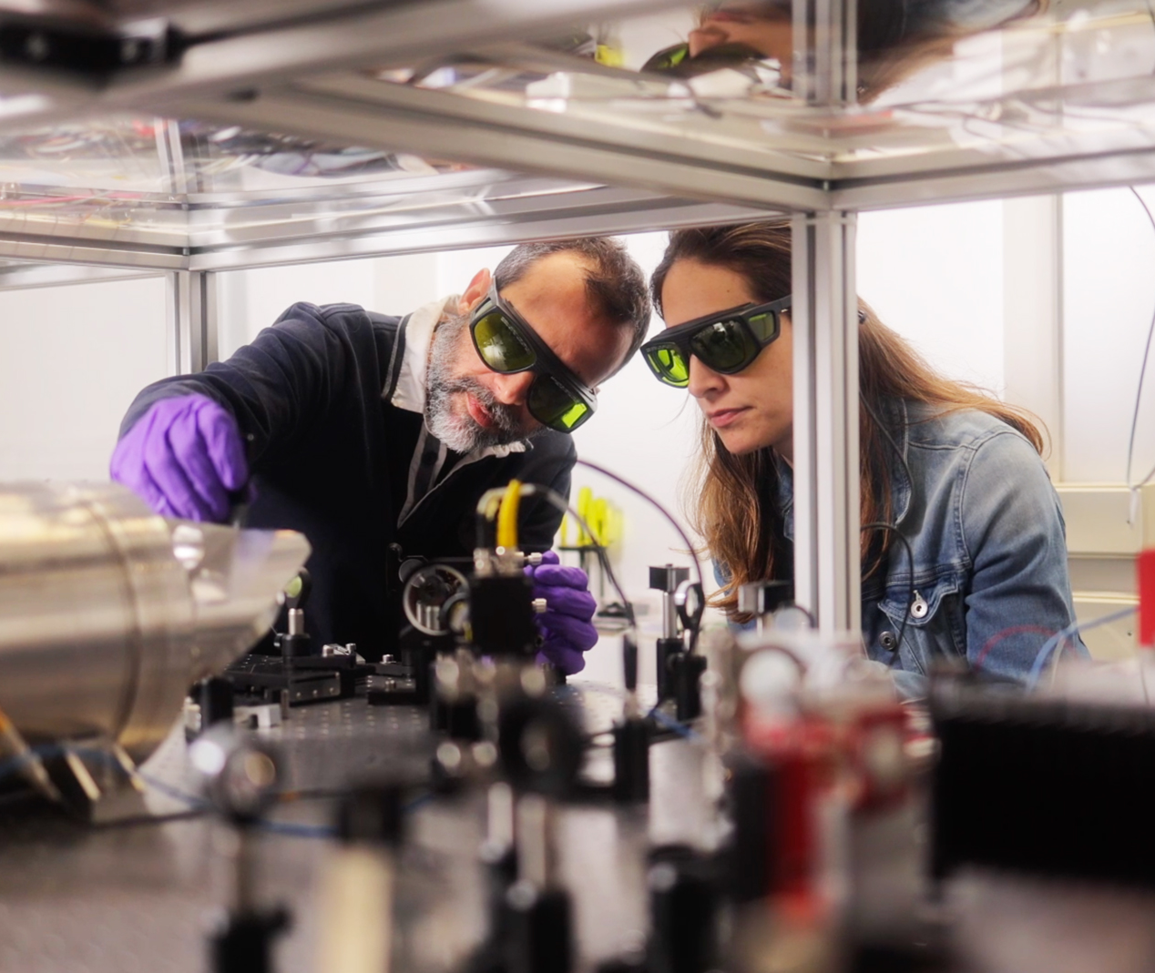
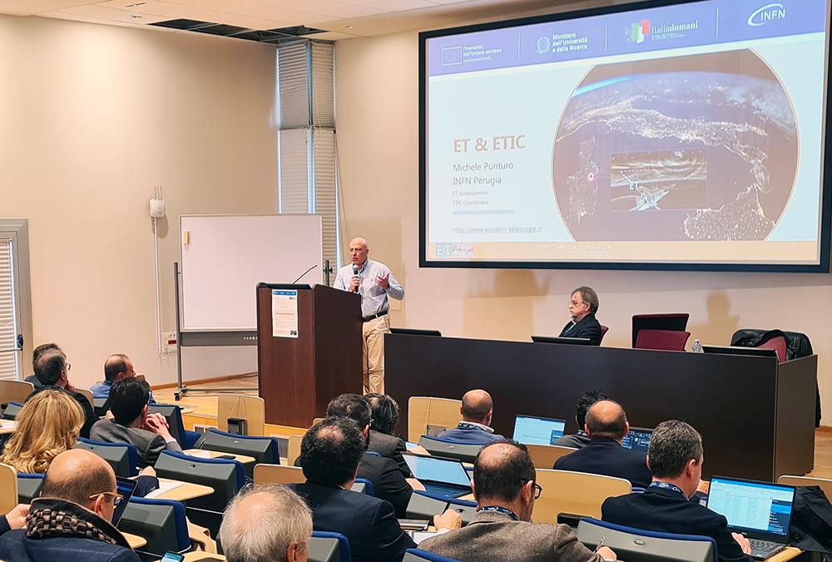
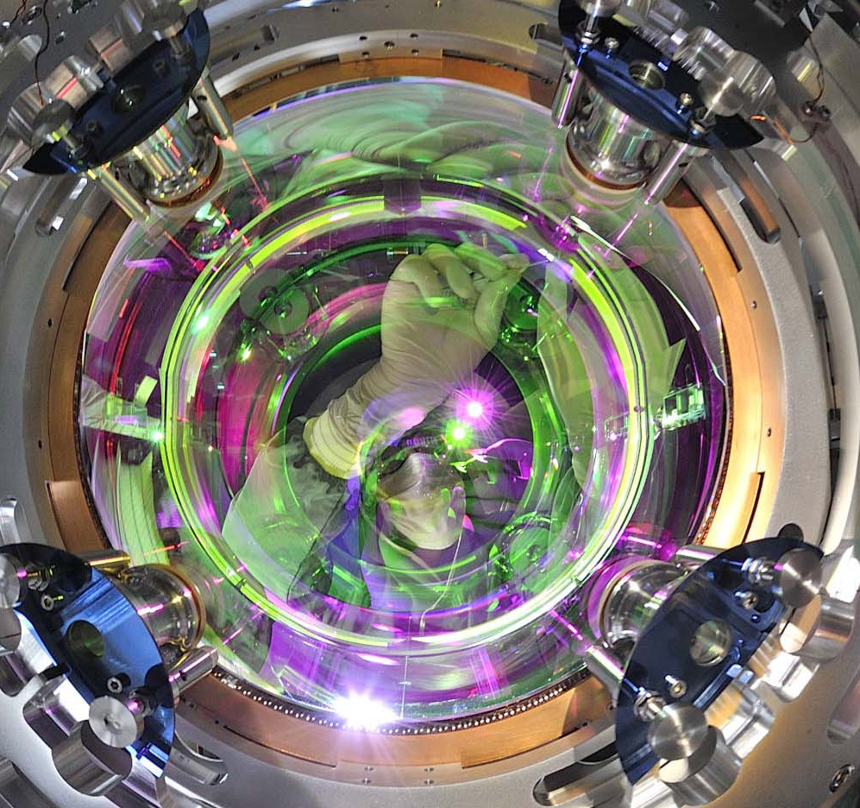
Relationships with companies were also already in place
ETIC Industry Day
16.02.23

Slide 5
Logo ET Italy - Evolution of the preliminary study
Final choice shared with the Minister

Slide 6
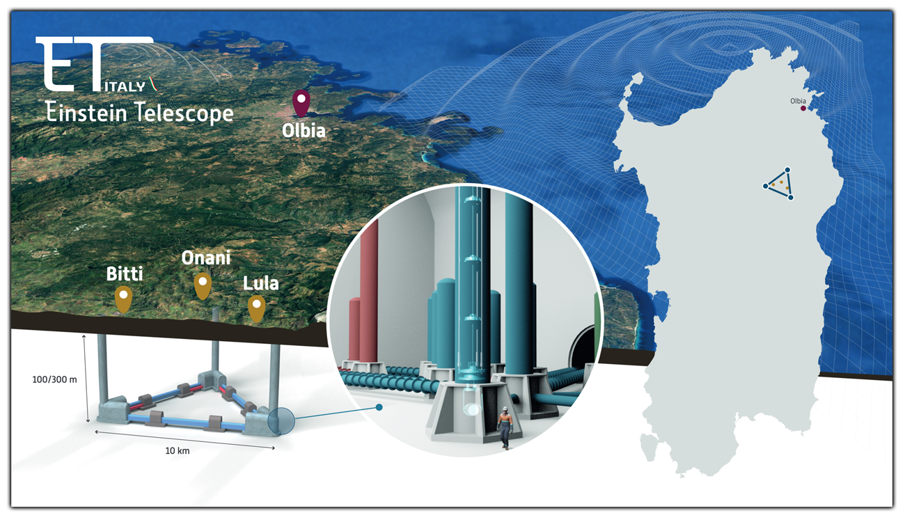
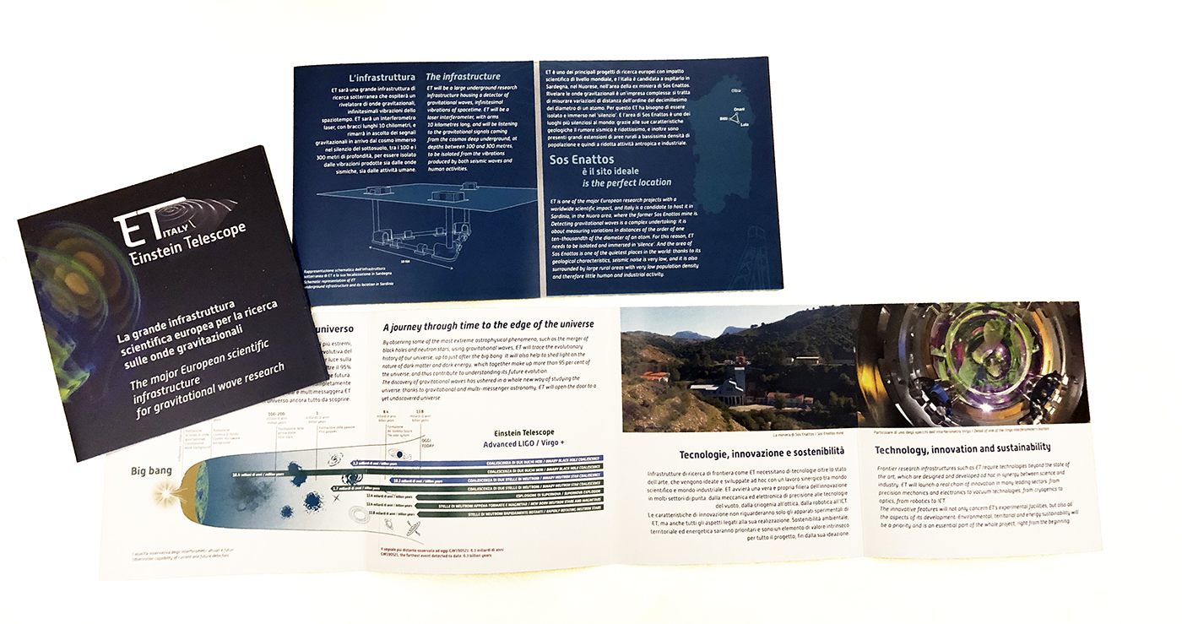
Visual identity

Slide 7
Inter-ministerial collaboration
for ET communication:
INFN, Ministry for University and Research, Ministry of Foreign Affairs, Autonomous Region of Sardinia
Next goal:
a coordinated communication with all Italian research facilities involved in ET

Slide 8
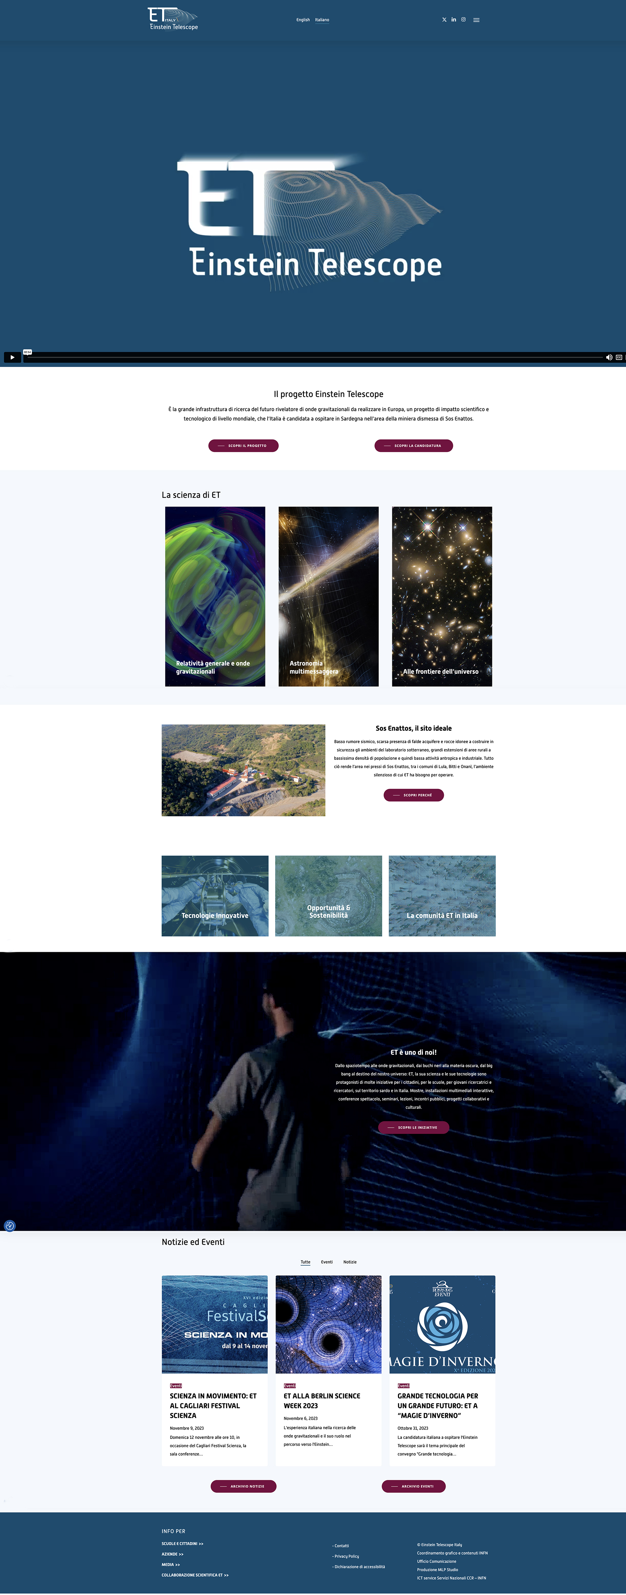
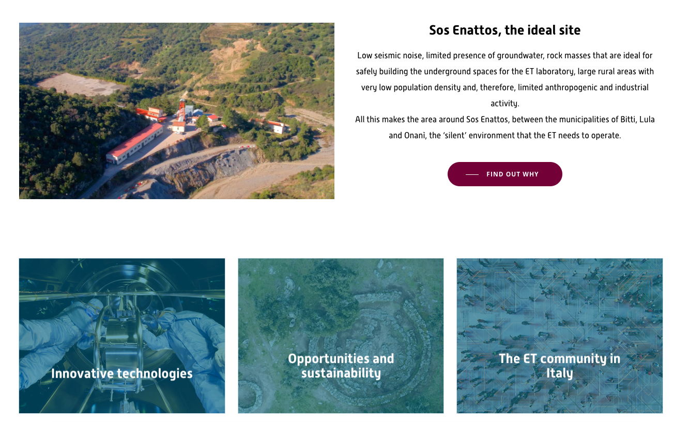
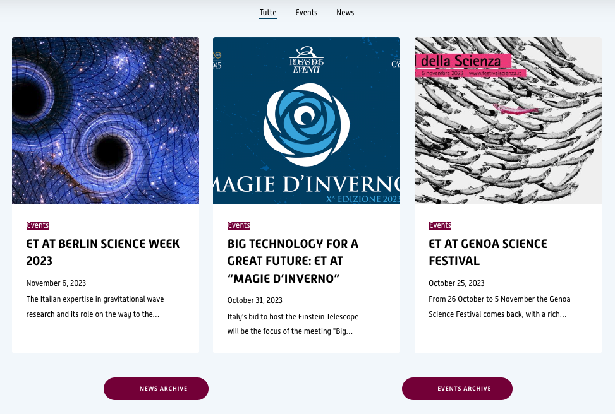
WEBSITE
www.einstein-telescope.it
Video ET-Italy
Sos Enattos
News and events

Slide 9
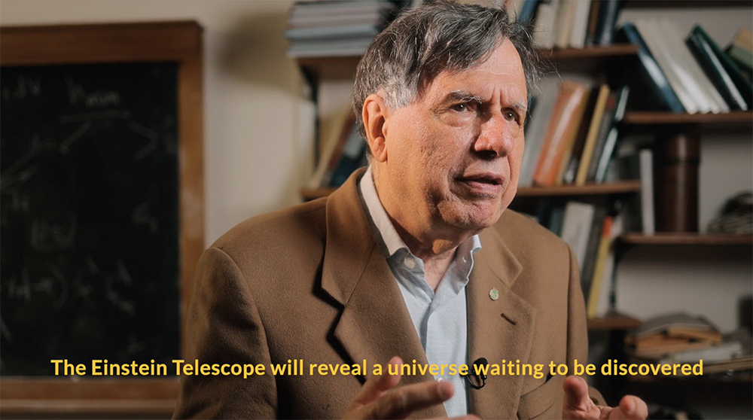
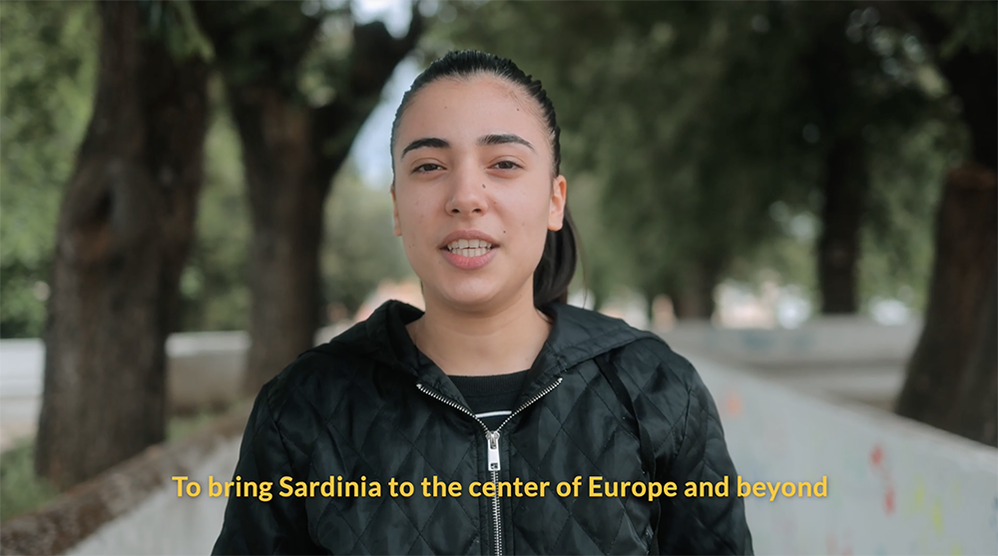
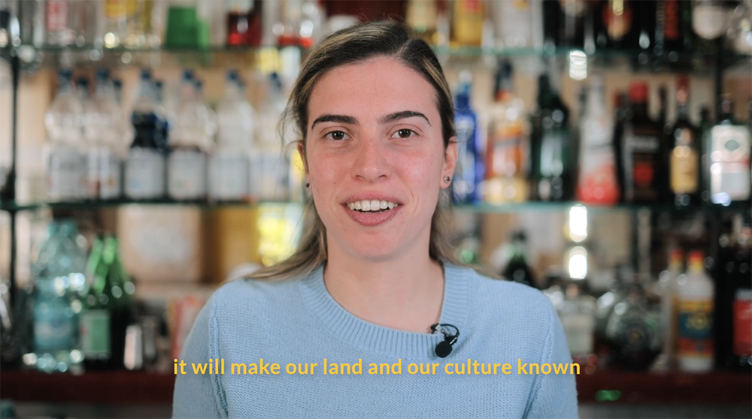
VIDEO
realized with the direct engagement of the Lula local citizens and with Giorgio Parisi, Nobel Prize, president of the scientific committee to promote the ET Italian candidacy

Slide 10
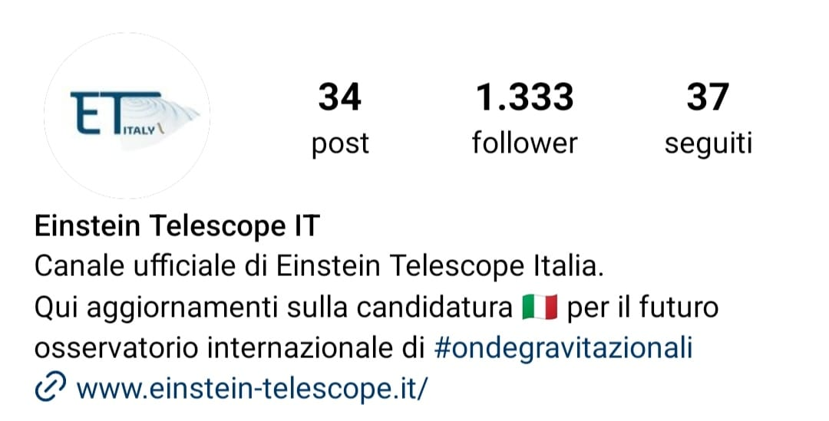
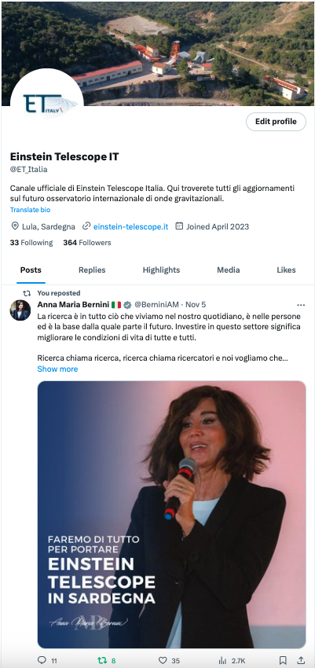
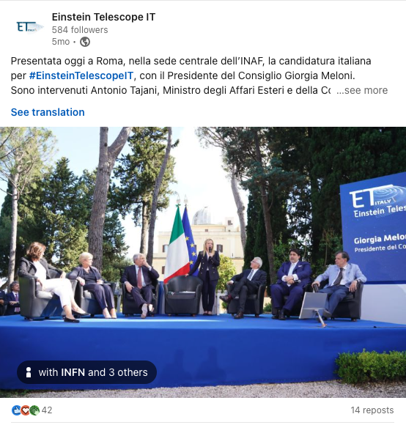
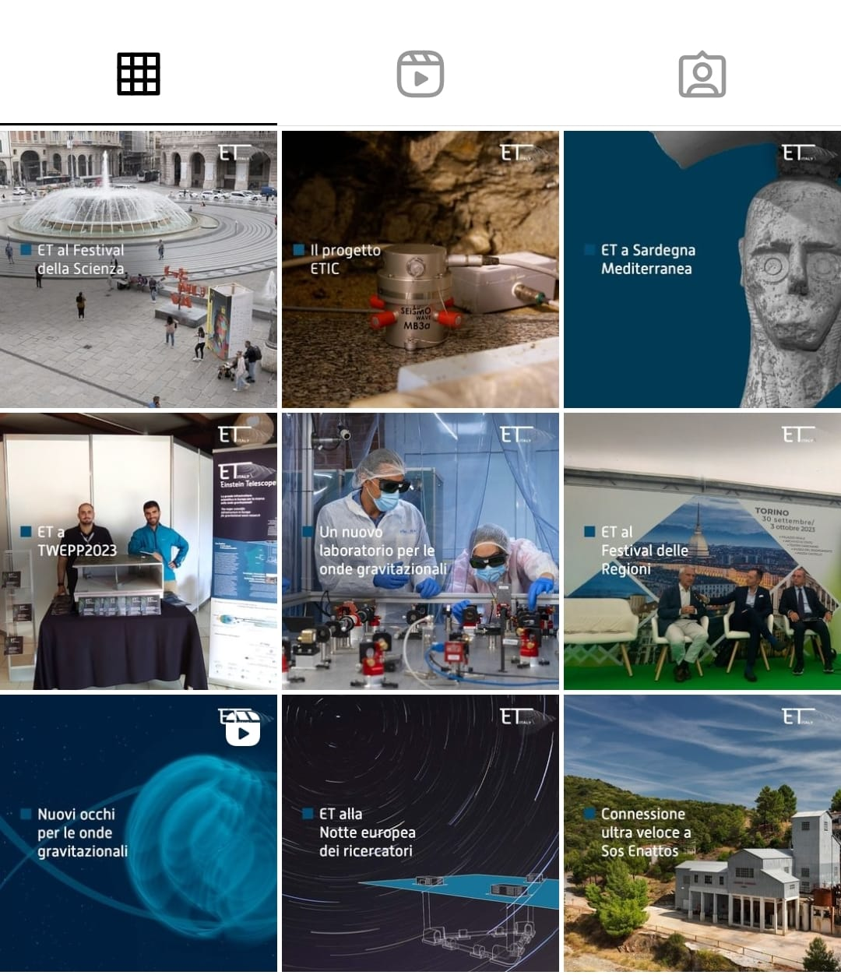
SOCIAL NETWORKS
instagram.com/einsteintelescope_it/
https://twitter.com/ET_Italia
linkedin.com/company/einstein-telescope-it/

Slide 11
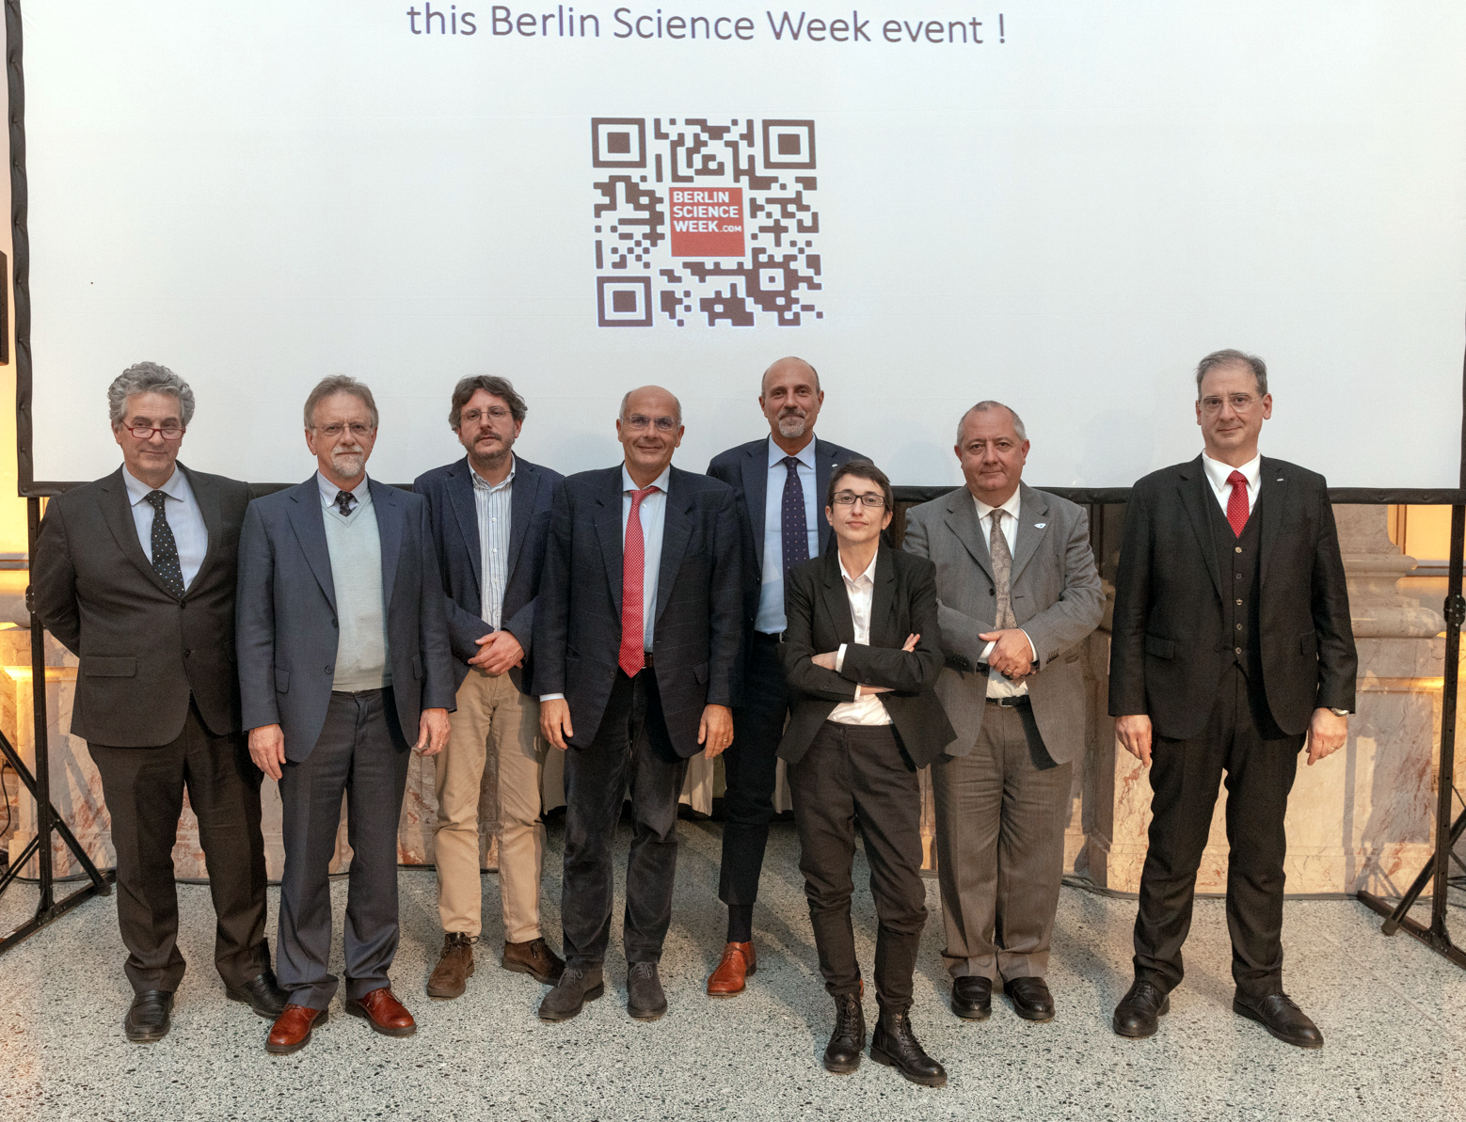
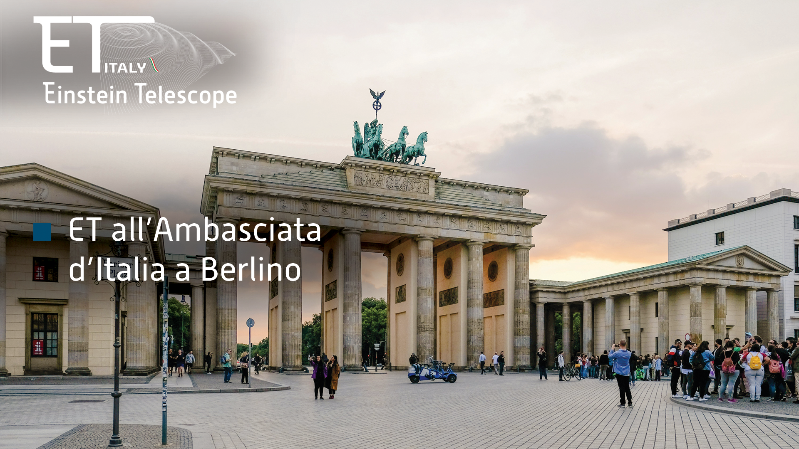
Berlin Science Week
9 November 2023
Embassy of Italy in Berlin
INTERNATIONAL
events

Slide 12
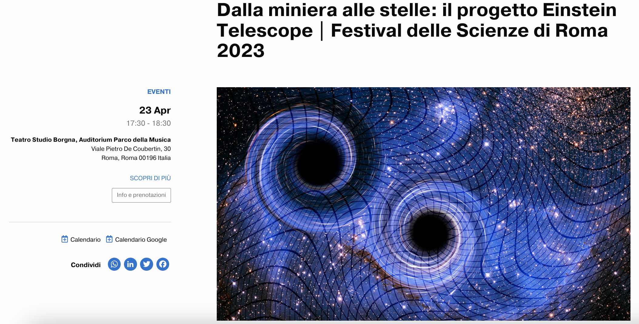
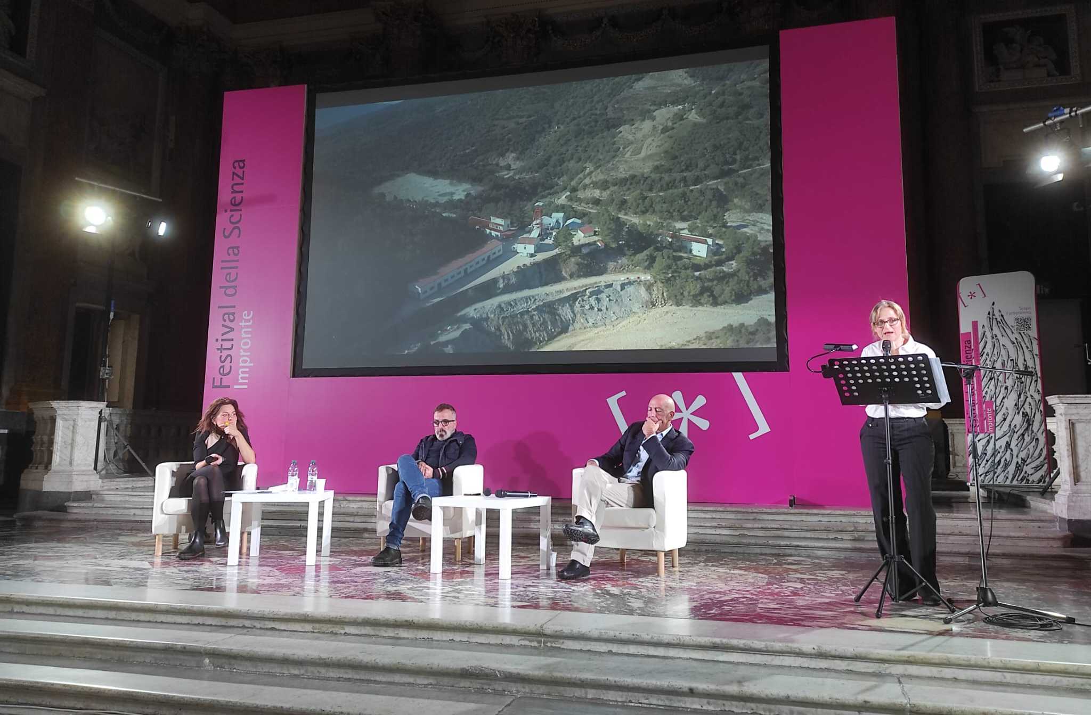
NATIONAL
events

Slide 13
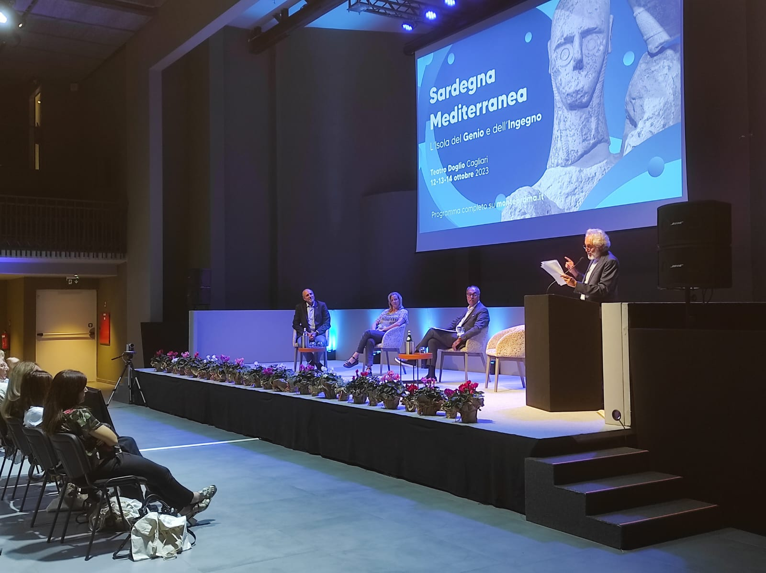
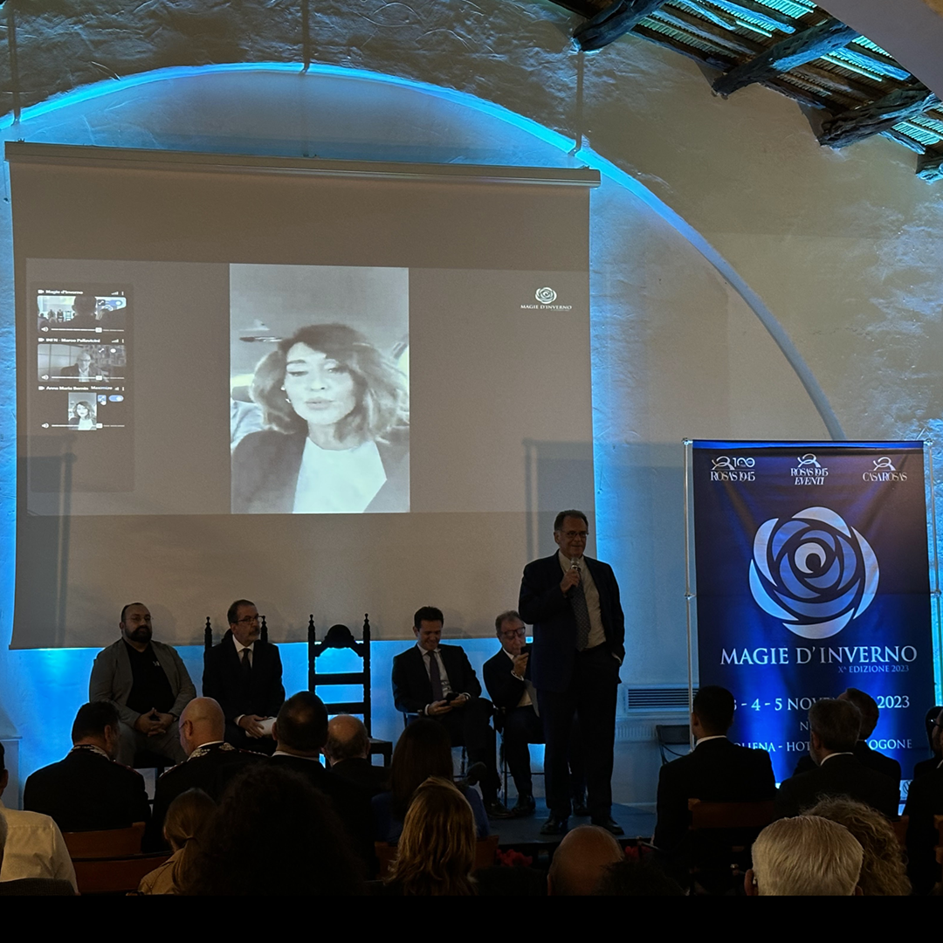
LOCAL
events
in Sardinia

Slide 14
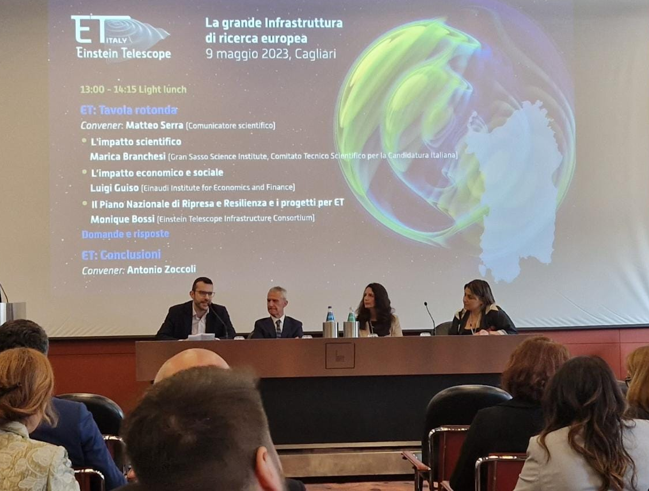
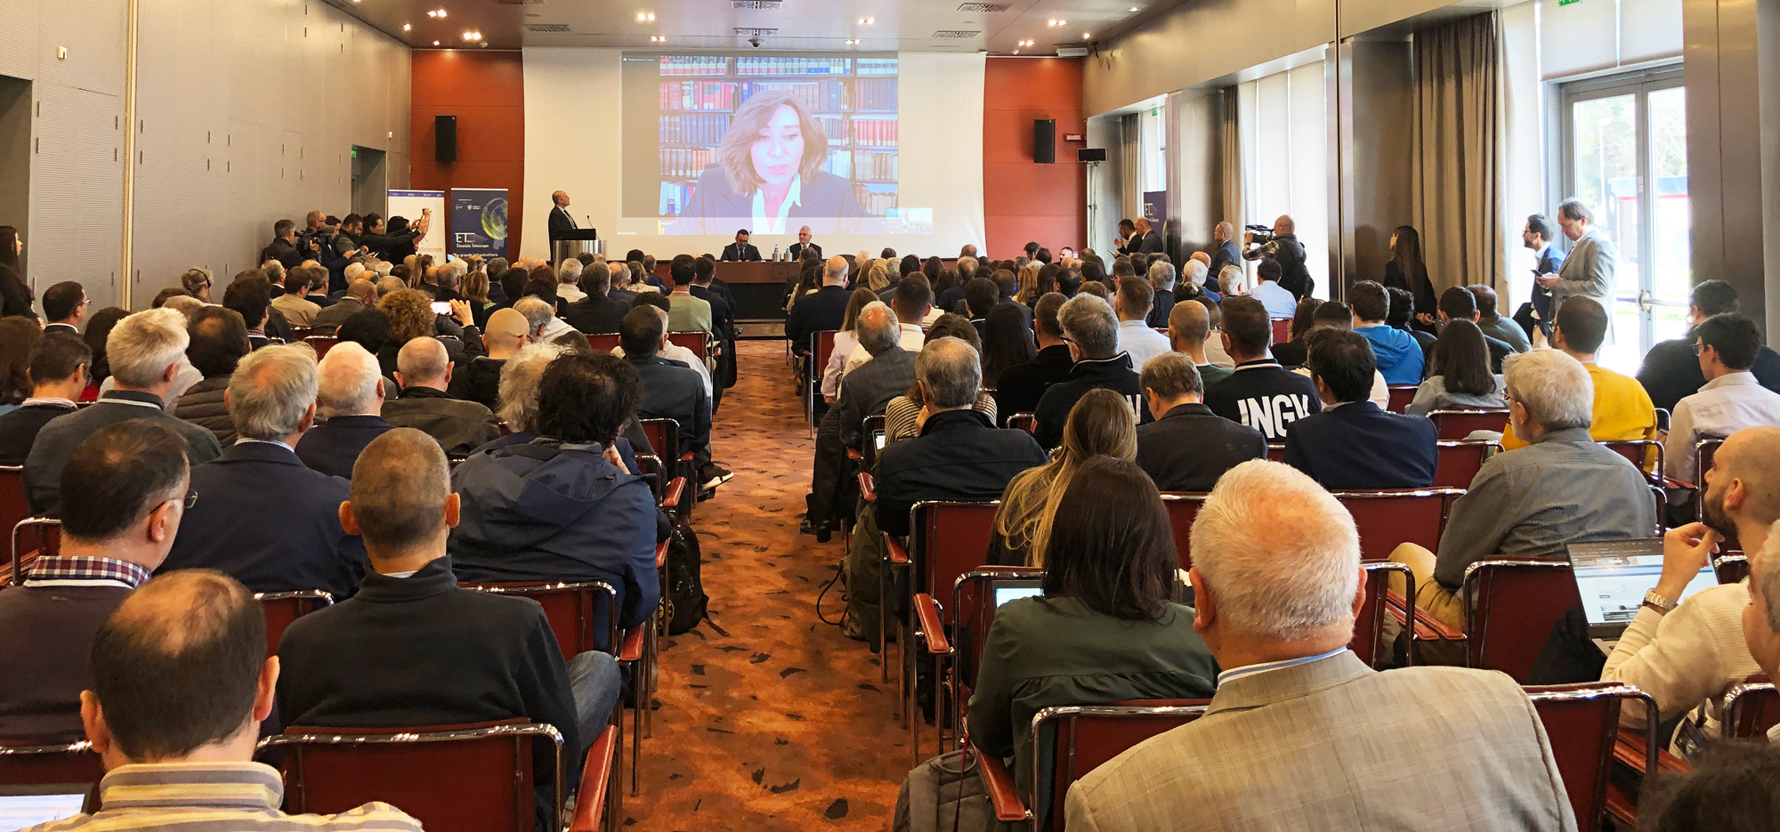
XIII ET SYMPOSIUM
Cagliari - 09.05.23

Slide 15
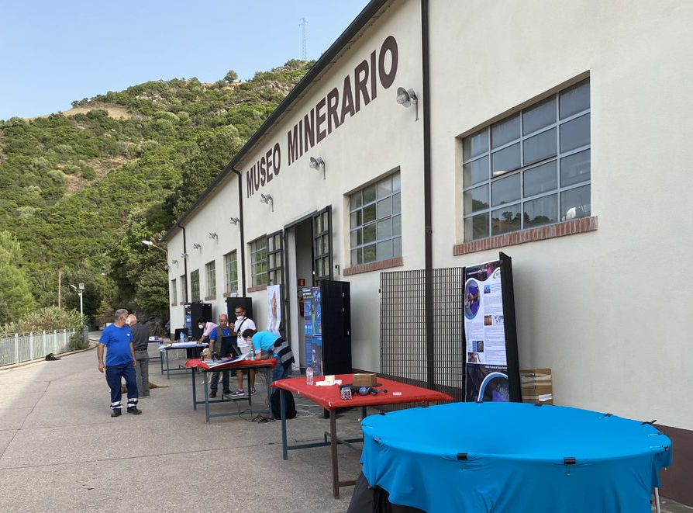
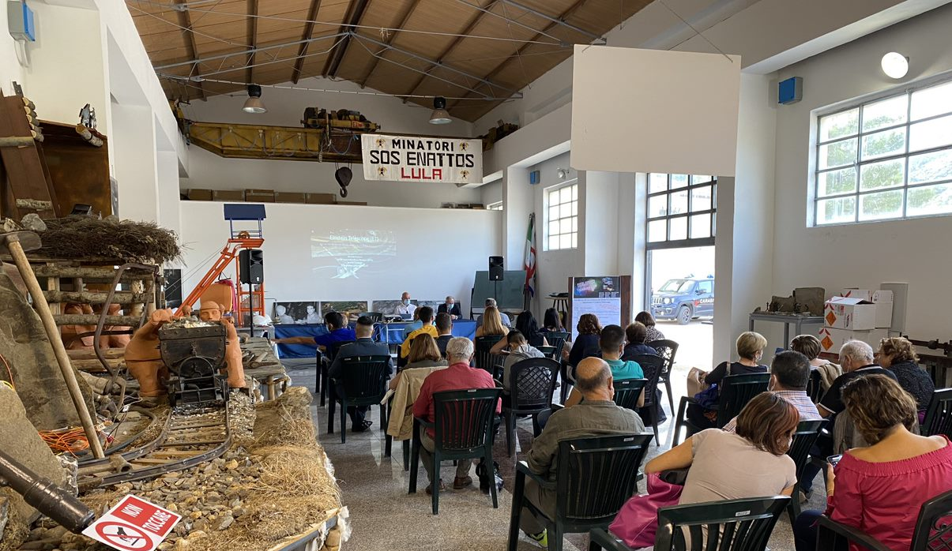
events and activities
NEAR THE SOS ENATTOS MINE

Slide 16
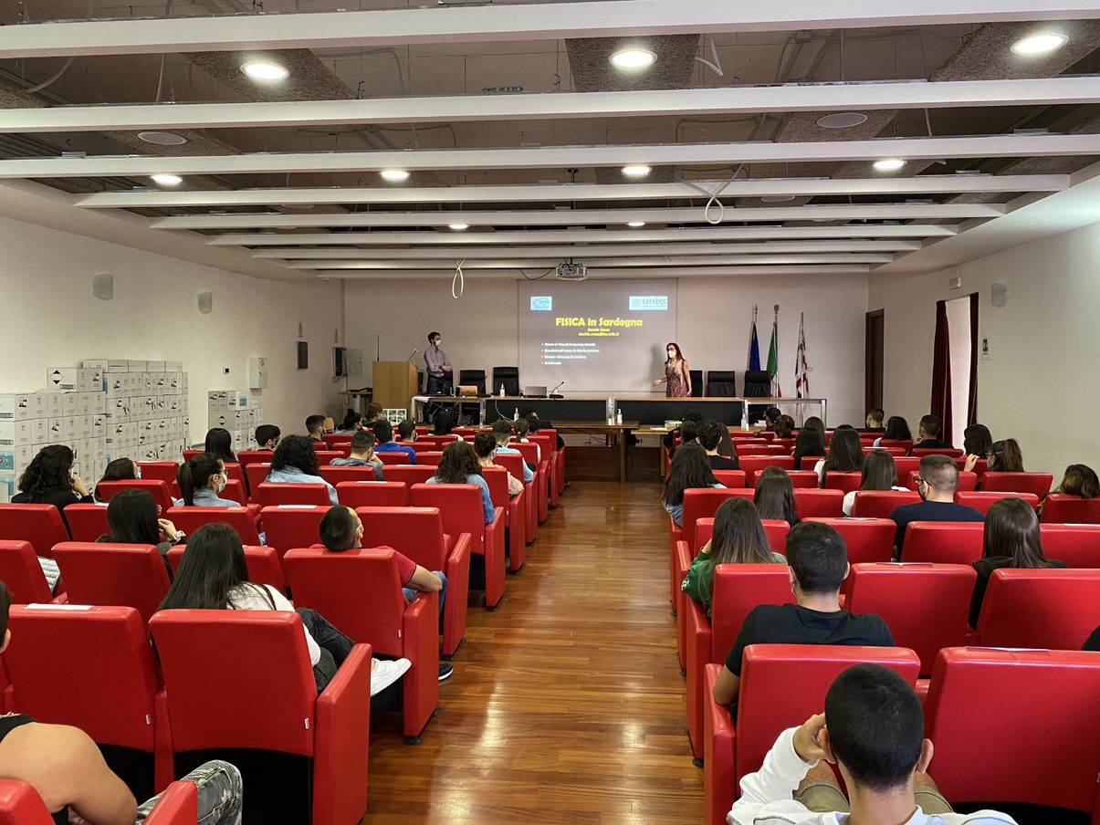
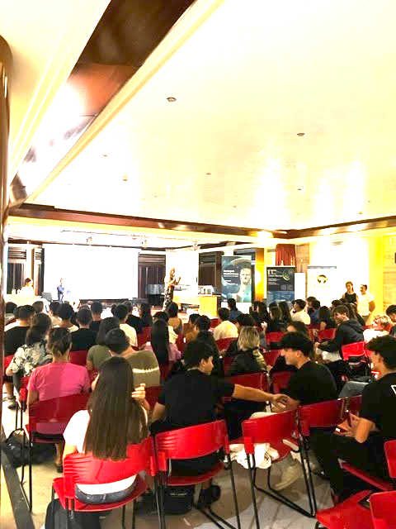
events
WITH SCHOOLS

Slide 17
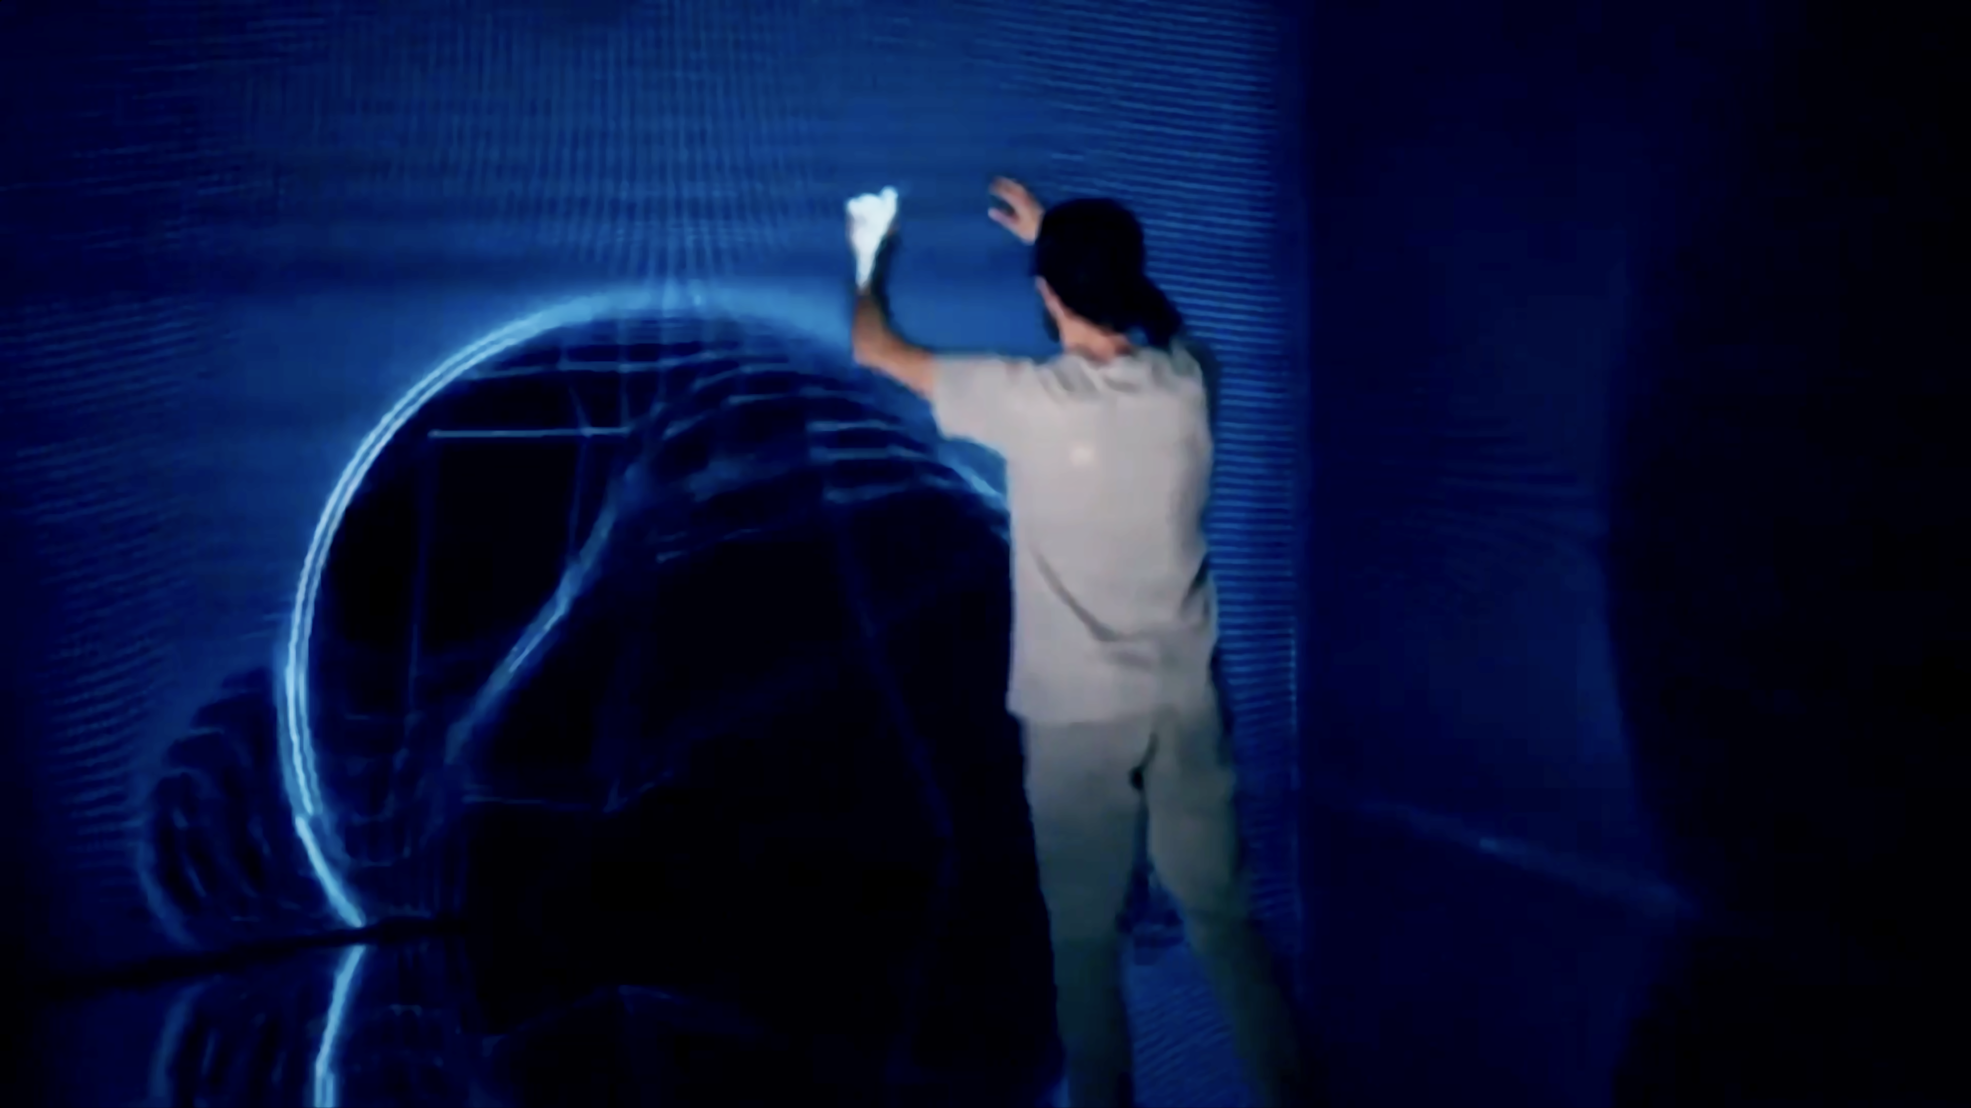
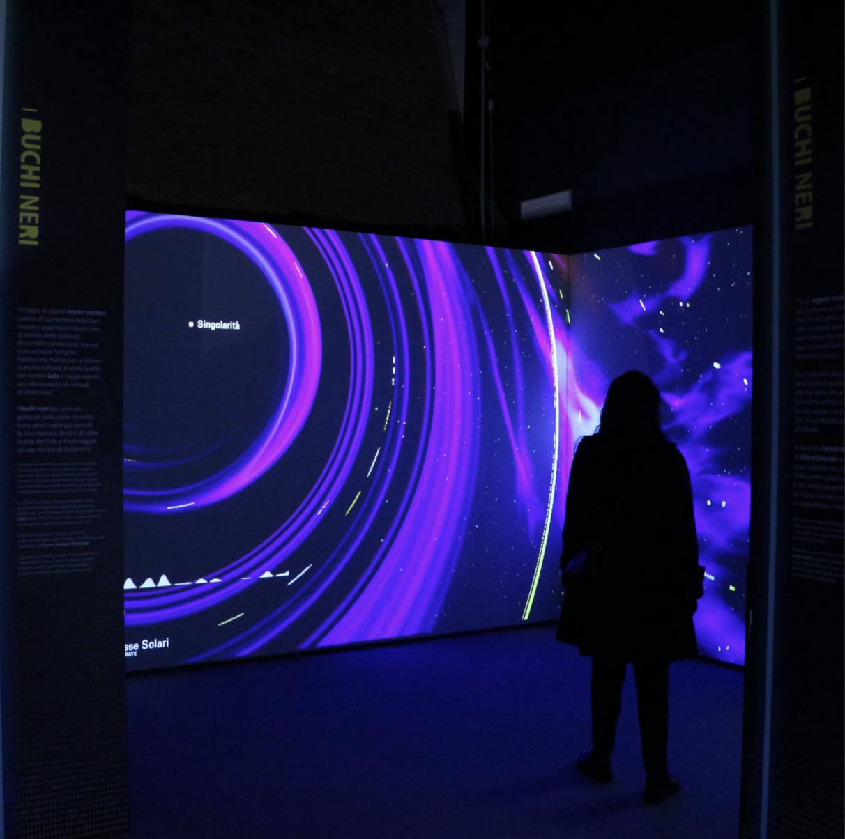
INTERACTIVE EXHIBITS

Slide 18
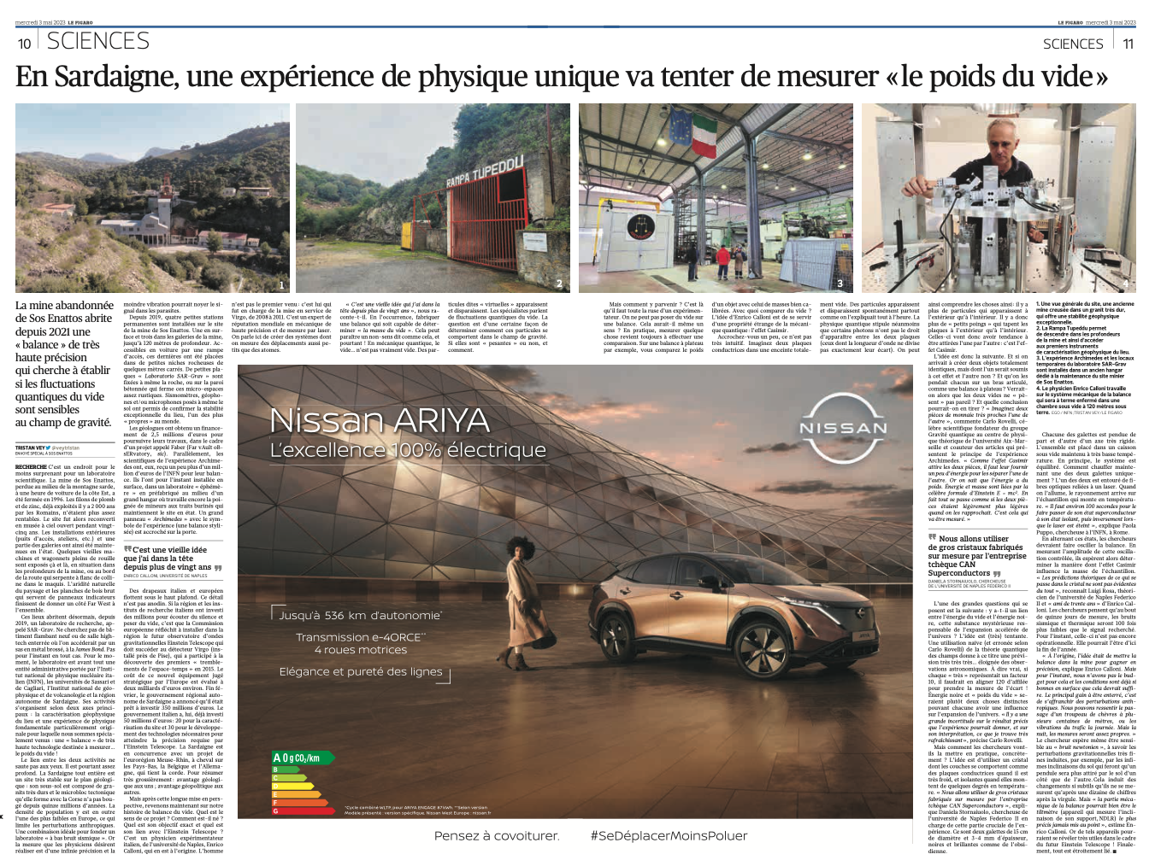
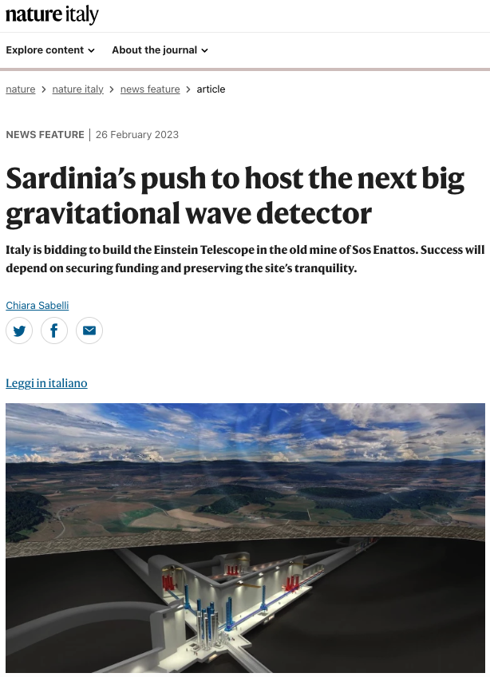
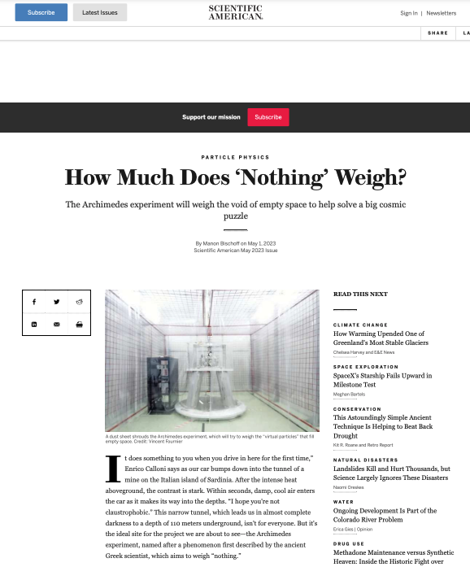
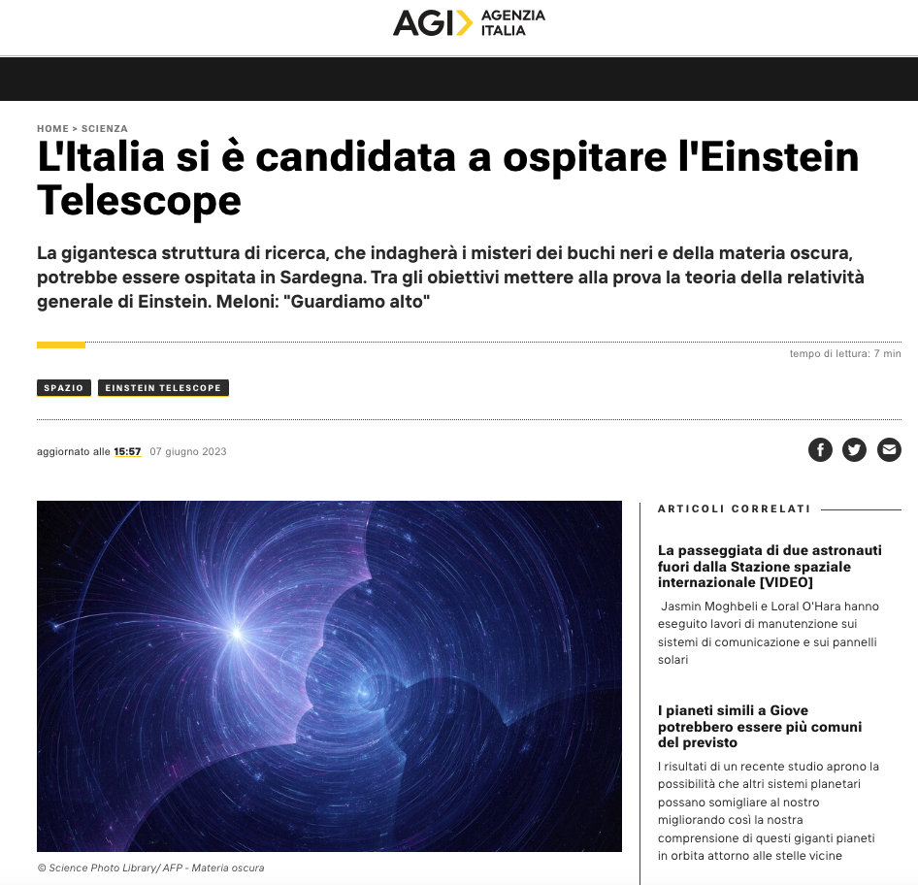
Da una rapida ricerca su ecostampa io ho trovato: 1300 citazioni stampa
38 radio and tv
Prova a verificare anche tu
PRESS COVERAGE
2023 citations:
On the press and web: 1300
On the radio and TV: 38

