Slide 1

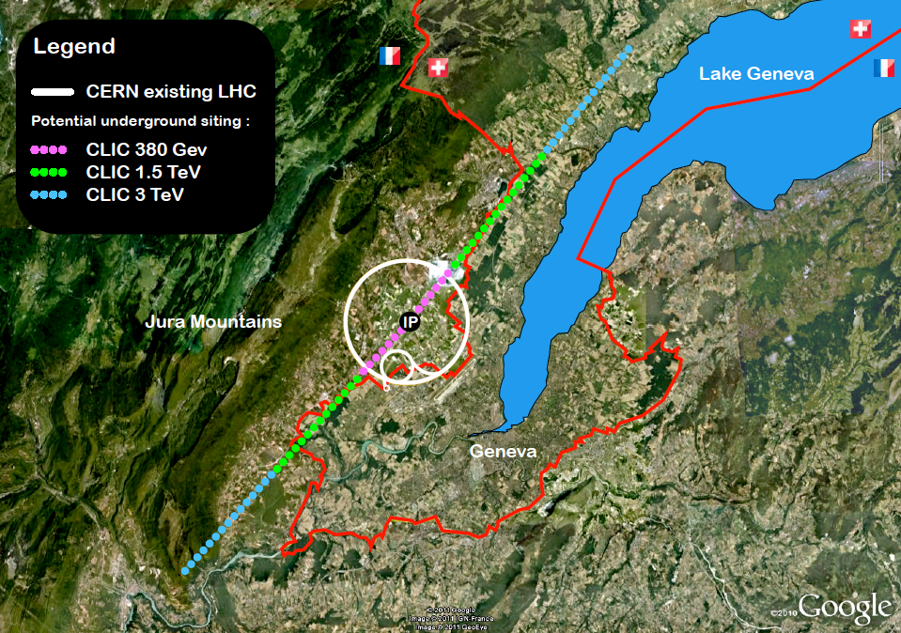


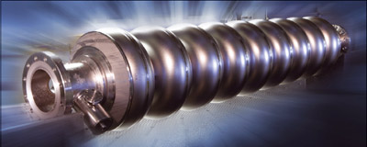
ILC-ITN: System Design of ILC FFS ATF2-3
3
A. Faus-Golfe
Notes:
On behalf of the ATF collaboration

Slide 2
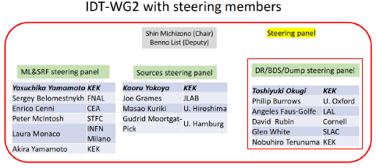
ILC-IDT
Technical preparation
(May 2021)
Time critical WPs
(March 2022)
Notes:
In 2020: ICFA set up International Development Team (IDT) ‘towards … timely realisation of ILC’
1 + 4-year ‘Pre-lab’ to finalise technical prototypes, prepare Engineering Design Report, secure cooperation among funding agencies, and prepare for construction start
Members of ILC_IDT WG2
A detailed and comprehensive R&D plan has been made by the ILC-IDT WG2 dedicated to the accelerators. Different areas are considered for focused R&D in the 4 years of the pre-lab and all the details will be found in the white paper. ATF2 activities are part of the WP15: ILC Final Focus.
The MEXT make a review in 2021-2022, recognize the importance of the Higgs Physics but found premature the Ilc pre-lab.
The ILC-IDT appointed a steering panel to identify ‘time-critical’ work packages (~ years 1-2 of Pre-lab) and is exploring collaboration among KEK and international partners should significant additional funds appear at KEK in JFY2023.

Slide 3
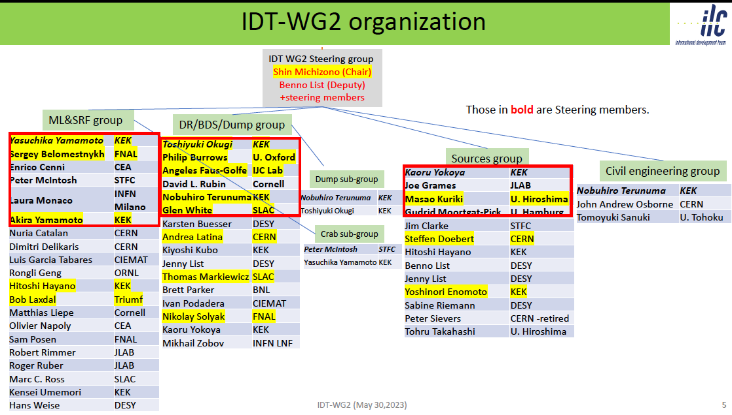
ILC-IDT

Slide 4
The European ITN activities – end May 2023
European presentation of ILC studies, distributed on five main activity areas
A1 with three SC RF related tasks
SRF: Cavities, Module – CEA/INFN/KEK: materials and single cell cavities
Crab-cavities – UK/CERN: programme after down-select to be discussed
A2 Sources
Pulsed magnet to production drawing level - Univ. Hamburg, DESY
Wheel/target: need to discuss more widely scope and plans (Europe and US)
A3 Damping Ring including kickers
Low Emittance Ring community – not yet addressed
A4 ATF activities for final focus and nanobeams
Many European groups active in ATF – UK, France, Spain, DESY, CERN, Friday operation meetings restarted.
A5 Implementation including Project Office
Dump, CE, Cryo, Sustainability, MDI, others (many of these are continuations of on-going collaborative activities) – Spain/KEK: ML quads and cold BPMs (own funding), EAJADE started (EU funding), sustainability studies also(e.g. ARUP) (CERN LC funding), etc
Personnel with interest and skills in European labs/Univ., local infrastructure. See left.
Material funds as estimated (major/core part from KEK), in some cases complemented by local funding. Agreement in final draft, KEK board discussion Friday.
EAJADE, MC exchange project supporting Higgs factory personnel exchange to Japan and the US. Kick off 1.3.2023.
CERN LC, project office (within existing LC resources at CERN) LC budget line in MTP until end 2028.
EAJADE: Information at LINK
Notes:
Shorten text on left ?

Slide 5
ILC – IDT WP15 System Design of ILC FFS
Time critical WPs relevant for ATF
WP15 Tasks : Maximize Luminosity potential of ILC
T1: ILC-FFS system design | T1.1: Hardware optimization
 | T1.2: Realistic beam line driven / IP design
T2: ILC-FFS beam tests | T2.1: Long-Term stability
 | T2.2: High-order aberrations
 | T2.3: R&D complementary studies
Long Term stability
High-order aberrations
Instrumentation R&D
Collimator
Incoherent Diffraction Cherenkov Radiation Monitor
Ultra-low β* studies
Intensity dependence studies
Energy bandwidth
Waveguide BPM
Notes:
More in detail for WP15:
The main objective of the ATF3 is to maximize the luminosity potential of ILC.
Two task has been identified:
- The system design of beam optics and hardware for the ILC FFS based on established technologies
- The necessary beam experiments to solve the long term stability operation issues, the deep understanding of the high-order aberration's and the R&D on complementary studies as beam instrumentation or other as collimation, kicker technologies....

Slide 6
ATF3 objectives and collaboration:
Based on the achievements of the ATF2 no showstopper for ILC has been found, ATF3 plan is to pursue the necessary R&D to maximize the luminosity potential of ILC. In particular the assessment of the ILC FFS system design from the point of view of the beam dynamics aspects and the technological/hardware choices and the long-term stability operation issues.
3
Long Term stability
Instrumentation R&D
High-order aberrations
Collimator
Incoherent Diffraction Cherenkov Radiation Monitor
Ultra-low β* studies
Intensity dependence studies
Energy bandwidth
Waveguide BPM
Notes:
Based on this achievements and with the support of the KEK DG we have started to plan the next operation years of ATF2 and the future ATF3.
The main objective of the ATF3 is to deep in the understanding of the luminosity optimization of the ILC.
In particular the system design and hardware and the long term stability operation issues.

Slide 7
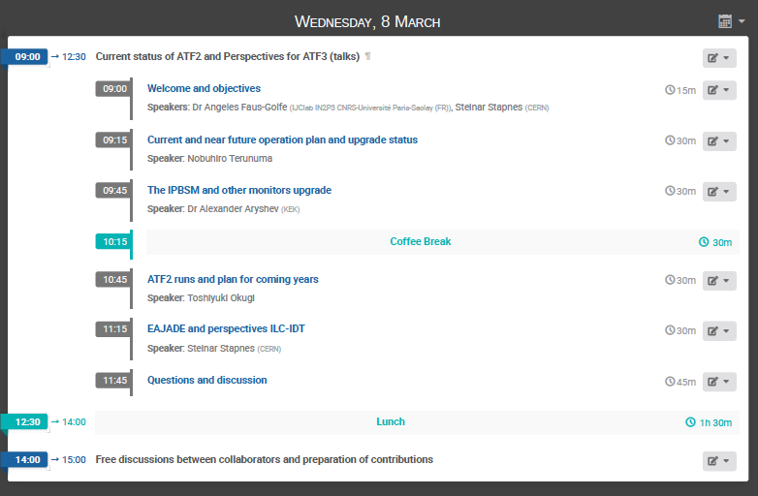
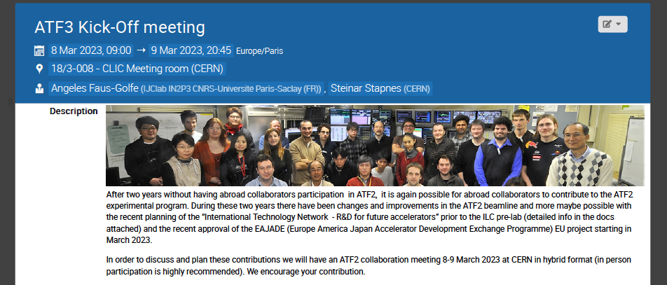
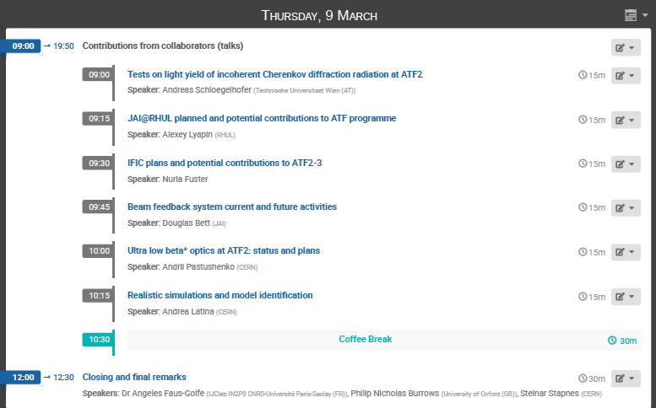
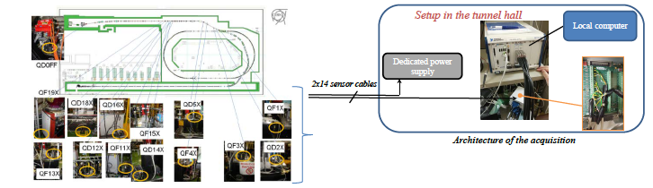

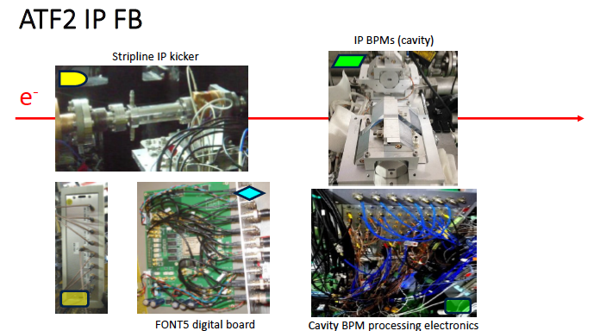
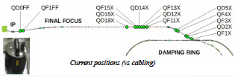
ATF3 Kick-Off meeting
https://indico.cern.ch/event/1259176/
Vibrations long-term monitoring

Slide 8


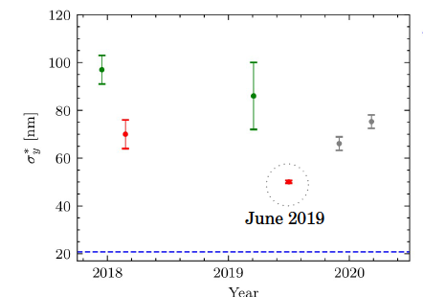
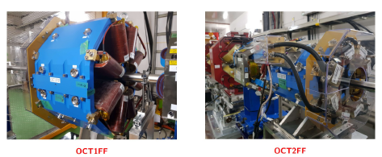

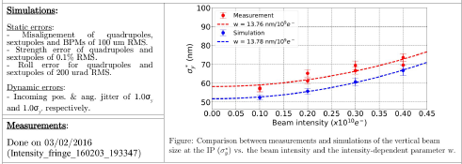
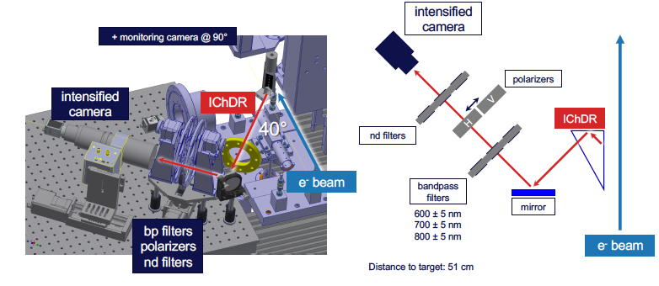
ATF3 overseas collaborations contributions
Ultra low-β beam tuning
Octupoles studies
Most of collaborators are willing to participate starting in June 2023. The ideal will be to arrive the week before in to check/familiarize with the ATF2 current situation.
Beam dynamics: CERN team will be interested not in specific beam time in June 2023 but just familiarize with the current ATF3.
Ultra-low studies (long L*...)
Optics optimization and simulation (wakefield mitigation)
Beam time in Nov-December 2023
Beam Instrumentation: ChDR checks and will be interested in some beam time starting in June 2023
WFS studies
Incoherent ChDR

Slide 9

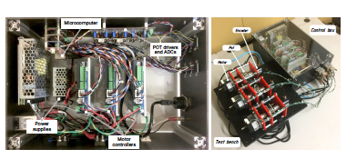
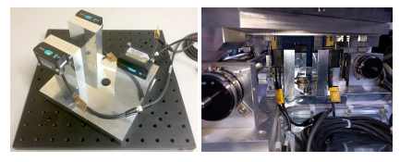
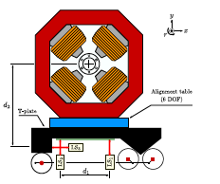
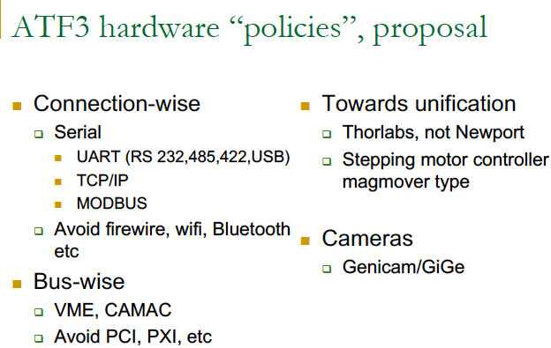
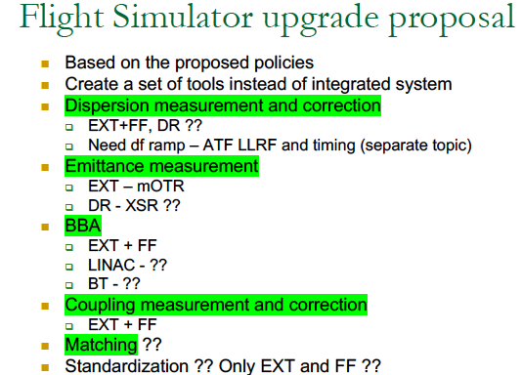

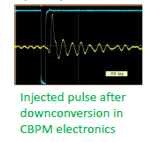

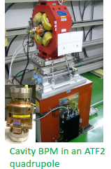
ATF3 overseas collaborations contributions
Database lattices with all the ATF2-3 upgrades
Task force in “magnet movers”: dedicated meetings will be organized to discuss the proposed upgrades (A. Aryshev, K. Kruchinin, S. Mazzoni, A. Schloegelhofer, L. Brunetti, P. Karataev, A. Lyapin)
Task force for “software new Flight simulator”: dedicated meetings will be organized to discuss the proposed upgrades. Agreed in one first tool and first implementation. (A. Aryshev, K. Kruchinin, A. Latina, P. Korysko, A. Aksoy, A. Pastushenko, R. Tomas, E. Manosperti, ).
Task force in “cavity BPMs”: dedicated meetings will be organized to discuss the proposed upgrades (A. Aryshev, K. Kruchinin, K. Popov, A. Lyapin, N. Fuster)
New control hardware design
New calibration bracket
CBPMs electronic upgrade
Cold CBPMs for ILC main linac
Notes:
Task forces ha been initiated.

Slide 10

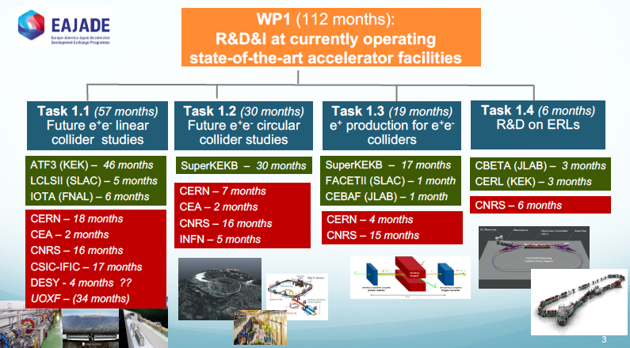
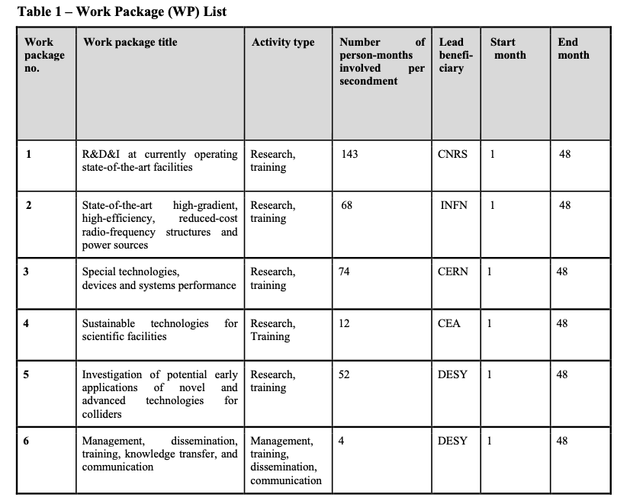
ATF3 in EAJADE project
EAJADE (Europe–America–Japan Accelerator Development and Exchange programme) focused in Higgs Factories, with participation of major EU (CERN, INFN, CEA, DESY, CNRS, CSIC, UOXF), Japan (KEK, Tokyo Univ., Tohoku Univ.) USA (BNL, FNAL, SLAC, JLAB, LBNL, Cornell Univ.) and Canada (VISPA) labs. (2023-2027)
Notes:
EAJADE (Europe–America–Japan Accelerator Development and Exchange programme) is a training, education and staff exchange network in the field of accelerator research for high-energy elementary particle physics (HEP).
The key technical challenges for the future Higgs factories are many but the most important addressed in EAJADE are, all with important training, skill development and knowledge exchange elements:
● Luminosity performance, hardware and method developments related to this, being addressed in smaller beam facilities, prototypes and laboratory tests (addressed in work packages 1,2 and 3 covering method studies and hardware evaluations in beam tests, development and tests of radio-frequency (RF) systems and special devices that are critical for nanobeam creation, conservation and diagnostics).
● Upgrading to higher energies and accelerating gradients (addressed in work packages 2 and 5 covering RF developments and plasma acceleration studies).
● Power efficiency and sustainability, importantly connected to RF (addressed in work packages 2 and 4 covering RF efficiency improvements and power/energy reductions and recovery, and sustainable facilities in a wider perspective).
● Best practices, international collaboration, exchange of ideas and collaborative studies across Higgs factory proposals, training related to prototyping and tests in facilities and laboratory setup (all work packages).
For all the on-going R&D activities, and for the Higgs factory studies and potential later implementation, training of future accelerator experts will be crucial. These projects are very long term and today it is important to train the future scientists and engineers who will implement them. The training, networking and interdisciplinary focus of EAJADE create an ideal and very international career development environment for these future experts and leaders in the field. Providing such an environment is therefore the overarching goal of EAJADE.

Slide 11
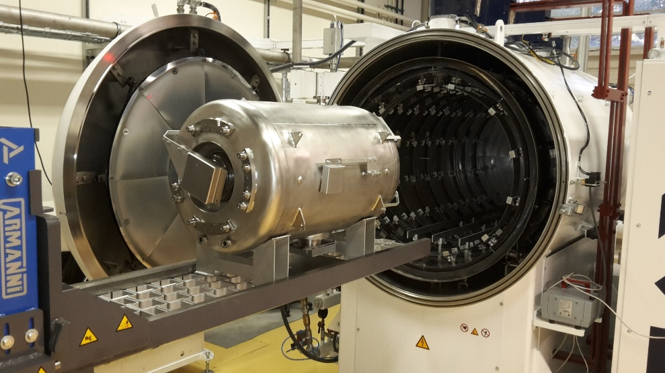
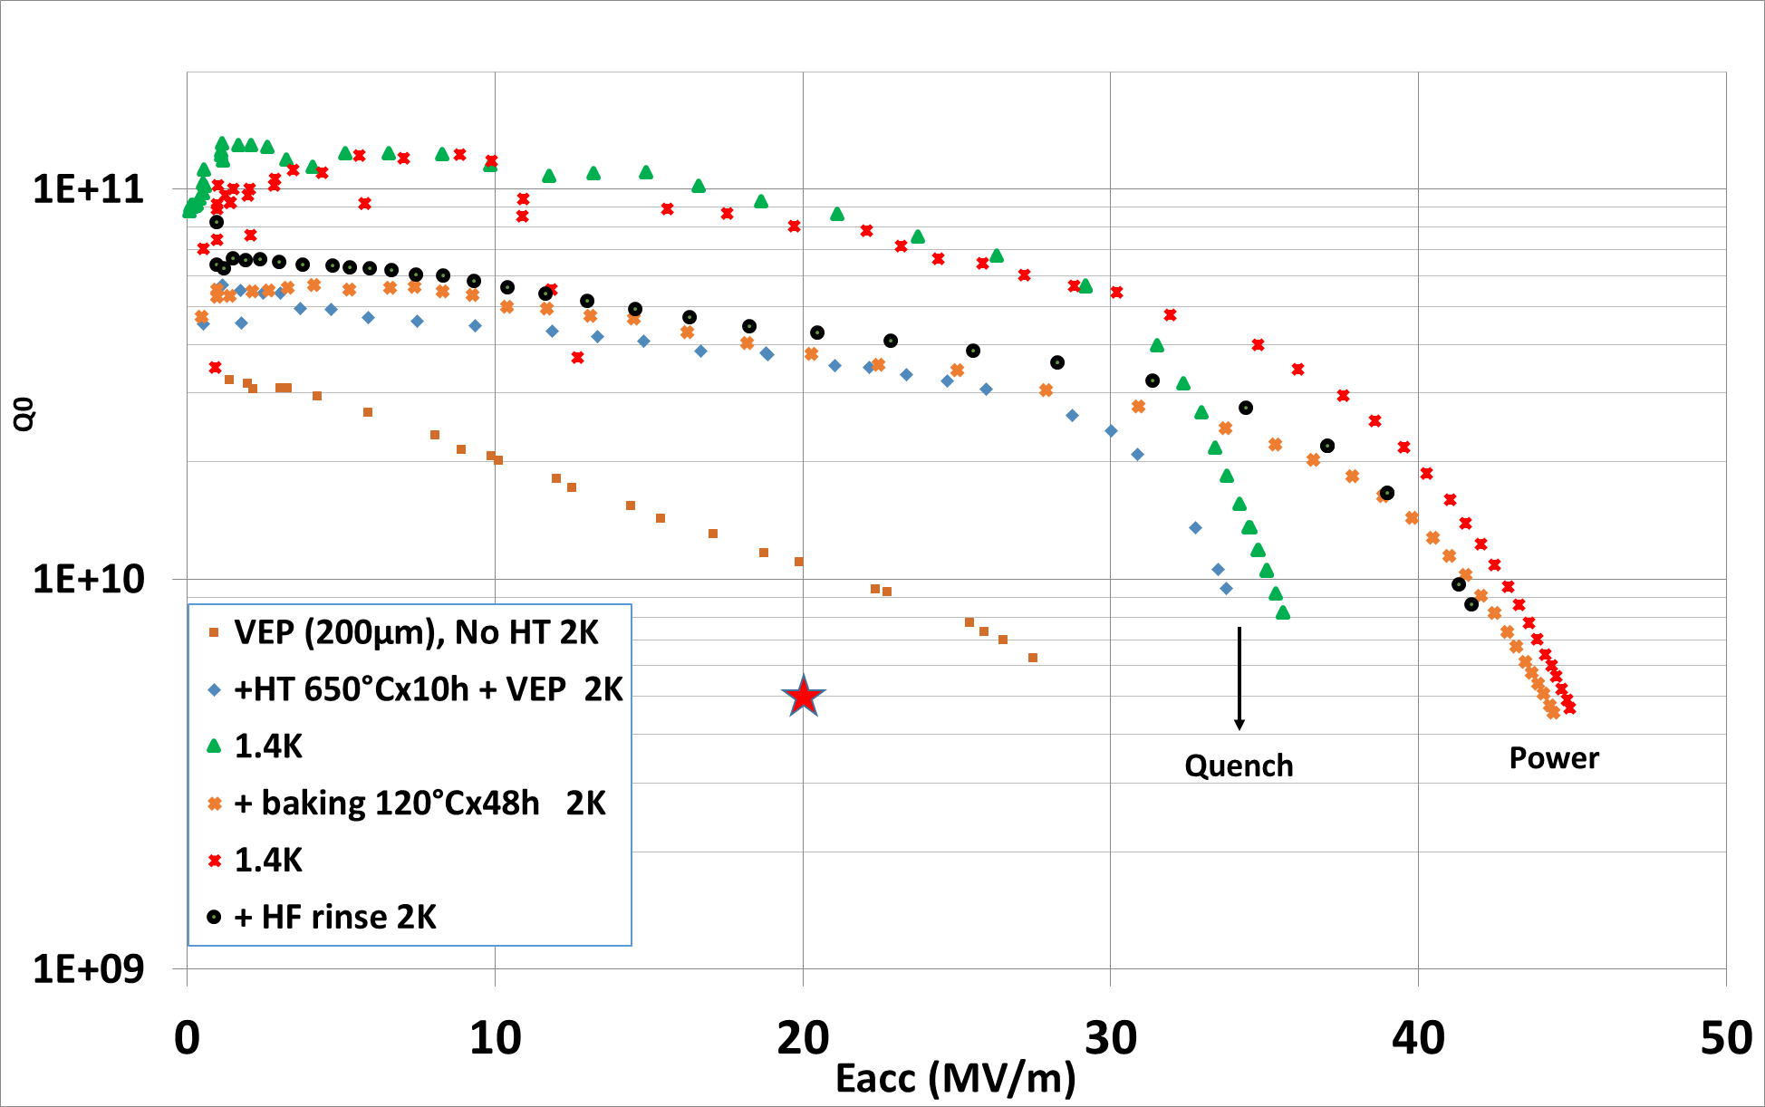
Potential contributions to ILC-IDT SRF (A. Miyakazi)
CNRS/IN2P3/IJCLab has been leading superconducting RF cavity development for proton drivers and heavy ion accelerators
SPIRAL2, ESS, MIRRHA, PIPII
Similar to activities in RIKEN and J-PARC
IJCLab developed an excellent and unique furnace for the state-of-the-art heat treatment of niobium superconducting RF cavities
In collaboration with CEA Saclay (E. Cenni), we may be able to start collider activities with superconducting cavities at IJCLab
Ideas
CEA Saclay fabricates cavities
IJCLab provides heat treatment
Measurement at CEA Saclay
Furnace @ IJCLab
Collaboration with CEA-Saclay
EAJADE funding???

