Slide 1
ThomX meeting Ring commissioning July 24, 2023

Slide 2
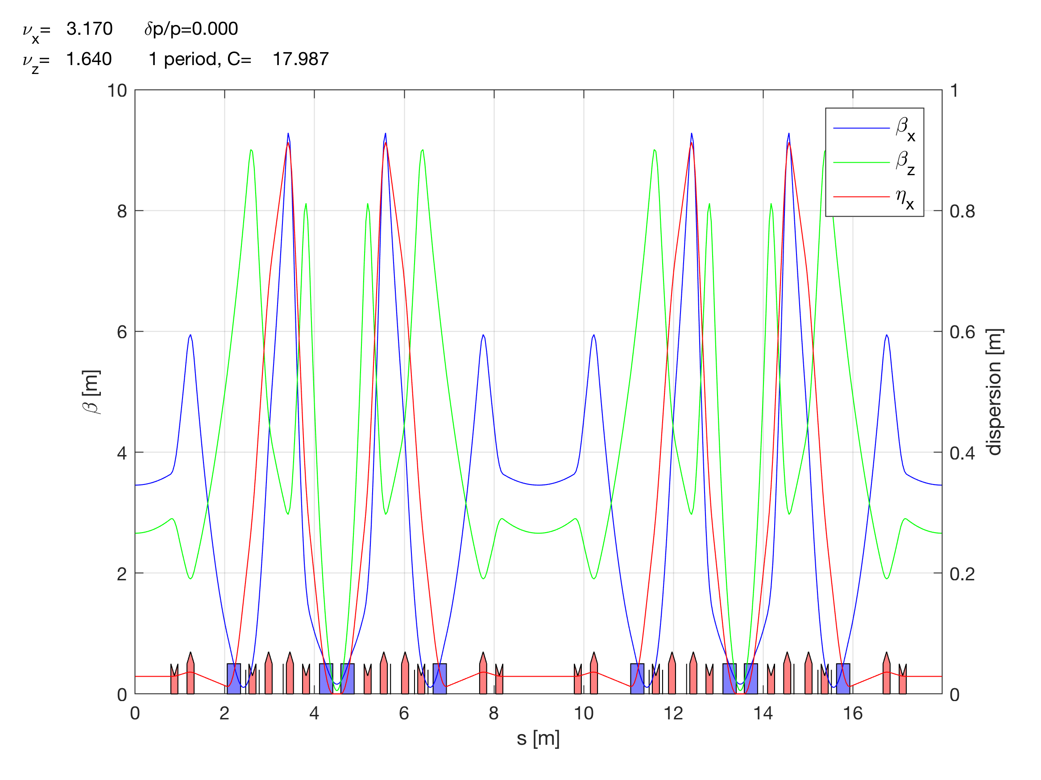
New lattice to obtain 500.25 MHz (from Alex)
TDR_0.17_0.64_r56_0.2_sx_Dff41.2_DipMagnL.str : MCF=0.0139 chro=0/0 (actual lattice)
TDR_0.17_0.64_r56_0.3_sx_Dff41.2_DipMagnL.str : MCF=0.0177 chro=0/0
TDR_0.17_0.64_r56_0.4_sx_Dff41.2_DipMagnL.str : MCF=0.0231 chro=0/0 (to start with)
Always dispersive orbit (f_{RF} ≠ f_{RF}^{NOM}) but smaller
Potential limitations: control of the orbit
Still impact on the Libera @500.25 MHz
should be investigated (if needed ask Instrumentation Technologies to increase the BW)

Slide 3
Roadmap to going to the nominal RF frequency
If the new optics is deployed successfully, operation at 500.25 MHz should be more smooth => X-rays production
Then there are two studies in parallel to be made (correct orbit)
Investigation of the use of metallic plates installed on the dipoles to modify the fringing field (studies with OPERA fieldmaps provided by SOLEIL).
Mechanical intervention to increase the circumference by ~14 mm. In this case, a new optics should be studies to restore the symmetry of the machine + beam dynamics simulations.
Precise modelization of the dipole for correct model of the ring (later)
The modelization of the dipole should be investigated in the AT.
Normally, no impact on the TL optics (only pathlength).

Slide 5
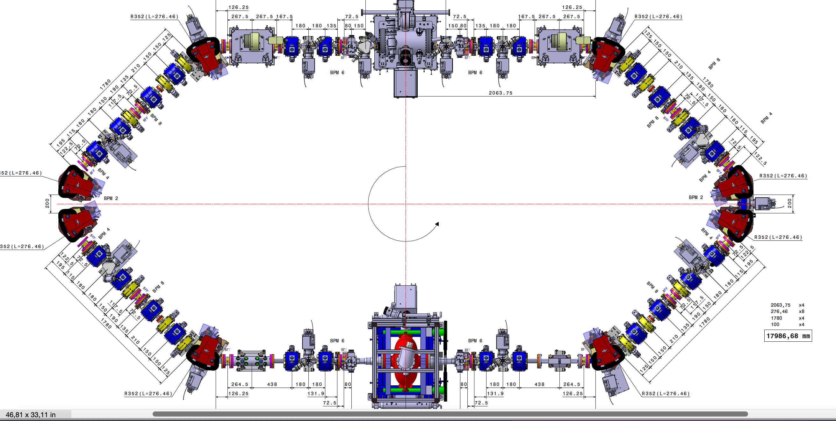
MML
[1 4]
[1 3]
[1 2]
[1 1]
QP2
-QP1
-QP1
QP2
[1 1]
[2 6]
HCOR
HCOR
[1 2]
[2 5]
HCOR
HCOR
[1 3]
-QP31
-QP31
[2 4]
HCOR
[1 5]
BPM 1
BPM 12
[2 12]
HCOR
QP41
[1 1]
QP41
[1 6]
[1 12]
QP4
BPM 2
BPM 11
QP4
[1 7]
[1 11]
-QP3
[1 2]
RI-C1
-QP3
[1 8]
BPM 3
BPM 10
BPM 4
RI-C2
BPM 9
-QP3
-QP3
QP4
BPM 5
BPM 8
QP4
QP41
BPM 6
BPM 7
QP41
HCOR
[1 12]
-QP31
HCOR
[1 4]
-QP31
[2 1]
[2 2]
[2 3]
[2 4]
[2 3]
HCOR
QP2
-QP1
-QP1
QP2
HCOR
[1 5]
[2 2]
HCOR
HCOR
[2 1]
[1 6]

Slide 6
Tango
QP.04
QP.03
QP.02
QP.01
STR.01-H.01
STR.01-V.01
STR.06-H.01
STR.06-V.01
STR.02-H.01
STR.02-V.01
STR.05-H.01
STR.05-V.01
STR.03-H.01
STR.03-V.01
QP.05
QP.12
BPM.02-LIB.03
BPM.01-LIB.03
STR.04-H.01
STR.04-V.01
QP.06
QP.11
QP.07
BPM.03-LIB.03
BPM.06-LIB.05
QP.10
QP.08
RI-C1
QP.09
BPM.04-LIB.03
BPM.05-LIB.05
BPM.05-LIB.04
RI-C2
BPM.04-LIB.05
QP.09
QP.08
QP.10
BPM.06-LIB.04
BPM.03-LIB.05
QP.07
STR.04-H.01
STR.04-V.01
QP.11
BPM.01-LIB.04
BPM.02-LIB.04
QP.06
STR.03-H.01
STR.03-V.01
STR.05-H.01
STR.05-V.01
QP.12
QP.05
QP.01
QP.02
QP.03
QP.04
STR.02-H.01
STR.02-V.01
STR.06-H.01
STR.06-V.01
STR.01-H.01
STR.01-V.01

Slide 7
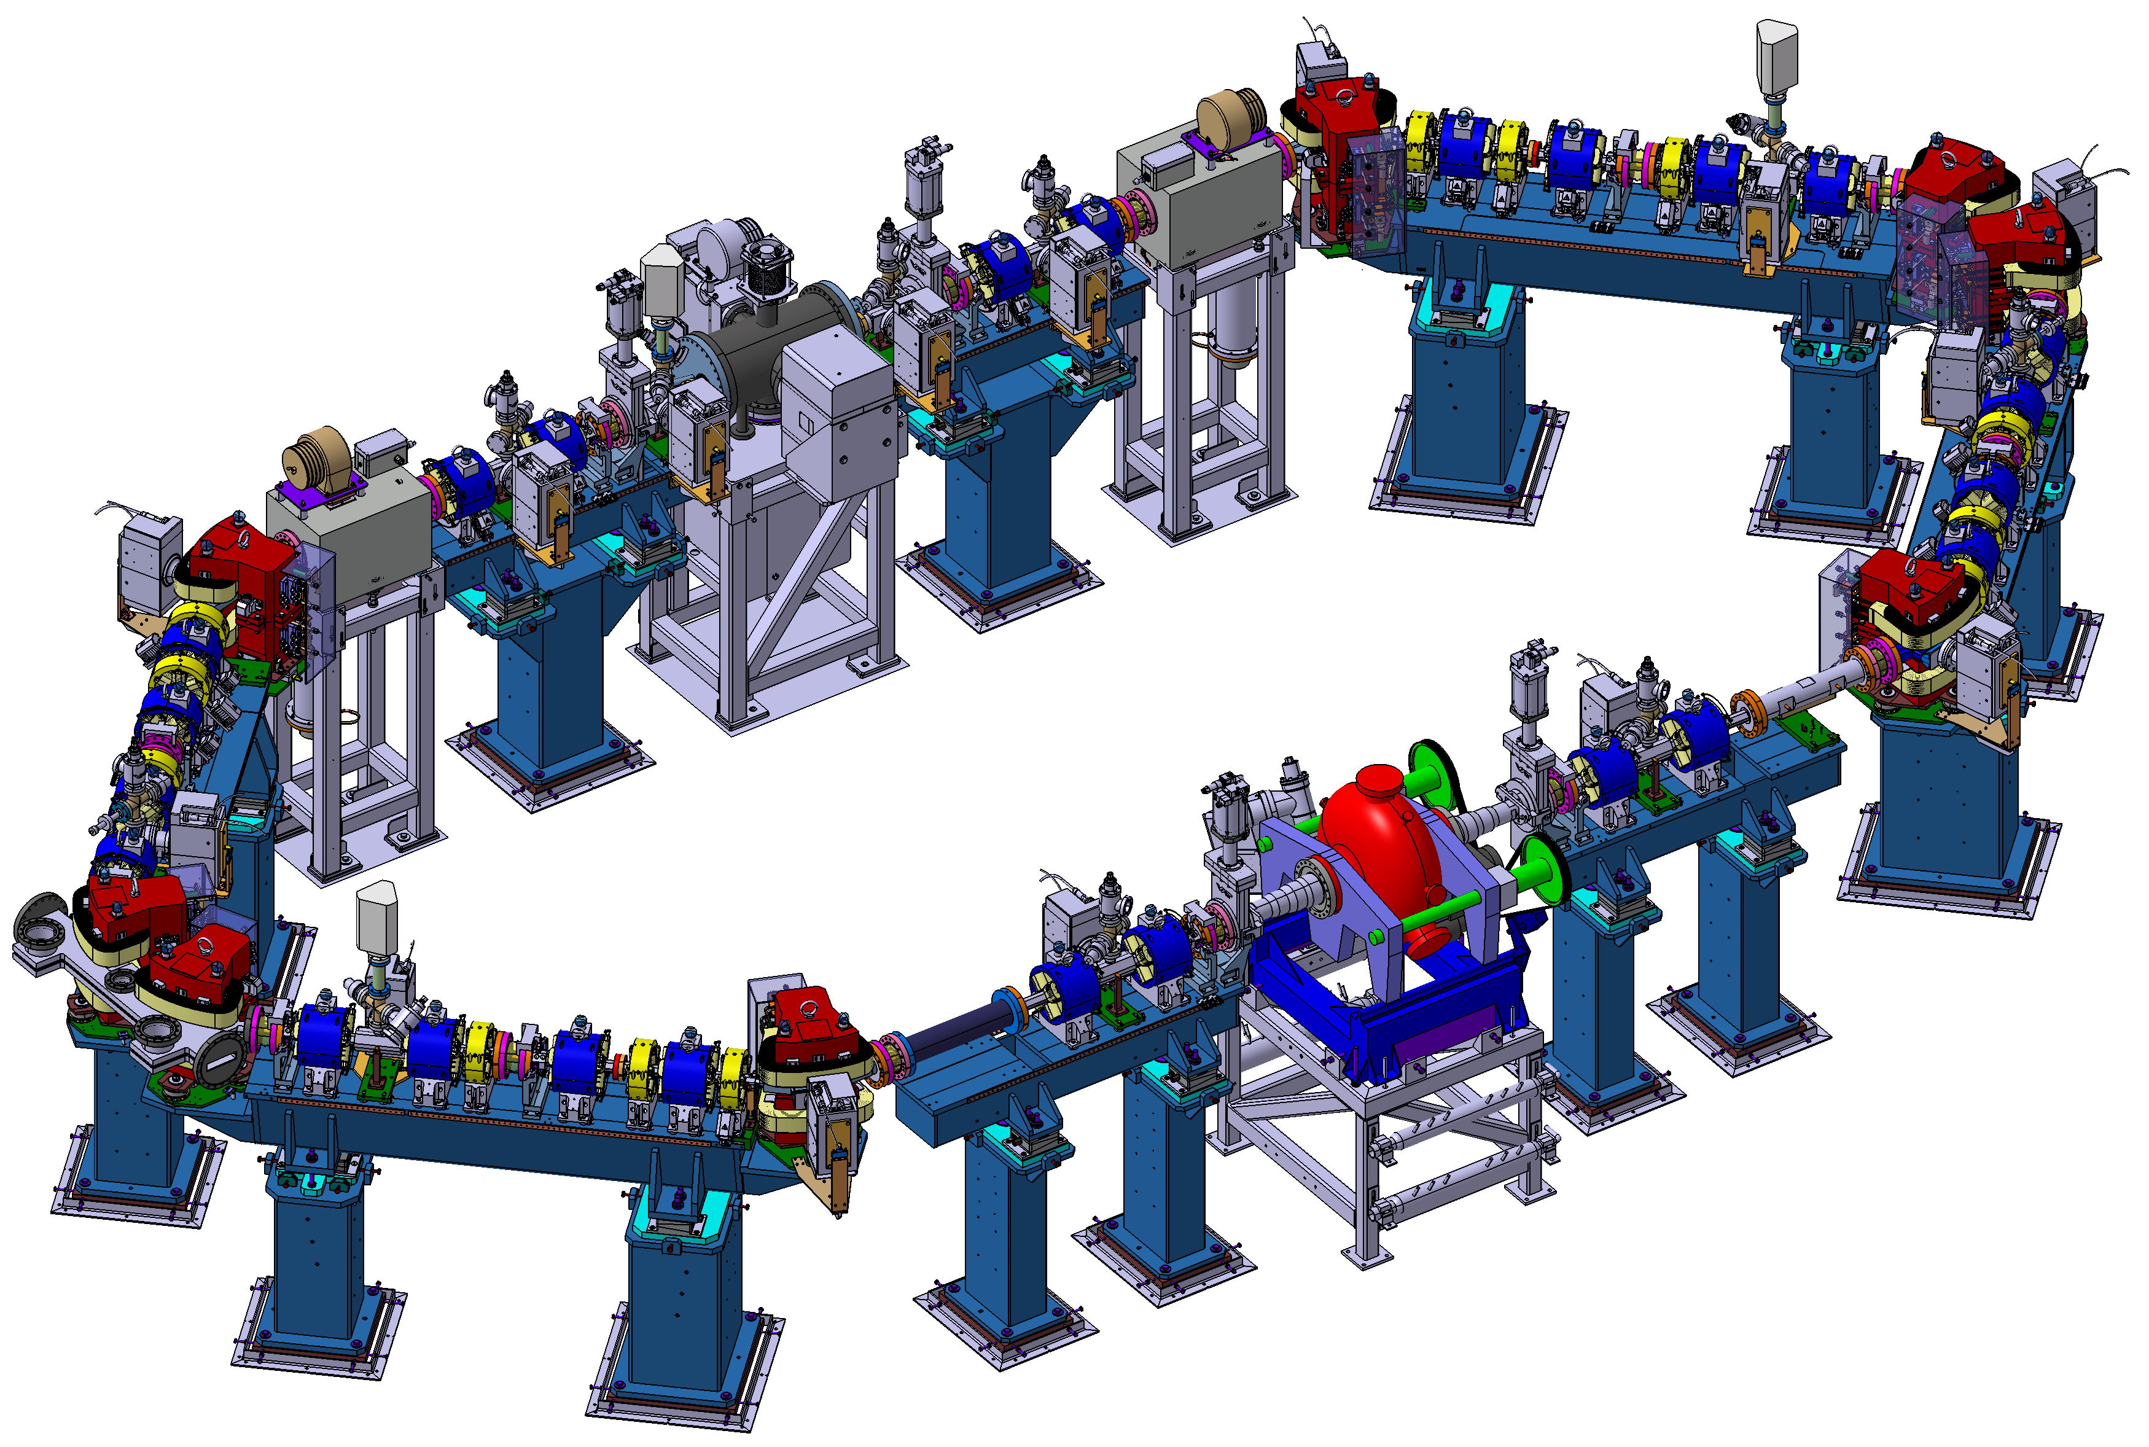
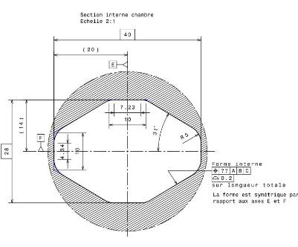
8 Dipoles
24 Quadrupoles
12 Sextupoles
2 Kickers
1 Septum
1 RF cavity
12 BPM
12 Correctors
ThomX SR: L = 18 m, T = 60 ns, Frep = 16.7 MHz
28x40

