Slide 1
Measurement of ³⁵Cl(n,p) Cross Section at NPL in the Energy Range 0.5 – 5 MeV
D. Smith, Pablo Torres, A. Bennet, M. Birch, M. Bunce, N. Florea, S. Kolmogorova, G. Lorusso, H. Mahmood, J. Mewburn, J. Praena, G. Taylor, D. Tofan, and T. Wright

Slide 2
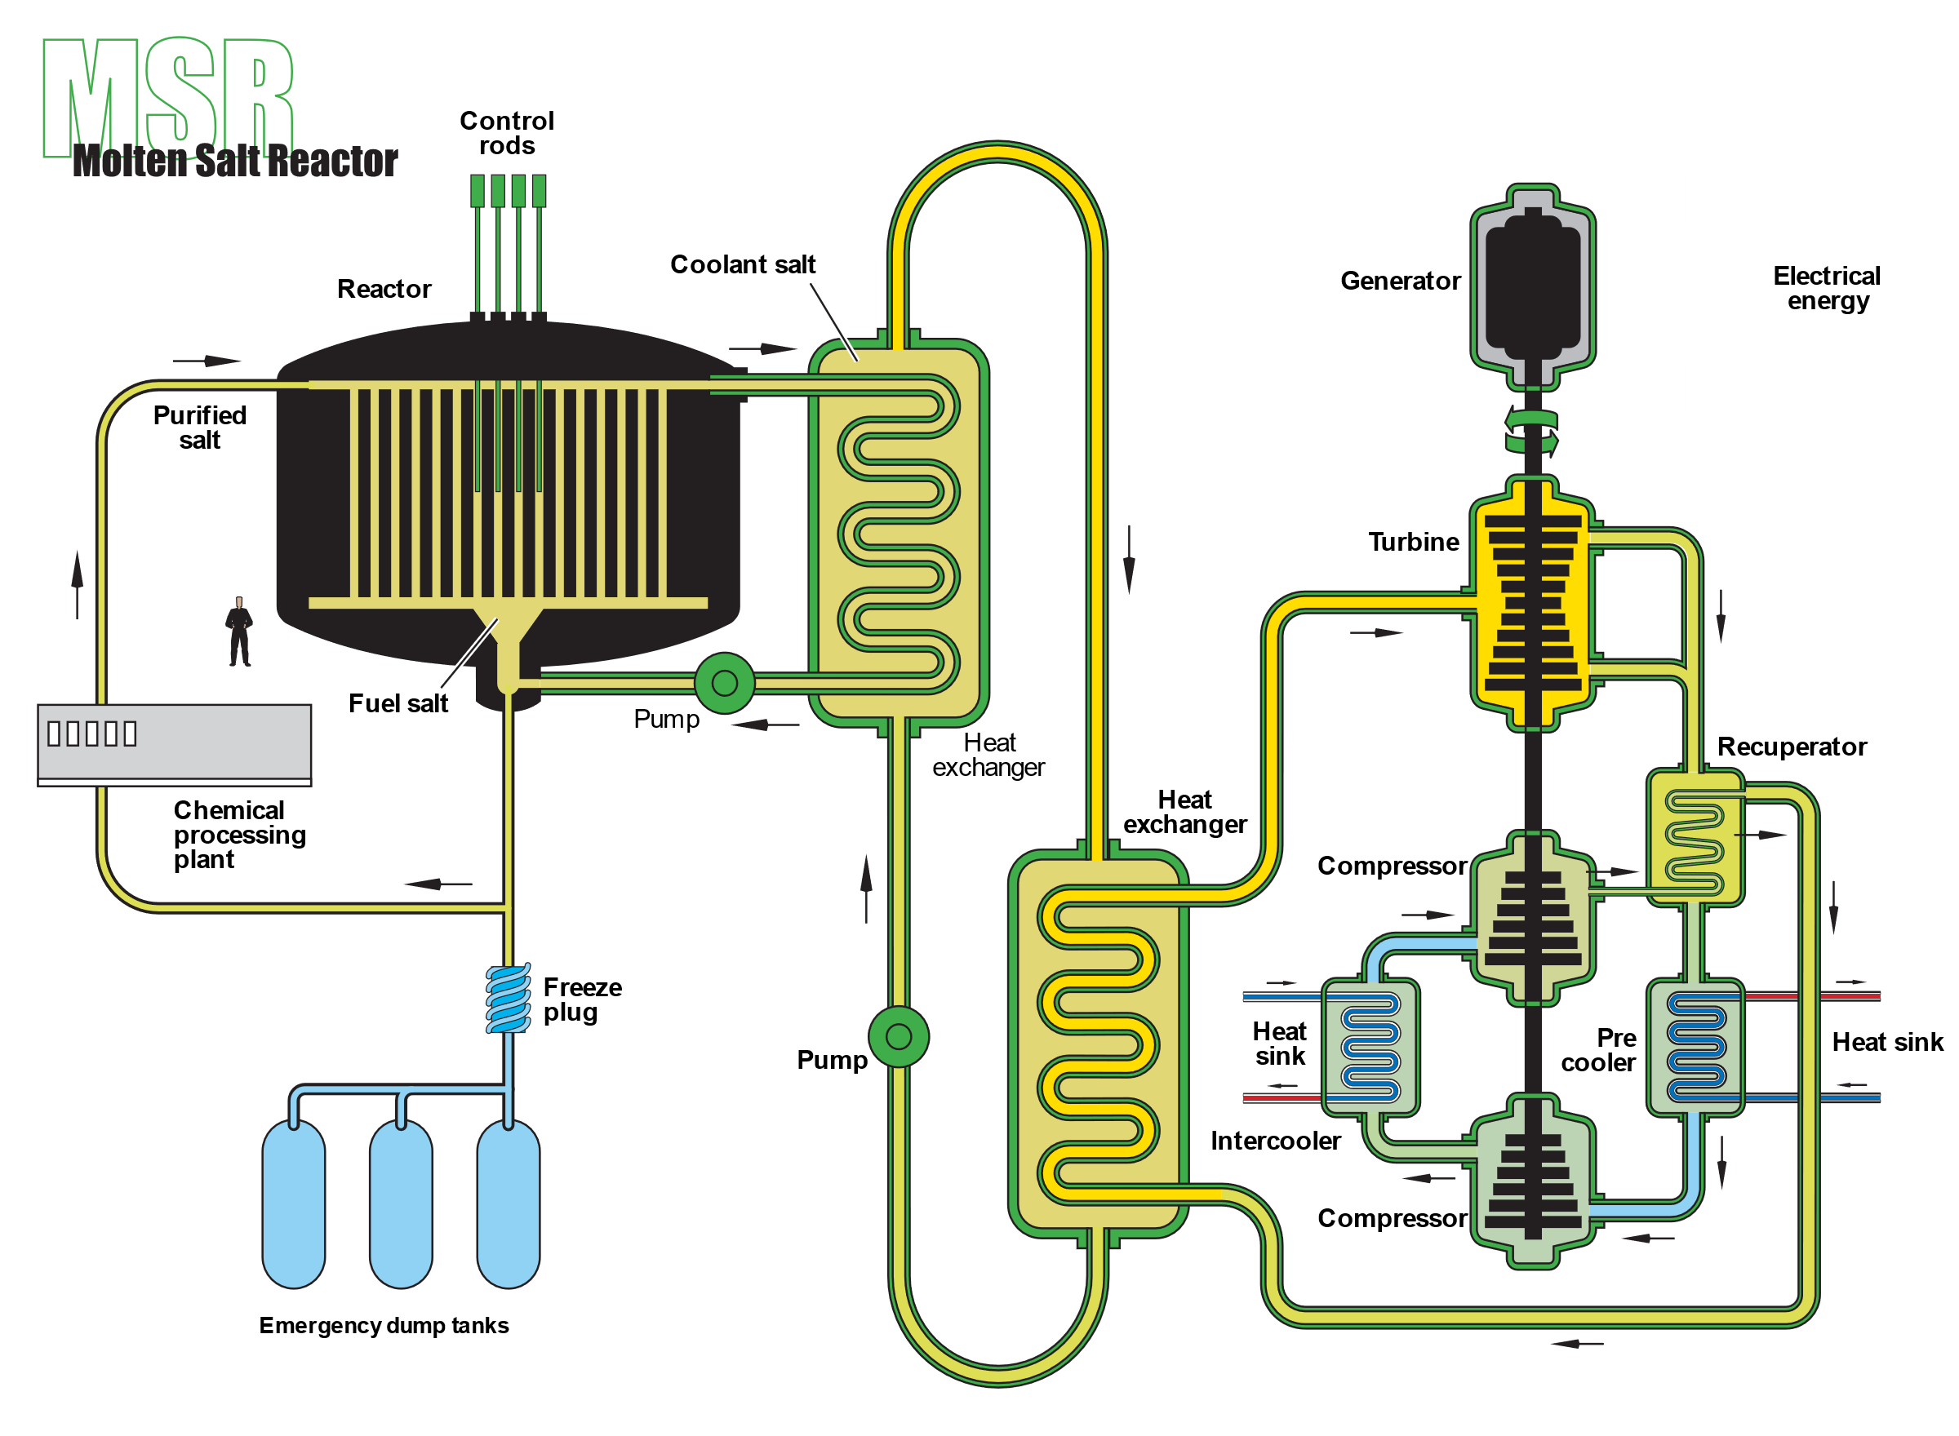
Molten Salt Reactors and the need for ³⁵Cl(n,p)³⁵S data
Pros:
Fuel can be drained
Operation at atmospheric pressure
High temperature ≈700˚
Kr/Xe gas bubbles out
Refuel while operating
Cons:
Molten salt is corrosive
Sensitive to neutron transmutation
k_{eff} uncertainty < 300 pcm
(currently due to ³⁵Cl(n,p)³⁵S is ~1000 pcm)
High priority list of the Nuclear Energy Agency (NEA)

Slide 3
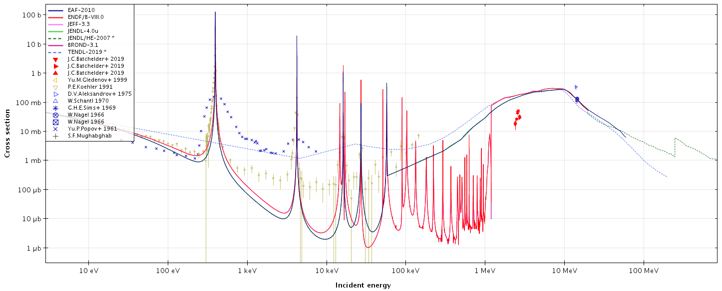
Cross section for σ (n,p)
EAF-2010
ENDF/B-VIII
Discrepancies among models
Discrepancies between models and experiment
Evaluations are poorly constrained

Slide 4
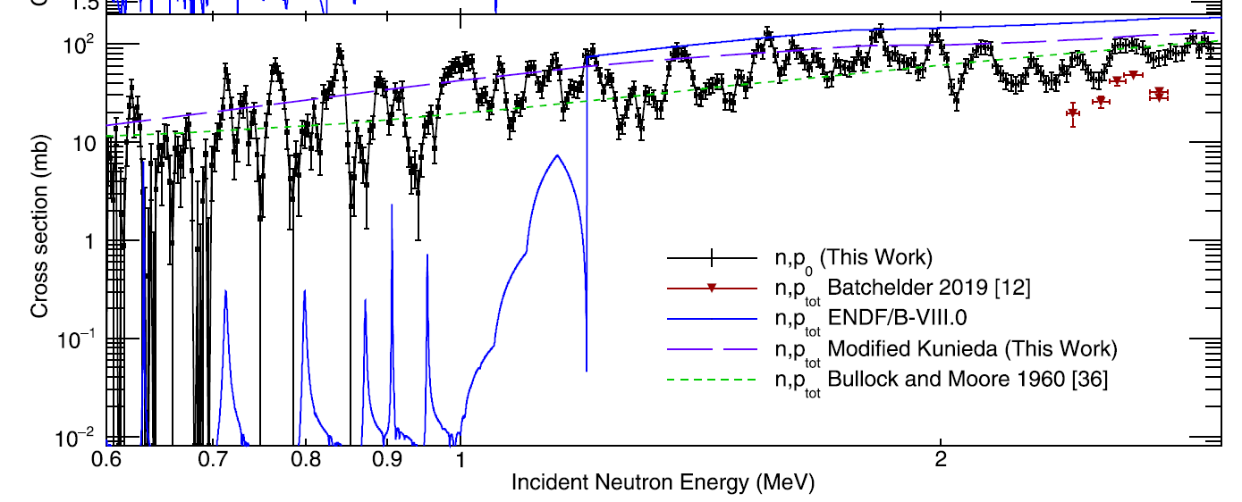
³⁵Cl(n,p)³⁵S recent measurement at LANL
LANL spallation neutron source using the LENZ experimental setup
Sharp cut between resonant and non-resonant cross section obviously an artefact
Experimental resonances broader than from models → density of state included is too small
Discrepancy with Batchelder 2019 measurement
S. A. Kuvin et al., PRC 102, 024623 (2020)

Slide 5
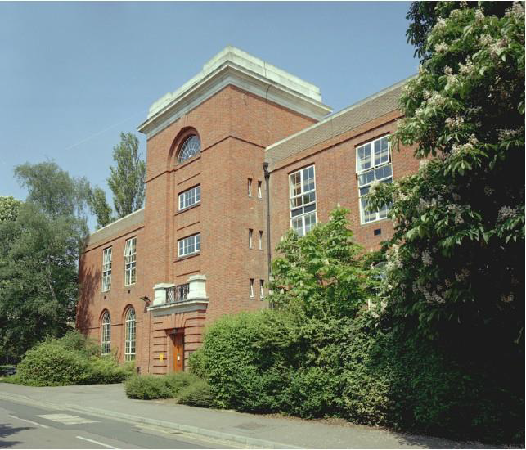
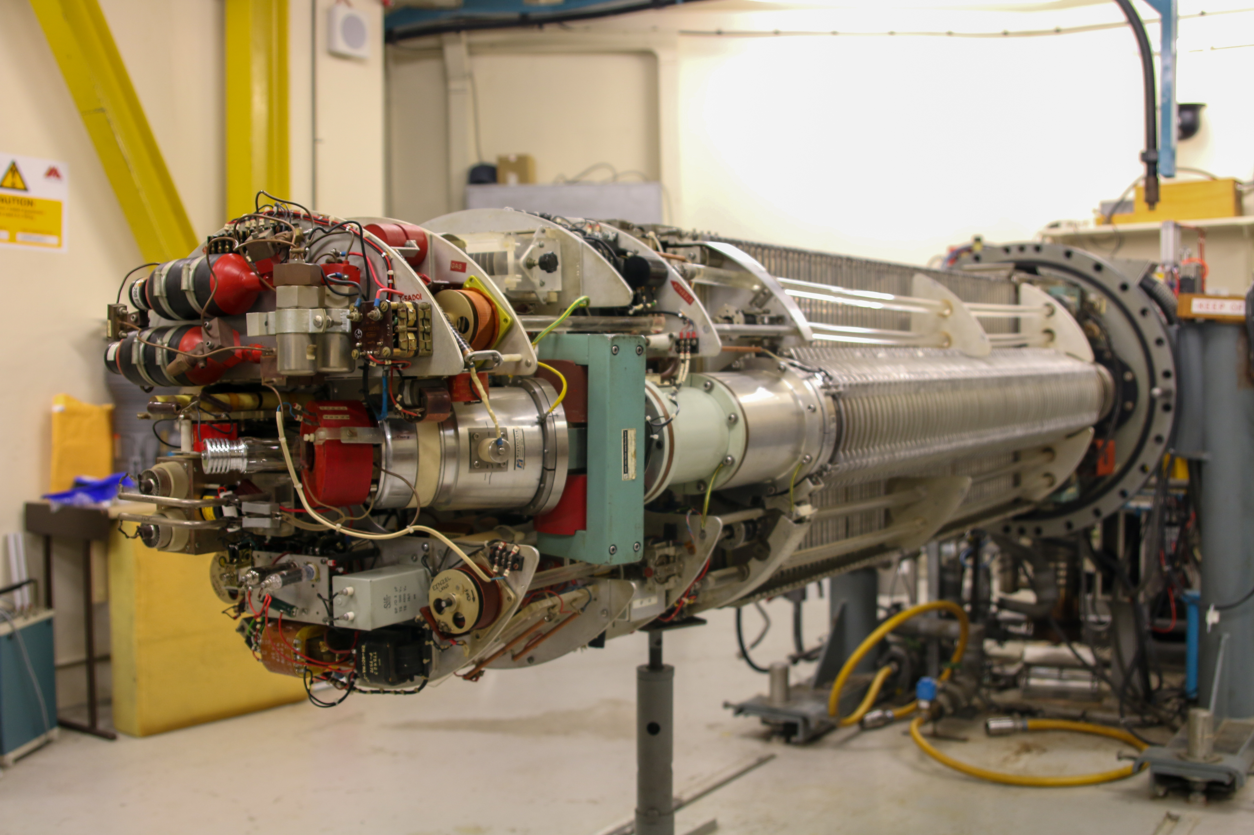
Van de Graaff electrostatic particle accelerator
NPL Chadwick building
Positive Ion Accelerator – Protons, deuterons and tritons
Produces a stable and controllable beam over wide range of energies – 1.0 – 3.5 M V
Producing free neutrons with various nuclear reactions
Neutron fluences are measured using a BF₃ long counter
Energy (MeV) | Reaction | Fluence (cm²s⁻¹)
0.144 | ⁷LI (p,n) ⁷Be | 1 10²
0.250 | ⁷LI (p,n) ⁷Be | 6 10²
0.565 | ⁷LI (p,n) ⁷Be | 1.6 10³
1.2 | T (p,n) ⁹He | 2 10²
2.5 | T (p,n) ⁹He | 6 10²
5.0 | D (d,n) ⁹He | 6 10²
16.5 | T(d,n)⁴He | 4.5 10²
3.5 MeV Van De Graff
neutron fluence @ 1 m

Slide 6
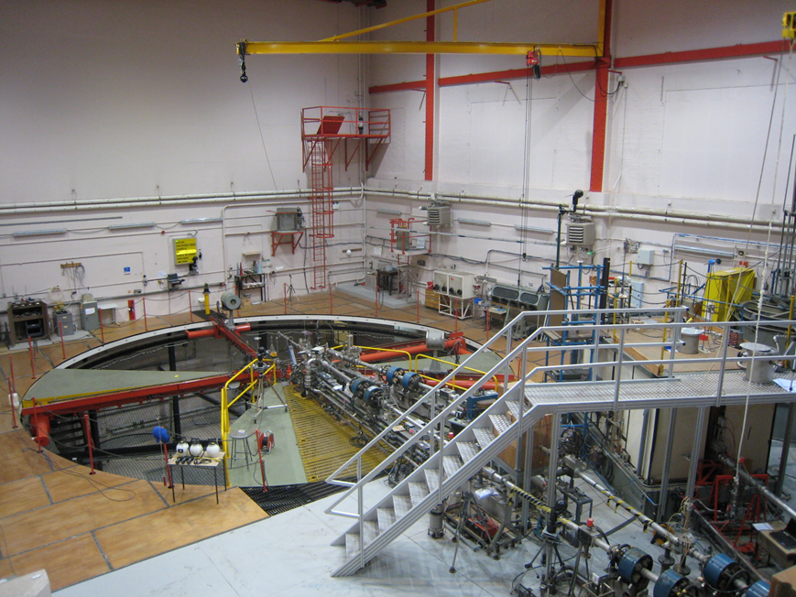
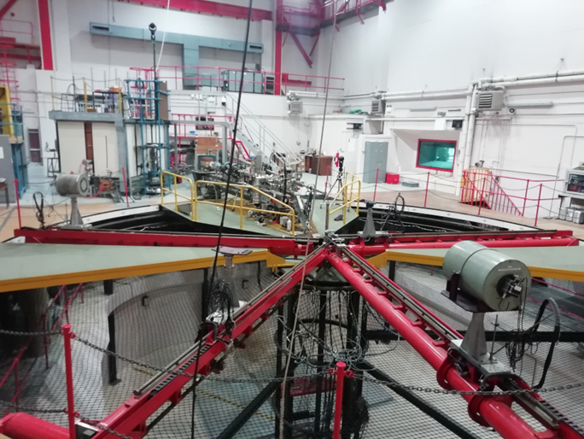
NPL monoenergetic neutron facility
Downstream view
Upstream view
Low neutron scattering (area size 18m x 18m x 26m)
Well know fluence from well calibrated long counter allows for absolute cross section measurements

Slide 7
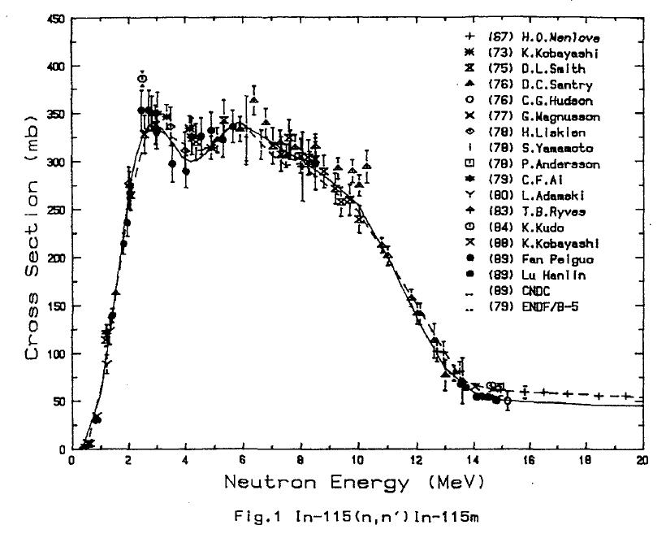
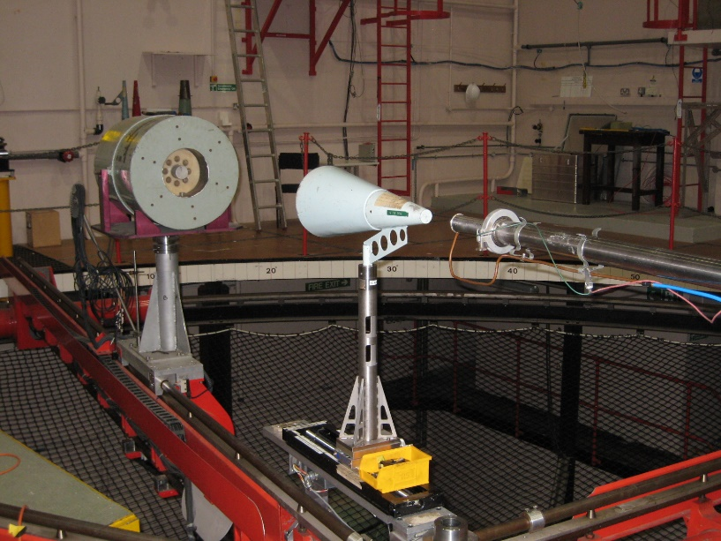
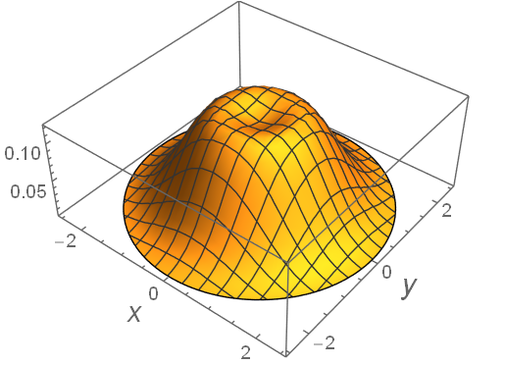
Neutron fluence measurement
¹¹⁵In(n,n’)^{115m}I cross section as standard reference
Fluence measurement at ~ 1 m with BF₃ long counter
318.5 +/- 1.7 mb
@ 5 MeV
Cai Dunjiu, evaluation of cross section for dosimetry reactions, IAEA report, 1991, IMDC(CPR)-024
Proton beam axis rotates (50Hz)
Neutron source distribution
Beam spot
Absolute measurement difficult
Large relative uncertainty of target distance
Stability of beam position is unknown
Profile of the beam is unknown
This data is an opportunity to study the feasibility of absolute cross section at NPL at short range
1 cm
Heat load management (T<180˚)

Slide 8
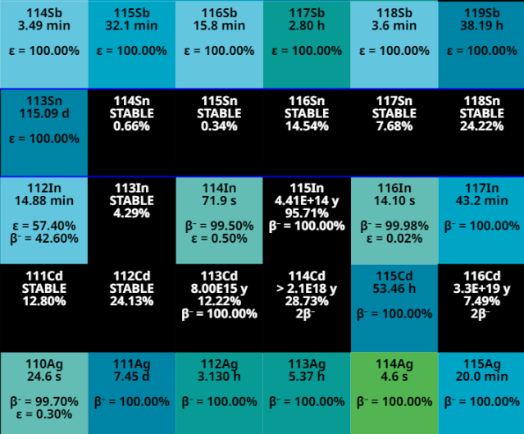
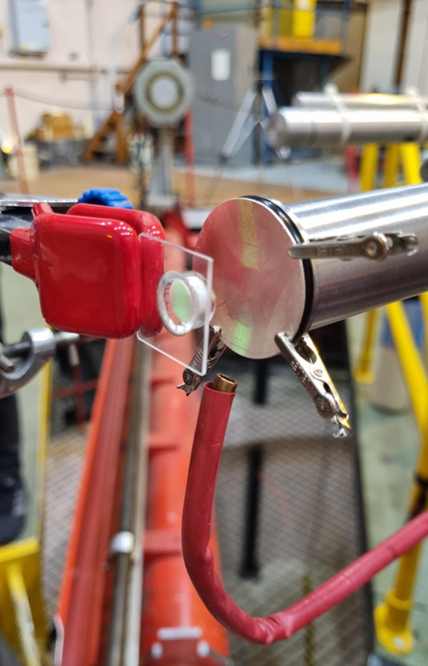
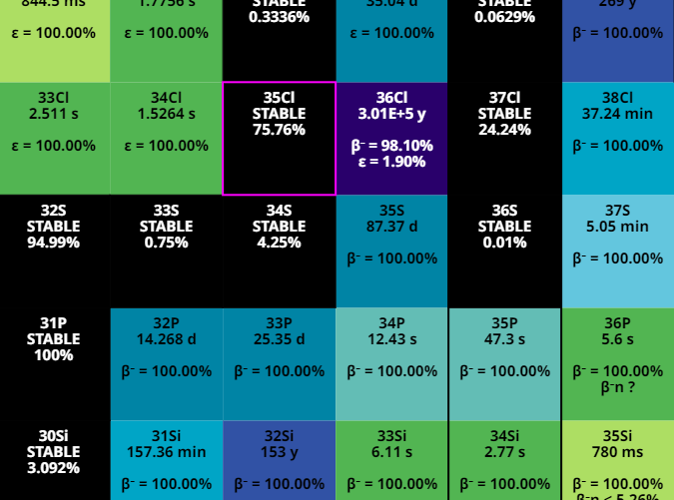
Activation measurement using the InCl₃ target
FISPACT-II calculations
5 hour irradiation test Dec23
proton beam
^{114m}In, T_{1/2} = 49.5 d
but low abundance of ¹¹³In
¹¹⁵Cd, T_{1/2} = 53.5 h
^{115m}Cd ,T_{1/2} = 44.5 d
but low (n,p) cross section
compressed air hose
^{nat}Cl → ³⁵Cl + ³⁷Cl
Deuterium target 50 μg/cm²
InCl₃ target
~500 mg InCl₃
Encapsulated in quartz crystal in Argon
Pressed sample fabricated at Target Preparation Laboratory IFIN-HH
Held at approx. 1.5 cm distance from target

Slide 9
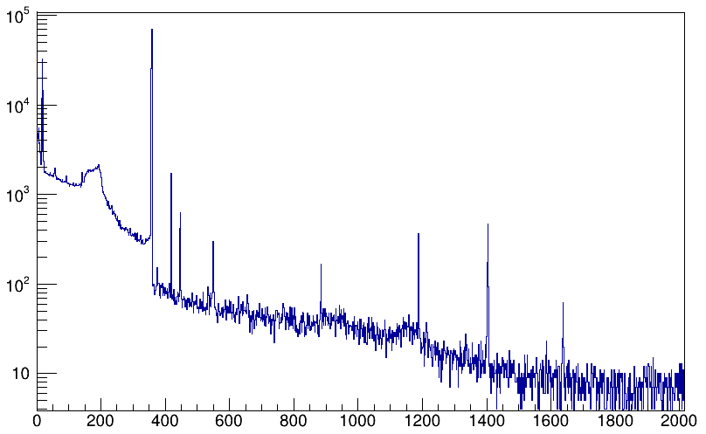
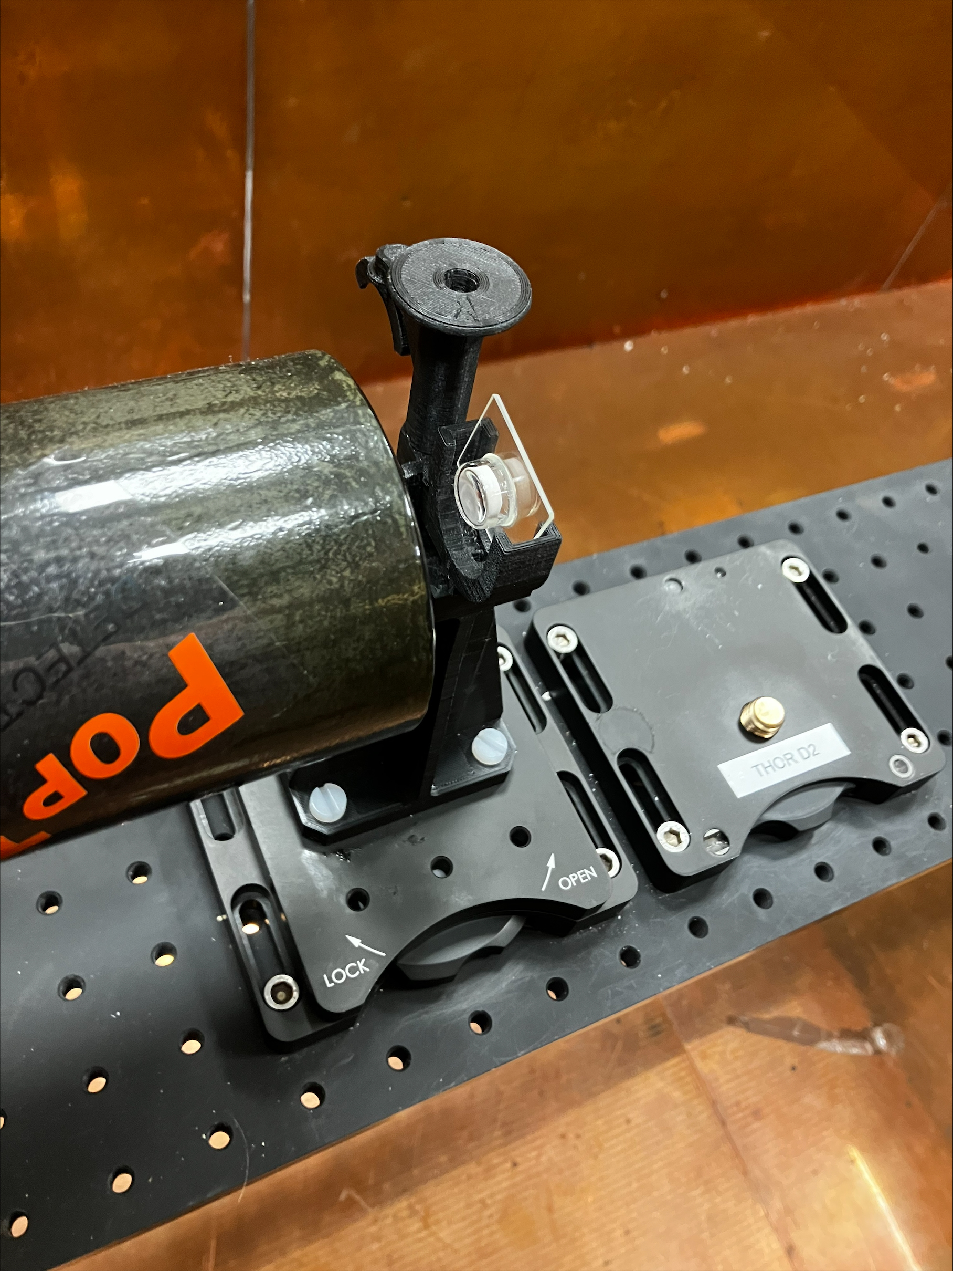
γ ray spectroscopy
¹¹⁵In(n,n’)^{115m}In
HPGe of the NPL g-spec lab
^{113m}In, ^{115m}In, ^{116m}In
336 keV
^{114m}In → 190, 311 keV
¹¹⁵Cd → 336.2 keV, 527 keV
^{115m}Cd → no strong γ-rays
^{114m}In
^{115m}Cd
Counts / keV
KeV
96512 counts in 8600 s → A ≈150 Bq
(γ- efficiency needs to be measured) → will achieve <1% uncertainty
No evidence of ^{114m}In and ^{115,115m}Cd
Contamination analysis can be improved running after ^{115m}In decay

Slide 10
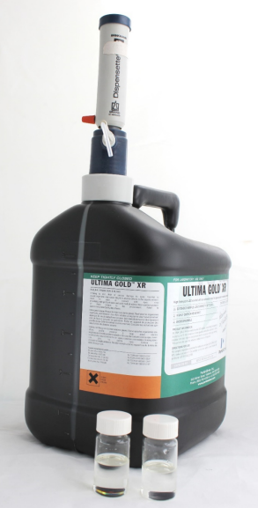
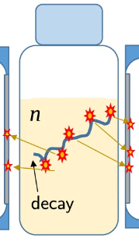
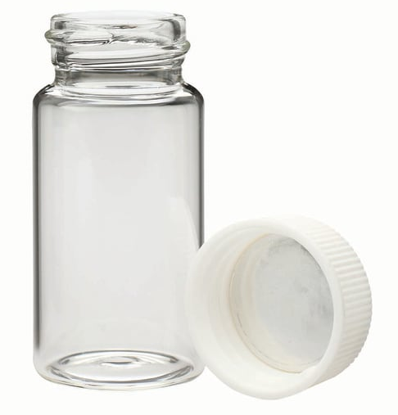
Liquid scintillation counting (detecting ³⁵P &³²S)
PMT 1
PMT 2
Low ^{39,41}K borosilicate vial
High counting efficiency (99.8 % ³²P and 91% ³⁵S)
No backscatter
Passive/active shield → Low background
Coincidence counting → low noise
Well suited to accurate measurement of low activity pure beta emitters
Scintillation Cocktail (Aqualight + NPE Free scintillant)
60-99% by volume is solvent + solubiliser
Primary fluor – Most primary fluor emit light in the UV range with wavelengths shorter than 400 nm.
Secondary fluor (wave shifter) –increases the wavelength of the emitted light to one more efficiently absorbed by the PMT.

Slide 11
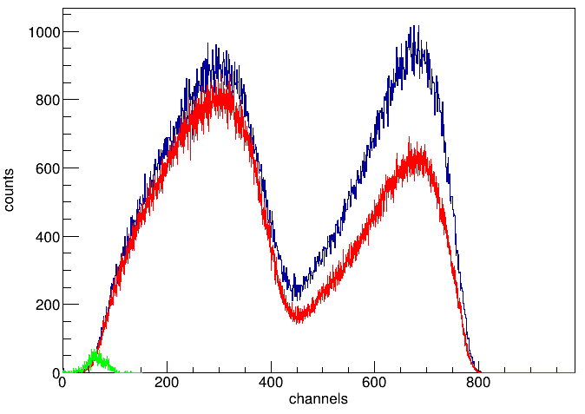
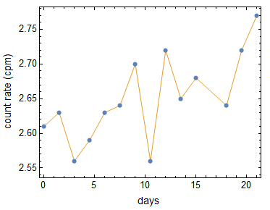
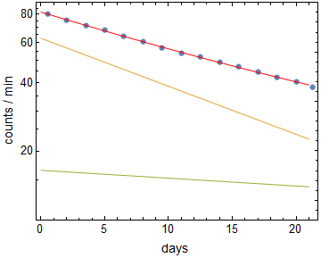
Liquid scintillation measurements
PMT pulse high spectrum
$Target was dissolved in 2 ml HCl 0.1 M \left(2.14 g\right)$
2 samples InCl₃ made into 0.5 g solution
1 sample of cocktail with HCl for background
Counting time 720 min (BKG, sample #1, sample #2)
Background
Sample 1
³⁵S
³²P
Bkg
Activity after irradiation
A(³²P) = 3.02(4) Bq
A(³⁵S) = 0.640(16) Bq

Slide 12
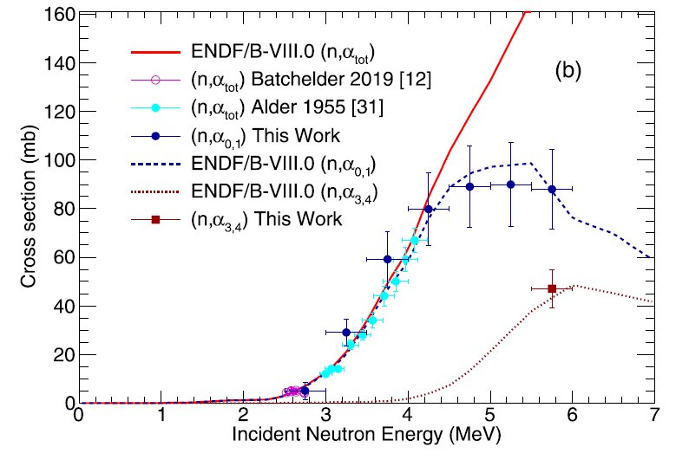
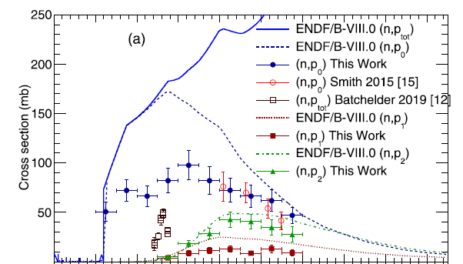
Preliminary result → σ(n,p) relative to σ_{ENDF}(n,α)
³⁵Cl(n, α)³²P
S. A. Kuvin (2020)
³⁵Cl(n, p)³⁵S
S. A. Kuvin (2020)
$σ(n,α)$= 135 mb @ 5 MeV (ENDF/B-VIII)
$σ(n,p)$= 154 (25) mb @ 5 MeV
$σ$(n,p0)+$σ$(n,p1)+ $σ$(n,p2)+ $σ$(n,p3)+ $σ$(n,p4)+ $σ$(n,p5)
decay during irradiation
decay before LS measurement
$σ(n,p)=σ(n,α)\frac{AS35(t0) }{AP32(t0)}$C($λ35,λ32$) = 175(5) mb

Slide 13
Summary
³⁵Cl(n,p)³⁵S cross section measurement is ongoing at NPL as part of ARIEL
First test run in December 2023 at NPL has provided data to optimising the measurement
Preliminary data shows compatibility with Kuvin et al., with potential to reduce the uncertainty
New irradiations at different energies are scheduled in February 2024
Target optimisation (thickness)
Redesign target holder
Characterise target distance

