Slide 1






Radiative capture study of silver γ-decay spectra using γγ-coincidences
David Knežević^{1,2}, N.Jovančević³, C. Stieghorst¹, Tamara Milanović⁴, László Szentmiklósi⁵, Zsolt Revay¹, Tamás Belgya⁵
¹Technical University of Munich - Forschungs-Neutronenquelle Heinz Maier-Leibnitz (FRM II), Garching, Germany
²Institute of Physics Belgrade, Serbia
³Faculty of Sciences, University of Novi Sad, Serbia
⁴Vinča Institute of Nuclear Sciences, Serbia
⁵Nuclear Analysis and Radiography Department, Centre for Energy Research, H-1121 Budapest, Hungary
This project has received funding from the Euratom research and training programme 2014-2018 under grant agreement No 847594 (ARIEL).
The MLZ is a cooperation between:
ARIEL FINAL Workshop 2024

Slide 2


Content
- Introduction
- Two-step gamma cascades method
- Previous results on level scheme, gamma transition
- Previous results for level density and radiative strength functions
- New measurements and preliminary results
- Conclusion
ARIEL FINAL Workshop 2024

Slide 3
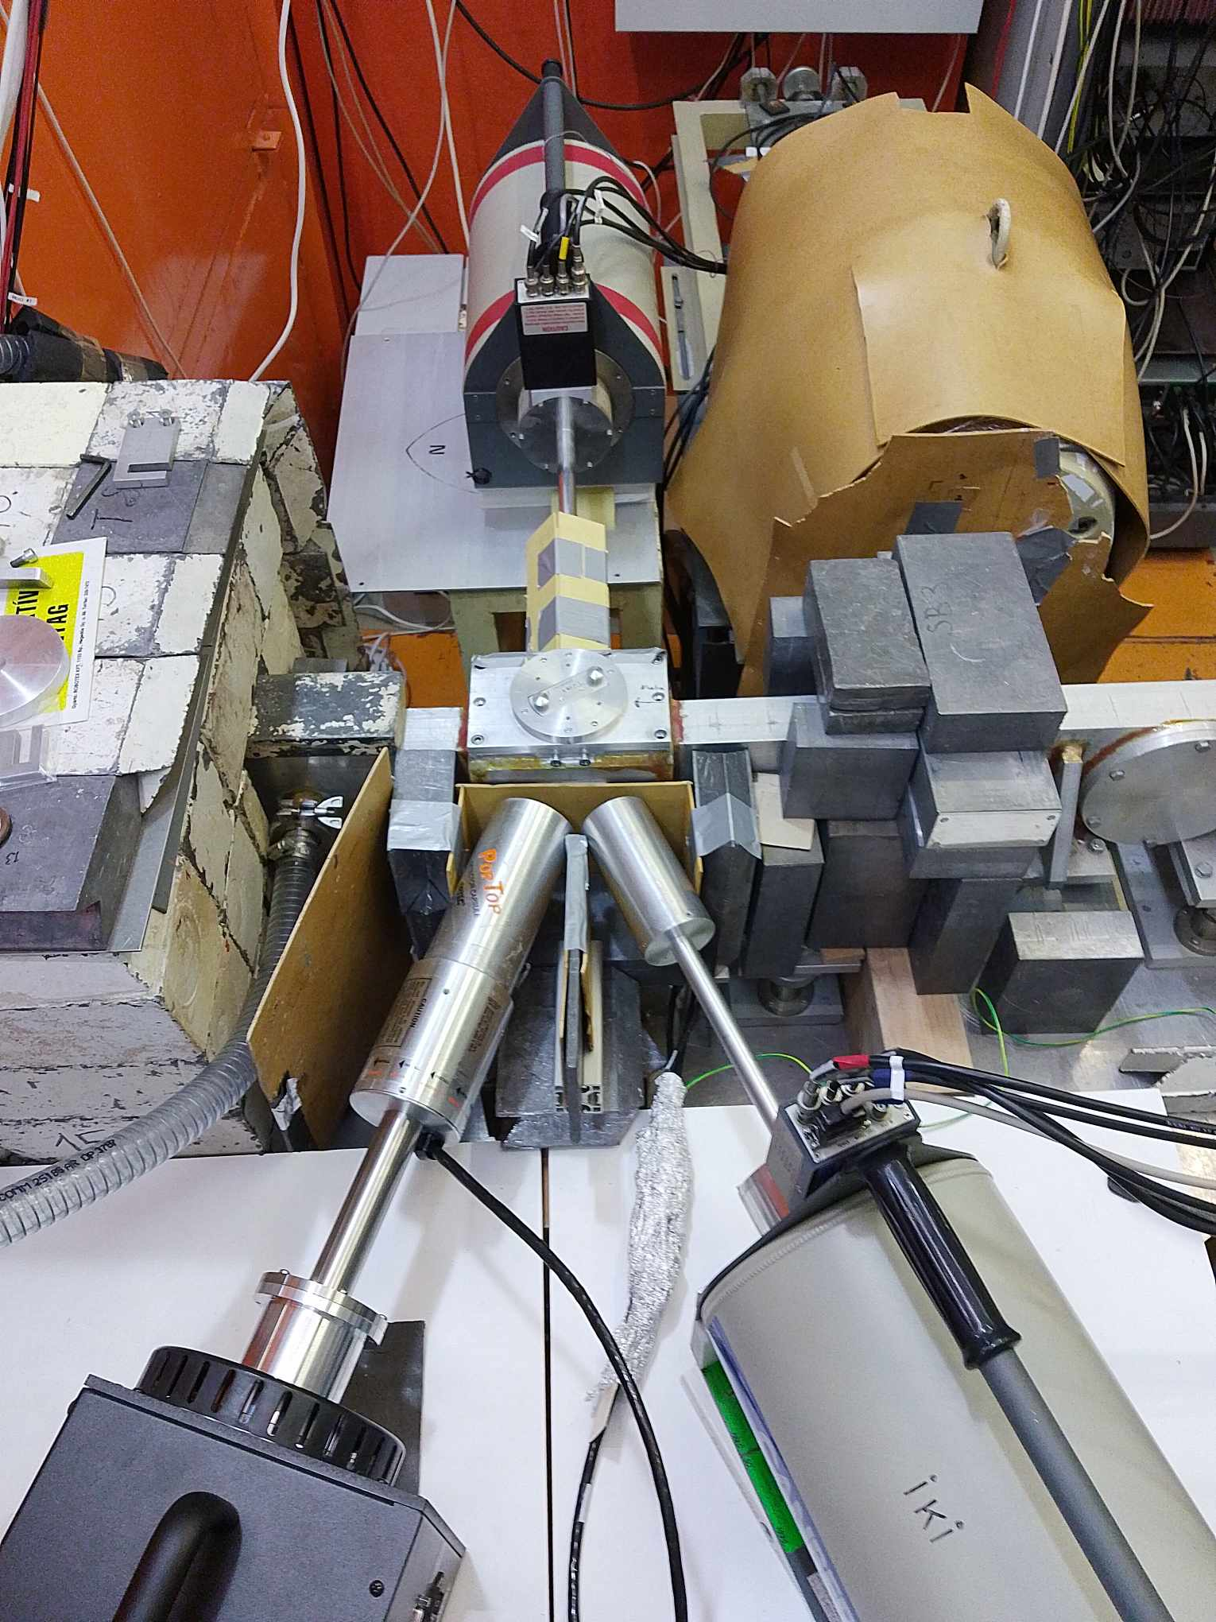
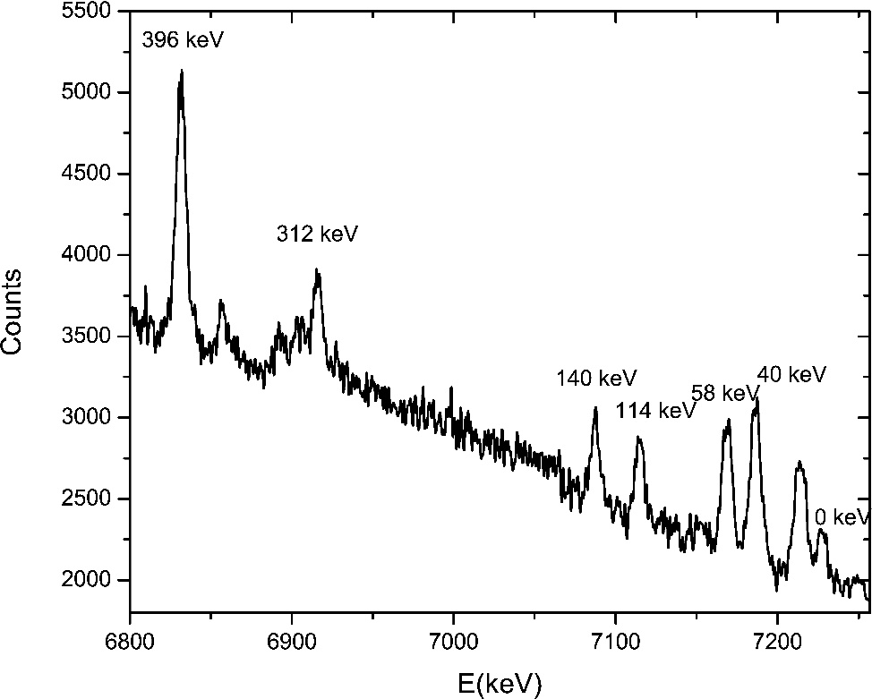
Introduction
Obtaining accurate experimental values of the level scheme, level density and radiative strength functions is necessary for fission, astrophysical studies etc.
It is necessary to develop the method for determination of these parameters.
Main problem : FWHM >> D_{i}.
Two-step gamma cascades method.
2. Practical model of the cascade gamma-decay.
ARIEL FINAL Workshop 2024

Slide 4
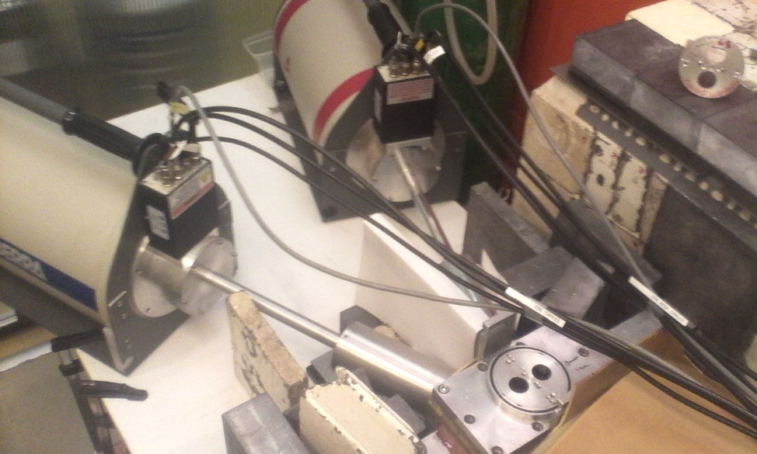
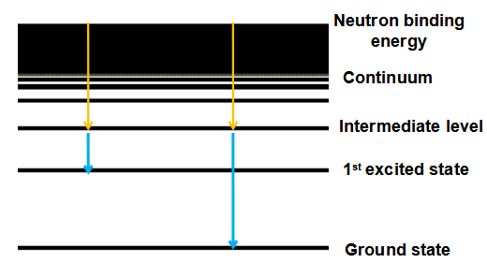
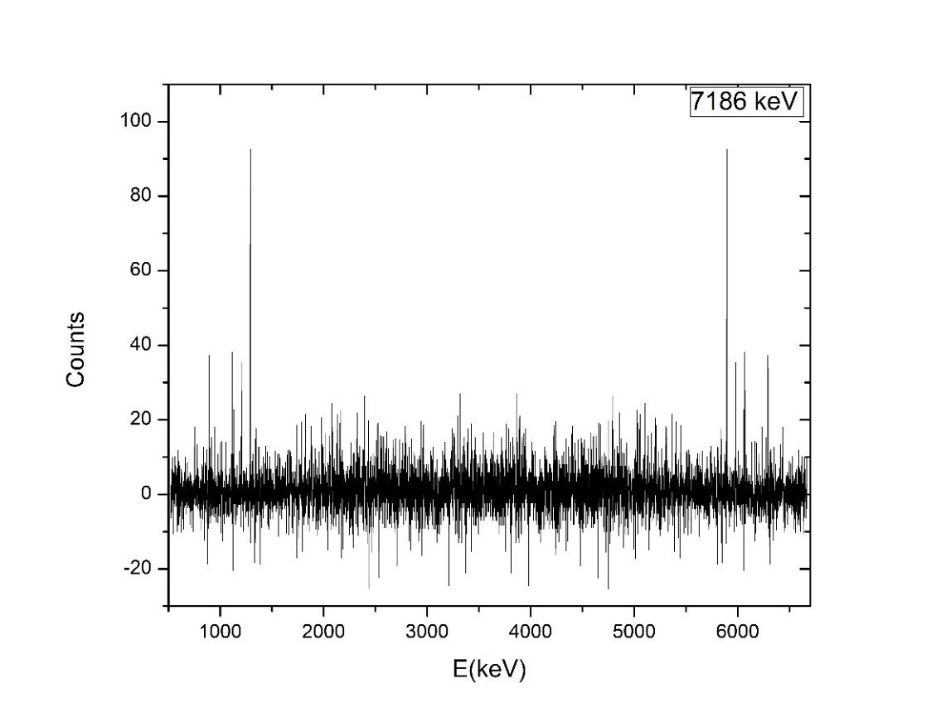
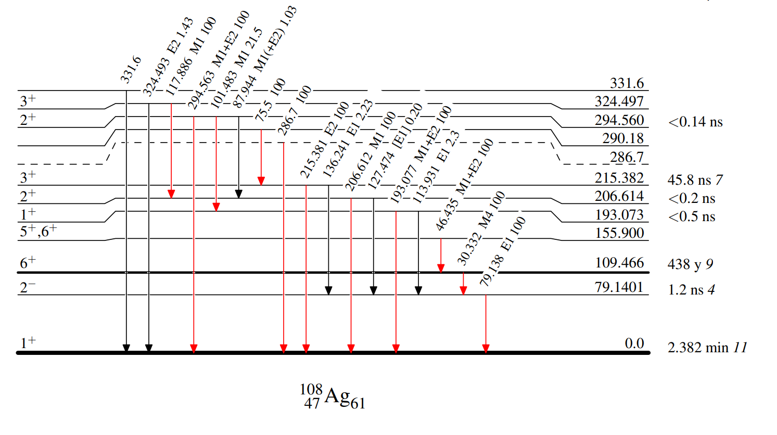
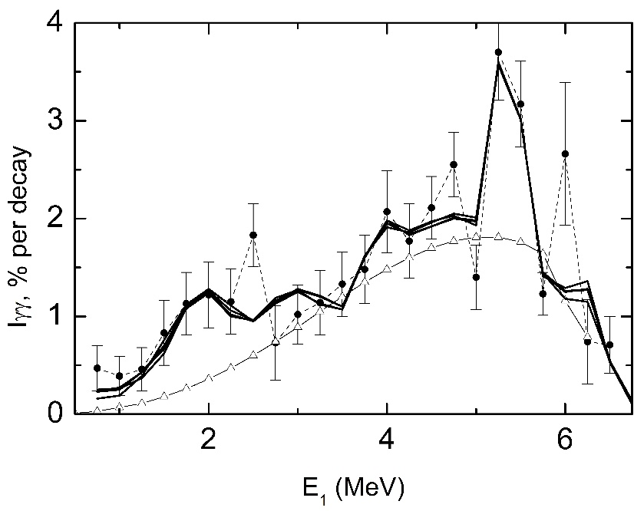
Two-step gamma cascades: Basic principles
Detecting two consecutive gamma rays emitted from the binding energy to the ground state or one of the low-lying excited levels after neutron capture: (n,2γ) reaction.
SACP Spectrum
TSC
ARIEL FINAL Workshop 2024

Slide 5
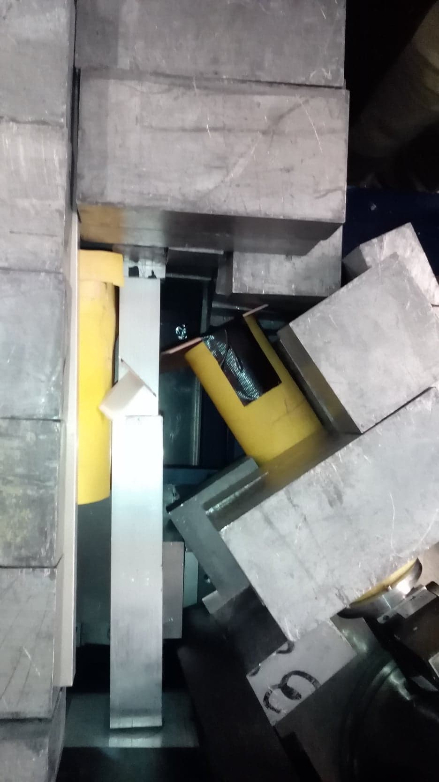
Measurement
Thermal neutron capture (n_{th},2γ) reaction.
Experimental setup is fairly simple: thermal neutron beam, two HPGe detectors, target and an acquisition system capable of recording channel and time stamps of the event.
ARIEL FINAL Workshop 2024

Slide 6
Measurement
⁹⁴Nb, ¹⁰⁴Rh and ¹⁰⁸Ag: PGAA facility of Centre for Energy Research (MTA EK), Budapest, Hungary (down).
⁵⁶Mn: Technische Universität München, Forschungsneutronenquelle Heinz Maier-Leibnitz (FRM II), Garching, Germany (left).
ARIEL FINAL Workshop 2024

Slide 7
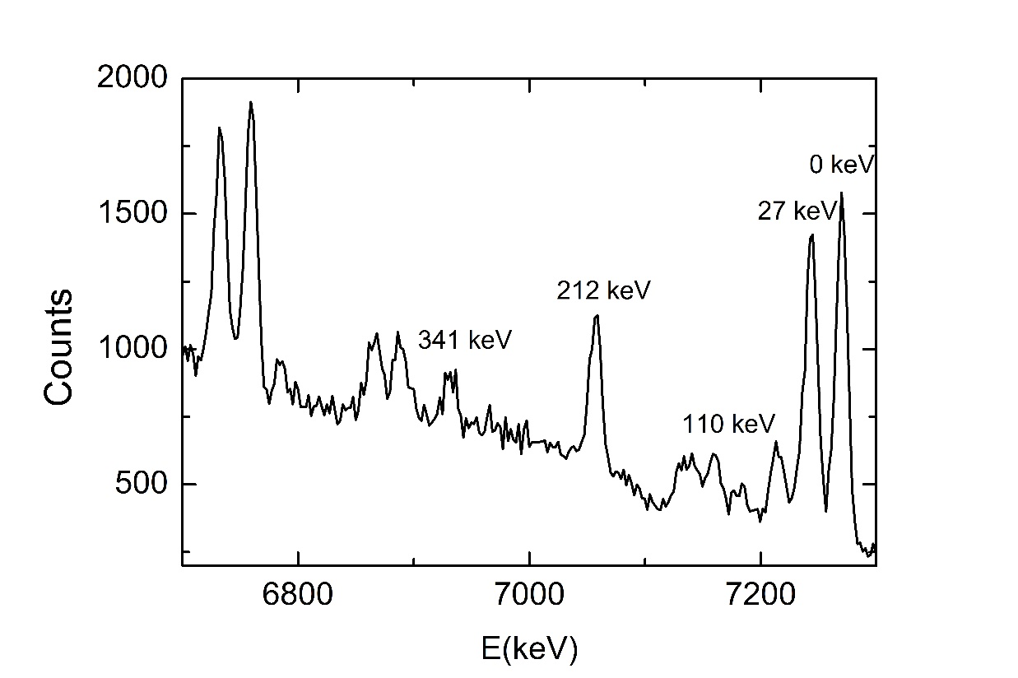
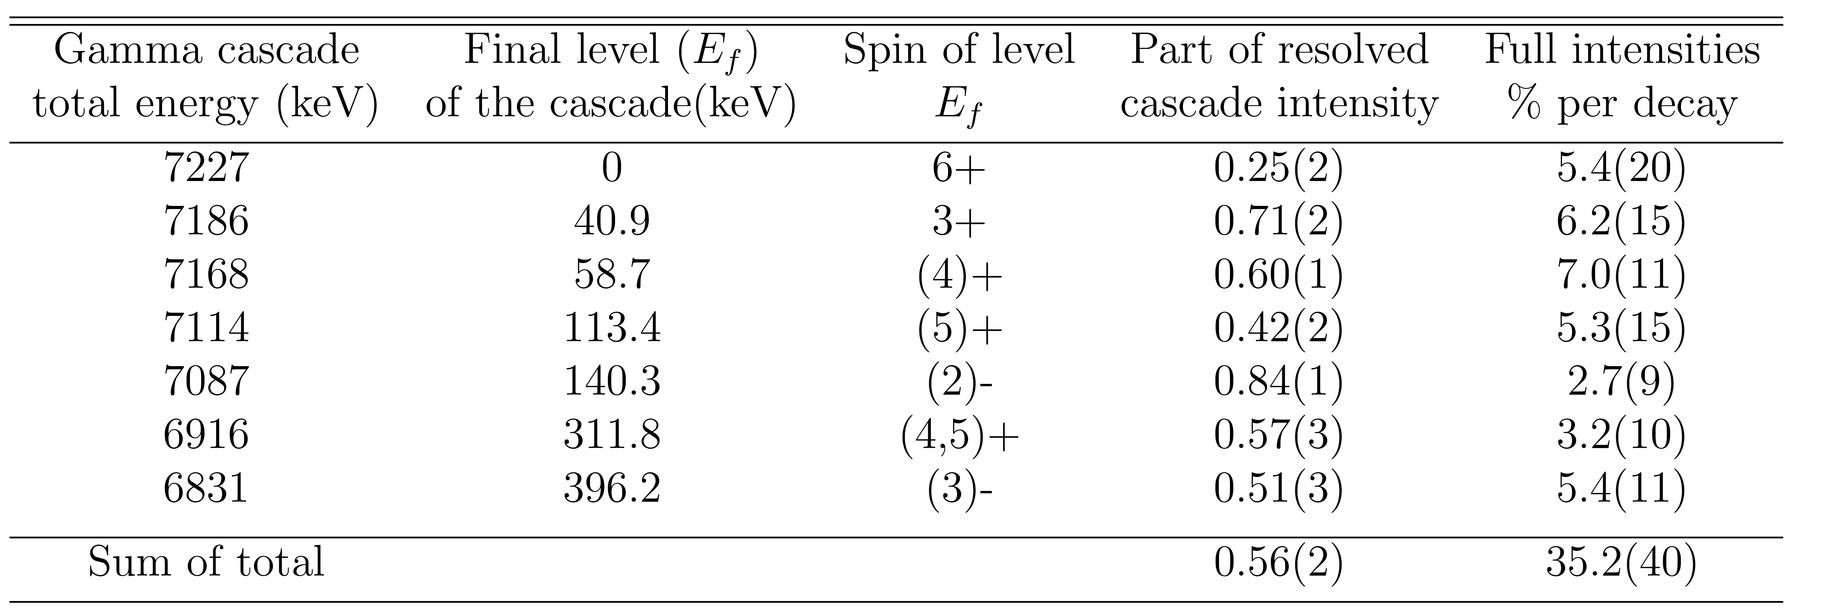
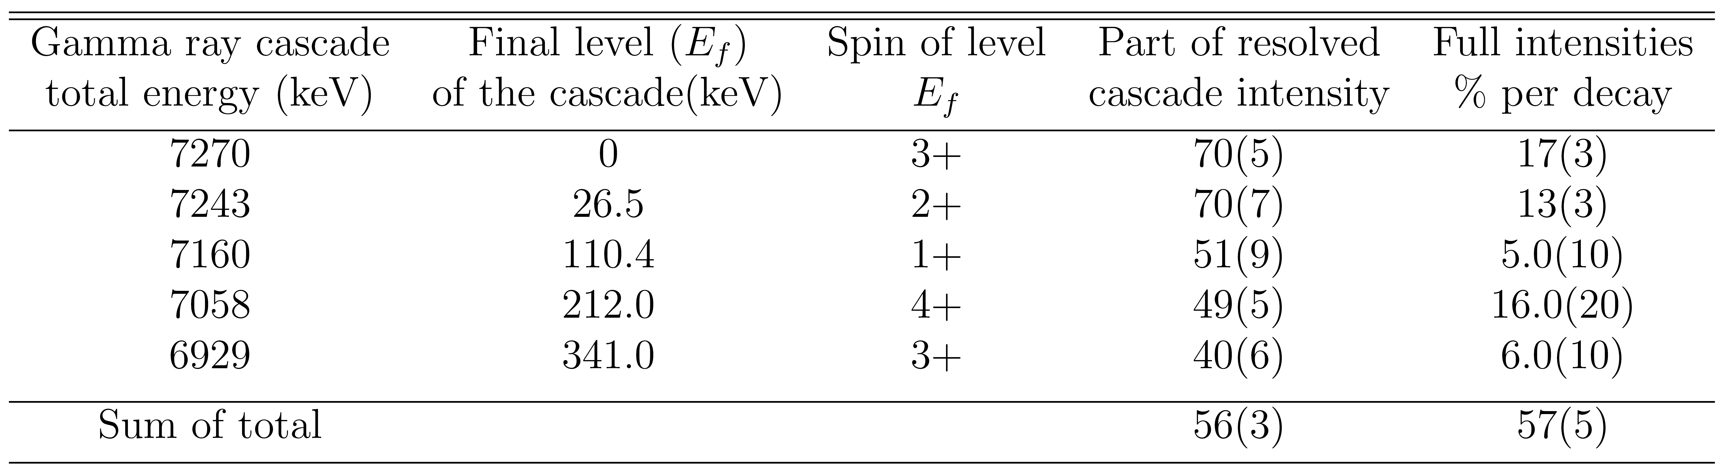
Spectrum of sums of amplitudes for coincident pulses (SACP)
⁹⁴Nb
⁵⁶Mn
ARIEL FINAL Workshop 2024

Slide 8
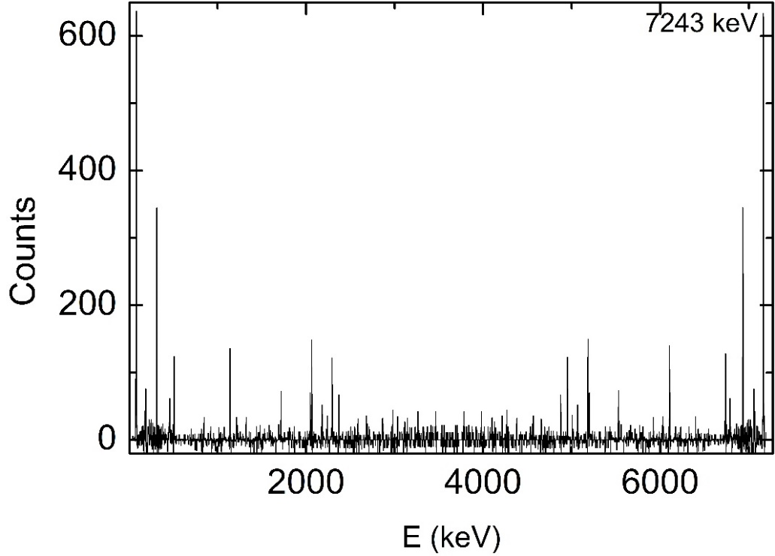
Determination of the level scheme
Two step gamma cascade (TSC) spectra
TSC spectra represent the cascades from the initial state to the defined final levels of the nucleus. The elimination of Compton background and random coincidences was done by gating on the region nearby the peaks of interest in the SACP spectrum.
The mirror-symmetrical peaks in the TSC spectra represent primary and secondary
transitions of the investigated two-step gamma cascade.
⁹⁴Nb
⁵⁶Mn
ARIEL FINAL Workshop 2024

Slide 9
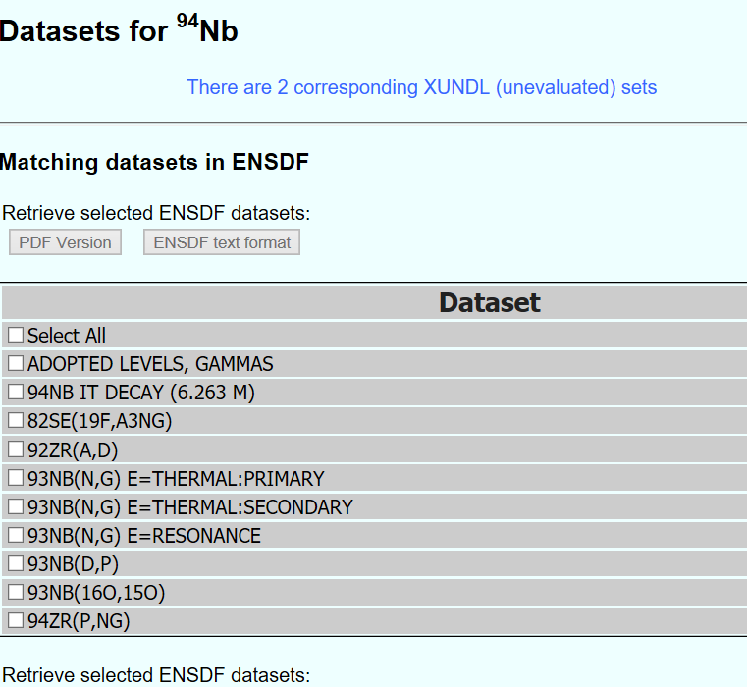
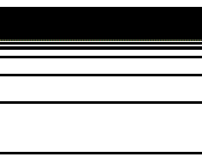
Determination of the level scheme
The order of the gamma quanta
The order of the gamma quanta in the cascade was determined using the maximum likelihood function.
Results obtained in this way were checked with two rules:
If the same gamma ray appears in multiple cascades, it is assumed that it is the primary gamma in the cascade.
If the primary or secondary gamma recorded is already included in the ENSDF database, its place in the cascade is assigned accordingly.
Neutron binding energy
Continuum
Intermediate level
1st excited state
Ground state
ARIEL FINAL Workshop 2024

Slide 10
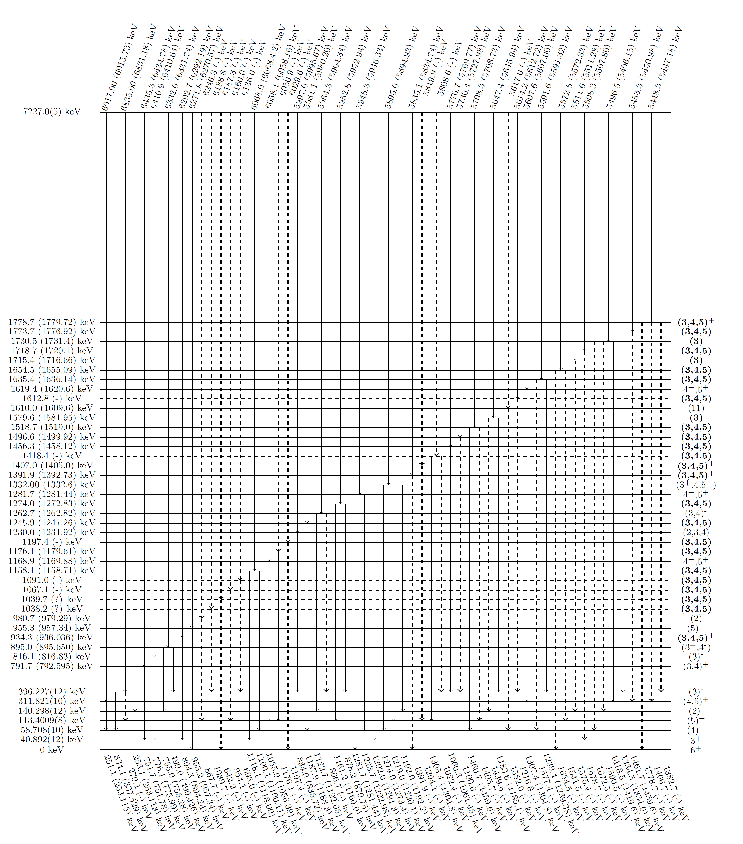
Spectroscopic results for ⁹⁴Nb
⁹⁴Nb
216 energy resolved cascades and, as a result of comparison with ENSDF library data:
27 recommendations for new primary transitions
29 recommendations for new energy levels
183 recommendations for new secondary transitions.
Knezevic et al. Nuclear Physics A, 993 (2020) 121645
ARIEL FINAL Workshop 2024

Slide 11
Spectroscopic results for ⁵⁶Mn
⁵⁶Mn
71 energy resolved cascades and, as a result of comparison with ENSDF library data:
23 recommendations for new primary transitions
24 recommendations for new energy levels
32 recommendations for new secondary transitions.
Knezevic et al. Nuclear Physics A, 992 (2019) 121628
ARIEL FINAL Workshop 2024

Slide 12

Intensity of two-step gamma cascades:
Important: The intensity of the cascade as a function of the energy of primary quanta of the cascade depends on the number of available levels as well as the partial widths of γ transition.
SACP spectra
Total intensity of two-step gamma cascades, I_{γγ}
ARIEL FINAL Workshop 2024

Slide 13
Practical model of the cascade gamma-decay
Constructing a model to explain the experimental data: Phenomenological and theoretical representations are combined.
The model of level density
The parametrized model of Strutinsky for density of n quasi-particle nuclear excitations.
Increase of a density of collective levels – a phenomenological relation between entropies of phases of the nuclear matter with taking into account a cyclical breaking of Cooper pairs.
ARIEL FINAL Workshop 2024

Slide 14
Practical model of the cascade gamma-decay
Constructing a model to explain the experimental data: Phenomenological and theoretical representations are combined.
The model for E1- and M1-transition strength functions
KMF (Kadmenskij, Markushev, Furman) + peaks in the functions
ARIEL FINAL Workshop 2024

Slide 15
Practical model of the cascade gamma-decay
Constructing a model to explain the experimental data: Phenomenological and theoretical representations are combined.
Proposed fitted parameters for our model:
the break up thresholds energies U_{l} up to l=4,
2) the E_{μ} and E_{ν} parameters, which are common for all Cooper pairs
3) the mutually independent parameters A_{l} of the density of vibrational levels above the break up threshold U_{l}
4) the coefficients w, κ and β
5) the ratio r of negative parity and the total level density.
ARIEL FINAL Workshop 2024

Slide 16
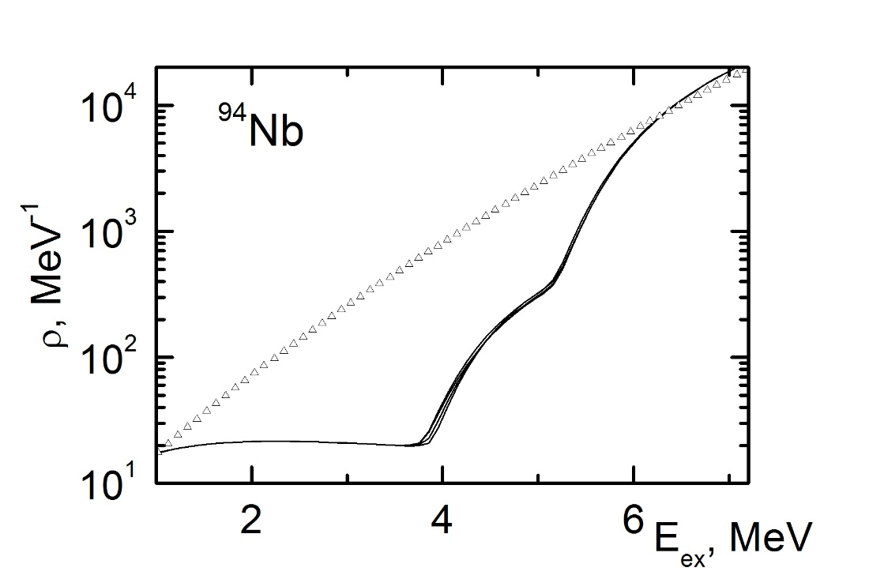
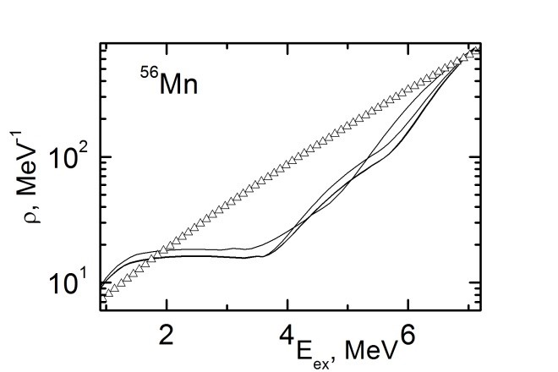
LD results
⁹⁴Nb
⁵⁶Mn
Multiple lines on every graph represent the fitting of data by varying fitting parameters.
LD data is compared to the BS Fermi gas model predictions.
ARIEL FINAL Workshop 2024

Slide 17
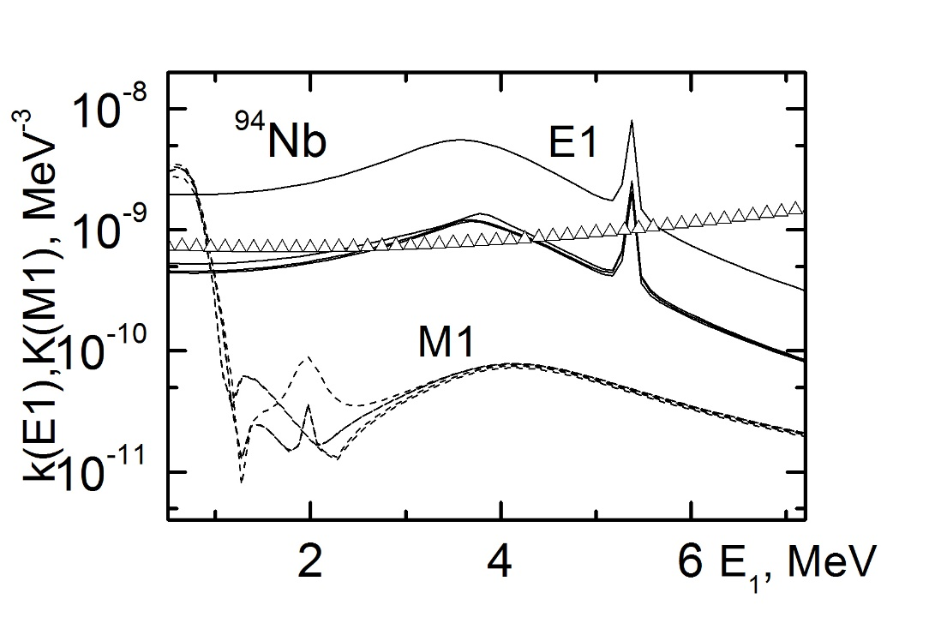
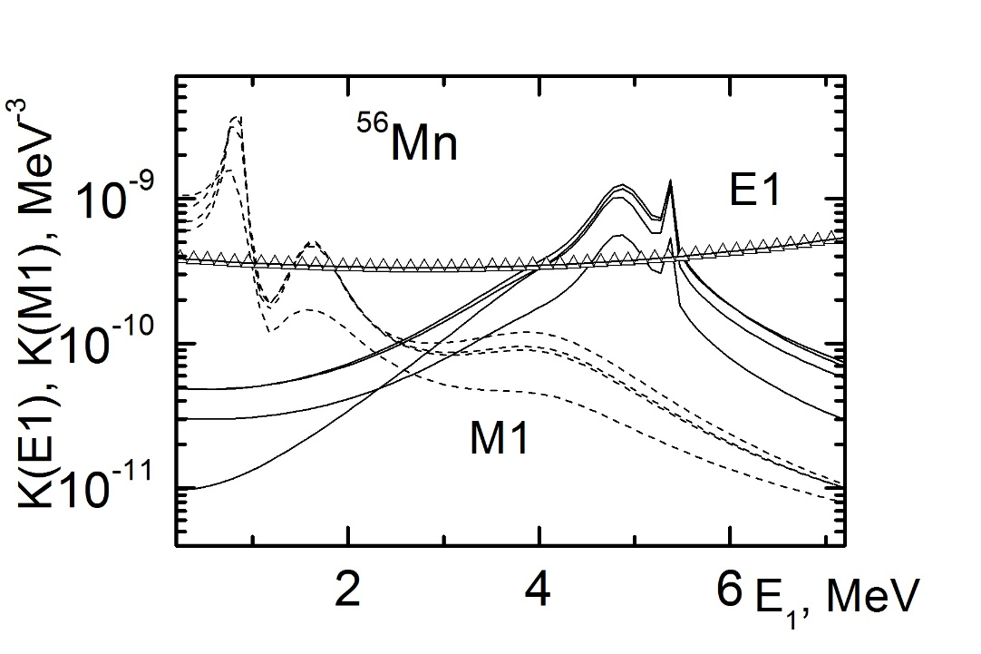
RSF results
⁹⁴Nb
⁵⁶Mn
Multiple lines on every graph represent the fitting of data by varying fitting parameters.
RSF data is compared to the KMF model predictions.
ARIEL FINAL Workshop 2024

Slide 18
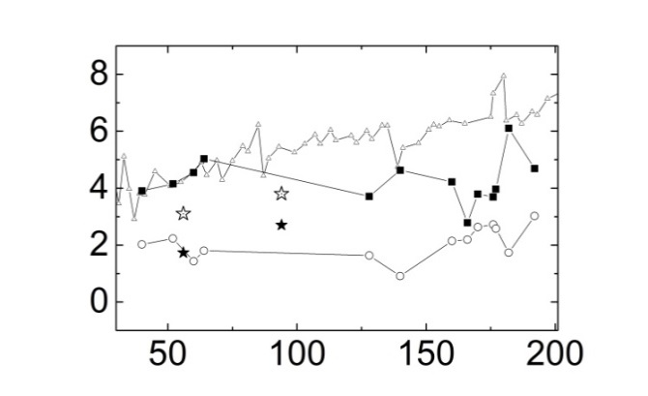
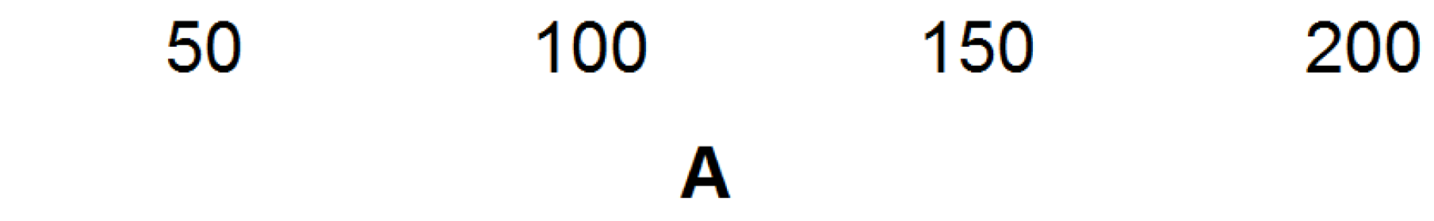
Cooper pairs braking points
Odd-odd nuclei
Even-even and even-odd nuclei
⁵⁶Mn and ⁹⁴Nb are both odd-odd
A
Experimentally derived breaking thresholds of Cooper pairs make it possible to study the dynamics of superfluid phase of nuclear matter (future plans: theoretical calculations).
ARIEL FINAL Workshop 2024

Slide 19
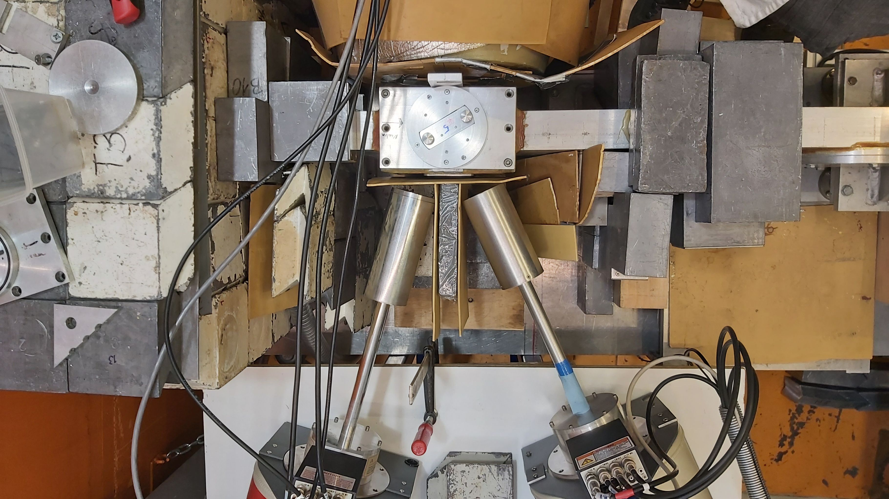
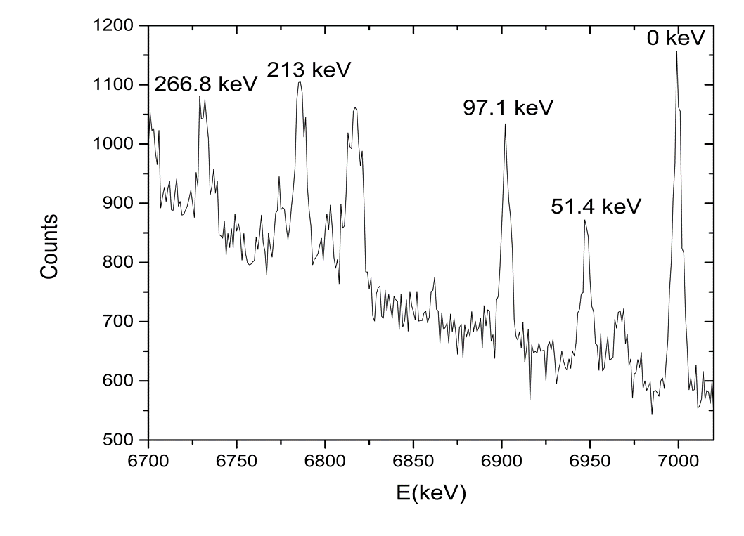
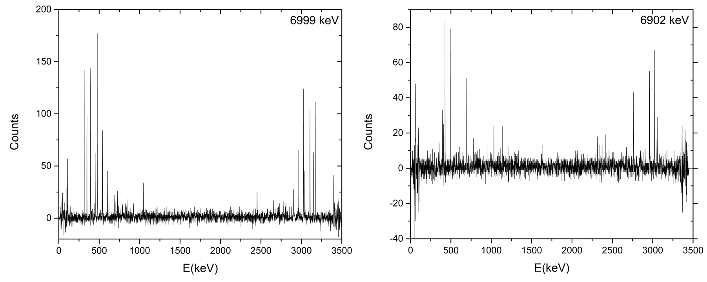
Measurement of ¹⁰⁴Rh
SV_2_4
ARIEL FINAL Workshop 2024

Slide 20
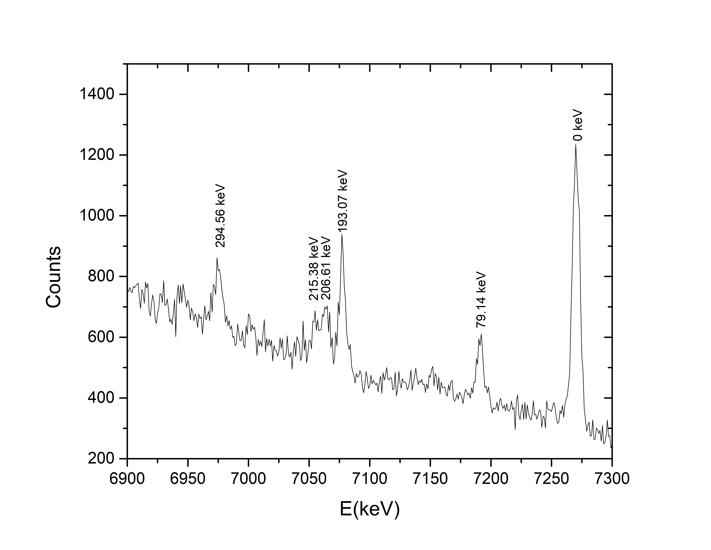
Measurement of ¹⁰⁸Ag
TAA_6_7
Enriched ¹⁰⁷Ag target (99.07%)
ARIEL FINAL Workshop 2024

Slide 21
SINDA – project overview
Join
Additional acknowledgments
SINDA – Science driven Improvement of Nuclear DAta
1. Technical University of Munich - Forschungs-Neutronenquelle Heinz Maier-Leibnitz (FRM II), Garching, Germany and 2. Faculty of Scinece, University of Novi Sad
- two years project 2022-2024
- support by DAAD and Ministry of Science, Republic of Serbia
Objectives:
1. Research: Obtaining new nuclear data (Nuclei of interest: ¹⁰⁸Ag, ¹¹⁰Ag, ¹⁵⁶Gd, ¹⁵⁸Gd, Reaction: (n,γ) and (n,2γ))
2. Education: Research experience and training at international level for young scientists; improvement of MSc and PhD studies and Serbia; exchange of knowledge between participating institutions
3. International collaboration: Strengthening of current collaboration; planning of future activities; involvement of new participants in the collaboration
MLZ's new group "Data Evaluation Group - DEVA" was very helpful for SINDA project
EvalSpek-ML: Development and evaluation of machine learning algorithms for the analysis of convex combined spectral data
ARIEL FINAL Workshop 2024

Slide 22
Conclusion
Two-step gamma cascade model can help improve the level scheme and gamma transition data.
Practical model of the cascade gamma-decay developed can go beyond the spectroscopic data and provide information about the LD and RSF (It was previously done for 44 nuclei).
Current and future work
Already measured: ⁹⁴Nb, ⁵⁶Mn, ¹⁰⁴Rh, ¹⁰⁸Ag.
Finished (spectroscopic part): ⁹⁴Nb, ⁵⁶Mn
In preparation (spectroscopic part): ¹⁰⁴Rh, ¹⁰⁸Ag.
Future plans:
- Level density studies for ⁹⁴Nb, ⁵⁶Mn, ¹⁰⁴Rh and ¹⁰⁸Ag.
- Application of ANN in data analysis
ARIEL FINAL Workshop 2024

Slide 23
Thank you for your attention!
ARIEL FINAL Workshop 2024

