Slide 1
Cross-Section Measurements Using Enriched Ge samples at the IRSN AMANDE facility
School of Applied Mathematical and Physical Sciences
National Technical University of Athens
National Centre for
Scientific Research “Demokritos”
S. Chasapoglou¹, M. Diakaki¹, R. Vlastou¹, M. Kokkoris¹, R. Babut², N. Magalotti²
¹National Technical University of Athens ²IRSN Institut de Radioprotection et de Sureté Nucléaire
ARIEL Final Workshop 17-19 January 2024

Slide 2
Motivation
Practical applications of Ge (n,x) reactions
Dosimetry
Nuclear medicine
Astrophysical projects
Used in γ-ray detectors
The use of highly enriched Ge isotopes yields more accurate experimental results with respect to ^{nat}Ge .
Fundamental Research
Cross sections on (n,p) reactions of elements with several stable isotopes reveal a decreasing trend with increasing neutron excess in the target nucleus (isotopic effect).
(n,x) reactions in Ge isotopes produce residual nuclei in high spin isomeric states. Experimental determination of these cross sections is of major importance for the study of the residual nucleus.
Discrepant experimental data above 14 MeV in (n,x) reactions on Ge isotopes, where ^{nat}Ge targets are most commonly used and theoretical corrections are inevitable.
Discrepant evaluations above 14 MeV
No interfering reactions from neighboring isotopes$→$no theoretical corrections needed
Accurate cross section results act as a sensitive test for the theoretical corrections and statistical model calculations
Easy to study isotopes with low natural abundance

Slide 3
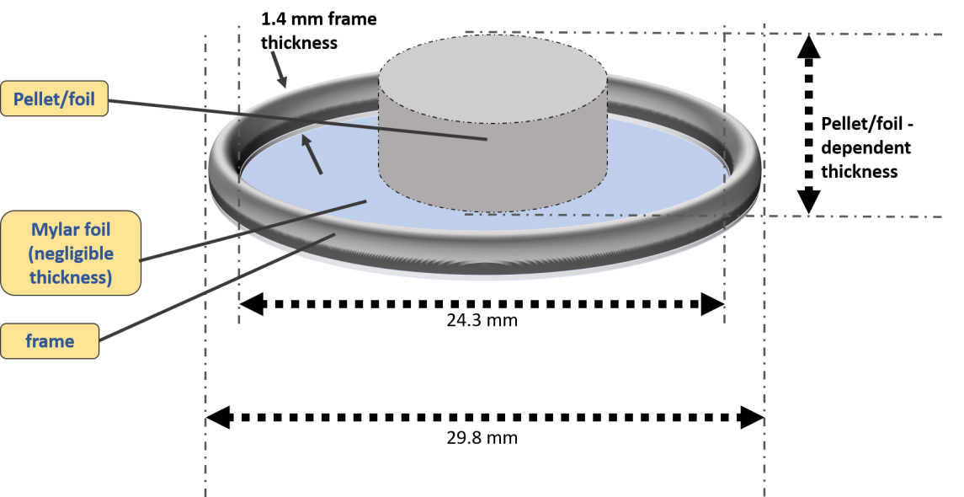
Ge Targets
Target/Isotopic distribution (%) | $${}_{}^{70}{Ge}$$ | $${}_{}^{72}Ge$$ | $${}_{}^{73}Ge$$ | $${}_{}^{74}Ge$$ | $${}_{}^{76}Ge$$
$${}_{}^{70}{Ge}$$ | 97.71 | 2.23 | 0.02 | 0.03 | 0.01
$${}_{}^{72}Ge$$ | 0.35 | 96.59 | 2.86 | 0.20 | 0.01
$${}_{}^{73}Ge$$ | 0.04 | 2.84 | 96.07 | 1.03 | 0.02
$${}_{}^{74}Ge$$ | 1.46 | 0.18 | 0.45 | 95.51 | 2.40
$${}_{}^{76}Ge$$ | 0.06 | 0.09 | 0.06 | 11.33 | 88.46
$${}_{}^{nat}Ge$$ | 20.52 | 27.45 | 7.76 | 36.52 | 7.75
Al frame
Ge target
Target holder
Provided by the n_TOF collaboration (CERN)
Back view
The activation technique was used for the cross section measurement of ${}_{32}^{A}Ge\left(n,x\right)Y$reactions
High purity reference Al metallic foils were used
Top view

Slide 4
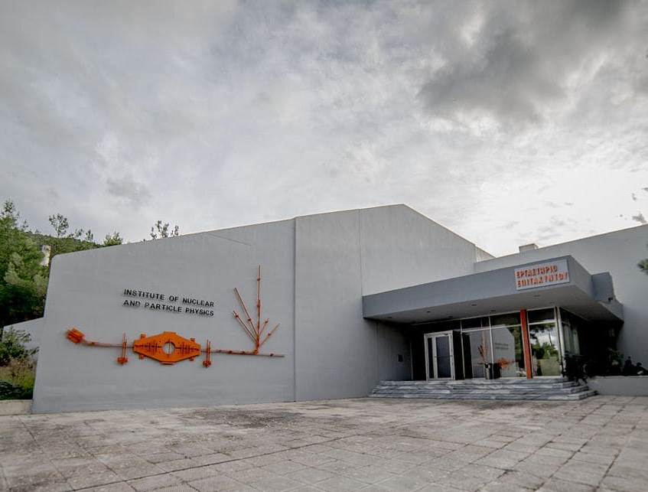
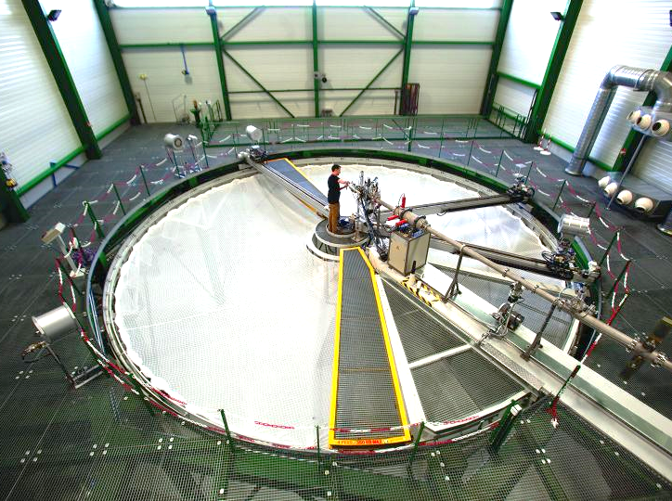
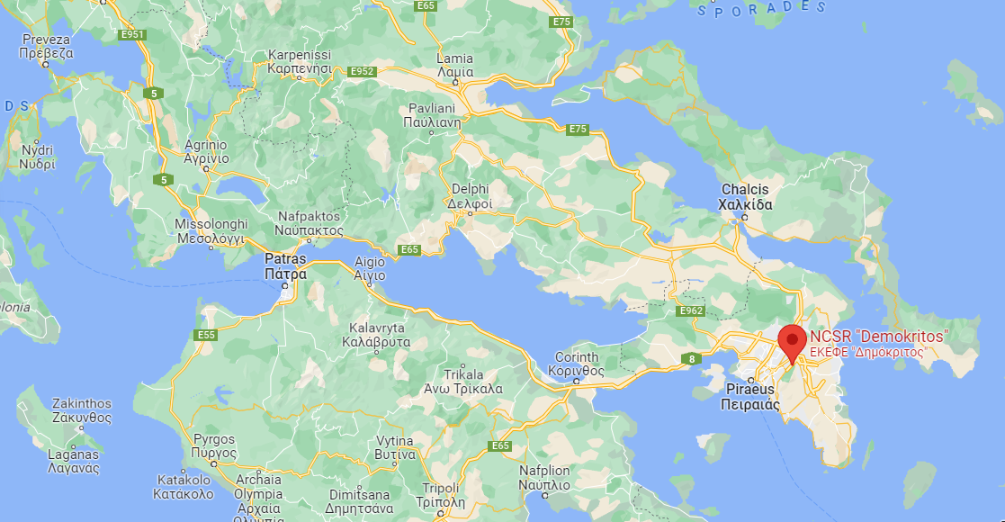
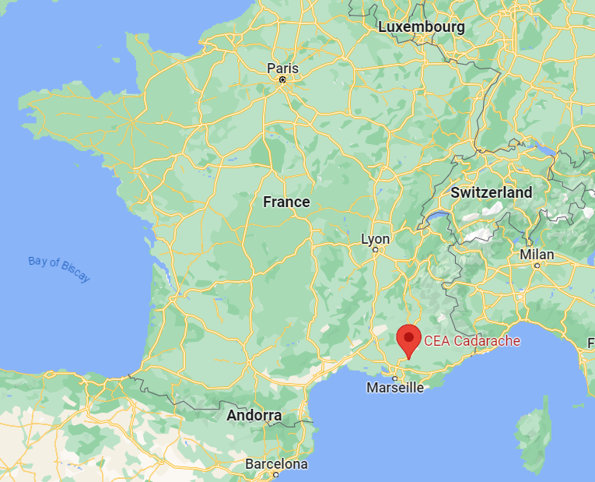
Neutron Induced Cross-Section Measurements @
NCSR “Demokritos” - Athens, Greece
“AMANDE” Facility – IRSN, France @ CEA Cadarache

Slide 5
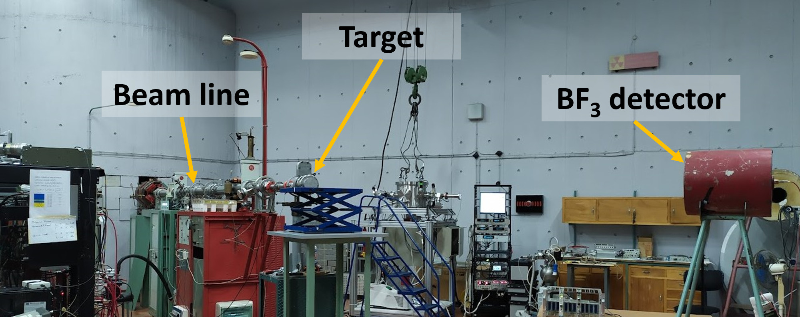
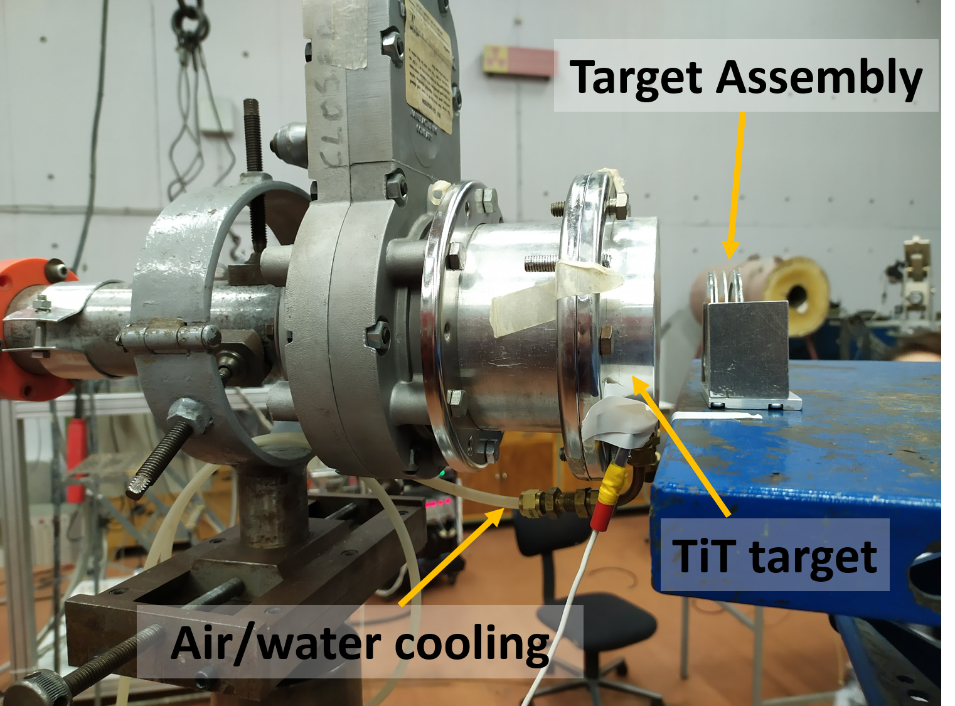
Neutron Facility – NCSR “Demokritos”
Ion beam
Quasi-monoenergetic neutron beams are produced in the energy range ~ 16 – 19 MeV via the ³H(d,n)⁴He reaction
2.1 μg/cm² TiT layer on a 1 mm Cu backing (373 GBq)
After the upgrade, the deuteron beam current on the TiT was measured to be higher by a factor of 10, relative to previous measurements.
Very stable beam conditions.
Neutron flux determined 10⁵ – 10⁶ n/cm²/s at 3.5 cm from the TiT target
Ion beam
Ion beam

Slide 6
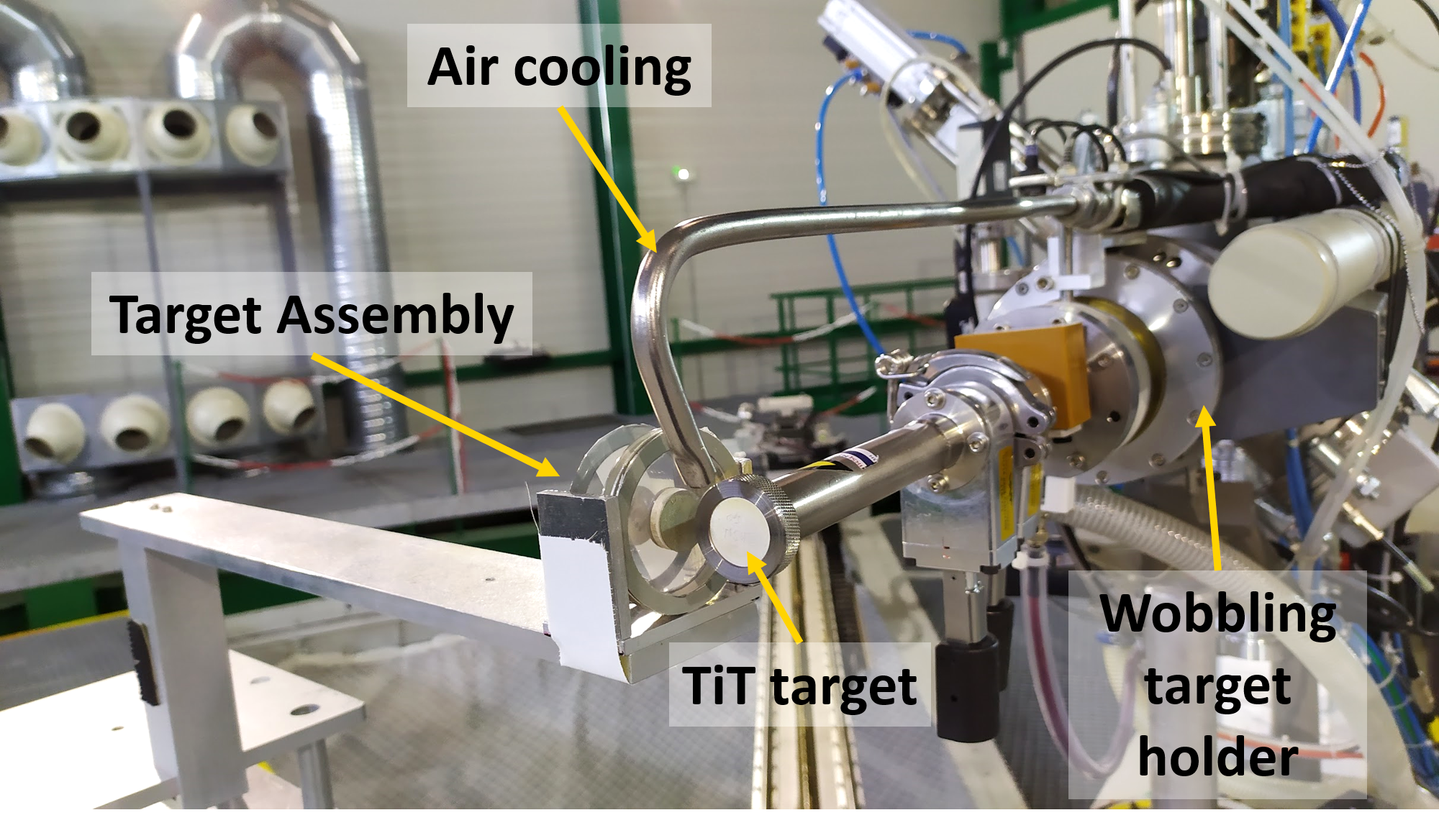
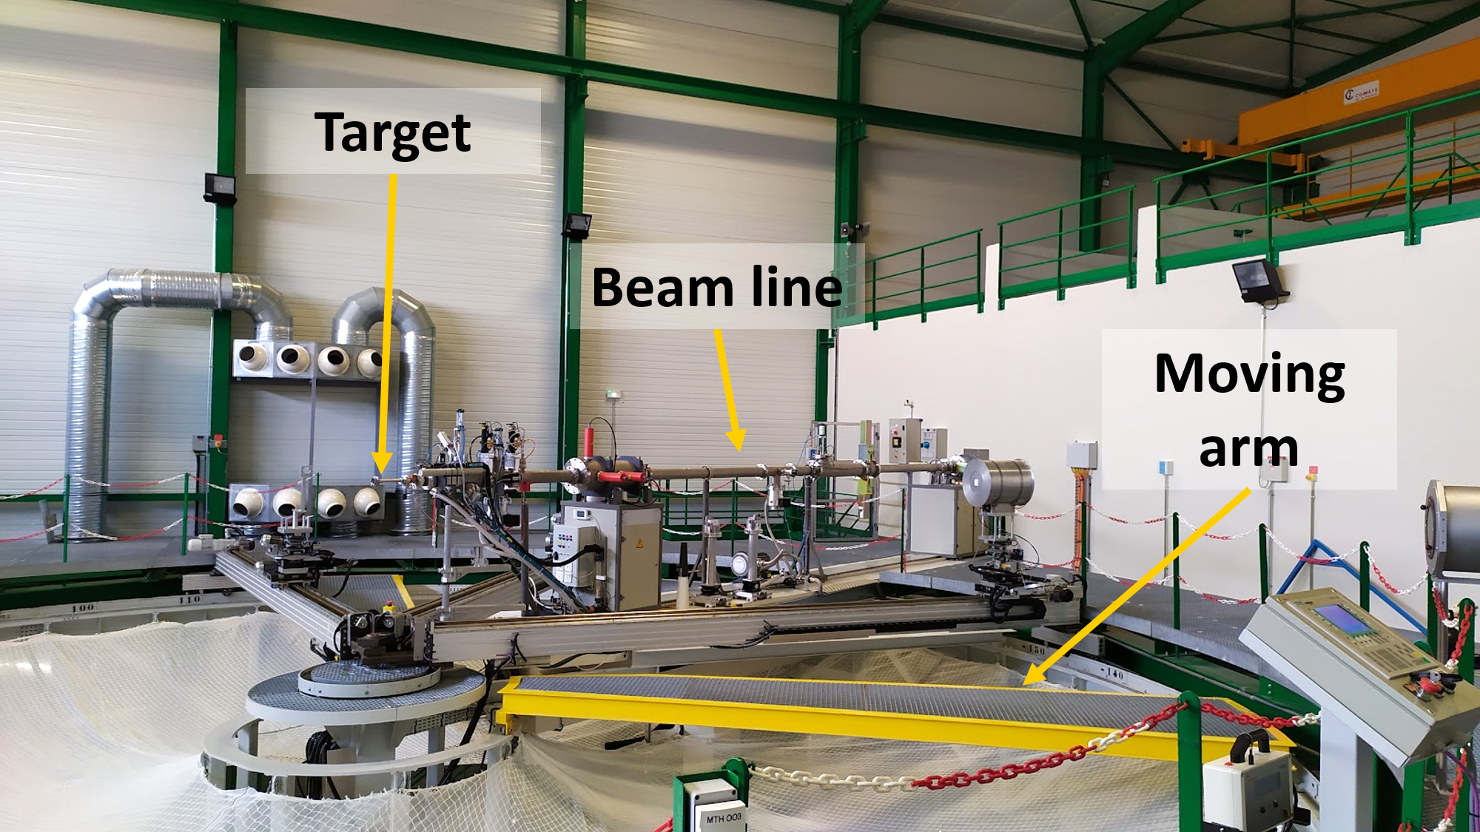
Neutron Facility – AMANDE
1 week visit Access to neutron facilities @ AMANDE, IRSN 30/1 – 3/2 2023
Quasi-monoenergetic neutron beams produced at 14 MeV via the ³H(d,n)⁴He reaction not possible at NCSR “D”
780 μg/cm² TiT layer
Very stable beam conditions.
Neutron flux determined 10⁶ – 10⁷ n/cm²/s at 2.5 cm from the TiT target and at a 100$°$ angle
Project name: ΤΑΑ 4_3 “Neutron induced cross section measurements on Ge isotopes at the AMANDE facility using mono-isotopic targets”
Spokesperson: Maria Diakaki
Contact person: Richard Babut
Ion beam
Ion beam

Slide 7
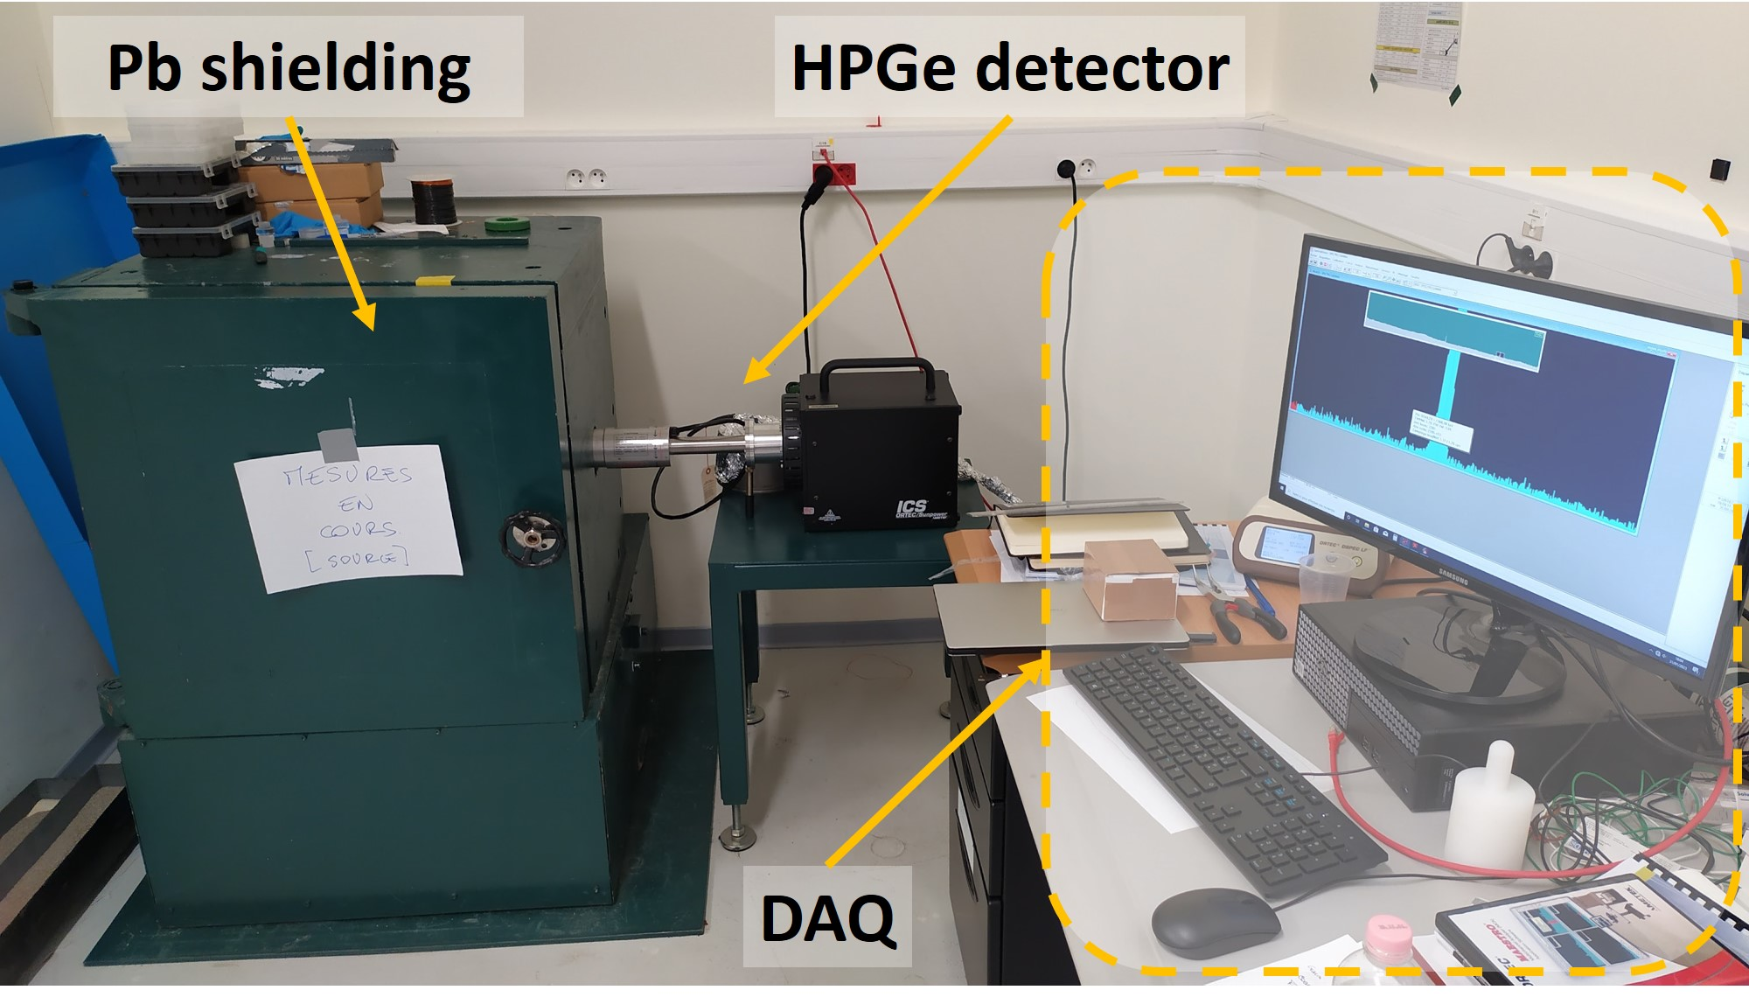
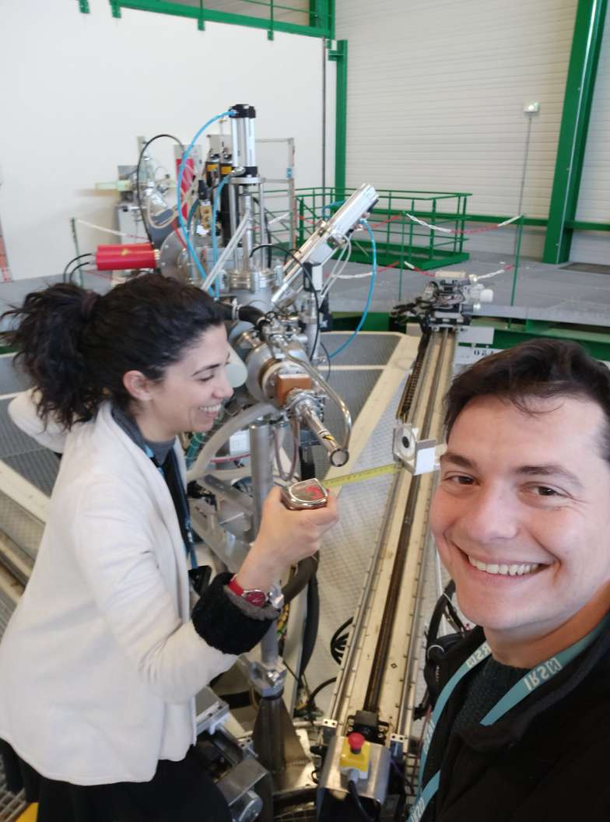
Neutron Facility – AMANDE
The induced radioactivity was measured via γ-ray spectroscopy
Very good Pb shielding
Local team (Richard Babut & Nelson Magalotti) very helpful – Excellent collaboration both before and during the measurements. Major help in the preparation of target holders, detector information etc.
Very successful experiment!
First activation experiment @ AMANDE $→$ fruitful exchange of expertise with the local team
Data analysis is complete
Very important contribution for my PhD thesis – constraint of the studied reactions in a wider energy range, complementing the data from NCSR “D”

Slide 8
Cross-Section Calculation - Activation
$$σ_{tar}=σ_{ref}∙\frac{N_{γ,tar}}{N_{γ,ref}}∙\frac{{\left(ε∙F∙I_{γ}∙D∙f_{c}∙N_{t}\right)}_{ref}}{{\left(ε∙F∙I_{γ}∙D∙f_{c}∙N_{t}\right)}_{tar}}∙\frac{Φ_{ref}}{Φ_{tar}}$$
$σ$ is the cross section in barns. The reference cross section for the ${}_{}^{27}Al{\left(n,α\right)}^{24}Na$was obtained from the ENDF/B-VIII.0 library.
$N_{γ}$ is the integral of the γ-ray peak, obtained from the spectrum of the HPGe detector
$ε=ε\left(E\right)$ is the absolute efficiency of the detector at the respective γ-ray energy
$F$ is a correction factor concerning the self-absorption of the γ-ray within the sample
$I_{γ}$ is the intensity of the γ-ray
$D=\exp\left(−λt_{1}\right)−exp⁡(−λt_{2})$
$t_{1}$ time interval between the end of the irradiation and the start of the measurement in the HPGe detector
$t_{2}$ time interval between the end of the irradiation and the end of the measurement in the HPGe detector
$f_{c}$ is a factor for the decaying nuclei during the irradiation, taking into account any needed correction for possible instabilities of the neutron beam
$N_{t}$ is the number of the total nuclei in the target
${Φ_{ref}}/{Φ_{tar}}$ is the neutron flux ratio between the reference Al foil and the measuring Ge target (Monte Carlo simulations)

Slide 9
Results ^{70,76}Ge(n,2n)^{69,75}Ge
⁷⁰Ge(n,2n)⁶⁹Ge
⁷⁶Ge(n,2n)⁷⁵Ge
Two general cross-section trends appear (possibly due to wrong Ι_{γ} values between the different available γ-rays ?)
Good agreement with the dataset of Hoang et al. and Pu Zhong-Sheng et al.
Fair agreement with the dataset of Konno et al. (enriched target)
The trend of the data of the present work is in agreement with the trend of Megha Bhike et al., Steiner et al. and with previous measurements from our group.
Contamination: ⁷⁵Ge(n,γ)⁷⁶Ge

Slide 10
Results ^{72,73}Ge(n,p)^{72,73}Ga
⁷³Ge(n,p)⁷³Ga
⁷²Ge(n,p)⁷²Ga
The trend of the data is followed by the dataset of Konno et al. and the ones from Hoang et al. at higher energies
Contamination: ⁷³Ge(n,np/d)⁷²Ga
The trend of the data is followed by the dataset of Konno et al. and the ones from Hoang et al. at higher energies
Contamination: ⁷⁴Ge(n,np/d)⁷³Ga, ⁷⁶Ge(n,α)⁷³Zn

Slide 11
Results ^{72,74}Ge(n,α)^{69m,72m}Zn
⁷²Ge(n,α)^{69m}Zn
⁷⁴Ge(n,α)^{72m}Zn
The trend of the data is followed by the dataset of Konno et al.
The dataset of Hoang et al. is lower than the cross-section values of the present work
Contamination: ⁷³Ge(n,α)^{69m}Zn
The trend of the data is followed by the dataset of Konno et al. and the one of Hoang et al.

Slide 12
Results ^{73,74}Ge(n,np/d)^{72,73}Ga
⁷³Ge(n,np/d)⁷²Ga
⁷⁴Ge(n,np/d)⁷³Ga
Reaction difficult to be studied with ^{nat}Ge targets
The trend of the data is followed by the dataset of Konno et al. which is the only one found in literature
Contamination: ⁷²Ge(n,p)⁷²Ga
Reaction difficult to be studied with ^{nat}Ge targets
The dataset of Konno et al. which is the only one found in literature, coincides in one data point
Great discrepancies with TENDL-2021
Contamination: ⁷³Ge(n,p)⁷³Ga

Slide 13
Results ⁷³Ge(n,nα)^{69m}Zn
Reaction difficult to be studied reaction with ^{nat}Ge targets
No other data were found in literature
Great discrepancies with TENDL-2021
Contamination: ⁷²Ge(n,α)^{69m}Zn

Slide 14
Phenomenological Investigation – EMPIRE 3.2.3
Nuclear Reaction Mechanisms
Compound Nucleus Reactions
Slow process (10⁻¹⁸ – 10⁻¹⁶ s)
Incident particle transfers its energy to all the nucleons
Thermodynamic equilibrium is reached before a particle escapes the nucleus
The exit channel is independent of the way the compound nucleus was formed (Bohr hypothesis)
Pre-equilibrium Reactions
Incident particle gradually loses its energy
A particle escapes the nucleus before thermodynamic equilibrium is reached
Some “memory” of the input channel is conserved
Direct Reactions
Fast process (10⁻²² s)
Incident particle interacts mainly with the peripheral nucleons
Part of the energy of the incident particle is transferred
Favored against compound nucleus reactions as projectile energy increases
Exciton model
MSD
MSC

Slide 15
Hauser-Feshbach Theory
The Hauser-Feshbach theory describes reactions following the compound nucleus mechanism
$$ρ_{C}(E_{C^{∗}})$$
Transmission coefficients $→$ Optical models
$$ε_{β}$$
$$ρ_{β}(E_{Β^{∗}})$$
$$ε_{α}$$
$$σ_{αβ}\left(J,S′\right)=\frac{π}{k_{α}^{2}}∙\frac{2J+1}{\left(2s+1\right)(2S+1)}∙\frac{{\sum_{l,j,l^{′},j^{′}}{T_{l}\left(ε_{α}\right){∙T}_{l^{′}}\left(ε_{β}\right){∙ρ}_{Β}\left(Ε_{Β}^{∗},S^{′}\right)}}_{}}{\sum_{γ,l^{′′},j^{′′} }{T_{γ,l^{′′}}{∙ρ}_{Γ}∙\left(Ε_{Γ}^{∗}\right)}}$$
Level densities $→$ different models
$$Q(C^{∗}→B+β)$$
Remarks
Transmission coefficients calculated from optical models (RIPL-3) more sensitive in the low energy region (near reaction threshold)
Level density models and pre-equilibrium effects more sensitive in the high energy region
Choice of a coherent set of parameters for the reproduction of all reaction channels simultaneously, taking into account all the available data
$$Compound \\ nucleus C^{∗}$$
$$a+A→C^{∗}→B+β$$

Slide 16
First step: n-OMP & level density model
⁷⁰Ge(n,2n)⁶⁹Ge
⁷⁶Ge(n,2n)⁷⁵Ge
Optical model of B. Morillon and P. Romain (RIPL-3 #2411)
Level density model: EGSM (levden=0)
Optical models for protons, alphas, deuterons, tritons and ³He were left at default values
All pre-equilibrium parameters were left at default values (MSD, MSC activated (=1), PCROSS=1.5)
The ^{70,76}Ge(n,2n)^{69,75}Ge reactions are very well reproduced

Slide 17
Second step: p-OMP
Optical model of A. J. Koning, J. P. Delaroche (RIPL-3 #5405)
Pre-equilibrium mechanism via exciton model modified only for the following nuclei : ⁷²Ge: PCROSS=1.2 ⁷³Ge: PCROSS=0.6 ⁷⁴Ge: PCROSS=0.6
Level density model and n-OMP as before
Optical models for alphas, deuterons, tritons and ³He were left at default values
⁷³Ge(n,p)⁷³Ga
⁷²Ge(n,p)⁷²Ga
⁷⁴Ge(n,np/d)⁷³Ga
⁷³Ge(n,np/d)⁷²Ga

Slide 18
Third step: α-OMP
⁷²Ge(n,α)^{69m}Zn
⁷⁴Ge(n,α)^{71m}Zn
Optical model of V. Avrigeanu, P. E. Hodgson, and M. Avrigeanu (RIPL-3 #9600)
$\tilde{a}$ tune on the residual nuclei: ⁶⁹Zn: ATILNO=0.81 (default value: 1)
Level density model, n-OMP and p-OMP as before
Pre-equilibrium mechanism via exciton model left as before: ⁷²Ge: PCROSS=1.2 ⁷⁴Ge: PCROSS=0.6
Optical models for deuterons, tritons and ³He were left at default values
⁷³Ge(n,nα)^{69m}Zn

Slide 19
Conclusions – Future Perspectives
Five enriched Ge targets (^{70,72,73,74,76}Ge) were employed for the measurement of 9 reaction channels ^{70,76}Ge(n,2n)^{69,75}Ge, ^{72,73}Ge(n,p)^{72,73}Ga, ^{72,74}Ge(n,α)^{69m,71m}Zn, ⁷³Ge(n,np/d)⁷²Ga, ⁷⁴Ge(n,np/d)⁷³Ga and ⁷³Ge(n,nα)^{69m}Zn in the high MeV energy range (14-19 MeV), where no other data (above 17 MeV) or few and discrepant data exist, implementing the activation technique.
Accurate cross section data produced from such targets can act as a very important constraint in statistical model calculations
Theoretical investigation of all reaction channels from the threshold of each reaction $→$ Very good reproduction of all reaction channels using the same set of input parameters, including data in lower energies
Need for accurate cross-section data in the high MeV energy region
Despite their cost and difficulty to obtain, selected measurements with enriched targets in key medium-heavy isotopes can vastly improve the quality of statistical model calculations and future evaluation libraries
Extension of the theoretical study in neighboring isotopes with technological or theoretical interest (e.g. ⁷⁵As NEA Nuclear data high priority request list for dosimetry)

Slide 20
Thank you very much for your attention!
The research work was supported by the Hellenic Foundation for Research and Innovation (HFRI) under the 3rd Call for HFRI PhD Fellowships (Fellowship Number: 5597)
The research work was funded by the Basic Research Program PEVE 2021 of the National Technical University of Athens.
This project has received funding from the Euratom research and training programme 2014-2018 under grant agreement No 847594 (ARIEL)

