Slide 1
Assessment of the feasibility of measuring neutron-induced reactions at a laser-driven neutron beam
ARIEL FINAL WORKSHOP (IJC Lab, Orsay, France)
17 - 19 JANUARY 2024
M. A. Millán-Callado^{1,2,*}, C. Guerrero^{1,2}, A. Alejo³, S. Assenbaum⁵, J. Benlliure³, R. Beyer⁴, B. Fernández²,
E. Griesmayer^{6,7,8}, A. R. Junghans⁴, J. Kohl⁹, F. Kroll⁵, I. Prencipe⁵, J. M. Quesada¹, C. Rödel⁹,
T. Rodríguez-González^{1,2}, S. Scheuren⁹, U. Schramm⁵, S. Urlass⁴, C. Weiss^{6,8} and K. Zeil⁵
1 Dpt. Física Atómica, Molecular y Nuclear (FAMN), Facultad de Física. Universidad de Sevilla (US), Sevilla, Spain.
2 Centro Nacional de Aceleradores (CNA, US - Junta de Andalucía – CSIC), Sevilla, Spain.
3 Instituto Galego de Física de Altas Enerxías, Universidad de Santiago de Compostela (IGFAE-USC), Santiago de Compostela, Spain.
4 Institute of Radiation Physics, Dpt. Nuclear Physics, Helmholtz-Zentrum Dresden-Rosendorf (HZDR), Dresden, Germany.
5 Institute of Radiation Physics, Dpt. Laser Particle Acceleration, Helmholtz-Zentrum Dresden-Rosendorf (HZDR), Dresden, Germany.
6 CIVIDEC Instrumentation GmbH, Wien, Austria.
7 Faculty of Electrical Engineering and Information Technology, Technische Universität Wien, Wien, Austria.
8 Atominstitut, Technische Universität Wien, Wien, Austria.
9 Institute for Nuclear Physics, Technische Universität Darmstadt, Darmstadt, Germany.

Slide 2
1.INTRODUCTION
COMPACT NEUTRON SOURCES AND LASER ACCELERATION

Slide 3
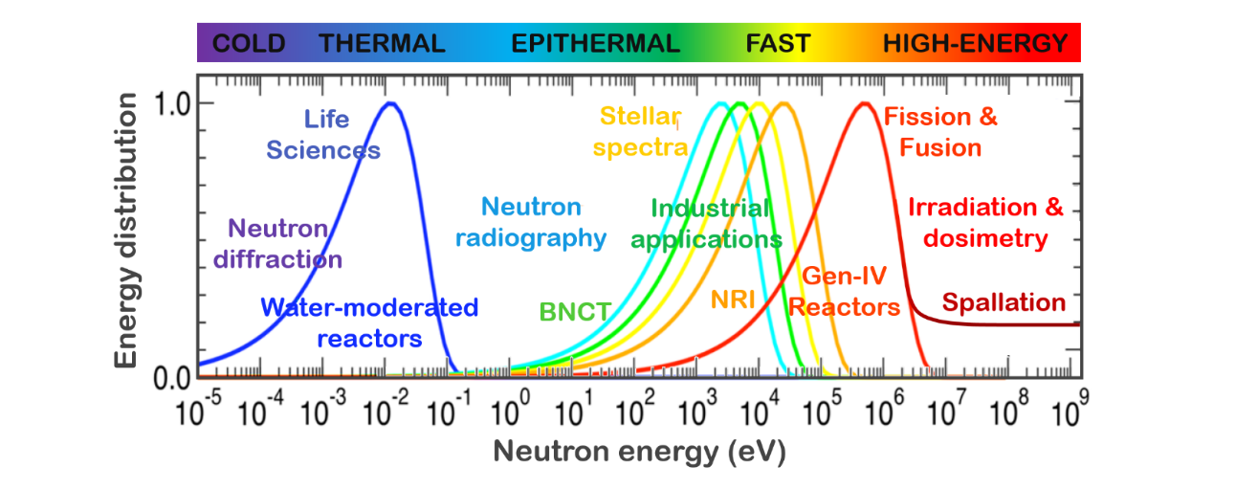
NEED FOR SMALL-SCALE NEUTRON SOURCES
Image credit: F. Gunsing and then_TOF collaboration
EAR1 @200 m
1,4 GeV
Booster
50 MeV Linac
20 GeV PS
Restricted transfer of knowledge outside a research center.
Not exploited to their full capacity.
Limited availability
Huge size and complexity of conventional high intensity neutron sources.
Progressive shut down of research reactors.
n_TOF@CERN spallation source Accelerators chain extended for about 1 km
Collaboration > 30 institutions
WHY?

Slide 4
“
There is a general belief […] that neutron methods are an emerging technique and not exploited to their full capacity. This is partly due to the fact that useful neutron beams can only be generated at advanced research reactors and/or high energy neutron spallation sources.
- IAEA-TECDOC-1439, Development opportunities for small scale accelerator driven neutron sources, Report of a technical meeting, Vienna, 18-21 May 2004
”

Slide 5
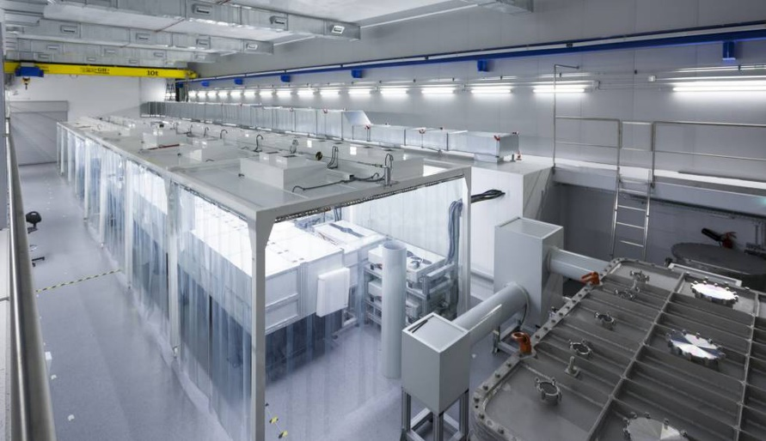
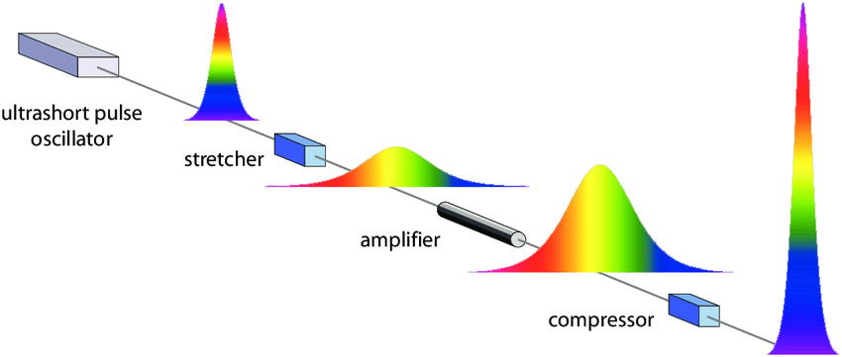
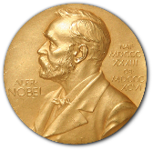
LASER-DRIVEN NEUTRON SOURCES
PW Laser VEGA@CLPU (Salamanca, SPAIN)
World-class table-top lasers:
Short pulse duration (few fs)
High repetition rate, typically 1-10 Hz
High power (~PW range)
Intensities exceeding 10²¹ W/cm²
Technology in fast development → Next generation of multi-PW lasers (up to 10 PW) under construction (about 1 shot/minute)
CPA PRINCIPLE

Slide 6
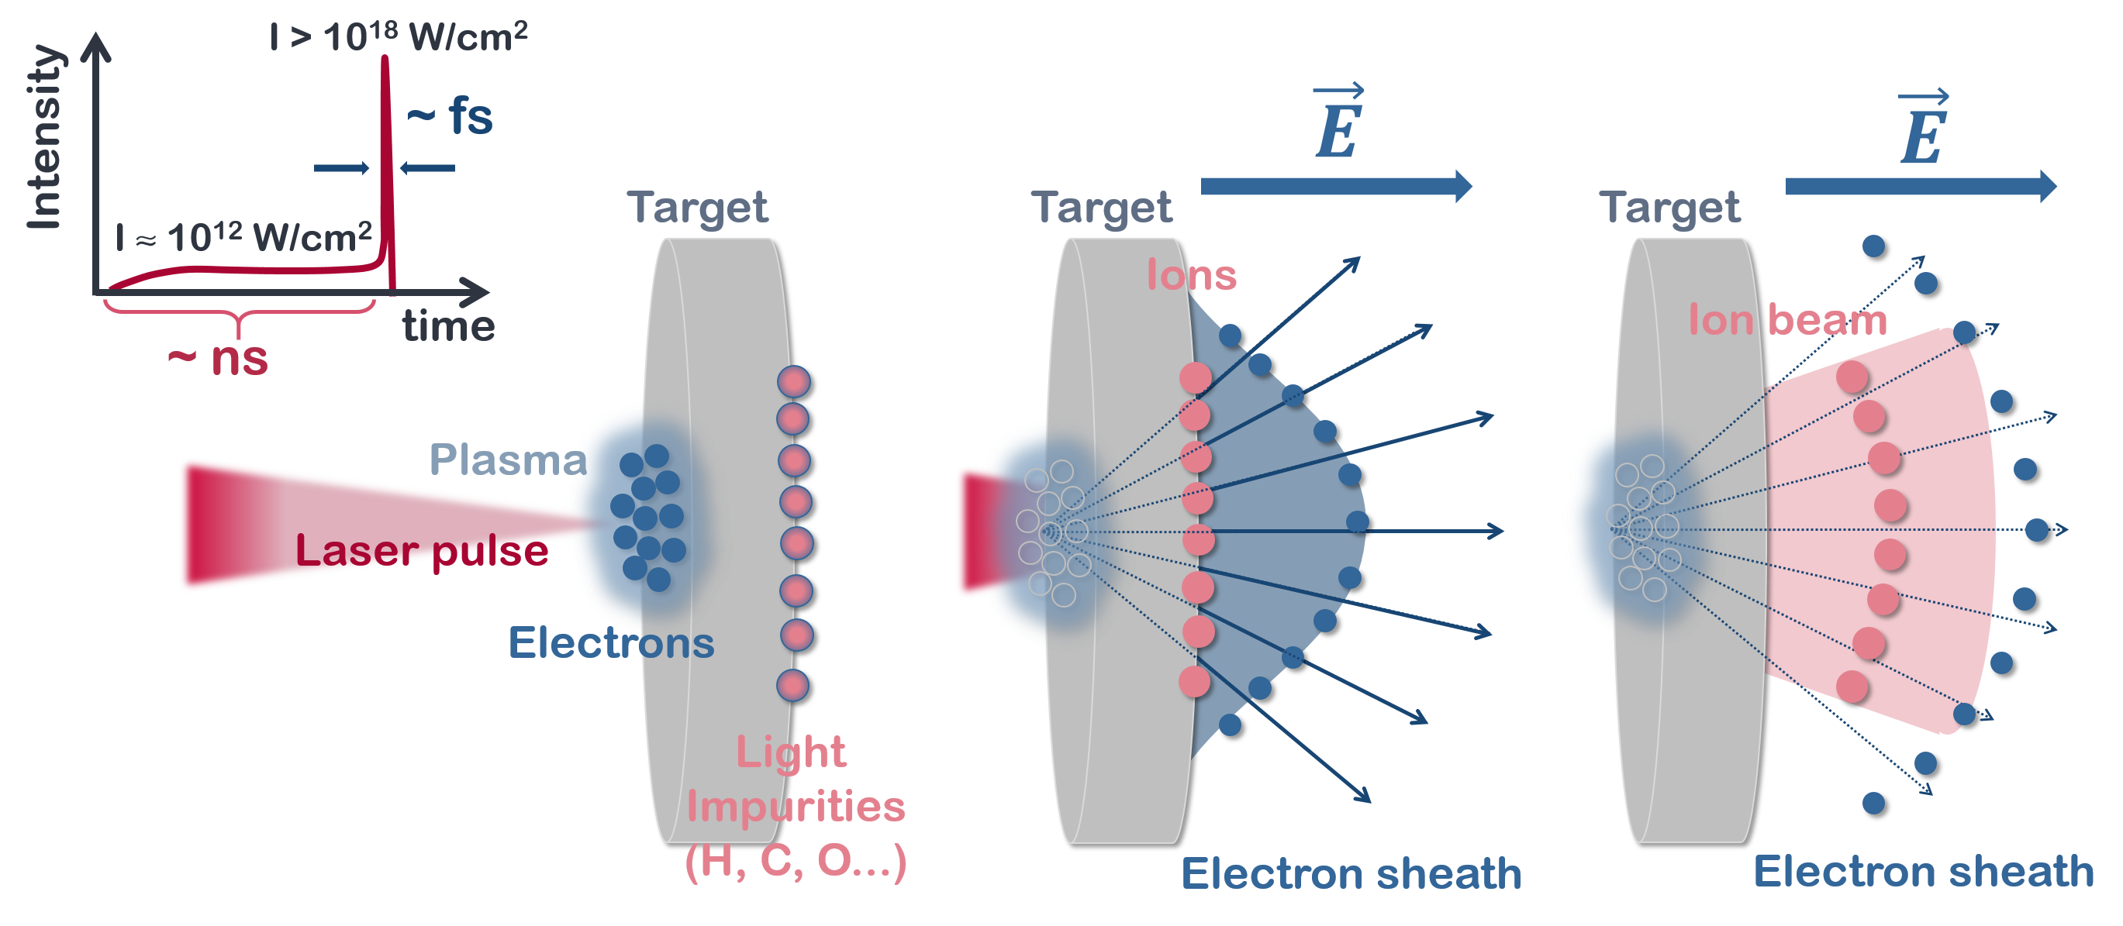
LASER-DRIVEN NEUTRON SOURCES: TARGET NORMAL SHEATH ACCELERATION (TNSA)

Slide 7
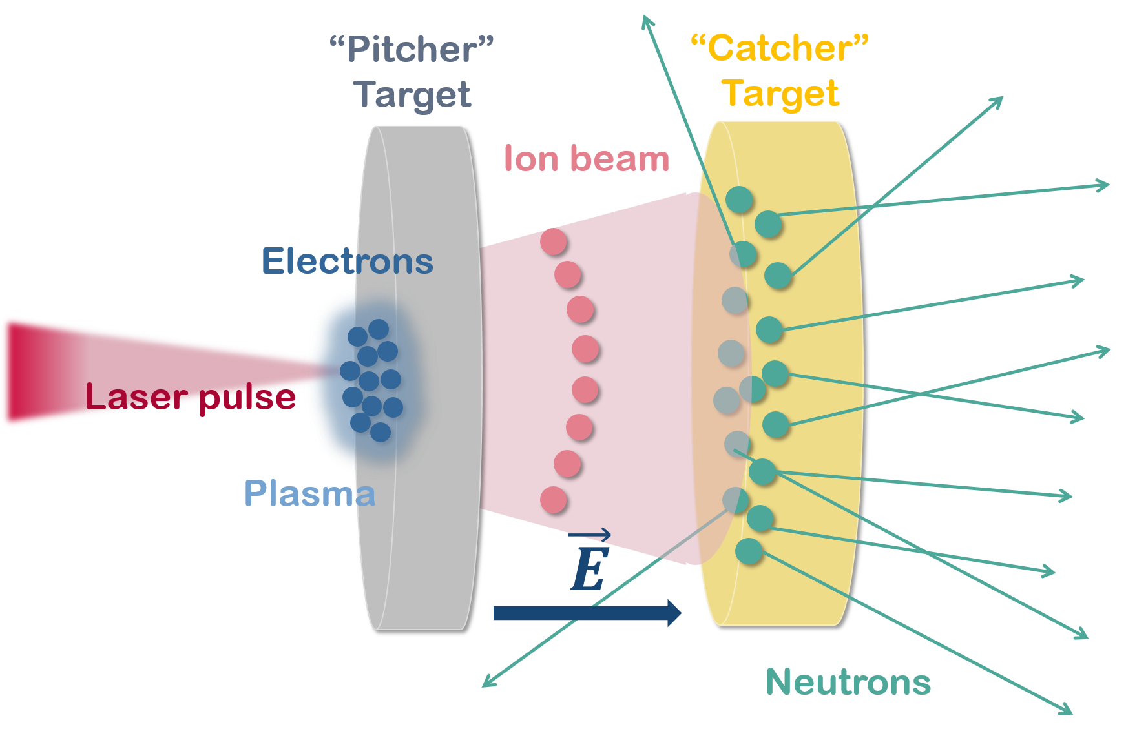
LASER-DRIVEN NEUTRON SOURCES: PITCHER-CATHER SETUP
Brack, FE., Kroll, F., Gaus, L. et al. Spectral and spatial shaping of laser-driven proton beams using a pulsed high-field magnet beamline. Sci Rep. 10, 9118 (2020). https://doi.org/10.1038/s41598-020-65775-7

Slide 8
LASER-DRIVEN NEUTRON SOURCES: STATE-OF-THE-ART
Neutrons per pulse of a laser-driven neutron source vs laser intensity. – Roth, M. et al. Los Alamos National Lab. (LANL) Technical Report. LA-UR-17-23190. (2017). https://doi.org/10.2172/1352436
Neutron flux based in M. Roth, et al. results from 2013 experiments at TRIDENT PW Laser System. (80 J, 600 fs, 10²¹ W/cm²). 1 m of flight path and 10 Hz are supposed.
C. Guerrero et al. Eur. Phys. J. A, 53, 87 (2017). https://doi.org/10.1140/epja/i2017-12261-2

Slide 9
2.DRACO@HZDR (LDNS)
FEASIBILITY STUDY OF NUCLEAR PHYSICS EXPERIMENTS

Slide 10
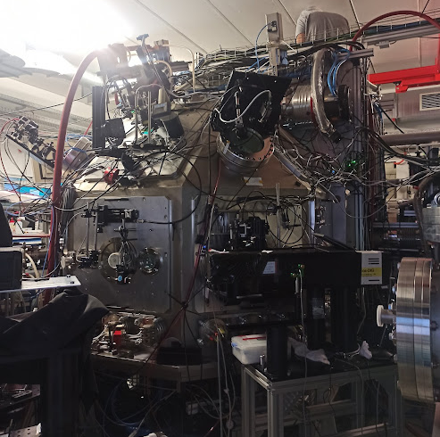
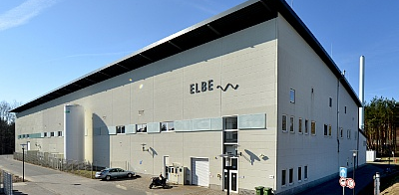
EXPERIMETAL CAMPAIGN AT DRACO@HZDR (DRESDEN, GERMANY)
Establishing a link between the laser acceleration community and the neutron-users community.
Performing a series of experiments at a laser facility to produce and characterize the neutron beam resulting from laser-driven ion beams.
Analyzing the response of the different nuclear physics detectors in this new environment.
Assessing the suitability of laser-driven neutron beams for nuclear physics experiments.
DRACO@HZDR
PW-class 30 J Laser System (18 J on target)
30 fs laser pulse / ~ps ion pulse
Up to 1 Hz (compressor) (~ 1 shot/minute during the experiment)
~200 shots/day
HZDR hosts both the nELBE neutron facility and the DRACO laser facility, a combination of facilities that make it the best suited research center for the purpose discussed herein
.

Slide 11
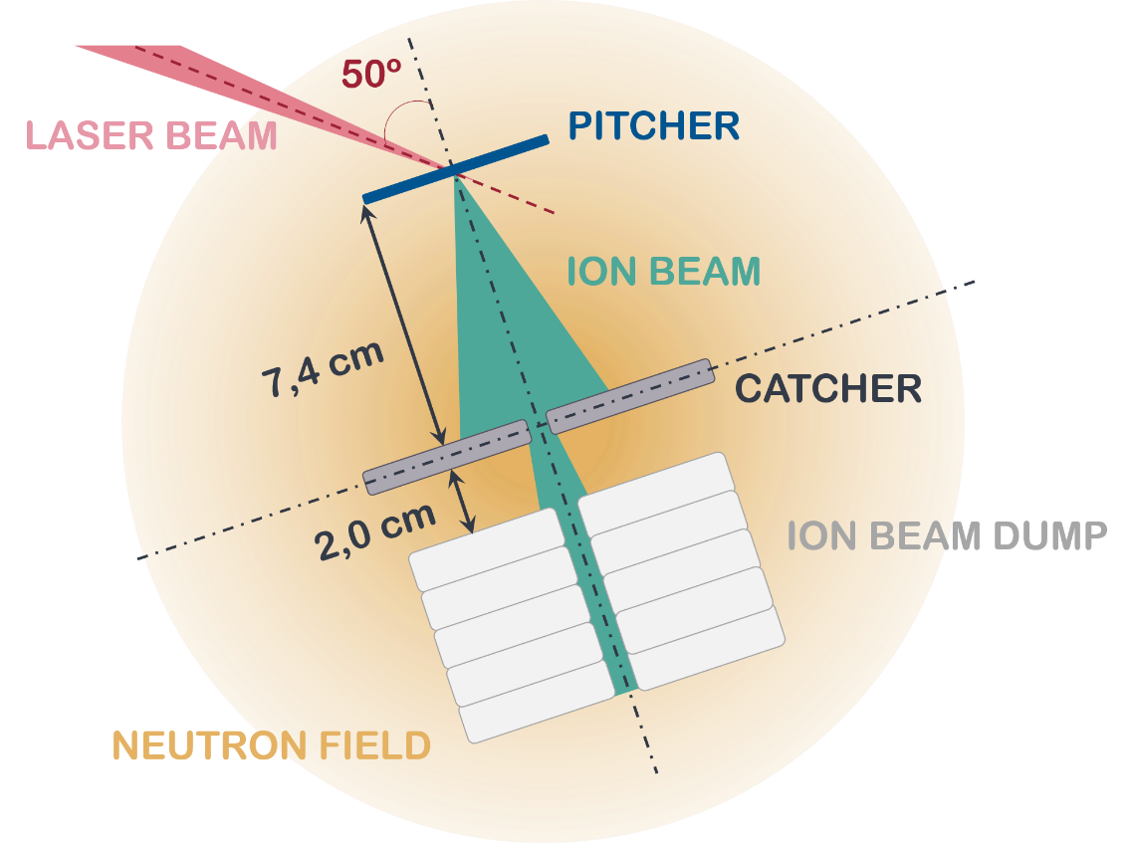
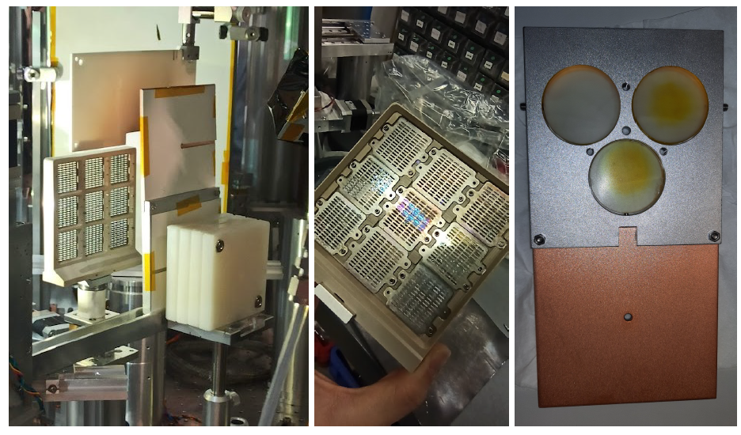
“PITCHER-CATCHER” NEUTRON PRODUCTION SETUP
Pitcher-Catcher Setup
Pitcher Targets
~200 nm formvar
Catcher Targets
25 mm LiF
Beamdump
60 mm PE
3 mm Cu
~ 180 nm deuterated polystyrene
~ 180 nm polystyrene

Slide 12
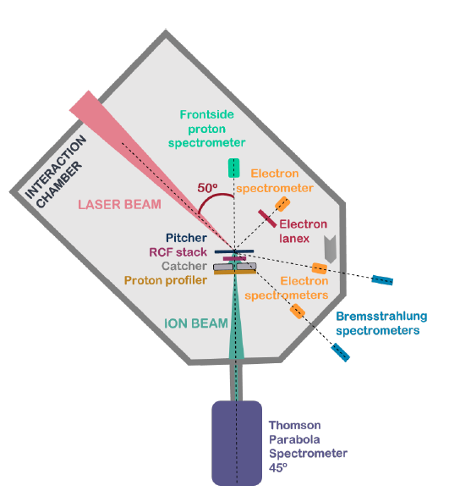
ION DIAGNOSTICS
LASER DIAGNOSTICS
Electron spectrometers: Plasma characteristics and the acceleration mechanism.
Bremsstrahlung spectrometer (BS): γ-ray background
Electron lanex in the specular direction: Target focus
ION BEAM DIAGNOSTICS
Proton profiler: Spatial distribution and alignment of the ion beam in the catcher.
Proton frontside spectrometer: Backwards ion beam energy distribution.
Thomson Parabola Spectrometer (TPS): Shot-to-shot ion beam energy spectrum calibrated for the number of particles.
Radiochromic film (RCF) stacks: Integral double differential (in energy and angle) proton production per shot.

Slide 13
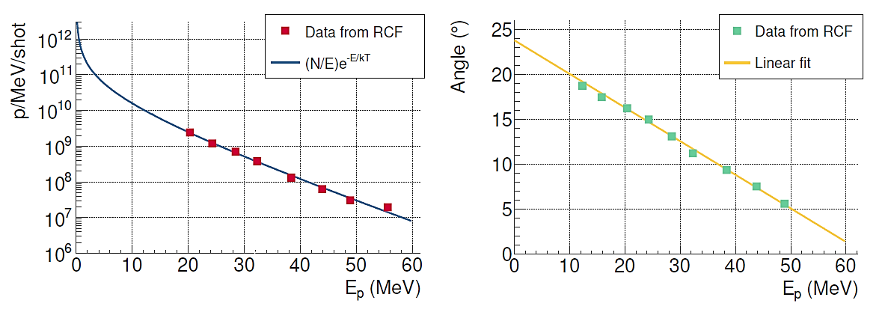
ION SOURCE CHARACTERIZATION: RCF STACK
5 · 10¹¹ p/shot & 20° divergence
Data provided from a previous characterization campaign of the proton source → Used as a reference proton shot.

Slide 14
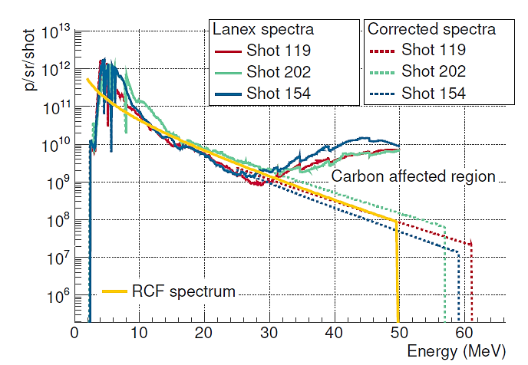
ION SOURCE CHARACTERIZATION: THOMSON PARABOLA SPECTROMETER
Proton profiler
LANEX Image
H⁺
C^{n+}
Neutrals
Spectrum
E_{p} (MeV)
MCP Image
C^{n+}
H⁺
TNSA analytical spectrum fit
Neutrals
E_{Cut-off}
E_{p} (MeV)

Slide 15
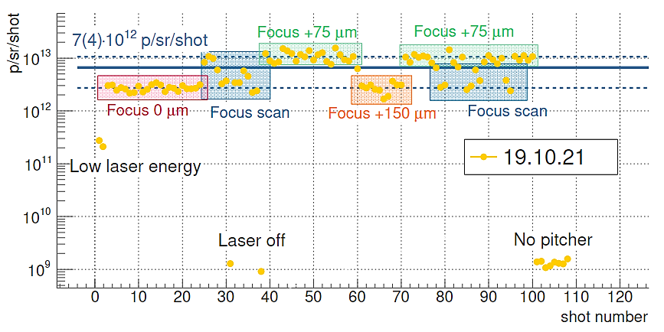
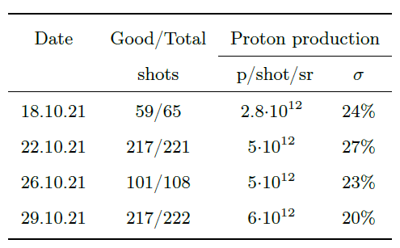
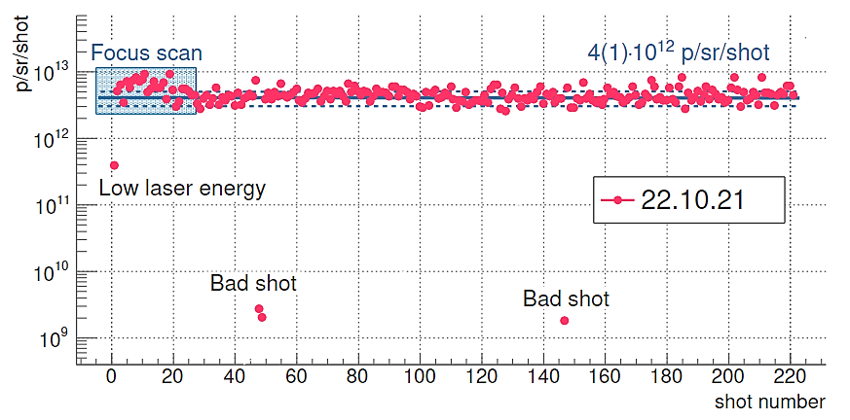
ION SOURCE STABILITY
Source stable shot-to-shot 20-30%
But
Up to x2 difference between days

Slide 16
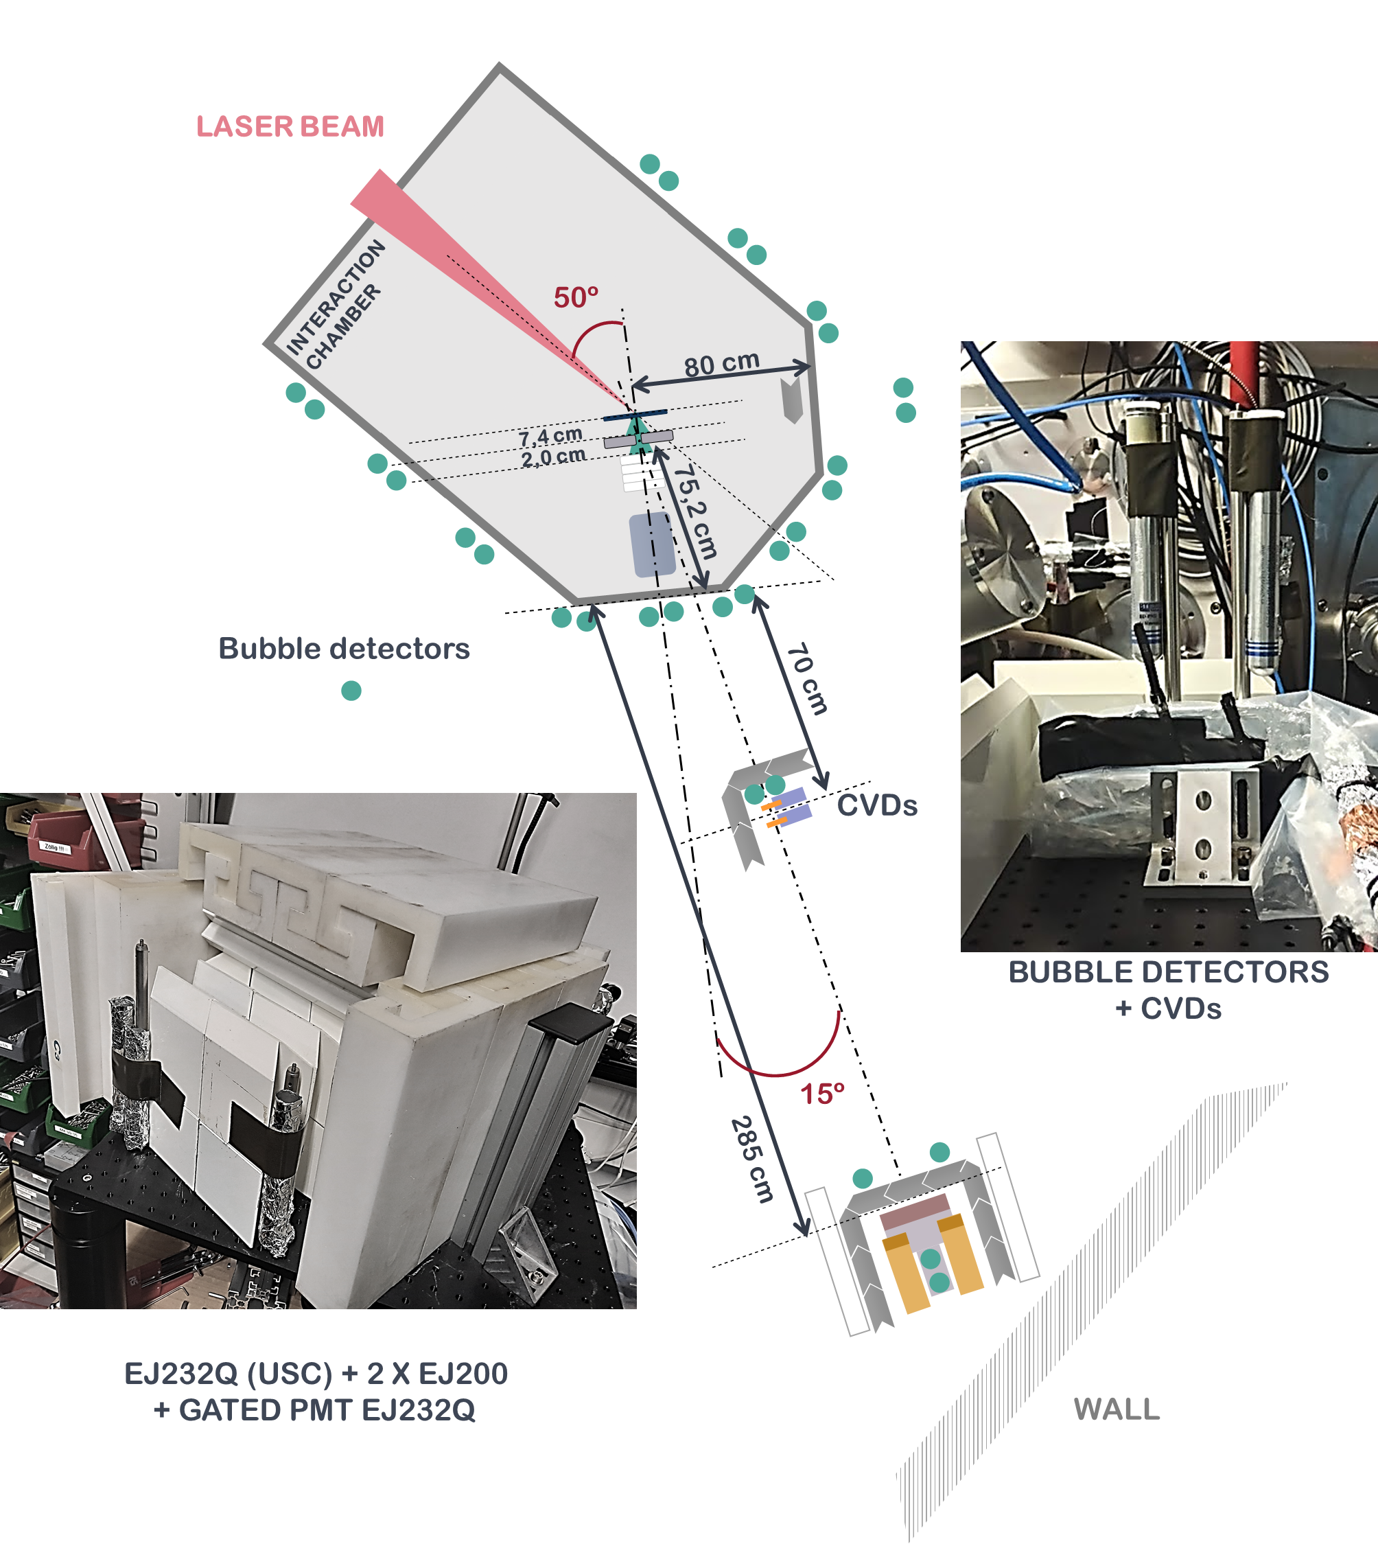
NEUTRON DETECTION SETUP
Neutron detectors Setup
Scintillators
2 x EJ200 (US)
Particle detectors
EJ232Q (USC)
2 x diamond detector (CIVIDEC + HZDR)
Passive detectors
EJ232Q + Gated PMT (HZDR)
13 x Bubble detectors (TUD + USC)

Slide 17
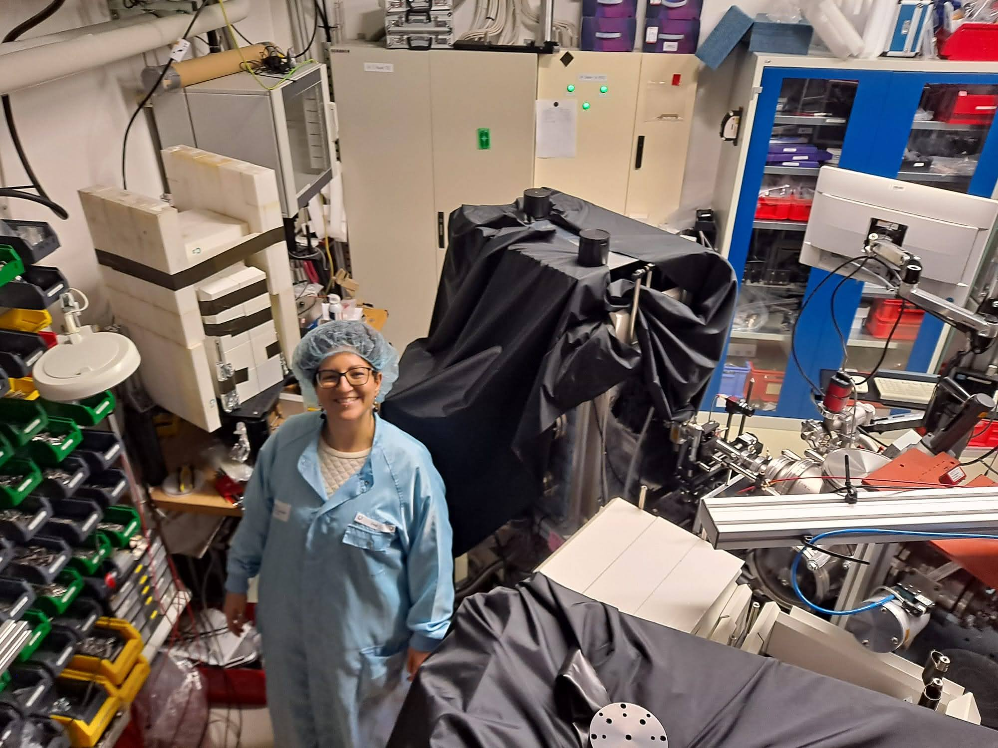
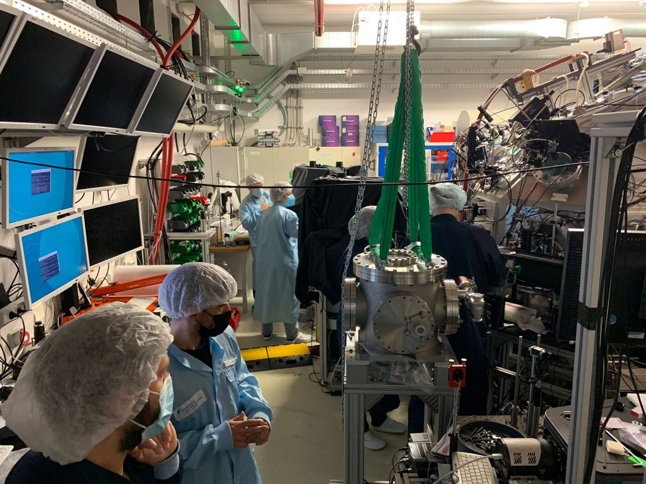
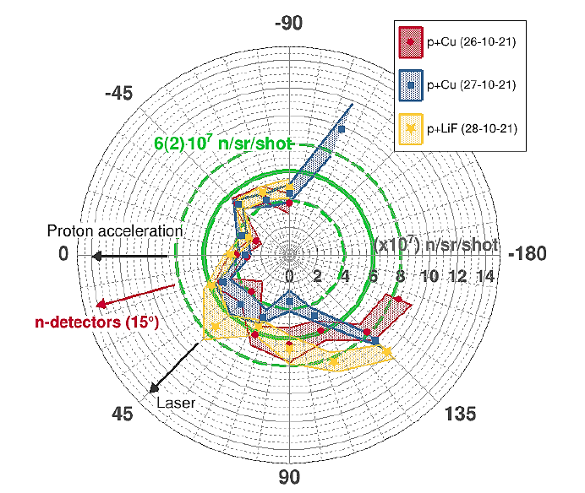
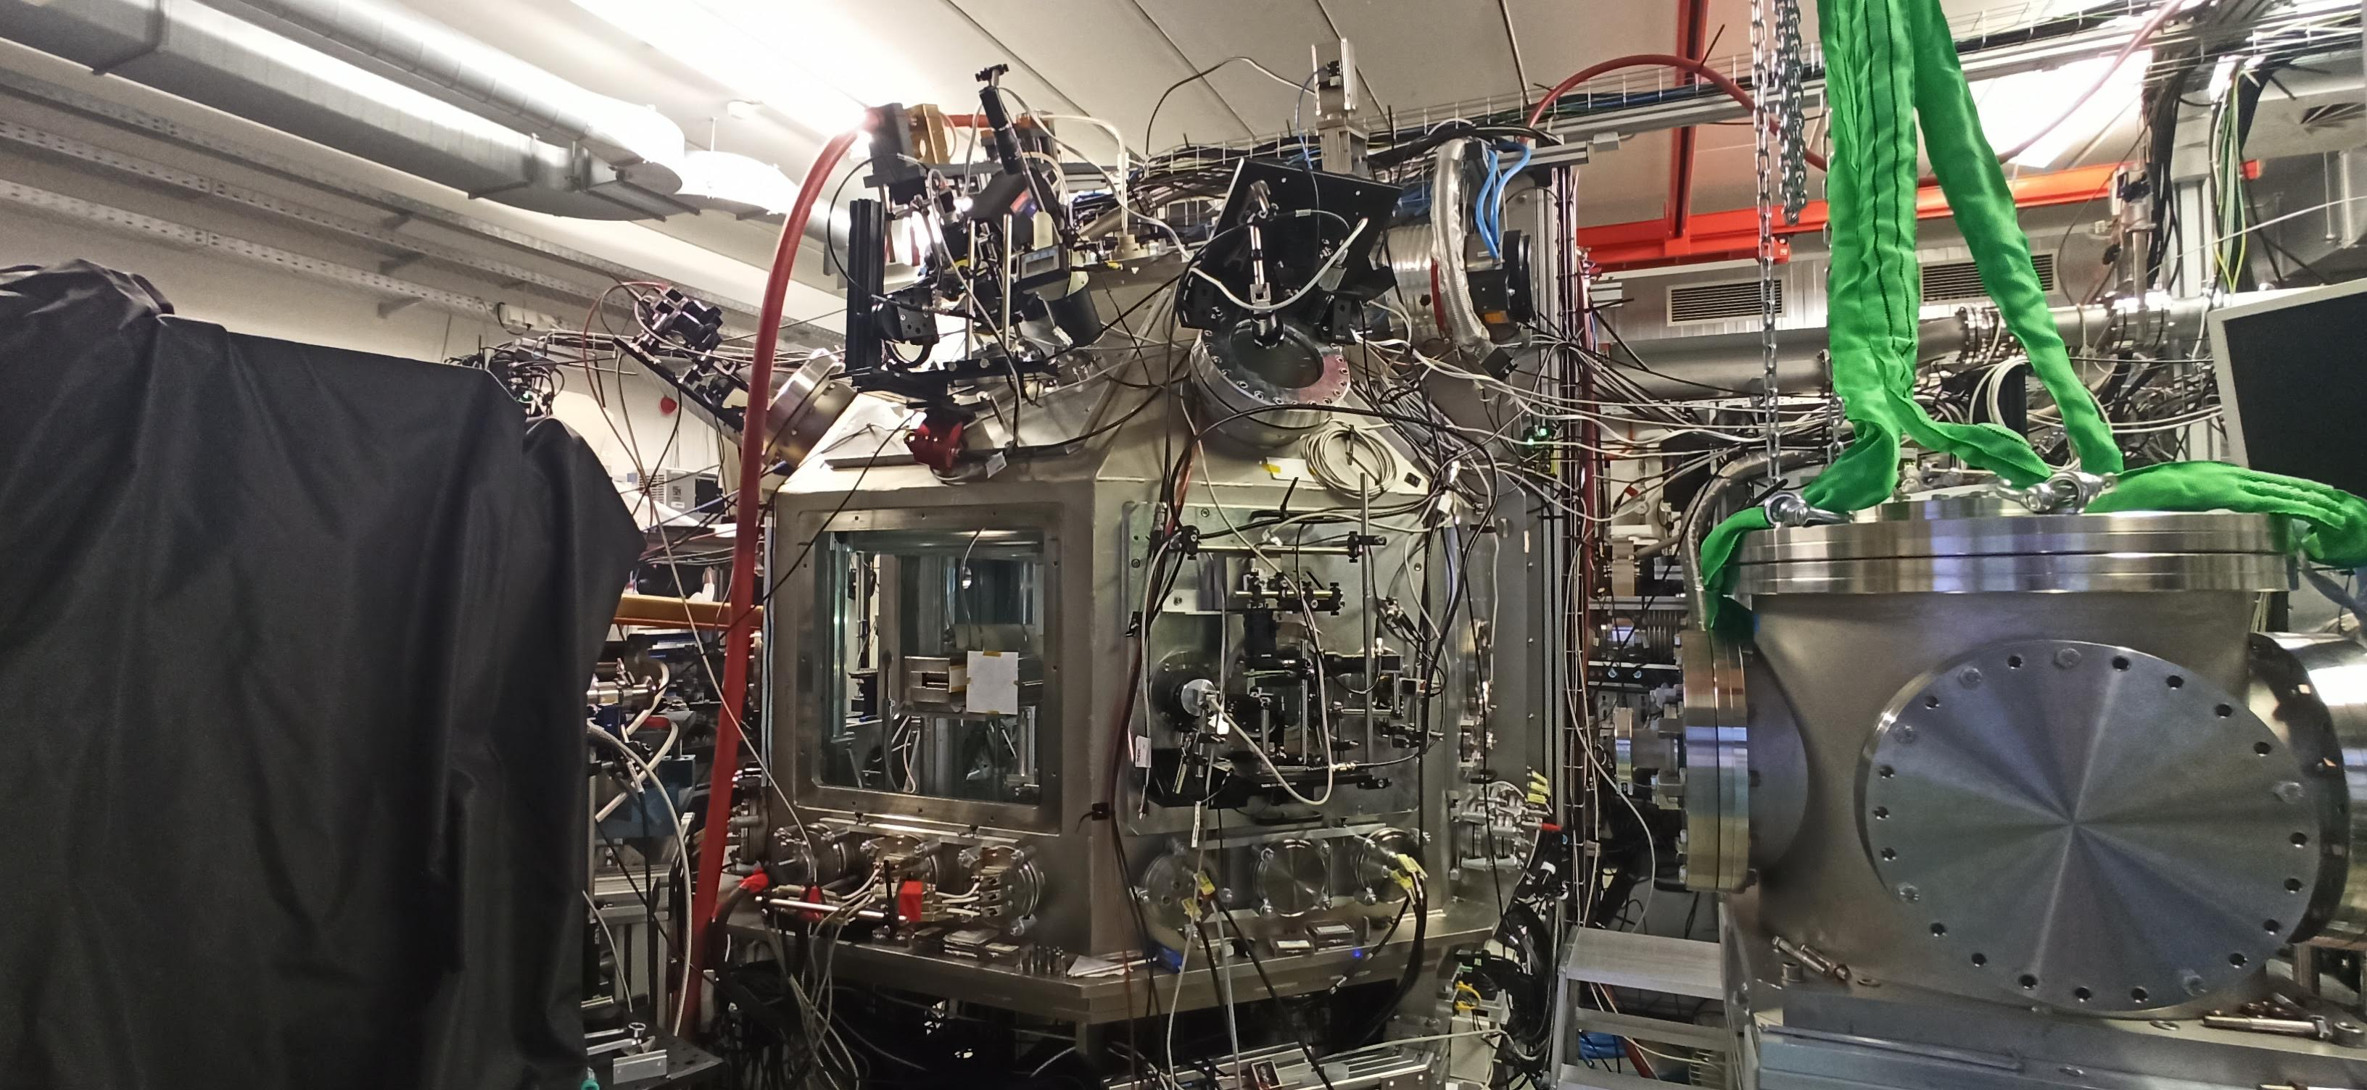
NEUTRON PRODUCTION: BUBBLE DETECTORS
Bubbles detectors distribution (in different runs):
In the chamber wall, at 0º, ±22,5º, ± 45º, ± 67,5º, ± 90º, ± 112,5º, 135º, 157,5º (from the proton line).
$$Φ_{n}\left(\frac{n}{sr}\right)=\frac{n_{b}∙L^{2}}{C∙S}$$
N_{b} → Number of bubbles.
C (bubbles/rem) → Calibration factor (given by the manufacturer).
S = 3,5 · 10⁵ bubbles/(n·cm²) correction factor
L² (cm) → Distance to the neutron source
~ 8(3)·10⁸ neutrons*/shot
* Assuming isotropic production

Slide 18
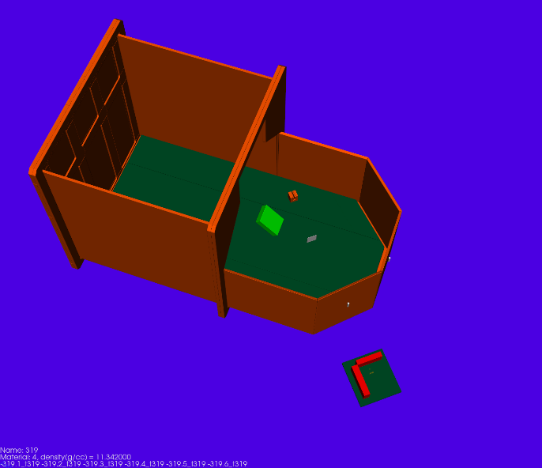
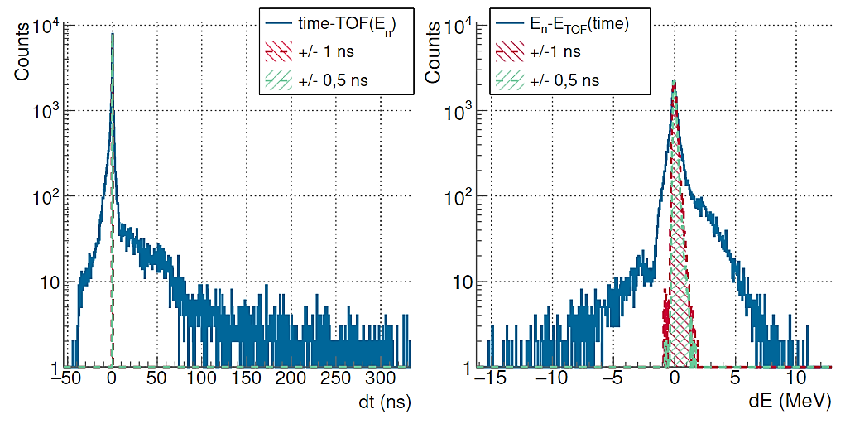
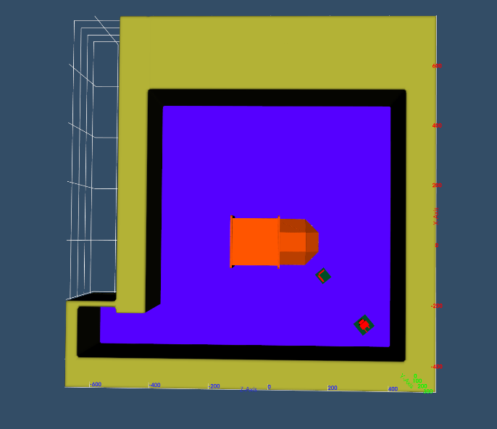
BACKGROUND SIMULATIONS
BUBBLE DETECTOR AT 0º
$$dt=t−\frac{72,293·L_{tof}}{\sqrt{E_{n}}}$$
$$dE=E_{n}−{\left(\frac{72,293·L_{tof}}{t}\right)}^{2}$$
Direct component: 50-40% for the bubbles
PHITS simulations → S. Scheuren (TUD) PhD thesis.

Slide 19
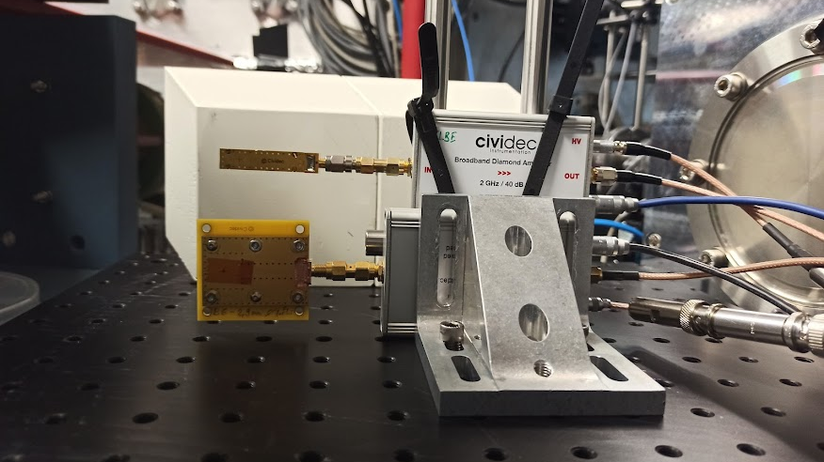
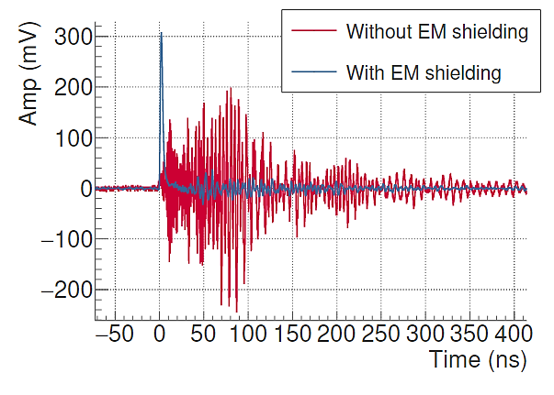
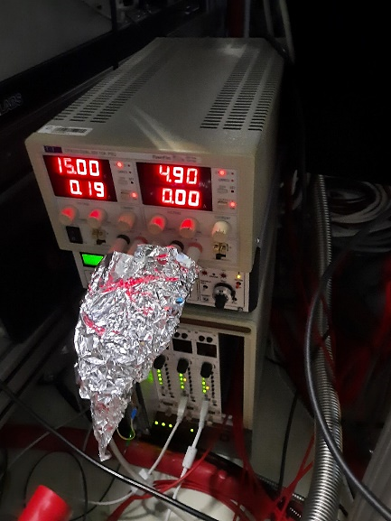
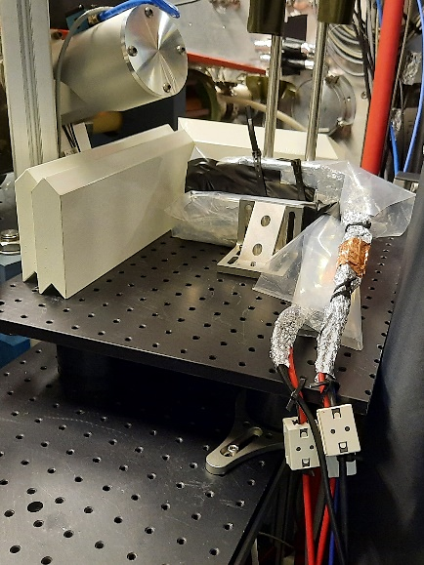
SINGLE-EVENT DETECTORS (DIAMONDS)
Operated with a 2 GHz Broadband Amplifier (low-noise)
For fast neutrons detection
Low sensitive to gammas. → Small shielding needed.
Fast response (sub ns rise time) and small size → Fast recovery after saturation.
Sensitive to charged particles in (n,chp) reactions. → Suitable for nuclear physics measurements
Need of a high repetition source → Typical of neutron physics exp. but limited in lasers

Slide 20
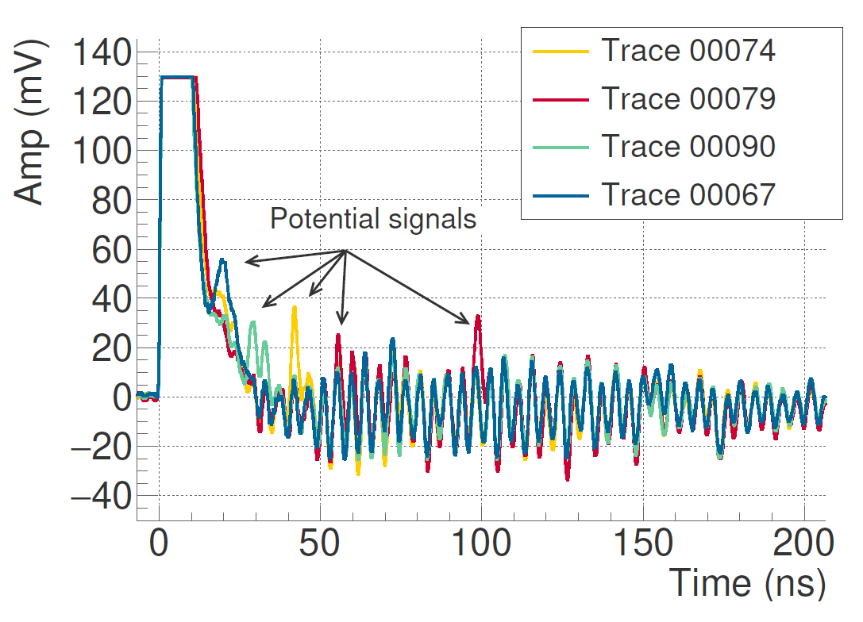
SINGLE-EVENT DETECTORS (DIAMONDS)
Operated with a 2 GHz Broadband Amplifier (low-noise)
For fast neutrons detection
Low sensitive to gammas. → Small shielding needed.
Fast response (sub ns rise time) and small size → Fast recovery after saturation.
Sensitive to charged particles in (n,chp) reactions. → Suitable for nuclear physics measurements
Need of a high repetition source → Typical of neutron physics exp. but limited in lasers

Slide 21
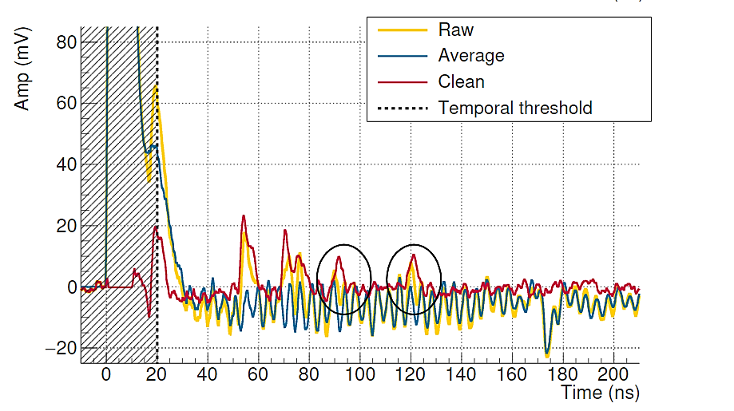
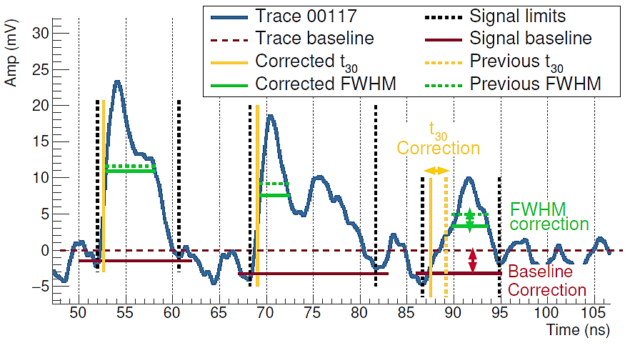
SIGNAL ANALYSIS ALGORITHM
Substration of the oscilating average baseline
Definition of the gamma flash temporal threshold (set to 20 ns)
Threshold in amplitude Amp_{th} to find signal candidates
Define signal parameters: Amp_{max}, FWHM, t₃₀
Define signal limits → No signal detected until the previous one ends
Define the individual signal baseline
Recalculate signal parameters from the signal baseline
Small signal pop-up once the ringing is substracted
Amp_{th}(Detect signal candidates)
Trace baseline (set to zero)

Slide 22
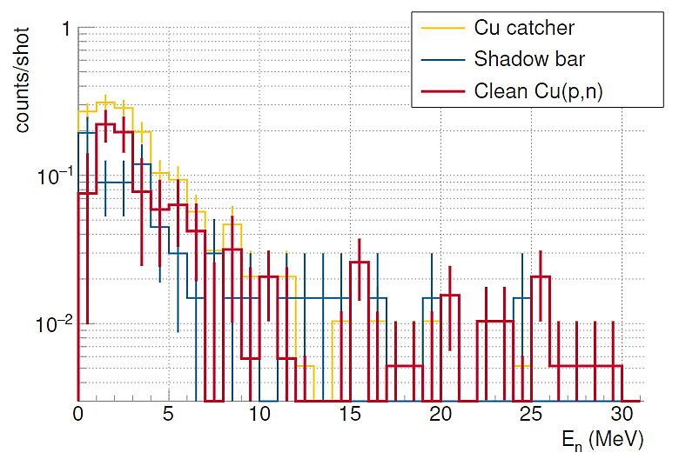
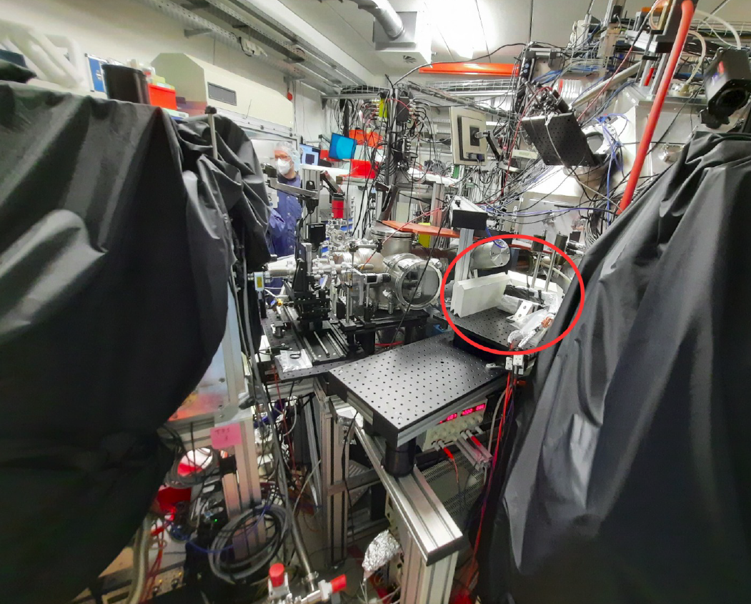
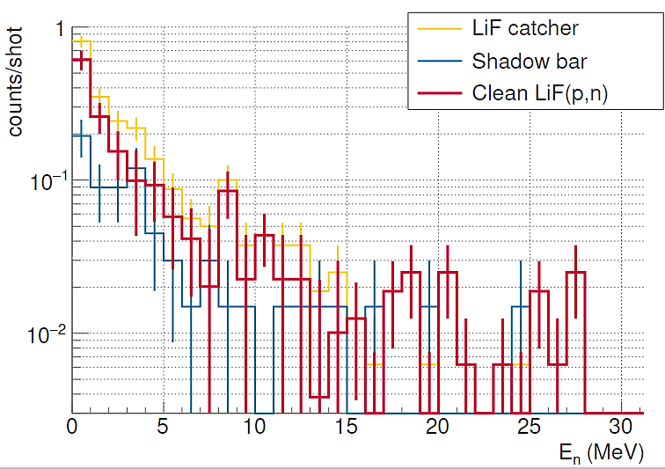
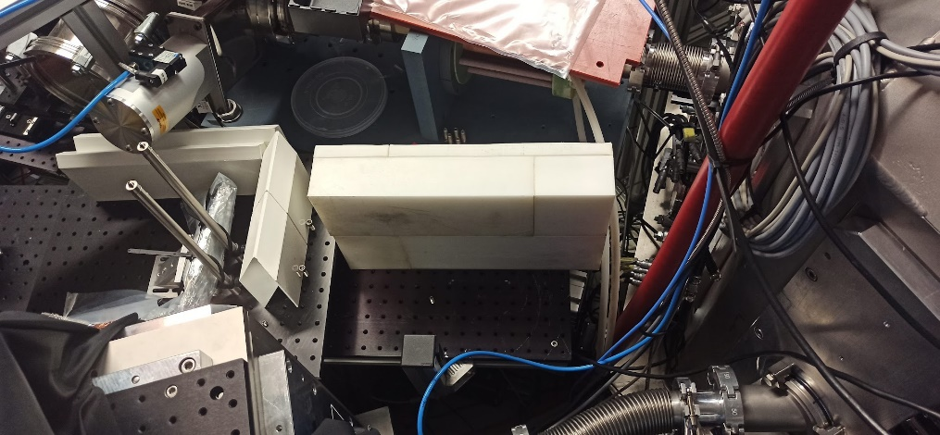
NEUTRON SCATERING BACKGROUND IN DIAMOND (SHADOW BARS)
40-50% BACKGROUND
Geant4 Simulations → Shadow bar features 99,9% efficiency to remove or scatter neutrons below 50 MeV (99,0% if only E_{n} > 10 MeV considered)
DETECTOR
40-50% BACKGROUND

Slide 23
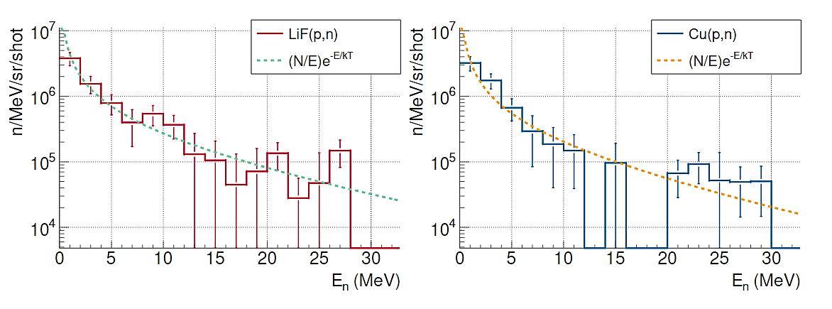
EXPERIMENTAL NEUTRON FLUX
$$\frac{dN_{n}}{dE_{n}}=\frac{N_{0}}{E_{n}}e^{−\frac{E_{p}}{kT}}$$
LiF(p,n): 9(3)·10⁶ n/sr/shot (kT ~19 MeV)
Cu(p,n): 7(2)·10⁶ n/sr/shot (kT ~17 MeV)
TNSA ANALYTICAL SPECTRUM:

Slide 24
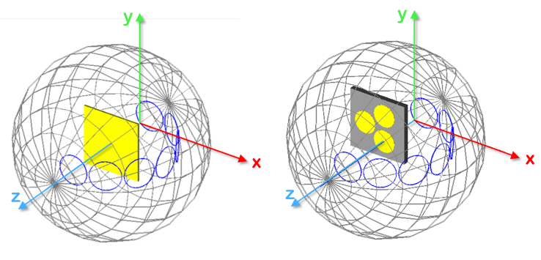
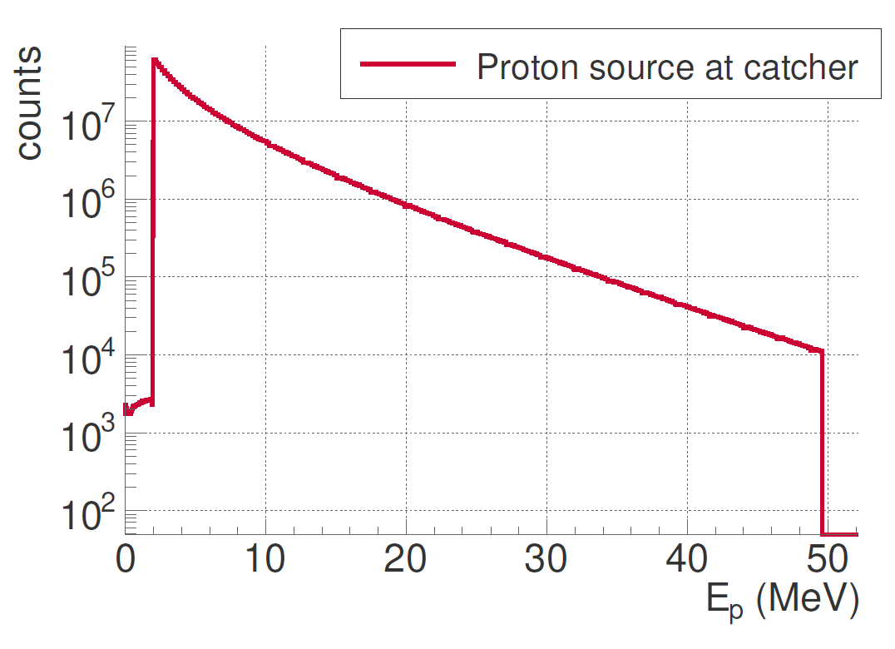
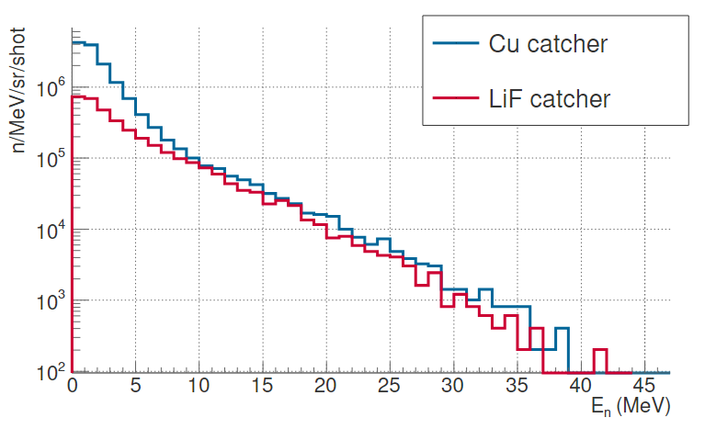
EXPECTED NEUTRON FLUX (RCF+Geant4)
QGSP_BIC_AllHP
FROM RCF

Slide 25
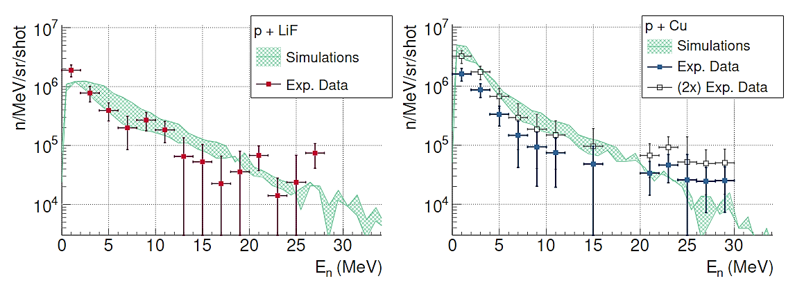
EXPERIMENTAL vs SIMULATIONS: DIAMOND DETECTOR

Slide 26
3.CONCLUSIONS
SUMMARY AND OUTLOOK

Slide 27
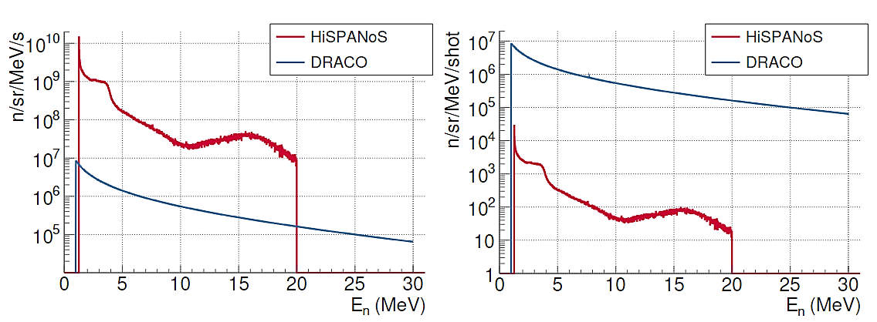
CONCLUSIONS AND OUTLOOK
Strong EMP: High-frequency noise ringing in detector signals. → Reduced, but not avoided, with EM shielding.
Harsh/challenging radiation environment: Strong detector saturation due to prompt components (with a limited duration). Need of huge shielding (extra source of background) or ultrafast detectors with low efficiency (e.g. diamonds. Need of a high repetition source).
Almost 1300 shots & laser-plasma source setup mostly unchanged → Statistical analysis of shot-to-shot fluctuations and proton acceleration stability.
First single-event measurement of a fast neutron flux produced by a PW laser with a nuclear physics detector with results in agreement with the expectations from simulations → First steps for nuclear reactions measurements in a laser facility.
The work opens the door to future measurements of nuclear reactions at LDNS, considering:
It is carried out in a room adjacent to the laser-interaction room, in order to reduce the EMP, the gamma-flash saturation and the neutron scattering background
Fully exploitation of the laser repetition rate → Target refreshment (Hot topic in laser acceleration community) + Plasma mirror limitation
Low efficiency detectors to reduce the effect of the gamma flash saturation and the signal pile-up

Slide 28
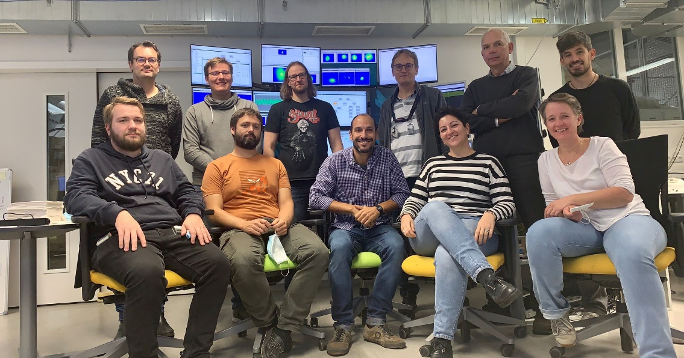
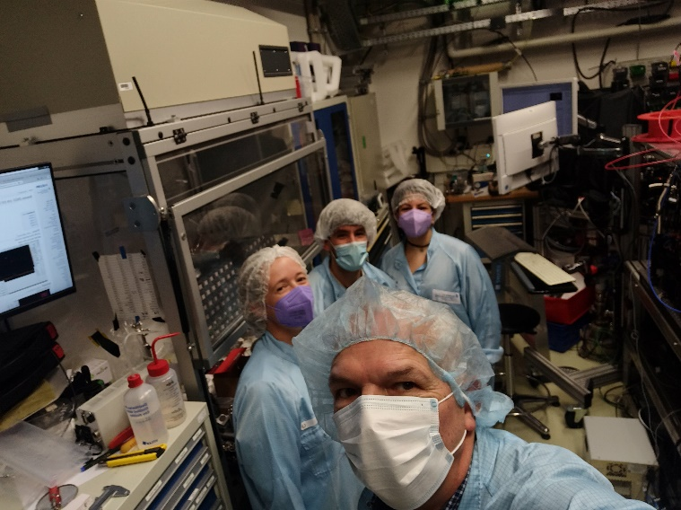
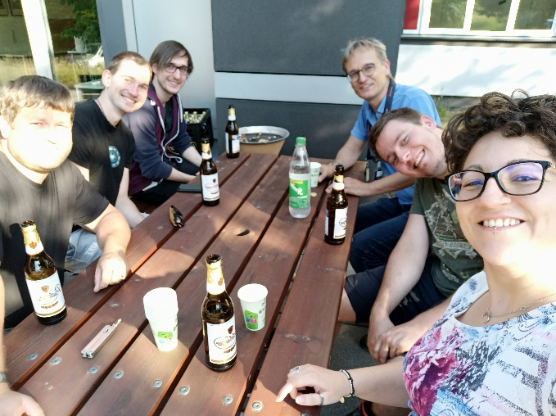
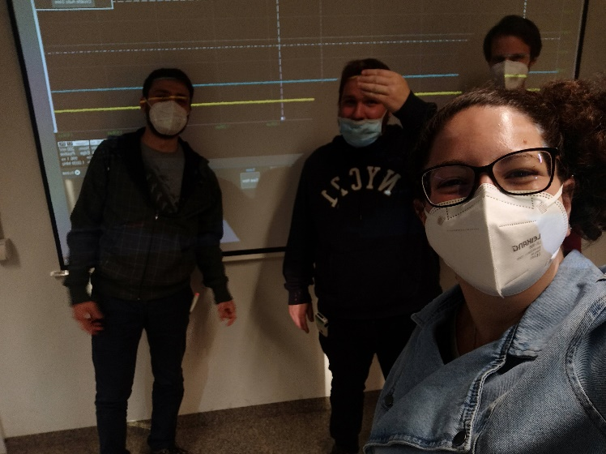
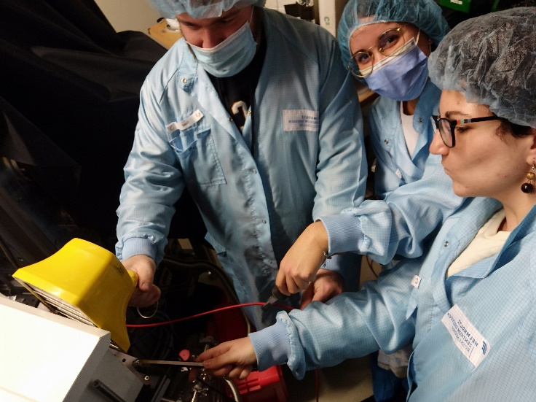
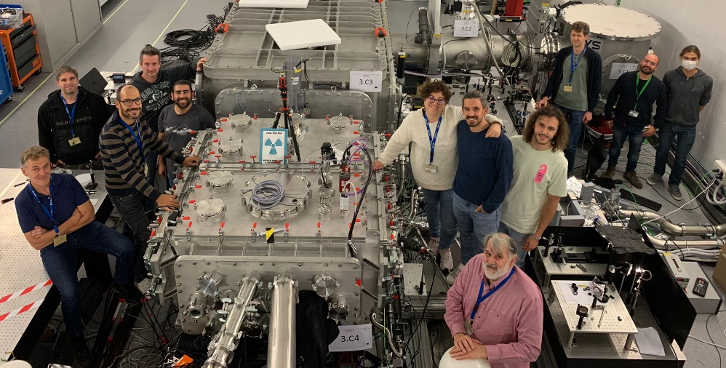
¡¡GRACIAS!!
Any question?
Acknowledgements
This project has received funding from the EC H2020-Euratom research and training programme 2014-2018 under grant agreement 847594 (ARIEL).

Slide 29
BACK-UP SLIDES

Slide 30
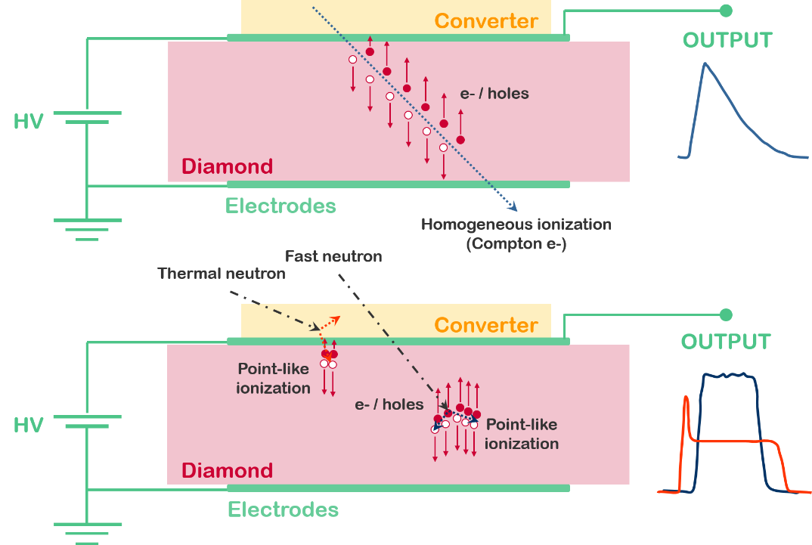
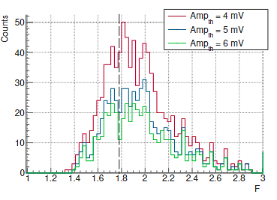
PSD LIMITATIONS
$$F=\frac{W·Amp}{A}$$
F ~1 → Point-like ionization
F ~2 → Homogeneous ionization
F < 1,6 Usual qualifier for neutrons

Slide 31
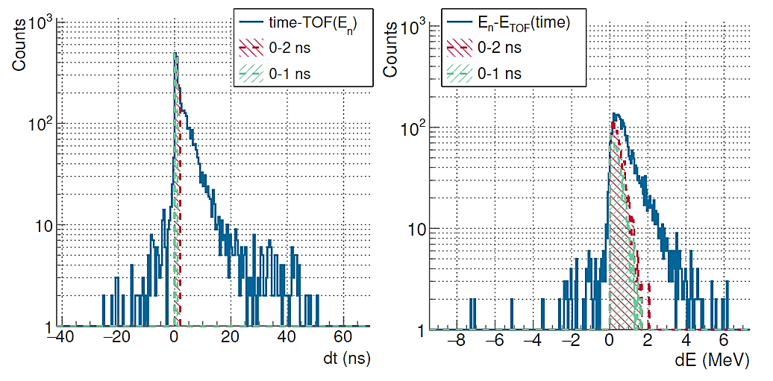
BACKGROUND SIMULATIONS
DIAMOND DETECTOR
$$dt=t−\frac{72,293·L_{tof}}{\sqrt{E_{n}}}$$
$$dE=E_{n}−{\left(\frac{72,293·L_{tof}}{t}\right)}^{2}$$
Direct component: 30-40% for the diamond detector → 50-60% according to the SB.
PHITS simulations → S. Scheuren (TUD) PhD thesis.

Slide 32
BACKGROUND SIMULATIONS
SCINTILLATORS
$$dt=t−\frac{72,293·L_{tof}}{\sqrt{E_{n}}}$$
$$dE=E_{n}−{\left(\frac{72,293·L_{tof}}{t}\right)}^{2}$$
Direct component: 1-6% for the EJ-232Q Scintillator
PHITS simulations → S. Scheuren (TUD) PhD thesis.

Slide 33
NEUTRON PRODUCTION: BUBBLE DETECTORS
$$Φ_{n}\left(\frac{n}{sr}\right)=\frac{n_{b}∙L^{2}}{C∙S}$$
N_{b} → Number of bubbles.
C (bubbles/rem) → Calibration factor (given by the manufacturer).
S = 3,5 · 10⁵ bubbles/(n·cm²) correction factor
L² (cm) → Distance to the neutron source

Slide 34
DATA COMPARISON WITH SIMULATIONS: BUBBLES
* The value for PHITS corresponds to the simulation in the forward direction (2π)

Slide 35
NOISE REDUCTION
For a previous campaign in May 2021 (different detector)

Slide 36
DETECTION EFFICIENCY AND ENERGY CALIBRATION
Geant4 Simulations → Monoenergetic beams in 1 MeV steps

Slide 37
DETECTION EFFICIENCY AND ENERGY CALIBRATION
Geant4 Simulations → Monoenergetic beams in 1 MeV steps
A (V·s) → Signal area
Z = 50 Ω → Impedance
G = 150 → Amplifier gain
Q = 1,6· 10⁻¹⁹ C → e- charge
E_{ioniz} = 13 eV → Ionization energy
$$E_{dep}=\frac{A·E_{ioniz}}{Z·G·q}$$
5 MeV
Noise
15 MeV

Slide 38
SCINTILLATOR TIME-OF-FLIGHT TRACES
Superposition of all the signals produced during each shot (pile-up)
+
Mixed field of gammas and neutrons
+
Shielding effect
Need of deconvolution algorithms and detailed simulations to resolve it

Slide 39
SIGNALS FROM THE SCINTILLATORS
Gammaflash substractions
This traces are the result of the superposition of all the signals produced during each shot (pile-up)
Extra effort to be unfolded
Pitcher-catcher production comparison

Slide 40
ACCELERATOR-BASED & LASER-DRIVEN NEUTRON SOURCES
LASER-DRIVEN
(LDNS)
Advantages
Higher instantaneous flux
Shorter pulses
Technology in fast development
Drawbacks
Lower repetition rate (for now)
Lower reproducibility
New /Unknown environment
Accelerator-based (ABNS)
Advantages
Higher integrated flux
Higher stability
Robust and well-know technology
Drawbacks
Longer pulses
Lower instantaneous flux
DRACO@HZDR |  | HiSPANoS@CNA
PW-class 30 J Laser System (18 J on target) | Facility | 3 MV Tandem Accelerator
30 fs laser / ~ps ions | Pulse duration | 1-2 ns
Up to 1 Hz (compressor) (1 shot/minute during the experiment) | Repetition rate | 500 kHz
7-9·10⁶ (Assuming isotropic production) | Production (n/sr/pulse) | ~ 10⁵
7-9·10⁶ | Flux (n/sr/s) | 4-5·10¹⁰
~ 200 shots/day
(plasma mirror)

Slide 41
THE HiSPANoS NEUTRON SOURCE
Reaction | Q-value (MeV) | E_{th} (MeV) | Target |  |  | Neutron spectra
 |  |  | Material | Thickness | Diameter
²H(d,n)³He | 3,27 | 0,0 | D/Ti | 546 µg/cm² | 30 mm | Quasi-monoenergetic 2,2 – 6,1 MeV
⁹Be(p,n)⁹B | -1,85 | 2,06 | Be | 500 µm | 25 mm | Continuum up to 4 MeV
⁹Be(d,n)¹⁰B | 4,36 | 0,0 |  |  |  | Continuum up to10 MeV
⁷Li(p,n)⁷Be | -1,64 | 1,88 | Li | 500 µm | 25 mm | Continuum up to 4 MeV
⁷Li(d,n)⁸Be | 15,03 | 0,0 |  |  |  | Continuum up to20 MeV
General
¹H, ²H, ⁴He beams
Up to 6 MeV (9 MeV for ⁴He)
Continuous mode
Up to 10 uA
Pulse mode
1-2 ns pulse width
32,5 kHz - 2 MHz
2 % duty cycle at 500 kHz
1- 4 m flight path

Slide 42
PLASMA MIRROR

Slide 43
AVERAGE SIGNAL AND DISPERSION

Slide 44
EXPERIMENTAL CAMPAIGN AT VEGA@CLPU (Spain)
VEGA3@CLPU
PW-class 30 J Laser System
30 fs laser pulse / ~ps ion pulse (200 fs during the experiment)
Up to 1 Hz (compressor) (~ 0,1 Hz during the experiment)
~ 500 shots/day (+ 3500 during the whole campaign)
~ 1·10⁷ neutrons/shot (Based on LiF activation)
CLPU (Centro de Láseres Pulsados) is an ICTS (Unique research facility) opened to external users and located in Salamanca (Spain). It hosts the VEGA laser facility with 3 different beamlines (VEGA1, VEGA2 and VEGA3). It

Slide 45
Campaign VEGA3@CLPU: Pitcher-Catcher
Laser Beam
Rotating Wheel:
8000 targets
Capable to rotate at 0.1 Hz @ 30J
1 Hz @ 12 J
Neutron Detectors

Slide 46
Campaign VEGA3@CLPU: Neutron Detectors
Bonner Spheres
Rotating “Pitcher” target wheel
Laser Beam
PPAC (U-238/Th-232)
LiF “catcher” target
Bonner Spheres
Thick PE beam-dump
B-11 sample
Diamond detector
EJ200 + Gated PMT EJ232Q
He-3 Counters

Slide 47
Campaign VEGA3@CLPU: Neutron Detectors
Bonner Spheres
Rotating “Pitcher” target wheel
Laser Beam
PPAC (U-238/Th-232)
LiF “catcher” target
Bonner Spheres
Thick PE beam-dump
B-11 sample
Diamond detector
EJ200 + Gated PMT EJ232Q
He-3 Counters

Slide 48
CONCLUSIONS AND OUTLOOK
Harsh radiation environment: Strong detector saturation due to prompt components (with limited duration) → Need of huge shielding (extra source of background) or ultrafast detectors with low efficiency (e.g. diamonds. Need of a high repetition source).
Strong EMP: High frequency noise ringing in diamond and PPAC signals. → Reduced, but not avoided, with EM shielding.
***
More than 3500 shots & laser-plasma source setup mostly unchanged → Statistical analysis of shot-to-shot fluctuations and proton acceleration stability.
We were able to measure with conventional scintillators in single signal mode substituting the massive lead shielding for a 5 cm Pb filter
Bigger room + Longer flightpath → Reduction of the number of signal in the detector and increasing the signal to noise ratio.
Lower power → Less neutron production and lower cut-off energy (Still suitable for nuclear physics) → Compensated with a high repetition neutron source (0,1 Hz)…
But all this factors reduce the counting in the low efficiency detectors (PPACs + Diamonds)

Slide 49
CONCLUSIONS AND OUTLOOK
Harsh radiation environment: Strong detector saturation due to prompt components (with limited duration) → Need of huge shielding (extra source of background) or ultrafast detectors with low efficiency (e.g. diamonds. Need of a high repetition source).
Strong EMP: High frequency noise ringing in diamond and PPAC signals. → Reduced, but not avoided, with EM shielding.
***
More than 3500 shots & laser-plasma source setup mostly unchanged → Statistical analysis of shot-to-shot fluctuations and proton acceleration stability.
We were able to measure with conventional scintillators in single signal mode substituting the massive lead shielding for a 5 cm Pb filter
Very very very preliminary...

Slide 50
NEUTRONS FOR NUCLEAR PHYSICS: ENERGY RANGE AND APPLICATIONS
Image credit: n_TOF collaboration
$$E_{n}=\frac{1}{2}m_{n}{\left(\frac{L_{TOF}}{t_{TOF}}\right)}^{2}$$
NEUTRON ENERGY RANGES:
High energy: >20 MeV
Fast: From 100s keV to 20 MeV
Epithermal: From eV to 100s keV
Thermal: Water moderated at room temperature ∼25 meV
Cold: Less than < 25 meV
NEUTRON TEMPORAL STRUCTURE:
Continuous beams: Irradiation studies, activation analysis, production of radioisotopes, dosimetry, and other applications that focus on integral effects.
Pulsed beams: differential cross-section measurements, neutron resonance imaging, detector characterization, metrology, and applications to which the energy of the neutrons is relevant.

Slide 51
A WORLD-CLASS EXAMPLE: ELI-NP
2x10 PW HIGH-POWER LASER SYSTEM
80 International Scientific Collaborations
310 M€ budget
Intensities of 10²³ W/cm² and electrical fields up to 10¹⁵ V/m
Fundamental Research
laser-driven acceleration mechanism
Exotic nuclei and photo-fission
Vacuum properties and particle creation in laser-gamma beams interactions
Nuclear structure and astrophysics studies
Applied Research
Materials under extreme irradiation for space science
Management of nuclear materials
Industrial tomography
Brilliant positron source for materials / processes characterization
Radioisotopes for medical applications
Webpage: www.eli-np.ro
“
The infrastructure will provide a new European laboratory addressing a broad range of scientific research areas, from frontier fundamental physics, new nuclear physics and astrophysics to applications in nuclear materials, radioactive waste management, material science and life sciences.
”

