Slide 1
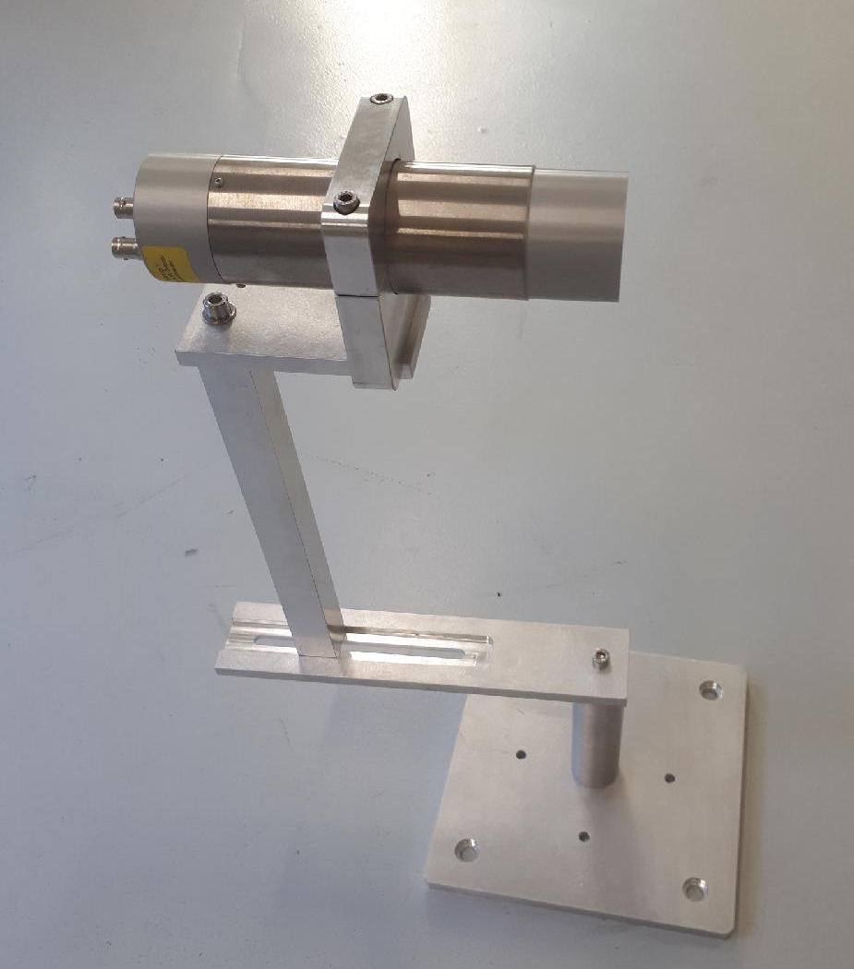
Neutron characterization of scintillators for neutron metrology from 100 keV to 22 MeV
D. QUEVAUVILLERS, M. PETIT , C. RENARD-CARETTE, L. OTTAVIANI, X. LEDOUX, E. PIROVANO, A. ALLOUA
These projects have received funding from the Euratom research and training program 2014- 2018 under grant agreement No. 847594
Notes:
I’m Diane QUEVAUVILLERS and I will talk about the Neutron characterization of scintillators for neutron metrology from 100 keV to 22 MeV which is a part of my thesis directed by Laurent Ottaviani, Christelle Reynard-Carrette at AIX-Marseille University and tutored by Michael PETIT at the French Institut of Radioprotection and Nuclear Safety.

Slide 2
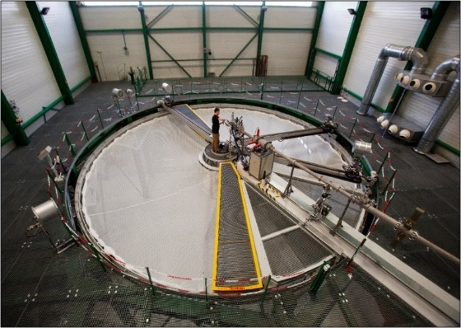
Introduction
The Laboratory for Micro-irradiation, Neutron Metrology and Dosimetry (LMDN)
-> French metrological references for neutron fluence energy distribution by LNE
-> Located at Cadarache in France
-> The laboratory has facilities, neutrons sources (²⁵²Cf and ²⁴¹Am-Be) and AMANDE
Cadarache
AMANDE (facility)
-> An ion accelerator (4 MV in pulsed or continue mode) producing a neutron mono-energetic field between 70 keV up to 22 MeV (and 2 keV to 52 keV with resonance)
AMANDE (Facility)
AMANDE Reaction
ISO Energy
Energy Range of AMANDE
Notes:
My laboratory is the LMDN, the laboratory of Micro-irradiation and neutron metrology and dosimetry. The laboratory is located at Cadarache in the South of France. It is responsible for French metrological references for neutron fluence energy distributions by LNE; the French NMI, National Metrology Institute. For these metrological needs, the laboratory has some facilities, among which AMANDE: an ion accelerator that interacts with a target to produce a mono-energetic neutron field between 70 keV and 22 MeV. It is a tandem of 4 Mega Volt used in pulsed or continuous mode. You can see the energy range possible on AMANDE with reaction and ISO energy on the picture.

Slide 3
Objectif
The needs
Secondary detectors for the metrology
To be able to characterize a complex field
Time-Of-Flight measurement
Specifications
To have neutron detectors to be determine the fluence distributions in energy
To have energy range between 100 keV and 22 MeV for AMANDE facility
To have a fast response for Time-Of-Flight
To detect and discriminate photon for TOF purpose
Easy to move and to set up
Notes:
So, for the metrological references, the laboratory needs to have neutron detectors as secondary standard. The detector should be able to Time-Of-Flight and characterize a complex field with the energy range between 100 keV and 22 MeV. We also need a fast response and photon detection for Time-Of-Flight. If possible, the detector is easy to use and set up on different facilities.

Slide 4
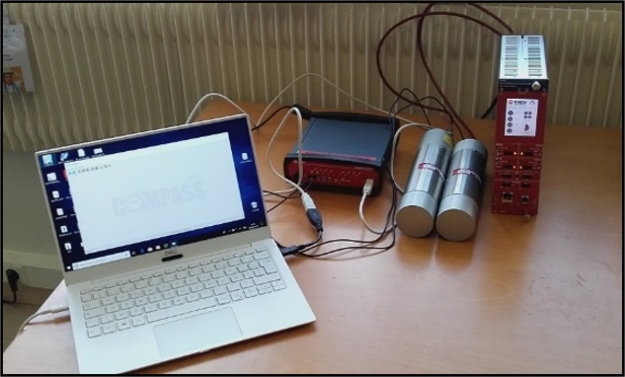
The scintillators
Detector of neutron and photon
Two Stilbene Scintillators with a 2’’x2’’ Stilbene crystal (C₁₄H₁₂)
Two EJ309 Scintillators with a 2’’x2’’ liquid scintillator (~C₈H₁₀)
Stilbene Scintillator
Coupled with the digital acquisition is enabled to keep the parameters between each measurement, analyze the signal and estimate: time stamps, light output and PSD
EJ309 Scintillator
Benchmarking a new digital data acquisition system for fast neutron metrology , Andy BUFFLER and Al. NIMPR (2022)
Digital acquisition: CAEN DT5730
 | Energy range | Resolution time | Response
SX1 | 0.5-22 MeV | 1 ns | Anisotropic
SX2 | 0.1-2 MeV | 2-4 ns | Anisotropic
EJ309 01 | 1-22 MeV | 1 ns | Isotropic
EJ309 02 | 1-22 MeV | 1 ns | Isotropic
Notes:
The laboratory bought four scintillators: two stilbene scintillators with a different photomultiplicator. The SX1 has longer pm, so, the amplification is more important and the response is faster but, the low energy is lost. Unlike the first, the SX2 has smaller pm, the amplification is lower but measure and discrimination in low energy is possible because the collected light output is more important. Stilbene scintillators have two by two-inch crystal and have the capacity to detect and discriminate photon and neutron as low as 100 keV, but it is anisotropic and so, the incidence of the neutron changes the function response. That is complicates its use in multidirectional fields. This is the reason why the laboratory bought two other scintillators: EJ309. It is an isotropic and liquid scintillator and is isotropic, but it can’t detect and discriminate below 1 MeV because it doesn’t have an efficiency.

Slide 5
The scintillators
Detector of neutron and photon
Two Stilbene Scintillators with a 2’’x2’’ Stilbene crystal (C₁₄H₁₂)
Two EJ309 Scintillators with a 2’’x2’’ liquid scintillator (~C₈H₁₀)
Stilbene Scintillator
Coupled with the digital acquisition is enabled to keep the parameters between each measurement, analyze the signal and estimate: time stamps, light output and PSD
EJ309 Scintillator
Benchmarking a new digital data acquisition system for fast neutron metrology , Andy BUFFLER and Al. NIMPR (2022)
Digital acquisition: CAEN DT5730
 | Energy range | Resolution time | Response
SX1 | 0.5-22 MeV | 1 ns | Anisotropic
SX2 | 0.1-2 MeV | 2-4 ns | Anisotropic
EJ309 01 | 1-22 MeV | 1 ns | Isotropic
EJ309 02 | 1-22 MeV | 1 ns | Isotropic
Notes:
Moreover, these scintillators are coupled with a digital acquisition by CAEN. Today, in our laboratory, the references are in analogue acquisition. Laboratory want to transfer the metrological references in digital acquisition. The advantage of digital acquisition is to use the parameters at each measurement, an interesting thing in metrology. It is easy to move and to set up. The signals are analyzed, and we can have the time stamps with a nanosecond resolution and the discrimination by pulse shape is directly done.

Slide 6
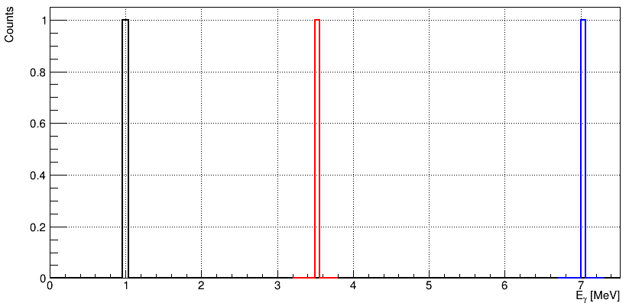
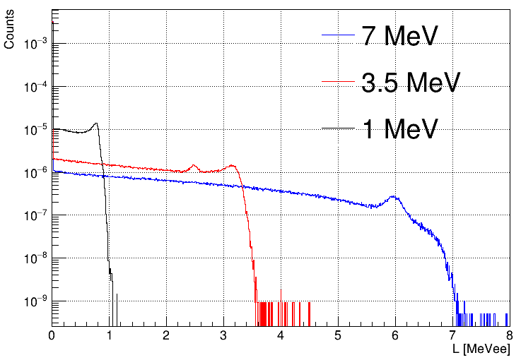
The characterization of scintillators
For the use of the scintillators, we need to characterize for the neutrons and photons
Indeed, the scintillators response is different than the emission spectrum. So, we need to determine the function to link the scintillator response and the emission spectrum : The response matrix
1 MeV
3.5 MeV
7 MeV
Incident spectrum [1]
Detector Response [1]
[1] Gamma-response characterization of a solution-grown stilbene scintillators in the 59 keV - 4.44.MeV energy range; an alternative low-resolution gamma spectrometer , Augusto DI CHICCO and Al. NIMPR (2022)
Notes:
Well, we have our scintillators but to use them, we need to characterize each for both neutron and photon Indeed, the detector don’t give the incident spectrum, we have only the detector response.

Slide 7
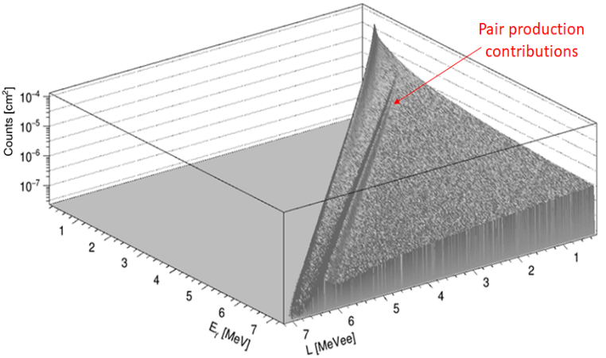
The characterization of scintillators
For the use of the scintillators, we need to characterize for the neutrons and photons
Indeed, the scintillators response is different than the emission spectrum. So, we need to determine the function to link the scintillator response and the emission spectrum : The response matrix
1 MeV
3.5 MeV
7 MeV
Incident spectrum [1]
Detector Response [1]
[1] Gamma-response characterization of a solution-grown stilbene scintillators in the 59 keV - 4.44.MeV energy range; an alternative low-resolution gamma spectrometer , Augusto DI CHICCO and Al. NIMPR (2022)
Photon response matrix [1]
Notes:
So, to obtain the incident spectrum from detector response, we need the response matrix to link the two. One matrix for photon response and one for neutron. Today, I’m going to show you the method we used to determine the response matrix for neutron.

Slide 8
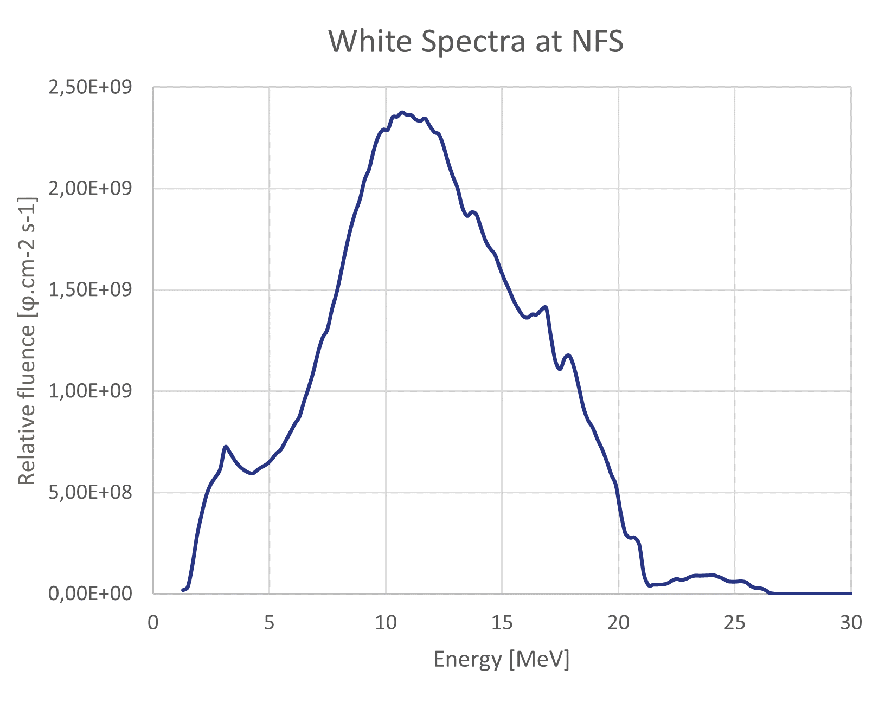
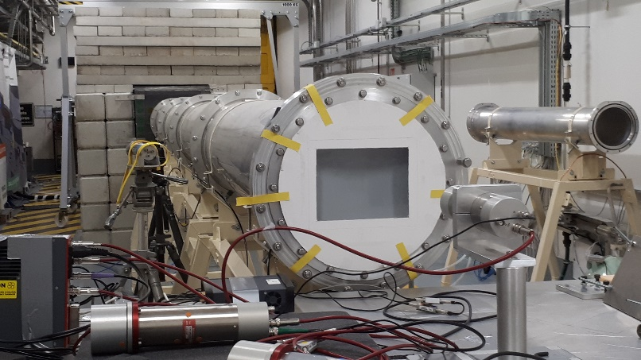
How to determine the shape of the neutron response matrix ?
To determine experimentally the shape of the neutron response matrix, we realised :
A measurement of white spectrum in Time of Flight has been done at Neutron For Science (NFS/GANIL) in Caen (France)
NFS (Caen)
The Time of Flight is the metrological method to determine, knowing the distance, the neutron energy from the time difference between neutron emission and detection
Notes:
To begin, how to determine the shape of the neutron response matrix? We decided to determine the shape experimentally with a white spectrum in Time-Of-Flight. Time-Of-Flight is the metrological method to determine, knowing the distance, the neutron energy from the time difference between neutron emission and detection. A measurement of white spectrum has been done at Neutron For Science (NFS) in Caen in September 2023. Many white spectra are possible at NFS and we chose the one on the graph because it’s the best to characterize our energy range.

Slide 9
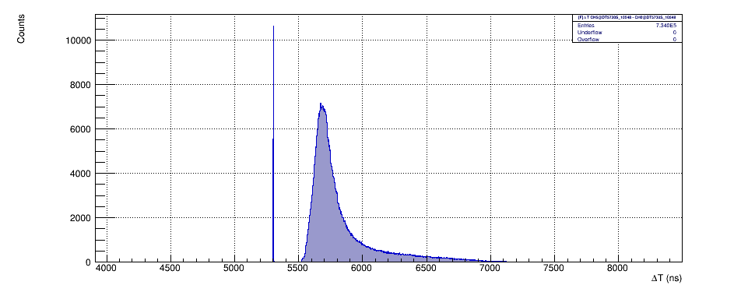
How to determine the shape of the neutron response matrix ?
The measure has been realized in TOF with the pulsed beam with time windows at 8000 ns
To keep only neutron and photon directly emitted by the pulsed beam
Measure TOF with SX1 at NFC
Notes:
For the measurement, the detector was positioned at 29 meters of the target. The measurement has been done in coincidences between the pulsed beam and the detector with an eight µs window. It enabled us to keep only photons and neutrons emitted directly by the pulse beam and to reduce both noise and scattered neutrons. So, we obtained this graph. It is a time difference in nanosecond between the pulsed beam and the particle detection.

Slide 10
How to determine the shape of the neutron response matrix ?
The measure has been realized in TOF with the pulsed beam with time windows at 8000 ns
The photon pic is used to determine the neutron emission time for the TOF because the neutron emission time is determined by the photon emission at the same time
Measure TOF with SX1 at NFC
Photon pic
Neutron spectra
Notes:
The first peak is a photon detection time and the spectrum after is neutron detection time. The lower the neutron energy, the greater the time difference. But unlike, the pulsed beam can’t give the neutron emission time because the pulsation is given before the interaction between the ion beam and the target, and so, we don’t know the interaction time in the target. To obtain the neutron emission time, we use the photon peak as we know the photon speed and the distance between the detector and the target.

Slide 11
How to determine the shape of the neutron response matrix ?
The measure has been realized in TOF with the pulsed beam with time windows at 8000 ns
The photon pic is used to determine the neutron emission time for the TOF because the neutron emission time is determined by the photon emission at the same time
Emission time
Measure TOF with SX1 at NFC
TOF
Photon pic
Neutron spectra
Notes:
As we know the photon emission time, we can calculate the neutron TOF knowing it was emitted at the same time as the photon.

Slide 12
How to determine the shape of the neutron response matrix ?
The measure has been realized in TOF with the pulsed beam with time windows at 8000 ns
A time windows in neutron spectra to determine the neutron energy range
with the time difference between the emission and detection time
Emission time
Measure TOF with SX1 at NFC
Time Windows
TOF
Photon pic
Neutron spectra
Notes:
Well, to determine the shape of neutron response. A time windows in the neutron spectrum is taken and corresponds to the neutron energy range. We only take neutrons in this time windows and to draw the detector response.

Slide 13
How to determine the shape of the neutron response matrix ?
The measure has been realized in TOF with the pulsed beam with time windows at 8000 ns
A time windows in neutron spectra to determine the neutron energy range
The neutron response is determined for each a time windows
Scintillator response at 14.8 MeV
Emission time
Measure TOF with SX at NFC
Preliminary
Time Windows
TOF
Photon pic
Neutron spectra
Notes:
We obtain the neutron response for an energy range. You can see a preliminary result. We'll get a smoother answer when I've analyzed all the data.

Slide 14
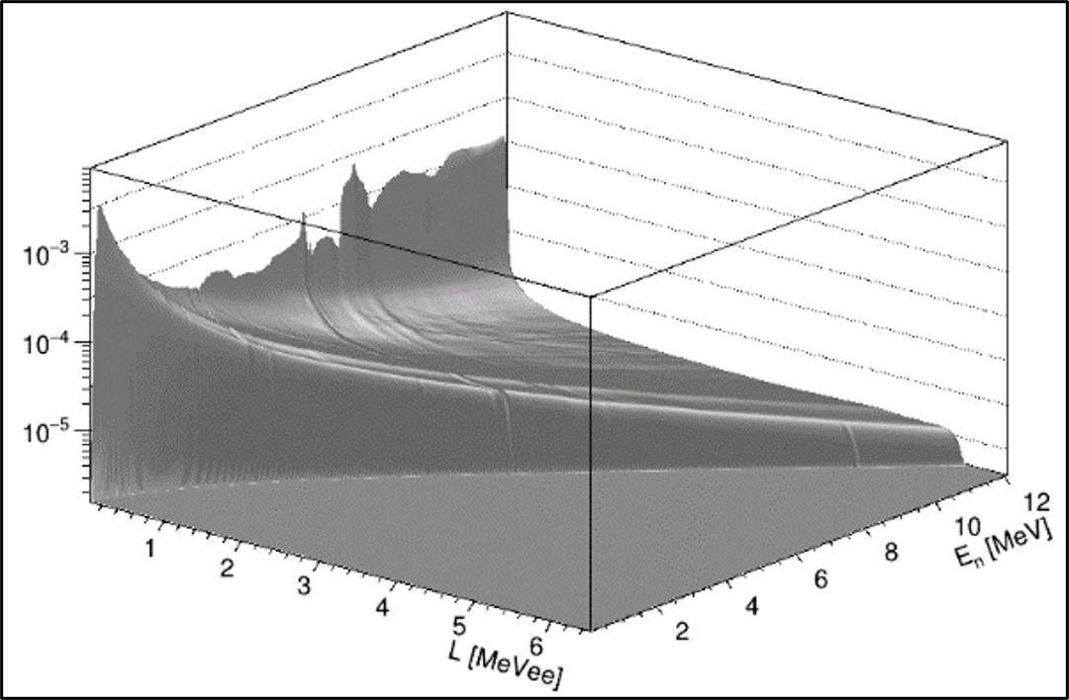
How to determine the shape of the neutron response matrix ?
The measure has been realized in TOF with the pulsed beam with time windows at 8000 ns
A time windows in neutron spectra to determine the neutron energy range
The neutron response is determined for each a time windows after corrections
Scintillator response at 14.8 MeV
The shape of the neutron response matrix
Measure TOF with SX at NFC
Preliminary
Example of neutron response matrix from A. DI CHICCO PHD
Notes:
We will do this for each time window, and we obtain the neutron response matrix with a resolution equal to the energy range.

Slide 15
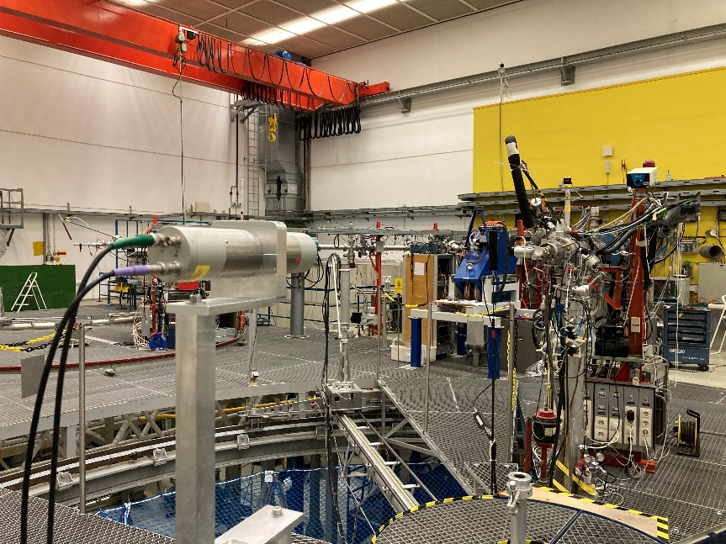
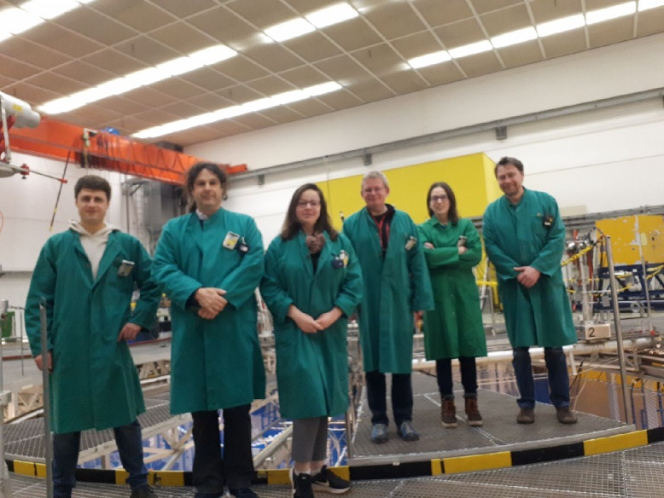
The neutron fluence
For the laboratory metrological need, we should know the neutron fluence energy distribution. For this reason, we must calibrate the neutron response matrix in fluence :
Fluence measurements at neutron monoenergetic fields were done at Physikalisch-Technische Bundesanstalt (PTB) in Braunschweig (Germany) via ARIEL
PTB (Brausweig)
Notes:
We have the shape of the neutron response and to complete the neutron characterization, we need neutron fluence reference. Indeed, the fluence at NFS is estimated fluence but for the metrological need, we must calibrate our scintillators in fluence. For this reason, we went at PTB in Braunschweig in November 2023. Thanks to ARIEL. In a first time, a measurement of white spectra is scheduled but the cyclotron has been capricious and finally we have been done a fluence measurement on neutron mono-energetic fields. It is a good alternative solution for calibrate the scintillators in fluence.

Slide 16
The neutron fluence
For the laboratory metrological need, we should know the neutron fluence energy distribution. For this reason, we must calibrate the neutron response matrix in fluence :
Fluence measurements at neutron monoenergetic fields were done at Physikalisch-Technische Bundesanstalt in Braunschweig (Germany) via ARIEL
Neutron Energy | Pulsed beam | Reaction
1.2 MeV | Not Pulsed | T(p,n)
2.8 MeV | Not Pulsed | T(p,n)
5.0 MeV | Pulsed | D(d,n)
14.8 MeV | Not Pulsed | T(d,n)
17.0 MeV | Pulsed | T(d,n)
19.0 MeV | Pulsed | T(d,n)
The pulsed beam allows to determine the neutron energy with the Time-Of-Flight
Notes:
So, we have been done six fluence measurements, one point two MeV; two-point eight MeV; five MeV; fourteen point eight MeV; seventeen MeV and nineteen MeV. The fluence reference is done by PTB with proportional counter or Proton recoil telescope. We have been done the measurement on pulsed beam for the energy with significant secondary reaction as five, seventeen and nineteen MeV. This allows to know the neutron energy with TOF and to keep only the neutron with the good energy and determine the fluence for this energy. For other energy, we have been measured in continue beam because it is easier.

Slide 17
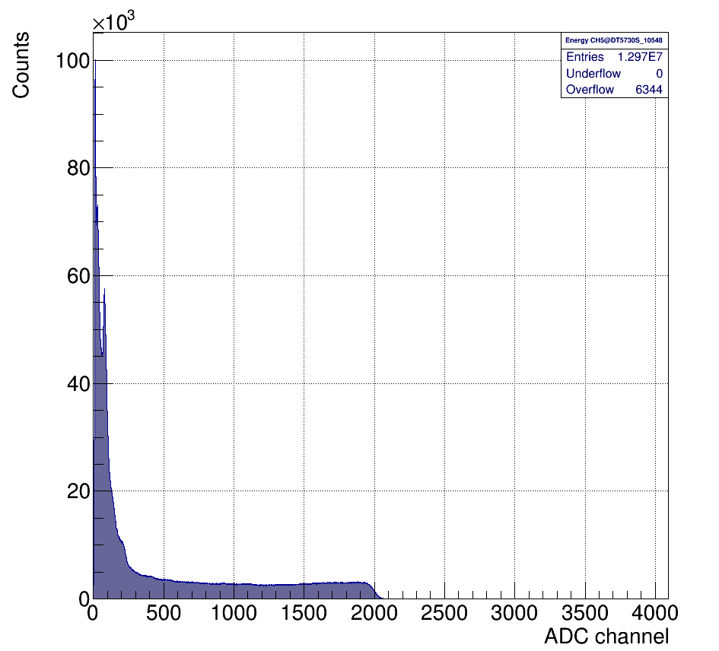
The neutron fluence
For the laboratory metrological need, we should know the neutron fluence energy distribution. For this reason, we must calibrate the neutron response matrix in fluence :
Fluence measurements at neutron monoenergetic fields were done at Physikalisch-Technische Bundesanstalt in Braunschweig (Germany) via ARIEL
Measure at 14.8 MeV with SX1 at PTB
Preliminary
Scintillator response at 14.8 MeV
Notes:
The reference fluence measurement will be used to calibrate the fluence of the neutron response function shape for the six points.

Slide 18
The neutron fluence
For the laboratory metrological need, we should know the neutron fluence energy distribution. For this reason, we must calibrate the neutron response matrix in fluence :
Fluence measurements at neutron monoenergetic fields were done at Physikalisch-Technische Bundesanstalt in Braunschweig (Germany) via ARIEL
Measure at 14.8 MeV with SX1 at PTB
To determine the fluence reference between each energy point:
A ratio is determined between MCNP simulation and the measurement for each energy point
A simulation is realized for other neutron energy
A ratio is applicated on the simulation fluence
Alpha recoil
Proton recoil
Notes:
How to determine the fluence references between the six points? We will do a MCNP simulation in the same conditions as PTB for each energy point. We will compare the fluence between the MCNP simulation and PTB. For the measure, we will consider only the fluence associated with the recoil proton. Indeed, in the neutron response, we have two interactions: recoil proton and alpha particles. To allow to compare simulation and measurement, we take into counter to recoil proton fluence because the angular distribution and cross section for alpha partcles aren’t enough known with neutron. This is not the case of proton. So, we determine neutron fluence from recoil proton. We will determine a ratio between measurements and simulations. This ratio is applicated on the simulation for other neutron energy to determine a fluence simulation. This method allows to have corrected fluence between 1 MeV to 22 MeV.

Slide 19
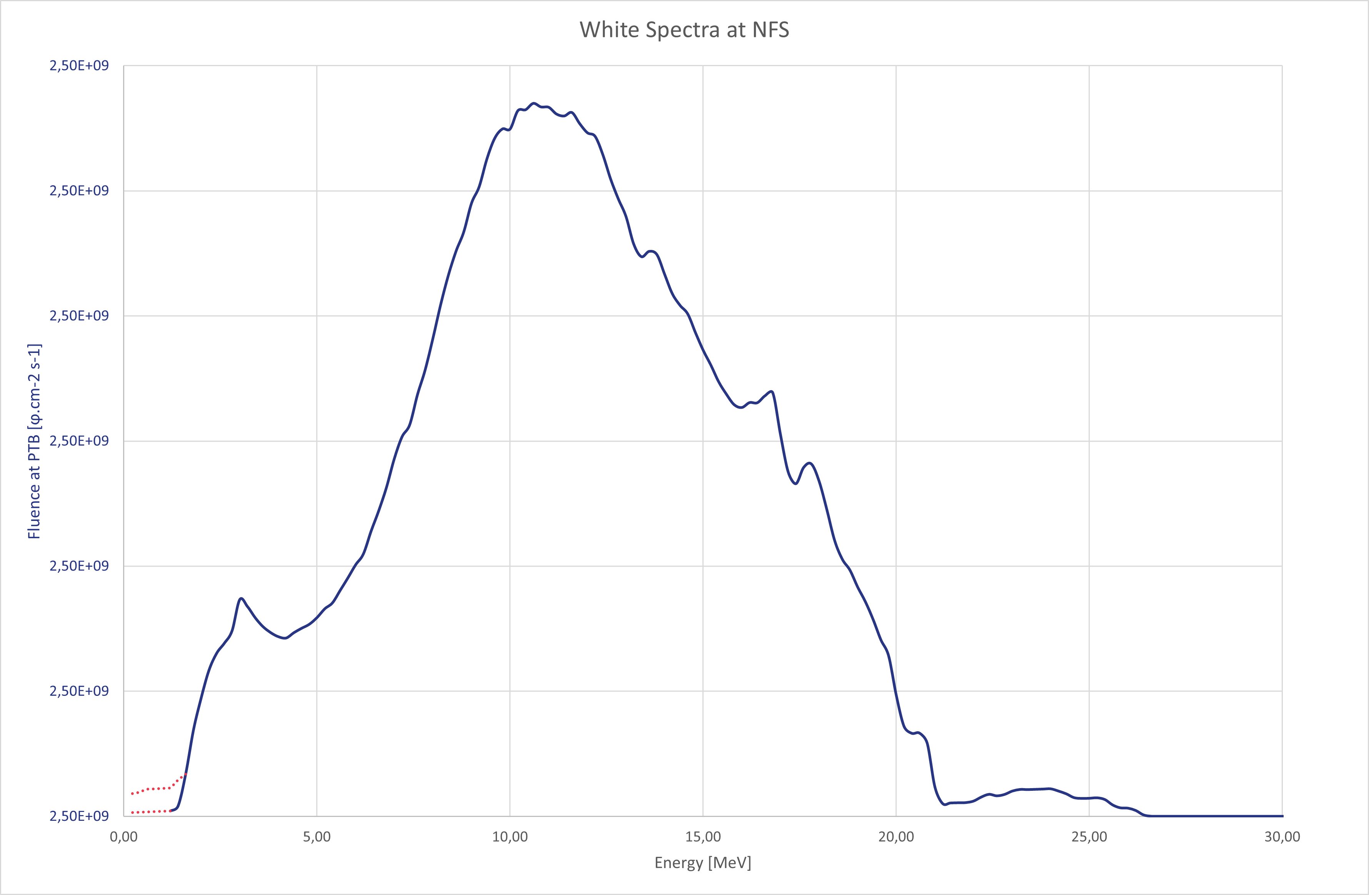
A specific study between 100 keV and 1 MeV
The 100 keV - 1 MeV decade is not much studied.
Most of scintillators cannot detect neutrons under 1 MeV energy. So, the measurements of white spectra begin at 1 MeV.
The decade component between 100 keV and 1 MeV was measured at NFS
Only one calibration reference at 1.2 MeV at PTB
Verification of fluence with mono-energy neutron fields on AMANDE
Notes:
I will finish this presentation on a specific study between 100 keV and 1 MeV will be done after the completed characterization between 1 MeV to 22 MeV. Today, common scintillators can’t detect and discriminate below 1 MeV. It a reason why the fluence measurement begin at 1 MeV at NFS and PTB. Today the shape of neutron response for this decade is not well known. A specific study will be done for stilbene scintillators. At PTB, a measurement has been done at one point two MeV for the fluence reference. Additional energy points on AMANDE mono-energetic neutron fields could be done to complete the characterization for this decade.

Slide 20
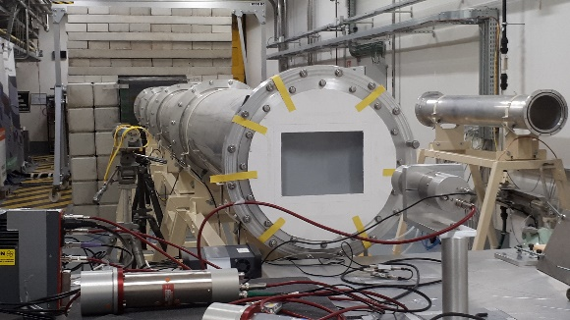
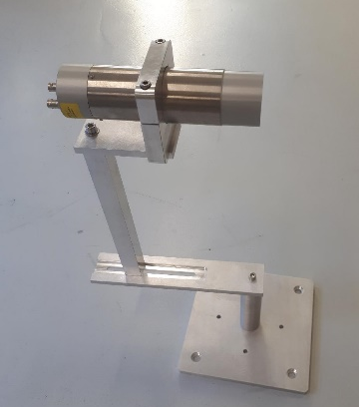
Conclusion
For the neutron characterization of scintillators :
A measurement of white spectrum in Time-Of-Flight at NFS (September 2023)
To determine the shape of the neutron response of the four scintillators
Fluence measurements of neutron monoenergetic field at PTB (November 2023)
To determine the fluence response of the four scintillators
A specific study for the 100 keV - 1 MeV decade
Publication expected in the first semester of 2025
Thank you for your attention
Notes:
Thank to Elisa and pTB Team for your welcome and expertise
Thank to ARIEL project for the support

