Slide 1
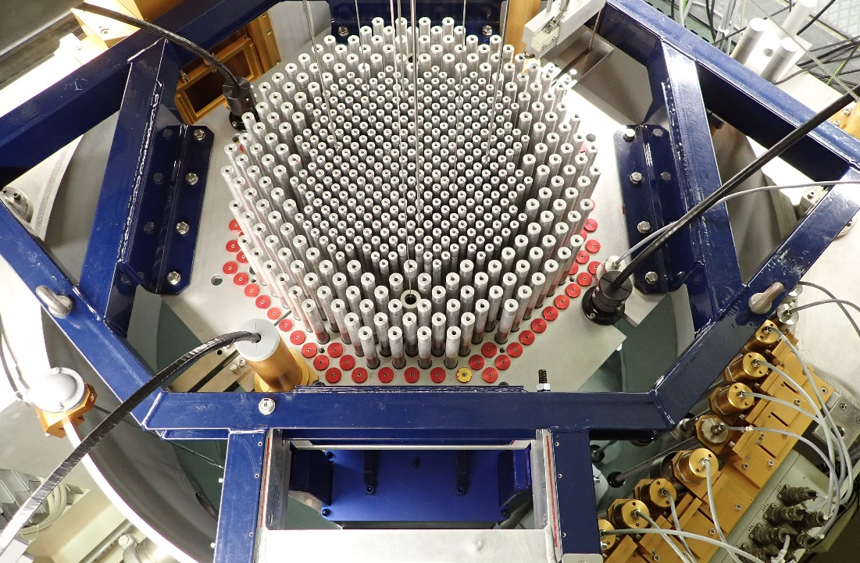
GRAPE : GELINA Reproduction on Accelerator of PETALE Experiments
T. Ligonnet, A. Laureau, V. Lamirand, A. Pautz
ARIEL Final Workshop
January 17, 2024
Laboratory for Reactor Physics and Systems Behaviour

Slide 2
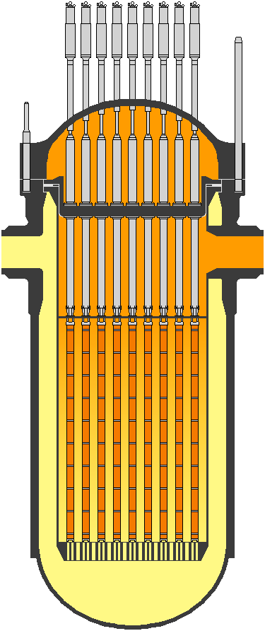
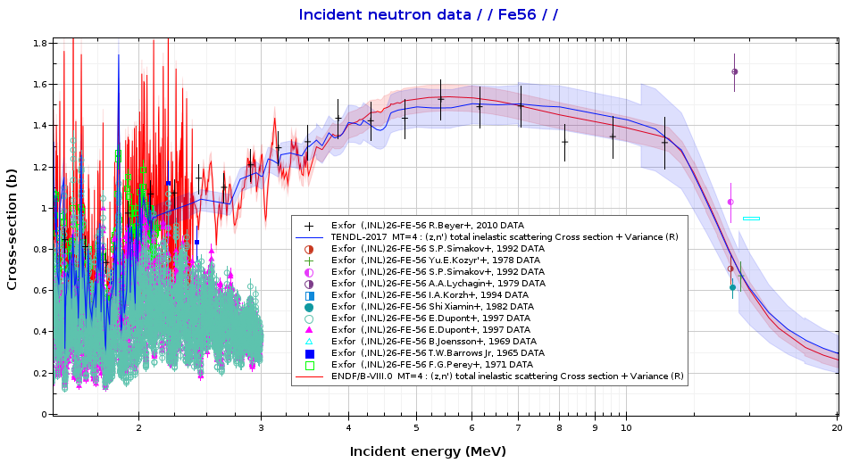
Objective: stainless steel nuclear data
Provide new constraints in the MeV-range and above for stainless steel nuclear data
Fission: heavy reflectors (GEN-III PWR)
Fusion: 14 MeV neutrons
Accelerators: activation
Programme in CROCUS on elemental-type reflector experiments, in the prospect of data assimilation
Separate study of steel, Fe, Ni and Cr
Reactivity worth of reflectors
Transmission using activation dosimetry
Collaboration between CEA & EPFL
Collaboration
between CEA & EPFL
Flux tilt at
interface?
ARIEL Final Workshop
Iron inelastic scattering cross section data (JANIS)
EPR heavy reflector
By ChNPP at English Wikipedia, CC BY 3.0, https://commons.wikimedia.org/w/index.php?curid=22017751

Slide 3
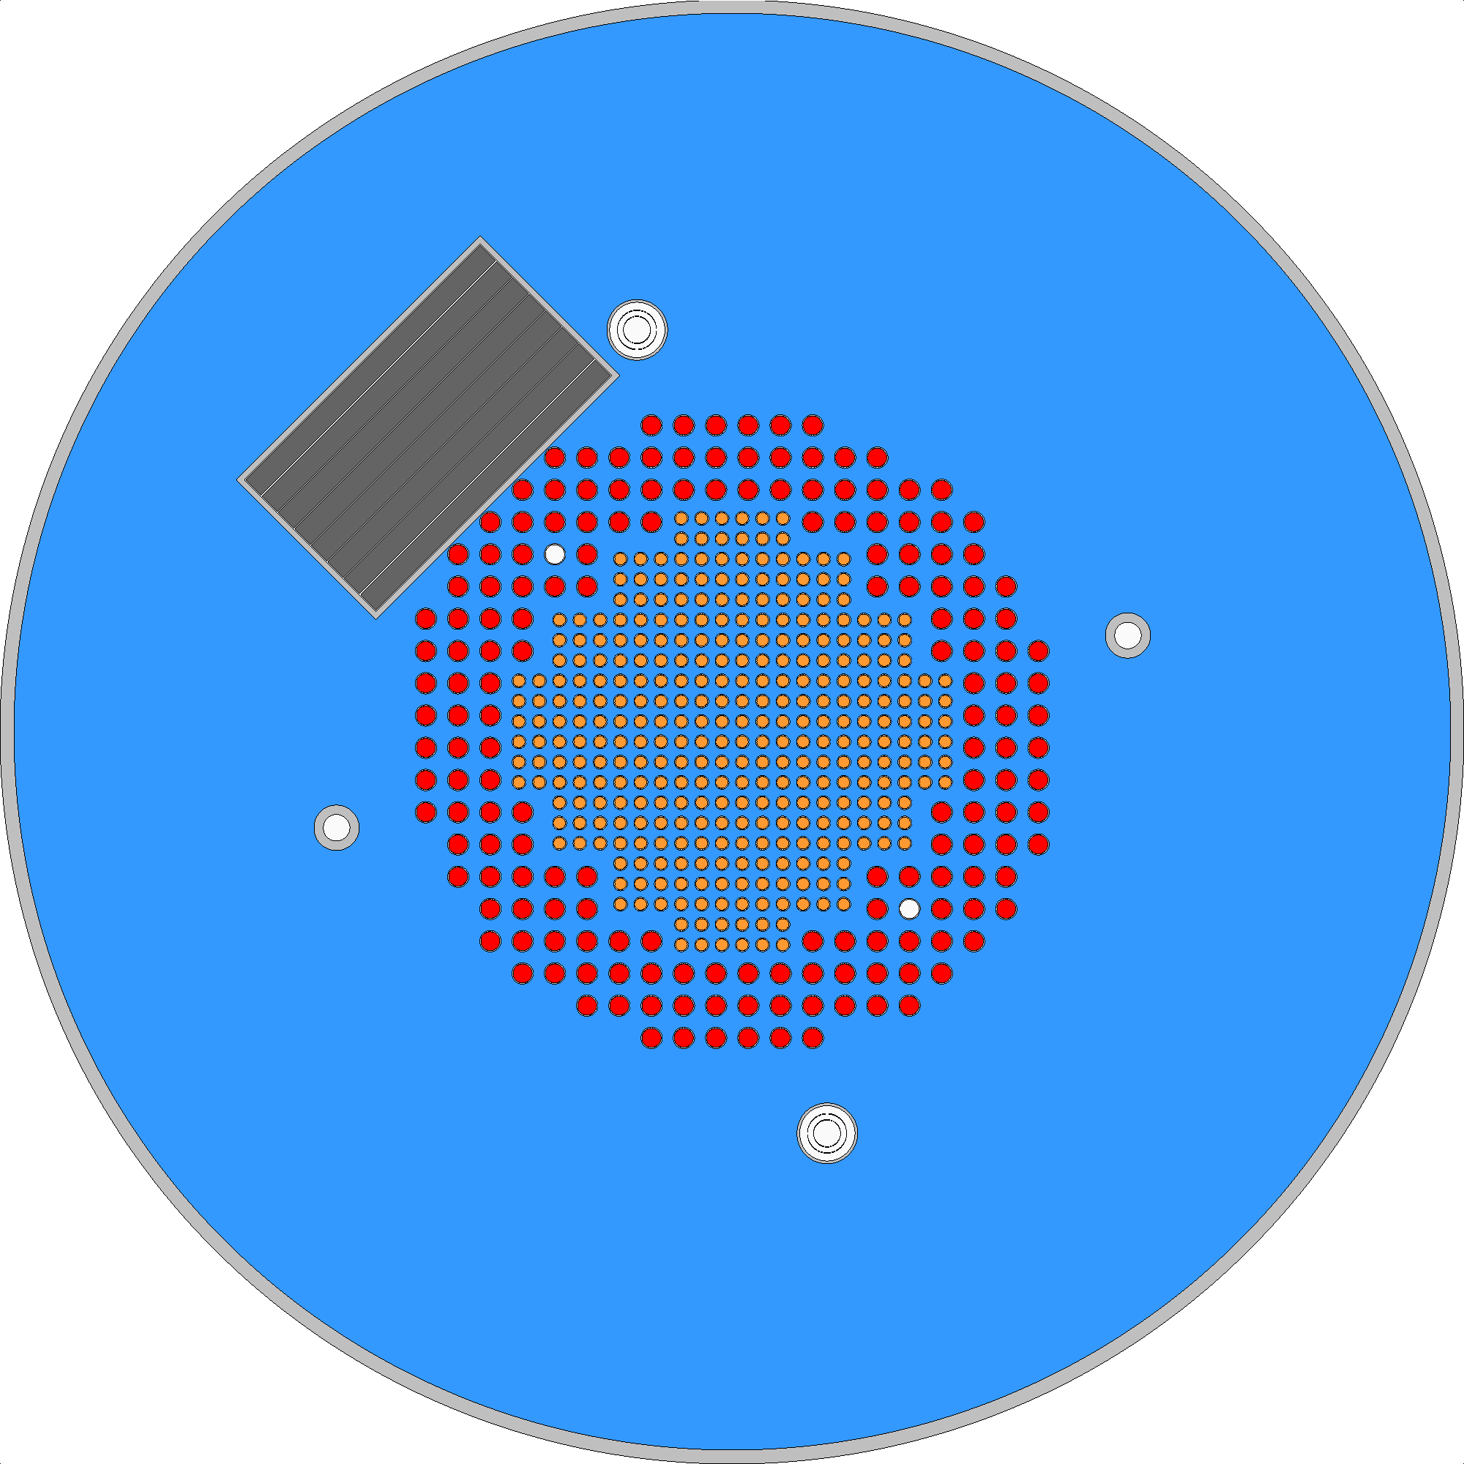
Objective: stainless steel nuclear data
Provide new constraints in the MeV-range and above for stainless steel nuclear data
Fission: heavy reflectors (GEN-III PWR)
Fusion: 14 MeV neutrons
Accelerators: activation
Programme in CROCUS on elemental-type reflector experiments, in the prospect of data assimilation
Separate study of steel, Fe, Ni and Cr
Reactivity worth of reflectors
Transmission using activation dosimetry
Collaboration between CEA & EPFL
Collaboration
between CEA & EPFL
~4 m
≫
1.3 m
ARIEL Final Workshop
~20 cm
Cross section of the CROCUS
reactor core for PETALE
EPR heavy reflector
By ChNPP at English Wikipedia, CC BY 3.0, https://commons.wikimedia.org/w/index.php?curid=22017751

Slide 4
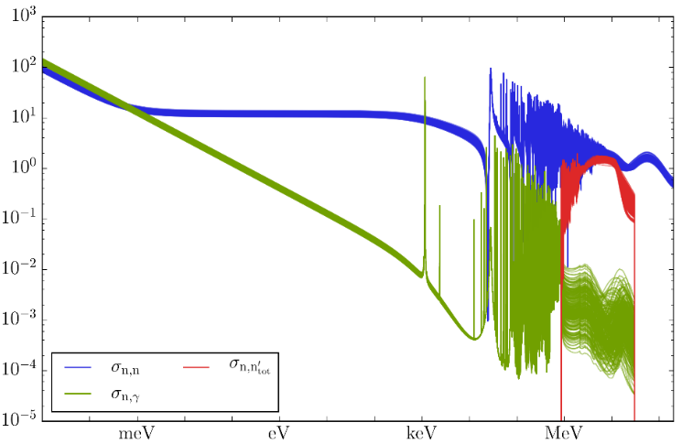
Experimental design by uncertainty propagation
Relating XS uncertainty distribution with measured reaction rates using Total Monte Carlo and Correlated Sampling^{1,2}
× N full core Monte Carlo calculations
⇔ 1 node week
1.2
1.0
0.8
0.6
0.4
0.2
Reaction rate
(a.u.)
Cross section (barn)
15
10
5
0
-5
-10
ARIEL Final Workshop
Variation
(%)
2%
✔
Energy (MeV)
Entry
2
4
6
8
Exit
⁵⁶Fe cross sections dispersion in TENDL 2017
Dosimeter position in the reflector
Reaction rate distributions with In(n,γ)
in the iron metal reflector (128 ACE files)
¹ A. Laureau et al., “Uncertainty propagation for the design study of the PETALE experimental programme in the CROCUS reactor,” EPJ Nucl. Sci. Technol., vol. 6, p. 9, 2020.
² V. Lamirand et al., “An Experimental Programme optimized with Uncertainty Propagation: PETALE in the CROCUS Reactor,” EPJ Web Conf., vol. 211, p. 03003, Jun. 2019.

Slide 5
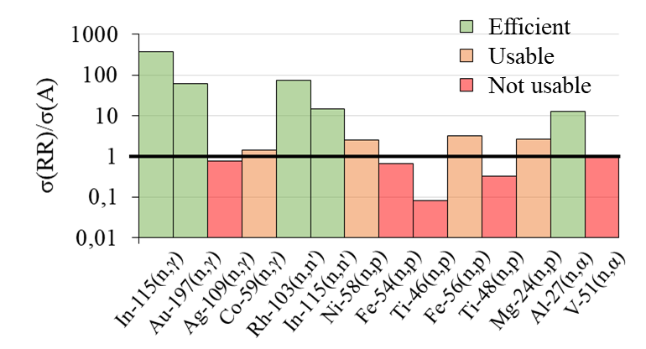
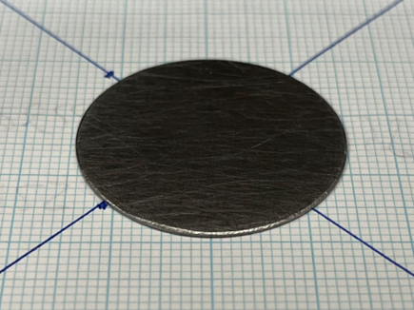
Experimental design by uncertainty propagation
Relating XS uncertainty distribution with measured reaction rates using Total Monte Carlo and Correlated Sampling^{1,2}
× N full core Monte Carlo calculations
⇔ 1 node week
1.2
1.0
0.8
0.6
0.4
0.2
Reaction rate
(a.u.)
15
10
5
0
-5
-10
ARIEL Final Workshop
Variation
(%)
2%
✔
Entry
2
4
6
8
Exit
Comparison between measurement uncertainties and expected variation coming from nuclear data in the system
Dosimeter position in the reflector
Reaction rate distributions with In(n,γ)
in the iron metal reflector (128 ACE files)
¹ A. Laureau et al., “Uncertainty propagation for the design study of the PETALE experimental programme in the CROCUS reactor,” EPJ Nucl. Sci. Technol., vol. 6, p. 9, 2020.
² V. Lamirand et al., “An Experimental Programme optimized with Uncertainty Propagation: PETALE in the CROCUS Reactor,” EPJ Web Conf., vol. 211, p. 03003, Jun. 2019.

Slide 6
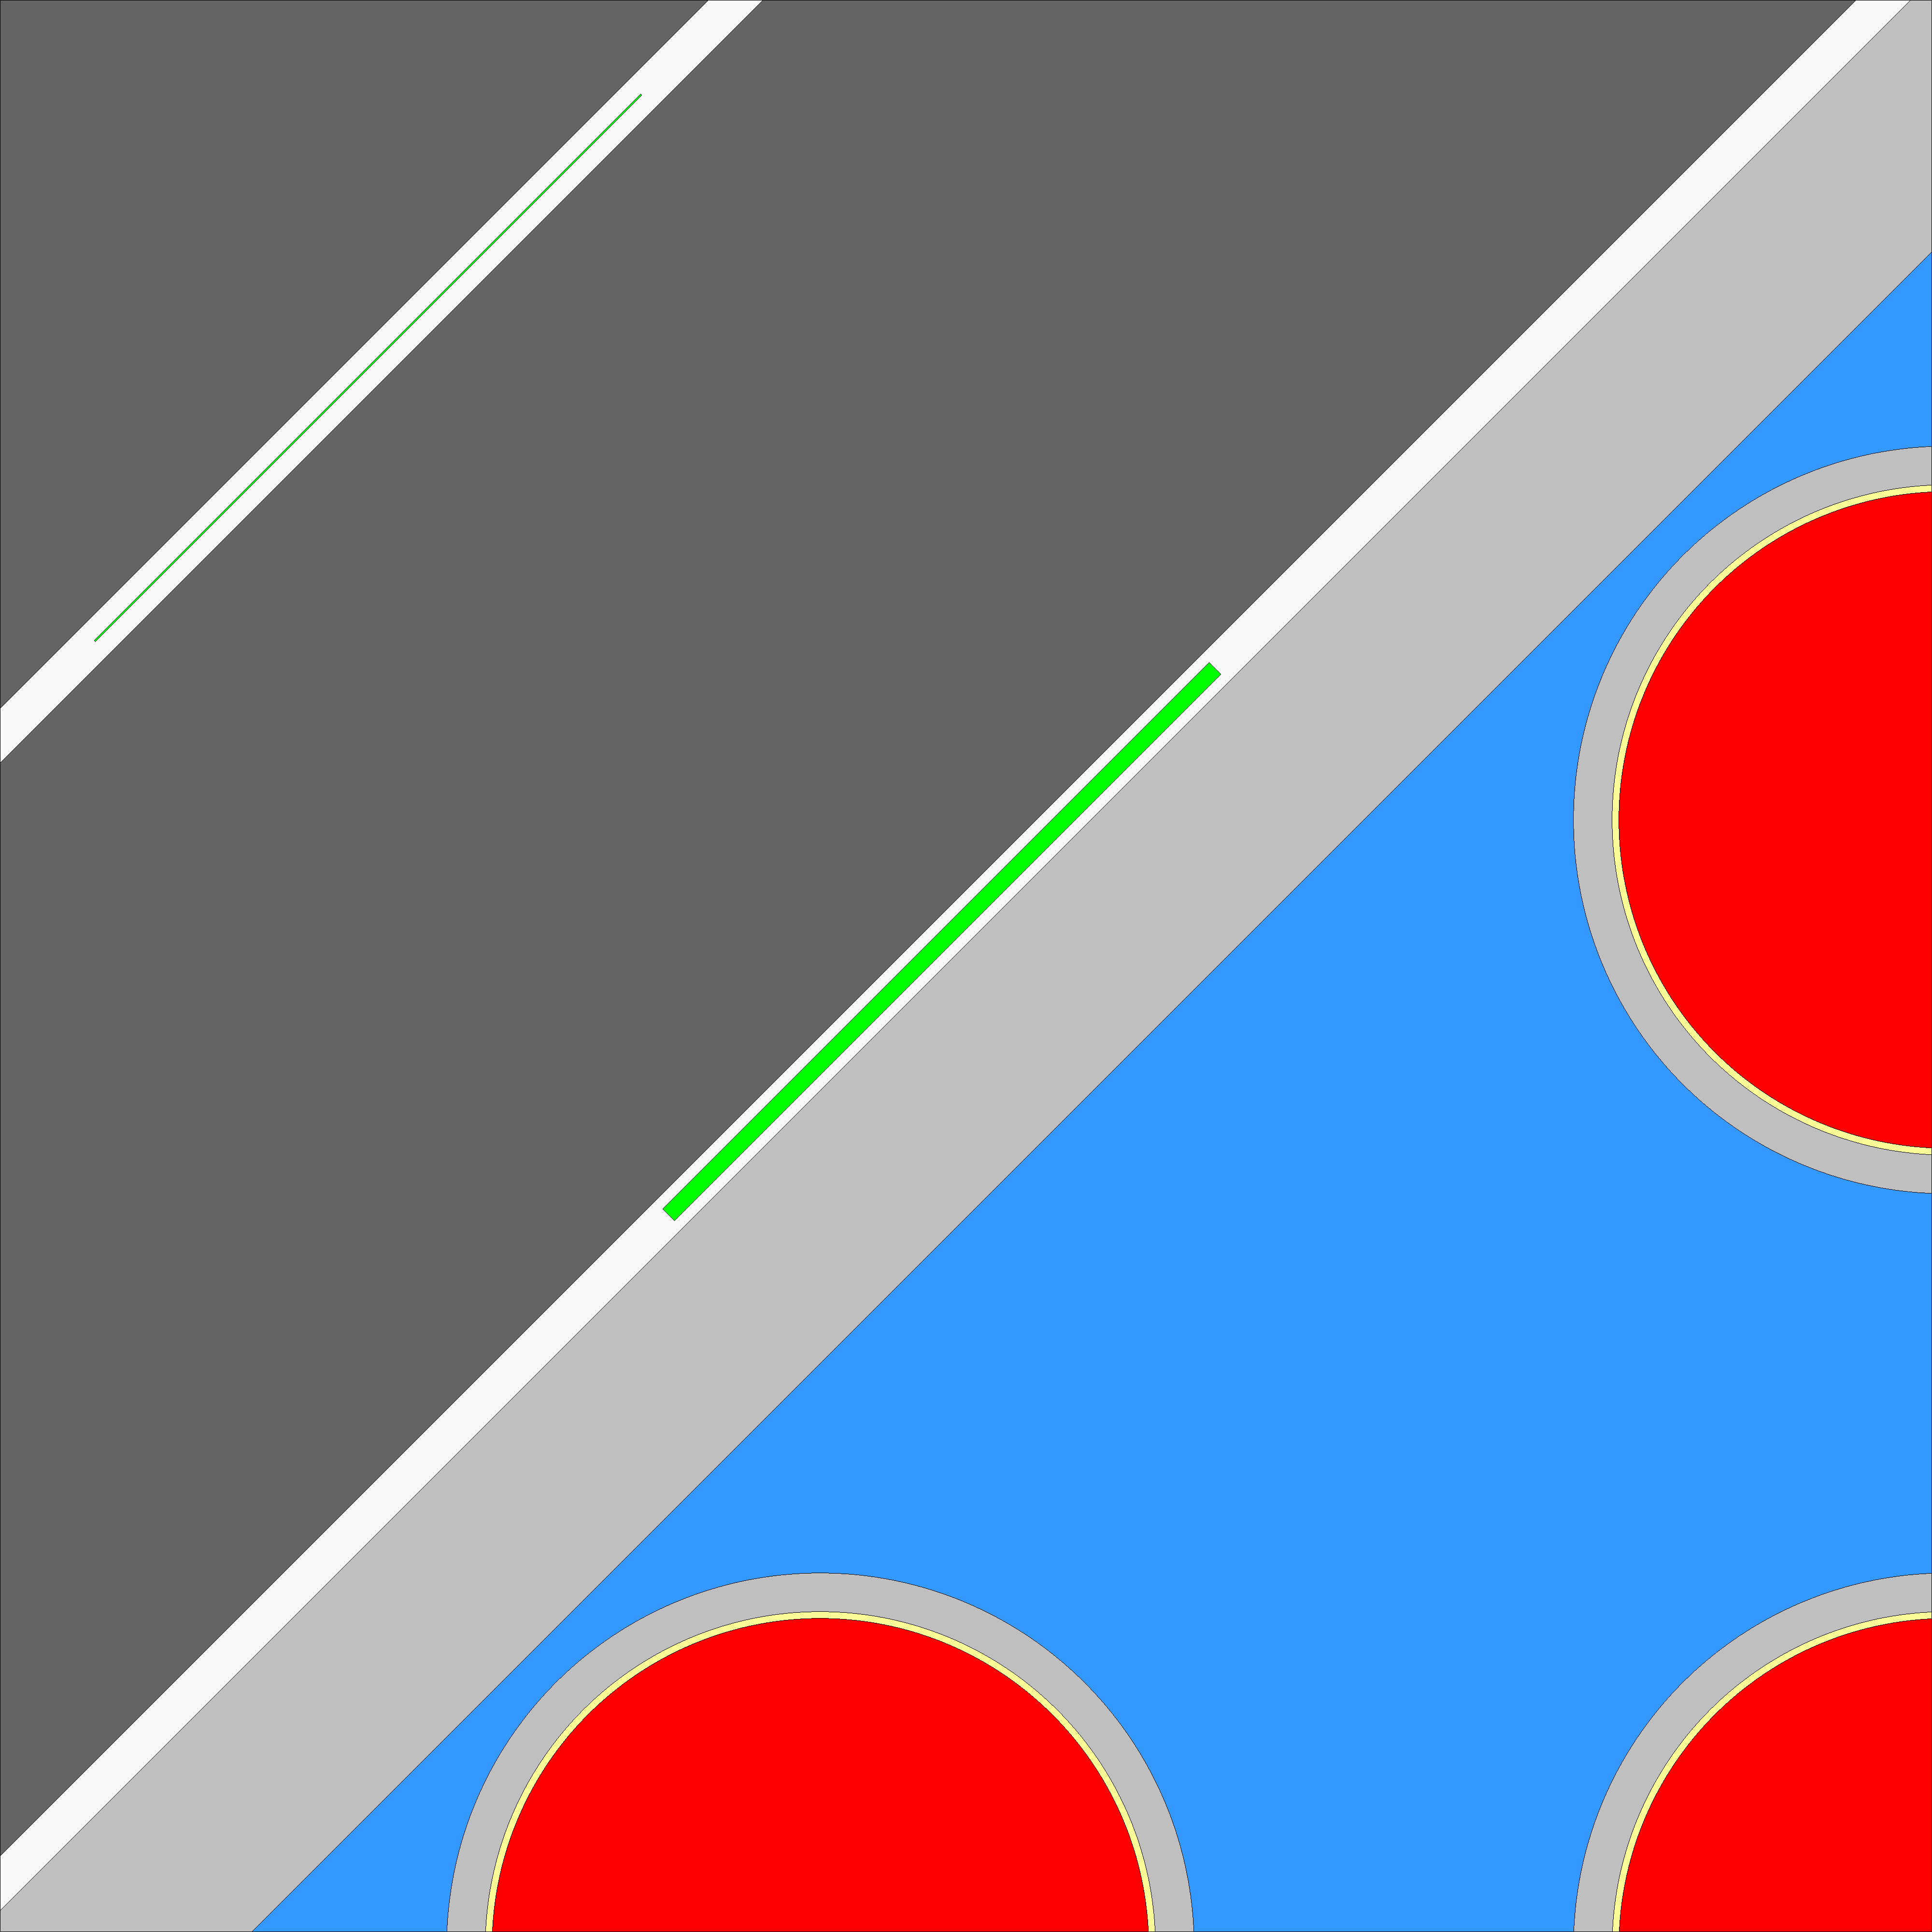
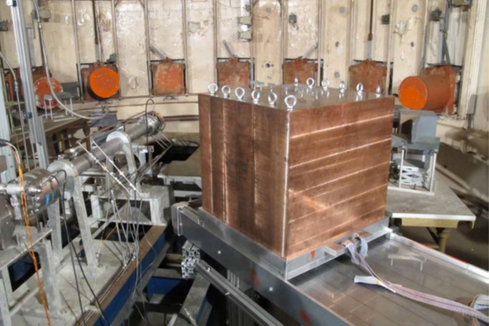
GRAPE at JRC-Geel
Foils
Sheet
Within the HARVEST-X project
Reproduction of PETALE transmission experiments
Activation dosimeters between reflector sheets
Output: reaction rates in dosimeters
4 metal blocks: Fe, Cr, Ni, stainless steel (304L)
GRAPE
White neutron source instead of spectrum from light water reactor (fission + moderation)
Focused on the fast neutron range
Objective of a Benchmark in SINBAD
Metal reflector
30 × 30 × 16
M. Pillon et al., “Integral Benchmark Experiments on a Large Copper Block Using the GELINA Accelerator to Validate natCu Neutron Cross Sections From Different Neutron Cross-Sectional Databases,” IEEE Transactions on Plasma Science 47 6, 2943 (2019); https://doi.org/10.1109/TPS.2019.2911706.

Slide 7
Activation Dosimetry Setup
5 types of activation dosimeters
Over the fast neutron range only
3 of them need onsite measurements
${}_{ }^{115}{In}$, ${}_{ }^{56}{Fe} and$ ${}_{ }^{27}{Al}$
2 of them will be measured later, at our lab
${}_{ }^{58}{Ni}$ and ${}_{ }^{54}{Fe}$
ARIEL Final Workshop
Material | $${}_{ }^{115}{In}$$ | $${}_{ }^{58}{Ni}$$ | $${}_{ }^{54}{Fe}$$ | $${}_{ }^{56}{Fe}$$ | $${}_{ }^{27}{Al}$$
Reaction | n, n’ | n, p | n, p | n, p | n, α
Half-life | 4.49 h | 70.86 days | 312.2 days | 2.58 h | 15 h
Median activation energy | 1.8 MeV | 3.8 MeV | 4.3 MeV | 8.3 MeV | 9.3 MeV

Slide 8
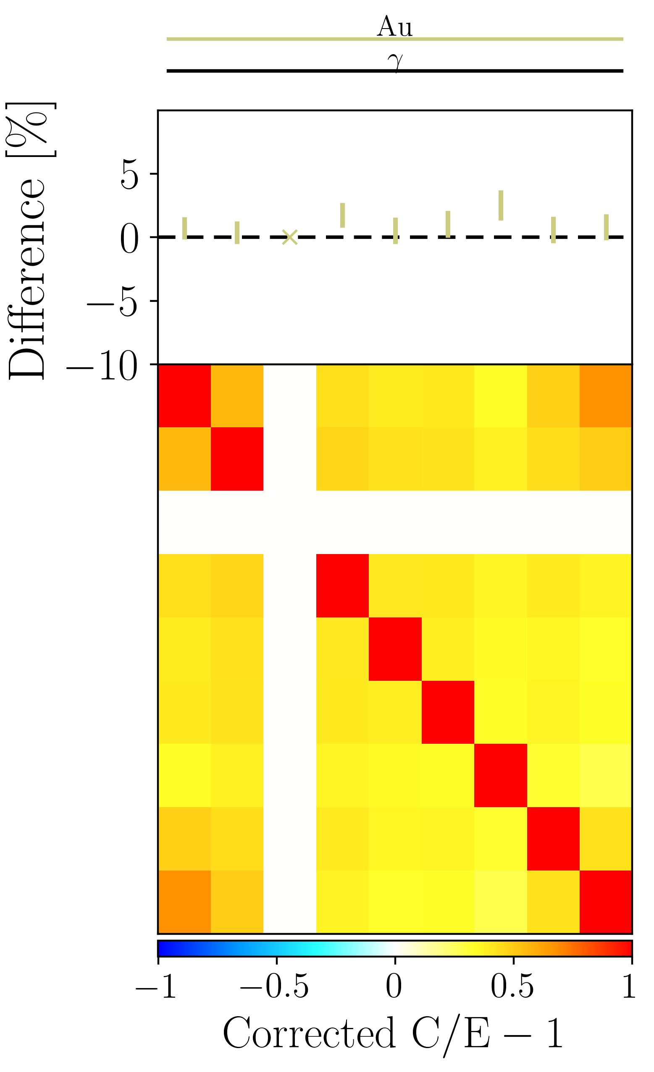
Computational Methods
←fuel PETALE reflector→
Metal block
Monte Carlo neutron transport simulation
Serpent2, modified build
Transport using the JEFF-3.3 nuclear data library
Dosimetry using the IRDFF-II library
Normalization by the 3rd dosimeter (default)
Covariances propagation
Block depth
Correlations
ARIEL Final Workshop
considered sources of uncertainty
ND_{dosi}
HPGe Calibration
Auto-absorption
Measurements
ND_{source}
Position
Computations

Slide 9
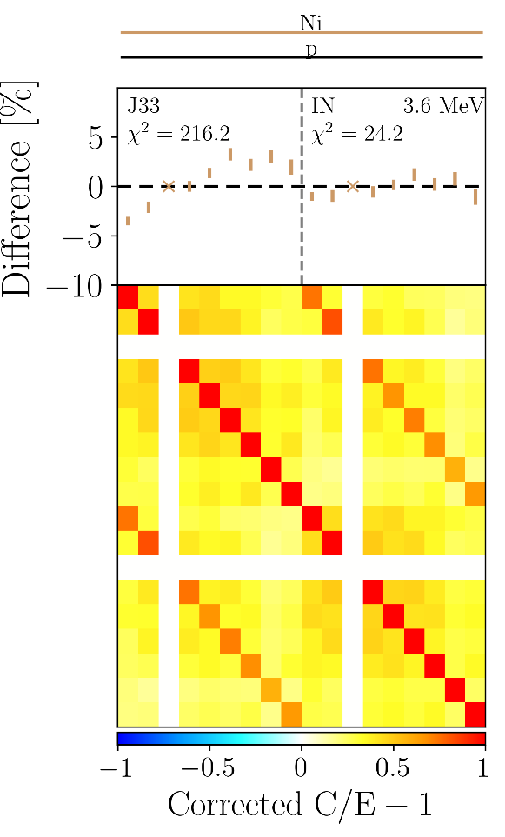
Methods… up to PETALE results
Monte Carlo neutron transport simulation
Serpent2, modified build
Transport using the JEFF-3.3 nuclear data library
Dosimetry using the IRDFF-II library
Normalization by the 3rd dosimeter (default)
Covariances propagation
ARIEL Final Workshop

Slide 10
Methods… up to PETALE results
Monte Carlo neutron transport simulation
Serpent2, modified build
Transport using the JEFF-3.3 nuclear data library
Dosimetry using the IRDFF-II library
Normalization by the 3rd dosimeter (default)
Covariances propagation
What are the remaining risks?
Biases!!!
Methodology → Motivation for BLOOM in CROCUS
System → Motivation for GRAPE
ARIEL Final Workshop

Slide 11
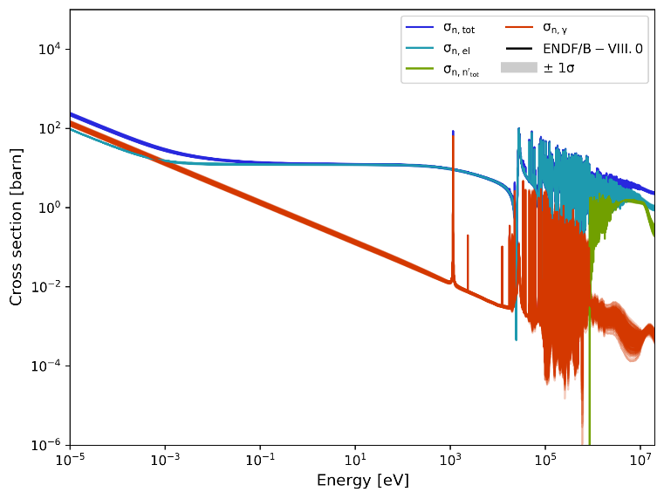
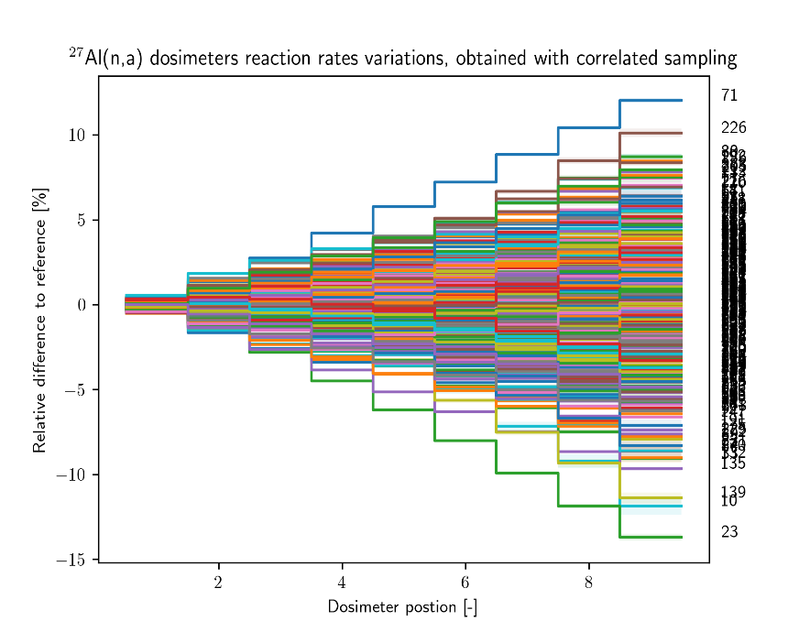
GRAPE design with perturbed XS
Set of perturbed XS obtained using available covariance matrices
Processed with NJOY
Some minor isotopes do not have covariances and are not currently perturbed.
Performed Monte Carlo simulations
Currently, simulations with 256 perturbed XS
Output: dosimeter reaction rates
Spectrum from “On the feasibility to perform integral transmission experiments in the GELINA target hall at IRMM”, Pierre Leconte et al. (2017)

Slide 12
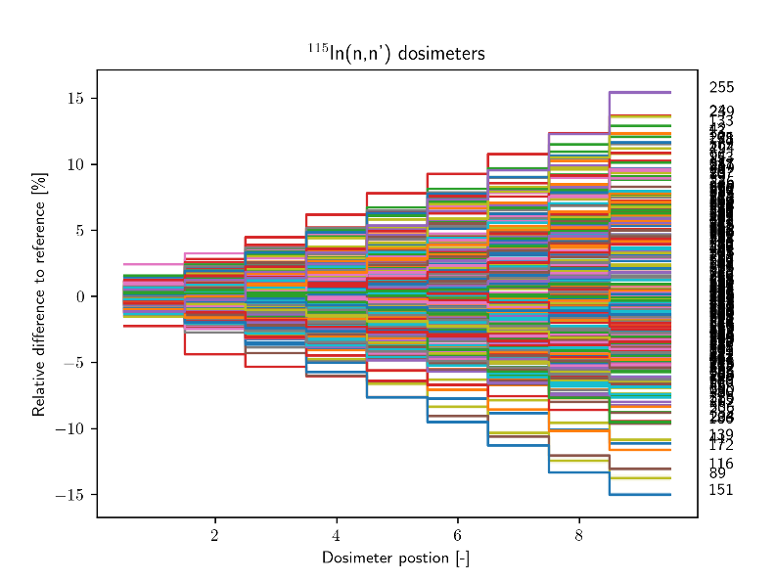
GRAPE design with perturbed XS
Propagation results are close to PETALE
Observed dispersion smaller for JEFF-3.3 than ENDF/B-VII.1 and B-VIII.0
For both Cr and Ni
B-VIII.0 similar to B-VII.1, for both elements
 | Relative standard deviation for the ninth dosimeter [%]
Reflector | Iron |  |  |  |  | Chromium |  |  |  |  | Nickel
Database | JEFF-3.3 |  | ENDF/B-VII.1 |  | ENDF/B-VIII | JEFF-3.3 |  | ENDF/B-VII.1 |  | ENDF/B-VIII | JEFF-3.3 |  | ENDF/B-VII.1 |  | ENDF/B-VIII
Isotopes | 54,56,57,58 |  | 54,56,57 |  | 56 | 50, 52, 53, 54 |  | 50, 52, 53 |  | 50, 52, 53 | 58, 60, 62 |  | 58, 60 |  | 58, 60
Setup Dosimeter | PETALE | GRAPE | PETALE | GRAPE | GRAPE | PETALE | GRAPE | PETALE | GRAPE | GRAPE | PETALE | GRAPE | PETALE | GRAPE | GRAPE
In | 4.34 ± 0.17 | 3.77 ± 0.15 | 5.5 ± 0.2 | 5.9 ± 0.3 | 4.14 ± 0.17 | 1.23 ± 0.05 | 0.96 ± 0.04 | 6.4 ± 0.3 | 5.2 ± 0.2 | 5.1 ± 0.2 | 1.18 ± 0.05 | 1.08 ± 0.04 | 6.6 ± 0.3 | 5.7 ± 03 | 5.8 ± 0.2
Ni | 6.7 ± 0.3 | 5.5 ± 0.3 | 5.1 ± 0.2 | 5.1 ± 0.2 | 7.2 ± 0.3 | 2.32 ± 0.10 | 2.00 ± 0.08 | 9.4 ± 0.4 | 7.6 ± 0.3 | 7.4 ± 0.4 | 2.03 ± 0.09 | 1.77 ± 0.08 | 10.4 ± 0.5 | 8.6 ± 0.4 | 8.2 ± 0.3
Fe-54 | 7.0 ± 0.4 | 5.6 ± 0.3 | 5.4 ± 0.2 | 5.4 ± 0.2 | 7.6 ± 0.3 | 2.48 ± 0.10 | 2.13 ± 0.08 | 9.9 ± 0.4 | 8.0 ± 0.3 | 7.9 ± 0.4 | 2.33 ± 0.10 | 1.99 ± 0.08 | 11.2 ± 0.6 | 9.1 ± 0.4 | 8.6 ± 0.4
Fe-56 | 5.0 ± 0.2 | 4.5 ± 0.2 | 8.3 ± 0.4 | 8.1 ± 0.3 | 8.0 ± 0.4 | 2.17 ± 0.09 | 2.09 ± 0.09 | 10.2 ± 0.4 | 10.6 ± 0.5 | 10.5 ± 0.6 | 2.97 ± 0.13 | 2.79 ± 0.11 | 8.7 ± 0.4 | 8.3 ± 0.4 | 7.9 ± 0.4
Al | 5.5 ± 0.2 | 4.4 ± 0.2 | 9.1 ± 0.4 | 8.5 ± 0.4 | 7.9 ± 0.4 | 2.28 ± 0.10 | 2.22 ± 0.09 | 11.9 ± 0.5 | 11.9 ± 0.5 | 12.2 ± 0.6 | 3.01 ± 0.13 | 2.88 ± 0.12 | 8.4 ± 0.4 | 8.5 ± 0.4 | 8.2 ± 0.4
Ni

Slide 13
GRAPE design with perturbed XS
Propagation results are close to PETALE
Observed dispersion smaller for JEFF-3.3 than ENDF/B-VII.1 and B-VIII.0
For both Cr and Ni
B-VIII.0 similar to B-VII.1, for both elements
 | Relative standard deviation for the ninth dosimeter [%]
 | Chromium
 | JEFF-3.3 |  | ENDF/B-VII.1 |  | ENDF/B-VIII
 | 50, 52, 53, 54 |  | 50, 52, 53 |  | 50, 52, 53
 | PETALE | GRAPE | PETALE | GRAPE | GRAPE
In | 1.23 ± 0.05 | 0.96 ± 0.04 | 6.4 ± 0.3 | 5.2 ± 0.2 | 5.1 ± 0.2
Ni | 2.32 ± 0.10 | 2.00 ± 0.08 | 9.4 ± 0.4 | 7.6 ± 0.3 | 7.4 ± 0.4
Fe-54 | 2.48 ± 0.10 | 2.13 ± 0.08 | 9.9 ± 0.4 | 8.0 ± 0.3 | 7.9 ± 0.4
Fe-56 | 2.17 ± 0.09 | 2.09 ± 0.09 | 10.2 ± 0.4 | 10.6 ± 0.5 | 10.5 ± 0.6
Al | 2.28 ± 0.10 | 2.22 ± 0.09 | 11.9 ± 0.5 | 11.9 ± 0.5 | 12.2 ± 0.6
ARIEL Final Workshop
 | Relative standard deviation for the ninth dosimeter [%]
Reflector | Iron |  |  |  |  | Chromium |  |  |  |  | Nickel
Database | JEFF-3.3 |  | ENDF/B-VII.1 |  | ENDF/B-VIII | JEFF-3.3 |  | ENDF/B-VII.1 |  | ENDF/B-VIII | JEFF-3.3 |  | ENDF/B-VII.1 |  | ENDF/B-VIII
Isotopes | 54,56,57,58 |  | 54,56,57 |  | 56 | 50, 52, 53, 54 |  | 50, 52, 53 |  | 50, 52, 53 | 58, 60, 62 |  | 58, 60 |  | 58, 60
Setup Dosimeter | PETALE | GRAPE | PETALE | GRAPE | GRAPE | PETALE | GRAPE | PETALE | GRAPE | GRAPE | PETALE | GRAPE | PETALE | GRAPE | GRAPE
In | 4.34 ± 0.17 | 3.77 ± 0.15 | 5.5 ± 0.2 | 5.9 ± 0.3 | 4.14 ± 0.17 | 1.23 ± 0.05 | 0.96 ± 0.04 | 6.4 ± 0.3 | 5.2 ± 0.2 | 5.1 ± 0.2 | 1.18 ± 0.05 | 1.08 ± 0.04 | 6.6 ± 0.3 | 5.7 ± 03 | 5.8 ± 0.2
Ni | 6.7 ± 0.3 | 5.5 ± 0.3 | 5.1 ± 0.2 | 5.1 ± 0.2 | 7.2 ± 0.3 | 2.32 ± 0.10 | 2.00 ± 0.08 | 9.4 ± 0.4 | 7.6 ± 0.3 | 7.4 ± 0.4 | 2.03 ± 0.09 | 1.77 ± 0.08 | 10.4 ± 0.5 | 8.6 ± 0.4 | 8.2 ± 0.3
Fe-54 | 7.0 ± 0.4 | 5.6 ± 0.3 | 5.4 ± 0.2 | 5.4 ± 0.2 | 7.6 ± 0.3 | 2.48 ± 0.10 | 2.13 ± 0.08 | 9.9 ± 0.4 | 8.0 ± 0.3 | 7.9 ± 0.4 | 2.33 ± 0.10 | 1.99 ± 0.08 | 11.2 ± 0.6 | 9.1 ± 0.4 | 8.6 ± 0.4
Fe-56 | 5.0 ± 0.2 | 4.5 ± 0.2 | 8.3 ± 0.4 | 8.1 ± 0.3 | 8.0 ± 0.4 | 2.17 ± 0.09 | 2.09 ± 0.09 | 10.2 ± 0.4 | 10.6 ± 0.5 | 10.5 ± 0.6 | 2.97 ± 0.13 | 2.79 ± 0.11 | 8.7 ± 0.4 | 8.3 ± 0.4 | 7.9 ± 0.4
Al | 5.5 ± 0.2 | 4.4 ± 0.2 | 9.1 ± 0.4 | 8.5 ± 0.4 | 7.9 ± 0.4 | 2.28 ± 0.10 | 2.22 ± 0.09 | 11.9 ± 0.5 | 11.9 ± 0.5 | 12.2 ± 0.6 | 3.01 ± 0.13 | 2.88 ± 0.12 | 8.4 ± 0.4 | 8.5 ± 0.4 | 8.2 ± 0.4
Cr

Slide 14
A closer look at Chromium
Propagation results are close to PETALE
A bit lower for In, Ni, and ⁵⁴Fe dosimeters
 | Relative standard deviation for the ninth dosimeter [%]
 | Chromium
 | JEFF-3.3 |  | ENDF/B-VII.1 |  | ENDF/B-VIII
 | 50, 52, 53, 54 |  | 50, 52, 53 |  | 50, 52, 53
 | PETALE | GRAPE | PETALE | GRAPE | GRAPE
In | 1.23 ± 0.05 | 0.96 ± 0.04 | 6.4 ± 0.3 | 5.2 ± 0.2 | 5.1 ± 0.2
Ni | 2.32 ± 0.10 | 2.00 ± 0.08 | 9.4 ± 0.4 | 7.6 ± 0.3 | 7.4 ± 0.4
Fe-54 | 2.48 ± 0.10 | 2.13 ± 0.08 | 9.9 ± 0.4 | 8.0 ± 0.3 | 7.9 ± 0.4
Fe-56 | 2.17 ± 0.09 | 2.09 ± 0.09 | 10.2 ± 0.4 | 10.6 ± 0.5 | 10.5 ± 0.6
Al | 2.28 ± 0.10 | 2.22 ± 0.09 | 11.9 ± 0.5 | 11.9 ± 0.5 | 12.2 ± 0.6
ARIEL Final Workshop

Slide 15
A closer look at Chromium
Propagation results are close to PETALE
A bit lower for In, Ni, and ⁵⁴Fe dosimeters
JEFF-3.3: similar for most dosimeters
Around 2%-2.5%
Lower for ¹¹⁵In(n,n’)
 | Relative standard deviation for the ninth dosimeter [%]
 | Chromium
 | JEFF-3.3 |  | ENDF/B-VII.1 |  | ENDF/B-VIII
 | 50, 52, 53, 54 |  | 50, 52, 53 |  | 50, 52, 53
 | PETALE | GRAPE | PETALE | GRAPE | GRAPE
In | 1.23 ± 0.05 | 0.96 ± 0.04 | 6.4 ± 0.3 | 5.2 ± 0.2 | 5.1 ± 0.2
Ni | 2.32 ± 0.10 | 2.00 ± 0.08 | 9.4 ± 0.4 | 7.6 ± 0.3 | 7.4 ± 0.4
Fe-54 | 2.48 ± 0.10 | 2.13 ± 0.08 | 9.9 ± 0.4 | 8.0 ± 0.3 | 7.9 ± 0.4
Fe-56 | 2.17 ± 0.09 | 2.09 ± 0.09 | 10.2 ± 0.4 | 10.6 ± 0.5 | 10.5 ± 0.6
Al | 2.28 ± 0.10 | 2.22 ± 0.09 | 11.9 ± 0.5 | 11.9 ± 0.5 | 12.2 ± 0.6
ARIEL Final Workshop
1% – 2.5%

Slide 16
A closer look at Chromium
Propagation results are close to PETALE
A bit lower for In, Ni, and ⁵⁴Fe dosimeters
JEFF-3.3: similar for most dosimeters
Around 2%-2.5%
Lower for ¹¹⁵In(n,n’)
ENDF: uncertainties increase with increasing dosimeters’ energy range
From 5% up to 12%
No significant differences between ENDFs
 | Relative standard deviation for the ninth dosimeter [%]
 | Chromium
 | JEFF-3.3 |  | ENDF/B-VII.1 |  | ENDF/B-VIII
 | 50, 52, 53, 54 |  | 50, 52, 53 |  | 50, 52, 53
 | PETALE | GRAPE | PETALE | GRAPE | GRAPE
In | 1.23 ± 0.05 | 0.96 ± 0.04 | 6.4 ± 0.3 | 5.2 ± 0.2 | 5.1 ± 0.2
Ni | 2.32 ± 0.10 | 2.00 ± 0.08 | 9.4 ± 0.4 | 7.6 ± 0.3 | 7.4 ± 0.4
Fe-54 | 2.48 ± 0.10 | 2.13 ± 0.08 | 9.9 ± 0.4 | 8.0 ± 0.3 | 7.9 ± 0.4
Fe-56 | 2.17 ± 0.09 | 2.09 ± 0.09 | 10.2 ± 0.4 | 10.6 ± 0.5 | 10.5 ± 0.6
Al | 2.28 ± 0.10 | 2.22 ± 0.09 | 11.9 ± 0.5 | 11.9 ± 0.5 | 12.2 ± 0.6
ARIEL Final Workshop
5% – 12%

Slide 17
A closer look at Chromium
Propagation results are close to PETALE
A bit lower for In, Ni, and ⁵⁴Fe dosimeters
Observed dispersion smaller for JEFF-3.3 than ENDF/B-VII.1 and B-VIII.0
For both Cr and Ni blocks
 | Relative standard deviation for the ninth dosimeter [%]
 | Chromium
 | JEFF-3.3 |  | ENDF/B-VII.1 |  | ENDF/B-VIII
 | 50, 52, 53, 54 |  | 50, 52, 53 |  | 50, 52, 53
 | PETALE | GRAPE | PETALE | GRAPE | GRAPE
In | 1.23 ± 0.05 | 0.96 ± 0.04 | 6.4 ± 0.3 | 5.2 ± 0.2 | 5.1 ± 0.2
Ni | 2.32 ± 0.10 | 2.00 ± 0.08 | 9.4 ± 0.4 | 7.6 ± 0.3 | 7.4 ± 0.4
Fe-54 | 2.48 ± 0.10 | 2.13 ± 0.08 | 9.9 ± 0.4 | 8.0 ± 0.3 | 7.9 ± 0.4
Fe-56 | 2.17 ± 0.09 | 2.09 ± 0.09 | 10.2 ± 0.4 | 10.6 ± 0.5 | 10.5 ± 0.6
Al | 2.28 ± 0.10 | 2.22 ± 0.09 | 11.9 ± 0.5 | 11.9 ± 0.5 | 12.2 ± 0.6
ARIEL Final Workshop
1% – 2.5%
5% – 12%

Slide 18
A closer look at Chromium…
Propagation results are close to PETALE
A bit lower for In, Ni, and ⁵⁴Fe dosimeters
Observed dispersion smaller for JEFF-3.3 than ENDF/B-VII.1 and B-VIII.0
For both Cr and Ni blocks
NB: JEFF design dispersion
was unrealistic for PETALE
when compared to results
 | Relative standard deviation for the ninth dosimeter [%]
 | Chromium
 | JEFF-3.3 |  | ENDF/B-VII.1 |  | ENDF/B-VIII
 | 50, 52, 53, 54 |  | 50, 52, 53 |  | 50, 52, 53
 | PETALE | GRAPE | PETALE | GRAPE | GRAPE
In | 1.23 ± 0.05 | 0.96 ± 0.04 | 6.4 ± 0.3 | 5.2 ± 0.2 | 5.1 ± 0.2
Ni | 2.32 ± 0.10 | 2.00 ± 0.08 | 9.4 ± 0.4 | 7.6 ± 0.3 | 7.4 ± 0.4
Fe-54 | 2.48 ± 0.10 | 2.13 ± 0.08 | 9.9 ± 0.4 | 8.0 ± 0.3 | 7.9 ± 0.4
Fe-56 | 2.17 ± 0.09 | 2.09 ± 0.09 | 10.2 ± 0.4 | 10.6 ± 0.5 | 10.5 ± 0.6
Al | 2.28 ± 0.10 | 2.22 ± 0.09 | 11.9 ± 0.5 | 11.9 ± 0.5 | 12.2 ± 0.6
ARIEL Final Workshop

Slide 19
… and iron
Propagation results are close to PETALE
Libraries behave differently for different dosimeter ranges
 | Relative standard deviation for the ninth dosimeter [%]
 | Iron
 | JEFF-3.3 |  | ENDF/B-VII.1 |  | ENDF/B-VIII
 | 54,56,57,58 |  | 54,56,57 |  | 56
 | PETALE | GRAPE | PETALE | GRAPE | GRAPE
In | 4.34 ± 0.17 | 3.77 ± 0.15 | 5.5 ± 0.2 | 5.9 ± 0.3 | 4.14 ± 0.17
Ni | 6.7 ± 0.3 | 5.5 ± 0.3 | 5.1 ± 0.2 | 5.1 ± 0.2 | 7.2 ± 0.3
Fe-54 | 7.0 ± 0.4 | 5.6 ± 0.3 | 5.4 ± 0.2 | 5.4 ± 0.2 | 7.6 ± 0.3
Fe-56 | 5.0 ± 0.2 | 4.5 ± 0.2 | 8.3 ± 0.4 | 8.1 ± 0.3 | 8.0 ± 0.4
Al | 5.5 ± 0.2 | 4.4 ± 0.2 | 9.1 ± 0.4 | 8.5 ± 0.4 | 7.9 ± 0.4
ARIEL Final Workshop
 | Relative standard deviation for the ninth dosimeter [%]
Reflector | Iron |  |  |  |  | Chromium |  |  |  |  | Nickel
Database | JEFF-3.3 |  | ENDF/B-VII.1 |  | ENDF/B-VIII | JEFF-3.3 |  | ENDF/B-VII.1 |  | ENDF/B-VIII | JEFF-3.3 |  | ENDF/B-VII.1 |  | ENDF/B-VIII
Isotopes | 54,56,57,58 |  | 54,56,57 |  | 56 | 50, 52, 53, 54 |  | 50, 52, 53 |  | 50, 52, 53 | 58, 60, 62 |  | 58, 60 |  | 58, 60
Setup Dosimeter | PETALE | GRAPE | PETALE | GRAPE | GRAPE | PETALE | GRAPE | PETALE | GRAPE | GRAPE | PETALE | GRAPE | PETALE | GRAPE | GRAPE
In | 4.34 ± 0.17 | 3.77 ± 0.15 | 5.5 ± 0.2 | 5.9 ± 0.3 | 4.14 ± 0.17 | 1.23 ± 0.05 | 0.96 ± 0.04 | 6.4 ± 0.3 | 5.2 ± 0.2 | 5.1 ± 0.2 | 1.18 ± 0.05 | 1.08 ± 0.04 | 6.6 ± 0.3 | 5.7 ± 03 | 5.8 ± 0.2
Ni | 6.7 ± 0.3 | 5.5 ± 0.3 | 5.1 ± 0.2 | 5.1 ± 0.2 | 7.2 ± 0.3 | 2.32 ± 0.10 | 2.00 ± 0.08 | 9.4 ± 0.4 | 7.6 ± 0.3 | 7.4 ± 0.4 | 2.03 ± 0.09 | 1.77 ± 0.08 | 10.4 ± 0.5 | 8.6 ± 0.4 | 8.2 ± 0.3
Fe-54 | 7.0 ± 0.4 | 5.6 ± 0.3 | 5.4 ± 0.2 | 5.4 ± 0.2 | 7.6 ± 0.3 | 2.48 ± 0.10 | 2.13 ± 0.08 | 9.9 ± 0.4 | 8.0 ± 0.3 | 7.9 ± 0.4 | 2.33 ± 0.10 | 1.99 ± 0.08 | 11.2 ± 0.6 | 9.1 ± 0.4 | 8.6 ± 0.4
Fe-56 | 5.0 ± 0.2 | 4.5 ± 0.2 | 8.3 ± 0.4 | 8.1 ± 0.3 | 8.0 ± 0.4 | 2.17 ± 0.09 | 2.09 ± 0.09 | 10.2 ± 0.4 | 10.6 ± 0.5 | 10.5 ± 0.6 | 2.97 ± 0.13 | 2.79 ± 0.11 | 8.7 ± 0.4 | 8.3 ± 0.4 | 7.9 ± 0.4
Al | 5.5 ± 0.2 | 4.4 ± 0.2 | 9.1 ± 0.4 | 8.5 ± 0.4 | 7.9 ± 0.4 | 2.28 ± 0.10 | 2.22 ± 0.09 | 11.9 ± 0.5 | 11.9 ± 0.5 | 12.2 ± 0.6 | 3.01 ± 0.13 | 2.88 ± 0.12 | 8.4 ± 0.4 | 8.5 ± 0.4 | 8.2 ± 0.4
Fe

Slide 20
… and iron
Propagation results are close to PETALE
Libraries behave differently for different dosimeter ranges
JEFF: larger dispersion for Ni/⁵⁴Fe ranges
B-VII.1: larger dispersion for ⁵⁶Fe/Al ranges
 | Relative standard deviation for the ninth dosimeter [%]
 | Iron
 | JEFF-3.3 |  | ENDF/B-VII.1 |  | ENDF/B-VIII
 | 54,56,57,58 |  | 54,56,57 |  | 56
 | PETALE | GRAPE | PETALE | GRAPE | GRAPE
In | 4.34 ± 0.17 | 3.77 ± 0.15 | 5.5 ± 0.2 | 5.9 ± 0.3 | 4.14 ± 0.17
Ni | 6.7 ± 0.3 | 5.5 ± 0.3 | 5.1 ± 0.2 | 5.1 ± 0.2 | 7.2 ± 0.3
Fe-54 | 7.0 ± 0.4 | 5.6 ± 0.3 | 5.4 ± 0.2 | 5.4 ± 0.2 | 7.6 ± 0.3
Fe-56 | 5.0 ± 0.2 | 4.5 ± 0.2 | 8.3 ± 0.4 | 8.1 ± 0.3 | 8.0 ± 0.4
Al | 5.5 ± 0.2 | 4.4 ± 0.2 | 9.1 ± 0.4 | 8.5 ± 0.4 | 7.9 ± 0.4
ARIEL Final Workshop

Slide 21
… and iron
Propagation results are close to PETALE
Libraries behave differently for different dosimeter ranges
JEFF: larger dispersion for Ni/⁵⁴Fe ranges
B-VII.1: larger dispersion for ⁵⁶Fe/Al ranges
B-VIII.0: large and similar values for all four
 | Relative standard deviation for the ninth dosimeter [%]
 | Iron
 | JEFF-3.3 |  | ENDF/B-VII.1 |  | ENDF/B-VIII
 | 54,56,57,58 |  | 54,56,57 |  | 56
 | PETALE | GRAPE | PETALE | GRAPE | GRAPE
In | 4.34 ± 0.17 | 3.77 ± 0.15 | 5.5 ± 0.2 | 5.9 ± 0.3 | 4.14 ± 0.17
Ni | 6.7 ± 0.3 | 5.5 ± 0.3 | 5.1 ± 0.2 | 5.1 ± 0.2 | 7.2 ± 0.3
Fe-54 | 7.0 ± 0.4 | 5.6 ± 0.3 | 5.4 ± 0.2 | 5.4 ± 0.2 | 7.6 ± 0.3
Fe-56 | 5.0 ± 0.2 | 4.5 ± 0.2 | 8.3 ± 0.4 | 8.1 ± 0.3 | 8.0 ± 0.4
Al | 5.5 ± 0.2 | 4.4 ± 0.2 | 9.1 ± 0.4 | 8.5 ± 0.4 | 7.9 ± 0.4
ARIEL Final Workshop

Slide 22
Conclusion on dispersion
 | Relative standard deviation for the ninth dosimeter [%]
Reflector | Iron |  |  |  |  | Chromium |  |  |  |  | Nickel
Database | JEFF-3.3 |  | ENDF/B-VII.1 |  | ENDF/B-VIII | JEFF-3.3 |  | ENDF/B-VII.1 |  | ENDF/B-VIII | JEFF-3.3 |  | ENDF/B-VII.1 |  | ENDF/B-VIII
Isotopes | 54,56,57,58 |  | 54,56,57 |  | 56 | 50, 52, 53, 54 |  | 50, 52, 53 |  | 50, 52, 53 | 58, 60, 62 |  | 58, 60 |  | 58, 60
Setup Dosimeter | PETALE | GRAPE | PETALE | GRAPE | GRAPE | PETALE | GRAPE | PETALE | GRAPE | GRAPE | PETALE | GRAPE | PETALE | GRAPE | GRAPE
In | 4.34 ± 0.17 | 3.77 ± 0.15 | 5.5 ± 0.2 | 5.9 ± 0.3 | 4.14 ± 0.17 | 1.23 ± 0.05 | 0.96 ± 0.04 | 6.4 ± 0.3 | 5.2 ± 0.2 | 5.1 ± 0.2 | 1.18 ± 0.05 | 1.08 ± 0.04 | 6.6 ± 0.3 | 5.7 ± 03 | 5.8 ± 0.2
Ni | 6.7 ± 0.3 | 5.5 ± 0.3 | 5.1 ± 0.2 | 5.1 ± 0.2 | 7.2 ± 0.3 | 2.32 ± 0.10 | 2.00 ± 0.08 | 9.4 ± 0.4 | 7.6 ± 0.3 | 7.4 ± 0.4 | 2.03 ± 0.09 | 1.77 ± 0.08 | 10.4 ± 0.5 | 8.6 ± 0.4 | 8.2 ± 0.3
Fe-54 | 7.0 ± 0.4 | 5.6 ± 0.3 | 5.4 ± 0.2 | 5.4 ± 0.2 | 7.6 ± 0.3 | 2.48 ± 0.10 | 2.13 ± 0.08 | 9.9 ± 0.4 | 8.0 ± 0.3 | 7.9 ± 0.4 | 2.33 ± 0.10 | 1.99 ± 0.08 | 11.2 ± 0.6 | 9.1 ± 0.4 | 8.6 ± 0.4
Fe-56 | 5.0 ± 0.2 | 4.5 ± 0.2 | 8.3 ± 0.4 | 8.1 ± 0.3 | 8.0 ± 0.4 | 2.17 ± 0.09 | 2.09 ± 0.09 | 10.2 ± 0.4 | 10.6 ± 0.5 | 10.5 ± 0.6 | 2.97 ± 0.13 | 2.79 ± 0.11 | 8.7 ± 0.4 | 8.3 ± 0.4 | 7.9 ± 0.4
Al | 5.5 ± 0.2 | 4.4 ± 0.2 | 9.1 ± 0.4 | 8.5 ± 0.4 | 7.9 ± 0.4 | 2.28 ± 0.10 | 2.22 ± 0.09 | 11.9 ± 0.5 | 11.9 ± 0.5 | 12.2 ± 0.6 | 3.01 ± 0.13 | 2.88 ± 0.12 | 8.4 ± 0.4 | 8.5 ± 0.4 | 8.2 ± 0.4
ARIEL Final Workshop
Fe
Cr
Ni
Given the estimated dispersions, aiming for 1% HPGe precision seems reasonable

Slide 23
GRAPE Irradiation Revised Schedule
Constraints
10000 counts per dosimeter in HPGe (3 detectors, on site)
No longer than a week
2 hours of waiting for dose decay before retrieval
More for In dosimeters (high activity)
As much as possible for blocks changes
No late-night stay for dosimetry (if possible)
50% operational margin on source rate
ARIEL Final Workshop

Slide 24
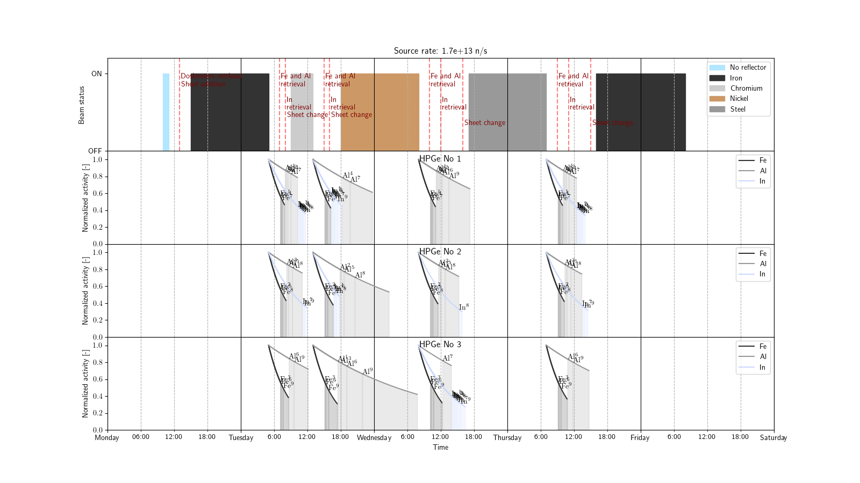
GRAPE Irradiation Revised Schedule
Constraints
10000 counts per dosimeter in HPGe (3 detectors, on site)
No longer than a week
2 hours of waiting for dose decay before retrieval
No late-night stay for dosimetry (if possible)
50% operational margin on source rate
Beam Status
HPGe No. 1 Schedule
ARIEL Final Workshop
HPGe No. 2 Schedule
HPGe No. 3 Schedule

Slide 25
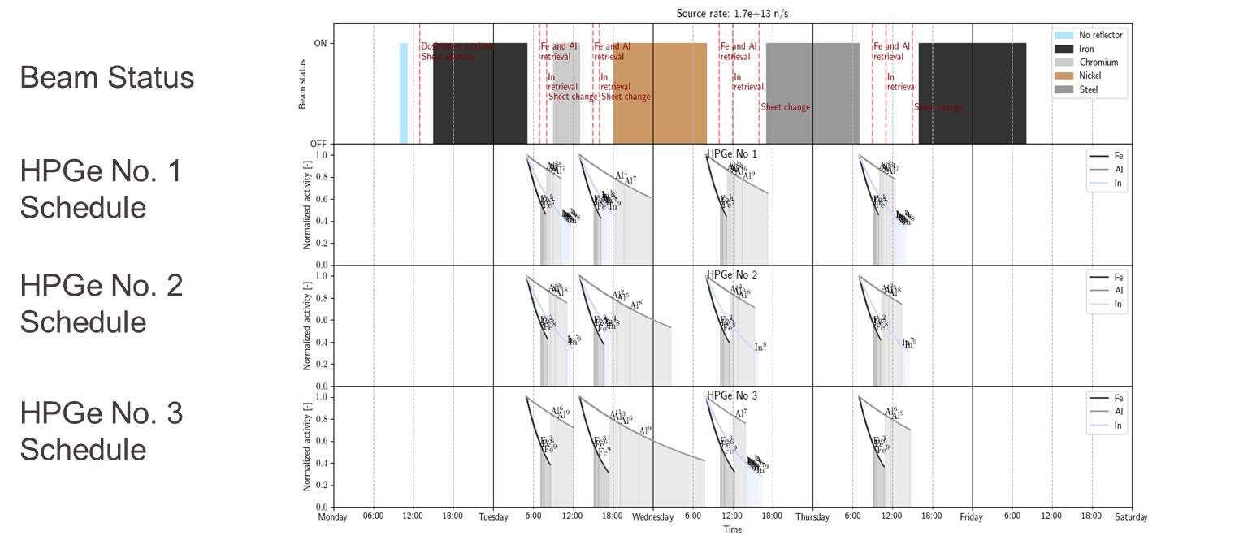
GRAPE Irradiation Revised Schedule
Constraints
10000 counts per dosimeter in HPGe (3 detectors, on site)
No longer than a week
2 hours of waiting for dose decay before retrieval
No late-night stay for dosimetry (if possible)
50% operational margin on source rate
Beam shutdown
Dosimeters retrieval
Al & ⁵⁶Fe
In
ARIEL Final Workshop
Decay
Measurements

Slide 26
Conclusion
GRAPE nuclear data dispersion estimates are of the same order as PETALE
Same level of feedback is expected, i.e. beneficial!
Thus useful for bias identification
Dispersion for nickel and chromium are surprisingly low with JEFF-3.3
2% vs. up to 12% with ENDF/B
Too low wrt. to PETALE results (see PETALE presentation at 2023 JEFF meetings)
Dispersion for iron shows different energy trends between libraries, but with similar order of magnitude
Ranging from 4% to 8%
Globally highest for ENDF/B-VIII.0
Conclusion of the design study
The irradiation campaign was proved feasible and useful for one week beam time
An optimized schedule has been prepared
Final objective: new benchmark in SINBAD
ARIEL Final Workshop
“This project has received funding from the Euratom research and training programme 2014-2018 under grant agreement No 847594 (ARIEL).“

Slide 27
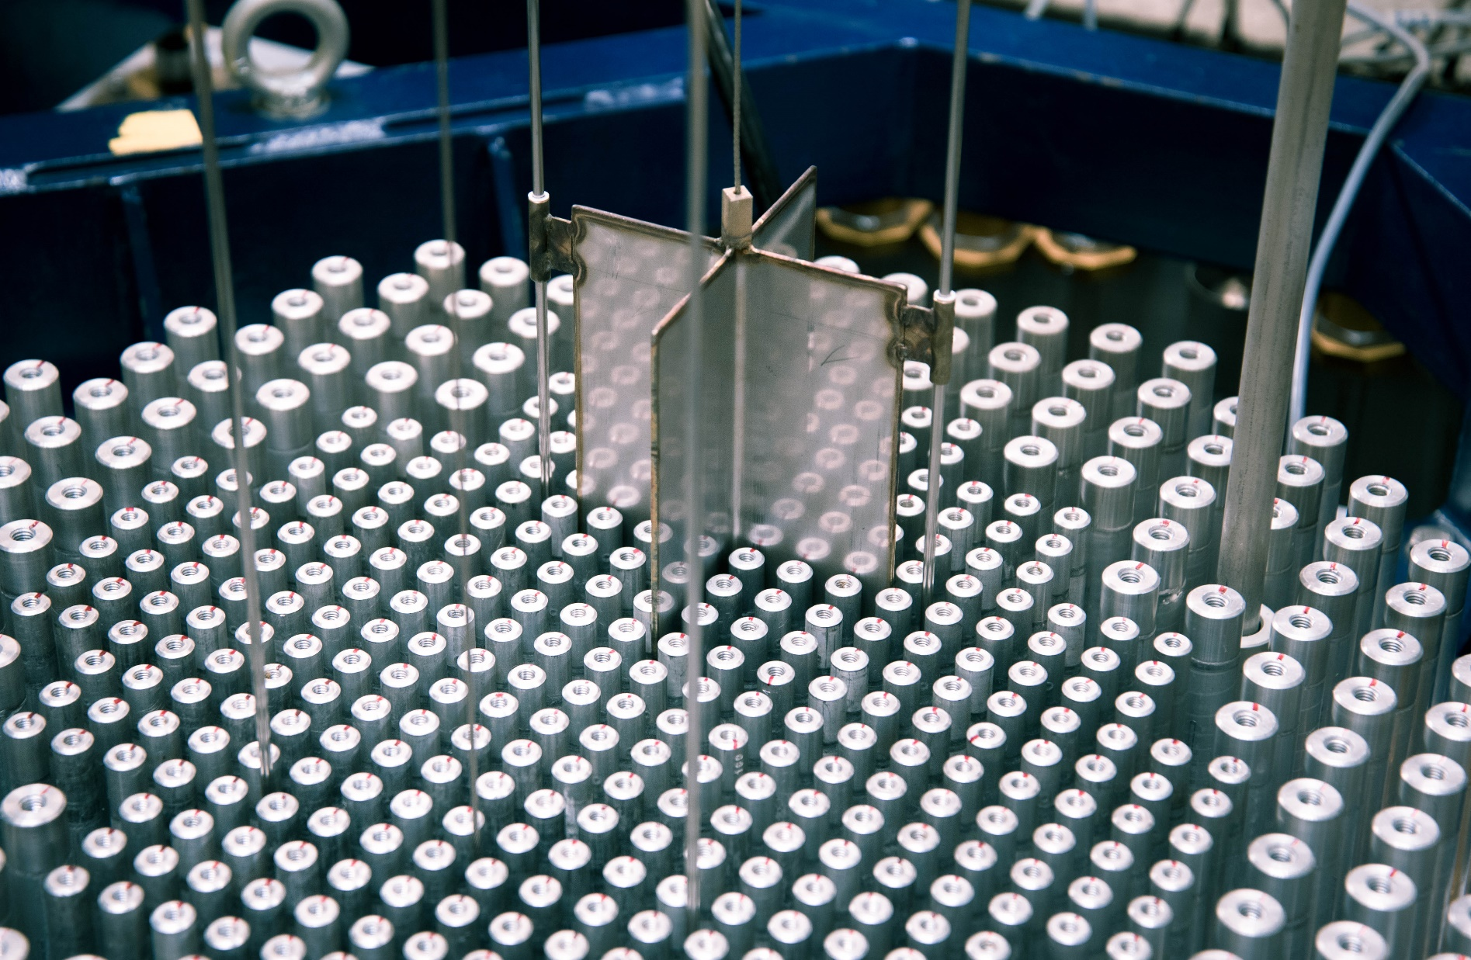
Merci
ARIEL Final Workshop
Thomas Ligonnet
© Maxime Filliau

Slide 28
Any Questions ?
ARIEL Final Workshop

Slide 29
Annexes
ARIEL Final Workshop

Slide 30
GRAPE Irradiation Revised Schedule
Constraints
10000 counts per dosimeter in HPGe (3 detectors, on site)
No longer than a week
2 hours of waiting for dose decay before retrieval
More for In dosimeters (high activity)
As much as possible for blocks changes
No late-night stay for dosimetry (if possible)
50% operational margin on source rate

Slide 31
GRAPE Irradiation Schedule
Irradiation planning optimization ongoing
In(n,g) reaction is driving the radioprotection
Fe-56 are measurements should start 2h after irradiation
Table version and day per day close-up on the next slides

Slide 32
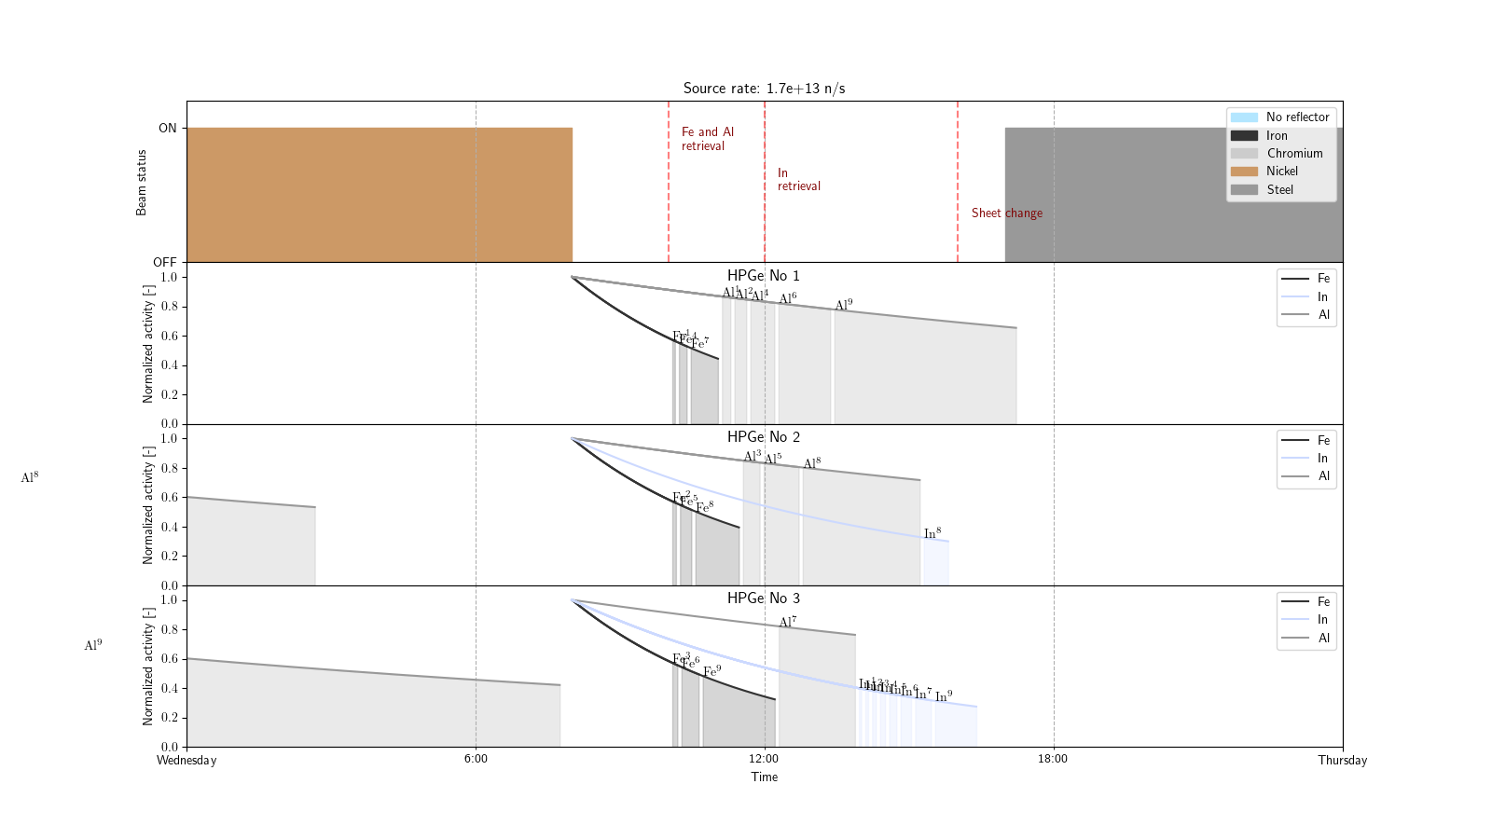
GRAPE Irradiation Revised Schedule
Under the assumption that our box design allows swift retrieval of the dosimeters
Fe/Al retrieval after 2h and Indium retrieval after 4h for decay of ¹¹⁶In (lower dose-rate)
Sheets change to steel after 8h for lower room dose-rate

Slide 33
GRAPE Irradiation Revised Schedule
Constraints
10000 counts per dosimeter in HPGe (3 detectors, on site)
No longer than a week
2 hours of waiting for dose decay before retrieval
No late-night stay for dosimetry (if possible)
50% operational margin on source rate

Slide 34
GRAPE Irradiation Revised Schedule
Taking into account that at least three HPGe, with an efficiency similar to ours, should be usable. the number of necessary irradiation was reduced to 6 irradiations with a characterization one
The neutron used for the planning is 1.7x10¹³ n/s
Current cumulative beam time: 63h
Requested to ARIEL: 78h
Day | Hour | Description | Beam time [h] | Cumulative beam time [h]
1 | 10:00 | Characterisation (low intensity possible) | 1 | 1
1 | 13:00 | Dosimeters retrieval and reflector setup (iron sheets) | - | -
1 | 15:00 | Iron reflector irradiation | 14 | 15
2 | 07:00 | Fe and Al dosimeters retrieval | - | -
2 | 08:00 | Change of reflector to chromium and In dosimeters retrieval | - | -
2 | 09:00 | Chromium reflector irradiation | 4 | 19
2 | 15:00 | Fe and Al dosimeters retrieval | - | -
2 | 16:00 | Change of reflector to Nickel and In dosimeters retrieval | - | -
2 | 18:00 | Nickel reflector irradiation | 14 | 33
3 | 10:00 | Fe and Al dosimeters retrieval | - | -
3 | 12:00 | In dosimeters retrieval | - | -
3 | 16:00 | Change of reflector to Steel (304L) | - | -
3 | 17:00 | Steel reflector irradiation | 14 | 47
4 | 09:00 | Fe and Al dosimeters retrieval | - | -
4 | 11:00 | In dosimeters retrieval | - | -
4 | 15:00 | Change of reflector to Iron with 18 sheets | - | -
4 | 16:00 | Iron (18 sheets) reflector irradiation (Beam time is provisional) | 16 | 63
5 | 10:00 | Fe and Al dosimeters retrieval | - | -
5 | 12:00 | In dosimeters retrieval | - | -

Slide 35
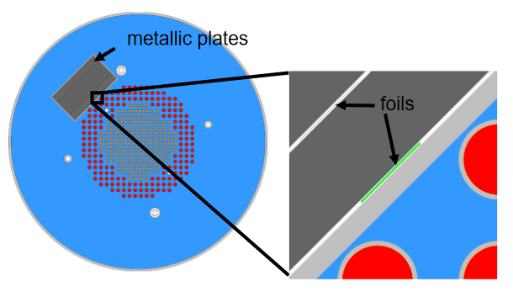
GRAPE at JRC-Geel
HARVEST-X:
Heuristic Assimilation, Reproduction, and Validation of Experiments for stainless STeel Cross sections
Reproduction of the PETALE experimental program on stainless-steel heavy reflectors.
Neutron transmission experiments
Activation dosimeters between reflector sheets
Output: dosimeters reaction rates
Four reflectors
Iron, chromium, nickel, stainless-steel (304L)
GRAPE
White neutron source instead of a heavily thermalized reactor
Focused on the fast neutron range
Endorsed by ARIEL-h2020
UMo

Slide 36
GRAPE shielding
Shielding test with INTEGRAAL2-like shield
15cm of polyethylene on sides and 30cm on back
Simulation with 0.5 mm thick cadmium layer as neutron absorbent
Comparison with 5 mm B₄C layer
polyethylene
Cadmium
UMo
Reflector
He
Dosimeter

Slide 37
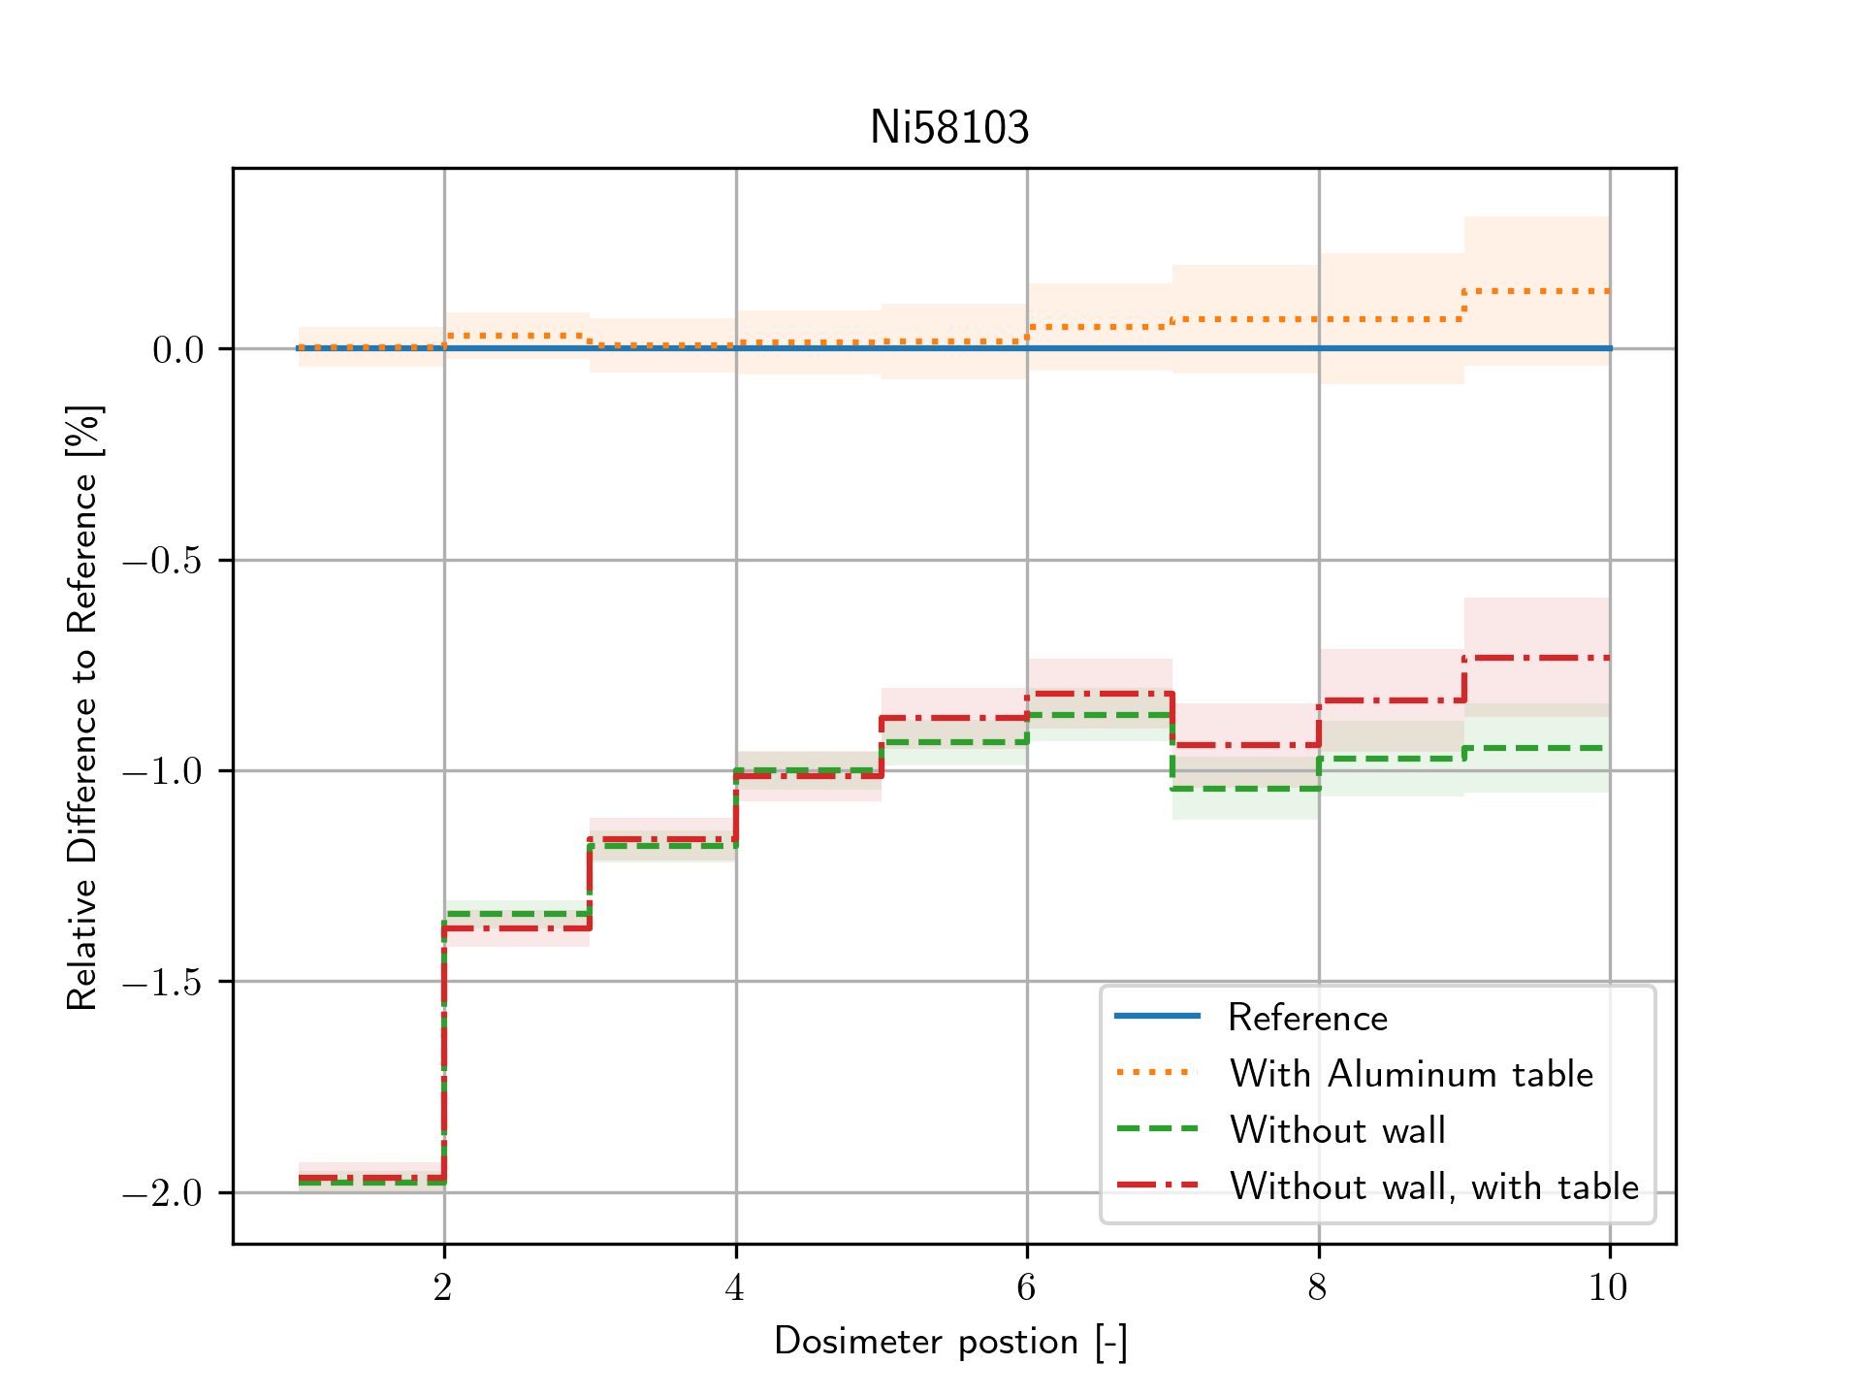
GRAPE shielding
Shielding test with INTEGRAAL2-like shield
15cm of polyethylene on sides and 30cm on back
Simulation with 0.5 mm thick cadmium layer as neutron absorbent
Test with large aluminum table (30cm thick)
Effect from the wall on reaction rates decreased from 15% to 1%

Slide 38
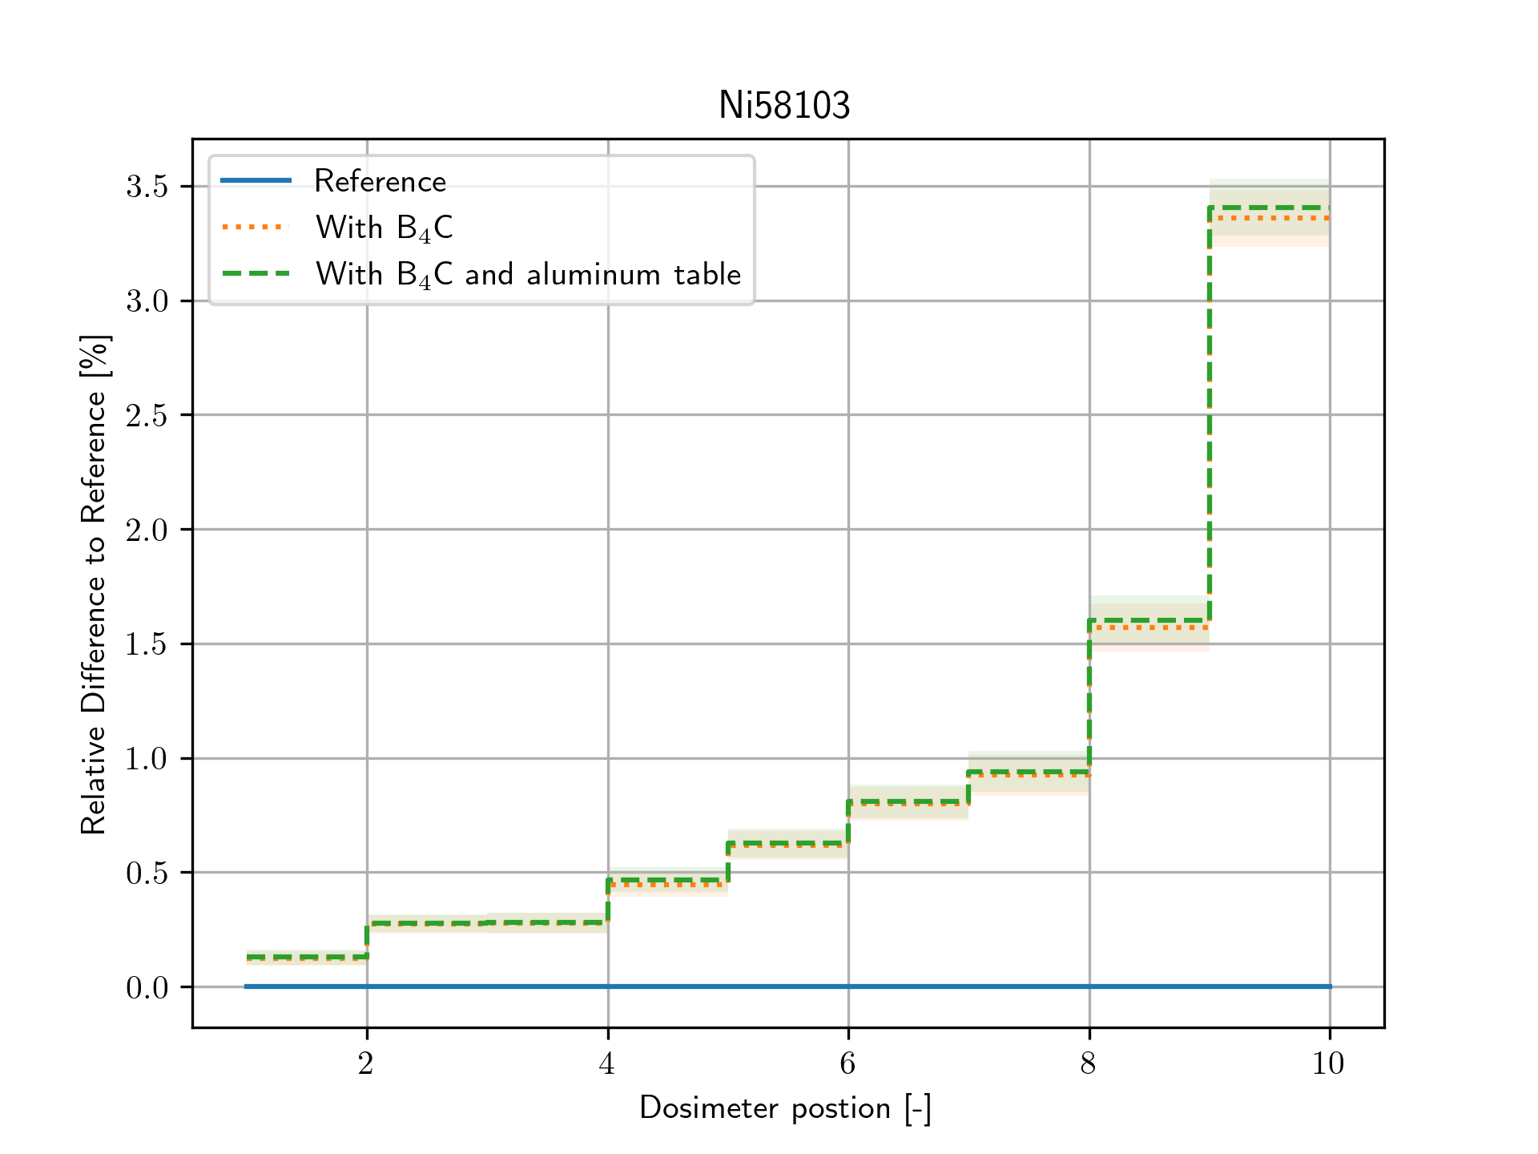
GRAPE shielding
Video space
Shielding test with INTEGRAAL2-like shield
15cm of polyethylene on sides and 30cm on back
Comparison between 0.5 mm of cadmium and 5 mm of B₄C
Systematic differences due to the change in shield

Slide 39
GRAPE shielding
Video space
Shielding test with INTEGRAAL2-like shield
15cm of polyethylene on sides and 30cm on back
Simulation with cadmium as neutron absorbent
UMo
He
He

Slide 40
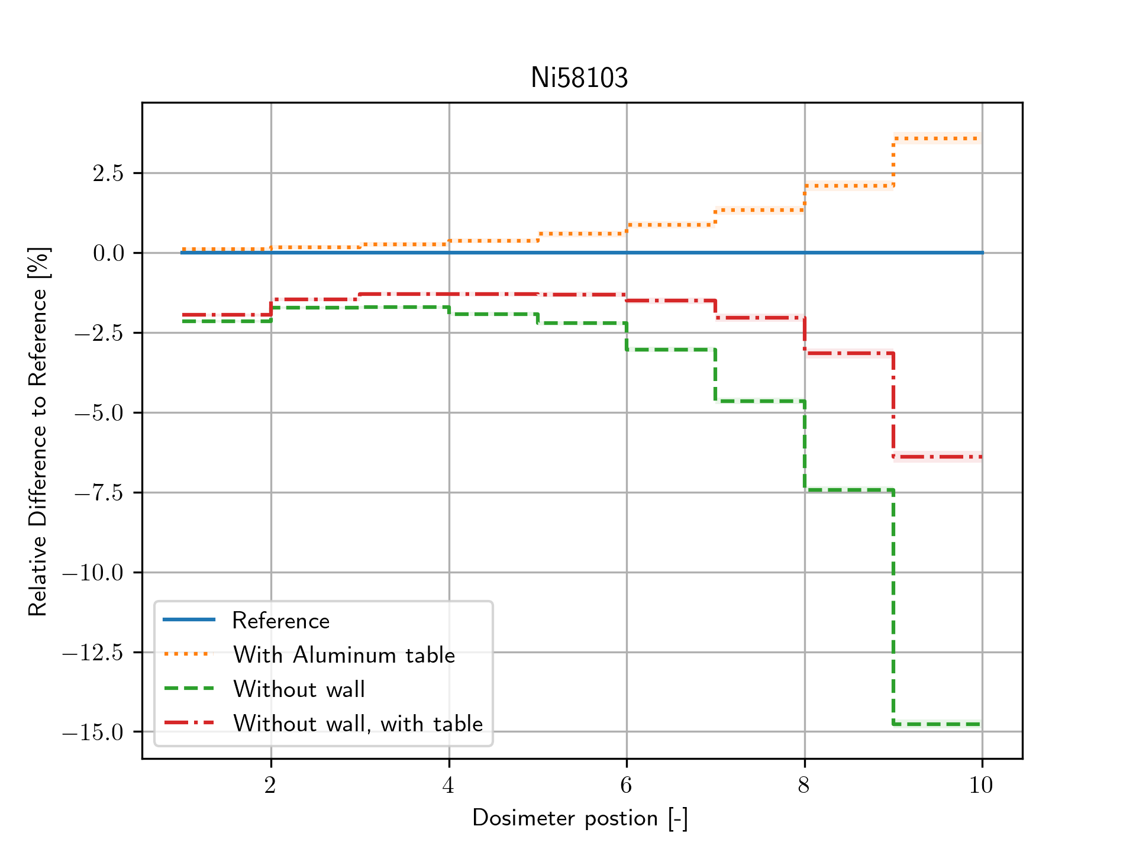
GRAPE shielding
Video space
Shielding test with INTEGRAAL2-like shield
15cm of polyethylene on sides and 30cm on back
Simulation with 0.5 mm thick cadmium layer as neutron absorbent
Test with large aluminum table (30cm thick)

Slide 41
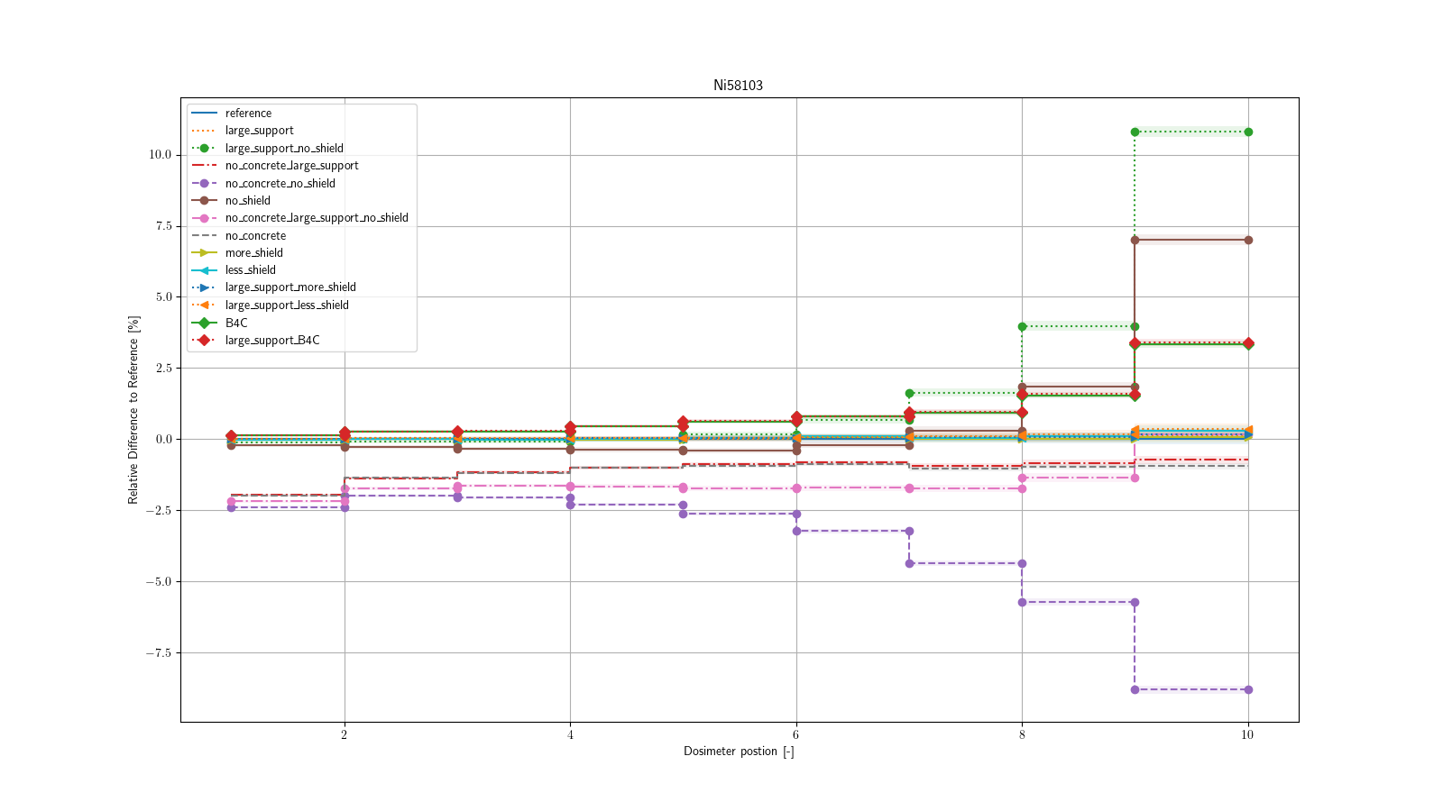
GRAPE shielding
Video space
Shielding test with INTEGRAAL2-like shield
15cm of polyethylene on sides and 30cm on back
Simulation with 0.5 mm thick cadmium layer as neutron absorbent
Test with large aluminum table (30cm thick)

Slide 42
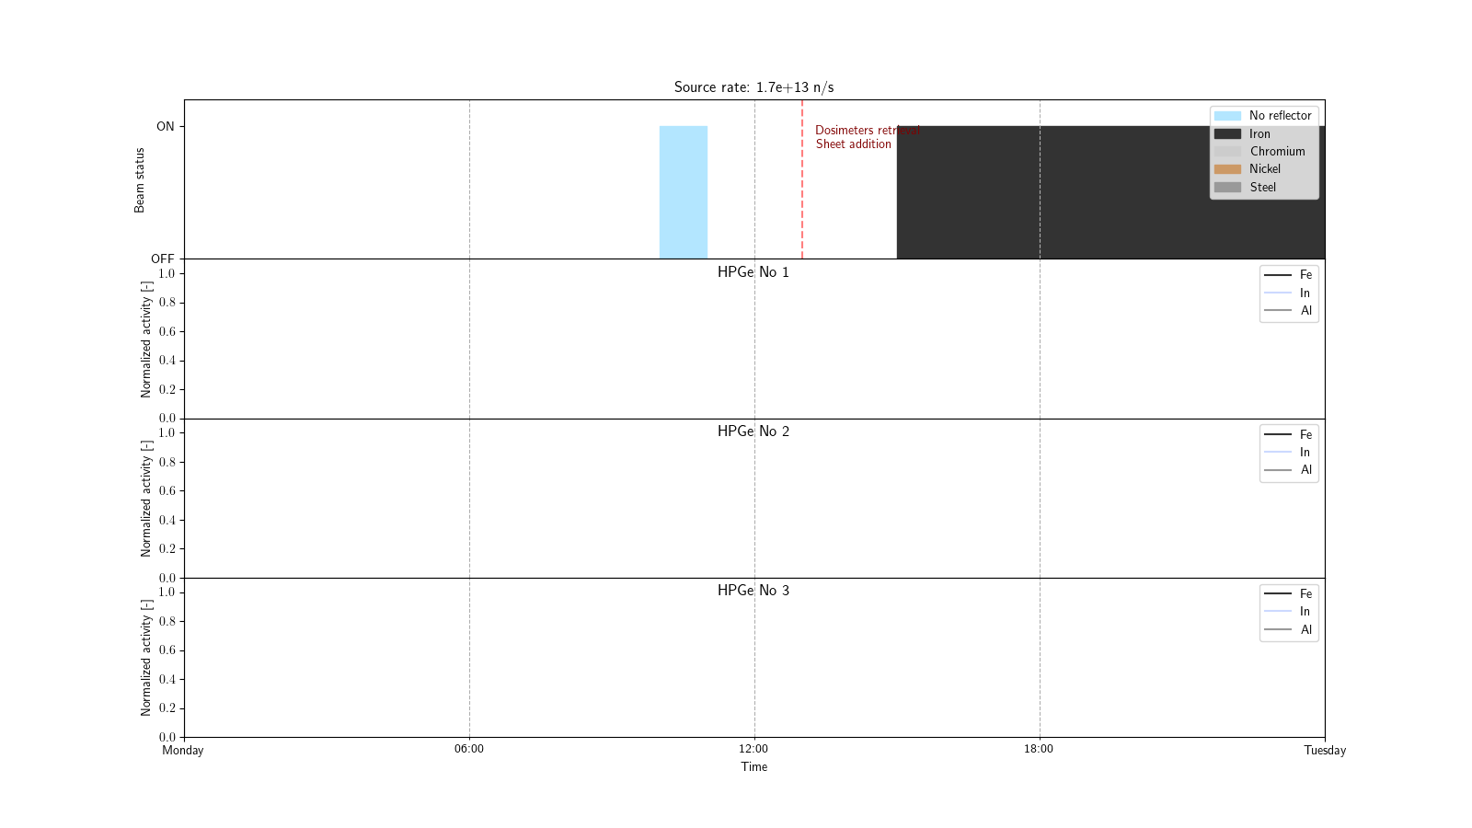
GRAPE Irradiation Revised Schedule
Short irradiation for beam characterization and HPGe efficiency ratio measurement
Small number of dosimeters, low intensity possible
Preparation of the first reflector irradiation

Slide 43
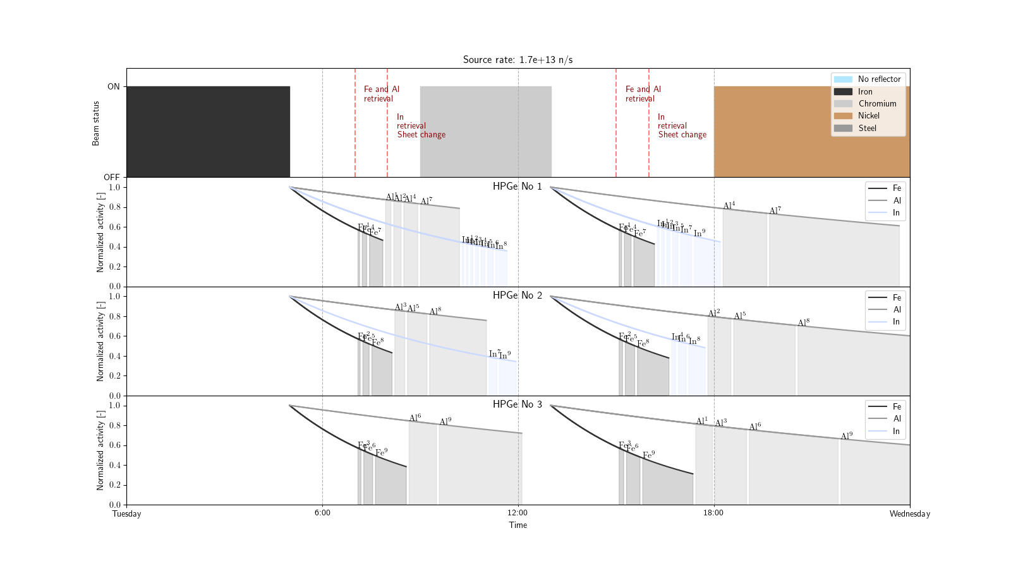
GRAPE Irradiation Revised Schedule
Biggest day while the residual radiation should be the lowest
Only day with two reflector irradiations
Shorter irradiation with Chromium reflector (implying long HPGe measurements)
Last HPGe start around 22:00, goes through the night
Dosimeters are numbered from the nearest to the farthest from the source

Slide 44
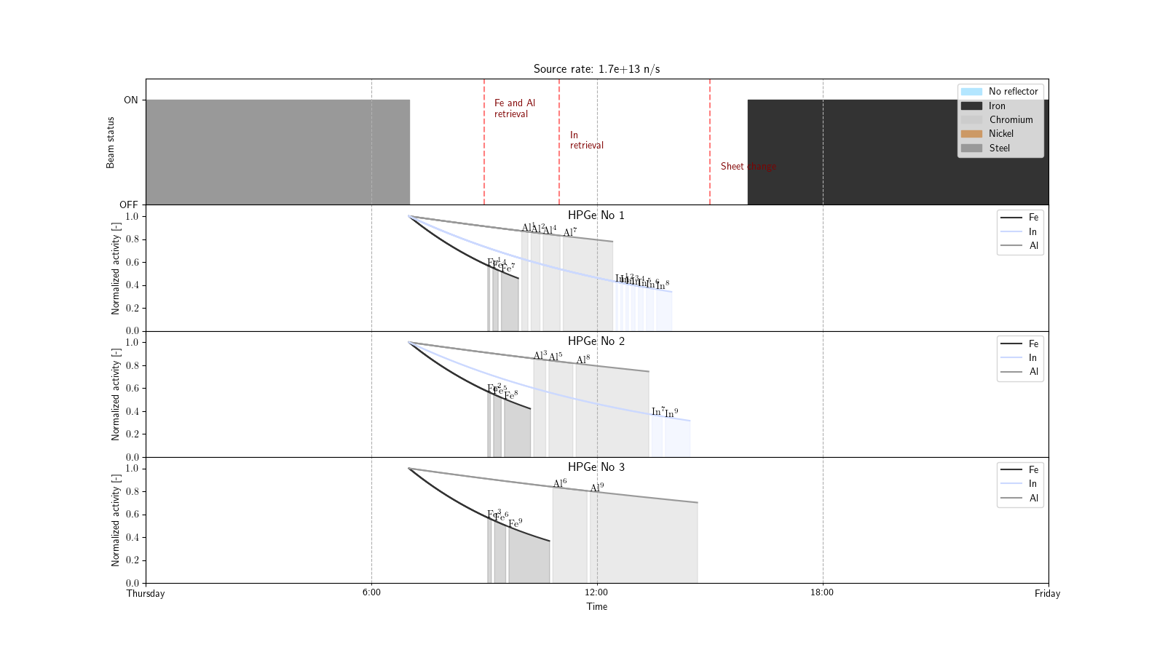
GRAPE Irradiation Revised Schedule
Under the assumption that our box design allows swift retrieval of the dosimeters
Fe/Al retrieval after 2h and Indium retrieval after 4h for decay of ¹¹⁶In (lower dose-rate)
Sheets change to Iron (18 plate instead of 8) after 8h for lower room dose-rate

Slide 45
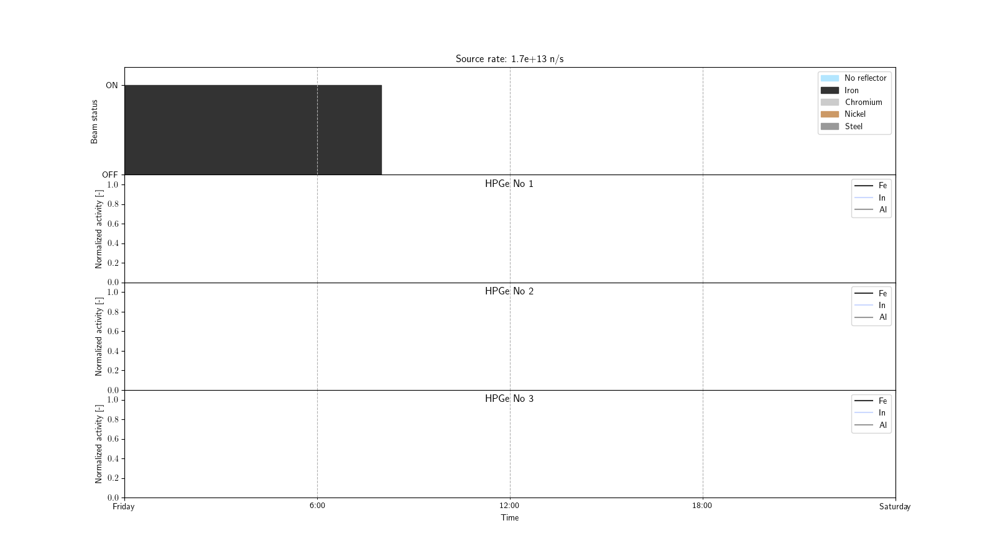
GRAPE Irradiation Revised Schedule
End of last irradiation
Provisional duration: 16h
Measurement times to be estimated

Slide 46
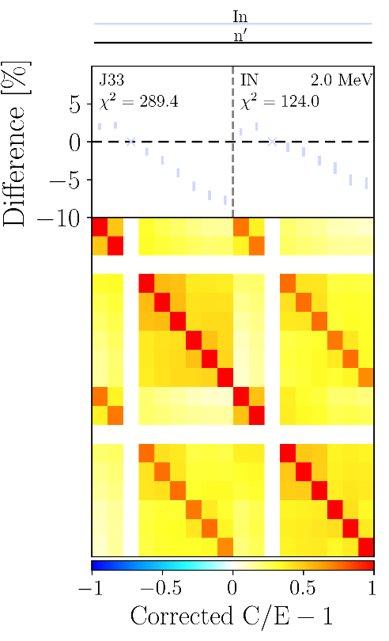
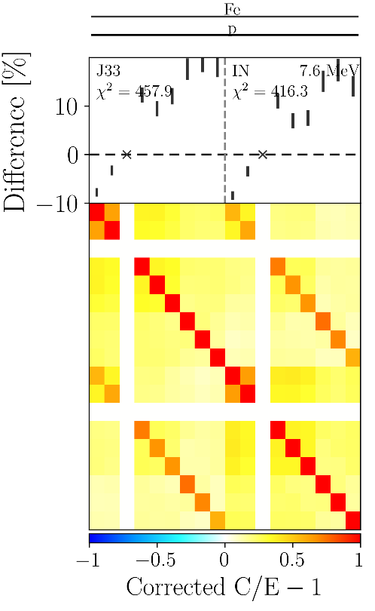
GELINA design with perturbed XS
Propagation results are close to PETALE
Observed dispersion tends to be smaller for JEFF-3.3 than ENDF/B-VII.1 and B-VIII.0
Especially for Cr and Ni
B-VIII.0 similar to B-VII.1 for both elements
Surprising with respect to PETALE C/E
 | Relative standard deviation for the ninth dosimeter [%]
Reflector | Iron |  |  |  |  | Chromium |  |  |  |  | Nickel
Database | JEFF-3.3 |  | ENDF/B-VII.1 |  | ENDF/B-VIII | JEFF-3.3 |  | ENDF/B-VII.1 |  | ENDF/B-VIII | JEFF-3.3 |  | ENDF/B-VII.1 |  | ENDF/B-VIII
Isotopes | 54,56,57,58 |  | 54,56,57 |  | 56 | 50, 52, 53, 54 |  | 50, 52, 53 |  | 50, 52, 53 | 58, 60, 62 |  | 58, 60 |  | 58, 60
Setup Dosimeter | PETALE | GRAPE | PETALE | GRAPE | GRAPE | PETALE | GRAPE | PETALE | GRAPE | GRAPE | PETALE | GRAPE | PETALE | GRAPE | GRAPE
In | 4.34 ± 0.17 | 3.77 ± 0.15 | 5.5 ± 0.2 | 5.9 ± 0.3 | 4.14 ± 0.17 | 1.23 ± 0.05 | 0.96 ± 0.04 | 6.4 ± 0.3 | 5.2 ± 0.2 | 5.1 ± 0.2 | 1.18 ± 0.05 | 1.08 ± 0.04 | 6.6 ± 0.3 | 5.7 ± 03 | 5.8 ± 0.2
Ni | 6.7 ± 0.3 | 5.5 ± 0.3 | 5.1 ± 0.2 | 5.1 ± 0.2 | 7.2 ± 0.3 | 2.32 ± 0.10 | 2.00 ± 0.08 | 9.4 ± 0.4 | 7.6 ± 0.3 | 7.4 ± 0.4 | 2.03 ± 0.09 | 1.77 ± 0.08 | 10.4 ± 0.5 | 8.6 ± 0.4 | 8.2 ± 0.3
Fe-54 | 7.0 ± 0.4 | 5.6 ± 0.3 | 5.4 ± 0.2 | 5.4 ± 0.2 | 7.6 ± 0.3 | 2.48 ± 0.10 | 2.13 ± 0.08 | 9.9 ± 0.4 | 8.0 ± 0.3 | 7.9 ± 0.4 | 2.33 ± 0.10 | 1.99 ± 0.08 | 11.2 ± 0.6 | 9.1 ± 0.4 | 8.6 ± 0.4
Fe-56 | 5.0 ± 0.2 | 4.5 ± 0.2 | 8.3 ± 0.4 | 8.1 ± 0.3 | 8.0 ± 0.4 | 2.17 ± 0.09 | 2.09 ± 0.09 | 10.2 ± 0.4 | 10.6 ± 0.5 | 10.5 ± 0.6 | 2.97 ± 0.13 | 2.79 ± 0.11 | 8.7 ± 0.4 | 8.3 ± 0.4 | 7.9 ± 0.4
Al | 5.5 ± 0.2 | 4.4 ± 0.2 | 9.1 ± 0.4 | 8.5 ± 0.4 | 7.9 ± 0.4 | 2.28 ± 0.10 | 2.22 ± 0.09 | 11.9 ± 0.5 | 11.9 ± 0.5 | 12.2 ± 0.6 | 3.01 ± 0.13 | 2.88 ± 0.12 | 8.4 ± 0.4 | 8.5 ± 0.4 | 8.2 ± 0.4

Slide 47
GELINA design with perturbed XS
Propagation results are close to PETALE
Observed dispersion tends to be smaller for JEFF-3.3 than ENDF/B-VII.1 and B-VIII.0
Exception: B-VIII.0 in Ni/⁵⁴Fe dosimeter range
Superior to both other that are close to each other
And B-VII.1 in the ¹¹⁵In(n,n’) dosimeter range
 | Relative standard deviation for the ninth dosimeter [%]
Reflector | Iron |  |  |  |  | Chromium |  |  |  |  | Nickel
Database | JEFF-3.3 |  | ENDF/B-VII.1 |  | ENDF/B-VIII | JEFF-3.3 |  | ENDF/B-VII.1 |  | ENDF/B-VIII | JEFF-3.3 |  | ENDF/B-VII.1 |  | ENDF/B-VIII
Isotopes | 54,56,57,58 |  | 54,56,57 |  | 56 | 50, 52, 53, 54 |  | 50, 52, 53 |  | 50, 52, 53 | 58, 60, 62 |  | 58, 60 |  | 58, 60
Setup Dosimeter | PETALE | GRAPE | PETALE | GRAPE | GRAPE | PETALE | GRAPE | PETALE | GRAPE | GRAPE | PETALE | GRAPE | PETALE | GRAPE | GRAPE
In | 4.34 ± 0.17 | 3.77 ± 0.15 | 5.5 ± 0.2 | 5.9 ± 0.3 | 4.14 ± 0.17 | 1.23 ± 0.05 | 0.96 ± 0.04 | 6.4 ± 0.3 | 5.2 ± 0.2 | 5.1 ± 0.2 | 1.18 ± 0.05 | 1.08 ± 0.04 | 6.6 ± 0.3 | 5.7 ± 03 | 5.8 ± 0.2
Ni | 6.7 ± 0.3 | 5.5 ± 0.3 | 5.1 ± 0.2 | 5.1 ± 0.2 | 7.2 ± 0.3 | 2.32 ± 0.10 | 2.00 ± 0.08 | 9.4 ± 0.4 | 7.6 ± 0.3 | 7.4 ± 0.4 | 2.03 ± 0.09 | 1.77 ± 0.08 | 10.4 ± 0.5 | 8.6 ± 0.4 | 8.2 ± 0.3
Fe-54 | 7.0 ± 0.4 | 5.6 ± 0.3 | 5.4 ± 0.2 | 5.4 ± 0.2 | 7.6 ± 0.3 | 2.48 ± 0.10 | 2.13 ± 0.08 | 9.9 ± 0.4 | 8.0 ± 0.3 | 7.9 ± 0.4 | 2.33 ± 0.10 | 1.99 ± 0.08 | 11.2 ± 0.6 | 9.1 ± 0.4 | 8.6 ± 0.4
Fe-56 | 5.0 ± 0.2 | 4.5 ± 0.2 | 8.3 ± 0.4 | 8.1 ± 0.3 | 8.0 ± 0.4 | 2.17 ± 0.09 | 2.09 ± 0.09 | 10.2 ± 0.4 | 10.6 ± 0.5 | 10.5 ± 0.6 | 2.97 ± 0.13 | 2.79 ± 0.11 | 8.7 ± 0.4 | 8.3 ± 0.4 | 7.9 ± 0.4
Al | 5.5 ± 0.2 | 4.4 ± 0.2 | 9.1 ± 0.4 | 8.5 ± 0.4 | 7.9 ± 0.4 | 2.28 ± 0.10 | 2.22 ± 0.09 | 11.9 ± 0.5 | 11.9 ± 0.5 | 12.2 ± 0.6 | 3.01 ± 0.13 | 2.88 ± 0.12 | 8.4 ± 0.4 | 8.5 ± 0.4 | 8.2 ± 0.4

Slide 48
Context and Background: CROCUS
Video space
Experimental zero power reactor
Two fuel zones
Inner zone: 336 ${UO}_{2}$ enriched at 1.806 wt.%
Outer zone: 174 ${U_{m}}_{ }$ enriched at 0.947 wt.%
Criticality control systems
2 control rods (privileged for PETALE)
Spillway for adjustable water level
4 operation monitors
2 fission chambers E/W (power monitors)
2 ionization chambers N/S

