Slide 2
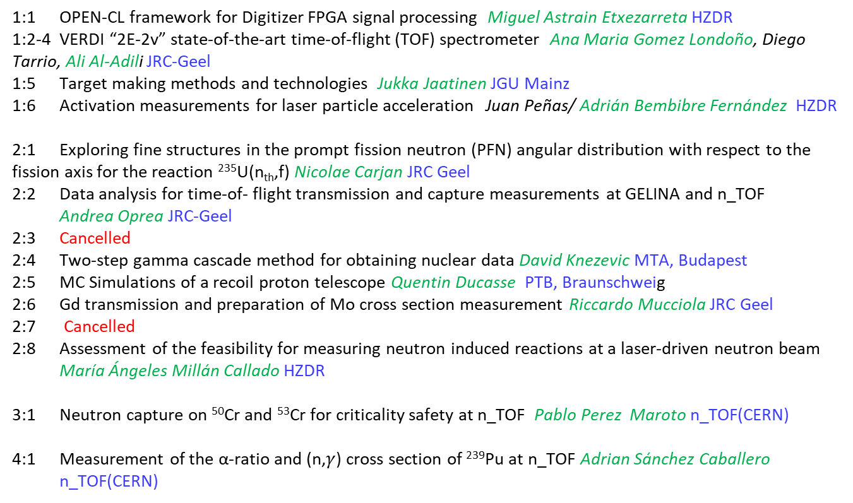
Supported Education and Training Applications
1:1 OPEN-CL framework for Digitizer FPGA signal processing Miguel Astrain Etxezarreta HZDR
1:2-4 VERDI “2E-2v” state-of-the-art time-of-flight (TOF) spectrometer Ana Maria Gomez Londoño, Diego Tarrio, Ali Al-Adili JRC-Geel
1:5 Target making methods and technologies Jukka Jaatinen JGU Mainz
1:6 Activation measurements for laser particle acceleration Juan Peñas/ Adrián Bembibre Fernández HZDR
2:1 Exploring fine structures in the prompt fission neutron (PFN) angular distribution with respect to the fission axis for the reaction ²³⁵U(n_{th},f) Nicolae Carjan JRC Geel
2:2 Data analysis for time-of- flight transmission and capture measurements at GELINA and n_TOF Andrea Oprea JRC-Geel
2:3 Cancelled
2:4 Two-step gamma cascade method for obtaining nuclear data David Knezevic MTA, Budapest
2:5 MC Simulations of a recoil proton telescope Quentin Ducasse PTB, Braunschweig
2:6 Gd transmission and preparation of Mo cross section measurement Riccardo Mucciola JRC Geel
2:7 Cancelled
2:8 Assessment of the feasibility for measuring neutron induced reactions at a laser-driven neutron beam María Ángeles Millán Callado HZDR
3:1 Neutron capture on ⁵⁰Cr and ⁵³Cr for criticality safety at n_TOF Pablo Perez Maroto n_TOF(CERN)
4:1 Measurement of the α-ratio and (n,$γ$) cross section of ²³⁹Pu at n_TOF Adrian Sánchez Caballero n_TOF(CERN)

Slide 3
Supported Education and Training Applications
5:1 Time-of-Flight transmission measurements and data analysis on natural iron at the GELINA facility Georgios Gkatis JRC-Geel
5:2 Employing VERDI to investigate nuclear fission Ana Maria Gomez Londoño JRC-Geel
5:3 Characterisation of spectroscopic 248Cm targets and measurement of prompt gamma-ray spectra from 248Cm(sf) Andreas Oberstedt JRC-Geel
5:4 Exploring fine structures in the prompt fission neutron (PFN) angular distribution with respect to the fission axis for the reaction 235 U(n th ,f) (continuation) Nicolae Carjan JRC-Geel
5:5 Optimization and intercomparison of the chopper+buncher systems at CNA-HISPANOS and JRC-Geel-MONNET David Pascual JRC-Geel
5:6 Preparation of the 243Am(n,f) cross section measurements with Micromegas detectors at the CERN n_TOF facility Nikolaos Kyritsis nTOF
5:7 Direct measurement of the n_TOF NEAR time of flight neutron fluence with diamond detectors
Kalliope Kaperoni nTOF
5:8 235U(n,f) cross section relative to the 10B(n,α) reaction with Micromegas detectors at the CERN n_TOF facility Veatriki Michalopoulou nTOF
5:9 Employing VERDI to investigate nuclear fission Ali Al-Adili nTOF
6:1 Neutron and photon yields for the 51V(p,n)51Cr Antònia Verdera Garau JRC-Geel
6:3 Development of the new annular double-sided silicon detector at the CERN n_TOF facility Styliani Goula nTOF
7:1 Differential cross-section measurements and data analysis of neutron elastic and inelastic scattering on 56Fe and natC at the GELINA facility Georgios Gkatis JRC-Geel
7:2 Methodology to improve evaluated data in the resonance region Mathieu Hursin JRC-Geel
7:3 Neutron interactions with Magnesium isotopes and Fluorine Marco Antonio Martinez Cañadas. JRC-Geel
7:4 Neutron capture measurements at NEAR of the n_TOF facility Zinovia Eleme nTOF
7:5 243Am(n,f) cross section measurements with Micromegas detectors at the CERN n_TOF facility Nikolaos Kyritsis nTOF

Slide 4
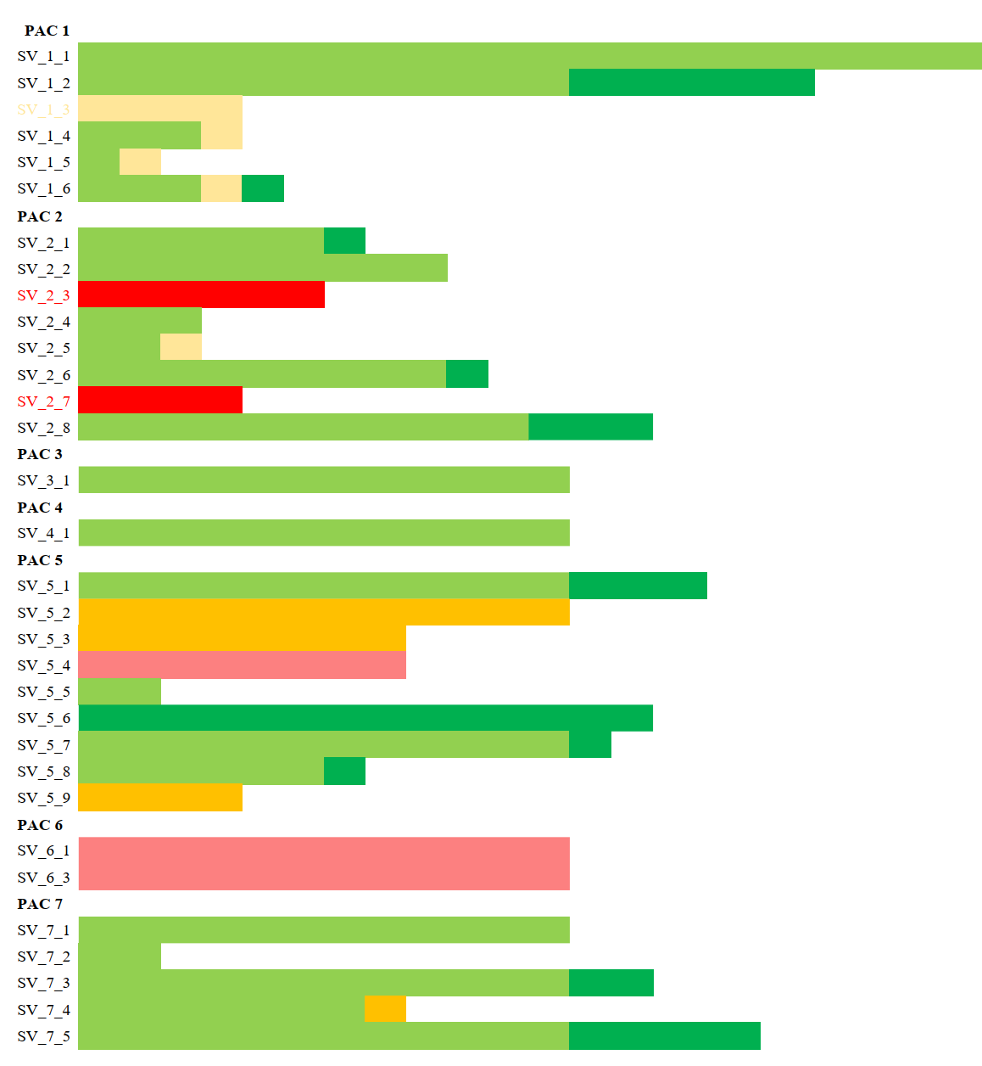
Summary of Education and Training Activities Weeks
12

Slide 5
Summary of Education and Training Activities Weeks
12

Slide 6
Some random conclusions
A suprising high percentance of the E&T visits have been completed in time
Despite covid… that packed the visits close to the end of the project
Some have been excellent in streching the budget! People take making science seriously, thank you very much!
Still just one thing:
Please report the dissemination!
Seminars, conferences, other talks, articles, books, whatever
where you have reported the excellent work you have been doing
in the numerous E&T visits you have made!

