Slide 1
Delayed neutron data measurements for the fast neutron induced fission of 238U at the PTB Ion Accelerator facility
ARIEL final meeting – 17th-19th January 2024
D.Belverge¹, P.Leconte¹, B.Geslot¹, G.Kessedjian¹, R. Combe¹ P.Mutti²,
F.Rodiac¹, E.Pirovano³, B.Lutz³, X.Ledoux⁴, L.Mathieu⁵, O.Meplan⁶
¹ CEA/DES Cadarache
² ILL, Grenoble
³ PTB, Braunschweig
⁴ GANIL, Caen
⁵ IN2P3 / LP2i Bordeaux
⁶ IN2P3 / LPSC Grenoble

Slide 2
Summary
Context of work
Principle of the measurement
Experimental setup
ALDEN-U238 campaigns: First results
Conclusions and outlooks

Slide 3
Context of work
1

Slide 4
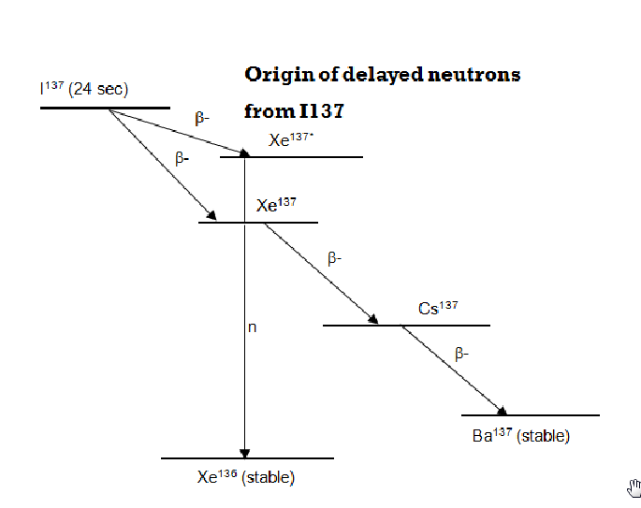
Context: The delayed neutrons (DN)
Nucleus + neutron
Fission fragments
Fission products
Delayed neutrons
Fission
Prompt emission
β_{n}⁻ decay
Delayed neutrons
0,5 – 2,5 % of the emitted neutrons
E_{mean} ∼ 500 keV
Emitted 1 ms - 1 min after fission
Key role in nuclear reactors control and safety
Microscopic data: associated to each precursor (FY, Pn)
Macroscopic data: integrated over groups of precursors
Emitter
Precursor
Delayed neutron
4

Slide 5
Context: The DN macroscopic data
Delayed neutron multiplicity ν_{d}
Measured in the past but with high uncertainties !
Mean number of delayed neutrons emitted after fission
Kinetics parameters describing the emission : group parameters (a_{i}, λ_{i})
Precursors gathered in 8 families → 8 relative abundances (ai)
Spriggs model (1997)
$$n_{d}\left(t\right)= \sum_{k=1}^{≈300}{x_{k}.N_{k}(t)}.P_{n,k}$$
$$\sum_{i=1}^{G}{a_{i}.}e^{−λ_{i}.t}$$
⬄
Exact model
Groups model(G = 8)
$$_{i}\text{=}\overline{{\left(λ_{k}\right)}_{k = 1..n_{i}}}$$
$$a_{i}\text{=}\frac{\sum^{n_{k}}{\sum_{k}^{n_{i}}{Y_{k}.x.P_{xn,k}}}}{\text{n}\text{d}} (\sum_{i}{a_{i}=1})$$
i : considered group
k : group I precursors
Group spectra
5
From Spriggs & al, « An 8-Group Delayed Neutron Model Based on a Consistent Set of Half-lives » (1998)

Slide 6
Context: the ALDEN collaboration
Average Lifetime of Delayed Neutrons (2018 - )
New evaluation of the delayed neutrons macroscopic data: ν_{d} and (a_{i}, λ_{i})
Reduced uncertainties
Isotopes of interest for Gen2&3 reactors
ALDEN – 1
²³⁵U – thermal spectrum
ILL (Grenoble)
ALDEN – 2
²³⁵U – thermal spectrum
ILL (Grenoble)
ALDEN – 3
²³⁵U, ²³³U, ²³⁹Pu – thermal spectrum
ILL (Grenoble)
2018
2019
2020
2021
2021 - : ²³⁸U – fast spectrum !
Account for 10 - 20 % of the β_{eff} in thermal reactors *
More challenging experimental conditions
Low cross sections and neutron flux
Subject of a PhD (2021 - )
β_{eff} : effective delayed-neutron fraction, fraction of fissions induced by delayed neutrons
* V. Zammit-Averlant. Validation Integrale des Estimations du Parametre Beta Effectif pour les Reacteurs MOX et Incinerateurs. PhD thesis, Universite Aix-Marseille I, 1998.

Slide 7
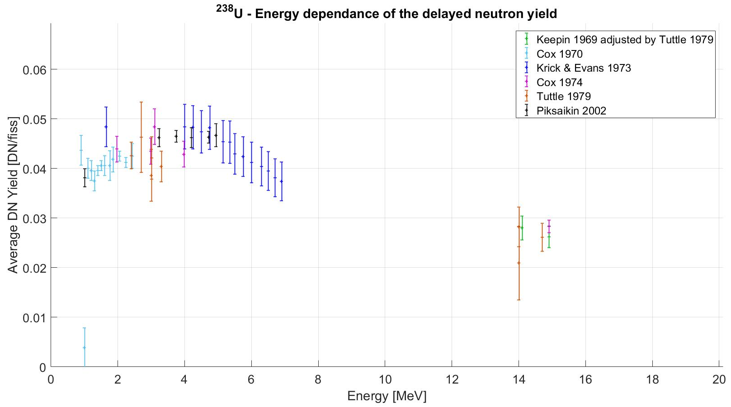
Context: Motivation and state of the art for ²³⁸U(n_{f}, f)
Delayed neutron multiplicity
Experimental data: insufficient quality
Uncertainties: 7 – 10 %
No identifiable trend (< 5 MeV)
Gap with no data (7 – 14 MeV)
Discrepancies between evaluations
Up to 8 % between ENDF/B-VIII.0 and JEFF-3.3
New experimental data needed
Target accuracy < 5 %
1 – 5 MeV : reactor calculations
7 – 20 MeV : nuclear physics model
Group abundances:
2 measurement only analysed with the 8 groups model - 3.75 MeV and 14 MeV
7

Slide 8
Principle of the measurement
2

Slide 9
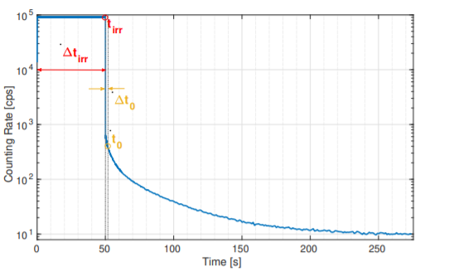
Principle of the measurement: In theory …
“Macroscopic” technique: measurement of the integral of all delayed neutrons precursors
Phase 1: Irradiation – creation of precursors
Phase 2: Decay – delayed neutrons counting
Phase 1 Irradiation
Phase 2
Decay
Example of experimental curve obtained for ²³⁵U – From D.Foligno PhD (2019)

Slide 10
Principle of the measurement: In theory …
“Macroscopic” technique: measurement of the integral of all delayed neutrons precursors
Phase 1: Irradiation – creation of precursors
Phase 2: Decay – delayed neutrons counting
F: Fission rate in the sample
ε_{p,} _{d,i}: Detector efficiency for prompt neutrons / delayed neutrons from group i
Phase 1
Phase 2
End of irradiation

Slide 11
Principle of the measurement: In theory …
“Macroscopic” technique: measurement of the integral of all delayed neutrons precursors
Phase 1: Irradiation – creation of precursors
Phase 2: Decay – delayed neutrons counting
F: Fission rate in the sample
ε_{p,} _{d,i}: Detector efficiency for prompt neutrons / delayed neutrons from group i
For t_{irr} >> max(T_{i,1/2}) (saturation of the precursors population)
Challenges:
Irradiation cut off: efficient and fast
ν_{d} measurement: saturation of precursors population
a_{i} measurement: low background
Phase 1
Phase 2
End of irradiation

Slide 12
Principle of the measurement: … and in practice !
→ Cycles of irradiation / decay to increase the statistic in a limited time !
ν_{d} : short cycles (ex. 2s on / 0.2s off)
Short t_{measurement}
ν_{d} is obtained at the beginning of the decay phase
Short t_{irrad.}
Compromise between precursors saturation and statistics
Precursors equilibrium built during the first cycles (≈ 10 min.)
Abundances: long cycles (ex. 50s on / 300s off)
Long t_{measurement}
Counting of the delayed neutrons emitted from the 8 groups (T_{1/2, i} = 0.195 – 55.6s)
Long t_{irrad.}
Precursors equilibrium built for each cycle
→ After summation of the cycles:
$$c\left(t\right)= b_{off}+ ν_{d} . F_{0} . \sum_{i=1}^{8}{a_{i} . ε_{i} . \frac{\left(1 − e^{{−λ}_{i} .t_{irr}}\right). e^{{−λ}_{i} . t}}{1 − e^{{−λ}_{i} .t_{m}}}}$$
t = 0 end of irradiation
t_{irr} irradiation duration
t_{m} cycle duration
12

Slide 13
Experimental setup
3

Slide 14
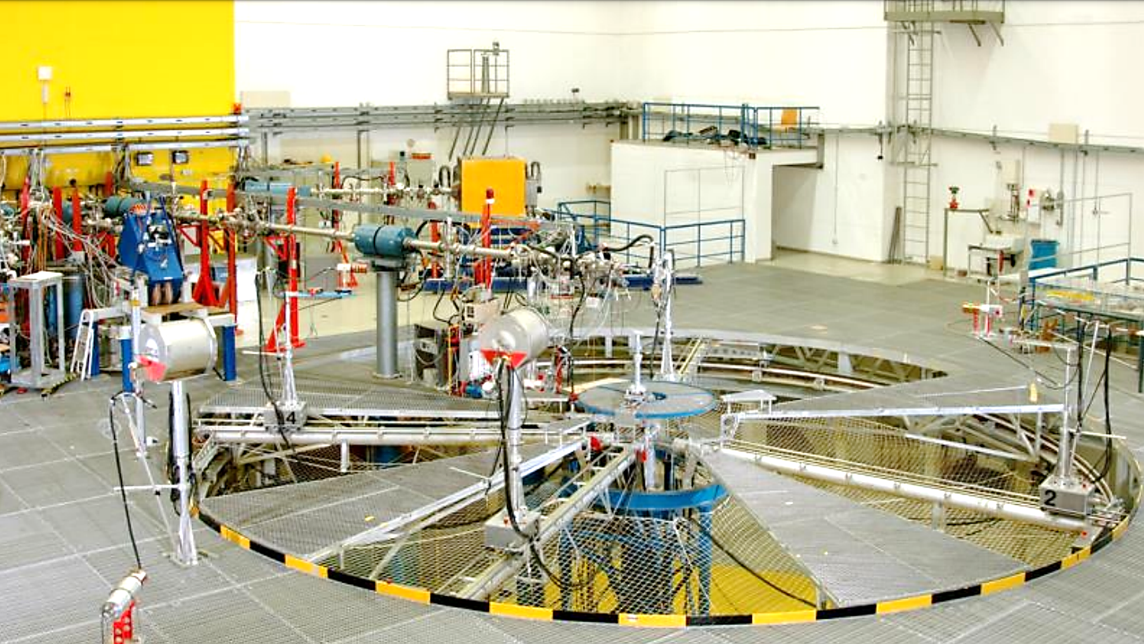
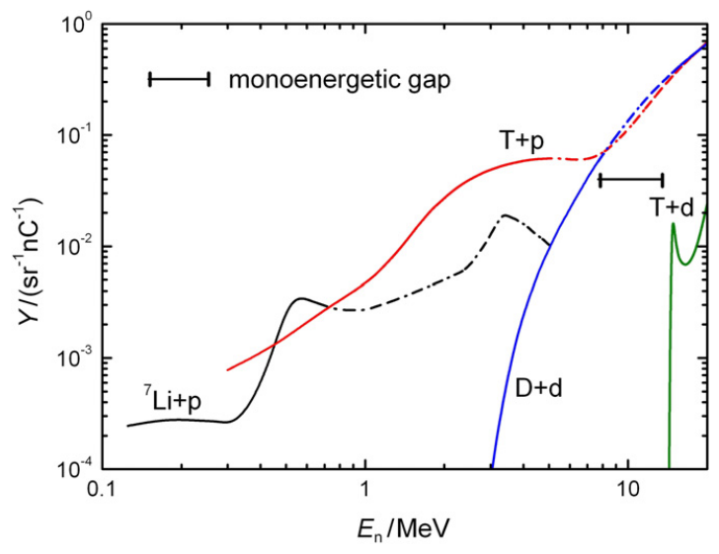
Experimental setup
PTB Ion Accelerator Facility (PIAF, Braunschweig, Germany)
T + p
1.2 – 3.2 MeV
T + d
14 - 19 MeV
D + d
3.5 – 8 MeV
Low scatter hall - PIAF
From R. Nolte et D. J. Thomas, « Monoenergetic fast neutron reference fields: I. Neutron production » (2011)
Monoenergetic neutron flux between 1 and 20 MeV
Reactions: T(p, n), D(d, n), T(d, n)
Similar measurements performed in the past
Delayed neutron measurements of 232Th neutron-induced fission, X.Ledoux, D.Dore et al., 2014

Slide 15
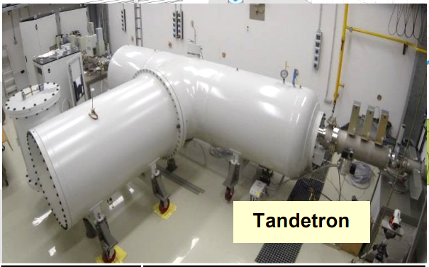
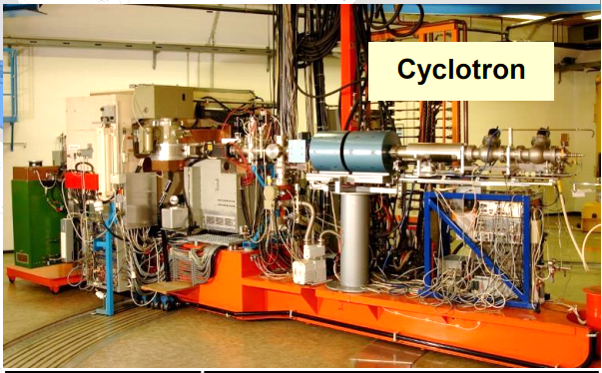
Experimental setup
PTB Ion Accelerator Facility (PIAF, Braunschweig, Germany)
E_{n}
1.2 – 6.8 MeV
14.8 – 19 MeV
Reactions
T(p, n), D(d,n) et T(d,n)
Tandetron
Protons
Deuterons
Acceleration
Beam cut off
Neutrons
Magnetic deflection
Cyclotron
Target
Tritium or Deuterium
E_{n}
7 – 14.7 MeV
Typical fluxes (n . cm⁻² . s⁻¹)
ILL : 10⁹ (PF1B)
PTB : 2 . 10³ – 2 . 10⁴ (at 1 m)
* 10⁻⁵ !!!

Slide 16
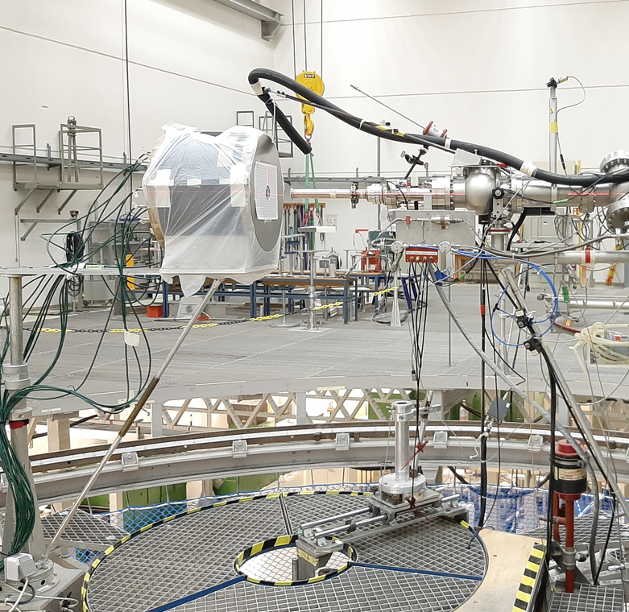
Experimental setup
Neutron detector: LOENIEv2
- Polyethylene cylinder
→ Neutron moderation
- 16 ³He counters
→ Thermal neutron detection
- Flexibore
→ Thermal neutron absorption, noise reduction
→ Flat efficiency between 0.1 and 1 MeV (≈ 12%)
Rear view of LOENIEv2

Slide 17
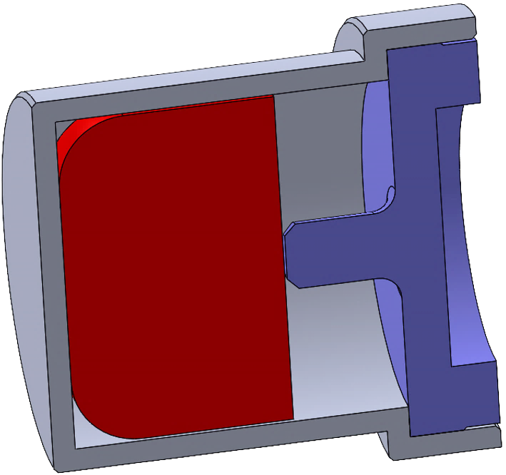
Experimental setup
Neutron detector: LOENIEv2
- Polyethylene cylinder
→ Neutron moderation
- 16 ³He counters
→ Thermal neutron detection
- Flexibore
→ Thermal neutron absorption, noise reduction
→ Flat efficiency between 0.1 and 1 MeV (≈ 12%)
Sample: uranium metal
Container
- Purity: | 99.8% (²³⁸U)
- Mass: | 30 g
- Diameter: | 15 mm
- Height: | 9.7 mm
Sample
Plug
Inside LOENIEv2 → Start measuring as soon as irradiation stops
Close to LOENIEv2 entrance → Compromise detection efficiency / fission rate
Sample in irradiation position

Slide 18
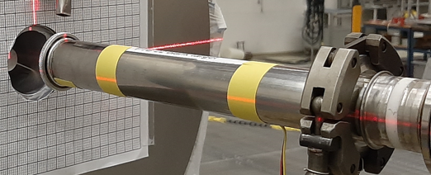
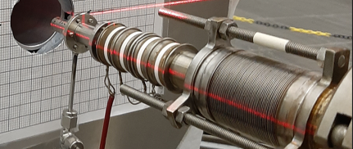
Experimental setup
Neutron detector: LOENIEv2
- Polyethylene cylinder
→ Neutron moderation
- 16 ³He counters
→ Thermal neutron detection
- Flexibore
→ Thermal neutron absorption, noise reduction
→ Flat efficiency between 0.1 and 1 MeV (≈ 12%)
Sample: uranium metal
Container
- Purity: | 99.8% (²³⁸U)
- Mass: | 30 g
- Diameter: | 15 mm
- Height: | 9.7 mm
Sample
Plug
Inside LOENIEv2 → Start measuring as soon as irradiation stops
Close to LOENIEv2 entrance → Compromise detection efficiency / fission rate
Proximity with the neutron production target (few cm)
Maximisation of the fission rate
Saturation of the acquisition during irradiations
→ Inhibition of the ³He counters (except for the rising and falling edges)
→ Synchronisation with the accelerator
Sample in irradiation position
Tritium solid target (top)
Deuterium gas target (down)

Slide 19
ALDEN-U238 campaigns: First results
4

Slide 20
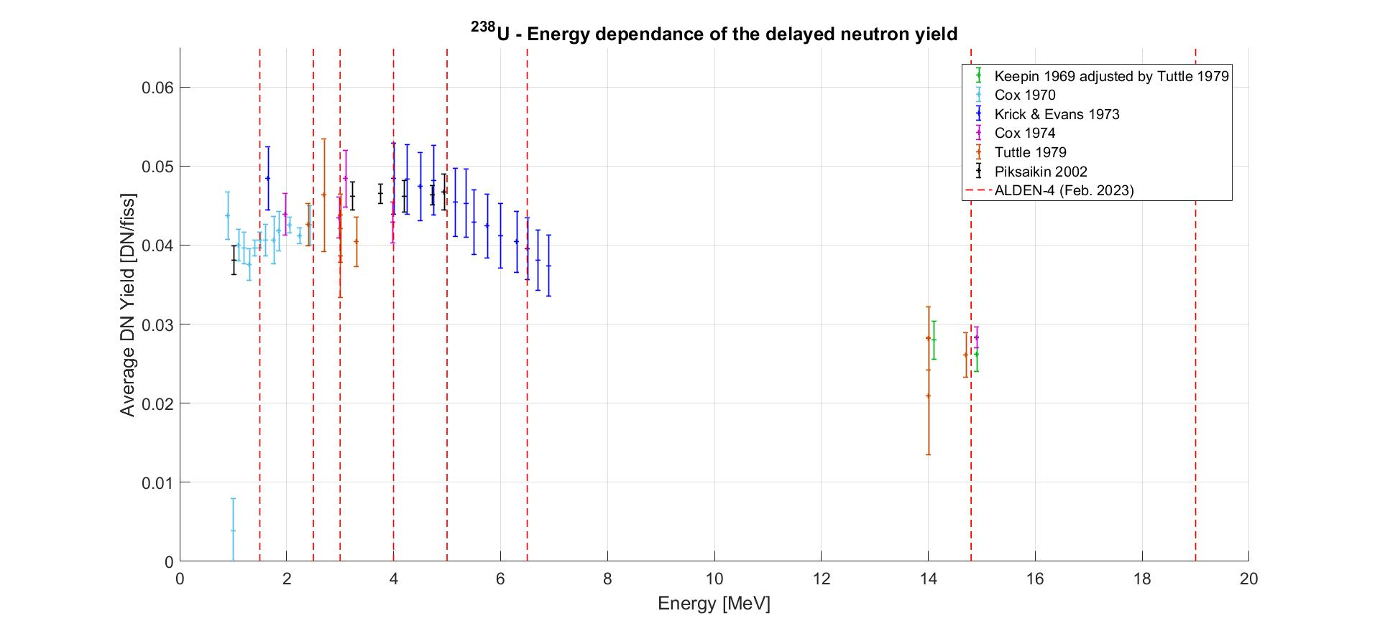
ALDEN-U238 campaigns: First results
Overview
2 * test week : Dec. 2022 and June 2023
2 * measurement campaign (2 weeks each)
ALDEN-4 (Feb. 2023) : 8 ν_{d} + 3 abundances measurement → E_{n} = 1.5 – 2.5 – 3 – 4 - 5 – 6.5 - 14.8 – 19 MeV (Tandetron)
ALDEN-5 (Sept. 2023) : 7 ν_{d} measurements → E_{n} = 2 – 3.5 – 6 MeV (Tandetron) + 8 – 10 – 12.2 – 14.7 MeV (Cyclotron)

Slide 21
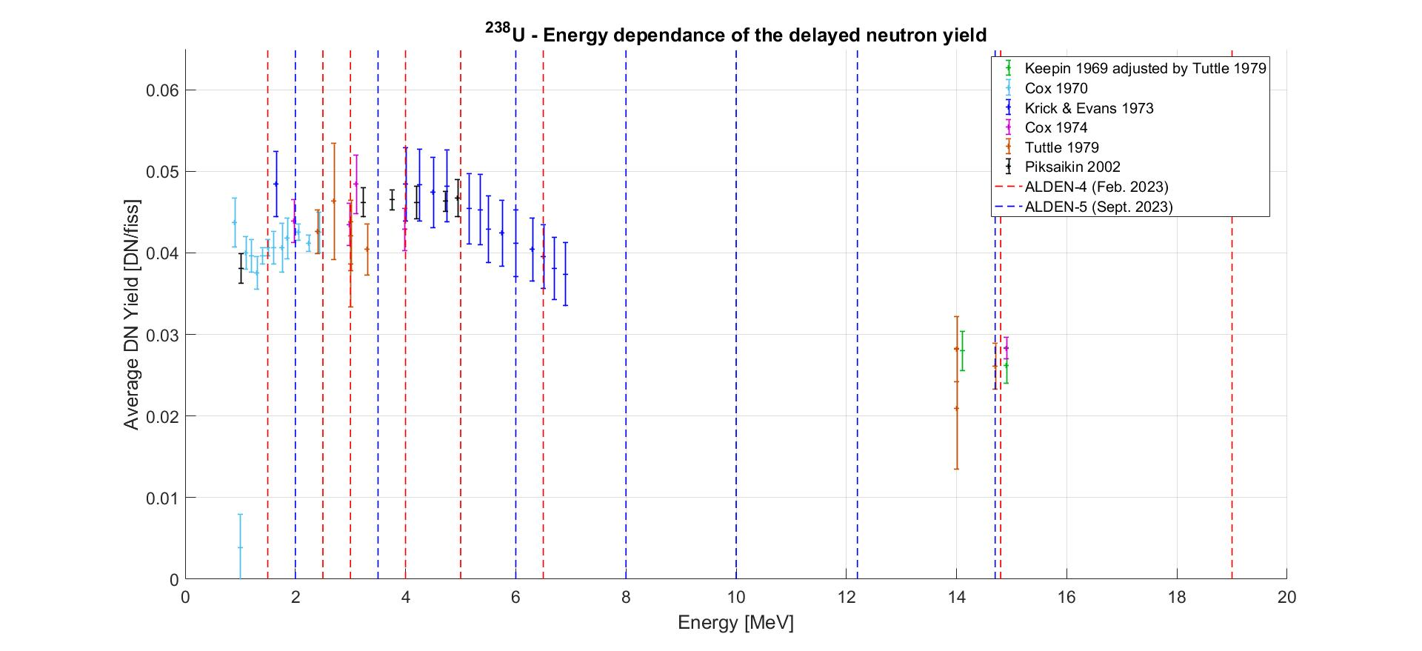
ALDEN-U238 campaigns: First results
Overview
2 * test week : Dec. 2022 and June 2023
2 * measurement campaign (2 weeks each)
ALDEN-4 (Feb. 2023) : 8 ν_{d} + 3 abundances measurement → E_{n} = 1.5 – 2.5 – 3 – 4 - 5 – 6.5 - 14.8 – 19 MeV (Tandetron)
ALDEN-5 (Sept. 2023) : 7 ν_{d} measurements → E_{n} = 2 – 3.5 – 6 MeV (Tandetron) + 8 – 10 – 12.2 – 14.7 MeV (Cyclotron)
≈ 225 h of beam time !
7 experimenters

Slide 22
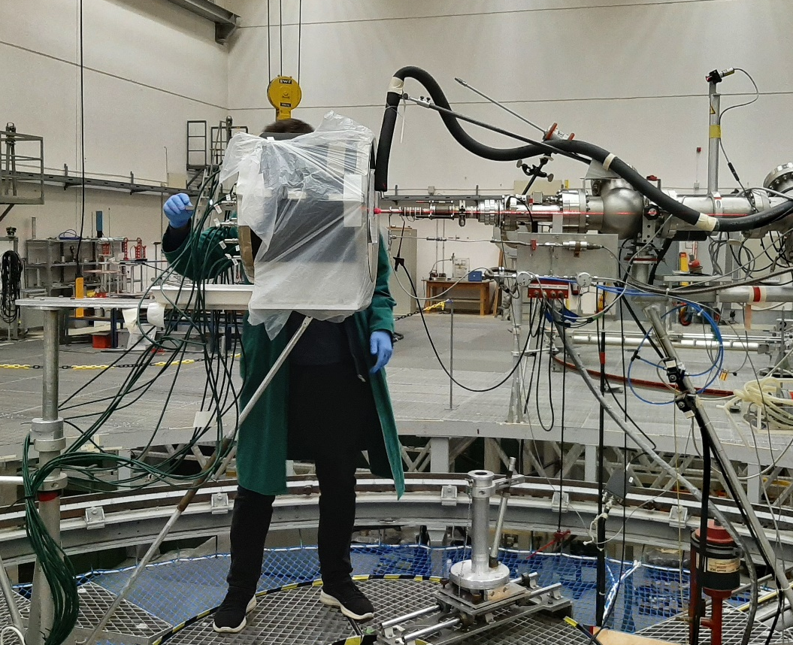
ALDEN-U238 campaigns: First results
Typical day (1 energy / day)
Neutron flux calibration (PIAF staff) (2h)
Detector placement (1h)
Optimisation / measurement of the background and beam cut off duration (1 – 2h)
Neutron flux calibration with dosimetry (30’ – 1h)
Measurement of the short-lived radionuclides at the facility
ν_{d} / abundances measurement (1 – 7h)
Measurement of the distance between LOENIEv2 and the accelerator
Stack of dosimeters
Placement and irradiation of the sample

Slide 23
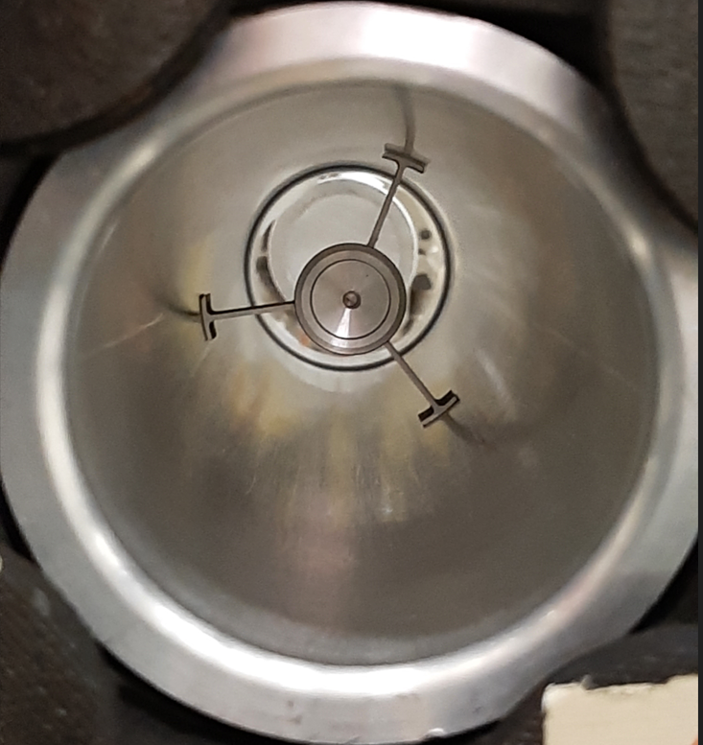
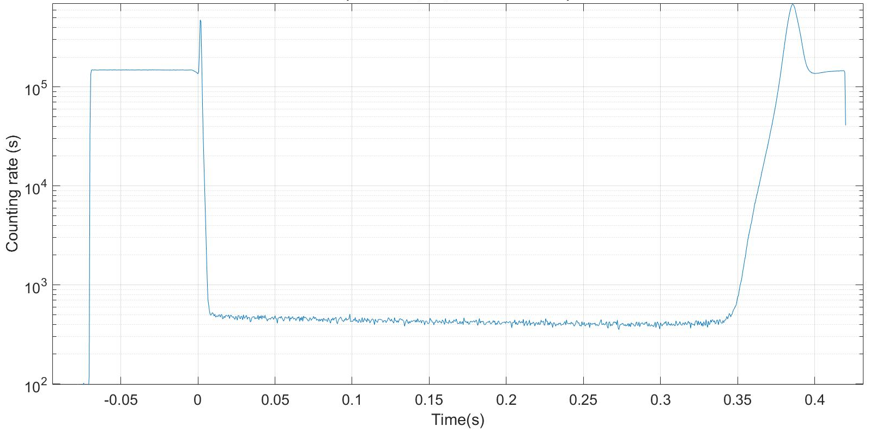
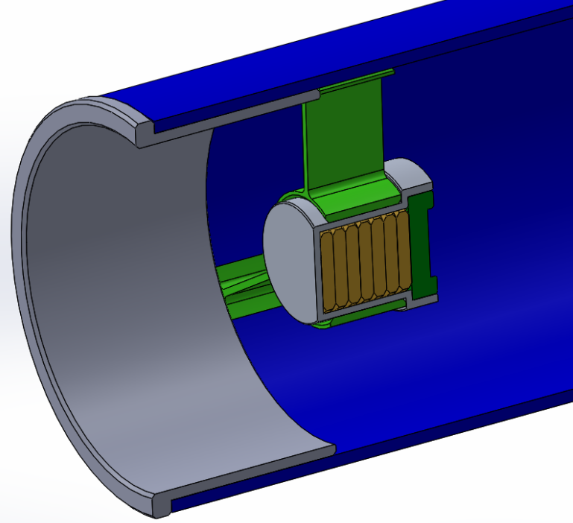
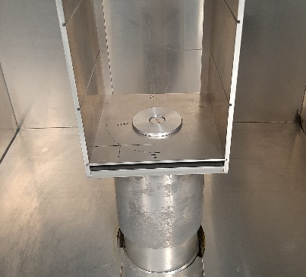
ALDEN-U238 campaigns: First results
Analysis process: 3 main steps
Encapsulation and counting of an AmBe neutron source
Detector efficiency estimation
Monte-Carlo model of LOENIEv2
Experimental validation with an AmBe neutron source
Delayed neutron counting curves production
Many step to process the acquisition files (conversion to readable format, synchronisation and summation of cycles, dead time correction …)
Irradiation
Delayed neutrons counting
Irradiation
For each energy !
Fission rate estimation (3 methods tested)
Neutron flux monitoring
Dosimetry (Indium, Nickel, Cobalt, Magnesium, Iron, Titanium, Niobium)
Sample activation (1st energy of each campaign)
Example of delayed neutron counting curve obtained
(ν_{d} measurement)
Dosimeters placement and counting (left, centre)
Post-irradiation counting of the sample (right)

Slide 24
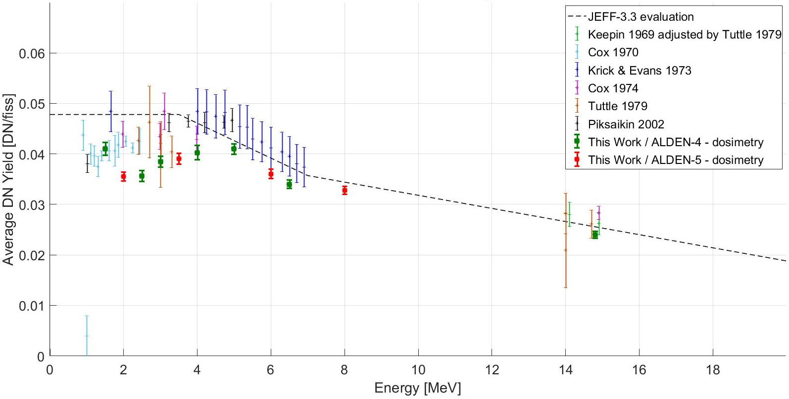
ALDEN-U238 campaigns: First results
11 ν_{d} measurements analysed (for monoenergetic flux)
ν_{d} energy dependence
Good agreement overall with the literature
Reduced uncertainties: 2 – 3 %
Remaining geometrical uncertainties to be propagated
ν_{d} lower than expected at ≈ 2 MeV
Apparent decrease between 1.5 and 2 MeV
Evolution of the precursors Fission Yields ?

Slide 25
Conclusions and outlooks
5

Slide 26
Conclusions and outlooks
Conclusion
Four weeks of measurements performed at the PTB Ion Accelerator Facility (Germany) in 2023
15 delayed neutron yield measurements for ²³⁸U (1.5 – 19 MeV)
3 group abundances measurements (2.5, 5 and 14.8 MeV)
11 ν_{d} measurements analysed yet
Outlooks
Analysis of the 3 a_{i} measurements
Analysis of the 4 remaining ν_{d} measurements (10, 12, 14.2 and 19 MeV)
Non monoenergetic neutron flux due to contaminations (D break up reactions / impurities in the target)
Additional measurements required (TOF) → performed by PIAF staff in the beginning of 2024
Evaluation of the ν_{d} energy dependence + comparison with the current evaluations for reactor applications
Submission of an article on the ν_{d} measurements to a peer-reviewed journal by the end of 2024

Slide 27
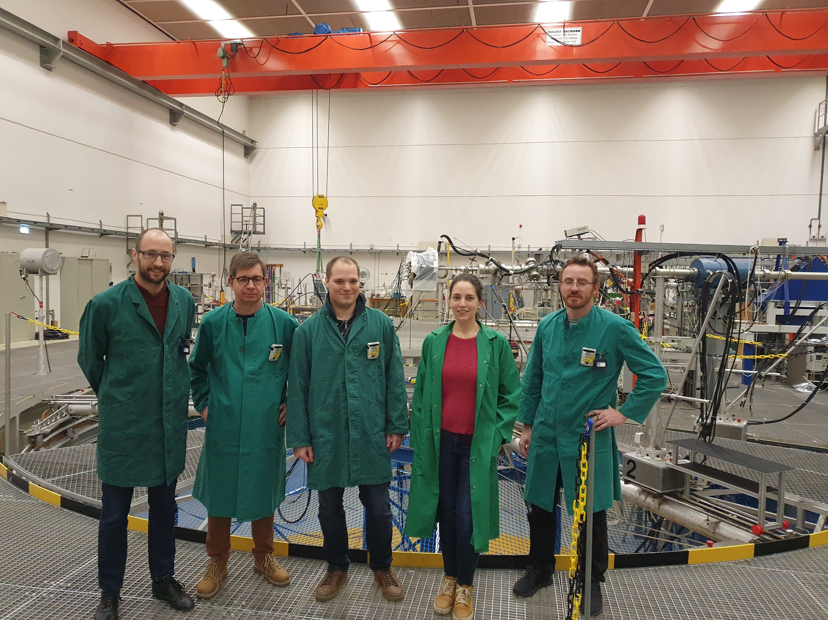
Thank you for your attention
Acknowledgment
Special thanks to the PIAF technical STAFF for their support !
This project has received funding from the Euratom research and training programm 2014-2018 under grant agreement No 847594 (ARIEL)
This project was partly funded by I3P (CEA, EdF, Framatome).
From left to right: P.Leconte, X.Ledoux, D.Belverge, E.Pirovano, L.Mathieu
CEA CADARACHE
13115 Saint-Paul-lez-Durance Cedex
France
dorian.belverge@cea.fr

Slide 28
Appendices

Slide 29
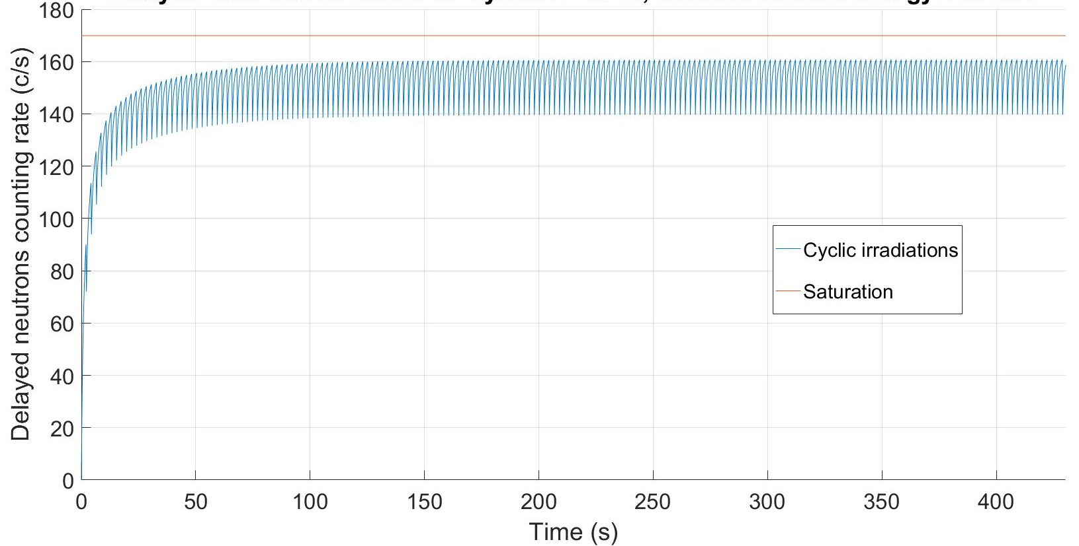
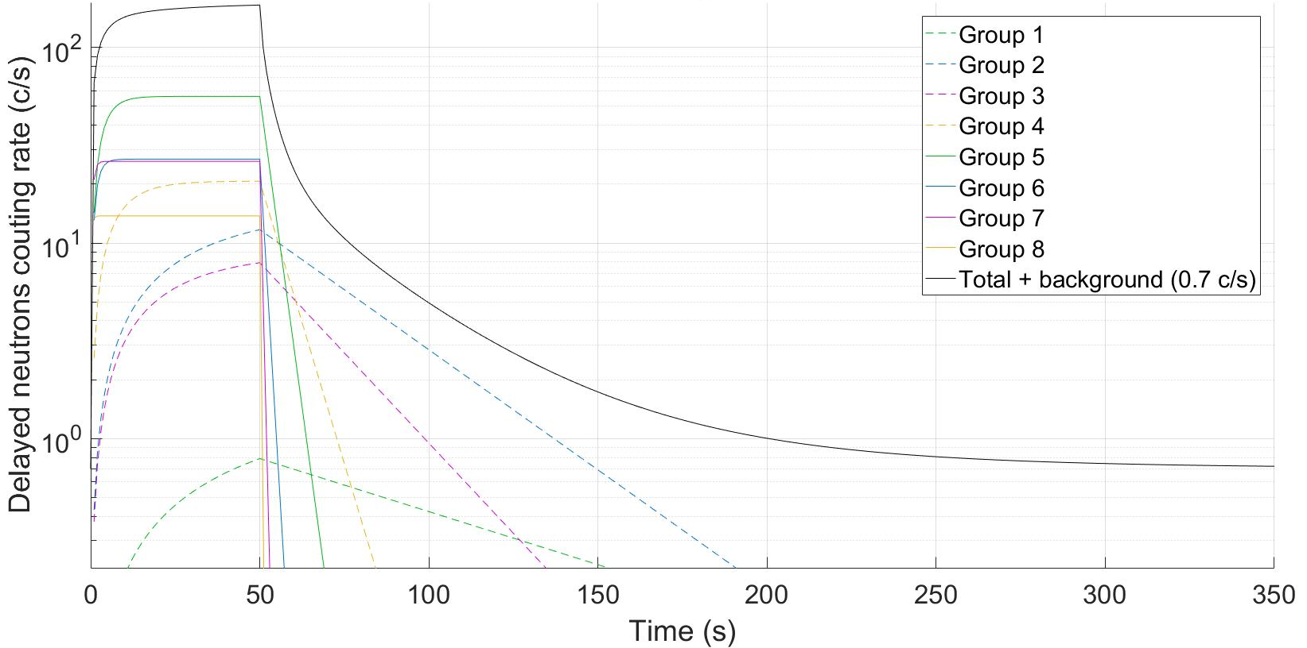
Appendices: Principle of the measurement
Simulation of delayed neutrons counting in LOENIEv2 for cycles 2-0.2s – Energy 2.5 MeV
ν_{d} measurement: short cycles (e.g. 2s on / 0.2s off)
Short t_{decay}: ν_{d} obtained at the beginning of the decay phase
t_{irr}: compromise between precursors saturation and statistics
Equilibrium built by the first cycles, maintained by the following
→ Cycles 2/0.2 s: 95% of the saturation
Simulation of the delayed neutrons counting in LOENIEv2 per group for cycles 50 - 300s – Energy 2.5 MeV
a_{i} measurement: long cycles (e.g. 50s on – 300s off)
Long t_{decay}: counting delayed neutrons emitted from the 8 groups
T_{1/2, i} = 0.195 – 55.6s
Long t_{irr}: equilibrium must be built for each cycle
Background estimation during the last 50s
DN emission negligible after 5 x max(T_{1/2,} _{i})
29

Slide 30
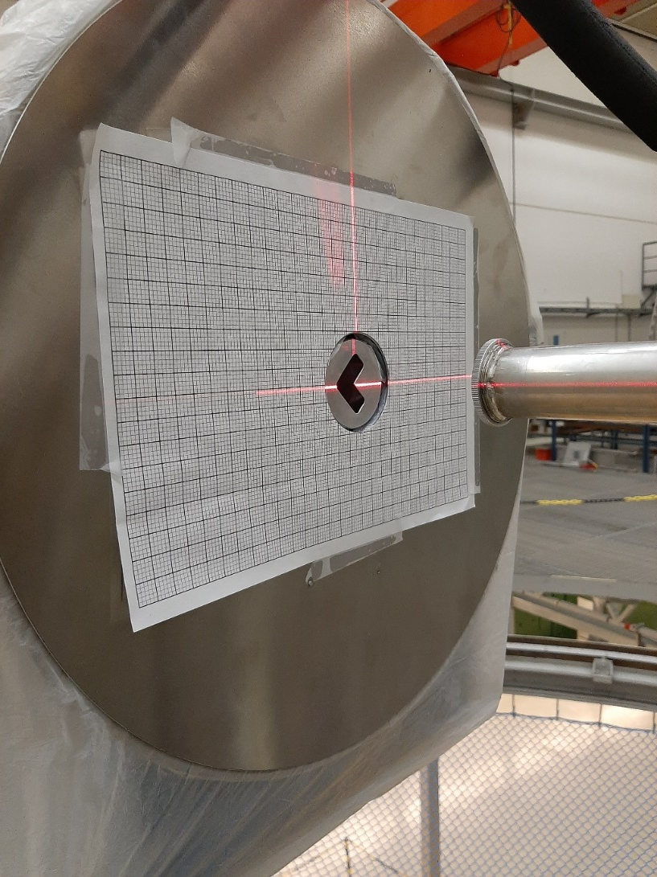
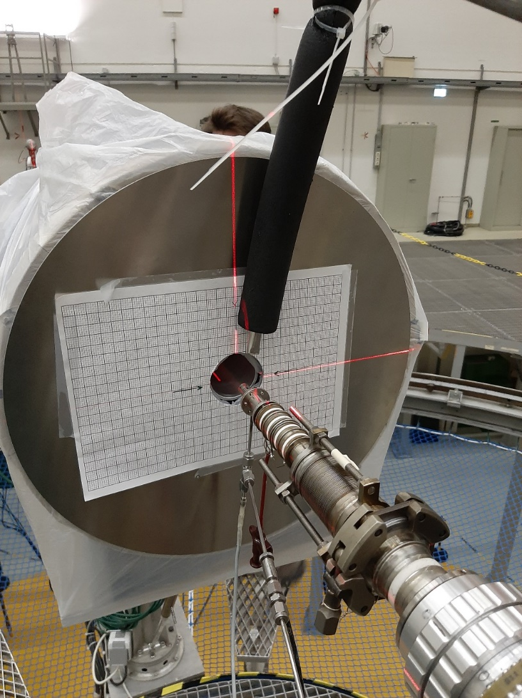
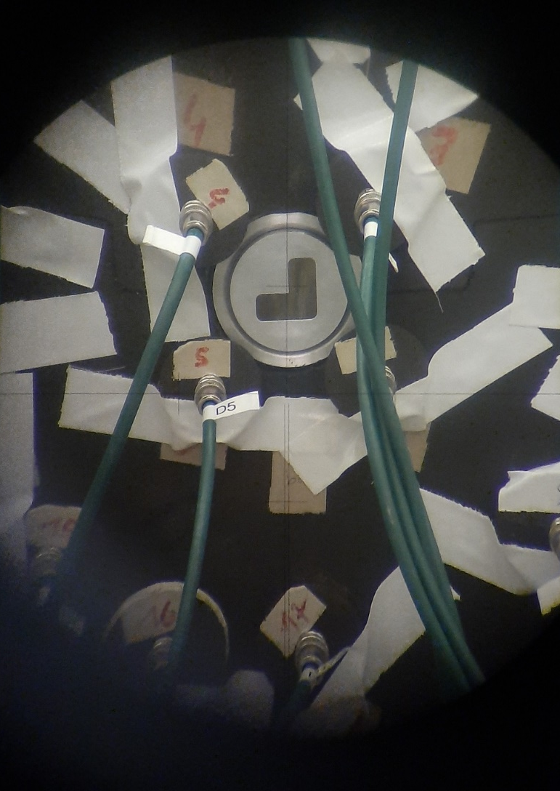
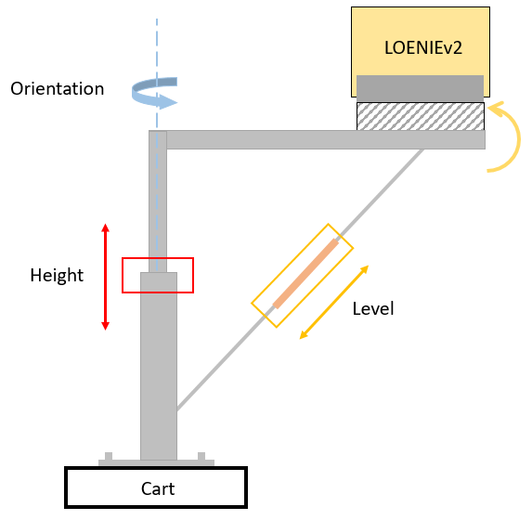
Appendices: Experimental setup
Alignment of the detector
Front face with lasers
Rear face with telescopes

Slide 31
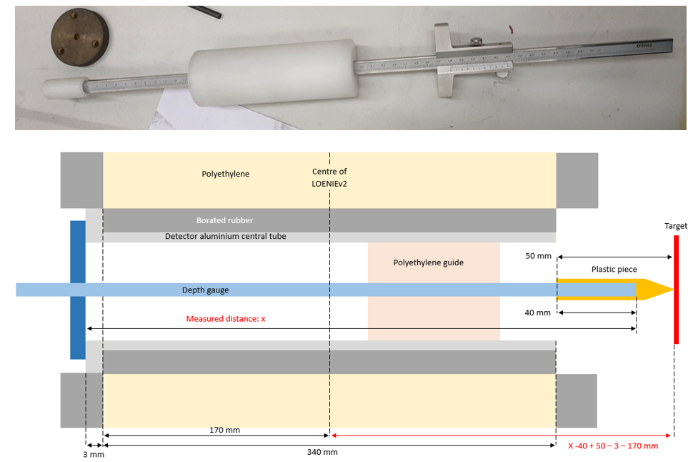
Appendices: Experimental setup
Measurement of the distance between LOENIEv2 and the accelerator
Modified depth gauge used to measure the distance separating LOENIEv2 from the target

Slide 32
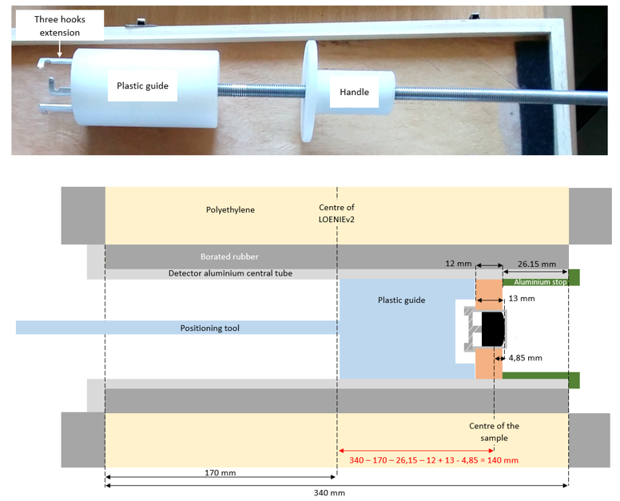
Appendices: Experimental setup
Placement of the ²³⁸U sample
Model of a stack of dosimeters in irradiation position
Insertion of the ²³⁸U sample inside LOENIEv2
Three wings aluminium holder used to ensure radial centring
²³⁸U sample in irradiation position

Slide 33
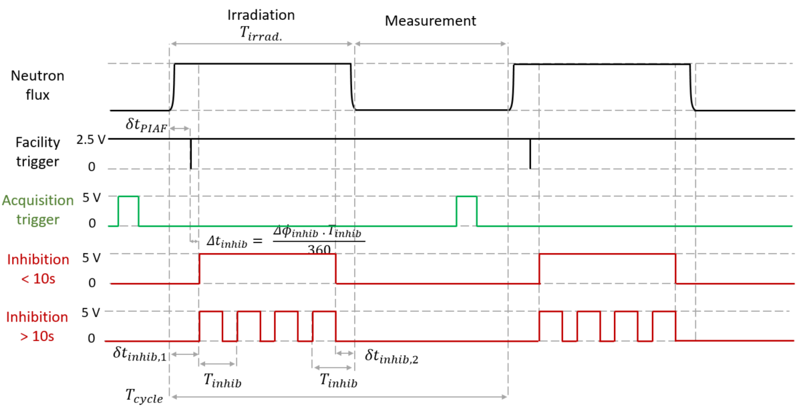
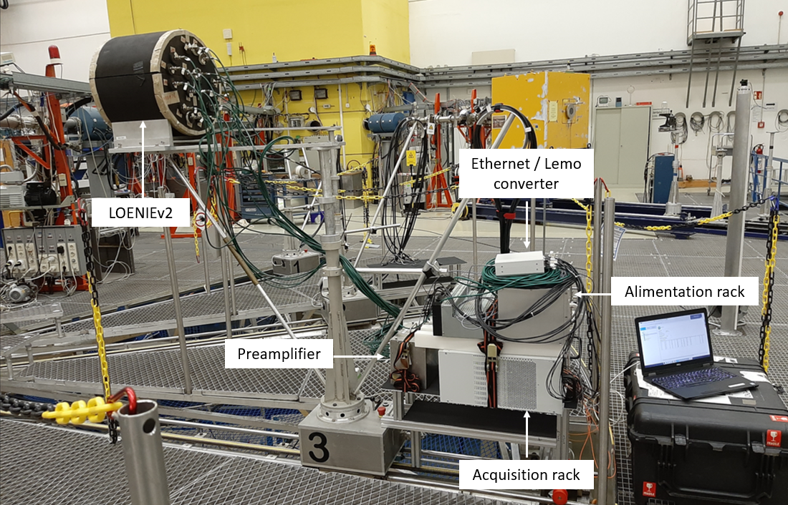
Appendices: Experimental setup
Acquisition system
Acquisition system
Generation of inhibition signal and synchronisation with the accelerator

Slide 34
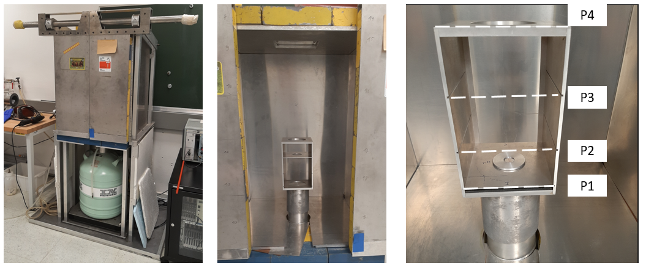
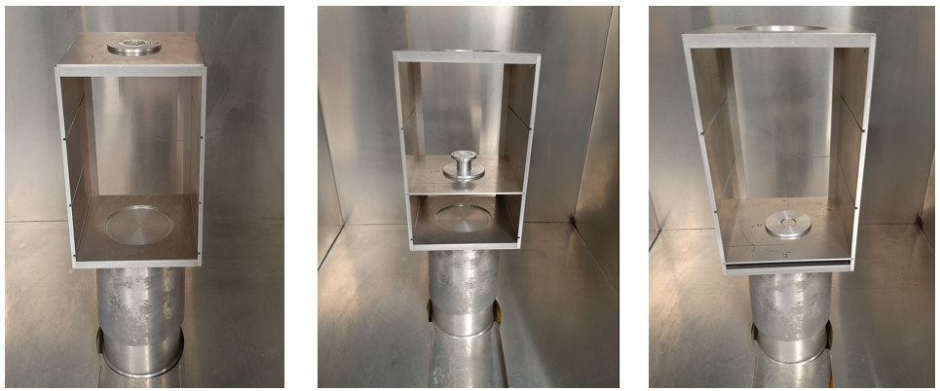
Appendices: Experimental setup
PIAF HPGe detector
Neutron source measured in P4
Sample + europium source
Dosimeter measurement in P1

Slide 35
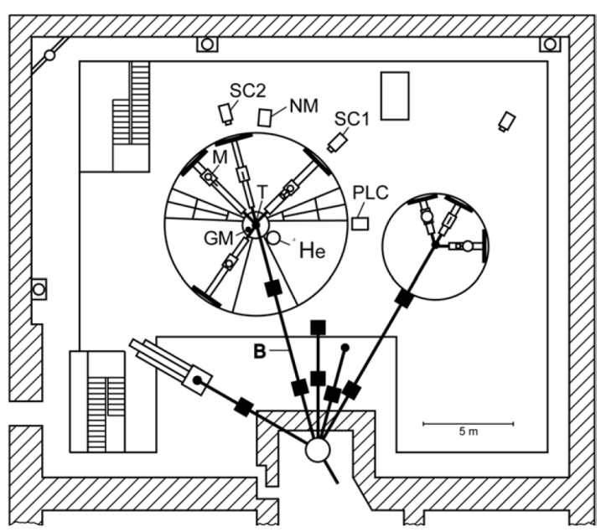
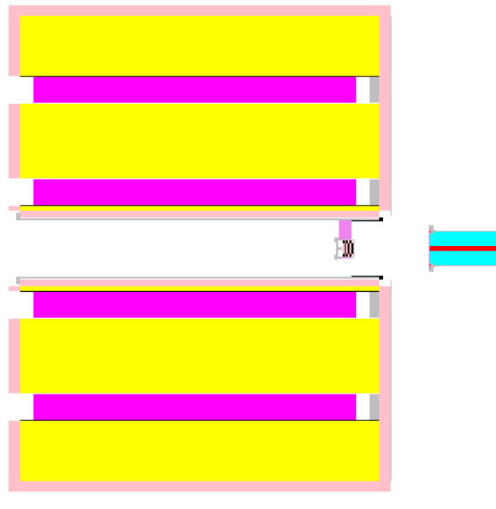
Appendices: Analysis
Upper-view of the PIAF experimental hall
Simulation of the experimental setup with TRIPOLI-4®
Fission rate estimation (2 methods)
Monitor 1
16 °
1 : Flux calibration and monitoring performed by PIAF
Monitor 2
97 °
Source
PIAF calibration
Real Φ_{surf} (1m, 0°)
« open field »
(n . cm⁻² . s⁻¹)
Neutron monitor counting rate during the measurement
Emitted flux (4π)
(n . s⁻¹)
Simulated Φ_{surf} (1m, 0°)
« open field »
(n . cm⁻² . n_{source}⁻¹)
Real fission rate
(s⁻¹)
E = f(θ) and I = f(θ) distributions of the sources
TRIPOLI-4®
NeusDesc
TRIPOLI-4® model of the setup
Simulated fission rate
(n_{source}⁻¹)

Slide 36
Appendices: Analysis
Fission rate estimation (2 methods)
Gamma counting of a dosimeter using the HPGe detector of the facility
2 : Flux calibration using dosimetry
Neutron monitor counting rate during the dosimeters irradiation
Fluctuation of the neutron flux
Neutron monitor counting rate during the measurement
Emitted flux (4π)
(n . s⁻¹)
Dosimeters irradiation
Dosimeters measured reaction rates
(s⁻¹)
Dosimeters activity measurement
(PTB / LBA)
Real fission rate
(s⁻¹)
Dosimeters simulated reaction rates
(n_{source}⁻¹)
E = f(θ) and I = f(θ) distributions of the sources
TRIPOLI-4®
TRIPOLI-4® model of the setup
Simulated fission rate
(n_{source}⁻¹)
NeusDesc

Slide 37
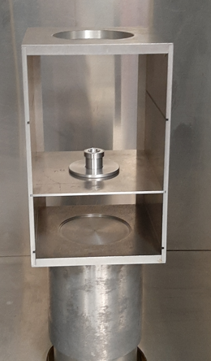
Appendices: Analysis
Fission rate estimation (2 methods)
Gamma counting of the sample after activation
Additional method: 238U sample activation
Only available for the 1st energy of each campaign → Energy 14.8 MeV : FY better known
Validation of the 2 other methods
Fluctuation of the neutron flux
²³⁸U sample irradiation
Activities of fission products
(s⁻¹)
Real fission rate
(s⁻¹)
Sample activity measurement
(PTB)
⁹²Sr, ¹³⁵I
Cumulative Fission Yields
No simulation required !!!
JEFF-3.11

Slide 38
Appendices: Analysis
Dosimetry
Dosimeter | Isotope | Reaction | Product | T ½ | Threshold | Rays (keV)
Indium | ¹¹³In | (n, g) | ^{114m}In | 49.5 j | Thermal | 190.3 – 558.4 – 725.2
 | ¹¹³In | (n, n’) | ^{113m}In | 1.66 h | 0.5 MeV | 391.7
 | ¹¹⁵In | (n, g) | ^{116m}In | 54.3’ | Thermal | 138.3 - 416.9 – 818.7 – 1097.3 – 1293.5 – 1507.4
 | ¹¹⁵In | (n, n’) | ^{115m}In | 4.5 h | 340 keV | 336.24
 | ¹¹⁵In | (n, 2n) | ^{114m}In | 49.5 j | 9 MeV | 190.3 – 558.4 – 725.2
Nickel | ⁵⁸Ni | (n, p) | ⁵⁸Co | 70.5 j | 0.4 MeV | 810.76
 | ⁶⁰Ni | (n, p) | ⁶⁰Co | 5.3 a | 4 MeV | 1173.2 – 1332.5
 | ⁵⁸Ni | (n, 2n) | ⁵⁷Ni | 1.5 j | 12.5 MeV | 136.5 – 1377.6
Cobalt | ⁵⁹Co | (n, g) | ⁶⁰Co | 5.3 a | Thermal | 1173.2 – 1332.5
 | ⁵⁹Co | (n, p) | ⁵⁹Fe | 44.5 j | 3 MeV | 192.3 – 1099.2 – 1291.6
 | ⁵⁹Co | (n, α) | ⁵⁶Mn | 2.6 h | 5 MeV | 846.8 – 1810.7
 | ⁵⁹Co | (n, 2n) | ⁵⁸Co | 71 j | 11 MeV | 810.76
Magnesium | ²⁴Mg | (n, p) | ²⁴Na | 15 h | 6 MeV | 1368.6
Iron | ⁵⁸Fe | (n, g) | ⁵⁹Fe | 44.5 j | Thermal | 1099.2 – 1291.6
 | ⁵⁴Fe | (n, p) | ⁵⁴Mn | 312 j | 2 MeV | 834.8
 | ⁵⁶Fe | (n, p) | ⁵⁶Mn | 2.6 h | 5 MeV | 846.8
Titanium | ⁴⁷Ti | (n, p) | ⁴⁷Sc | 3.3 j | 1 MeV | 159.4
 | ⁴⁶Ti | (n, p) | ⁴⁶Sc | 83.8 j | 2 MeV | 889.3 – 1120.5
 | ⁴⁸Ti | (n, p) | ⁴⁸Sc | 1.8 j | 4 MeV | 175.4 – 983.5 – 1037.5 – 1212.8 – 1312.12
Niobium | ⁹³Nb | (n, 2n) | ^{92m}Nb | 10.15 j | 9 MeV | 912.6 – 934.44

Slide 39
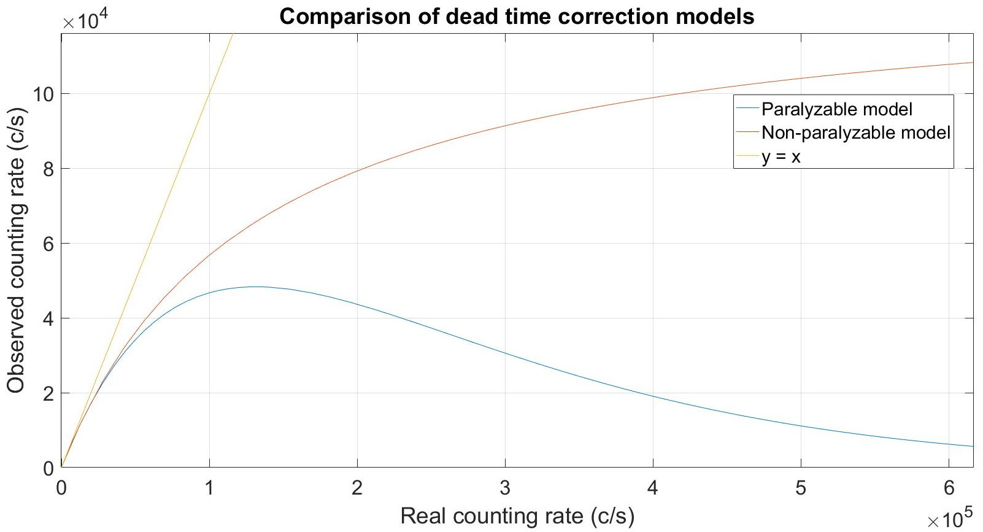
Appendices: Analysis
Dead time correction
Non-paralyzable model: $m= \frac{n}{1+ τ.n}$
Paralyzable model: $m=n.e^{−n.τ}$
Dead time parameter τ = 7.61 ± 0.07 µs

Slide 40
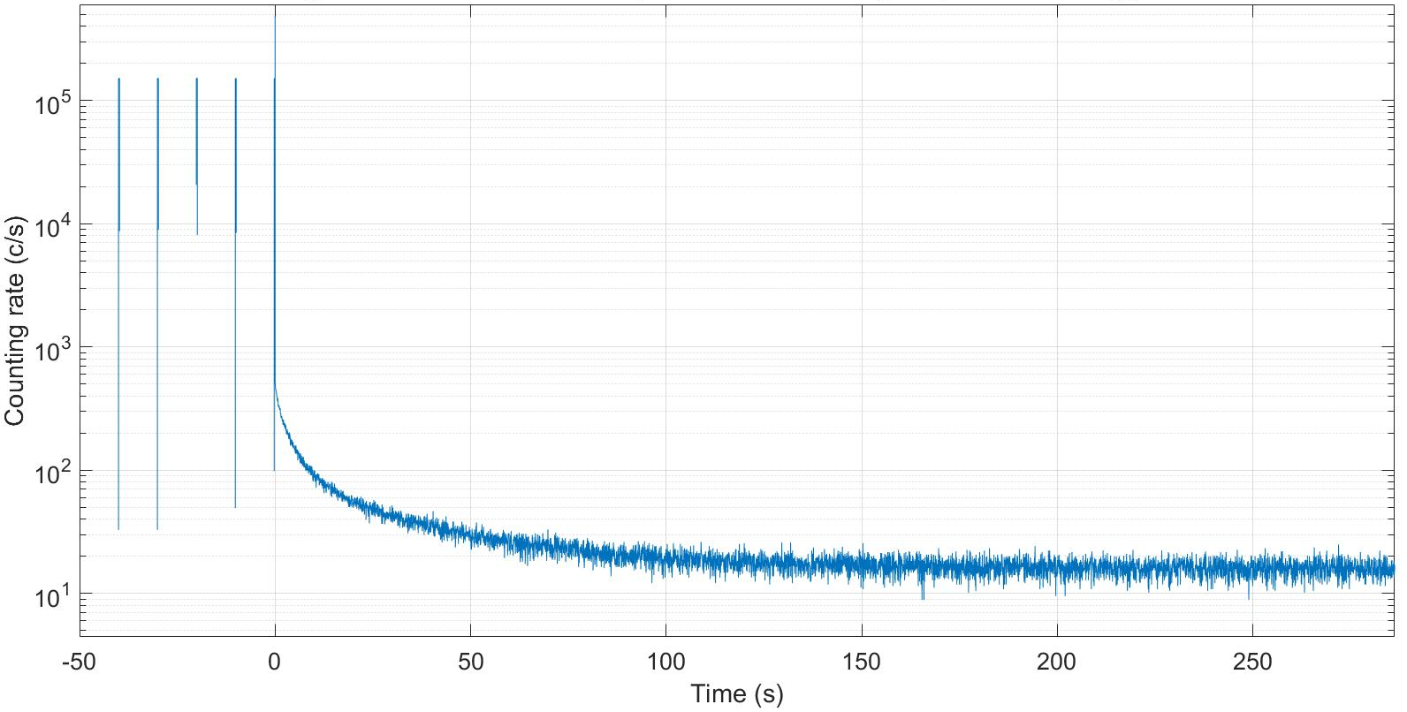
Appendices: First results
Preliminary decay curves
→ a_{i} measurement at 14.8 MeV (2h, 3 121 cycles)
Irradiation
Delayed neutrons counting
Background measurement
Summation of 61 cycles (6h)
n(t = t_{irr}) ≈ 450 counts/s
Background ≈ 16 counts/s
t_{irr} / t_{decay} ≈ 50 / 300 s
T_{cut off} ≈ 15 ms
→ Veto time after end of irradiation
Preliminary
Total counting rate in LOENIEv2, cycles “50 – 300s

