Slide 1
Finalizing reporting for ARIEL Dr. Carola Franzen PLSIGN for ARIEL
This project has received funding from the Euratom research and training programme 2014-2018 under
grant agreement No 847594.
ARIEL Final Workshop 17.01.-19.01.2024

Slide 2
Project Life Time
2nd periodic Report
31.08.2022
within 60 days
1st periodic Report
28.02.2021
within 60 days
Final Report
29.02.2024
within 60 days
Project start
01.09.2019
Project Duration 4 years; 01.09.2019 – 29.02.2024
Prefinancing
received: 04.09.19
Interim Payment
Interim Payment
Payment of the Balance

Slide 3
Periodic/Final Reporting
Continuous reporting
e.g. deliverables, milestones, outputs/outcomes, critical risks, indicators, etc; if any), in the Portal Continuous Reporting tool and in accordance with the timing and conditions it sets out
Part A
Portal
includes an overview of the action implementation. It must be prepared using the template available in the Portal Periodic Reporting tool
Technical part
Final reporting
Part B
Narrative text (pdf)
Within 60 days following the end of each reporting period
Financial part
For interim and final payments
Financial statement (individual and consolidated)
Report on the use of resources – cost explanations
*Certificates on the financial statements

Slide 4
Deliverables

Slide 5
Milestones

Slide 6
Publications
Publications should be uploaded to the portal up to five years after the project. Ask the scientists to publish and to not forget the acknowledgement.
“This project has received funding from the Euratom research and training programme 2014-2018 under
grant agreement No 847594”.

Slide 7
Dissemination & Communication Activities
Specify the total funding amount used for Dissemination and Communication activities linked to the project
Specify the number of Dissemination and Communication activities linked to the project for each of the following categories
Organisation of a Conference
Organisation of a Workshop
Press release
Non-scientific and non-peer-reviewed publication (popularised publication)
Exhibition
Flyer
Training
Social Media
Website
Communication Campaign (e.g. Radio, TV)
Participation to a Conference
Participation to a Workshop
Participation to an Event other than a Conference or a Workshop
Video/Film
Brokerage Event
Pitch Event
Trade Fair
Participation in activities organised jointly with other EU project(s)
Other

Slide 8
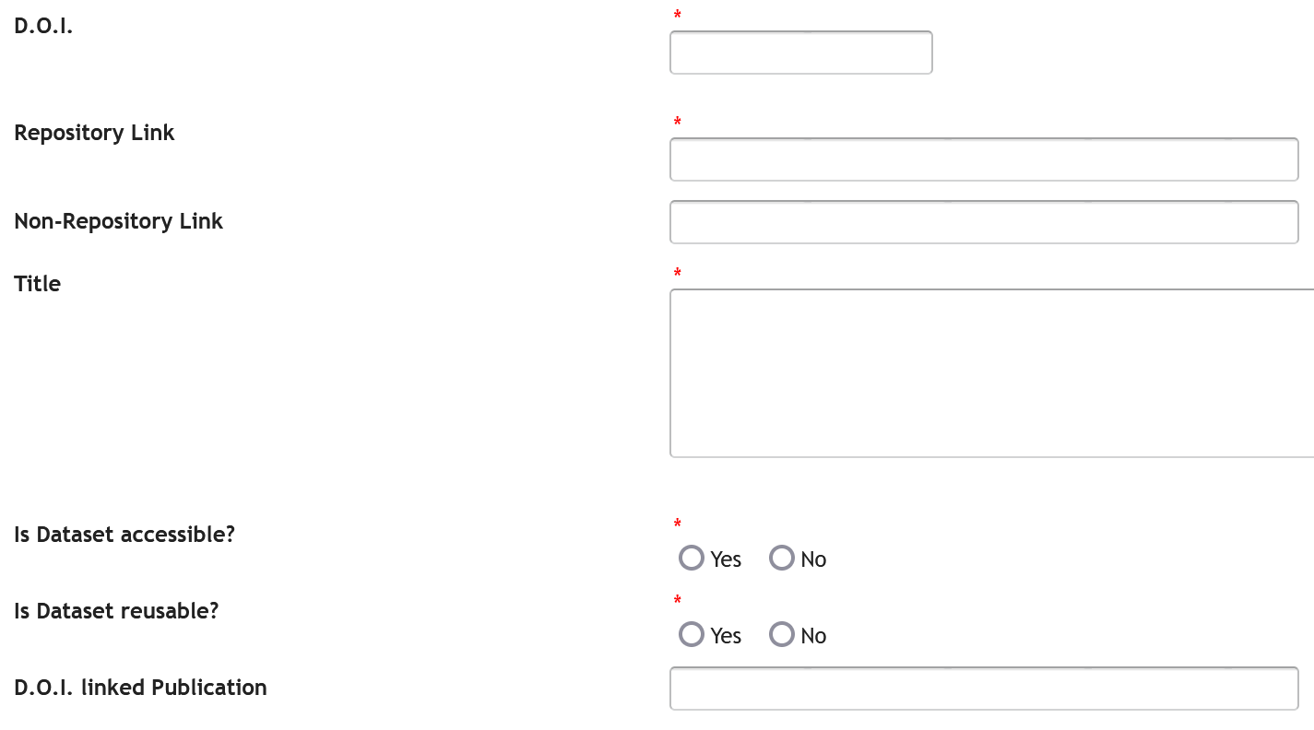
Open Data

Slide 9
Gender

Slide 10
Finanical Support to Third Parties
All business trip accounts and reports must be submitted in full to the HZDR before the end of the project. Deadline: 15.02.2024

