Slide 1
ARIEL WP5: Schools
Carlos GUERRERO
Universidad de Sevilla, 41012 Seville, Spain
Centro Nacional de Aceleradores (CNA), 41092 Seville, Spain
H2020 ARIEL Final meeting
IJCLab (Orsay, FR)
January 17th 2024

Slide 2
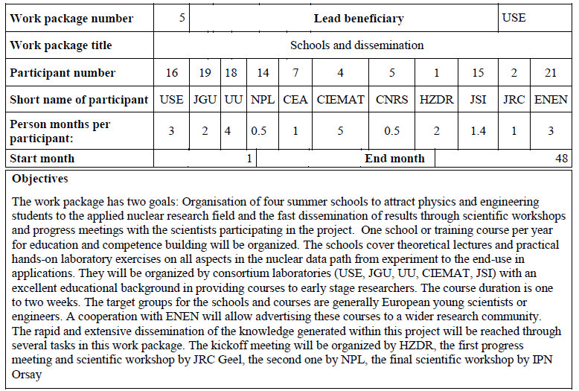
WP5 Schools and Dissemination

Slide 3
WP5: Schools summary
2020/21: COVID mobility resctrictions
1/2022 @CIEMAT, Madrid, Spain
Nuclear data: the path from the detector to the reactor calculation
(20 participants)
9/2022 @CNA, Seville (Spain)
Hands-on school on the production, detection and use of neutron beams
(18-24 participants)
9/2023 @Budapest Neutron Center (BNC) & BME NTI, Budapest, Hungary
Hands-on school on nuclear data from Research Reactors
(25 participants)
[Back-up to the initially intended EXTEND School in Sweden]
11/2023 @JGU, Mainz, Germany
Lab course in Reactor Operation and Nuclear Chemistry
(10 participants)

Slide 4
NuDataPath:
the path from the detector to the reactor calculation
Director: Daniel Cano-Ott
https://agenda.ciemat.es/event/3201/

Slide 5
The NuDataPath school (I)
Goal: to provide an overview of the complete nuclear data cycle
=> Affected by COVID mobility restrictions: fully online
Seminars on:
Nuclear data (1 hr)
Nuclear data for reactor technologies (1 hr)
The JEFF project (1 hr)
Nuclear data for thermal and fast reactors (1 hr)
Nuclear data for nuclear fuel cycles (1 hr)
Nuclear data for nuclear technologies
Seminars on:
Sensitivity analyses (1 hr)
Data for non-energy applications (1 hr)
Identification of nuclear data priorities
Hands-on lectures with computer tools:
Sensitivity analysis methodologies (3 hr)
Sensitivity analyses of thermal and fast reactors (2 hr)
Nuclear data evaluation
Seminars on:
Evaluation (1.5 hr)
Automatised evaluation (1 hr 10 min)

Slide 6
The NuDataPath school (I)
Seminars on:
Neutron facilities and techniques (1 hr)
Facilities for decay studies (1 hr)
Samples for cross section measurements (1 hr)
Identification and propagation of uncertainties (1 hr)
Nuclear data dissemination (1 hr)
Nuclear data measurements
Hands-on lectures with a neutron reaction calculator:
Experimental effects: TOF, Doppler, resolution, background, statistical fluctuations (2 hr)
Transmission, capture and fission experiments (3 hr)
Seminars on:
Simulation codes and processing tools (1 hr)
Integral experiments and validation (1 hr)
Verification and validation
Hands-on lectures with a neutron reaction calculator:
Visualisation of nuclear data – JANIS (1 hr)
Processing of nuclear data – NJOY (1 hr)
Integral experiment databases – ICSBEP (1 hr)
Validation with integral experiments (2 hr)

Slide 7
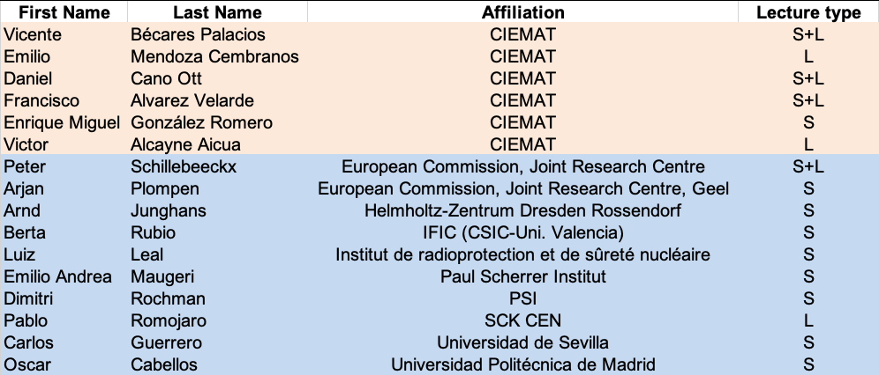
Lecturers of the school
16 scientists giving seminars (S) and hands-on lectures (L).
About 450 years of accumulated research experience
Average age of 50 years

Slide 8
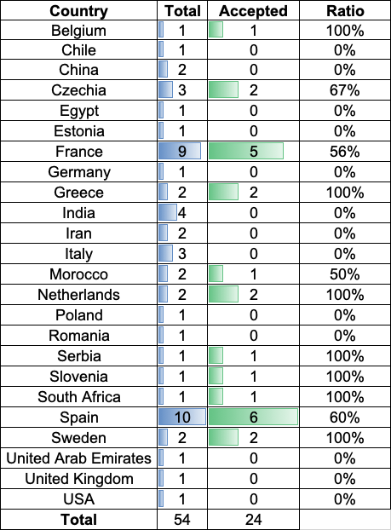
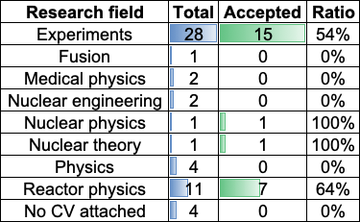
Applicant/participant statistics

Slide 9
Hands-on lectures
Interactive sessions with applications developed ad-hoc for the school and some standard software for data visualisation and processing.
A list of exercises and extra tasks that could be done after the school.
Some of the programs (neutron TOF calculator) will be of public use after some modification.

Slide 10
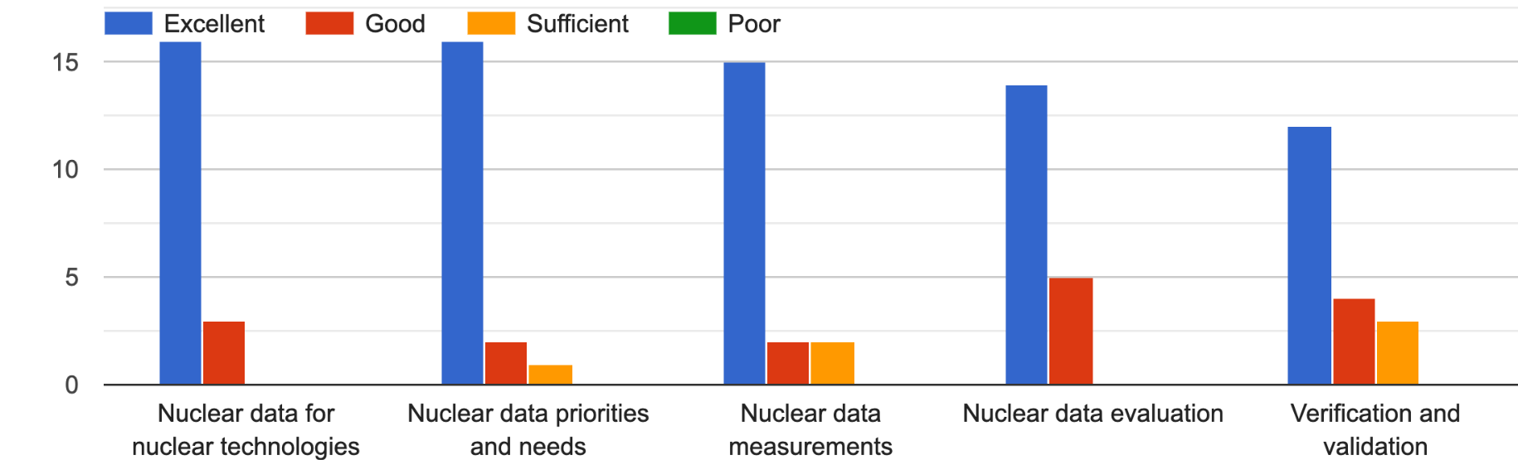
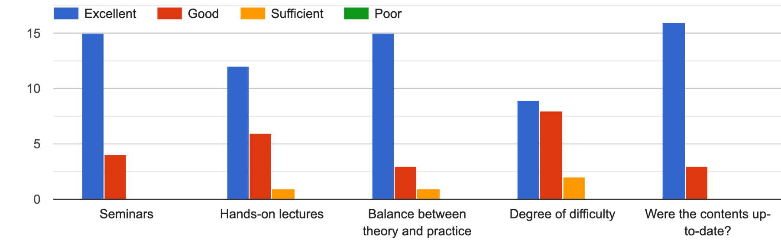
Satisfaction survey

Slide 11
Summary and conclusions
The school fulfilled its goal of covering the entire nuclear data cycle.
We had a wonderful group of lecturers who did a great job preparing their slides and material. Many thanks to all of them!
The development of the on-line tools was very time consuming and required a huge effort. Many thanks to Emilio, Pablo, Paco, Vicente and Víctor!
We think that the result was very satisfactory and the students enjoyed and appreciated it.
Some of the tools such as the neutron TOF calculator will become public for other users.
The feedback from the students was very helpful and we got a very positive evaluation.
We think that it would be worth organising a similar school in some years from now and benefit from the work already done for NuDataPath.

Slide 12
Hands-on school on the production, detection and use of neutron beams
Director: Carlos Guerrero
https://indico.cern.ch/event/865322/

Slide 13
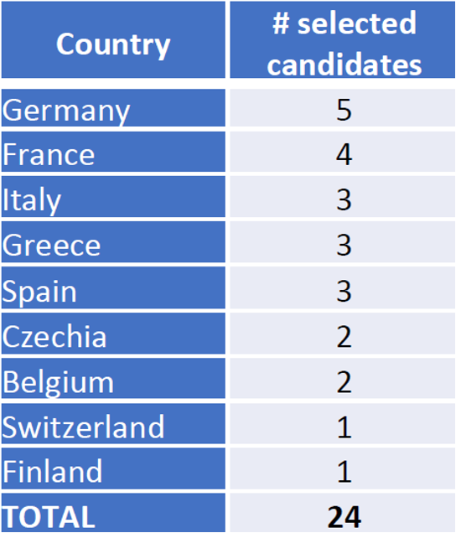
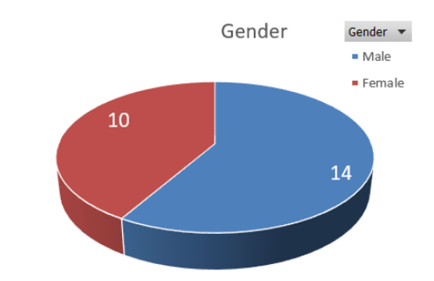
Selection of participants
Applications:
Number: 59 from 24 countries
Academic level: McS students: (37%), PhD students (60%) & Postdocs (3%)
Gender: Male (54%) & Female(46%)
International Advisory Committee:
Arnd Junghans (HZDR), Arjan Plompen (JRC), Gabriel Pavel (ENEN)
Enrique González (CIEMAT), Roberto Capote (IAEA)
Selection process:
Academic level => MSc students: 1 pt PhD & Postdocs: 3 pt
Origin => EU: 2 pt non-EU: 0 pt
Affinity => up to 5 pt
Selected participants:

Slide 14
Content of the School
Lectures
Interaction of neutrons with matter (J.L. Taín, IFIC)
Principles and examples of neutron production (C. Guerrero, CNA)
Principles and examples of neutron detection (D. Cano-Ott, CIEMAT)
Seminars (“The role of neutrons and neutron beam experiments on”)
Nuclear technology (F. Álvarez, CIEMAT & C. Guerrero,CNA)
Astrophysics (C. Domingo Pardo, IFIC)
Medicine (I. Porras, UGR)
Experiments
Fast neutrons: Time-of-flight with a fast pulsed neutron beam and detectors providing pulse shape discrimination (B. Fernández/C. Guerrero)
Epithermal neutrons: Neutron capture MACS measurements by activation using an epithermal neutron beam. (P. Pérez-Maroto/C. Guerrero)
Thermal (and fast) neutrons: Thermal neutron radiography with thermal neutrons via full moderation of an initially fast neutron beam. (M. A. Millán-Callado)
Fission neutrons: Study of the neutron distribution from ²⁵²Cf fission with the miniBELEN detector. (A Tarifeño)

Slide 15
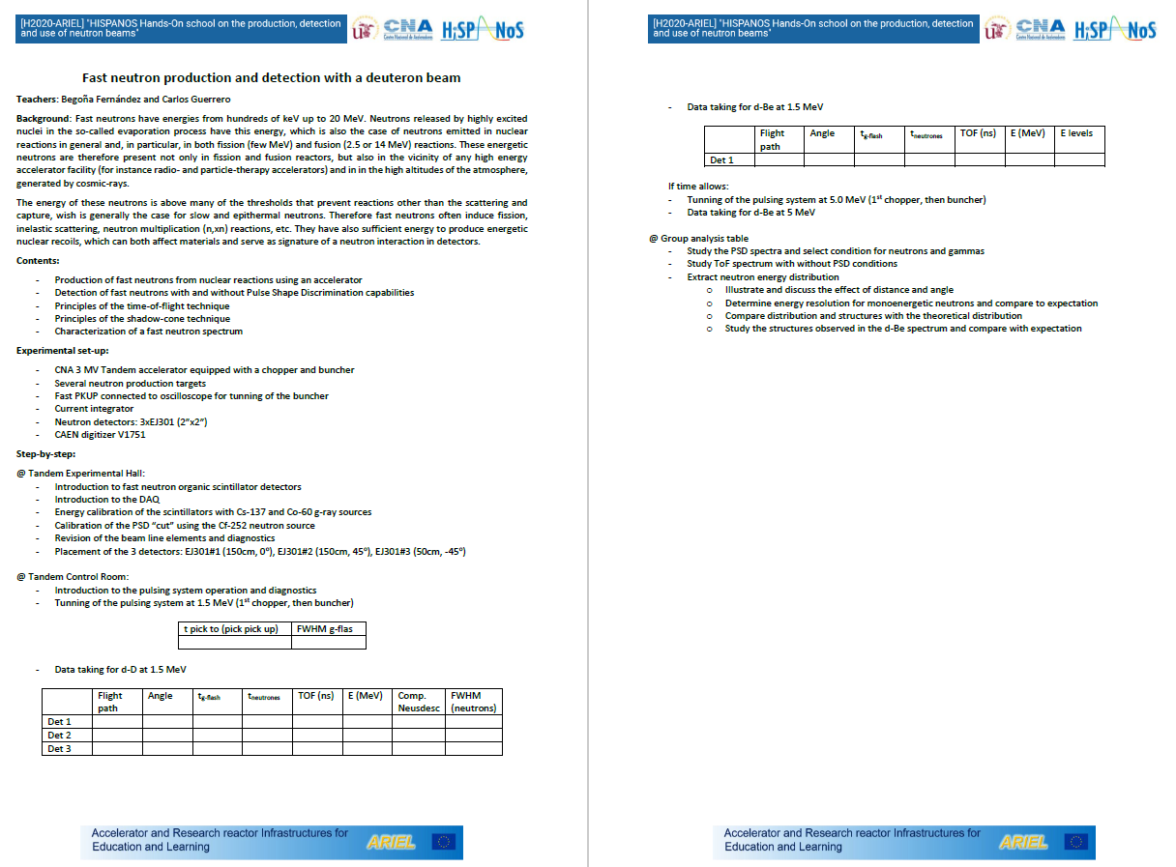
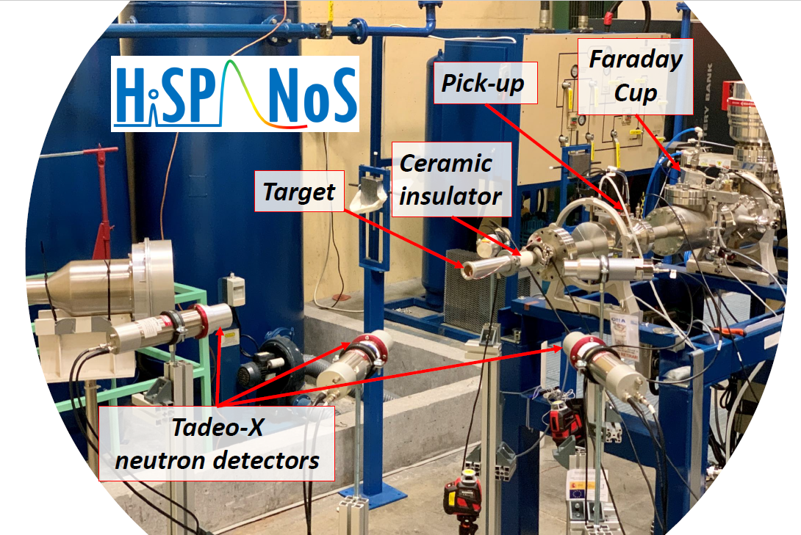
Fast neutrons: ToF and PSD

Slide 16
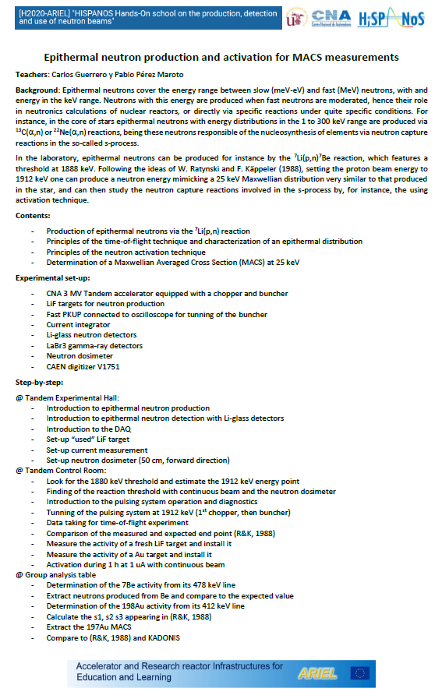
Epithermal neutrons: MACS measurements

Slide 17
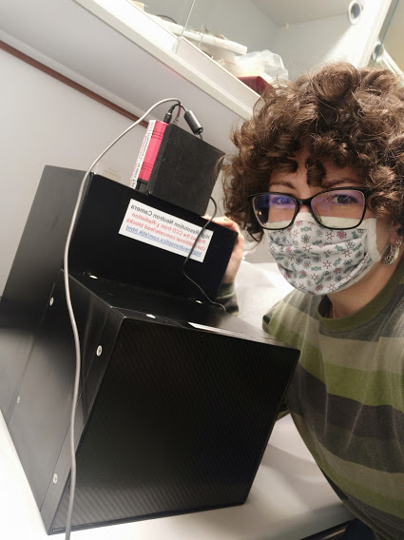
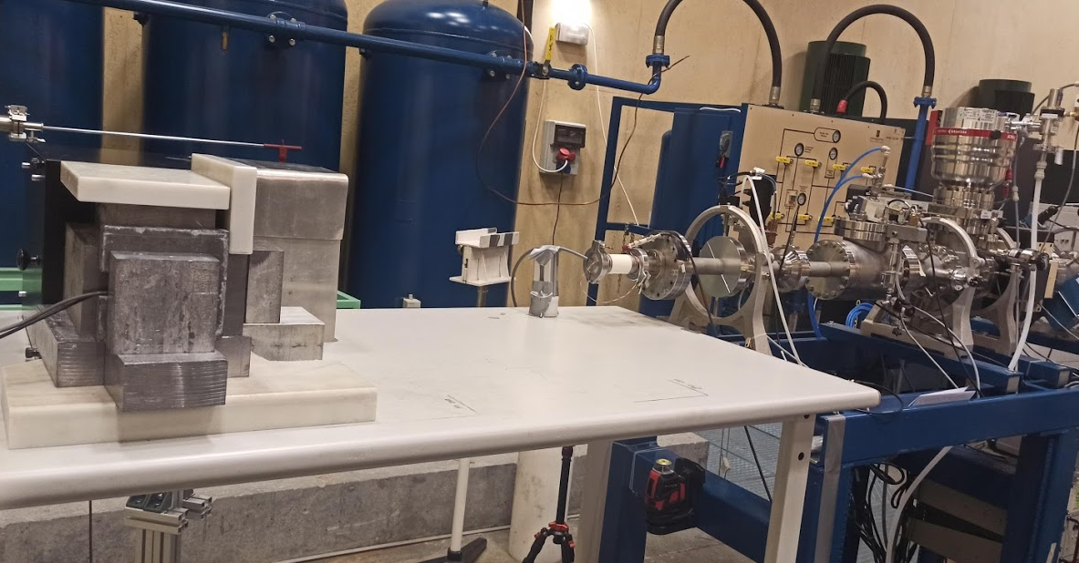
Thermal neutrons: n-imaging (& x-ray)

Slide 18
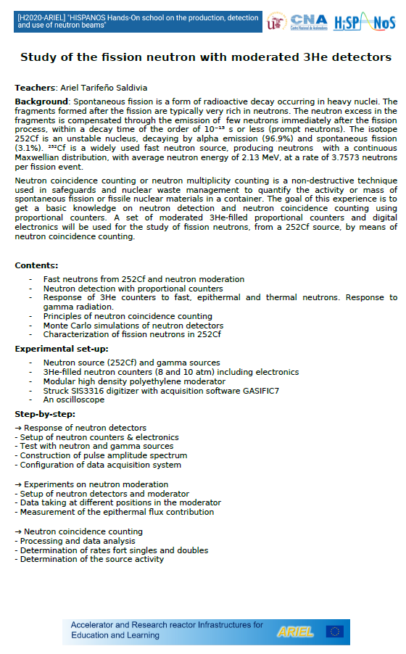
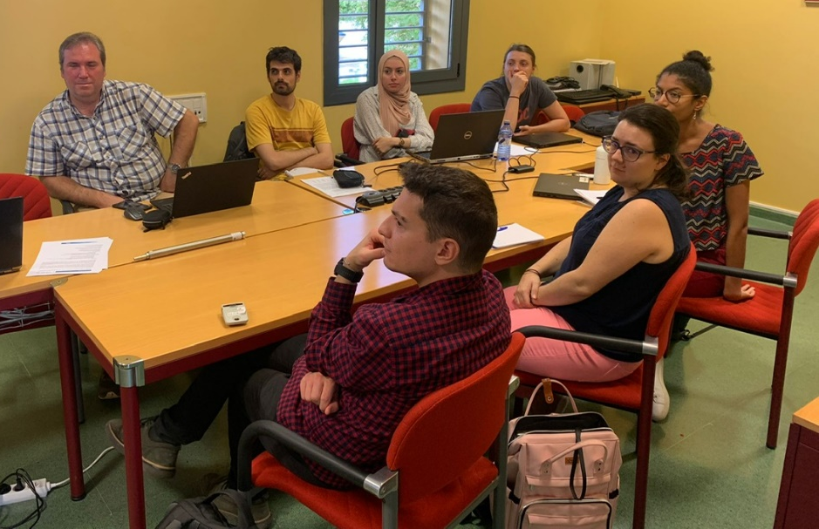
Fission neutrons: moderation + absorption

Slide 19
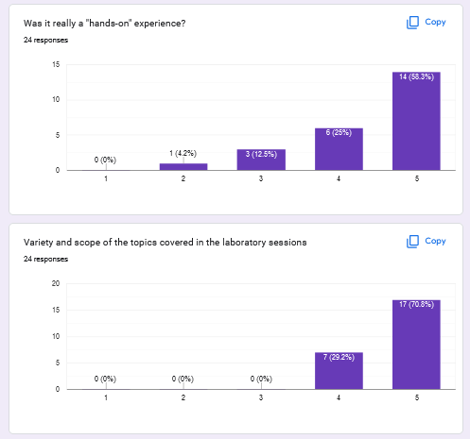
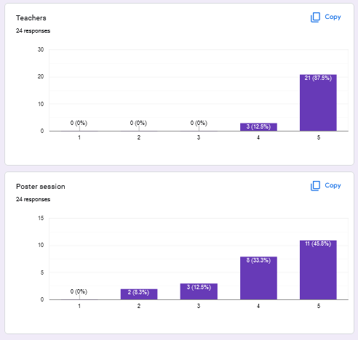
Feedback survey

Slide 20
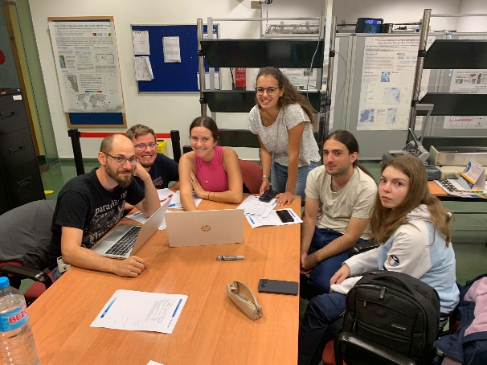
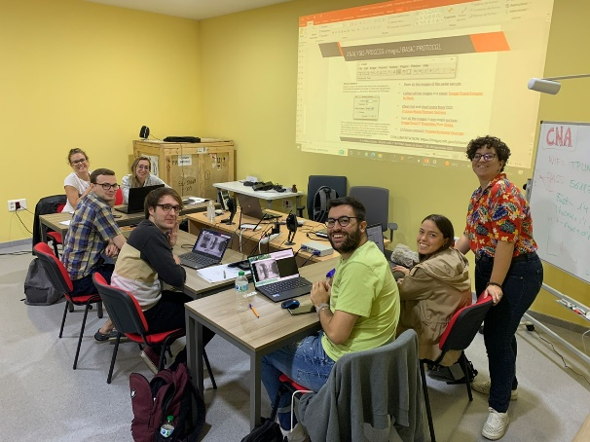
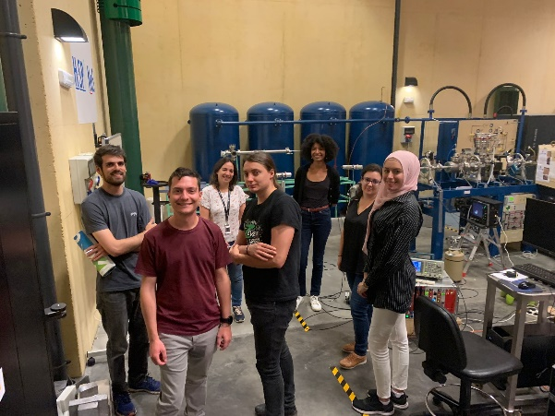
Best poster award & some more pictures

Slide 21
Hands-On School on Nuclear Data from Research Reactors
Director: Tamas Belgya
https://indico.cern.ch/event/1290109/

Slide 22
Report on the ARIEL Education and Learning School in Budapest
Replacement of the planned summer school at Uppsala Univ.
The decision was made on the GA in Teddington, UK in March 2023, where the offer of the organizers (BME NTI & EK BNC), the program and financial conditions were presented by TB
By mid-June the Homepage https://indico.cern.ch/event/1290109/, the call and the international advisory board of the school were ready and started to inform applicants about the participation
The program had three parts. On the first two days, theoretical lectures were presented by invited experts, teachers of NTI and researchers of BNC on nuclear data evaluations, measurements and applications.
Four different practical lectures were conducted at the NTI’s teaching reactor and the Budapest Research Reactor over the next two days.
The four groups of participants were rotated among the four hands-on tasks each with about 3 hours long.
The four parallel lectures,
NTI1 Reactor operation exercise & vertical flux distribution measurements using Dy-Al wire
NTI2 Neutron activation analysis, determination of the unknown composition of a sample
BNC1 Neutron capture XS measurements with comparator method at PGAA & Simulations
BNC2 Integral experiments, neutron reaction XS measurements at the RAD & NAA stations
Notes:
> as you may know, next week I have to summarize the ARIEL actions on > "Schools". For this, I'd need a few slides from each of you > summarizing the program, mentioning something about the selected > participants, and hopefully with some pictures and comments.

Slide 23
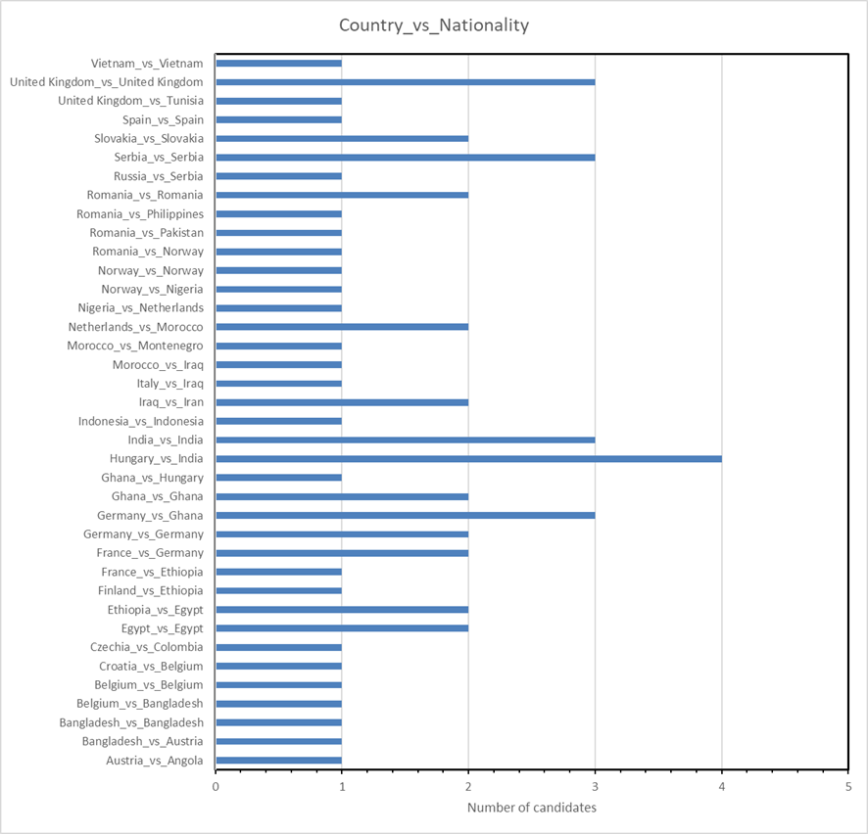
58 registered candidates.
The International Advisory Board helped us with the scoring of the CVs and Motivation letters.
The candidates were from 27 countries with 28 nationalities on 3 continents (Africa, Asia, and Europe)
The male/female gender ratio was 34/24 for candidates, and 15/8 for the selected participants.
Participant selection and statistics
Educational level | Number of participants
Master student | 8
PhD student | 10
Postdoc | 3
Senior Professional | 4
Sum | 25

Slide 24
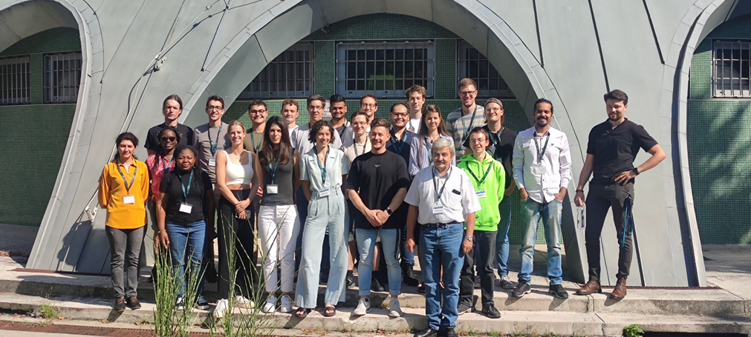
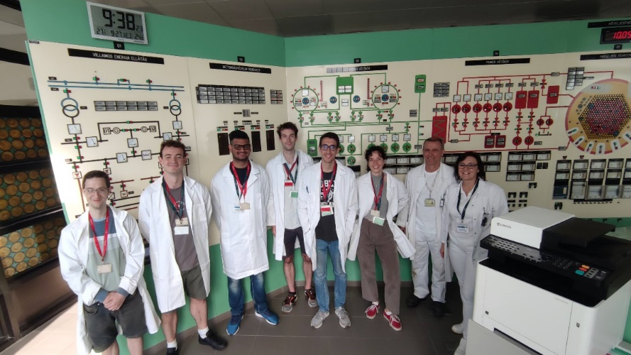
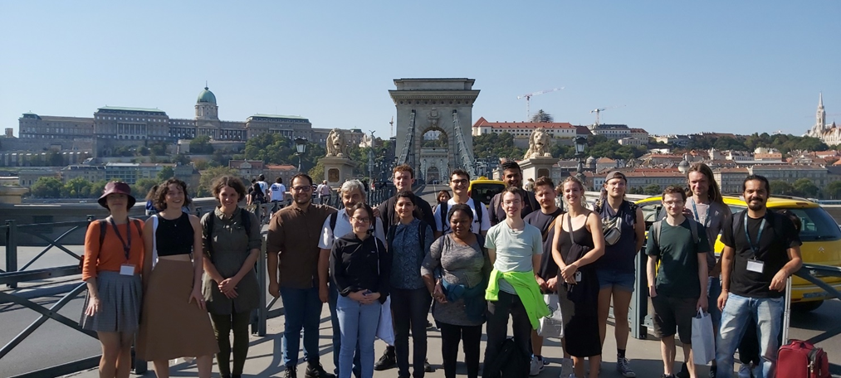
School pictures and closing of the school
Group photo taken in front of the teaching reactor
In the Budapest Research Reactor’s operator room
The last day was devoted to handing out the participation certificates and having a quiz on the questions formulated by the lecturers. The presenters were asked to give three quiz questions from their lecture materials. The first 3 students received some small rewards from the EK and NTI.
The students were also asked to select the best flash presentation from the 2nd day. A young Norwegian master's student lady, Gulla Louise Serville Torvund, won the first prize. She also received a present. The school was closed which was followed by a tour in the city.
Walking in the heart of the city after closing the school

Slide 25
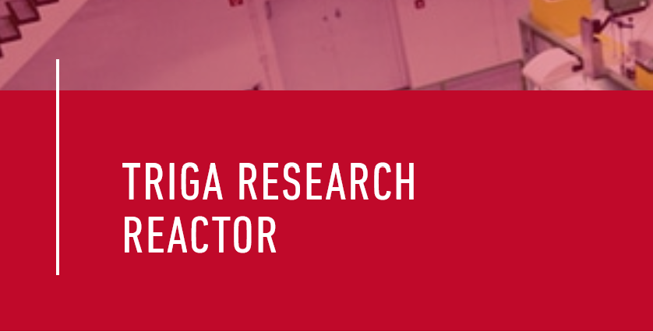
Lab course in Reactor Operation and Nuclear Chemistry
Director: Klaus Eberhardt
https://indico.cern.ch/event/1271212/

Slide 26
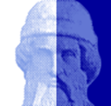
Lab Course on Reactor Operation and Nuclear Chemistry
Organized by the Johannes Gutenberg-University Mainz, Germany
54 Applications
Europe, Asia, Africa, South America
Masterstudents, PhD-Students, Post-Docs
Selection committee:
Arnd Junghans
Arjan Plompen
Carlos Guerrero
Christopher Geppert
Klaus Eberhardt
Selection criteria:
Motivation letter
CV / Age
Country (EU/non-EU)
Academic level
Five ranking lists
10 candidates selected:
9 EU (France (x2), Portugal, Belgium, Czech Rebublic, Slovakia, Sweden, Italy, Netherlands)
1 Asia (India)
6 Master / 4 PhD
4 Female / 6 Male
1.
Top ten of each list
Common selection
2.
Top 50% of each list

Slide 27
Lab Course on Reactor Operation and Nuclear Chemistry
Organized by the Johannes Gutenberg-University Mainz, Germany
LECTURES AND SEMINARS
The Discovery of Nuclear Fission (Tobias Reich, JGU, Mainz, Germany)
Neutron Activation Experiments for Nuclear Astrophysics Studies (Tanja Heftrich, Goethe-Universität, Frankfurt, Germany)
Application of Research Reactors for Science and Industry (Nuno Pesseo-Barradas, IAEA, Vienna, Austria)
Basic Reactor Physics (Christopher Geppert, JGU, TRIGA Mainz, Germany)
The Research Reactor TRIGA Mainz (Klaus Eberhardt, JGU, TRIGA Mainz, Germany)
Neutron Activation Analysis (Christian Stieghorst, TU München, Germany)
Production of Ultra-cold Neutrons at the TRIGA Mainz (Simon Kaufmann, JGU Mainz, Germany)
The OKLO-Phenomenon: The Natural Nuclear Fission Reactors in Gabon, Africa (Benoit Gall, Strasbourg, France)

Slide 28
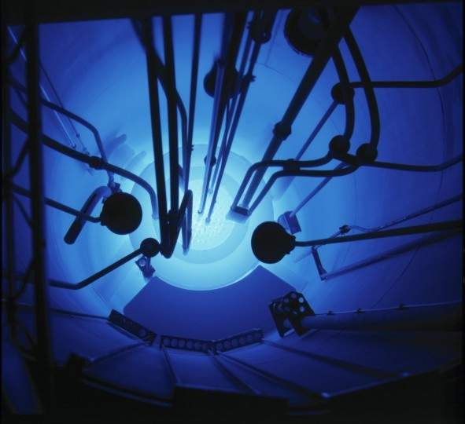
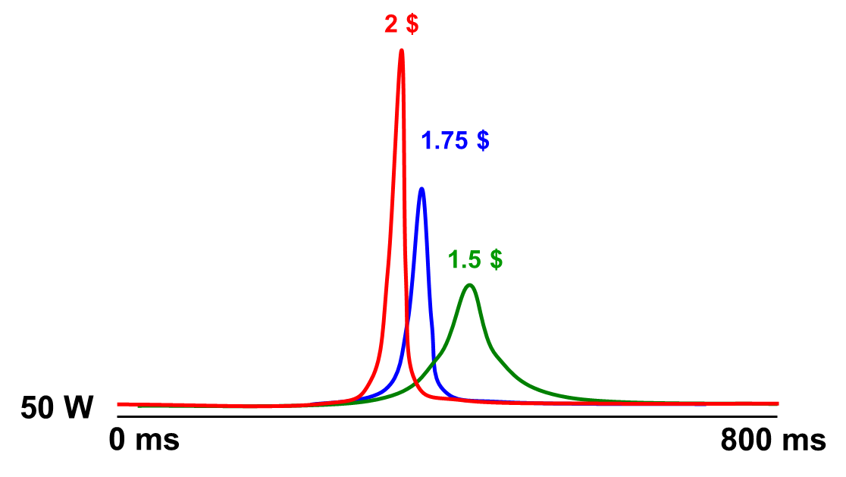
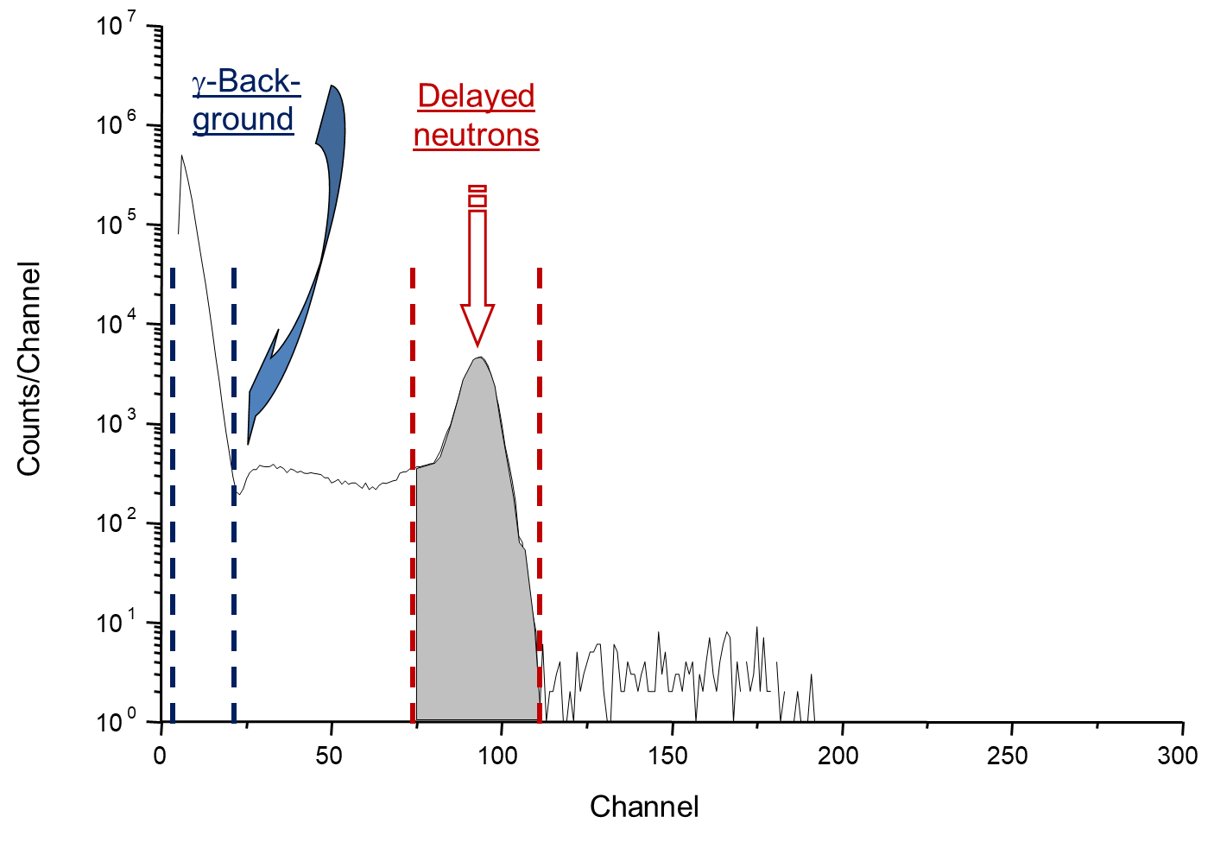
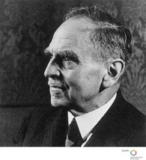
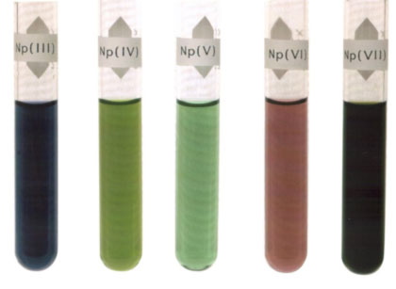
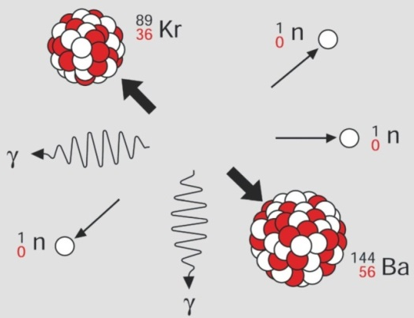
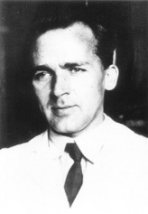
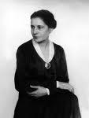
Lab Course on Reactor Operation and Nuclear Chemistry
Organized by the Johannes Gutenberg-University Mainz, Germany
EXPERIMENTS
Reactor operation in steady-state and in pulse-mode
Time structure of reactor pulse
Reactivity experiment: Fast introduction of Cd-samples with the pneumatic sample transfer system
Experiments on the discovery of nuclear fission
Measurement of ß-delayed neutrons
Decay scheme of Os-190m

Slide 29
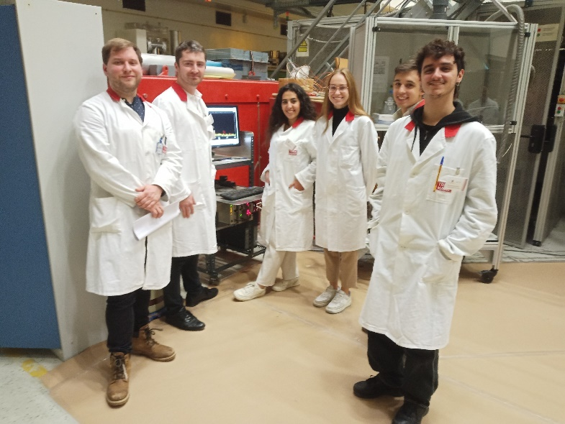
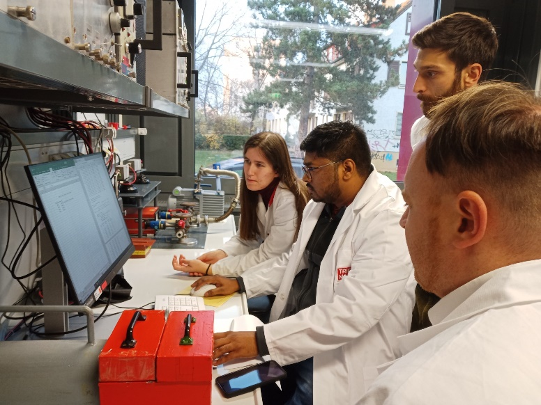
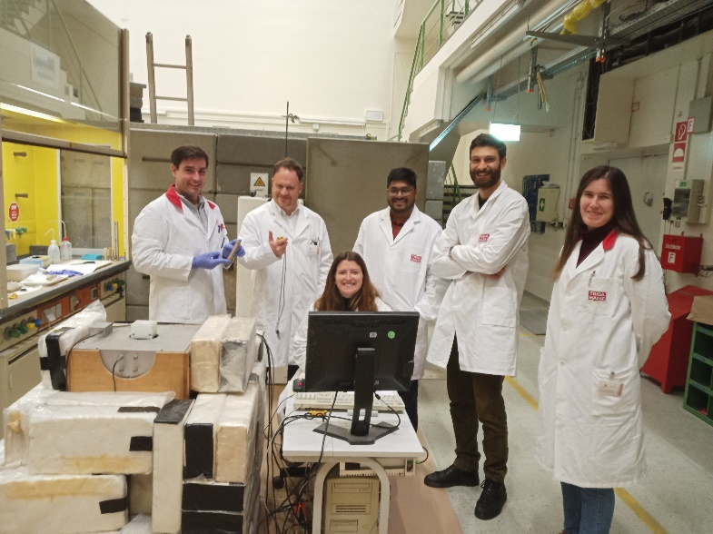
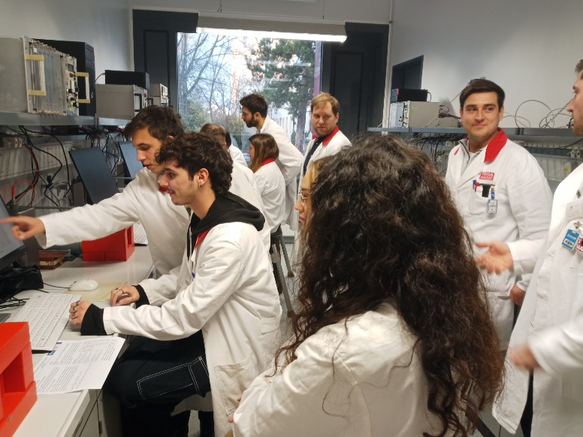
Lab Course on Reactor Operation and Nuclear Chemistry
Organized by the Johannes Gutenberg-University Mainz, Germany

Slide 30
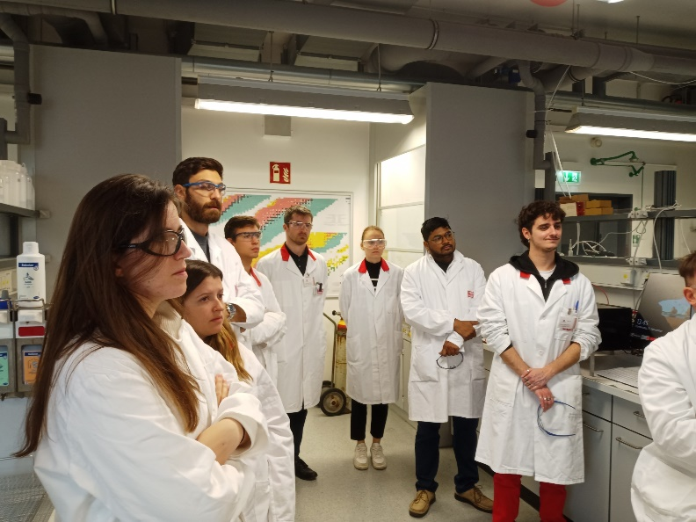
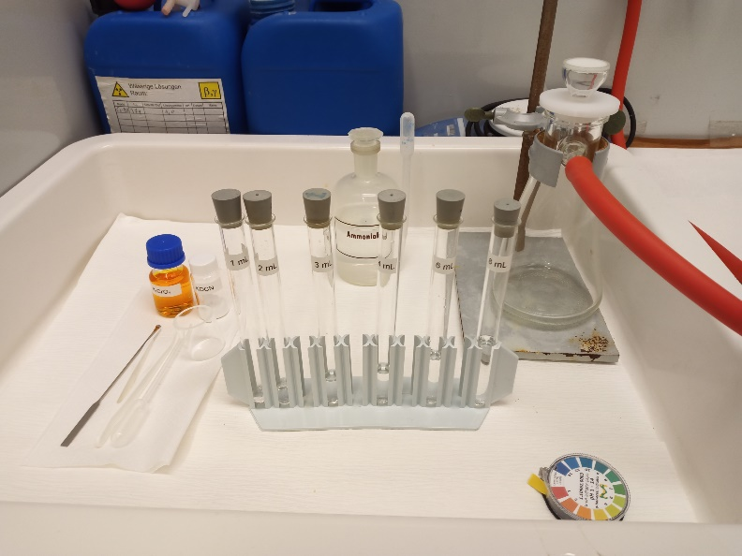
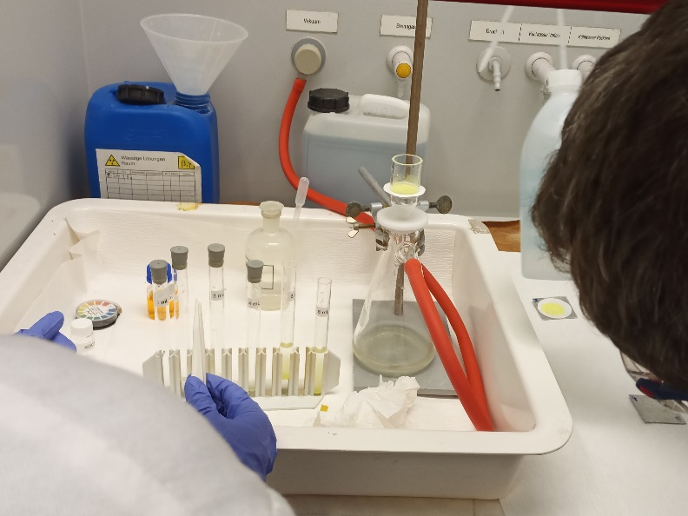
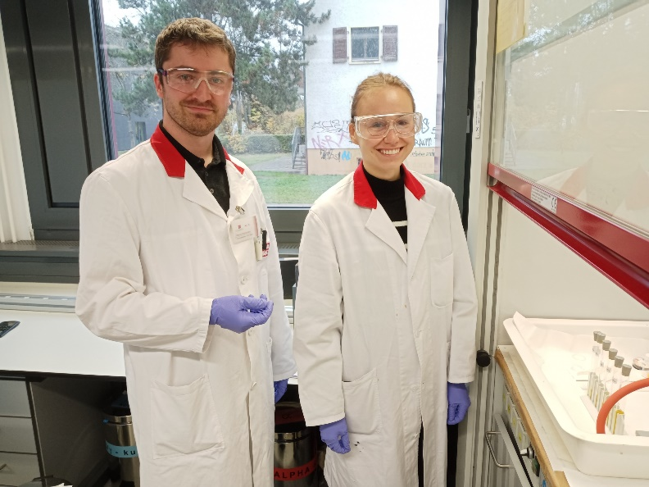
Lab Course on Reactor Operation and Nuclear Chemistry
Organized by the Johannes Gutenberg-University Mainz, Germany

Slide 31
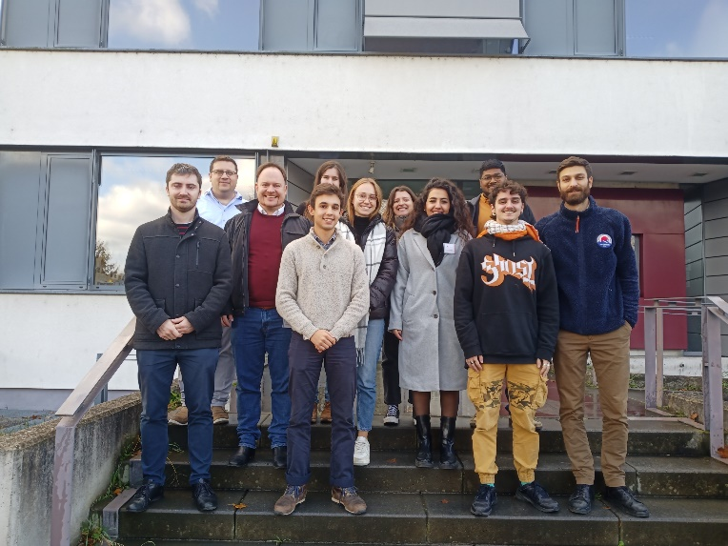
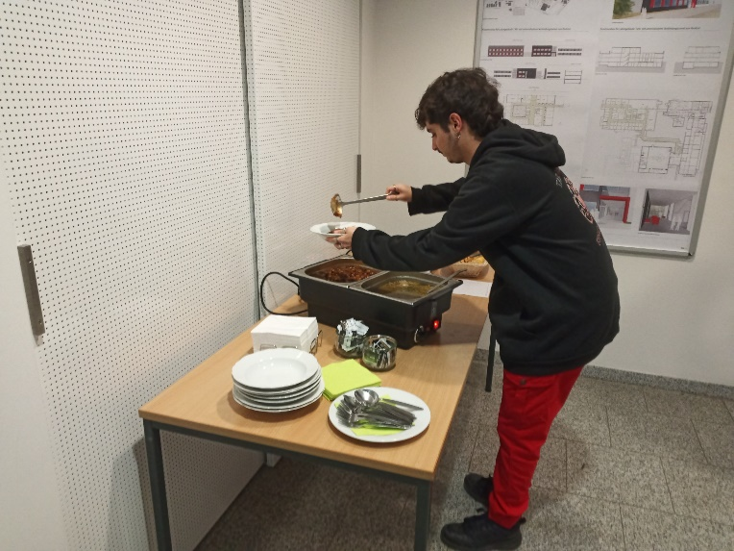
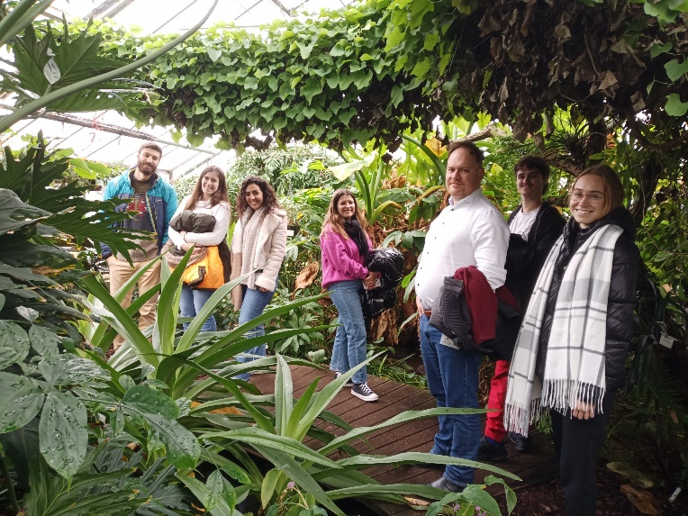
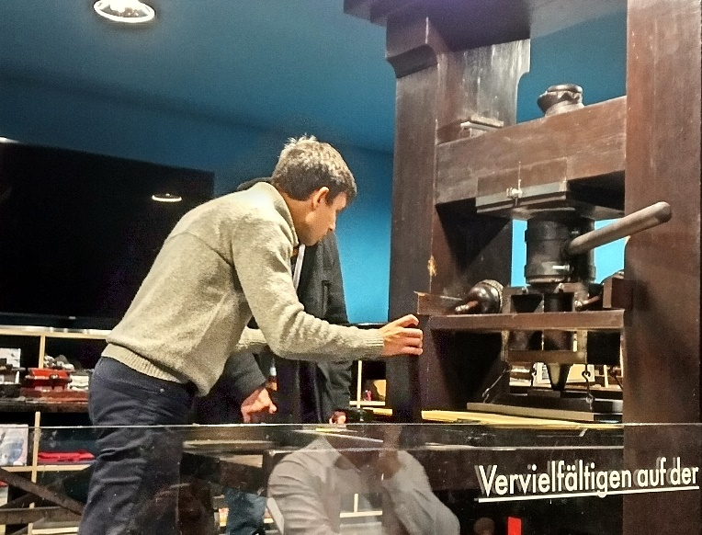
Lab Course on Reactor Operation and Nuclear Chemistry
Organized by the Johannes Gutenberg-University Mainz, Germany

Slide 32
Summary & Conclusions
Initial issues:
- The begining of the project was heavily affected by the COVID pandemic.
- Issues with the NESSA accelerator forced canceling the EXTEND School.
But solutions were found and the full program of 4 schools was implemented:
- The CIEMAT’s NuDataPath School was succesfully organized ONLINE in 2022.
- After a one year delay, the USevilla/CNA “hands-on” school was carried out in late 2022.
- The “hands-on” school at the Triga reactor in Mainz took place in late 2023.
- A “hands-on” school was organized in very short time by BNC/BME as alternative to the EXTEND School and took place in late 2023.
In all cases:
- applications exceeded largely the number of available places.
- surveys showed, when implemented, a high level of satisfaction
- some of the schools will be repeated soon:
- HiSPANoS ”Hands-on school…” in 2025 within EC APRENDE.
- The JGU Triga lab reactor course for German citizens.

