Slide 1
Explications - Rules
Welcome to IJCLab

Slide 2
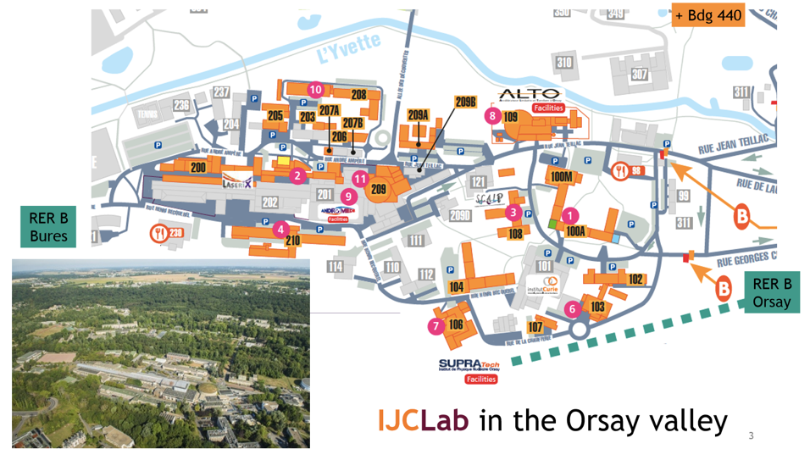
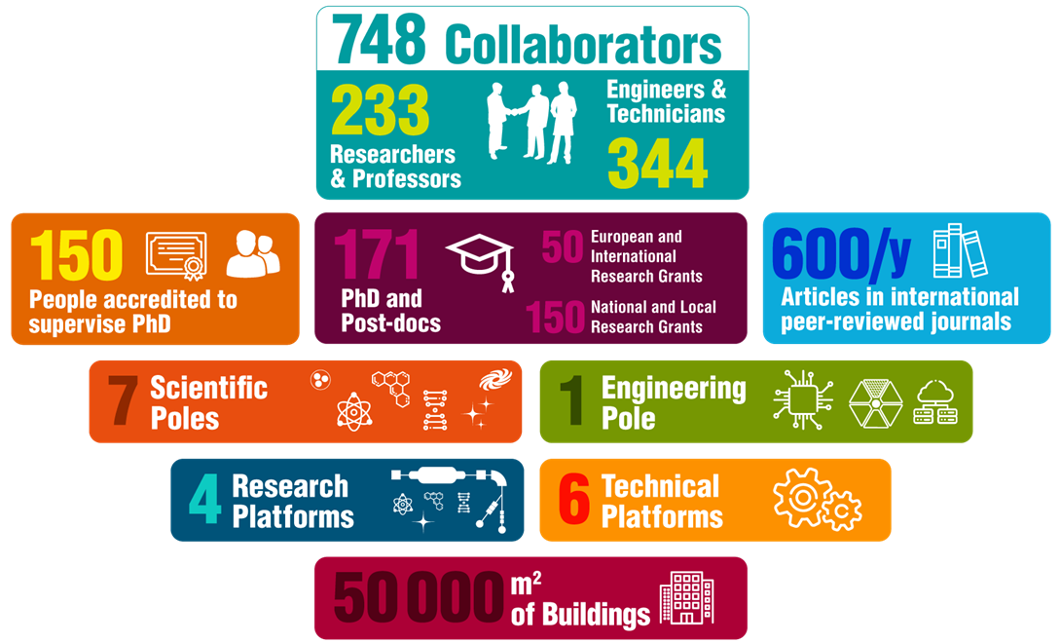
IJCLab in a nutshell
IJCLab
Laboratoire de physique des deux infinis Irène Joliot-Curie
A new laboratory born in January 2020
From the fusion of 5 historical laboratories in Orsay
www.ijclab.in2p3.fr

Slide 3
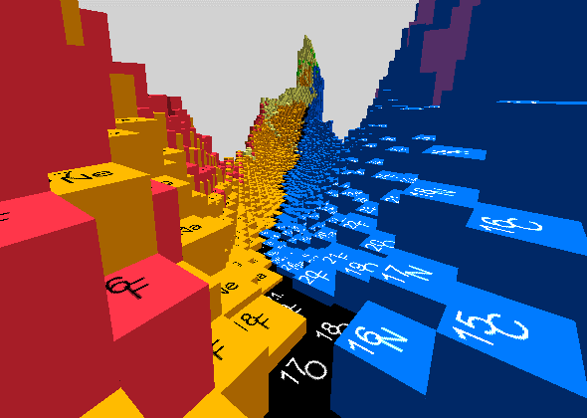
~ 70
Accelerator physics
~ 90
~ 60
~ 100
Theory
~ 80
Energy and Environment
~ 40
Health Physics
~ 25
~ 110 PhD students

Slide 4
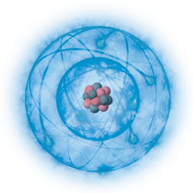
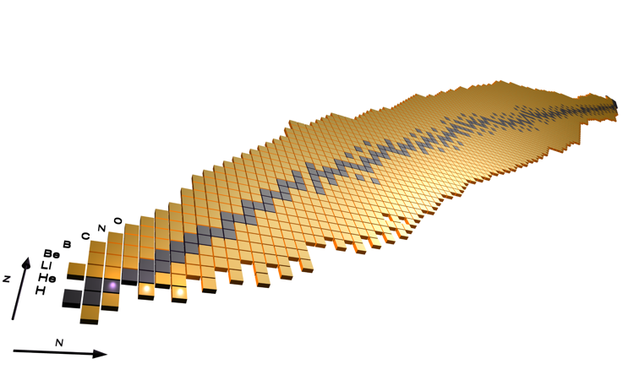
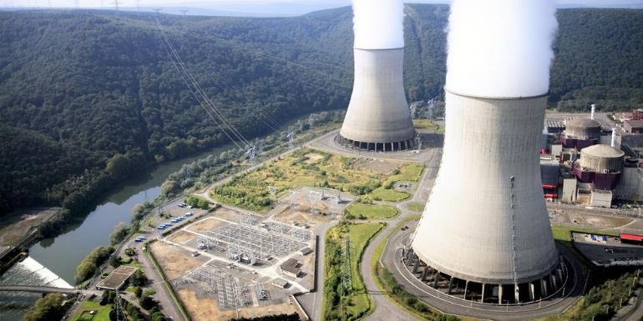
Extreme in spin
Extreme in mass
Extreme in isospin
Energy and environment
(Nuclear energy, radiochemistry …)
Nuclear Physics
Understanding the building blocks of matter, their interactions, and how the properties of matter emerge.
Tools and concepts applied in fields with
a significant impact on society.

Slide 5
Technical activities
Technical staff with the essential technical expertise to design, draw and build instruments:
Engineering Division with 4 Technical Departments
Accelerator Centre with RF (Radio Frequency) and Cryogenics departments.)
Expertise in the other research divisions, platforms and support services
Support
Micro-electronics
Ront end Electronics
Exploitation
timing/
slow control
System
Cabling - CAD
Infrastruct.
software development
Administration
Data acquisition
Radioprotection
& Safety
Electrotech./RF
Communication
Détectors/Instrumentation
Cryogenics
Logistics
Mecanical design
vaccum
Laser
library
Mecanical workshop
Radiochemistry
Matérials
Biology
Accelerators and other specialities
Mécanics
Electronics
IT
Biology, chemistry
Detectors

Slide 6
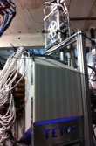
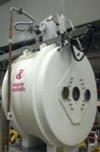
ALTO: a TNA within the framework of the ARIEL project
Nuclear physics, health physics, Irradiation, material science, accelerator physics
15 MV Tandem (from proton to aggregates)
Electron electron Linac -> radioactive beams produced by photofission

Slide 7
Explications - Rules
Have a nice workshop

