Slide 1
Hybrid Positron source Fahad Alharthi

Slide 2
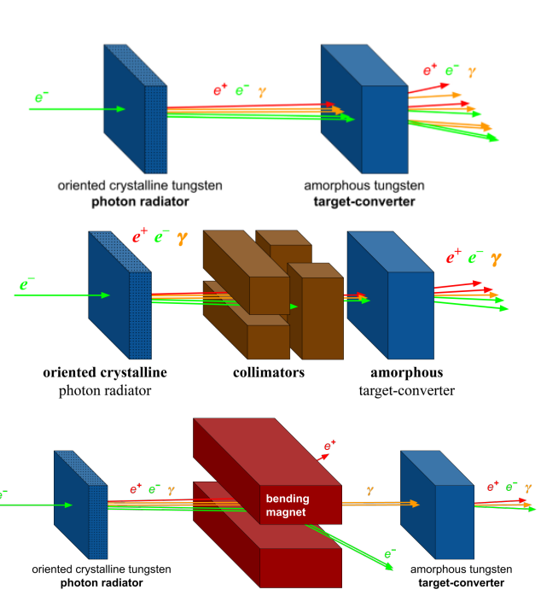
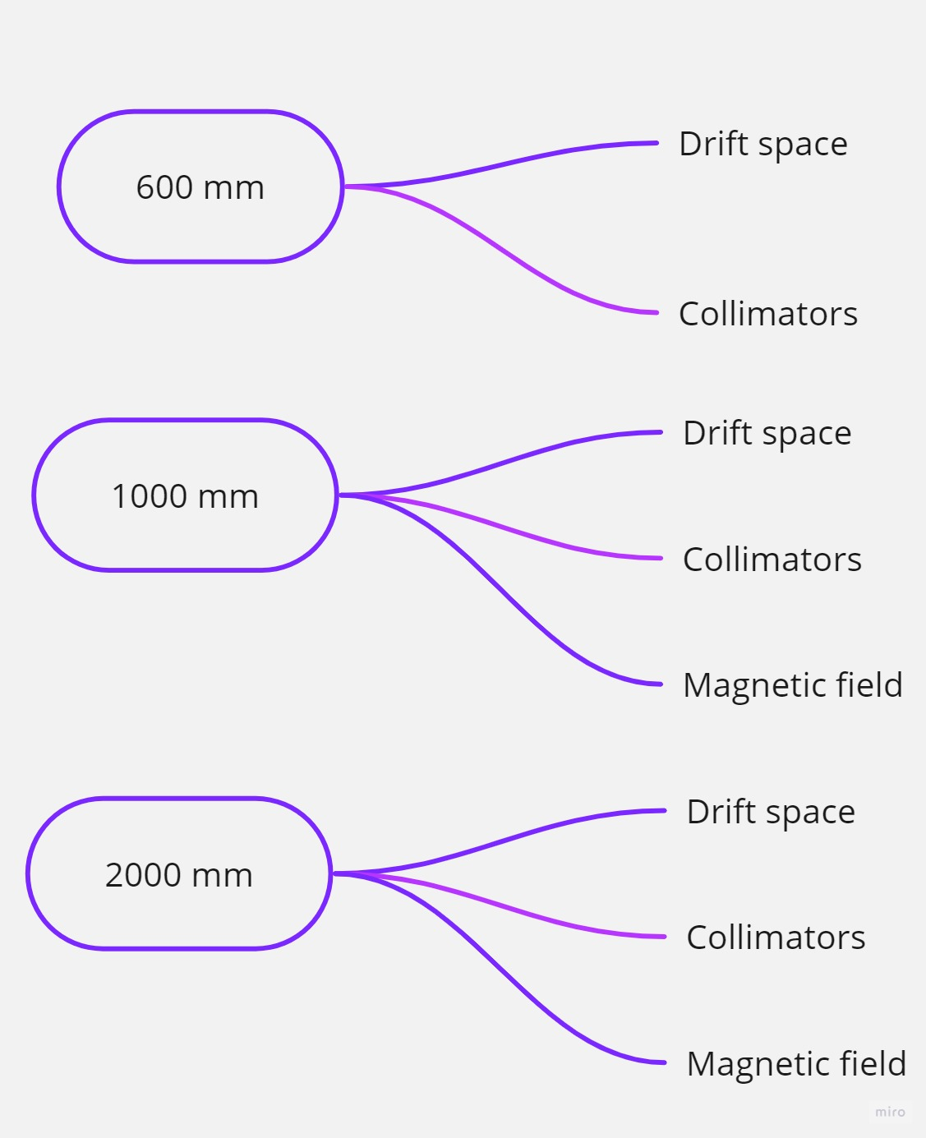
8 different configurations :

Slide 3
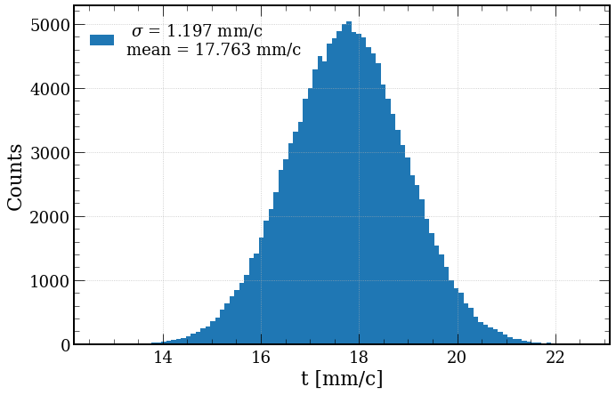
Tracking in RF-Track I
There is no time distribution in Mattia G4 output.
The RF phase is time dependent.
To reduce the time and complexity of the phase optimization:
Make the same time distribution for the 8 configurations , this will result in optimization the RF phases only one time.
After discussion with Yongke I decided to use the same phases as the conventional scheme.
To do so I made a gaussian sampling with mean and std as the conventional scheme

Slide 4
Tracking in RF-Track II
RF phases is based on Yongke optimization:
RF Phases = [ -130 -130 -135 -75 -75 ] degree
There are some updates on RFT regarding the autophase() :
we changed the momentum of the reference particle to be p_ref = 10000MeV/c in order to keep using the same phases.
Ref_particle [0 0 0 0 248.8 10000]
Tracking performed in three steps :
AMD (HTS)
RFT- Volume
RF Structures
RFT- Lattice
Positron Linac
Analytical formula

Slide 5
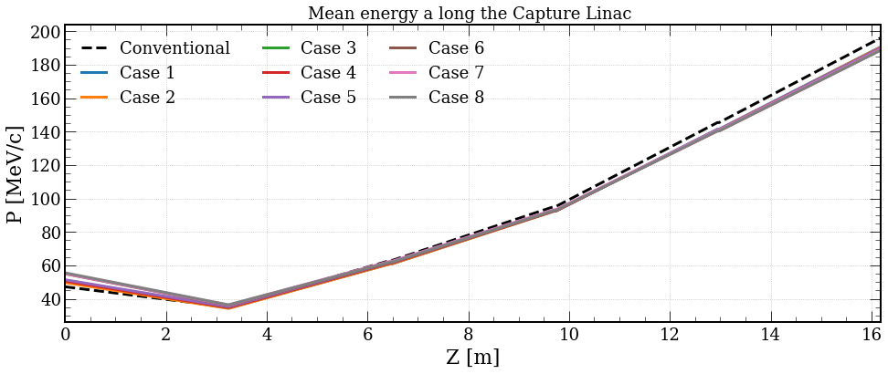
Energy gain along the capture section

Slide 6
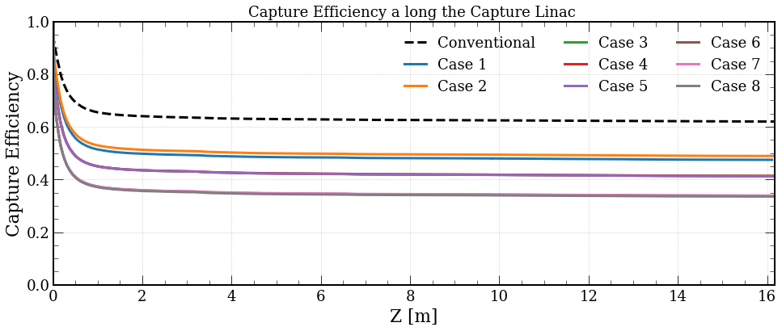
Capture efficiency along the capture section

Slide 7
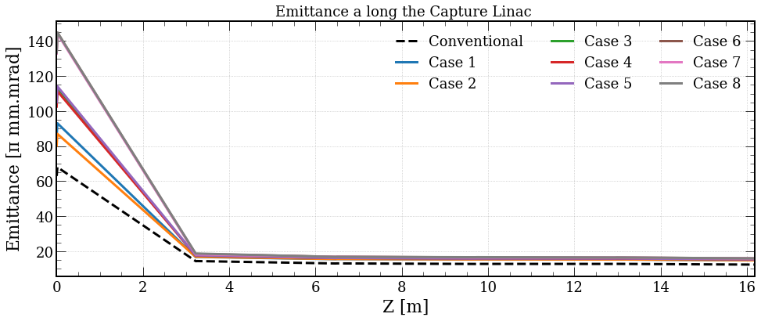
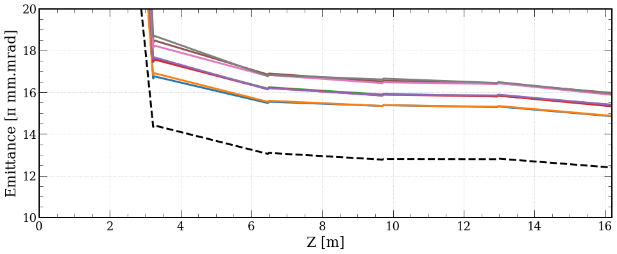
Emittance along the capture section

Slide 8
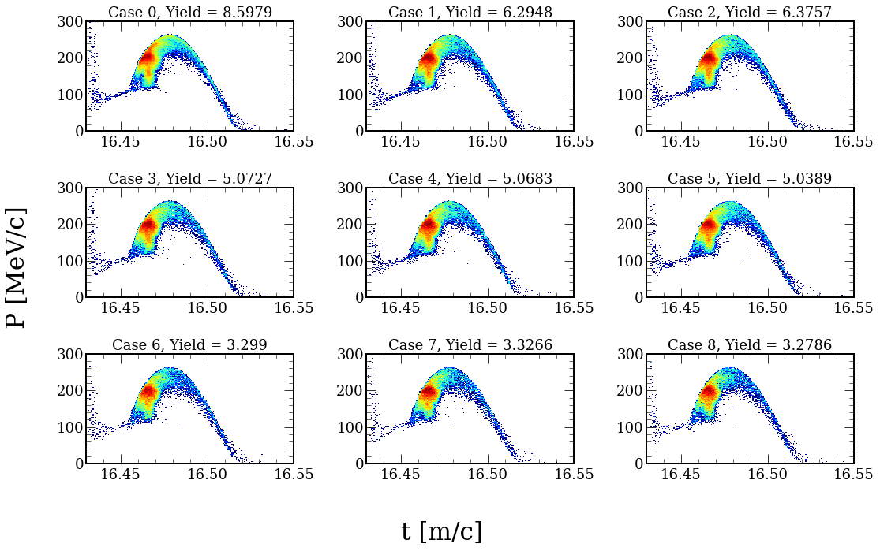
Longitudinal phase space after the CS.
0.6 m
1.0 m
2.0 m

Slide 9
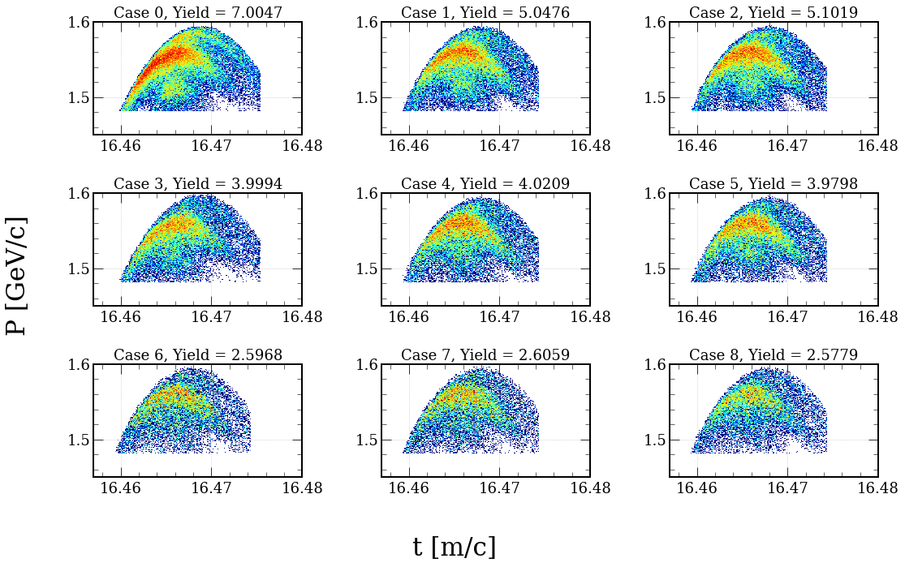
Longitudinal phase space after the PL.
Window cut :E = +/-3.8%, t = 16.7mm/c
0.6 m
1.0 m
2.0 m

Slide 10
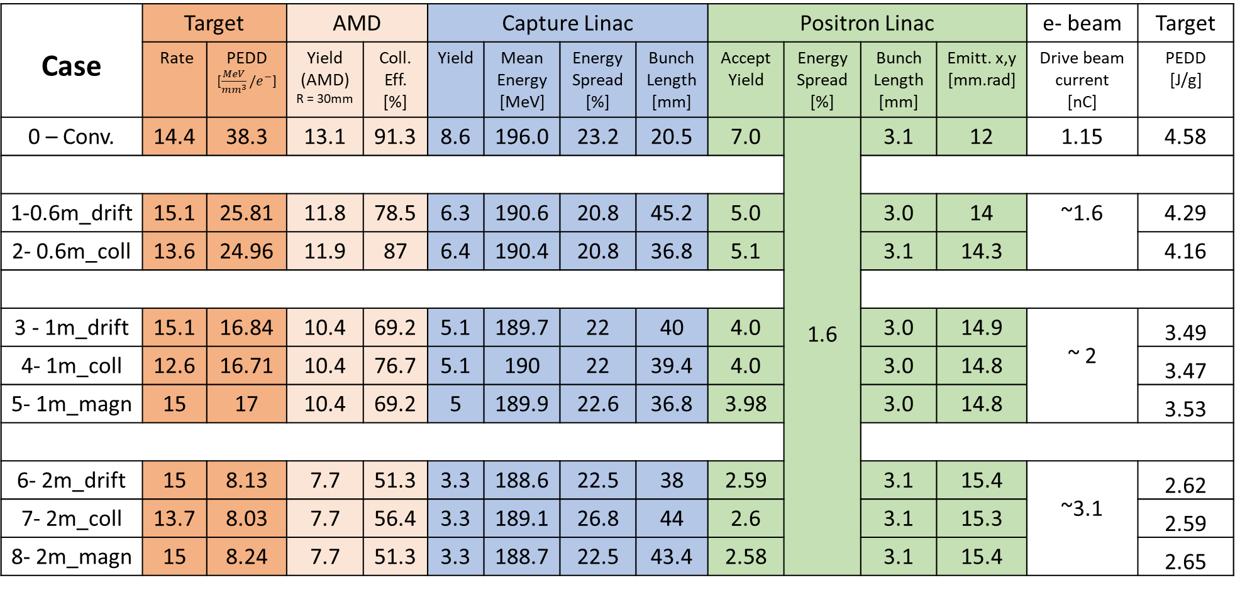
Summary table
Case | Target |  | AMD |  | Capture Linac |  |  |  | Positron Linac |  |  |  | e- beam | Target
 | Rate | PEDD [$\frac{MeV}{{mm}^{3}}/e^{−}$] | Yield (AMD) R = 30mm | Coll. Eff. [%] | Yield | Mean Energy [MeV] | Energy Spread [%] | Bunch Length [mm] | Accept Yield | Energy Spread [%] | Bunch Length [mm] | Emitt. x,y [mm.rad] | Drive beam current [nC] | PEDD [J/g]
0 – Conv. | 14.4 | 38.3 | 13.1 | 91.3 | 8.6 | 196.0 | 23.2 | 20.5 | 7.0 | 1.6 | 3.1 | 12 | 1.15 | 4.58
1-0.6m_drift | 15.1 | 25.81 | 11.8 | 78.5 | 6.3 | 190.6 | 20.8 | 45.2 | 5.0 |  | 3.0 | 14 | ~1.6 | 4.29
2- 0.6m_coll | 13.6 | 24.96 | 11.9 | 87 | 6.4 | 190.4 | 20.8 | 36.8 | 5.1 |  | 3.1 | 14.3 |  | 4.16
3 - 1m_drift | 15.1 | 16.84 | 10.4 | 69.2 | 5.1 | 189.7 | 22 | 40 | 4.0 |  | 3.0 | 14.9 | ~ 2 | 3.49
4- 1m_coll | 12.6 | 16.71 | 10.4 | 76.7 | 5.1 | 190 | 22 | 39.4 | 4.0 |  | 3.0 | 14.8 |  | 3.47
5- 1m_magn | 15 | 17 | 10.4 | 69.2 | 5 | 189.9 | 22.6 | 36.8 | 3.98 |  | 3.0 | 14.8 |  | 3.53
6- 2m_drift | 15 | 8.13 | 7.7 | 51.3 | 3.3 | 188.6 | 22.5 | 38 | 2.59 |  | 3.1 | 15.4 | ~3.1 | 2.62
7- 2m_coll | 13.7 | 8.03 | 7.7 | 56.4 | 3.3 | 189.1 | 26.8 | 44 | 2.6 |  | 3.1 | 15.3 |  | 2.59
8- 2m_magn | 15 | 8.24 | 7.7 | 51.3 | 3.3 | 188.7 | 22.5 | 43.4 | 2.58 |  | 3.1 | 15.4 |  | 2.65

Slide 11
Conclusion
The shorter the distance between the radiator and the convertor is better for :
High yield.
Low emittance.
Low current of the drive beam.
The yield decreased as the increase at the worst case (2 m) the yield drops by~ 65%.
The PEDD decreases as the distance increases, at best case PEDD decreased ~40% compared to conventional scheme.
There is no big dependence on what ever is placed between the radiator and the convertor.

Slide 12
Pedd/e- | Bunch charge | #particle /bunch | PEDD
0.0383 | 1.15E-09 | 7.18E+09 | 4.58E+00
0.0258 | 1.60E-09 | 9.99E+09 | 4.29E+00
0.025 | 1.60E-09 | 9.99E+09 | 4.16E+00
0.0168 | 2.00E-09 | 1.25E+10 | 3.49E+00
0.0167 | 2.00E-09 | 1.25E+10 | 3.47E+00
0.017 | 2.00E-09 | 1.25E+10 | 3.53E+00
0.00813 | 3.10E-09 | 1.93E+10 | 2.62E+00
0.00803 | 3.10E-09 | 1.93E+10 | 2.59E+00
0.00824 | 3.10E-09 | 1.93E+10 | 2.65E+00

Slide 13
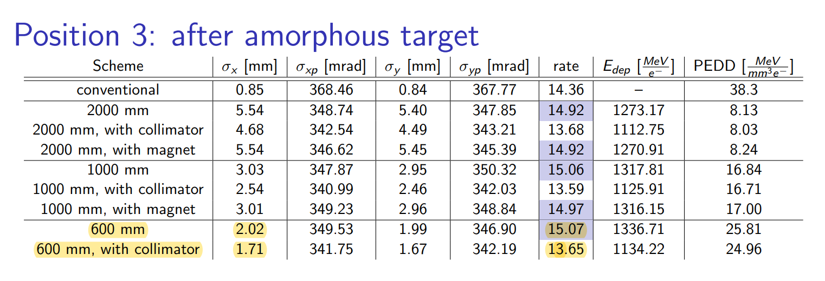
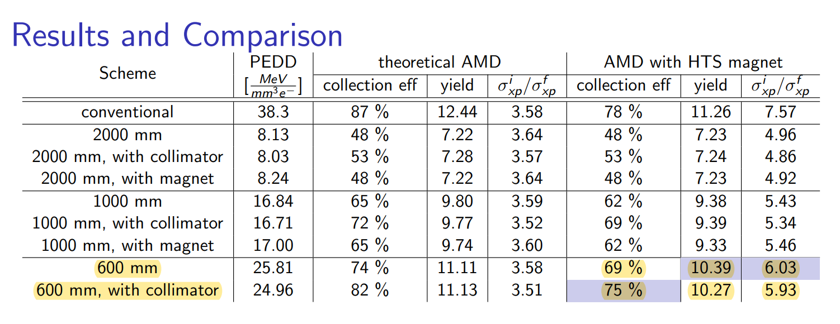
Sasha master internship 2023

